Slide 1
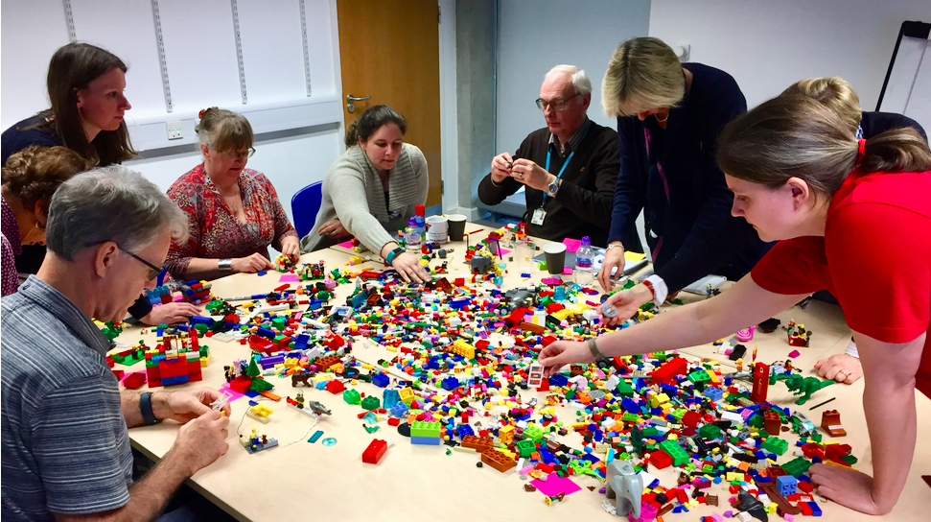
Streaming Readout and Data-Stream Processing With ERSAP
Environment for Real-time Streaming, Acquisition and Processing
V. Gyurjyan, D. Abbott, M. Goodrich, G. Heyes, E. Jastrzembski, D. Lawrence, B. Raydo, C. Timmer

Slide 2
“Enable full offline analysis chains to be ported into real-time, and develop frameworks
that allow non-expert offline analysis to design and deploy physics data processing systems.”
A Roadmap for HEP Software and Computing R&D for the 2020s. HEP Software Foundation, Feb. 2018

Slide 3
Outline
Looking forward to future experiments at the JLAB and EIC
Reevaluate existing readout systems and their interface to the back-end
Reactive, actor-model based programming model
Results from ERSAP based pilot applications.

Slide 4
Streaming system components: Tiered storage model
Storage capacity/ retention time >= . Processors latency
Detector
Tier 1
DAQ
Tier 2
Tier N
Final Tier
Online/nearline data processing
Offline data processing
FE
Detector 1
FE
Buffer
Online
Storage
Nearline
Storage
Permanent
Storage
Aggregator
Processor
FE
Detector 2
FE
Buffer
Processors
Processors
FE
Detector N
FE
Buffer
Processor
Processors
Components | Framework Support
A stream-oriented timing system
A standard stream data format
Front-end electronics that outputs time-based streams of data
Efficient streaming data transport
A stream oriented random-access data storage tier
A framework for data processing tasks (virtual triggers, calibration, reconstruction, monitoring, data storage, etc.)
A framework for data-flow orchestration and data-stream processing application design and deployment

Slide 5
Flow-Based Programming Paradigm
Proposed in the late 60s by J. Paul Rodker Morrison
“Assembly line” data processing
Data flows through asynchronous, concurrent processors (“black box” actors)
Actors communicate via data chunks (called information packets or data-quanta)
Data-quanta are traveling across predefined connections (conveyor belts), where connections are specified externally to the processors.
Data is pushed through actors, while actors are reacting on passing data quantum.
Actors are performing independent, well-defined functions
Simple reconfigure
Fault tollerant

Slide 6
ERSAP architecture
UE
Event reactive actors, networked by data pipelines.
Compositional actors with conditional data routing at runtime.
Orchestrator
SM
SM
Network
SM
Data
DPS
DPS
DPS
DPS
DPS
DPE
DPE
DPS : Data Processing Station
UE : User Engine
DPE : Data Processing Environment
SM : Shared Memory
Source
Init(Object O)
Object process(Object O)
Sync
Actor

Slide 7
Data processing station: actor
User engine run-time environment.
Engine follows data-in/data-out interface.
Engine gets JSON object for run-time configuration.
UE
User provided code
Engine
Runtime Environment
Multi-threading
Data Processing Station
Communication
Configuration

Slide 8
ERSAP 3-layer structure
Orchestration Layer
Local Registration
Local Registration
DPE
DPE
SC
SC
SC
SC
FE
Registration
gateway
security
Local Registration
Local Registration
DPE
DPE
SC
SC
SC
SC
Actor Layer
Meta-Data
Data
ZeroMQ(xMsg)
POSIX Shared Memory (FIPC)
in-Memory Data-Grid

Slide 9
Streaming data transport (conveyer belt)
Address
Topic
Envelop
Metta-Data
Version
Status
Data Location
Shared Memory address
Description
Author
Severity-ID
Sender
Sender State
Communication ID
Composition
Execution Time
Action
Control
Data Type
Data Description
Reply To
Byte Order
Data
Serialized Native
Serialized Custom
Publish/Subscribe
P2P
Communication
Transient Data
Meta-description
Serialization
0MQ/POSIX_SHM/Data-Grid
Data-Stream Pipe

Slide 10
EIC prototype calorimeter SRO pipeline at DESY
CODA
ERSAP
Calorimeter
Cosmic Event
Identifier
VXS Crate
VTP payload
F
ADC
VT
P
ROC
DC
ET
VTP
Receiver
Format2
DL
VTP
Frame Decoder
Beam Event
Identifier
VXS Trigger Processor
Zero
Suppression
4Gbyte
DDR3
Frame Builder
10Gbps Ethernet
(TCP) Stream
12FADC250
Stream
(32 channels)

Slide 11
Event Identification. Fixed size sliding window technique
Stream of 65.5us VTP frames
Sliding pointers
Find min/max time of hits within the frame
Cosmic Event
Hits in only 3 modules on the path of muons
Beam Event
Only 1 hit/channel
Cut on min number of hits
Central channel energy deposition > than any other
Sliding step – 1ns
Sliding window – 32ns

Slide 12
Adaptive Window Streaming Event Time-Based Clustering Algorithm
Stream of events
W_{L} Edge
Moves if t_{e} –t_{s} > T_{h}
W_{R} Edge
Moves to get N_{h} events
Adaptive window
Initialize Window W for each t > 0
Do
W←W ∪ {x_{t}} // Move W_{R} = 1
Until elements = N_{h}
If ( t_{e} – t_{s} ) <= T_{h} ) {
Identified a cluster;
Move W_{L} = W_{R} // drop all elements
} else {
While ( t_{e} –t_{s} > T_{h} ) {
Move W_{L} = 1 // drop one element
}
Adaptive window edge movement direction

Slide 13
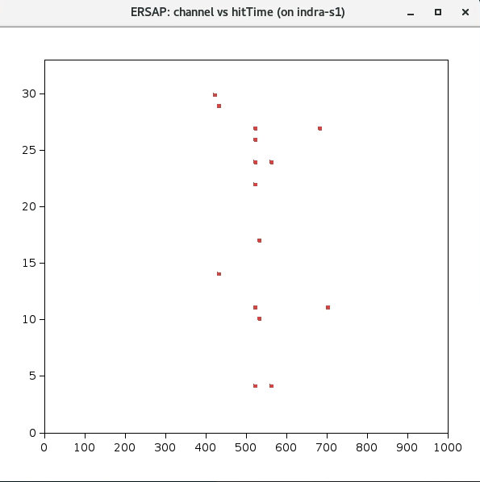
Time distribution of hits
32nsec
fADC Channel
Time[ns]

Slide 14
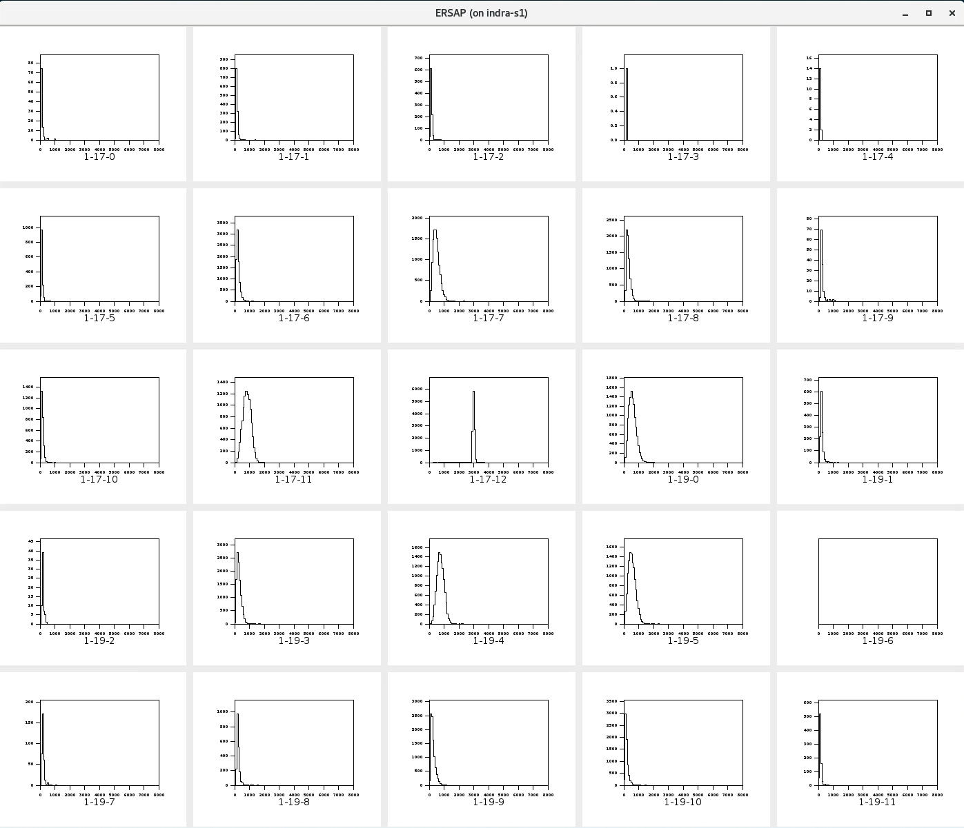

Slide 15
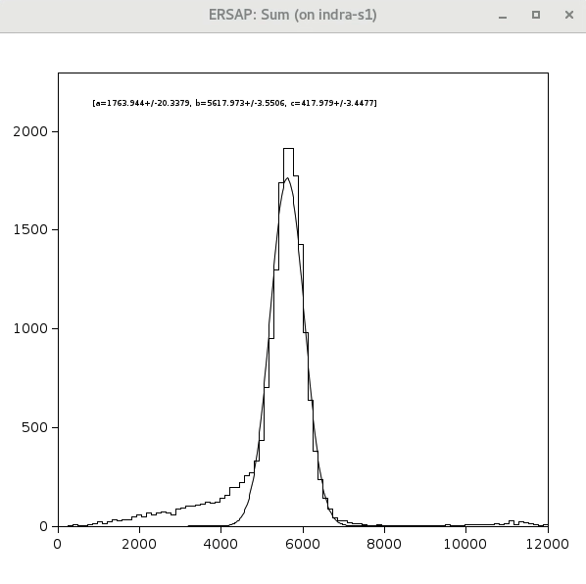
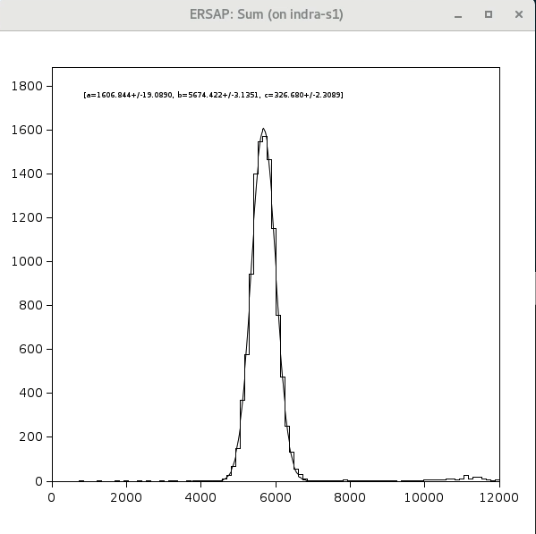
Charge cut effect
No energy/charge cut in the soft trigger
2GeV, TET=50
DESY_stream_134.evt.0
Total frames – 1861687
Empty frames – 1807602
Total identified (soft trigger) – 18774
97% empty frames
34.71% identified as beam events
2GeV, TET=50
DESY_stream_134.evt.0
Total frames – 1861687
Empty frames – 1807602
Total identified (soft trigger) – 11487
97% empty frames
21.24% identified as beam events

Slide 16
fADC threshold effects (2GeV)

Slide 17
Calorimeter response linearity

Slide 18
Summary
ERSAP is a software LEGO system
Encourages application design based on software artifacts (LEGO bricks)
Easier to understand and develop
Reduced develop-deploy-debug cycle
Easy to migrate to data
Scales independently
Independent optimizations
Improves fault isolation
Easy to embrace hardware as well as software heterogeneity.
Eliminates long term commitment to a single technology stack.
Agile framework that makes easy software evolution over time!

Slide 19
Thank You

Slide 20
EIC prototype calorimeter SRO application design and configuration
configuration: io-services: writer: frame_title: "ERSAP" frame_width: 1400 frame_height: 1200 #> hist_titles is a string containing the list of crate-slot-channel separated by , hist_titles: "1-17-0, 1-17-1, 1-17-2, 1-17-3, 1-17-4, 1-17-5, 1-17-6, 1-17-7, 1-17-8, 1-17-9, 1-17-10,
hist_bins: 100 hist_min: 0 hist_max: 8000 scatter_reset: true #> grid_size defines a layout for histogram visualization #> (e.g. 5 will plot 25 histograms in 5x5 matrix) grid_size: 5 services: Beam: s_window: 32 s_step: 1 s_hits: 5 # t_slot: 17 # t_channel: 14 b_thr: 20 bc_slot: 17 bc_channel: 12 bc_qmin: 0 bc_qmax: 8000 Cosmic: s_window: 32 s_step: 1 s_hits: 5 mime-types: - binary/data-evio - binary/data-jobj
--- io-services: reader: class: org.jlab.ersap.coda.engines.AggFileReaderEngine name: Source writer: class: org.jlab.ersap.coda.engines.AggStoreHistogramEngine name: Sync services: - class: org.jlab.ersap.coda.engines.FAdcIdEngine name: Beam - class: org.jlab.ersap.coda.engines.FAdcCosmicIdEngine name: Cosmic
# -class: KMeanEvtdentifier
# name: cppBeam
# lang: cpp

