Slide 1
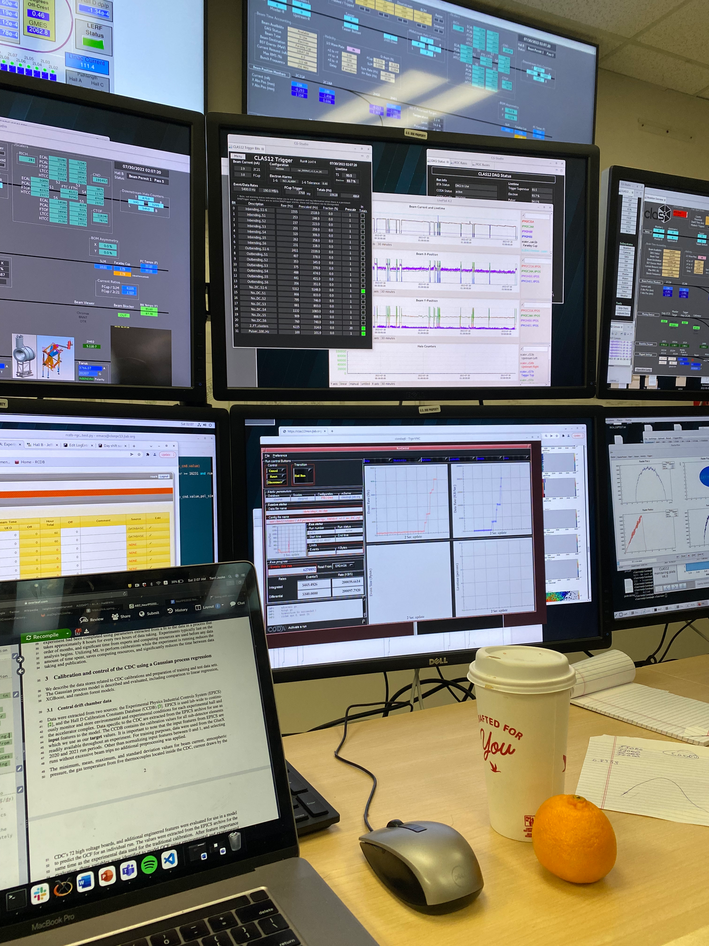
COMPUTER VISION FOR REAL TIME DATA QUALITY MONITORING
CHEP 2023
TORRI JESKE
THOMAS BRITTON
DAVID LAWRENCE
KISHANSINGH RAJPUT
roark@jlab.org
tbritton@jlab.org
davidl@jlab.org

Slide 2
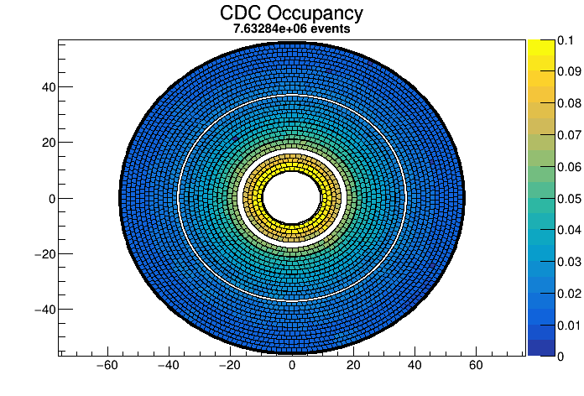
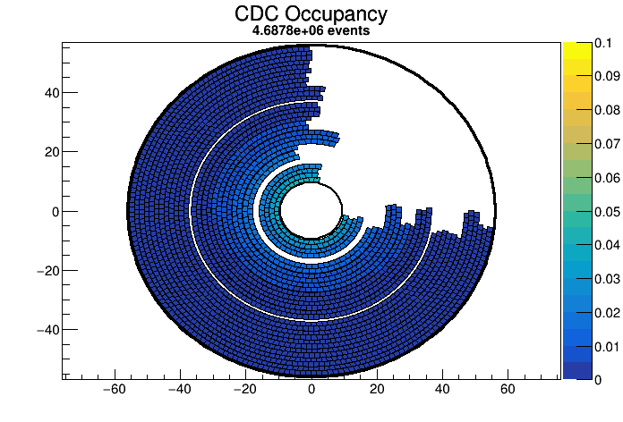
Human Classification
What influenced your decision?
1/ Probably good
2/ Probably NOT good
We expect to see higher occupancies closer to the beam line. This appears to look consistent with other monitoring histograms.
Turns out this giant hole is *fine* if you temporarily donate some electronics to another detector.
This is an obvious example!
2

Slide 3
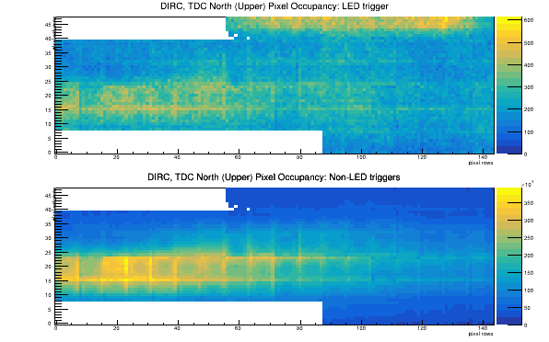
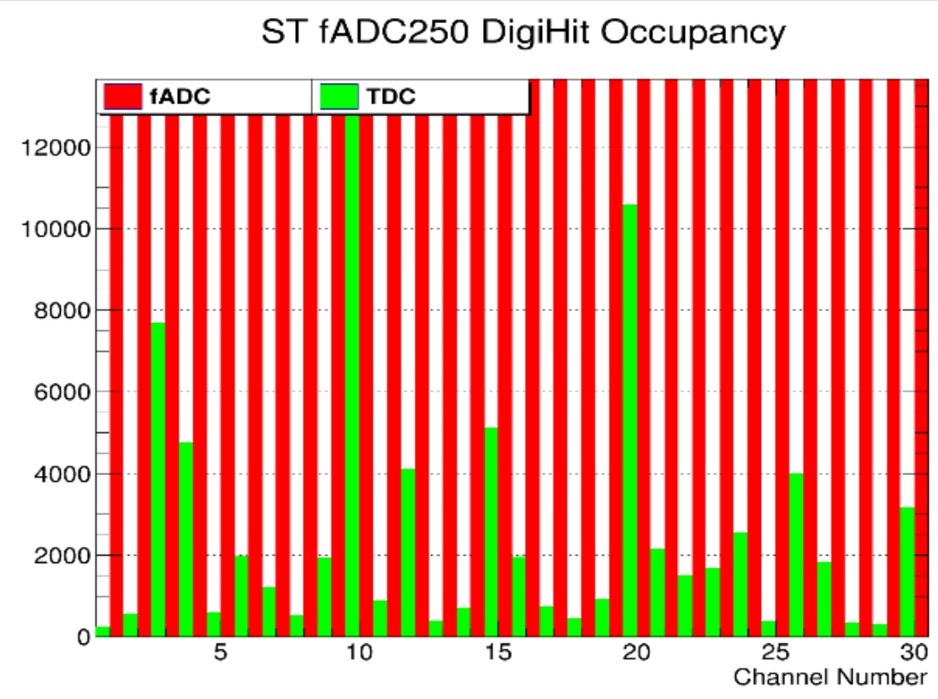
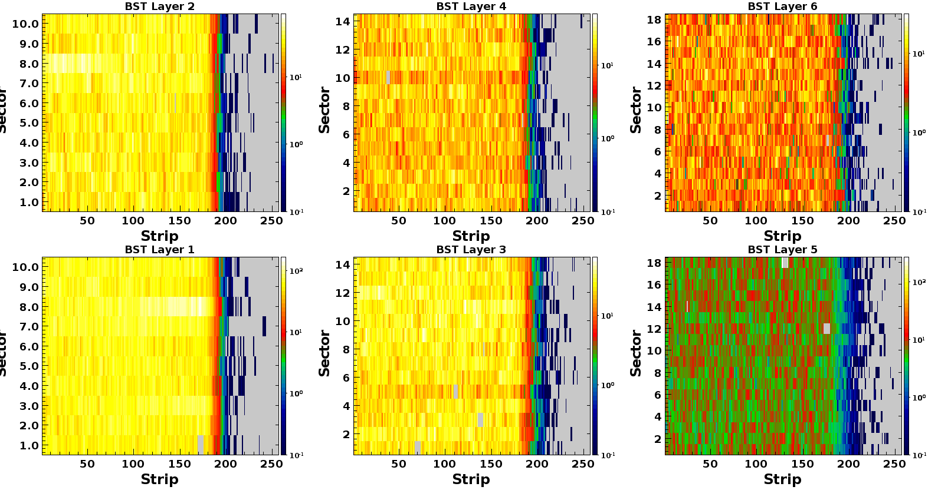
Less Obvious Examples
It's hard to tell right away if an image is bad!
3
Notes:
Get the low occupancy board image from David

Slide 4
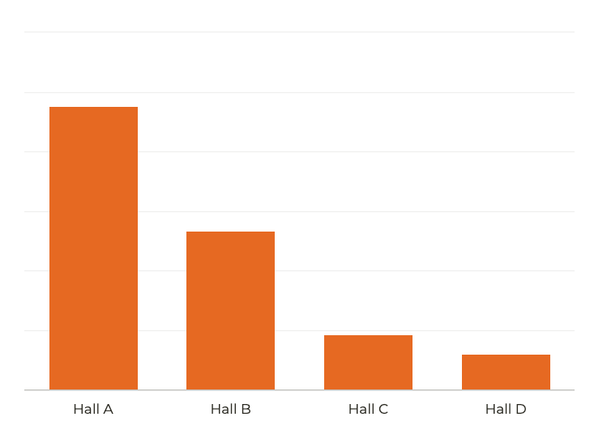
714
Online monitoring is tedious.
400
Varying levels of expertise
Inconsistent monitoring
138
Multiple plots per detector system
90
Probably too many plots to look at
Approximate number of individual histograms per experiment per run, monitored by the shift crew for each experimental hall.
4

Slide 5
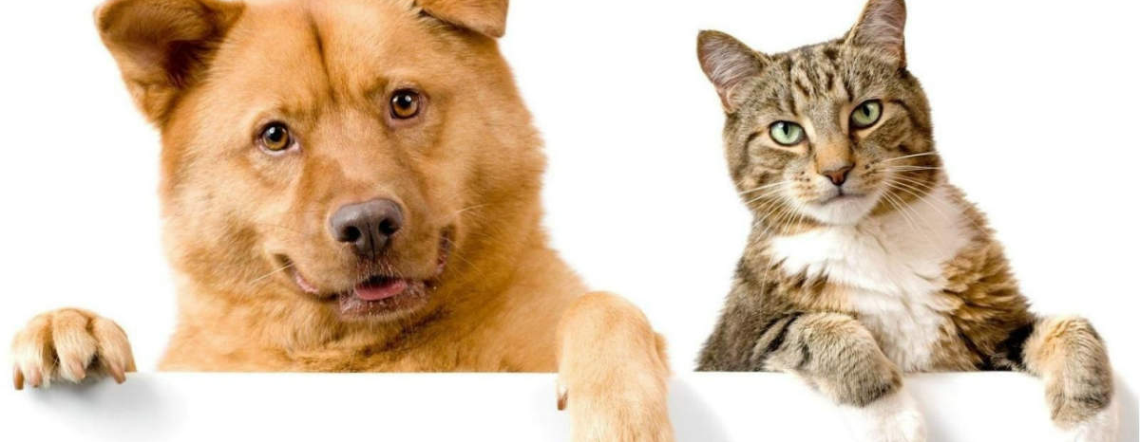
Can we use computer vision to mimic the Shift Crew?
Reduce inconsistencies inherent with human-based monitoring.
Correctly classify monitoring images quickly and more frequently than humans
Explainable predictions: can the model tell us what influenced it's decision?
Shift Crew
AI
PREDICTED: [('N02112137', 'CHOW', 4.611241), ('N02124075', 'EGYPTIAN_CAT', 4.3817368)] HTTPS://KERAS.IO/EXAMPLES/VISION/GRAD_CAM/
5
Notes:
replace with better images

Slide 6
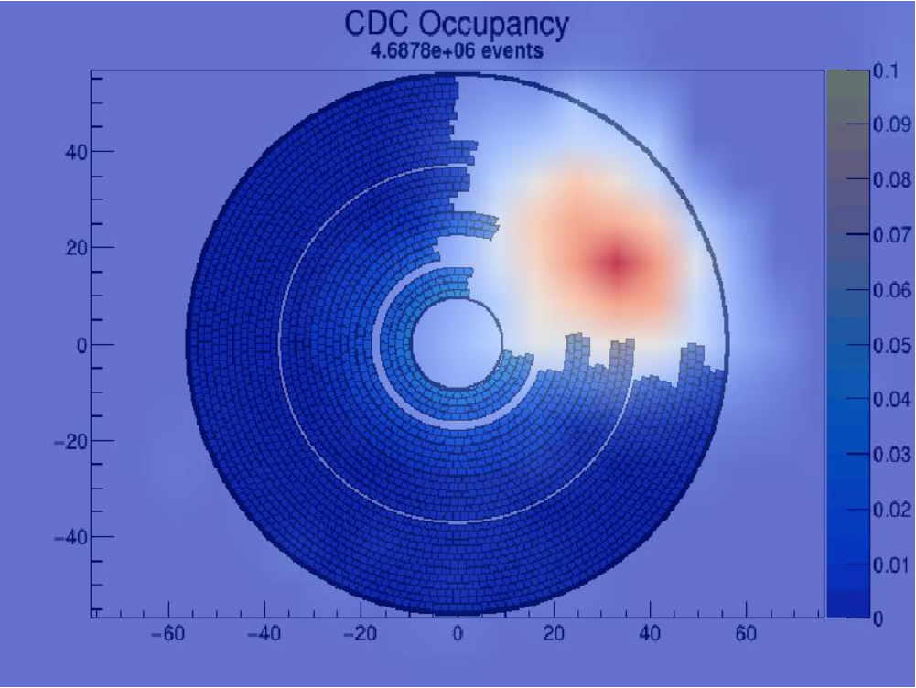
Why did the model make that prediction?
Deep neural networks have great performance but are hard to interpret.
Interpretability matters, especially when implementing smart systems into our typical work flows.
Visual explanations with Gradient-weighted Class Activation Maps (GradCAM)
Uses the gradients of any target concept flowing into the final convolutional layer to produce a map that highlights important regions in the image for the prediction
We are usually much more interested in what makes an image bad than good.
Reference: https://arxiv.org/pdf/1610.02391.pdf
6

Slide 8
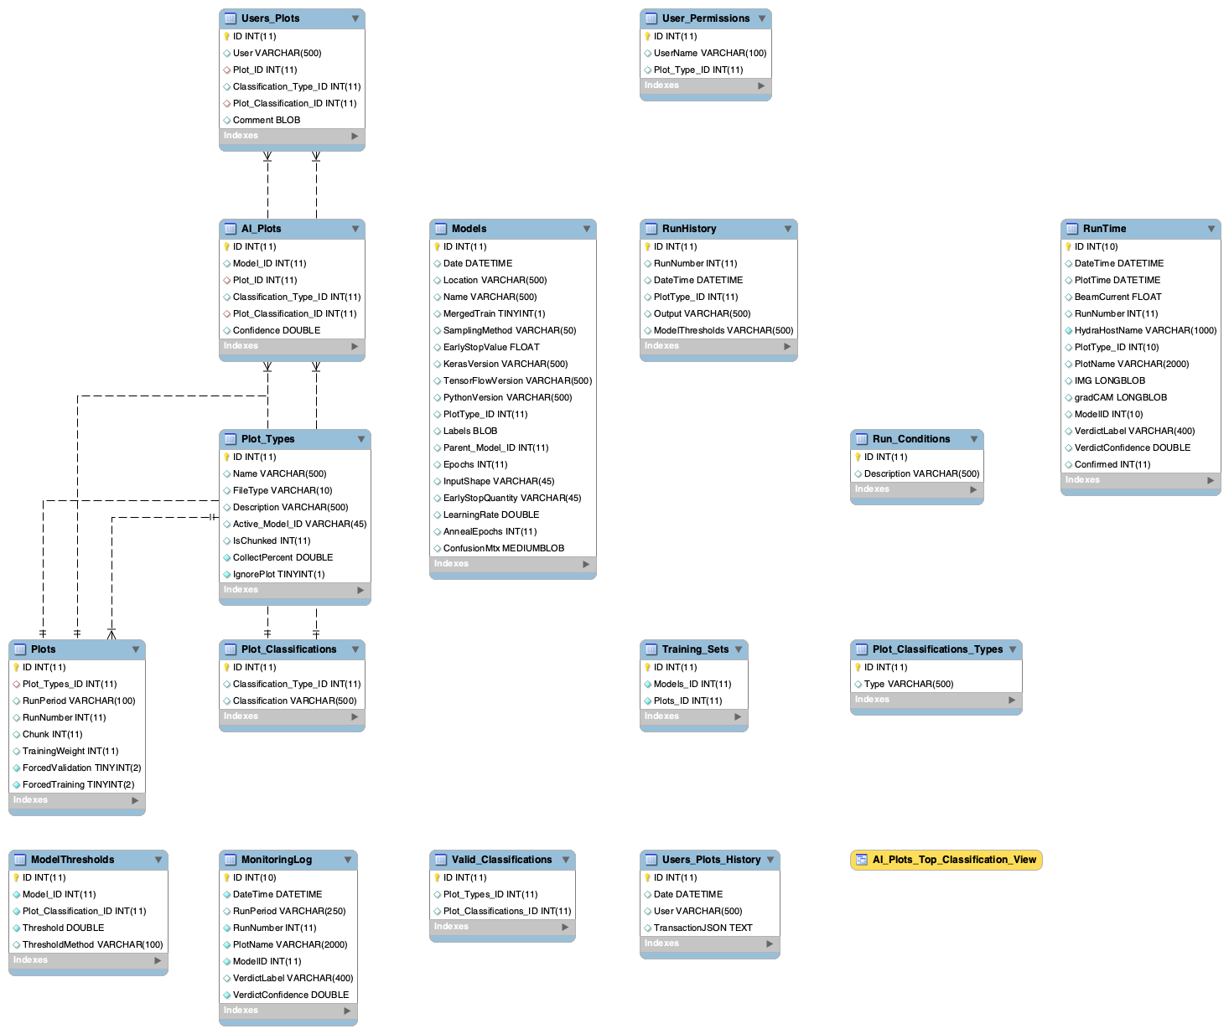
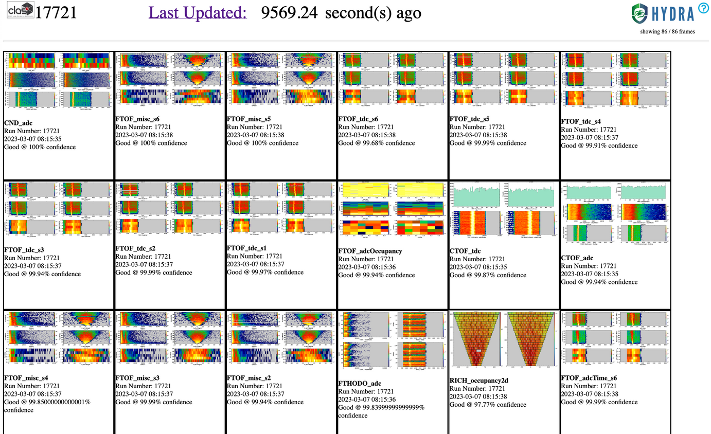
Online Data Quality Monitoring with HYDRA
An extensible framework for training, managing, and evaluating AI for real time data quality monitoring.
1/ MySQL back end
2/ Web based front end
Unique plot identifiers, model training parameters, classifications, user permissions, labels, and more are all stored in a database.
Web based front end for labeling, monitoring, and model validation.
8

Slide 9
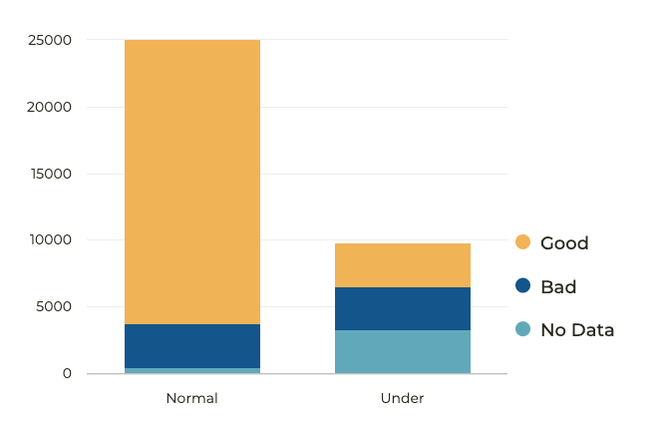
HYDRA Fast Facts
Features
Push button model training
Strategically under sample to account for large class imbalance without sacrificing performance
Metrics from model training are automatically generated for evaluation
Strategic sampling of training data: the variation of 'good' images is much smaller than the variation of 'bad' images
9

Slide 10
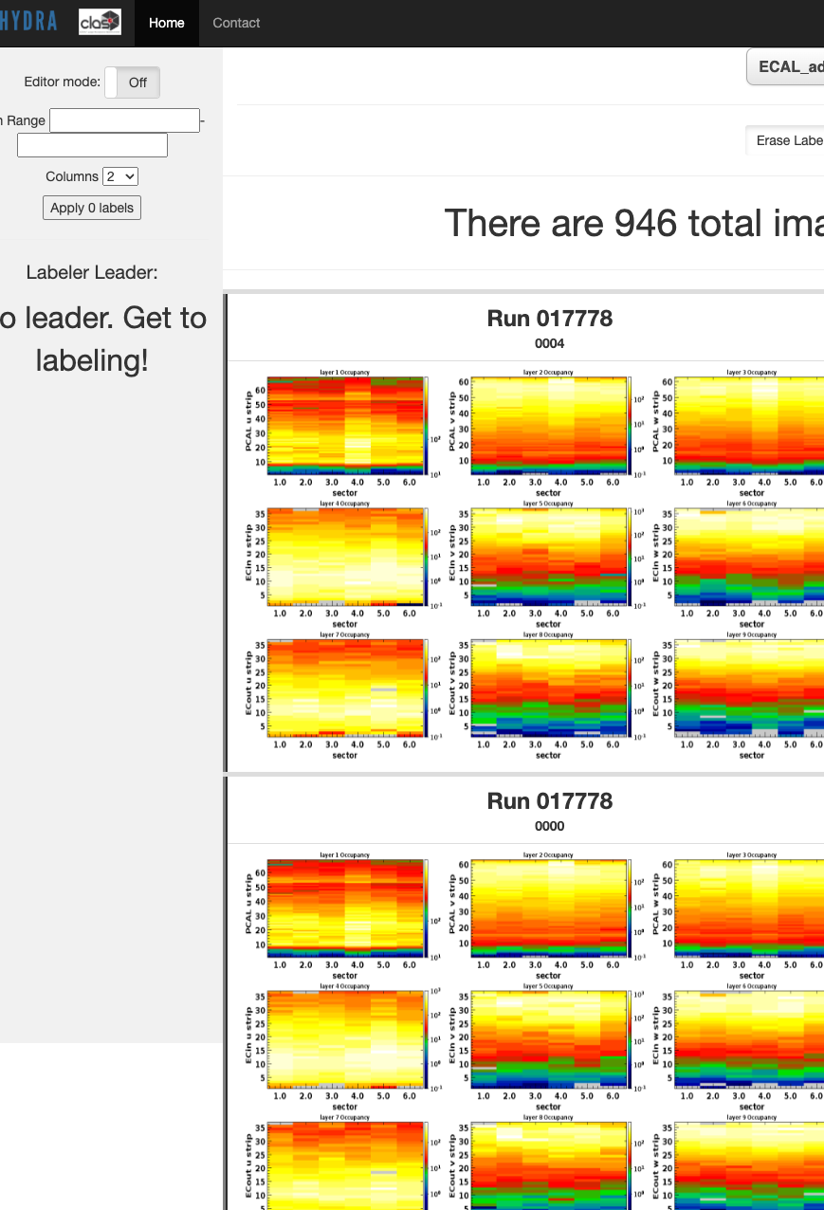
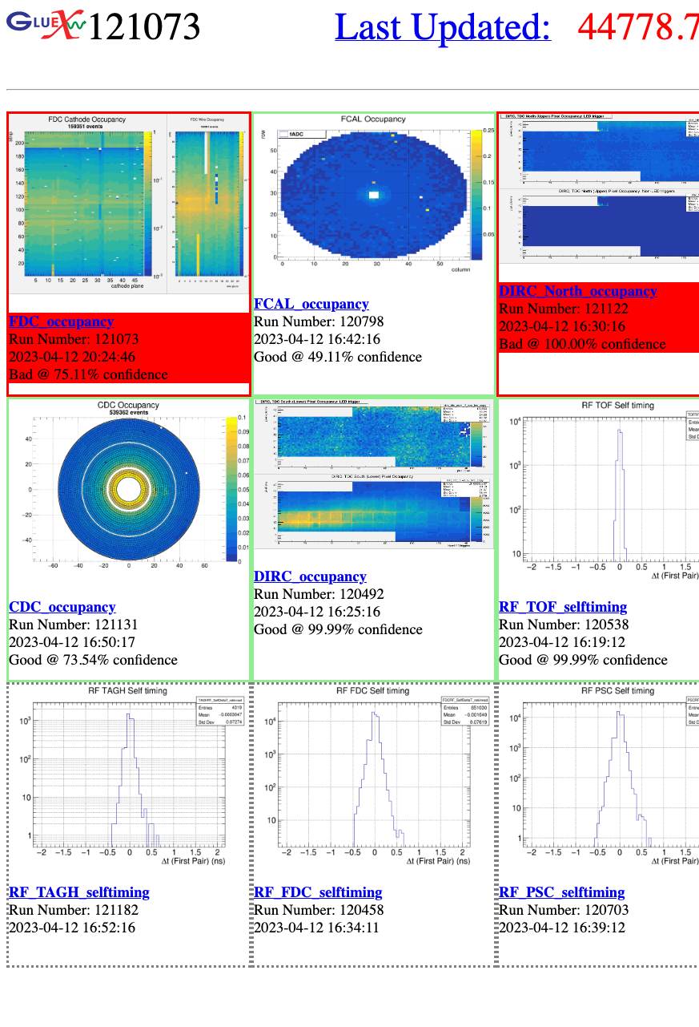
HYDRA: Front End
Web based for user convenience.
Data Labeler
Library
Run
Grafana
Log
Efficiently label hundreds (thousands) of images
Contains enhanced confusion matrix, thresholds, active model designations
See near real time predictions
Dashboard displays all predictions over time
Display concerning plots sorted by detector from previous day
10

Slide 11
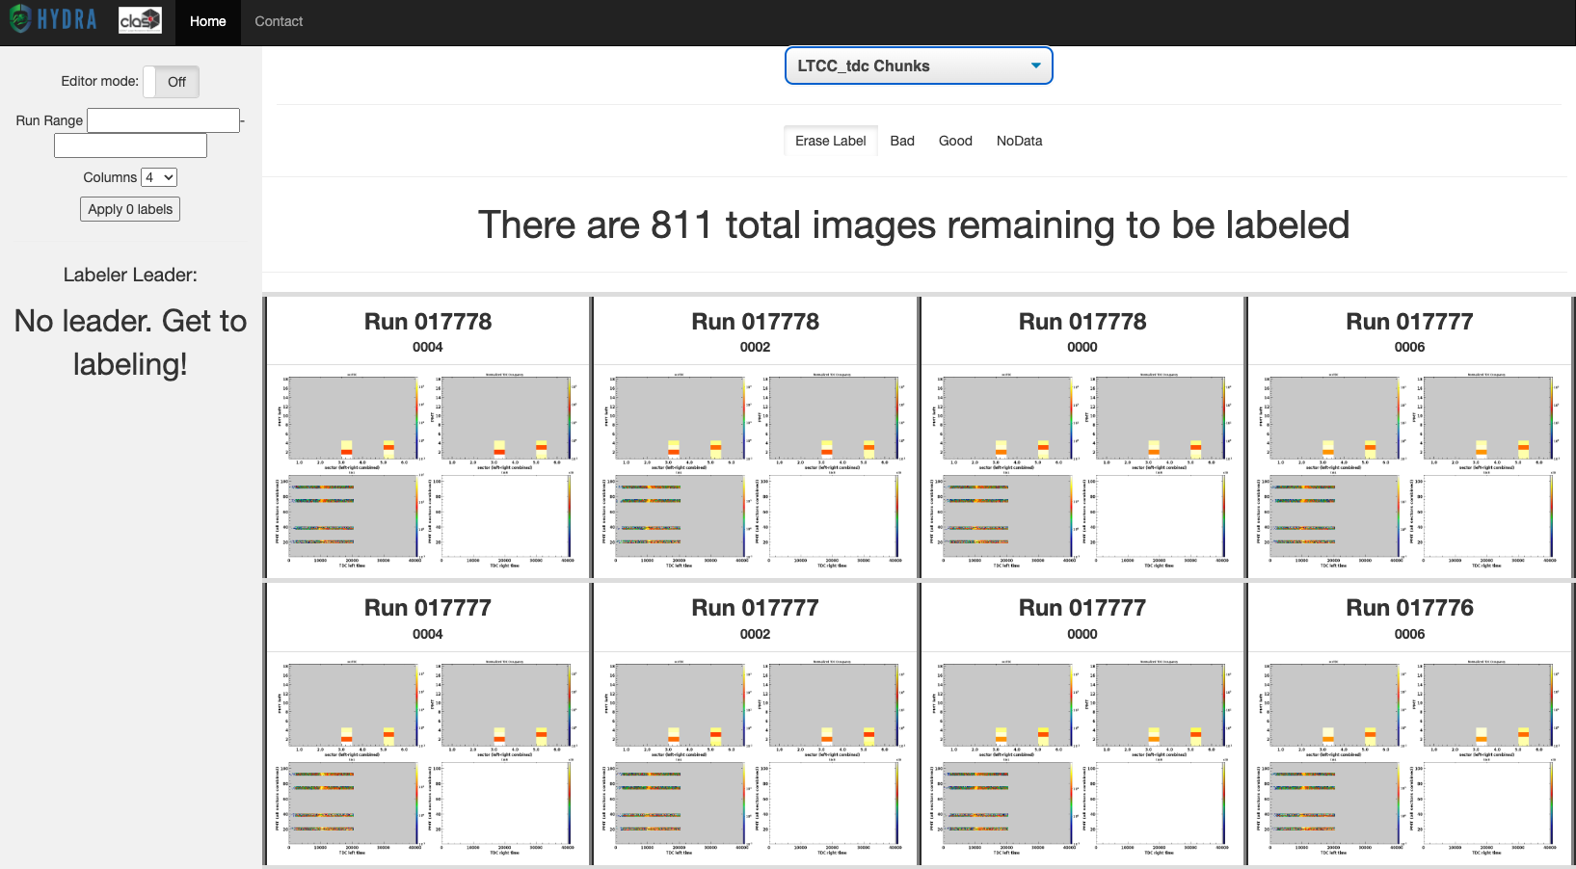
HYDRA: Data Labeler
Efficiently label multiple monitoring plots. Labels and images are automatically uploaded to database.
11

Slide 12
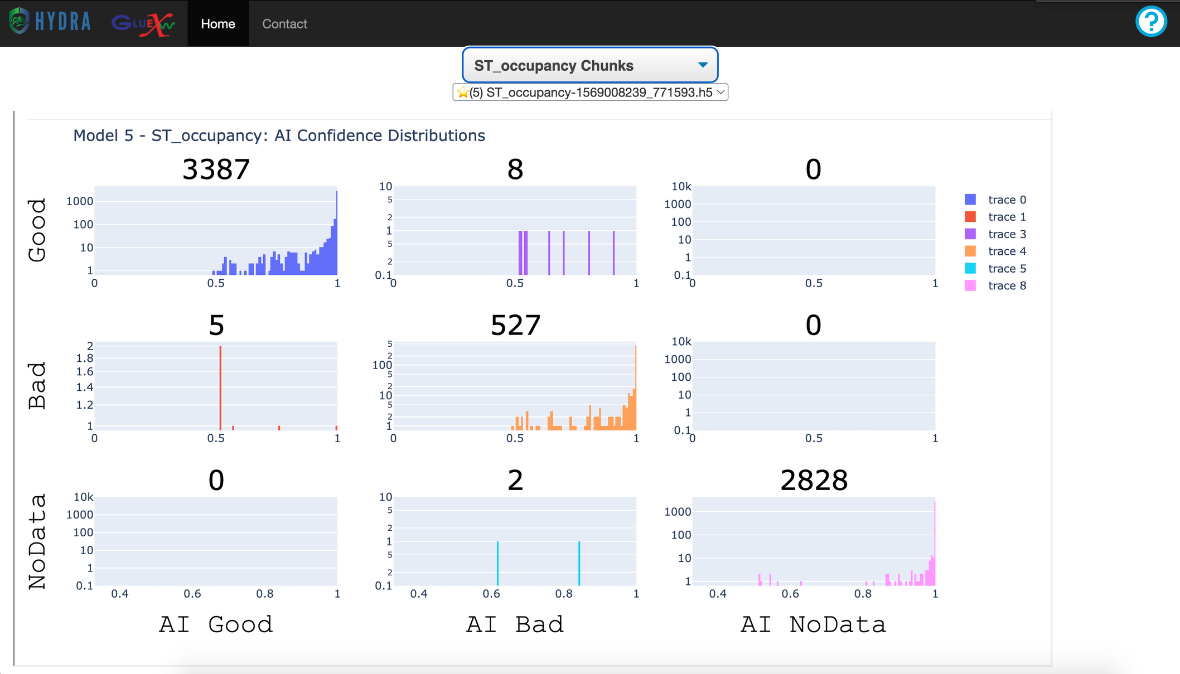
HYDRA: Library
Visualize model performance, thresholds, active models, etc.
Enhanced confusion matrix
Each cell contains AI confidence distribution and total counts
12

Slide 13
HYDRA: Run
Watch predictions in real time from anywhere
GradCAM visualizations are optional
13

Slide 14
HYDRA: Grafana Dashboard
Look at any prediction over time.
14

Slide 15
HYDRA: Log
See 'Bad' or 'Unconfirmed' images from previous runs, separated by detector.
Easily identify when a particular problem started
15

Slide 16
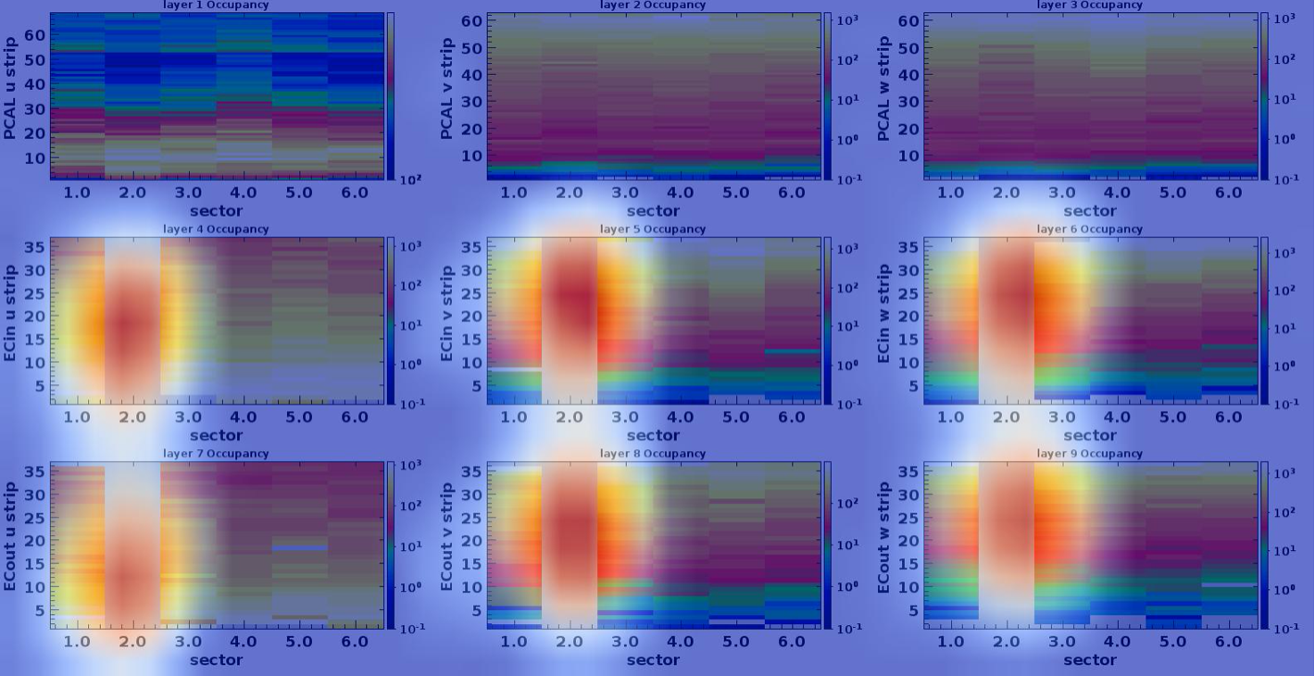
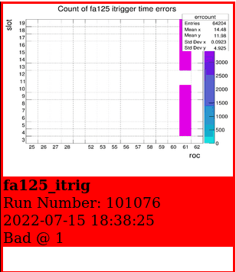
Anecdotes: Does it actually work?
In some cases, Hydra identifies issues before the shift takers can.
1/ Hall B
2/ Hall D
A sector of a calorimeter in the CLAS12 spectrometer dropped. Hydra correctly recognized this as bad due to no occupancies in Sector 2.
This monitoring histogram should always be empty, if not, an audible alarm with the EPICS alarm handler is sounded to alert the shift crew to stop the run.
16

Slide 17
Back End
Front End
Model Implementation Scores
GradCAM++
Adding model implementation scores to database
Enhanced GradCAM for visualizing explanations
Synchronize Databases
Hydra Log
Automatic database synchronization across Halls
Enhanced query for returning 'Bad' or 'Unconfirmed' classifcations
Features and Developments
Hydra Run
Dynamic image ordering for multi-image use cases
In the works
User interface improvements
Not an exhaustive list!
17

Slide 18
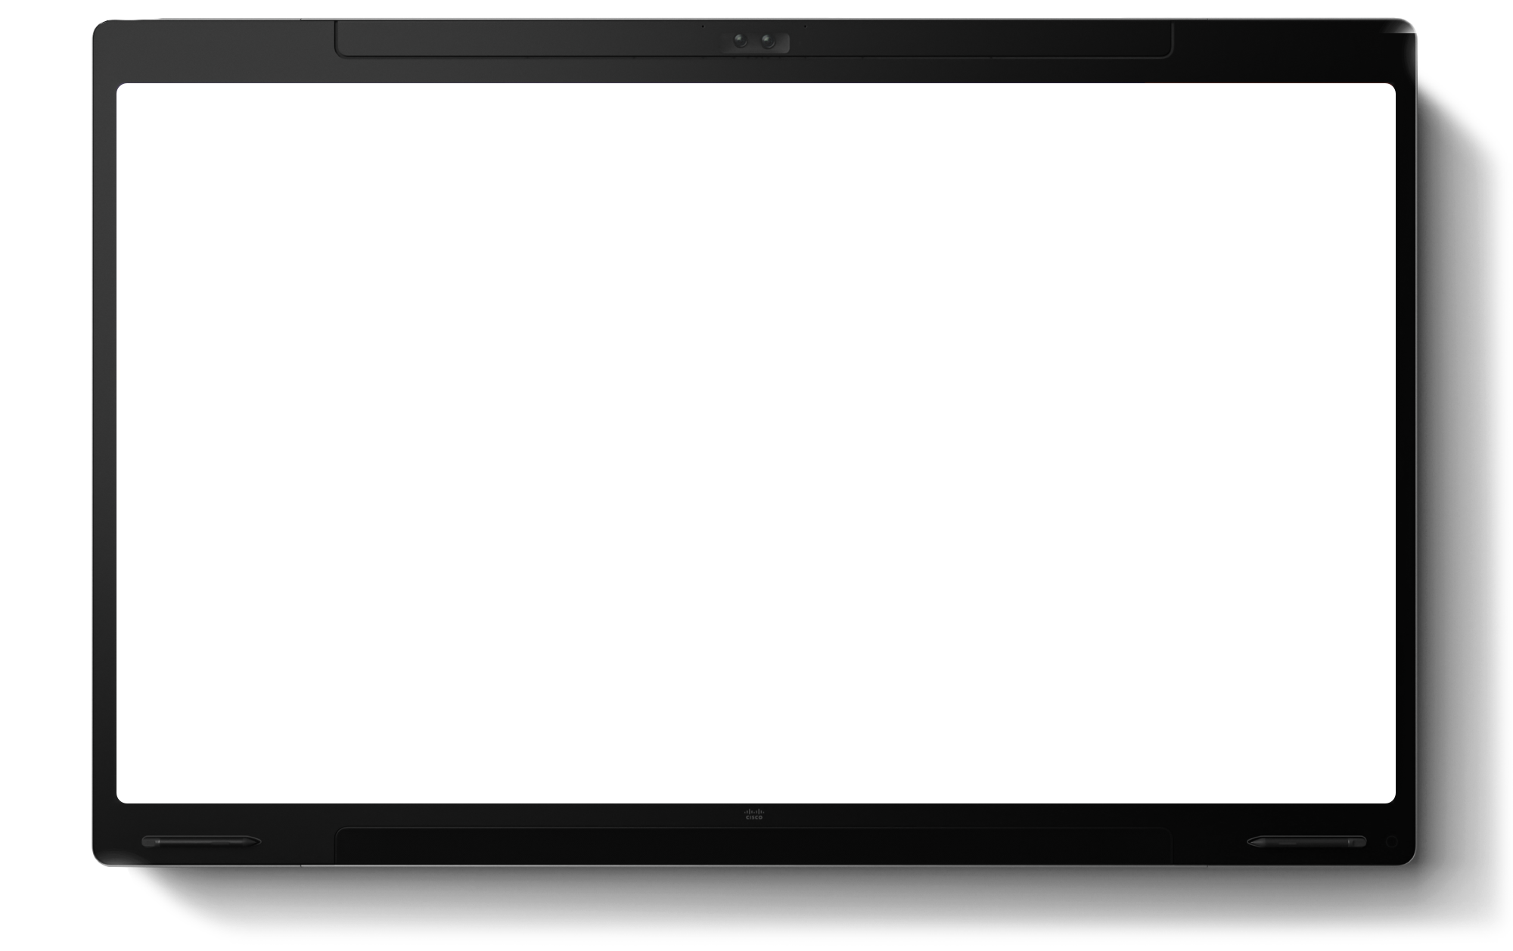
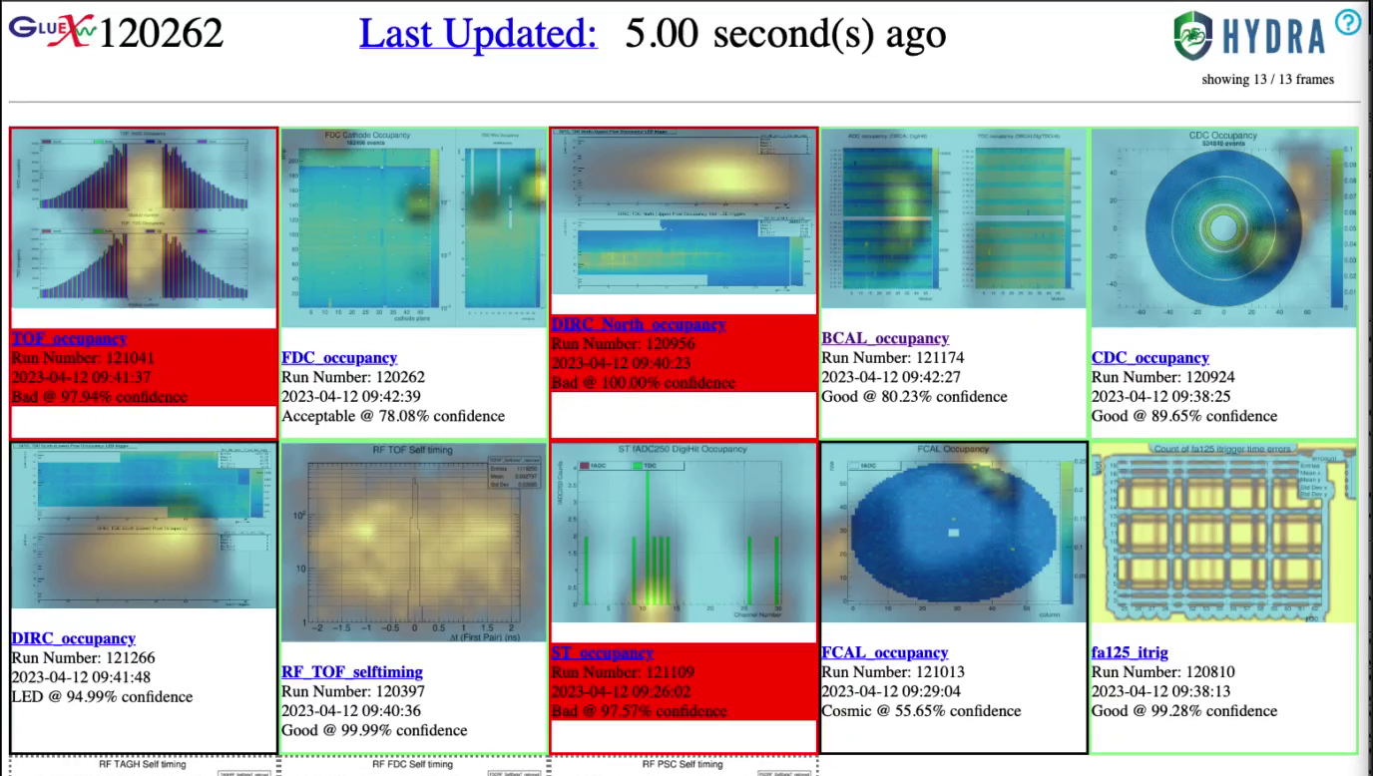
Questions?
Virtual Workshop for Data Quality Monitoring
Summer 2023 | tbritton@jlab.org
Poster
Towards High Performance AI4NP Applications on Modern GPU Platforms by Cissie Mei
18

Slide 19
back ups

Slide 21
Model Validation
When do we implement a model?
Obtain labeled images
Train Model
Analyze Model
AI Approval
Expert Approval
Regroup
Analysis
Evaluation
Implementation
21

