Slide 1
ATLAS LAr Calorimeter Commissioning for LHC Run-3
CHEP2023
Marin FURUKAWA
The University of Tokyo
on behalf of the ATLAS LAr Collaboration

Slide 2
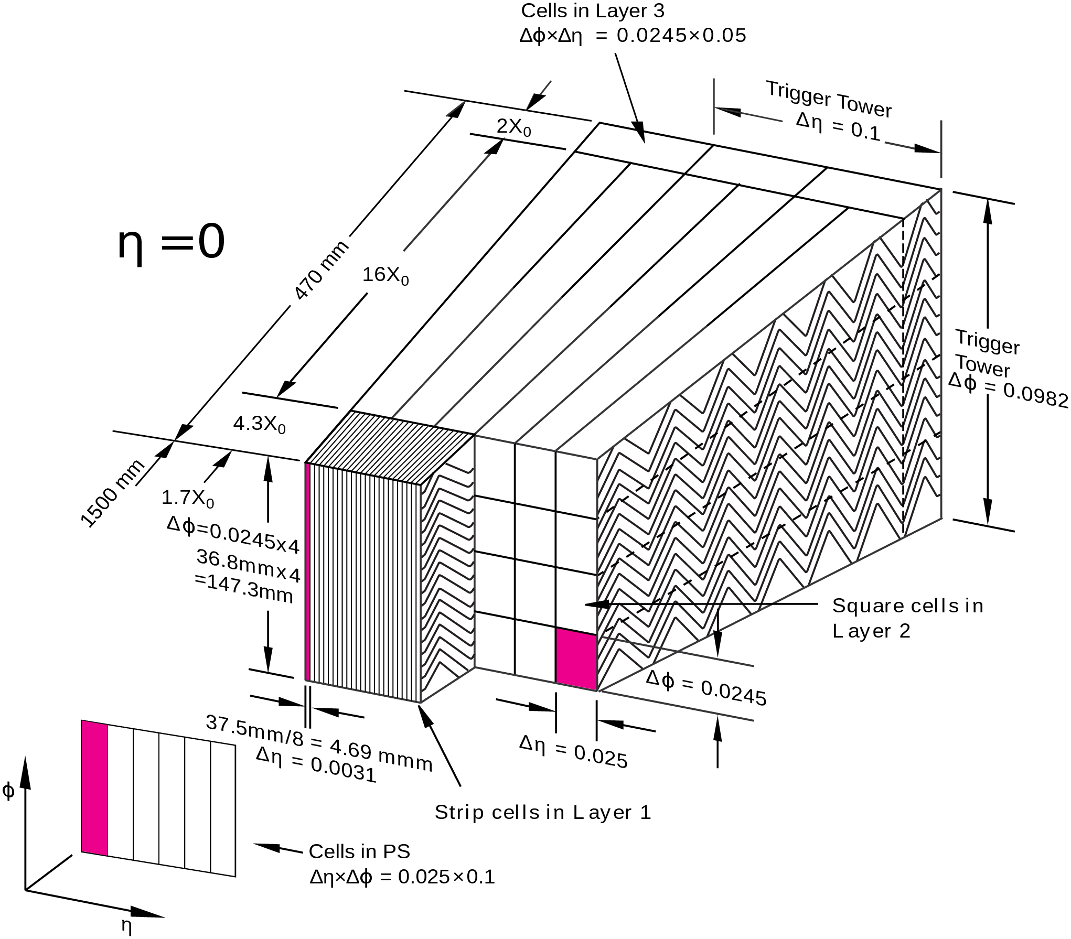
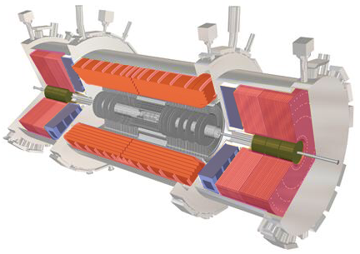

ATLAS Liquid Argon (LAr) Calorimeter
Measure the momentum of electrons, photon, and hadron jets.
Sampling Calorimeter Lead, copper, and tungsten as absorber material.
Liquid argon as active material.
Around 200,000 channels, EM Barrel has 4 layers, the others have 1〜4 layers depending on the regions.
The information is provided to the 1st level of the ATLAS trigger (L1 Trigger).
EMEC
(electromagnetic)
Fcal
(electromagnetic & hadronic)
Back
HEC
(hadronic)
Middle
Front
EM Barrel
(electromagnetic)
Presampler(PS)
C-side
$$η=0$$
A-side
▲Layer structure
▲LAr Calorimeter

Slide 3
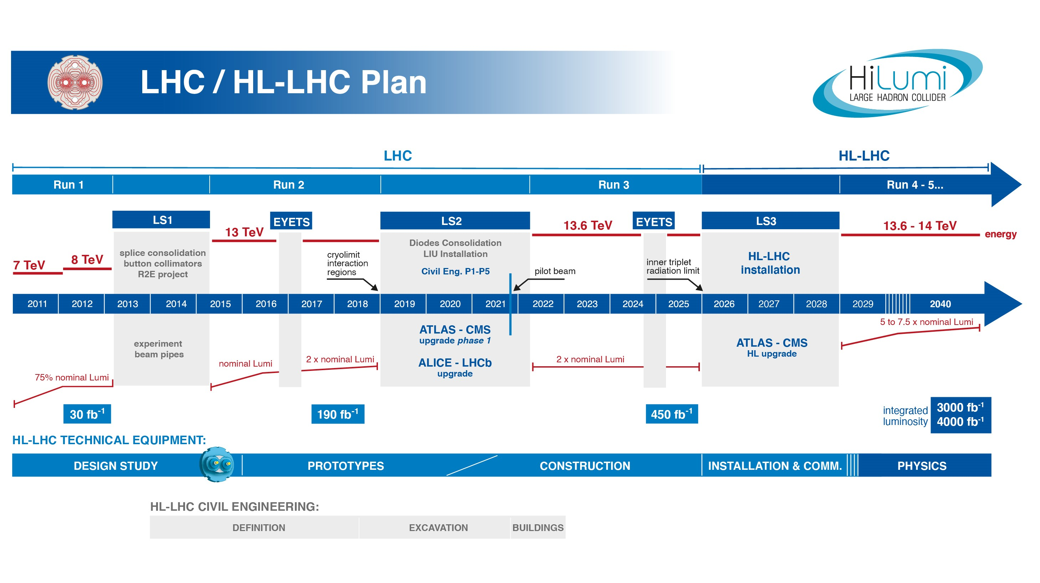
LHC-Plan
Run 2
Run 3
LS 2
LS3 and
HL-LHC
Today’s talk
Installation
Commissioning
Trigger upgrade HW installation
Now
New trigger system have been installed during Long Shutdown 2 (LS2).
Under the final commissioning using Run 3 data to use as the trigger in 2023
Talk theme: Commissioning status of newly installed trigger system for LHC Run-3

Slide 4
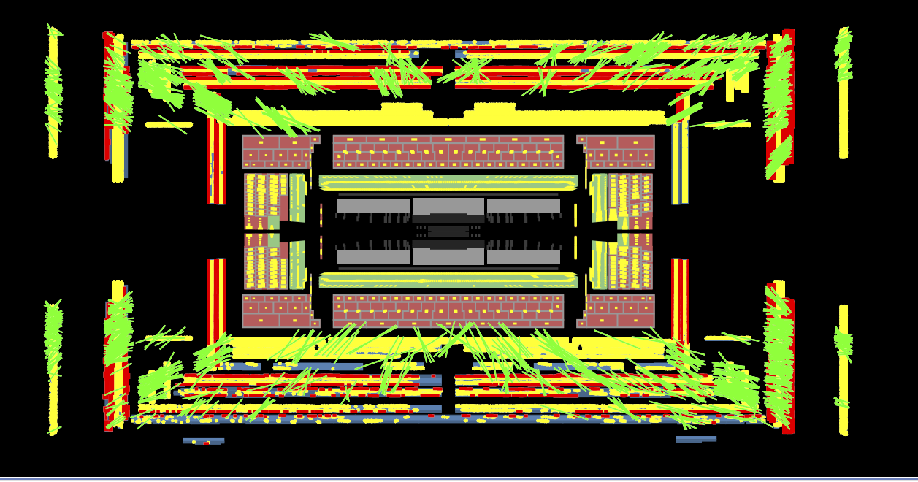
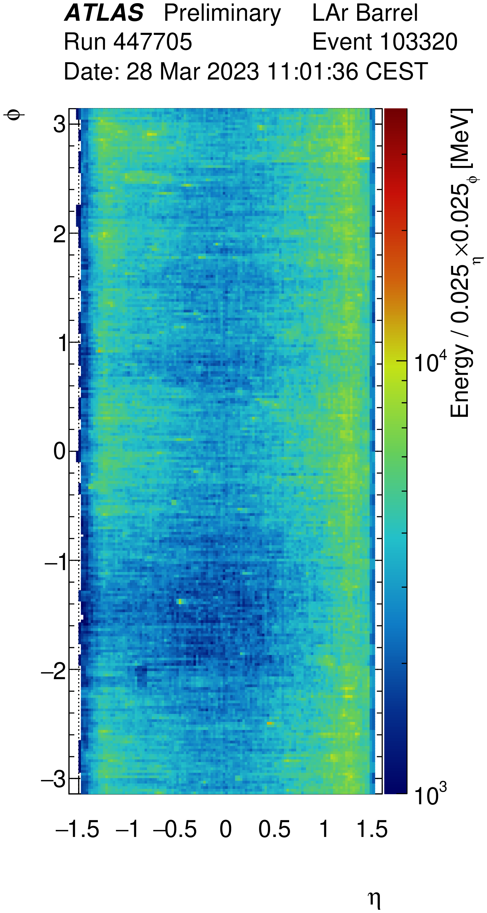
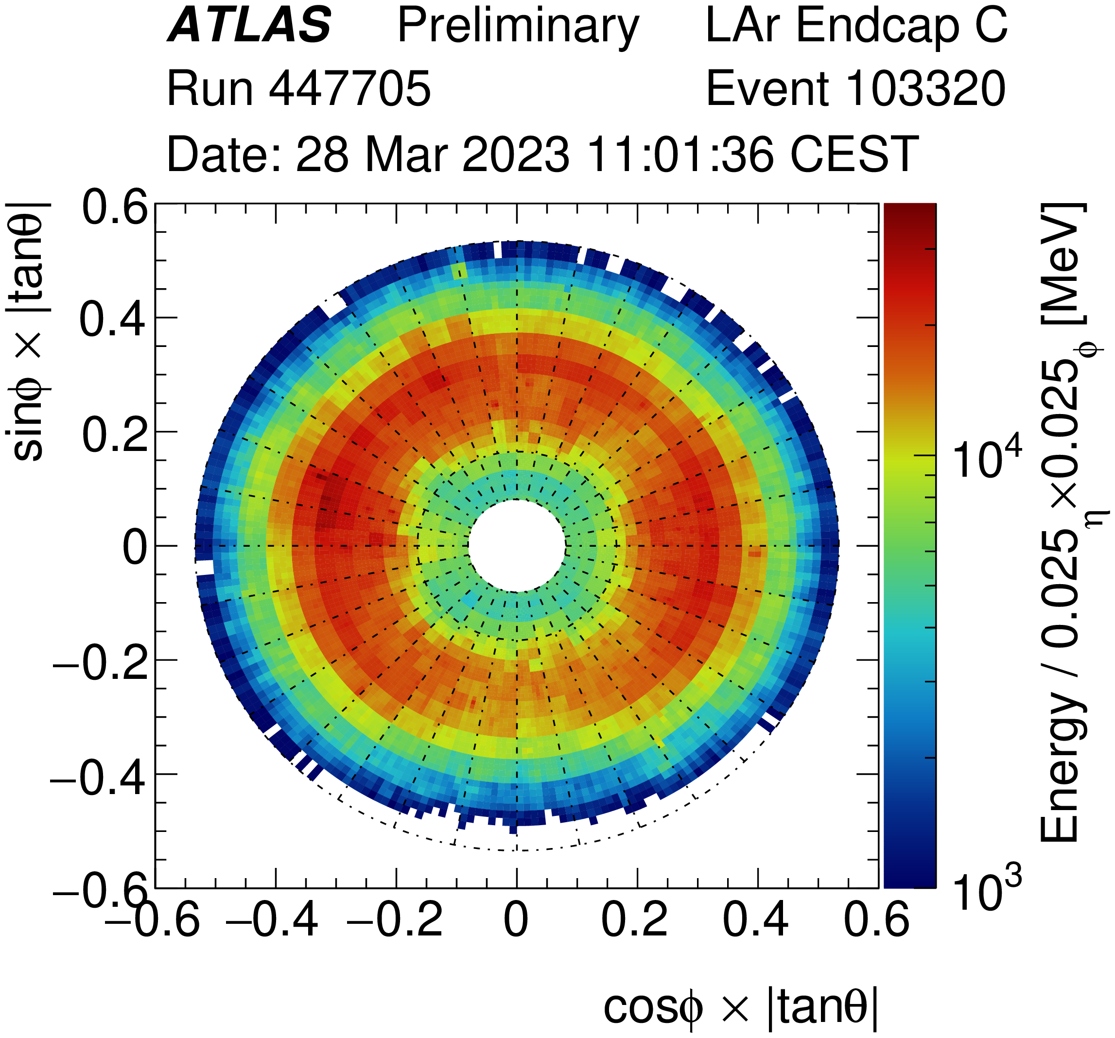
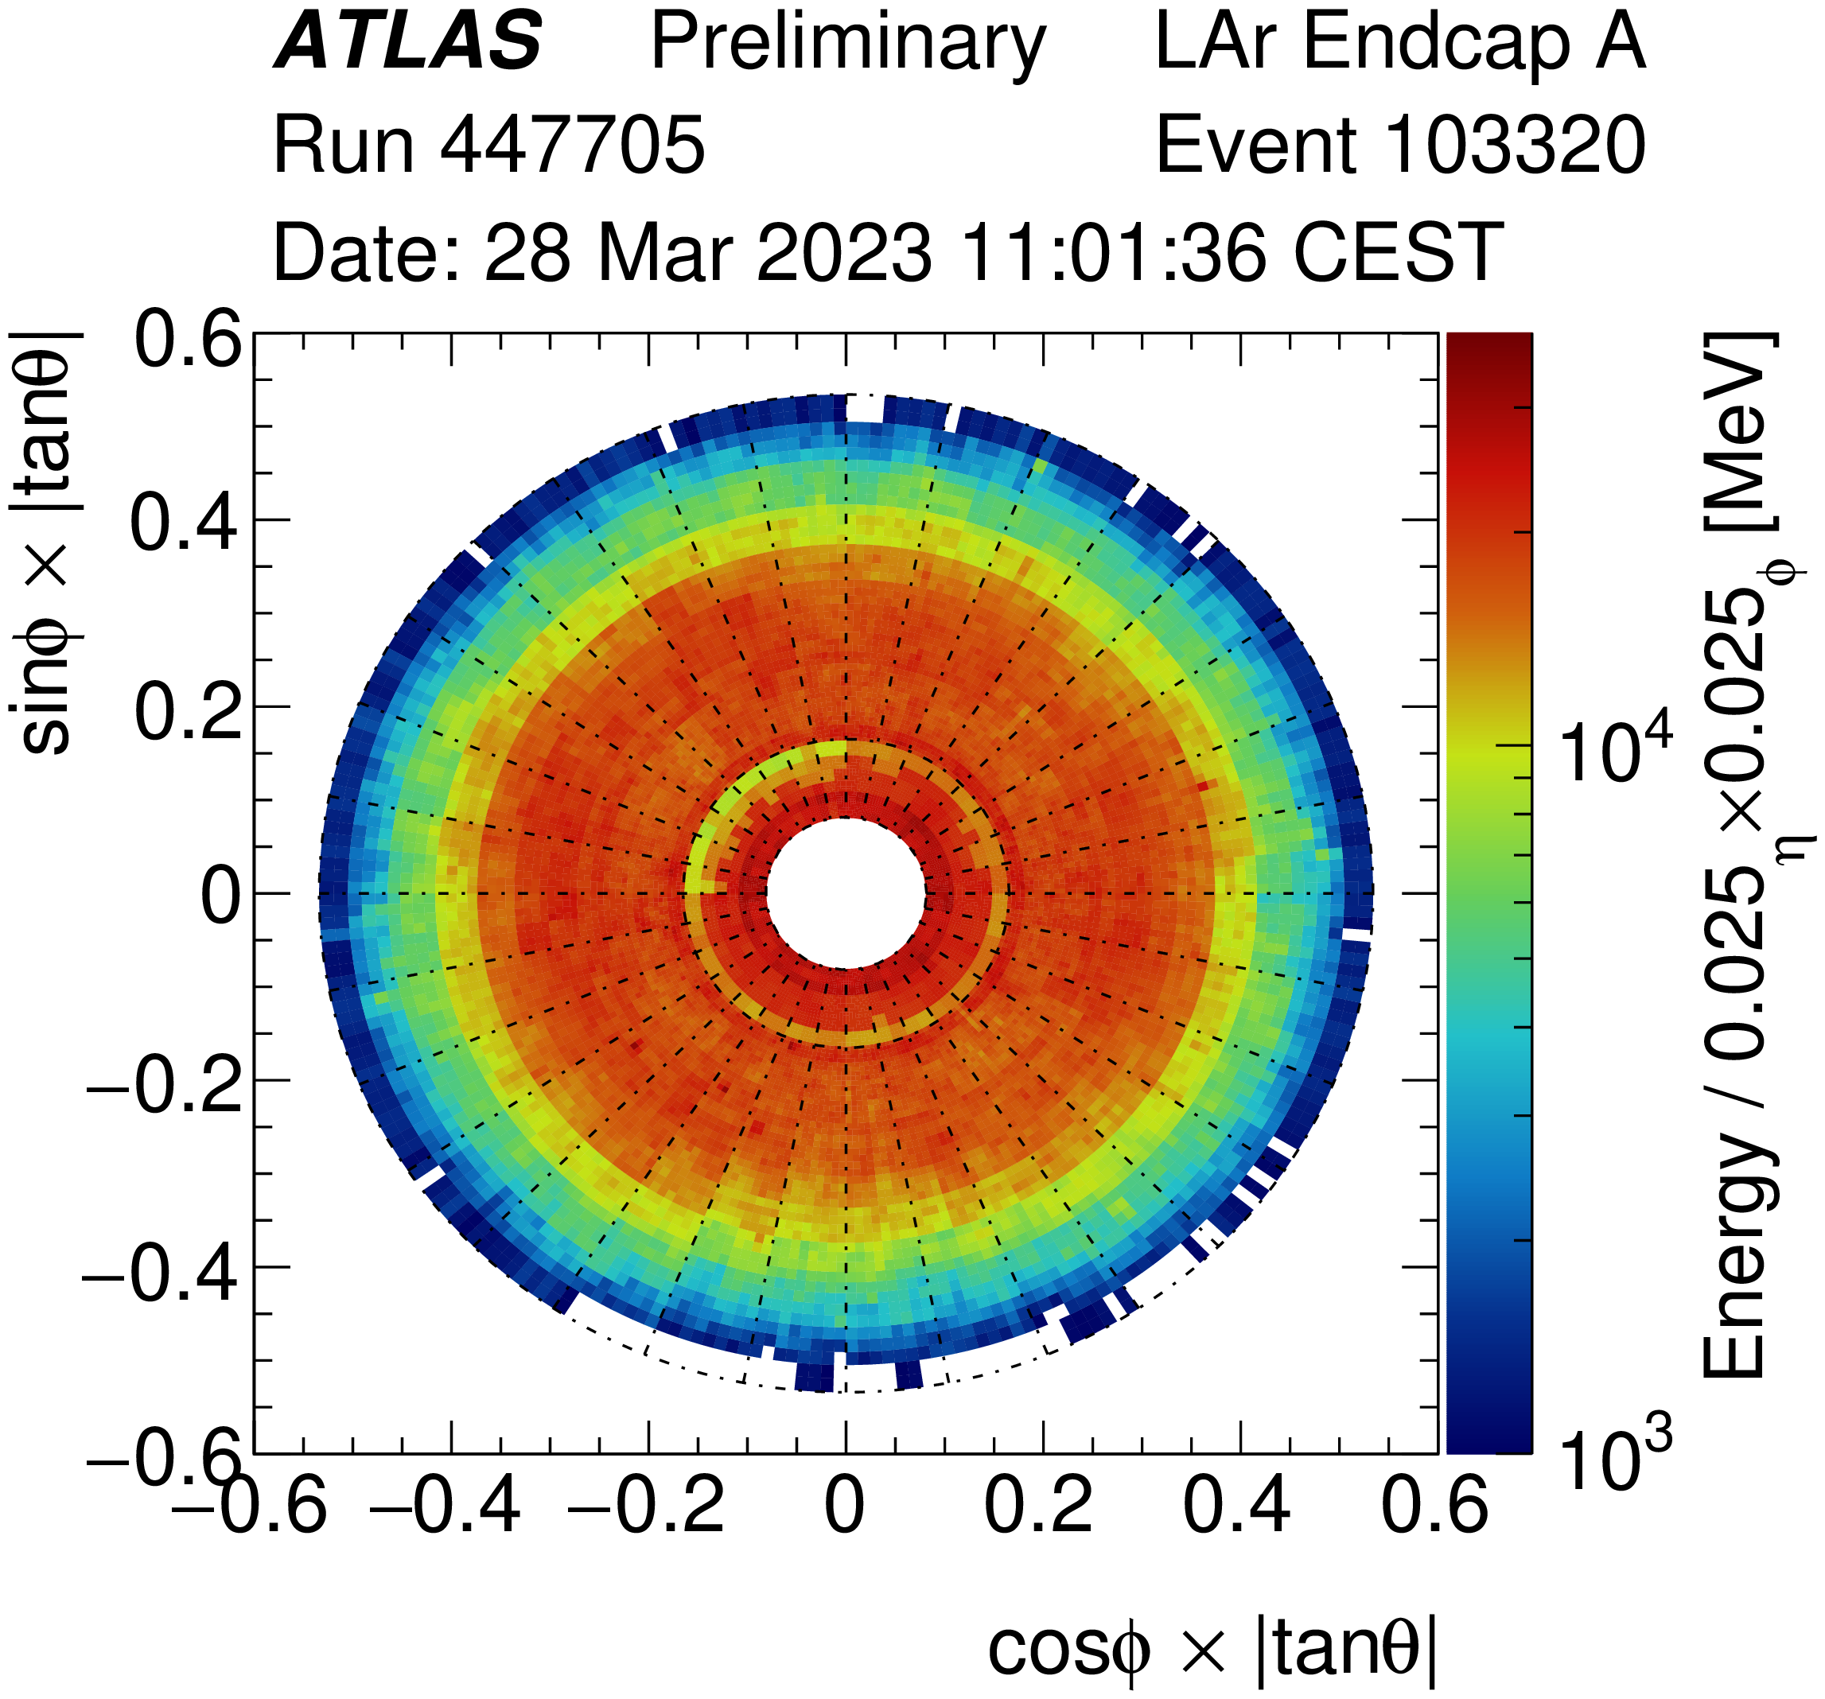
Current status
Single beam Splash run is done
on 28th Mar. 2023
before having a collision
Beam
Beam entered from C side to A side
Main readout works well.

Slide 5
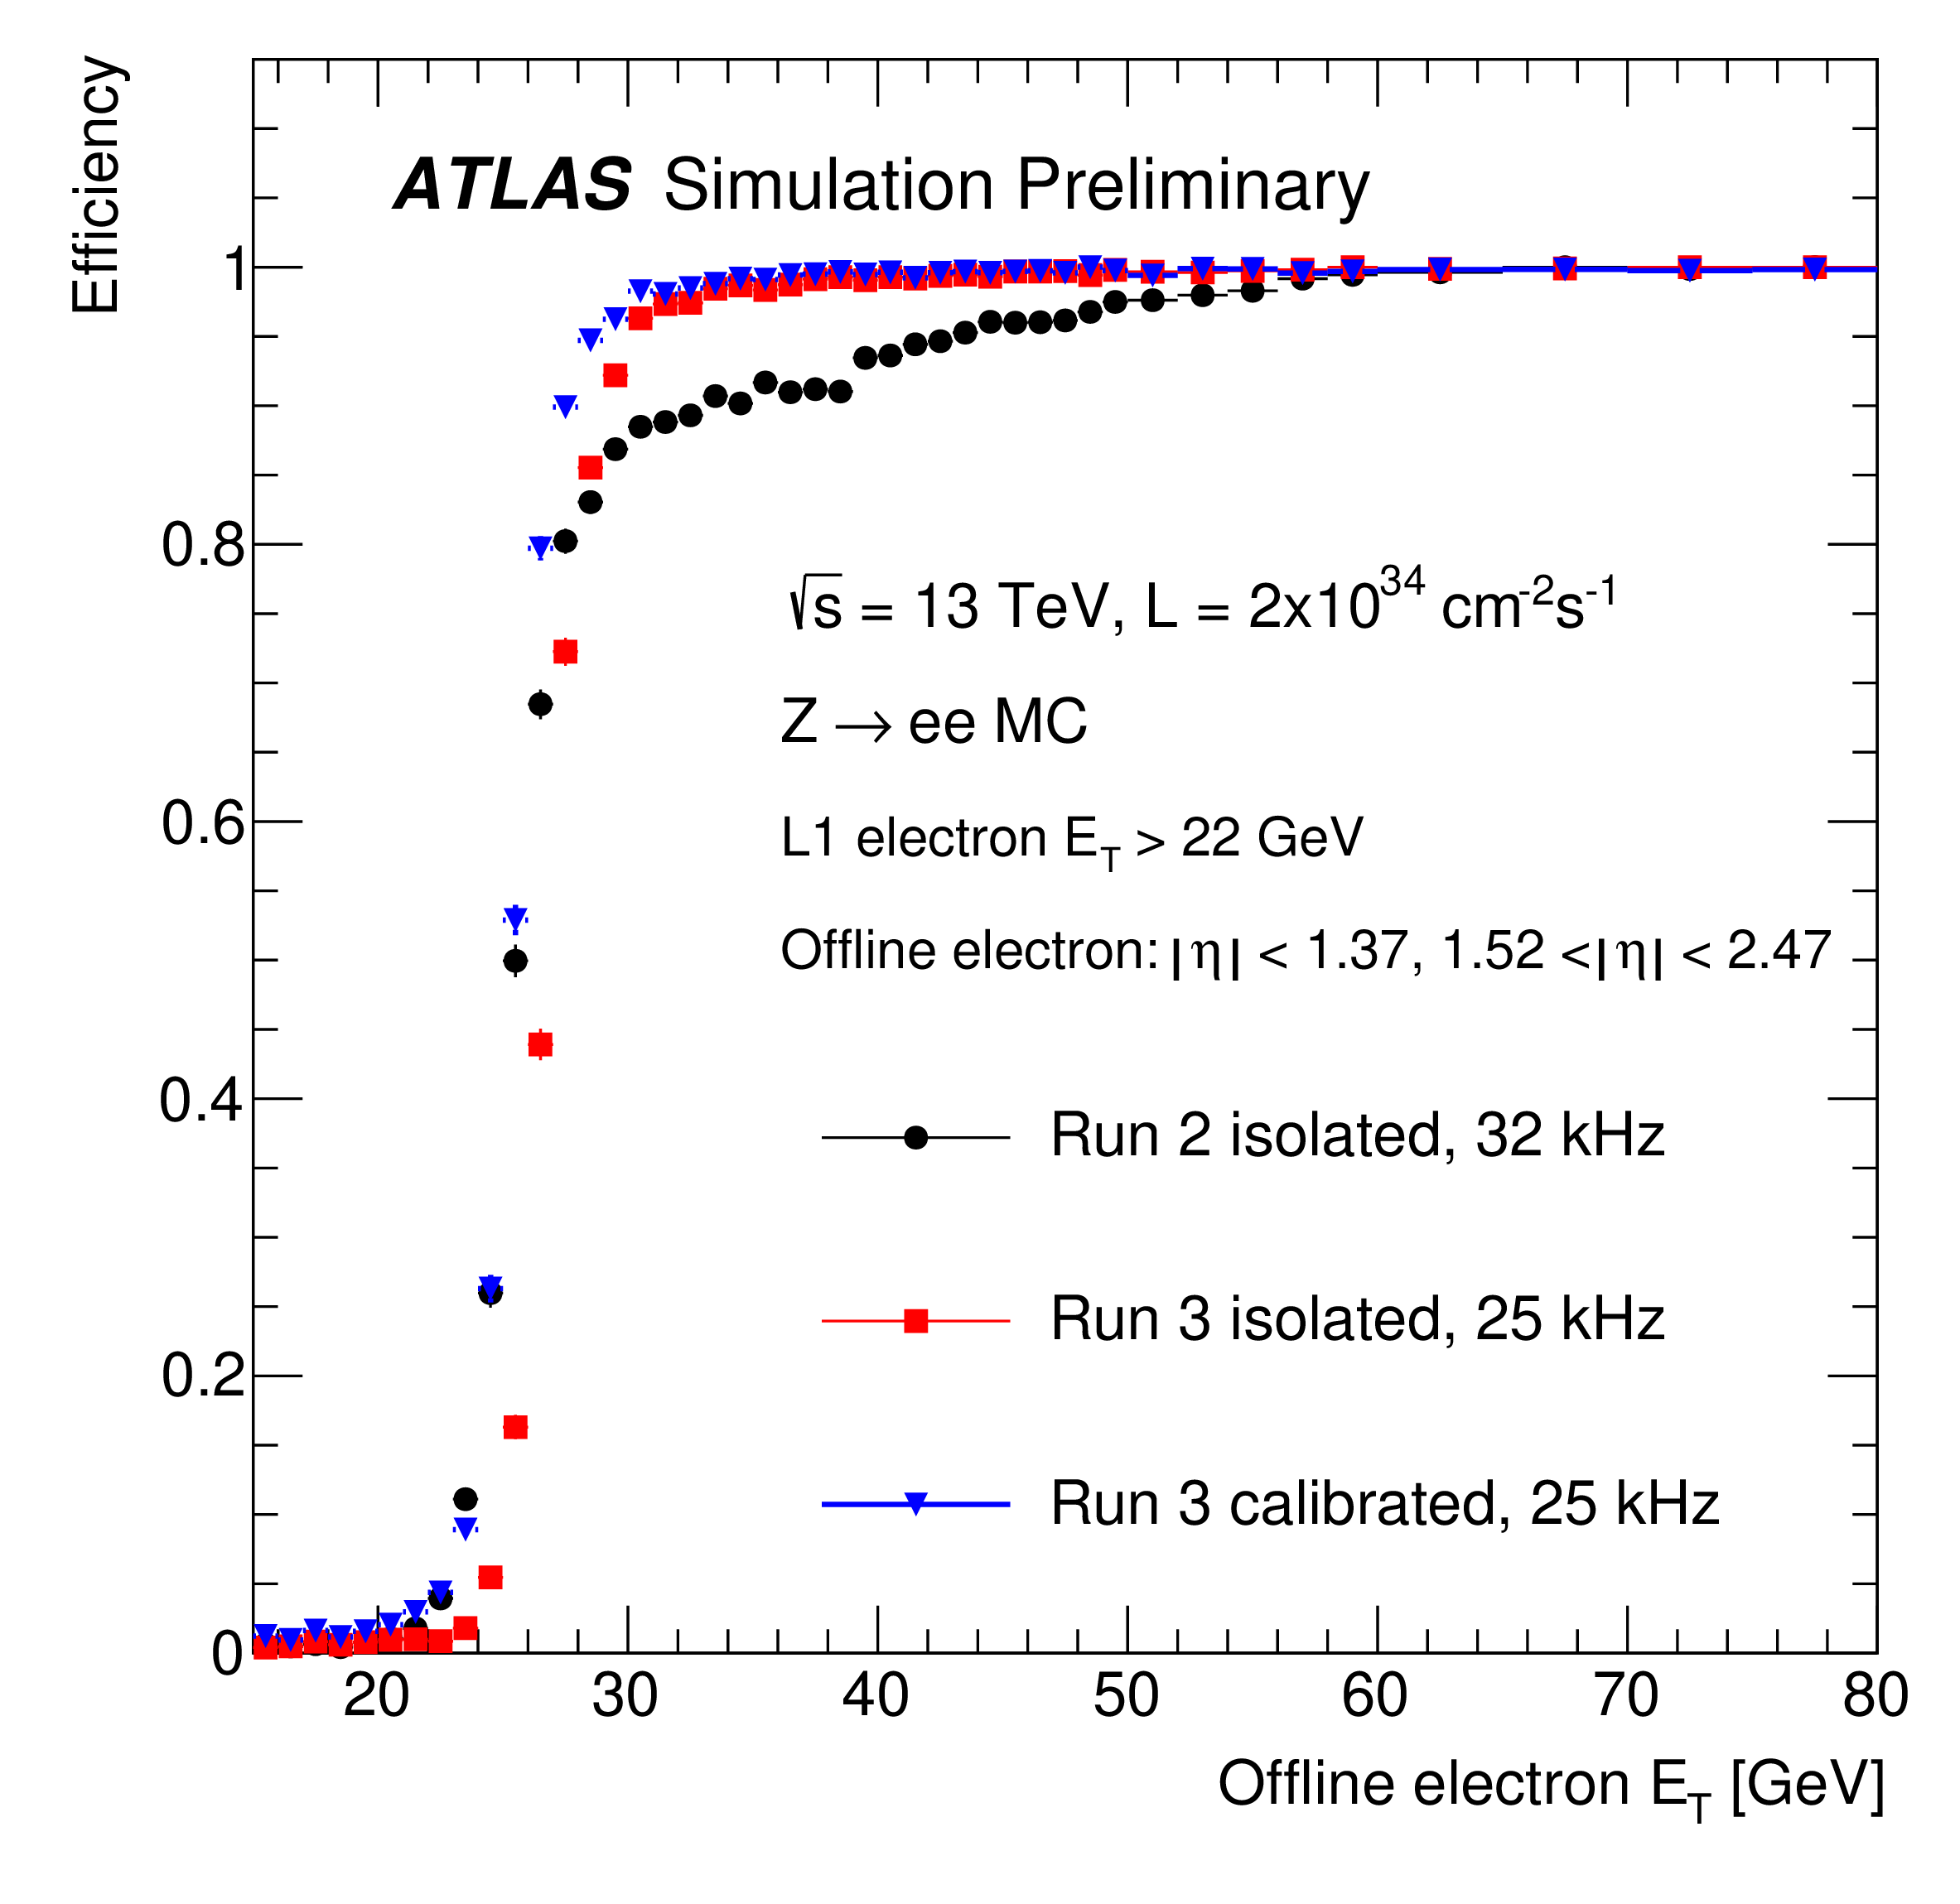
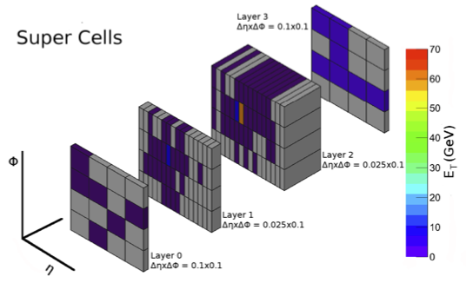
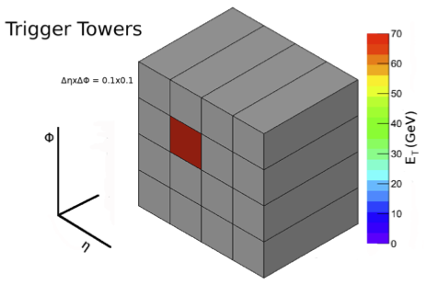


Trigger readout upgrade for luminosity increase
In LHC-Run3, luminosity and pileup increased more than Run2, while ATLAS L1 Trigger keep at 20 kHz for electron and photon.
Increasing the momentum threshold for an increase in background events can miss the target signal event.
Trigger system is upgraded
Readout unit changed to 10 times finer Super cell (SC).
Whole of system replaced from analogue to digital.
Not fully raised
Threshold
(with legacy system)
Hadron jet $ΔR≈0.4$
(with digital system)
EM shower $ΔR≈0.04$
▲Efficiency of lowest unprescaled single EM trigger
SC achieves efficient object identification!
It maintains triggering efficiency
without raising the threshold.
▲Readout unit during Run2
▲Readout unit during Run3

Slide 6
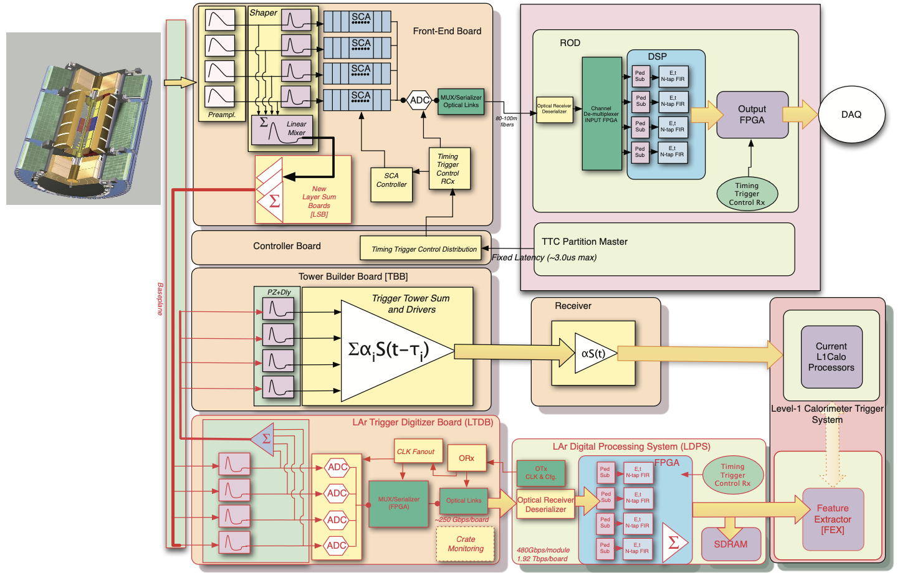
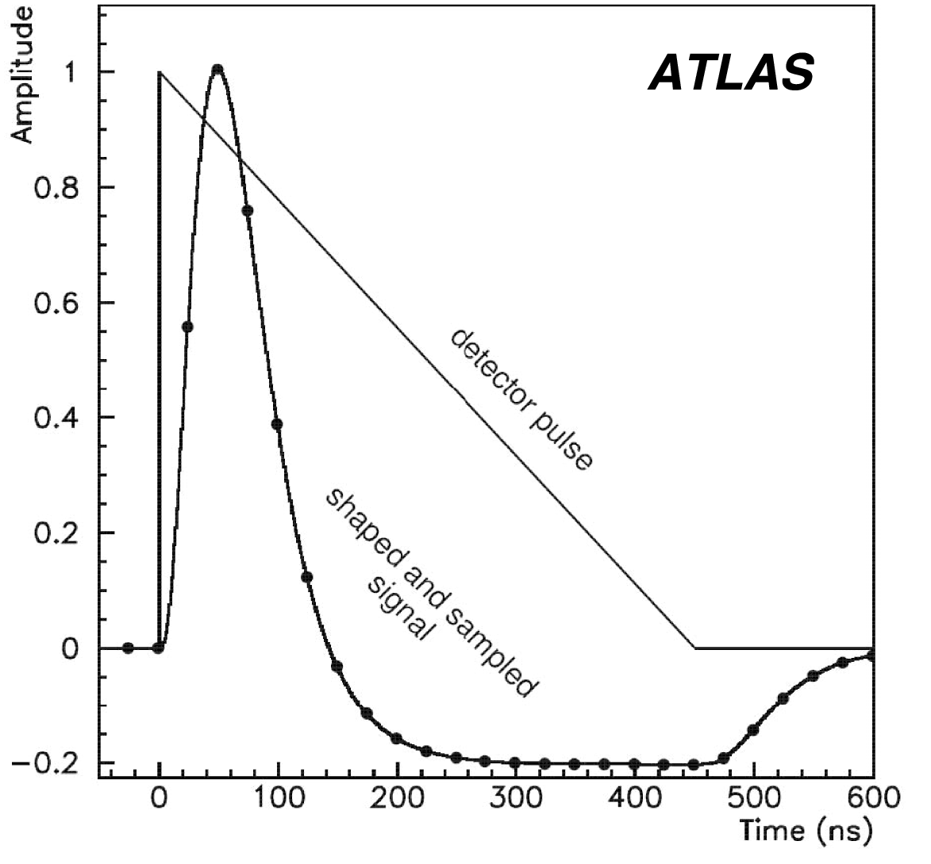
LAr Calorimeter Trigger System
Front-End
Back-End
Signals
200k channels
(BC at 40 MHz)
Main readout for analysis
Amplitude
Mezzanine
Signals summed up by SC unit
(in total 34,048 SCs)
Time [ns]
Legacy
trigger system
Pulse from calorimeter is around 600 ns long.
L1
Trigger
Digitizer
Processor
70m
25.2 Tbps
10 m
40 Tbps
114 Baseplanes on crates.
Path to the Digitizer
New digital trigger system
31 Processor ATCA Blades
4 AMCs (LATOME) per blade.
124 Digitizer Boards
Digitized with 40 MHz clock,
ADC is sent in 12 bit.

Slide 7
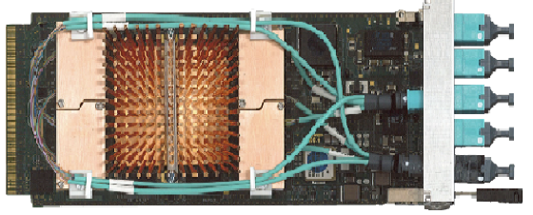
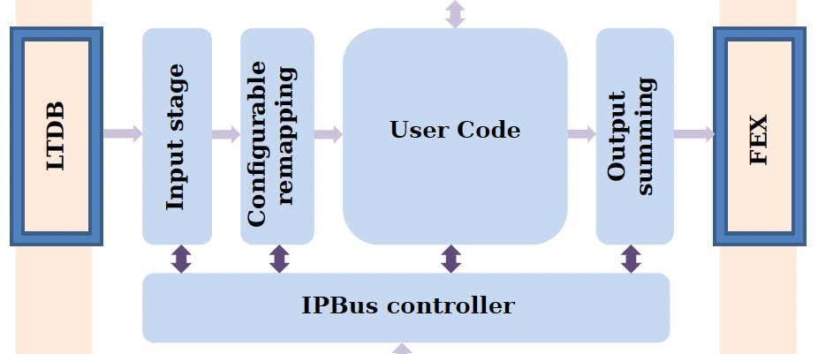
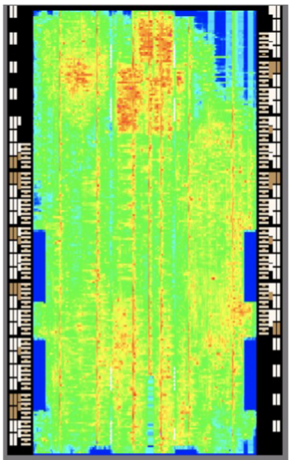




Firmware for digital processing
Input: 5.12 GHz/fiber in total 40 fibers
Output: 11.2 GHz/fiber in total 40 fibers
LATOME
(Intel Arria-10 FPGA)
In total 116 FPGAs
8 SC × 16 bit ＝128 bit is sent as 1 frame to Input stage
by 320 MHz.
*Approximately 8200 fibers.
Data is formed to be sent to the next stage.
Digitizer
Main module
L1 Trigger
The frequency is reduced to 240 MHz for easier handling in the main module.
Momentum reconstruction
Transvers momentum magnitude $E_{T}$and injected timing $τ$ are reconstructed by “Optimal Filter”, one of the FIR computation in real-time at fixed latency 125 ns.
Bunch Crossing (BC) identification
Identify from which BC the particle came from and use its information to trigger.
+Saturation detection
$$E_{T} ＝\sum_{i=0}^{3}{\tilde{A_{i}}(S_{i}−p −b)}$$
$$E_{T}τ ＝\sum_{i=0}^{3}{\tilde{B_{i}} (S_{i}−p −b)}$$
Proportional to momentum
FPGA resource occupancy is large
92% of Logic unit
95% memory
We have managed to avoid any timing violation!
$$S_{i}$$
$$p$$

Slide 8
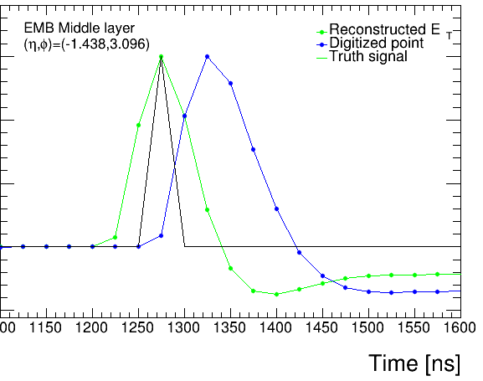


Timing Alignment for BC identification
Simple toy simulation
$$τ^{Reco}=0 ns$$
Each digitized point is associated with BCID.
Amplitude
Injected timing is calculated for all points and the momentum and BCID that timing is 0 ns is sent to the later stage.
$$τ^{Reco}=25 ns$$
8 …
Important!
Matching the BCID of the LHC with the BCID assigned to each data point.
0
1
2 …
7
… 6
1BC
(LHC clock)
All of 4458 fibers have been scanned and fixed taking latency into account.
BCID = 7

Slide 9
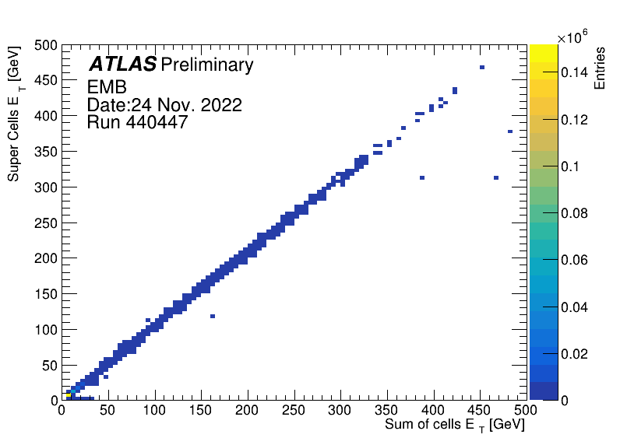
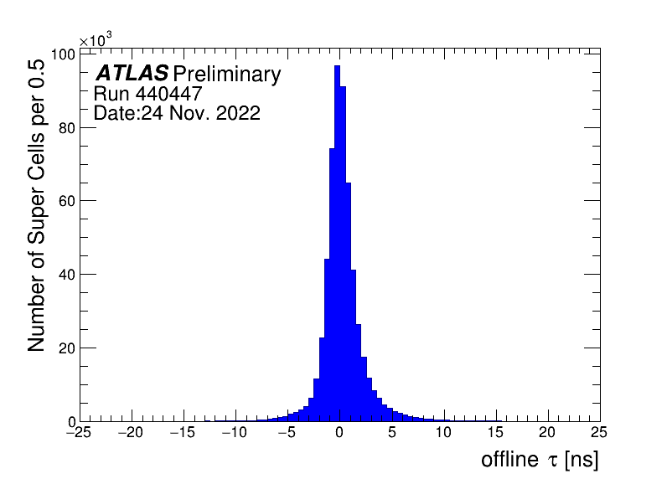
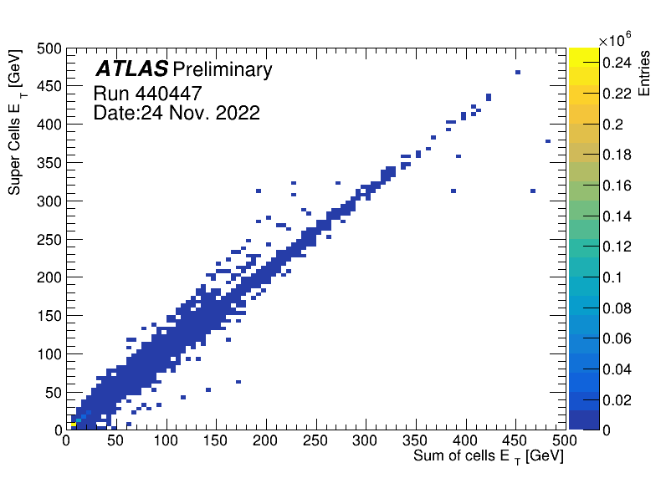
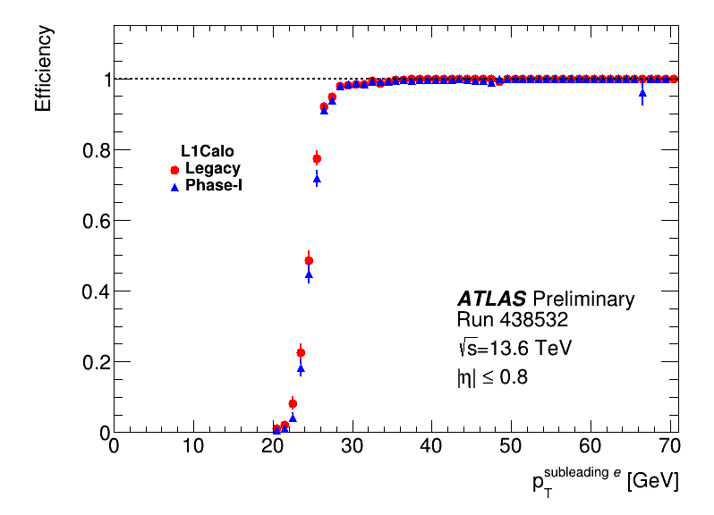
Run 3 collision data after the Timing Alignment
Data of SCs in good condition and not affected by FW configuration error are shown.
EM Barrel
No discrepancy
Hadronic section
95%
Injected timing distribution
Momentum comparison (DT vs main readout)
EM Barrel
In case no FW or HW errors, the digital trigger perform well as expected.
EM section will be used as main from this month.
5%
Digital triggers reach 95% more quickly and rate is lower.

Slide 10
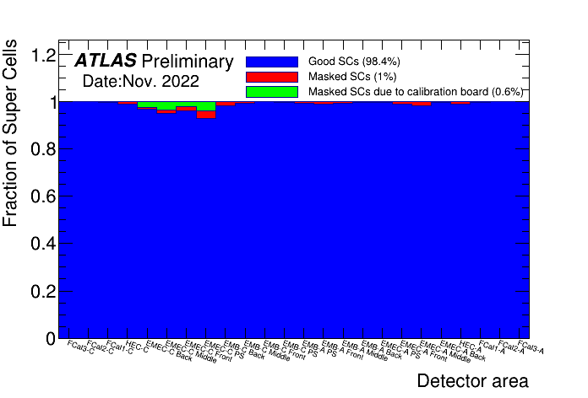
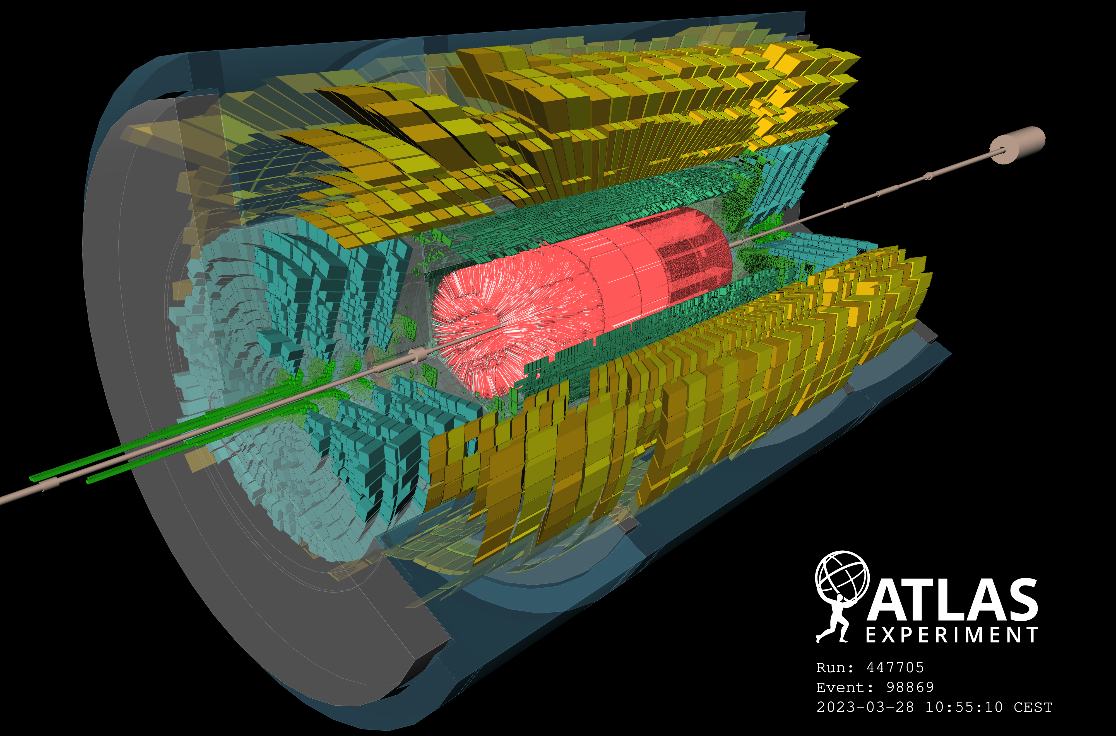
Supercells status
Signal caught in LAr Calorimeter
Beam splash on 28 Mar. 2023
Issue of the digitizer board, pulse shape, or the parameter to reconstruct momentum.
A board for calibration system was out of order since Apr. 2022
→ All fixed in early 2023
More than 99 % of SCs are working in good condition and no spots of malfunctioning now!

Slide 11

Summary
ATLAS LAr Digital Trigger system has been introduced as Phase-I upgrade.
10 times higher granularity (Supercell) to use EM shower shape to suppress multi-jet background for EM triggers.
High speed and high density digital processing system is introduced!
  More than 8200 fast links with 116 FPGAs in total.
  Momentum and timing calibration has been established.
  → 99% Super Cells are functional.
  EM trigger performance is good.
  (close to expected in Technical Design Report)
  → EM digital trigger will be used as main from this month.
LAr Calorimeter main readout is performing well
as in Run-2.

Slide 12
Back up

Slide 13
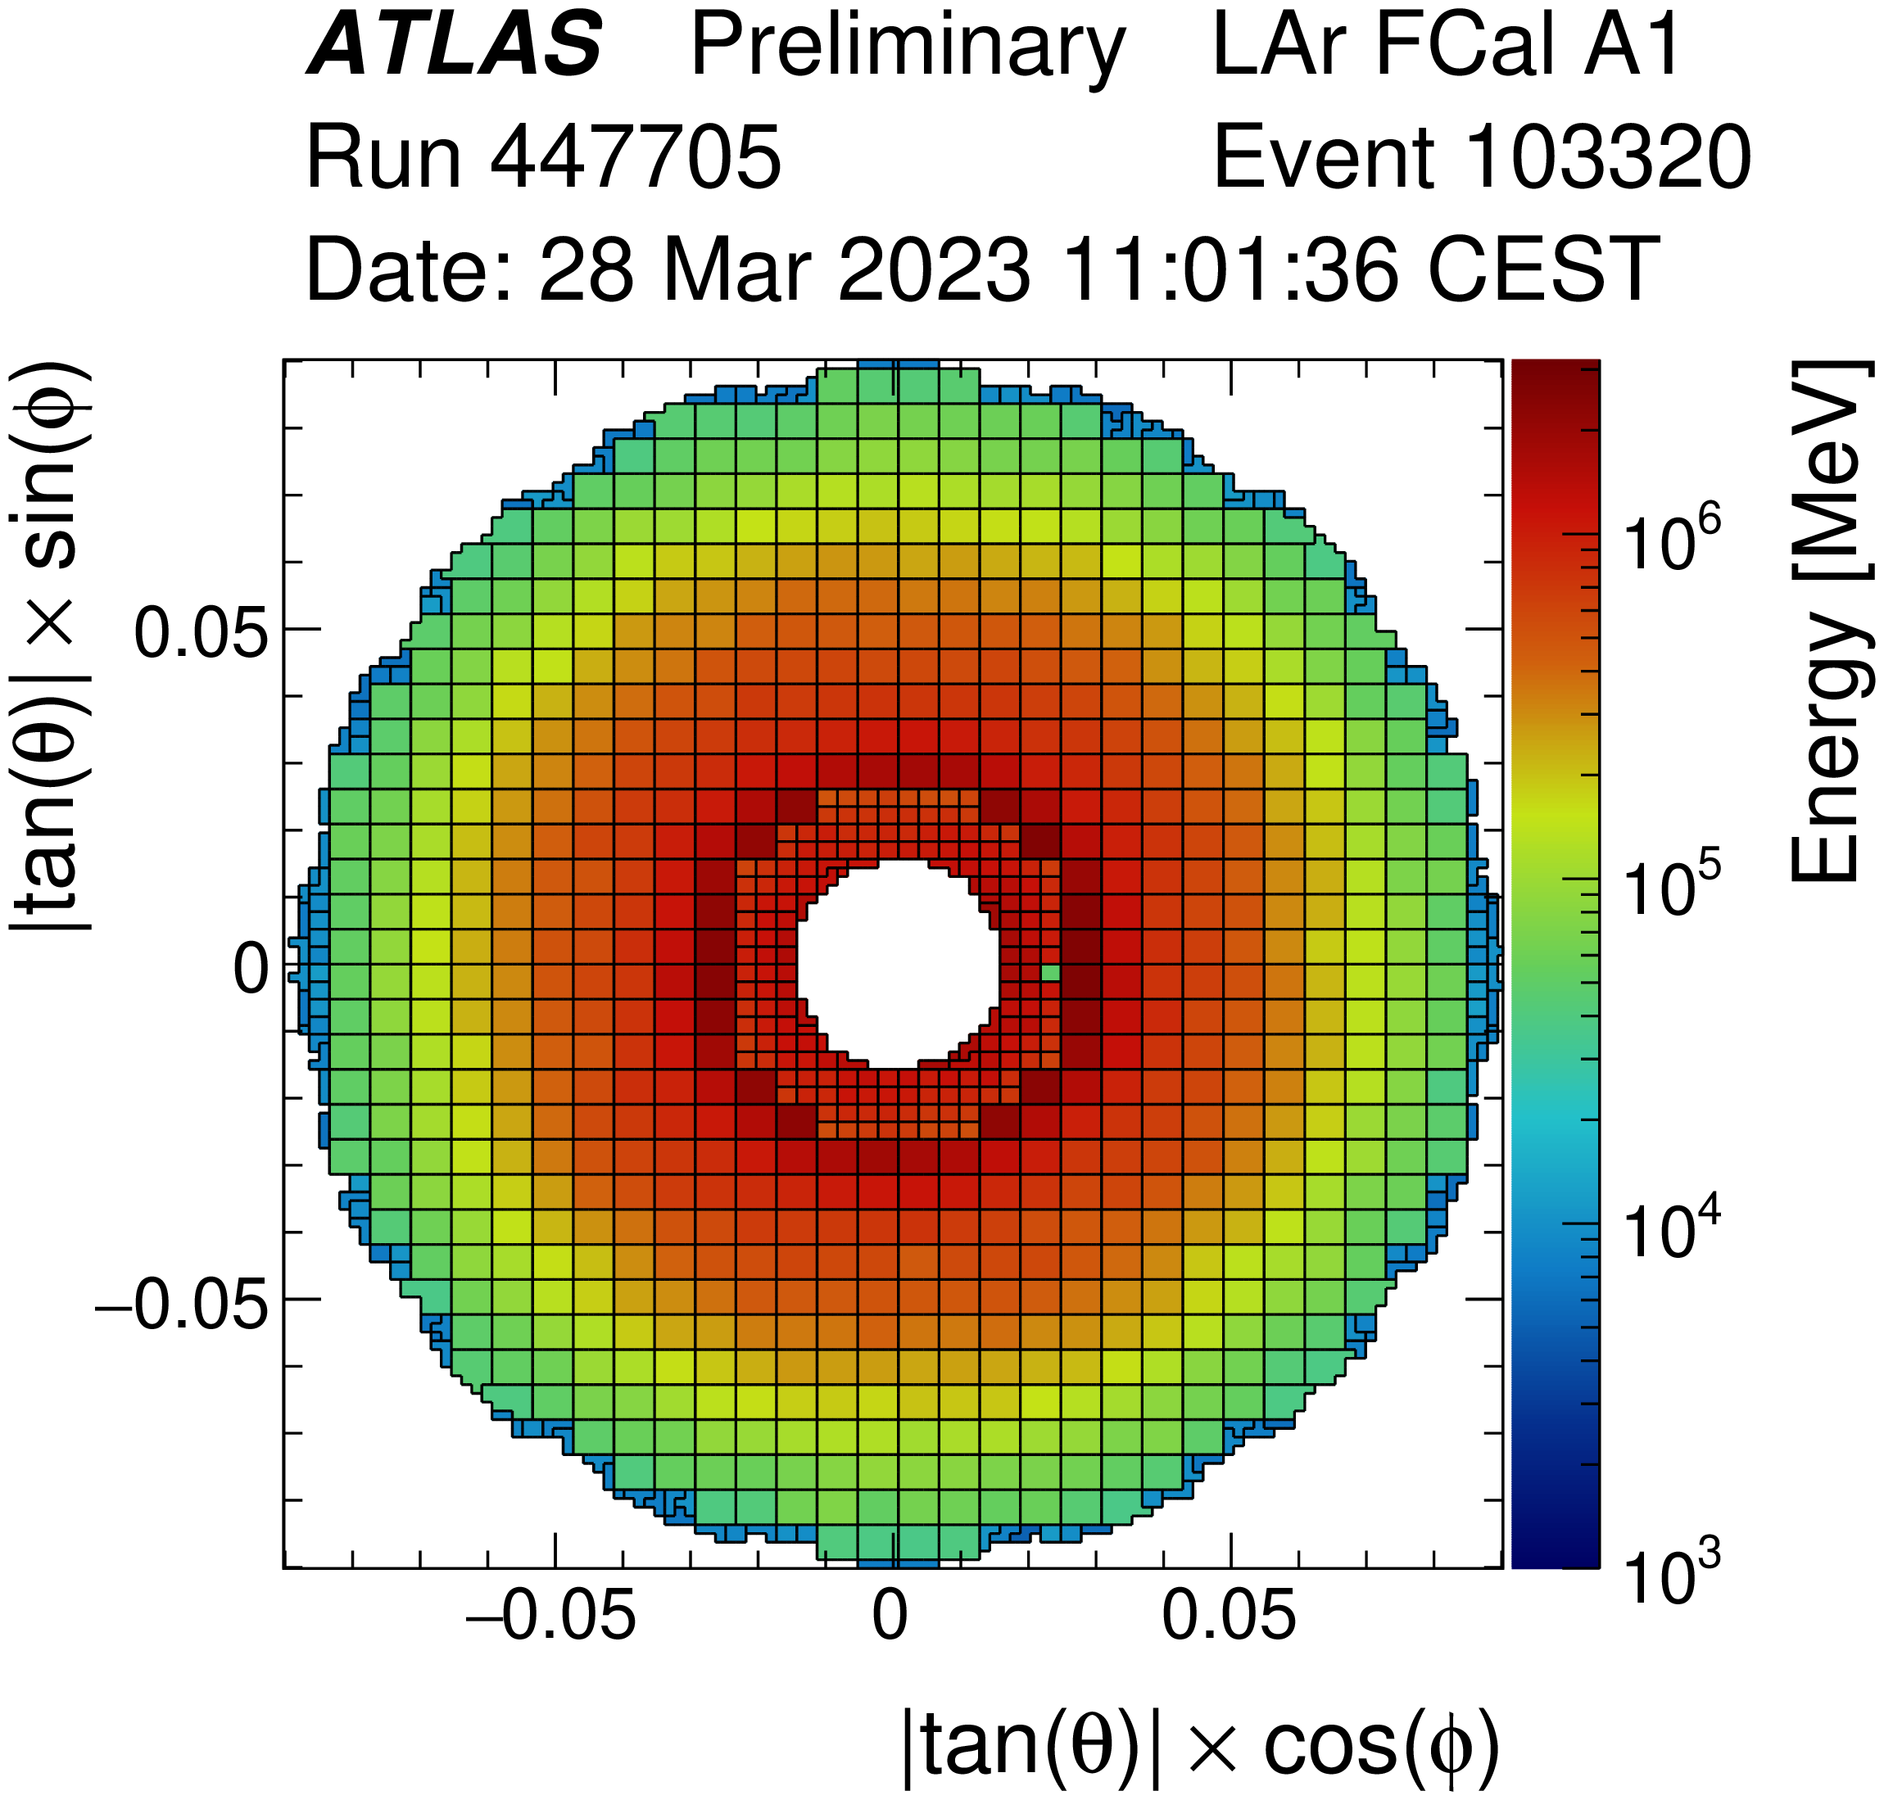
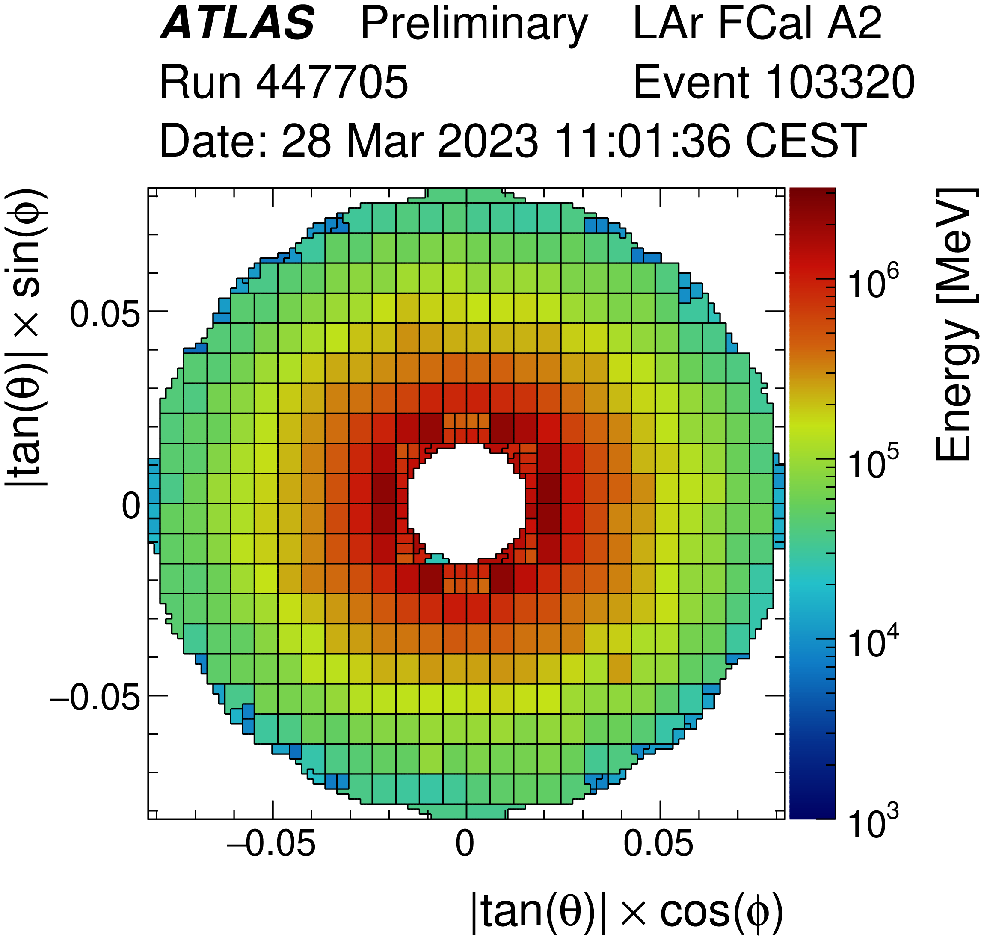
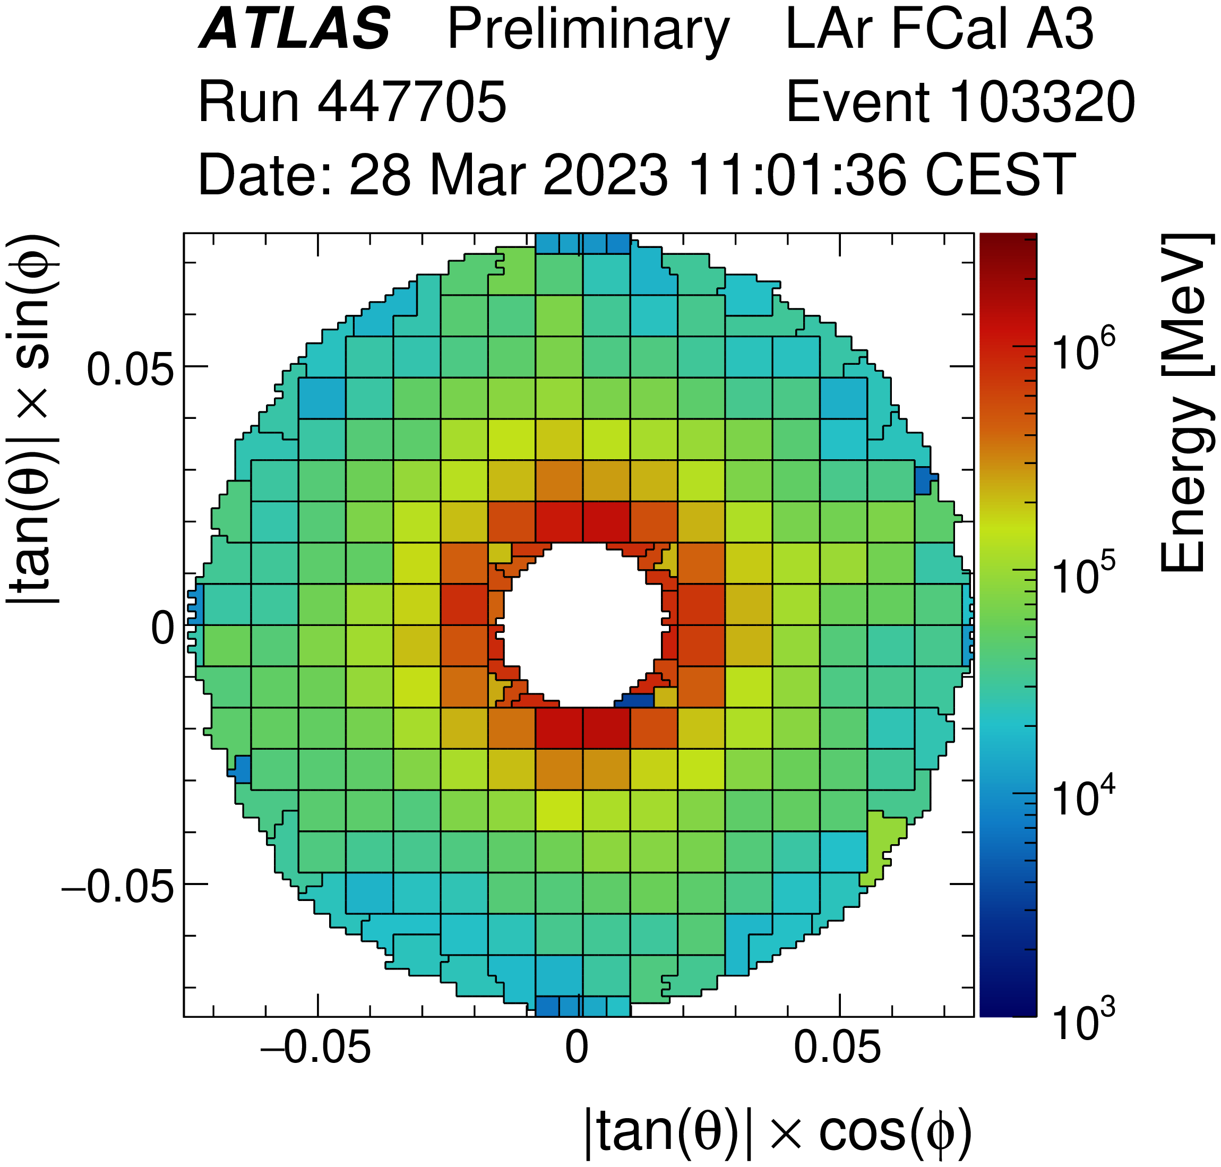
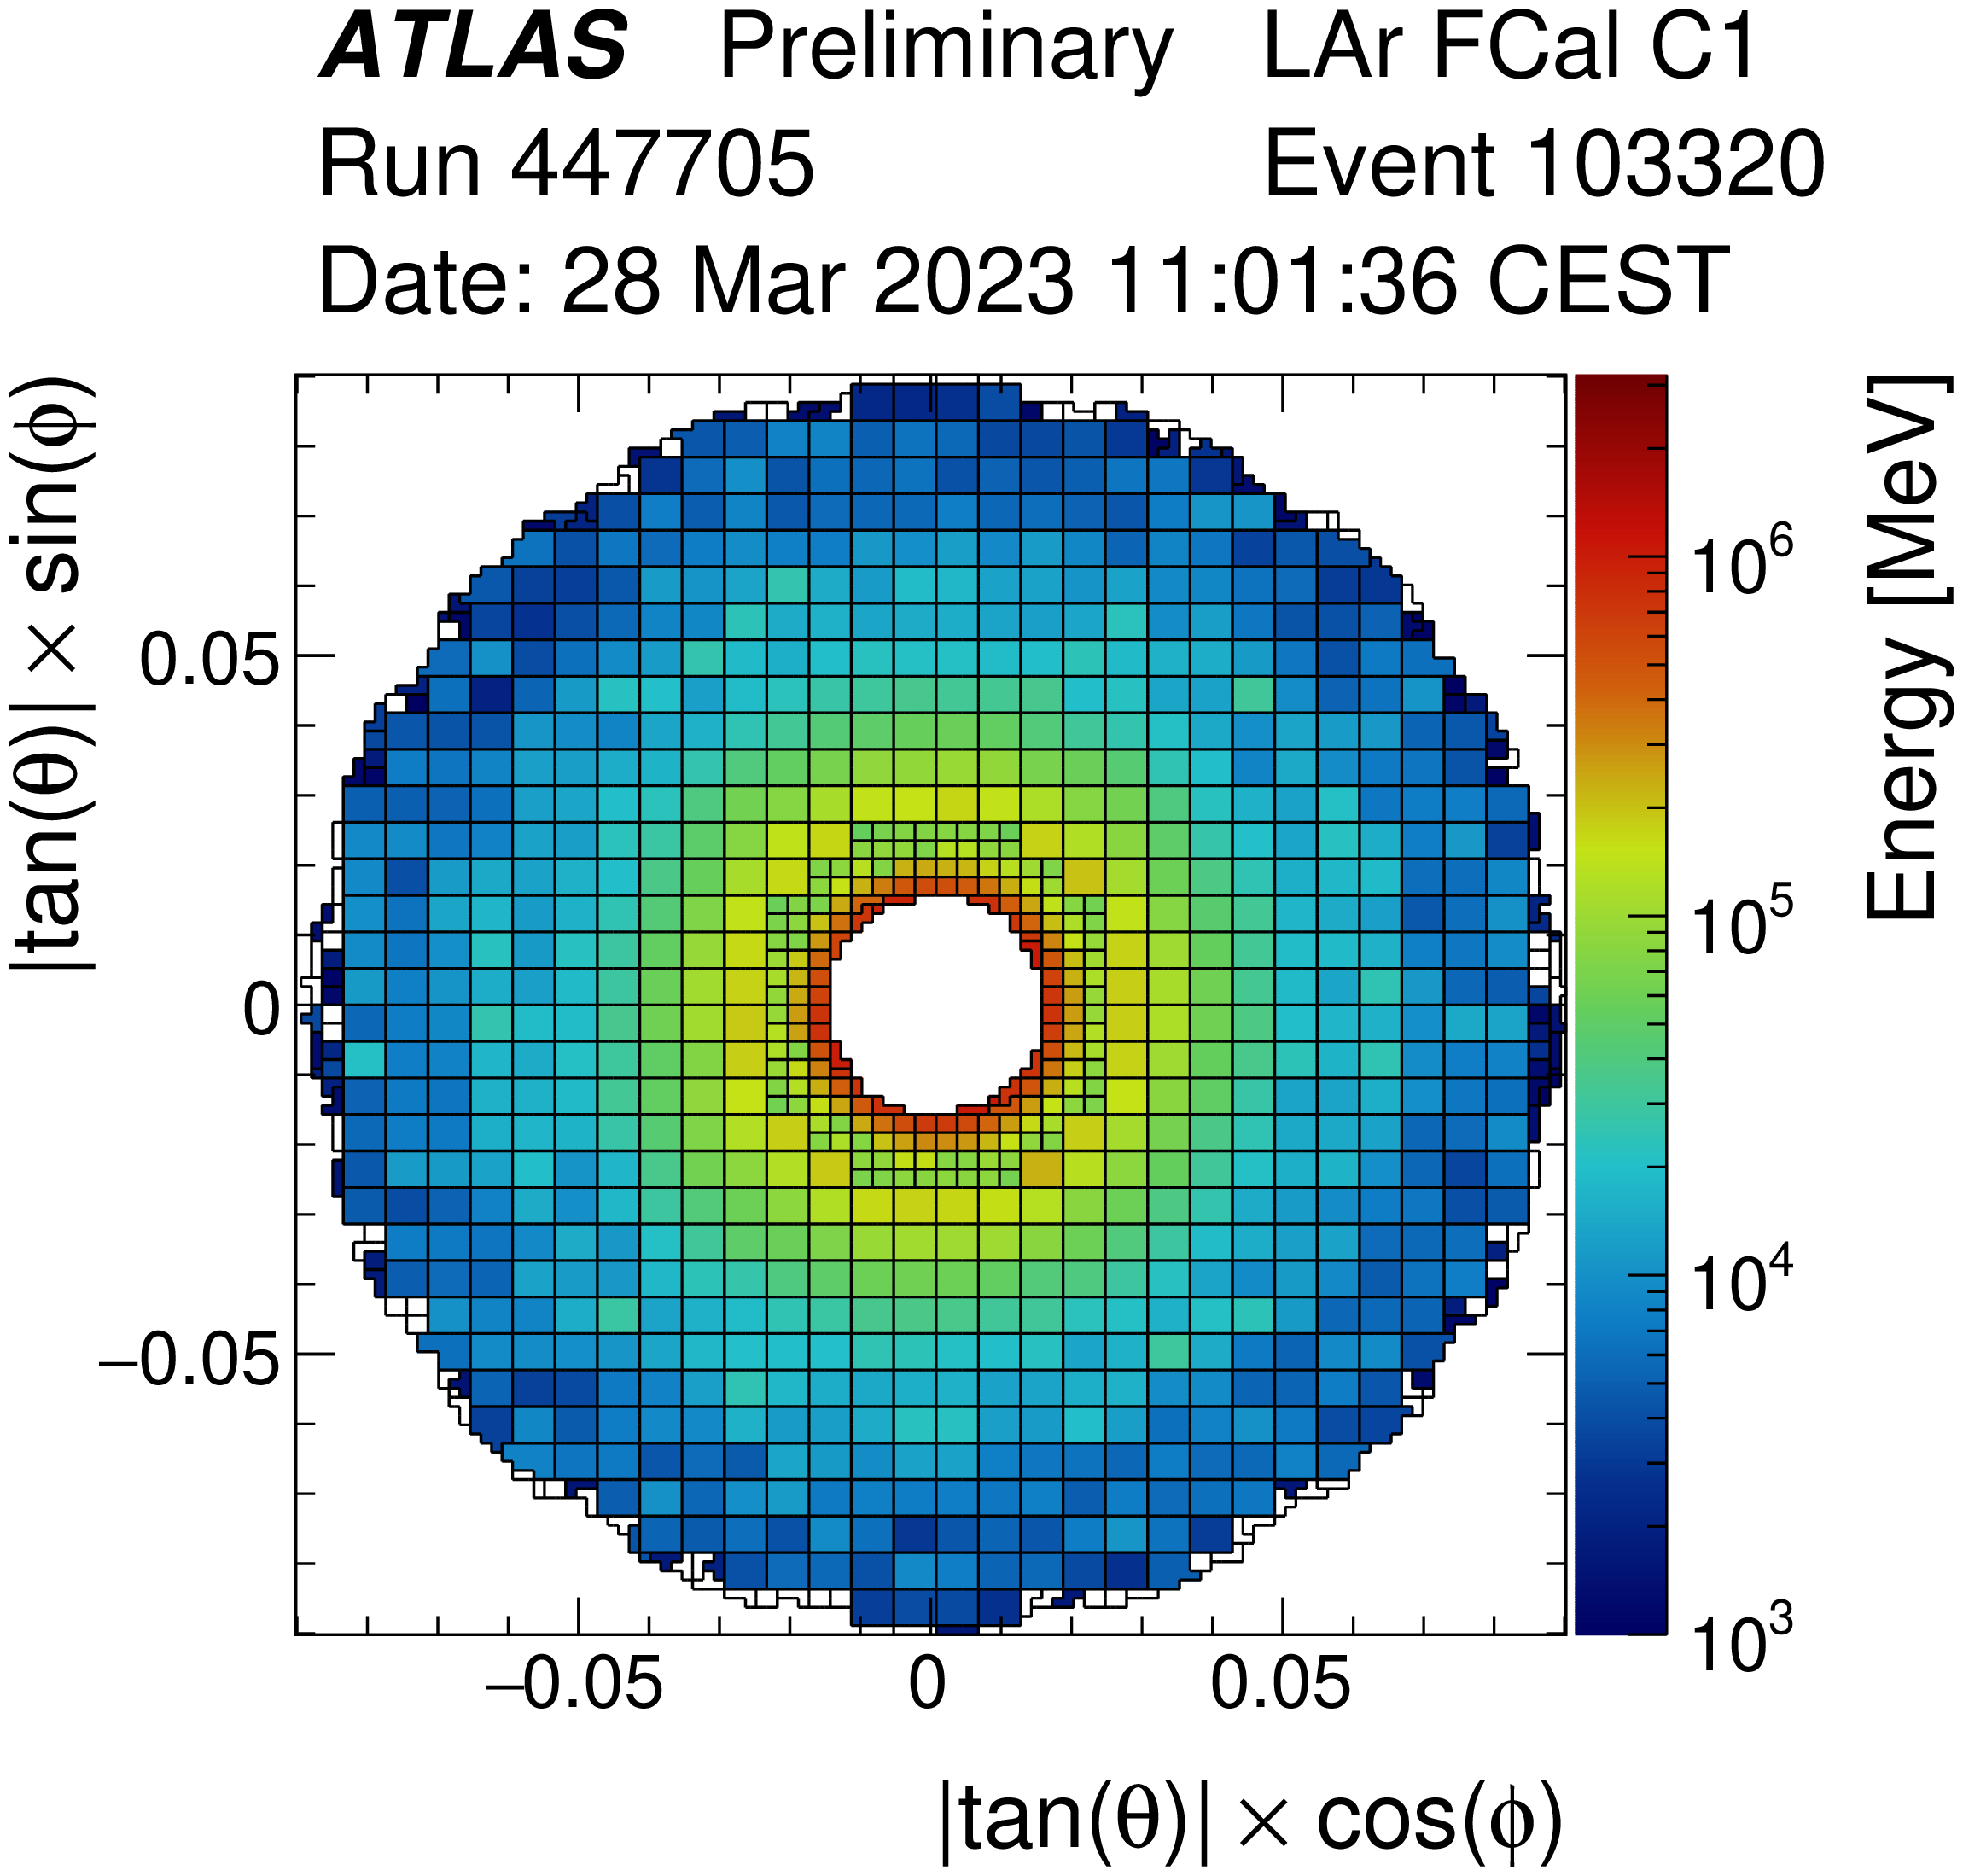
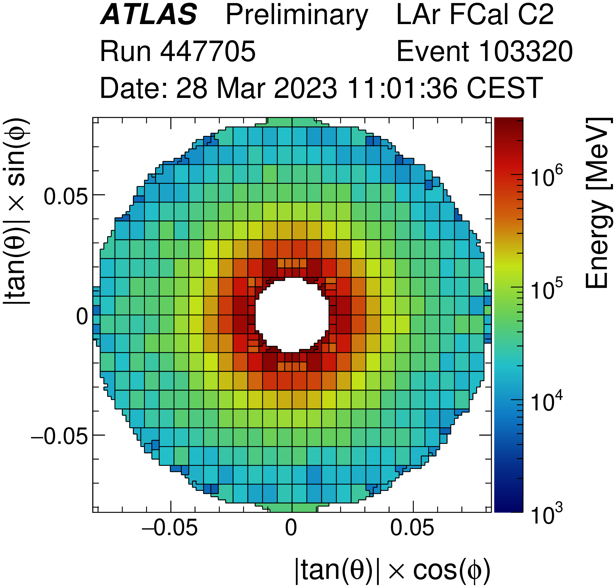
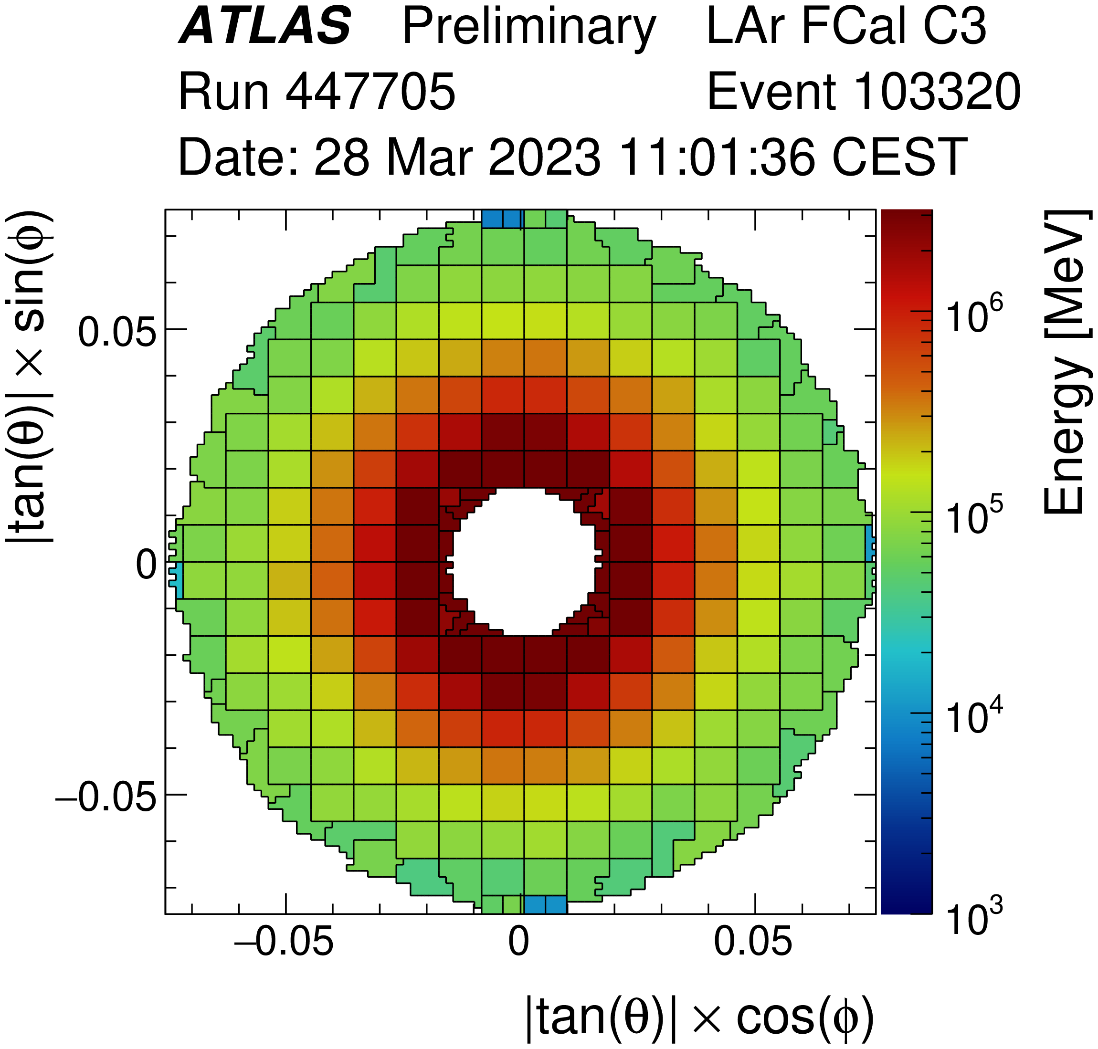
Inner
Outer

Slide 14
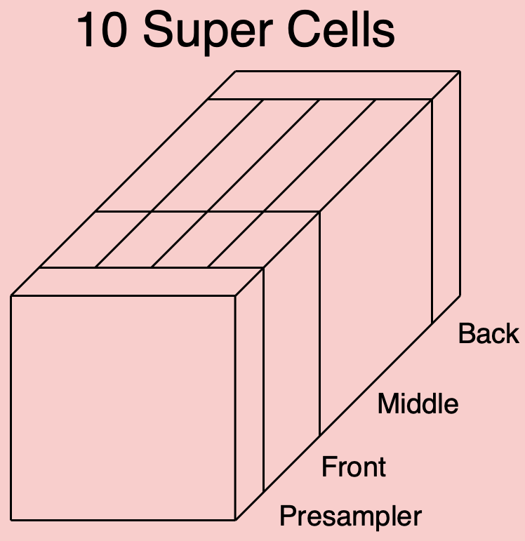
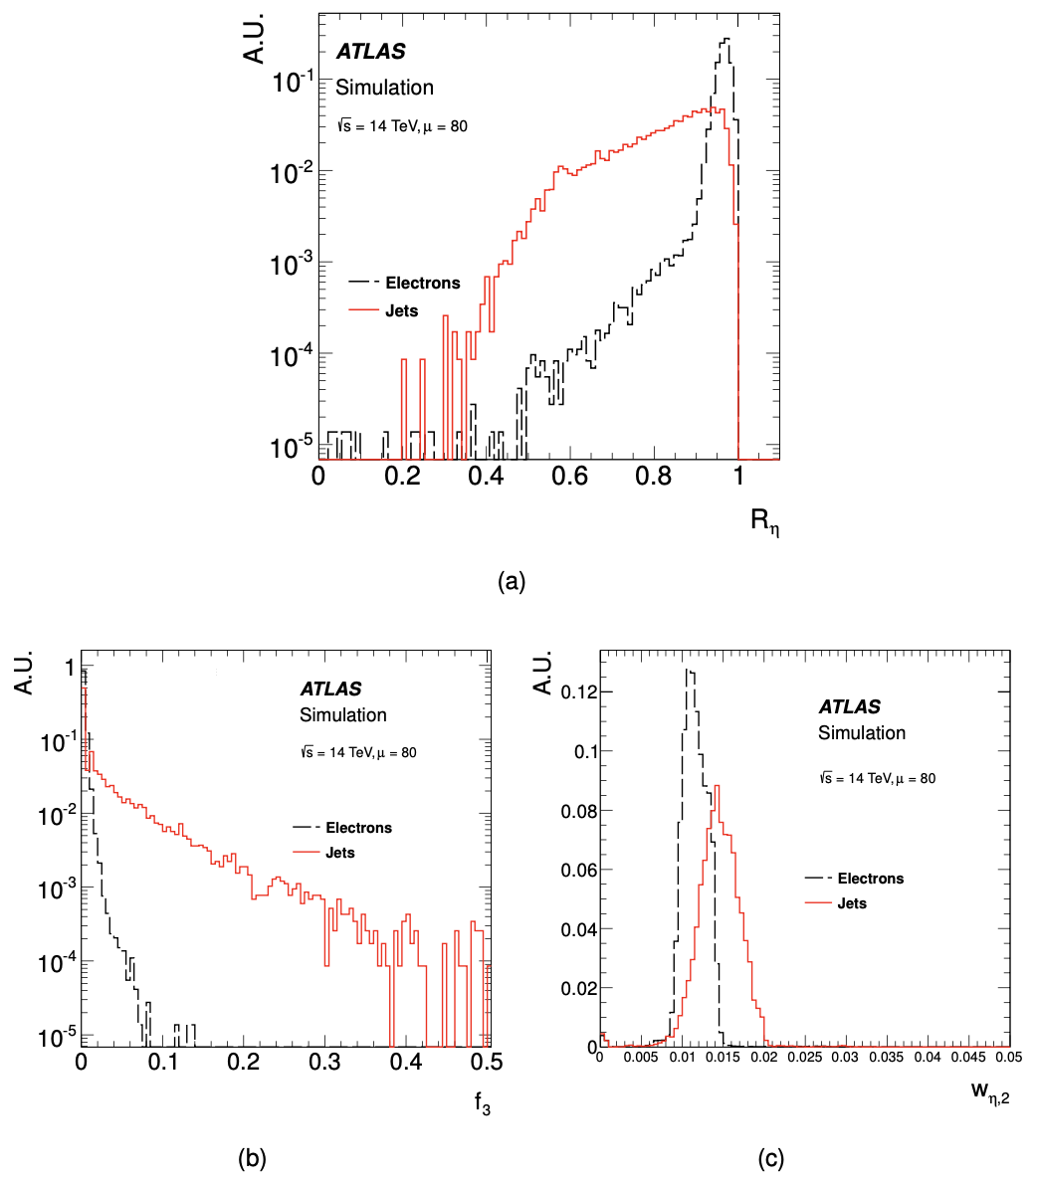
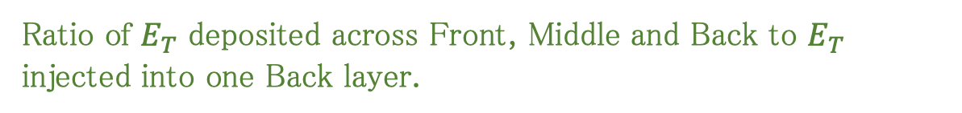
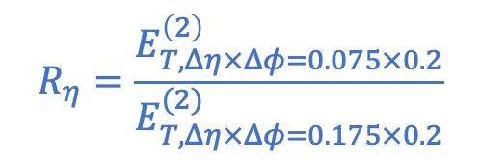
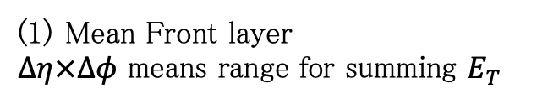
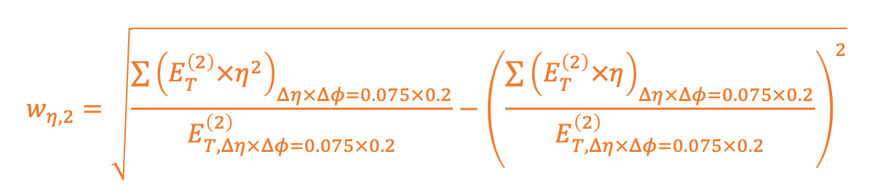
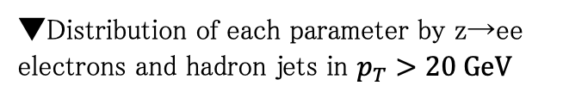
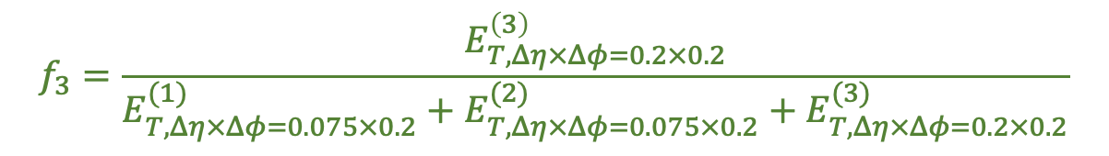
Trigger by Shower shape
▼Distribution of each parameter by z→ee electrons and hadron jets in $p_{T}>20 GeV$
Mean Front layer
$Δη×Δφ$ means range for summing $E_{T}$
The SC with the highest incident momentum in the Middle layer is the centre.
(3)
$$R_{η}=\frac{E_{T,Δη×Δφ=0.075×0.2}^{\left(2\right)}}{E_{T,Δη×Δφ=0.175×0.2}^{(2)}}$$
(2)
←3×2 SCs
(1)
←7×2 SCs
Ratio of $E_{T}$ deposited across Front, Middle and Back to $E_{T}$ injected into one Back layer.
$$f_{3}=\frac{E_{T,Δη×Δφ=0.2×0.2}^{\left(3\right)}}{E_{T,Δη×Δφ=0.075×0.2}^{(1)}+E_{T,Δη×Δφ=0.075×0.2}^{(2)}+E_{T,Δη×Δφ=0.2×0.2}^{(3)}}$$
Spread of 𝐸_𝑇 of 3 $×$ 2 SCs of Middle layer
$$w_{η,2}=\sqrt{\frac{\sum{{\left(E_{T}^{\left(2\right)}×η^{2}\right)}_{Δη×Δφ=0.075×0.2}}}{E_{T,Δη×Δφ=0.075×0.2}^{\left(2\right)}}−{\left(\frac{\sum{{\left(E_{T}^{\left(2\right)}×η\right)}_{Δη×Δφ=0.075×0.2}}}{E_{T,Δη×Δφ=0.075×0.2}^{\left(2\right)}}\right)}^{2}}$$

Slide 15
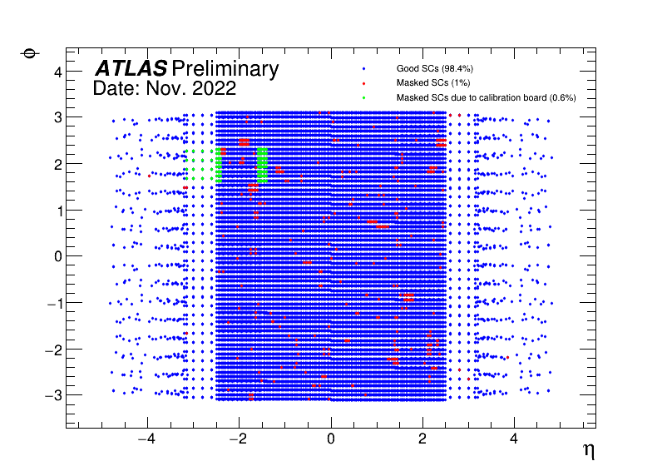
Supercells status
Masked SC: Issue of LTDB, pulse shape, or the parameter to reconstruct momentum.
A board for calibration system was out of order since Apr. 2022
→ replaced with new one (early 2023)
More than 99 % of SCs are working in good condition and no spots of malfunctioning now.

Slide 16
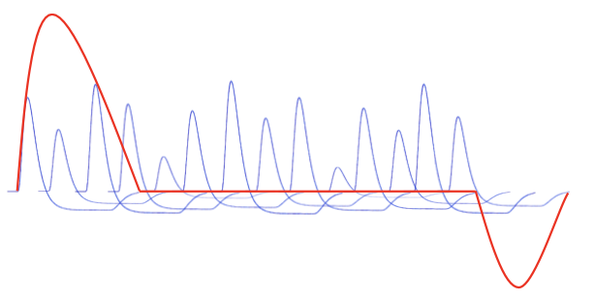
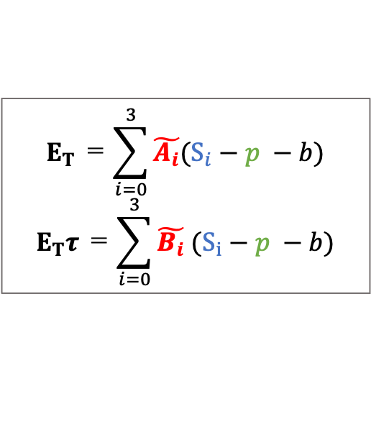
Baseline correction
Optimal Filter
$$E_{T} ＝\sum_{i=0}^{3}{\tilde{A_{i}}(S_{i}−p −b)}$$
$$E_{T}τ ＝\sum_{i=0}^{3}{\tilde{B_{i}} (S_{i}−p −b)}$$
empty
Filled bunch
Bunch structure
……
Summed pulse
Pile up
Pulse
Baseline shift
Bipolar pulse have zero integral value with time. → Large amounts of pileups cancel each other out.
At the ends of successive BCs, the amount of pileup is not sufficient so that base line is shifted.

Slide 17
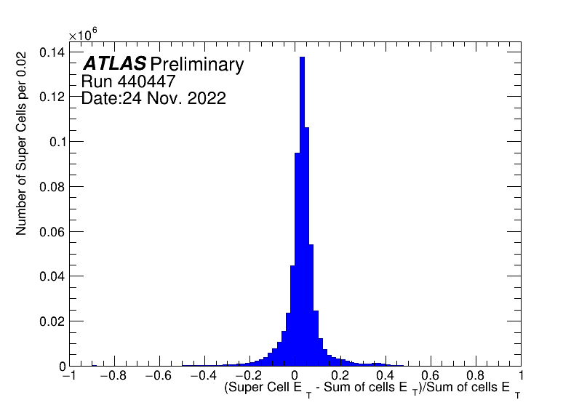

Relative difference between $E_{T}^{DT}$ and $E_{T}^{main}$

Slide 18
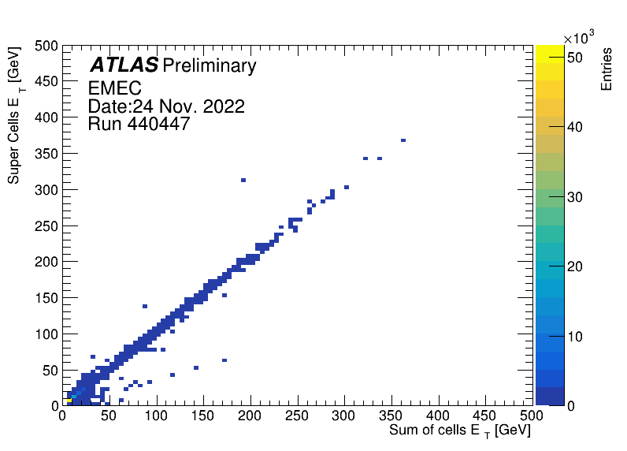
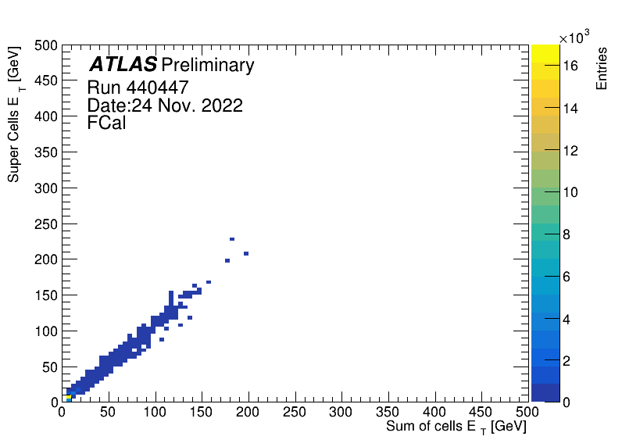
Momentum comparison

