Slide 1
AI Driven Experiment Calibration and Control
Thomas Britton
David Lawrence
Naomi Jarvis
Torri Jeske
Diana McSpadden
Nikhil Kalra
05/09/23
‹#›

Slide 2
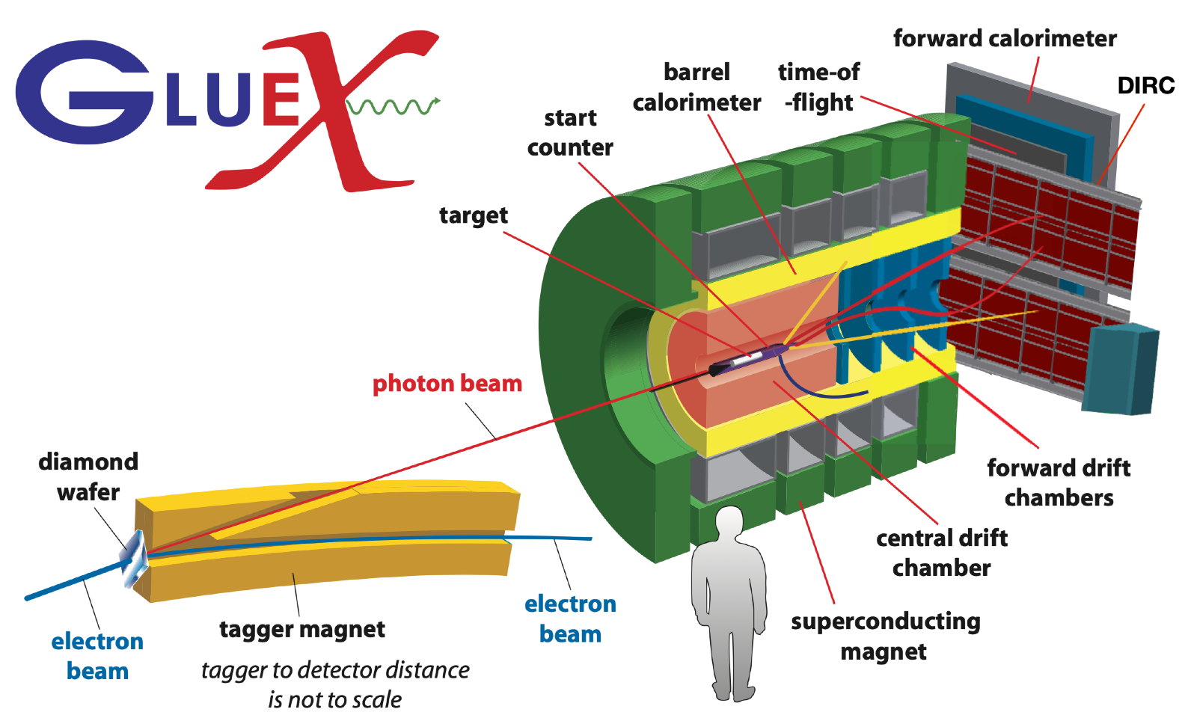
The Gluonic Excitations Experiment: GlueX
GlueX detector located in Hall D at Jefferson Lab, VA
05/09/23
‹#›

Slide 3
The GlueX Central Drift Chamber
Used to detect and track charged particles with momenta p > 0.25 GeV/c
1.5 m long x 1.2 m diameter cylinder
3522 anode wires at 2125 V inside 1.6 cm diameter straws
50:50 Ar:CO₂ gas mixture
Requires two calibrations: chamber gain and time-to-distance
05/09/23
‹#›

Slide 4
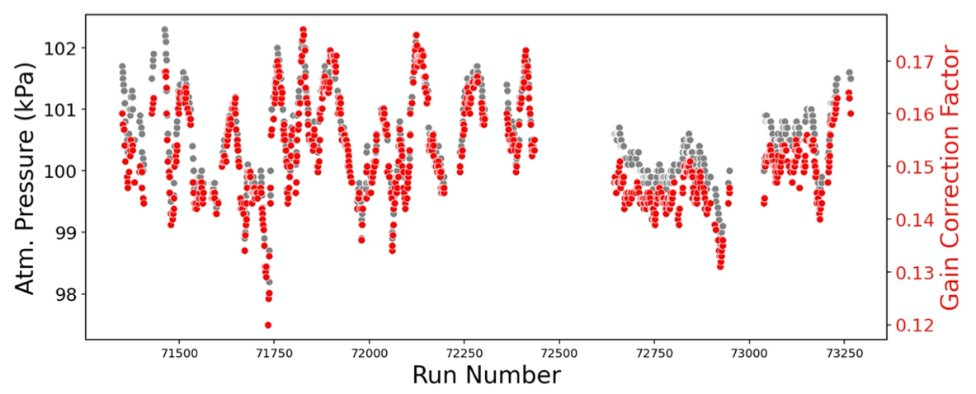
Calibrating Drift Chamber Gain
CDC gain calibrations have the most variation +/- 15%
If we know what gain to expect before taking data, we can adjust the high voltage to stabilize the gain
Perhaps eliminating the need to perform gain calibrations at all…
05/09/23
‹#›

Slide 5
Motivation
Detector calibrations cause a significant delay between data collection, analysis, and publication
Calibration can be made more efficient using AI
Less CPU time, less personal attention from experts
Get to the point of “fine-tuning” calibrations with less iterations
05/09/23
‹#›

Slide 6
Goals
ML-recommended HV setting to maintain GlueX Central Drift Chamber gain
Have ML determine calibration constants as quickly as possible
Apply to other detector systems
ML
05/09/23
‹#›
Notes:
Change AI to ML in the box

Slide 7
Diverse Data = Better Model
2020 and 2021 Run Periods: 601 production runs
2020 ↑ high voltage board current (mean 9.0 uA), pressure (mean 100.5 kPa), gas temperature (299.2 K)
2021 ↓ high voltage board current (mean 0.9 uA), pressure (mean 99.9 kPa), gas temperature (299.8 K)
We pressure balanced high, medium, low atm. pressure for both 2020 and 2021
Training: 430 runs: 2020; 50 runs: 2021
Test: 106 runs: 2020; 15 runs: 2021
Gaussian process with a trained prior
max %err | MAPE | # > 3% err | # > 5% err
4.8% | 0.84% | 3 | 0
05/09/23
‹#›

Slide 8
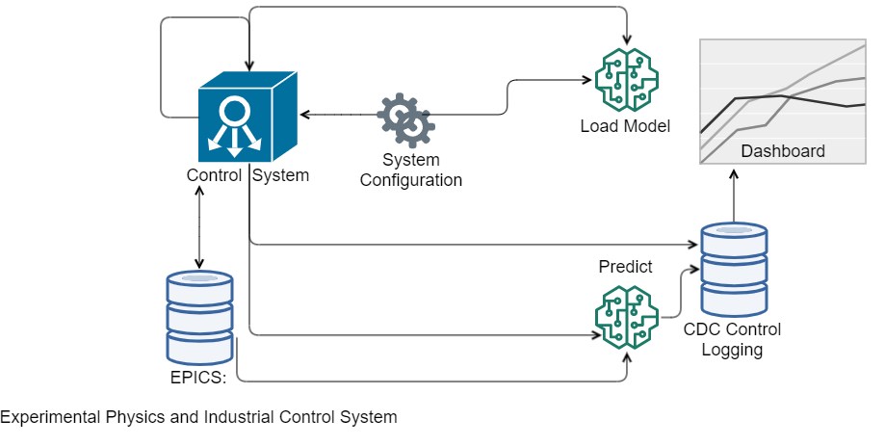
Modular System: RoboCDC
05/09/23
‹#›
Notes:
I’ve described the motivation for a machine learning system to control CDC gain. Here’s a chart of the system, which, for this talk I will cheekily call RoboCDC.
We designed the system to be modular, and have implemented RoboCDC.
I’ll describe the elements, including the Gaussian Process model.

Slide 9
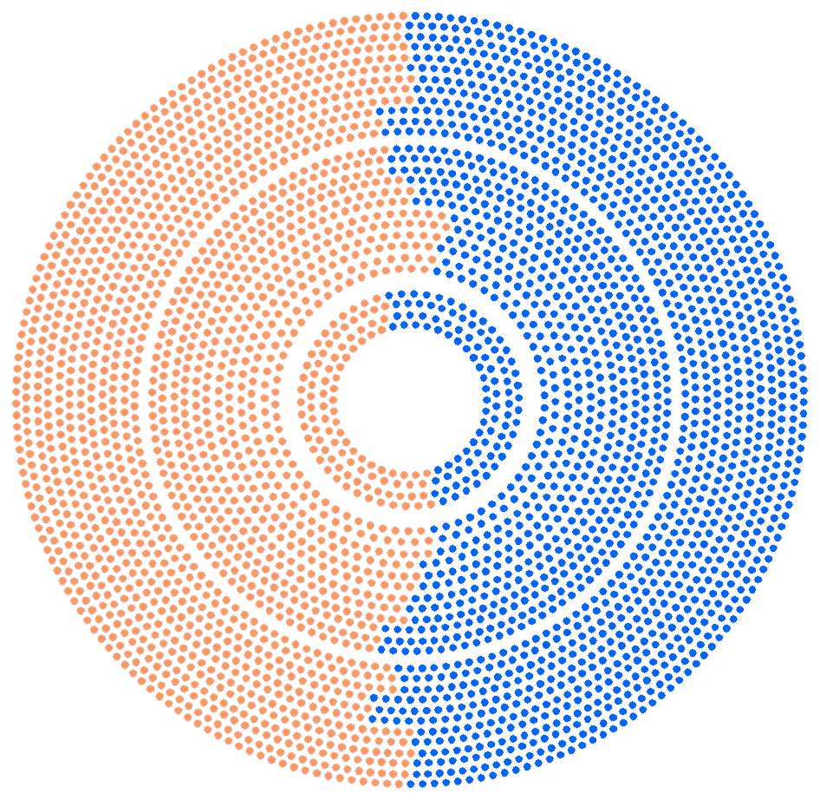
Deployment 1 – Cosmic Ray Test
Sorted high voltage boards (HVB) into two groups:
AI Tuned
Constant: 2130 V (5V higher than normal to compensate for no beam)
ML
Update every 5 minutes
Completely autonomous
Should see the gain stabilized for the Tuned group
05/09/23
‹#›

Slide 10
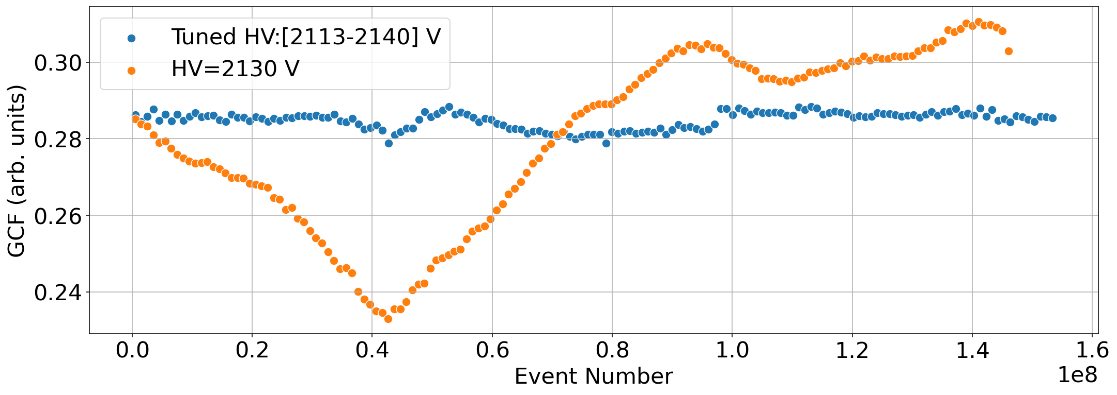
Deployment 1 – Cosmic Ray Test
05/09/23
‹#›

Slide 11
Deployment 1 – Cosmic Ray Test
SUCCESS!
05/09/23
‹#›

Slide 12
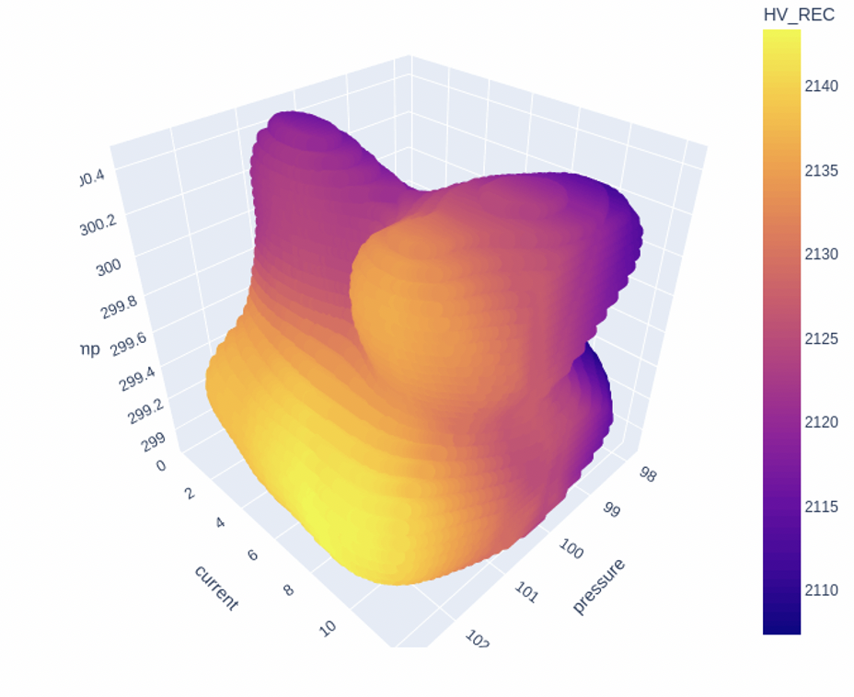
Deployment 2 – Charged Pion Polarizability May-June 2022
RoboCDC used automatically at the start of each 2h run
Use recommended HV if std <= 3% ideal GCF
Otherwise, use the closest ‘confident’ HV in Euclidean distance on the uncertainty mesh
Reverted to 2125V for empty target runs
Low stakes - CDC not critical for CPP run period
CPP: unusual running conditions
Different target in different location
Low beam current
HV
Temp (K)
HVB current (uA)
Pressure
05/09/23
‹#›

Slide 13
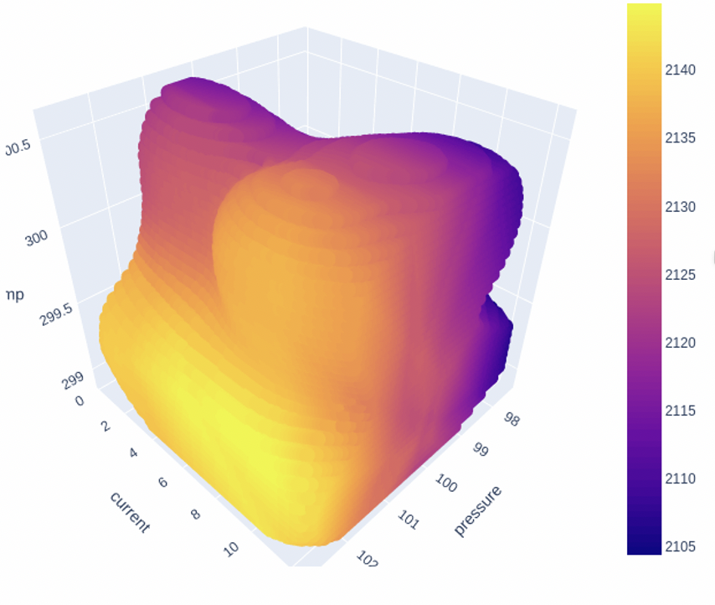
Deployment 2 – Charged Pion Polarizability May-June 2022
RoboCDC used automatically at the start of each 2h run
Use recommended HV if std <= 3% ideal GCF
Otherwise, use the closest ‘confident’ HV in Euclidean distance on the uncertainty mesh
Reverted to 2125V for empty target runs
Low stakes - CDC not critical for CPP run period
CPP: unusual running conditions
Different target in different location
Low beam current
HV
Temp (K)
HVB current (uA)
Pressure
05/09/23
‹#›

Slide 14
Deployment 3 – PrimEx-η June-Dec 2022
GCF obtained from dE/dx after the run
Preliminary results show GCF predominantly within 5% of ideal value for runs with tuned HV
Plot of GCF/ideal for tuned HV and fixed HV also shows pressure/temperature
Tuned HV
Fixed HV
Pressure/Temperature
GCF/Ideal GCF (0.144)
05/09/23
‹#›

Slide 15
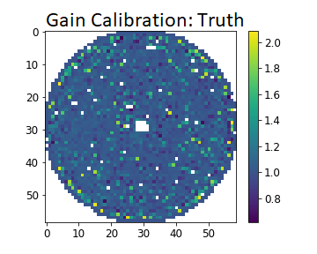
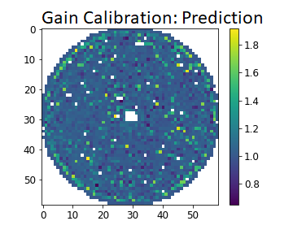
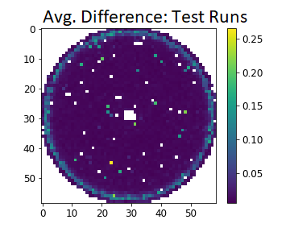
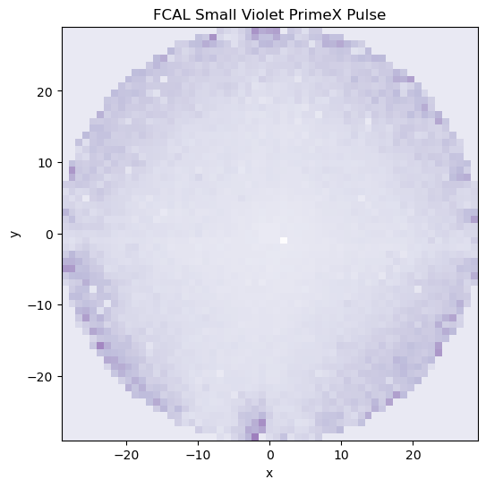
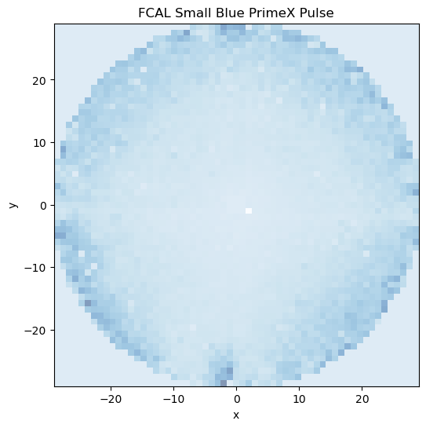
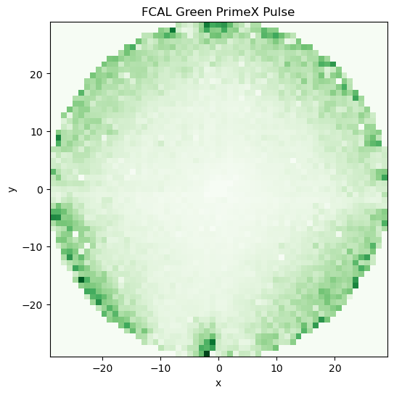
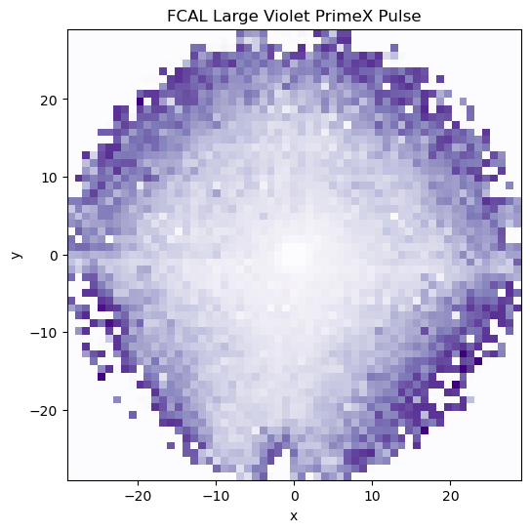
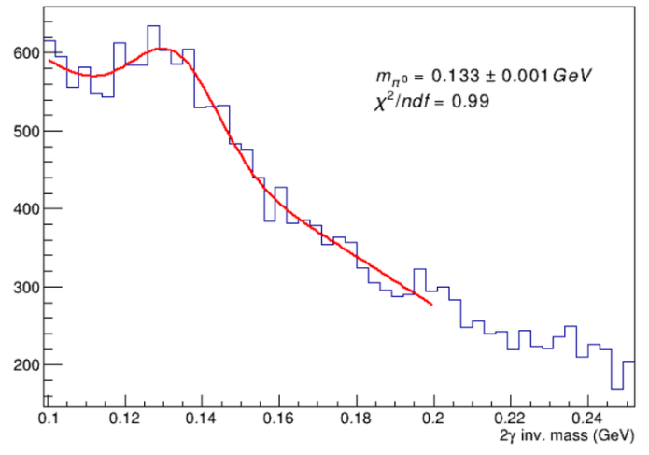
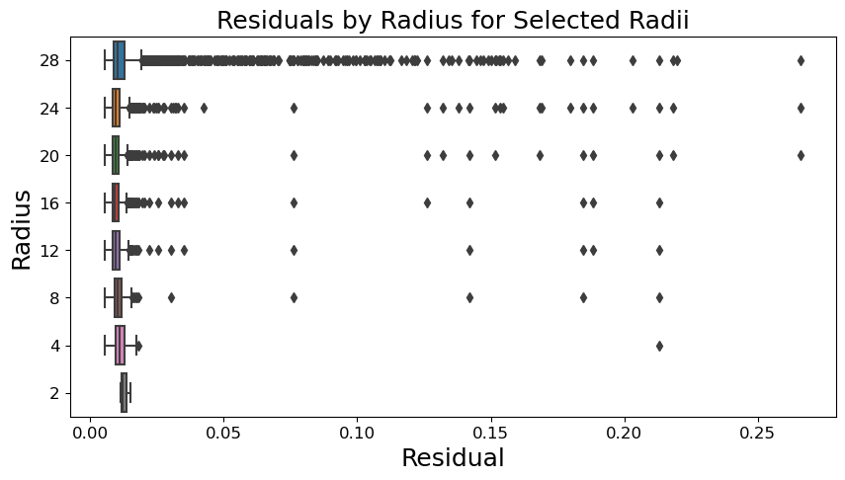
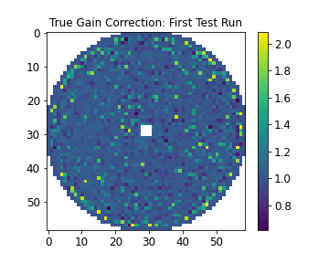
Calibration of the Forward Calorimeter
Diana McSpadden, Cullan Bedwell, Abhijeet Chawhan, Julie Crowe
Traditional Calibration:
iterative over π⁰s
Requires particle reconstruction
Statistics sometimes difficult
Can we use the LED monitoring system and Machine Learning?
Can ML learn traditional calibrations?
Initial Physics Comparison
Does prediction accuracy result in good physics results?
We have an initial π⁰ analysis
Single run, entire FCAL
Average results over 5-fold cross validation
=
Gain calibration values
π⁰_{PDG} mass: 134.98 MeV
Using our calibrations: 133.31 MeV
05/09/23
‹#›
Notes:
Add UVA thing

Slide 16
Conclusion
Implemented a Gaussian process to predict the gain correction factor from environmental conditions
Can exploit this prediction to compute a recommended HV via comparisons to an ideal gcf
Deployed a system that serves as an interface between the ML model, the EPICS Archiver, and the GlueX Controls system
It is uncertainty aware
It has been in production for over 4 different deployments
Stabilizes the gain within 5% of ideal
Begun work on calibrating the FCAL using the LED data
05/09/23
‹#›

Slide 17
Acknowledgements
Jefferson Science Associates, LLC operated Thomas Jefferson National Accelerator Facility for the United States Department of Energy under U.S. DOE Contract No. DE-AC05-06OR23177
This work was supported by the US DOE as LAB 20-2261.
The Carnegie Mellon Group is supported by the U.S. Department of Energy, Office of Science, Office of Nuclear Physics, DOE Grant No. DE-FG02-87ER40315.
GlueX acknowledges the support of several funding agencies and computing facilities: www.gluex.org/thanks.
05/09/23
‹#›
Notes:
Thank you to all the groups that contribute to this work.

Slide 19
GlueX
GlueX detector located in Hall D at Jefferson Lab, VA
9 GeV polarized
pair spectrometer
12 GeV
11/05/21
‹#›

Slide 20
Introducing the CDC
06/07/22
‹#›

Slide 21
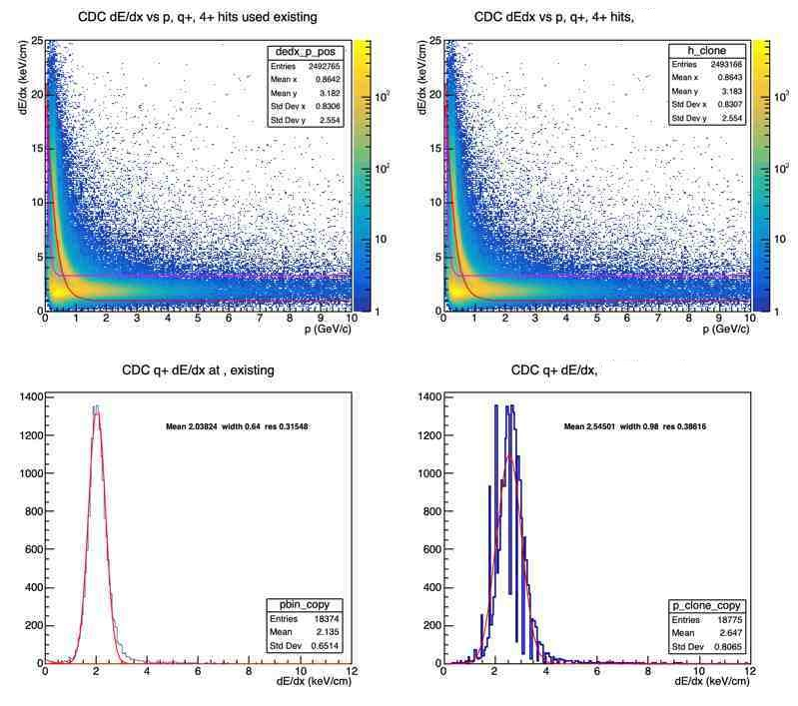
Motivation
Calibrations cause a delay between data collection and analysis
At present several calibration rounds are used, due to interplay between subdetector calibrations
Calibration could be made more efficient using AI (less iterations)
Less cpu time
Less personal attention from experts
* We expect to fine-tune the calibrations in the usual way
CDC gain calibrations have the most variation +/- 15%
If we know what gain to expect before taking data, we can adjust the HV to maintain constant gain
Perhaps eliminating the need to perform gain calibrations at all…
Artificially modified gain 33%
11/05/21
‹#›

Slide 22
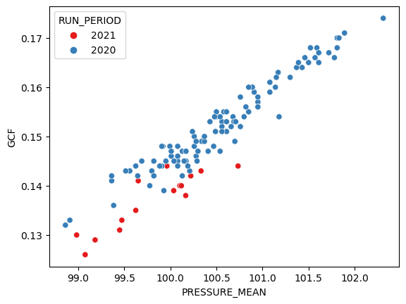
Our model
2020 and 2021 Run Periods: 601 production runs
2020 run period had ↑ high voltage board current (mean 9.0 uA), ↑ pressure (mean 100.5 kPa), gas temperature (K) is the same
2021 run period high voltage board current (mean 0.9 uA), pressure (mean 99.9 kPa)
Provides a diversity of data
Pressure balanced between high, medium, low atm. pressure for both 2020 and 2021 run periods
Training: 480 runs
2020: 430 runs
2021: 50 runs
Test: 121 runs
2020: 106 runs
2021: 15 runs
Gaussian process with a trained prior
Compared isotropic and anisotropic kernels – similar performance
 | max %err | MAPE | # > 3% err | # > 5% err
isotropic | 4.8% | 0.84% | 3 | 0
anisotropic | 4.7% | 0.90% | 4 | 0
Isotropic

Slide 23
Cosmics Test
Split the CDC into 2 halves
Leave one side at a fixed HV
Let the AI control the other
AI
Update the HV every 5 min
Completely autonomous
Should see the AI system side’s gains stabilized
06/07/22
‹#›

Slide 24
Conclusions
A system has been developed to interface between the ML model and both the EPICS Archiver and GlueX controls system
A gaussian process has been trained to predict the gain correction factor from environmental conditions
Can exploit this prediction to compute a recommended HV via comparisons to an ideal gcf
It is uncertainty aware
It has been in successful production over multiple deployments
Stabilizes the gain within 5% of ideal
Begun work on calibrating the FCAL using the LED data

