Slide 1
The new ALICE Data Acquisition system (O2/FLP) for LHC Run 3
Vasco Barroso, Barthélémy von Haller, Konstantinos Alexopoulos, Martin Boulais, Sylvain Chapeland, Filippo Costa, Roberto Divia, Ulrich Fuchs, Claire Guyot, Jik Huijberts, Piotr Konopka, Iosif-Charles Legrand, Teo Mrnjavac, George Raduta, Adam Wegrzynek, Pierre Vande Vyvre on behalf of the ALICE O2/FLP project

Slide 2
Outline
ALICE Upgrade
ALICE O²/FLP portfolio
First operational experience

Slide 3
ALICE Upgrade

Slide 4
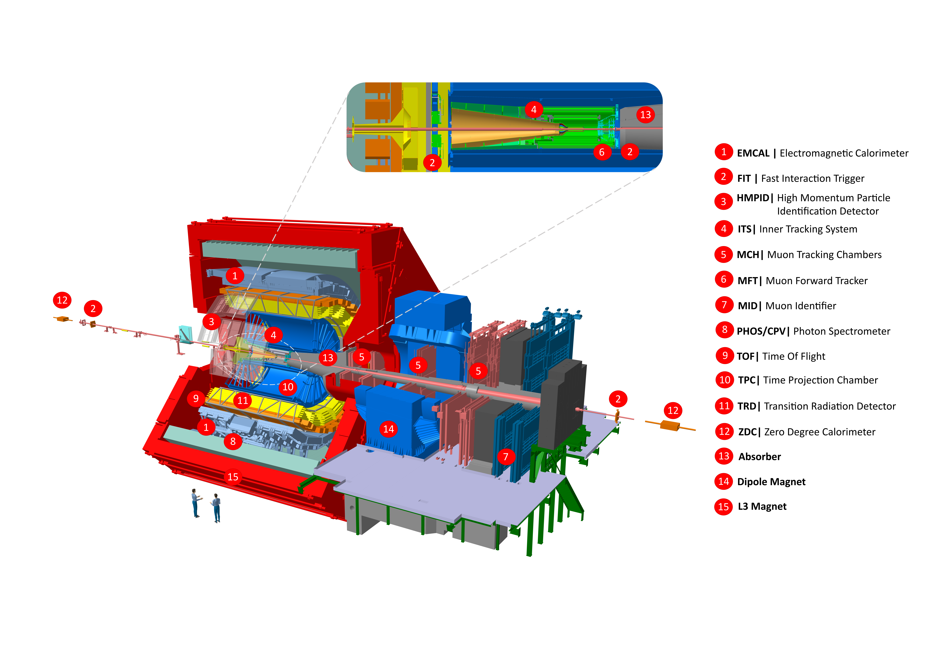
ALICE Upgrade
An overview
ALICE upgrades during the LHC Long Shutdown 2
Online Offline (O2) system
new computing facility
on line tracking & data compression
50kHz PbPb event rate

Slide 5
ALICE Upgrade
O² computing system
Detector
HI run 3.5 TB/s
9000 links
488 readout cards
First Level Processors
HI run 900 GB/s
Event Processing Nodes
HI run 130 GB/s
Storage

Slide 6
ALICE Upgrade
O² computing software
Guiding principles:
Clean-sheet design
Leverage existing 3rd party tools

Slide 7
ALICE O²/FLP portfolio

Slide 8
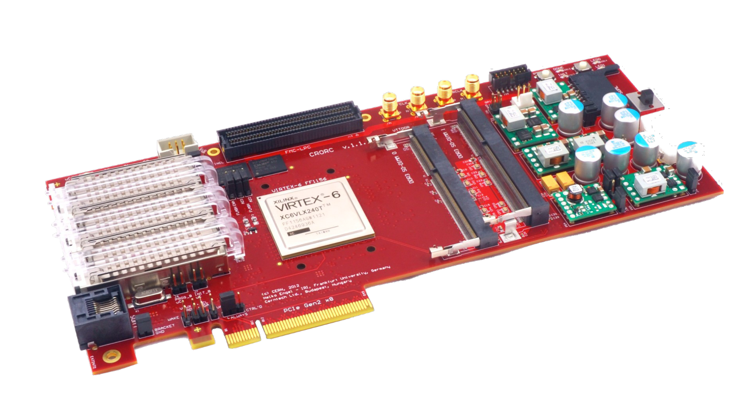
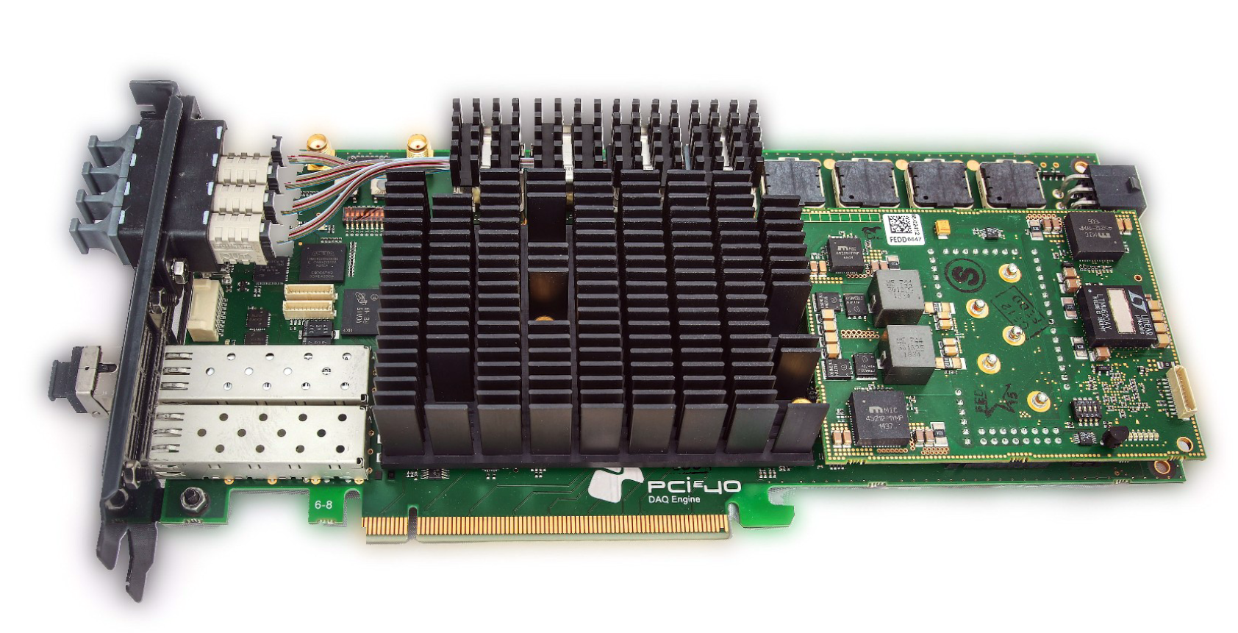
Detector readout
Readout cards
CRU
LHCb PCIe40
Intel Arria 10
PCIe Gen 3
472 cards
CRORC
ALICE Run 2 legacy
Xilinx VIRTEX6
PCIe Gen 2
16 cards

Slide 9
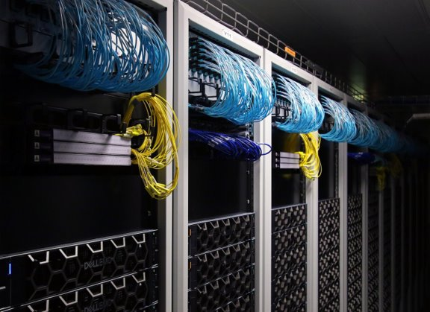
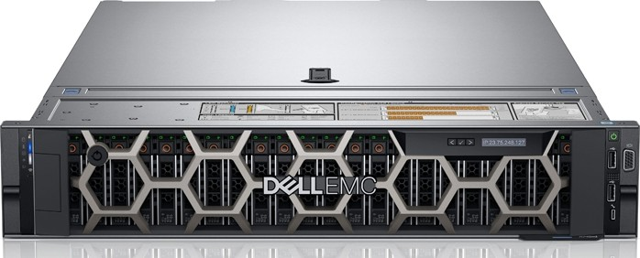
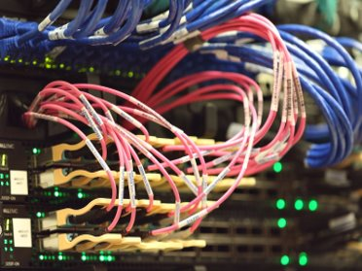
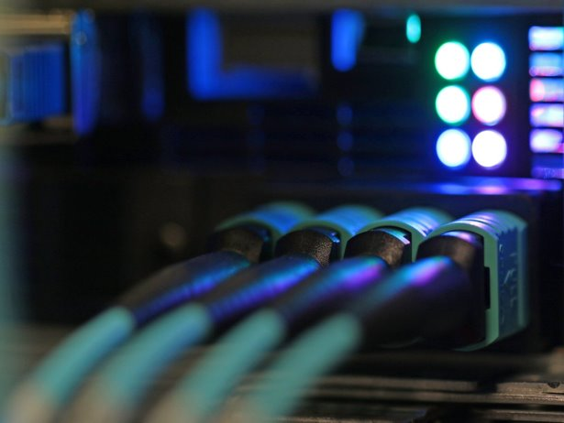
Detector readout
Servers: the FLPs (First Level Processors)
Dell PowerEdge R740
Up to 3 CRUs
96 GB RAM
2x Xeon Silver 4210 (10 cores) ⁽¹⁾
202 servers
⁽¹⁾ A few nodes with 2x Xeon Gold 6230 (20 cores)

Slide 10
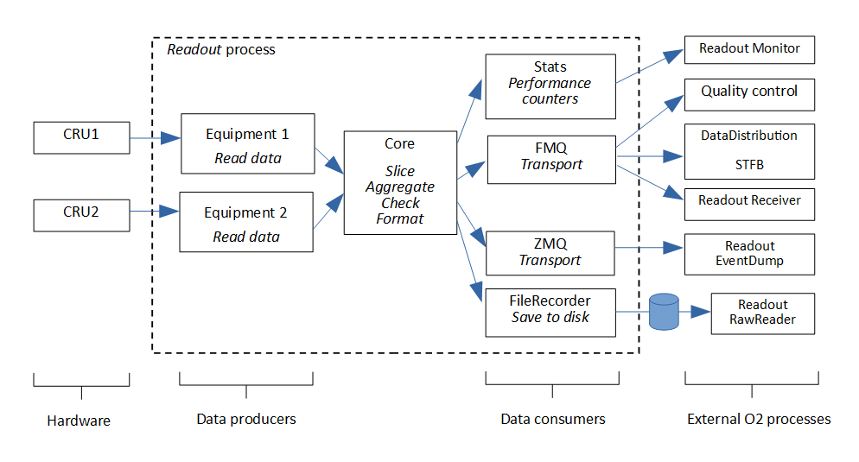
Detector readout
Software
CHEP 2023 talk Thu 14:15
S. Chapeland, Commissioning of the ALICE readout software for LHC Run 3
Readout
ReadoutCard
Data readout process
Launched on each FLP
Written in C++
Writte in C++ (python bindings)
High level interface for accessing and controlling the readout cards
Uses Portable Driver Architecture (PDA)

Slide 11
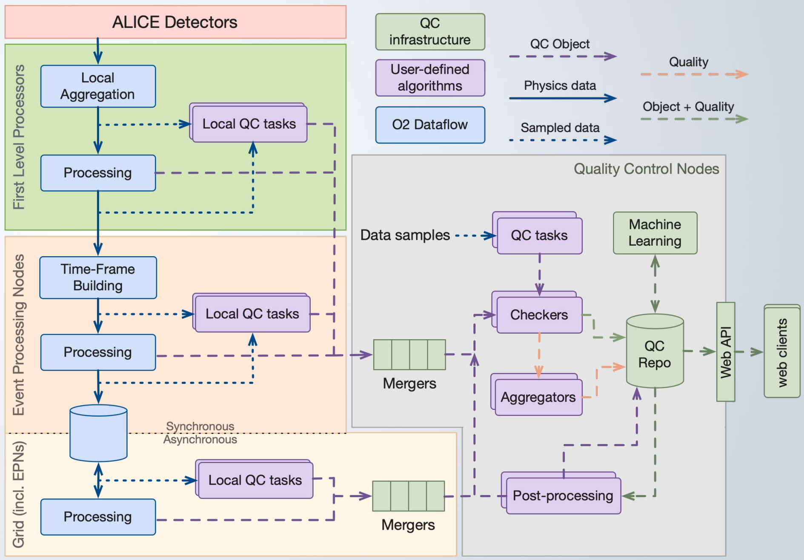
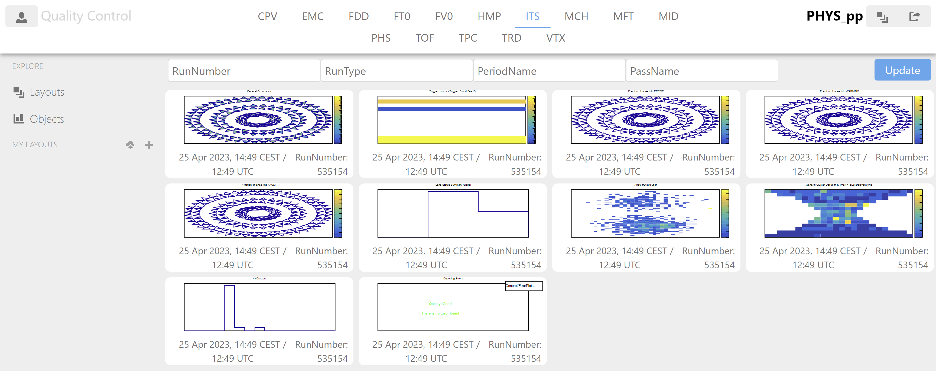
Quality Control
CHEP 2023 talk Tue 12:00
P. Konopka, The ALICE Data Quality Control
QC Framework
QC GUI
Sample, process, merge, check, aggregate, store
Covers both online and offline worlds
Written in C++
Web-based: Javascript, nodejs
Visualize and interact with QC objects
Uses JSROOT

Slide 12
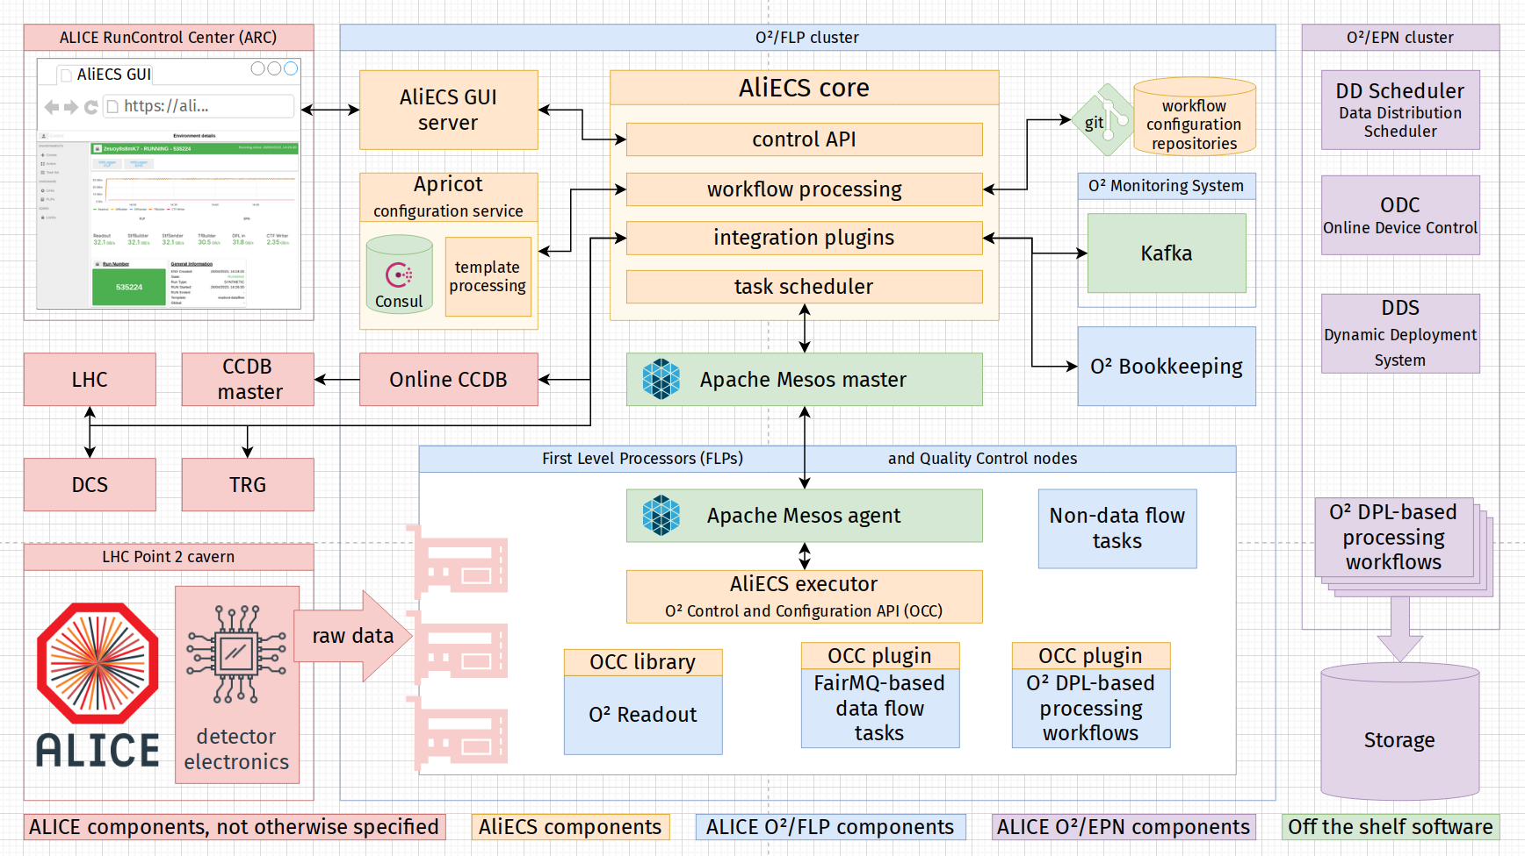
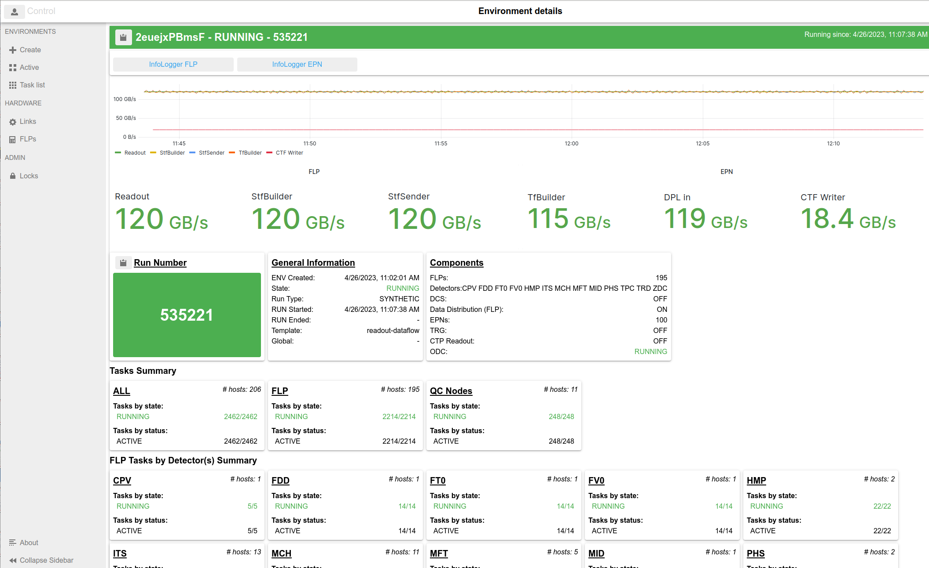
Experiment Control System
CHEP 2023 poster Tue 15:30
T. Mrnjavac, The ALICE Experiment Control System in LHC Run 3
AliECS
AliECS GUI
Direct control of the tasks running in FLP and QC nodes
Overall orchestration of ALICE data taking activities
Written in Go
Web-based: Javascript, nodejs
Deploy/shutdown tasks, start/stop runs

Slide 13
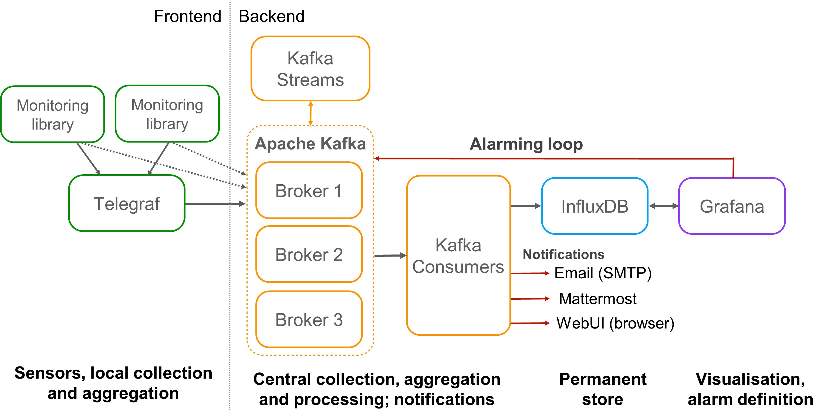
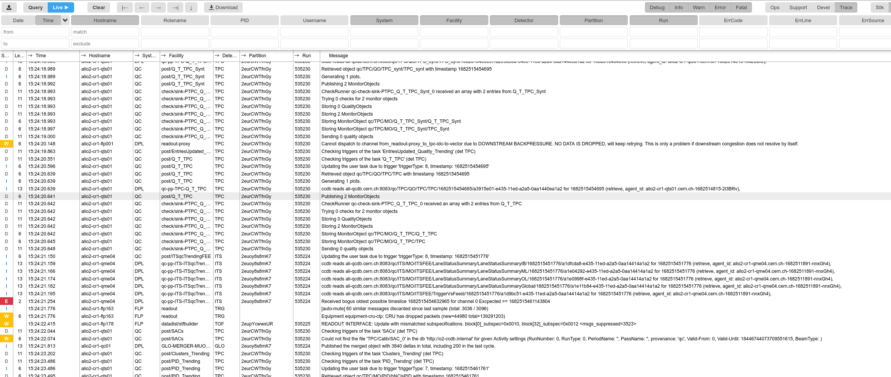
Operational Services
Monitoring, Logging, Configuration, Bookkeeping
Monitoring
Modular stack: telegraf + Kafka + Influxdb + Grafana
C++ library to inject metrics from O² tasks
Logging
InfoLogger in-house tool for application logs
ELK (Elastic, Logstash, Kibana) stack for system logs

Slide 14
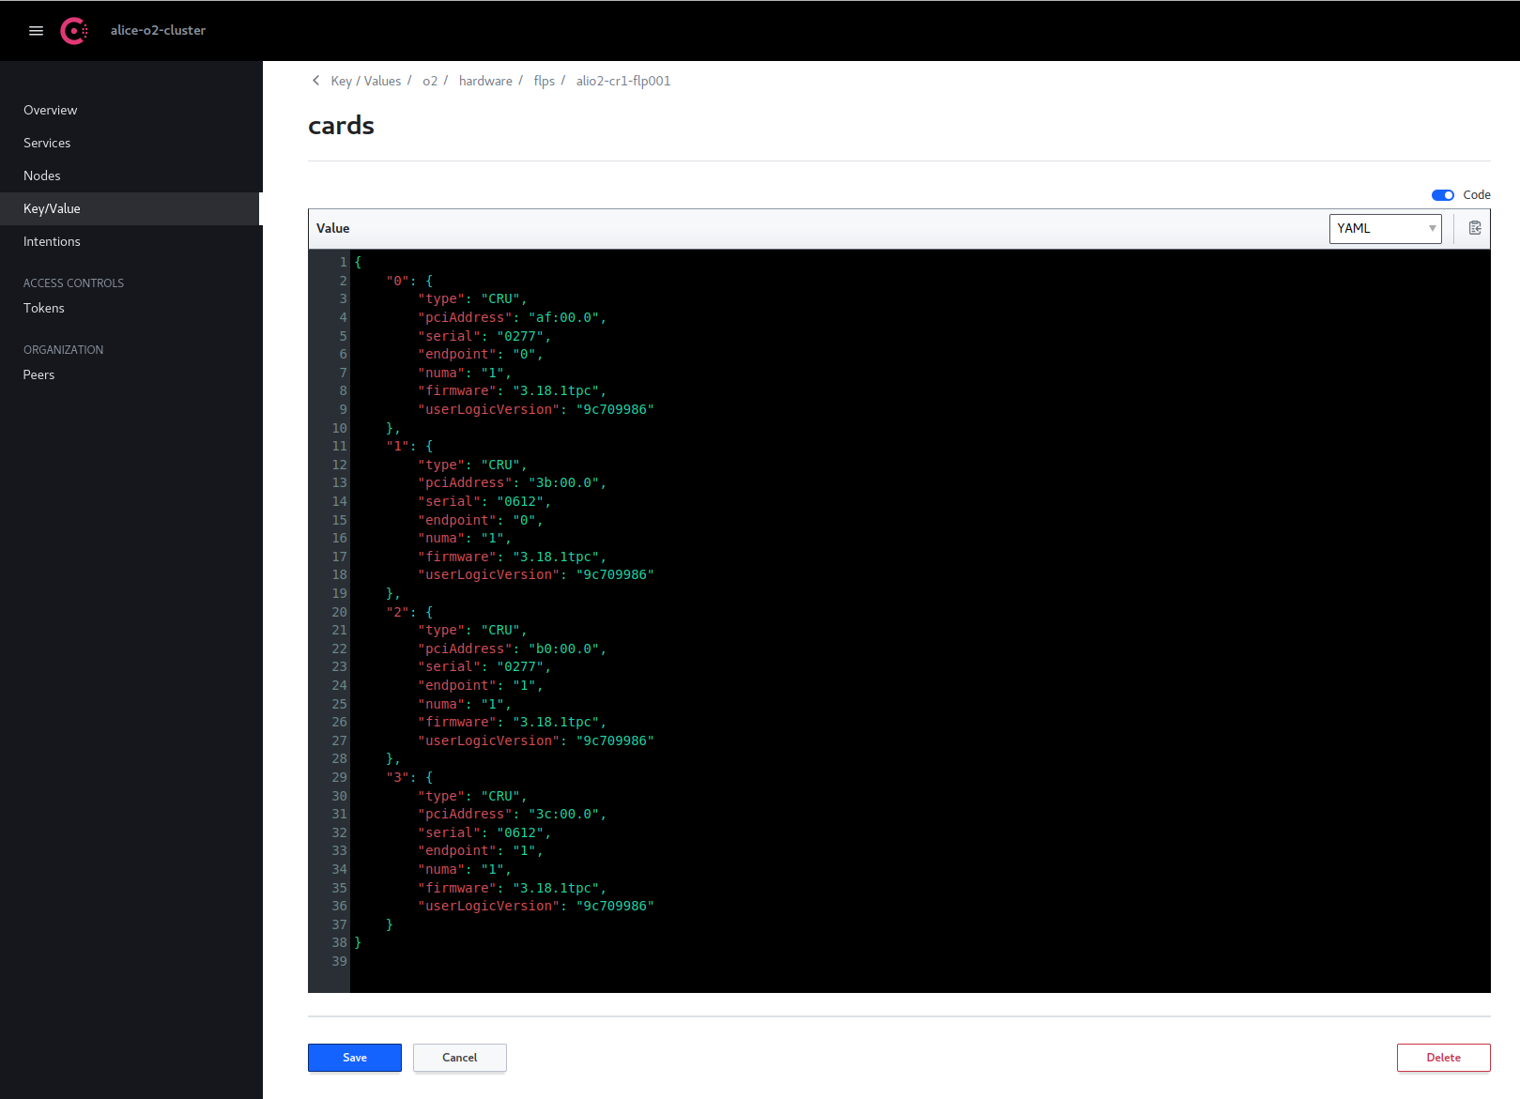
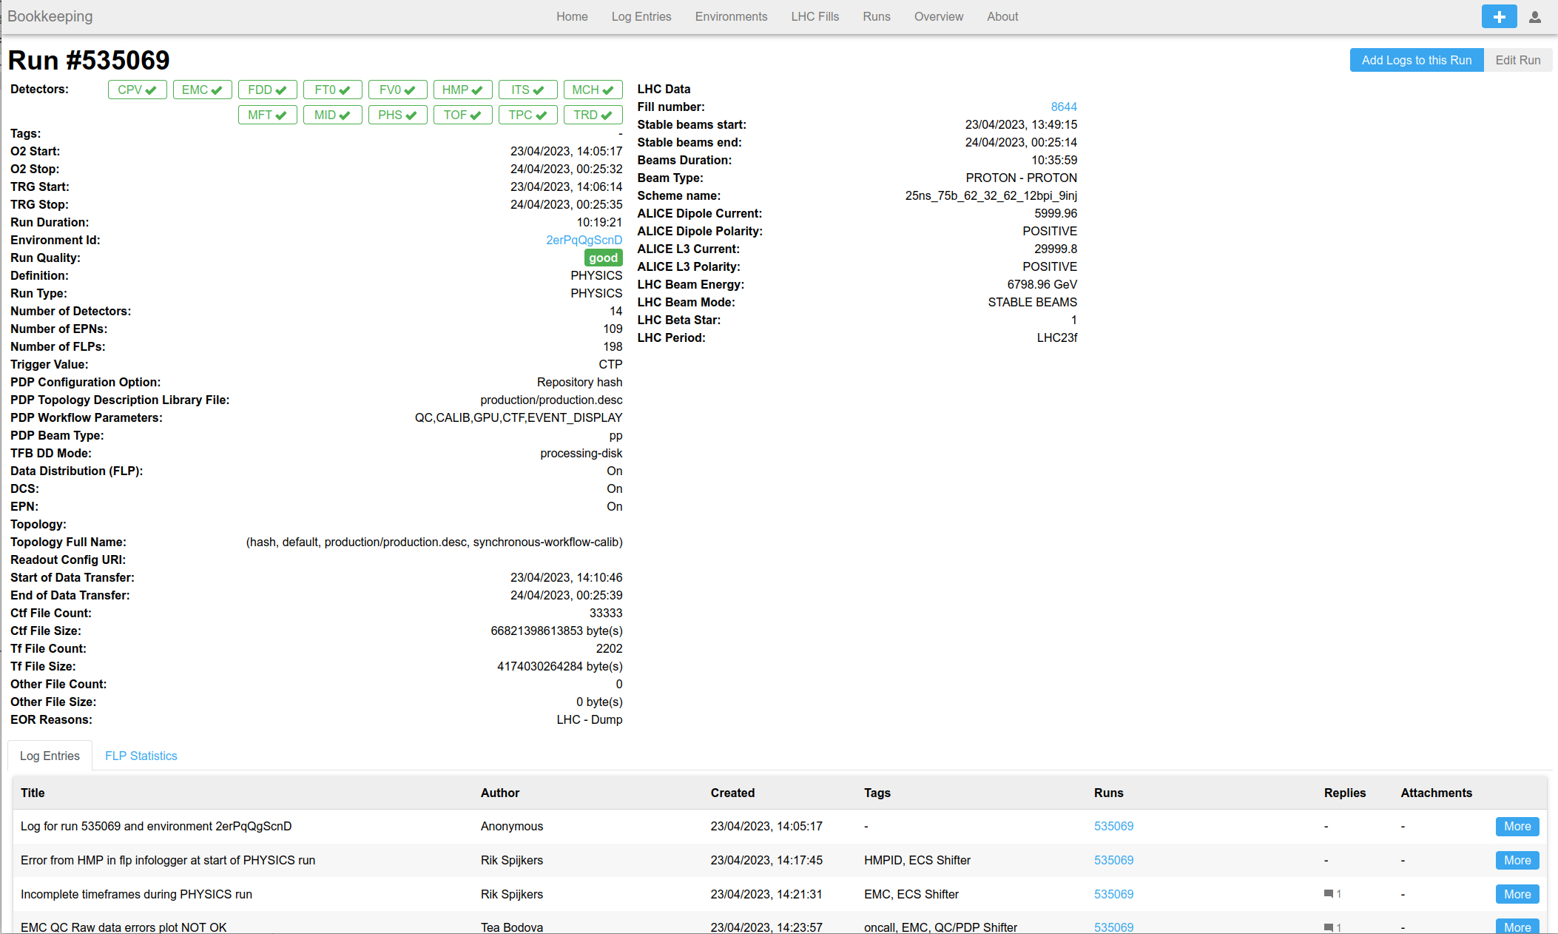
Operational Services
Monitoring, Logging, Configuration, Bookkeeping
Configuration
C++ library to access config from O² tasks
Consul for key/value store, service discovery
Bookkeeping
Web-based: Javascript, nodejs, mariadb, gRPC
Electronic logbook
CHEP 2023 talk Tue 15:00
G. Raduta, Security Models for ALICE Online Web-Based Applications
CHEP 2023 poster Tue 15:30
G. Raduta, Bookkeeping, a new logbook system for ALICE

Slide 15
First operational experience

Slide 16
First operational experience
Data rates limits
Aggregated
Per FLP
12.5 GB/s line rate
network
11 GB/s
10-11 GB/s
1.24 TB/s
10 GB/s
8.6 GB/s design value
650 GB/s design value

Slide 17
First operational experience
Run types
⁽¹⁾ expected
SYNTHETIC
Replay of MC data
1-1200 GB/s readout
COSMICS
Commissioning
85 GB/s readout
PHYSICS p-p
pp collisions at 500 kHz
500 GB/s readout
PHYSICS Pb-Pb ⁽¹⁾
130 GB/s storage
PbPb collisions at 50 kHz
2 GB/s storage
No writing to storage
30 GB/s storage
900 GB/s readout

Slide 18
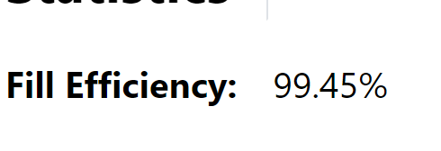
First operational experience
Data taking efficiency

Slide 19
Key takeaways
ALICE has a brand new DAQ system
Extensive portfolio with mixture of in-house and 3rd party tools
Excellent initial performance, quite promising for Run 3

Slide 20
Backup

Slide 21
ALICE Upgrade
An overview
New Inner Tracking System (ITS)
improved pointing precision
less material -> thinnest tracker at the LHC
ALICE upgrades during the LHC Long Shutdown 2
Muon Forward Tracker (MFT)
new Si tracker
Improved MUON pointing precision
Time Projection Chamber (TPC)
New readout chambers using GEM technology
New electronics for continuous readout (SAMPA)
New Trigger Detectors (FIT)
New Central Trigger Processor (CTP)
TOF, TRD new readout electronics
PHOS, EMCAL, CPV, HMPID
improvement of readout rate with existing electronics
MUON ARM
New electronics for Muon Chambers (SAMPA)
New electronics for Muon Trigger
Online Offline (O2) system
new computing facility
on line tracking & data compression
50kHz PbPb event rate
Common Projects:
Common Readout Unit (CRU) for all detectors (PCI card)
SAMPA common FE chip for TPC and Muon arm

Slide 22
ALICE Upgrade
O² computing system
Requirements
LHC min bias Pb-Pb at 50 kHz
Rare physics processes with very small signal over background ratio
Triggering techniques very inefficient if not impossible
50 kHz > TPC inherent rate Support for continuous read-out
Unmodified raw data of all interactions shipped from detector to online farm in triggerless continuous mode
Detector Electronics
9000 GBTs links
HI run 3.5 TByte/s
200 First-Level Processors
Hw acc: FPGAs
Baseline correction and zero suppression
Data volume reduction.
No event discarded.
Average compression factor 4
IB network
900 GByte/s
New computing system
Read-out the data of all interactions
Compress these data intelligently by online reconstruction
One common online-offline computing system: O²
Data volume reduction by online tracking. Only reconstructed data to data storage.
Average compression factor 7
350 Event Processing nodes
Hw acc: GPUs
90 GByte/s
130 GByte/s
Switching Network
Data Storage
1 year of compressed data
20 GByte/s
Write 130 GB/s
Read 75 GB/s
Capacity: 120 PB
Tier 0, Tiers 1 and
Analysis Facilities
Asynchronous (hours) event reconstruction with final calibration

Slide 23
Deployment
FLP Suite
Set of Ansible roles
In house-tool as wrapper
Deployment in production via gitlab pipeline
40-50 min for a full provisioning of all tools
Set of CI tests including run start/stop via GUI

