Slide 1
The HSF Conditions Database Reference Implementation
Andrea Formica¹, Lino Gerlach², Giacomo Govi³, Paul Laycock², Ruslan Mashinistov², Chris Pinkenburg²
¹Université Paris-Saclay (IRFU/CEA, FR)
²Brookhaven National Lab (US)
³Fermilab (US)
9 May 2023

Slide 2
Conditions Data – Introduction
“Conditions data is any additional data needed to process event data”
Changes over time
High access rates
Heterogenous data
Repeat detector calibration with larger cosmic dataset
Improve calibration algorithms
Distributed computing jobs access same conditions data simultaneously
Access rates up to ~kHz
Granularity varies (time indexed, run-indexed, constant)
Structure of payload varies (3D map, time-indexed values, single number, …)
Versioning & configuration
Fast DB queries & effective caching
Payload agnostic by design
Similar challenges for various HEP experiments

Slide 3
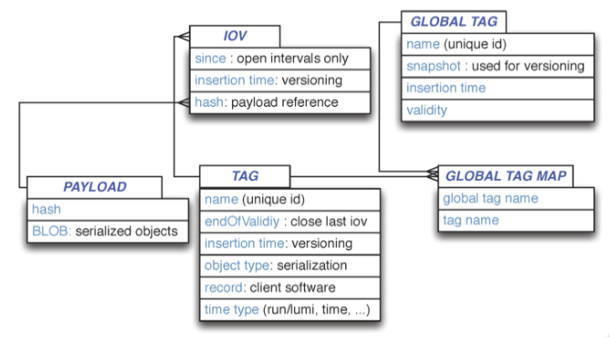
Conditions Data – Recommendations
HSF Conditions Databases activity: https://hepsoftwarefoundation.org/activities/conditionsdb.html
Discussions across various experiments
Key recommendations for conditions data handling
Separation of payload queries from metadata queries
Schema below to organise payloads
top-level configuration of all conditions data
‘Interval of Validity’: generalized concept of time (begin can be time stamp, run number, lumi block, …)
HEP Software Foundation Community White Paper Working Group – Conditions Data
actual data (e.g. in a file)
configuration for each type of conditions data

Slide 4
Conditions Data – Use Cases
Use case
Example
HSF Conditions Database meeting: use cases https://indico.cern.ch/event/1280790/
Most can be realised w/ HSF Recomm.
Online
High Level Trigger
Reprocessing
Run reco w/ improved calib.
Analysis
High level physics analysis
Development
Fast-processing
Test new calib. within existing GT
Process data w/ just-in-time calib.
Exception: Fast-Processing. Goal:
Publish data for analysis fast
Maximize physics performance
Need additional info: end of IOV

Slide 5
Implementation – Overview
client side
server side
remote payload store
nopayloadclient:
Client-side stand-alone C++ tool
payload
Communicates with nopayloaddb (server)
Local caching
Handling of payloads
nopayloadclient
REST*
Experiment- agnostic lib
nopayloaddb
nopayloadclient
sPHENIX- specific lib
DUNE- specific lib
*Example query (simplified)
curl http://<host>/api/payloadiovs/?gtName=test_gt&iovNum=42 -> {type_1: url_1, type_2: url_2, …}
sphenixnpc
dunenpc

Slide 6
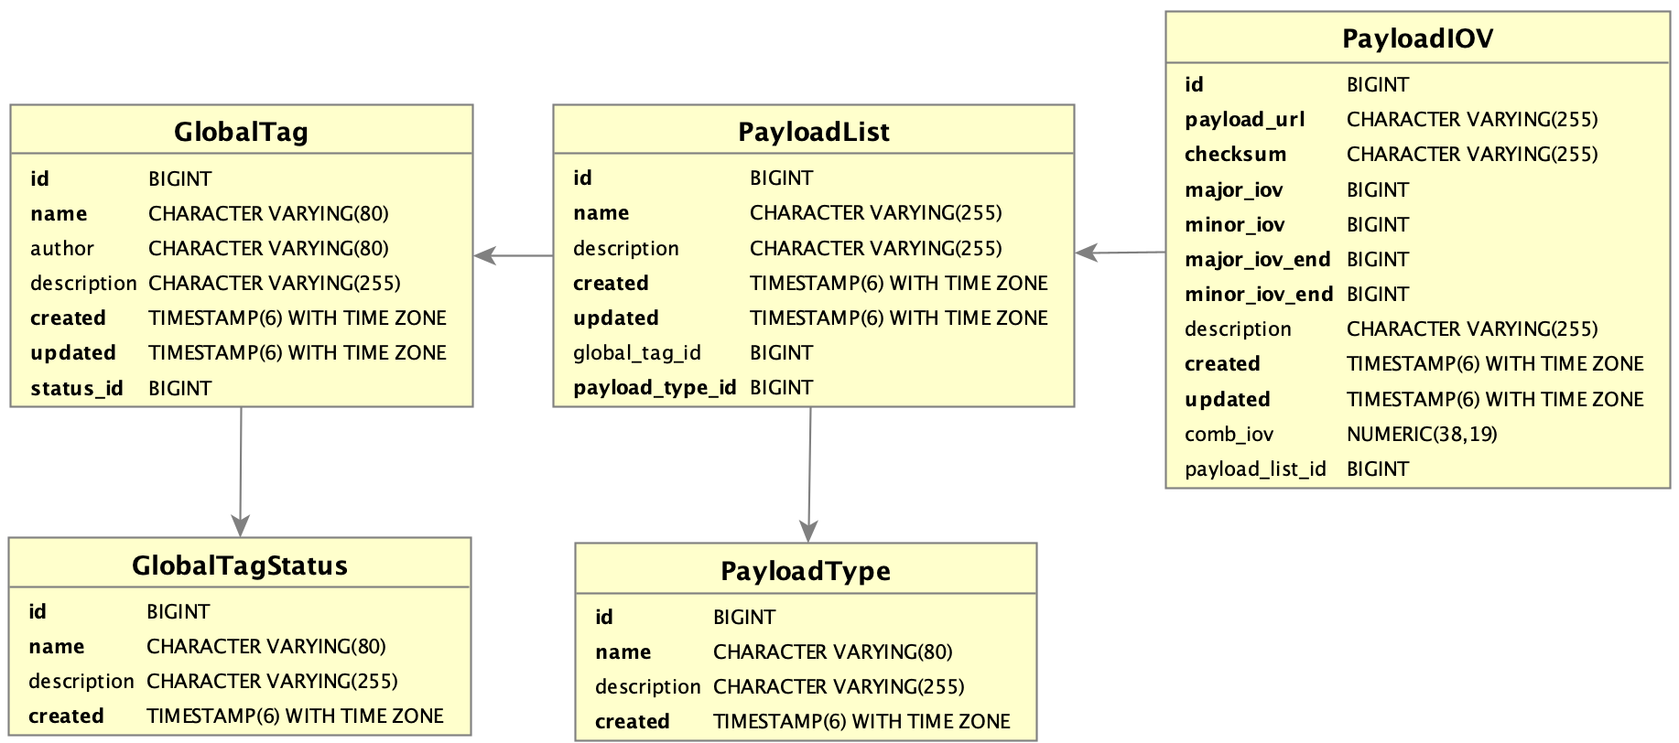
Implementation – Database Schema
Payloads are not stored in schema
major- & minor IOV for more flexibility
IOVs also have an end
Combination of major and minor IOV into single column for performance optimisation
Locked
Unlocked

Slide 7
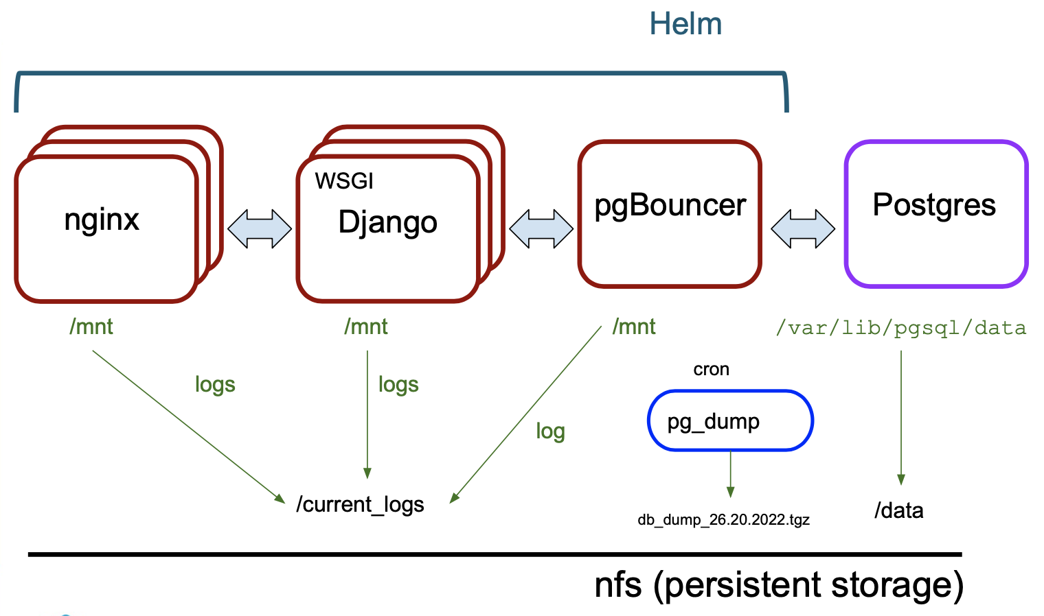
Deployment on OKD
Automated deployment on OKD (Helm chart)
Horizontally scalable
Open Source only
Easily adoptable for various HEP experiments
Powered by

Slide 8
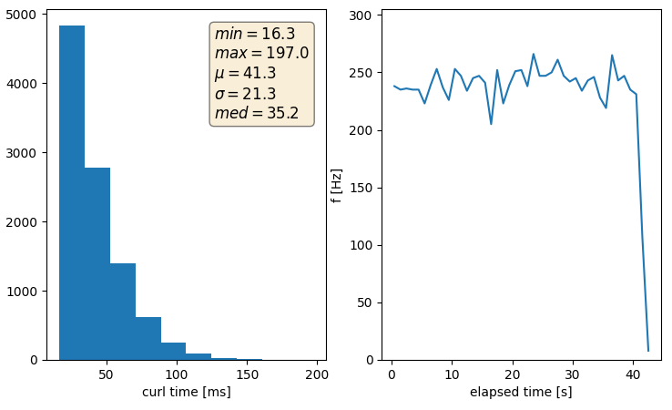
Performance Testing – Strategy
Simulate expected DB occupancy
mean response time
mean response frequency
Simulate access patterns
Query read API for payload URL
Parallel requests via HTC or MT
Scenario | Payload Types | Payload IOVs (per type)
tiny | 10 | 100 (10)
tiny-moderate | 10 | 2000 (200)
moderate | 100 | 20000 (200)
heavy-usage | 100 | 500000 (5000)
worst-case | 200 | 5200000 (26000)
All following tests:
Random major- and minor IOV, no caching
Query metadata only, no payloads

Slide 9
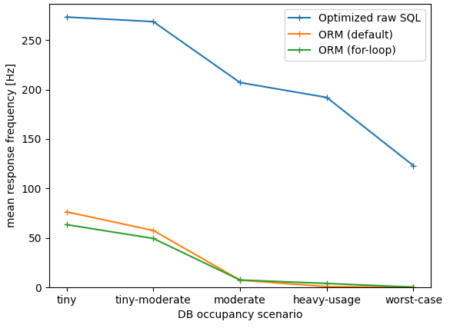
Performance Testing – ORM vs Raw SQL
Resp. freq. vs size of queried GT
High frequency read API workflow:
Filter on global tag, major- and minor IOV *
Find ‘latest’ IOV for each payload type **
Return payload type, file URL, IOV
Django’s ORM writes query for user
Optimized raw SQL query
Covering index (index-only scan)
Combined IOV column <major.minor>
Lateral join operation
*: my_major<major_iov OR (my_major=major_iov AND my_minor<=minor_iov) **: for max major_iov, find max minor_iov

Slide 10
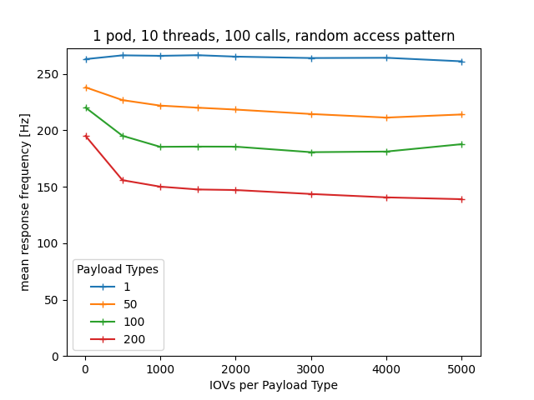
Performance Testing – Scaling
Resp. freq. vs size of queried GT
Investigate scaling w/ size of queried GT
Content of DB remains constant
Measure mean response frequencies
Scales with number of payload types
More data to sort and return
Almost flat vs number of IOVs
Index scan (covering index)
Also tested scaling w.r.t. size of DB
No dependence, plot in backup
1M IOVs

Slide 11
Conclusion
HSF recommends how to handle conditions data
Presented experiment-agnostic reference implementation
Django REST API: nopayloaddb
Automized deployment on OKD
C++ client-side client: nopayloadclient
Performance tests show solid results
After raw SQL query optimisation
Already in use at sPHENIX
ProtoDUNE planning to deploy as well

Slide 12
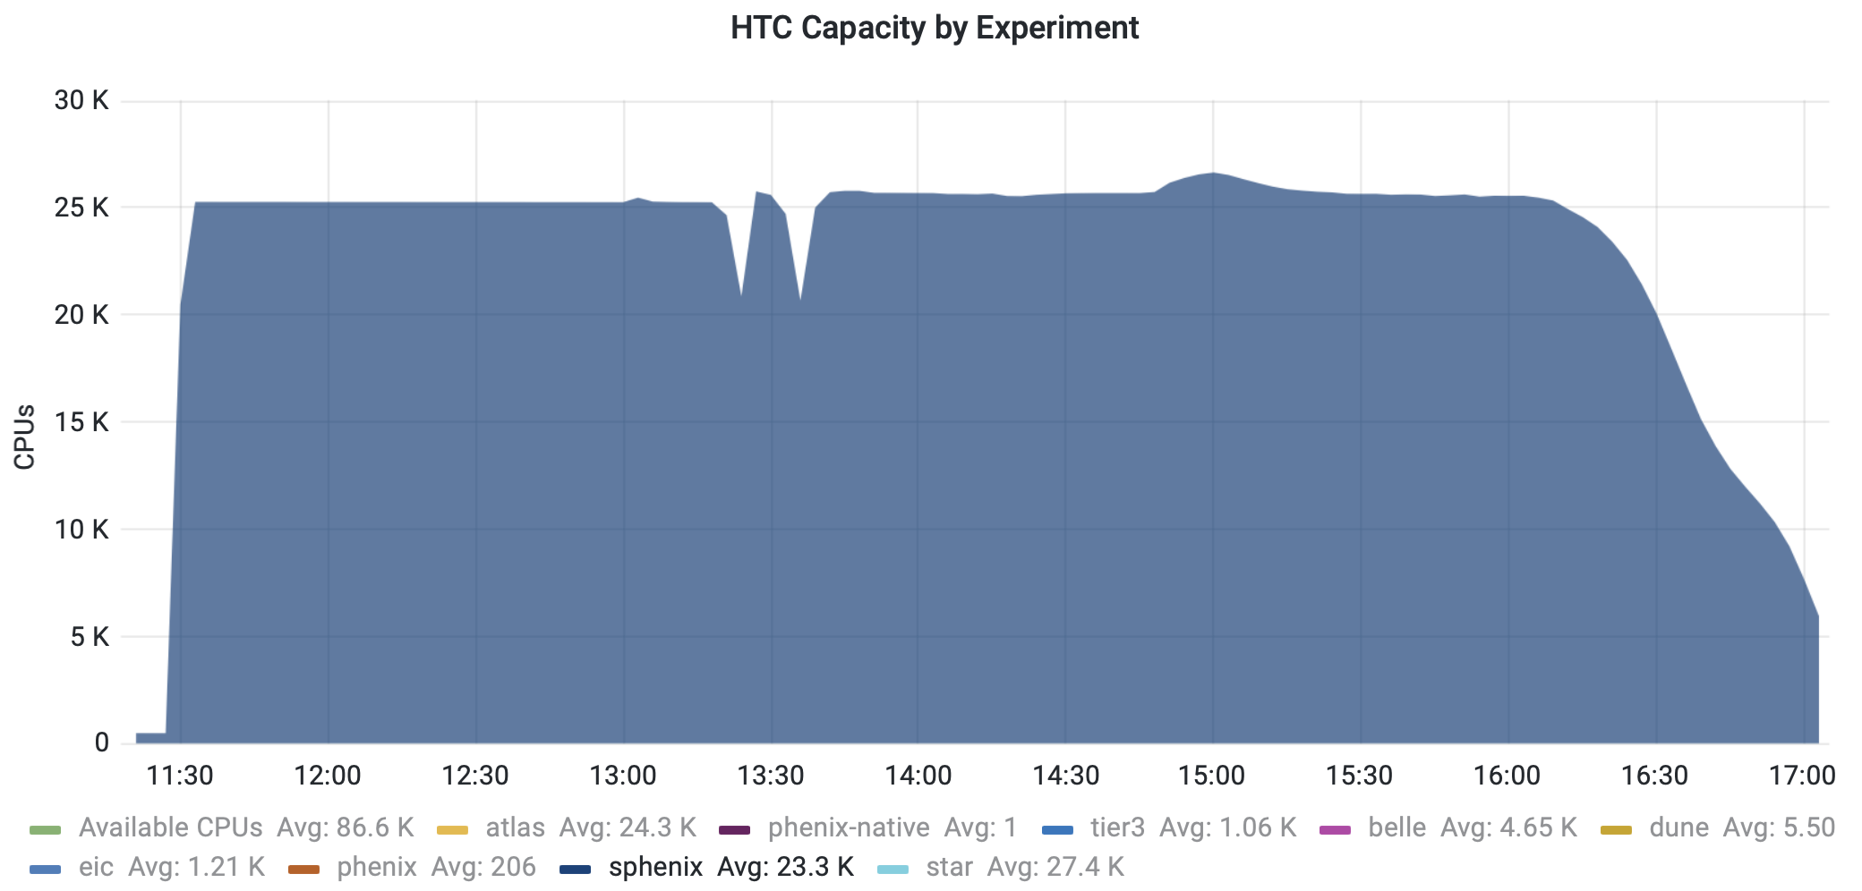
Thank you for your Attention!

Slide 13
Backup

Slide 14
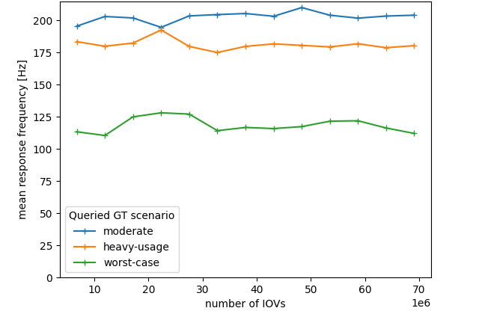
Performance Testing – Scaling
Resp. freq. vs size of queried GT
Resp. freq. vs DB size
Scales with number of payload types
Almost flat w.r.t. number of IOVs
Performance depends on size of queried GT
Additional ‘stuff’ in DB has no significant impact

Slide 15
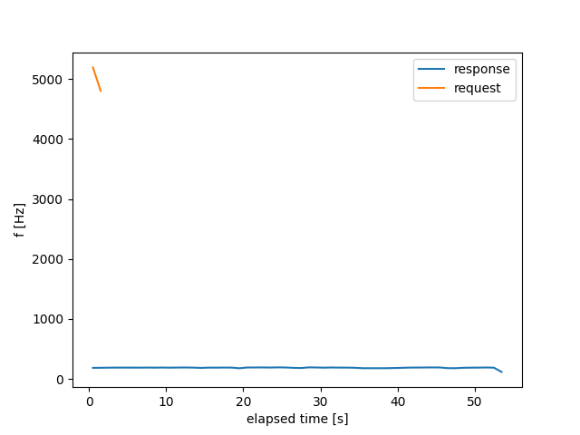
Performance Testing – High Frequency
Simulate offline reco use case
Many jobs launched at same time
Cooperative multithreading (asynchio)
Send requests firsts
Process responses later
Allows very high peak request frequency
Server-side queuing of requests works
10k requests sent within ~1.2 secs
received all responses within ~55 sec

Slide 16
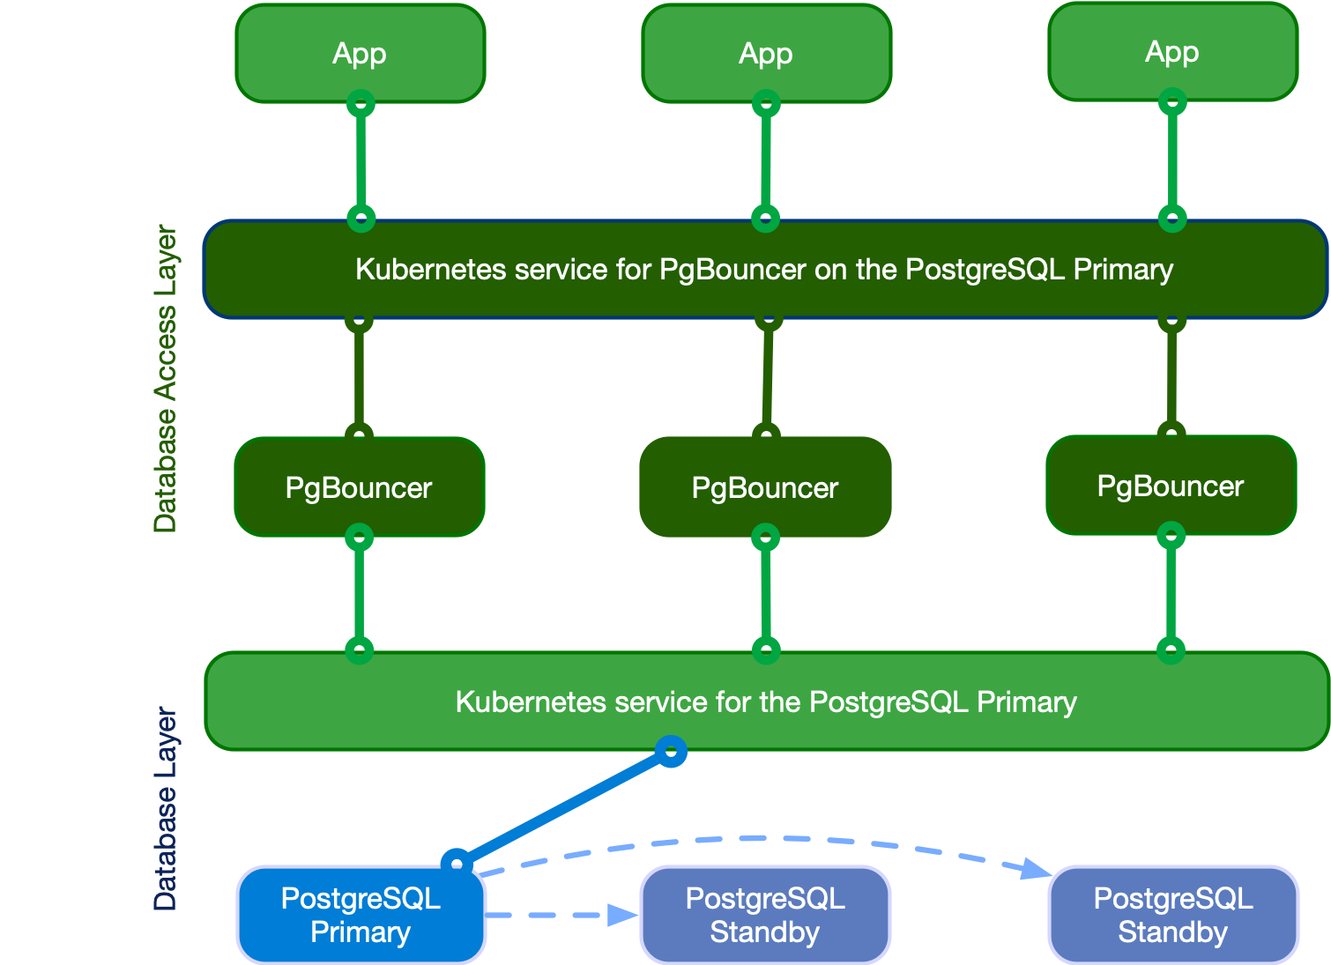
PostgreSQL High-Availability Cluster
Open source Kubernetes operator for HA PostgreSQL
Consider DB cluster for high-availability and higher performance
CloudNativePG:
Open source operator (Kubernetes) for PostgreSQL
Primary / Standby architecture
Native support for pgBouncer connection pooling

Slide 17
PayloadIOV Read API – Raw SQL Query
SELECT pi.payload_url, pi.major_iov, pi.minor_iov, pt.name, …
FROM "PayloadList" pl
JOIN "GlobalTag" gt ON pl.global_tag_id = gt.id AND gt.name = %(my_gt)s
JOIN LATERAL (
SELECT payload_url, major_iov, minor_iov, …
FROM "PayloadIOV" pi
WHERE pi.payload_list_id = pl.id
AND pi.comb_iov <= CAST(%(my_major_iov)s + CAST(%(my_minor_iov)s AS DECIMAL(19,0)) / 10E18 AS DECIMAL(38,19))
ORDER BY pi.comb_iov DESC
LIMIT 1
) pi ON true
JOIN "PayloadType" pt ON pl.payload_type_id = pt.id;
For each PayloadList (Type)
Get Payloads descending ordered by combined IOV
Limit return to 1 line - latest Payload for a given IOVs
And then append the results of each subquery to create the final output
LATERAL joining. Without LATERAL, each sub-SELECT is evaluated independently and so cannot cross-reference any other FROM item
Covering index on Payload table including combined IOV and reference to the PayloadList

Slide 18
Investigating Query Plans - I
Hash Join (cost=7.23..410.15 rows=86 width=70) (actual time=6.111..365.158 rows=200 loops=1)
Hash Cond: (pl.payload_type_id = pt.id)
-> Nested Loop (cost=0.71..403.40 rows=86 width=69) (actual time=6.017..364.977 rows=200 loops=1)
-> Nested Loop (cost=0.15..11.70 rows=86 width=16) (actual time=0.048..0.133 rows=201 loops=1)
-> Seq Scan on "GlobalTag" gt (cost=0.00..1.09 rows=1 width=8) (actual time=0.023..0.025 rows=1 loops=1)
Filter: ((name)::text = 'worst-case'::text)
Rows Removed by Filter: 6
-> Index Scan using "PayloadList_global_tag_id_2b35c85f" on "PayloadList" pl
(cost=0.15..9.75 rows=86 width=24) (actual time=0.022..0.083 rows=201 loops=1)
Index Cond: (global_tag_id = gt.id)
-> Limit (cost=0.56..4.53 rows=1 width=61) (actual time=1.815..1.815 rows=1 loops=201)
-> Index Only Scan using combo_covering_idx on "PayloadIOV" pi
(cost=0.56..3484.55 rows=876 width=61) (actual time=1.815..1.815 rows=1 loops=201)
Index Cond: (payload_list_id = pl.id)
Filter: ((major_iov < 100000000) OR ((major_iov = 100000000) AND (minor_iov <= 100000000)))
Rows Removed by Filter: 24669
Heap Fetches: 0
-> Hash (cost=4.01..4.01 rows=201 width=17) (actual time=0.078..0.078 rows=201 loops=1)
Buckets: 1024 Batches: 1 Memory Usage: 19kB
-> Seq Scan on "PayloadType" pt (cost=0.00..4.01 rows=201 width=17) (actual time=0.018..0.043 rows=201 loops=1)
Planning Time: 0.996 ms
Execution Time: 365.221 ms
major- & minorIOV
Hash Join (cost=7.23..90.89 rows=86 width=70) (actual time=0.309..3.244 rows=200 loops=1)
Hash Cond: (pl.payload_type_id = pt.id)
-> Nested Loop (cost=0.71..84.14 rows=86 width=69) (actual time=0.075..2.935 rows=200 loops=1)
-> Nested Loop (cost=0.15..11.70 rows=86 width=16) (actual time=0.028..0.121 rows=201 loops=1)
-> Seq Scan on "GlobalTag" gt (cost=0.00..1.09 rows=1 width=8) (actual time=0.013..0.018 rows=1 loops=1)
Filter: ((name)::text = 'worst-case'::text)
Rows Removed by Filter: 6
-> Index Scan using "PayloadList_global_tag_id_2b35c85f" on "PayloadList" pl
(cost=0.15..9.75 rows=86 width=24) (actual time=0.012..0.063 rows=201 loops=1)
Index Cond: (global_tag_id = gt.id)
-> Limit (cost=0.56..0.82 rows=1 width=61) (actual time=0.014..0.014 rows=1 loops=201)
-> Index Only Scan using combo_covering_idx on "PayloadIOV" pi
(cost=0.56..232.55 rows=876 width=61) (actual time=0.013..0.013 rows=1 loops=201)
Index Cond: ((payload_list_id = pl.id) AND (major_iov < 100000000))
Heap Fetches: 0
-> Hash (cost=4.01..4.01 rows=201 width=17) (actual time=0.073..0.074 rows=201 loops=1)
Buckets: 1024 Batches: 1 Memory Usage: 19kB
-> Seq Scan on "PayloadType" pt (cost=0.00..4.01 rows=201 width=17) (actual time=0.008..0.036 rows=201 loops=1)
Planning Time: 0.645 ms
Execution Time: 3.299 ms
Only majorIOV

Slide 19
Investigating Query Plans - II
-> Limit (cost=0.56..4.53 rows=1 width=61) (actual time=1.815..1.815 rows=1 loops=201)
-> Index Only Scan using combo_covering_idx on "PayloadIOV" pi
(cost=0.56..3484.55 rows=876 width=61) (actual time=1.815..1.815 rows=1 loops=201)
Index Cond: (payload_list_id = pl.id)
Filter: ((major_iov < 100000000) OR ((major_iov = 100000000) AND (minor_iov <= 100000000)))
Rows Removed by Filter: 24669
Heap Fetches: 0
Index Condition & Filter
-> Limit (cost=0.56..0.82 rows=1 width=61) (actual time=0.014..0.014 rows=1 loops=201)
-> Index Only Scan using combo_covering_idx on "PayloadIOV" pi
(cost=0.56..232.55 rows=876 width=61) (actual time=0.013..0.013 rows=1 loops=201)
Index Cond: ((payload_list_id = pl.id) AND (major_iov < 100000000))
Heap Fetches: 0
Index Condition Only

Slide 20
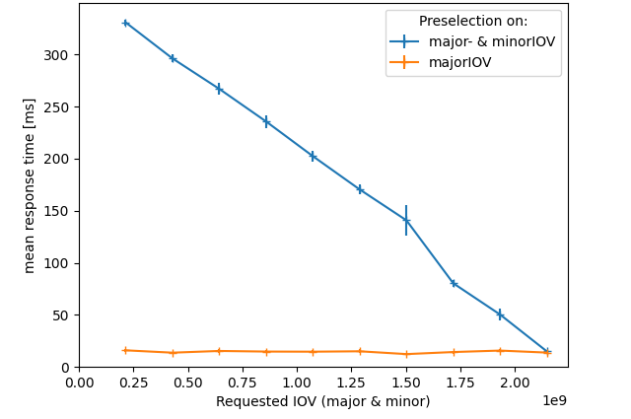
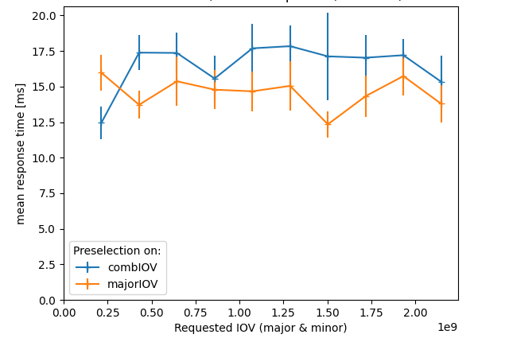
Raw SQL - Combined IOV Column
Preselection on major- & minor IOV ( AND / OR )
Scales with entries to consider
Query uses ‘Filter’
Preselection on single column ( <= )
Constant time
Query uses ‘Index Condition’
Combine major- and minor IOV into single column:
bigint bigint decimal(38, 19)
Fast across all values while selecting on both

