Slide 1
ALTO/TCN: Toward an Architecture of Efficient and Flexible Data Transport Control for Data-Intensive Sciences using Deep Infrastructure Visibility
Presenter: Y. Ryan Yang
Team: Mario Lassnig, Mihai Patrascoiu,
Jordi Ros-Giralt, Harvey Newman, Kai Gao, Jensen Zhang,
Jacob Dunefsky, Mahdi Soleimani, Y. Richard Yang
05/08-12/2023
CHEP 2023
Notes:
Abstract: There is increasing demand for the efficiency and flexibility of data transport systems supporting data-intensive sciences. With growing data volume, it is essential that the transport system of a data-intensive science project fully utilize all available transport resources (e.g., network bandwidth); to achieve statistical multiplexing gain, there is an increasing trend that multiple projects share the same transport infrastructure, but the wide deployment of a shared infrastructure requires flexible resource control. In this talk, we first conduct a rigorous analysis of existing data transport systems and show that considering the infrastructures as a black box can limit efficiency and flexibility. We then introduce ALTO/TCN, a new architecture that introduces deep infrastructure visibility to achieve efficient, flexible data transport. We will provide additional details on 3 key components to realize the architecture: (1) how to achieve infrastructure visibility in multi-domain networks, using the Internet Engineering Task Force (IETF) Application-Layer Traffic Optimization (ALTO) protocol and the openalto.org visibility orchestrator; (2) how to integrate visibility into transport scheduling optimization, with zero-order/first-order gradient and time-multiplexing control, using FTS integration as an example; and (3) how to integrate visibility into data selection orchestration, with general distances as a visibility abstraction, using Rucio integration as an example. We will report evaluation results and implementation lessons. We conclude with planning for the next steps, in particular, how the project complements existing related efforts in HEP, such as application awareness (e.g., packet marking) and adaptive networking resource allocation (e.g., NOTED/SENSE/AutoGOLE).

Slide 2
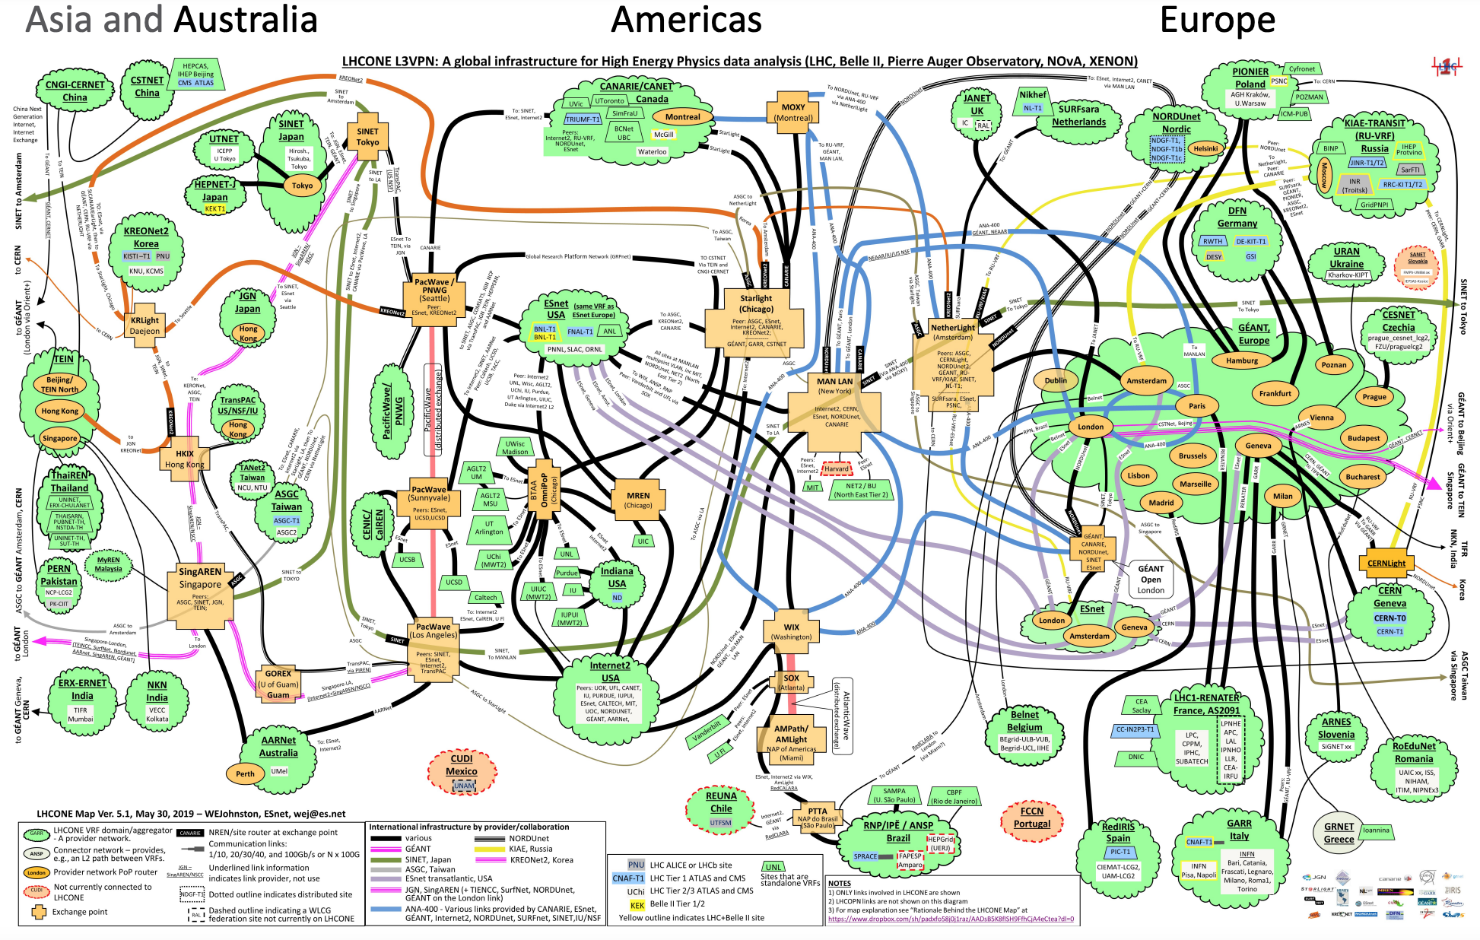
Motivation/Requirements
Requirement for high efficiency, e.g.,
  HL-HLC resource demand growth and flat budget => not leave resources under-utilized
Trend toward a increasingly shared infrastructure
  Existing LHCONE is already a shared infrastructure
  WLCG motivates building shared, common infrastructure
  Interests from other experiments to build a similar infrastructure or share the same infrastructure, e.g., MultiONE discussions
  [2]
Transport capacities of resources (e.g., disk transfer, network transfer) define a capacity region
project 2
Fair Share Control
Share Control
inefficient
[1] WLCG Strategy towards HL-LHC, WLCG-LHCC-2018-001
[2] MultiONE LHCONE/OPN Community Meeting.
project 1
Notes:
It is not just a mechanism for saving hardware and operational costs, but is also a real opportunity for building commonality, moving data management into the infrastructure layer, common optimisation of performance, common operations, and much better prospects for the long-term sustainability of the solutions.

Slide 3
Gaps of General Networking Transport Mechanism
Efficient, fair-shared transport resource is one of the main topics
in computer networking, but existing work has major gap:
Mechanism | Gap
TCP Transport Rate Control | Provides low level, individual-transfers resource allocation; assumes (fixed-capacity) networking resources; data-intensive transport need higher level allocation structures, supporting both networking transport and storage transport
Datacenter/hyper-scaler Scheduling | Hyper-scaler scheduling is single domain (w/ strong controllability, relative uniform setting), deep infrastructure expertise, but data-intensive transport should support multidomain (w/ weak control, heterogenous domains), and lacking of technical (net-config) expertise in some domains Hyper-scaler scheduling focuses on highly diverse, low latency (ms-sensitive) workload, but data-intensive is on less (RTT-level) delay-sensitive larger transfers
Notes:
Transition sentence: Building efficient, fair-shared resource transport infrastructure is .. The figure on the top right is a textbook figure showing that the goal of TCP is to achieve efficient, fair transport capacity allocation

Slide 4
HEP Community Innovation: FTS Transport Control
Basic Mechanisms:
Setup transfer queue for each src/dst pair (we call it a pipe)
Concurrency control loop to adjusts # concurrent TCP connections per pipe
Dispatches transfer if allowed by concurrency level
Data-Intensive Workflows
Data Management / Transfer Orchestration
(e.g., Rucio)
Transfer Scheduling
(e.g., FTS)
2
2
4
Transfer Data Plane
(e.g., GridFTP, XRootD, HTTP)
Concurrency Control Loop Goals:
Efficiency: neither overload or underload transport capacity
Fairness/control: upper bound to avoid overload/overuse
Internet Transport Layer
(e.g., TCP, TCP/Cubic, BBR)
Networking Layer (e.g., traditional networking, AutoGOLE/SENSE, NOTED, Programmable net)

Slide 5
Concurrency Control as an Elegant Base Architecture
bw2
Efficiency, Fairness Goals
bw1
Concurrency Control (FTS Optimizer)
Use universally available control knob
  Build on top of fully distributed, fast (per RTT) congestion control (CC) as building block (atom)
Sit at application level, can understand application semantics
No need to acquire tech expertise at each domain to configure per domain network config
n2
TCP Congestion Control (TCC)
n1
Heterogeneous, Multi-Domain Network Settings
A
B
C

Slide 6
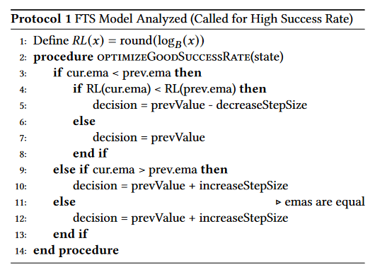
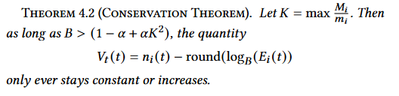

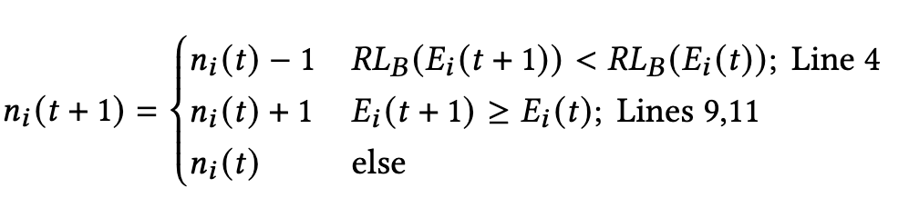
Gap of Current Concurrency Control (FTS3)
Simple Semi Zero-Order Gradient Alg, with Manual Per-Pipe Upper Bound, Optimizing for Each Pipe Alone
Keep track of the exponential moving average (EMA) of throughput.
Implicit upper limit control,
not explicit resource structure model
controllability gap
Update the number of connections based on EMA.
Theorem: In a Throughput-Deterioration Model, semi zero order will achieve throughput that is <= 1/√B of the optimal (under default settings).
efficiency gap
Can be suboptimal in some cases

Slide 7
ALTO/TCN High-Level Design Overview
Efficiency, Fairness Goals
From
To
User interface: Manual, implicit per-pipe upper bound
Algorithm: semi
zero-order gradient, optimizing for each pipe alone
User interface: Intuitive, direct resource model
Algorithm: full
zero-order/first order gradient,
with joint optimization
ALTO/TCN Controller based on FTS
TCP Congestion Control (TCC)
Heterogeneous, Multi-Domain Network Settings

Slide 8
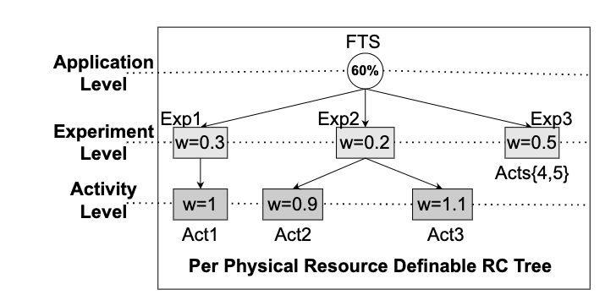
ALTO/TCN Architecture
pipe[i].src
pipe[i].dst
AS 1
AS 2
AS 3
Link 1.1
Link 3.1
experiment
activity
pipe
Resource model
Resource use visibility
Scheduler: concurrency level, time multiplexing control loop
Trans q1
Trans q2
Trans q2
Language
ALTO

Slide 9
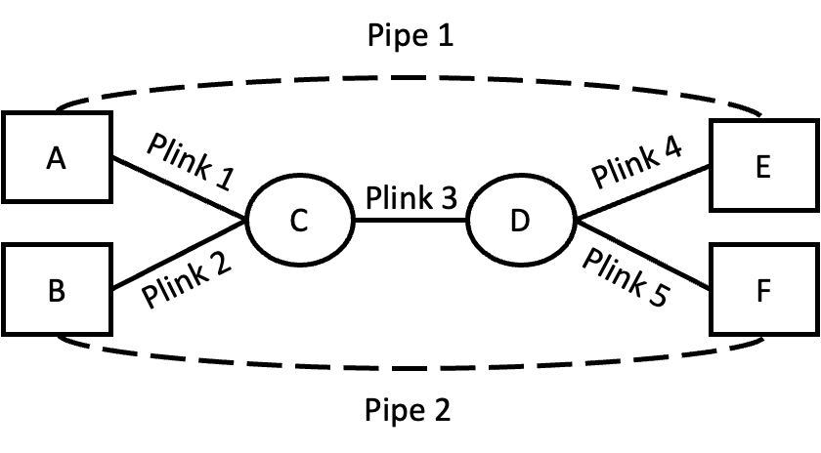
ALTO/TCN Resource Model, Resource-Use Visibility (Simple Example 1)
Resource Model:
Experiment X:
R1: <Plink 1> <= 5G
R2: <Plink 2> <= 10G
R3: <Plink 3> <= 12G
5G
12G
10G
4G
Experiment X Uses 2 pipes:
Pipe1.traffic = 4G, Pipe2.traffic = 9G
5G
4G
12G
Since usage on Plink 3 is over resource model, controller reduces concurrency levels of Pipe 1 and Pipe 2.
13 (=4+9G
Resource Use Visibility (ALTO):
Pipe 1: {Plink 1, Plink 3, Plink 4}.
Pipe 2: {Plink 2, Plink 3, Plink 5}.
10G
9G
9G
Notes:
5,10G are absolute bounds.

Slide 10
ALTO/TCN Resource Model, Resource-Use Visibility (Simple Example 2)
Resource Model (Plink 3):
Experiment X <= 12 G
X.Activity-1 : X.Activity-2 = 1:2
12G
1:2
4G
Experiment App Accounting (Pipe 1 for X.Activity-1;
Pipe 2 for X.Activity-2):
Pipe1.traffic = 4G, Pipe2.traffic = 9G
12G
Since usage on Plink 3 is over resource model due to Activity-2, controller reduces concurrency level of Pipe 2.
13 (=4+9)G
Resource Use Visibility (ALTO):
Pipe 1: {Plink 1, Plink 3, Plink 4}.
Pipe 2: {Plink 2, Plink 3, Plink 5}.
9G
Notes:
5,10G are absolute bounds.

Slide 11
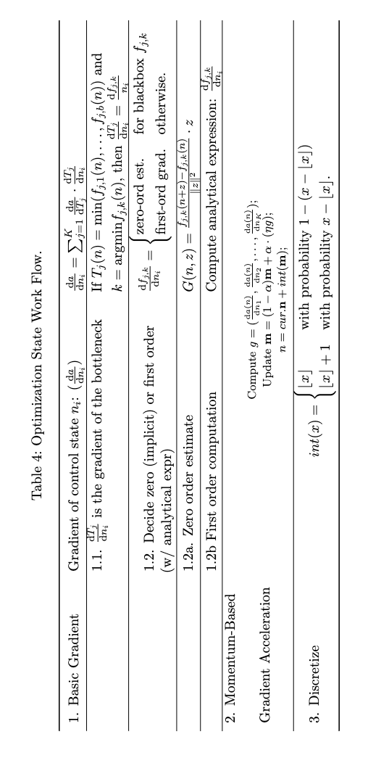
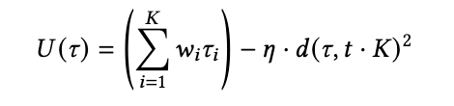
Implementation: ALTO/TCN Control Loop (for completeness)
Integral, quadratic distance function
Zero-order stochastic rounding

Slide 12
ALTO/TCN Implementation: Visibility
Based on the Internet Engineering Task Force (IETF) Application-Layer Traffic Optimization (ALTO) standard
  provide a standard for applications and networks to work together to optimize both network and application performance
ALTO/TCN uses the Path-Vector ALTO service to obtain resource elements used on the path
Problem Statement
(RFC 5693)
Xdom Service Discovery
(RFC 8686)
Base Protocol (RFC 7285)
Multicost
(RFC 8189)
Path Vector
(RFC 9275)
Requirements (RFC 6708)
SSE/Incr Update (RFC 8895)
Cost Calendar (RFC 8896)
Cost Metrics
(RFC editor)
Server Discovery (RFC 7286)
Comcast Deployment
(RFC 5632)
Deployment
(RFC 7971)
CDNi
(RFC 9241)
Unified Properties (RFC 9240)
Notes:
Entity: A network consists of a set of entities, Path: a network-traversal path from a src entity to a dst entity

Slide 13
Basic ALTO/TCN Benchmarking/Simulation (Real Esnet Topology)
ALTO/TCN FTS
ALTO/TCN FTS
7.39x total BW utilization.
5.54x Max RCT improvement. (Short-tailed)
Global Objective, Zero-order gradients, and Resource Control Constraints.
Setting: 30 <src, dst> pipes, one request per pipe, each request 20K transfers, file size = 100MB. the total in the workload is 60TB.
Resource Control goal: all equal weights
Notes:
Key: Now that we have an understanding, let’s see if these are still true in a real ALTO/TCNology.
30 <src, dst> pipes, each pipe has 20K transfers, each transfer file size is 100MB, for a total 2TB per pipe, the total in the workload is 60TB
Transition: Next, For the system wide measures and static arrival patterns, we moved to a more complicated substrate network (ESnet) with 30 x 2TB transfers. We can see improvements in max BW utilization and Max FCT improvements. Our discussions with the CERN team indicates the importance of max FCT as the practical transmission times distribution of FTS is currently long-tailed.

Slide 14
Summary and Next Steps
ALTO/TCN can be considered as an instance of application-defined networking, extending beyond software-defined networking
ALTO visibility can be applied not only to FTS but also Rucio (uniform distance abstraction)
Substantial implementation and evaluation in progress
Welcome feedback and collaboration!

Slide 15
Backup Slides

Slide 16
High-Level Motivation and Goal
User Demands Evolve
Higher efficiency to use all available resources to satisfy increasing traffic volumes
Higher flexibility to share the same infrastructure among multiple user experiments
Network Infrastructure Capabilities Evolve
Increasingly more advanced control network behaviors (e.g., SENSE/AutoGOLE, NOTED)
Protocol providing visibility of network state (e.g., IETF ALTO Protocol RFC7285)
System Architectures Evolve
Traditional networking
Software defined networking (SDN)
Application-defined infrastructure/network
Project goal: Extend FTS as an application-defined networking controller, through deeper network (resource) state visibility, to improve its efficiency and flexibility.

Slide 17
ALTO/TCN Optimization Framework
Driven by an optimization framework, in the form:
max f_{obj}
s.t. direct, flexible resource control as constraints K
Solve the optimization using a systematic gradient framework.

Slide 18
ALTO Visibility Implementation
IETF ALTO Protocol as Front End
Other Sources
Control Plane
Data Plane Control: FIB
Data Plane Data: Sample
GeoIP
Config->FIB
FIB/DP driven
G2 snapshot
Samples (netflow, sflow)
PerfSonar (ICMP)
Equivalent Class
Looking Glass
P4
<switch interface , pkt attr>
<src, dst, <metric, val>>
adjac
subnets
BGP input

Slide 19
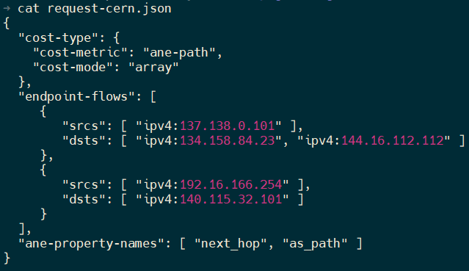
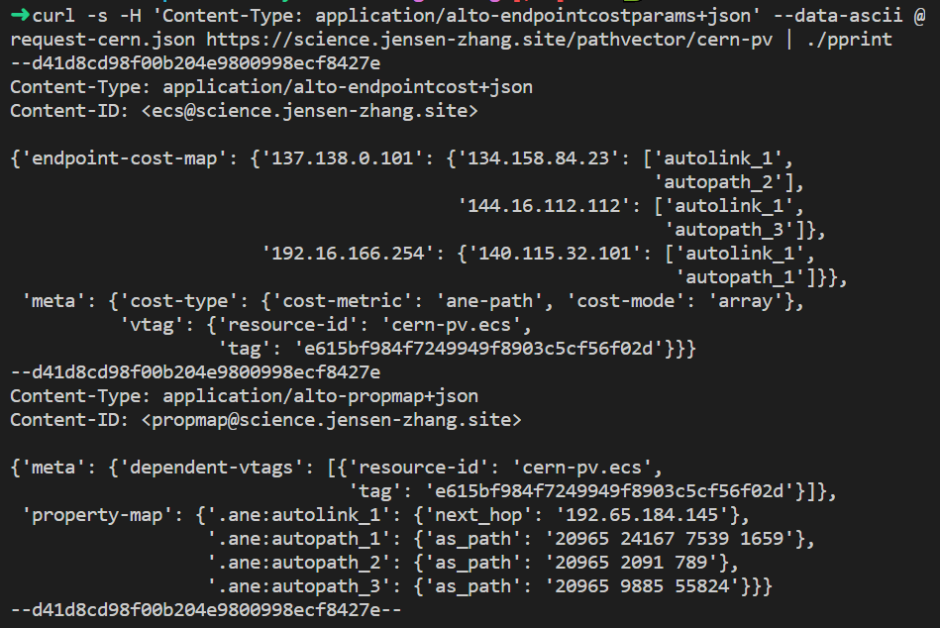
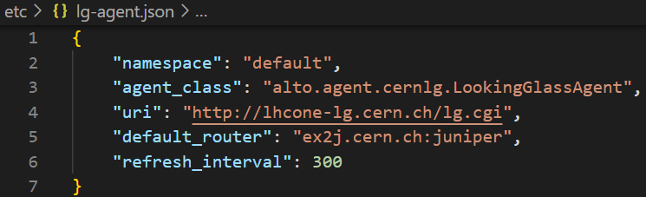
Implementation: First Hop Visibility
Query Example (ECS with path vector extension)
Query/Response
Routing Plane Retrieval (Looking Glass of CERN and GEANT)
Implementation
Jensen/Kai/Lauren

Slide 20
ALTO/Rucio Objective: Uniform Orchestration Selection
Rucio Orchestrator
Uniform ALTO Sorting Interface
Diverse Network Visibility Resources

Slide 21
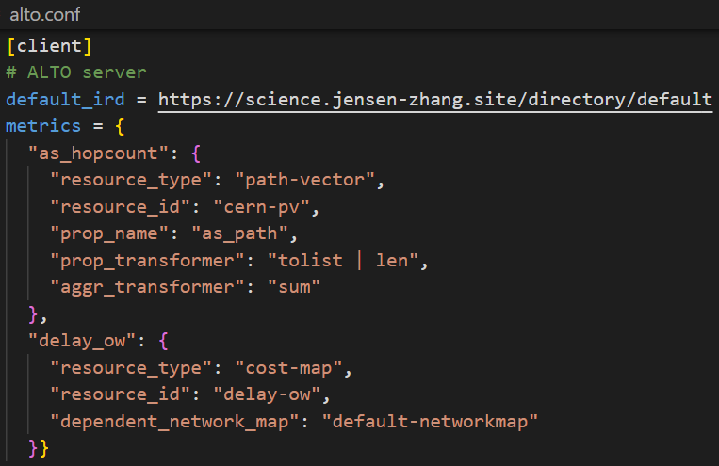
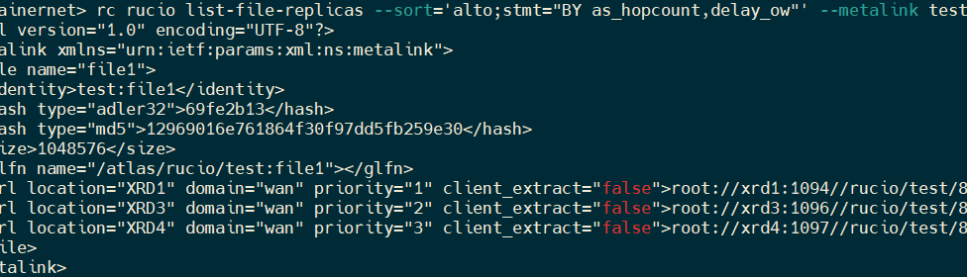
ALTO/Rucio Using Query Expression
Step 1: Configuration
Configure ALTO client at Rucio server to fetch visibility using ALTO
Step 2: Express Sorting using ALTO/Rucio Expression
ALTO sorting expression enables Rucio download command to sort replicas based on a combination of distances and properties, e.g.,
BY=as_hopcount,delay_ow WHERE continent=”EU”
Map properties of ANEs into end-to-end metrics
Jensen/Kai/Lauren

Slide 22
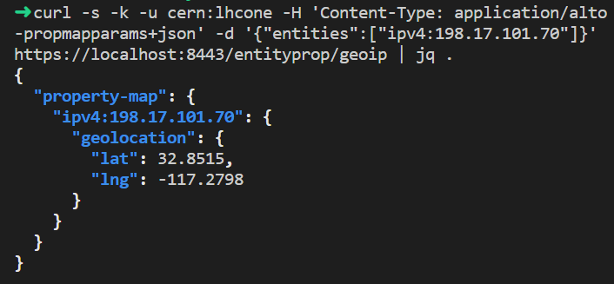
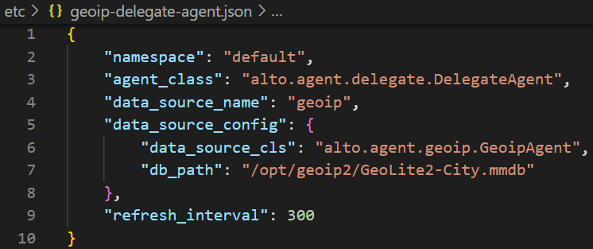
ALTO/Rucio Using Query Expression: Default/Backup GeoIP/Distance
Providing geoip property using the standard ALTO endpoint property service [RFC 9240]
Providing geo distance between endpoints using the standard ALTO Endpoint Cost Service (ECS) [RFC 7285]
Query interface
Implementation Config
Notes:
Wording: Initial, not to change the default Rucio selecting data movement. GeoDistance is a default data movement selection mechanism in Rucio, and we now use alto to provide the standard implementation. Unifying the interface. Use download file; or use Web service

Slide 23
Summary: Current ALTO/FTS+Rucio: 3 Main Components
Resource
Control
Model
Data Flow Orchestration (build on Rucio)
Scheduling of Data Movement Tasks (build on FTS Integration)
Visibility of Multidomain Infrastructure
(e2e aggregation and select control assets)

Slide 24
Milestones and Main Remaining Tasks
Milestone
  Wrap up implementation and test in summer 2023
Some focusing tasks
  Finalize language to specify resource model
  Work with sites and higher-level workflows (e.g., Rucio) to specify typical control goals
  Finish initial design of multi FTS instance control coordination
  Integrate with infrastructure control (e.g., NOTED)

Slide 25
Application-Layer Traffic Optimization (ALTO)
ALTO is an effort of the ALTO working group in the Transport Area of Internet Engineering Task Force (IETF)
ALTO high-level goal: provide a standard for applications and networks to work together to optimize both network and application performance
Two core components:
  Abstractions of network state/services
  Transport and discovery of abstractions
Problem Statement
(RFC 5693)
Xdom Service Discovery
(RFC 8686)
Base Protocol (RFC 7285)
Multicost
(RFC 8189)
Path Vector
(RFC 9275)
Requirements (RFC 6708)
SSE/Incr Update (RFC 8895)
Cost Calendar (RFC 8896)
Cost Metrics
(RFC editor)
Server Discovery (RFC 7286)
Comcast Deployment
(RFC 5632)
Deployment
(RFC 7971)
CDNi
(RFC 9241)
Unified Properties (RFC 9240)
Notes:
Entity: A network consists of a set of entities, Path: a network-traversal path from a src entity to a dst entity

Slide 26
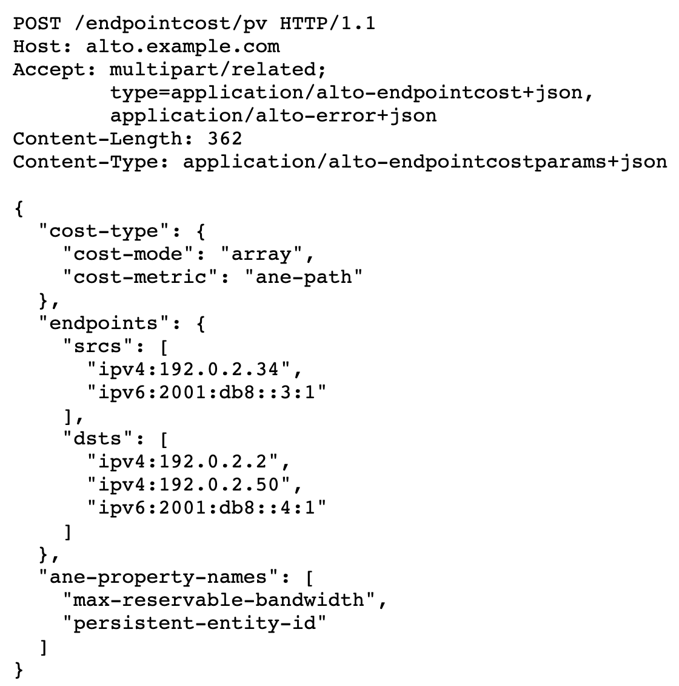
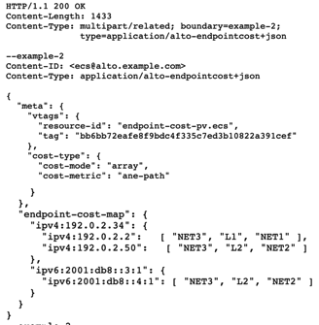
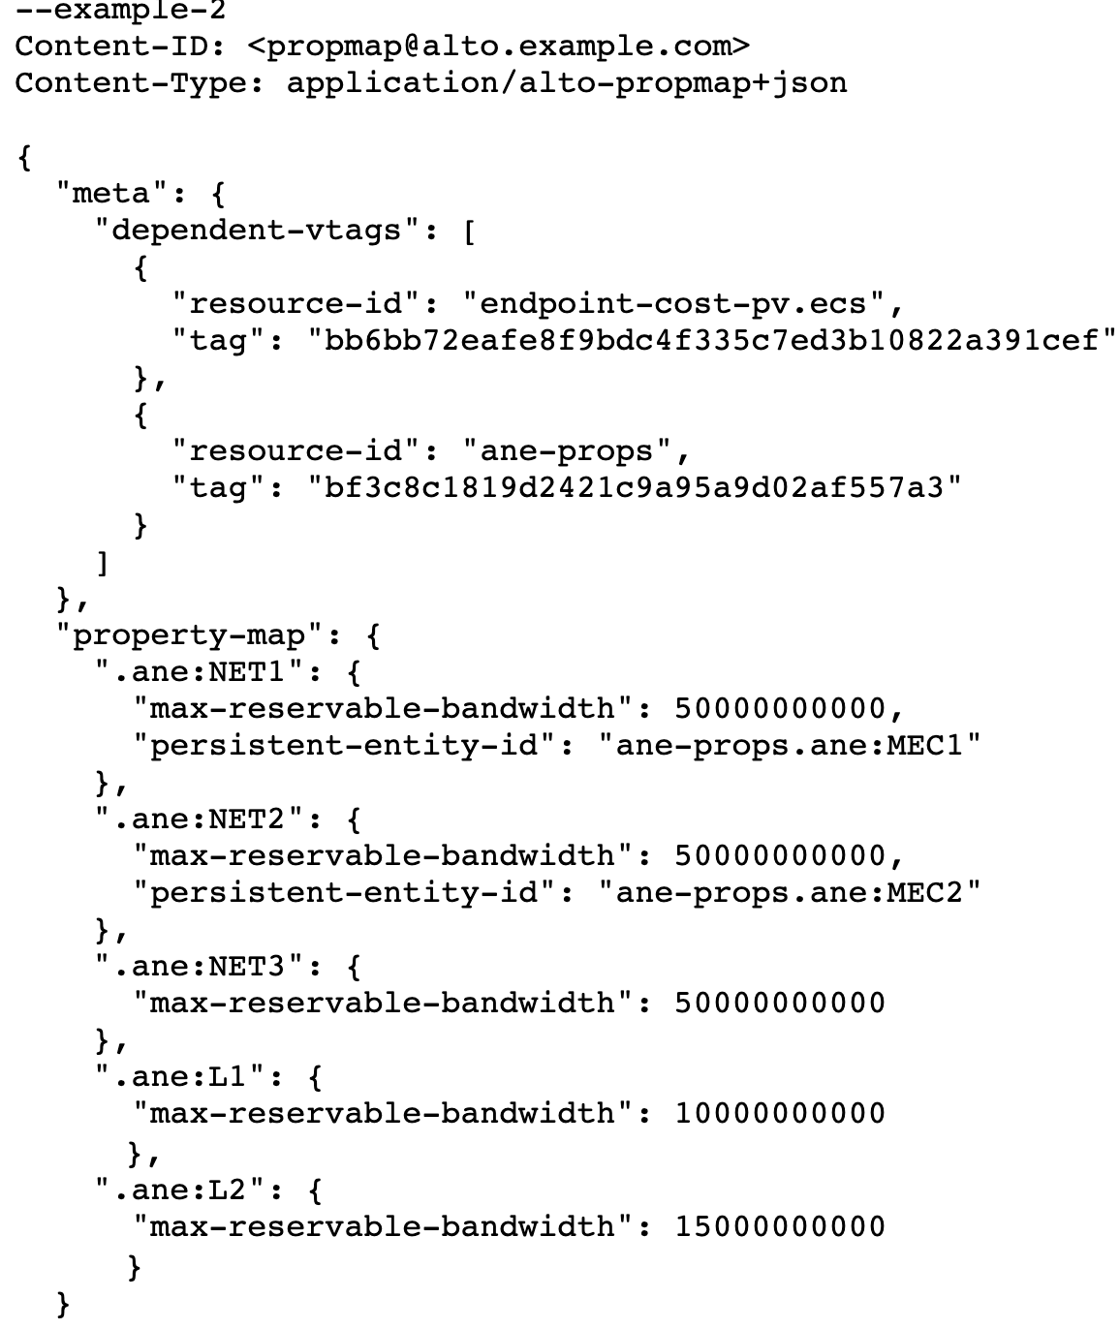
ALTO Abstraction Example: Path Vector
More details see https://datatracker.ietf.org/doc/html/draft-ietf-alto-path-vector-21#section-8.1

