Slide 1
Data popularity for the Cache Eviction Algorithms using Random Forests
Olga Chuchuk^{1,2}, Markus Schulz¹
(1) CERN, IT-GOV Group
(2) University of Côte d’Azur
CHEP 2023, Norfolk, VA, USA
11 May 2023

Slide 2
Motivation for research: Improving Cache Performance for Remote Physics Analysis
Ways to perform analysis remotely in the WLCG:
The file can be read (therefore, moved or replicated) before the computation starts
The file can be streamed while the computations runs (but removed from the processing node right after)
The file can be cached (also streamed during the computation and saved in the cache).
$$Bytes Hit Ratio \left(BHR\right)==\frac{amount of bytes retrieved from the cache}{amount of requested bytes}$$
$$Bytes Miss Ratio \left(BMR\right)=1−BHR$$
Data popularity for the Cache Eviction Algorithms using Random Forests

Slide 3
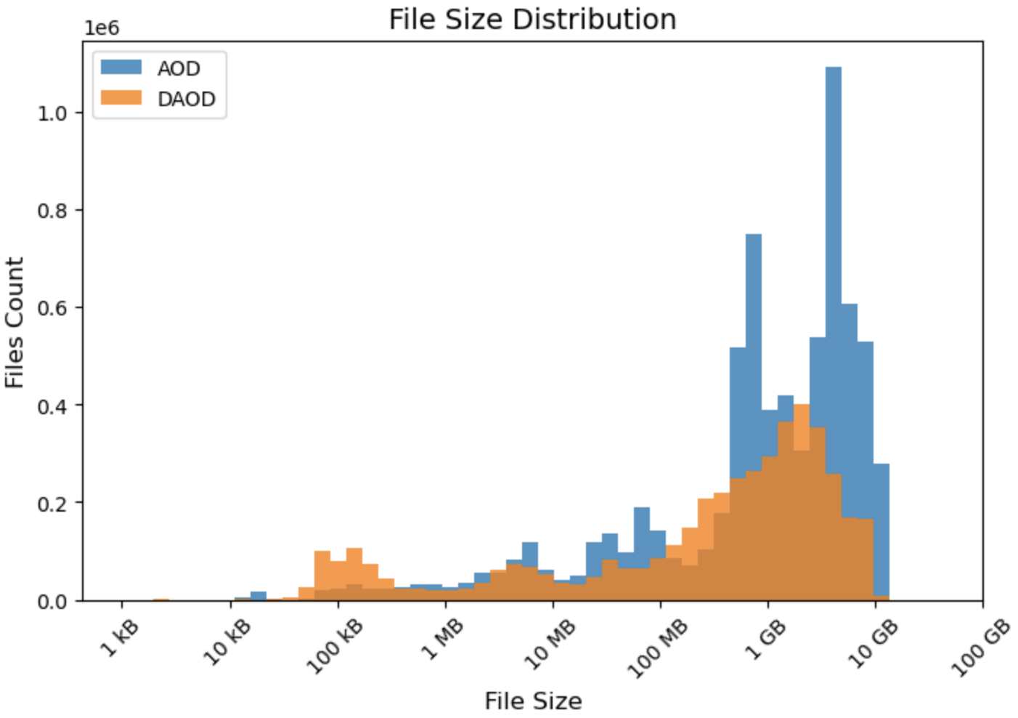
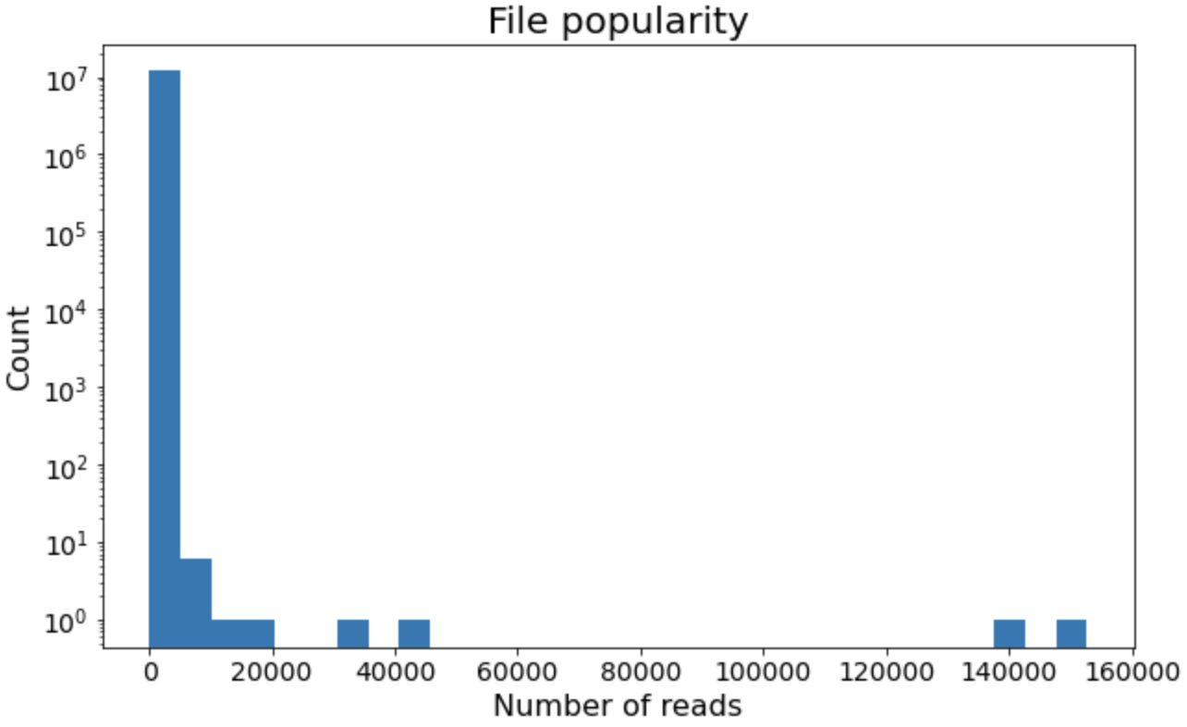
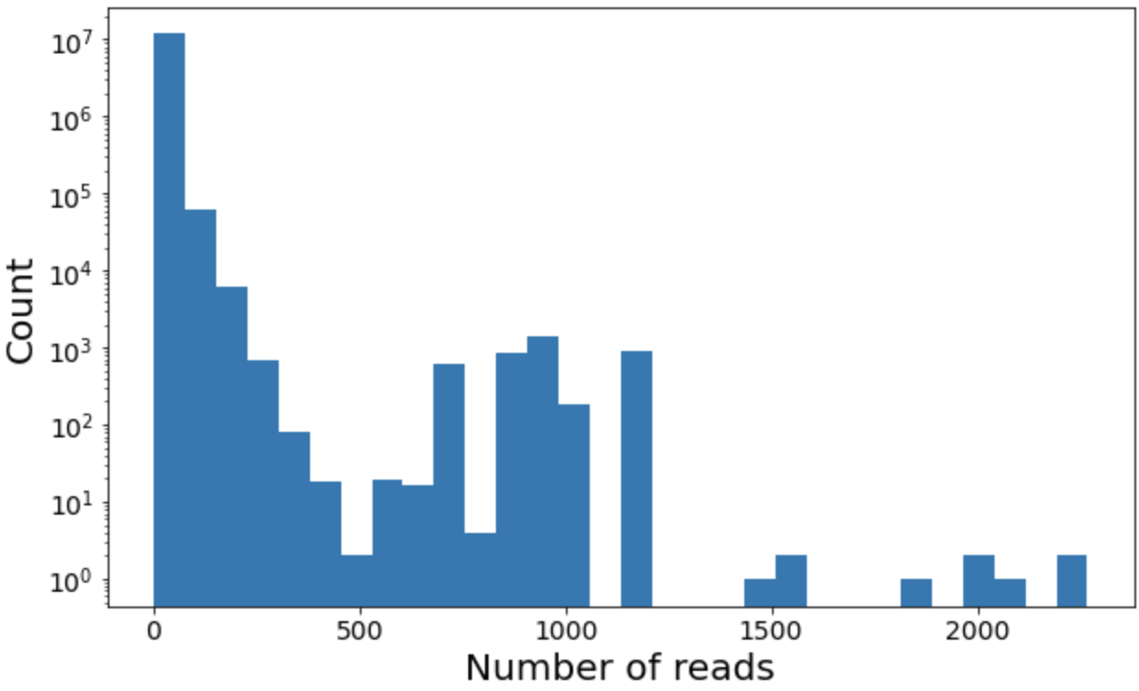
Data access trace
Total number of reads
N = 5.6e8
Total number of files
M = 1.2e7
Total number of datasets
D = 2.9e5
Average File Size
2.13GB
Max File Size
51.30GB
Log data sources:
1. EOS Report Logs (CERN)
2. Rucio Logs
CERN ATLAS EOS node, 3 months (Feb-Apr 2022), AOD & DAOD files only

Slide 4
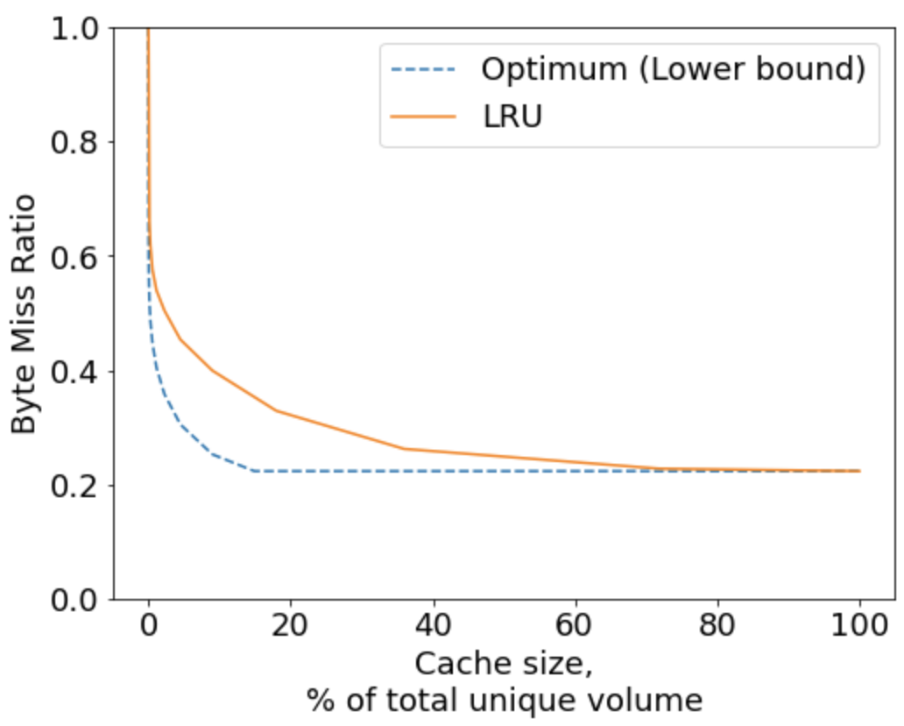
Comparing caching algorithms
Cache performance plots:
Decays from 1 to a particular value as the cache size increases
Cold misses determine the min value
Allow to compare the performance of different cache eviction policies
Least Recently Used (LRU)
Easy to implement and maintain
Performs well on this trace
Lower Bound of the Optimal ${Policy}^{(∗)}$
Optimum is NP-hard to construct
Only theoretical as requires the knowledge of the future reads
($∗$) Chuchuk, O., Neglia, G., Schulz, M., & Duellmann, D. (2022, March). Caching for dataset-based workloads with heterogeneous file sizes. In ISGC 2022-International Symposium on Grids & Clouds 2022.
Data popularity for the Cache Eviction Algorithms using Random Forests

Slide 5
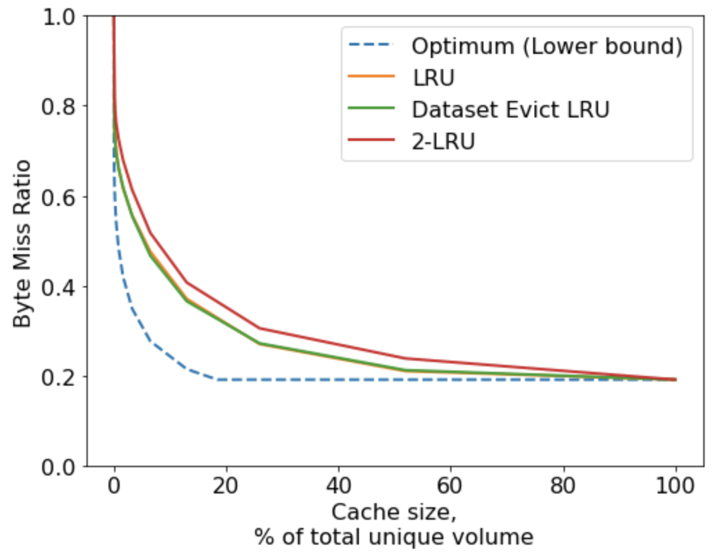
Previous attempts to improve BMR
Why is our problem different?
Optimization of the BMR
Different from CDNs and Web
File size
Number of users
Directions that we explored:
Existing cache eviction policies (like 2-LRU and 2-staged LRU)
Dataset-specific policies (having in mind that files within one dataset tend to be read together)
Data popularity for the Cache Eviction Algorithms using Random Forests

Slide 6
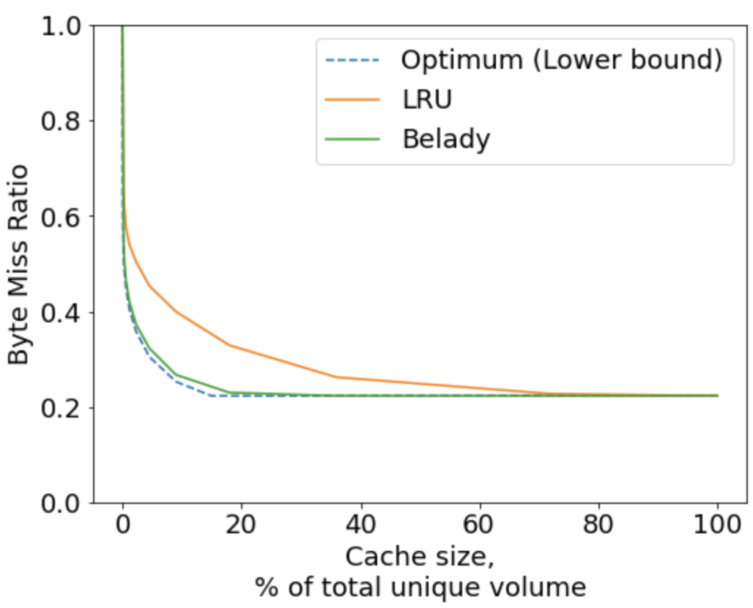
Performance of the clairvoyant algorithm
The clairvoyant algorithm (or Belady):
Removes the files that will be used the furthest into the future.
Only theoretical as requires the knowledge of the future.
Performs optimally when the file sizes are equal.
When applied to our trace:
Approaches optimum
Significantly outperforms LRU
Data popularity for the Cache Eviction Algorithms using Random Forests

Slide 7
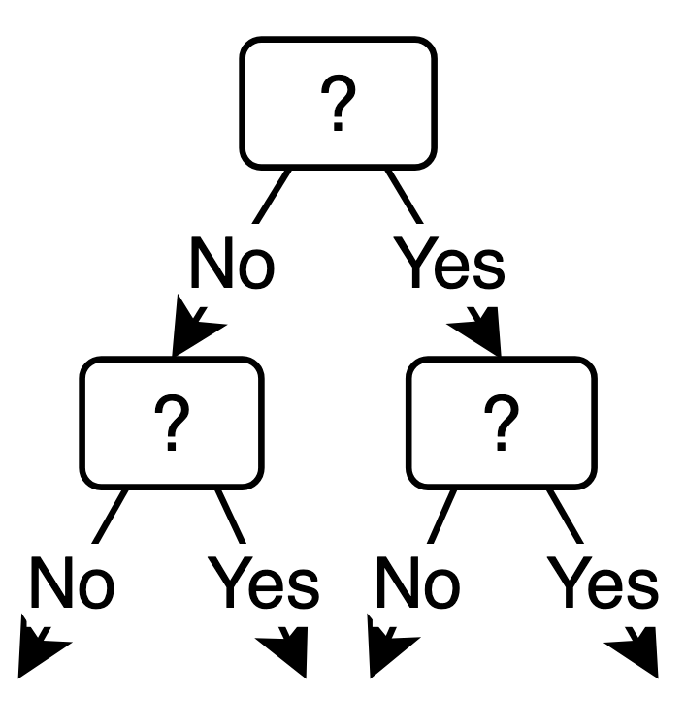
Architecture of the ML-based approach
Features of existing files
Predicted time (or probability) of file reuse
Cache eviction decisions
Random Forest advantages:
Classification and regression
No need for feature normalization
Parallelizable
Interpretable
Predicting future
file reads
(Random Forest model):
Integration into the caching model
…
…
…
…
…
…
…
…
…
…
…
…
…
Data popularity for the Cache Eviction Algorithms using Random Forests

Slide 8
Prediction of the file reads. Regression Predicting the logarithm of the reuse distance
Features:
Target:
List of features:size (volume)
File size
Dataset size (volume)
Frequency of the reads
Recency of the reads
Duration of the reads
Dataset size (number of files)
…
(18 features in total)
Results:
0.29 – RMSE* on the training data (70%)
0.34 – RMSE on the
test data (30%)
Threshold
Data volume:
Filtering stage | Number of files | Percentage of files
Before the threshold | 10,556,833 | 88.98%
With 2+ accesses | 4,719,609 | 39.78%
With creation time | 2,378,787 | 20.05%
With target access | 342,878 | 2.89%
*RMSE = Root Mean Squared Error
Data popularity for the Cache Eviction Algorithms using Random Forests

Slide 9
Prediction of the file reads. Classification Predicting if reread in the next 15 days
Results:
0.11 – RMSE on the training data (70%)
0.12 – RMSE on the
test data (30%)
0.99 – AreadUnderROC* on the training data
0.99 – AreadUnderROC on the test data
Features:
Target:
List of features:size (volume)
File size
Dataset size (volume)
Frequency of the reads
Recency of the reads
Duration of the reads
Dataset size (number of files)
…
(18 features in total)
Threshold
Data volume:
Filtering stage | Number of files | Percentage of files
Before the threshold | 10,556,833 | 88.98%
With 2+ accesses | 4,719,609 | 39.78%
With creation time | 2,378,787 | 20.05%
After target balancing | 686,942 | 5.79%
*ROC = (Receiver Operating Characteristic). Plots the true positive rate (TPR) against the false positive rate (FPR)
Data popularity for the Cache Eviction Algorithms using Random Forests

Slide 10
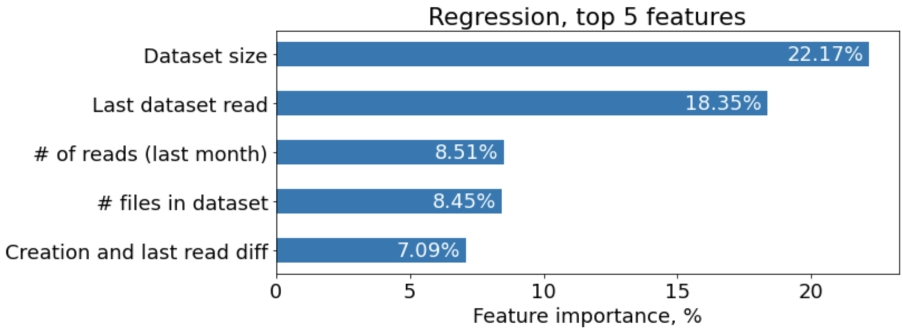
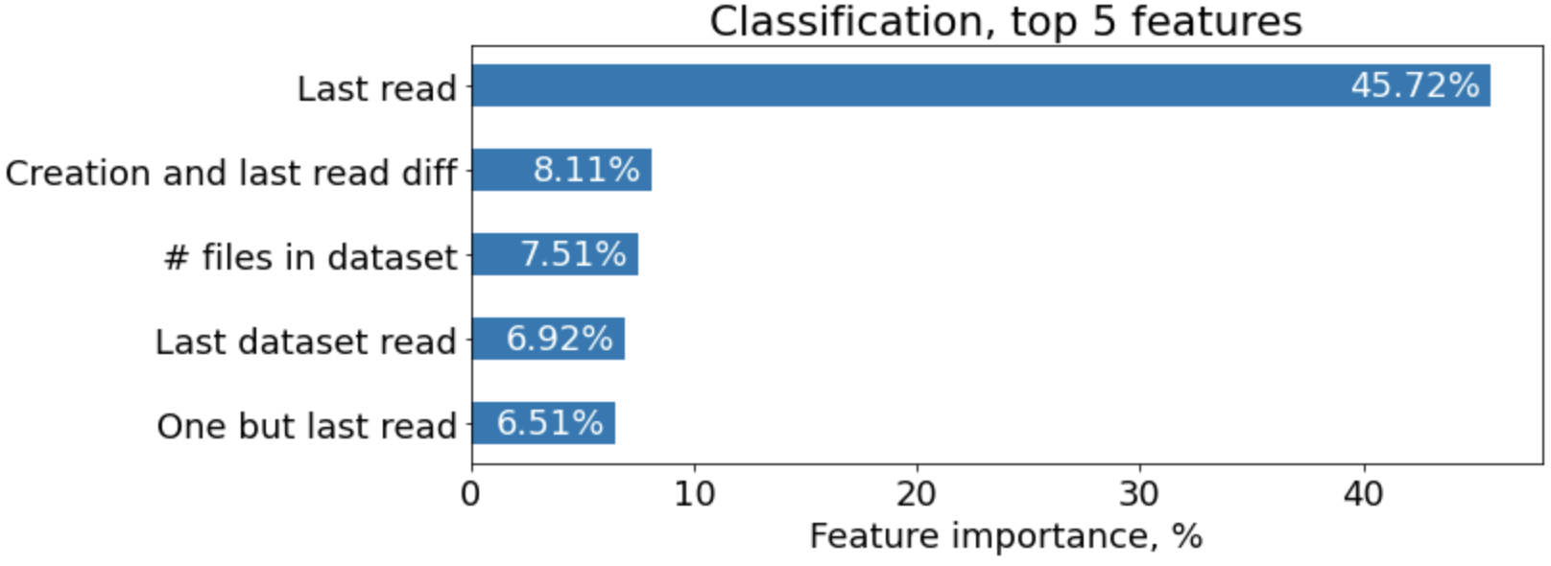
Feature importance
Feature importance is calculated based on how frequently the feature is chosen for a split, and the subsequent decrease in the impurity of the decision tree nodes.
The higher the feature importance score, the more important the feature is for the model's predictions.
Dataset-related features tend to contribute greatly to the models, as well as the recency (last read, last dataset read).
Data popularity for the Cache Eviction Algorithms using Random Forests

Slide 11
ML model with the features existing in the trace
Regression:
0.43 (0.29) – RMSE on the train data (70%)
0.46 (0.34) – RMSE on the test data (30%)
List of features
(6 in total):size
(volume)
File size
Time of last read
Duration of last read
Dataset size (volume)
Dataset size (number of files)
Time of last dataset read
Classification:
0.19 (0.11) – RMSE on the train data (70%)
0.19 (0.12) – RMSE on the test data (30%)
0.98 (0.99) – AreadUnderROC on the train data
0.98 (0.99) – AreadUnderROC on the test data
Data popularity for the Cache Eviction Algorithms using Random Forests

Slide 12
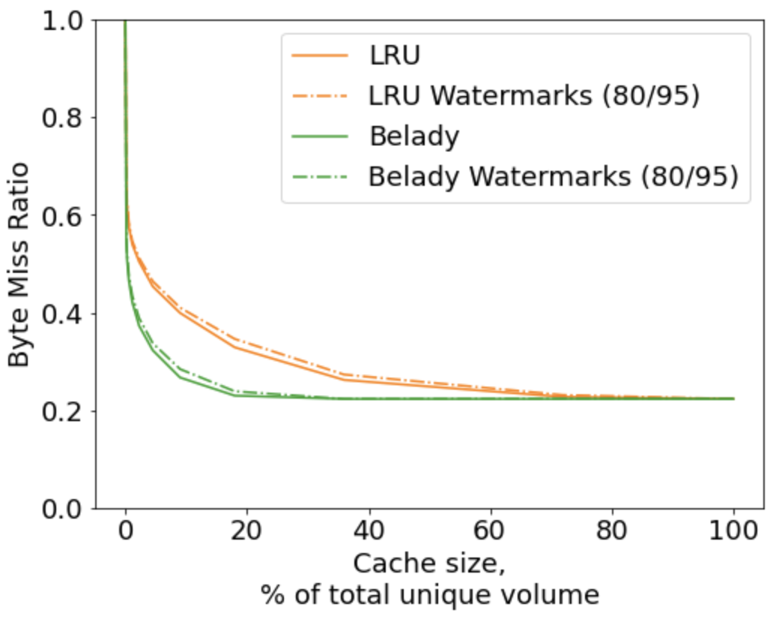
Realistic cache implementation High and Low Watermarks
High and Low Watermarks indicate the maximum and minimum amount of data that should be stored in the cache.
When the high watermark is hit, the cache cleaning processed is triggered: based on the implemented cache eviction policy, the files are evicted until the low watermark is reached.
As expected, the performance is slightly worse than that of the original algorithm, but not significantly.
Advantage: the cache cleanup is only run once in a while. Less load on CPU.
Data popularity for the Cache Eviction Algorithms using Random Forests

Slide 13
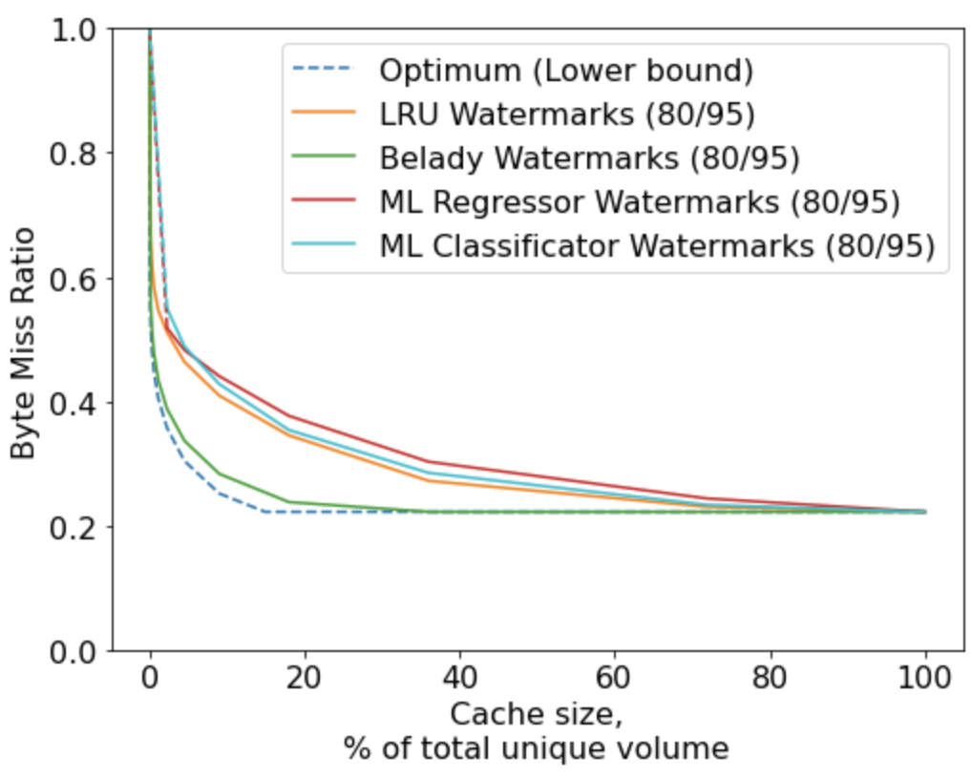
Comparing ML-based models with LRU
When the high watermark is hit, prediction is run on all the files present in the cache. We then sort them based on the predicted reuse distance (or probability to be reused) in order to be evicted from the cache.
Model with classification permofrms better, but still not able to beat LRU.
When the cache size is 2-5 %, the difference between 1-2 days of reuse and 1-2 weeks becomes more crucial.
Data popularity for the Cache Eviction Algorithms using Random Forests

Slide 14
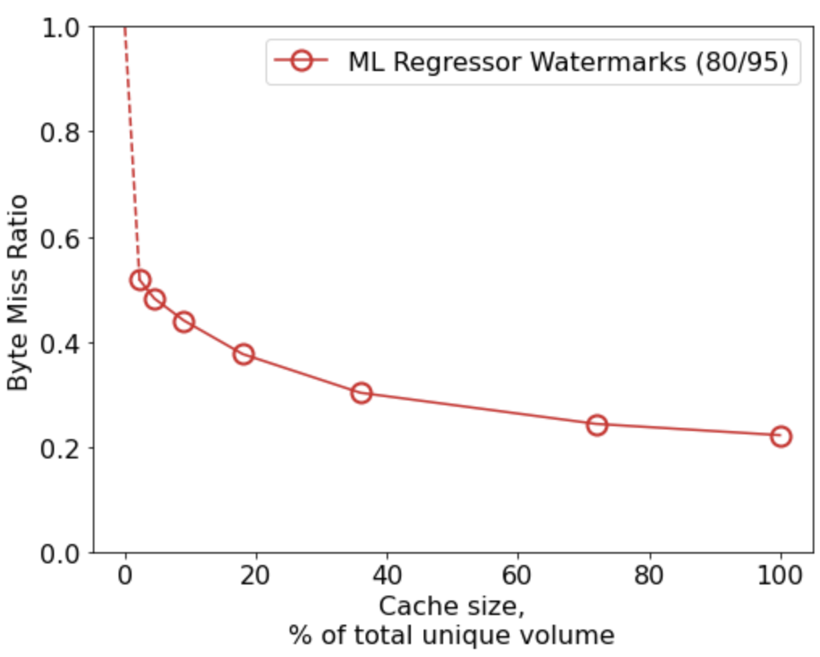
Evaluating ML model real performance
Average prediction scores
Why the models perform poorly on the actual trace:
~60% of the files were used only once.
The prediction was limited to a 15-day period.
2.39
2.12
1.99
1.94
1.79
1.61
Cache size | # of cache cleanups
100% | 0
72% | 4
36% | 18
18% | 53
9% | 136
4% | 319
2% | 724
RMSE on the test data: 0.46
Data popularity for the Cache Eviction Algorithms using Random Forests

Slide 15
Conclusions
The LRU replacement policy exhibits satisfactory performance on our trace.
There is scope for enhancements to the existing approach, at least theoretically.
Our research has demonstrated that surpassing LRU is challenging (supported by the feature importance distributions obtained from the ML models).
The challenge is not solely to predict future reads, but also to select the most appropriate way to integrate the predictive model into caching. Possible alternative ways to do so:
Expanding the training dataset.
Different combinations of ML models can be explored.
Optimizing the hyperparameters remains an area of opportunity.
Data popularity for the Cache Eviction Algorithms using Random Forests

Slide 16
Thank you for your attention! Any questions?
Olga Chuchuk
CERN, IT-GOV group
olga.chuchuk@cern.ch
Data popularity for the Cache Eviction Algorithms using Random Forests

Slide 17
Backup Slides

Slide 18
My data processing pipeline
Input Data
Processed Data
EOS Report Logs
Intermediate Files
Nature: storage log files; >60 metrics: fid, access time, file size, read/written bytes, etc.
Format: .eosreport.gz, collected from EOS headnodes
Size: from 100MB to 8GB per day per experiment
Nature: data after parsing, filtering, groupping and merging
Format: .parquet files
Size: From 600MB to 7GB per month (reduction rate is ±30).
Python
PySpark
pySpark
pySpark
Ordered Trace
Results
Rucio Logs
Nature: Rucio database dumps, contains information about active datasets
Format: collected from HDFS
Size: almost 50GB for 3 months
Nature: slimmed, adapted to each Cache Eviction Policy
Format:.csv files, ordered by timestamp
Size: From 2 to 6GB for 3 months
Plots and Statistics
C++
Python
PySpark

Slide 19
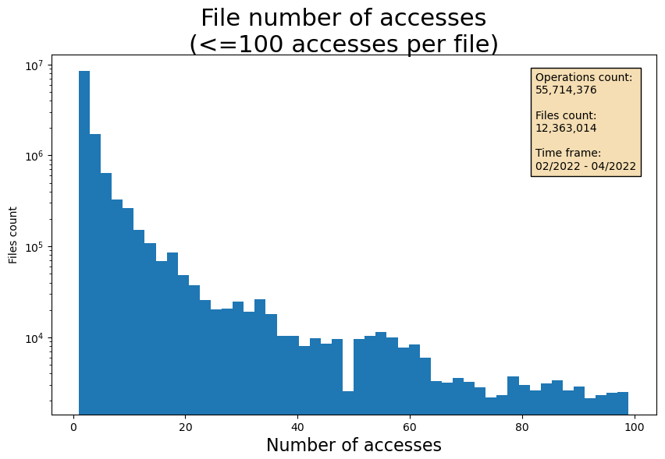

Slide 20
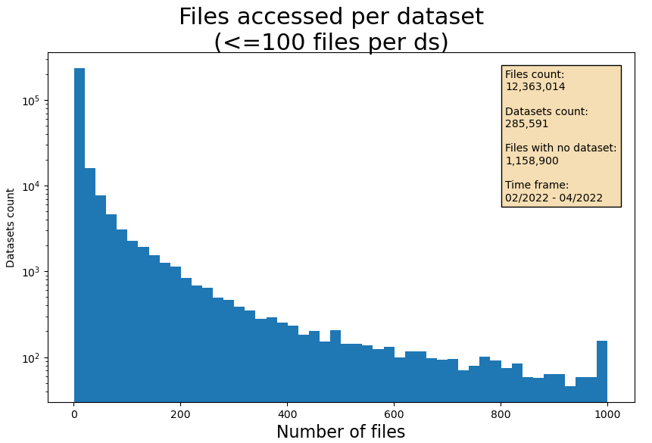

Slide 21
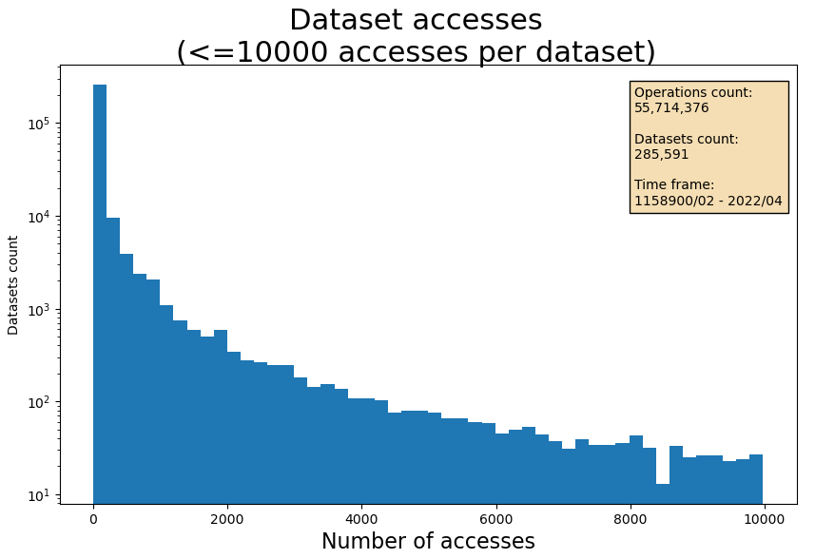

Slide 22
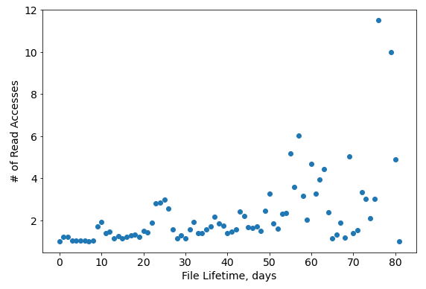
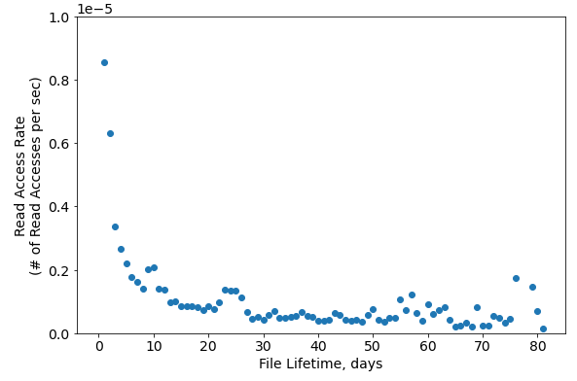
Dependency between the file lifetme and the number of accesses

Slide 23
Time between consecutive reads

Slide 24
Time between the first file accesses within a dataset

Slide 25
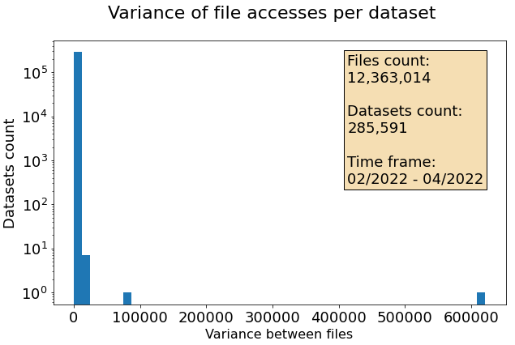
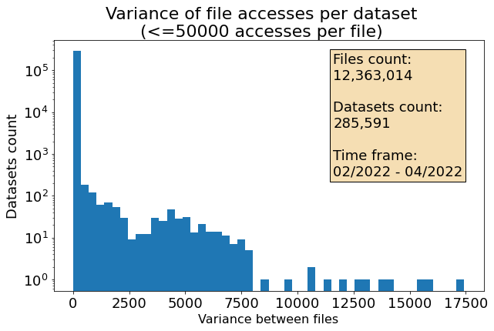

Slide 26
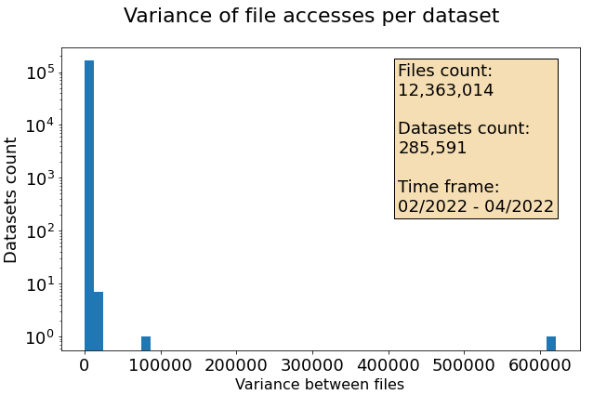

Slide 27
Variance of the number of reads per dataset
Dataset count

Slide 28
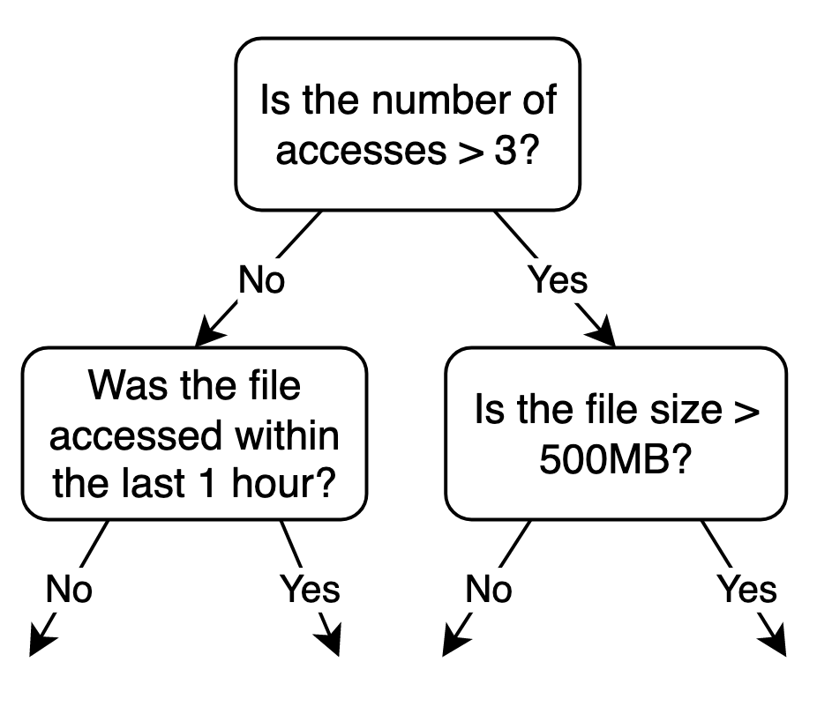
Decision Trees (DT) and Random Forests (RF)
Decision Tree:
+ Classification and regression
+ Can be parallelized
+ Solve the overfitting issue
+ Able to handle high-dimensional data and noise
- More complex to interpret
Random Forest:
DT 1:
DT 2:
DT N:
…
…
…
…
+ Classification and regression
+ Easy to interpret
- Prone to overfitting
…
…
…
…
…
…
…
…
…
…
…
…
…

Slide 29
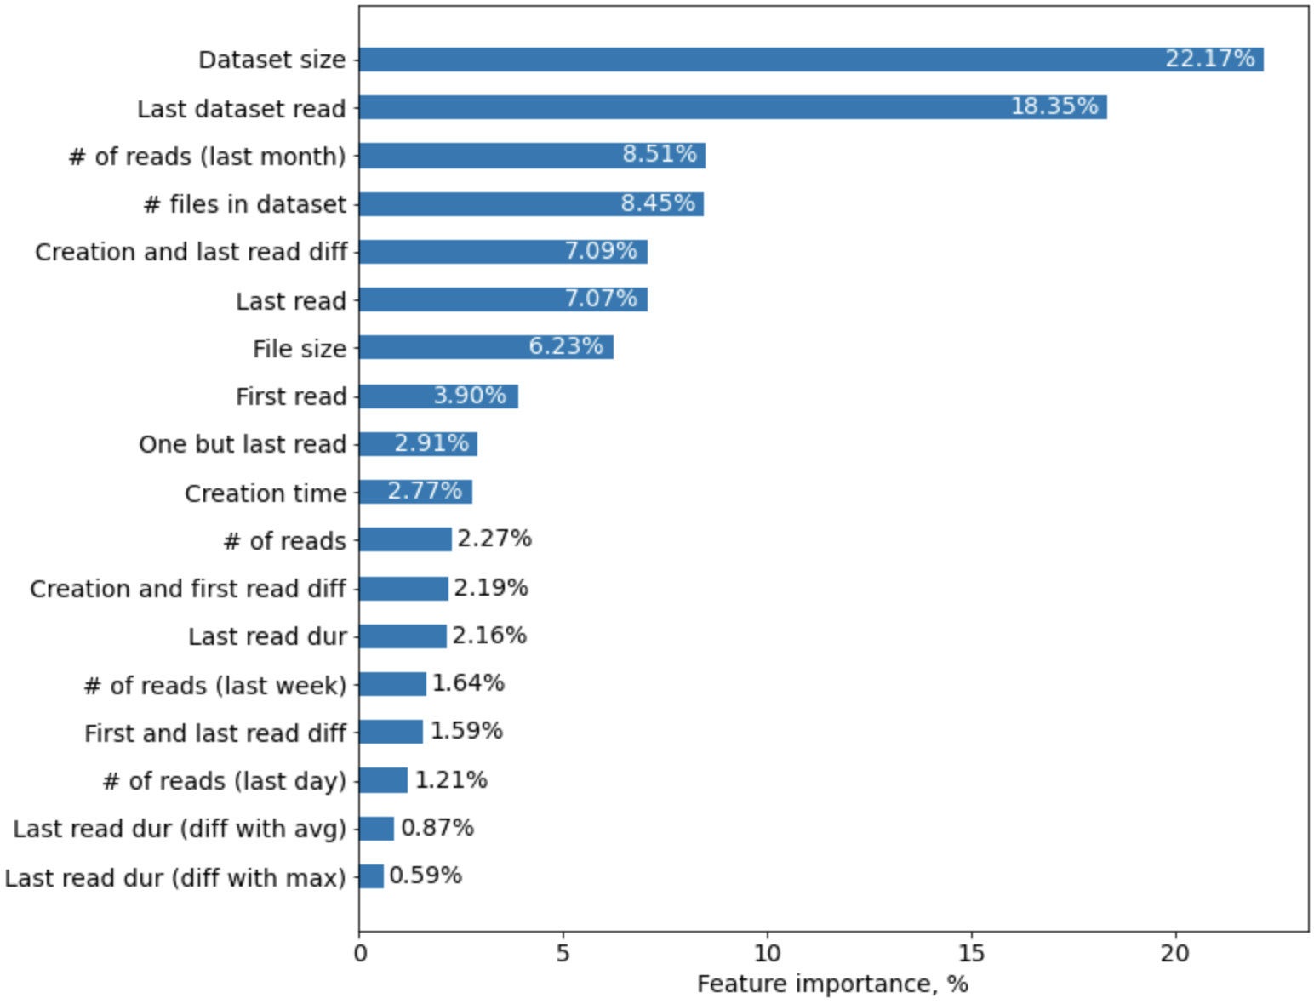
Feature importance

