Slide 1
Xrootd S3 Gateway for WLCG Storage
Computing in High Energy & Nuclear Physics
CHEP May 8-12, 2023
Andrew Hanushevsky, SLAC

Slide 2
S3 Gateway Architecture
Based on XrdCl (xrootd client) http plug-in
Uses Davix, an HTTP SDK developed at CERN
Very reliable and supported
Performs better than most commercial SDK’s
Bridges HEP & commercial world security
HMAC key
X509
SciTokens
Cloud
Storage
Gcloud border
S3 Gateway
Data Source
Or Target
S3
http, xroot
Commercial World
HEP World

Slide 3
S3 Gateway Applicability
AWS
Ceph
http
xroot
S3 Gateway
GCS
Minio
Any S3 API
Commercial or Institutional

Slide 4
S3 Gateway Scaling
S3 Gateway Cluster
S3 Gateway
To S3 API
http
xroot
S3 Gateway
Redirector(s)
S3 Gateway
To S3 API
Redirector selects gateway
either round robin or
based on actual load
Non-working gateways ignored
Potential to federate
Gateway clusters in different regions
Pick appropriate regional gateway
S3 Gateway
To S3 API
Unlimited Instances

Slide 5
S3 Gateway Test Setup
EC Redirector Node
The actual S3
gateway node
EC Node:
12 core CPU
24 GB RAM
10—12 HD’s
1Gpbs NIC
8+2 layout
1 MB stripes
S3 Gateway
Mirrored SSD
100 Gbps NIC
S3
Cloud
Davix
Buffer
Cluster of 19 Such Nodes
XrdEC File system
>= 19 Gbps
What is xrdEC? It’s an XRootD configuration that functions like an erasure encoded parallel file system. Performance is typically stripe size x single disk bandwidth which allows very high throughput.

Slide 6
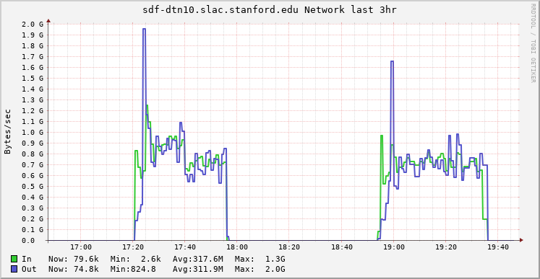
Ingress Performance
≈ 35 minute run time
FTS managed
3120 files 1.36TB
50 to 230 concurrent xfers
No check summing
100% xfers succeeded
In/out non-tracking due to
internal Davix buffering
GCS
AWS
SLAC
dtn’s
In
S3 Gateway
Out
Cloud

Slide 7
Internal Davix Buffering
Current Davix fully buffers stream I/O
Stream I/O creates a physical file
File is then forwarded to endpoint
Future Davix eliminates this buffering
Working with Davix team to implement this
Will be part of final product

Slide 8
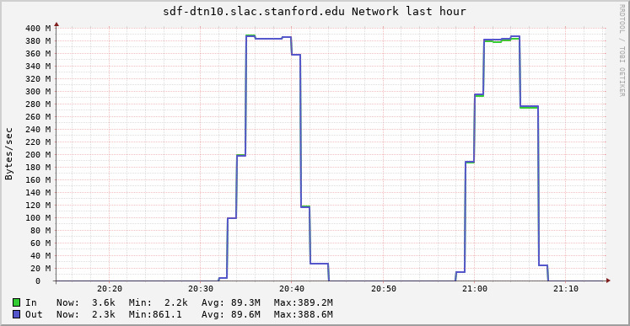
Egress Performance
≈ 10 minute run time
FTS managed
312files 136GB
50 to 230 concurrent xfers
Local check summing
100% xfers succeeded
Unexplained 400 MB/s
hard limit (hardware?)
GCS
AWS
Cloud
In
S3 Gateway
Out
SLAC
dtn’s

Slide 9
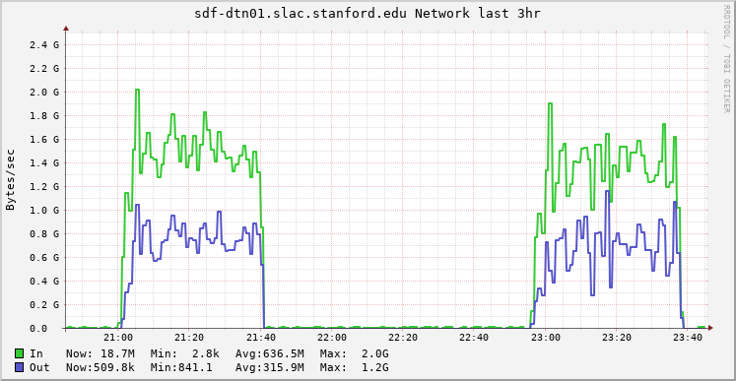
S3 Gateway CKS Performance
≈ 40 minute run time
FTS managed Ingress
3120 files 1.36TB
50 to 130 concurrent xfers
Check summing
Out transfer ½ of in because
data read back w/ egress charge
to compute checksum
GCS
AWS
SLAC
dtn’s
In
S3 Gateway
Out
Cloud

Slide 10
Avoiding CKS Egress Charge I
AWS & GCS provide server-less computing
AWS via lambda
Python, Java, Google Go and C#
GCS via Google Cloud Functions
Python, Java, Google Go, .NET, Ruby, and PHP
Leverage these to compute checksum
S3 Gateway triggers server-less cks program
Checksum computed in the cloud (no egress)
Result transmitted back to S3 gateway

Slide 11
S3 Gateway for multiple API’s
The S3 Gateway is universal
Work with all S3 storage flavors we tested
work with both s3v4 and older s3v2
S3 credentials: different names, but same thing
AWS: ACCESS_KEY_ID & SECRET_ACCESS_KEY
Ceph: HMAC key pair
GCS: HMAC key pair
MinIO: username & password
S3 Gateway/Davix uses AWS naming convention

Slide 12
Conclusion
S3 Gateway is extremely economical
Avoids most cloud charges
Except egress when fetching data from the cloud
Built-in authorization can restrict who can do this
S3 Gateway provides uniform access
Regardless of S3 provider access is the same
Automatic conversion of HEP auth to S3 auth
Proven scalability and performance
Doc on Xrootd-HowTo

