Slide 1
dCache: storage system
for data intensive science
26th CHEP
Dmitry Litvintsev for the dCache collaboration

Slide 2
The Egyptian vulture (Neophron percnopterus), also called the white scavenger vulture or pharaoh's chicken
https://en.wikipedia.org/wiki/Egyptian_vulture

Slide 3
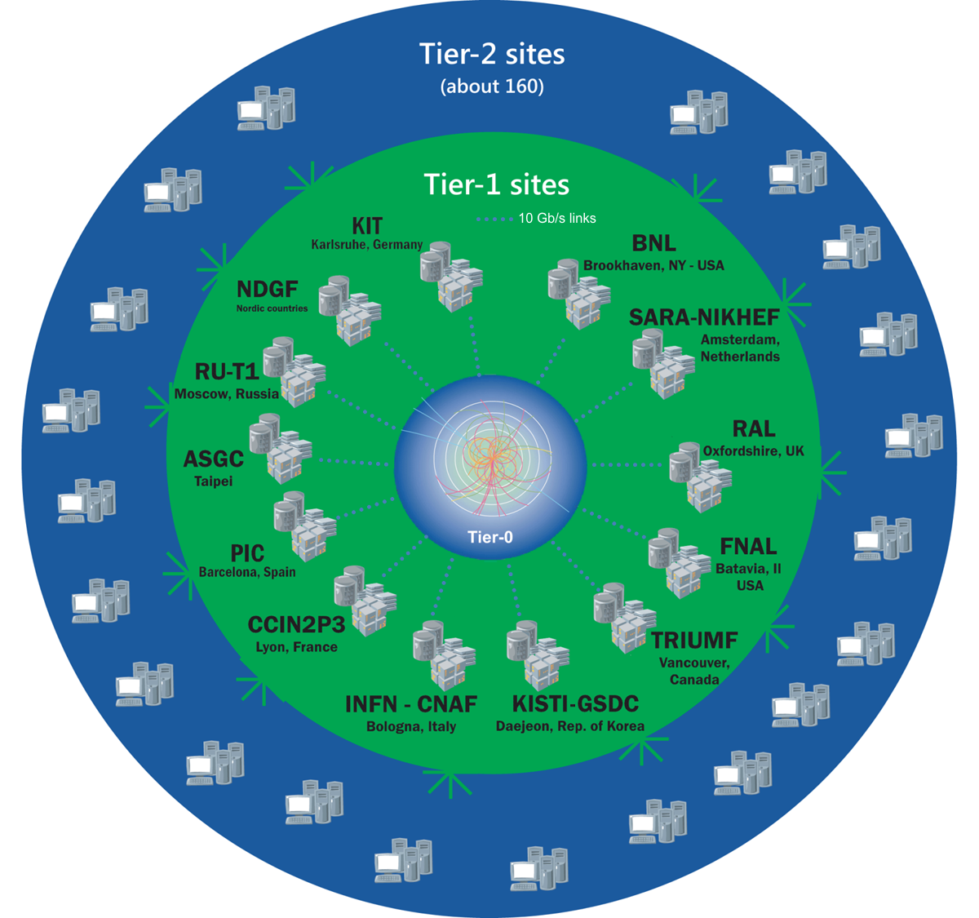
Data intensive science
Energy Frontier
LHC, Belle II
Intensity Frontier
Neutrino physics
Dune, Icarus, Nova, Microboone…
Rare phenomena, BSM, precision SM tests
Mu2e, g-2 …
Photon Science
EuXFEL
Cosmic Frontier
Dark Energy / Dark matter search
Astro-physics
Astro-particle physics
Life sciences
Notes:
Originally, dCache was developed for HERA experiments at DESY and Tevatron experiments at Fermilab.
Today, dCache is used world-wide.
Almost all sites running dCache provide storage to at least one of LHC experiments.
However, local sciences at Fermilab and DESY have high priority. We provide storage to DUNE and Nova experiments at Fermilab, to photon scientists, EuXFEL users at DESY … Many sites that use dCache support other communities as well: Acelrator development, Lofar, CTA, IceCube, Life since, Genome research, just to name some …

Slide 4
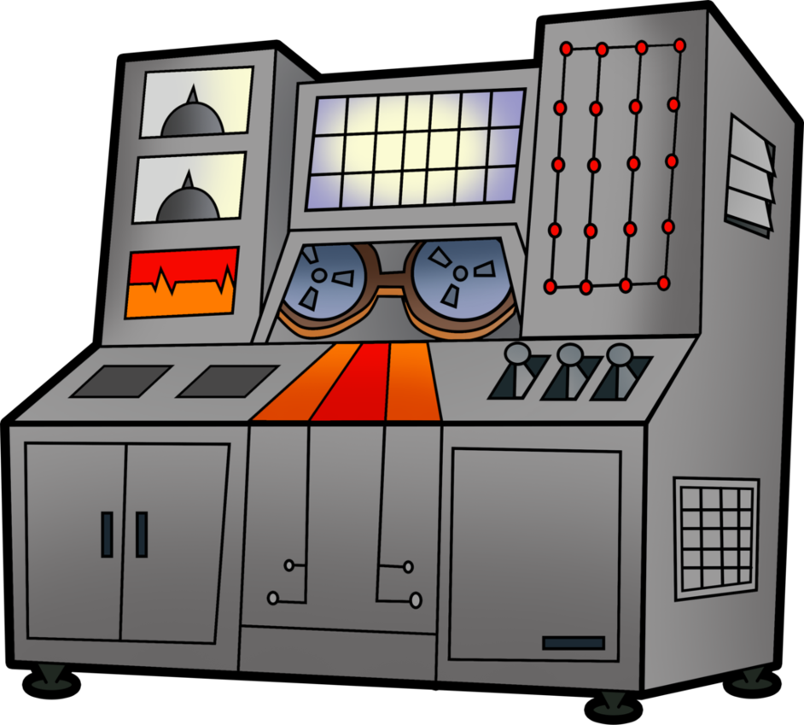
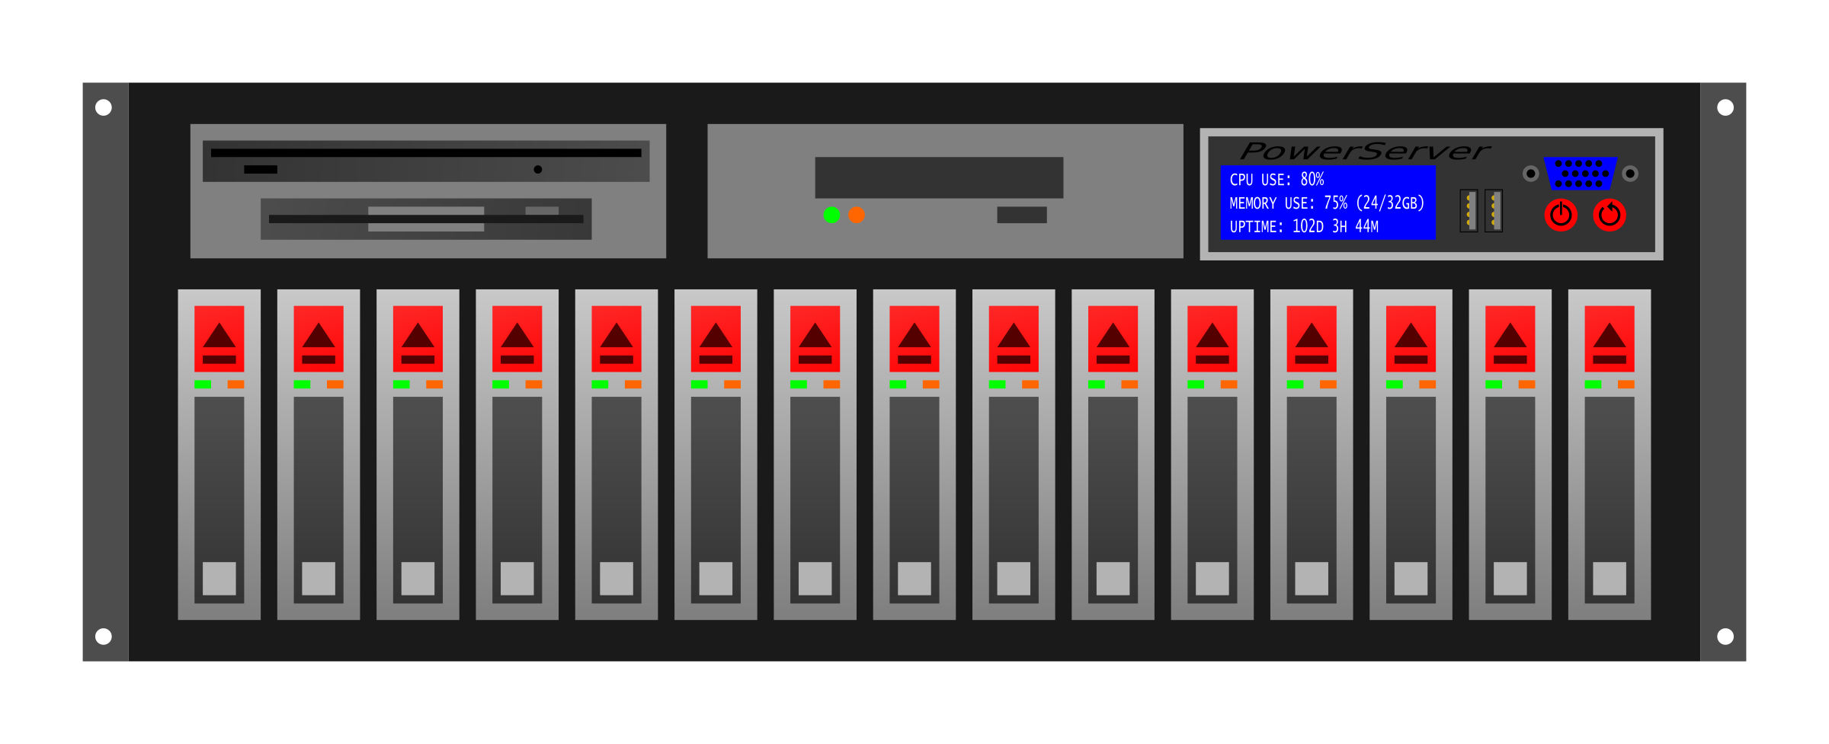
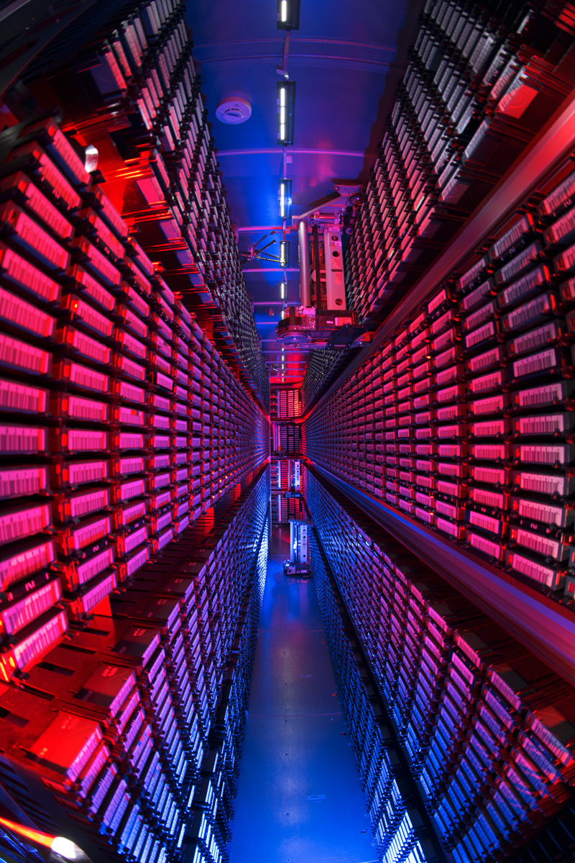
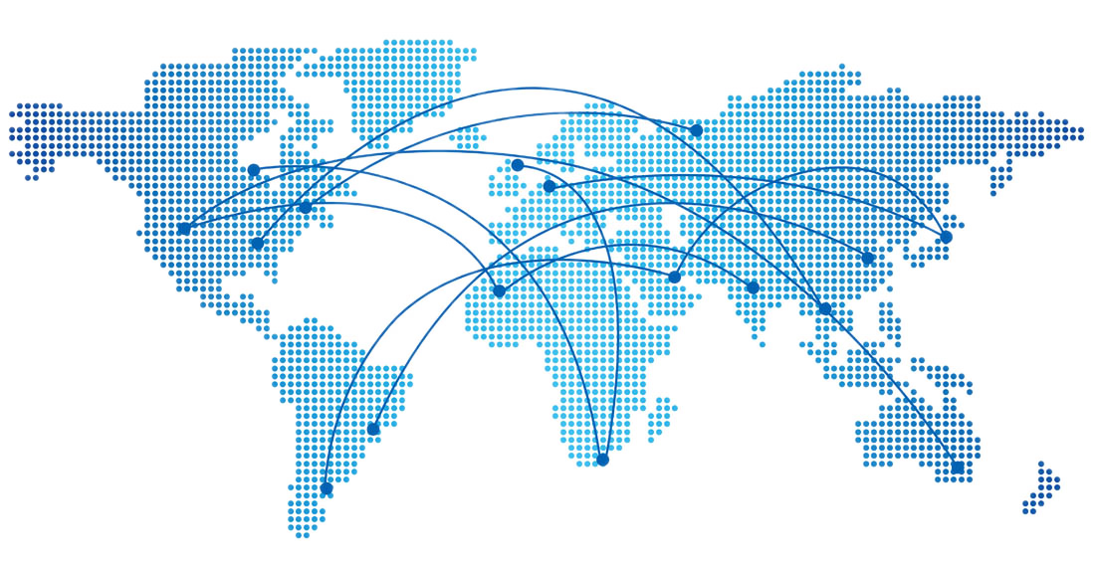
dCache: typical data flows and challenges
High speed
data ingest
Batch processing
Data management
flow control
Interactive analysis
Wide Area Transfers
Tape archive

Slide 5
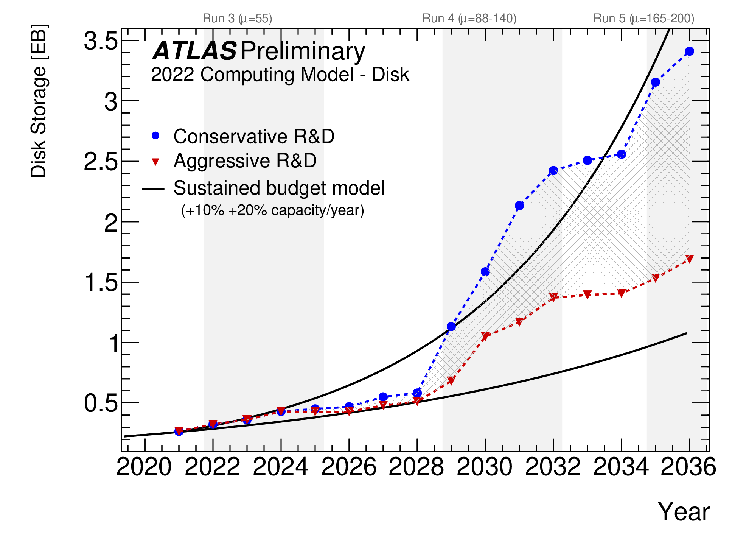
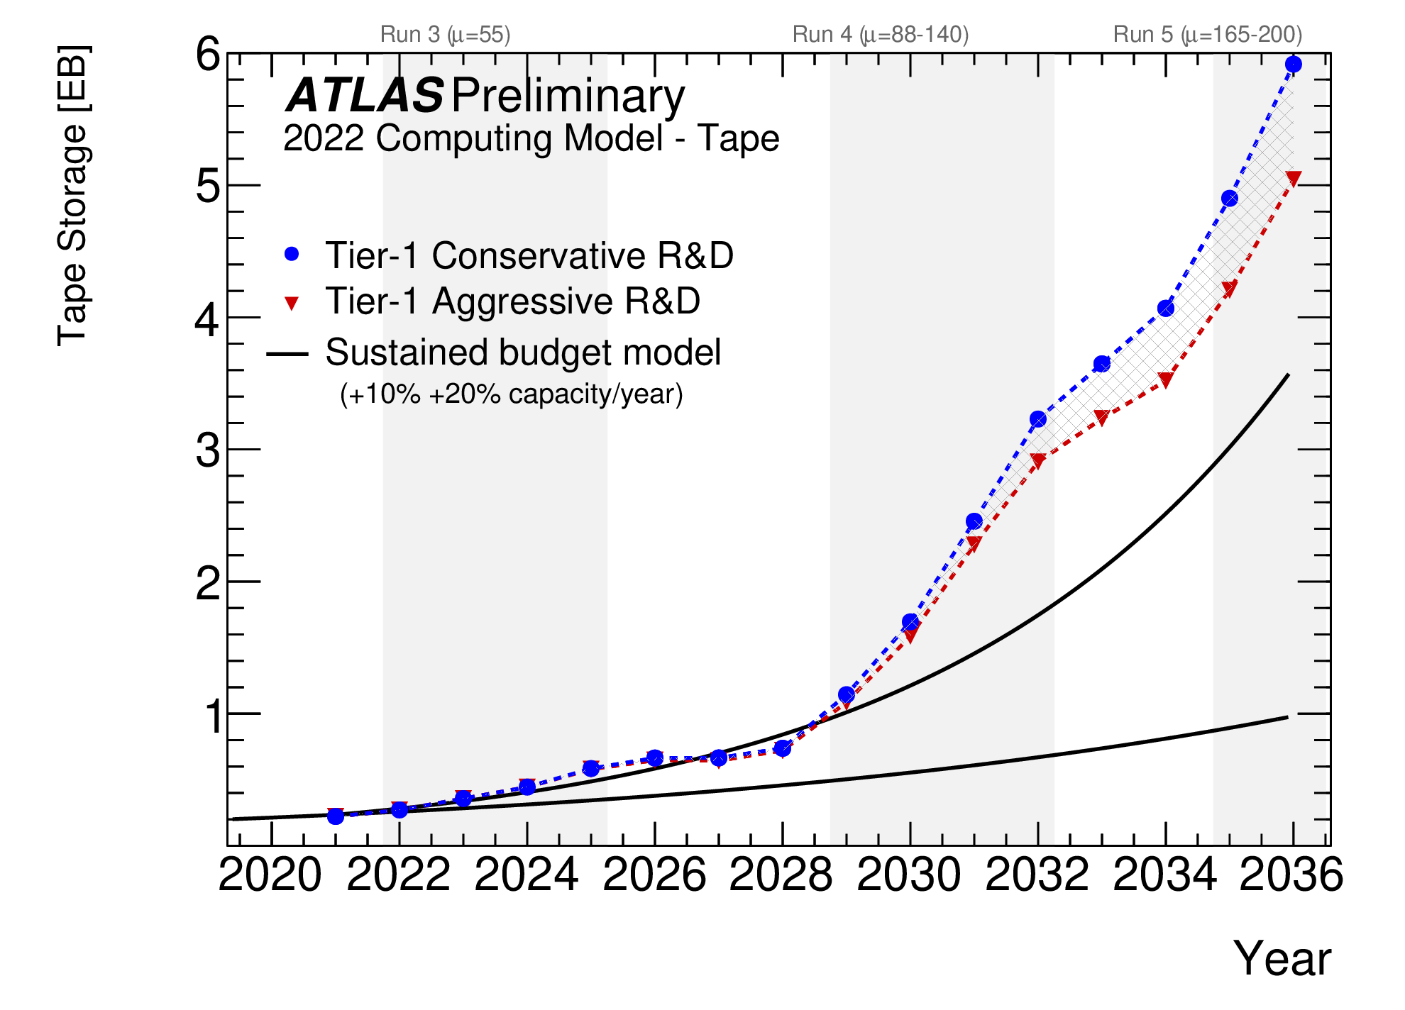
The Challenge
Source: ATLAS Software and Computing HL-LHC Roadmap
https://cds.cern.ch/record/2802918
Data intensive science is expected to be … even more data intensive
Flat budgets => reliance on tape for long term storage.
Notes:
When we talk about HL-LHC, on the storage side we talk about the data amount that experiments are going to collect and store on tape and disk. This is example for ATLAS that I publicly found.
To predict the ‘future’ we should have a close look at the past ant present.

Slide 6
Takeaway for dCache
Cache / tape ratio is expected to drop.
Fosters more managed sequential bulk data processing cycle (“tape carousel”).
Optimization of tape access on storage back-end becomes paramount:
Tape access is intrinsically sequential.
Massive tape recalls accessing many tapes in parallel should be implemented in a way that:
Access to one tape does not block other requests to other tapes.
Files recalls are grouped and fed into HSM in a way that minimizes volume mounts and seeks https://inspirehep.net/files/6ed866ef28a432cb2a3895634a54ce28
Access to cached data for bulk processing over low latency network should not suffer from interference from slower WAN transfers and (more) chaotic user analysis activity.
Redundancy of dCache services should eliminate or minimize downtimes so that bulk data processing is not impacted as any minute will count more as we go into the future.

Slide 7
How do we meet the challenges
Scale out
Namespace
Number of pools
Federated identity
Token based AA
Improve Analysis Facility support
POSIX access and protocol compliance
HPC workload support
Storage QoS and data lifecycle
Tape:
WLCG Tape REST API
Integration with CTA
Notes:
HPC – turning CPU limitation into IO limitation

Slide 8
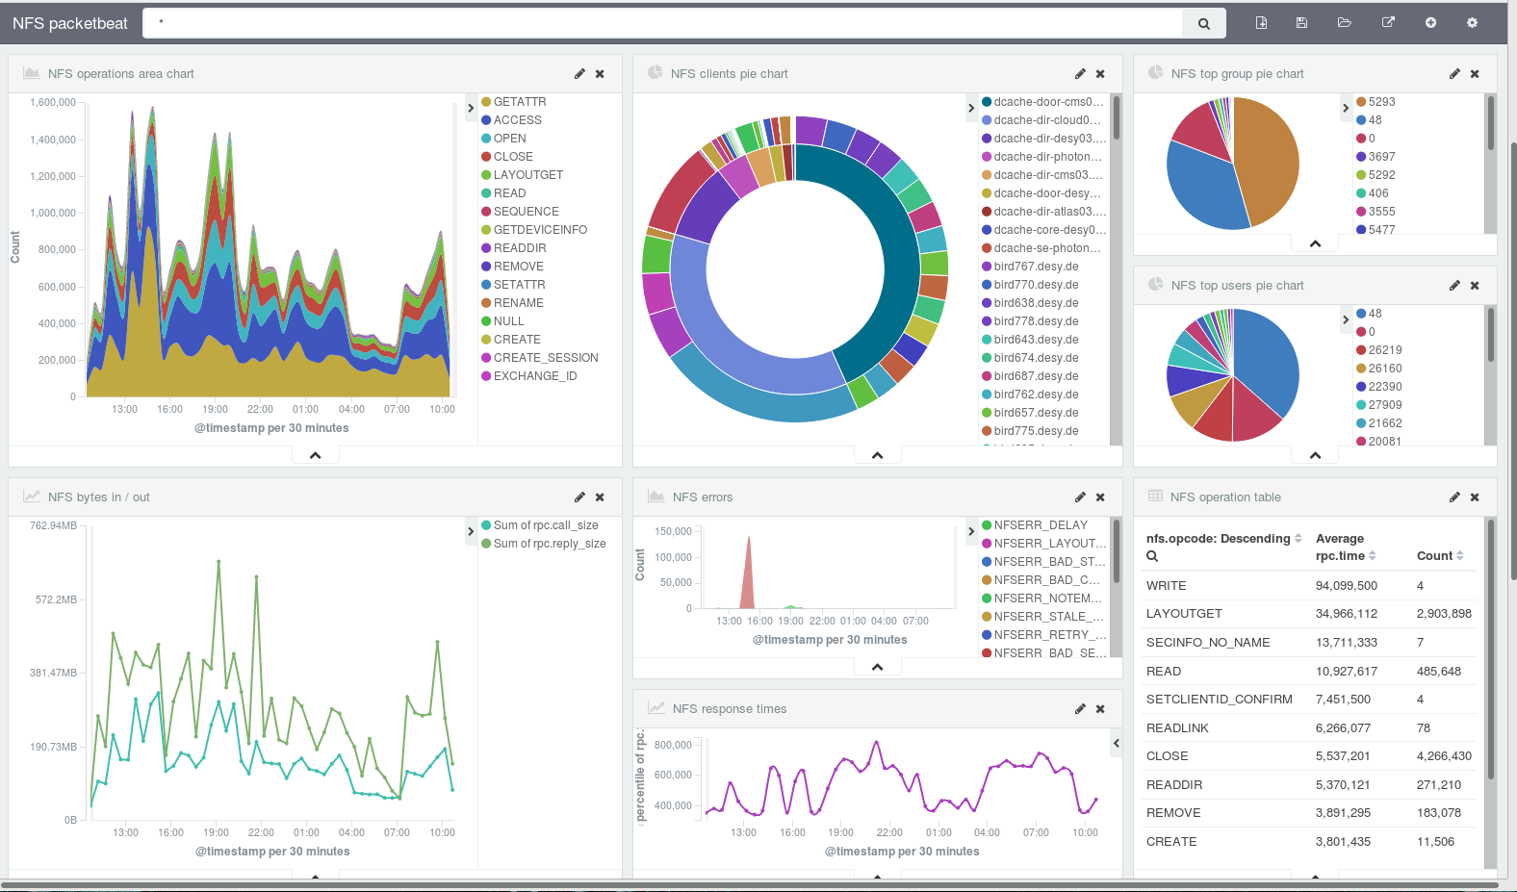
Standards Everywhere…
HTTP, NFS, FTP
SSE
Clients accessing dCache with standard protocols.
Workflow and processing build on top of widely used (de-facto standard) tools.

Slide 9
User/Group Quotas
dCache was conceived as a disk cache buffer in front of tape HSM.
Cache is managed based on LRU.
Capacity of HSM system was assumed to be infinite.
=> There has been no provision for user quotas.
As system is also used in disk-only (no HSM back-end) setups, the need in user and group quotas has been recognized.
We have added user and group quota support in dCache 7.2 release. See poster session https://indico.jlab.org/event/459/contributions/11352/ at this conference.
Features:
Lazy quota updates, based on periodic namespace scans.
Users are allowed to go over quota until next scan is run.
Removed space is not reclaimed instantly.
Global per file system.
No quota per directory tree.
Respects file Retention Policy:
Allows to limit ”disk” and “tape” used space by UID/GID

Slide 10
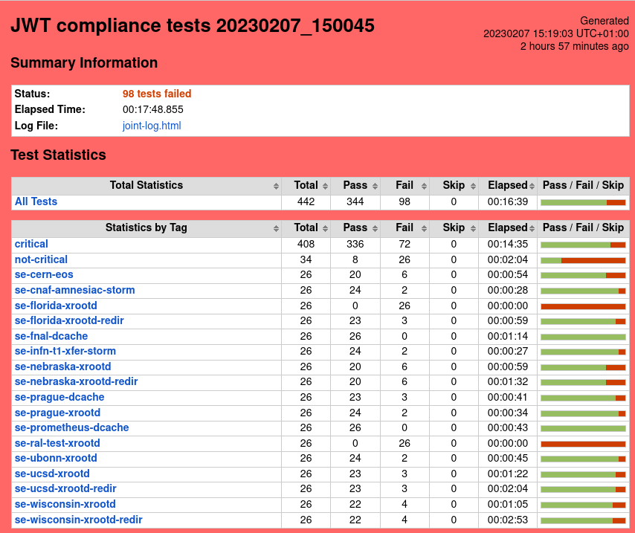
Token-based Authn/Authz
Core functionality is there.
Sites have started deployments.
Documentation update in progress.

Slide 11
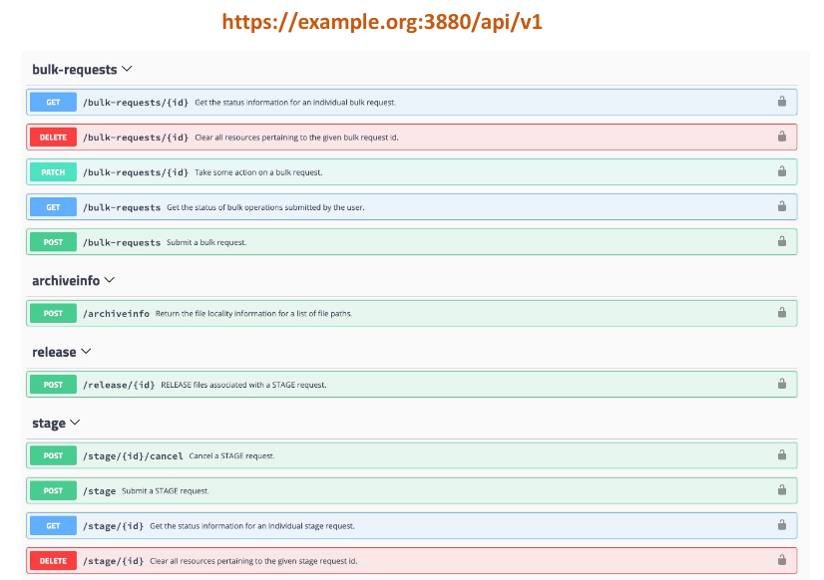
Tape rest API
dCache bulk API
WLCG Tape API

Slide 12
Integration with CTA
cta-admin cli
Scheduler
EOS frontend
Catalog
dCache frontend
Tape server

Slide 13
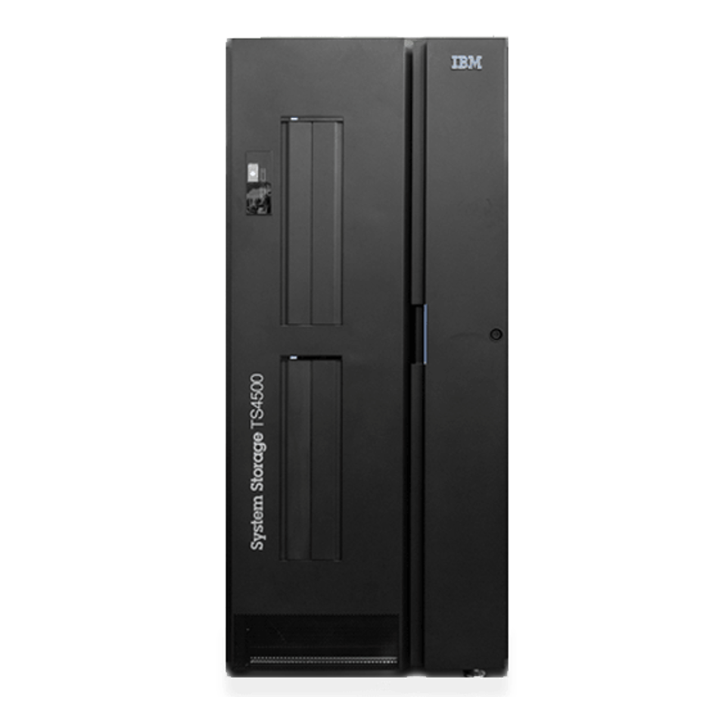
Production Deployment at DESY
dCache frontend
CTA 5.7.14
dcache-cta 0.9.0
dCache 8.2.7
IBM TS 4500
4xIBM TS1160
4xLTO9
PostgreSQL 14.1
Catalog
Object Store
(NFS)
Tape server

Slide 14
dCache+CTA Status
Seamless integration with dCache is merged into upstream CTA code at CERN.
The latest official CERN releases provides dCache required functionality.
The proposed dCache interface utilizing gRPC is being adopted for EOS as well.
The existing ENSTORE/OSM tape format is supported for READ.
The ENSTORE/OSM tape catalog conversion procedures are successfully tested at DESY and Fermilab.
All HERA experiments and BELLE-II at DESY migrated to CTA (5.4 PB)
EuXFEL migration will take place during summer shutdown (99 PB)
dCache+CTA deployment at other HEP sites.
Fermilab and PIC Barcelona have successfully replicated DESY setup in test environment (production currently uses dCache + ENSTORE).
RAL in UK plans to migrate to PostgreSQL from ORACLE based on our experience.

Slide 15
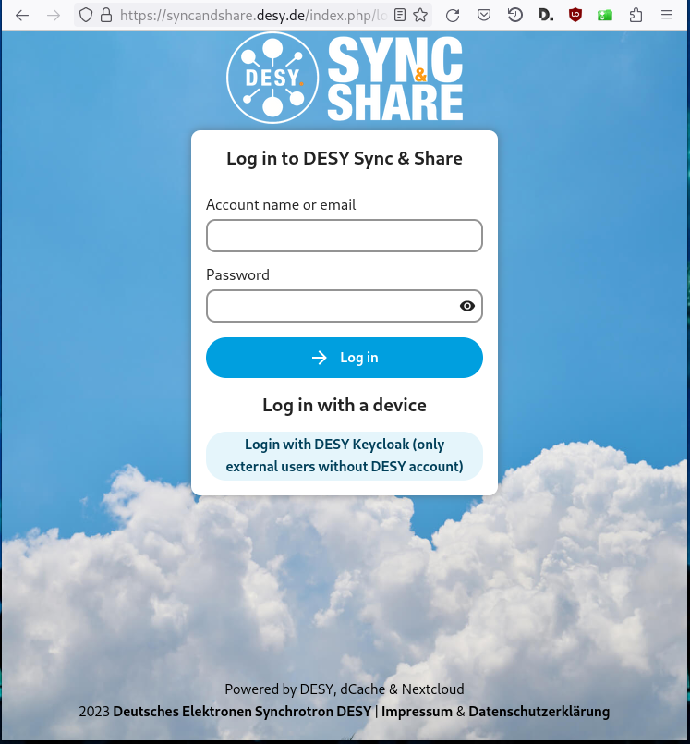
NextCloud Instance @ DESY
pNFS
pNFS
core
services
pNFS
core
services
pNFS
NextCloud-25
dCache-8.2

Slide 16
dCache as a Cloud Storage Backend
PB-scale storage system.
No changes in Nextcloud required.
Unique functionality:
Tape integration.
File ownership preservation.
NFS export to selected users.
Storage events.
Data visible by all protocols and security flavors.

Slide 17
Scale out - some numbers
XFEL
Total capacity ~120 PB
~400 physical hosts (~4000 dCache pools)
20-40 GB/s injest
Photon
DB size – 2.5TB
ACL table 600GB
Directories with 3 10⁶ files
1.2 10⁹ file system objects
100K files in the flush queue
Two tape copies, different media type
ATLAS
dir/file → 1/3

Slide 18
Self-Adaptive dCache
Joint project with Hamburg University on Applied Science.
MAPE-Loop.
Automation of large deployments.
Hotspot detection and re-balance.
Self-healing load optimization.
Notes:
Monitor-Analyze-Plan-Execute

Slide 19
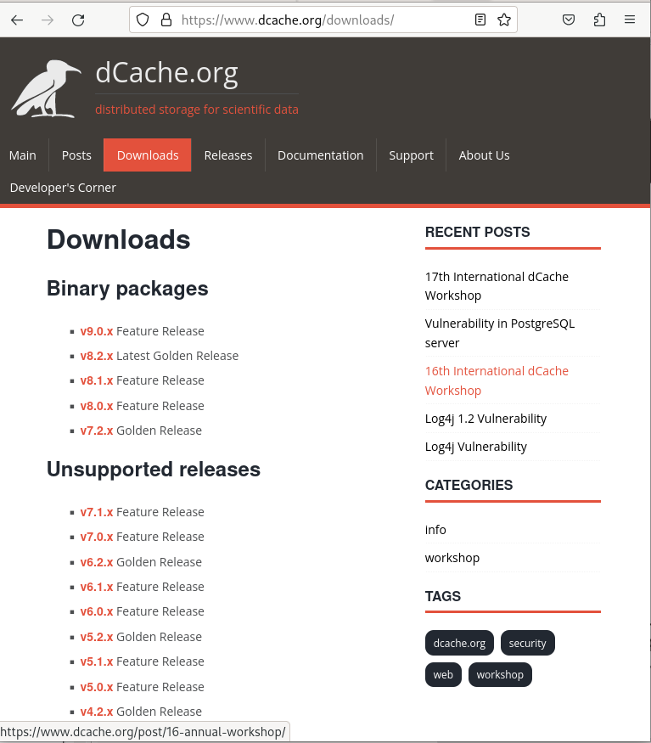
Supported OS platforms
6.2 - 8.2
RHEL 7, 8, 9
JVM 11
9.0 (Feb. 2023)
RHEL 7, 8, 9
JVM 11, 17
10.0 (~ 1Q 2024)
RHEL 8, 9
JVM 17

Slide 20
DPM migration
Influx of new users.
Series of tutorials.
Help from EGI.
Many thanks to Petr Vokac for facilitating the transition.
https://docs.google.com/spreadsheets/d/1KDVAJ9JzlycA3Wrz1iY2fQxZndWdAezFnLaDAxXIpUs/edit

Slide 21
Summary of major changes in dCache
BULK Service.
WLCG Tape API.
WLCG/Scitokens support.
TPC improvements.
NFSv4.1/pNFS improvements.
XROOT evolution (TLS, tokens, TPC, proxy-IO).
Namespace performance improvements.
User/Group quota.
CTA integration.

Slide 22
More info:
https://dcache.org
Contribute/complain:
https://github.com/dCache/dcache
Help and support:
support@dcache.org,
user-forum@dcache.org
Developers:
dev@dcache.org
Thank You!

Slide 23
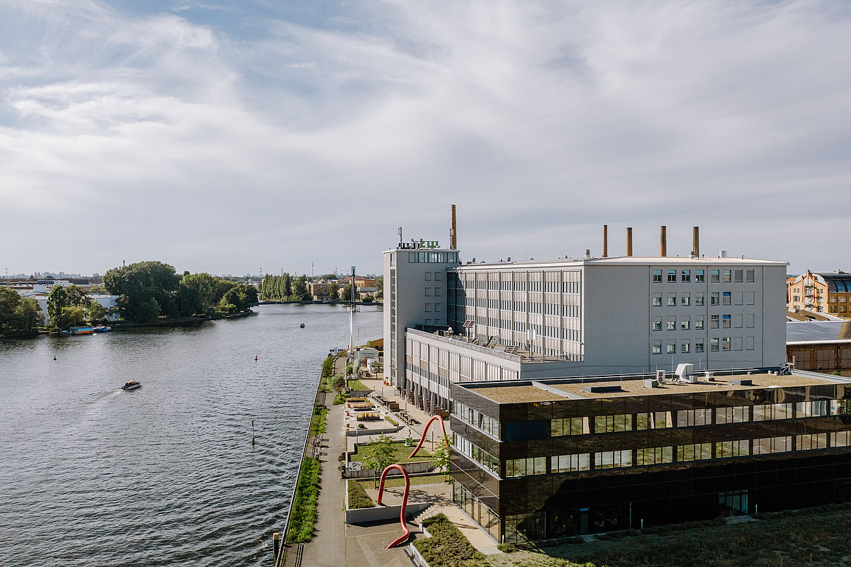
Come to Berlin this summer
17th International dCache Workshop May 31 – June 1
HTW-Berlin
© HTW Berlin/Alexander Rentsch
https://indico.desy.de/e/dcache-ws17

