Slide 1
Scale Tests of the New DUNE Data Pipeline
Steven Timm, Fermilab,
Wenlong Yuan, Univ. of Edinburgh,
Douglas Benjamin, Brookhaven National Lab.
For the DUNE Collaboration
CHEP 2023. 11 May 2023

Slide 2
DUNE Far Detector Data Flow
Far Detector Cryostat
Beam coincidence events are extremely important, but of limited total volume - ~1 Hz beam rate (most don’t trigger)
active online trigger in development
Region-of-Interest within module
online compression and zero-suppression being considered
Solar neutrino triggered events
Cosmic ray events and calibrations
Supernova readout events
~140 TB in 100 seconds per module
transfer out in 4 hours and process in 4 hours to point for optical follow up
DUNE requirement - less than 30 PB/year total to permanent storage from all active FDs (~1 GB/s)
More details in Michael Kirby talk at this same conference
Data volumes from DUNE Computing CDR

Slide 3
CERN and Neutrino Platform currently hosting ProtoDUNE
ProtoDUNE Single Phase and Dual Phase
constructed and operated 2018 - 2020
ProtoDUNE SP took 6 weeks of beam (~25 Hz)
invaluable information about performance, construction, and operations
5% of size of eventual far detector
ProtoDUNE II currently under construction
Horizontal Drift and Vertical Drift
HD anticipate filling LAr 2023Q4
VD assembly will proceed in parallel and operate after HD operations
Beam operations in 2023/2024
Charged particle beam data rate from ProtoDUNE (180MB/event), 4.5GB/s peak rate
Comparable to expected DC data rate from far detector (1GB/s)
CERN EHN1
Beam

Slide 4
New DUNE Data Management System
Fermilab replacing legacy unified data management / workflow system
Rucio for file replica cataloging and management
Well-known tool adopted by most big experiments in HEP community
Uses FTS3 for file transfers
MetaCat—new metadata service
Allows for hierarchical metadata and extensible queries against other databases.
Data Dispatcher—simple projects and data file delivery
In addition JustIN workflow system also developed by UK groups.
Other experiments already using these new data management tools

Slide 5
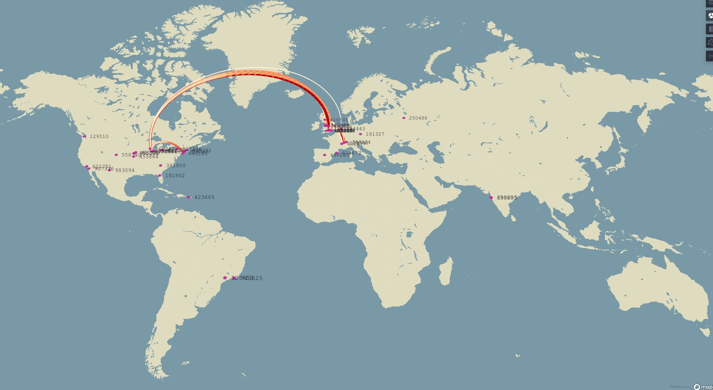
DUNE Data Challenge 4 (Summer 2022)
Storage Element
For this data challenge only:
Distribute test data to 3 other sets of storage elements (SE)s
For tests of local reading/writing.
Data from EHN1 to EOSPUBLIC
Declare files
Copy to tape @FNAL and CERN
UK
Storage Elements
Goals of the Data Challenge 4 were to test all the services and procedures that will be used in the forthcoming beam runs of ProtoDUNE-HD and ProtoDUNE-VD
These tests have been done and succeeded in transferring and processing data at the necessary scale
European
Storage
Elements
WE ARE HERE
Return outputs to Fermilab
(some via nearby writes first)
Reconstruct files
streaming at sites without SE’s, local for sites with SE’s
2nd copy of results to RAL and CCIN2P3
Compute Sites

Slide 6
Data Pipeline Diagram
Legacy file transfer system replaced by Ingest Daemon and Declaration Daemon
Ingest daemon brings files from experimental systems to dropbox
Can operate without connection to Fermilab.
All transfers done via FTS3
Declaration daemon declares them to MetaCat and Rucio and makes rules to get them to final destinations.
2 copies of raw data on tape
1 copy of sim/reco on tape
2 copies of sim/reco on disk distributed across global storage elements.

Slide 7
Summary of Data Challenge 4 Data Pipeline Phase
Ran 5 days, July 11-15, Midnight UTC to Midnight UTC
Copied a set of files from a sample area, renamed them with a timestamp and generated metadata for them.
3 samples: Vertical Drift Cold Box top electronics (3GB), Vertical Drift Cold Box bottom electronics (4GB). Horizontal Drift Monte Carlo(1.4GB)
Generated 250GB 4x an hour on 4 machines.
Ingest daemon copied it to CERN EOS
Declaration daemon declared it to MetaCat, Rucio and SAM
Generated ~500TB of data total
Near end of the challenge reached a peak of 3.6GB/s=28.8Gbit/s
Once pipeline was done we had 2 copies of the data set, one at CERN and one at Fermilab
For testing of locality reading, fanned it out: 1 copy split among 5 SE in the UK, 1 copy split between 3 SE in Europe, 1 full copy at BNL. So 5 copies of test data set total.

Slide 8
FTS3 monitoring: CERN->FNAL link
3.6
GB/s !
Big improvements during run:
Ingest Daemon ->100 threads
Speed up metadata script
Increase cores of declaration daemon from 2 to 8
Increase limit of simultaneous transfers in FTS3 from 143->500
07/11 00:00
07/16 00:00
https 3rd party transfers eospublic.cern.ch -> fndca1.fnal.gov

Slide 9
CERN–FNAL traffic
28.8GBit/s=3.6GB/s
Dedicated OSCARS link between CERN and Fermilab. Blue is CERN->Fermilab, Orange is Fermilab->CERN
We had enough network and transfer bandwidth to do the data challenge and still take raw data on the cold box.

Slide 10
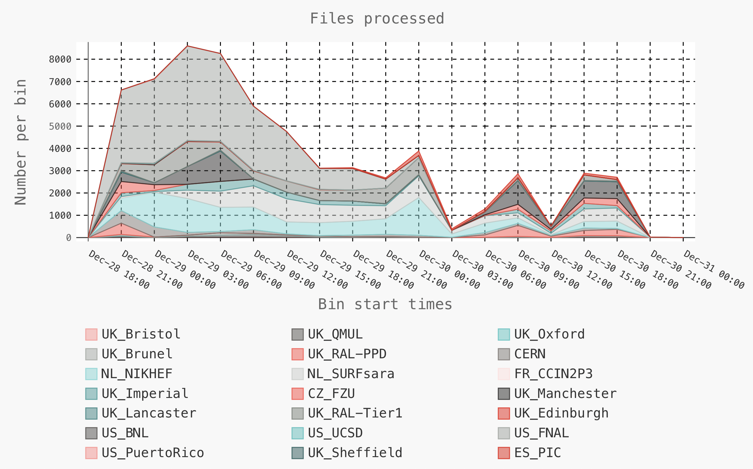
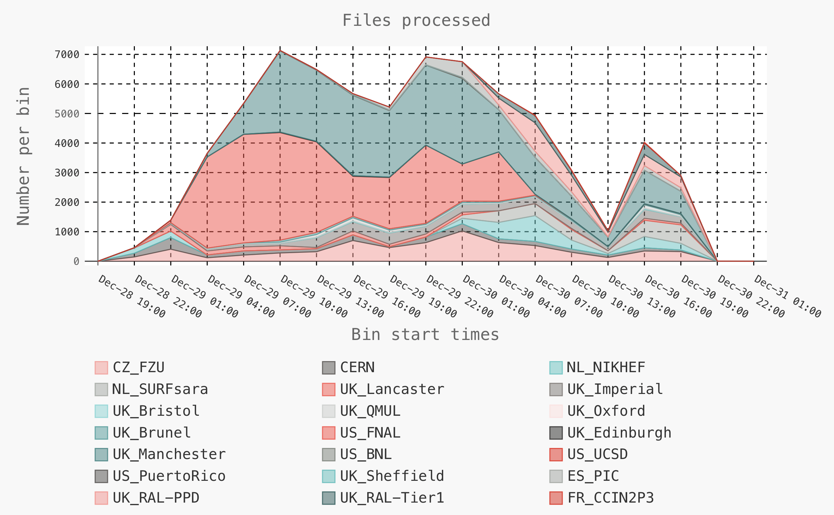
Distributed processing: justIN in Data Challenge 4
Plots of sites where processing occurred
Request 177
Not much data at Manchester
(VD coldbox top)
FNAL
Lots of data at Manchester!
(VD coldbox bottom)
Request 178
FNAL
Live monitoring shows how
jobs processing the files follow
the data to suitable sites,
using replica locations originally
from Rucio

Slide 11
Conclusions
We have tested that the full pipeline from experimental hall to CERN to Fermilab is functional and stable and can run at rates expected in the forthcoming ProtoDUNE II beam run (3.6GB/s)
The software deployed and tested has been deployed in production now as our production data pipeline.
Using this software to build a second pipeline for the DUNE Near Detector Liquid Argon Cube test beam this summer.
Converting output of offline production to use this pipeline as well.
Expect to use a very similar software stack when data starts to flow from SURF (1GB/s expected).

Slide 12
Acknowledgments
Storage dept. at Fermilab for operating Rucio, MetaCat, and Data Dispatcher servers as well as writing MetaCat, Data Dispatcher, and the ingest and declaration daemons (Igor Mandrichenko, Brandon White, Dennis Lee)
Jake Calcutt for Data Dispatcher testing
Andrew McNab, Chris Brew, Raja Nandakumar for justIN design, development and testing.
CERN IT staff for FTS3, EOS, CTA support.
DUNE Data management team, S. Timm, D. Benjamin, W. Yuan.
Rucio developers
This research is based upon work supported by the US Department of Energy, Office of Science, Office of High Energy Physics.

