Slide 1
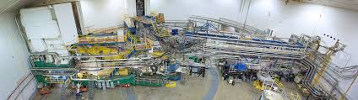

Hall A Update
Thia Keppel
PAC 49
July 2021

Slide 2
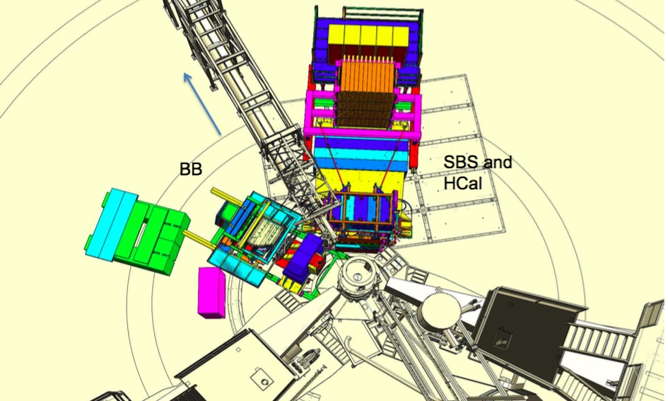

SuperBigBite Spectrometer (SBS)
New spectrometer for Hall A
To be used in conjunction with updated legacy equipment such as the BigBite Spectrometer (BB)
Also involves new general purpose equipment such as a large Hadron Calorimeter (HCal) and advanced polarized ³He target
e-
G_{M}^{n} Configuration – installation underway!
2

Slide 3
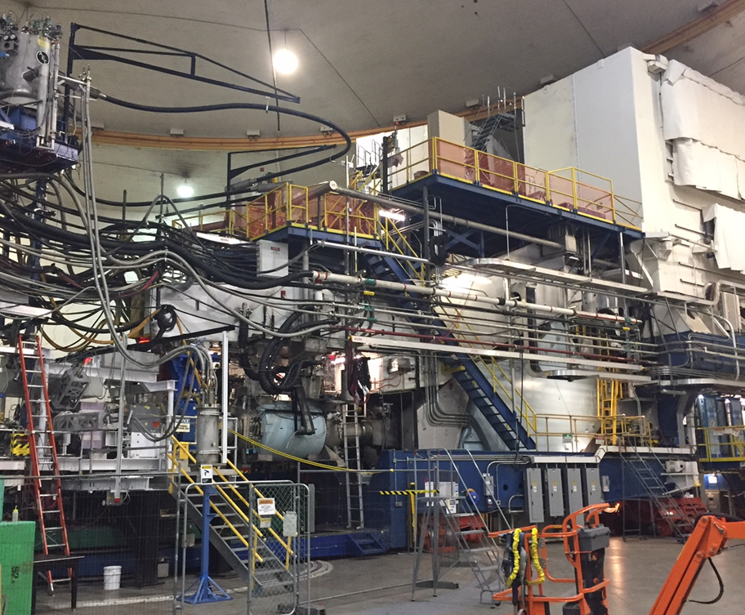
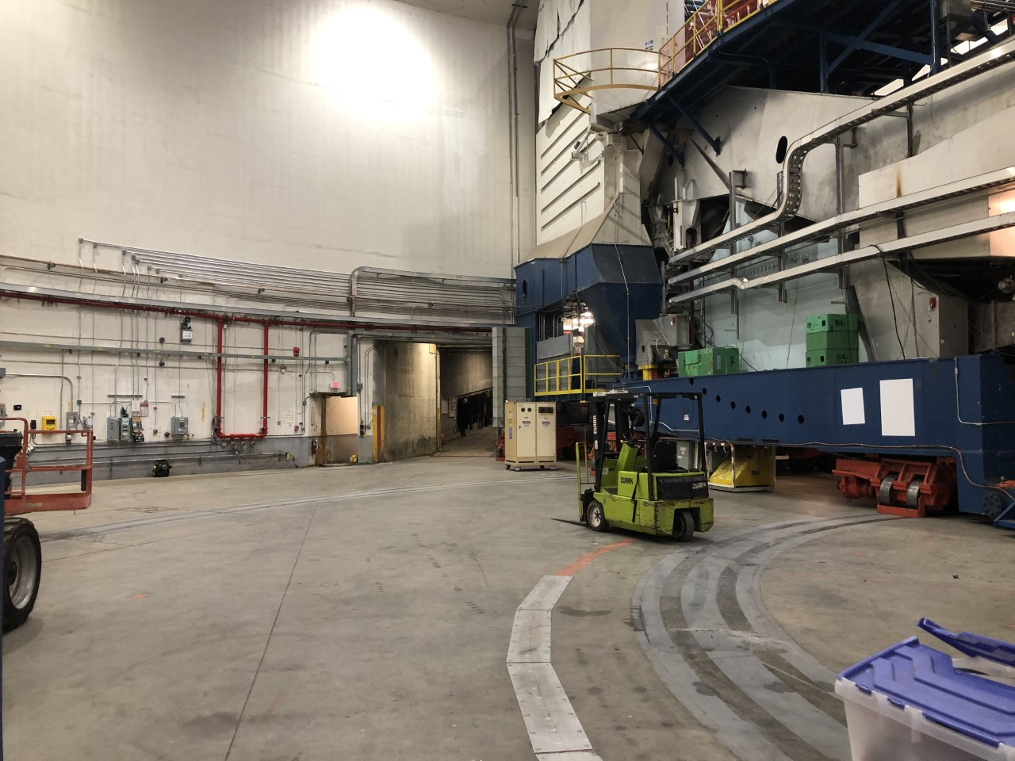
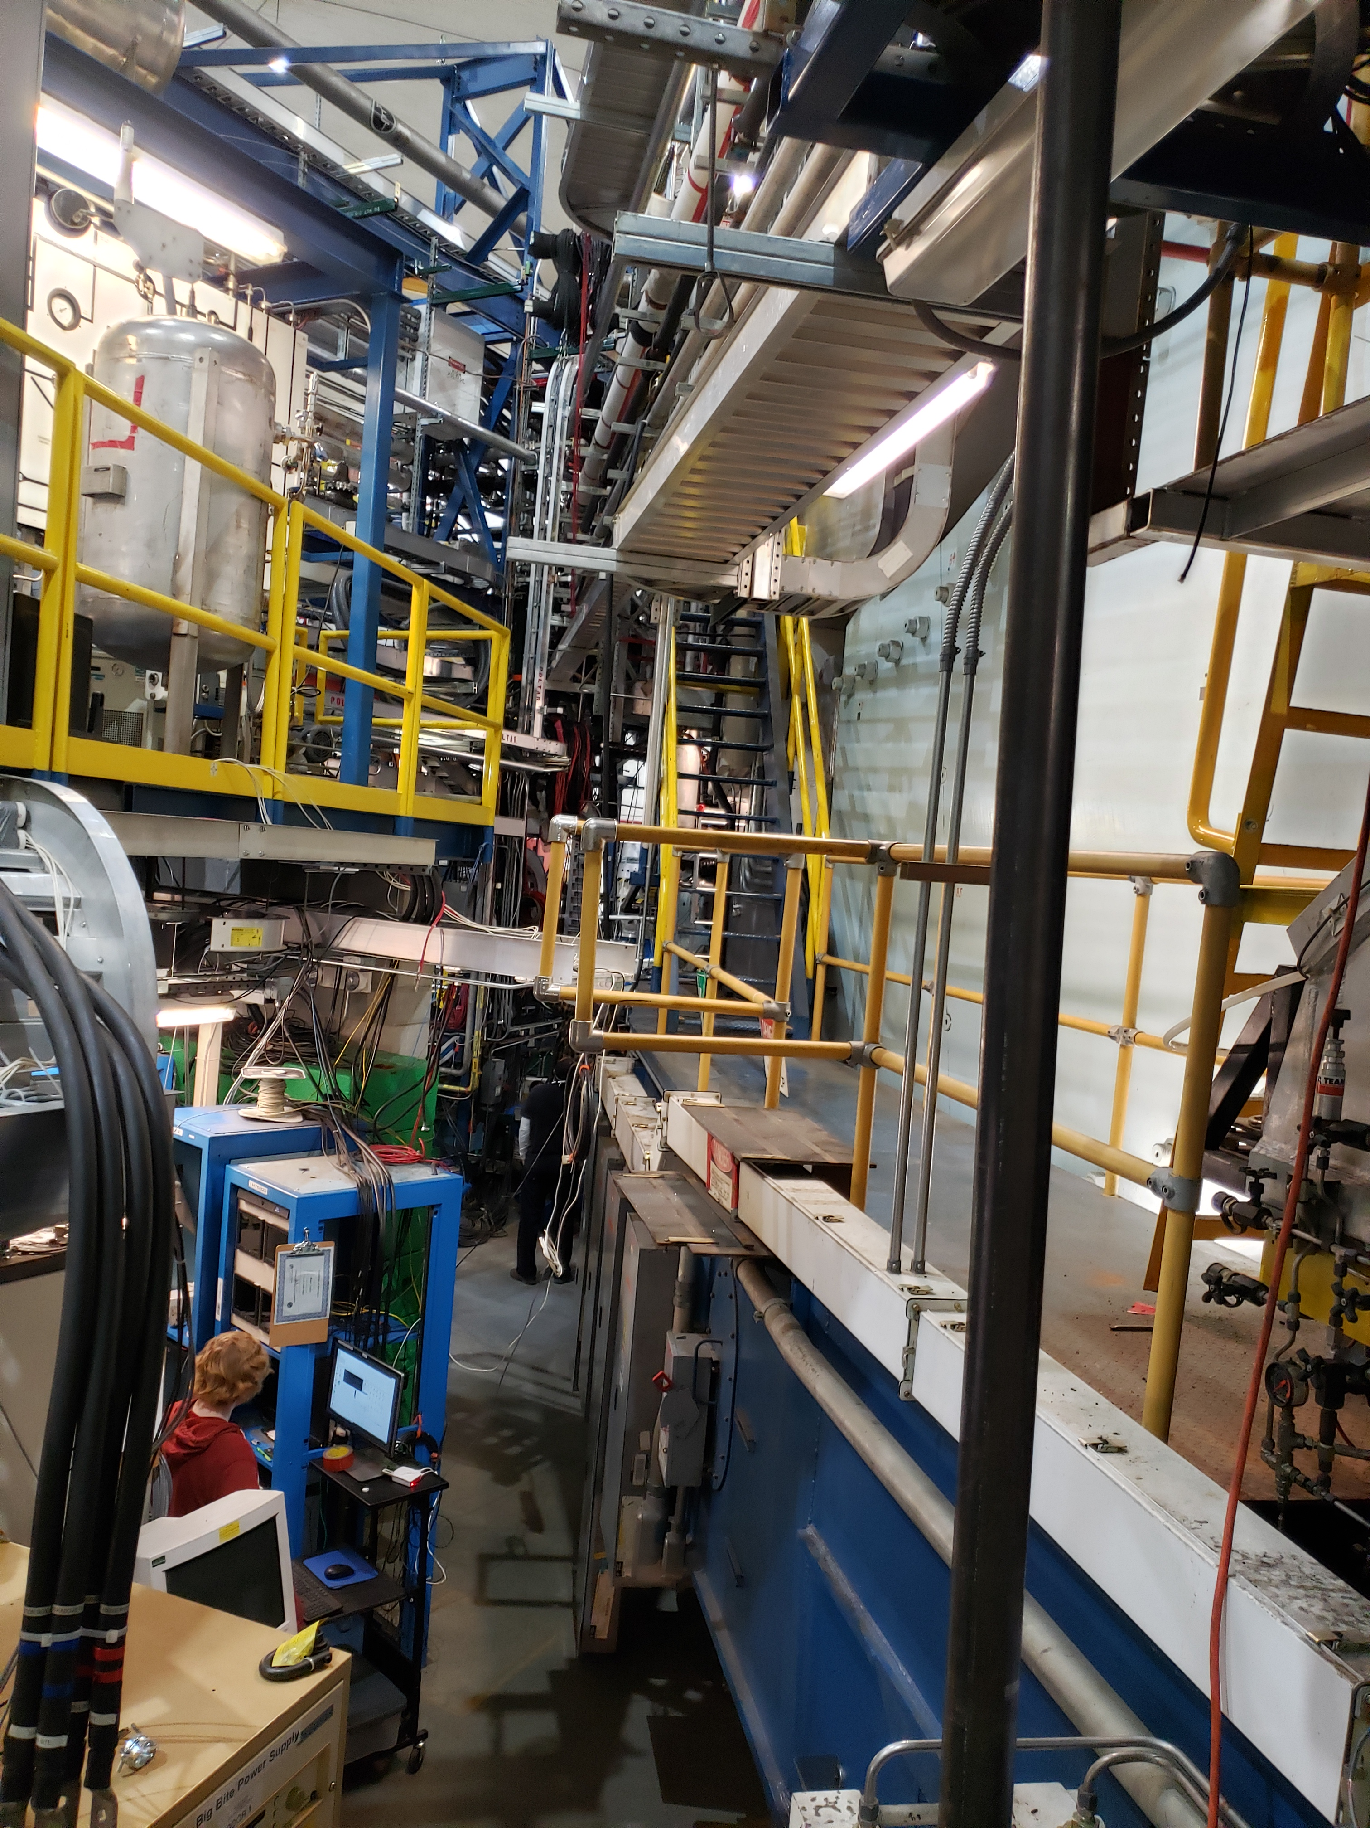
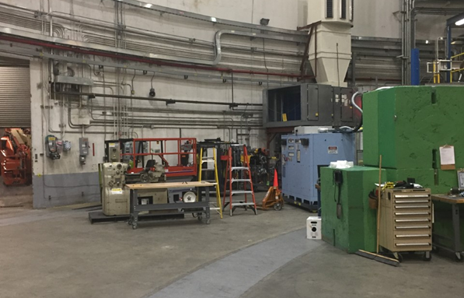
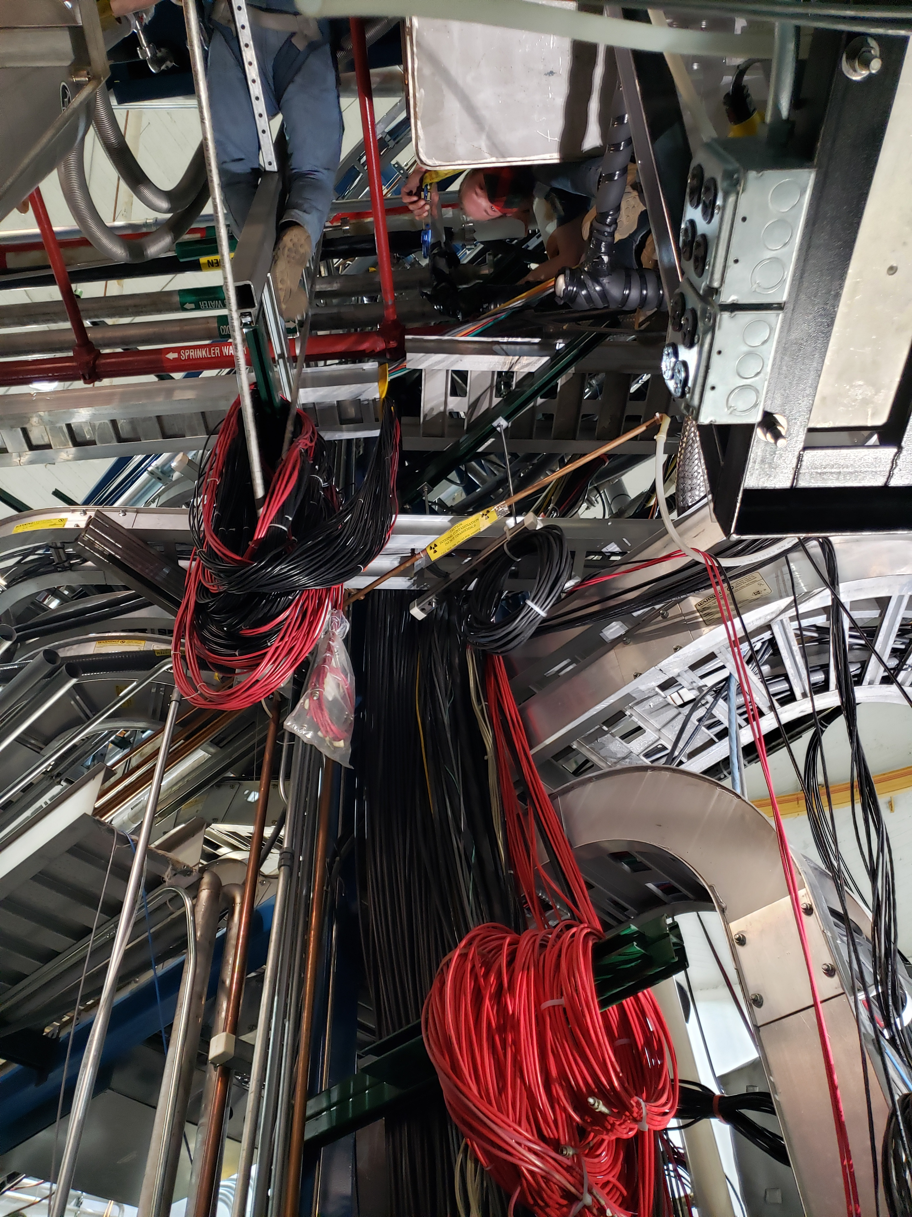
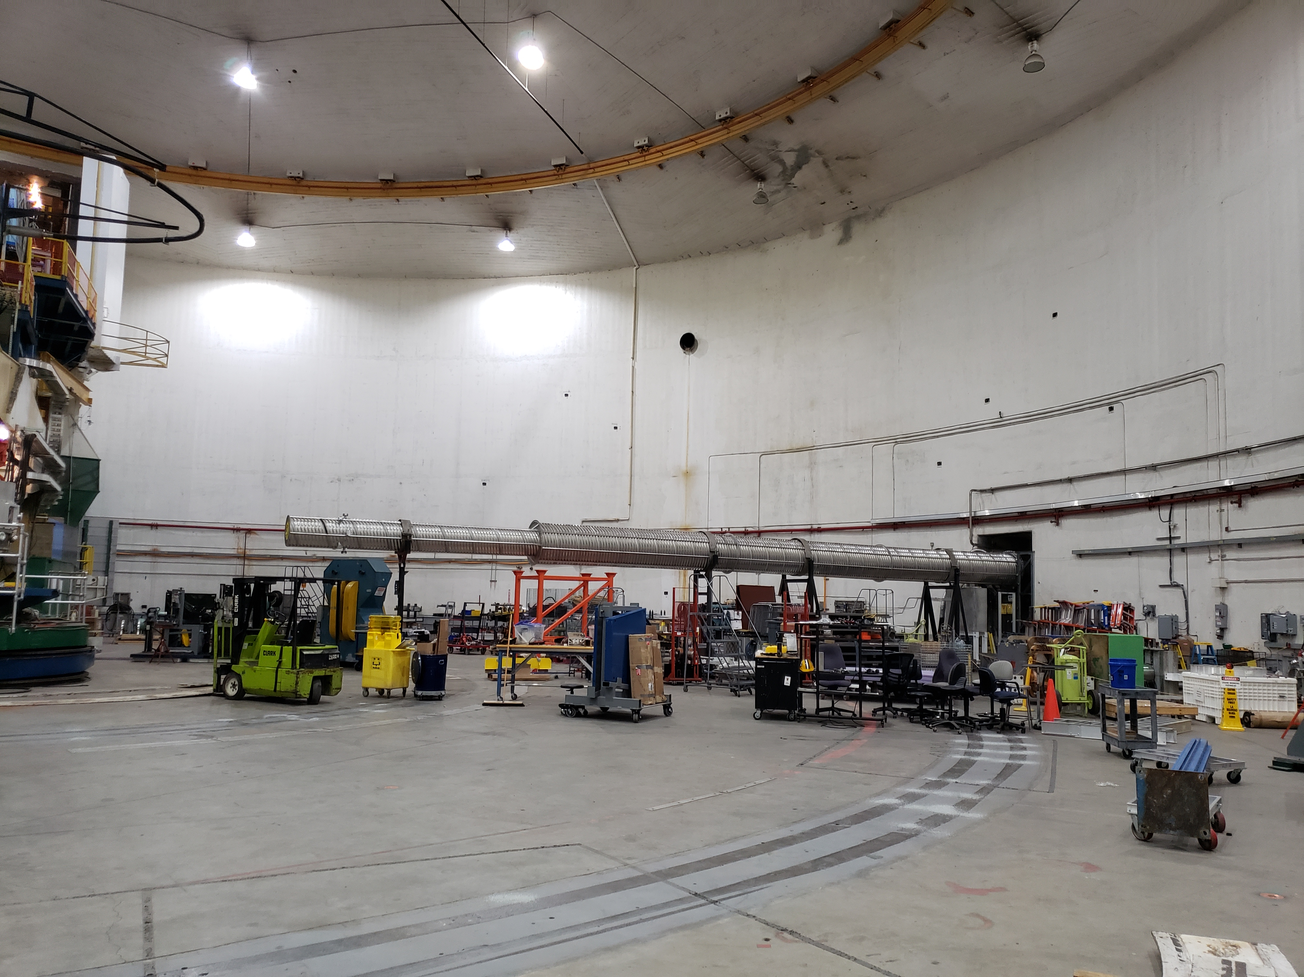
First Step in SBS Installation: Decommission (right) HRS – the end of an era

Slide 4
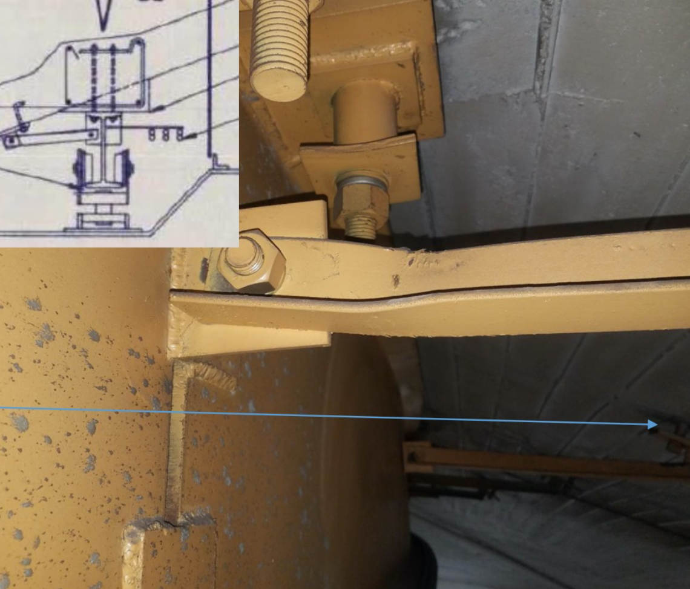
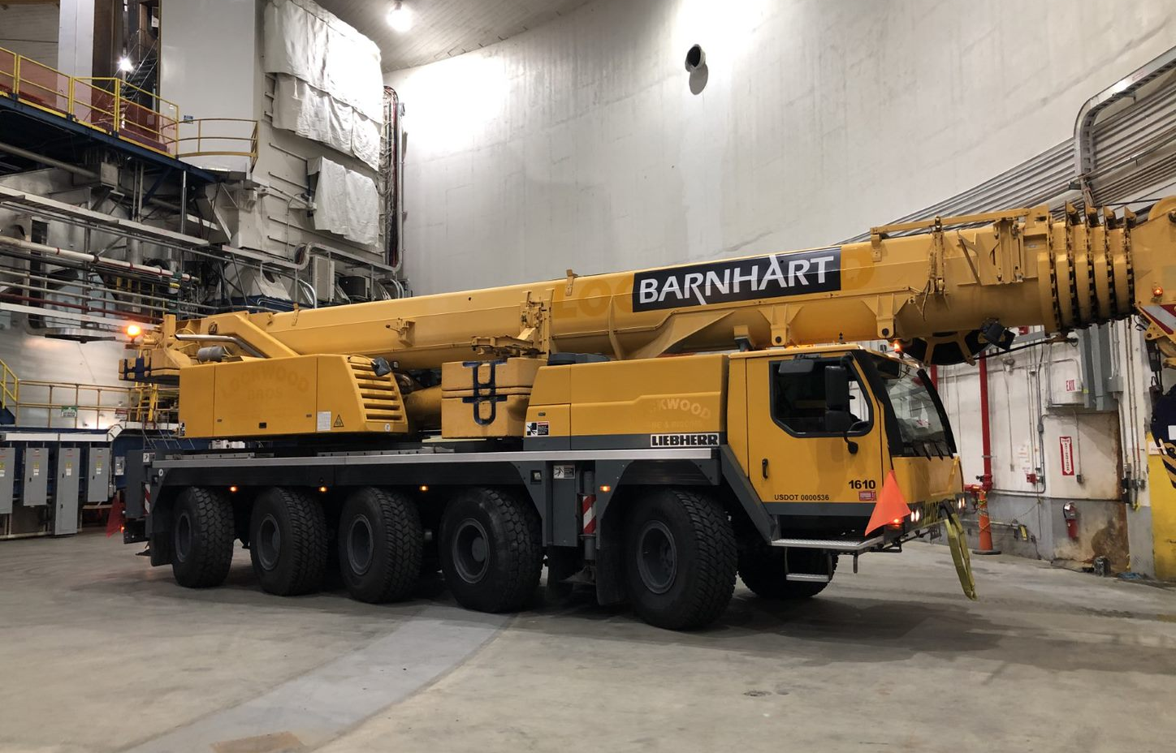
Overhead Crane
Concerns from Facilities inspection and subsequent structural consultant include:
  Bent anchor bolts
  Warped support rail
  Failed lateral brace
• Status:
  The Hall A ceiling crane is locked out until (major) repairs complete – next year
  Quick ramp up of requisite support from the laboratory
  Continuing to install major experimental equipment (SBS program)
  Managing multiple subcontractors working in Hall simultaneously
    Safety a priority
  Revised plan to keep on schedule
Ceiling crane concerns
Mobile Crane in Hall

Slide 5
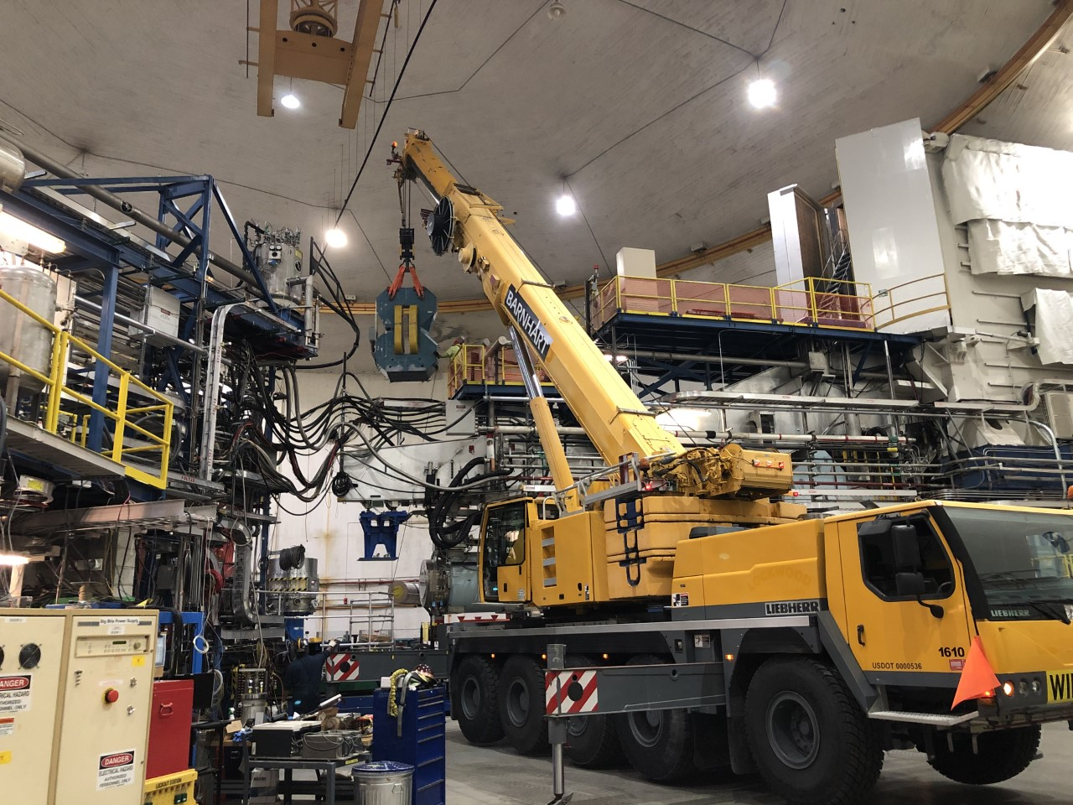
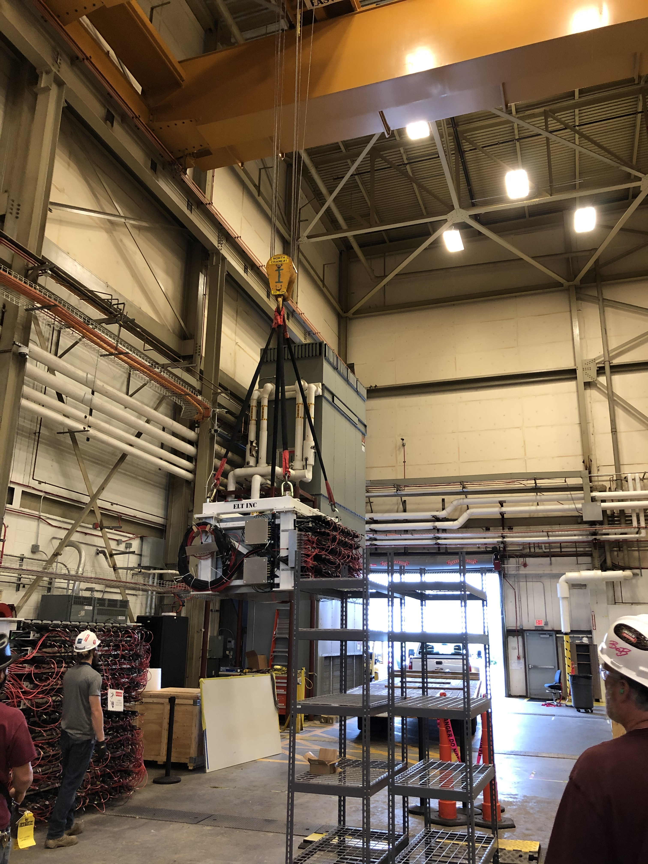
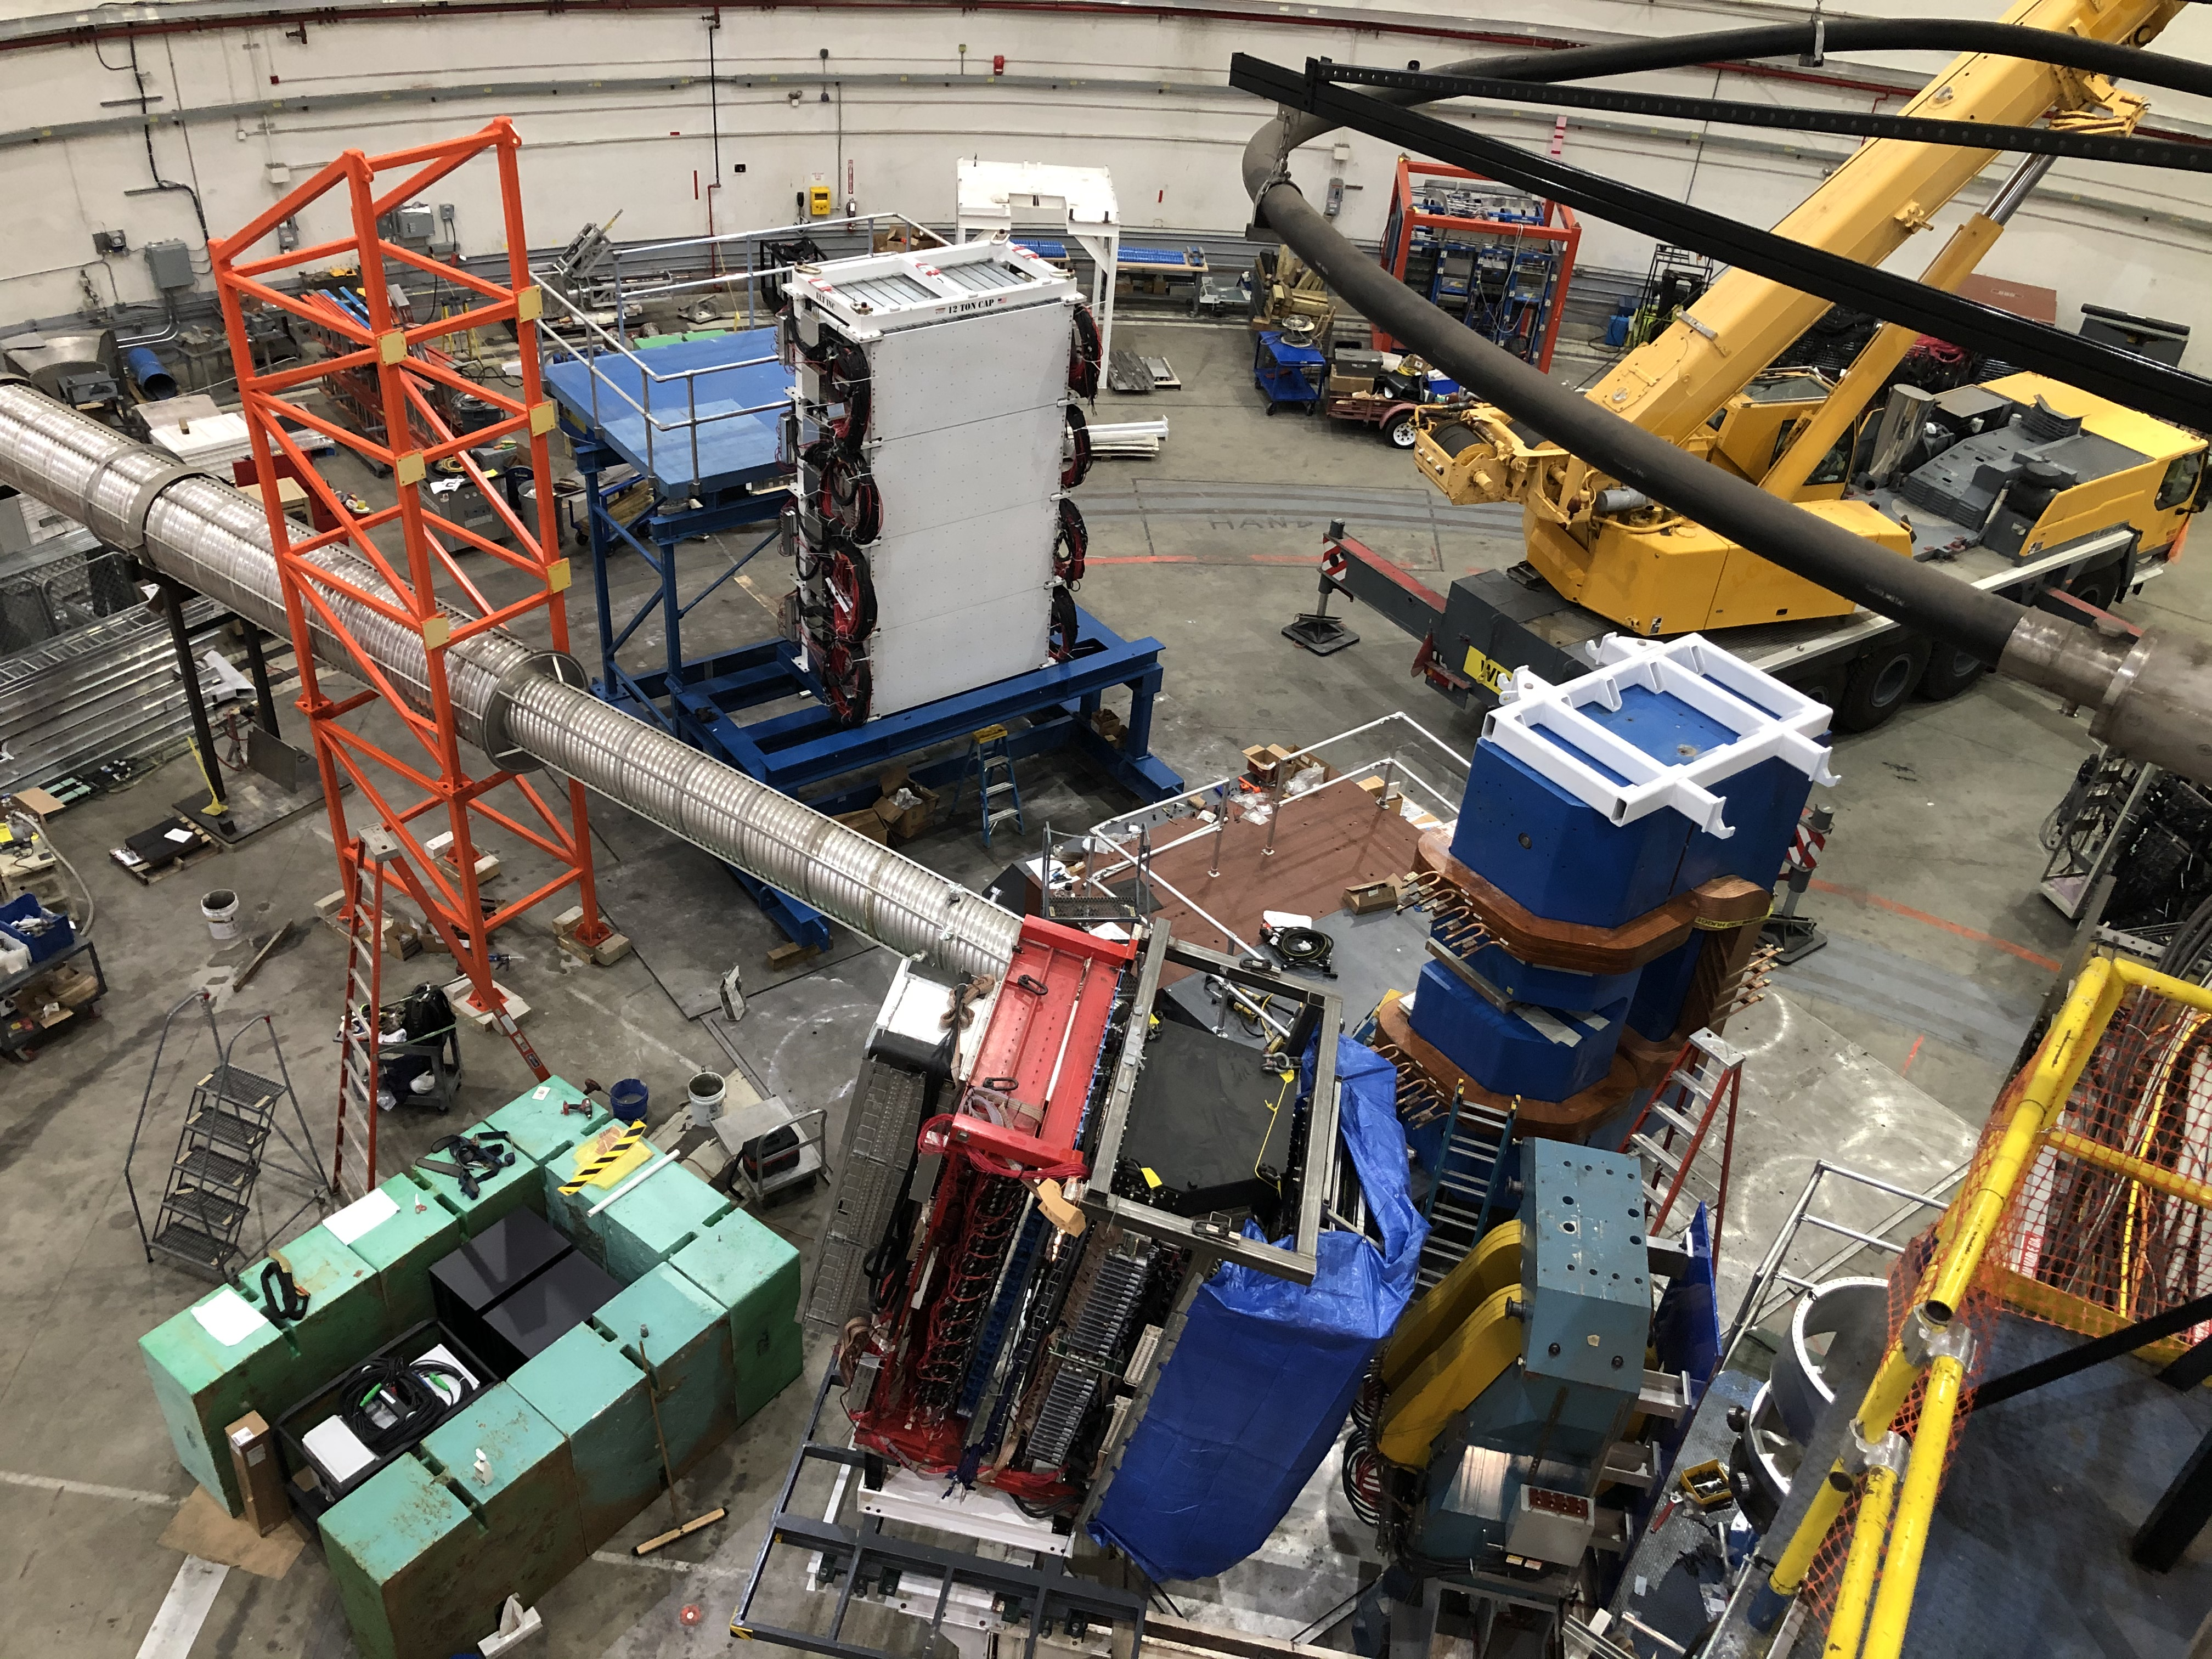
SBS Installation Underway
BigBite lift over HRS-R using mobile crane
HCal (component) removal from test lab
Monile crane, new downstream beamline, SBS counterweight and magnet, Hcal, Bigbite with detectors

Slide 6
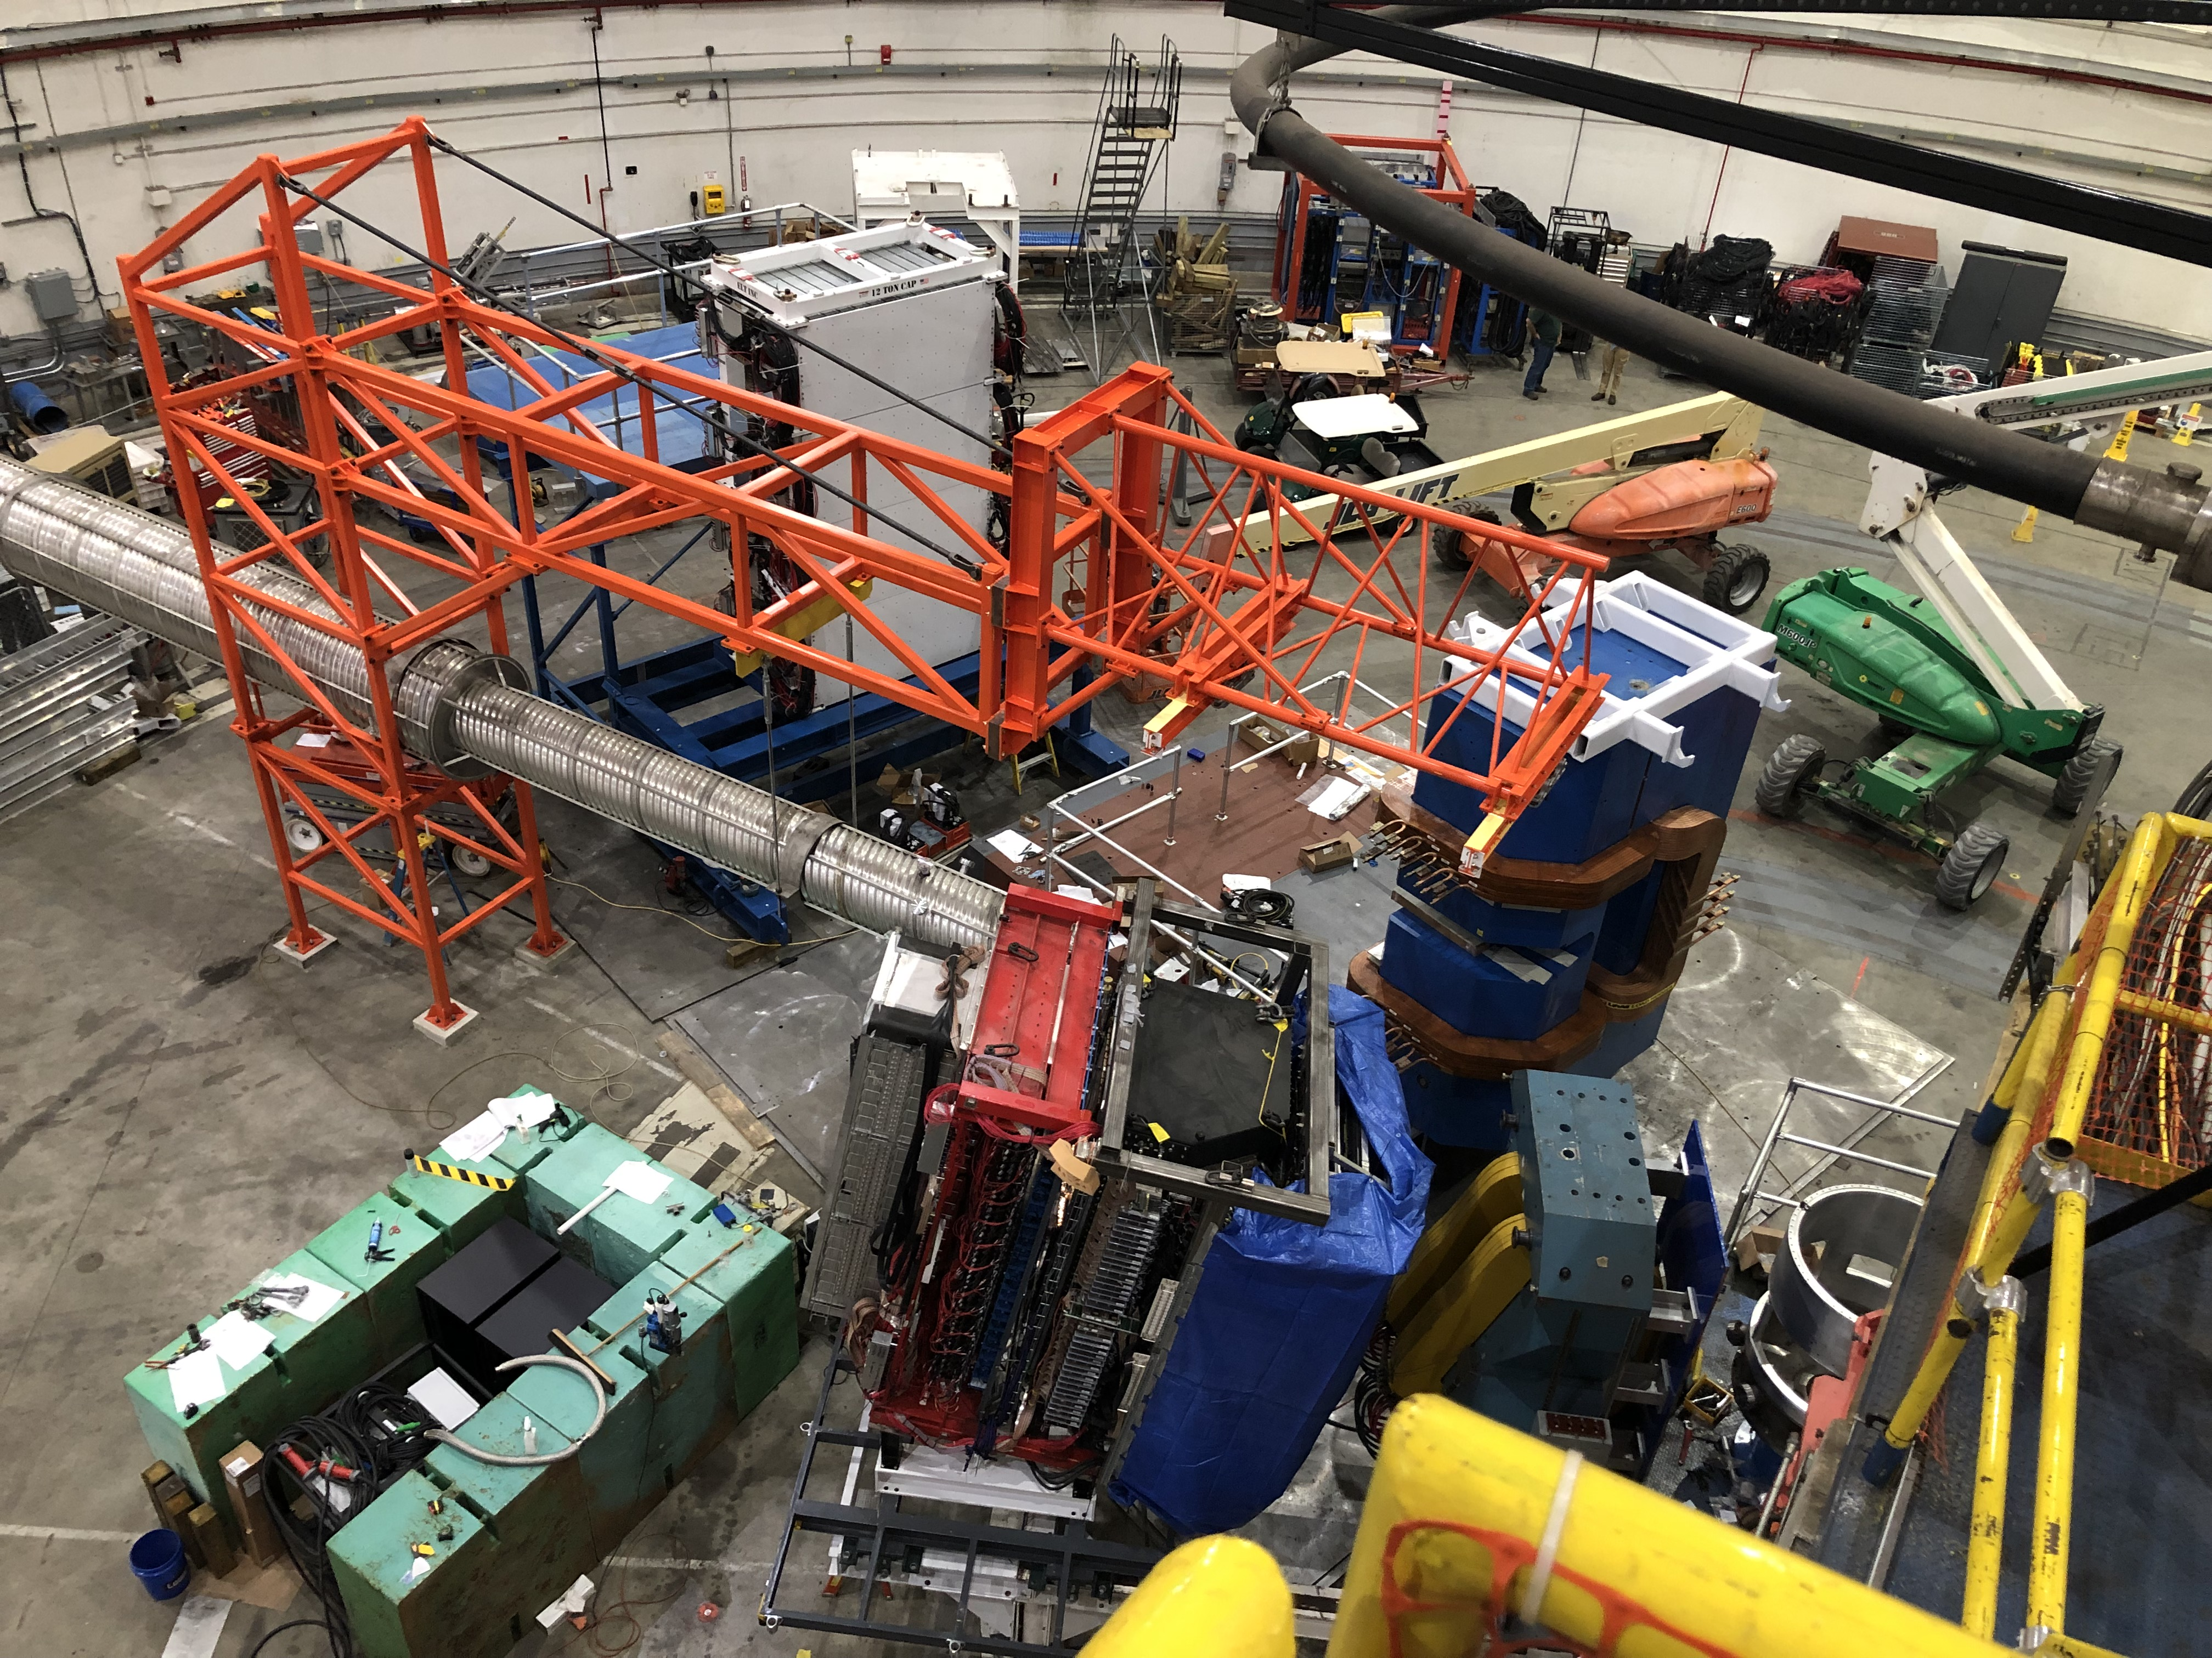
SBS Installation completion goal 9/3/21 – on track ☺☺
BigBite with detectors, SBS, HCal, beamline, GEM bunker

Slide 7
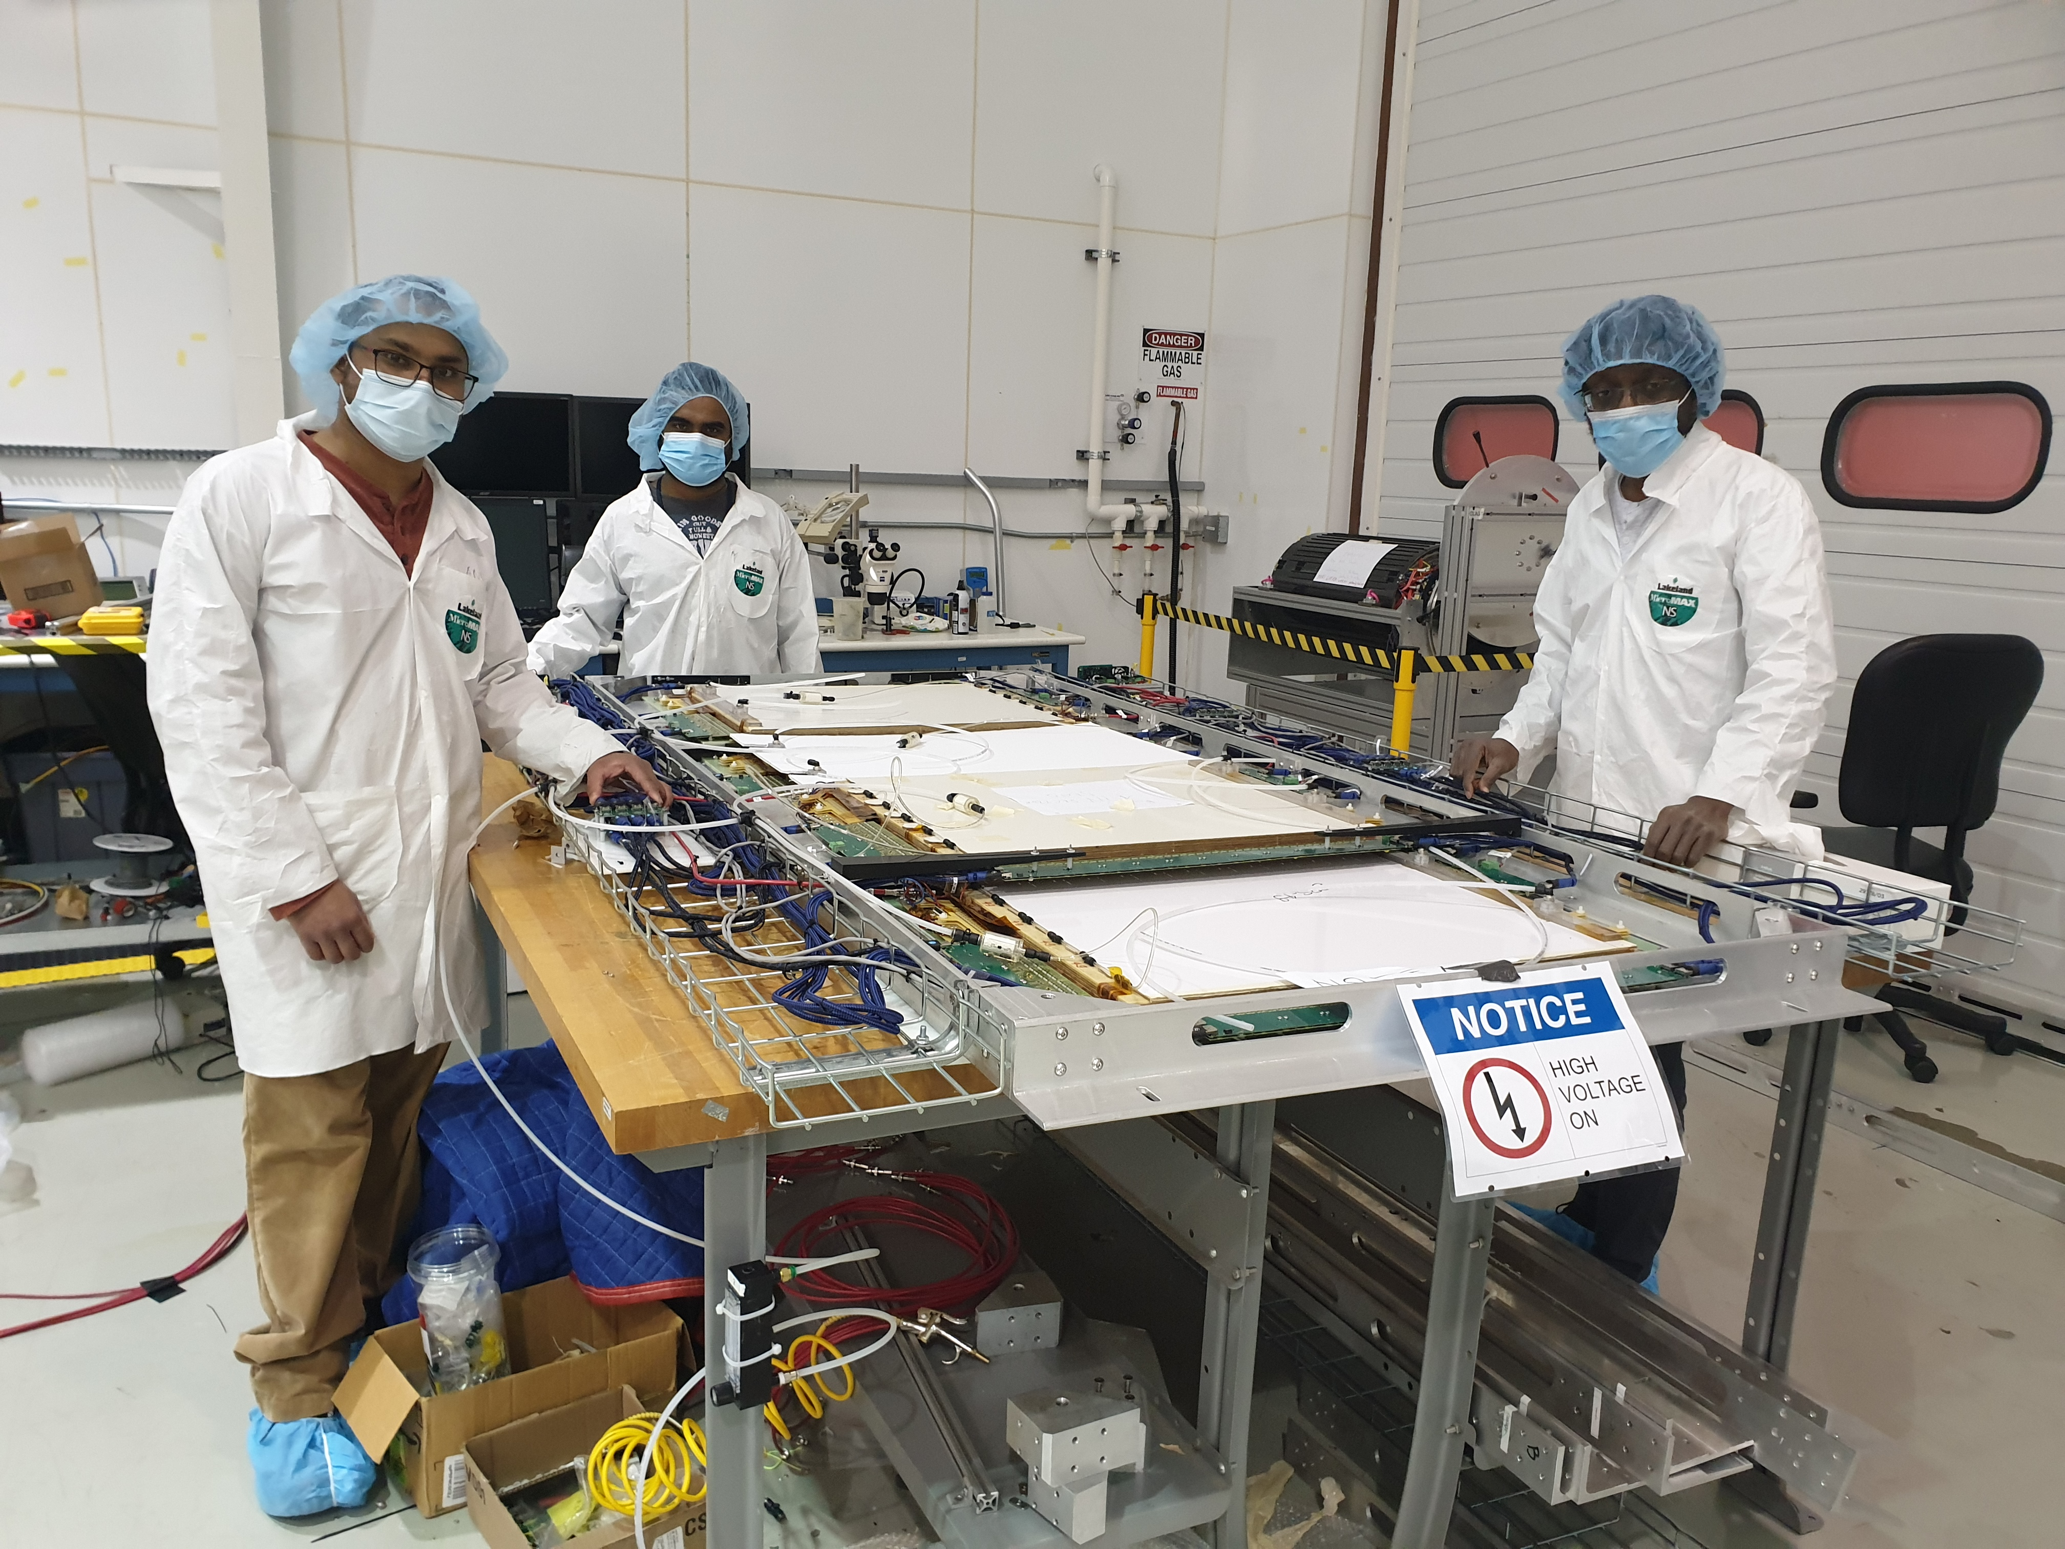
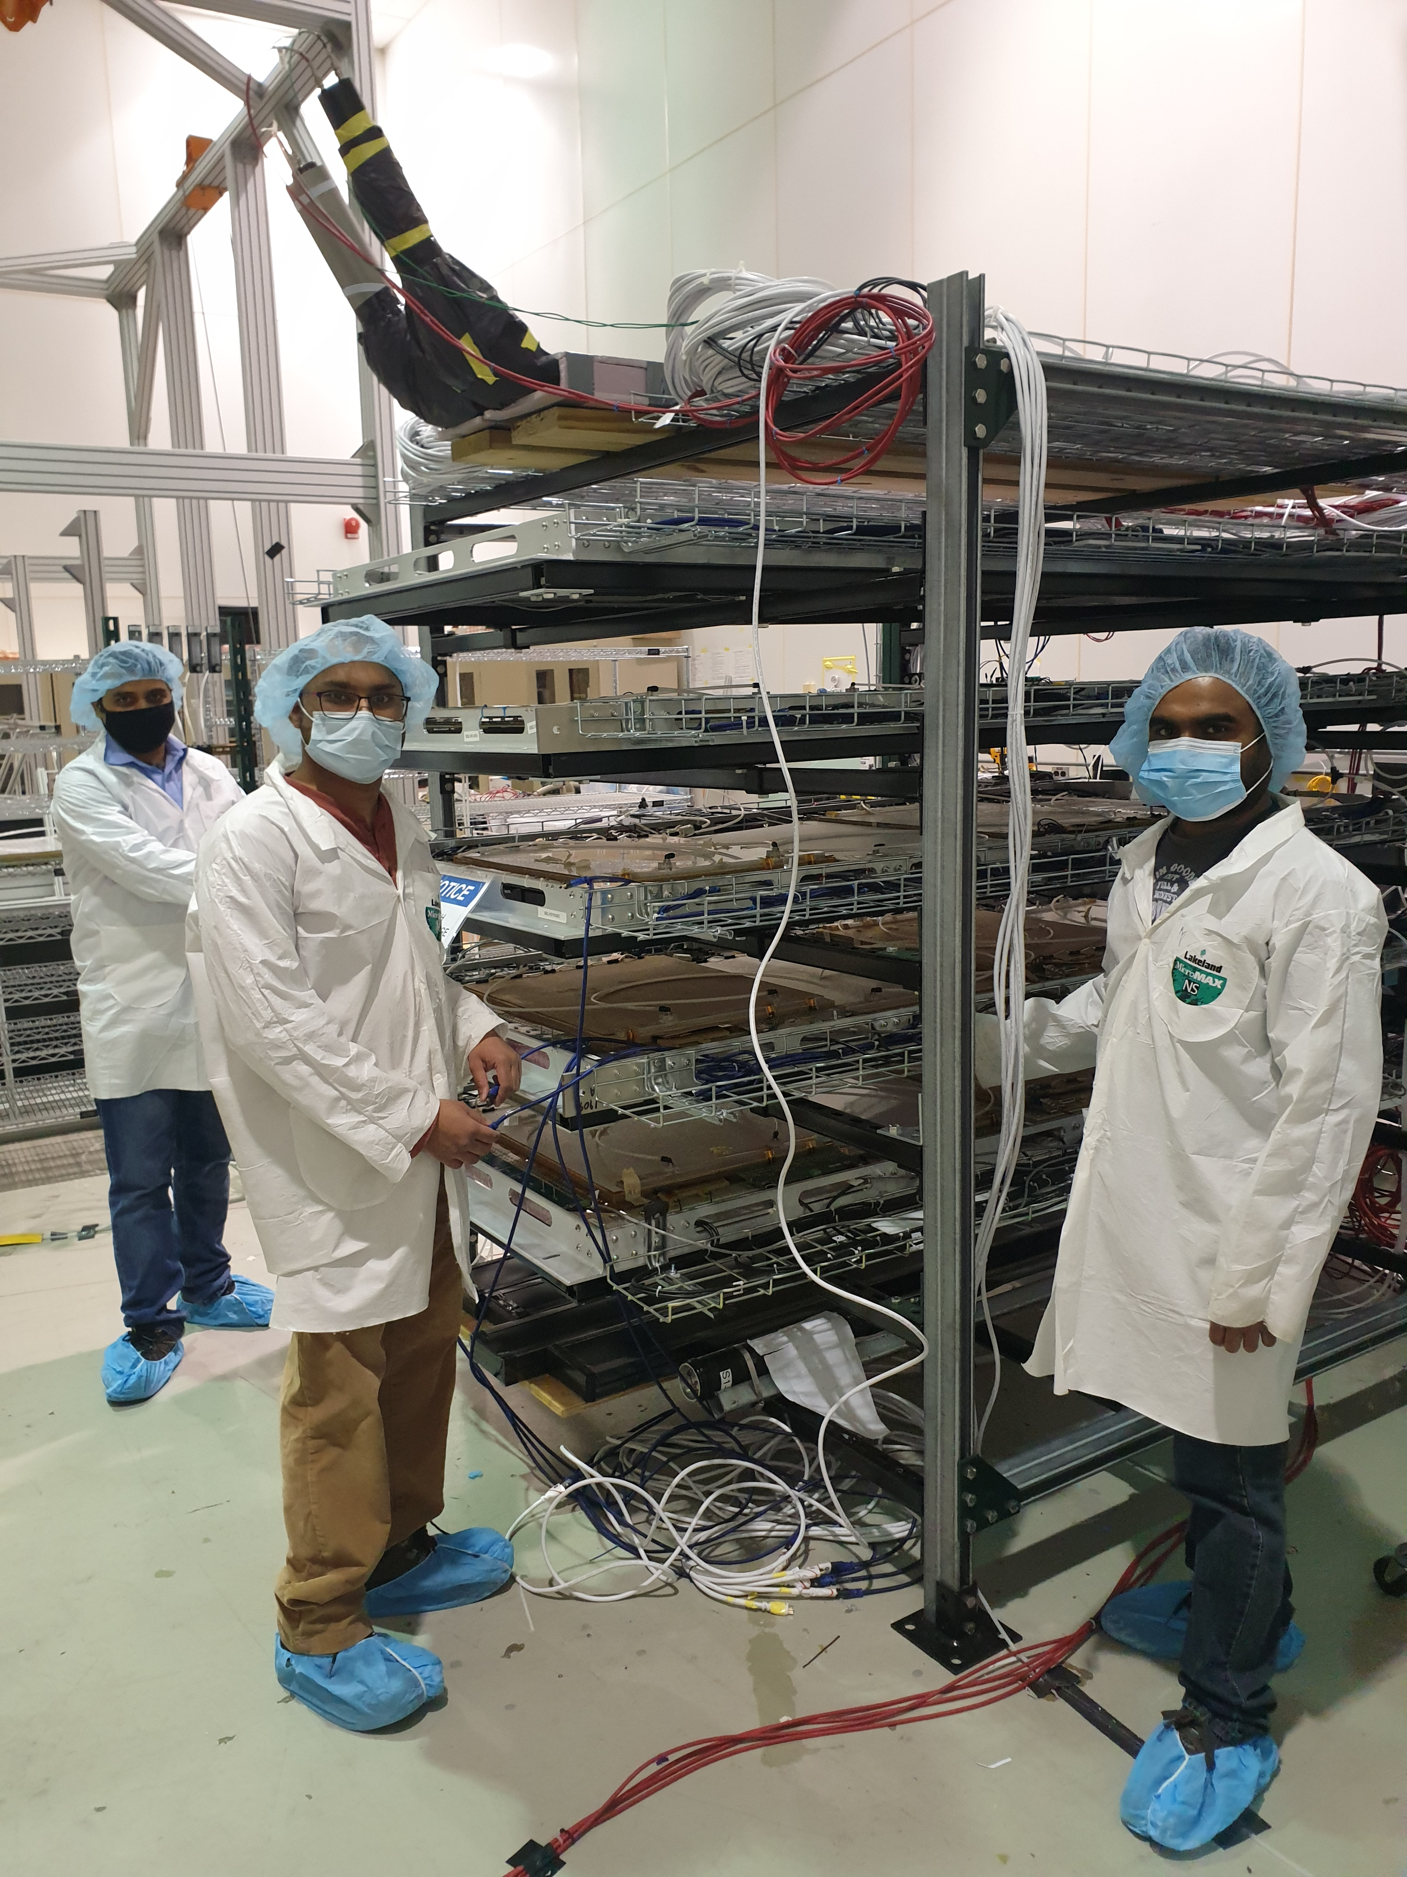
Outside of the Hall: Some SBS GEM testing continues
EEL 124 Clean Room Assembly….
….and Testing

Slide 8
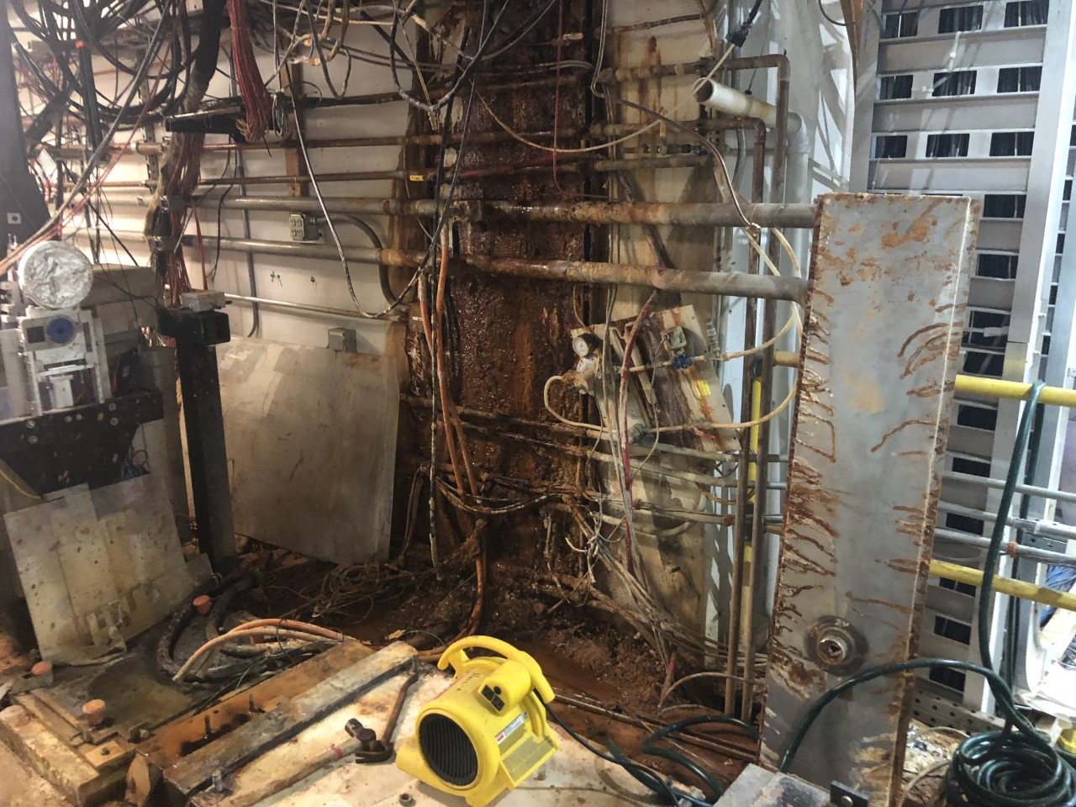
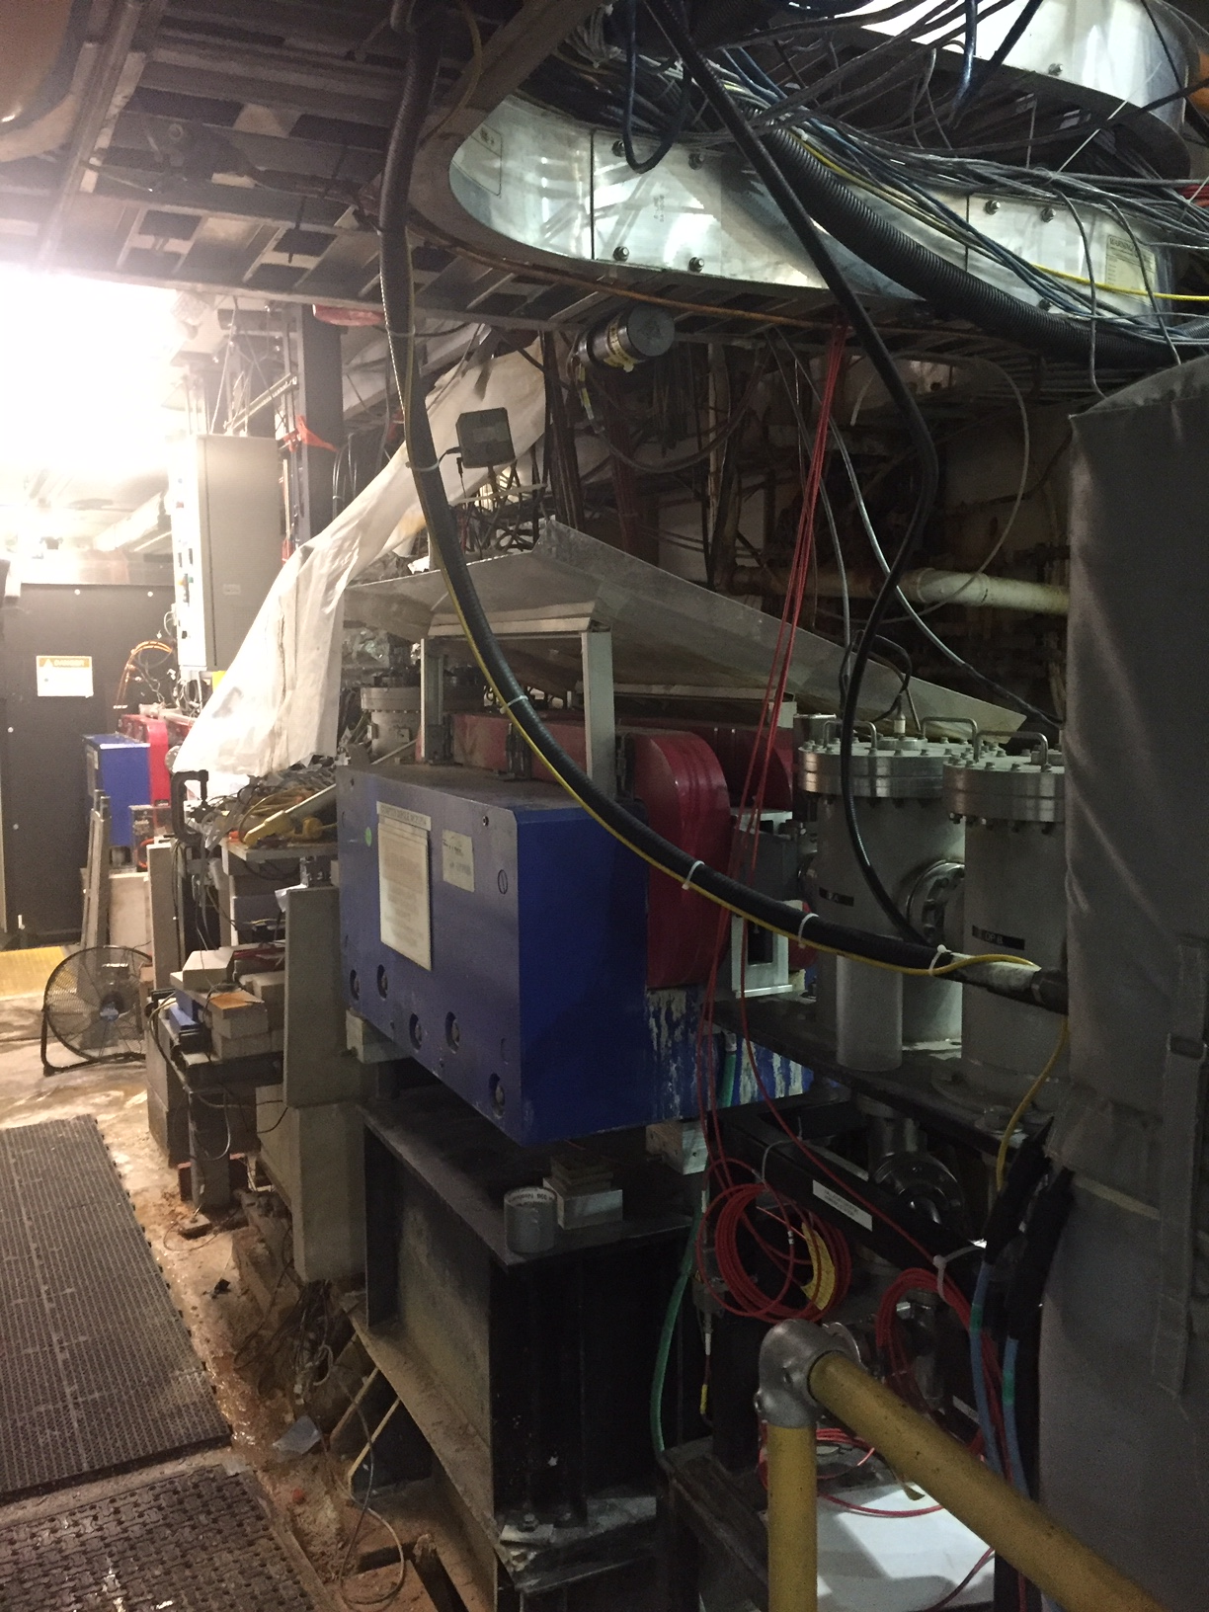
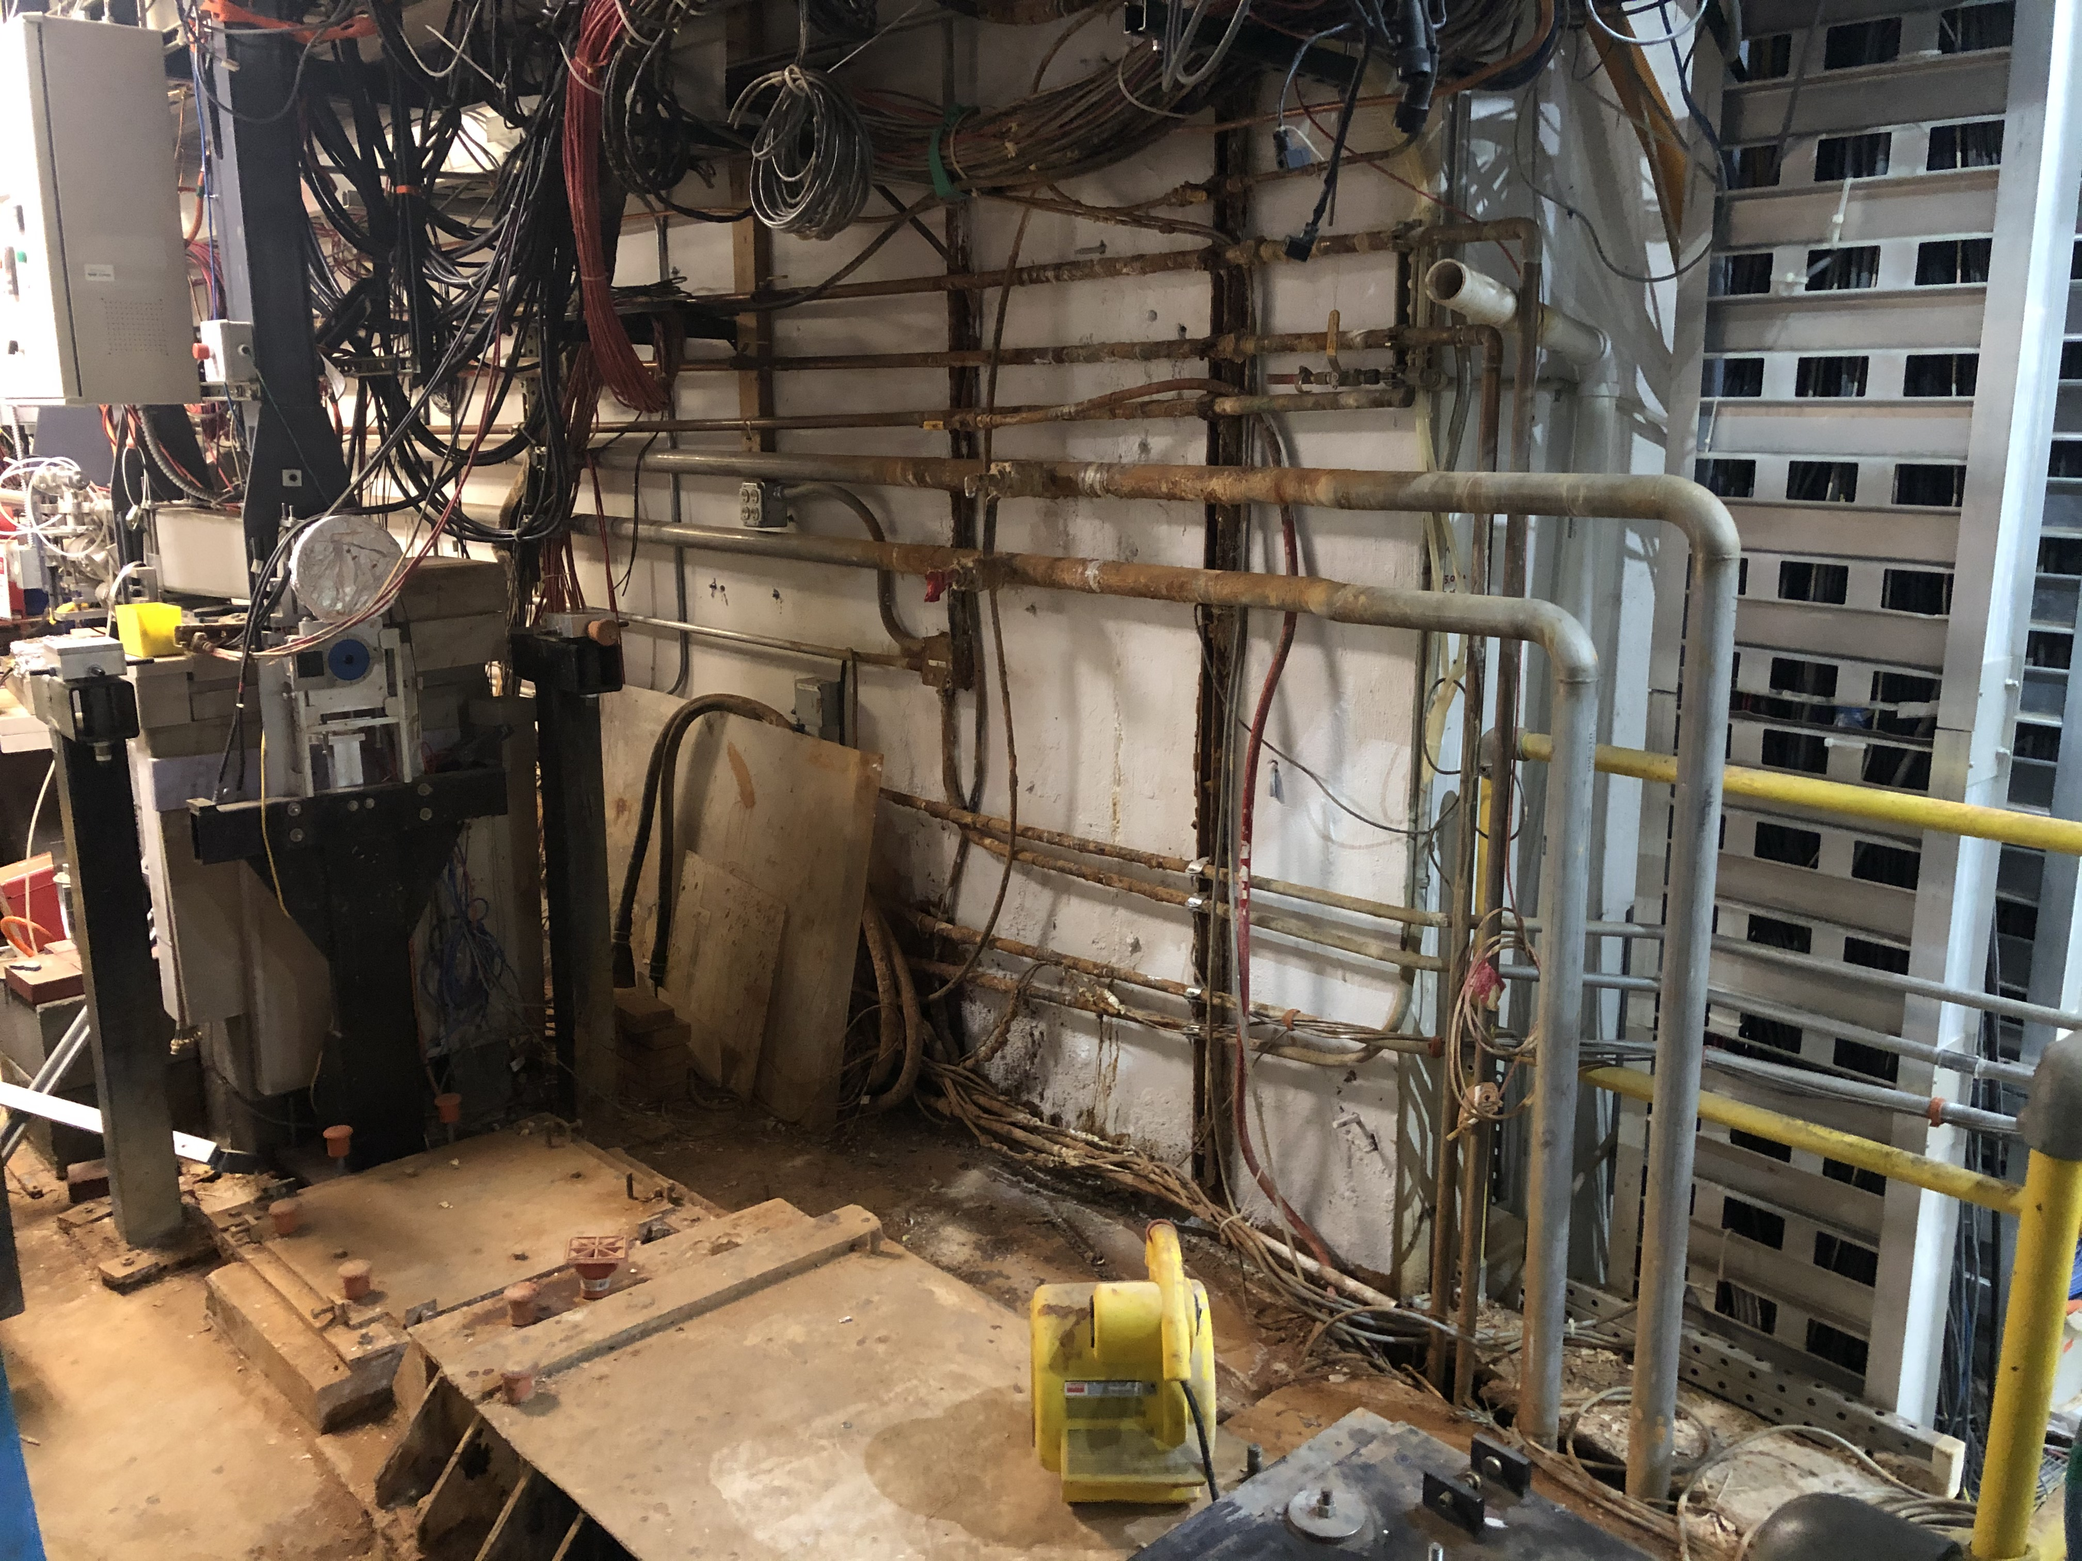
SAD provides opportunity to fix long-standing problem(s)
Example: repair groundwater leak near Compton
“Before”
After

Slide 9
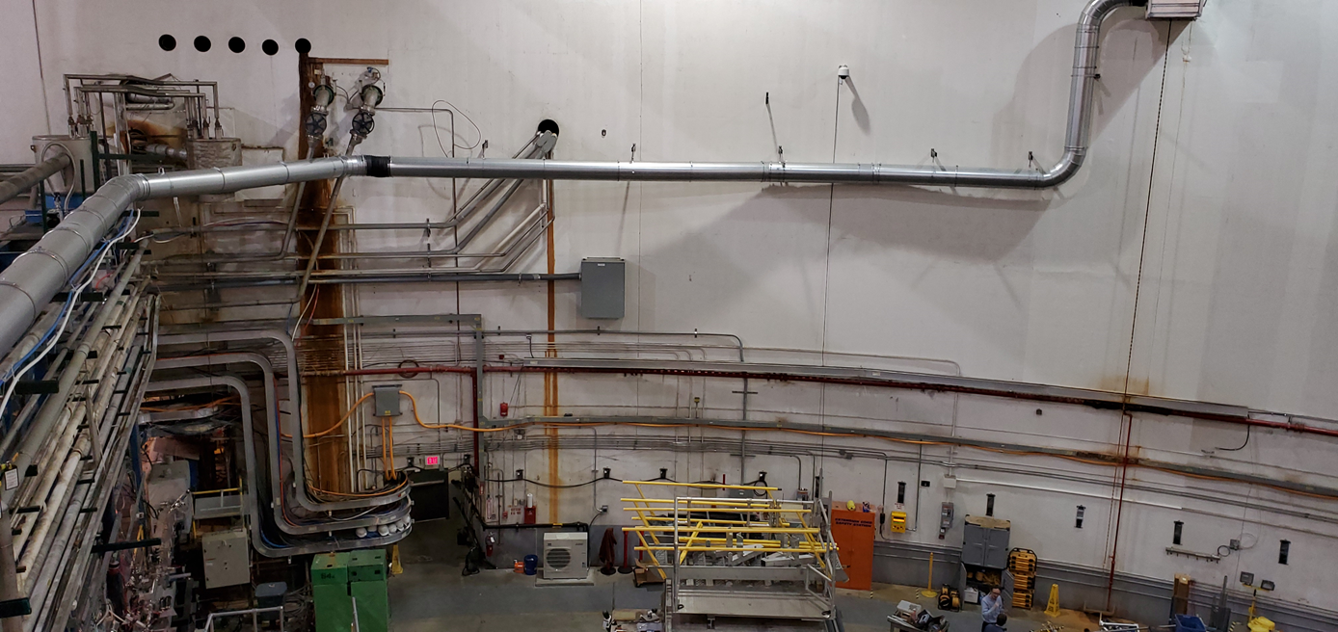
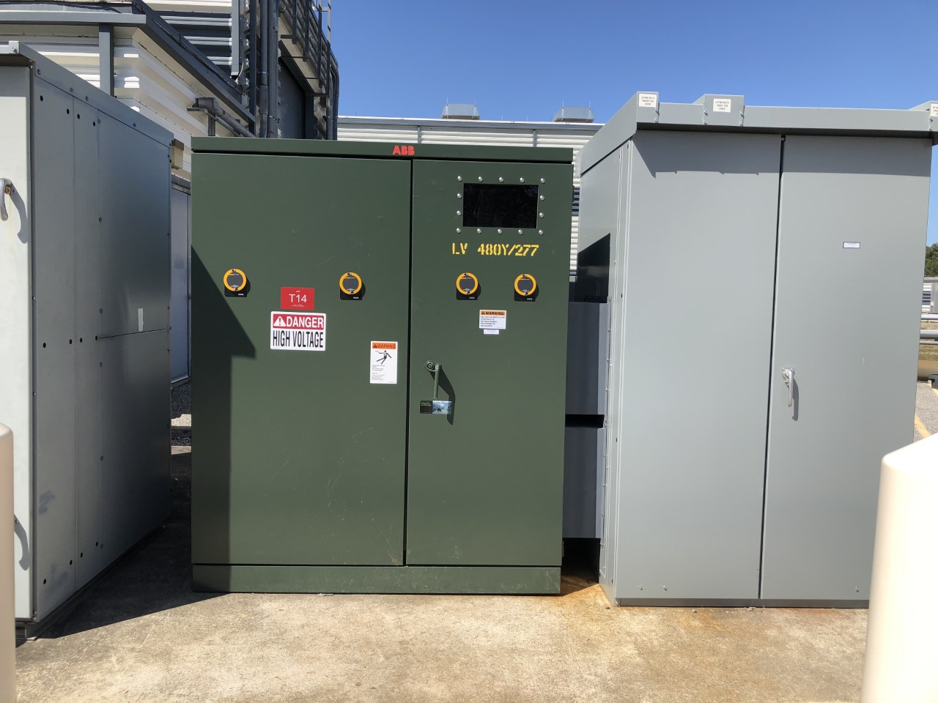
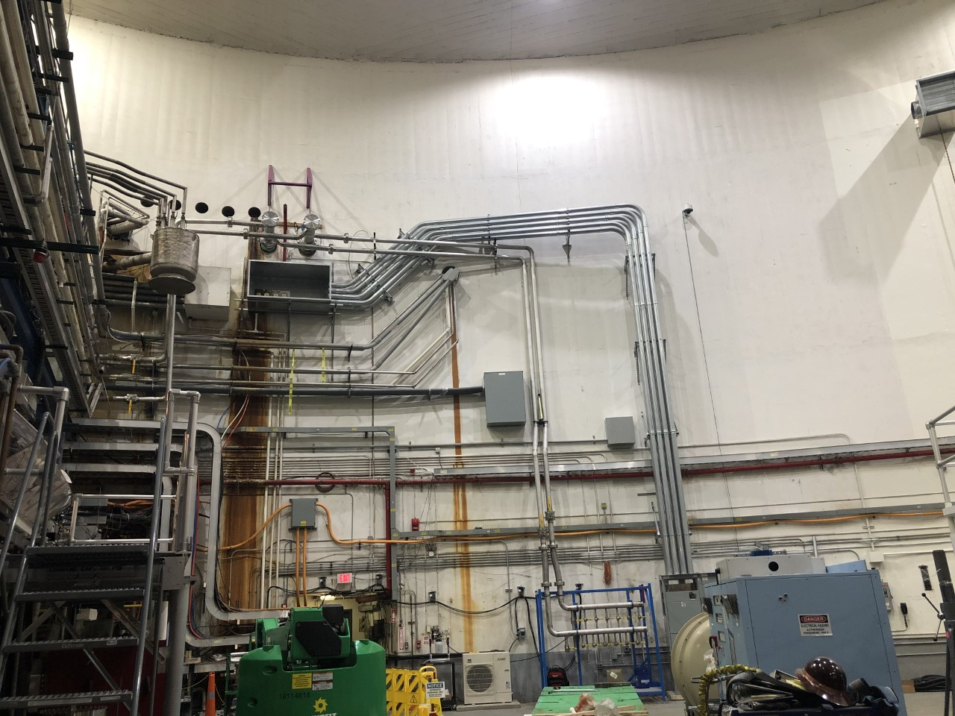
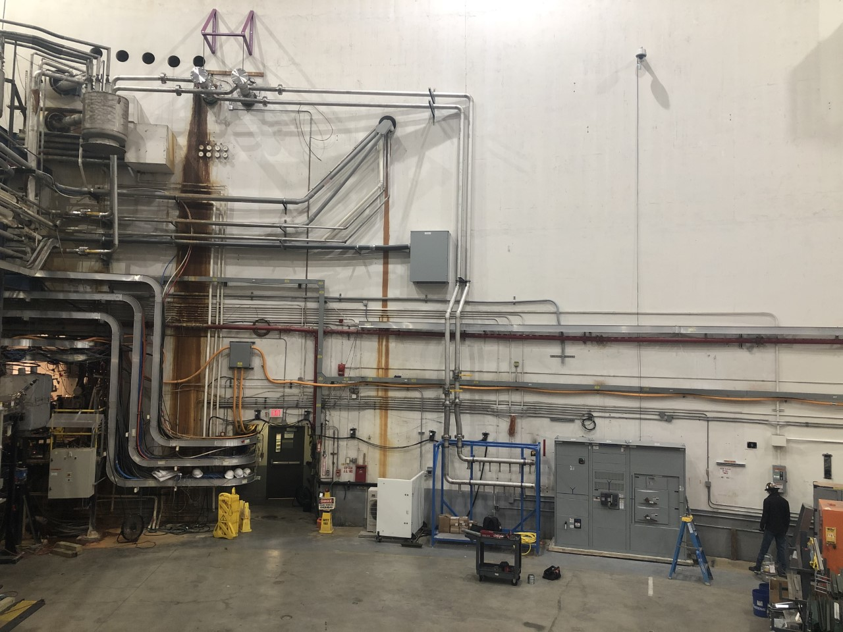
Before & After
LCW and 2MVA power upgrade
Remove tritium vent
LCW upgrade
2MVA power upgrade

Slide 10
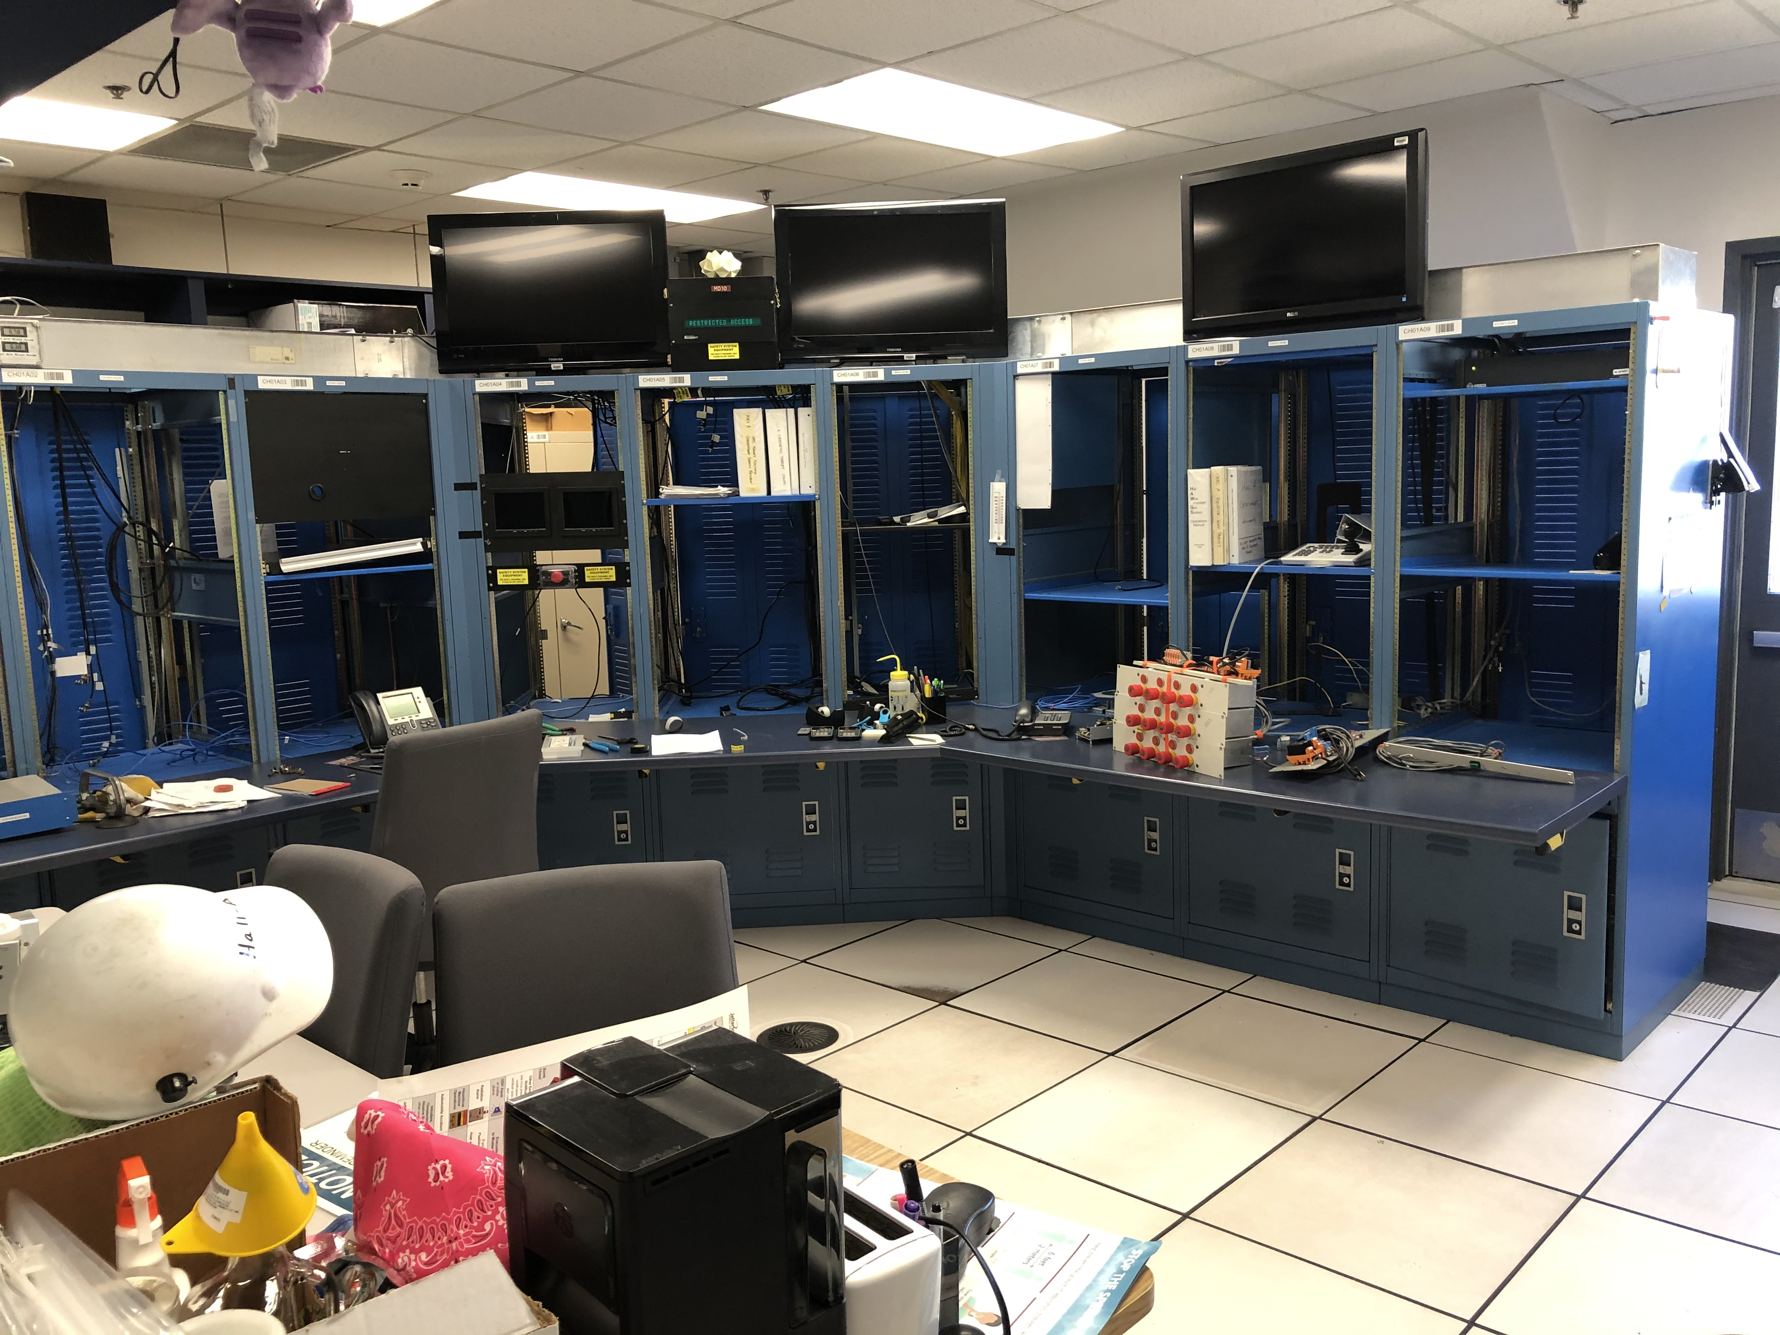
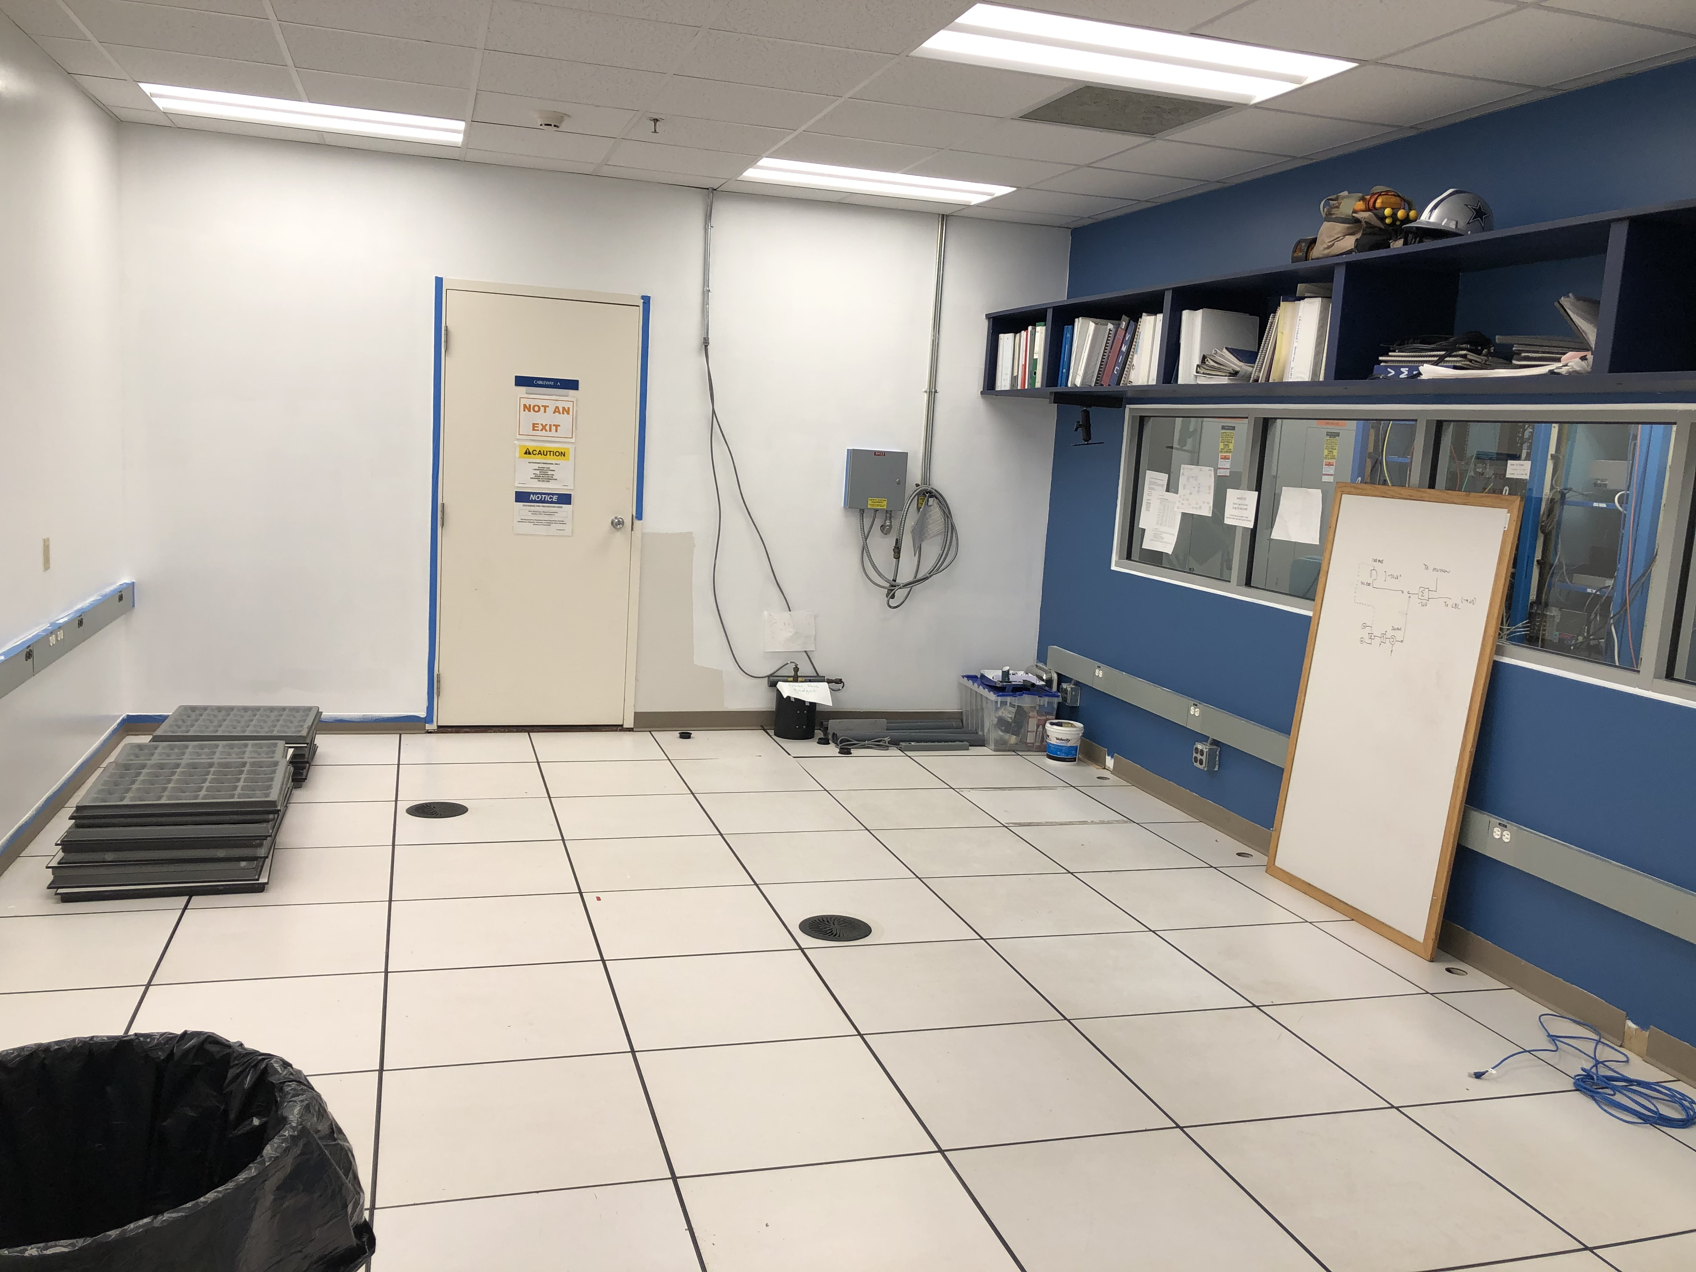
SBS and SAD provide opportunity also for upgrades and symbiotic (some dependency) work for MOLLER, SoLID….
ESR2
Parity beamline development and beam instrumentation
Precision polarimetry development
Hall A counting house upgrade
Polarized ³He target development

Slide 11

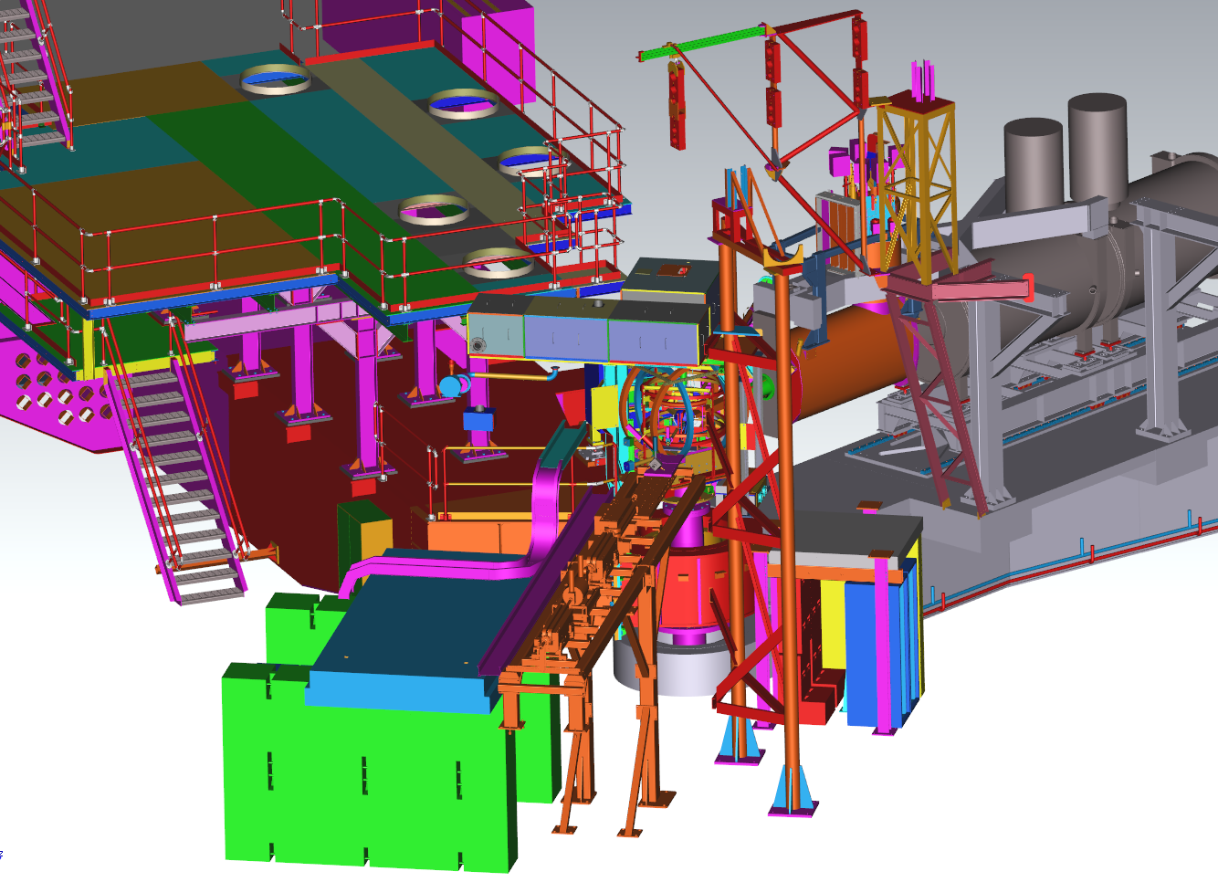
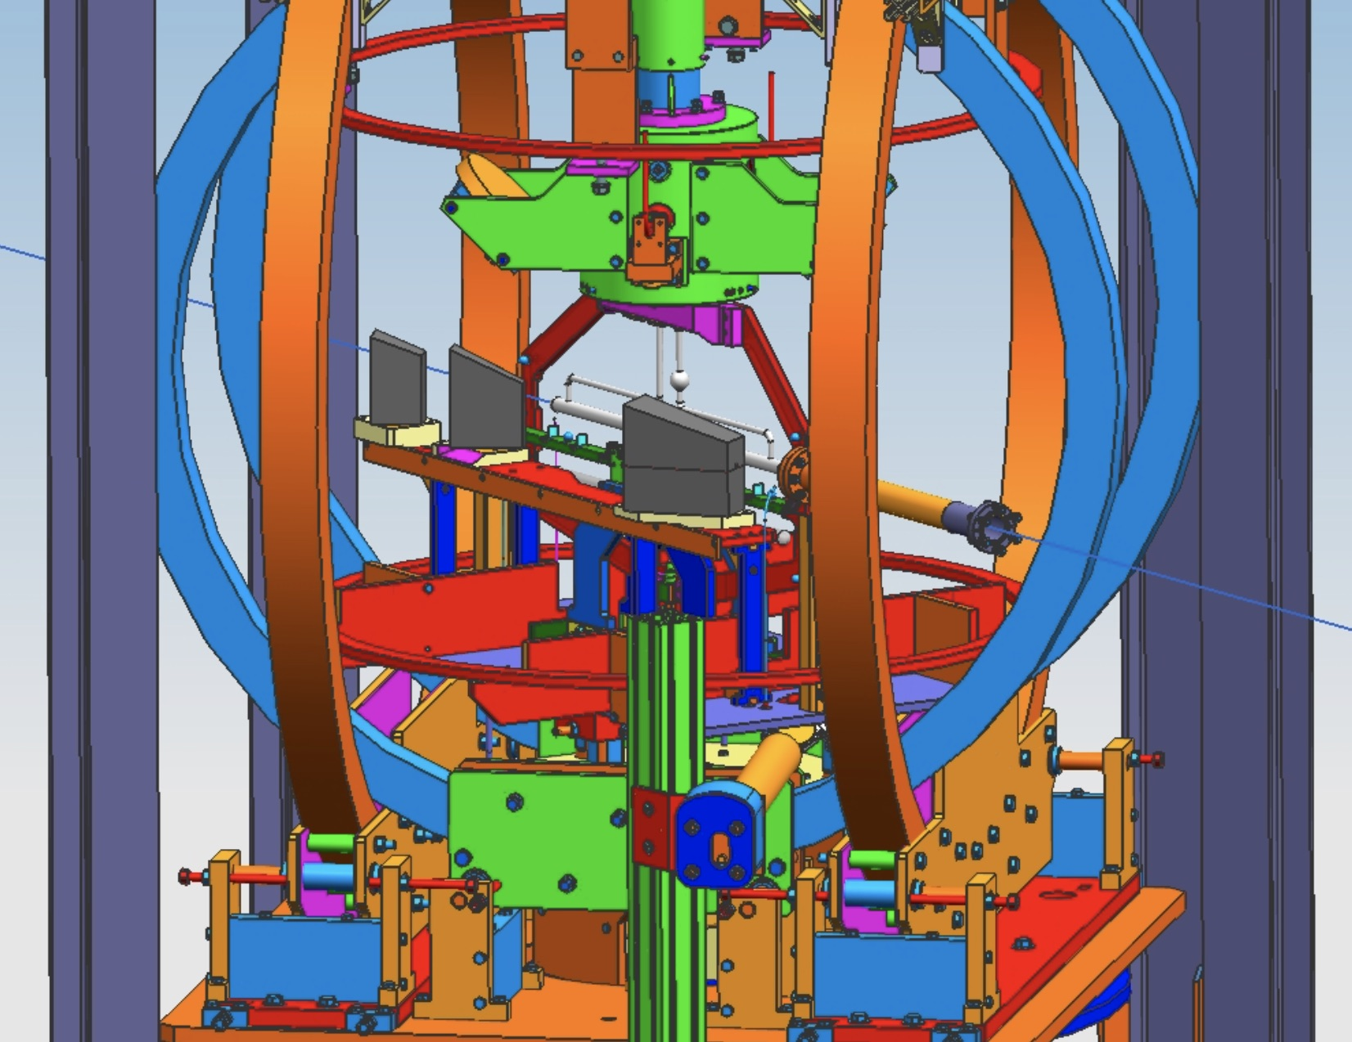
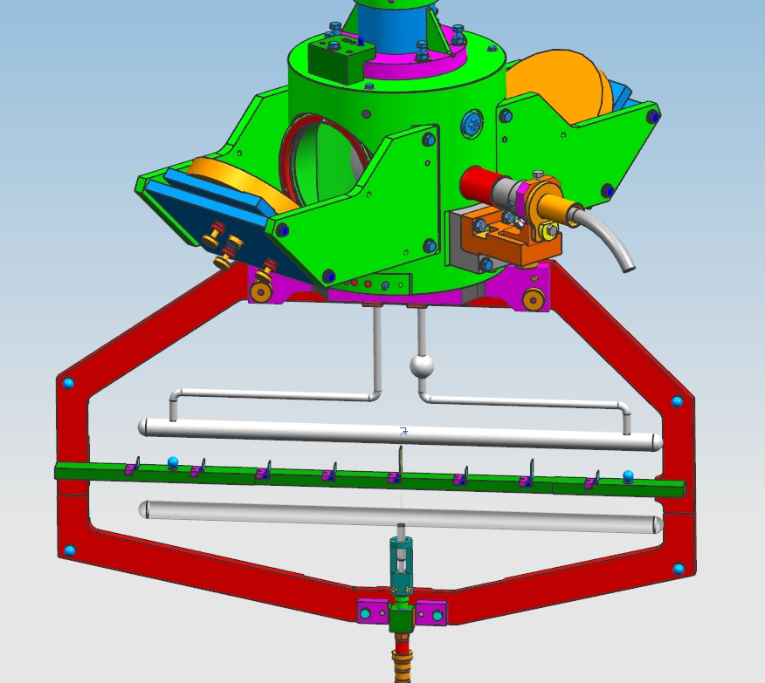
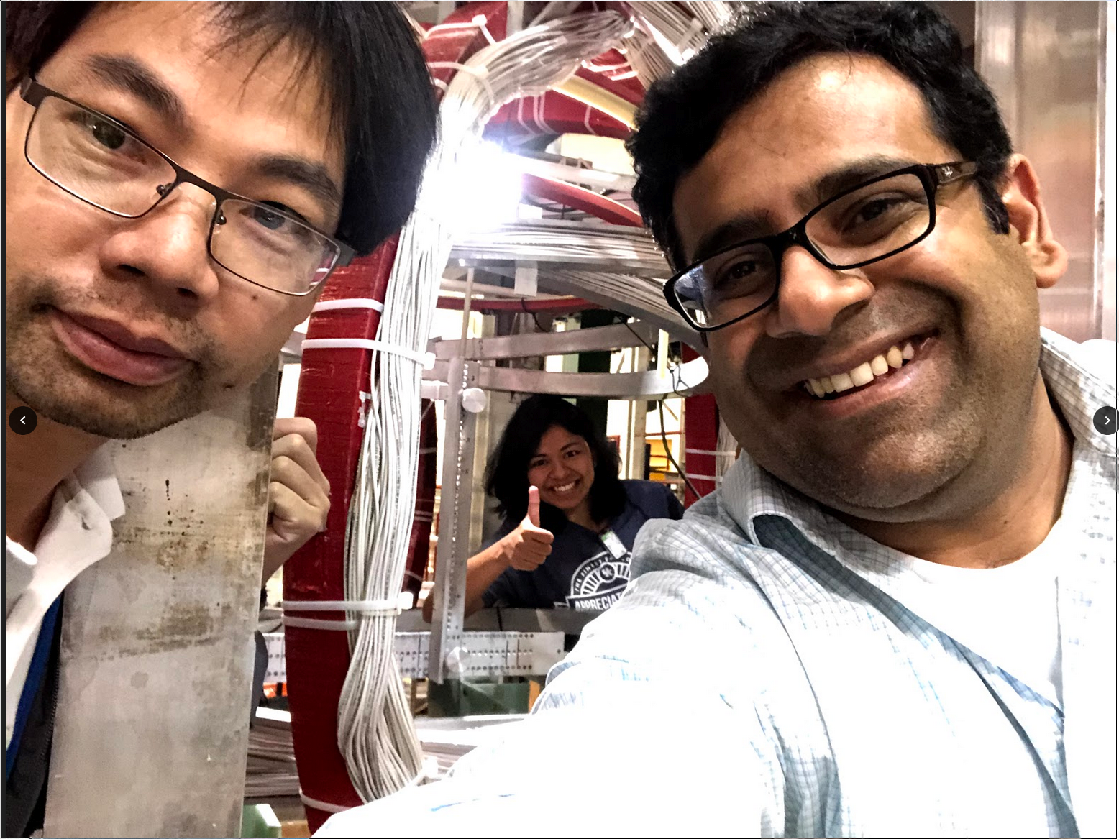
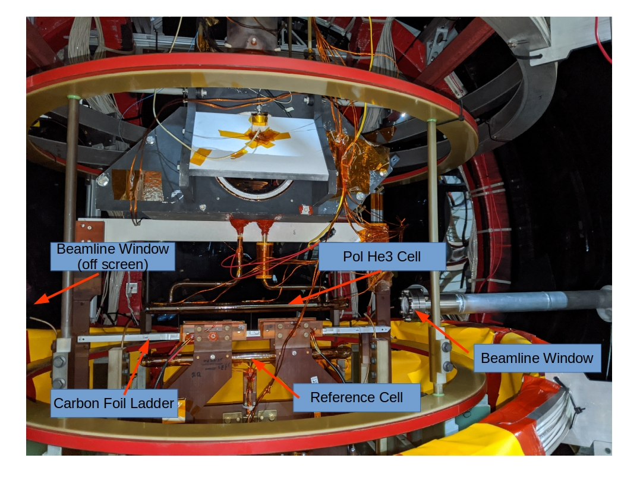
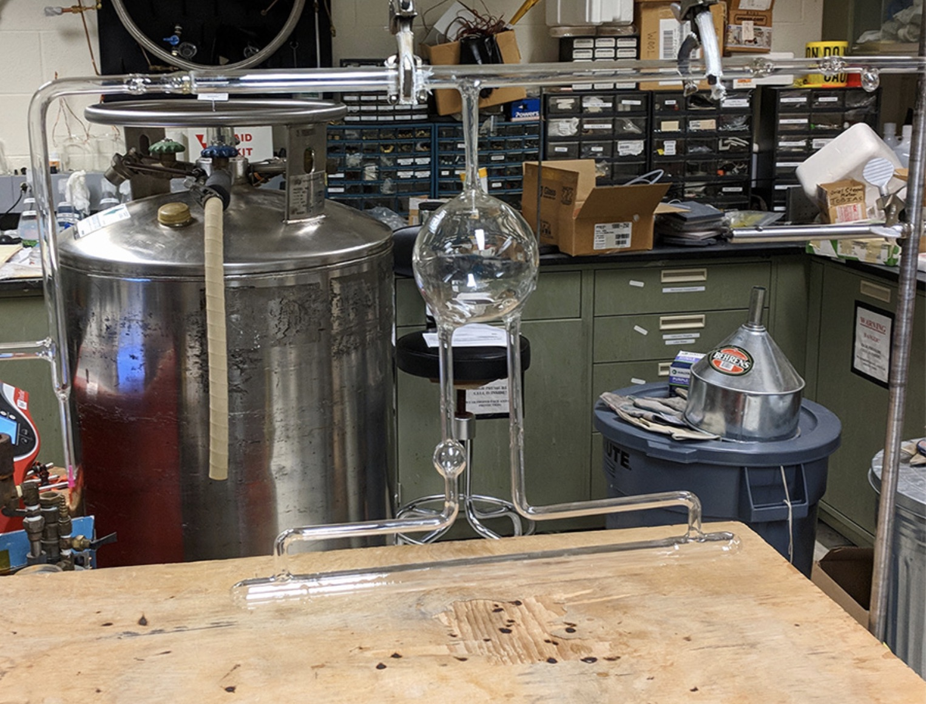
Polarized ³He target development
Polarized ³He for A1n/d2n experiment in Hall C
30 μA on 40 cm, ~10 atm ³He gas
L ~ 2.2x10³⁶ cm⁻²s⁻¹ – x2 previous highest L
In-beam polarization ~ 55%
Polarimetry precision ~ 3%
Polarized ³He for GEn experiment in Hall A
60 μA on 60 cm, ~10 atm ³He gas
L ~ 6.6x10³⁶ cm⁻²s⁻¹ – x3 higher L again
In-beam polarization ~ 55-60%
Polarimetry precision ~ 3%
Magnetic fields around SBS a challenge
SHMS
HMS
Pol ³He Target
e- beam

Slide 12
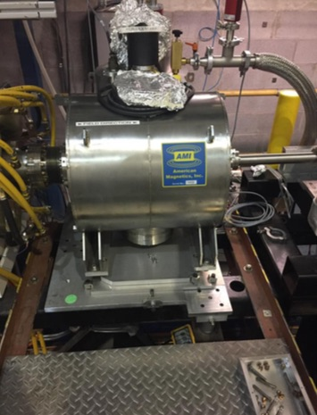
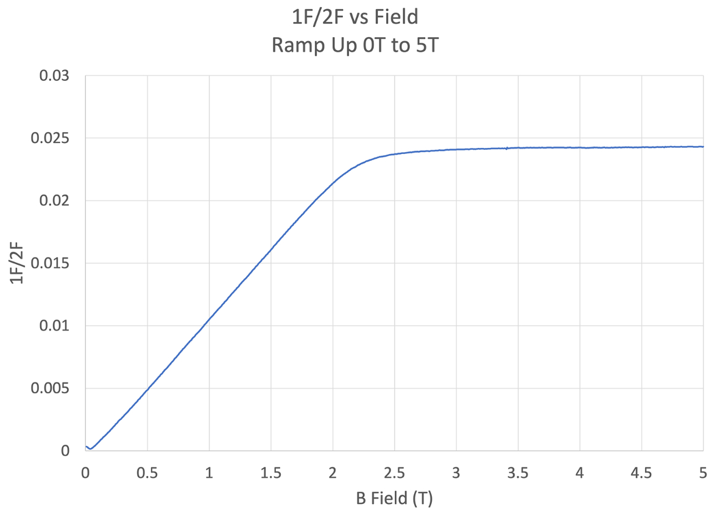
Moller Polarimetry
Working towards upgraded, largely common, Hall A/C polarimetry
0.89% precision achieved for PREX2
New Hall C MOLLER superconducting target magnet (identical to Hall A)
New MOLLER target ladders for Halls A and C
Kerr effect measurements underway to verify target foil saturation
Kerr effect signal→ foil magnetization
Notes:
Combine with next

Slide 13
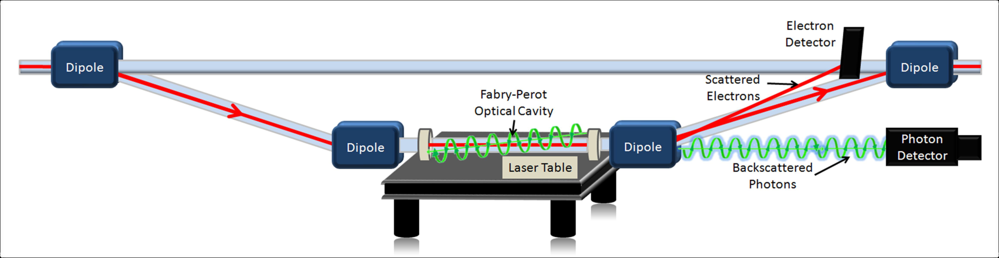
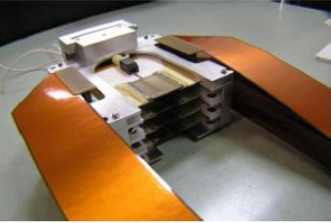
Compton Polarimetry
– testing in SBS and Hall C, preparing for MOLLER
HIPPOL capital equipment project goal: achieve similar capabilities in Compton polarimetry in Halls A and C
Improved laser system in Hall C → seed laser, fiber amplifier purchased
Update Hall C electron detector DAQ → VETROCs, VXS crate in hand, VETROCs used/commissioned during CREX
Larger electron detector in Hall C and new detector for Hall A (diamond)

Slide 14
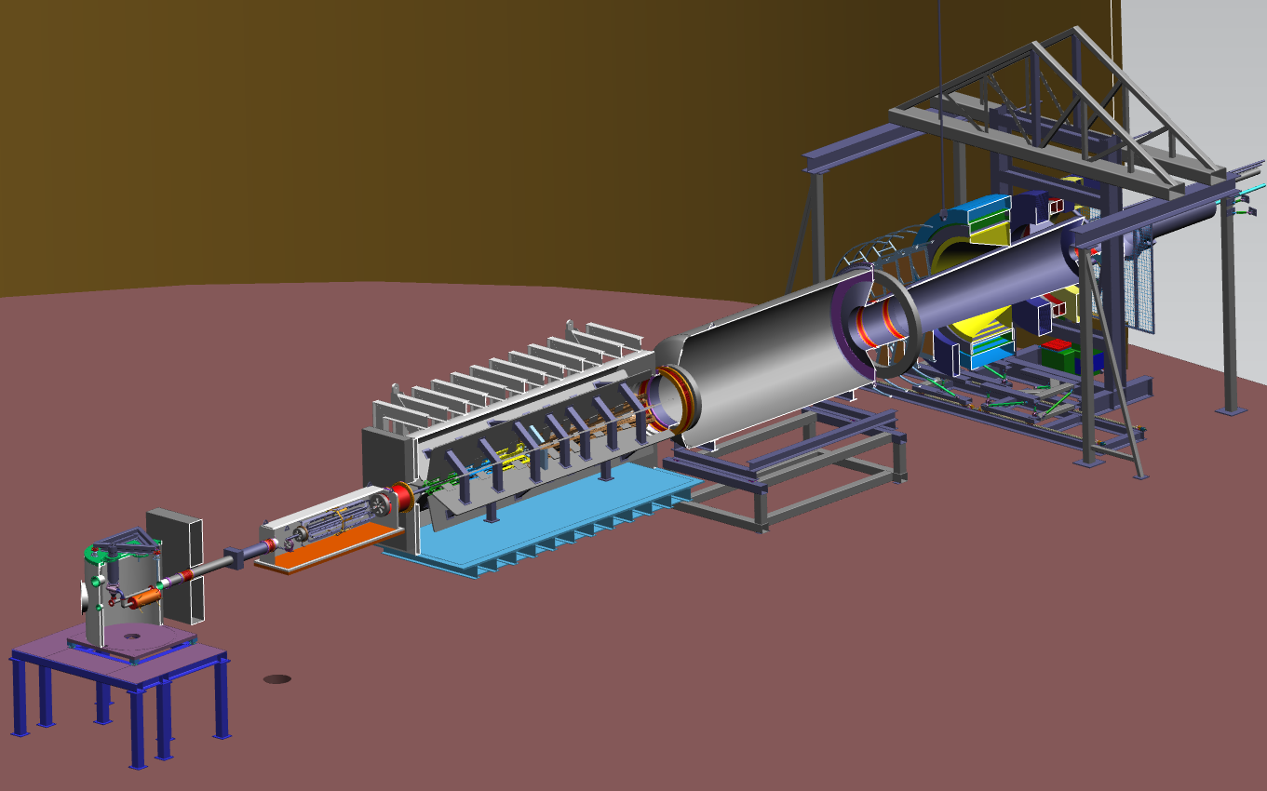
MOLLER Project Underway
DOE CD-1 approved December 2020
NSF Midscale and CFI/RM quickly followed
Much work underway!
MOLLER Project
1.01 Project Integration and Support
1.05 Tracking Detectors
1.02 Liquid Hydrogen Target
1.03 Spectrometer
1.04 Integrating Detectors
1.06 Hall A Integration
1.07 DAQ and Trigger
1.13 OPC
1.08 MOLLER Installation
WBS 1.06 (Jlab)
Hall A Infrastructure and Integration
WBS 1.07 (NSF/JLab)
DAQ and Trigger
WBS 1.04 (CFI & NSF)
Integrating Detectors
WBS 1.03 (Jlab) Spectrometer
WBS 1.05 (NSF/JLab)
Tracking Detectors
WBS 1.02 (JLab)
LH₂ Target
WBS 1.08 (JLab)
MOLLER Installation

Slide 15
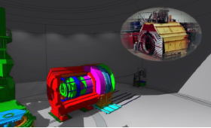
SoLID Proposed QCD & Fundamental Symmetries MIE
Unique Capability:
  High luminosity (10³⁷⁻³⁹)
  Large acceptance detector with full φ coverage
  State-of-the-Art Technology
Pre-R&D started 2020
Science Review – March 8-10, 2021
Waiting for report, and looking forward to CD0!
Notes:
BMcK revised 05Feb; AL format edits 06Feb; Dry Run edits 12Feb

Slide 16
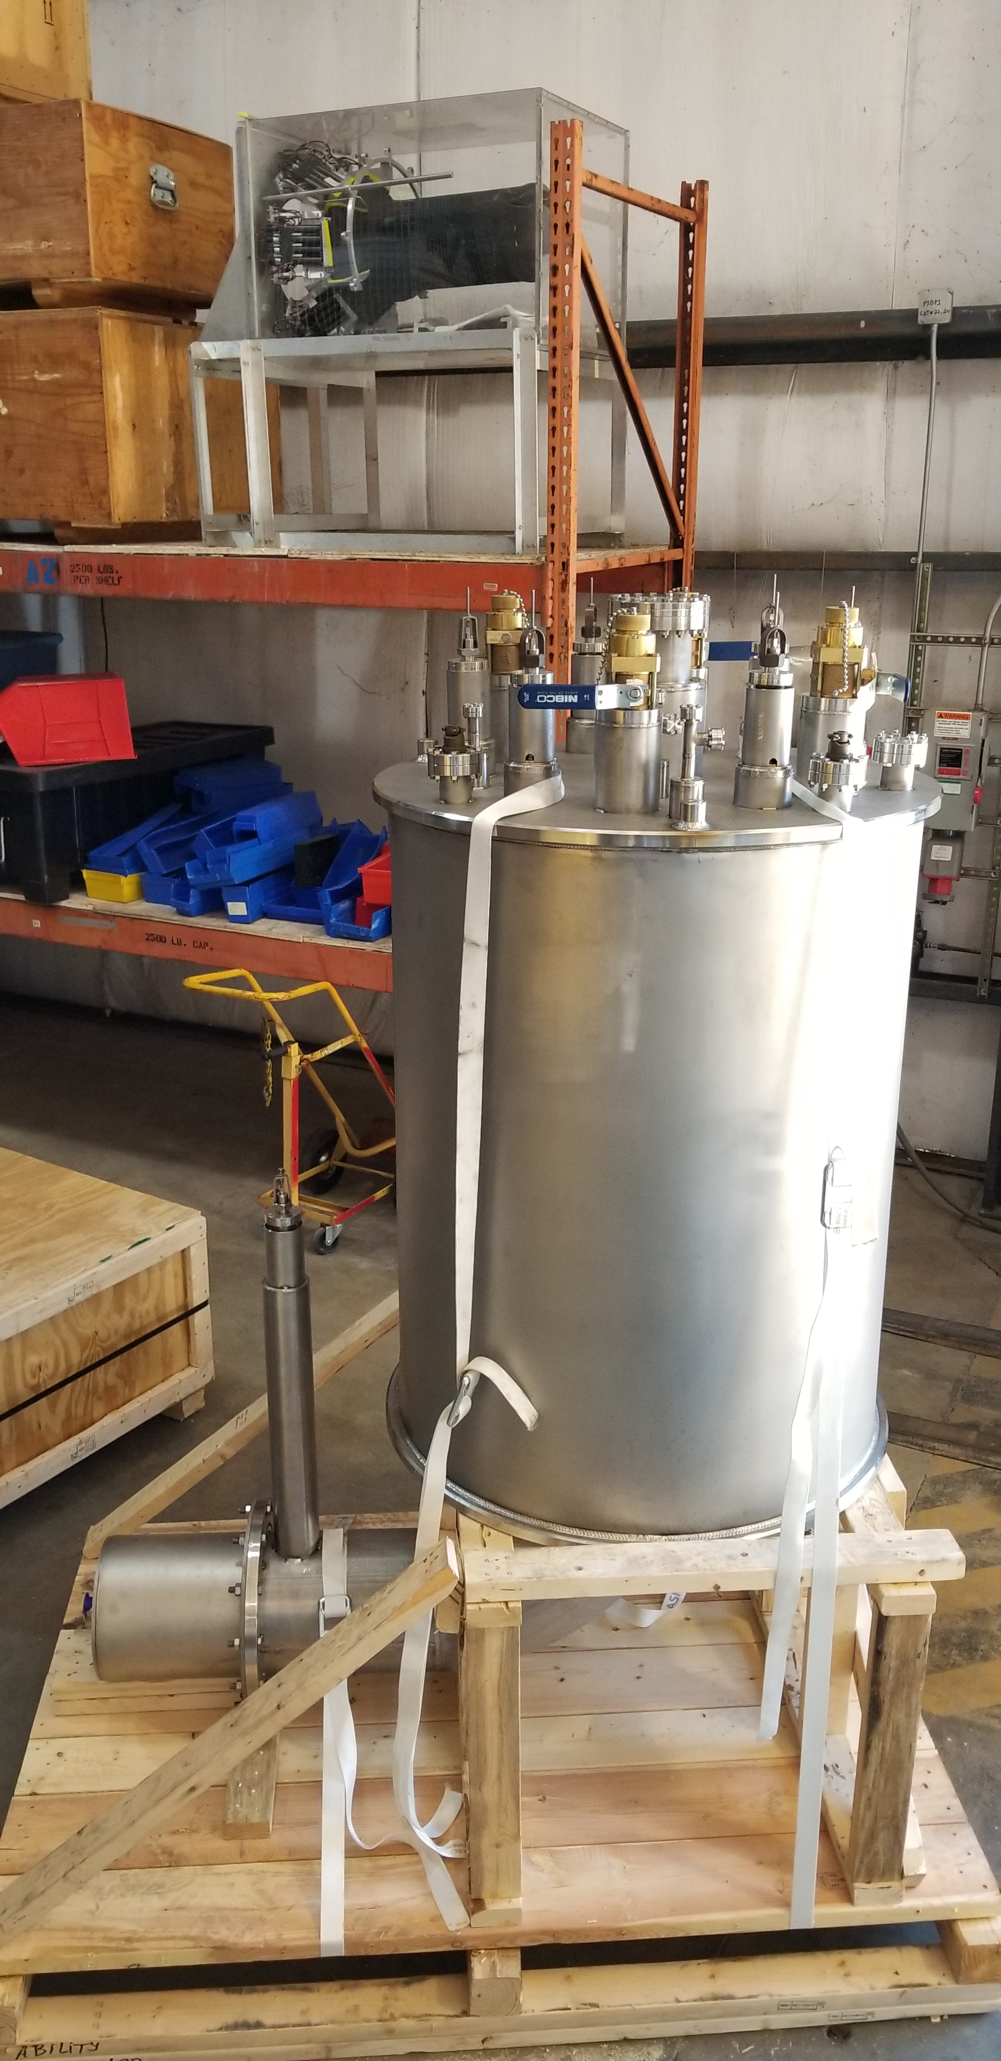
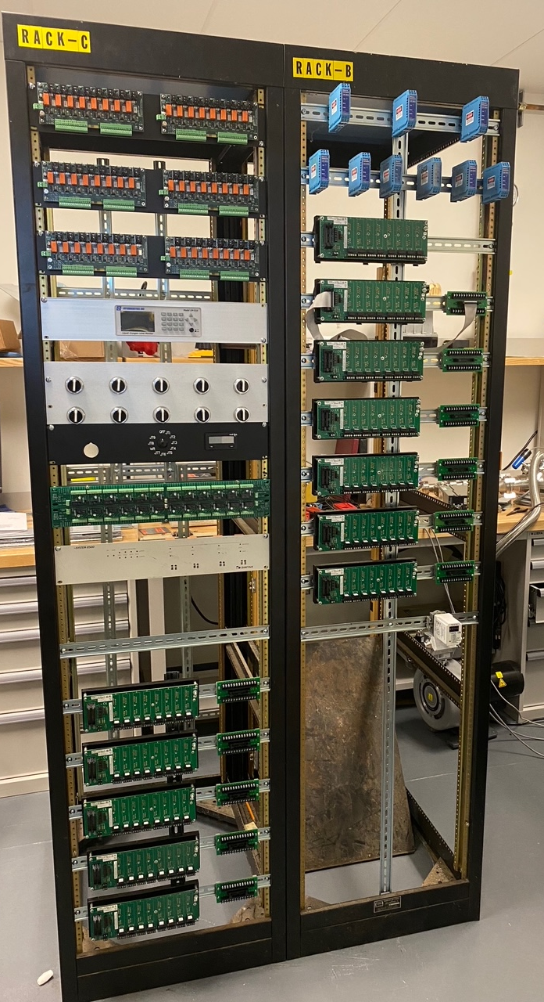
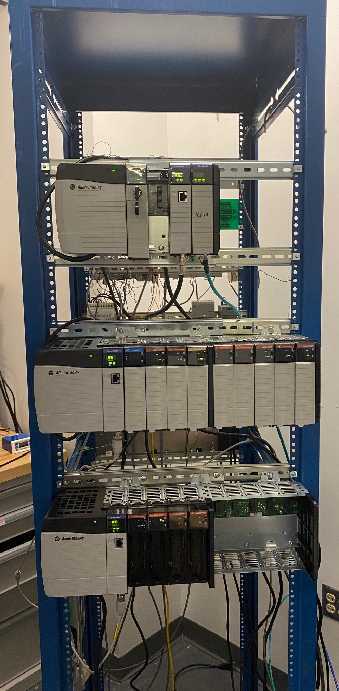
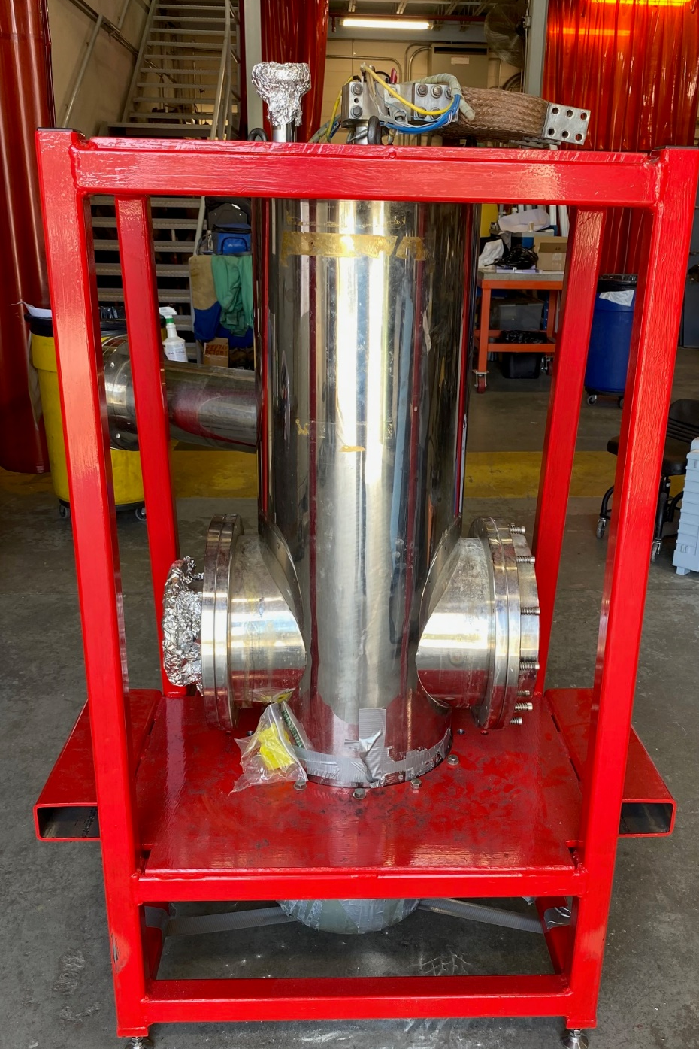
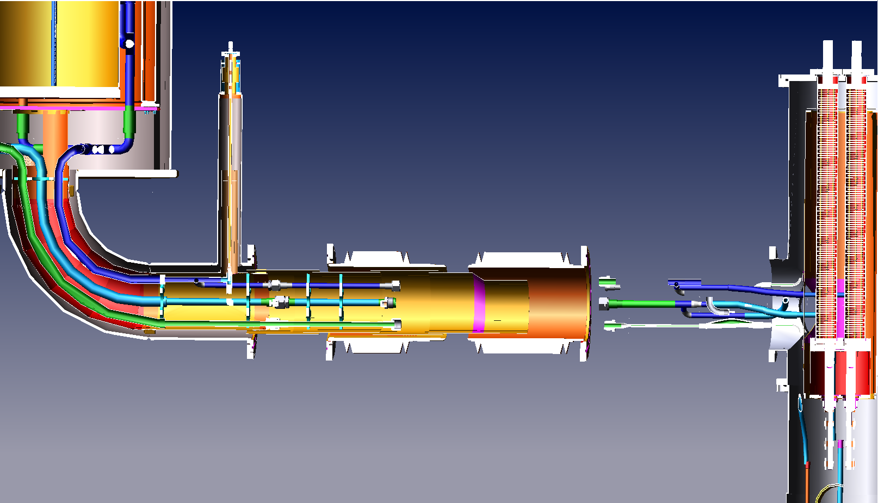
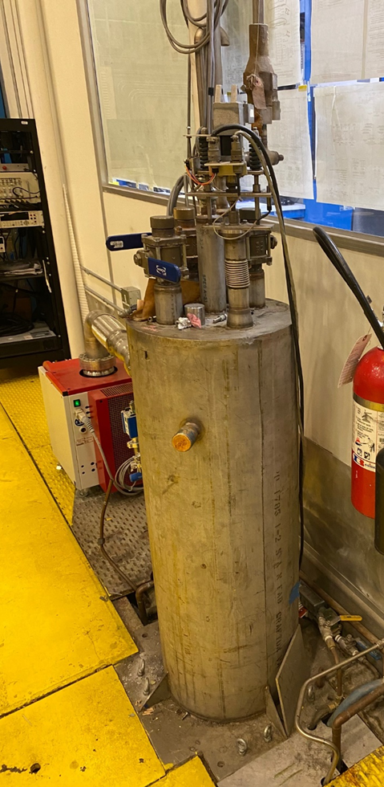
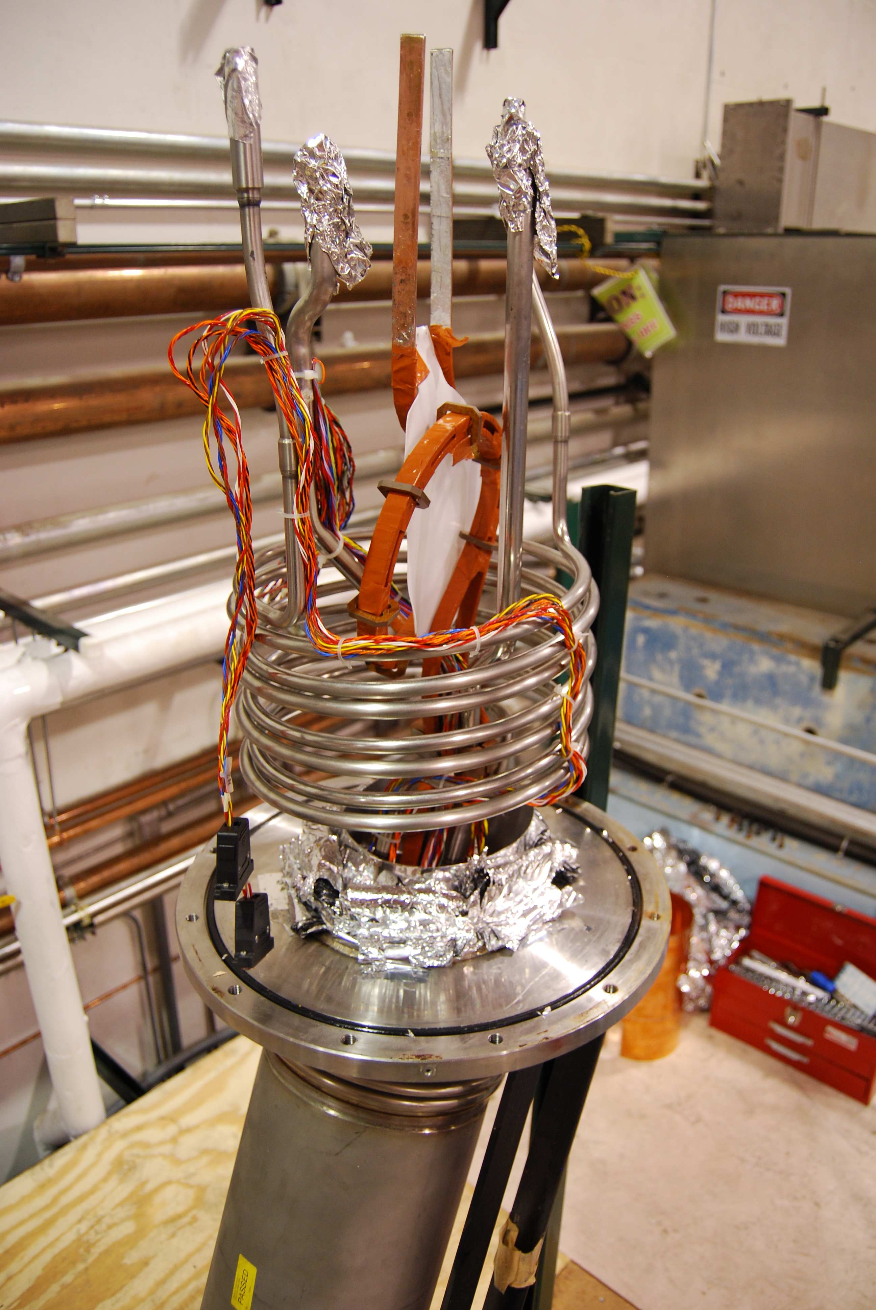
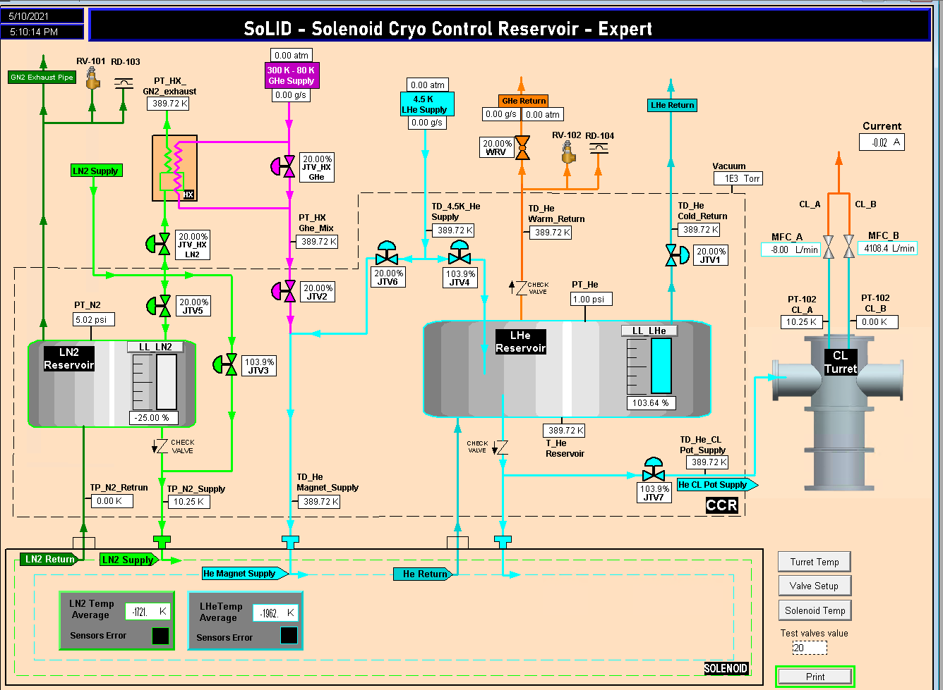
CLEOII Solenoid Rehab – Static and Cold Test
Solenoid rehab will confirm magnet condition
Provide project risk reduction
Refine magnet planning
I/O control rack hardware assembled
Needs wiring and cable termination.
Cable orders are in process and some have been delivered.
Current Lead Turret Separated from Dewar – to be connected to CCR then to Magnet
Connection Bellows To be order
Cryo Lines have been ID at JLAB
New Cryo-Can Reservoir Delivered (CCR)
Valve JT actuators, pressure gauges, liquid level meters, Vacuum gauges, relief devices and hardware are on hand and ready to install
On site acceptance pressure/vacuum testing passed
HMI screens are being developed and tested
Existing Current leads, Cryo lines and Instrumentation wiring on Top of the CLEO magnet
Cryo-Can Distribution in EEL
Meetings held with Cryo to discuss schedules and operation status of cryo in Test Lab
Estimated completion Sept 2021

Slide 17
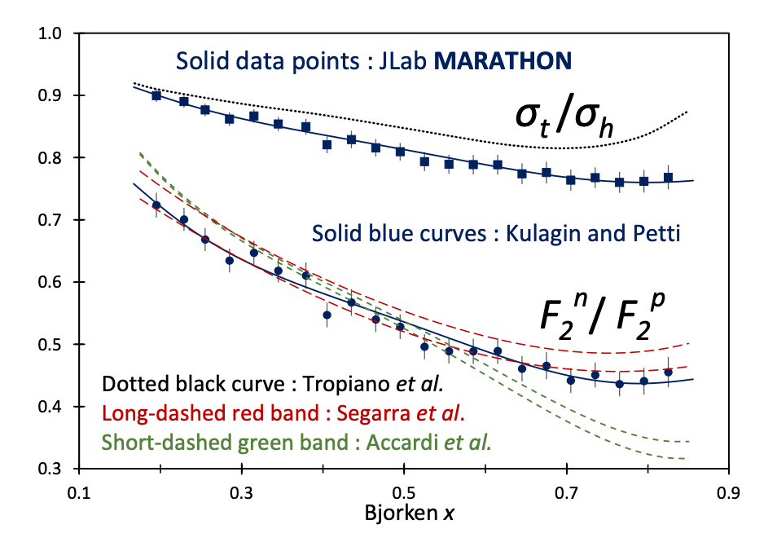
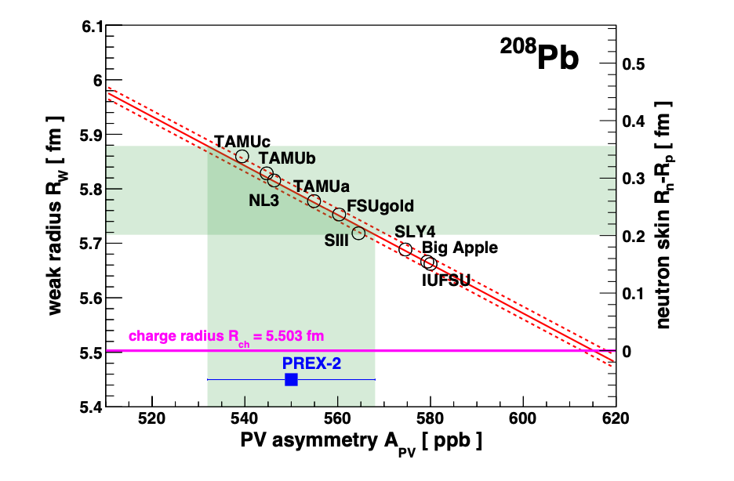
…and more!
The web page is being updated
7 2020 publications, 5 so far in 2021 (MARATHON, PREX2,..)

Slide 18

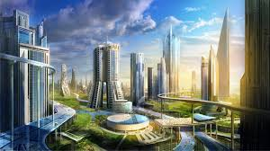
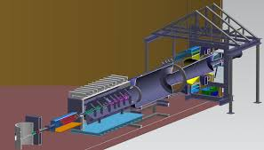
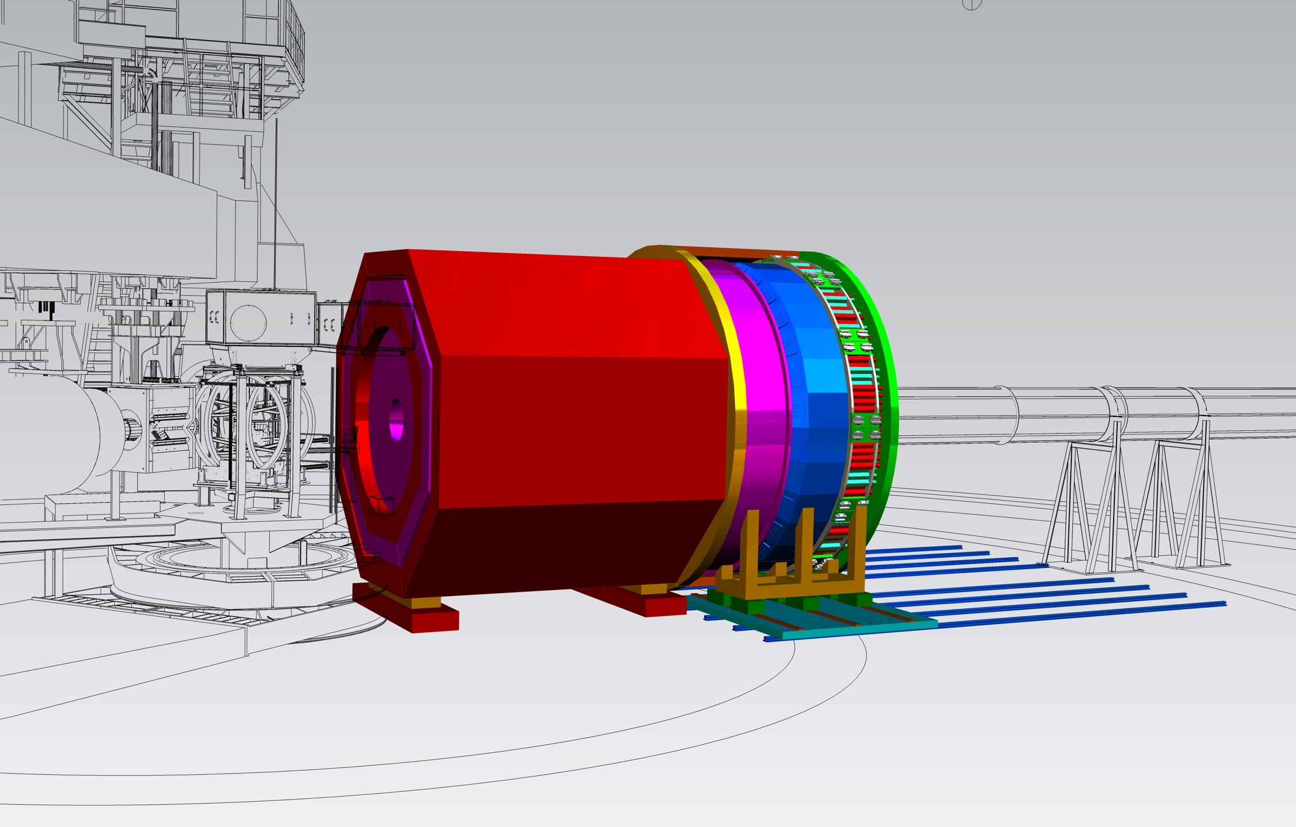





Questions?
?

