Slide 1
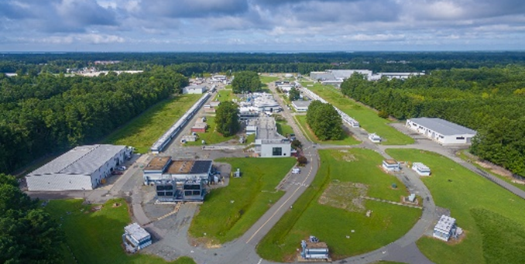
PAC49 Charge
Robert McKeown
PAC49
July 19, 2021

Slide 2
PAC Approved experiments (status at May 13, 2021)
Topic | Hall A | Hall B | Hall C | Hall D | Other | Total
Hadron spectra as probes of QCD | 0 | 2 | 1 | 4 | 0 | 7
Transverse structure of the hadrons | 7 | 4 | 3 | 1 | 0 | 15
longitudinal structure of the hadrons | 1 | 3 | 7 | 1 | 0 | 12
3D structure of the hadrons | 5.5 | 9 | 6.5 | 0 | 0 | 21
Hadrons and cold nuclear matter | 9 | 6 | 7 | 1 | 0 | 23
Low-energy tests of the Standard Model and Fundamental Symmetries | 3 | 1 | 0 | 1 | 1 | 6
Total | 25.5 | 25 | 24.5 | 8 | 1 | 84
Total Experiments Completed | 9.0 | 9.7 | 7.3 | 1.5 | 0 | 27.5
Total Experiments Remaining | 16.5 | 15.3 | 17.2 | 6.5 | 1.0 | 56.5

Slide 3
12 GeV Experiments by PAC Days (status at May 13, 2021)
 | Hall A | Hall B | Hall C | Hall D | Other | Total
Hadron spectra as probes of QCD | 0 | 219 | 11 | 740 | 0 | 970
Transverse structure of the hadrons | 152.5 | 125 | 146 | 25 | 0 | 448.5
Longitudinal structure of the hadrons | 19 | 170 | 211 | 33 | 0 | 433
3D structure of the hadrons | 361 | 812 | 225 | 0 | 0 | 1398
Hadrons and cold nuclear matter | 240 | 305 | 205 | 15 | 0 | 765
Low-energy tests of the Standard Model and Fundamental Symmetries | 547 | 180 | 0 | 79 | 0 | 806
Total Days | 1319.5 | 1811.0 | 798.0 | 892 | 0 | 4820.5
Total Days - (includes MOLLER) | 845.5 | 1811 | 798 | 892 | 0 | 4347
Total Approved Run Group Days (includes MIE) | 1319.5 | 1036 | 755 | 692 | 0 | 3802.5
Total Approved Run Group Days (includes MOLLER) | 845.5 | 1036 | 755 | 692 | 0 | 3329
Total Days Completed | 256.5 | 323 | 173.0 | 206 | 0 | 958.5
Total Days Remaining | 589 | 713 | 582 | 486 | 0 | 2370
A DECADE OF EXCELLENT SCIENCE!

Slide 4
PAC49
1 returning conditional
6 new proposals
1 run group addition
4 letters of intent
Charge:
Review new proposals, previously conditionally approved proposals, and letters of intent for experiments that will utilize the 12 GeV upgrade of CEBAF and provide advice on their scientific merit, technical feasibility and resource requirements.
Identify proposals with high-quality physics that, represent high quality physics within the range of scientific importance represented by the previously approved 12 GeV proposals and recommend for approval.
Also provide a recommendation on scientific rating and beam time allocation for proposals newly recommended for approval.
Identify other proposals with physics that have the potential for falling into this category pending clarification of scientific and/or technical issues and recommend for conditional approval. Provide comments on technical and scientific issues that should be addressed by the proponents prior to review at a future PAC.

Slide 5
Conditional Approval
Two types:
C1 – Approval pending technical review,
no need to return to PAC
C2 – Approval pending further review by
future PAC

Slide 6
Proposals with Parallel Running
Parallel running procedure
Intent is to encourage new proposals of “run groups”
– Summary only of additions to existing run group (PAC to comment)

Slide 7
Jeopardy
Policy
Finalized after discussion with UGBOD in September 2016
Rationale
Use normal yearly PAC for ~4 years to address all presently approved proposals that have not been scheduled, plus new proposals in the next few years. Estimate ~5-10 proposals per meeting
Start in 2019, hope to reach steady state in 2024 - proposals that have been approved for 4 years or more but are not scheduled will be considered in Jeopardy.

Slide 8
Policy on Equipment Availability
Categories for resource availability:
– Stage I: resources need to be identified/obtained
– Stage II: resources are essentially available
This will be considered a Laboratory issue
(not for PAC).

Slide 9
PAC Report
Draft report text must be complete before closeout on Friday. We will review all the draft text Friday morning before the closeout.
Susan Brown will assemble the draft text into a report for a final round of edits by email during 2 weeks following the PAC meeting.

Slide 10
Role of User Chair on PAC
Monitor communications between PAC and spokespersons – identify issues.
Monitor PAC meeting proceedings for conflicts of interest.
Monitor PAC meeting proceedings to identify issues of fairness and ethical behavior.
Participate in all scientific discussions to provide additional expertise (except where there is a conflict of interest)

Slide 11
Communication with PAC
Communication with PAC members should be limited to:
Submission of proposal before the deadline
Presentation/discussion at PAC meeting, must be in-person (not remote connection)
Responses from spokespersons and/or contact person to inquiries from PAC for further information or clarification
Note: TAC and Theory reports are not public documents – please do not distribute beyond your collaboration.

Slide 12
Conditional Proposals for PAC49
C12-19-002 would be Stage II if approved

Slide 13
New Proposals for PAC49
001, 005 would be Stage II if approved
002-4, 006 would be Stage I if approved

Slide 14
Parallel Running Additions
These run in parallel with previously approved or conditionally approved proposals. So they are considered already approved (or conditional) and are presented by collaborations – the PAC will provide a written comment for each of these in the report.

Slide 15
Letters of Intent
Letters of intent will be given the same “rights” to their scientific ideas as are
currently afforded to deferred experiments: LOI has established a claim to a physics measurement that lasts for the next two successive PAC meetings.

Slide 16
PAC49 Jeopardy
Partially completed:
 | #days completed/#days total
E12-06-121 | 14/29 | C - g2n, d2n
E12-09-011 | 32/40 | C - Kaon LT
E12-10-003 | 3/21 | C - d(e,e’p)
E12-10-009 | 11/34 | A - APEX
E12-11-112 | 16/19 | A - tritium
Not scheduled:
E12-11-002 | C - (e,e’p) recoil polarization
E12-11-009 | C - GEn from deut. (e,e’n)
E12-11-107 | C - SRC and EMC
E12-09-005 | MOLLER
E12-09-018 | SBS SIDIS 3He

Slide 17
Presentation procedure
Please mute during the 20 min. presentation.
10 minutes for questions:
- Markus will call on readers first
- Then other questions from the committee – unmute to be recognized by Markus

