Slide 1
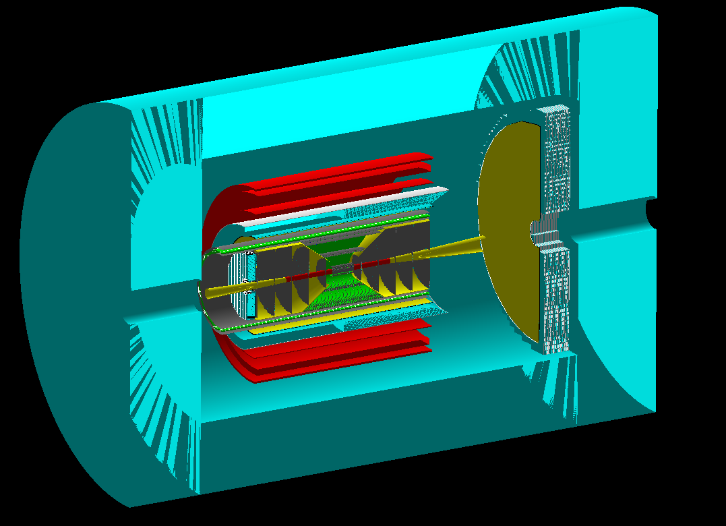
CORE: wiki and RHIC/AGS presentation highlights
CORE meeting, June 14, 2021

Slide 2
CORE wiki is up!
The CORE wiki is public, but hosted at JLab, so a JLab account is needed for editing.
Off-site access is straightforward
Instructions for registering are on the wiki page.
The wiki has direct links for editing subscription details for all CORE mailing lists.

Slide 3
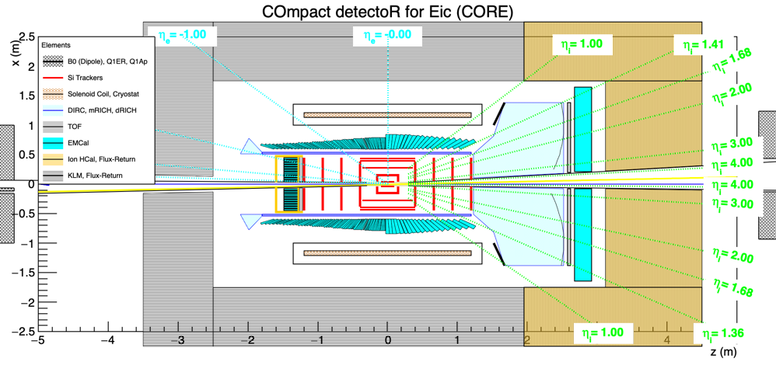
K₀ ID
The Belle II K_{L}-μ (KLM) system
K_{s} → π⁺π⁻ decays (cτ = 2.68 cm) can be measured in the outer part of the tracker
K_{s} with all momenta can be measured, but the efficiency will drop with momentum.
p/π⁺ ID in the DIRC will distinguish K_{s} → π⁺π⁻ from Λ → pπ⁻.
Tracker optimization
K_{L} will be detected in the KLM/Hcal, which will provide a precise angular measurement
p_{T} for a single neutral hadron can be obtained from p_{T} balance
For a single neutral hadron, n/K_{L} ID can be obtained from hermeticity and baryon conservation (target baryons stay near the beam)

Slide 4
4𝜋 EMcal
DVCS on nuclei:
A high-resolution EMcal in the electron hemisphere makes it possible to reconstruct the t-distribution from the DVCS photon
PWO (1-2%) for electron hemisphere: (up to 2π, η < 0 coverage)
Photons from DVCS on ⁴He (YR)
Both the endcap and barrel could be projective
The small-angle EMcal could be SciGlass.
W-Shashlyk (6%?) for hadron hemisphere: (η > 0 coverage)
Projective modules in the barrel
Non-projective modules in the endcap

Slide 5
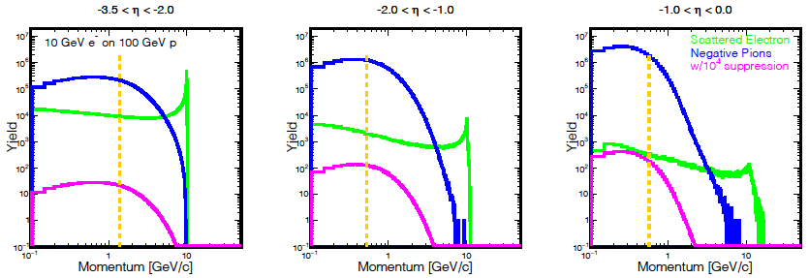
e/𝜋 identification in the electron hemisphere
η = -ln(tan(θ/2))
B. Schmookler
Q² > 1 &
y < 0.95
to the right of orange line
For the EIC, a clean identification of the scattered electron is essential.
The barrel region poses the greatest challenge and requires the best electron ID.
CORE addresses this issue by extending the PWO EMcal coverage up to η < 0 (or possibly -0.5)
Additional e/π suppression (at least 1:10 up to 1.2 GeV) is also provided by the DIRC.

Slide 6
Thank you!

Slide 7
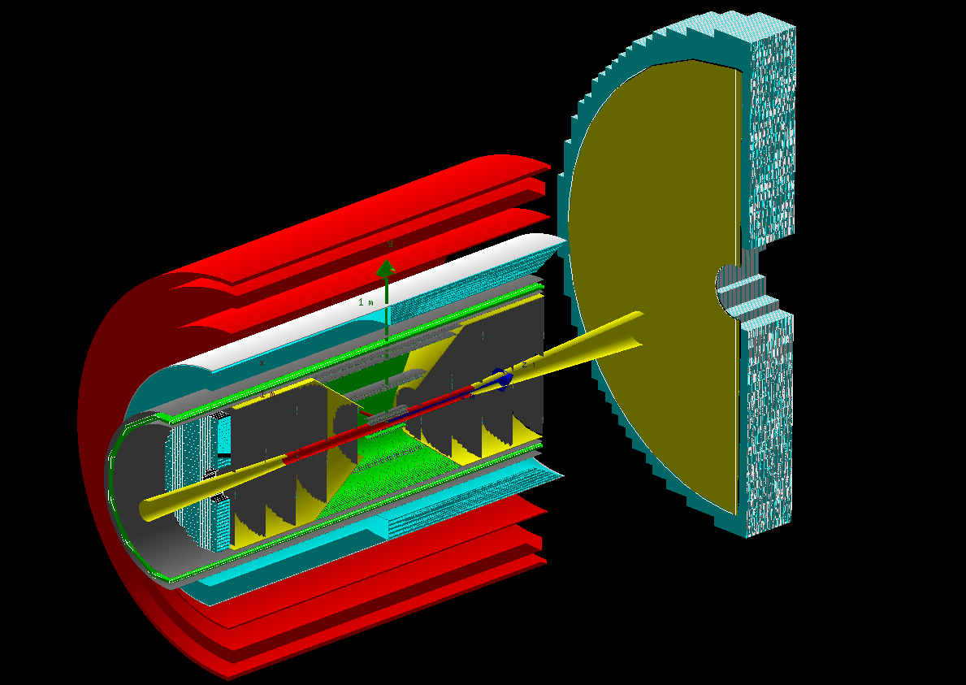
inner CORE in Geant (fun4all)
CORE systems
dRICH photosensors
B. Schmookler
New 2.5 T solenoid (2.5 m long, 1 m inner radius)
Tracking: central all-Si tracker (eRD25) and h-endcap GEM tracker (eRD6)
EMcal (eRD1): PWO for η < 0 and W-Shashlyk for η > 0
Cherenkov PID (eRD14): DIRC (50 cm radius) in barrel and dual-radiator RICH in h-endcap
TOF: LGADs in e-endcap (eRD29) and a simple TOF behind the dRICH
Hcal / K_{L}-μ (KLM) detector integrated with the magnetic flux return

Slide 8
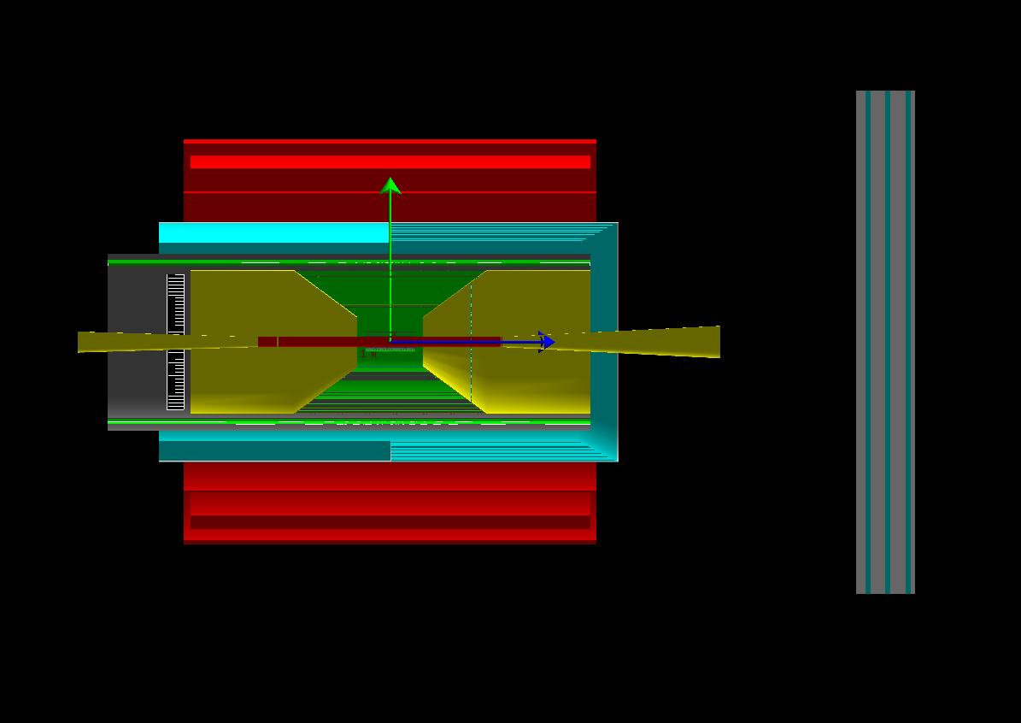
CORE solenoid
The CORE solenoid is 2.5 m long with a 1 m inner radius
CORE is compatible with any field in the 2 - 4 T range
2.5 T is the current baseline option
B. Schmookler
cost (2020 M$) = 1.8 x 0.458 x (stored energy)^{0.7}
M. A. Green and S. J. St. Lorant, Adv. Cryo. Eng. 39
A 1 m inner radius leaves 50 cm between the DIRC and solenoid
solenoid | field (T) | volume (m³) | 2020 cost (M$)
EIC-IP6 | 3 | 29 | 21
CORE | 3 | 7.8 | 8.5
CORE | 2.5 | 7.8 | 6.6
CORE | 2 | 7.8 | 4.8
Excellent projectivity for the field in the dual-radiator RICH.
The field at the DIRC photosensors is less than 2 T, enabling use of MCP-PMTs:
best performance and low technical risk

Slide 9
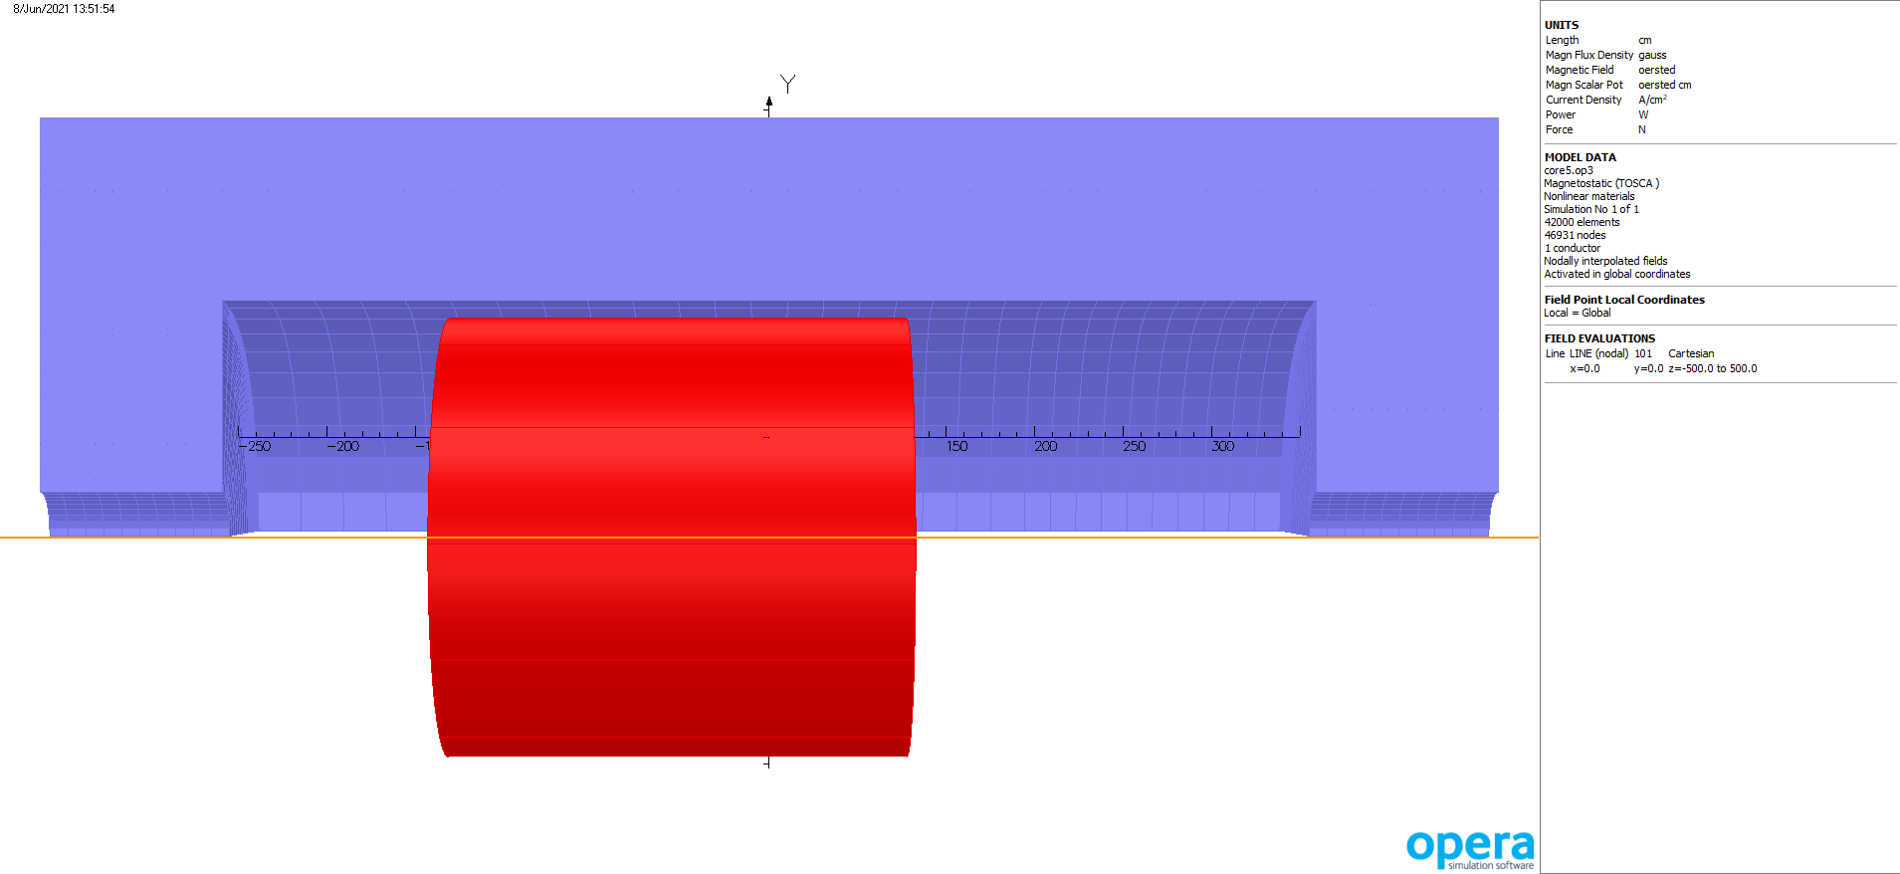
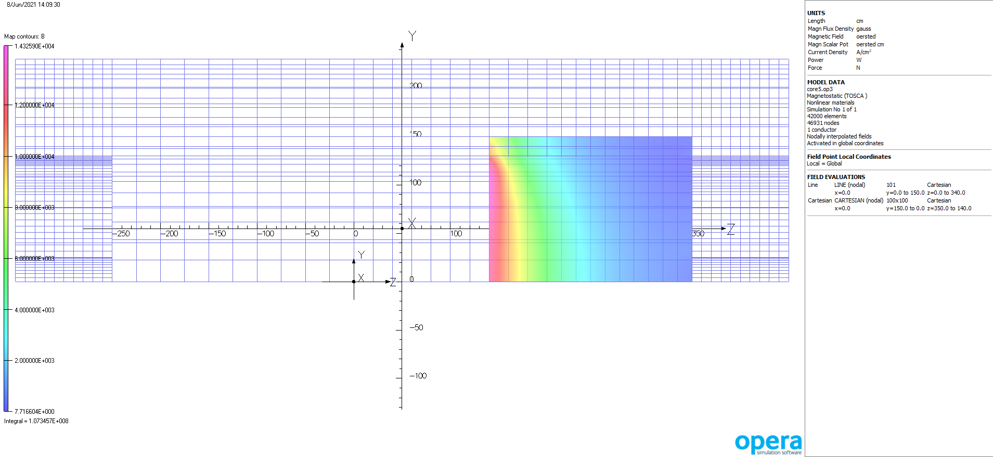
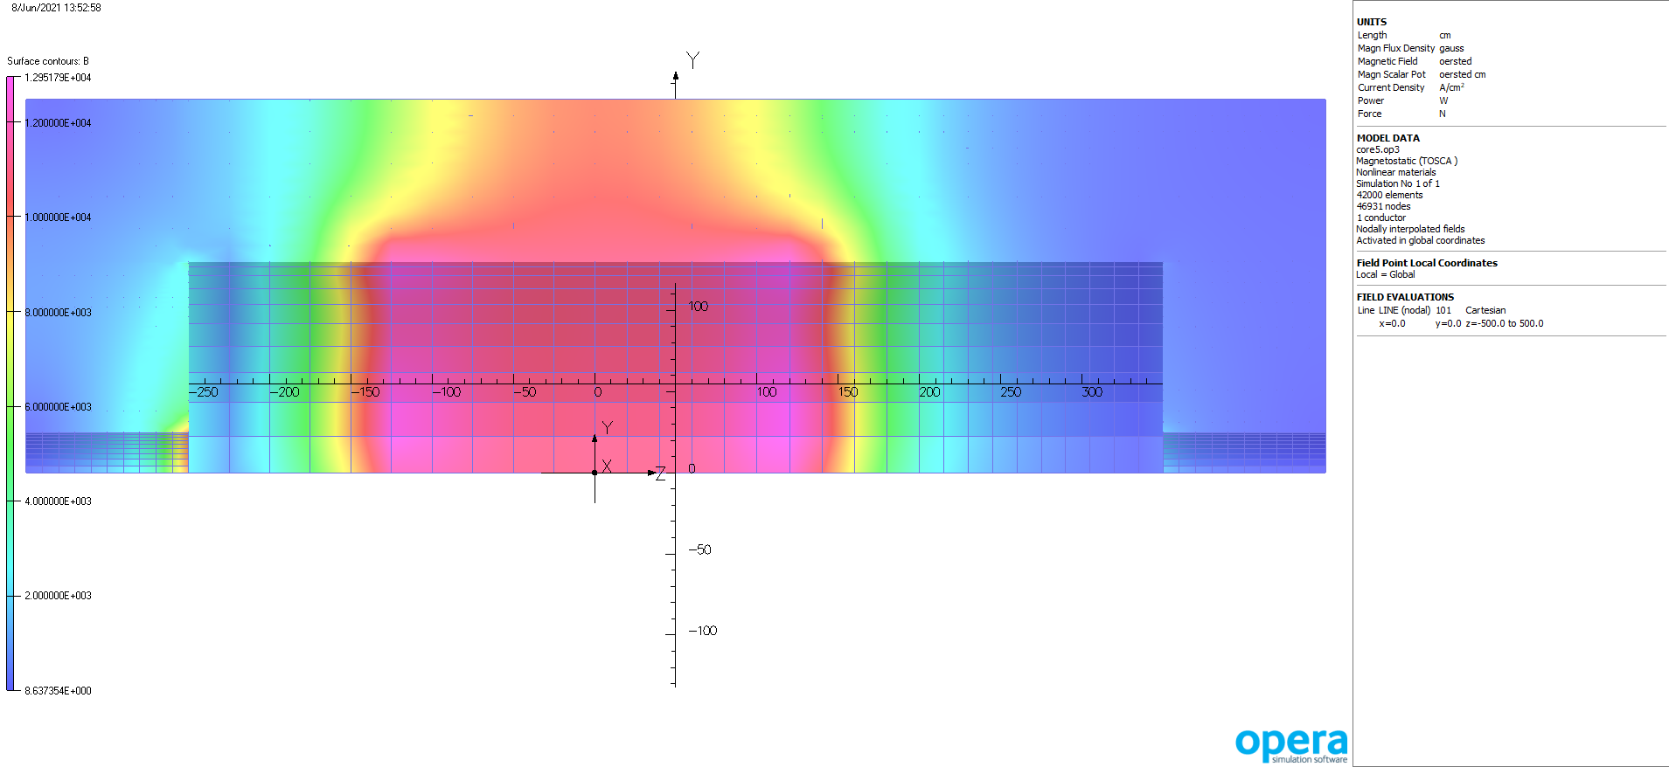
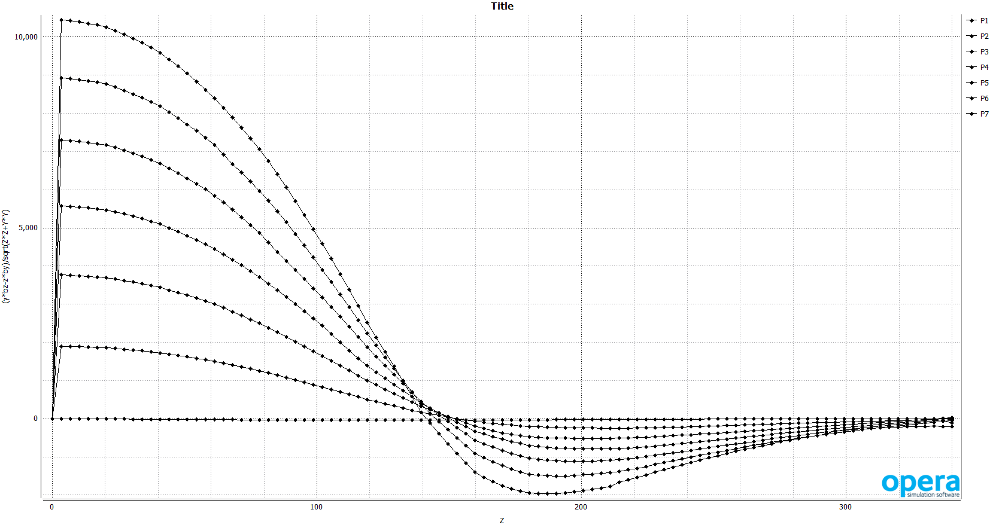
CORE solenoid in opera – 2.6 T on axis at IP
CORE in opera
Field in the dual-radiator RICH (dRICH)
Paul Brindza
Field on iron surfaces
Transverse field along the line-of-sight from the IP in the dRICH

