Slide 1
CORE
Various magnet and iron mods
Paul Brindza
June 8, 2021

Slide 2
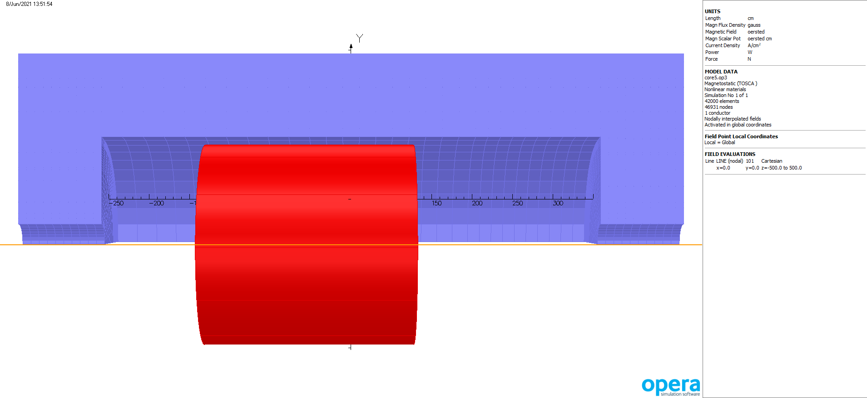
Core model move Ecal, larger radius

Slide 3
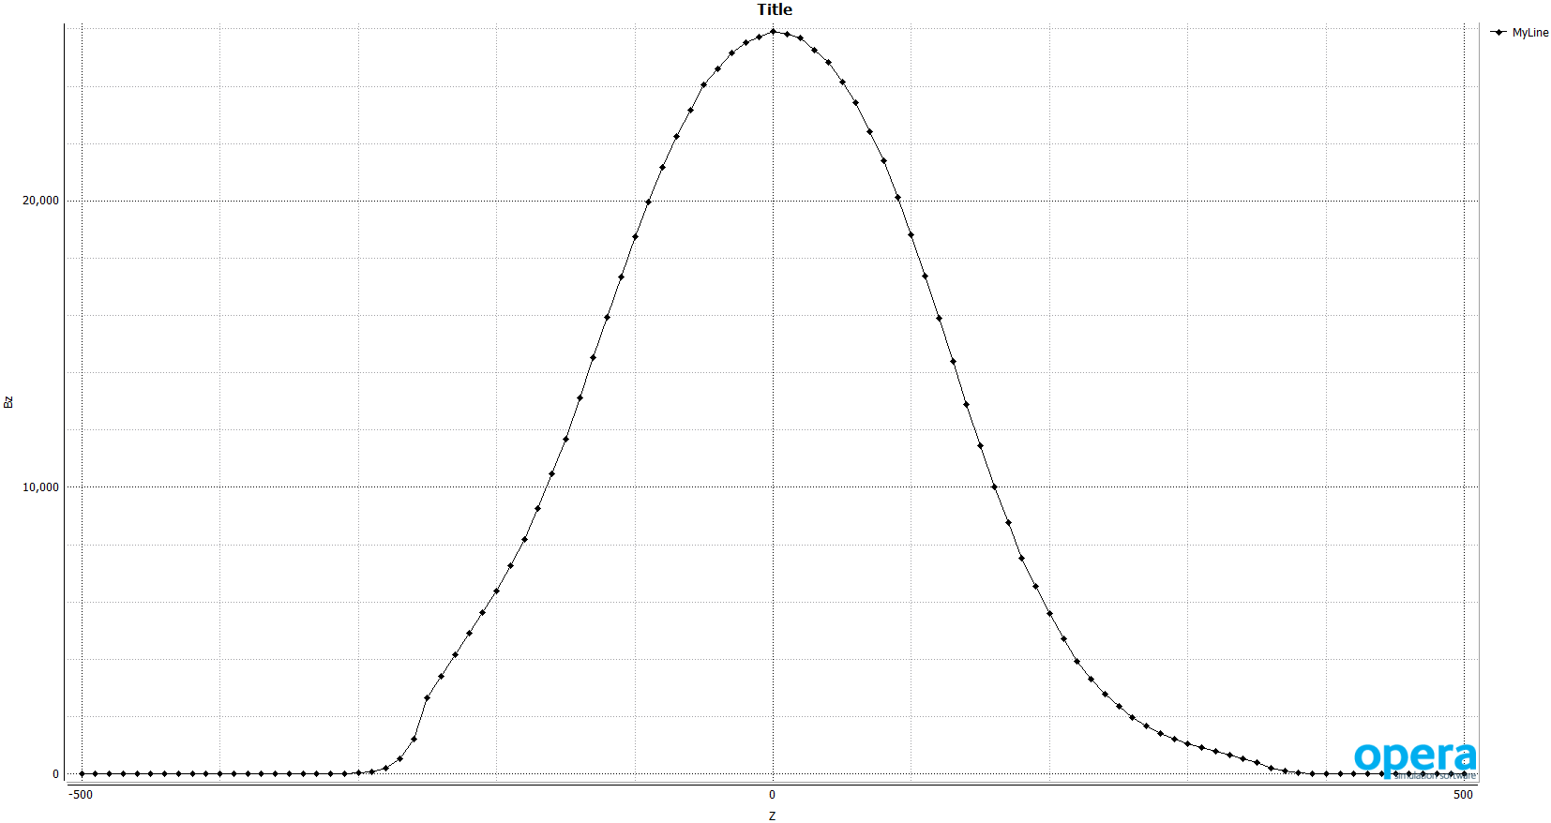
Bz on axis B(ooo) ~2.6 T

Slide 4
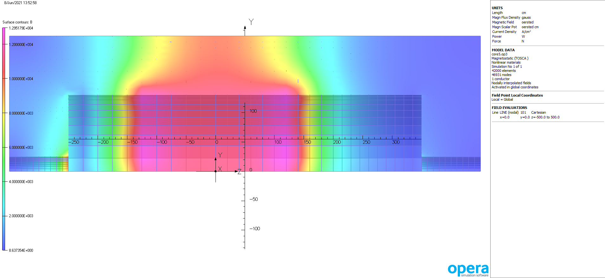
Field on iron surfaces

Slide 5
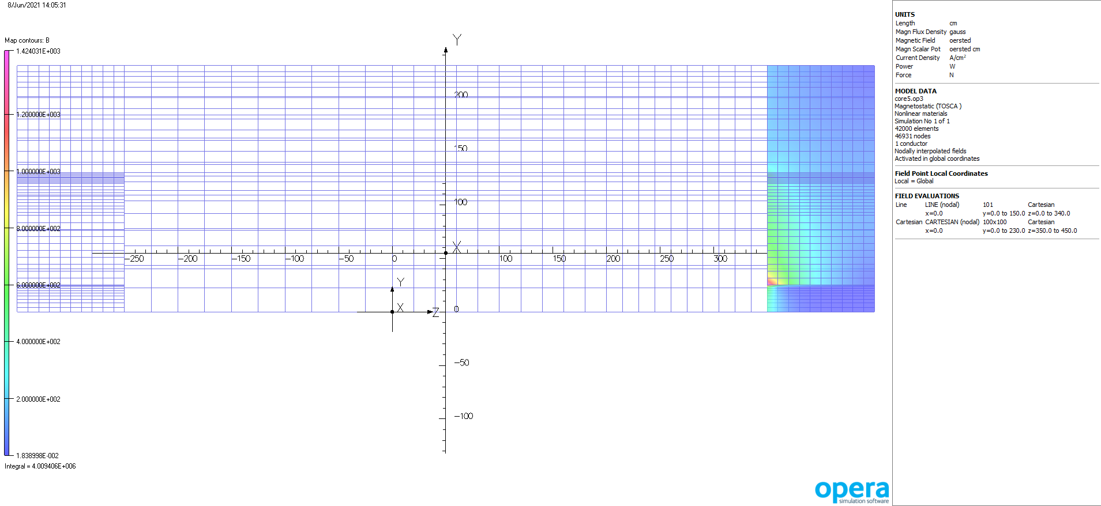
Field in Hcal

Slide 6
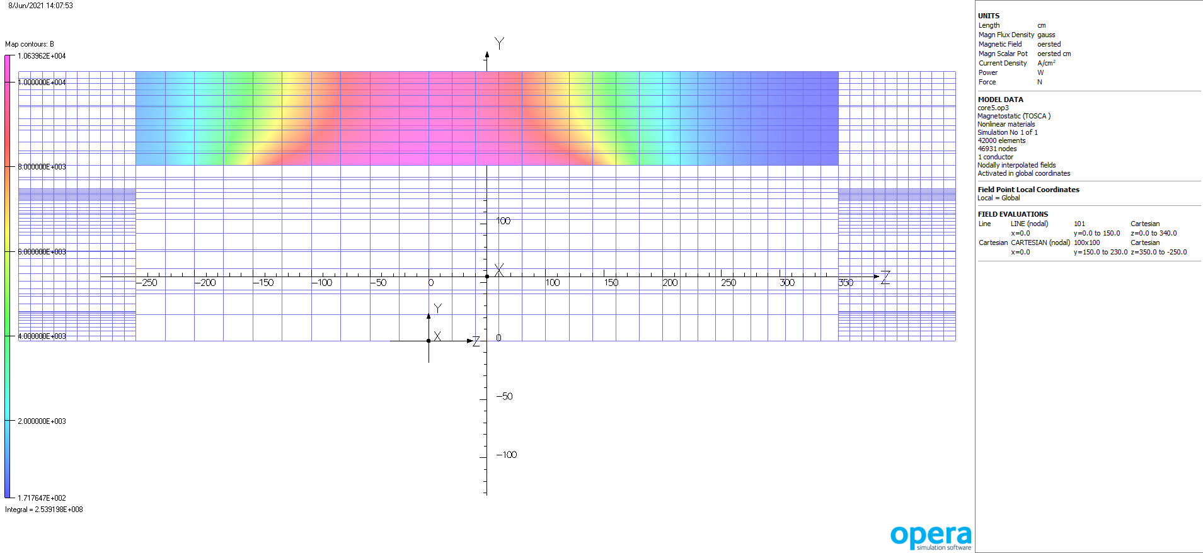
Field in Barrel

Slide 7
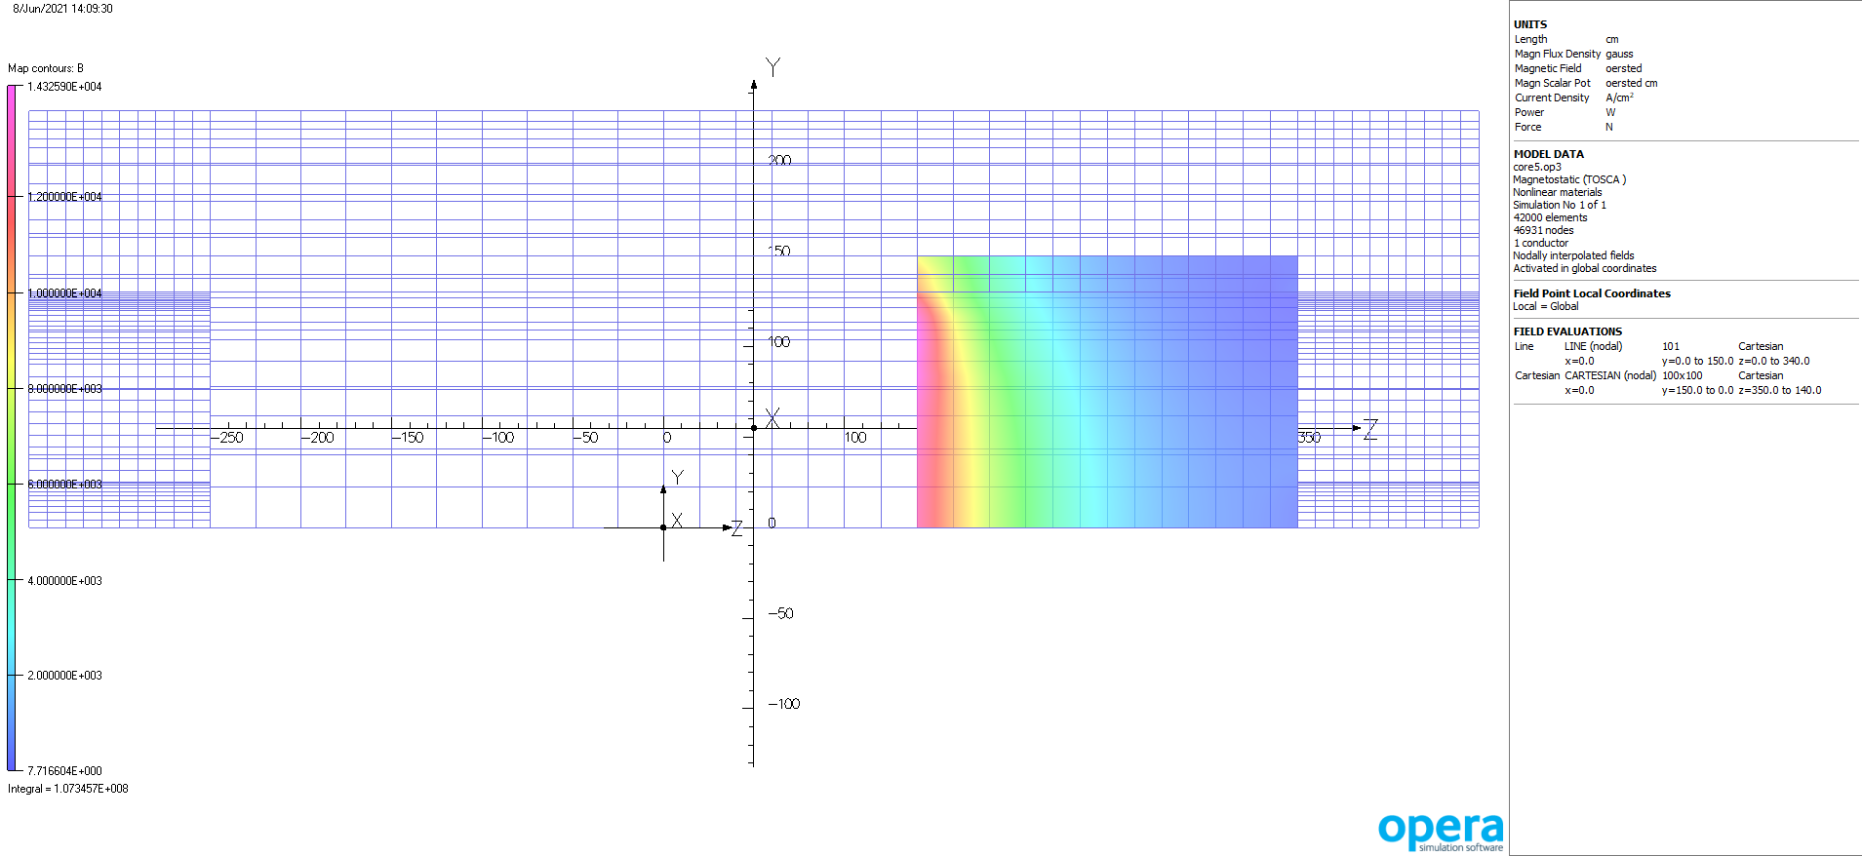
Field in dRich ( 140 < Z < 350)

Slide 8
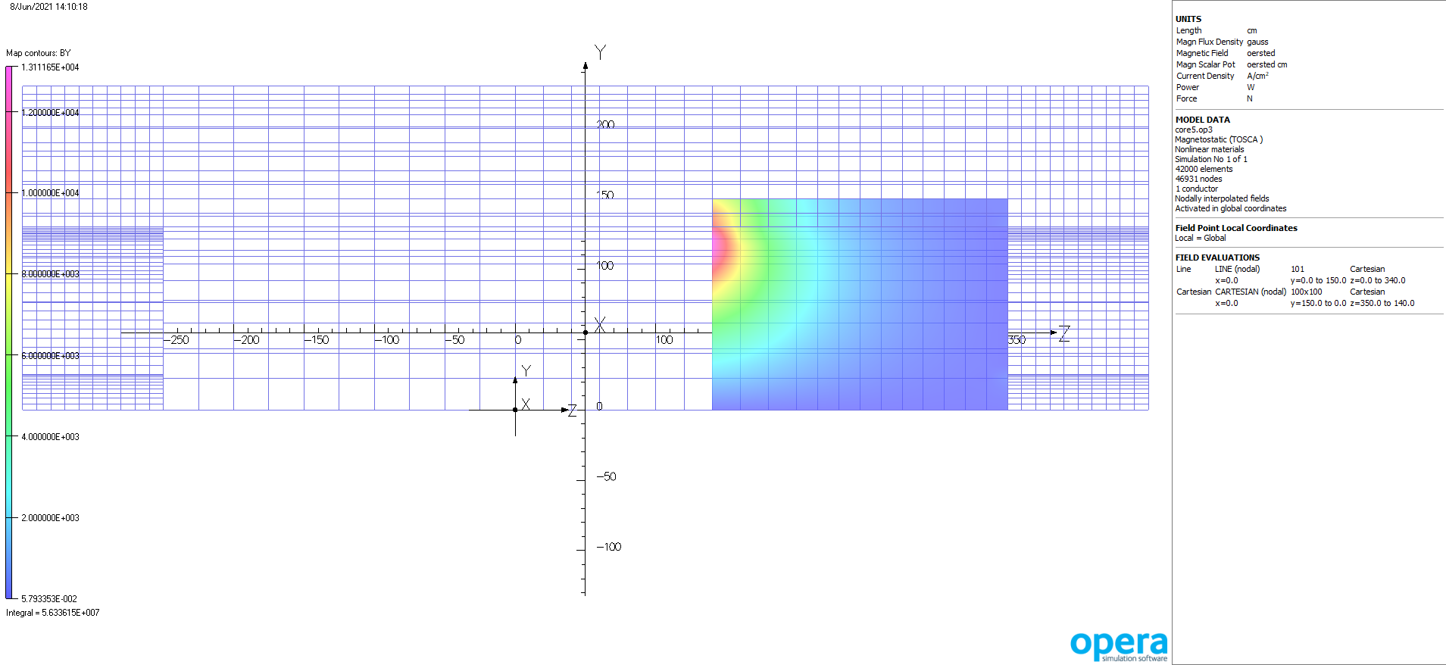
By in dRich( 140 < Z < 350)

Slide 9
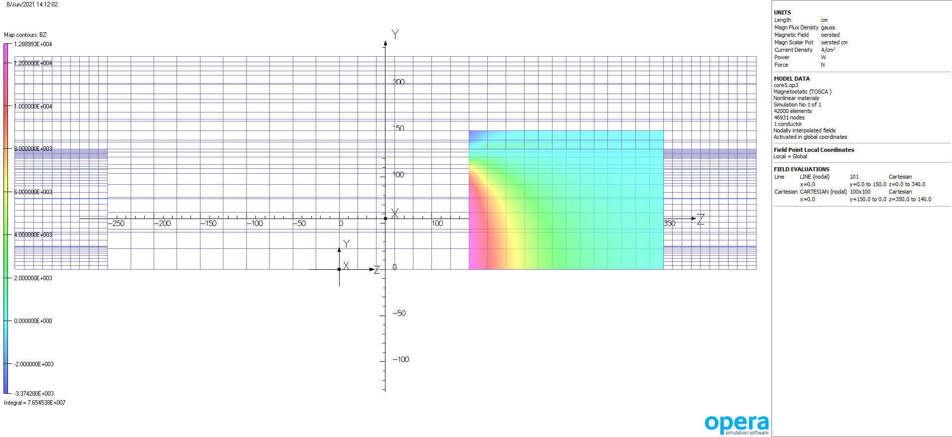
Bz in dRich( 140 < Z < 350)

Slide 10
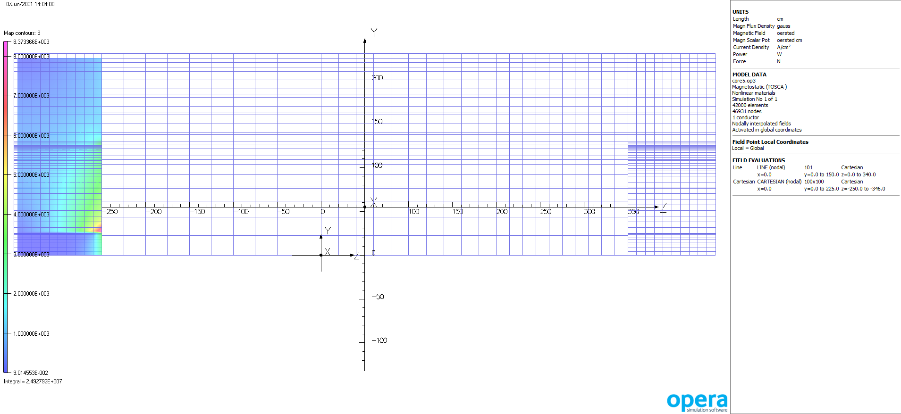
Field in Ecal

Slide 11
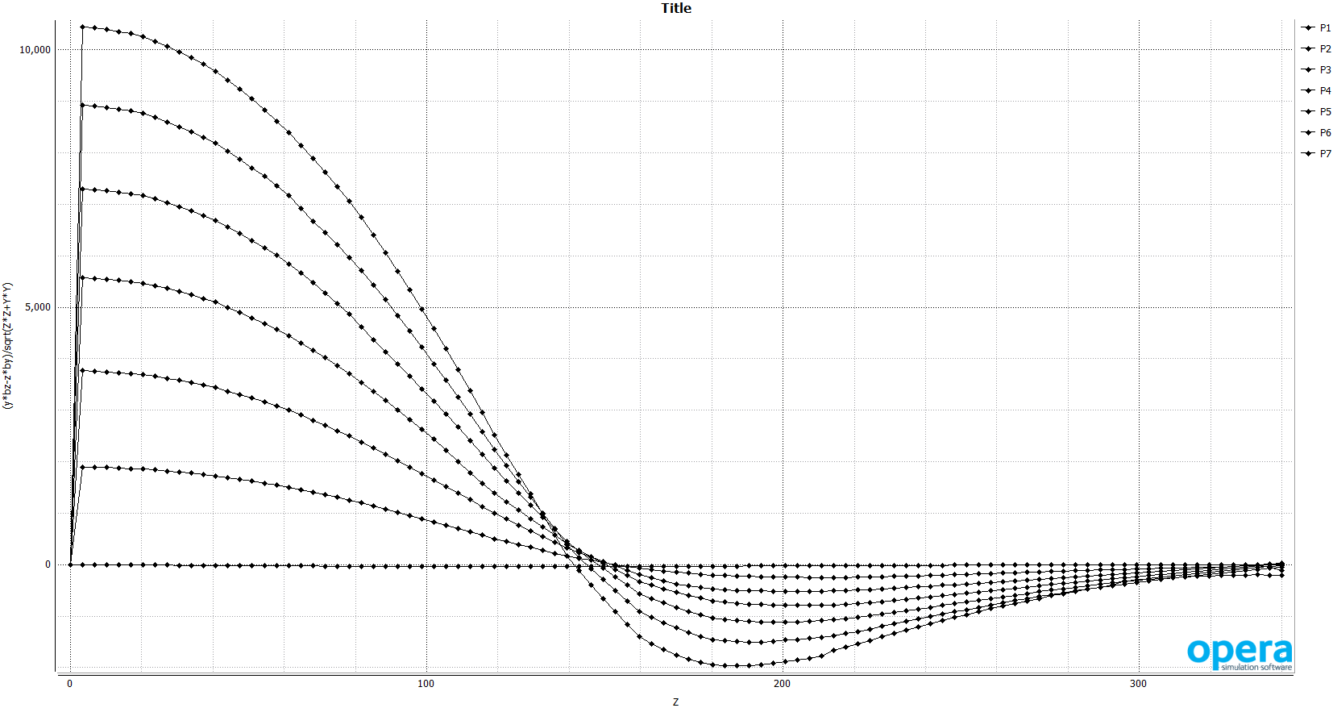
Projectivity

Slide 12
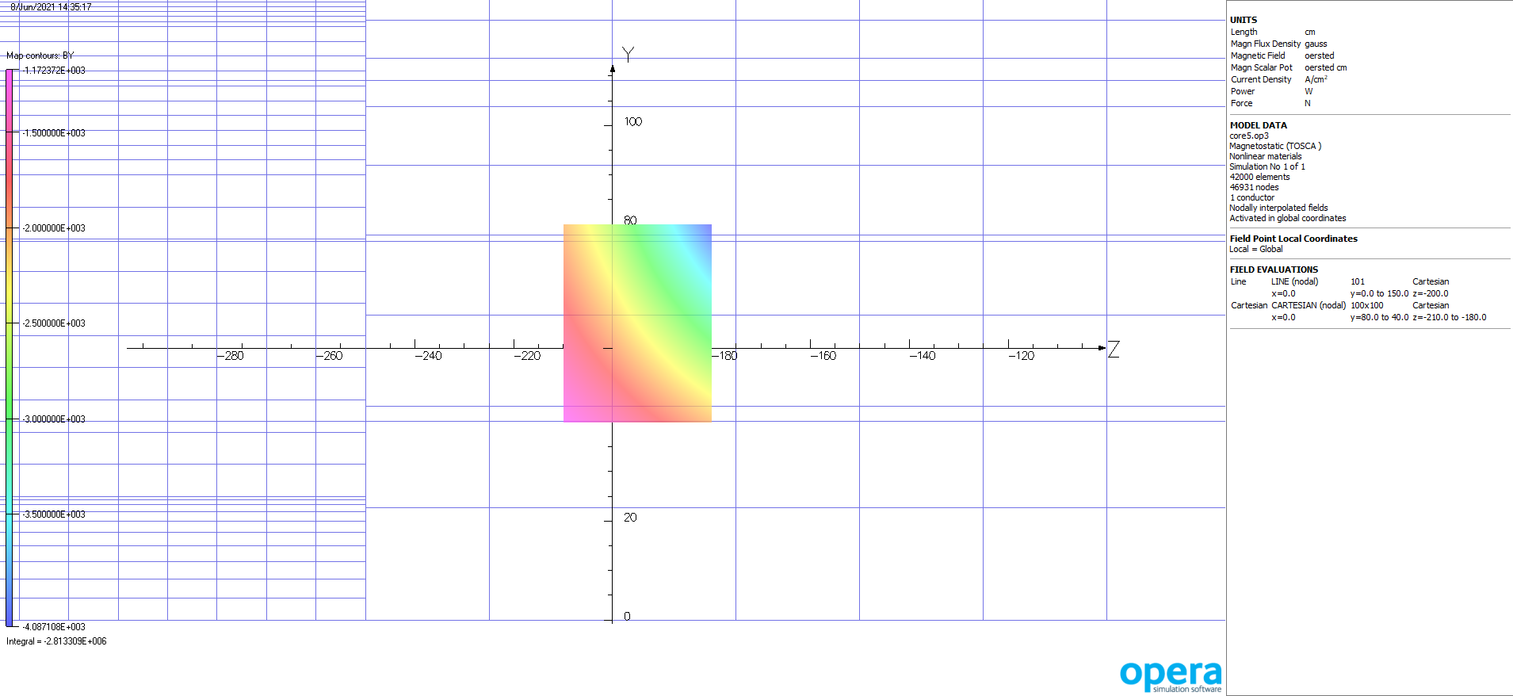
Bradial in DIRC detector

Slide 13
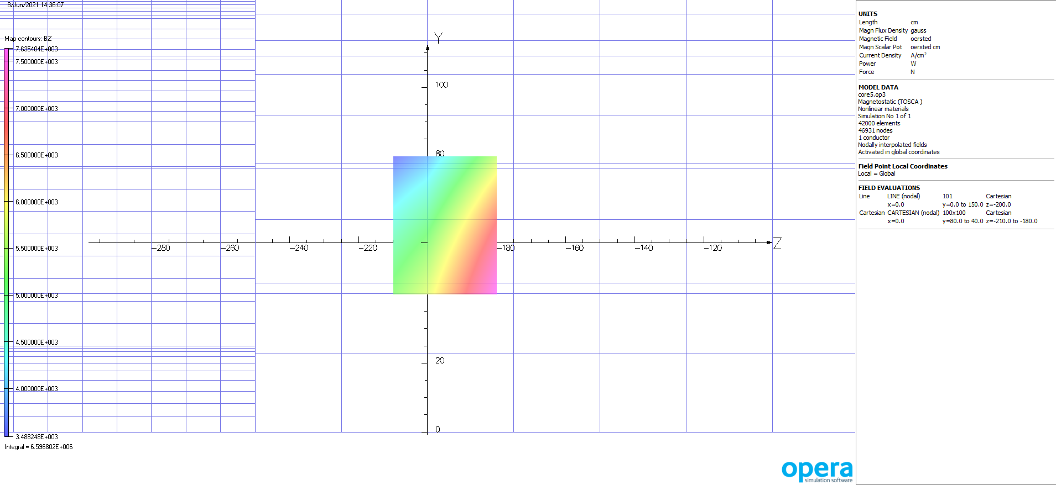
Bz in Dirc detector

Slide 14
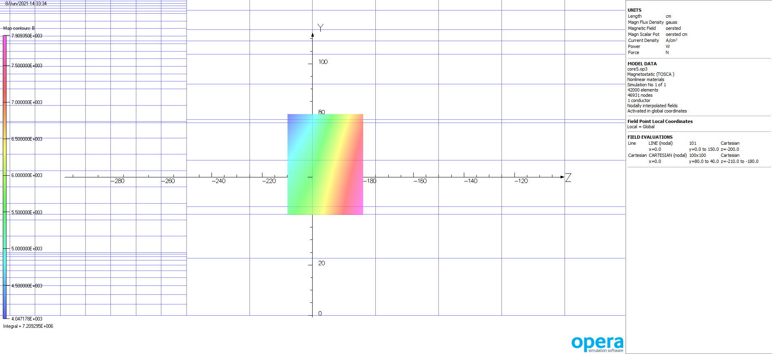
Field magnitude in detector for DIRC

Slide 15
comments
Increase of field to 2.6 T did not really change anything
Iron fields are all OK
Projectivity did not change much

