Slide 1
State-of-the-art Challenges and Emerging Technologies Radiotherapy Instrumentation
Jeff Buchsbaum, M.D., Ph.D., A.M., FASTRO
Radiation Research Program, DCTD, NCI

Slide 2
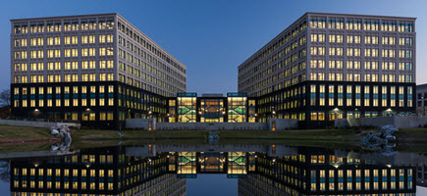
Conflicts of Interest to Declare: None. The opinions expressed in this presentation are those of the speaker and do not necessarily represent those of the NCI.

Slide 3
Outline
Beamline development
FLASH
Predictive Science and Radiobiology and Instrumentation

Slide 4
Conclusion
Collaboration between DOE and NIH is crucial on any number of levels. Radiation beams can cure cancer and help protect our country. Understanding complex, multiscale data and addressing change in real time is critical to medicine, security, and any number of technology fronts. Instrumentation needs to both create the data and the treatment.
Physics is Biology and Biology is Physics.

Slide 5
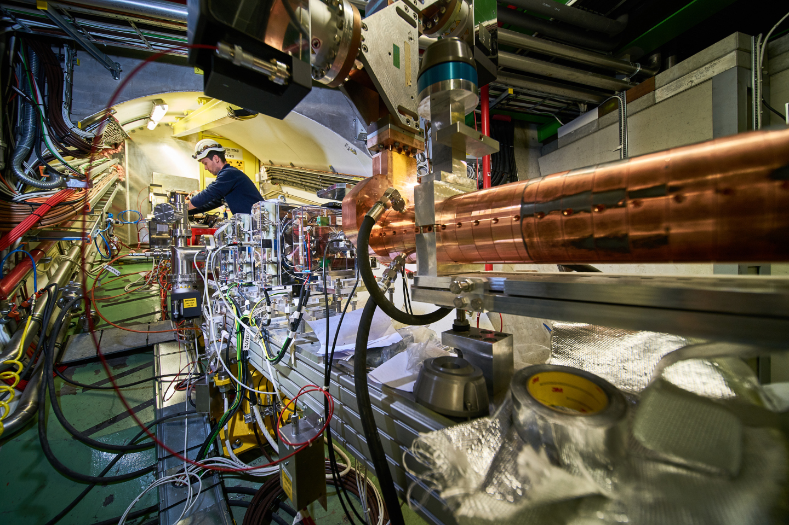
Beamline Development
https://home.cern/science/accelerators/accelerator-complex

Slide 6
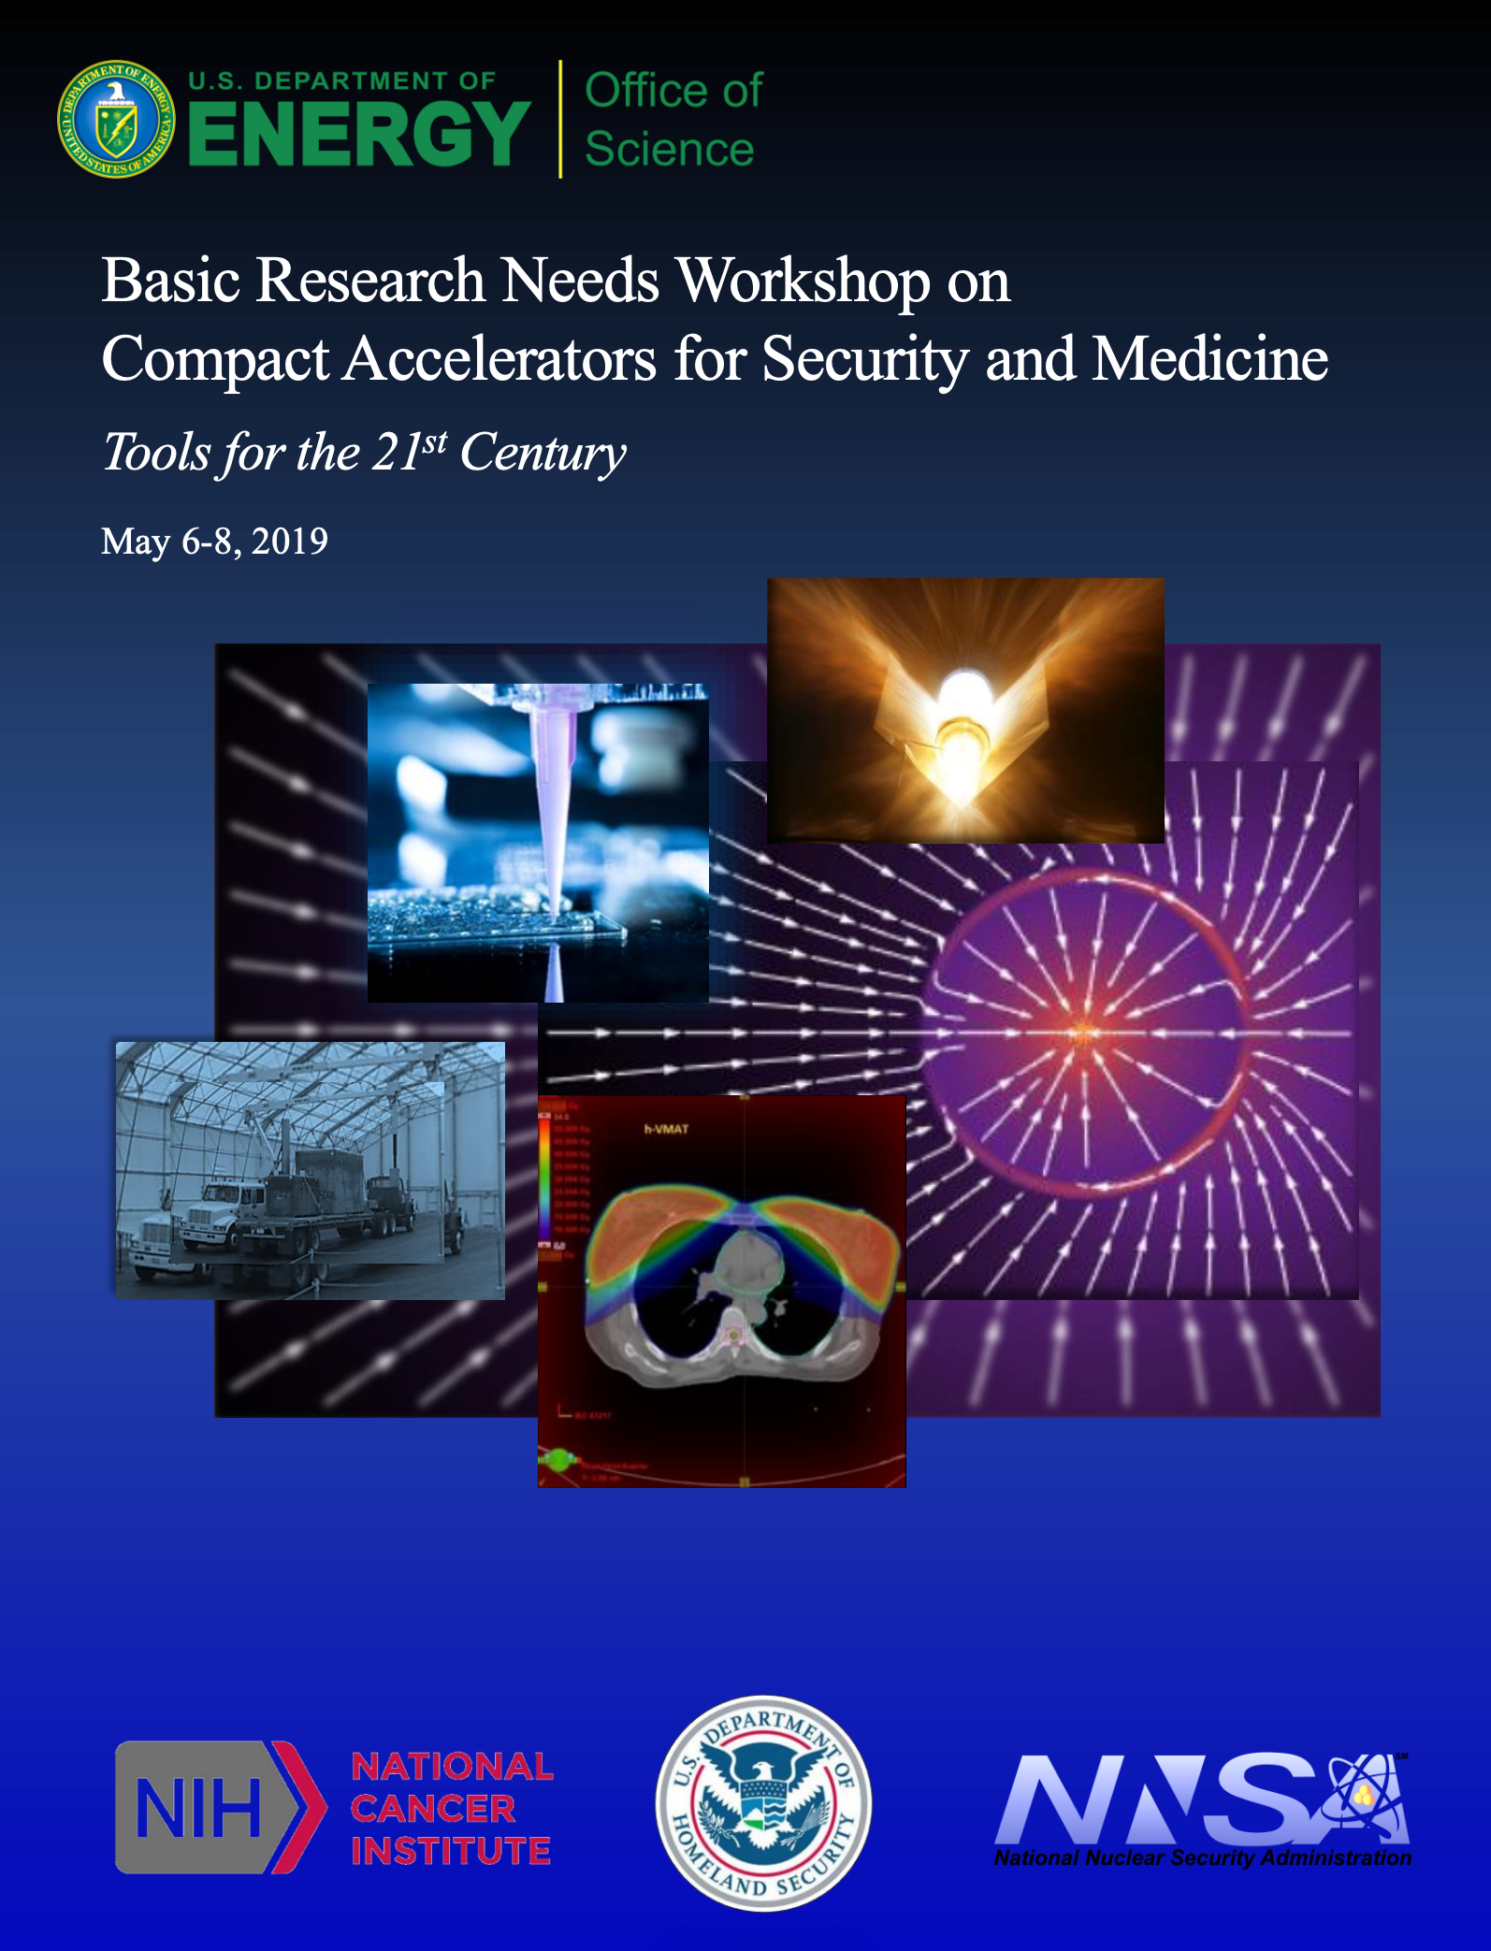
NCI/NIH and DOE share deep interest in accelerator science
https://www.osti.gov/servlets/purl/1631121/

Slide 7
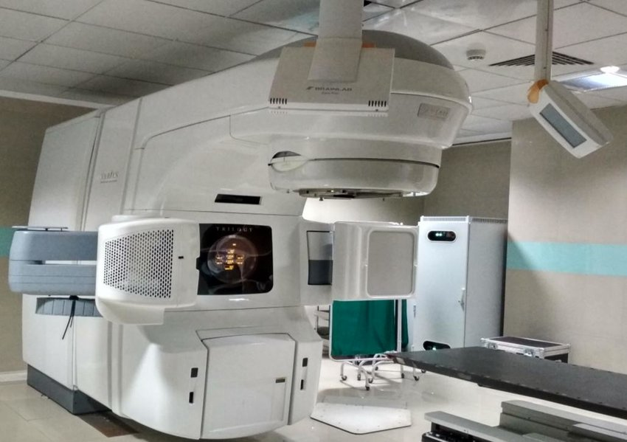
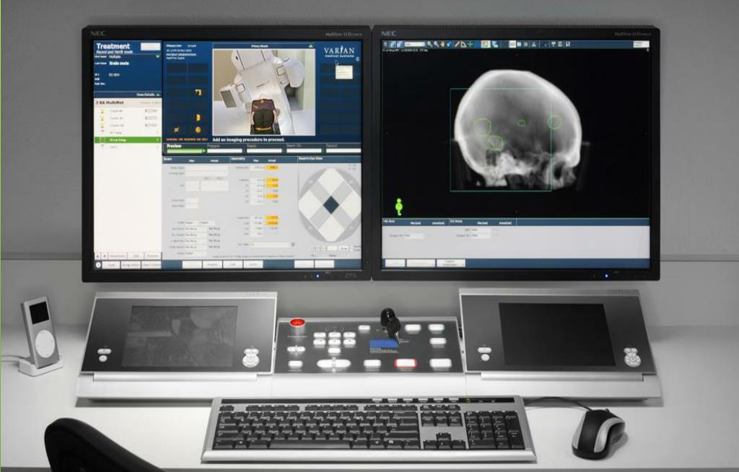
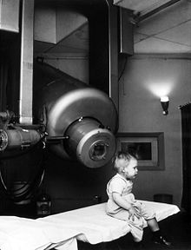
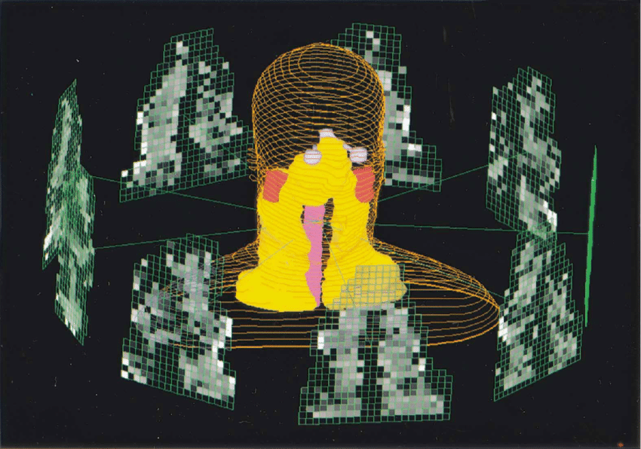
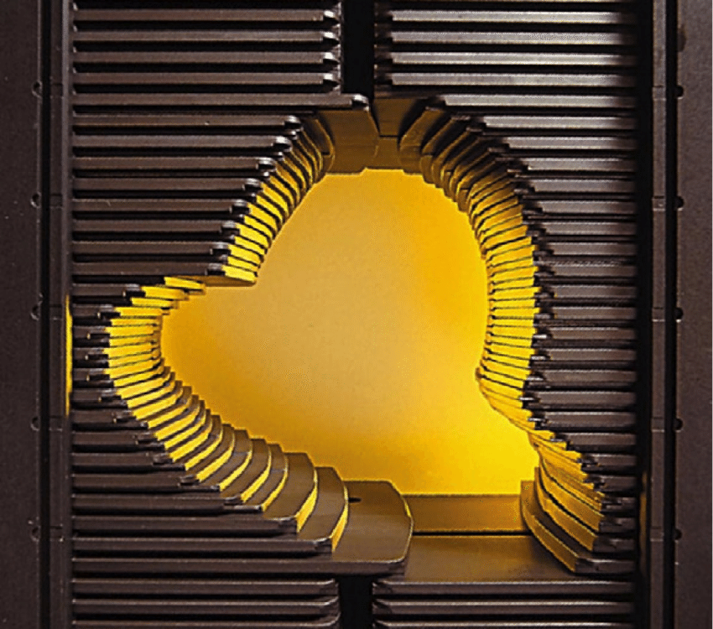
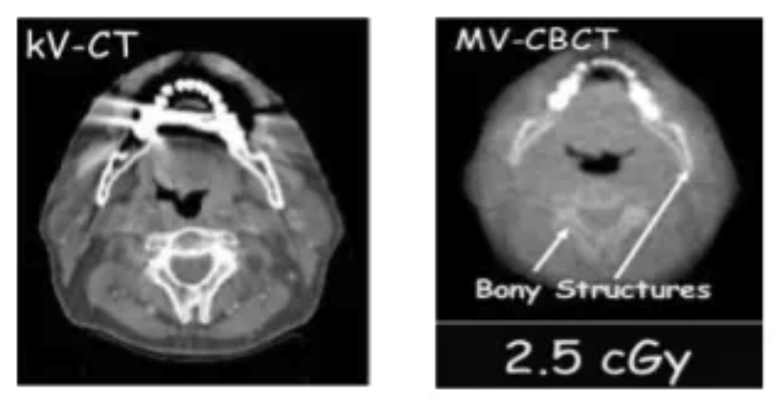
Examples of Medical Device Technology that Benefits from DOE Science: Background information – the basic LINAC
10.13140/RG.2.2.24165.73440
slideserve.com/sovann/varian-truebeam
Historical image showing Gordon Isaacs, the first patient treated with linear accelerator radiation therapy (in this case an electron beam) for retinoblastoma in 1957. Gordon's right eye was removed January 11, 1957, because his cancer had spread. His left eye, however, had only a localized tumor that prompted Henry Kaplan to try to treat it with the electron beam.
https://www.slideshare.net/vinayDesai12/linear-accelerator-vinay

Slide 8
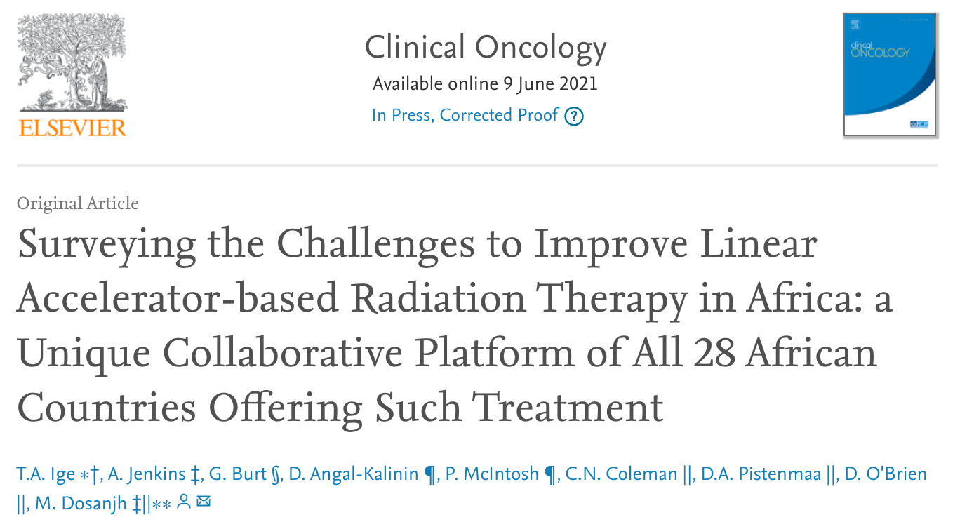
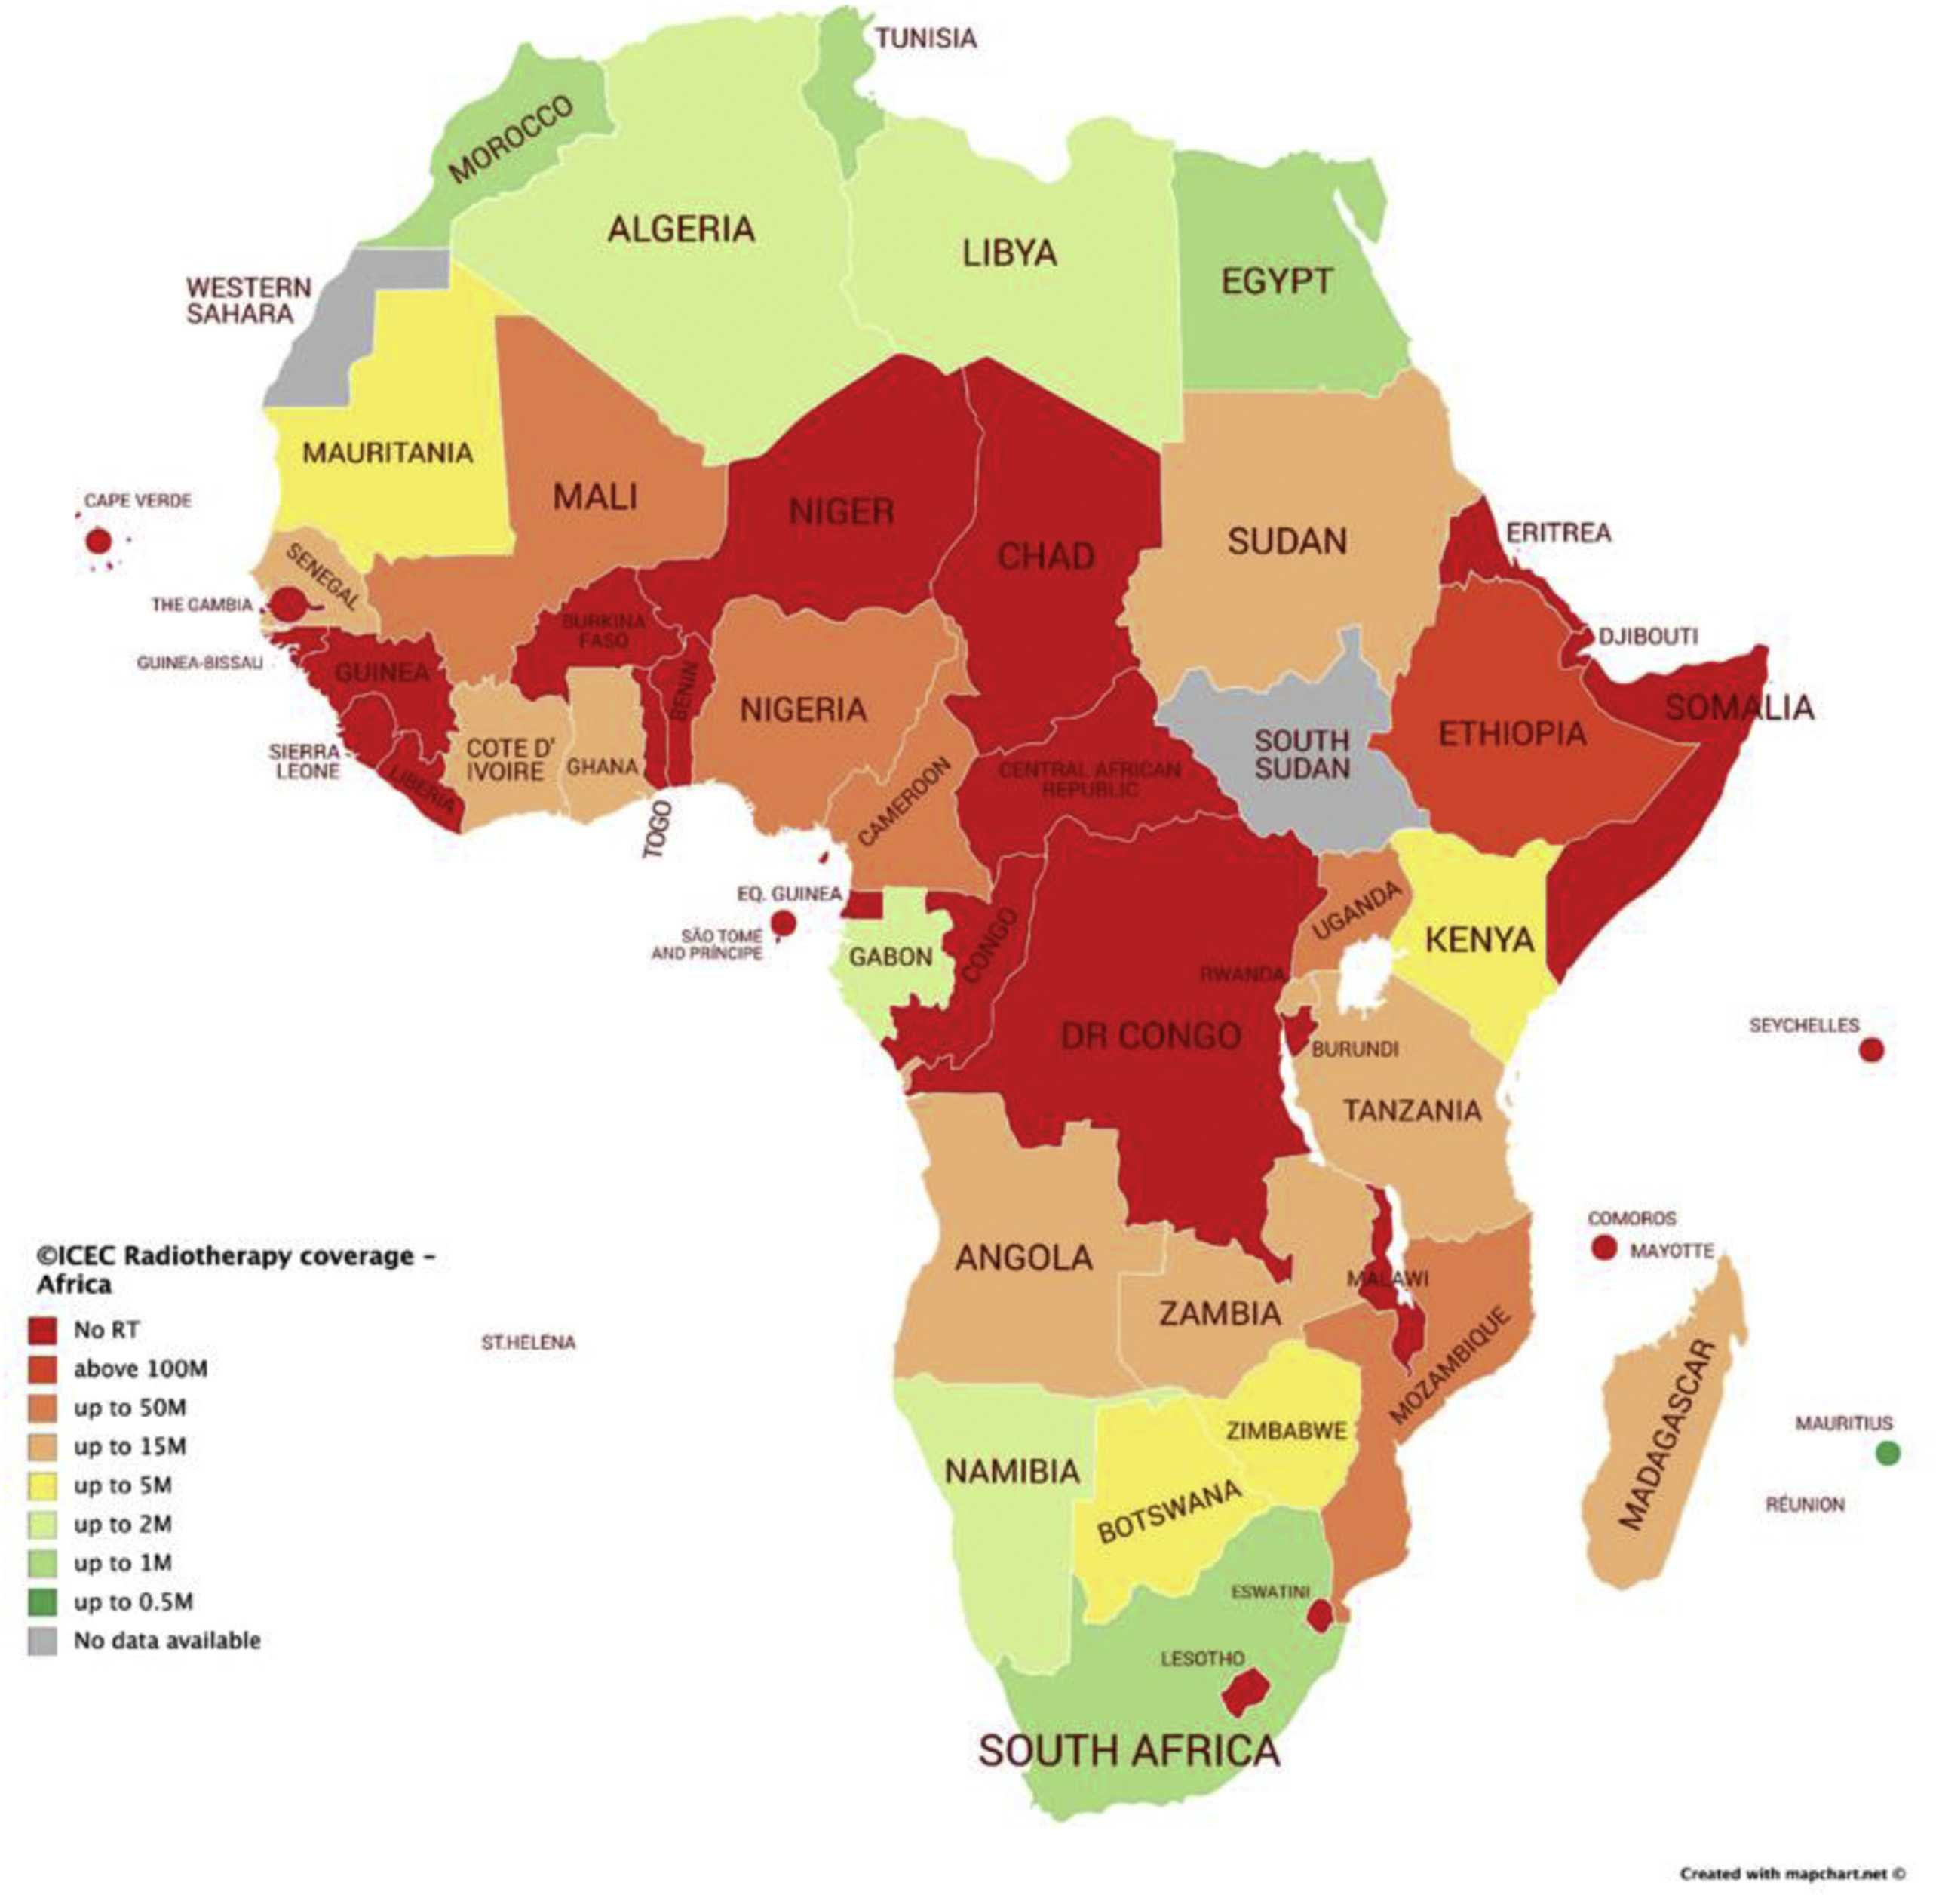
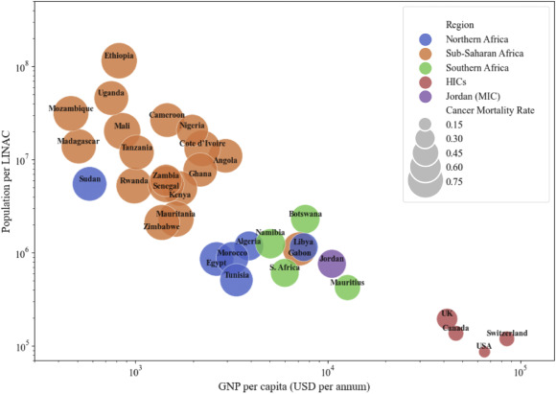
LINACs are critical to the world. These are pictures of Africa.
It is estimated India needs 10,000 LINACS today.

Slide 9
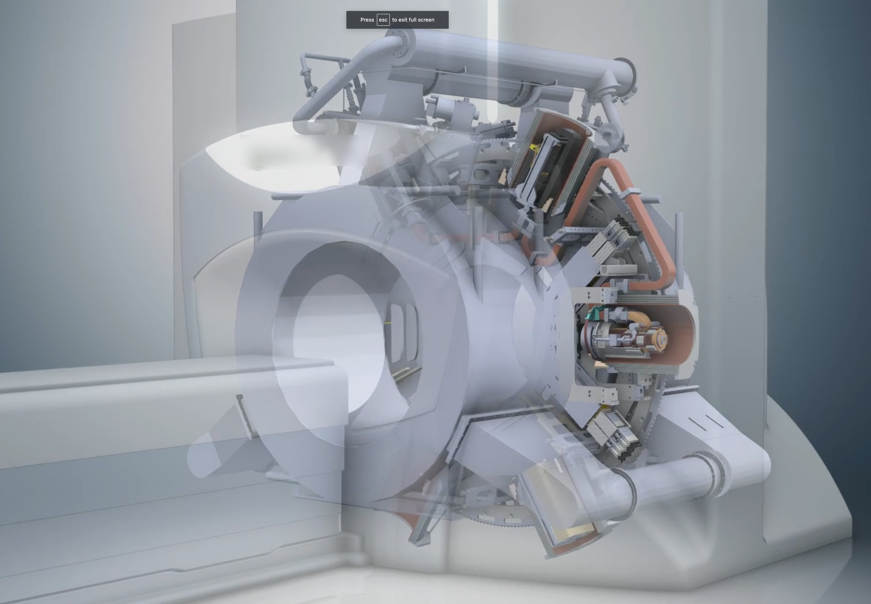
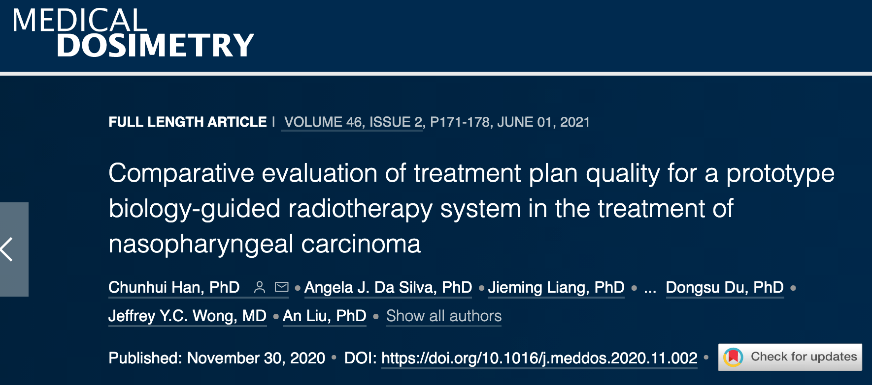
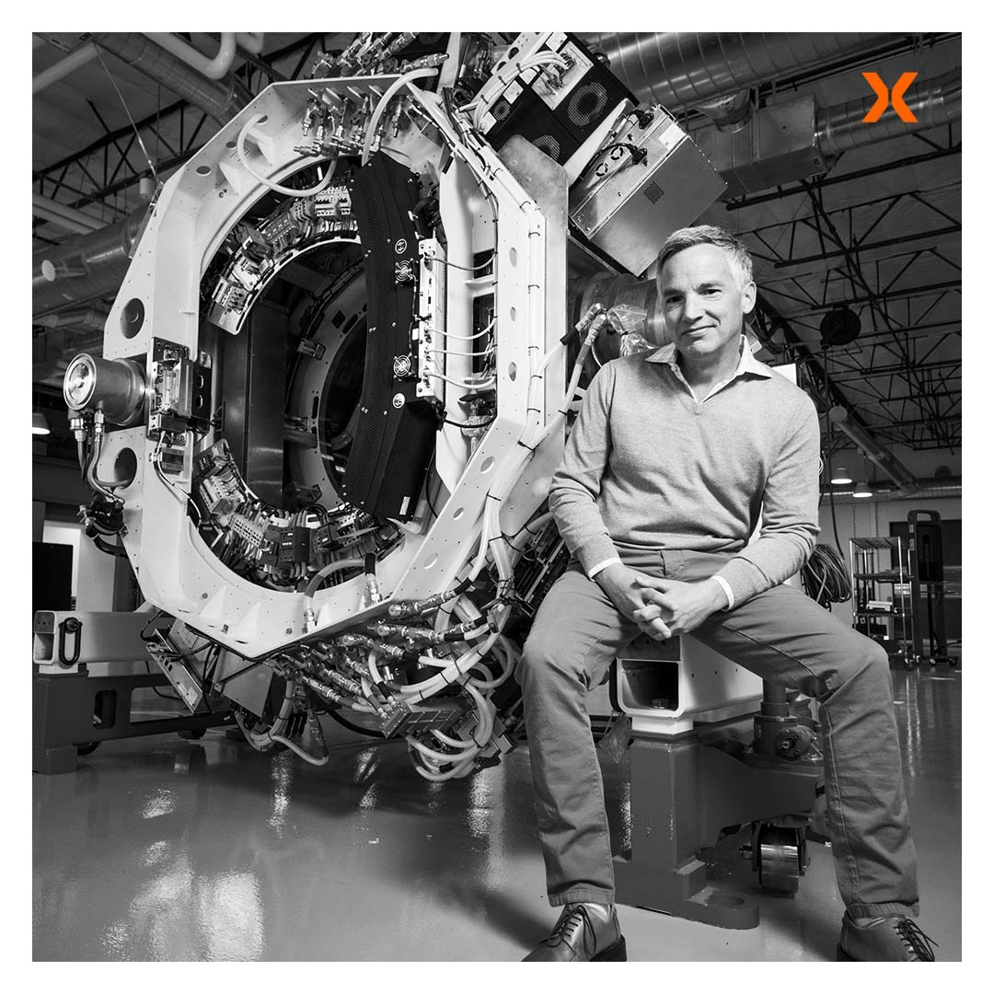
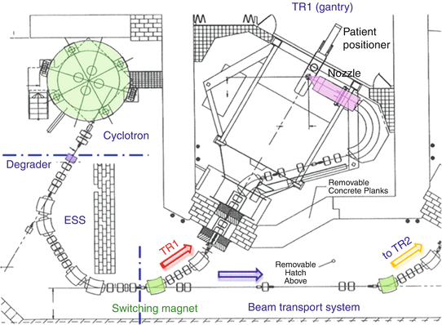
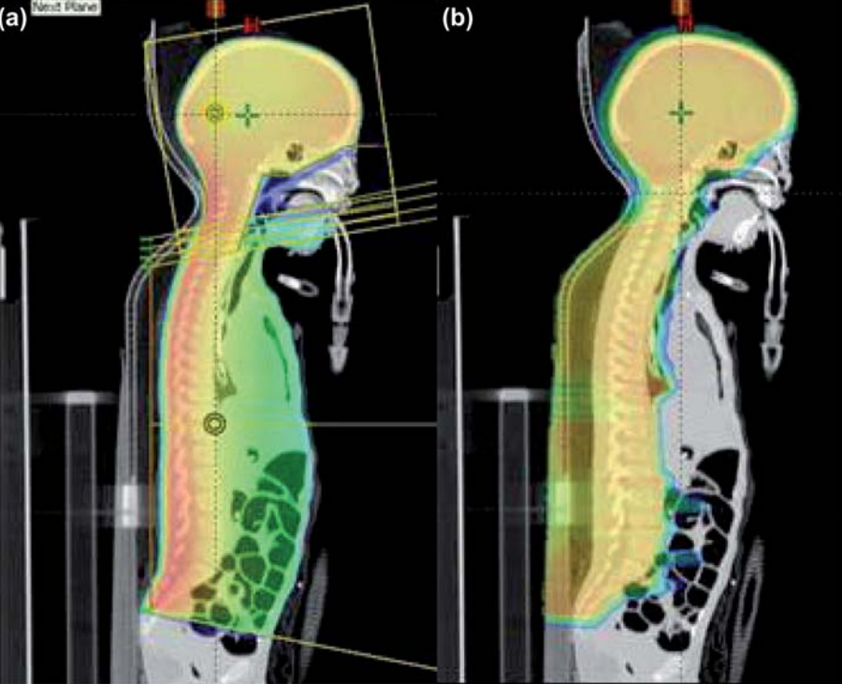
Current more exotic devices: MR LINAC, PET LINAC, Particles
reflexion.com
viewray.com/mri-guided-roar/
10.1007/978-3-540-85516-3_28

Slide 10
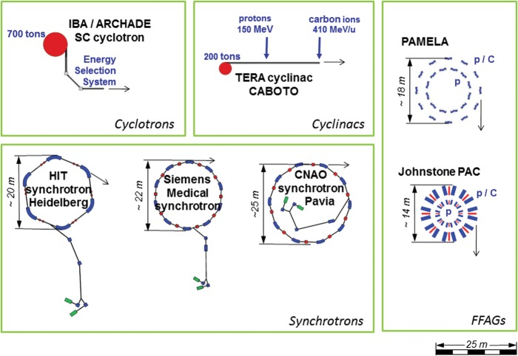
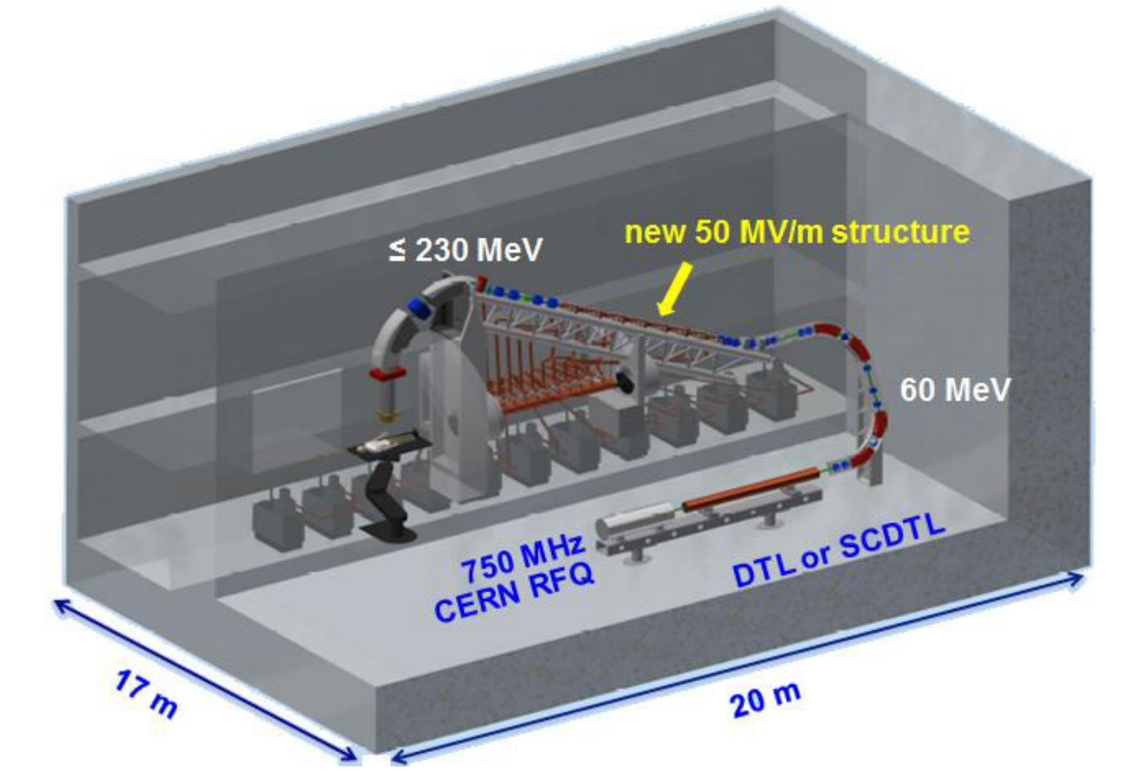
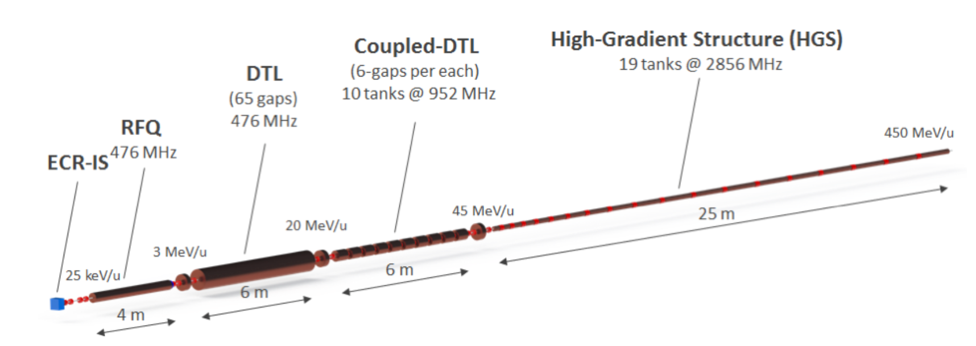
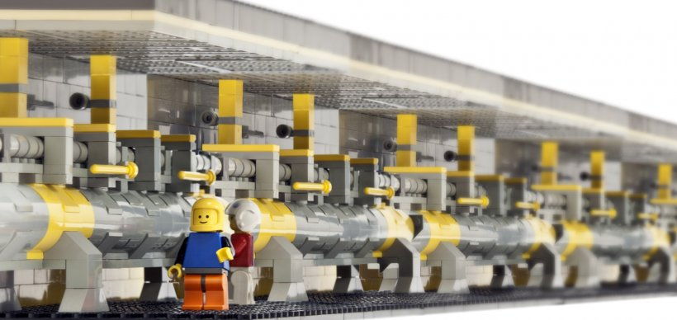
Next generation systems: LINAC based particle therapy
ISBN 978-3-95450-142-7
10.1093/jrr/rrt053
https://www.energy.gov/articles/photo-week-lego-rendition-slac-national-laboratorys-linear-particle-accelerator
https://www.anl.gov/aai/hadron-therapy-research

Slide 11
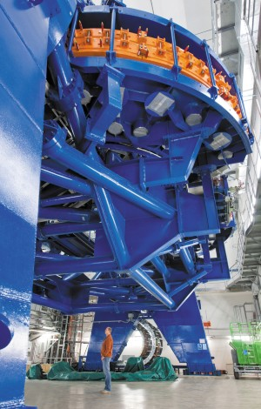
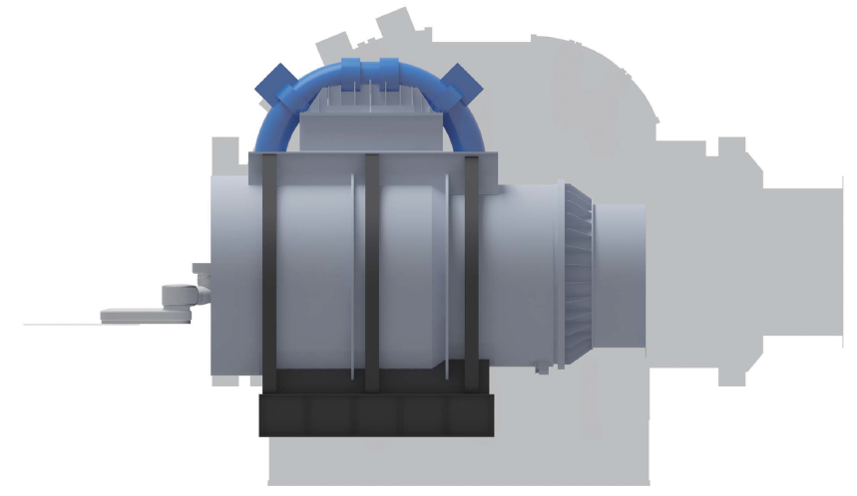
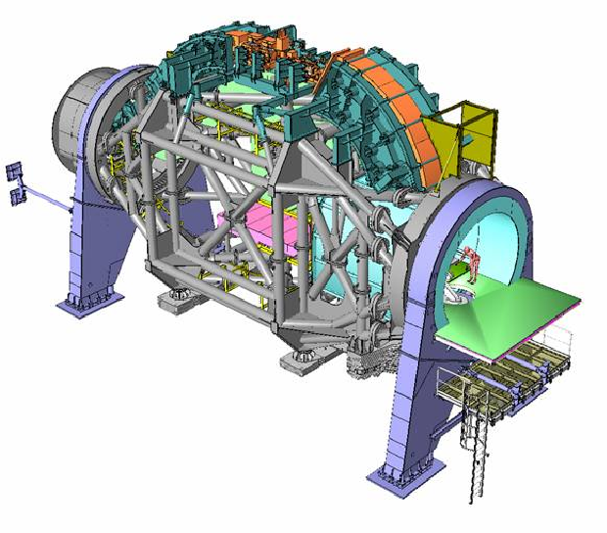
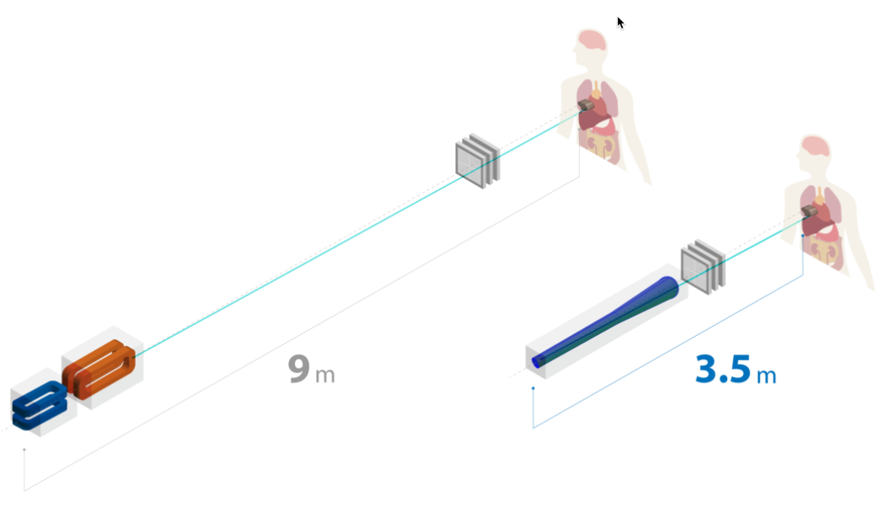
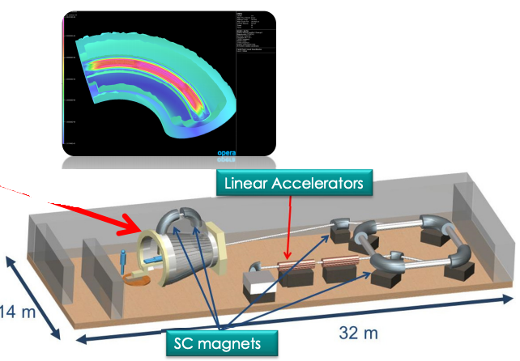
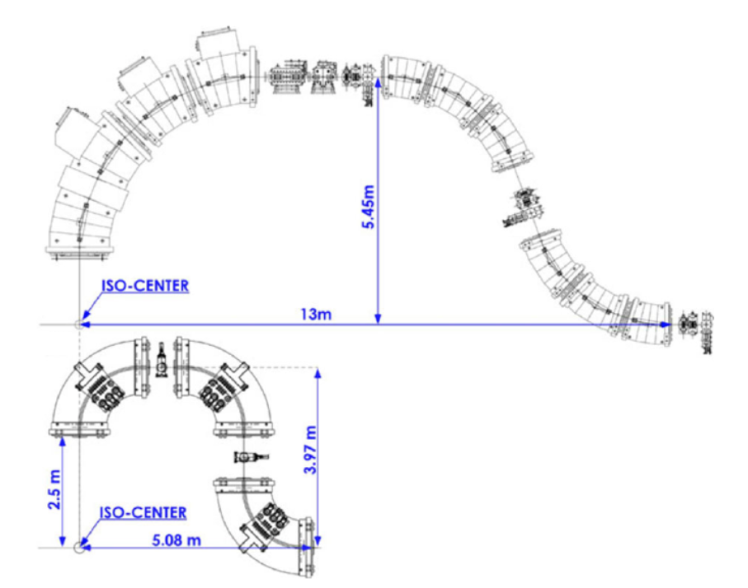
Next generation systems: gantries
accelconf.web.cern.ch/e08/papers/tupp133.pdf
qst.go.jp/site/qst-english/1077.html
10.1038/508133a
10.1002/mp.13193

Slide 12
FLASH

Slide 13
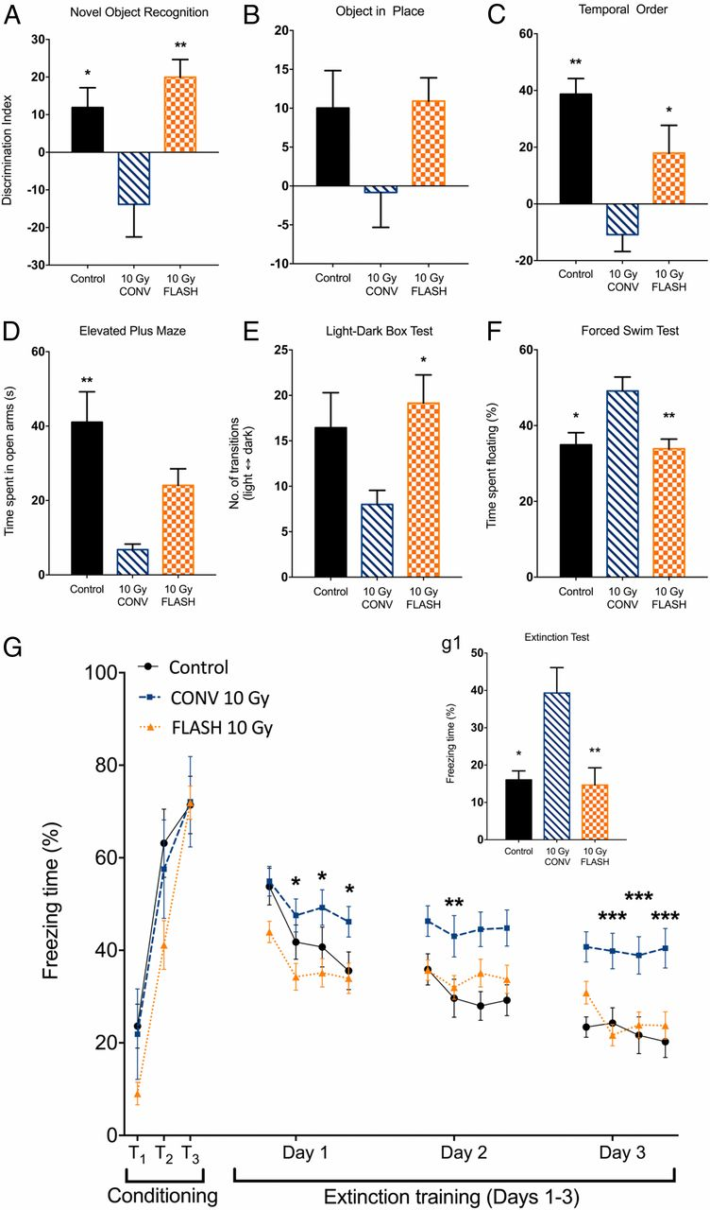
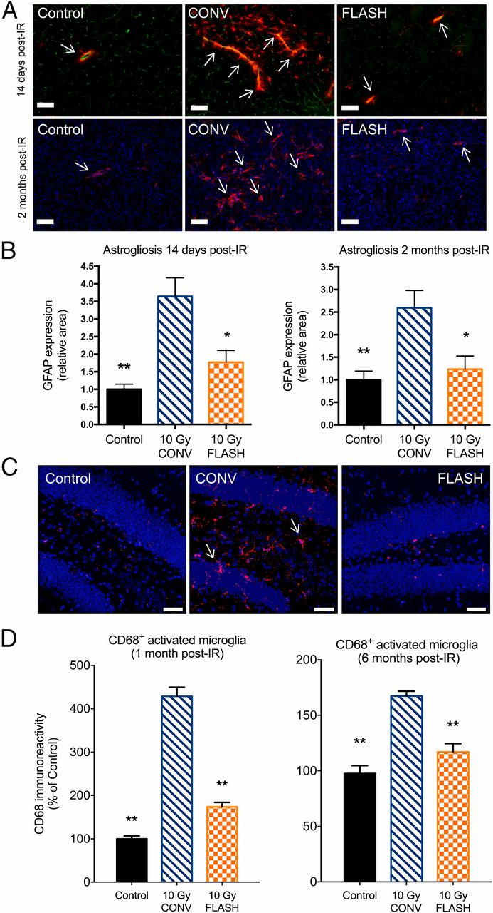
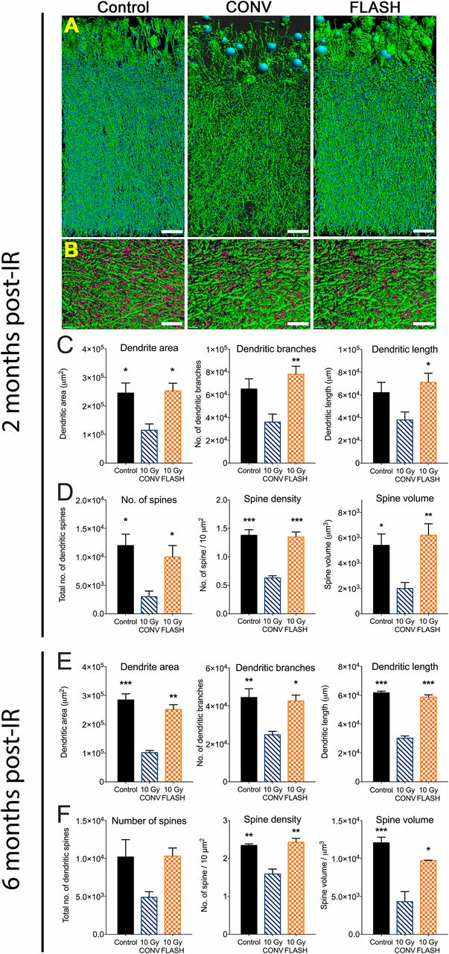
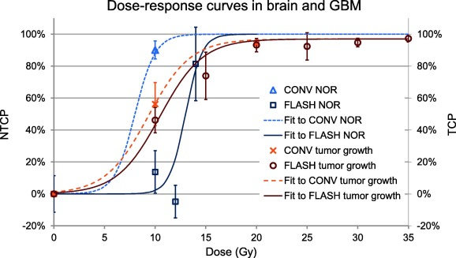
Defined > 50 Gy/s (normal clinical rate is 0.05 to 0.1 Gy/s)
FLASH delivery seems to protect normal brain tissue in mouse.
10.1073/pnas.1901777116
There is a relatively narrow window of dose for FLASH.
10.1016/j.radonc.2019.04.008

Slide 14
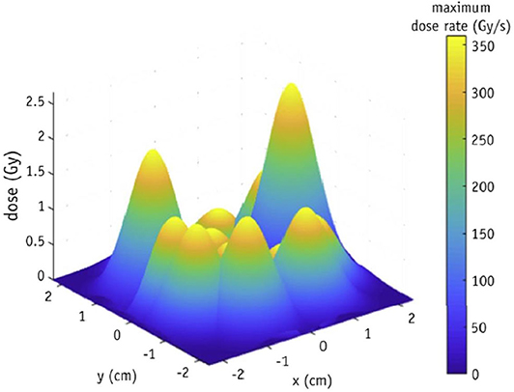
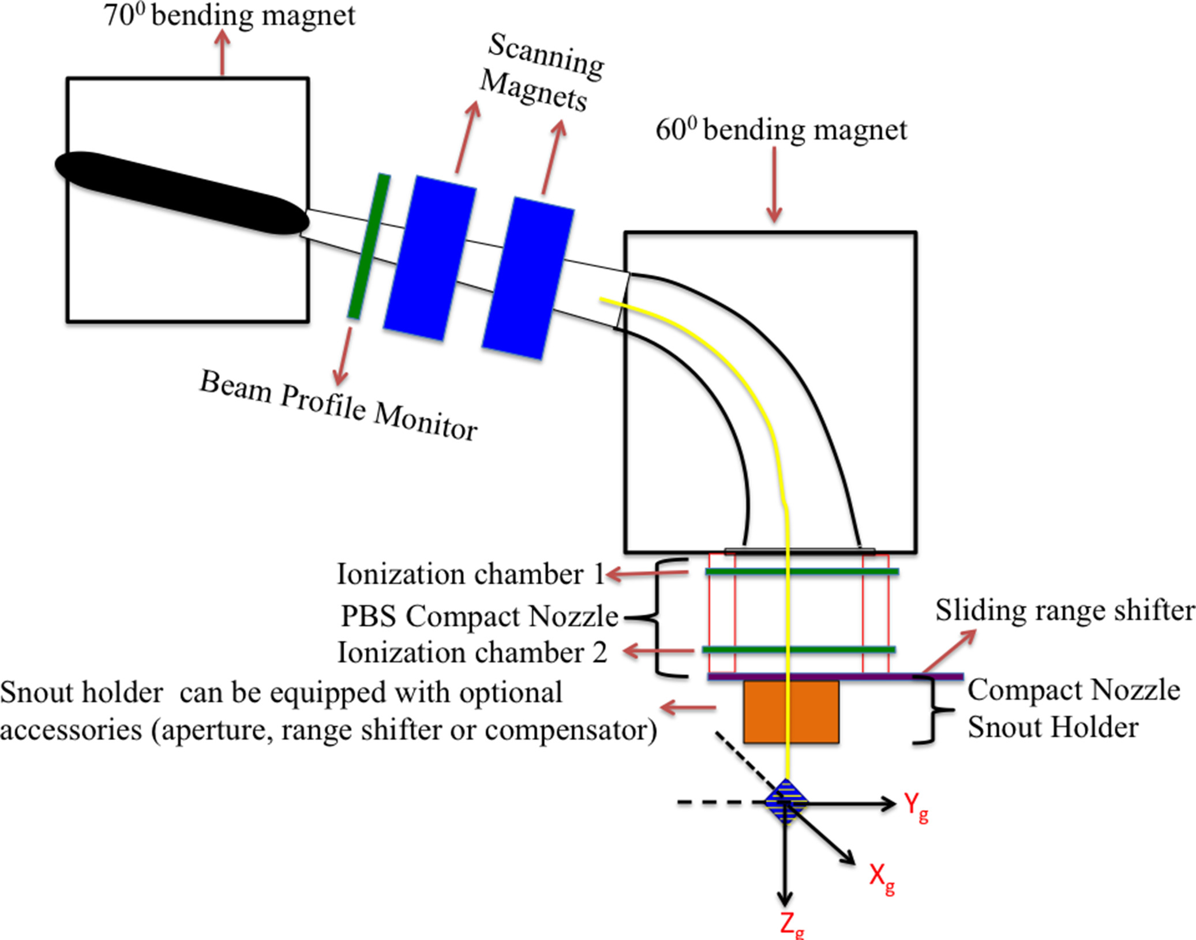
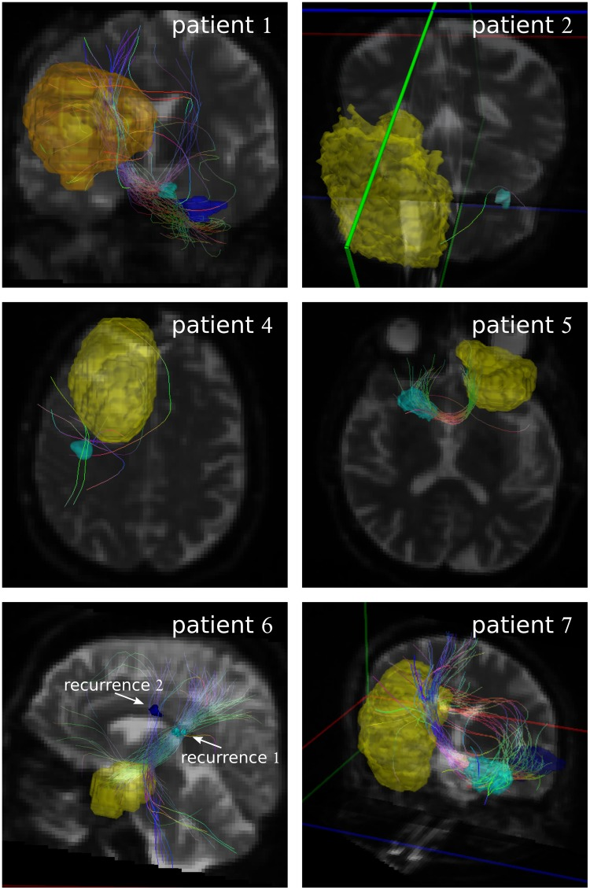
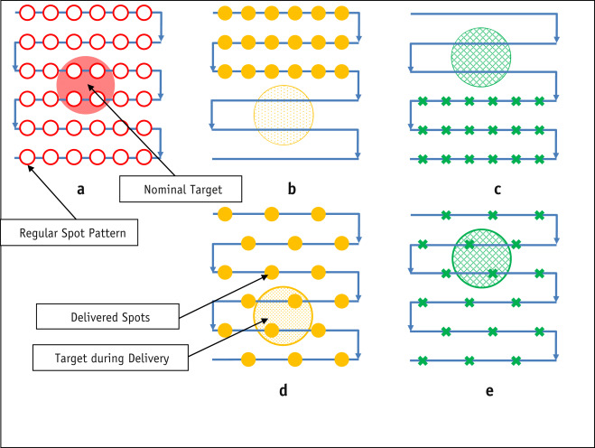
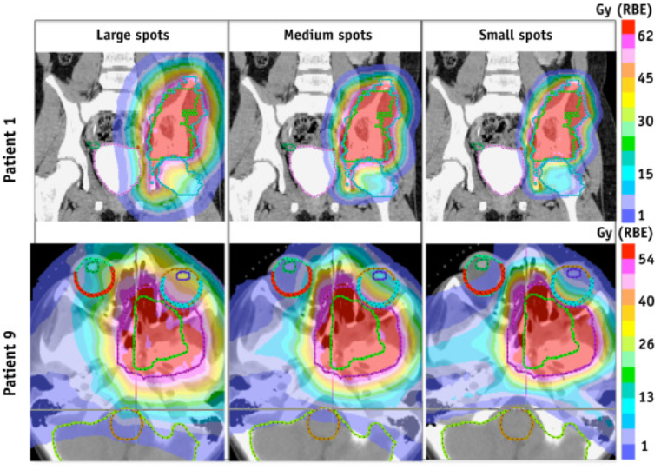
Flash spot scanning is complex
Location Matters
10.1016/j.ijrobp.2019.11.011
Cure Matters
10.1002/acm2.12225
Path Matters
Spot Size Matters
10.1016/j.ijrobp.2015.06.019
10.1016/j.ijrobp.2015.12.368
10.1371/journal.pone.0227146

Slide 15
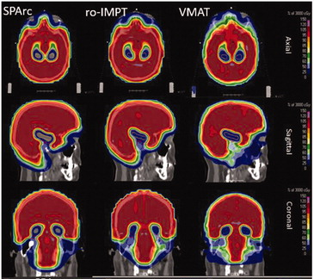
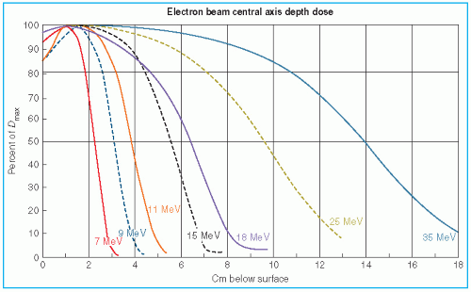
What can we use to deliver FLASH in the clinic?
Photons: Not at present due to target heat issues. And, after that, to get elegant dosimetry multiple beams (a lot more time) are needed.
Electrons: We lack high energy beams and collimation that is as elegant as photons and hadrons. Depth dose curves are an issue for clinical machines (currently being ”modified” at some centers)
Hadrons:
Spots as noted.
Through beams: neutrons and loss of the Bragg peak dosimetric advantage. Then multiple beams and a lot more time again.
10.1080/0284186X.2018.1555374
Tapley N, ed. Clinical Applications of the Electron Beam. New York, NY: John Wiley & Sons; 1976

Slide 16
Where are we today?
Flash promise in tiny fields and unclear applicability to real cancer patients.
This is an area of high interest globally.
Unknown safety systems (for a field very focused on Q/A)
Measurement tools
Control systems
Beam structure real time Q/A
“We developed a beam monitoring system for the eRT6 Oriatron linac, which was able to check that the beam parameters defined by the user (f, w, and N) corresponded to the characteristics of the delivered beam. In contrast to a standard monitor chamber installed on a clinical radiotherapy linac, the system was not coupled to a beam stopping device that could interrupt the beam in case the beam properties were out of tolerance.”

Slide 17
Predictive Oncology and Biologic Dose and New Opportunities

Slide 18
Dr. Greenspan will present more detailed history and current data on DOE-NCI collaborative projects including predictive oncology ideas that were a focus of a recent 6 part workshop series.
This section will then cover:
Biologic Dose
A New Opportunity for DOE/NIH collaboration in the new request for applications RFA-CA-21-040 “ROBIN”.

Slide 19
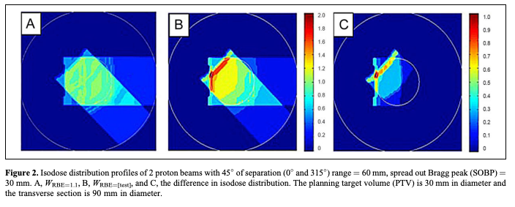
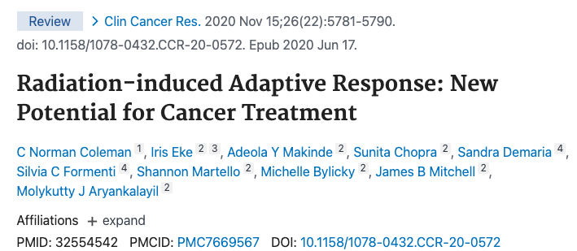
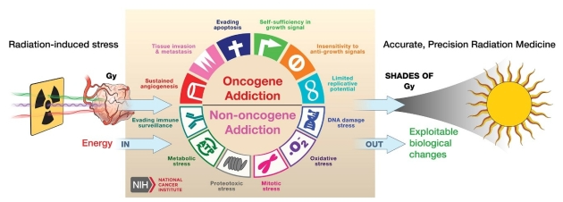
Biologic Dose
Computational capacity to address huge amounts of multidimensional and multiscale data will be critical in this endeavor.
10.1158/0008-5472
dctd.cancer.gov/NewsEvents/biological_consequences_of_radiation_therapy_workshop.htm

Slide 20
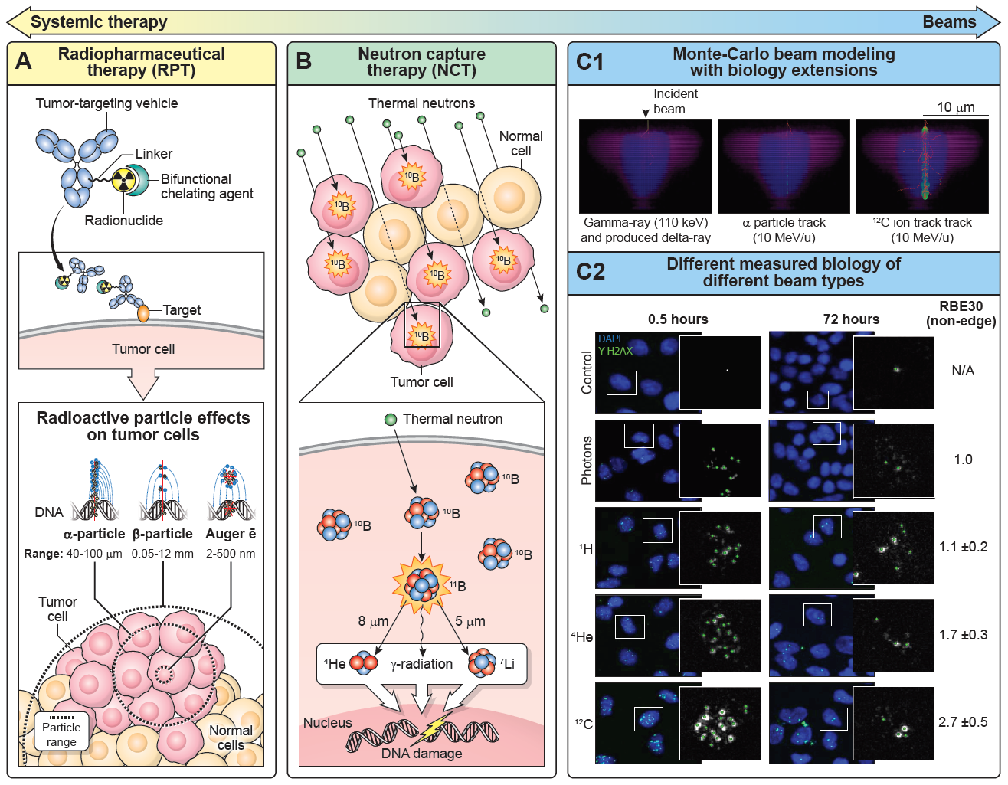
From System Therapy to Beams: Radiotherapy as Different Drugs

Slide 21
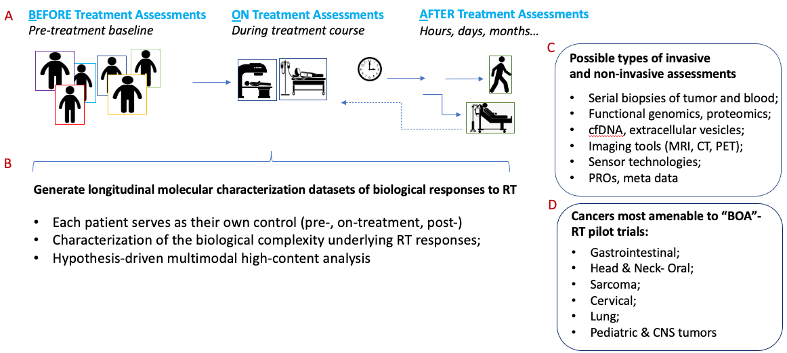
RRP as an example – its focus and a recent RFA
Radiation Oncology-Biology Integration Network (ROBIN) Centers (U54 Clinical Trial Required)
RFA-CA-21-040
The purpose of this Funding Opportunity Announcement (FOA) is to solicit applications for U54 Research Centers to form the Radiation Oncology-Biology Integration Network (ROBIN). The cadre of ROBIN Centers created through this FOA will establish an agile and effective national radiation oncology network infrastructure that collectively address critical hypothesis-based translational research knowledge gaps on the biological basis of responses in cancer patients who undergo radiation treatments.
https://grants.nih.gov/grants/guide/rfa-files/RFA-CA-21-040.html
https://grants.nih.gov/grants/guide/notice-files/NOT-CA-21-093.html
The pre-application webinar will be on July 16, 2021, at 1:00 pm to 3:00 pm EDT.

