Slide 1
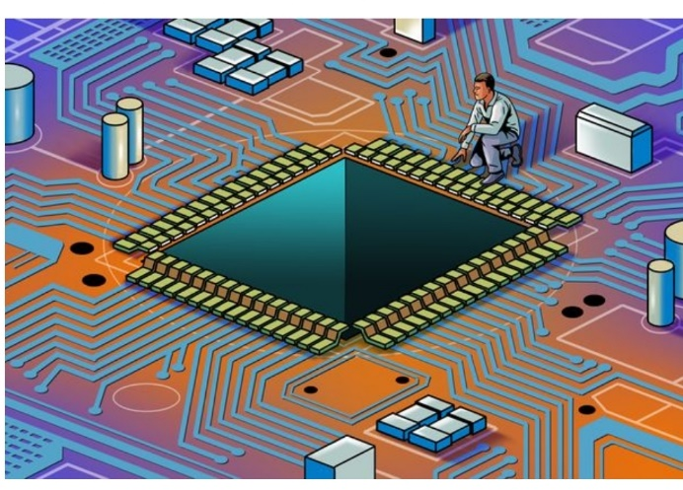
Streaming Readout and Fast Acquisition Techniques
Fast Electronics & Data Acquisition
‘FEDAQ’ Group
Chris Cuevas

Slide 2
Overview
Roll the acknowledgements first!
- Many slides provided by FEDAQ and EPSCI groups
- Streaming ReadOut techniques improving and evolving
- 12GeV Electronics designed with SRO capabilities
1. Brief Description of Streaming ReadOut mode
Hardware examples:
“Crates/Modules” – 12GeV model
“Crateless” Front End Electronics and FPGA Processing
- Used for GlueX DIRC and CLAS12 RICH
- Large detectors with >20k readout pixels
* Detector⬄ maPMT⬄ ASIC⬄FPGA⬄ Network
3. New Streaming Readout Paradigm and Summary

Slide 3
Streaming Readout Concepts
G. Hayes
Thomas Jefferson National Accelerator Facility

Slide 4
Streaming Readout Concepts
G. Hayes
G. Hayes
Thomas Jefferson National Accelerator Facility

Slide 5
D. Abbott
Thomas Jefferson National Accelerator Facility

Slide 6
Thomas Jefferson National Accelerator Facility

Slide 7
Streaming DAQ
Through the
VXS Trigger Processor
C
Use latest ASIC
High Channel Count
Detector
SSP
SBC
‘64x
A
VXS
B
Bypassing ‘64x Example
•
A
1 SSP manages 32 LC fiber @2.5Gbps
•
B
16 SSP/crate @20Gbps to VTP [ 4 lanes/@5Gbps ]
VME
• Streaming bandwidth 320Gpbs to VTP
• 40Gbe from VTP “CODA ROC”
▪
C
VTP can perform significant data processing
192 channels for FPGA front end so, Single VXS crate could stream
192_{FPGA} * 32_{Links} * 16_{SSP} == 98304 Channels
Thomas Jefferson National Accelerator Facility

Slide 8
Thomas Jefferson National Accelerator Facility

Slide 9
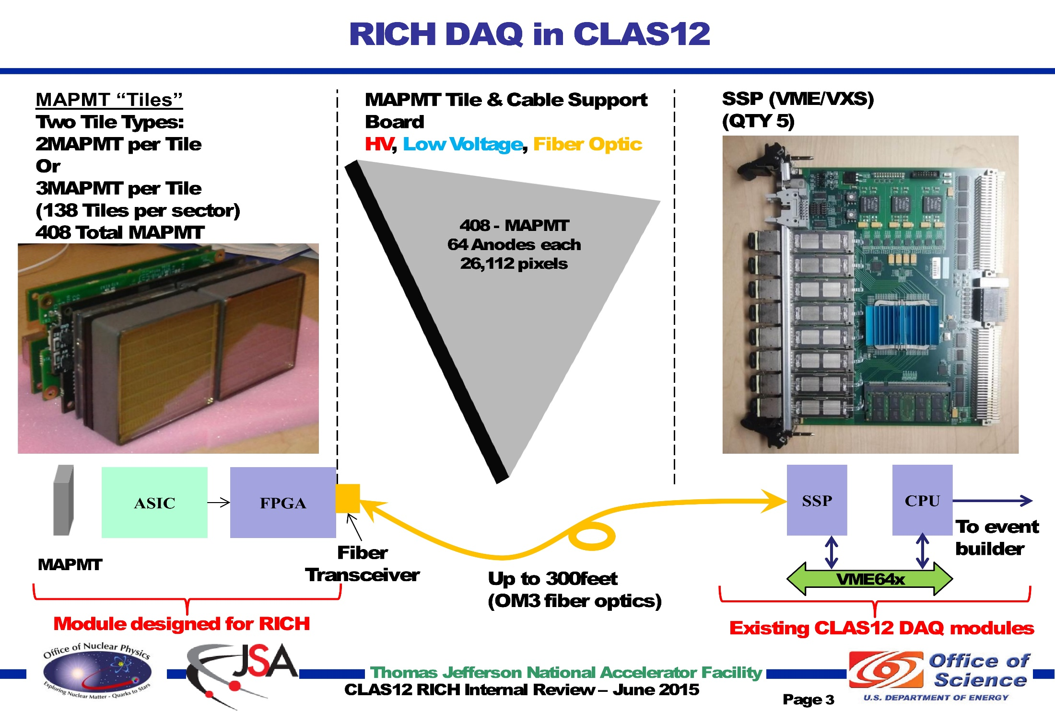
Thomas Jefferson National Accelerator Facility

Slide 10
Thomas Jefferson National Accelerator Facility

Slide 11
CODA “Gen 4” – Streaming
The primary goal for Streaming support at JLAB is to provide a “standardized” framework and set tools to allow for multiple experiments to take advantage of it
A transition to support of Streaming does not have to be done at the expense of the older
Trigger based systems. A “Hybrid” system seems not only possible but actually preferred.
҆JLAB clock/trigger distribution already exists and is suitable for both modes.
Flexible FPGA based front-ends can be enhanced by providing a User friendly and adaptable software framework (the CODA ROC) along with general driver libraries allowing User configuration and/or loading of custom firmware objects in the FPGA at runtime.
CODA Back-End components supporting the streaming model are being developed (by the EPSCI group) and can be integrated with the AFECS Run control system as well as with possible online processing/filtering framework like JANA2
Thomas Jefferson National Accelerator Facility

Slide 12
Summary
We have come a long way since 1999 and FERA CAMAC boards reading out LS0/GSO detectors with PSPMT!
Traditional ‘crate/backplane’ hardware is very useful and commercially available. Significant progress with high speed serial bus systems continues. [VPX, ATCA]
Detector geometry and channel segmentation drives the need for ASIC on board the detectors.
Placement of FPGA directly on ASIC board achieves data transfer requirements and allows AI or ML algorithms to further enhance real-time algorithms on ROI data.
SRO implementation will reduce data storage resources and eliminate the need for separate ‘trigger’ hardware
New network gear [Arista] includes high resolution time stamping ability
Software work to implement full SRO systems at JLAB is ongoing and becoming a High Priority in support of near future experiments
Questions?

Slide 13
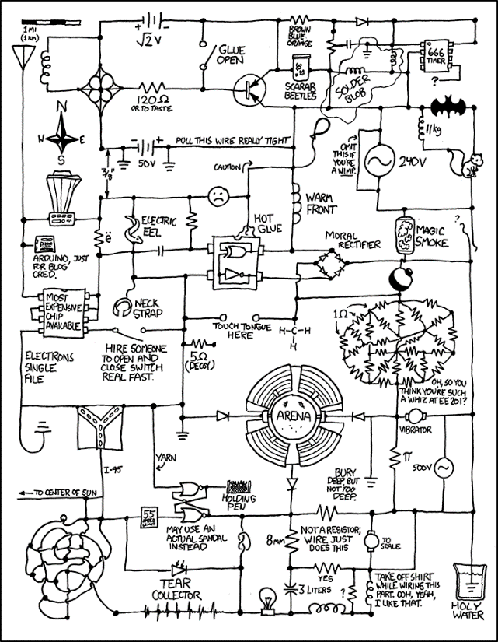
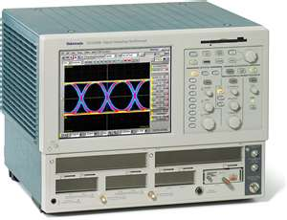
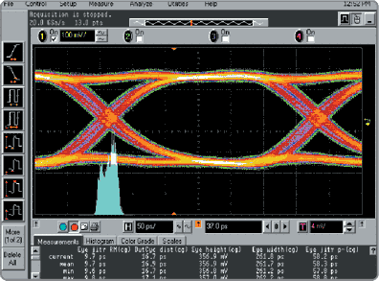
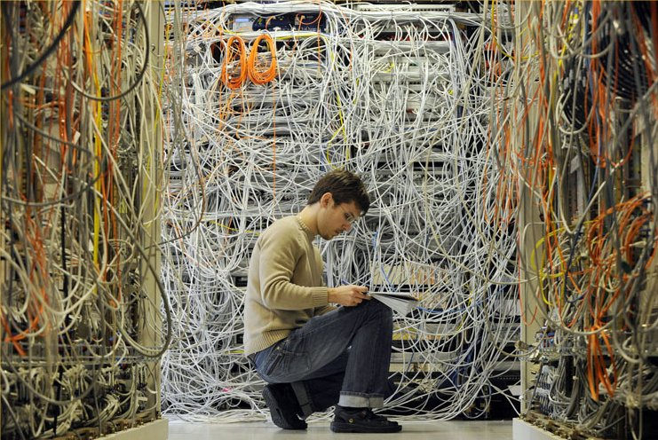
Backup slides
They said we were going “wireless”,,,

Slide 14
This Design will carry JLAB DAQ for another decade!!
Amazing Electronic Device!
Thomas Jefferson National Accelerator Facility

Slide 15
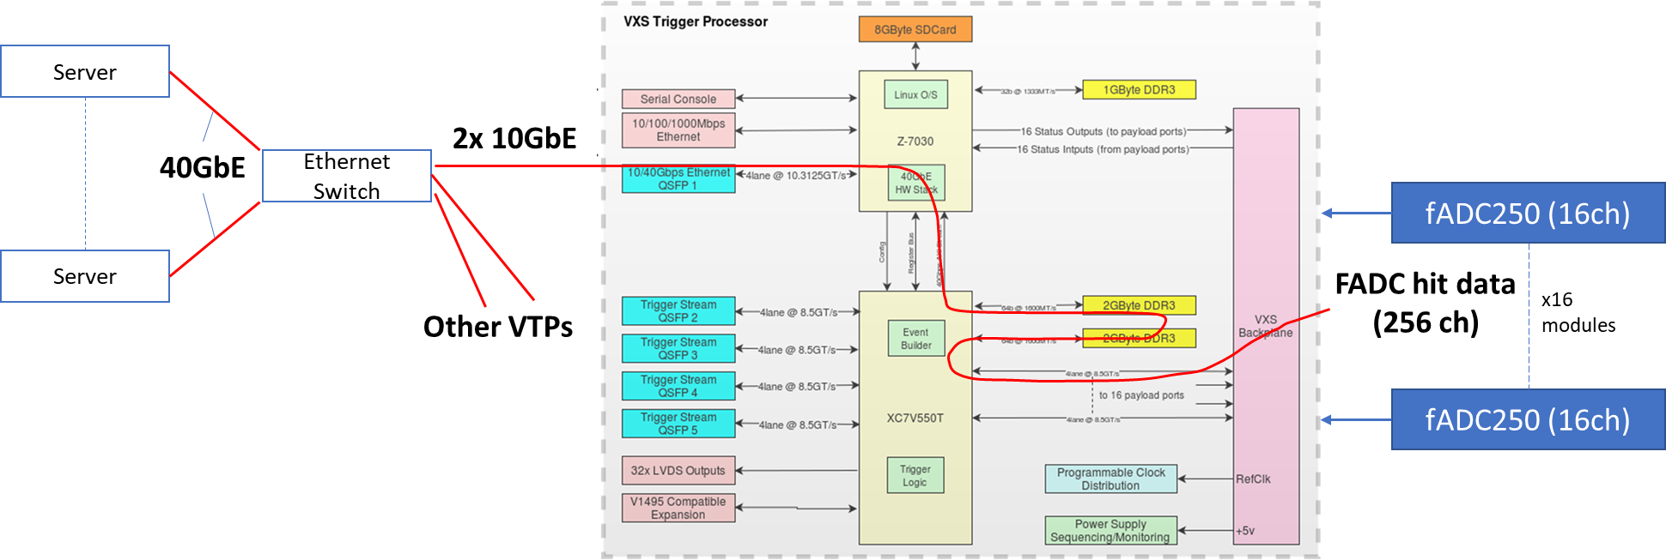
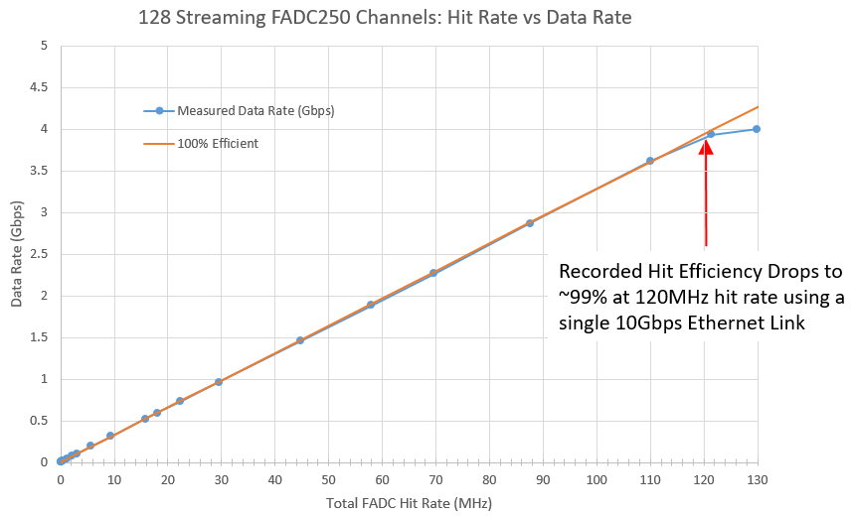
SRO of FT in CLAS12 with Beam
B. Raydo
CLAS12
Et Al,,
Drawing illustrates a test we performed in a Hall B beam test Feb 2020 using the CLAS12 FT calorimeter (336 FADC channels)
Front-end setup: 2 VXS crates, each with VTP w/ 2x 10GbE optical links, 11 FADC250 modules, 336 PbWO crystals w/APD
Backend setup: servers connected to front-end ethernet switch by 40GbE. Software as a combination of CODA, TRIDAS, JANA, ROOT that together performed configuration, event selection, event reconstruction, and online monitoring.
π⁰ reconstructed signal from streaming data:

Slide 16
Fast Electronics Streaming ReadOut Mode
FEDAQ
Streaming Read-Out – Experience
Augment existing pipelined hardware developed for the 12GeV experiment program. ( Flash ADC – 12bit/250Msps, High speed Gigabit backplanes)
Demonstrated high speed serial transmission that eliminates VME 200MByte/sec limitation
VXS uses multiple Giga-bit serial links on back-plane for data transfer
VXS Serial back-plane limit is 8GByte/sec
VXS Trigger_Processor[VTP] data transfer limit presently: ~2GByte/sec
VXS Trigger Processor with fADC250 boards on CLAS12 sub-detector used successfully during beam operations. [Forward Tagger]
16 fADC250 Modules ReadOut with serial mode to VTP
150MBytes peak data rates from Forward Tagger operated with beam
VTP uses 10GbitEthernet links to DAq network system

Slide 17
12GeV Examples of VXS Readout/Control with ASIC
C. Dickover
B. Raydo
CEA Saclay** INFN*
2.5Gbps line rate 16bit bus @ 125MHz for transmit and receive
RICH 25,000 pixels
2.5Gbps line rate 16bit bus @ 125MHz for transmit and receive
SBS GEM
+40K pads
APV25
FPGA MPD*
2.5Gbps line rate 16bit bus @ 125MHz for transmit and receive
DREAM
FPGA FEC**
MicroMegas
+20K strips
Forward Tracker
+3300 uMegas Strips
VME64x Readout Bandwidth [~200MBs]
OK Because Detector occupancy Is low (~1%)
Thomas Jefferson National Accelerator Facility

Slide 18
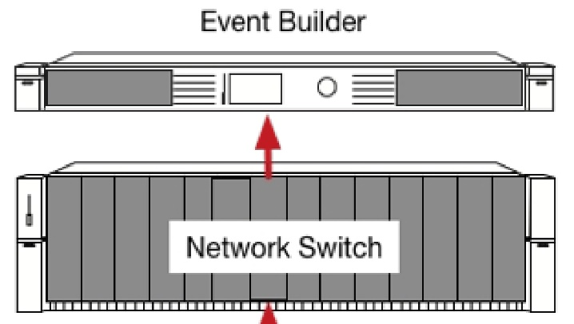
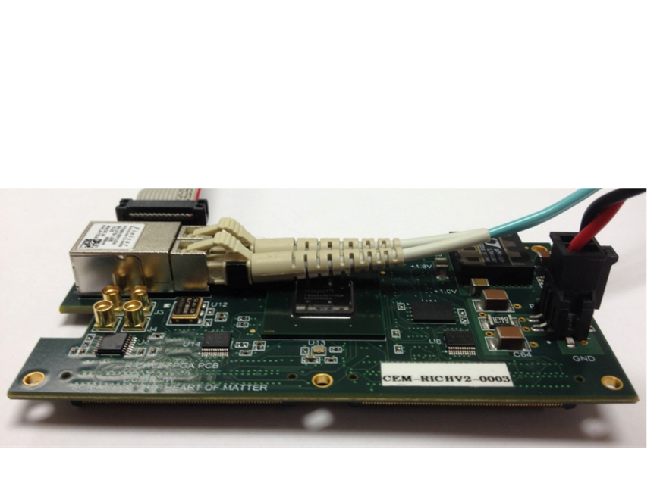
Streaming Without ‘Crates’
Readout/Control of ASIC <-->Network
FEDAQ Group
FPGA ReadOut & Control[ROC]
Develop interfaces with new ASIC:
Used MAROC3 for CLAS12 RICH and GlueX DIRC detectors
Petiroc 2A -> 32 Channel SiPM with Q and T conversion {10 bit ADC; 18ps timing[Prototype in development]
Xilinx Artix7
Fiber Optic
Aritsu Network Switch
Uses Xilinx FPGA
Innovation in Nuclear Data Readout and Analysis
INDRA Test Lab in CEBAF Center
Readout R&D lab for future 12GeV experiments
- TDIS
- SoLID
- Moeller
Development of new Software for managing streaming data storage
Developing Software Framework for processing tasks. i.e.) Calibration, monitoring, reconstruction.
Use new COTS {Aritsu} network gear that includes high level FPGA for control of data stream
Development of High Level Synthesis code for creating ‘virtual triggers’ from streaming data
JLAB FPGA Readout/Control Board
192 Channel Interface
Algorithms
1ns TDC
Scaler
Fixed Latency up to 8us
Optical Ethernet – Use Commercial 1Gbe
Finisar Transceiver capable of 10Gbps
Artix could run @3.125Gpbs
Mates to ASIC
+5VDC @1A

