Slide 1
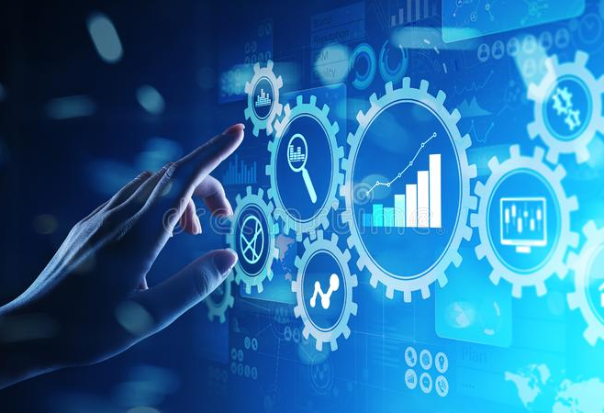
Capabilities from the Physical Sciences

Slide 2
Understanding the Science Workflow
Big science is not usually fast science.
  This would seem to be at odds with many aspects of healthcare were finding a solution quickly can be life saving.
  However, many underlying techniques are suitable for crossover.
In most science disciplines the workflow is something like this:
  Theory makes a prediction about how the world works and a test of the validity is identified.
  A simulation is run to see if the test will work.
  Equipment is designed and a simulation is run to see if it will behave as expected.
  The experiment runs:
    Physical quantities are converted into digital values.
    Data is acquired and monitored for quality control.
    The data is stored somewhere.
  After the experiment:
    A combination of simulated and real data is used to produce a calibration for the instrument.
    The calibration is used to convert the stored digital values back into physical quantities.
    The physical quantities are statistically analyzed to extract the physics that tests theory.
  Papers are written, and read, predictions are made, and we go back around the loop.
For the large experiments in the NP and HEP world the time to close the loop can be years or decades.

Slide 3
Workflow phases
There are a few key areas or phases where computing is involved.
  Simulation – before during and after data taking.
  Data acquisition – get the data off the instrument, reduce volume, format, and store.
  Monitoring – data quality and instrument behavior.
  Calibration – how to convert the acquired data back into physics.
  Reconstruction – do the conversion.
  Analysis – extract the science from the data.
These fall into two main groups:
  Online – data acquisition, monitoring and maybe calibration.
  Offline – simulation, calibration (usually), reconstruction, and analysis.
Why?
  Because the offline tasks are typically slow and need access large computing resources. Also, some offline tasks need to be done more than once.

Slide 4
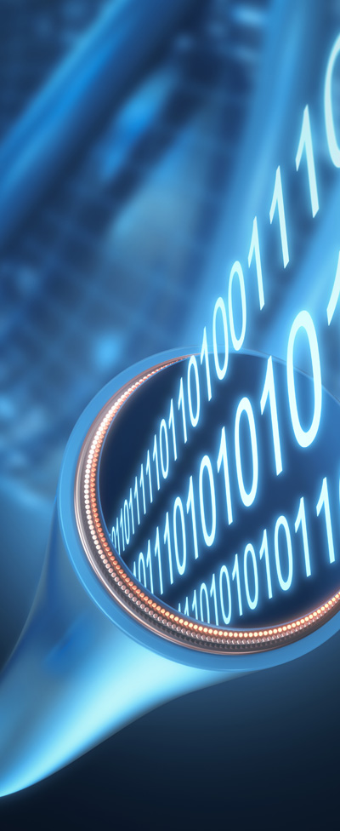
Online tasks – data acquisition
There are two types of instrument readout:
Triggered:
  A trigger signal from the instrument indicates that there is valid data and initiates readout.
    Many NP and HEP triggers are complex physics-based algorithms implemented in hardware.
    A poorly understood trigger introduces risk of biasing the experiment.
  The data is a sequence of variable sized packets at random times labeled with a trigger number.
Streaming:
  The instrument is read out continuously.
  Simple algorithms implement data reduction techniques.
    For example, suppressing signals below a noise threshold.
  The data is a stream of variable sized time stamped packets at fixed time intervals.
  Advantages:
    Richer data-set since all valid data is acquired.
    Risk of bias is almost eliminated.
    Costly custom trigger electronics is not needed.
    Data flow is smooth and predictable, all on clock ticks.
In the past streaming was not practical due to the amount of processing and data transfer bandwidth required. This is no longer the case.

Slide 5
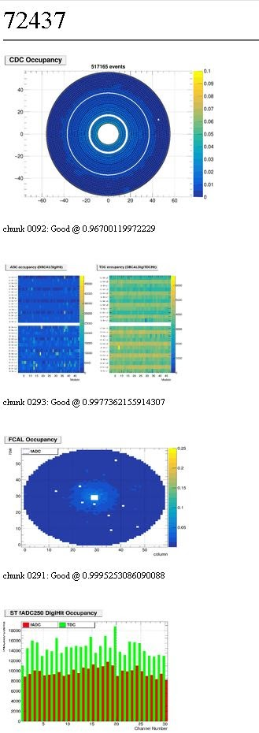
Online tasks – Monitoring
Usually, monitoring is done by people.
  Software analyses data as it is taken and plots histograms.
  Humans look at the histograms.
At JLab we have developed a system using AI/ML technology that we call Hydra.
  Hydra is trained using a set of many hundreds of histograms from past data taking runs that are classified by humans.
  After the training process Hydra can be “shown” a new histogram and classify it according to its training.
  It is between 93 and 99% accurate.
    Has found mislabeling by human experts.
  Processes can “listen” to hydra and act.
    Sound an alarm, produce high-level reports, etc.
  In 2020 Hydra detected an issue with the GLUEX experiment that was unnoticed by shift takers and would have seriously impacted data quality.

Slide 6
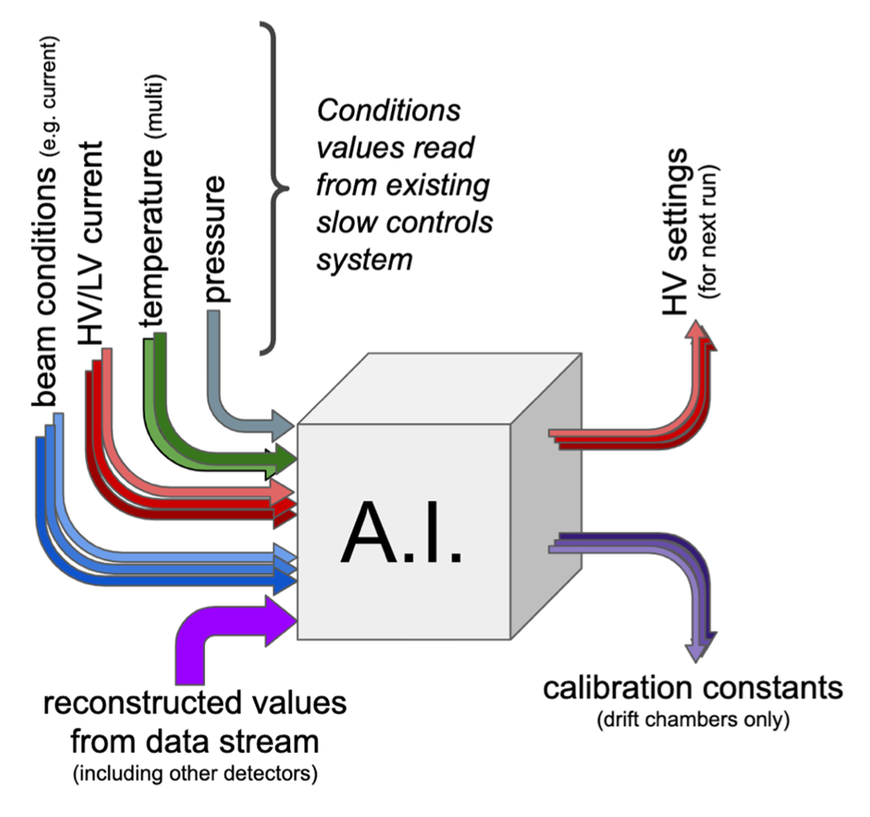
Online and maybe offline - calibration
We need to translate between the digitized value measured to the physical quantity it represents.
How calibration is done is very much dependent on the instrument.
In a triggered system the trigger can filter out data that could be useful for calibration.
  Needs special “calibration runs” so calibration is normally done offline.
A streaming system has no such limitation, and, in principle, a lot of calibration can be done online.
  A with Hydra for monitoring, it should be possible to use AI/ML to infer the calibration from observation of data and prior training. JLab has projects in this area.
Another project is to improve the stability of detector calibration by using AI/ML to control an instrument.
  At JLab we are looking at controlling voltage settings for a detector based on environment and data.

Slide 7
Offline tasks
Anything requiring high performance or high throughput computing (HPC or HTC) that happens out of band with data taking is referred to as offline.
Software packages developed for physical sciences, such as the GEANT simulation package are already in use by the health community.
I will focus here on some trends for the future.
  Distributed computing.
  Heterogeneous computing.
  Disaggregation.
  The blurring of the traditional offline/online boundary.
Raw data
Reconstruction
DSTs
Analysis train
Skim A
Skim B
…
Skim N
User Analysis
A
User Analysis
B
…
User Analysis
N

Slide 8
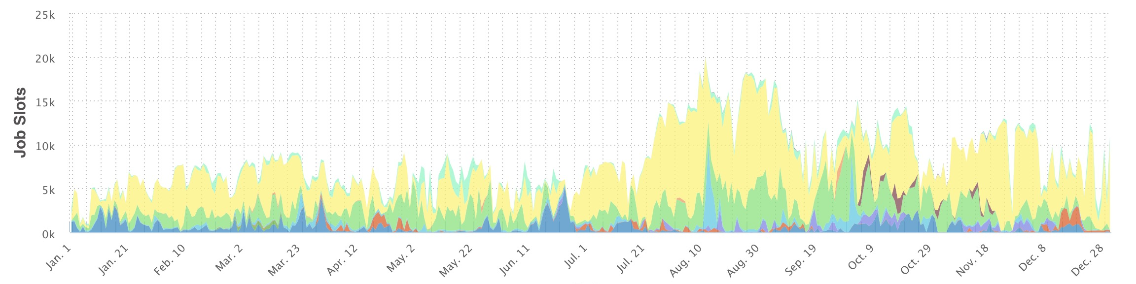
Realities of bulk data processing
There is a tension between people who pay for computing and people who use it.
  Data is only available after data taking and calibration.
  Once the experiment is ready, they want to process as quickly as possible.
  This leads to a pattern with bursts of activity.
Funders want to see that what they pay for is used.
  It is a waste of funding to overprovision to handle the peaks.
  Delaying processing is also costly but is a less visible cost.

Slide 9
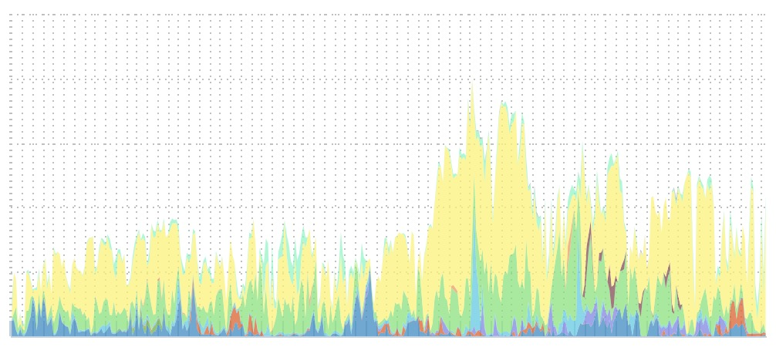
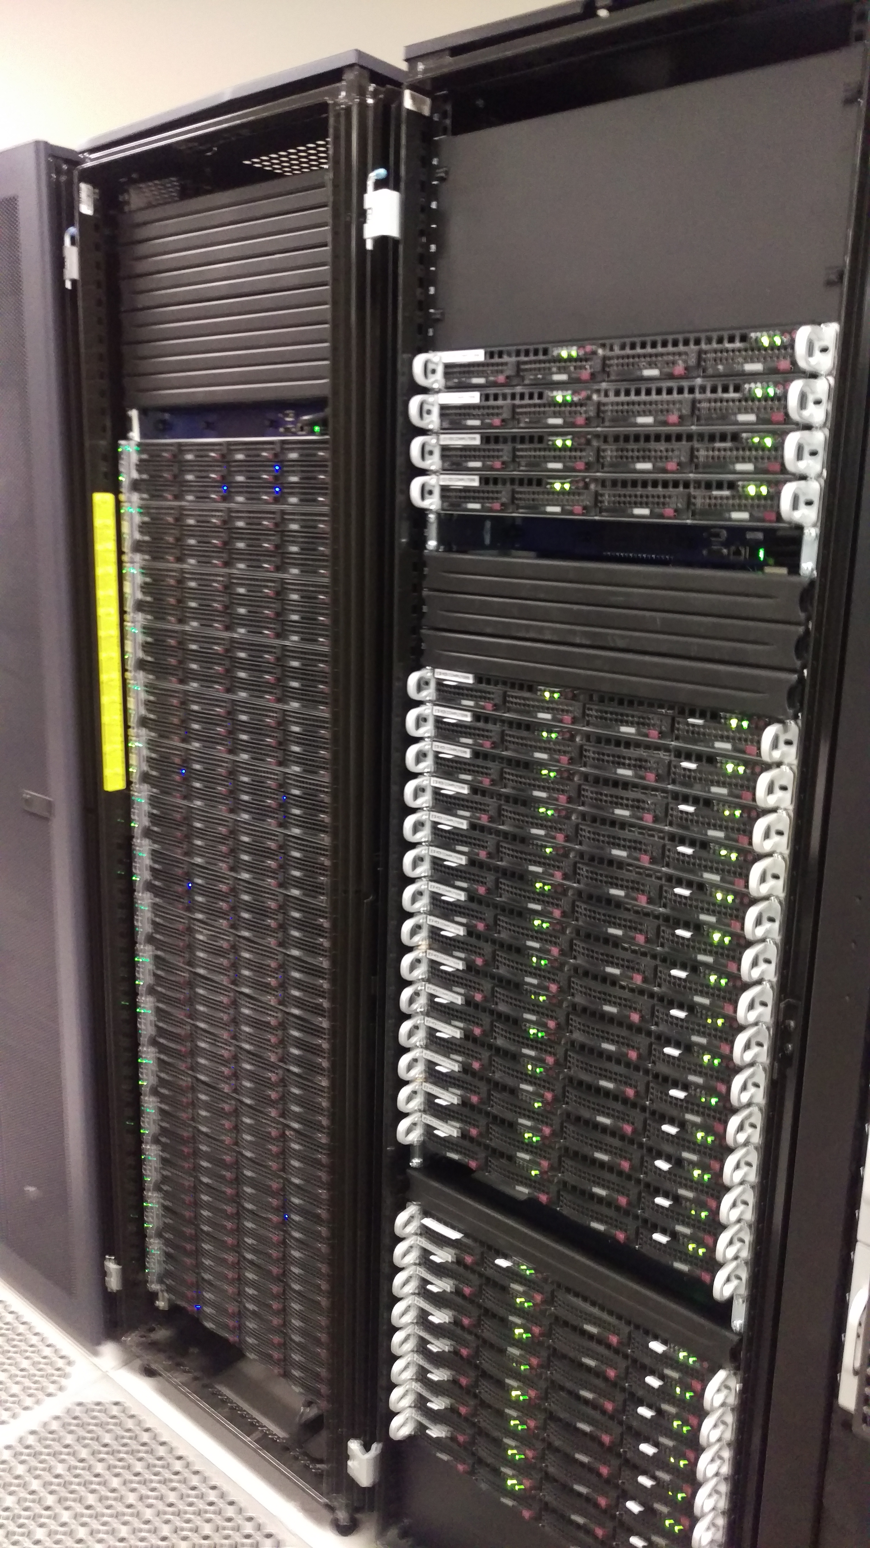
Distributed processing
Better to provision locally to fit the average load and use offsite resources for the peaks.
  Pay back the use of offsite resources by allowing offsite users to run in the valleys.
Offsite compute resources at JLab are a mix of :
  Locally at collaborating labs/universities (not via OSG).
  Remote via OSG (includes collaborators via OSG).
  Remote at supercomputer centers such as NERSC.
Success requires workflow management software.
  User submits a description of a sequence of tasks and the manager handles data transport and job execution.
User code requires containerization and software management.
  We don’t know what the environment is at the remote site. The container encapsulates the OS, user code, and support libraries.
Remote
Local

Slide 10
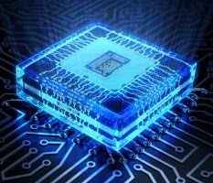
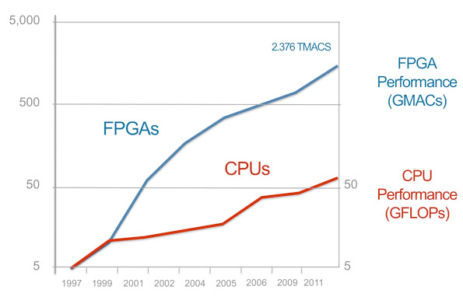
Heterogeneous compute.
CPUs have a reasonably large, but still modest, number of compute cores that allow simultaneous processing tasks. They have a rich instruction set that is easy to program.
  At JLab our latest nodes have dual AMD CPUs with 32 cores per node.
GPUs have several thousand cores with a reduced instruction set. There are more compute cycles, but they are harder to program efficiently.
FPGAs are general purpose chips that can be programmed to implement custom algorithms in firmware.
  In many cases use needs a trained FPGA expert.
The three technologies are progressively higher performance and harder to program. But:
  We have existing Firmware that was designed for online but could be reused online.
  Compilers that can make the same code run on any of the three platforms is being developed.
    Chip vendors don’t like their platform being rejected as hard to use.
  AI/ML techniques could allow a surrogate model of an algorithm to be implemented on any of the platforms without requiring re-coding by the user level.

Slide 11
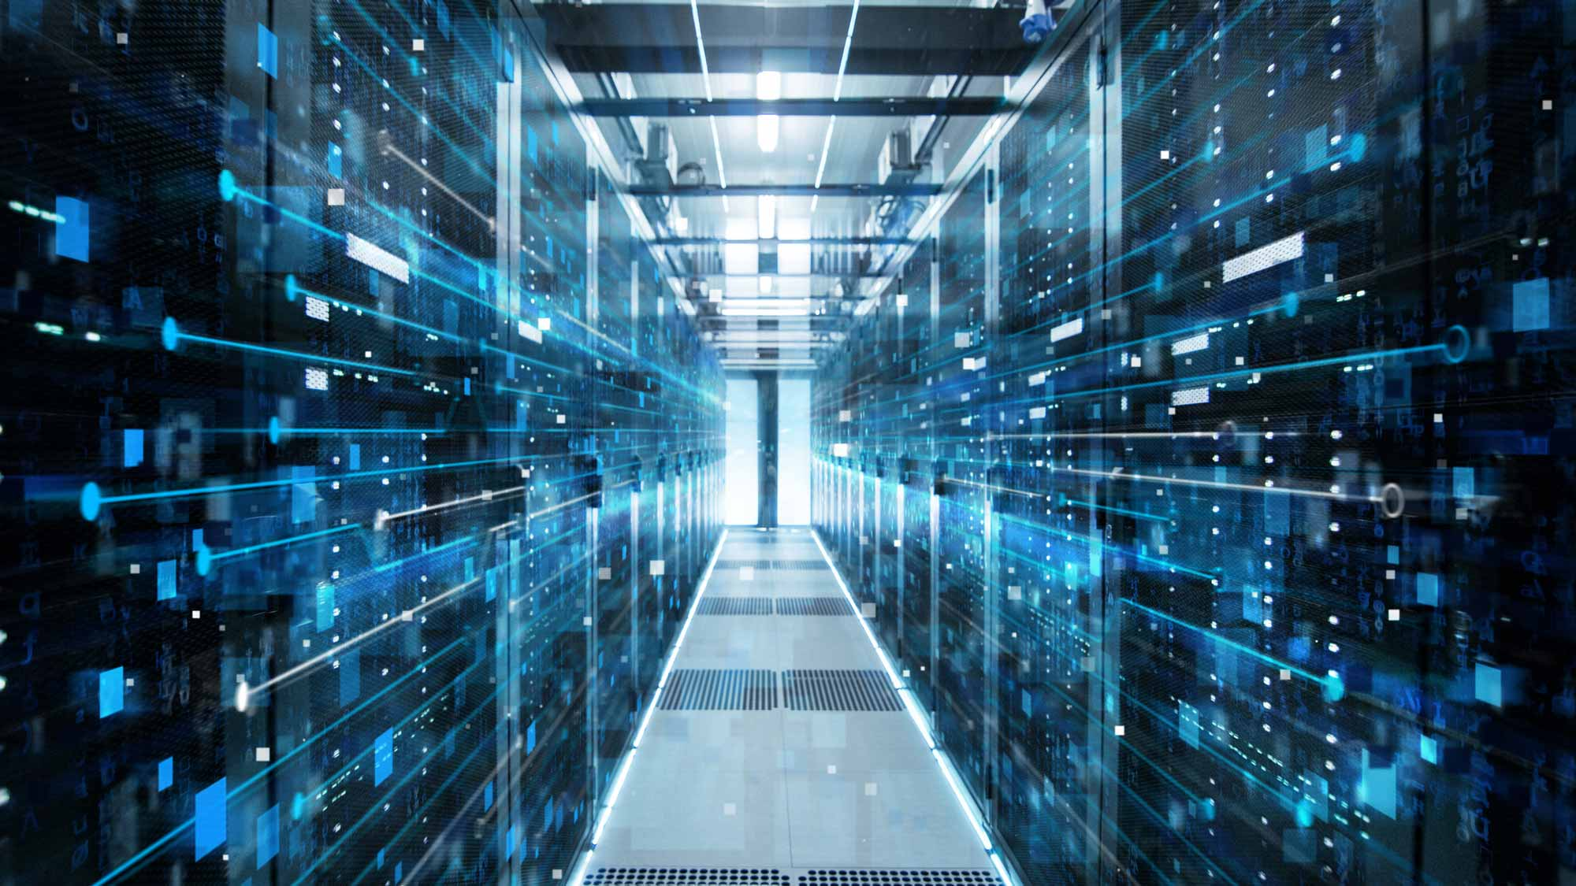
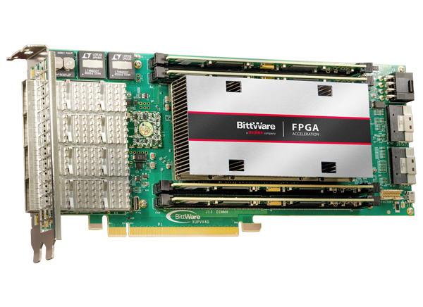
Disaggregation – thinking outside of the box
Off the shelf computing hardware restricts the mix of technologies that can be efficiently integrated into a single application.
  PCI slot space limits the GPU and FPGA cards in a single node.
  Communication between nodes involves the CPU which is slow.
What if we had no hardware limitation?
What if we could network heterogeneous hardware components and break out of the box?
We could then, on demand, assemble a virtual computer with whatever mix of technologies we want.
We already have a lot of the parts from the software point of view. Workflow management, control and monitoring, encapsulation of software in containers.
The hardware is appearing too. FPGA and GPU cards that have efficient high bandwidth optical connections that can be networked. GPU vendors are looking to running GPU-to-GPU communication, that now is restricted to within a node, over fiber between GPUs.

Slide 12
Vision of the future
Using technology developed for streaming readout and ESnet, a science dedicated wide area network, it will be possible to stream data between sites efficiently.
This would allow remote instruments and their associated “edge computing” to take advantage of a much larger computing resource than would be practical or cost effective to have locally. (See earlier slides on bulk data processing)
Advantages:
  Process data in real time – experiment steering
  Digital twinning.
  Novel technologies like AI.
We can envision a world where a user requests a virtual machine in the data center that is assigned for the duration of their experiment and assembled, using disaggregation, from components that meet their specification. The user’s code is a seamless application that incorporates hardware local to the instrument and the larger resources provided by the data center and runs in a containerized environment.

Slide 13
A Conceptional Compute and Data Facility
DOE uses ESnet as the WAN provider.
  This gives us control of the hardware and protocol.
The facility would be the core of a distributed, curated, storage system.
  Repository for data.
  Allows experiments immediate access to previous data runs, possibly from other instruments.
The facility computing would be designed specifically to meet the needs of science instruments.
Exascale Computing Project and other resources, such as NERSC, can contribute resources.

Slide 14
Summary
Although basic science and NIH may seem like very different worlds some of the computing challenges are the same.
  High data rates.
  Geographically distributed instruments.
  The need to process data and run simulations while the patient is being examined.
    Treatment steering.
  The tension between keeping costly resources busy and sporadic use patterns.
  The need to rapidly identify features and seamlessly deploy novel tech as it appears.
  The need to compare newly taken data with a large archive of previous results.
The type of facility described in the last slide has been a long-time dream of many science disciplines. It is not far from being realizable.
Maybe it can be a shared dream.

