Slide 1

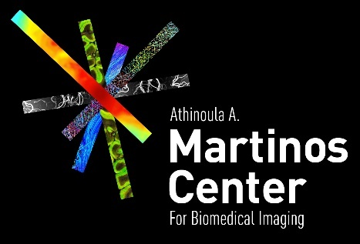

functional MRI
Joint DOE/NIH Workshop – Advancing Medical Care through Discovery in the Physical Sciences
Session 3 Advanced Magnetics: Overview & Community Perspectives Panel
Jonathan R. Polimeni, Ph.D.
Athinoula A. Martinos Center for Biomedical Imaging
Department of Radiology, Harvard Medical School
Massachusetts General Hospital
July 12th, 2021

Slide 2
applying MRI to measure brain function
functional MRI works by tracking blood flow and oxygenation
functional MRI is the most widely-used tool for measuring brain activity noninvasively in humans

Slide 3
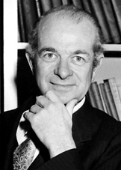
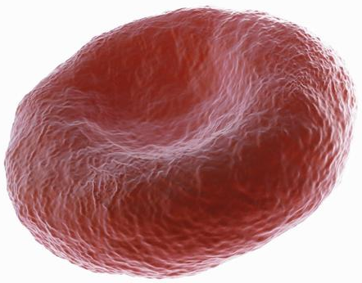
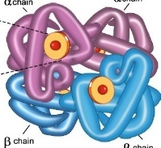
iron in blood
Linus Pauling
hemoglobin
O₂
oxygenated red blood cell
O₂
hemoglobin is principal oxygen carrier in the blood

Slide 4
iron in blood
Linus Pauling
hemoglobin
O₂
oxygenated red blood cell
DEoxygenated red blood cell
O₂

Slide 5
iron in blood
Blood-Oxygenation Level-Dependent (BOLD) signal
Linus Pauling
paramagnetic
hemoglobin
iron
(heme)
DEoxygenated red blood cell

Slide 6
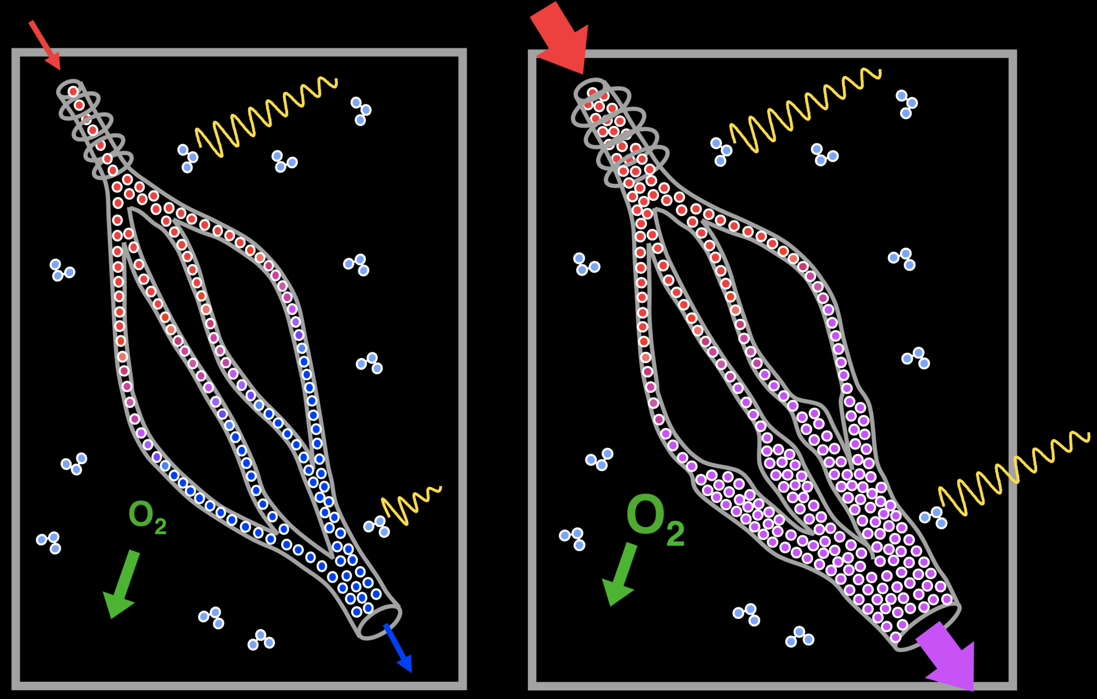
from neuronal activity to the BOLD fMRI signal
CBF
MRI voxel at rest
Cerebral blood flow (CBF) supplies oxygenated blood to capillary bed
Oxygen is extracted and consumed (CMRO₂)
Consequently, venous blood contains deoxygenated hemoglobin (dHb)
dHb is paramagnetic and perturbs the magnetic field
Baseline MR signal is intrinsically low
high T₂*
H₂O
low T₂*

Slide 7
from neuronal activity to the BOLD fMRI signal
CBF
MRI voxel at rest
CBF
MRI voxel upon activation
During stimulation (i.e. task) neuronal activity increases
O₂ consumption has moderate increase
CBF has LARGE increase and blood volume moderate increase
  ΔCBF ≫ ΔCMRO₂
Flushes out venous dHb
Decreased dHb results in a smaller field perturbation; MR signal increases (compared to baseline)
Basis of BOLD fMRI
high T₂*
high T₂*
H₂O
low T₂*
med. T₂*
Courtesy Bruce Pike, U Calgary

Slide 8
neurovascular coupling and blood flow regulation
tight communication between neural activity and hemodynamics
[Iadecola 2017, Neuron]

Slide 9
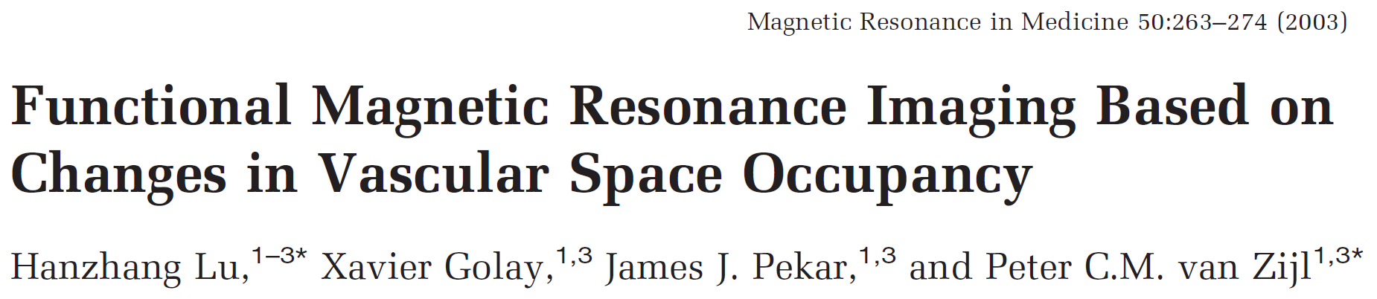
non-BOLD fMRI: tracking blood flow/volume
Williams et al. 1992, PNAS
cerebral blood flow (CBF)
  Arterial Spin Labeling (ASL)
Lu et al. 2003, Magn Reson Med
cerebral blood volume (CBV)
  VAscular Space Occupancy (VASO)
  contrast agent (gadolinium, Ferumoxytol)
  similar to Magnetic Particle Imaging (MPI)
Belliveau et al. 1991, Science
first human fMRI experiment!
these are more specific to neural activity, but less sensitive compared to BOLD

Slide 10
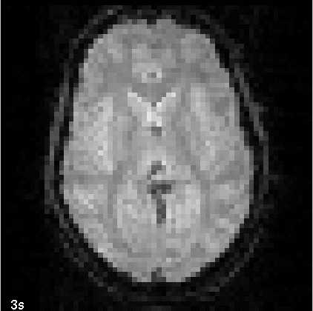
raw BOLD fMRI data – picking the signal out of the noise
T₂* weighted MRI data
movie credit: Doug Greve, MGH

Slide 11
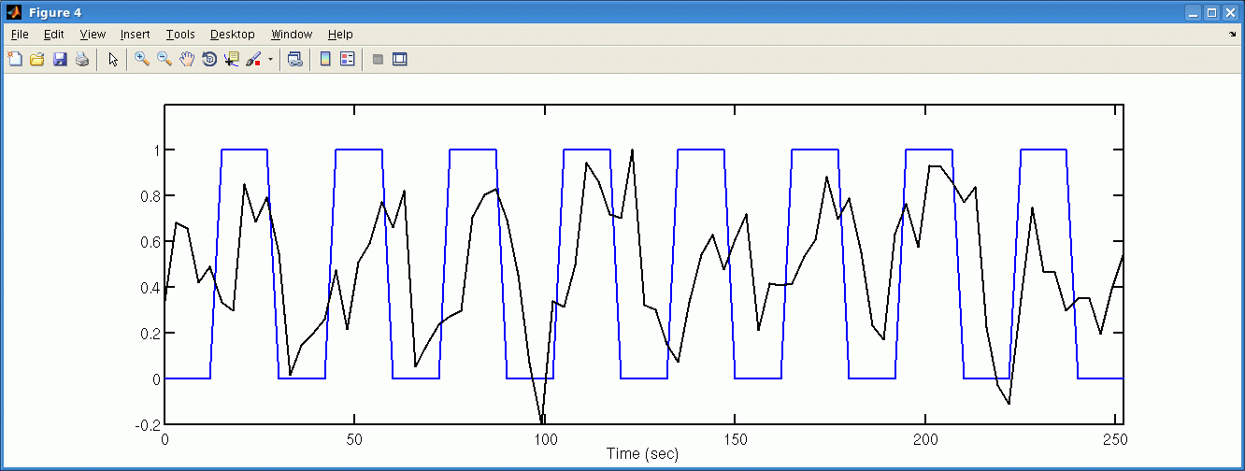
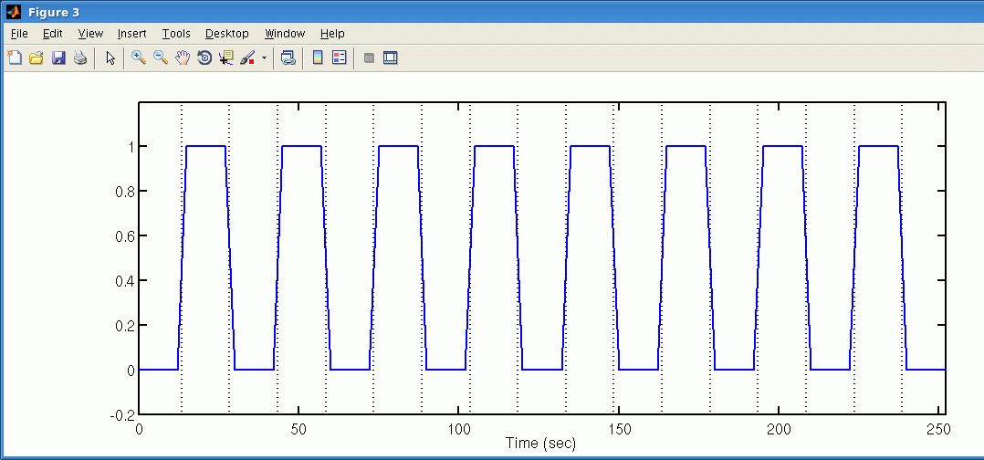
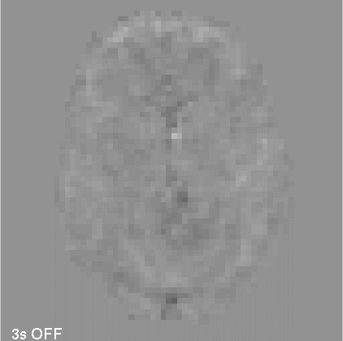
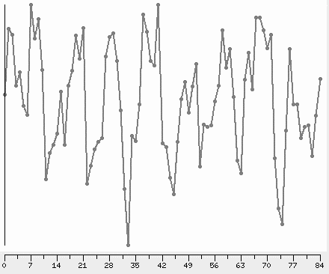
raw BOLD fMRI data – picking the signal out of the noise
T₂* weighted MRI data
with mean subtracted
fMRI analysis
motor
on
on
on
on
on
on
on
on
off
off
off
off
off
off
off
off
off
intensity
visual
time
movie credit: Doug Greve, MGH

Slide 12
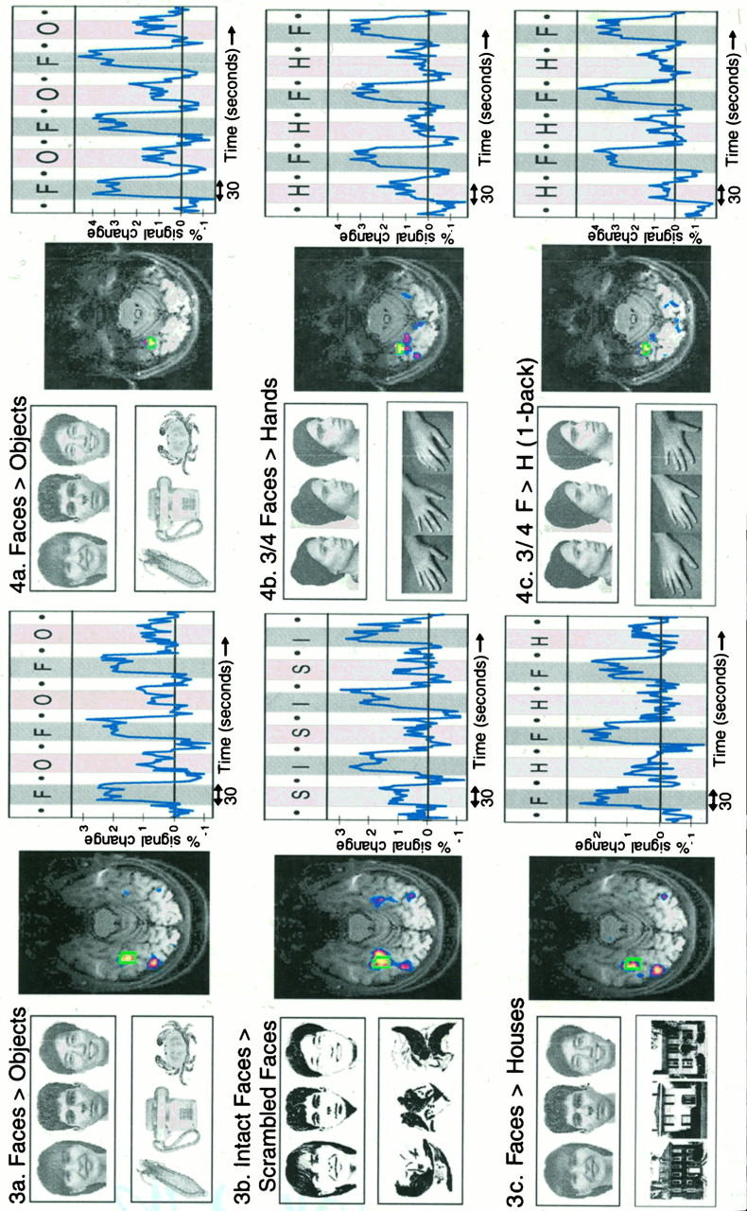
experimental design: subtracting two conditions
dedicated region to processing faces
modular theory of brain organization
[Kanwisher et al. 1997, J Neurosci]

Slide 13

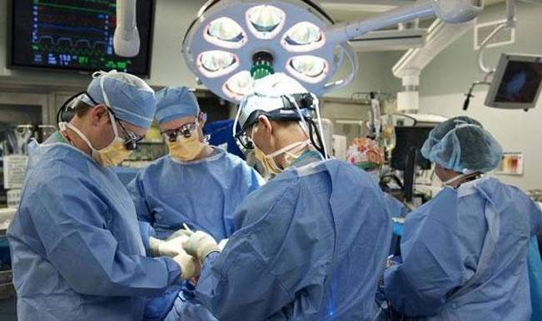
fMRI used clinically
“medically necessary to identify the eloquent cortex in presurgical evaluation of persons with:
brain tumors,
epilepsy, or
vascular malformations”
“considers fMRI experimental and investigational for the diagnosis, monitoring, prognosis, or surgical management of all other indications”
Last Review 10/31/2020
Effective: 11/09/2007
Next Review: 08/26/2021
http://www.aetna.com/cpb/medical/data/700_799/0739.html

Slide 14
resting-state fMRI and “functional connectivity”
correlated time courses:
functional connectivity
a coherent “network” of brain regions
[Raichle 2015, Ann Rev Neuro]

Slide 15
take-home messages
fMRI measures brain function through tracking changes in blood flow and oxygenation
fMRI response results from an active vascular response to neuronal activity
  has the potential to be far more neuronally specific than commonly believed
fMRI allows for tracking neural activity across the entire human brain

Slide 16

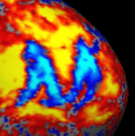
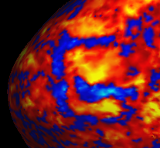
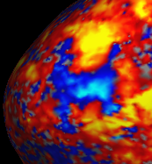






Thanks for your attention!
Questions? Comments?
Magnetic Resonance - Physics & Instrumentation Group
(MR PIGs)
jonp@nmr.mgh.harvard.edu
Athinoula A. Martinos Center for Biomedical Imaging,
NIH NIBIB P41-EB030006,
NIMH R01-MH111419, NIBIB R01-EB019437,
NINDS R21-NS106706, NIMH R01-124004

