Slide 1
Capabilities from the Physical Sciences – Superconducting Magnet Ecosystem
Kathleen Amm, Director, Magnet Division
7/12/2021

Slide 2
Outline
History of DOE impact on medical device development
Current state of collaborations between DOE labs and medical device development
Lessons learned from examples
Capabilities from DOE labs
Superconducting Magnet Ecosystem

Slide 3
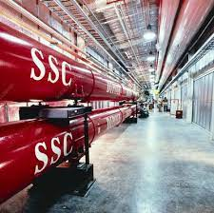
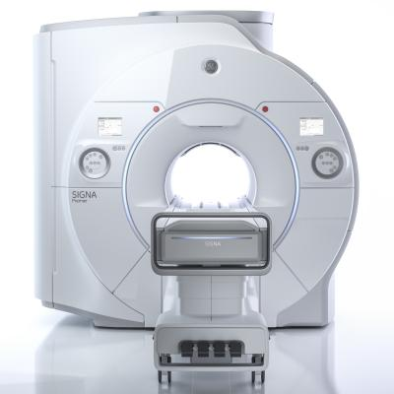
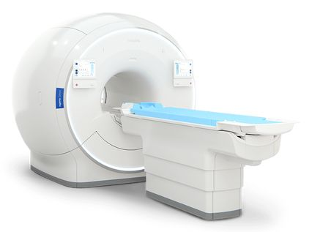
Tevatron and SSC – commercialization of MRI – synergy and serendipity
MRI was discovered by Paul Lauterbur just as FNAL started the Tevatron in 1974
The Tevatron commercialized superconductors right in time for commercial MRI
The SSC program made NbTi robust as the MRI market grew
Both project developed key talent for DOE, GE and IGC

Slide 4
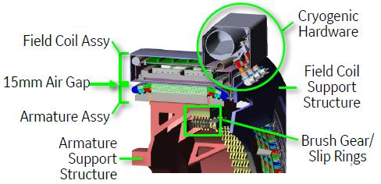
MRI to DOE – Offshore wind
GE is developing a novel technology for offshore wind based upon their experience in MRI development
DOE EERE is funding GE to develop this technology
GE has and is establishing relationships with DOE labs (LBNL and BNL) to enlist expertise based upon their experience in developing and testing large dipole magnets for accelerators
https://www.ge.com/research/project/high-efficiency-ultra-light-superconducting-generator
https://www.ge.com/news/reports/how-cool-is-this-superconducting-generators-aim-to-unlock-more-offshore-wind-power-at-lower

Slide 5
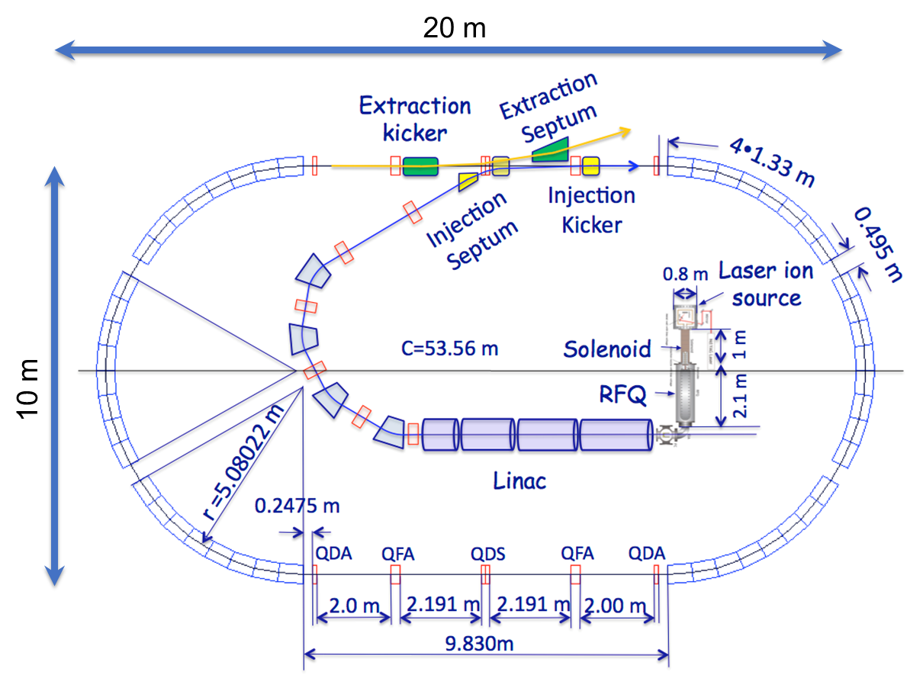
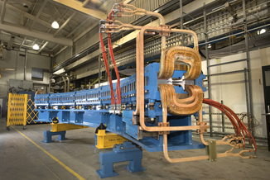
Proton/Carbon therapy – DOE to industry
DOE labs have advanced capabilities for focusing magnets, magnetic measurements
BNL – direct wind
LBNL – canted cosine theta
Industry partnerships have been developed – Best Medical, Varian
BMI & BNL have jointly developed a rapid cycling proton/carbon synchrotron that enables advanced features including:
A unique combination of advanced spot scanning with rapid energy modulation
Elimination of neutron contamination associated with patient specific hardware
Utilize capabilities for compact accelerators for medical therapy
Notes:
Rapid cycling technology has several natural advantages:
Intrinsically small beam emittances facilitating beam delivery with unprecedented precision
Small beam sizes – small magnets, light gantries – smaller footprint
Highly efficient single turn extraction
Efficient extraction, less charge per bunch – less shielding
Flexibility – protons and or carbon, future beam delivery modalities

Slide 6
Lessons Learned
Complete serendipity of timing
Tevatron and the SSC accelerated development of and risk reduction for the MRI industry
Even a significant failure (SSC) led to critical technology breakthrough – high performance NbTi – and development of technical talent
Partnerships are developing

Slide 7
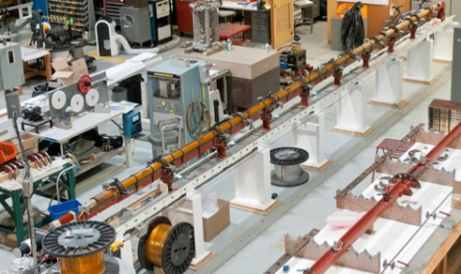
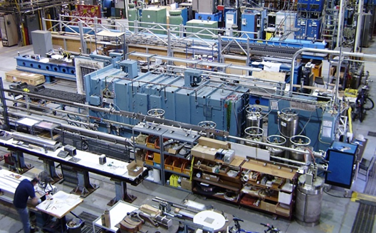
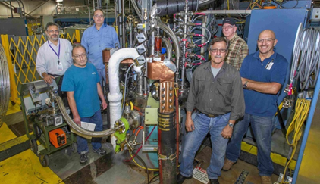
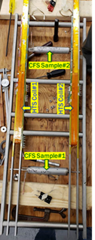
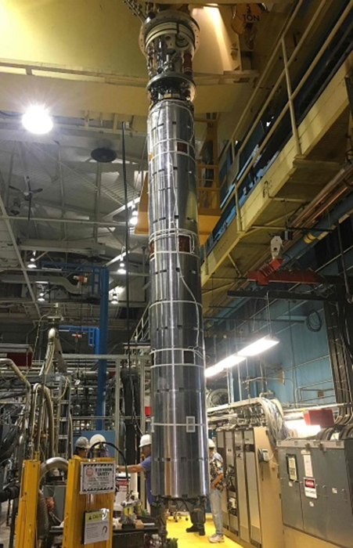
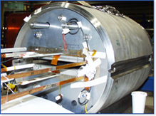
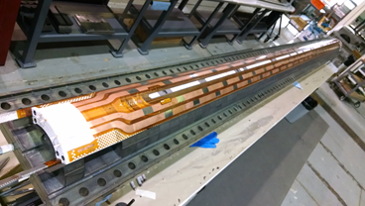
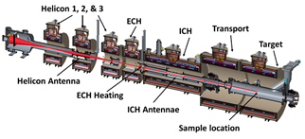
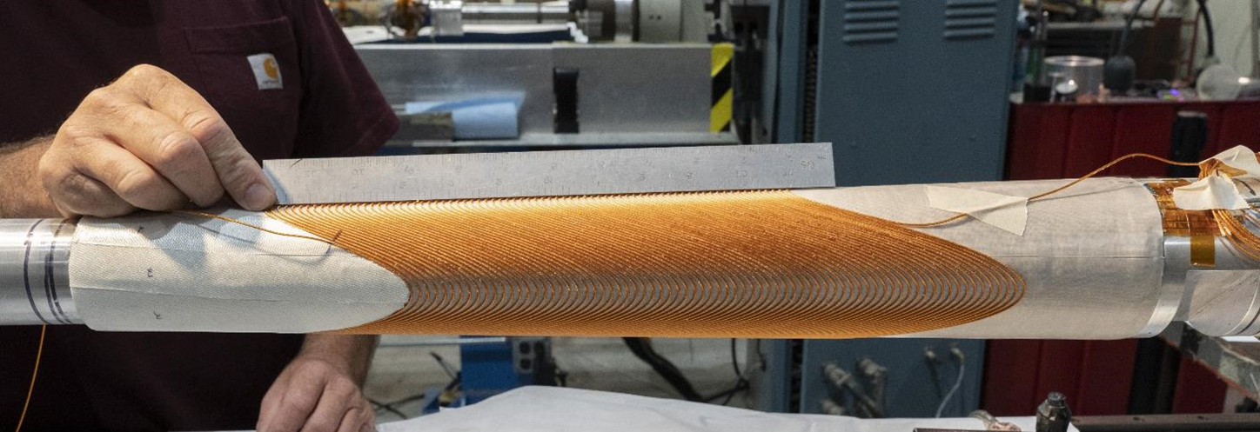
BNL Magnet Division – Capabilities and Priorities
Winding facility
Vision: To be a world class superconducting and electromagnetics team creating the future of superconducting magnet technology.
Magnet Division staff deliver leadership in:
Superconducting magnet technology
Magnet development, manufacturing and testing with application to accelerator, science, fusion and industry
Capabilities:
LTS and HTS superconducting magnets - 10m Coil Winding Capability, Nb₃Sn furnace 4.2 m
Direct wind magnets and facility -IR and Specialty Magnets, Precision Field Quality, 2.5m Coil Winding Capability
Magnet Test facility - 1.9K, 22KA, 6.1m deep, 71cm dia. – multiple test stands available
Current priorities:
Accelerator Upgrade project – coil construction, vertical magnet test
EIC magnets – IR, magnet measurement, RHIC magnet re-use
Magnet Development Project – HTS/LTS hybrid, Diagnostics
Fusion – INFUSE, ARPA-E (CFS), MPEX, SBIR
Nb₃Sn Furnace
Magnet Test facility
Deliver superconducting applications for DOE (SC, ARPA-E, ...) and SPP (Power, Fusion, MRI...)
Direct wind facility
MDP HTS/LTS Hybrid
Fusion joint test
AUP vertical test
and coil manufacturing
MPEX conceptual design
EIC coil designs and direct wind double helix
Notes:
Utilizing BNL’s strengths –
Continuing to enhance test facility
Unique manufacturing capabilities – direct wind
Utilizing leadership in HTS development to accelerate implementation – e.g. fusion
Strong history of industrial partnership
Strong ability to execute and deliver on projects
Strengthening collaboration and broad strategy with other labs, superconducting industry
AUP Project – now ready for CD-3 after key successful
MDP re-introduced
Unique manufacturing capabilities – Direct wind and HTS → IR in EIC and also Fusion
Growing role in EIC Project
EIC also supports 7 FTEs in Magnet Division who are playing a critical role in the design and development of all of the IR region magnets. The EIC project is including the magnet division in the design, R&D and also the building of the IR region magnets either in house or with suppliers who have the capability to build some of the IR magnets. Magnet division has a unique capability to design and build high precision, multipole, IR magnets that have been used in accelerators around the globe. This technology will be implemented by Magnet Division to deliver high performance, low cost, IR magnets for the EIC.
In addition to the current project role of 7 FTEs on the development of IR magnets, Magnet Division has also been asked to help in replacing and moving the diodes in the current RHIC magnets so they can continue to perform in both the RHIC collider and the future EIC with the higher anticipated radiation loads. The Magnet Division, with its deep expertise in having designed and successfully partnered with industry to build the incredibly successful RHIC magnets, has also been asked to engage in a number of activities by the EIC HSR Vacuum Chamber team on risk reduction for existing RHIC magnets performance in the EIC. The deep expertise that is retained in the Magnet Division based upon its development of the RHIC magnets and IR magnets around the globe is an invaluable asset to the EIC project and should be leveraged further to obtain the greatest impact on the EIC project

Slide 8
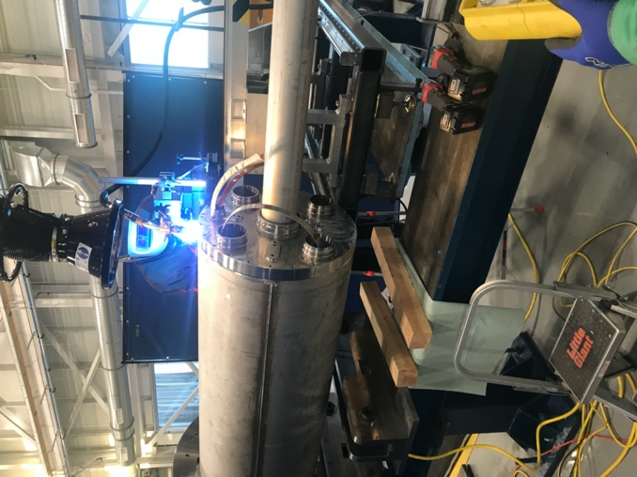
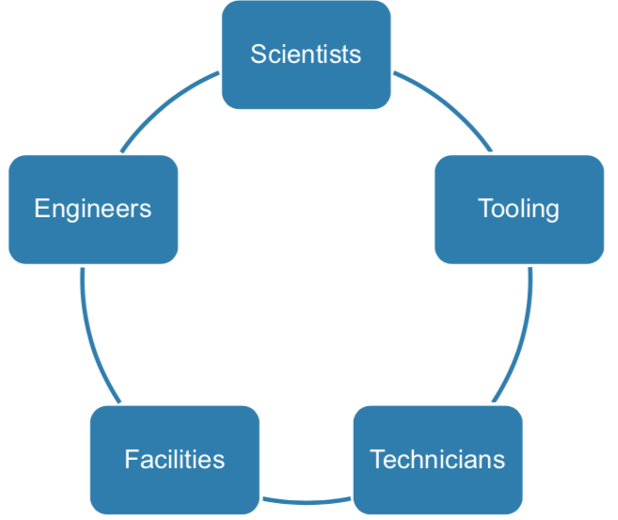
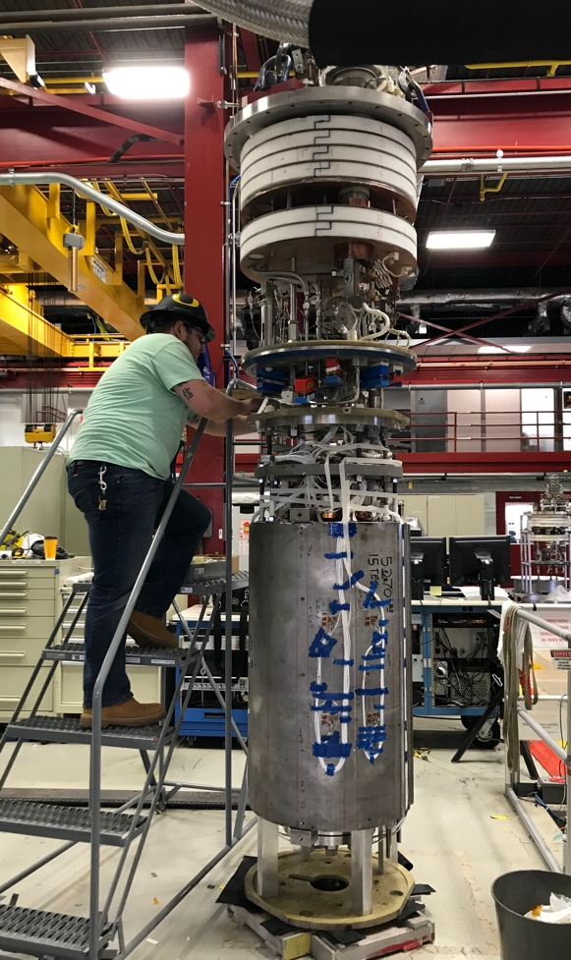
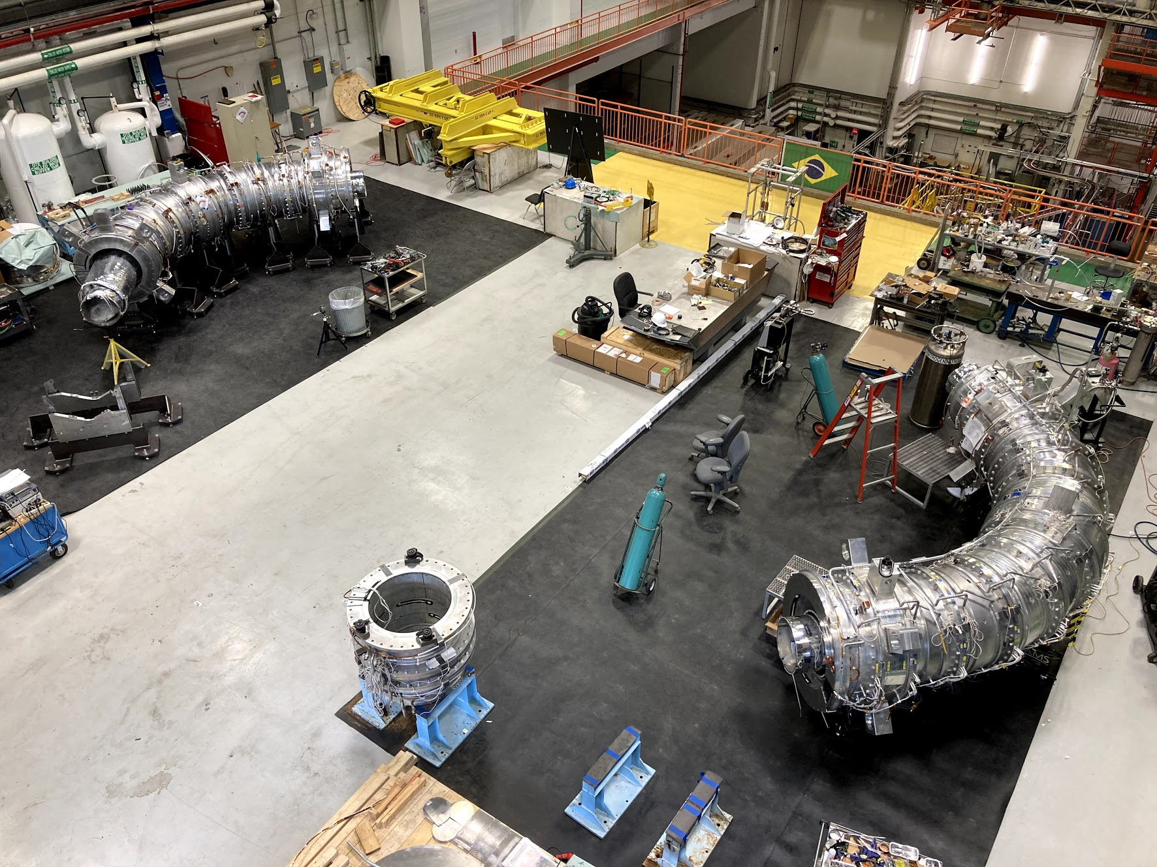
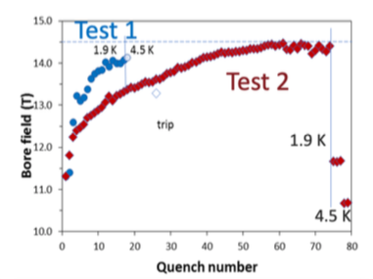
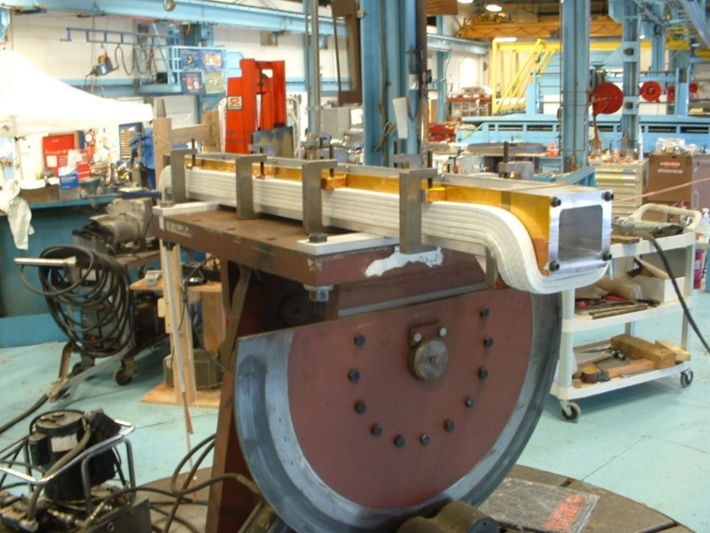
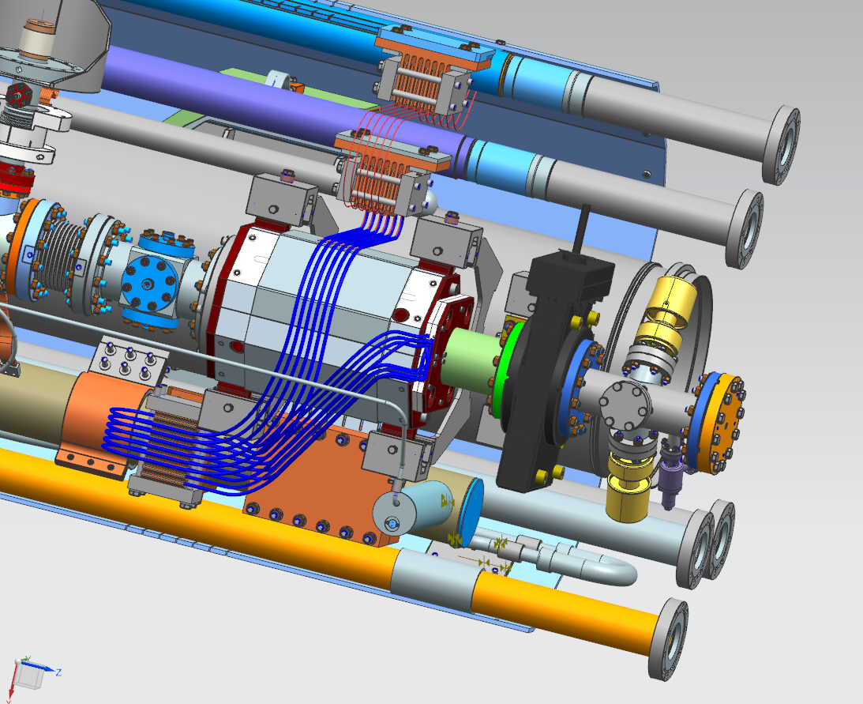
Fermilab: a world leader in Magnet Technology
Fermilab is a worldwide recognized leader in applied superconductivity and magnet technology. Decades of experience, a dedicated team and state of the art facilities are key to the laboratory ability to:
• Develop breakthrough technologies
• Complete world class projects
Five elements needed for a strong support of projects and magnet R&D
AUP cold mass assembly in cryostat
Projects:
LCLS-II CM SC quads and correctors
SC inflector for g-2
HL-LHC AUP Nb3Sn quads for LHC
Mu2e Solenoids
PIP-II conduction cooled solenoids
ORNL magnets for Proton Power Upgrade of SNS
Transport Solenoid assembly of the Muon-to-Electron Conversion exp.
Magnet Test facility and 15 T dipole
Ongoing R&D:
High field magnets – 14.5T dipole record
SC Nb3SN R&D – FCC specs
HTS iron dominated magnets for linear acc.
General magnet technology development
Conventional magnets coil winding
LCLS-II Magnet in the Cryomodule

Slide 9
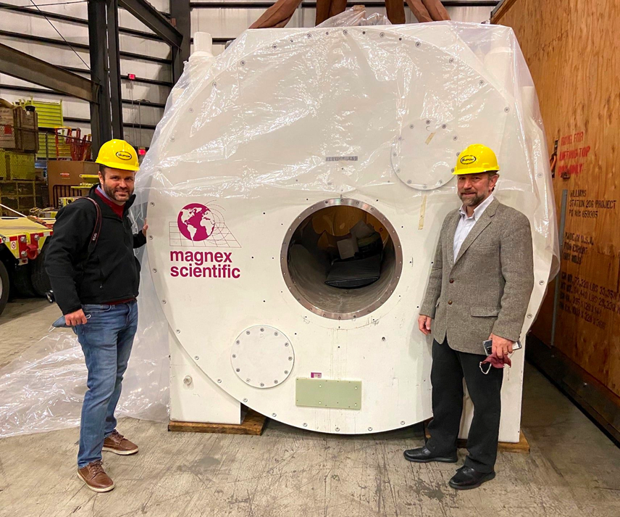
MRI - Columbia and BNL – potential collaborations
Columbia’s Zuckerman Institute is pushing the boundaries of imaging the brain and the body
Strong collaborative network with neuroscience community, industry
BNL – expertise in HTS, high field magnets, and MRI
Developing a collaboration to leverage strengths of BNL for development of innovative neuro scanners
1.5T YBCO Head-only scanner
9.4T MRI for translational neuroscience with GE at Nathan Klien Institiute
MgB₂ MRI system for global access – can be sited anywhere in the world
Notes:
This Major Research Instrument grant supports the development and implementation of a 9.4 tesla magnetic resonance imaging system which will be one of the most powerful imaging systems in the world for neuroscientists to study the human brain. This neuroimager will be used to safely and noninvasively observe human brain anatomy, metabolism and function at the highest spatial, spectral and temporal resolutions achievable. This instrument, to be sited at the New York State Office of Mental Health’s (OMH) Nathan Kline Institute for Psychiatric Research (NKI), will bring together neuroscience researchers from throughout the Greater New York City, Tri-State area. Funded investigators from Columbia and New York University as well as Cornell, Mt. Sinai, Princeton and Yale have already signed on. Centrally located in one of world’s top neuroscience communities, this 9.4T neuroimager is certain to foster significant new discovery in understanding the human brain and behavior.
The grant itself supports the development of a novel second-generation console to optimize the quality of data obtained from this ultra-high field strength magnet. This revolutionary engineering project will be carried out as a collaboration between Columbia, NYU and Cornell engineering schools and New York State industries including GE Global Research and Communications Power Corp. This console will be interfaced to an existing 9.4T head-only magnet to complete the neuro-imaging system. The OMH is building a new ultra-high-field imaging laboratory for this project at the NKI on the Orangeburg, NY campus. Participating in this project will be both academic faculty and industry engineers, students and technicians. Accordingly, educational and training programs will also be supported. A new generation of trained engineers and scientists and a new level of science and discovery will follow.

Slide 10
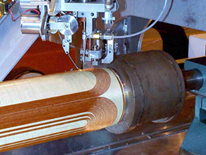
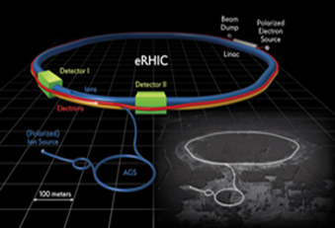
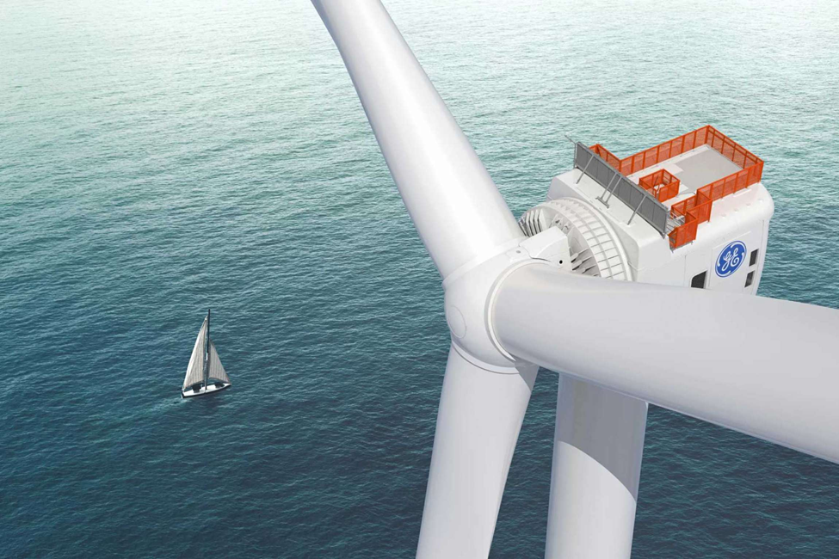
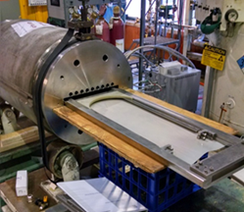
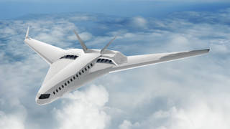
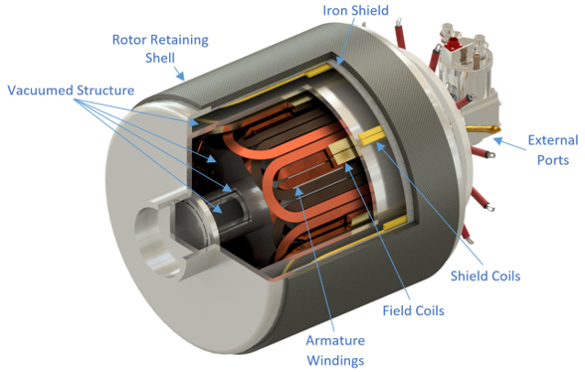
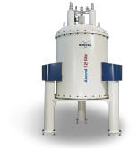
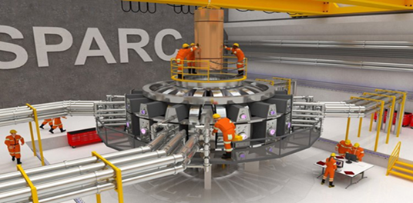
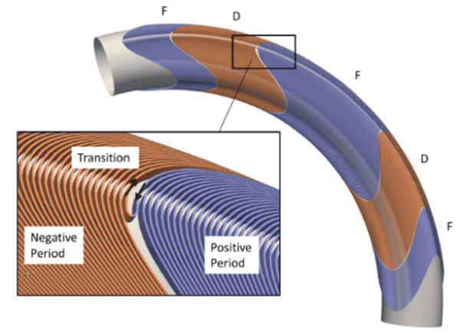
Vision for a Sustainable Superconducting Magnet Ecosystem
Connect and nurture an environment where Universities, Labs, and Industry connect and collaborate on key aspects of superconducting technology
Sustain critical aspects of superconducting technology, knowledge capture through this ecosystem
Accelerators are bust or boom – need synergies with other areas to retain talent and knowledge
Alstom, GE examples
Generators to MRIs
SSC to MRIs
MRIs to Generators
LHC to wind
Connect advanced technology companies in tangential areas
Can compact fusion drive HTS cost down?
Large potential markets for superconductivity in renewables and fusion
DOE and NIH are playing a pivotal role in this ecosystem
ARPA-E and INFUSE for compact fusion
HEP, HEP Stewardship and FES
ARPA-E for aerospace
EERE for superconducting wind
NIH developing High field NMR
NIH developing high field MRI
NIH developing compact, advanced, deployable MRI
CHEETA project, university of Illinois, NASA
Superconducting wind generator, GE Global research website
Notes:
Energy industry - $8.5 Trillion – Fusion is disruptive Forbes article “ Fusion Energy who has the courage to take it to market?” August 21st, 2019
Offshore wind - $36 Billion in 2019 – projected growth to $87 Billion by 2026 “Offshore Wind Energy Market By Component (Turbine, Substructure, Electrical Infrastructure and Others) and By Location (Shallow Water, Transitional Water, and Deep Water): Global Industry Outlook, Market Size, Business Intelligence, Consumer Preferences, Statistical Surveys, Comprehensive Analysis, Historical Developments, Current Trends, and Forecasts, 2020–2026” by facts and figures
2016

Slide 11
Potential models for sustainability- superconducting technology commons
Leverage the already existing network and infrastructure supported by DOE,NIH, NSF, DOD, NASA, industry forums, venture capital
Strengthen the magnet ecosystem – share technologies/development strategies needed across the ecosystem – like the semiconductor industry
DOE labs related to superconductivity applications and technology (BNL, FNAL, LBNL), NHFMFL, CAPS and key universities
Oversight
Fusion, Power, Aerospace, Medical Industry
Power systems engineering
SCT
commons
Academic R&D
PUSH – methods and new ideas
Magnet OEMs
Private funds & Pilot programs
Magnet systems engineering
Conductors, Coils, Cooling, Controls
SC Magnet &
Conductor R&D
Designs, Tests
Test Facilities
Conductor industry
PULL –simple solutions to real problems
Prototypes Pilot components
Federal and State Research Funds
Lance Cooley, Kiruba Haran

Slide 12
Benefits of a Sustainable Ecosystem
Superconducting magnets are critical to medical industry applications –existing MRI, emerging – proton therapy, compact cyclotrons
In the energy space, the next decade will be critical for fusion and renewables applications of superconductivity to prove out
A robust, sustainable ecosystem for superconducting magnet research and development will benefit a broad range of applications that are critical for DOE and NIH
Such an ecosystem is critical to retaining superconducting magnet knowledge for future accelerators
DOE and NIH are playing and can play a pivotal influencing role with programs and talent that have synergies in this space
Both NIH and DOE applications can reap substantial benefit from a healthy superconducting magnet ecosystem
We should not depend on serendipity again! – let’s work together to develop a strategy that gets the most bang for the buck between DOE, NIH, and Industry – a huge potential win for the US in science and medical outcomes
This is critical for the US to remain competitive in these critical technology applications in the future

