Slide 1

Capabilities from the Physical Sciences – Radiation Detection
Selected Radiation Detection and Imaging Developments for Medical Applications
A Perspective from an Experimental Nuclear Physicist
Kai Vetter
Emily Frame, Justin Ellin, Josh Cates, et al.
Department of Nuclear Engineering, UC Berkeley
Applied Nuclear Physics, LBNL

Slide 2
Evolution of Gamma-Ray Detection in Nuclear Physics
Last 120+ years have seen enormous and still ongoing advances in nuclear instrumentation, radiation detection, and medical imaging;
Advances in gamma-ray detection for nuclear physics studies
GRETA
Gamma-Ray Energy Tracking Array

Slide 3
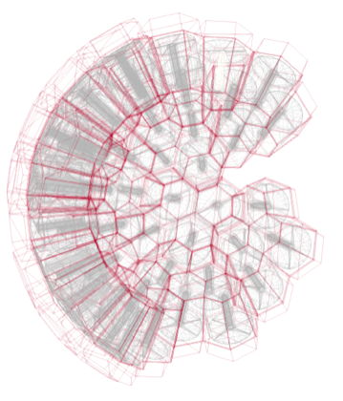
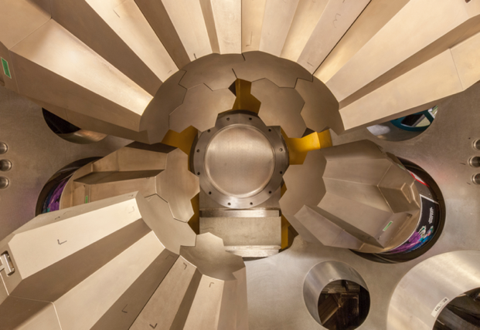
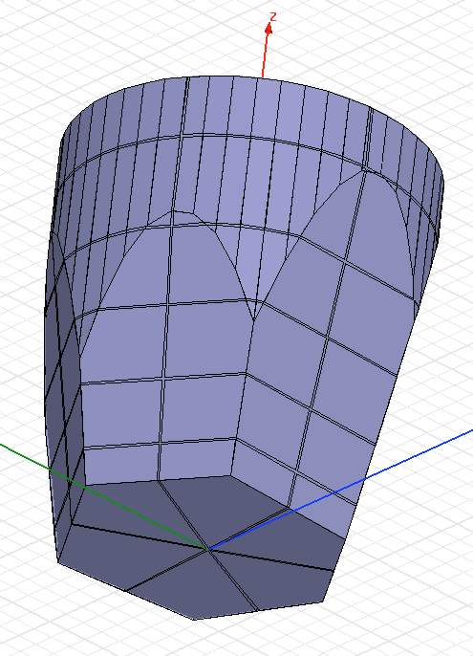
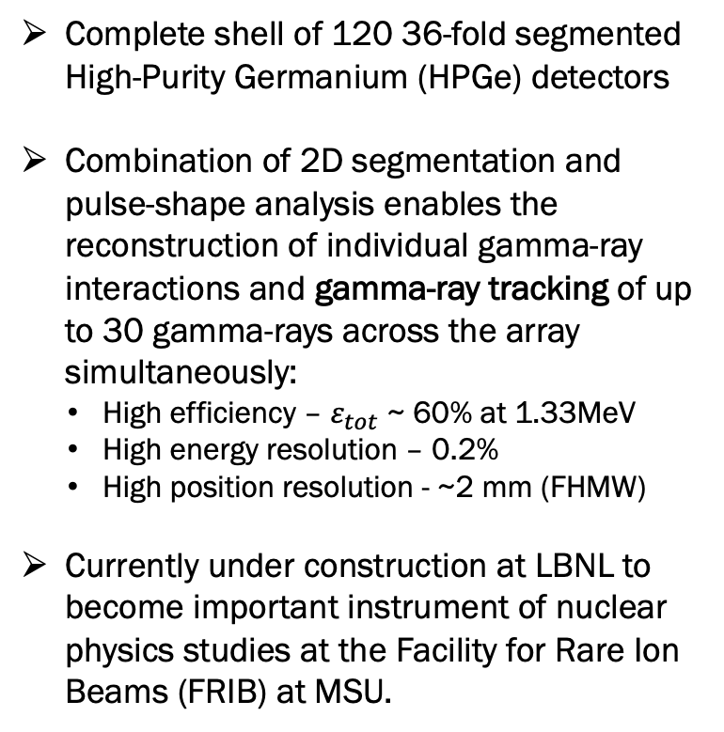
GRETA & Gamma-Ray Tracking
Complete shell of 120 36-fold segmented High-Purity Germanium (HPGe) detectors
Combination of 2D segmentation and pulse-shape analysis enables the reconstruction of individual gamma-ray interactions and gamma-ray tracking of up to 30 gamma-rays across the array simultaneously:
  High efficiency – $ε_{tot}$ ~ 60% at 1.33MeV
  High energy resolution – 0.2%
  High position resolution - ~2 mm (FHMW)
Currently under construction at LBNL to become important instrument of nuclear physics studies at the Facility for Rare Ion Beams (FRIB) at MSU.
GRETA
Gamma-Ray Energy Tracking Array

Slide 4
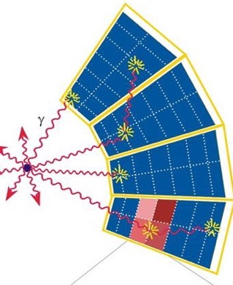
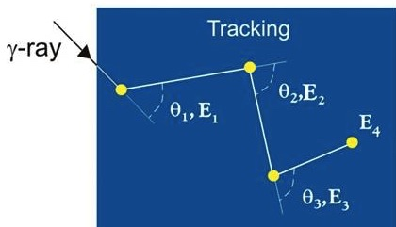
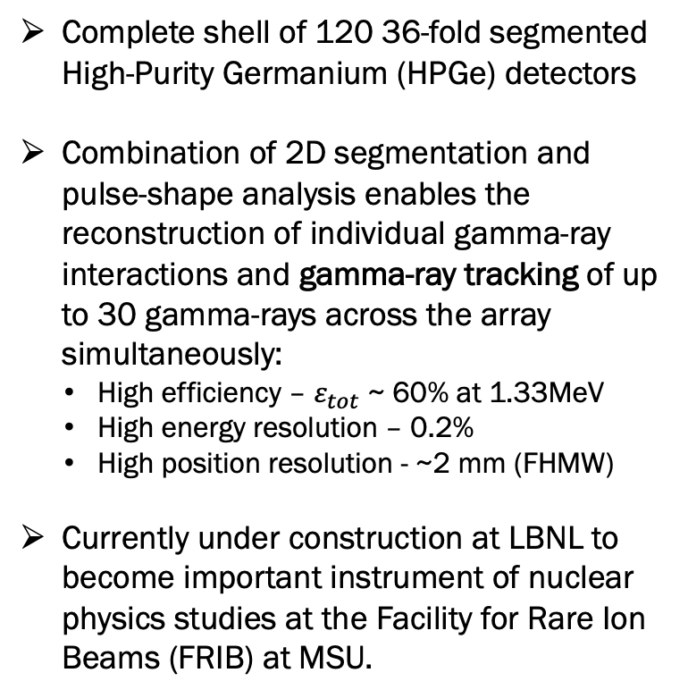
GRETA & Gamma-Ray Tracking
Complete shell of 120 36-fold segmented High-Purity Germanium (HPGe) detectors
Combination of 2D segmentation and pulse-shape analysis enables the reconstruction of individual gamma-ray interactions and gamma-ray tracking of up to 30 gamma-rays across the array simultaneously:
  High efficiency – $ε_{tot}$ ~ 60% at 1.33MeV
  High energy resolution – 0.2%
  High position resolution - ~2 mm (FHMW)
Currently under construction at LBNL to become important instrument of nuclear physics studies at the Facility for Rare Ion Beams (FRIB) at MSU.
GRETA
Gamma-Ray Energy Tracking Array

Slide 5
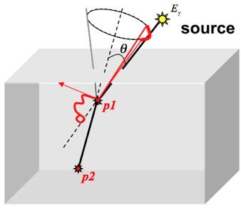
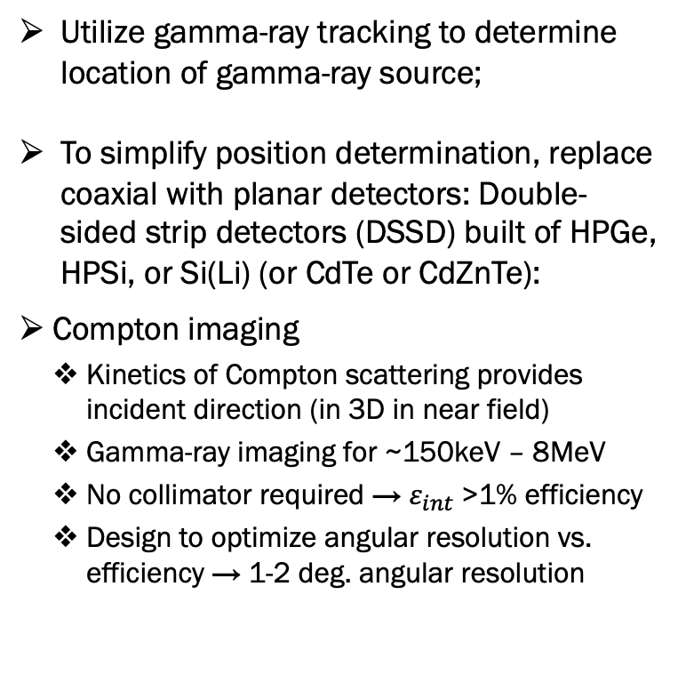
Gamma-Ray Tracking & Imaging
Utilize gamma-ray tracking to determine location of gamma-ray source;
To simplify position determination, replace coaxial with planar detectors: Double-sided strip detectors (DSSD) built of HPGe, HPSi, or Si(Li) (or CdTe or CdZnTe):
Compton imaging
  Kinetics of Compton scattering provides incident direction (in 3D in near field)
  Gamma-ray imaging for ~150keV – 8MeV
  No collimator required → $ε_{int}$>1% efficiency
  Design to optimize angular resolution vs. efficiency → 1-2 deg. angular resolution

Slide 6
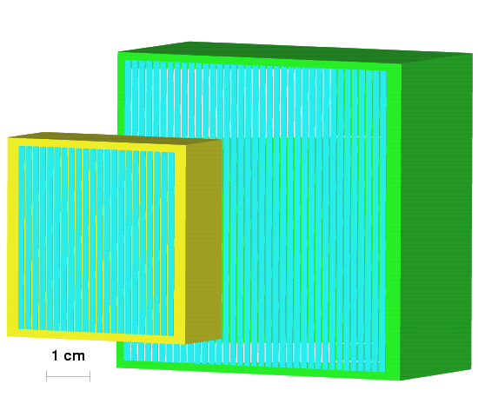
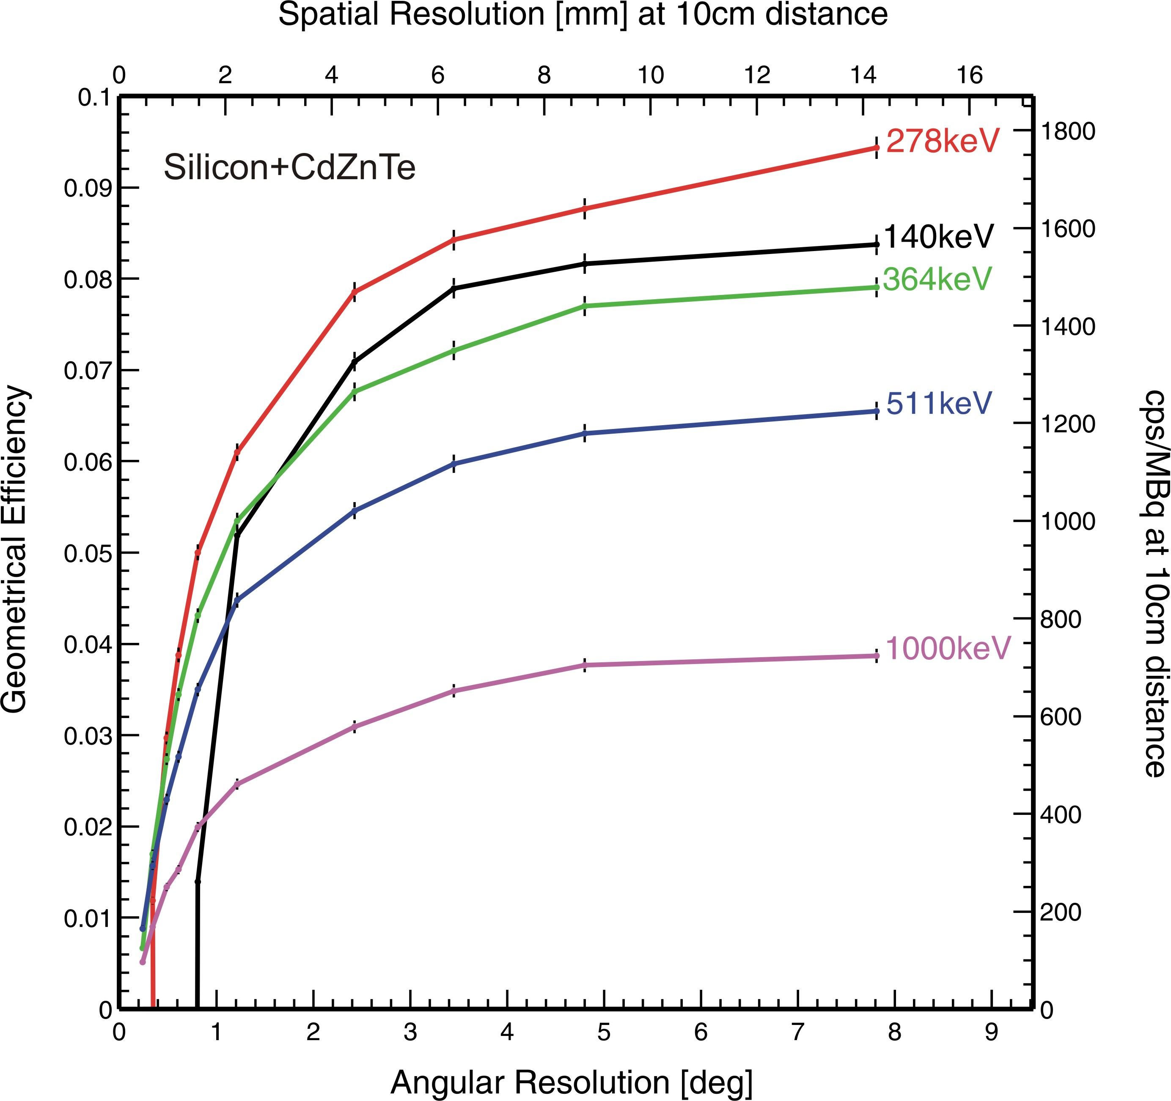

Gamma-Ray Tracking & Imaging
Utilize gamma-ray tracking to determine location of gamma-ray source;
To simplify position determination, replace coaxial with planar detectors: Double-sided strip detectors (DSSD) built of HPGe, HPSi, or Si(Li) (or CdTe or CdZnTe):
Compton imaging
  Kinetics of Compton scattering provides incident direction (in 3D in near field)
  Gamma-ray imaging for ~150keV – 8MeV
  No collimator required → $ε_{int}$>1% efficiency
  Design to optimize angular resolution vs. efficiency → 1-2 deg. angular resolution
Si
Ge
$$ε_{int}$$
Dimensions (using 2+2 detectors):
Si(Li):80x80x20mm³
HPGe: 80x80x30mm³

Slide 7
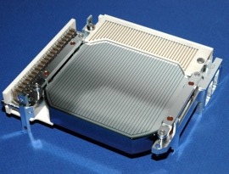
Gamma-Ray Tracking & Imaging
Compton imaging
  Kinetics of Compton scattering provides incident direction (in 3D in near field)
  Gamma-ray imaging for ~150keV – 8MeV
  No collimator required → >1% efficiency
  Design to optimize angular resolution vs. efficiency → 1-2 deg. angular resolution
  HPGe + Si(Li) DSSD detectors in two cryostats & digital DAQ
  Si(Li): 32+32 strips w/ 2 mm pitch size; 10 mm thickness; 1.9 keV at 60 keV
  HPGe: 37+37 strips w/ 2 mm pitch size; 15 mm thickness; 1.7 keV at 60 keV

Slide 8
Gamma-Ray Tracking & Imaging
2 spherical ¹¹³Sn sources (391 keV):
Diameter: Each 4 mm
Distance: 10 mm
Compton imaging
  Kinetics of Compton scattering provides incident direction (in 3D in near field)
  Gamma-ray imaging for ~150keV – 8MeV
  No collimator required → >1% efficiency
  Design to optimize angular resolution vs. efficiency → 1-2 deg. angular resolution
  HPGe + Si(Li) DSSD detectors in two cryostats & digital DAQ
  Si(Li): 32+32 strips w/ 2 mm pitch size; 10 mm thickness; 1.9 keV at 60 keV
  HPGe: 37+37 strips w/ 2 mm pitch size; 15 mm thickness; 1.7 keV at 60 keV

Slide 9
Gamma-Ray Tracking & Compton + Coded Aperture Imaging
Compton imaging
  Kinetics of Compton scattering provides incident direction (in 3D in near field)
  Gamma-ray imaging for ~150keV – 8MeV
  No collimator required → >1% efficiency
  Design to optimize angular resolution vs. efficiency → 1-2 deg. angular resolution
Coded aperture
  Extension of multi-pinhole with overlapping projections requiring image reconstruction
  Gamma-ray imaging for <300-400 keV
  50% opaque → >10% efficiency
  Angular resolution → <1 deg.

Slide 10
Example: Verification of ion-cancer therapy
Advances in radiation cancer therapy utilizing high Linear Energy Transfer (LET) and high Relative Biological Effectiveness (RBE) promise high efficacy in the curing of cancer, i.e.
  Targeted alpha particle therapy (TAT) and external ion beam cancer therapy (IBCT)
Since they can provide a well-localized and effective treatment, one has to ensure that the treatment is well localized within the cancer sparing the healthy tissue.
Conventional gamma-ray imaging modalities are insufficient in realizing the full potential since they require gamma-ray imaging capabilities over a broad range of energies.
TAT (e.g. Ac-225): E_{𝛾}~200-500 keV and <1𝜇Ci and <1 mm in small animals?
IBCT (e.g. protons): E_{𝛾} >3MeV and 1 mm range detection in-situ within one spot (e.g. 70ms)?
Notes:
TAT & HIT – but challenges in localization of dose!?
Trust but Verify…
Other imaging modalities – resolution and sensitivity
TAT: ~1uCi or less with ~mm or better resolution in small animals
HIT: ~mm range detection in-situ within one spot (e.g. 70ms)
Advances in high LET radiation cancer therapy promise high efficacy in the curing of cancer;

Slide 11
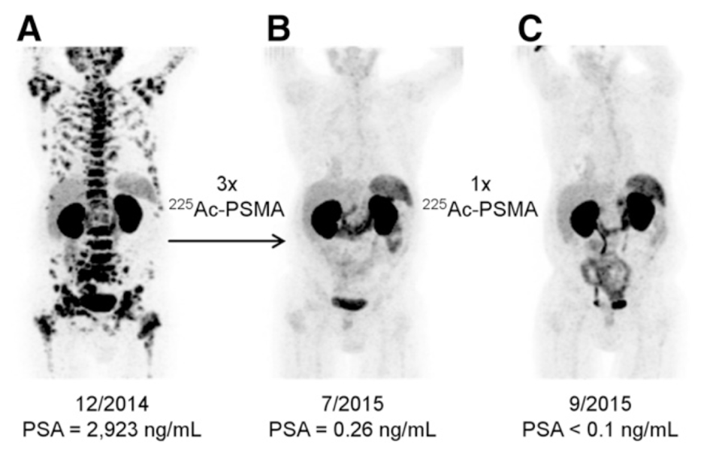
The Promise of Targeted Alpha-Particle Therapy with ²²⁵Ac
⁶⁸Ga-PSMA-11 PET/CT scans of patient with metastatic prostate cancer undergoing targeted alpha-particle therapy with ²²⁵Ac-PSMA-617. (A) tumor spread before treatment, (B) two months after the third cycle of ²²⁵Ac-PSMA-617, and (C) two months after one additional cycle.
¹Kratochwil, Clemens, et al. "225Ac-PSMA-617 for PSMA-targeted α-radiation therapy of metastatic castration-resistant prostate cancer." Journal of Nuclear Medicine
Notes:
Prostate-specific membrane antigen (PSMA) is a transmembrane protein that is anchored in the cell membrane of prostate cancer epithelial cells.¹ PSMA has been used as a phenotypic biomarker with positron emission tomography (PET) imaging approaches.²
PSMA can be overexpressed in metastatic prostate cancer relative to normal tissue and is present in over 80% of men with prostate cancer.

Slide 12
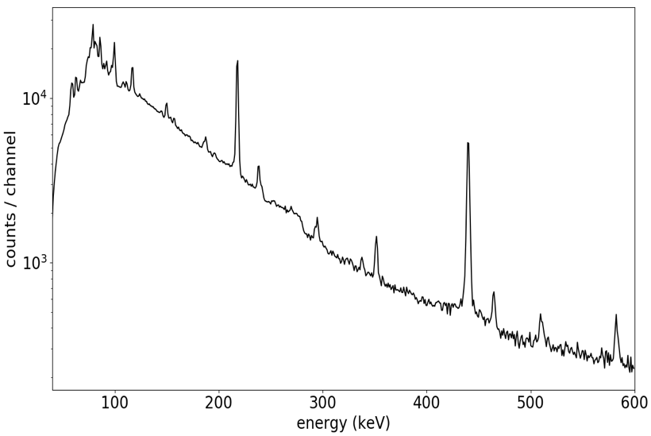






















²²⁵Ac Decay Characteristics and Daughter Redistribution
How can we ensure accuracy and effectiveness?
Due to a nuclear recoil effect and different chemical properties, are alpha-emitting daughters breaking free from radiopharmaceutical preparation?
²²⁵Ac
$10.0$ day
$$α$$
²²⁵Ac gamma-ray energy spectrum
$5.83$MeV
²²¹Fr
$4.90$ min
²²¹Fr
$$218 keV (12\%)$$
$$α$$
$6.34$MeV
²¹³Bi
$$440 keV (26 \%)$$
²¹⁷At
$32.3$ ms
²¹³Po
$4.20 μ$s
$$α$$
$$α$$
$7.07$MeV
$$β^{−}$$
$8.38$MeV
²¹³Bi
$45.6$ min
$$97.9\%$$
²⁰⁹Pb
$3.25$hr
$$2.09\%$$
$$α$$
$$β^{−}$$
$5.87$MeV
$$β^{−}$$
²⁰⁹Tl
$2.20$ min
²⁰⁹Bi
Stable
Use gamma ray imaging to understand kinetics and to verify treatment!

Slide 13
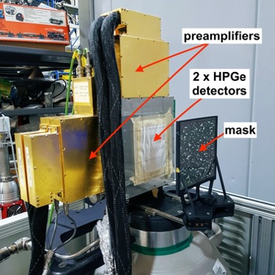
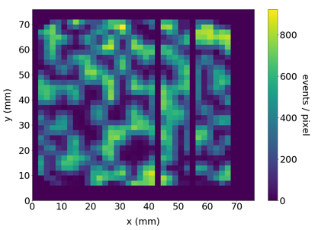

Verification of Targeted Alpha Therapy
Need for high sensitivity and good spatial resolution at 100’s of keV:
  Range → $≤$1mm spatial resolution
  High LET → ~18kBq or 0.5𝜇Ci for mice → >1% efficiency
Coded aperture
  Extension of multi-pinhole with overlapping projections requiring image reconstruction
  Gamma-ray imaging for <300-400 keV
  50% opaque → >10% efficiency
  Angular resolution → <1 deg.
  Detectors
  2 x planar HPGe DSSDs
  76 x 76 x 15-mm³ volume
  38 x 38 strips
  2-mm strip pitch
Tungsten Mask
  Pseudorandom array
  64 x 64 square elements of 2-mm size and thickness
  Converging elements to improve image contrast

Slide 14
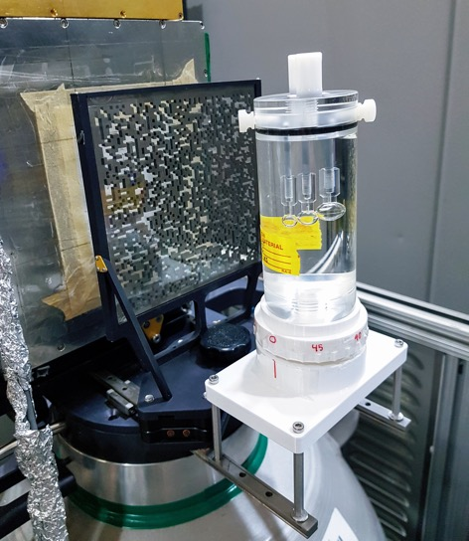
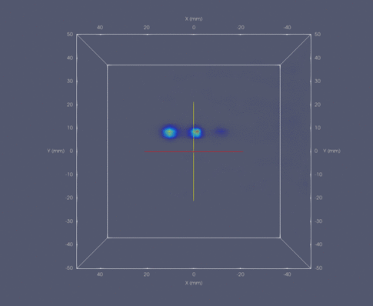
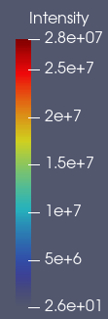

Coded Aperture Tomographic Image Reconstruction of an ²²⁵Ac-filled Phantom
Verification of Targeted Alpha Therapy
10-mm separation between spheres
3.7 $μCi$ in total
Experimental setup of phantom measurement in the coded aperture mode.
Max. Likelihood Expectation Maximization tomographic image reconstruction at the 218-keV line of ²²¹Fr.
~1mm spatial resolution with >1% efficiency at 218 keV

Slide 15
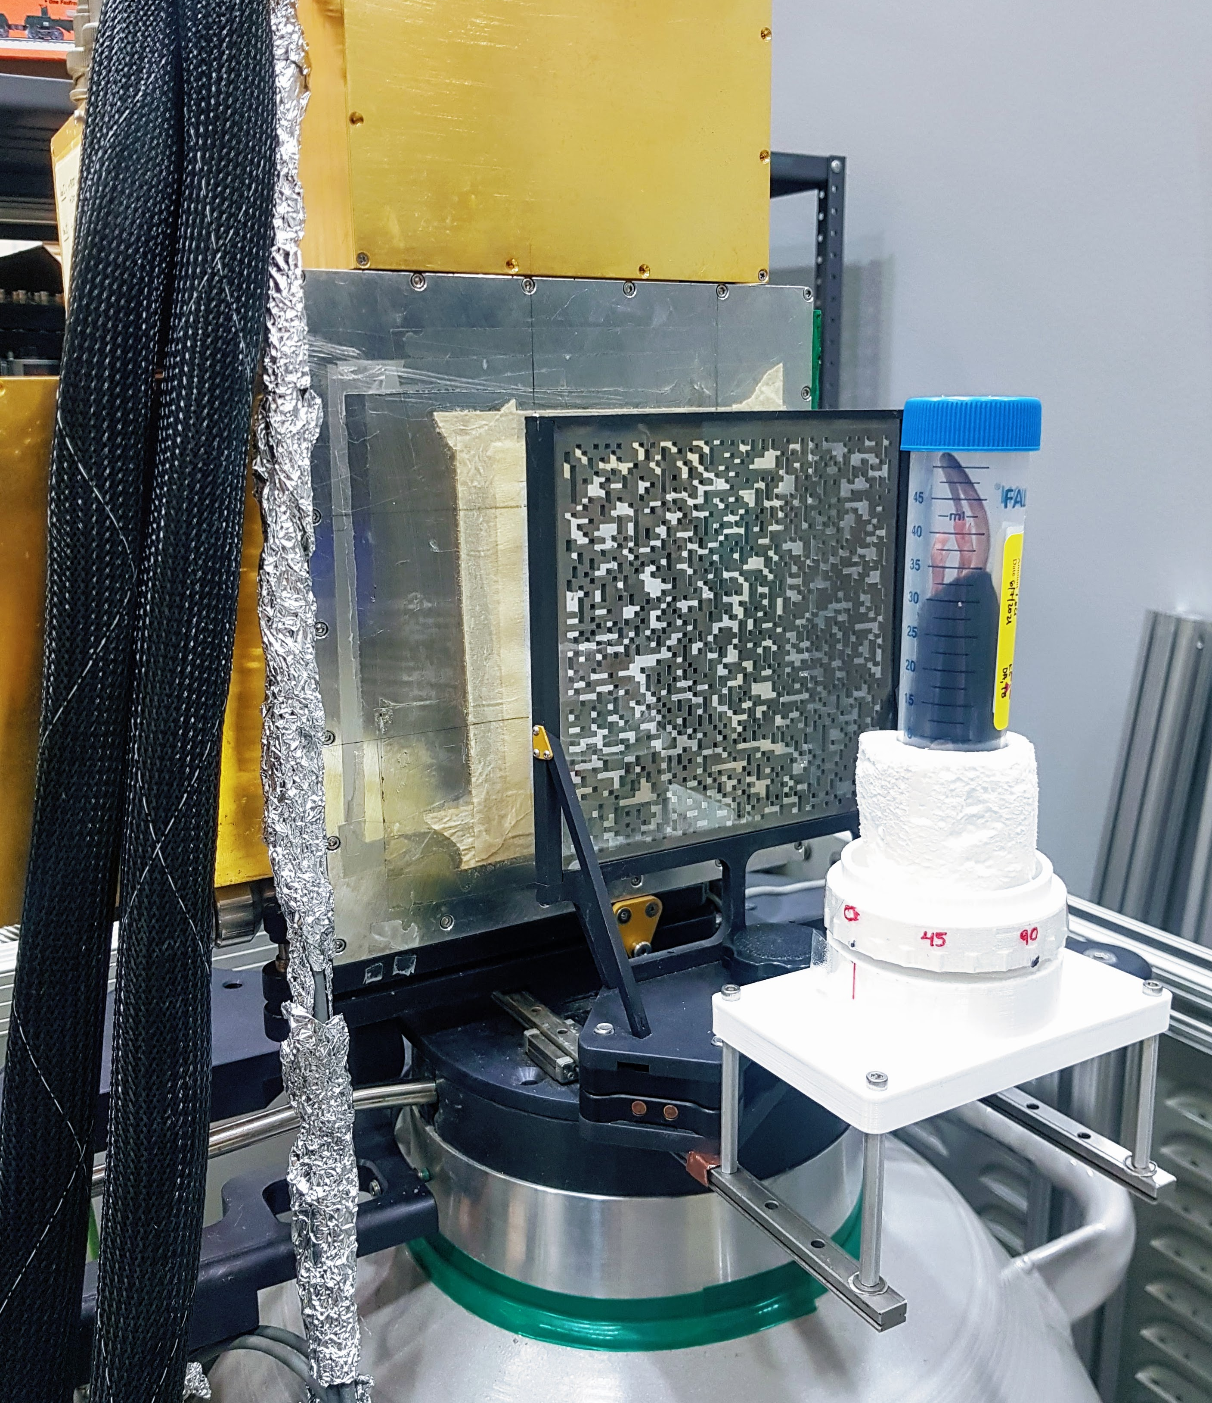
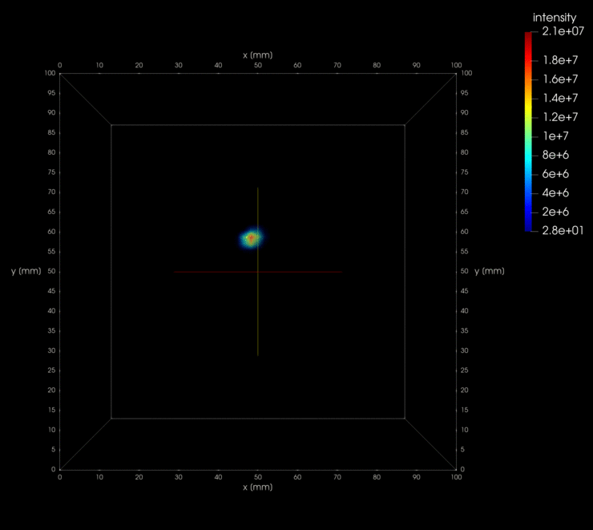
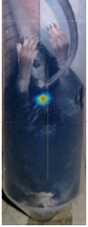

Coded Aperture Tomographic Image Reconstruction of an ²²⁵Ac injected mouse
(euthanized 1 hour after injection, measurement 3 days after)
Verification of Targeted Alpha Therapy
0.8 $μCi$ activity during measurement
Experimental setup of phantom measurement in the coded aperture mode.
Max. Likelihood Expectation Maximization tomographic image reconstruction at the 218-keV line of ²²¹Fr.
²²¹Fr accumulation in bladder

Slide 16
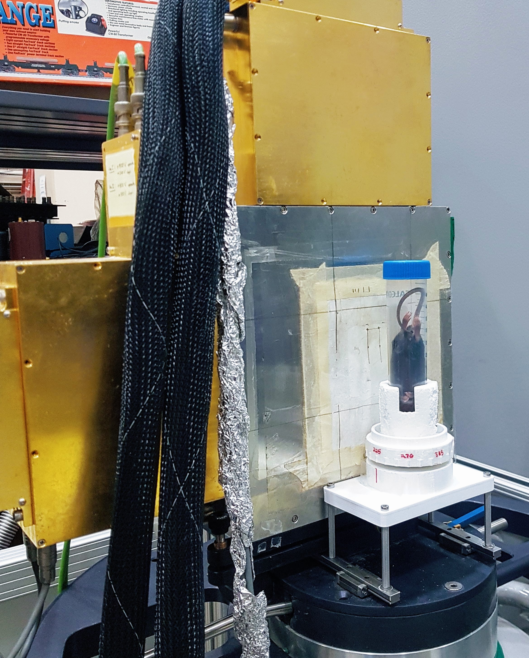
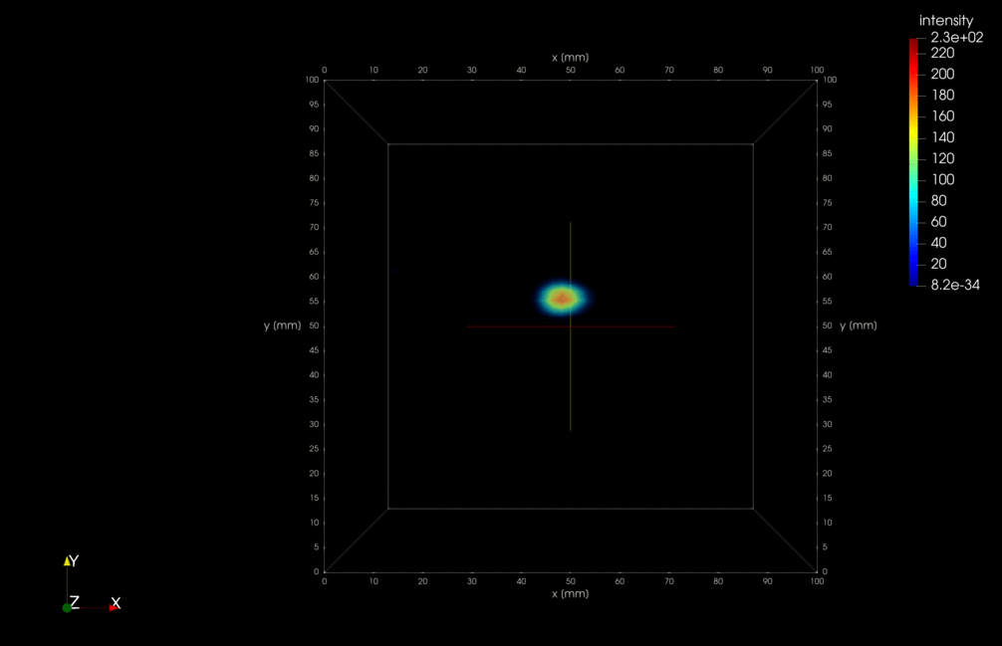
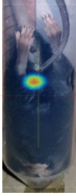

Compton Imaging Tomographic Reconstruction of an ²²⁵Ac injected mouse
(euthanized 1 hour after injection, measurement 4 days after)
Verification of Targeted Alpha Therapy
0.8 $μCi$ activity during measurement
Experimental setup of phantom measurement in the coded aperture mode.
Max. Likelihood Expectation Maximization tomographic image reconstruction at the 440-keV line of ²¹³Bi.
²¹³Bi accumulation in bladder

Slide 17
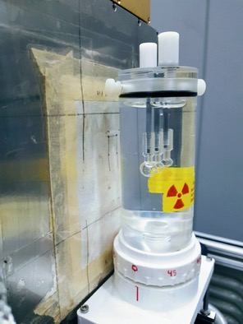
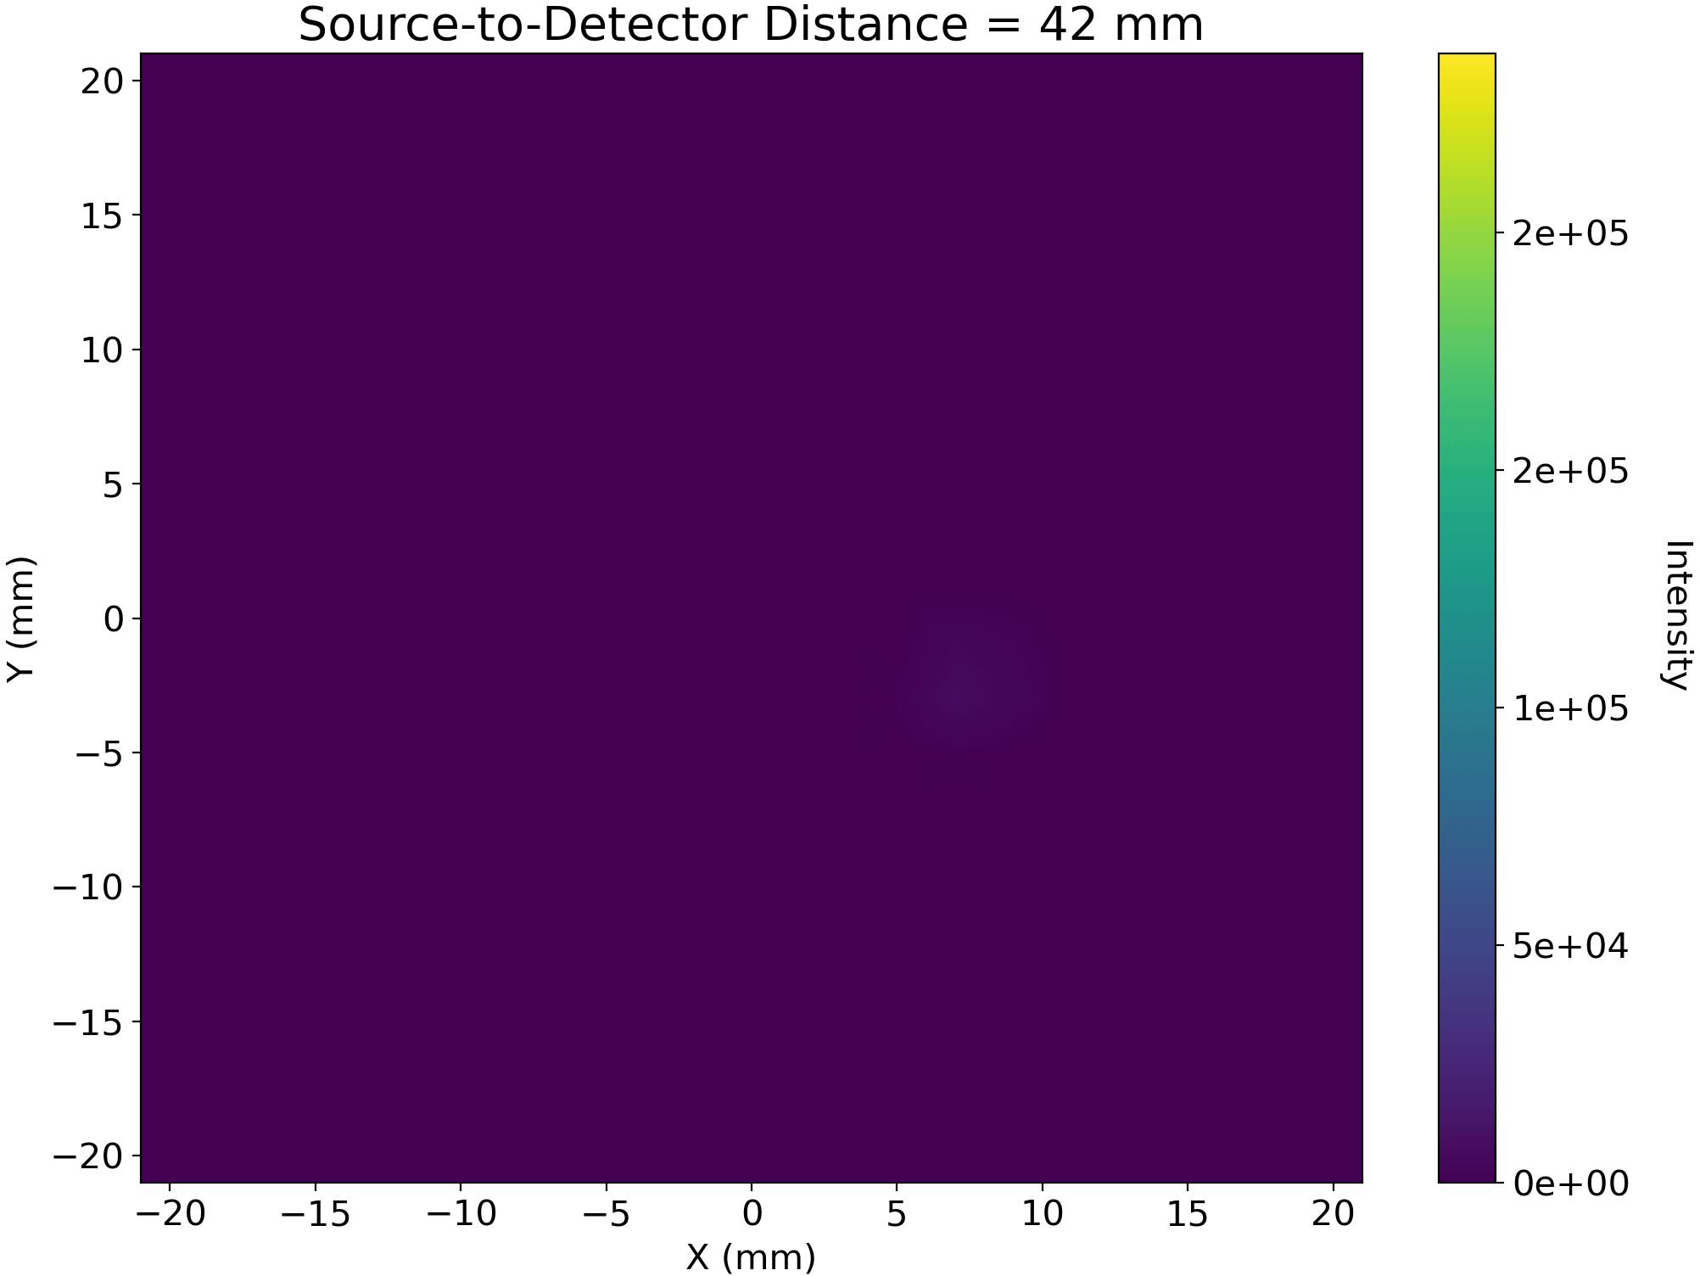
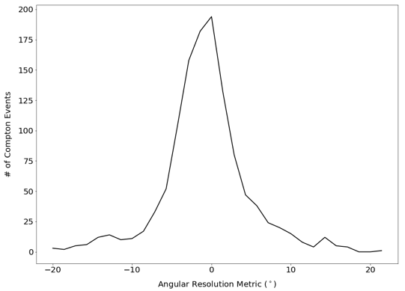


Compton Imaging Tomographic Reconstruction of an ²²⁵Ac-filled Phantom
2mm strip pitch w/ 2 HPGe DSSDs (at 440 keV)
Verification of Targeted Alpha Therapy
10-mm separation between spheres
2-mm strip pitch
$$FWHM_{θ}≈{7.0}^{∘}$$
FWHM_{(x,y)} $≈$6 mm
1.6 $μCi$ in total
Experimental setup of phantom measurement in the Compton mode.
3D MLEM tomographic image reconstruction at the 440-keV line of ²¹³Bi.
Histogram of an angular resolution metric for the Dual-Modality Imager. This metric was determined experimentally from a Cs-137 (662 keV) point source measurement.
~6mm spatial resolution with >1% efficiency at 440 keV

Slide 18
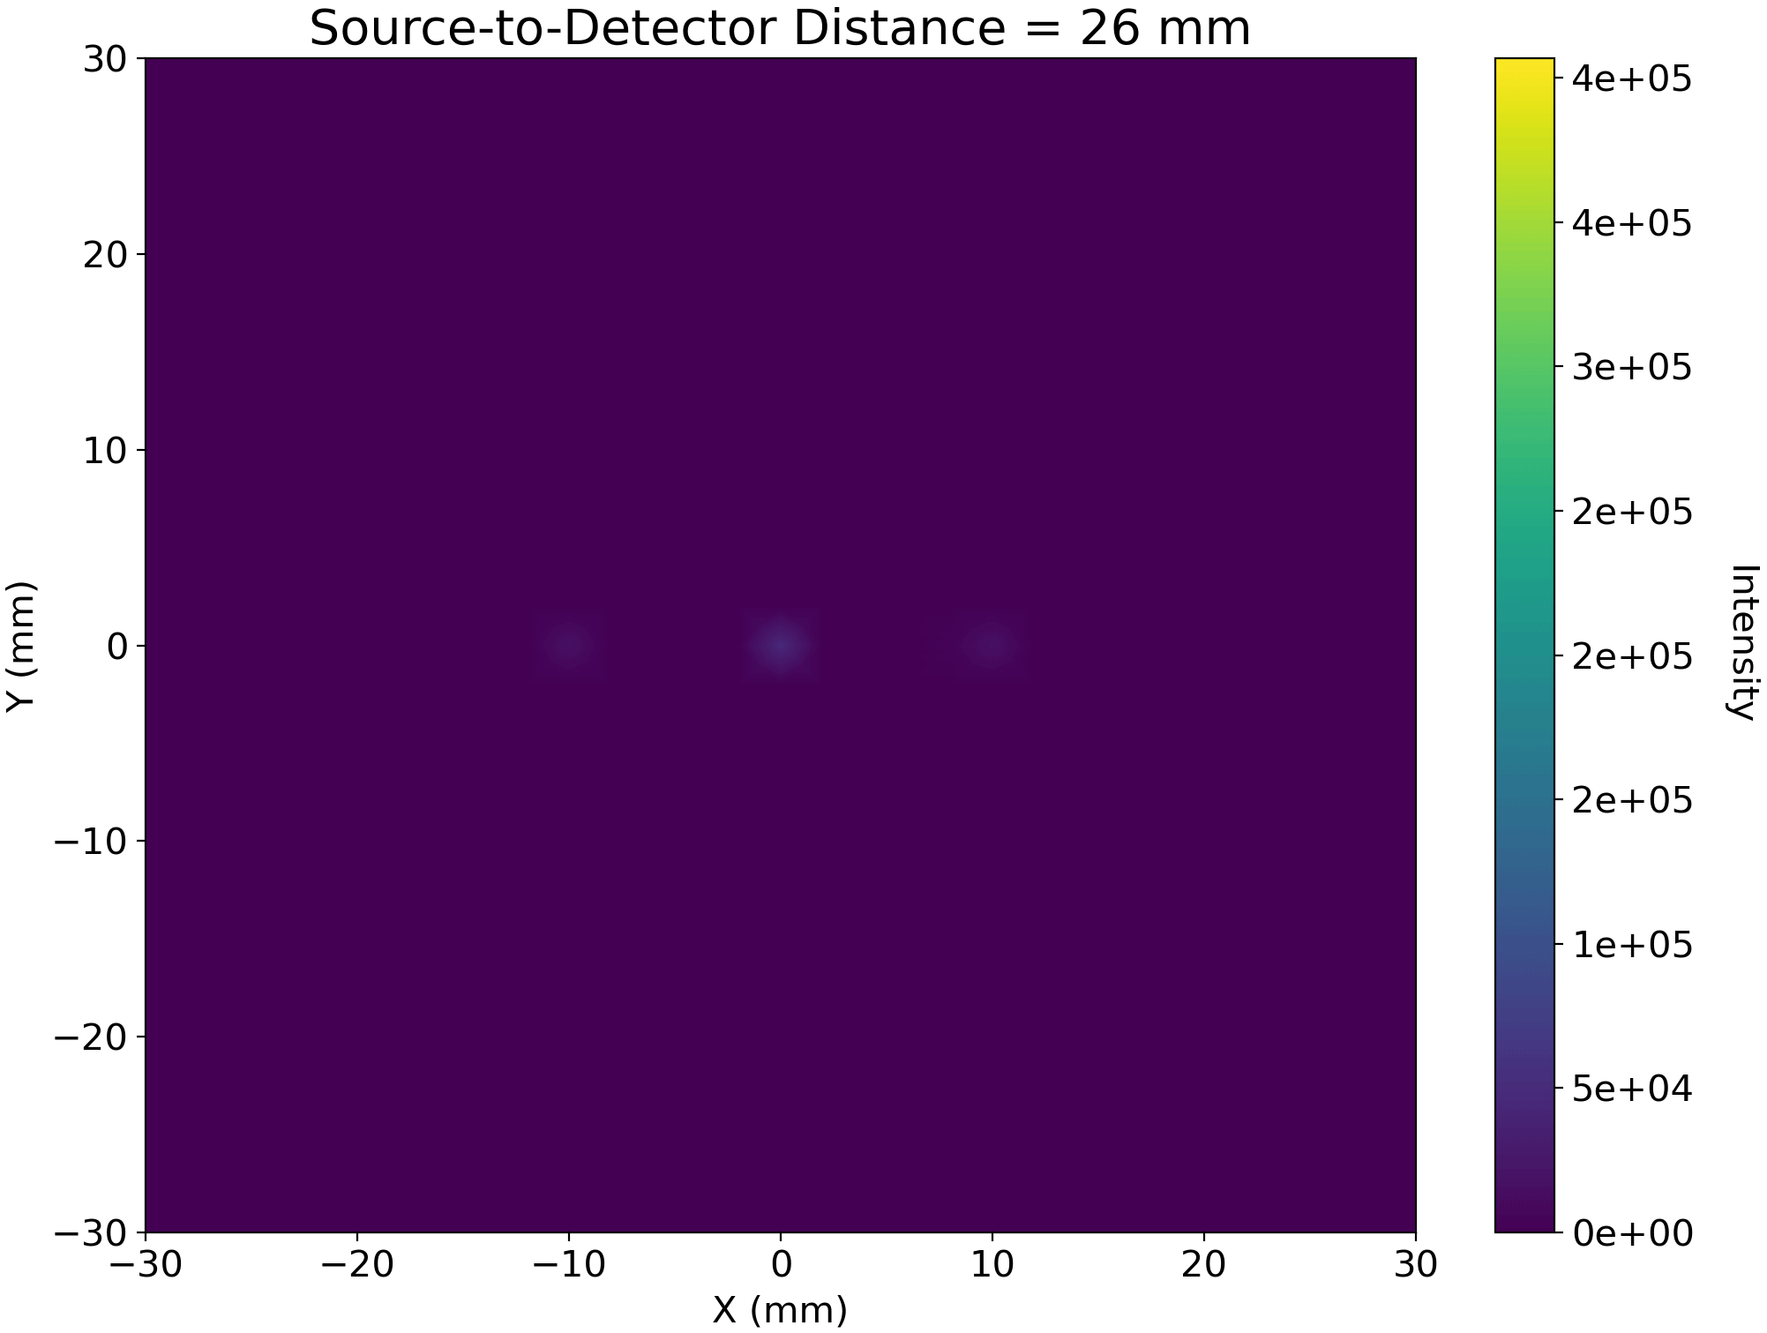
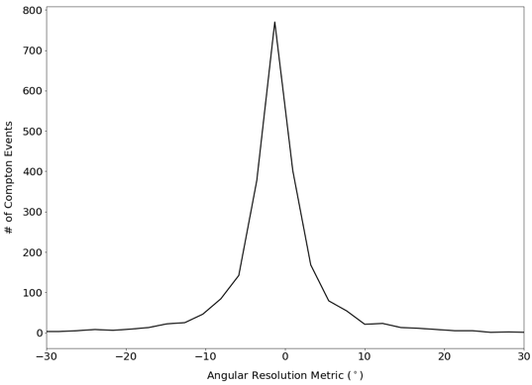


Verification of Targeted Alpha Therapy
Compton Imaging Tomographic Reconstruction of an ²²⁵Ac-filled Phantom
0.5 mm strip pitch w/ 2 HPGe DSSDs (at 440 keV)
0.5-mm position resolution
30-mm depth
0.5-mm strip pitch
$$FWHM_{θ}≈{2.5}^{∘}$$
$$FWHM_{x, y}≈1.5mm$$
3D MLEM image reconstruction of three simulated 440-keV point sources, each with a 10-mm separation distance, at a distance of 30 mm from an imager with 0.5-mm strip pitch.
Angular resolution metric for an imager with 0.5-mm strip pitch. This metric was determined from simulated 440-keV point source data.
Promise to obtain ~mm spatial resolution with >1% sensitivity at 440keV
Under development: 80x80x15mm³ HPGe DSSD with 0.5 mm pitch and <0.3% energy resolution at >2 Mcps with benefits for nuclear physics and medical imaging studies.

Slide 19
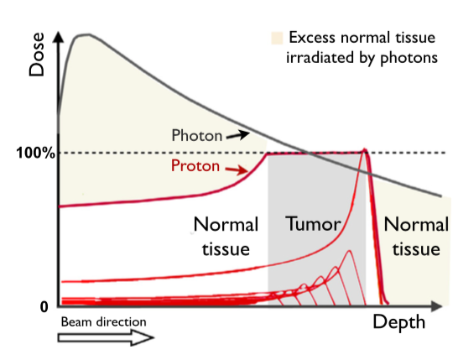
The promise (and challenge) of ion-beam cancer therapy
Spread-Out Brag Peak (SOBP)
High LET and high RBE right until the end of the range.
External signal? Proton is absorbed ⬄ photon-based therapy.
How accurate can we estimate the range?
LET: Linear Energy Transfer
RBE: Relative Biological Effectiveness (e.g. p/ph~1.1)

Slide 20
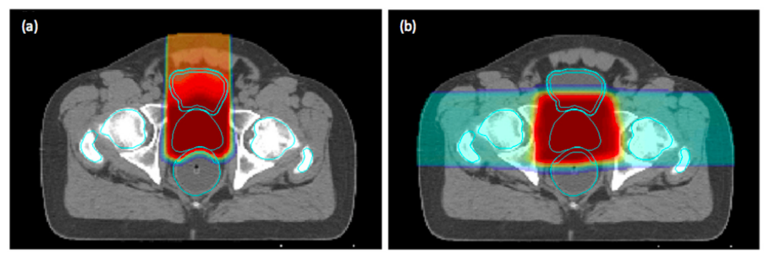
The promise (and challenge) of ion-beam cancer therapy
Impact of current range uncertainty
Ideal
Actual
Tang S, Both S, Bentefour H, Paly JJ, Tochner Z, Efstathiou J, et al. Improvement of prostate treatment by anterior proton fields. Int J Radiat Oncol Biol Phys. 2012;83: 408–418.
Comparison of treatment planning dose distributions for proton therapy treatment of prostate cancer with (a) one single anterior field and (b) two parallel­-opposed lateral fields.
Uncertainty in range requires larger margins in the treatment planning as should be required!
Conformal treatment is goal – trace edges of target volume/cancer;
Range uncertainty is dominating right now
  1mm is goal to be consistent with other uncertainties such as patient and beam alignment;
Use of lateral/anterior beams with smaller uncertainties/margins as compared to longitudinal uncertainties/range uncertainties;
Effectiveness of care and therapeutic endpoints are compromised due to additional margins.

Slide 21
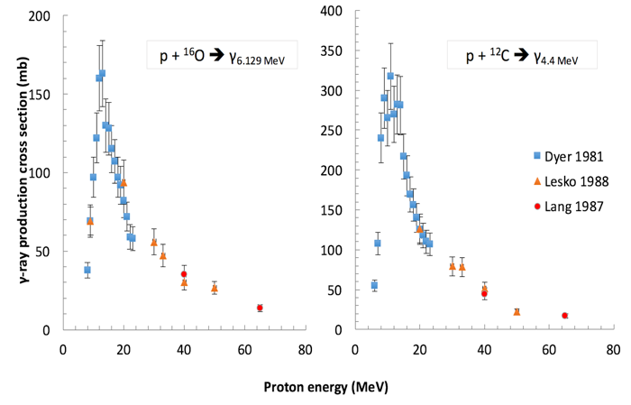
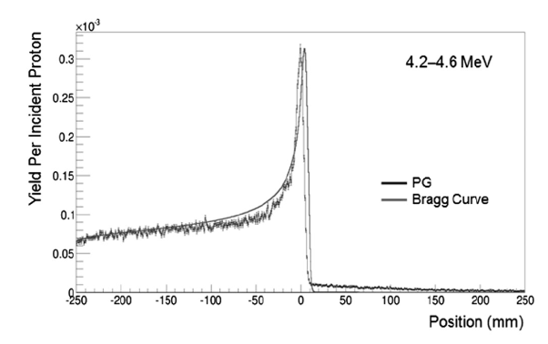
The promise (and challenge) of ion-beam cancer therapy
Prompt gamma-ray imaging
Nuclear Physics!
(De) Excitation functions
Key: Looks like Bragg Peak!

Slide 22
Verification of Ion-Beam Cancer Therapy
Prompt gamma-ray imaging at > 3MeV?
  Compton imaging for in-vivo verification?
    Coincidence timing challenge!
    Count rate: ~10⁷ cps on average is already a challenge;
    However, this is compounded by beam bunching resulting in gamma-ray bursts of >10⁸ cps requiring time coincidence windows of ~100s ps which is not feasible with current detectors.
  Coded-aperture?
    For high energies with high spatial resolution (~1mm) and high sensitivity (>1%) to enable the range determination with 10⁸ protons in 70 ms (i.e. one spot of scan)?
2D knife-edge coded aperture system!
Notes:
PET imaging:
In principle, yes, since C-11, O-15, N-15, etc. are being produced;
However, biological wash-out uncertainties due to long half-lives, creation of $β$+ emitters not at the end of the range, and/or associated with high Q-value;

Slide 23
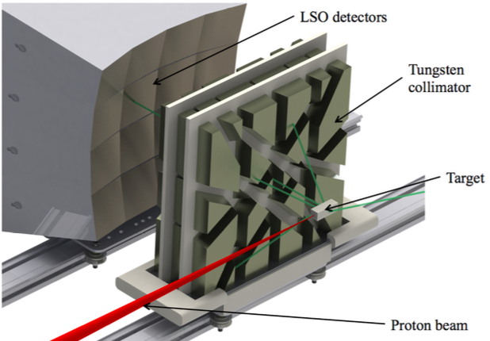
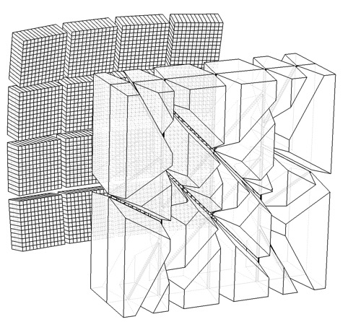
Verification of Ion-Beam Cancer Therapy
New 2D knife-edge coded aperture system

Slide 24
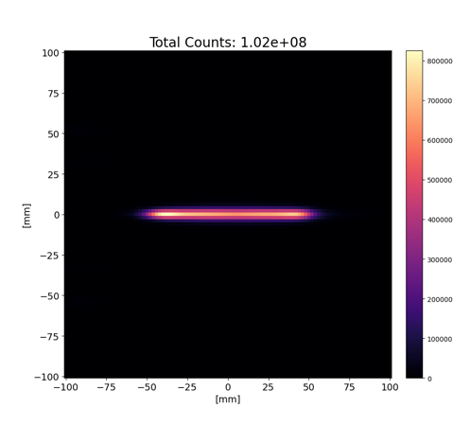
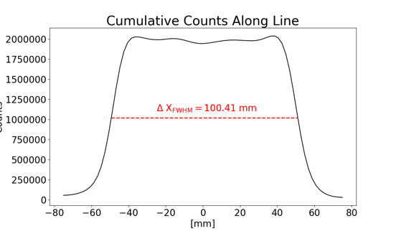

Verification of Ion-Beam Cancer Therapy
New 2D knife-edge coded aperture system
Line response – 2.614MeV$: \text{< 2}\text{mm} \text{FWHM}$ in both dimensions

Slide 25
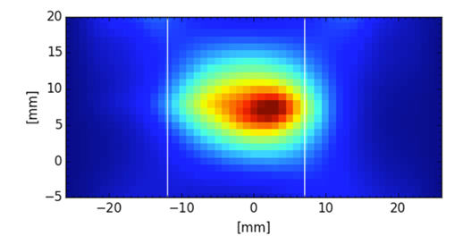
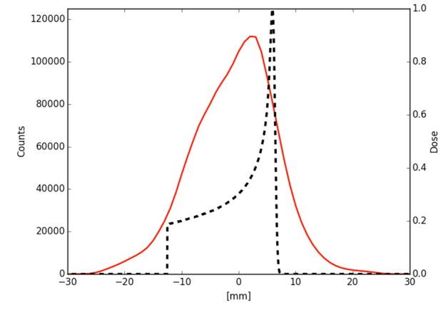
Verification of Ion-Beam Cancer Therapy
New 2D knife-edge coded aperture system
Imaging results w/ 50 MeV protons from LBNL 88” cyclotron onto PMMA target (~20mm range)

Slide 26
Verification of Ion-Beam Cancer Therapy
New 2D knife-edge coded aperture system
Estimated Bragg peak location at 58% falloff (5.6x10¹⁰ protons)
Range uncertainty vs. # of protons
Timing reference?
  Can we reduce field-of-view with time-of-flight (TOF)?
    40mm w/ ~100 ps? Feasible!
  Can we determine range with TOF ?
    1mm w/ <5ps? Not feasible, yet.
Per spot (~70ms)

Slide 27
Conclusions
Nuclear physics and associated instrumentation can complement more conventional gamma-ray imaging approaches;
As example, current limits in high LET radiation cancer therapy can potentially be overcome with advanced concepts in gamma-ray imaging, specifically in the verification of high LET cancer therapy
  Hybrid Compton imagers or dual modality Compton/ coded aperture imager have the potential to provide ~mm resolution for ~100’s nCi activities in small animals;
  2D knife-edge/ coded aperture imager has the potential to provide ~mm range accuracy required for range verification in proton cancer therapy (potentially within 70ms).
Many other developments in semiconductor and scintillation detection systems (detectors and integrated readouts) will provide enhanced 3D position resolution and count rate capabilities.

Slide 28

Thank you for your attention!

Slide 29
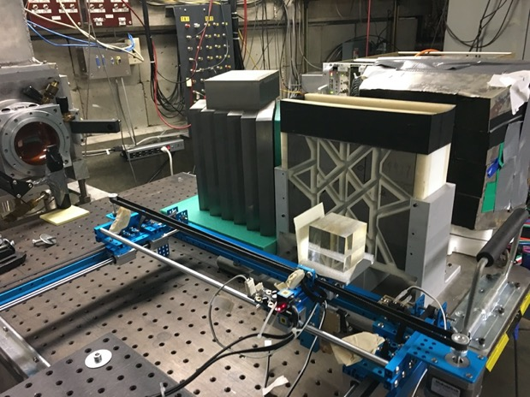
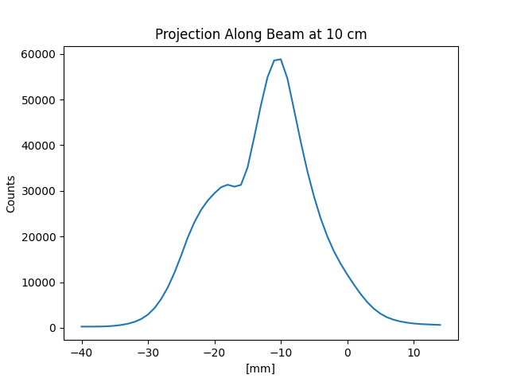
Verification of Ion-Beam Cancer Therapy
New 2D knife-edge coded aperture system
Very preliminary imaging results w/ 67 MeV protons from UC Davis Crocker Lab onto PMMA target (~35mm range)
Plastic scintillator
Timing reference?
  Can we reduce field-of-view with time-of-flight (TOF)?
    40mm w/ ~100 ps? Feasible!
  Can we determine range with TOF ?
    1mm w/ <5ps? Not feasible, yet.

Slide 30
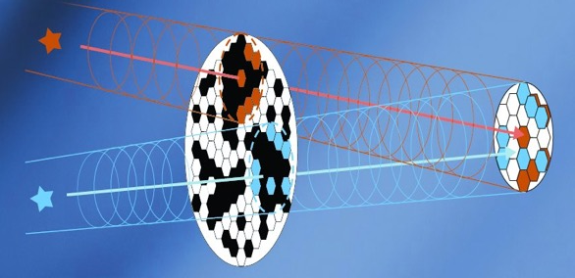
Gamma-Ray Imaging – How ?
Gamma-ray optics?
  Difficult since gamma-rays don’t refract (much) but interact;
  Grazing incidence mirrors w/ depth graded multilayers or crystal diffraction to focus with 2-D focal plan detector
Gamma-ray interaction-based and energy dependent:
  Photo-electric absorption domain (>~300 keV)
    Collimators (2-D detectors)
    Spatial (2-D) or temporal (1-D) modulation
  Compton scattering domain (~300keV-8MeV)
    Compton imagers (3-D detectors)
  Pair production domain (>8 MeV)
    Pair “tracker” (3-D detectors)
  Positron-emission based (511 keV photons)
Spatial modulation-coded aperture
Compton imaging
source
r1
r2
r4
r3

