Slide 1
Advancing Medical Care through Discovery in the Physical Sciences: Joint DOE- NIH Workshop
For cancer treatment, physics is biology and… For cancer cure, biology needs the physical sciences
C.Norman Coleman*
Radiation Research Program, DCTD and Radiation Oncology Branch, CCR, NCI
& Office of the Assistant Secretary for Preparedness and Response, DHHS
*Acknowledgment: colleagues in Rad Res Program, Rad Oncology Branch, NCI & DCTD & OD; NIAID; ASPR

Slide 2
Outline
Welcome from NCI
Personal opinion regarding the possibilities of physical sciences and biology producing new paradigms- radiation oncology and combined modality therapy
The road ahead
Disclaimer: This presentation is the personal opinion of the presenter and is not opinion or policy of NCI, NIH, ASPR, DHHS or US Government.
Conflict of interest: None

Slide 3
Physical sciences ←→ biology: scope of opportunities

Slide 4
Physical sciences ←→ biology: scope of opportunities
Transit dose (new/older technology)
Outcome
?
Assess physical size
Focus &
Measure
Energy:
Ionizing radiation
Charged particles
Systemic radiation
Hyperthermia
Phototherapy
Ultrasound
Etc
Hope it shrinks
Improve process & throughput
Hit the target

Slide 5
Physical sciences ←→ biology: scope of opportunities
Outcome
?
Assess physical size
Focus &
Measure
AI/ML
Energy:
Ionizing radiation
Charged particles
Systemic radiation
Post treatment analysis
Circulating DNA
Circulating cells
Biological imaging
Laboratory:
Tumor cell
Stroma
Normal tissues
Define specific target (or clinical trial)
Initiate treatment course
Biopsy, analyze failure- and back to treatment

Slide 6
Physical sciences ←→ biology Integration : scope of opportunities
Outcome
?
Assess physical size
+++ systemic Rx
Focus &
Measure
AI/ML
Chose Energy:
Ionizing radiation
Charged particles
Systemic radiation
Post treatment analysis
Circulating DNA
Circulating cells
Biological imaging
Laboratory:
Tumor cell
Stroma
Normal tissue
Define specific target (or clinical trial)
Initiate treatment course

Slide 7
Physical sciences ←→ biology Integration : scope of opportunities
Outcome
?
Assess physical size
+++ systemic Rx
Focus &
Measure
AI/ML
Chose Energy:
Ionizing radiation
Charged particles
Systemic radiation
Post treatment analysis
Circulating DNA
Circulating cells
Biological imaging
Laboratory:
Tumor cell
Stroma
Normal tissue
Define specific target (or clinical trial)
Initiate treatment course

Slide 8
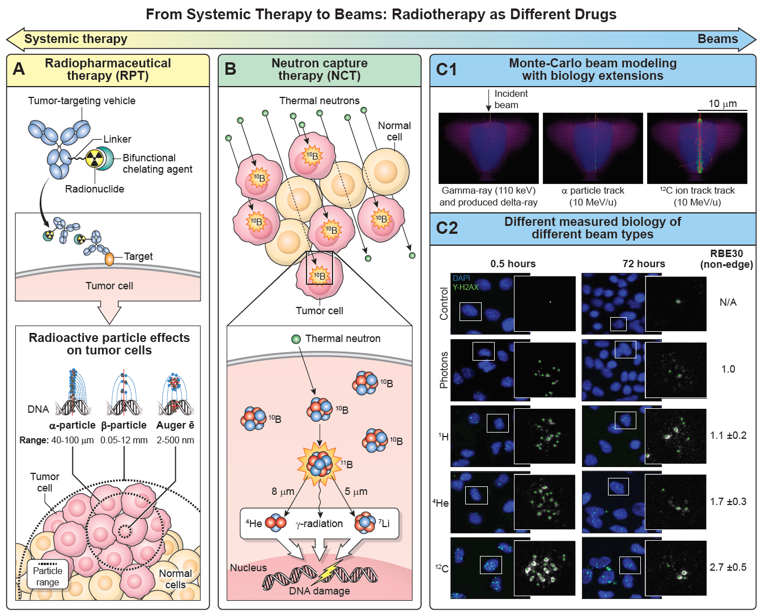
Choose type of physical treatment
JNCI Cancer Spectrum, in press

Slide 9
Physical sciences ←→ biology Integration : scope of opportunities
Outcome
?
Assess physical size
+++ systemic Rx
Focus &
Measure
AI/ML
Chose Energy:
Ionizing radiation
Charged particles
Systemic radiation
Laboratory:
Analyze adaptation early and frequently
Laboratory:
Tumor cell
Stroma
Normal tissues
Define specific target (or clinical trial)
Initiate treatment course

Slide 10
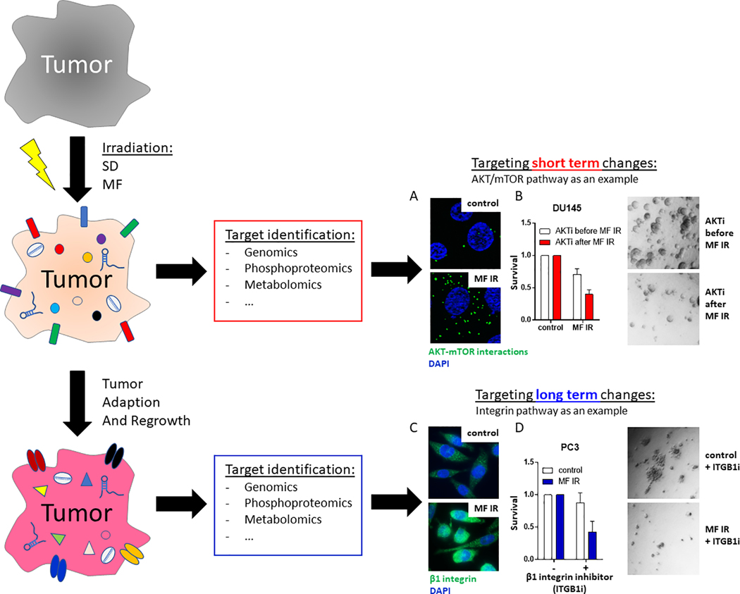
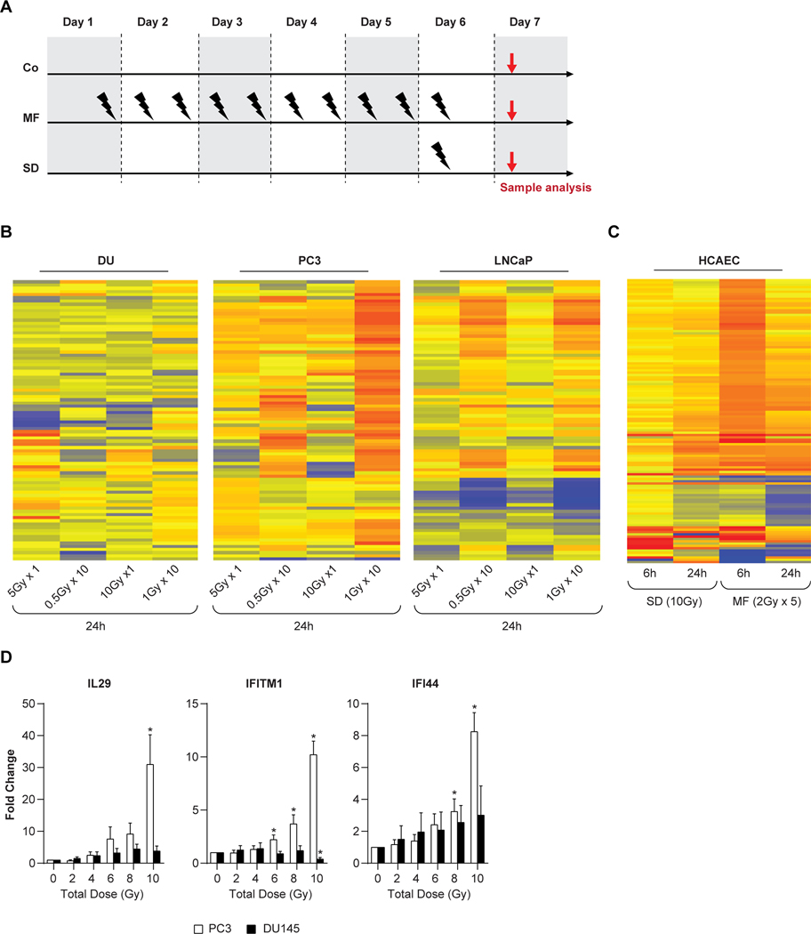
Tumors adapt rapidly:
Type of radiation, dose and schedule matter. Inducible adaptation potentially targetable post- radiation
Clin Ca Res 26: 5781, 2020

Slide 11
Our approach to treatment:
We should at least know what the tumor & normal tissues know
Tumors adapt rapidly:
Type of radiation, dose and schedule matter. Inducible adaptation potentially targetable post- radiation
Clin Ca Res 26: 5781, 2020

Slide 12
Physical sciences ←→ biology Integration : Anticipate and adapt
Image physical and biological properties→
Outcome
?
+++ systemic Rx
Focus &
Measure
AI/ML
Chose Energy:
Ionizing radiation
Charged particles
Systemic radiation
Laboratory:
Analyze adaptation early and frequently
Laboratory:
Tumor cell
Stroma
Normal tissues
Define specific target (or clinical trial)
Initiate treatment course
Personalized adaptive multi-modality therapy

Slide 13
Physical sciences ←→ biology Integration : Anticipate and adapt
Image physical and biological properties→
Outcome
!
+++ systemic Rx
Focus &
Measure
Mitigate
AI/ML
Chose Energy:
Ionizing radiation
Charged particles
Systemic radiation
Laboratory:
Analyze adaptation early and frequently
Laboratory:
Tumor cell
Stroma
Normal tissues
Define specific target (or clinical trial)
Initiate treatment course
Personalized adaptive multi-modality therapy

Slide 14
Where are we in integration of medical care and physical sciences (1)
Radiation as “Focused Biology”- ~2001 (presented to RSNA) “Therapeutic radiation is focused biology (ie, radiation produces molecular events in the irradiated tissue). (Radiology 2003)
Physical aspects of RT- discussion with NASA and RT targeting “6-degrees of freedom”: focusing and directing the shaped beam is readily do-able ~ 2002 {DOE- NCI Technology workshops- 2013, 2019}
Radiation adaptive response- happens early, is sustainable and targetable (in NCI ROB lab) ~2010 - present
Paradigm: Define radiation in both physical dose and biological perturbation: “Shades of Gy” NCI workshop, 2018. Consider choosing physical dose for biological goal.
Biomarkers of normal tissue injury- NCI, NIAID, BARDA (for nuclear disasters; clinical spinoff) –physics of radiation and point-of-triage/point-of-care detectors
Tumor plasticity being understood- single cell analysis, 4D relationships- application of physical sciences, analytical science (in lab); requires high level computation (DOE Workshop 2021)

Slide 15
Where are we in integration of medical care and physical sciences (2)
Biomarkers to tumor response- circulating cells and molecules; (COVID- detector) physical technology. NIBIB,NCI
Imaging – biology; Imaging- Radiomics (CIP, CBIIT NCI)
Embedded physical sensors to monitor and adapt tumor and normal tissue–physical sciences (NCI SBIR)
Integration of data- real-time high quality dense data sets; clinical paradigm (NCI, ROB ROBIN program - Radiation Oncology-Biology Integration Network launched)
Application of linacs: Basic Research Needs Workshop on Compact Accelerators for Security and Medicine (DOE, DHS, NNSA, NCI, 2019) (Also cost-effective technology global health)
This workshop →Advancing Medical Care through Discovery in the Physical Sciences (DOE, NCI, 2021)

Slide 16
Welcome !
Thank you
ccoleman@mail.nih.gov

