Slide 1
Richard Capobianco
University of Connecticut
HUGS, 2021
Pion SIDIS Analysis from RG-A

Slide 2
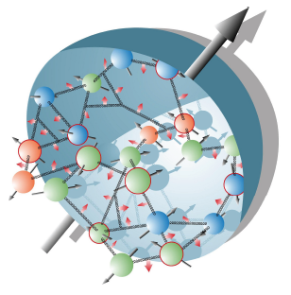
General Overview
Goals: Address the “Proton Spin Puzzle”
Study the 3-D structures of nucleons
What is the “Proton Spin Puzzle”?
A.K.A. The “Proton Spin Crisis”
Quark spin only accounts for 20-30% of proton spin
Possible Solution: Using angular momentum contribution

Slide 3
General Overview
Goals: Address the “Proton Spin Puzzle”
Study the 3-D structures of nucleons
Questions to be answered:
Do quarks undergo orbital motion?
Is there a connection between the motion of quarks, their spin and the spin of the proton?
How is the total spin of the proton built up from the spin and the orbital angular momentum of partons?
These questions cannot be answered without going into 3-dimensions

Slide 4
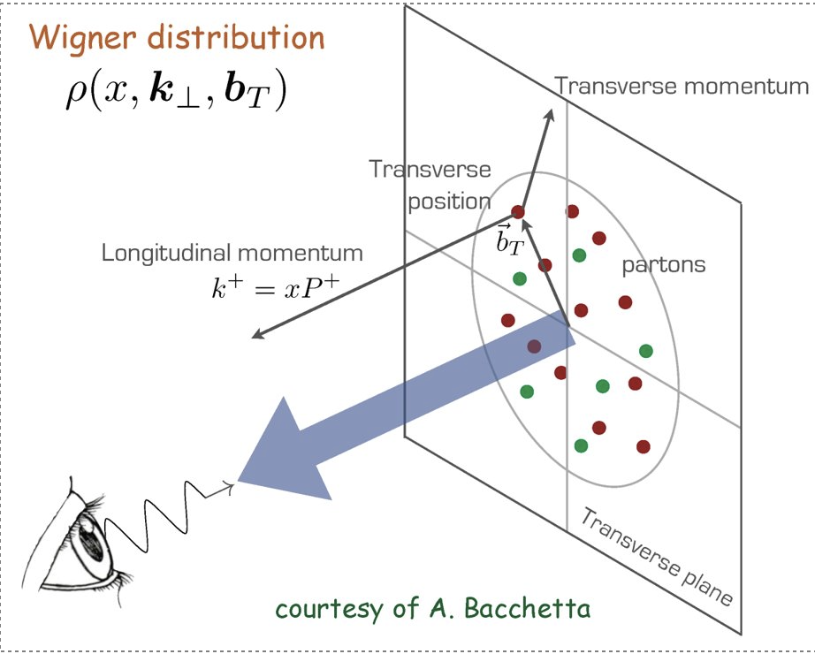
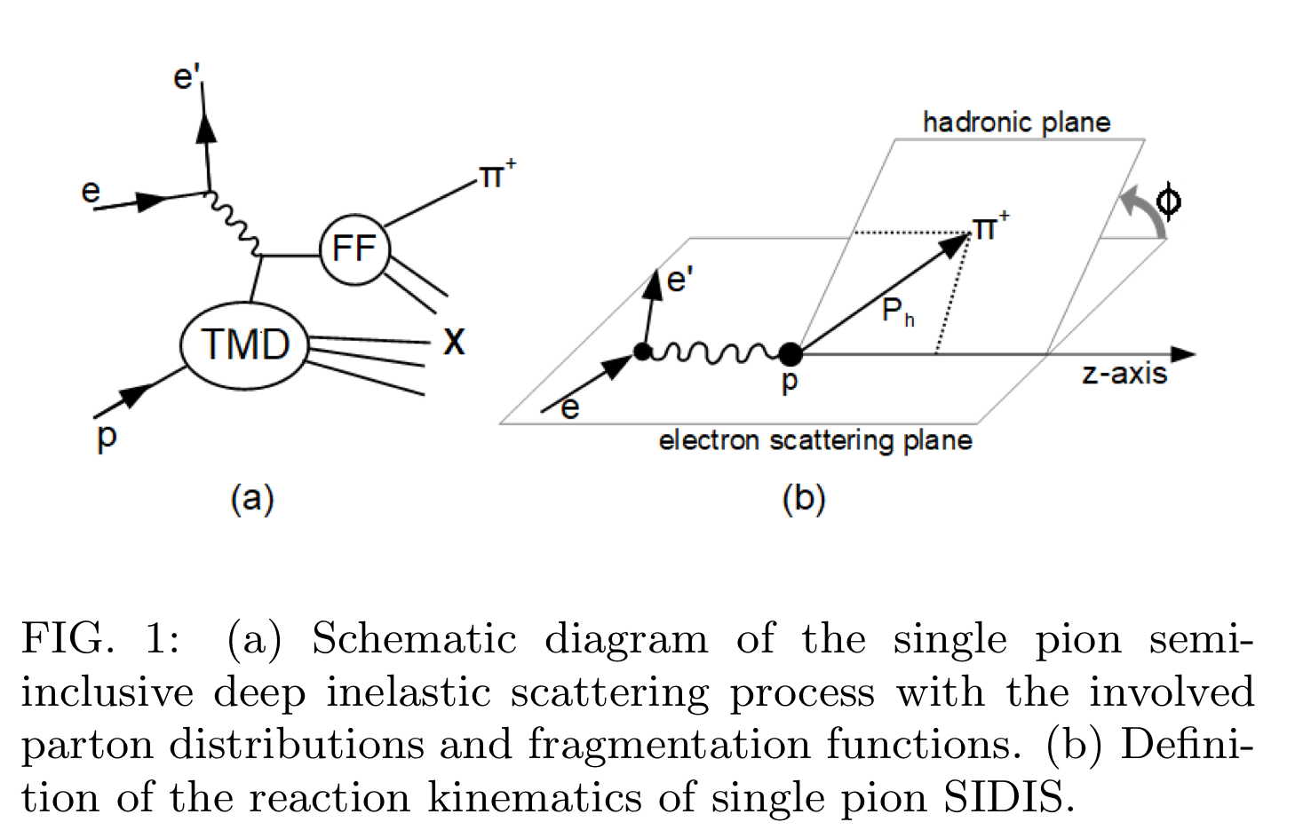
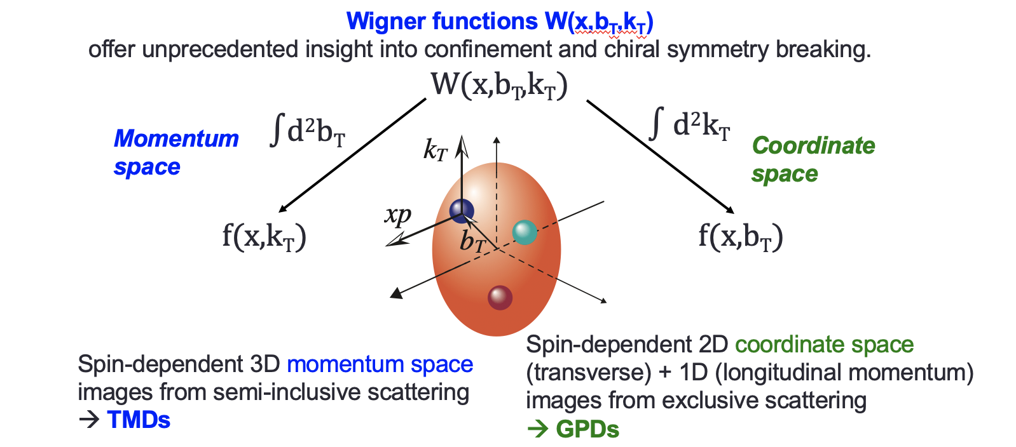
Semi-Inclusive Deep Inelastic Scattering (SIDIS)
Differs from DIS through the detection of a specified hadron
Directly related to TMDs and FFs

Slide 5
Semi-Inclusive Deep Inelastic Scattering (SIDIS)
Differs from DIS through the detection of a specified hadron
Directly related to TMDs and FFs

Slide 6
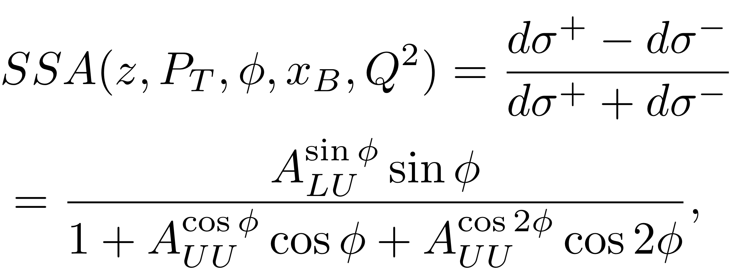
Semi-Inclusive Deep Inelastic Scattering (SIDIS)
Differs from DIS through the detection of a specified hadron
Directly related to TMDs and FFs

Slide 7
Recent Work
Longitudinally polarized electron beam (10.6 GeV) scattering off an unpolarized proton target
Q² range: 1.7 to 7.0 GeV²
x_{B} from 0.13 to 0.52
z from 0.18 to 0.7
P_{T} up to 0.85 GeV
arXiv: 2101.03544

Slide 8
Recent Work
Longitudinally polarized electron beam (10.6 GeV) scattering off an unpolarized proton target
Q² range: 1.7 to 7.0 GeV²
x_{B} from 0.13 to 0.52
z from 0.18 to 0.7
P_{T} up to 0.85 GeV
arXiv: 2101.03544

Slide 9
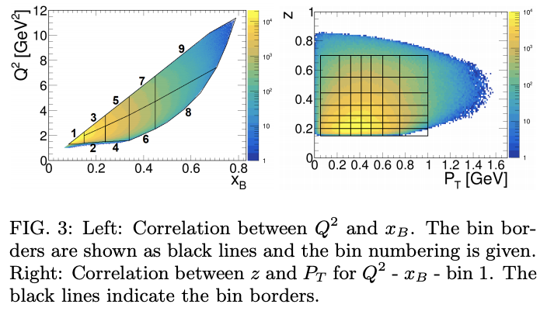
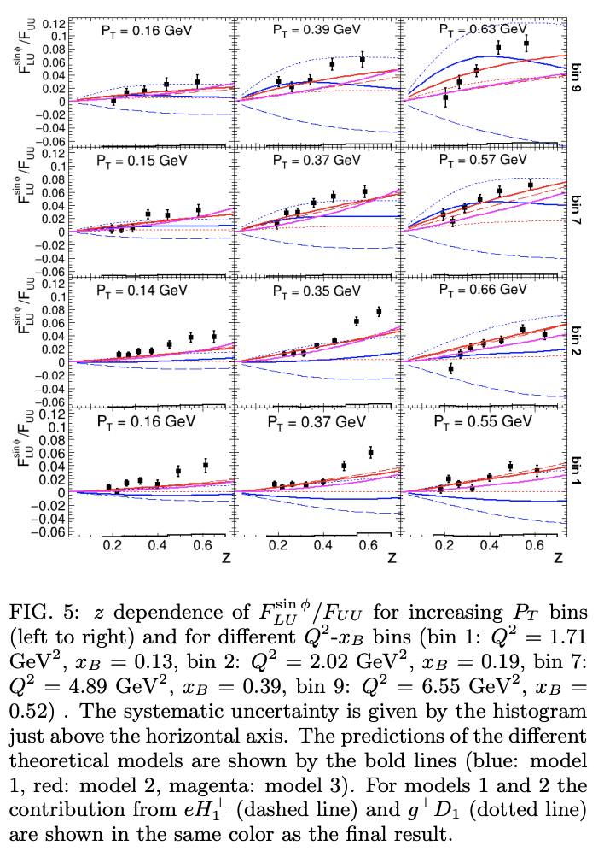
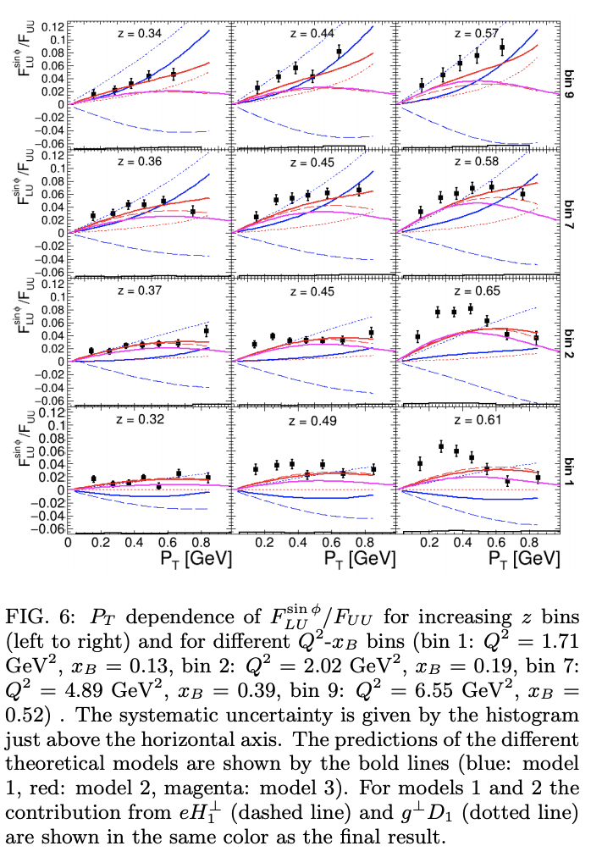
Recent Work
Longitudinally polarized electron beam (10.6 GeV) scattering off an unpolarized proton target
Q² range: 1.7 to 7.0 GeV²
x_{B} from 0.13 to 0.52
z from 0.18 to 0.7
P_{T} up to 0.85 GeV
arXiv: 2101.03544

Slide 10
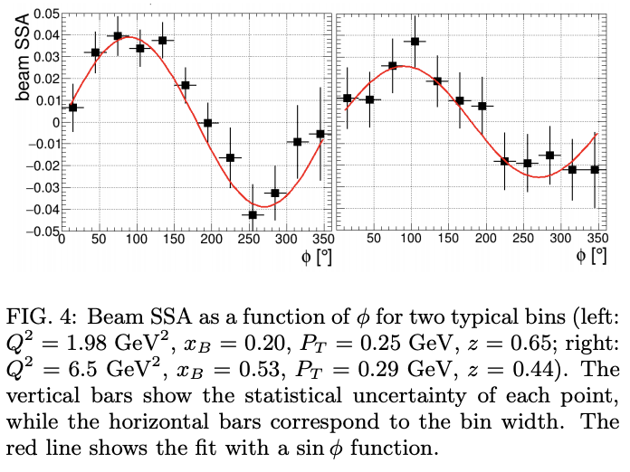
Recent Work
arXiv: 2101.03544

Slide 11
My involvement
I am joining the CLAS Collaboration now
Was learning how to access/use the data files to perform computational analysis as preparation for future work
I am in the early stages of performing cross-checks on existing SIDIS analysis data as part of my thesis work
Will be working towards producing ‘final’ files for analyzed data

Slide 12
Questions?

Slide 13
Thank you all for listening to my talk
I would also like to thank and give credit to Dr. Kyungseon Joo for some of the images and information shown in these slides
Credit also to everyone in the CLAS Collaboration who contributed to the paper discussed in this talk
Acknowledgements and Thanks
Notes:
Also credit to Stefan Diehl for some of the equations
Citation for the paper: arXiv:2101.03544

