Slide 1
Scientific Computing: The Offline World
HUGS Summer School
Amber Boehnlein
Associate Lab Director
Computational Science & Technology
1975

Slide 2
Overview
The goal of this lecture is to give you an overview of Scientific Computing as used in High Energy and Nuclear Physics
a taste of the complexity and breadth
Scientific Computing is a technical field
This is not a technical lecture
Some information will be Jefferson Lab based; others not.
Five additional lectures
Distributed Computing Model (Dr. Schram)
Online Computing (Dr. Heyes)
3 lecture course on Data Science (Dr. Schram)

Slide 3
Scientific Computing
Scientific Computing (sometimes called Research Computing) is
A layer of technologies that work together systematically that enable researchers to perform tasks that can only be accomplished computationally.
Engineered Systems
Enable compute at scale
Department Clusters to Supercomputers
Built to requirements
Reliability
Reproducibility
Standards
Budget
“Nations with the fastest supercomputers and most advanced light sources, for example, will have a distinct advantage in the race for discovery and innovation across a broad range of fields, from physics, materials science, and chemistry to genomics and medicines, and others —have become increasingly vital tools of scientific discovery.”

Slide 4
Scientific Computing Layers
Functional Layers of the system
User Interfaces
User Applications
Common Services
Infrastructure Services
Hardware
Data Center

Slide 5
Scientific Computing Layers
There is interplay between the layers—there is a connection between the hardware and the target applications
User Interfaces
User Applications
Common Services
Infrastructure Services
Hardware
Data Center
High Performance Computing: HPC
High Throughput Computing: HTC

Slide 6
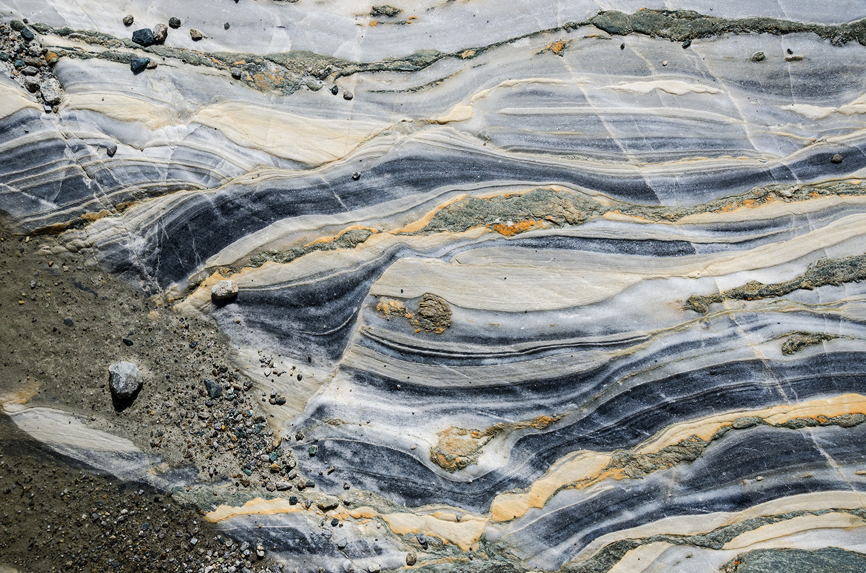
Scientific Computing
There are cross cutting considerations
Almost fractal in nature
Data Flow
User Interfaces
Security
User Applications
Common Services
Infrastructure Services
Hardware
Data Center

Slide 7
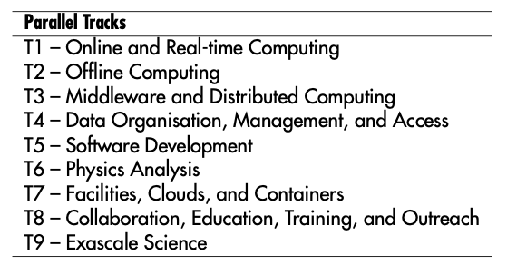
Scientific Computing
Computing In High Energy and Nuclear Physics
There are cross cutting considerations
Almost fractal in nature
Data Flow
User Interfaces
Security
User Applications
Common Services
Infrastructure Services
Hardware
Data Center
What we talk about amongst ourselves

Slide 8
Modeling the Computing Requirements
Engineered systems are built to requirements and specifications
The requirement gathering process starts with understanding what drives the compute and storage needs.
For experimental systems
Data rate and experiment live time and other accelerator considerations
Event Size
Application Processing time
Number of simulated events and Time to generate
For shared resources—all user requirements have to be considered
A model is developed
Typically work to the major drivers
Projections are multi-year
Notes:
This process is used at all scales, see for example the Exascale requirements reviews. The models are often spreadsheet based and vary in sophistication. The community is moving more towards more predictive modesl

Slide 9
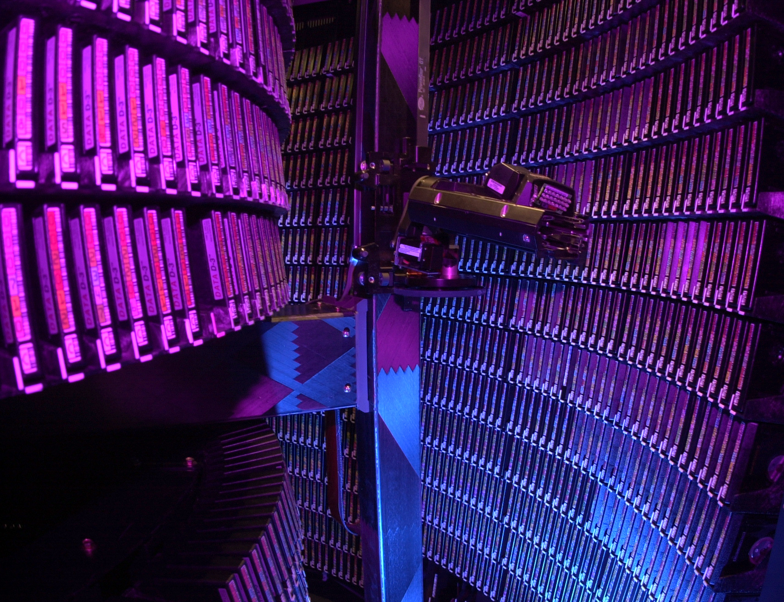
How is the requirements model used?
The architecture and implementation of the hardware and services
Data Center Utilization and Planning
Space, Power and Cooling
Data Center extensions or upgrades
Expensive
Disruptive
Long lead time equipment
Networking
Optical cables: ‘Local Area’
External Providers: ‘Wide Area’
Robotics for tape storage
Yearly refresh of computing and storage hardware
Projections based on vendor Technology roadmaps
Application mix determines the mixture of different types of compute and storage
Older model tape robot
Notes:
The mix of types of storage and compute depend on the application mix and on the profile of the data sources, and the usage of the data sources. The yearly refresh means some degree of technology speculation and there are also operationally concerns. Too many technologies are difficult to administer and tune—which can lead to downtime, inefficiency or issues with the user experience.

Slide 10
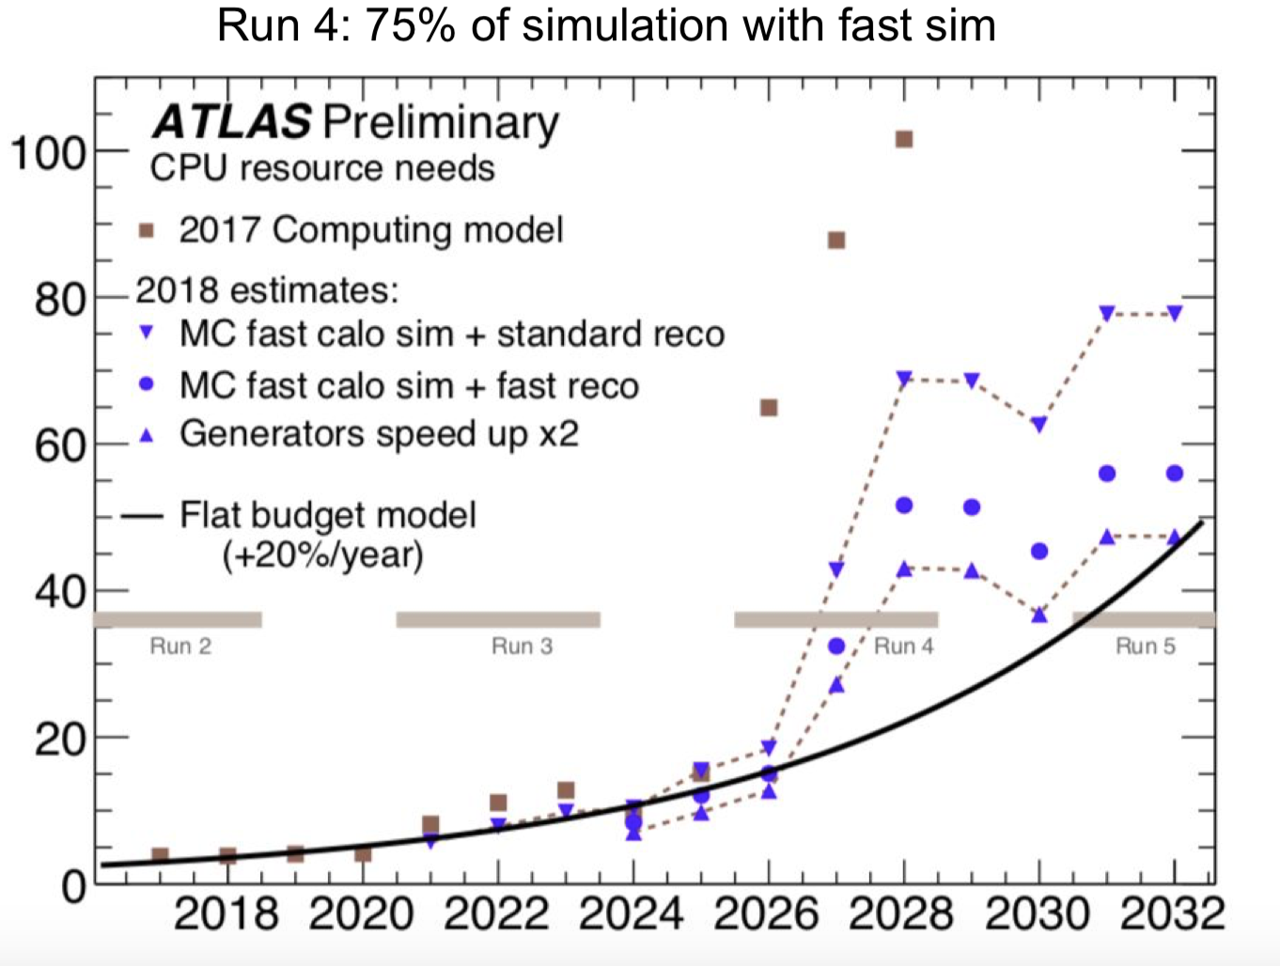
In the Real World
There are constraints that cause back pressure
Budget
Fixed Design Choices
ATLAS is an experiment at CERN
They are projecting needs into the far future when the luminosity increases
With a fixed budget and standard technology projections and the projected needs, their model doesn’t work.
Write down what you think the three best options are.

Slide 11
Some Options
Write less data or use less simulation?
Might Impact Physics goals
Develop faster algorithms?
Takes people, expertise and time
Port algorithms from CPUS to GPUs
Takes people, time, expertise
Trade off in precision/time?
90% of ‘fast sim’
Get more money
Means more data center space, power and cooling
Notes:
This is a natural segue to applications

Slide 12
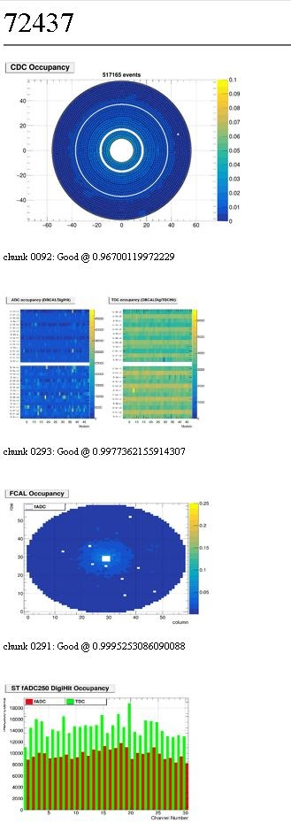
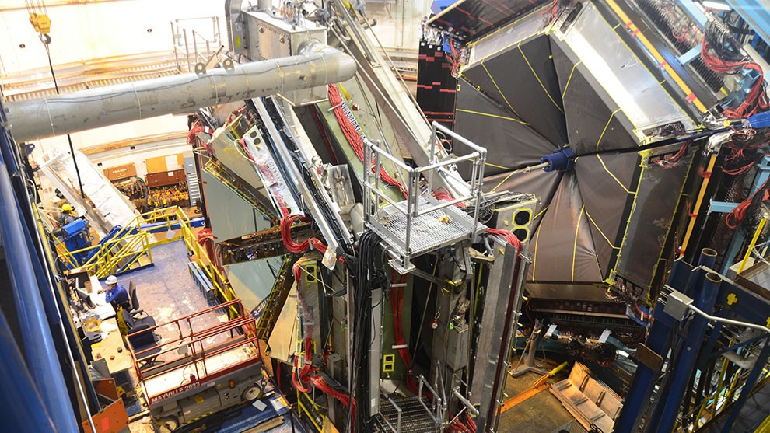
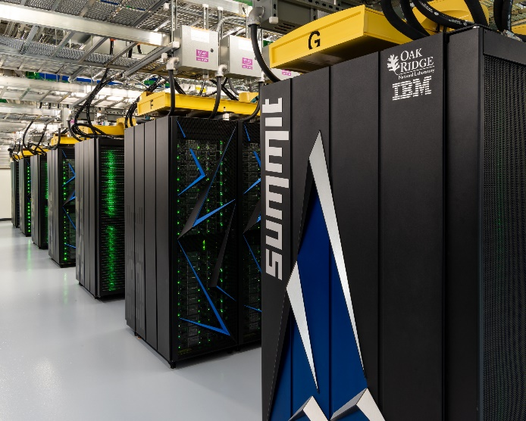
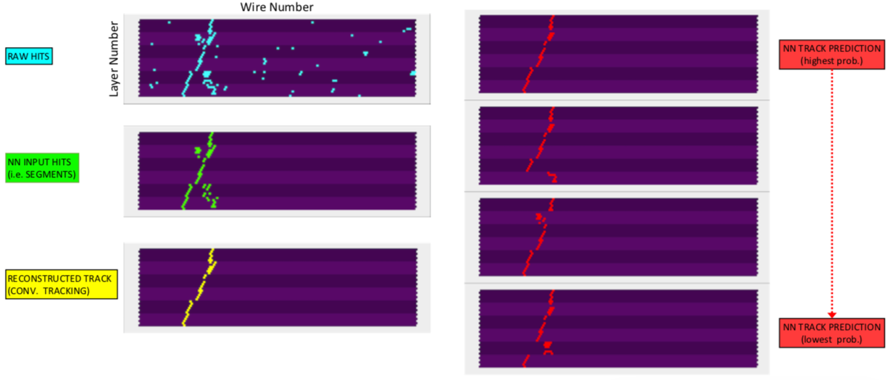
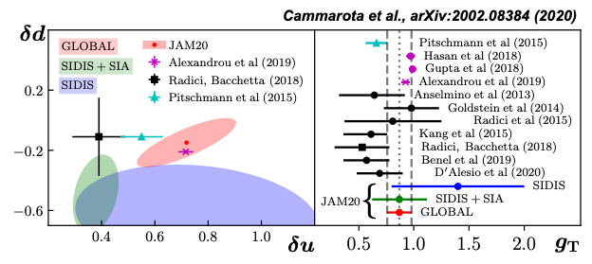
Jefferson Lab: The Application Layer
MCWRAPPER
SWIF2
OSG, NERSC
Monitoring
Experiment
ML - HYDRA
Streaming
Readout
Simulation
Calibration
LQCD gauge config.
JANA, CLARA, CODA
ML (CLAS12)
SWIF2
Reconstruction
ML tracking
SWIF2
JANA, CLARA
OSG, NERSC
Physics amplitudes
Analysis
CLAS12 trains
SWIF2
Theory
Spatial and momentum Distributions
Visualization
and
global analysis

Slide 13
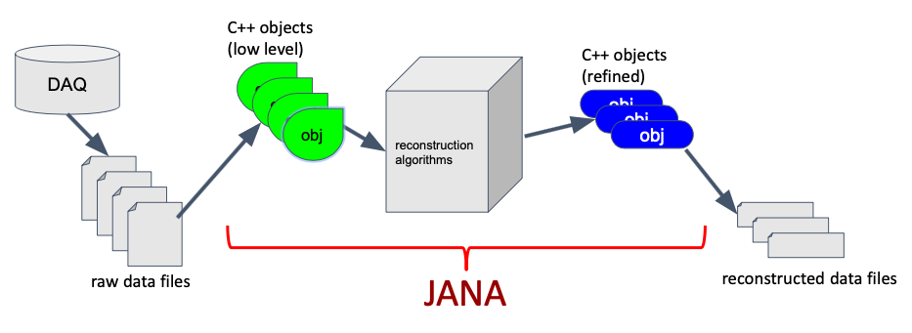
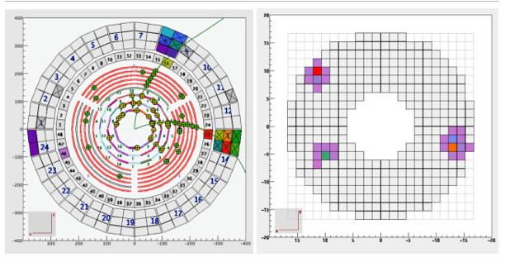
Frameworks and Reconstruction
‘Reconstruction’ is the process of transforming detector level information into physically meaningful entities
Reconstruction algorithms are generally managed by a ‘framework’ that handles common services (such as file input/out [I/O])
Typically centrally managed code base, processing and data sets
High bar for validation
Resource intensive
JANA2 Tutorial
CLAS12 Software framework and event reconstruction
CLAS12 Event Display

Slide 14
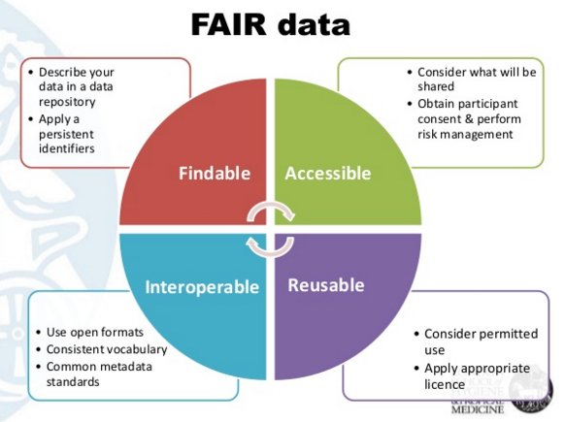
Data and Analysis
Analysis codes and data sets are typically less ‘centrally managed’
Measurement specific
Might want independence for cross-checks
FAIR data principles are in use in many sciences.
Important for integrative analyses.
Analysis framework: common toolkits and techniques
I/O
Graphics packages
Statistical packages
Fitting and minimization
Jupyter and Root are most common
Python is becoming lingua franca
Pro tips:
Document your analysis code,
Use repository (such as GIT) for code
Make sure your data is replicated and annotated.

Slide 15
Learn More
Jefferson Lab computing roundtable
HSF software foundation
IRIS-HEP
HEP Software and Computing Roadmap
vCHEP

Slide 16
Questions?
Thank you
Please Join Us at CHEP22
May 16-20, 2022
Norfolk, VA

