Slide 1
Spectroscopy high-energy/high-lumi
Alessandro Pilloni
CLAS Collaboration Meeting, June 2nd, 2021
H2020 MSCA COFUND G.A. 754496

Slide 2
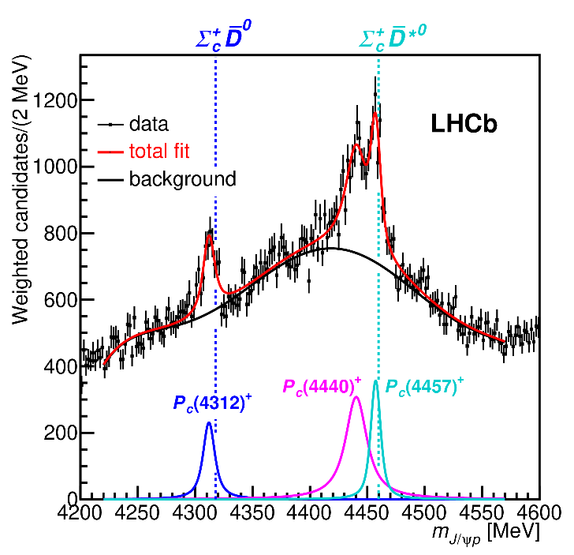
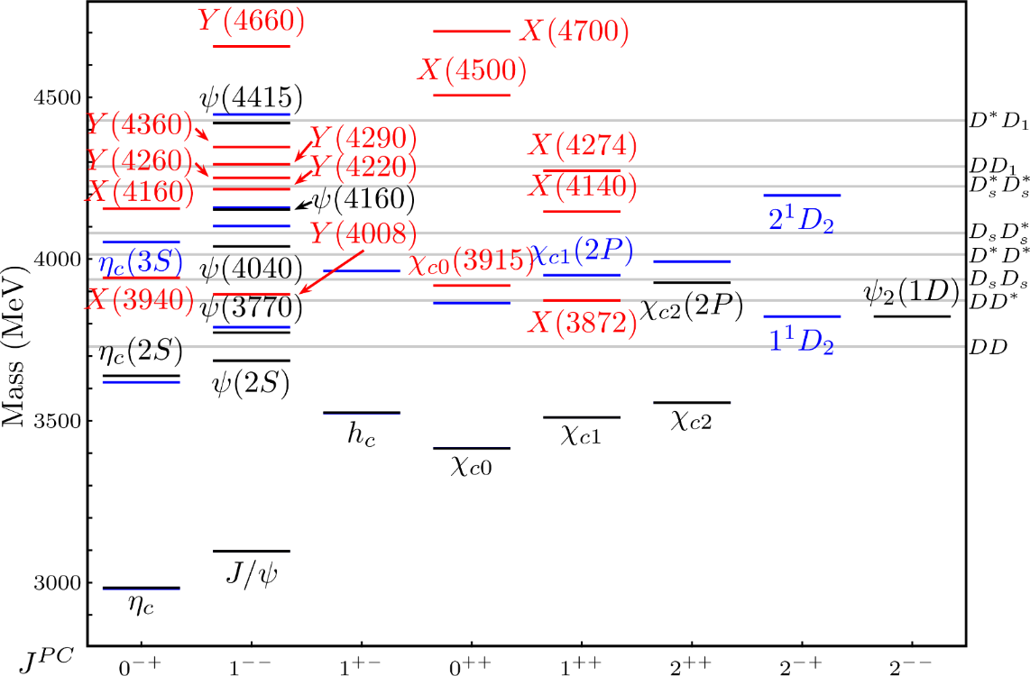
Exotic landscape
Estimates in M. Albaladejo et al. [JPAC], 2008.01001
LoI RF7_RF0_120
A. Pilloni – Spectroscopy HE/HL

Slide 3
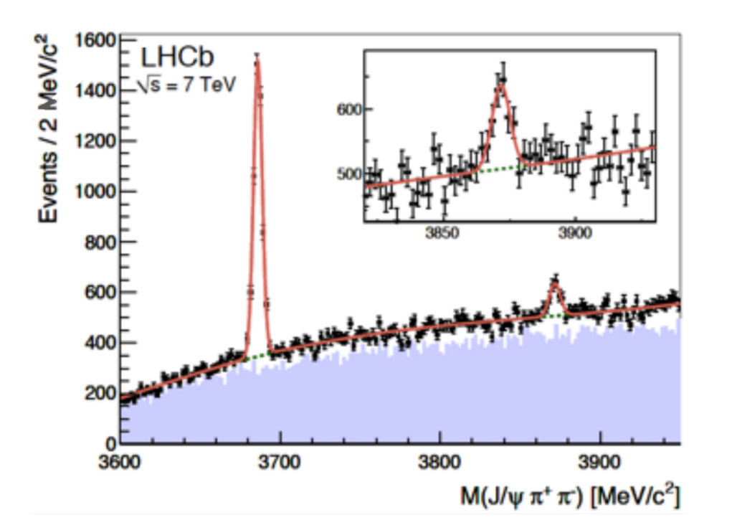
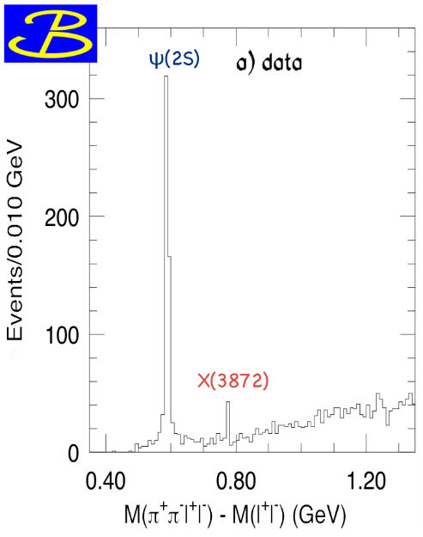
$X(3872)$
Discovered in $B→K X→K J/ψ ππ$
Quantum numbers $1^{++}$
Very close to $DD^{∗}$ threshold
Too narrow for an above-treshold charmonium
Isospin violation too big $\frac{Γ\left(X→J/ψ ω\right)}{Γ\left(X→J/ψ ρ\right)}\sim 0.8±0.3$
Mass prediction not compatible with $χ_{c1}(2P)$
Sizeable prompt production at hadron colliders, $∼5\%$ of $ψ(2S)$
$σ_{PR}×B(X→J/ψππ)=\left(1.06±0.11±0.15\right) \text{nb}$ @CMS
$M=3871.68±0.17$MeV
$$M_{X}−M_{DD^{∗}}=−3±192 \text{keV}$$
$$Γ=1.19±0.19 \text{MeV}$$
A. Pilloni – Spectroscopy HE/HL

Slide 4
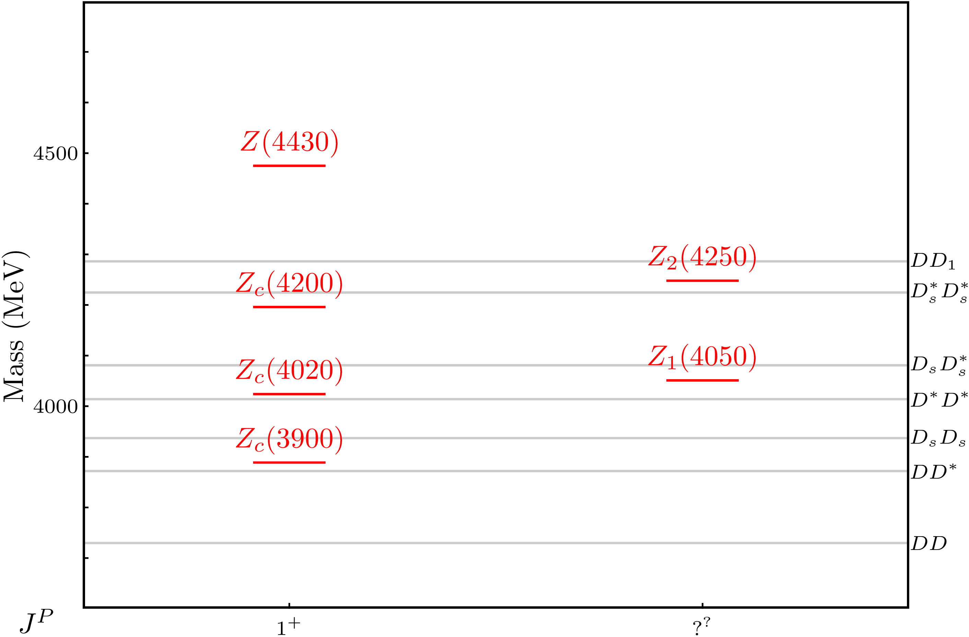
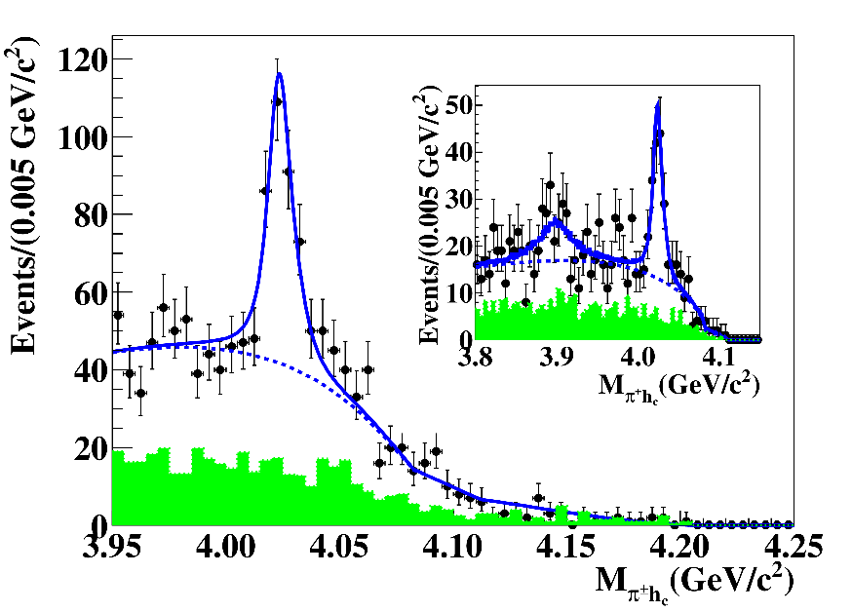
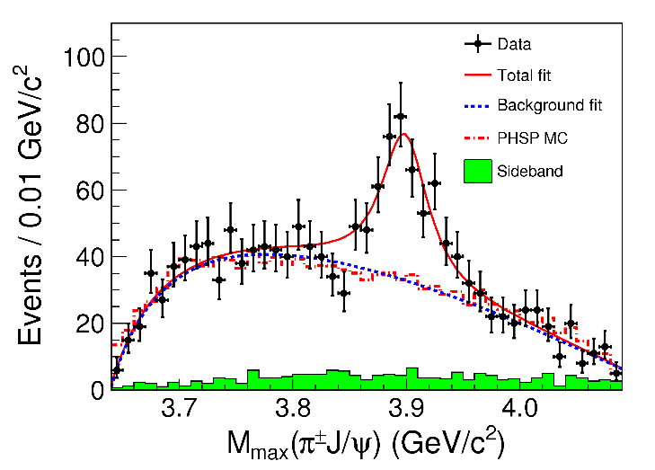
Charged $Z$ states: $Z_{c}\left(3900\right), Z_{c}^{′}(4020)$
Charged quarkonium-like resonances have been found, 4q needed
Two states $J^{PC}=1^{+−}$ appear slightly above $D^{(∗)}D^{∗}$ thresholds
$e^{+}e^{−}→Z_{c}{\left(3900\right)}^{+}π^{−}→J/ψ{ π}^{+}π^{−}$ and $→{\left(DD^{∗}\right)}^{+}π^{−}$ $M=3888.7±3.4$MeV, $Γ=35±7$ MeV
$e^{+}e^{−}→Z_{c}^{′}{\left(4020\right)}^{+}π^{−}→h_{c}{ π}^{+}π^{−}$ and $→{\overline{D}}^{∗0}D^{∗+}π^{−}$
$M=4023.9±2.4$MeV, $Γ=10±6$ MeV
A. Pilloni – Spectroscopy HE/HL
Notes:
Y(4260), M=4263 +- 5, Gamma = 95+-14
D_1(2420)^0, M=2421.3 ±0.6, Gamma =27.1 ±2.7
D_1(2420)^+-, M=2423.4 ±3.1, Gamma =25 ±6
I D_1 hanno J^P = 1^+
La molecola D_1 D sta 22 MeV sotto
Se la Y è D_1 D, il pione lega fortemente, come fa la Y a essere così larga?
Come funziona lo scambio del pione???

Slide 5
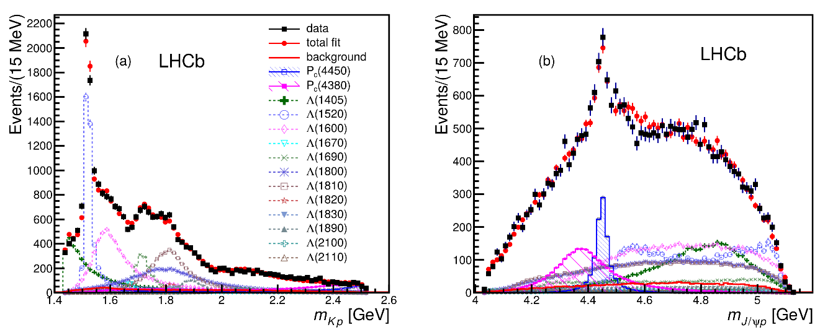
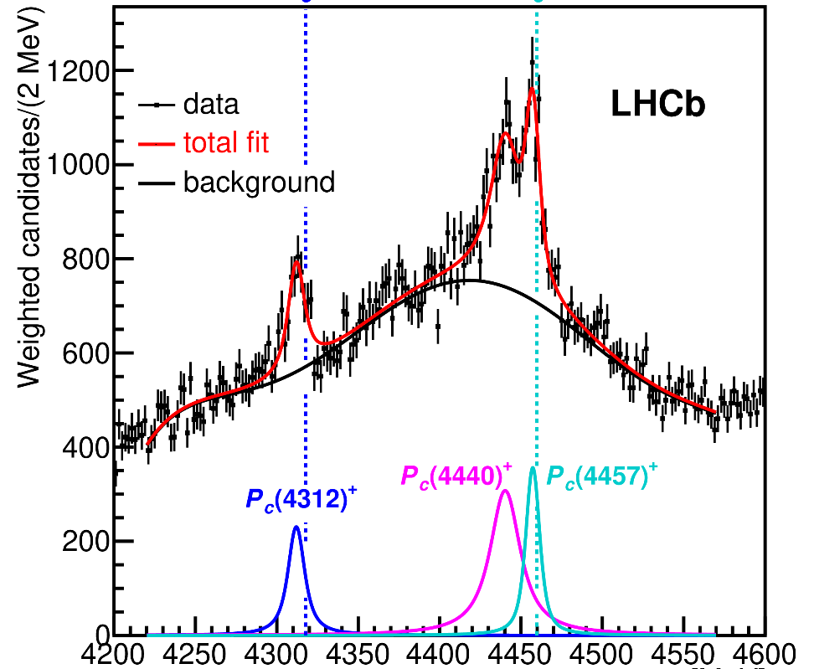
Pentaquarks!
LHCb, PRL 115, 072001
LHCb, PRL 117, 082003
Two states seen in $Λ_{b}→\left(J/ψ p\right) K^{−}$,
evidence in $Λ_{b}→\left(J/ψ p\right) π^{−}$
$$M_{1}=4380±8±29 \text{MeV} \\ Γ_{1}=205±18±86 \text{MeV}$$
$$M_{2}=4449.8±1.7±2.5 \text{MeV} \\ Γ_{2}=39±5±19 \text{MeV}$$
Quantum numbers $$J^{P}=\left({\frac{3}{2}}^{−},{\frac{5}{2}}^{+}\right) \text{or}\left({\frac{3}{2}}^{+},{\frac{5}{2}}^{−}\right)\text{or}\left({\frac{5}{2}}^{+},{\frac{3}{2}}^{−}\right)$$
LHCb, PRL 122, 222001
Higher statistics analysis revealed a two-peak structure of the narrow state, plus a new lighter one Quantum numbers still unknown
A. Pilloni – Spectroscopy HE/HL
Notes:
Y(4260), M=4263 +- 5, Gamma = 95+-14
D_1(2420)^0, M=2421.3 ±0.6, Gamma =27.1 ±2.7
D_1(2420)^+-, M=2423.4 ±3.1, Gamma =25 ±6
I D_1 hanno J^P = 1^+
La molecola D_1 D sta 22 MeV sotto
Se la Y è D_1 D, il pione lega fortemente, come fa la Y a essere così larga?
Come funziona lo scambio del pione???

Slide 6
Models
Compact
Hybrids
Containing gluonic degrees of freedom
Multiquark
Several (cluster) of valence quarks
Hadroquarkonium
Heavy core interacting with a light cloud via Van der Waals forces
$$π$$
$$π$$
$$J/ψ$$
$$π$$
Rescattering effects
Structures generated by cross-channel rescattering, very process-dependent
Molecule
Bound or virtual state generated by long-range exchange forces
Extended
A. Pilloni – Spectroscopy HE/HL

Slide 7
Exotic landscape
Broad mesons seen in $b$ decay:
$X(4140)$, $Z(4430)$, $Z_{cs}(4000)$...
Narrow structures seen in $b$ decay:
$X\left(3872\right), P_{c}$, $(P_{cs})$
Scarce consistency between various production mechanisms
Narrow structures seen in $e^{+}e^{−}$:
$X(3872)$, $Y(4260)$, $Z_{c,b}^{(′)}$
A. Pilloni – Spectroscopy HE/HL

Slide 8
Why photoproduction?
It’s new: no XYZ state has been uncontroversially seen so far
It is free from rescattering mechanisms that could mimic resonances in multibody decays
The framework is (relatively) clean from a theory point of view
Radiative decays offer another way of discerning the nature of the states
A. Pilloni – Spectroscopy HE/HL

Slide 9
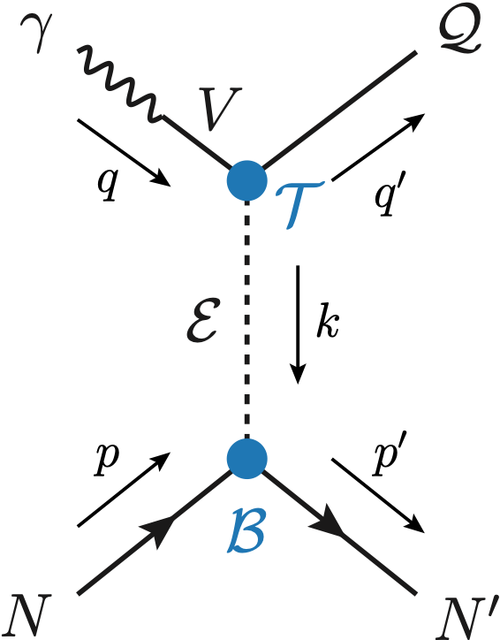
Exclusive (quasi-real) photoproduction
XYZ have not been seen in photoproduction so far : independent confirmation
Not affected by 3-body dynamics: determination of resonant nature
Experiments in the appropriate energy range are promising
We study near-threshold (LE) and high energies (HE)
Couplings from data as much as possible, not relying on the nature of XYZ
M. Albaladejo et al. [JPAC], PRD
$$<λ_{𝒬}λ_{N}^{′}|T|λ_{γ}λ_{N}>=\underset{V,ℰ}{∑}\frac{ef_{V}}{m_{V}}𝒯_{λ_{V}=λ_{γ},λ_{𝒬}}^{α_{1}⋯α_{j}}𝒫_{α_{1}⋯α_{j};β_{1}⋯β_{j}}ℬ_{λ_{N}λ_{N}^{′}}^{β_{1}⋯β_{j}}$$
Bottom vertex from standard photoproduction pheno, exponential form factors to further suppress large t
VMD is used to couple the incoming photon to a vector quarkonium V
Top vertex from measured $𝒬→Vℰ$ decay width
A. Pilloni – Spectroscopy HE/HL

Slide 10
Threshold vs. high energy
Fixed-spin exchanges expected to hold in the low energy region
$t$ channel grows as $s j$, exceeding unitarity bound, Regge physics kicks in: Reggeized tower of particles with arbitrary spin at HE
$$s^{j}⟶s^{α_{0}+α^{′}t }$$
Holds at low energy, fixed spin
Holds at high energy, resummation of leading $s$ power
If $ε≠$IP, $α_{0}<1$, $dσ/dt$ decreases with energy
Exchange of heavy particles further suppressed
A. Pilloni – Spectroscopy HE/HL

Slide 11
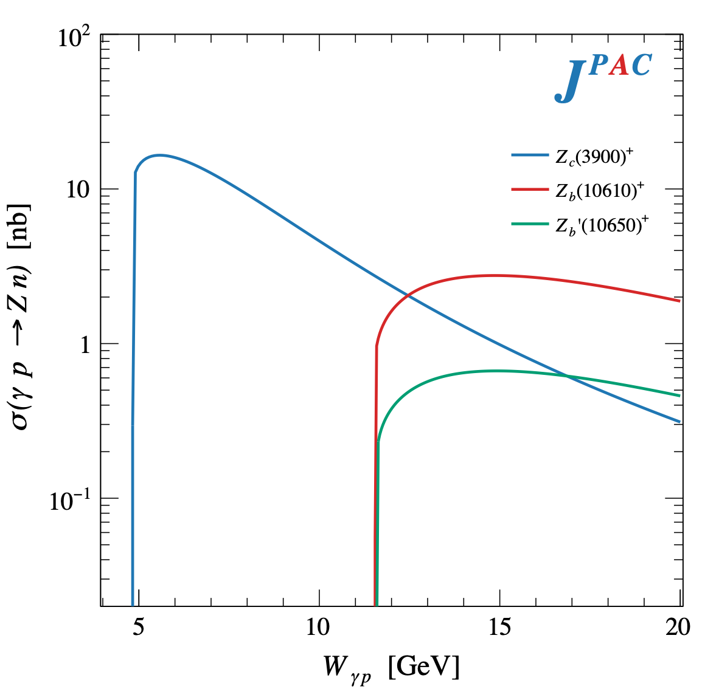
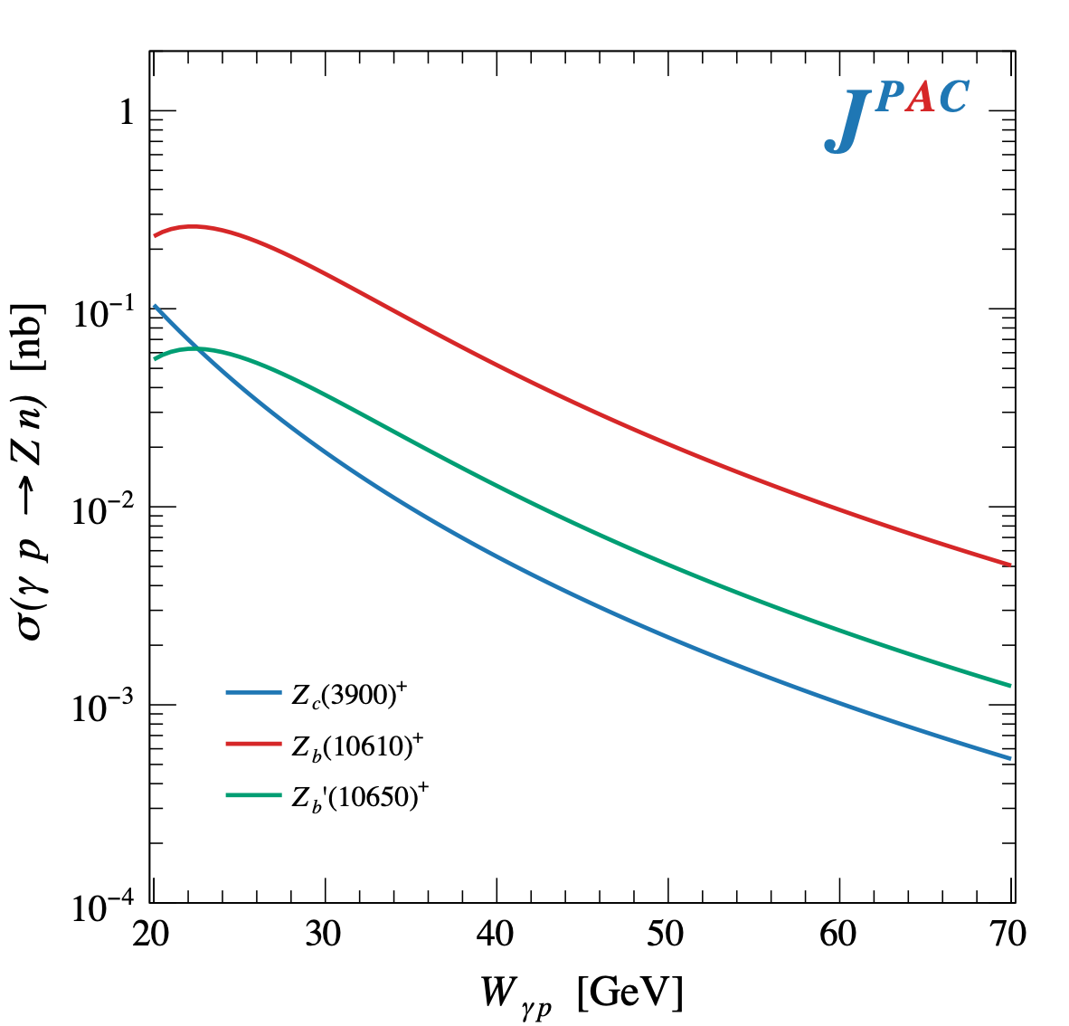
$Z$ photoproduction
The $Zs$ are charged charmoniumlike $1^{+−}$ states close to open flavor thresholds
Focus on $Z_{c}{\left(3900\right)}^{+}→J/ψ π^{+}$, $Z_{b}{\left(10610\right)}^{+},Z_{b}^{′}{\left(10650\right)}^{+}→Υ(nS) π^{+}$
The pion is exchanged in the $t$-channel
A. Pilloni – Spectroscopy HE/HL

Slide 12
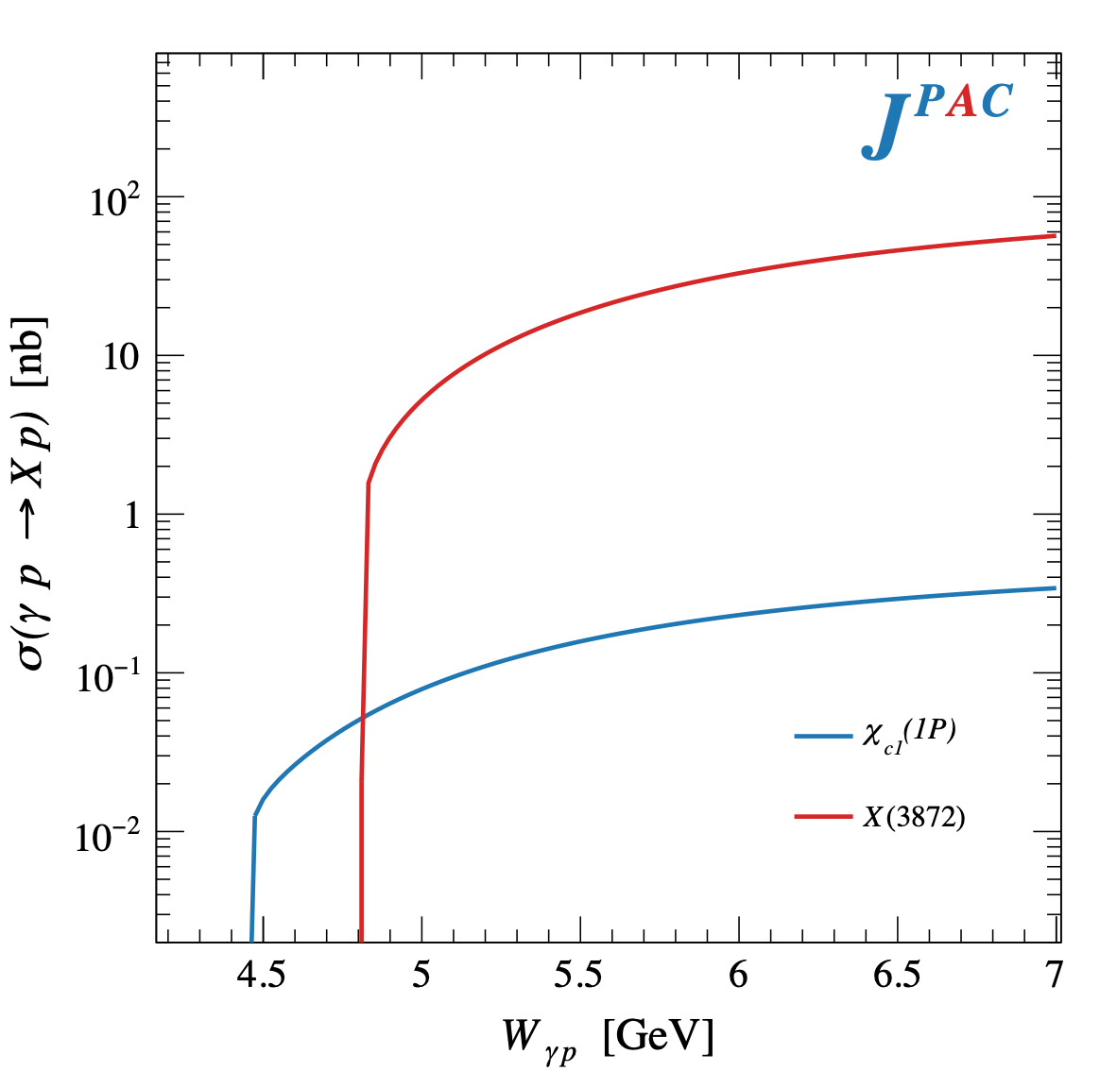
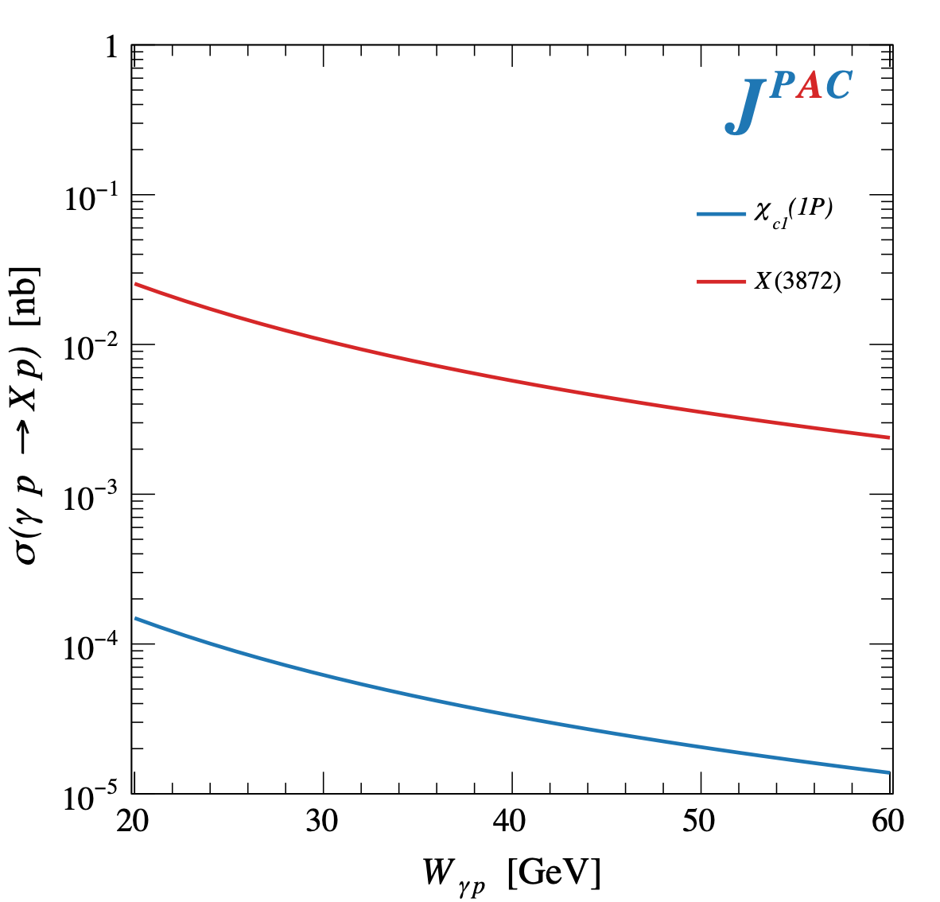
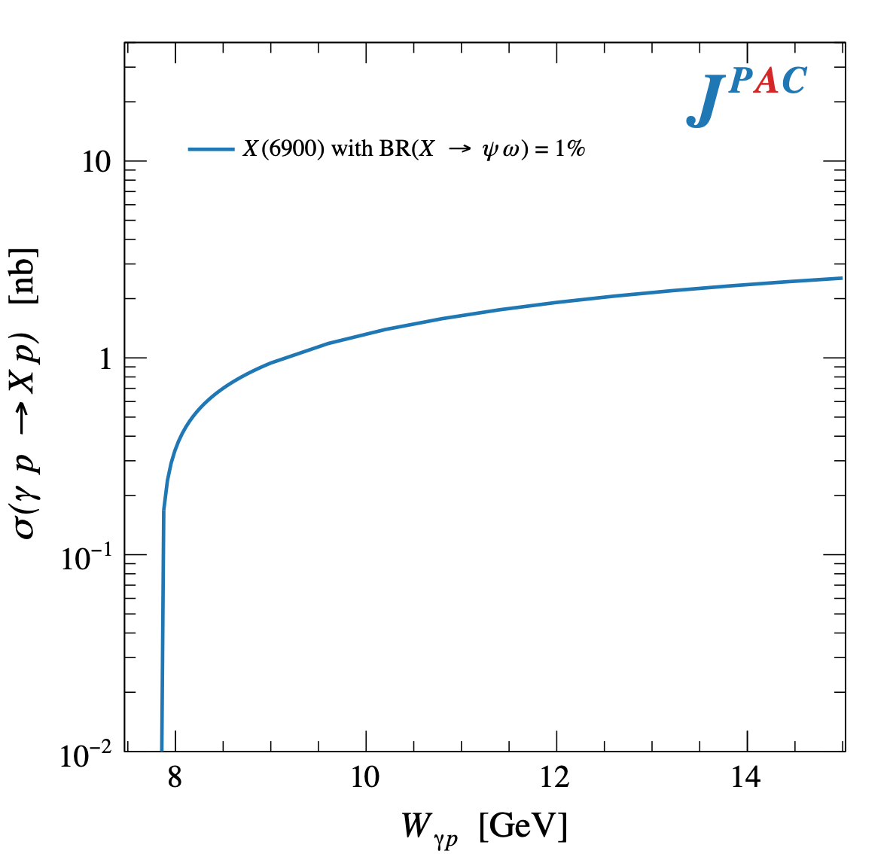
$X$ photoproduction
Focus on the famous $1^{++} X\left(3872\right)→J/ψ ρ,ω$
Studying also $X\left(6900\right)→J/ψ J/ψ$ (assumed $0^{++}$)
𝛚 and 𝛒 exchanges give main contributions: need to assume the existence of a OZI-suppressed $X\left(6900\right)→J/ψ ω$
A. Pilloni – Spectroscopy HE/HL

Slide 13
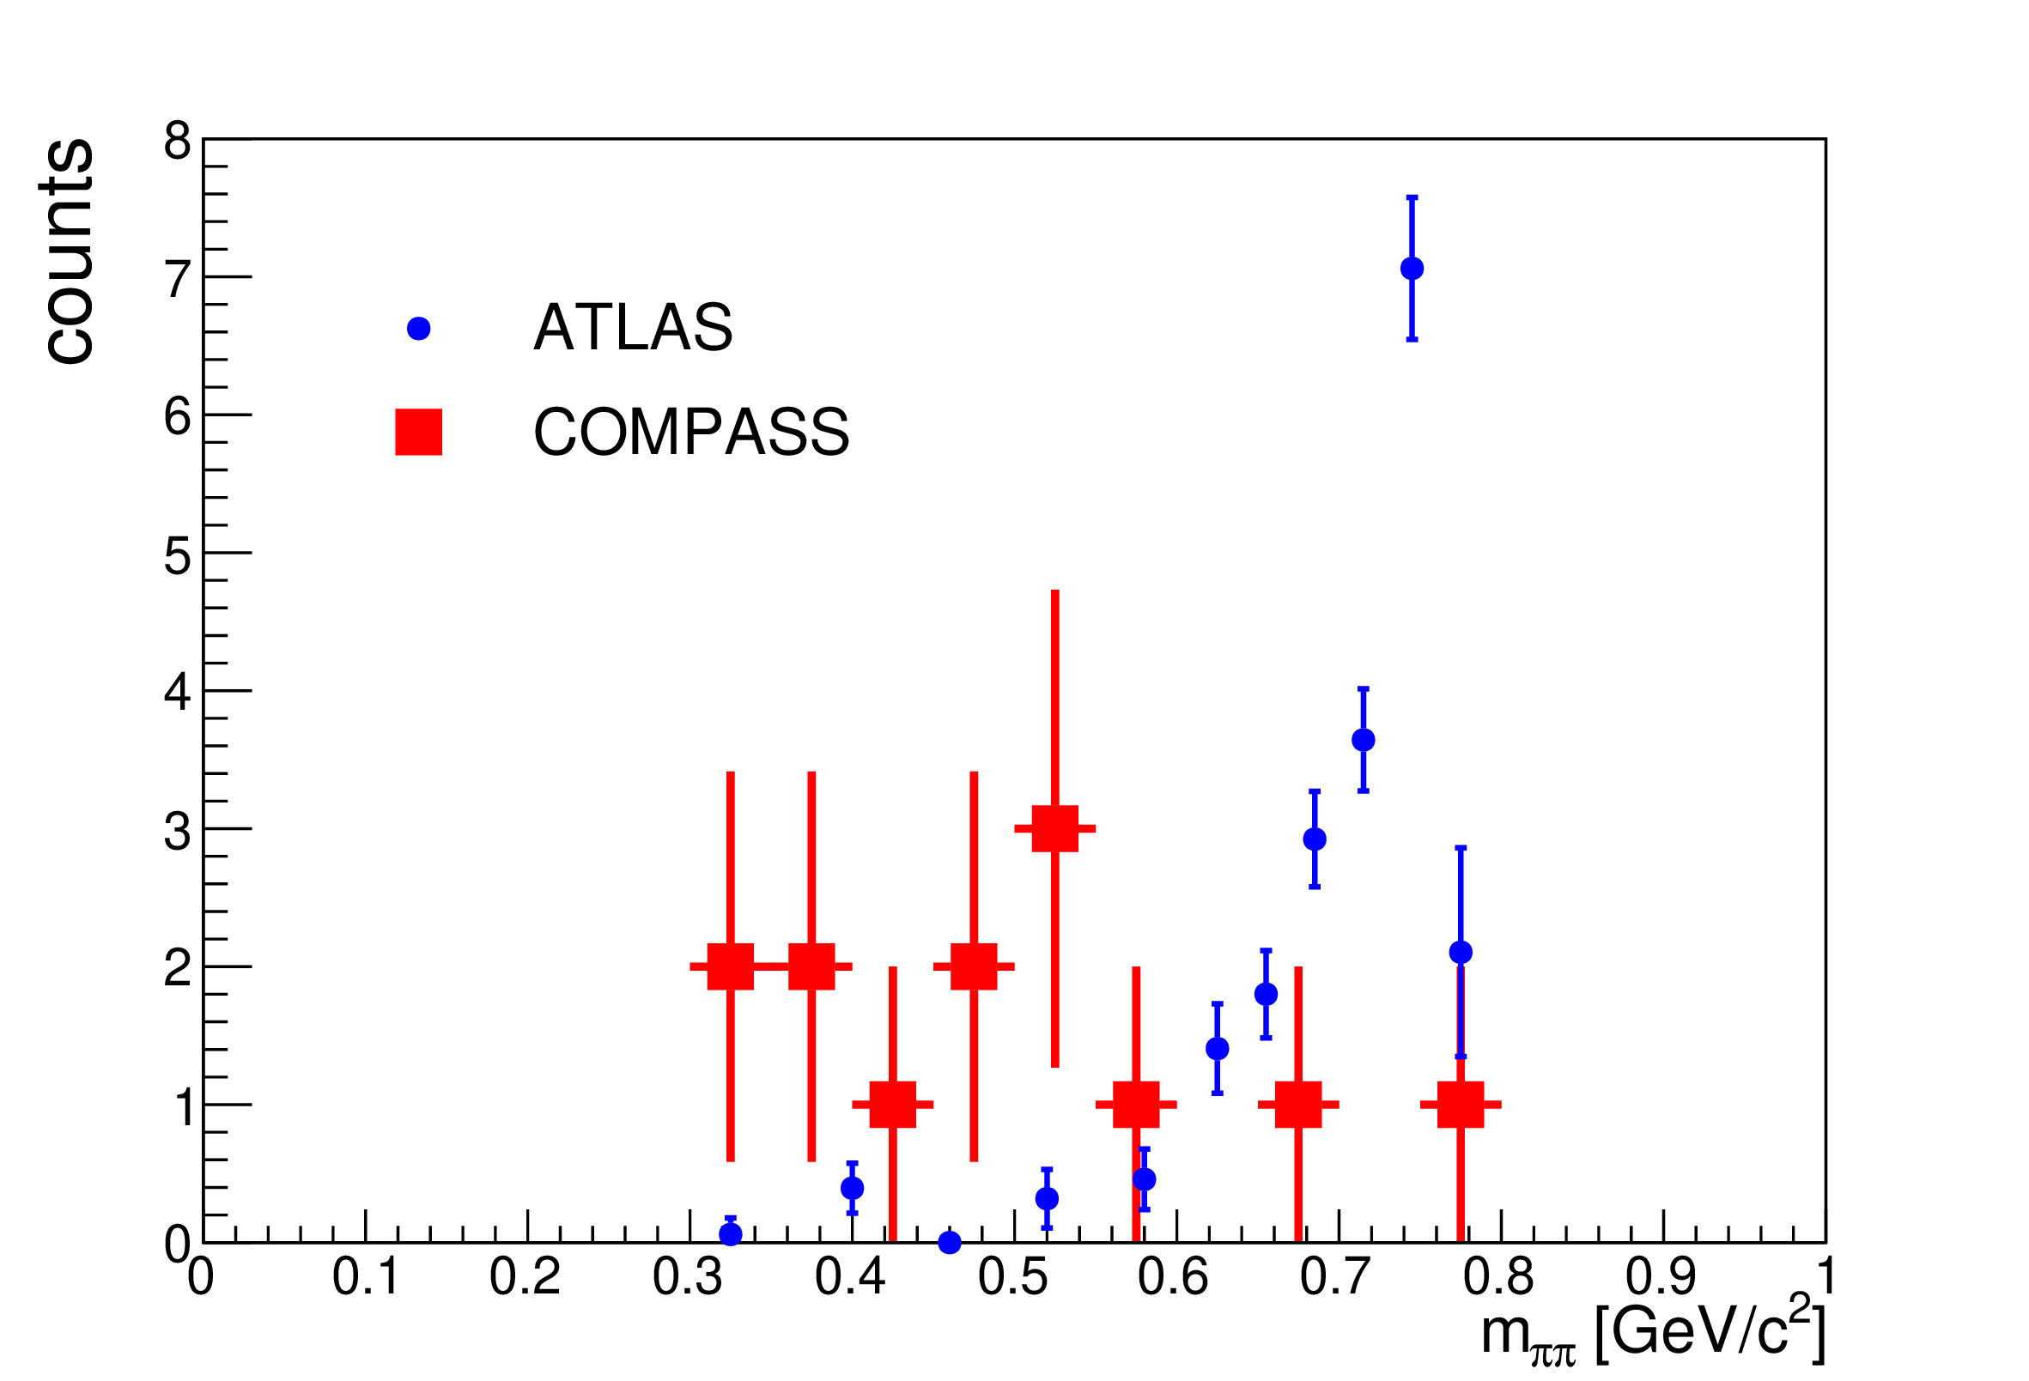
Another $\tilde{X}$?
A. Guskov
COMPASS claimed the existence of a state degenerate with the $X(3872)$, but with $C=1$
Large photoproduction cross section
A. Guskov
A. Pilloni – Spectroscopy HE/HL
Notes:
2 slides su Zc, a Bes e a Belle
2 slide su tetraquark model: dall’hamiltoniana di Jaffe al calcolo delle masse
1 slide su molecular models, dove sono i carichi? (non in Tornqvist, si in Hanhart, vedere Braaten, citare Nefediev)
2 slides su decay channels, dove si dovrebbe vedere, e a seconda del modello, vedere qualche plot
1 slide su Y(4260), tetraquark? C’è lo strano (si vede la f0)
1 slide su Zc a cleo (anche il neutro)

Slide 14
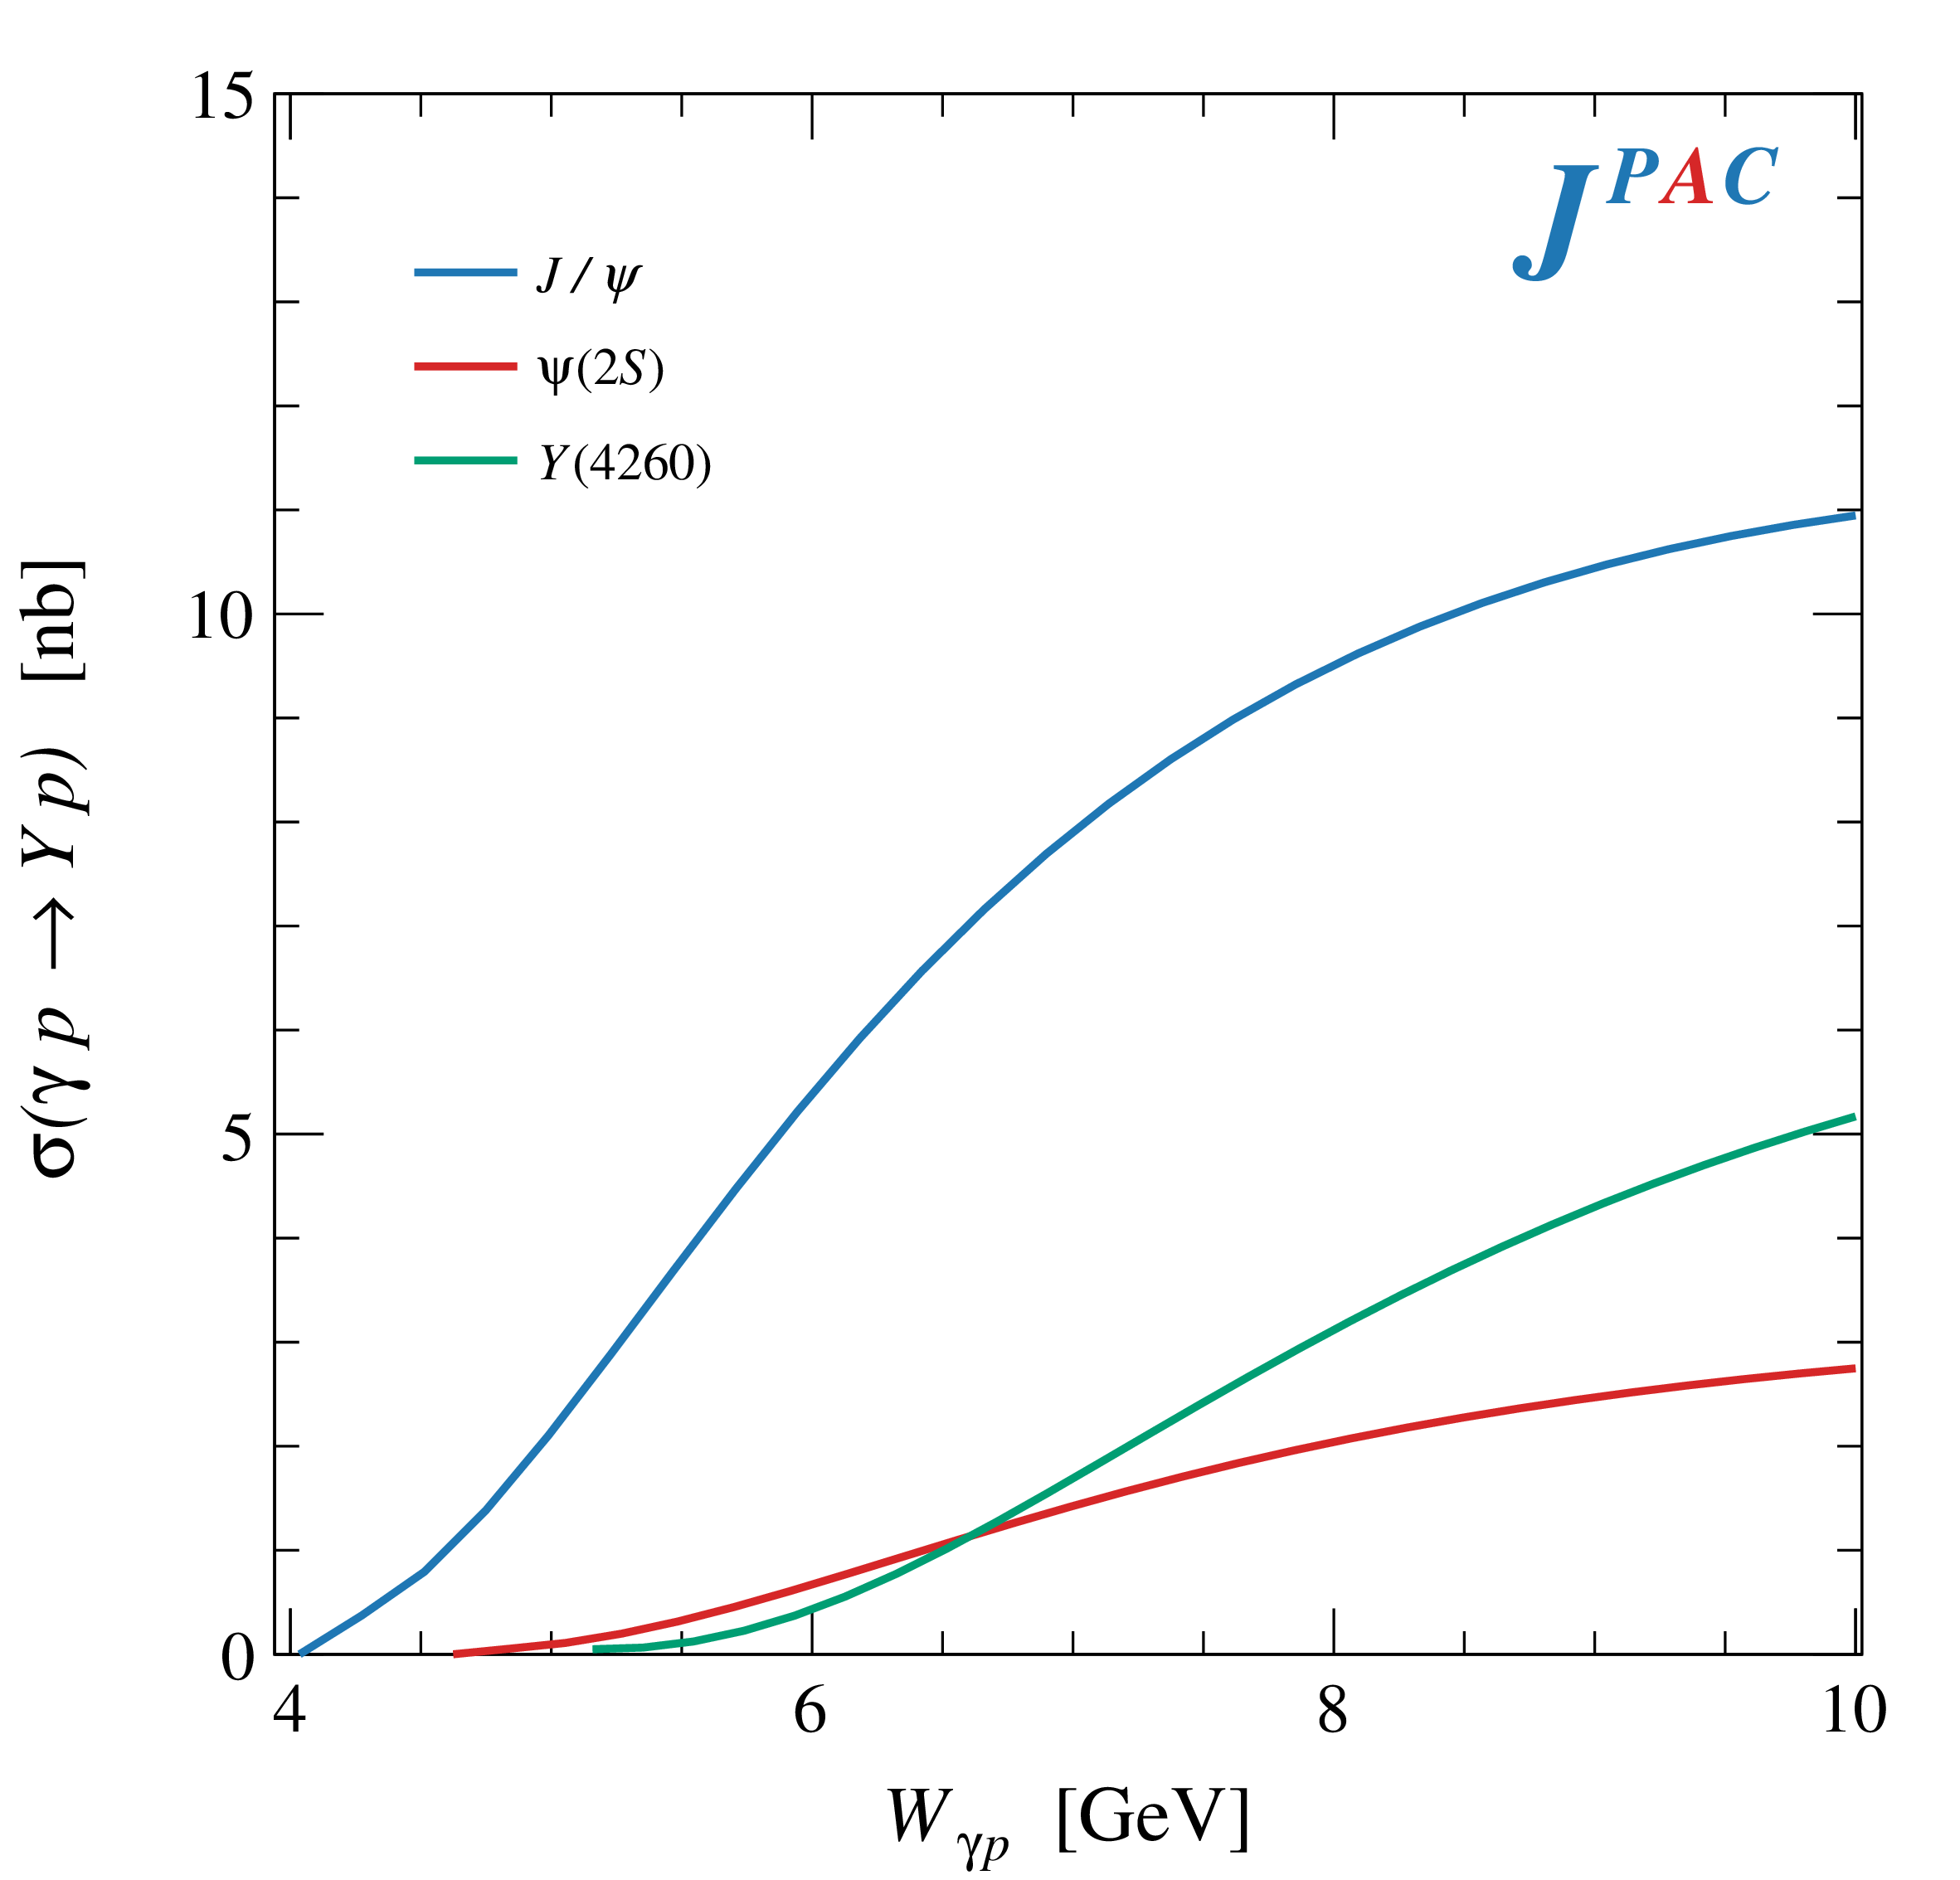
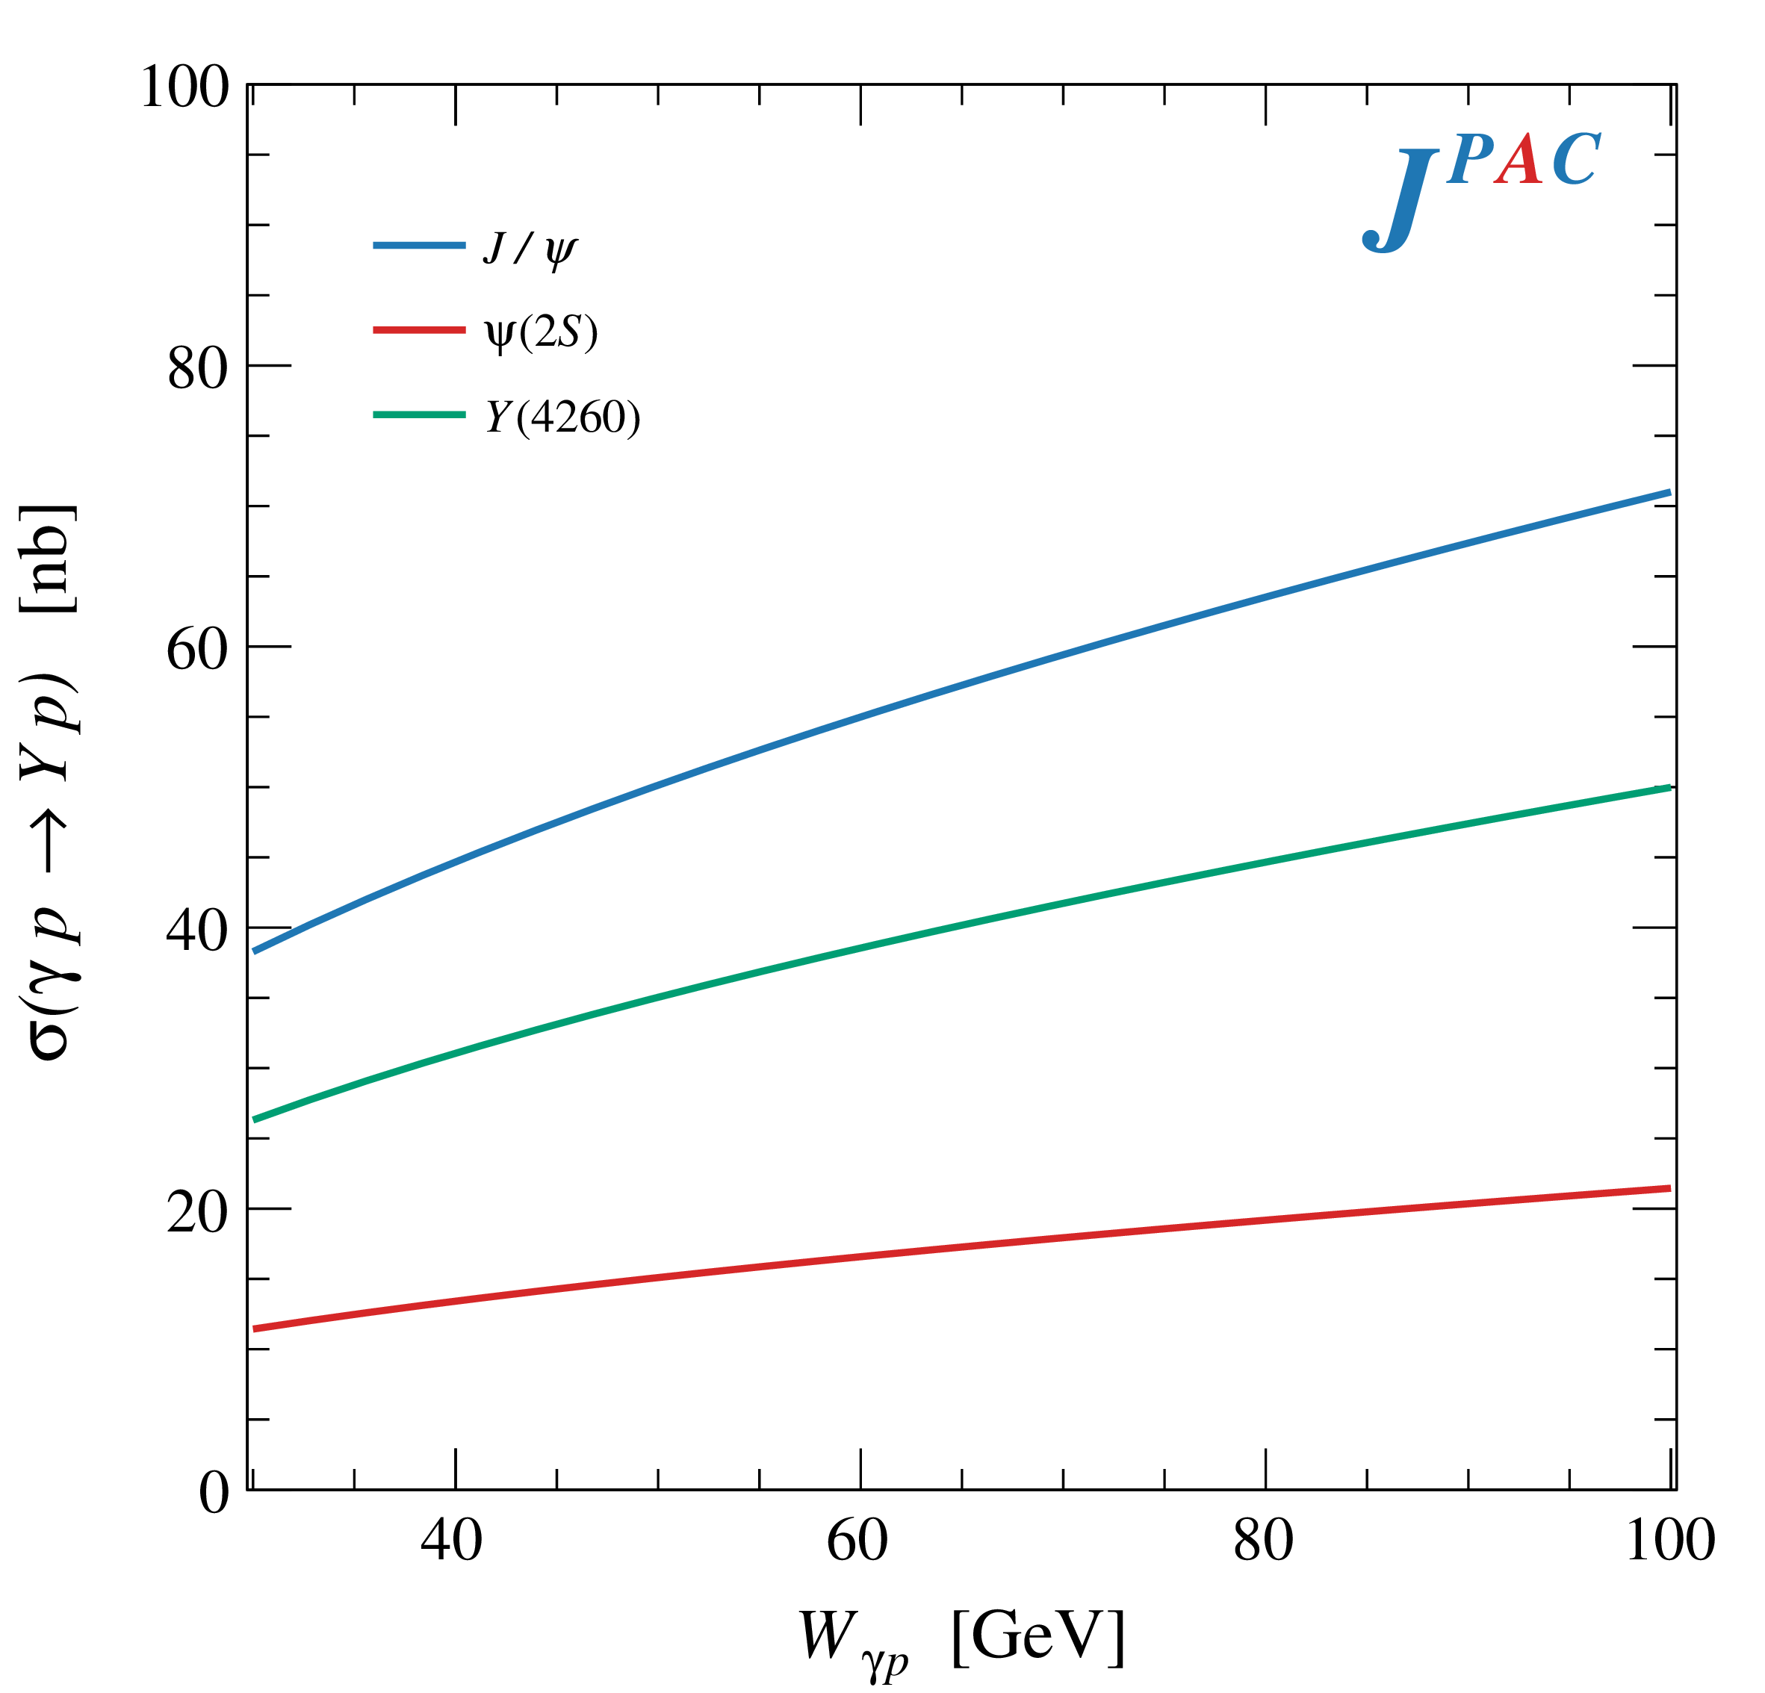
$Y$ (vector) photoproduction
Diffractive production, dominated by Pomeron (2-gluon) exchange
Existing data allow to put a 95% upper limit on the ratio of $ψ′/Y(4260)$ yields
Assuming previous formula, one gets: $Γ_{ee}^{Y}=930 eV$
(cfr. hep-ex/0603024, 2002.05641)
$BR\left(Y→J/ψππ\right)=0.96\%$
$R_{Y}=0.84$
$$R_{Y}=\frac{ef_{ψ}}{m_{ψ}}\sqrt{\frac{g^{2}(Y→ψππ)}{g^{2}(ψ→γgg)}\frac{g^{2}(ψ^{′}→ψgg)}{g^{2}(ψ^{′}→ψππ)}}$$
A. Pilloni – Spectroscopy HE/HL

Slide 15
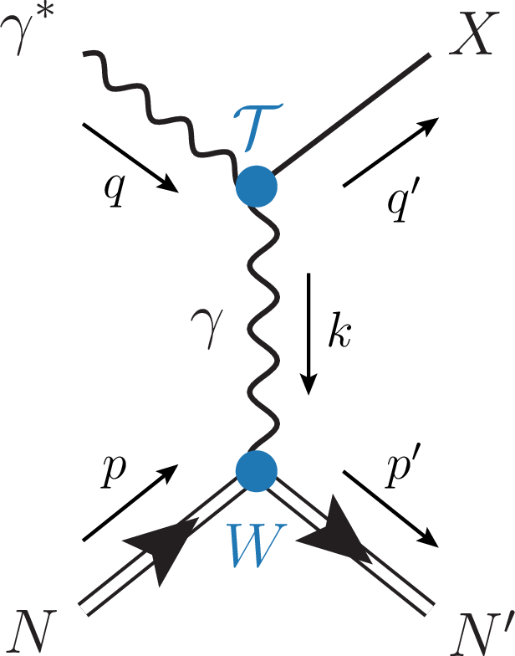
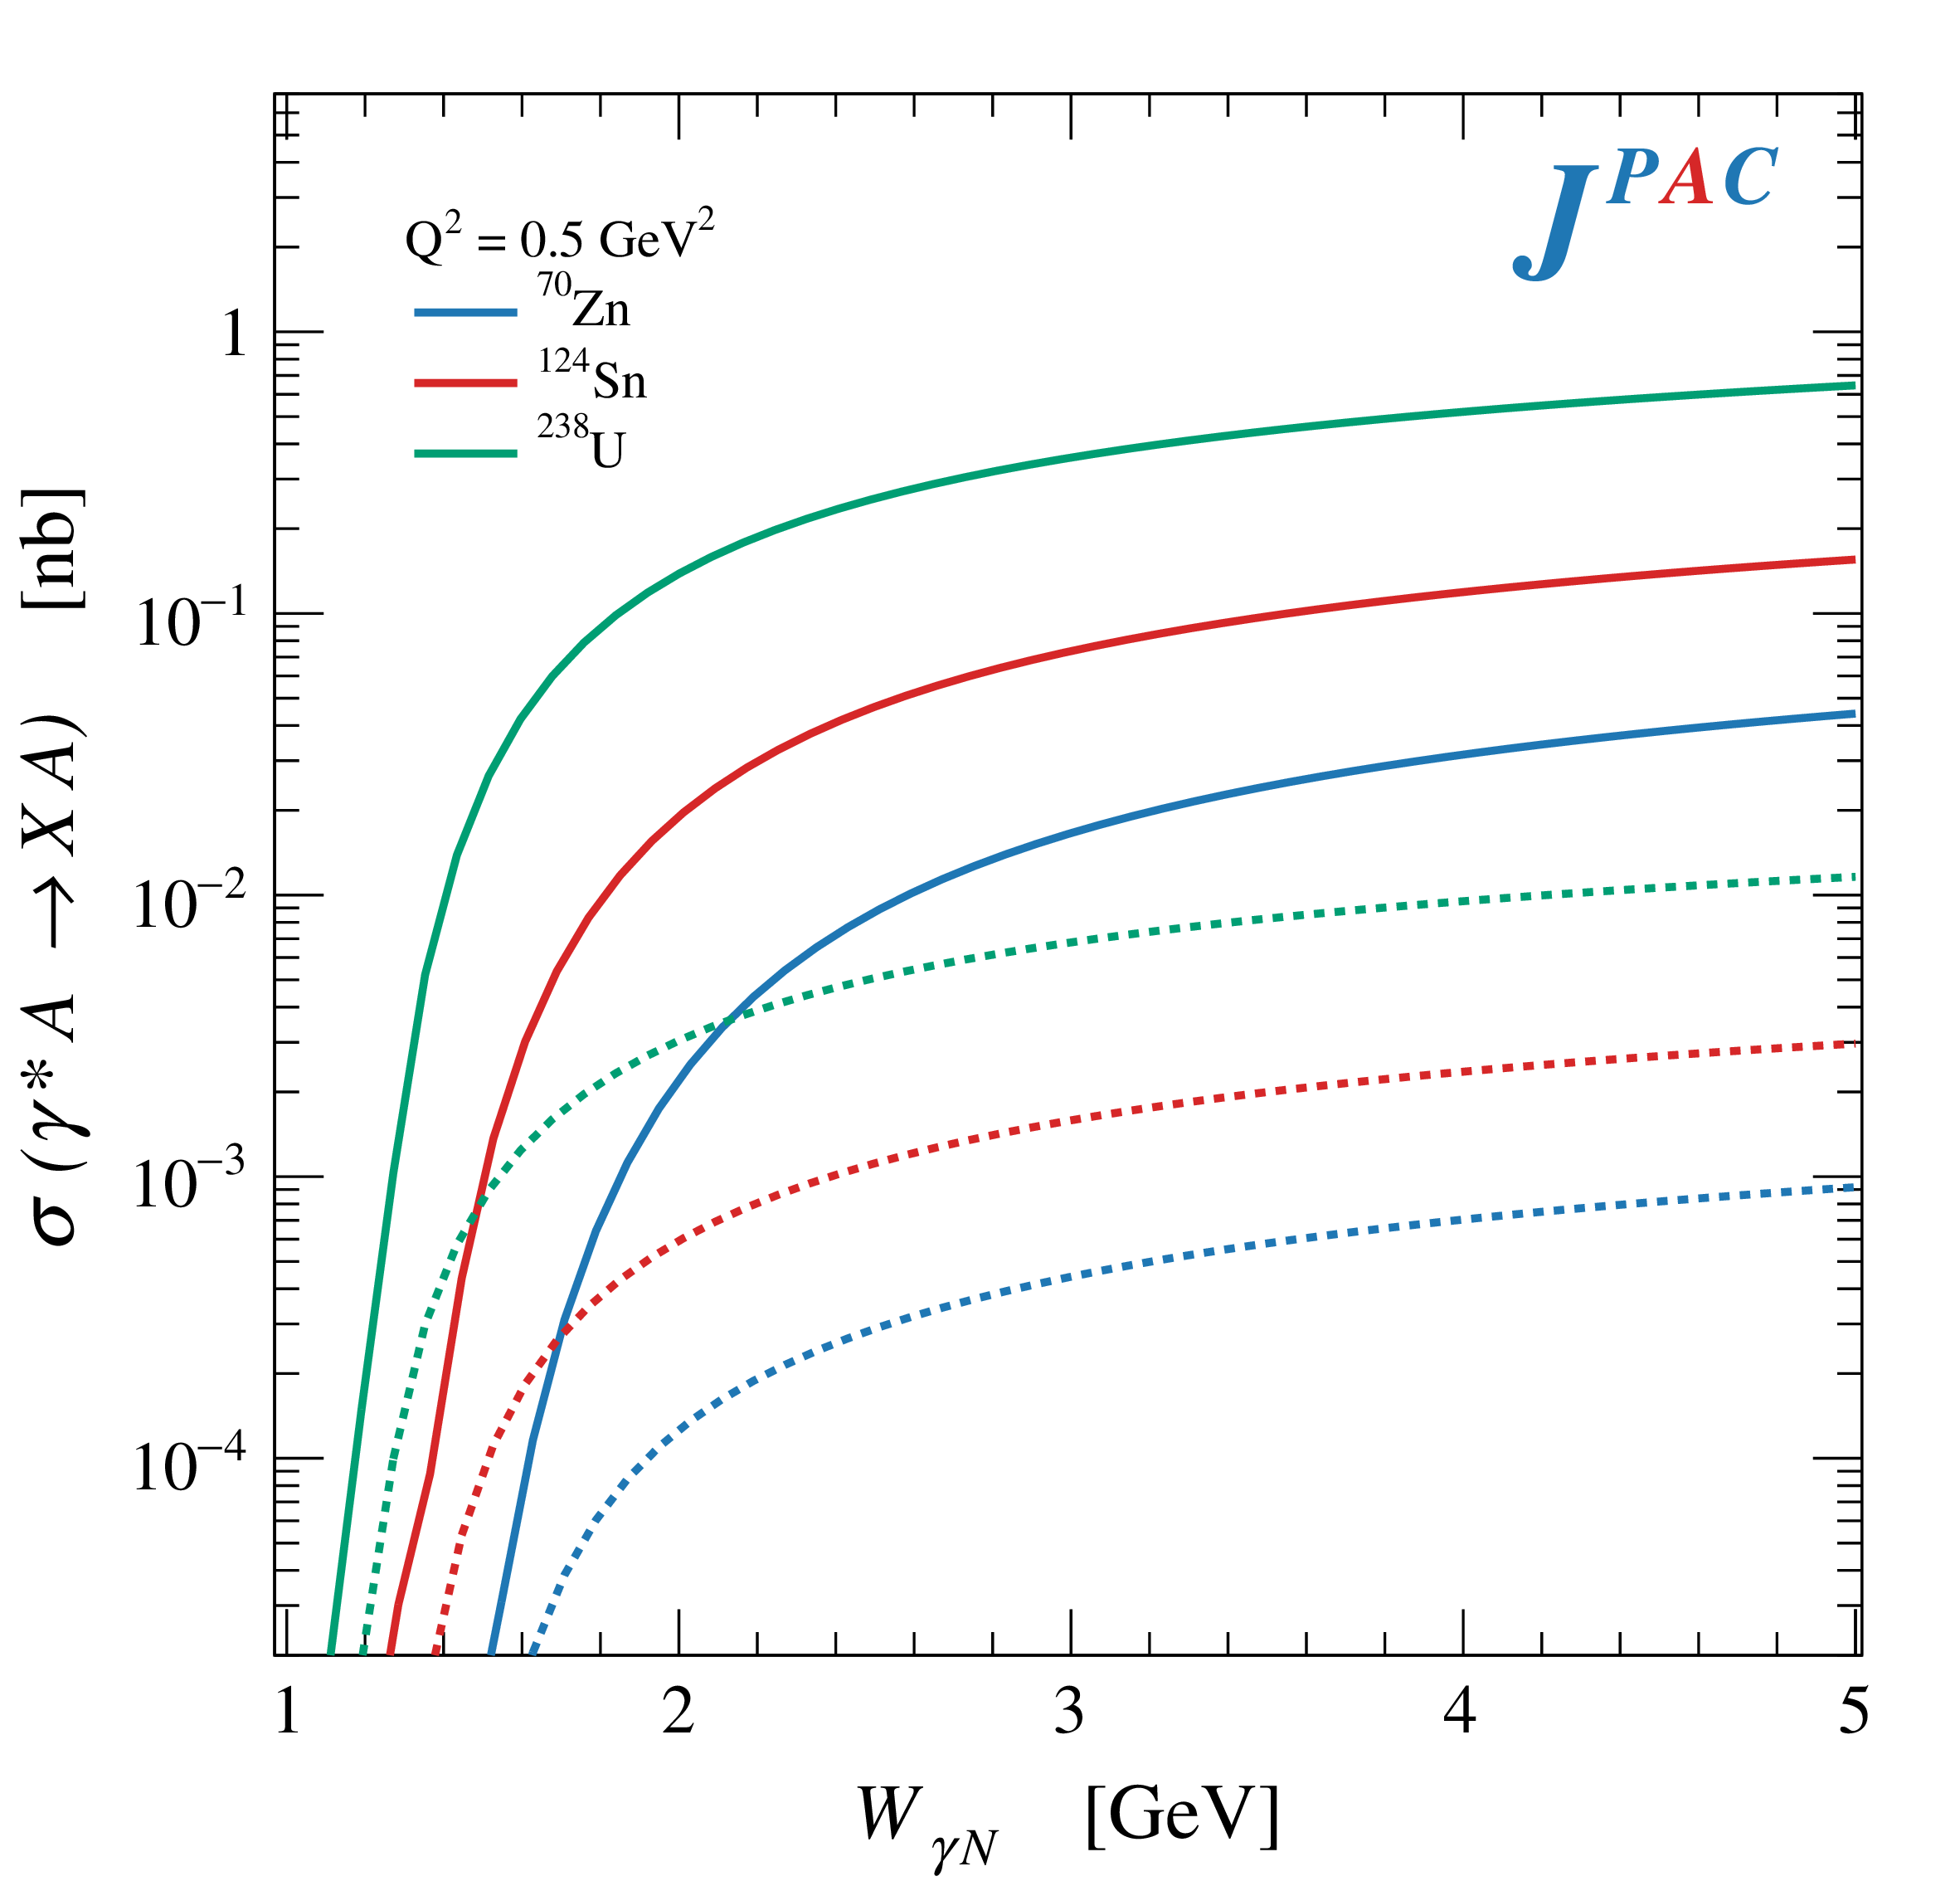
Primakoff X photoproduction
Using measurement of $Γ(X→γγ^{∗})$ from Belle, one can get predictions for Primakoff
Makes use of ion targets, enhancement of cross sections as $Z^{2}$
A. Pilloni – Spectroscopy HE/HL

Slide 16
Diffractive semi-inclusive $Z_{c}$ ph.
$$= \text{Im}$$
$$π$$
$$π$$
$$π$$
If the target fragments are separated from the beam ones, one can invoke Regge factorization
Quark-Regge duality allows to replace the intermediate hadrons with Pomeron , prediction reliable for $x_{B}∼1$, $t≪W_{γp}^{2}$
A. Pilloni – Spectroscopy HE/HL

Slide 17
An example of yield estimate
Example with an ideal SuperCEBAF
$E_{\text{lab}}∼20 \text{GeV}$, photon flux ${10}^{8} γ/\text{s}$
Typical target, $500 {\text{pb}}^{−1} /\text{yr}$
Assuming efficiency $1\%$
A. Pilloni – Spectroscopy HE/HL

Slide 18
Some quick thoughts about high intensity
At current energies, the only heavy exotic accessible are pentaquarks, negative results from JLab pose a conundrum:
Rescattering mechanisms proposed so far are not doing a good job in describing all the peaks
All models point to direct-channel physics: must see in photoproduction! Need estimates of BR that go beyond VMD
Light spectroscopy notoriously requires complicated PWA, high statistics can be a blessing and a curse
Looking for rare channels simpler to reconstruct of interest, ex.: radiative decays of (hybrid) mesons? Requires more theory effort
A. Pilloni – Spectroscopy HE/HL

Slide 19
Conclusions
Photoproduction is a valuable tool to study exotic states
Complementary infomation to other mechanisms
Facilities to study photoproduction at low energies are very welcome to pursue this program
Thank you!
A. Pilloni – Spectroscopy HE/HL
Notes:
2 slides su Zc, a Bes e a Belle
2 slide su tetraquark model: dall’hamiltoniana di Jaffe al calcolo delle masse
1 slide su molecular models, dove sono i carichi? (non in Tornqvist, si in Hanhart, vedere Braaten, citare Nefediev)
2 slides su decay channels, dove si dovrebbe vedere, e a seconda del modello, vedere qualche plot
1 slide su Y(4260), tetraquark? C’è lo strano (si vede la f0)
1 slide su Zc a cleo (anche il neutro)

Slide 20
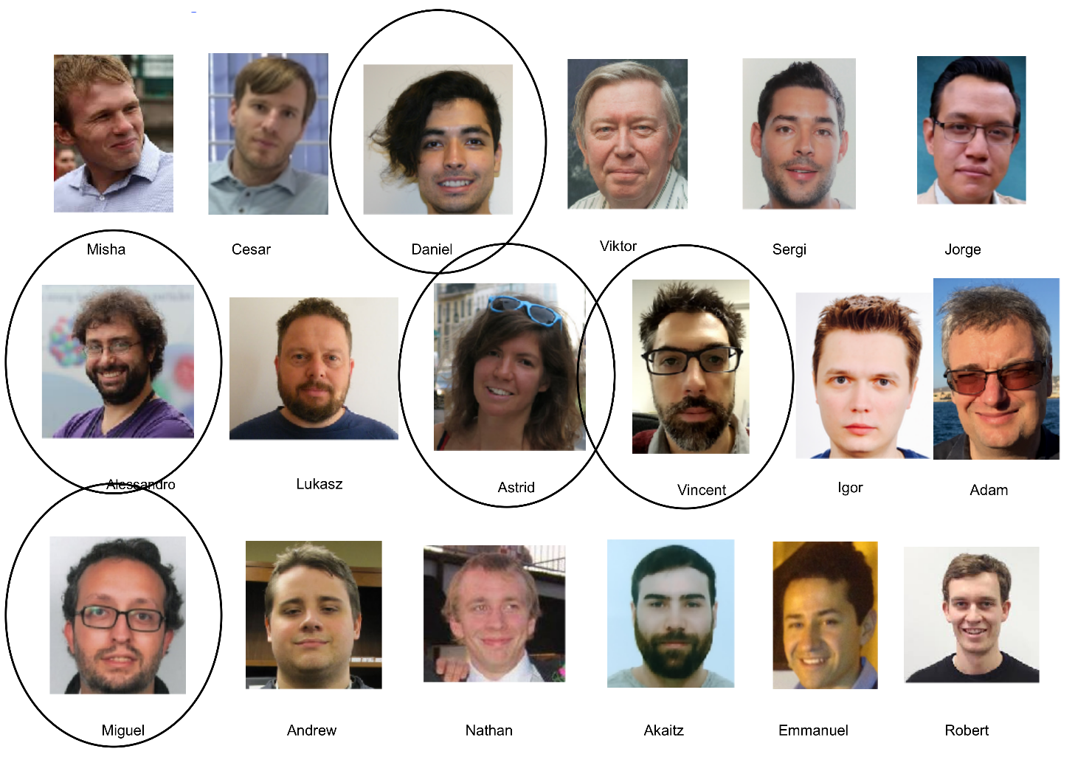
Joint Physics Analysis Center
Exclusive reactions: 2008.01001
Inclusive reactions: in progress
Code available on https://github.com/ dwinney/jpacPhoto
Contact : pillaus@jlab.org
A. Pilloni – Spectroscopy HE/HL

Slide 21
Backup

Slide 22
Another $\tilde{X}$?
A. Guskov
COMPASS claimed the existence of a state degenerate with the $X(3872)$, but with $C=1$
Large photoproduction cross section
A. Guskov
A. Pilloni – Spectroscopy HE/HL
Notes:
2 slides su Zc, a Bes e a Belle
2 slide su tetraquark model: dall’hamiltoniana di Jaffe al calcolo delle masse
1 slide su molecular models, dove sono i carichi? (non in Tornqvist, si in Hanhart, vedere Braaten, citare Nefediev)
2 slides su decay channels, dove si dovrebbe vedere, e a seconda del modello, vedere qualche plot
1 slide su Y(4260), tetraquark? C’è lo strano (si vede la f0)
1 slide su Zc a cleo (anche il neutro)

Slide 23
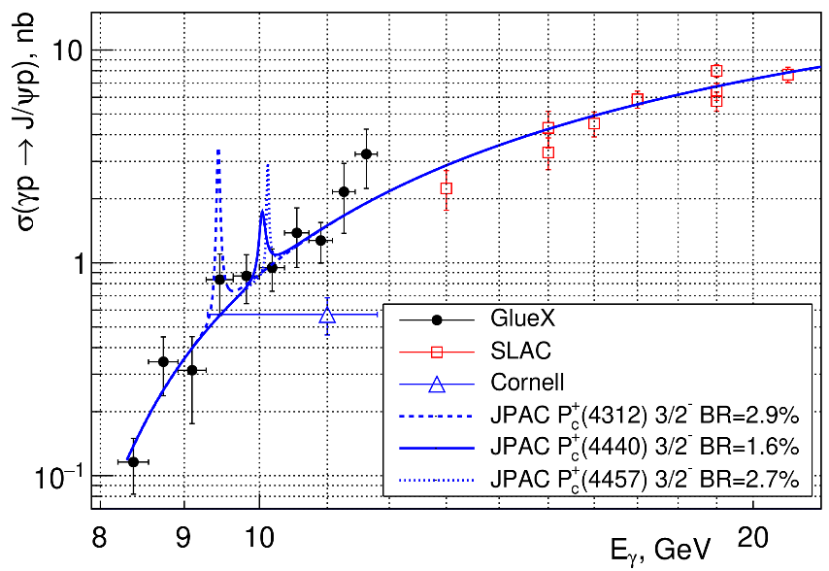
Exclusive $P_{c}$ photoproduction
At Jlab12 measurements of direct $P_{c}$ production are being performed
Using VMD, $BR\left(P_{c}→J/ψ p\right)∼1\%$
A. Pilloni – Spectroscopy HE/HL

Slide 24
Polarized $P_{c}$ photoproduction
$$∼s^{α(u)}$$
s channel resonances significant at low energies: u channel dominates at high energies
Main background from N(*) trajectories
Estimated $P_{c}$ coupling upper bound of same order of magnitude as $N^{(∗)}$ coupling
Reggeization suppresses $P_{c}$ due to larger mass (smaller trajectory intercept)
We estimate that the $P_{c}$ trajectories will hardly be visible at the EIC
$P_{b}$ searches still possible: $s$ channel at higher energies!
Cao et al., Phys.Rev. D 101, 074010 (2020) E. Paryev, arXiv:2007.01172 [nucl-th] (2020)
A. Pilloni – Spectroscopy HE/HL

Slide 25
$Y$ (vector) photoproduction
Focus on the $1^{−−} Y\left(4260\right)→J/ψ π^{+}π^{−}$, check with $ψ′→J/ψ π^{+}π^{−}$
Diffractive production, dominated by Pomeron (2-gluon) exchange
Good candidates for EIC: diffractive production increases with energy!
We have $γψ$-pomeron coupling from our analyses 1606.08912, 1907.09393
How to rescale from $J/ψ$ to $ψ′$ ?
$$R_{ψ^{′}}=\sqrt{\frac{g^{2}(ψ^{′}→γgg)}{g^{2}(ψ→γgg)}}∼0.55$$
$$g^{2}(ψ→γgg)=\frac{6m_{ψ}ℬ(ψ→γgg)Γ_{ψ}}{PS(ψ→γgg)}$$
A. Pilloni – Spectroscopy HE/HL

Slide 26
$Y$ (vector) photoproduction
Focus on the $1^{−−} Y\left(4260\right)→J/ψ π^{+}π^{−}$, check with $ψ′→J/ψ π^{+}π^{−}$
Diffractive production, dominated by Pomeron (2-gluon) exchange
Good candidates for EIC: diffractive production increases with energy!
We have $γψ$-pomeron coupling from our analyses 1606.08912, 1907.09393
How to rescale from $J/ψ$ to $Y(4260)$ ?
We assume VMD and $g^{2}\left(Y→ψππ\right)=g^{2}\left(Y→ψgg\right)×g^{2}(gg→ππ)$ (Novikov & Shifman)
$$R_{Y}=\frac{ef_{ψ}}{m_{ψ}}\sqrt{\frac{g^{2}(Y→ψππ)}{g^{2}(ψ→γgg)}\frac{g^{2}(ψ^{′}→ψgg)}{g^{2}(ψ^{′}→ψππ)}}$$
Caveat : $BR(Y→ψππ)$ only known times the leptonic width $Γ_{ee}^{Y}$
A. Pilloni – Spectroscopy HE/HL

Slide 27
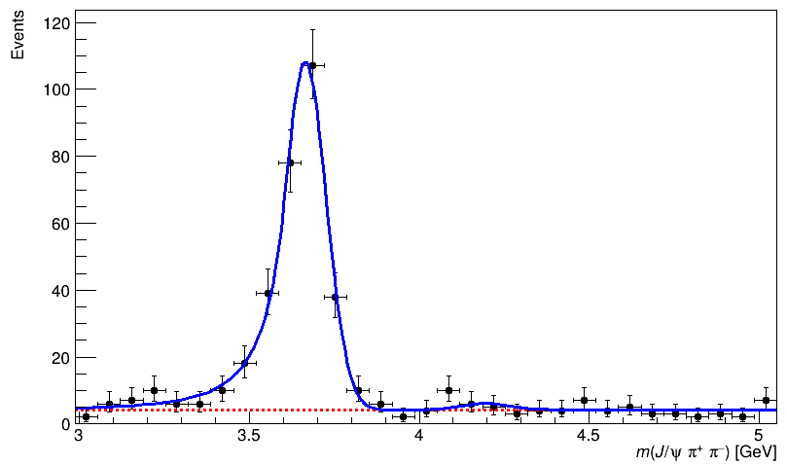
$Y$ (vector) photoproduction
Data from H1 hep-ex/971112
Existing data allow to put a 95% upper limit on the ratio of $ψ′/Y(4260)$ yields
Assuming previous formula, one gets: $Γ_{ee}^{Y}=930 eV$
(cfr. hep-ex/0603024, 2002.05641)
$BR\left(Y→J/ψππ\right)=0.96\%$
$R_{Y}=0.84$
A. Pilloni – Spectroscopy HE/HL

Slide 28
Primakoff X photoproduction
Using measurement of $Γ(X→γγ^{∗})$ from Belle, one can get predictions for Primakoff
Makes use of the ion beam, enhancement of cross sections as $Z^{2}$
A. Pilloni – Spectroscopy HE/HL

Slide 29
Diffractive semi-inclusive $Z_{c}$ ph.
$$= \text{Im}$$
$$π$$
$$π$$
$$π$$
If the target fragments are separated from the beam ones, one can invoke Regge factorization
Quark-Regge duality allows to replace the intermediate hadrons with Pomeron , prediction reliable for $x_{B}∼1$, $t≪W_{γp}^{2}$
A. Pilloni – Spectroscopy HE/HL

Slide 30
Semi-inclusive $X$ production
X. Yao
For large $Q^{2}$ one can invoke NRQCD factorization to describe quarkonium(-like) production
Perturbative partonic matrix element, calculable
Nonperturbative transition matrix element $Q\overline{Q}→H$ fitted from data
A. Pilloni – Spectroscopy HE/HL

Slide 31
Semi-inclusive $X$ production
One can assume the same NRQCD factorization for exotics, independent of their internal structure
Artoisenet and Braaten, PRD81, 114018 from Tevatron data
If one consider the first term only, it leads to
X. Yao
A. Pilloni – Spectroscopy HE/HL

