Slide 1
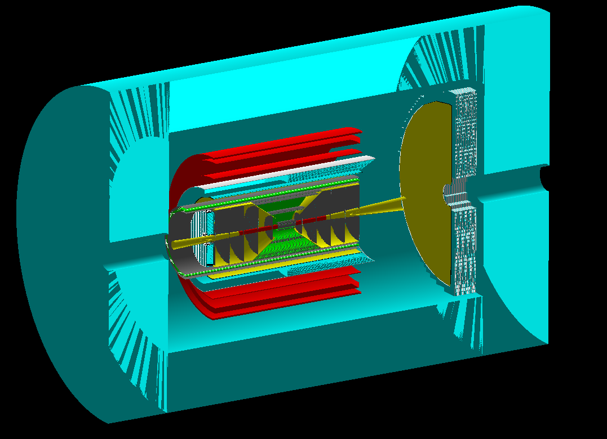
CORE: a COmpact detectoR for the EIC
- a Detector 2 (IP8) proposal
Charles Hyde
Old Dominion University
Pawel Nadel-Turonski
Stony Brook University
and the CORE pre-collaboration
(open to all users)
RIKEN Seminar, 02 June 2021

Slide 2
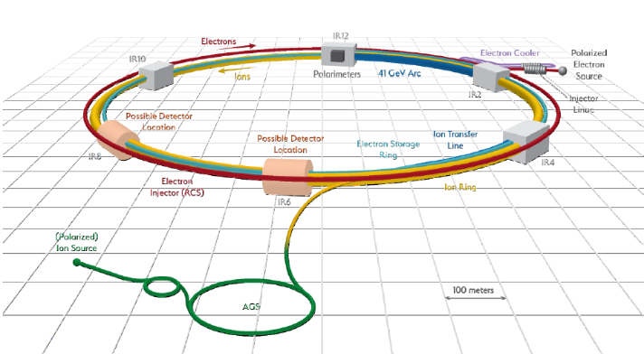
EIC Machine Parameters
DOE Total Project Cost
$2,249M
Includes
1 Interaction Region,
1 Detector
“6:00 O’Clock” position
Requires
~$70M “In-kind” contribution to detector
Second IR + Detector 100% “off-project”
“8:00 O’Clock” position
Double Ring Design Based on Existing RHIC Facilities
Hadron Storage Ring: 40 - 275 GeV |  | Electron Storage Ring: 2.5 - 18 GeV
RHIC Yellow Ring and Injector Complex |  | Many Bunches, Large Beam Current - 2.5 A
Many Bunches, 1160 @ 1A Beam Current |  | 9 MW Synchrotron Radiation
Bright Beam Emittance ε_{xp}= 9 nm |  | Superconducting RF Cavities , 10MW Power
Flat Beam, Requires Strong Cooling
High Luminosity Interaction Region(s) |  | Electron Rapid Cycling Synchrotron
25 mrad Crossing Angle with Crab Cavities |  | Spin Transparent Due to High Periodicity

Slide 3
Call for Detector Collaboration Proposals www.bnl.gov/eic/CFC.php
Proposals due 1 Dec 2021
The Proposals should include two parts:
A description of the science addressed and performance estimated through simulation including, but not limited to, e/γ, jets, π/K/p separation, vertex, and tracking, and how the simulated performance compares to the requirements detailed in the YR. The realization of the conceptual detector design given the technology choices, the R&D needs, risks, and, if applicable, adoption of emerging new technologies. ( < 40 pages)
A collaboration roster and structure, timescale and cost (including potential sources of funding sources and assumptions), and potential upgrade paths. (<20 Pages)

Slide 4
Three Detector “proto-Collaborations”
ATHENA: https://sites.temple.edu/eicatip6/
ECCE: https://www.jlab.org/ecce-eic-collider-experiment-consortium-remote
CORE: https://indico.jlab.org/event/444/
  Wiki page to be released soon: https://eic.jlab.org/core/index.php/Main_Page
  Mailing lists:
    eic-core@jlab.org
    eic-core-det@jlab.org
    eic-core-phys@jlab.org
  Everyone welcome (theorists too)!

Slide 5
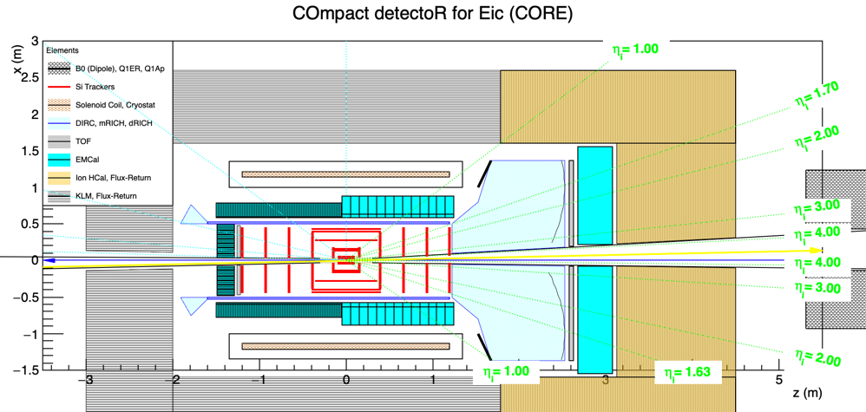
a COmpact detectoR for the Eic (CORE)
CORE in Geant (fun4all)
B. Schmookler
Hermetic general-purpose detector that fulfills the EIC physics requirements
Compact size reduces cost while allowing investment in critical components
Small central core leaves plenty of space within the flux return for support and services

Slide 6
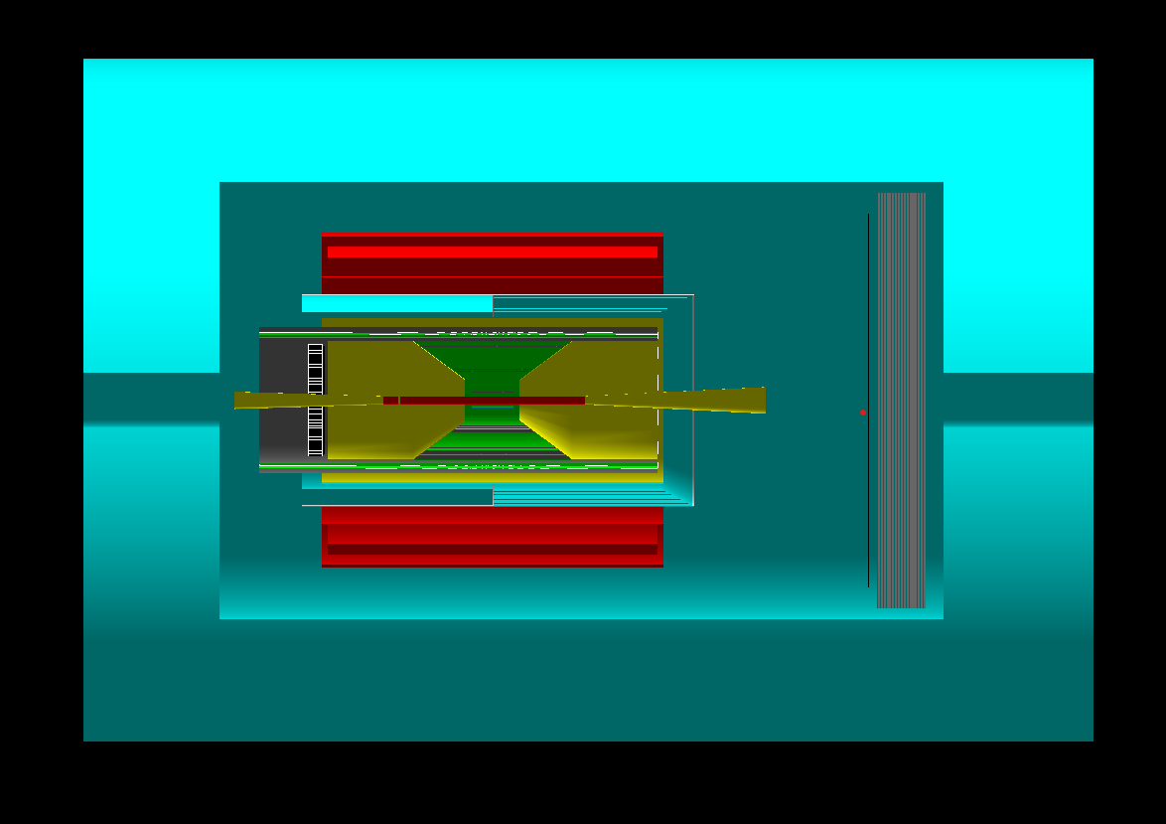
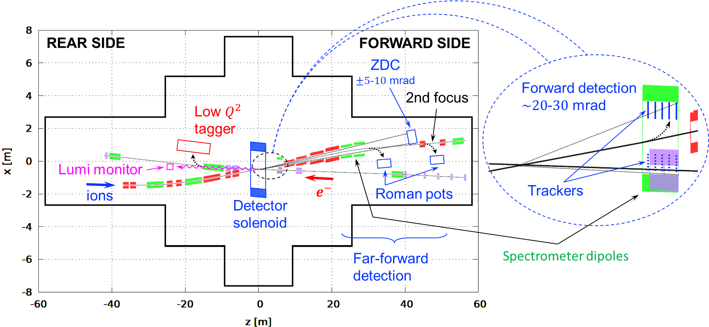
CORE will be submitted as a Detector 2 (IP8) proposal
B. Schmookler
IP8, schematic, preliminary
Although CORE would also fit IP6 (Detector 1), the proposal will be submitted as a Detector 2 proposal for IP8 to take full advantage of the forward spectrometer.
  The exceptional acceptance in rigidity (P’_{A} /Z’) is particularly important for nuclei but also impacts protons
  The interplay between CORE and the forward spectrometer will be part of the proposal
CORE fits into a -3.5 m to +4.5 m IR space.
  Simplifies IR integration and can offer a higher luminosity

Slide 7
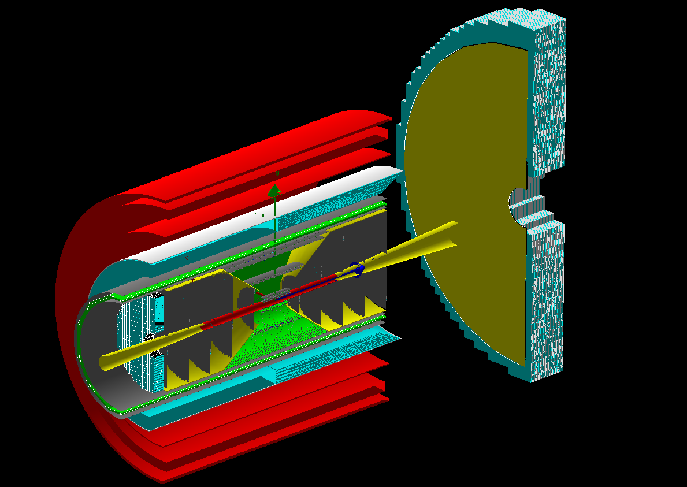
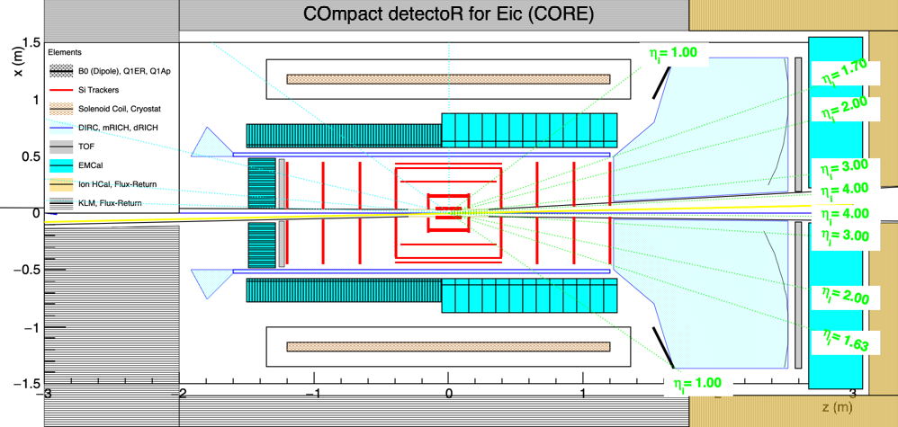
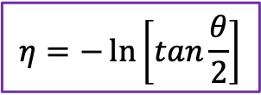
The core of CORE:
There is no compelling requirement for a large magnet
inner CORE in Geant (fun4all)
dRICH photosensors
B. Schmookler
Small solenoid (2.5 m long, 1.0 m inner radius)
Small central all-Si tracker (eRD25)
Radially compact, high-performance barrel DIRC Cherenkov (eRD14)
Dual-radiator RICH with outward-reflecting mirrors in the hadron endcap (eRD14)
Extended PWO₄ EMcal coverage (up to 2π, η < 0) on the electron side (eRD1)
TOF Si-LGAD electron-endcap (eRD29)
$$η=−\ln\left[tan\frac{θ}{2}\right]$$

Slide 8
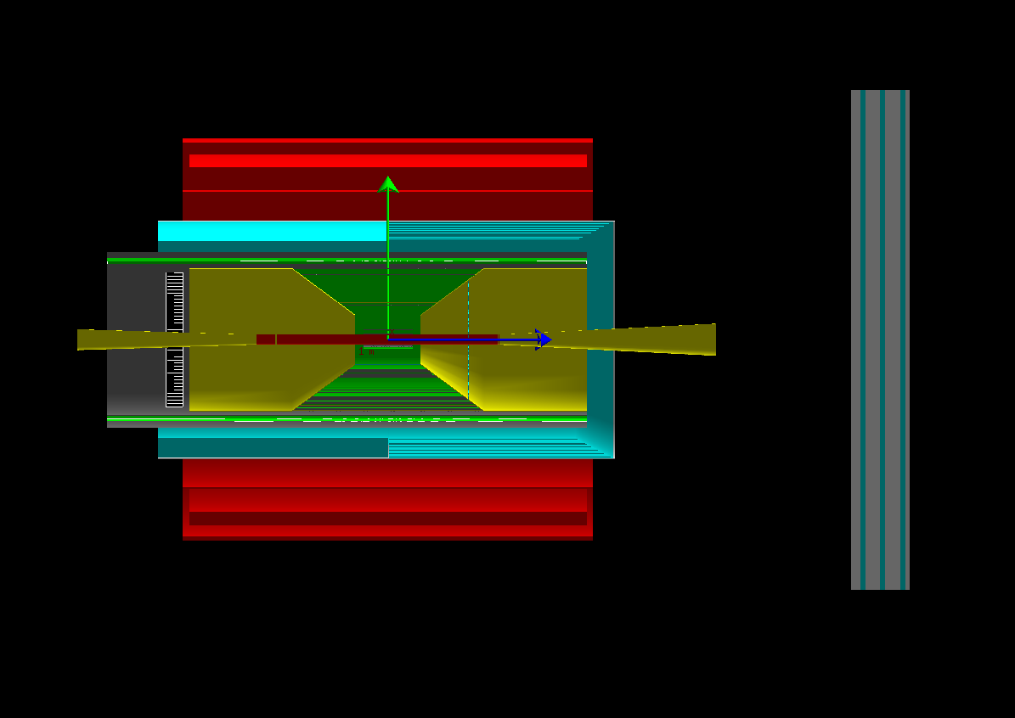
CORE solenoid
The CORE solenoid is 2.5 m long with a 1 m inner radius
CORE is compatible with any field in the 2 - 4 T range
2.5 T is the current baseline option
B. Schmookler
cost (2020 M$) = 1.8 x 0.458 x (stored energy)^{0.7}
M. A. Green and S. J. St. Lorant, Adv. Cryo. Eng. 39
A 1 m radius leaves 50 cm between the DIRC and solenoid
solenoid | field (T) | volume (m³) | 2020 cost (M$)
ATHENA | 3 | 29 | 21
CORE | 3 | 8 | 9
CORE | 2.5 | 8 | 7
CORE | 2 | 8 | 5
First round of TOSCA studies showed excellent [approximately projective] B-field in the dual-radiator RICH and [~⊥] at the DIRC photosensors for a 2 T on-axis field.,
A design and field map for the 2.5 T baseline option will be available soon.

Slide 9
Central Si-tracker and h-endcap GEM
A silicon tracker is compact, has a high resolution, and offers opportunities for future upgrades.
The tracker developed by eRD25 will utilize ALICE ITS3 technology. The flexible ITS3 geometry in the vertex layers would allow to take full advantage of an elliptic beam pipe if this could be incorporated into IP8.
  Fully digital “monolithic” technology
B. Schmookler
GEM layer (eRD6)
eRD25 Si-tracker
In addition to the h-endcap GEM, MPGDs could also be used for post-DIRC tracking (if needed)
 | ITS2/ALPIDE | ITS3
technology | 180 nm | 65 nm
pixel-size | 27 x 29 μm | 10 x 10 μm
thickness | 50 μm | 20-40 μm

Slide 10
4𝜋 EMcal
The PANDA PWO₄ EMcal covers both endcaps and barrel (outside of a DIRC)
PWO $\frac{σ(E)}{E}\sim (2\%)\sqrt{\frac{1 GeV}{E}}$ for electron hemisphere: (up to 2π, η < 0 coverage)
A PWO barrel Emcal:
e/𝜋/𝛾 ID
Track reconstruction.
P⊥ resolution for
ep→ ep𝛾
ep→ ep𝜋⁰
Both the endcap and barrel would be projective (cf. PANDA)
The small-angle EMcal behind the main detector could be SciGlass.
W-Shashlyk $\frac{σ(E)}{E}\sim (6\%)\sqrt{\frac{1 GeV}{E}}$ for hadron hemisphere: (η > 0 coverage)
Projective modules in the barrel
Non-projective modules in the endcap

Slide 11
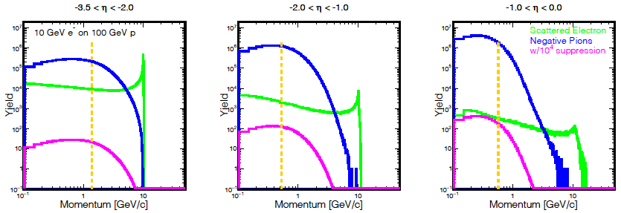
e/𝜋 identification in the electron hemisphere
η = -ln(tan(θ/2))
B. Schmookler
Q² > 1 &
y < 0.95
to the right of orange line
For the EIC, a clean identification of the scattered electron is essential.
The barrel region poses the greatest challenge and requires the best electron ID.\
CORE addresses this issue by extending the PWO EMcal coverage up to η < 0 (or possibly -0.5)
Additional e/π suppression (at least 1:10 up to 1.2 GeV) is also provided by the DIRC.

Slide 12
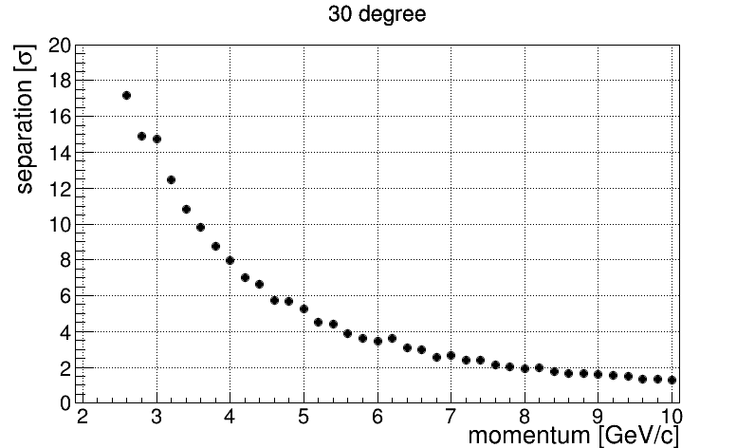
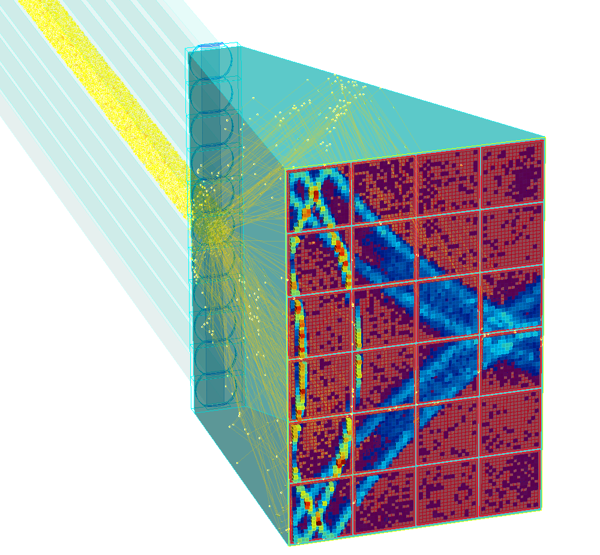
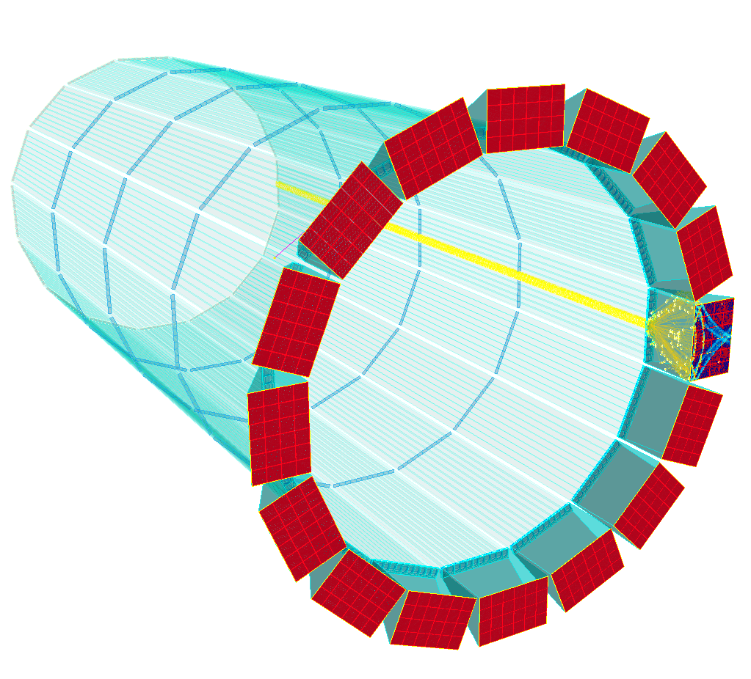
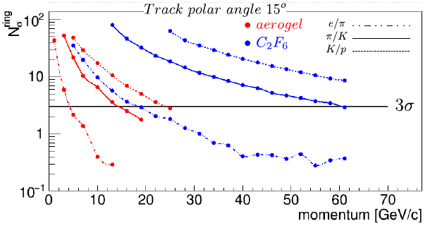
Hadron Identification in the barrel (hpDIRC) and hadron endcap (dRICH)
The hpDIRC has a π/K separation of >4σ up to 6 GeV (and 2σ at 8 GeV).
The minimum momentum for π/K ID in threshold mode is 0.2 GeV\
Central Detector
Using aerogel and gas radiators with a single set of photosensors the dRICH provides continuous π/K separation of >3σ up to 60 GeV and an excellent e/π separation
  e/π: 10σ at 10 GeV

Slide 13
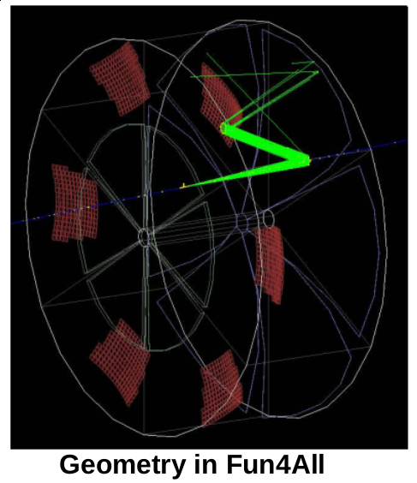
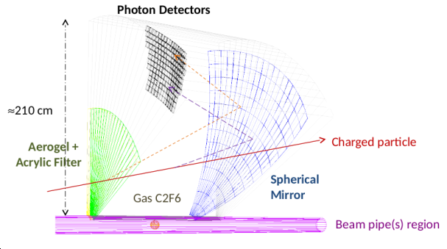
The dual-RICH in Fun4All
Christopher Dilks, Duke U.

Slide 14
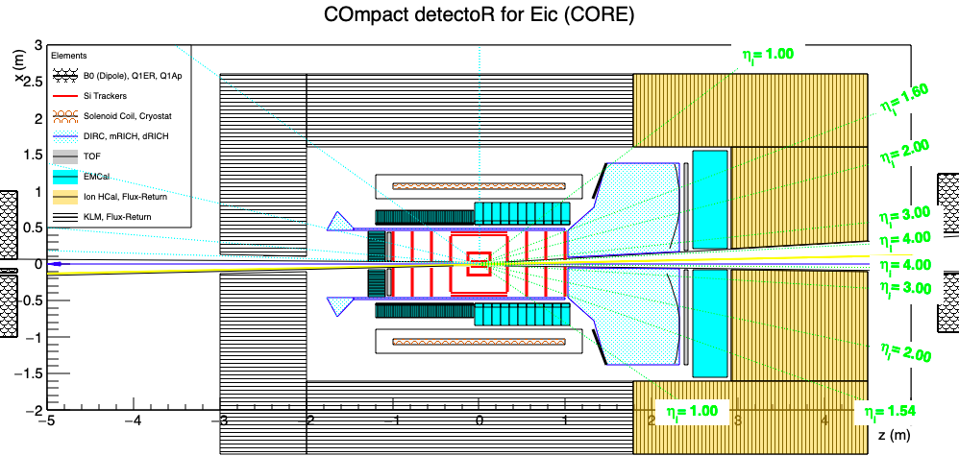
Muon ID
The Belle II K_{L}-μ (KLM) system
At the EIC, mid-rapidity muons have relatively low momenta. The Belle KLM (K_{L}-μ) detector, which is integrated with the flux return, can ID muons down to 0.6 GeV.
Since EIC mid-rapidity jets are best reconstructed from individual tracks, the KLM focus on measuring the neutral hadron angle rather than energy also fits the EIC needs well.
In the hadron endcap, both jet and muon energies are large. Here, a high-resolution Hcal (yellow) is important, but a muon tracker can be placed behind it.

Slide 15
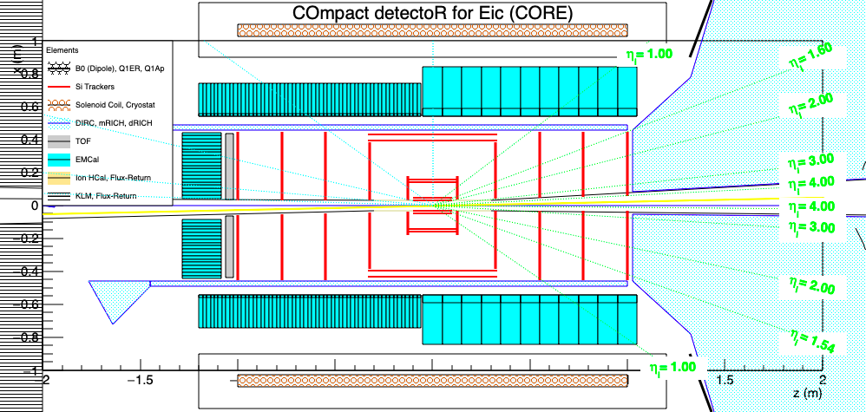
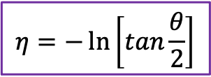
inner CORE in Geant (fun4all)
The core of CORE
B. Schmookler
dRICH photosensors
New 2.5 T solenoid (2.5 m long, 1 m inner radius)
Tracking: central all-Si tracker (eRD25) and h-endcap GEM tracker (eRD6)
EMcal (eRD1): PWO for η < 0 and W-Shashlyk for η > 0
Cherenkov PID (eRD14): DIRC (50 cm radius) in barrel and dual-radiator RICH with outward-reflecting mirrors at a moderate angle (minimizing aberrations) in h-endcap
TOF: LGADs in e-endcap (eRD29) and a simple TOF behind the dRICH
Forward HCal [1.5<𝜂<4] and K_{L} / muon [–4< 𝜂<1.5] detectors integrated with flux return
$$η=−\ln\left[tan\frac{θ}{2}\right]$$

Slide 16
Forward Detectors: The B0 Dipole
Acceptance relative to ion beam line:
  5.5 mrad < 𝜃 < 13.5-20 mrad
  6 > 𝜂 > 4

Slide 17
Far-Forward Detectors
IP8
“Off-Momentum”
𝜃<4.5 mr,
  Rigidity K = P/Z
  |K–K₀|/K₀< 0.5
“Roman-Pot” Trackers
  IP8, secondary focus at ~45 m
  |K–K₀|/K₀ > 0.005
Zero Degree Calorimeter
(ZDC)
IP6

Slide 18
Thank you!

Slide 19
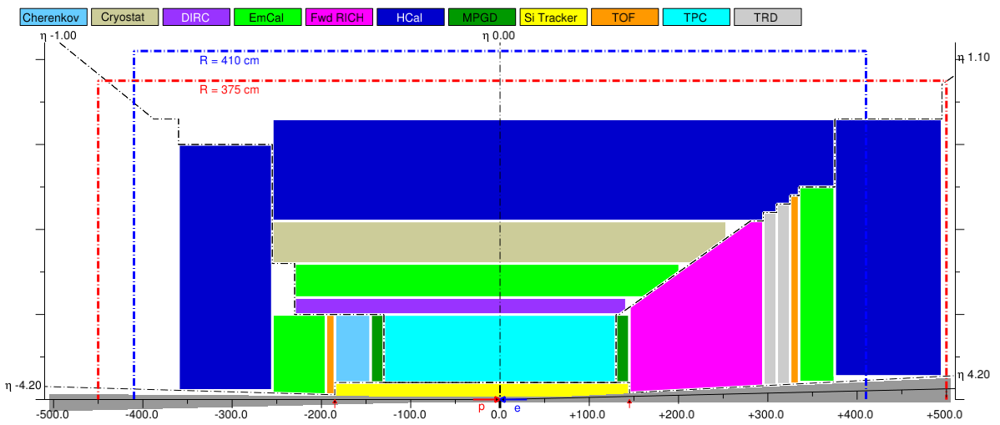
CORE 2π PWO₄ EMcal superimposed on the YR reference detector
The CORE barrel EMcal is shown in red/white
The much larger barrel EMcal for the reference is shown in green.

Slide 20
Pre-showers for γ/𝜋⁰ separation
W-Shashlyk may be have sufficient intrinsic position sensitivity not to require a separate pre-shower
  R&D will determine optimal configuration.
  No separate pre-shower needs to be implemented in simulation at this point
PWO crystals can provide γ/π⁰ separation at lower energies, but a pre-shower will improve separation and increase the energy range
  Would PWO alone be sufficient for the EIC?
Several PWO pre-shower options exist.
  Simplified configuration in simulation?
A LYSO pre-shower from the RD2012-13 proposal with fiber readout could be an interesting option.
The CMS PWO pre-shower uses cooled 6 mm Si-strip detectors in-between an initial layer and the main PWO blocks

Slide 21
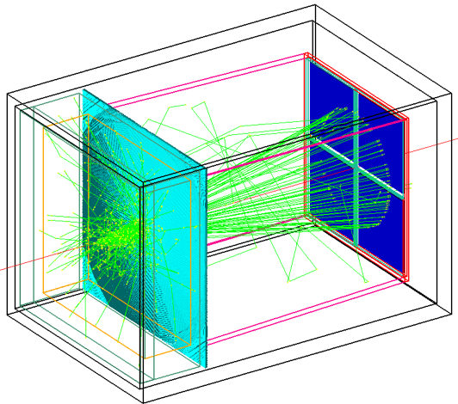
Hadron Identification in the electron endcap
While high-resolution TOF is not competitive with Cherenkov detectors in the central barrel (small radius), it could be a good solution for the electron endcap.
t₀ can be obtained using an electron scattered into the endcap and/or a separate ”start” layer integrated with the Si-tracker.
A Si timing “start” layer could be added in-between disks
The TOF installation is modest and resolution could improve through future upgrades.
High-resolution TOF using LGADs (eRD29) or LAPPDs (which work up to 2 T)
Alternatively, CORE could also support an aerogel RICH (e.g., the mRICH) by extending the endcap by 30 cm, for which there is plenty of space - although this would also extend the length of the PWO₄ EMcal.
Complementarity?

