Slide 1
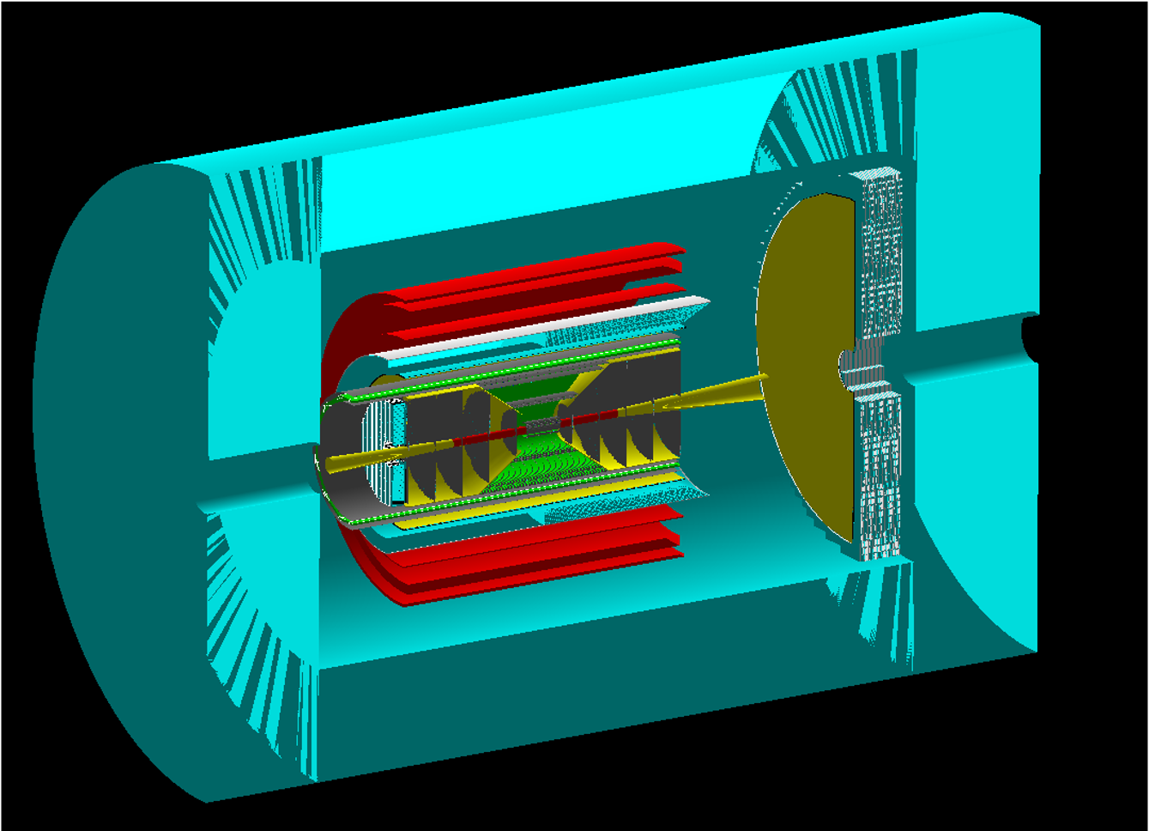
CORE Meetings with EIC Project
I. COSTING
II. Engineering
CORE Collaboration Meeting
17 May 2021
Charles Hyde
Old Dominion University
chyde@odu.edu

Slide 2
COSTING MEETING: 6 May 2021
Common Costing information for all Detector Proposals
  Costing will be done in 2021 US$ (US Commerce Dept)
  Equipment costing in $$
  Labor costing in hours per category (technician, engineering, etc).
EIC Costing Template, database of costing information linked to
“Call for Detector Collaboration Proposals”
  FAQ:
    Additional Material
      Material to Support Detector Costing
  https://indico.bnl.gov/event/10974/contributions/49222/

Slide 3
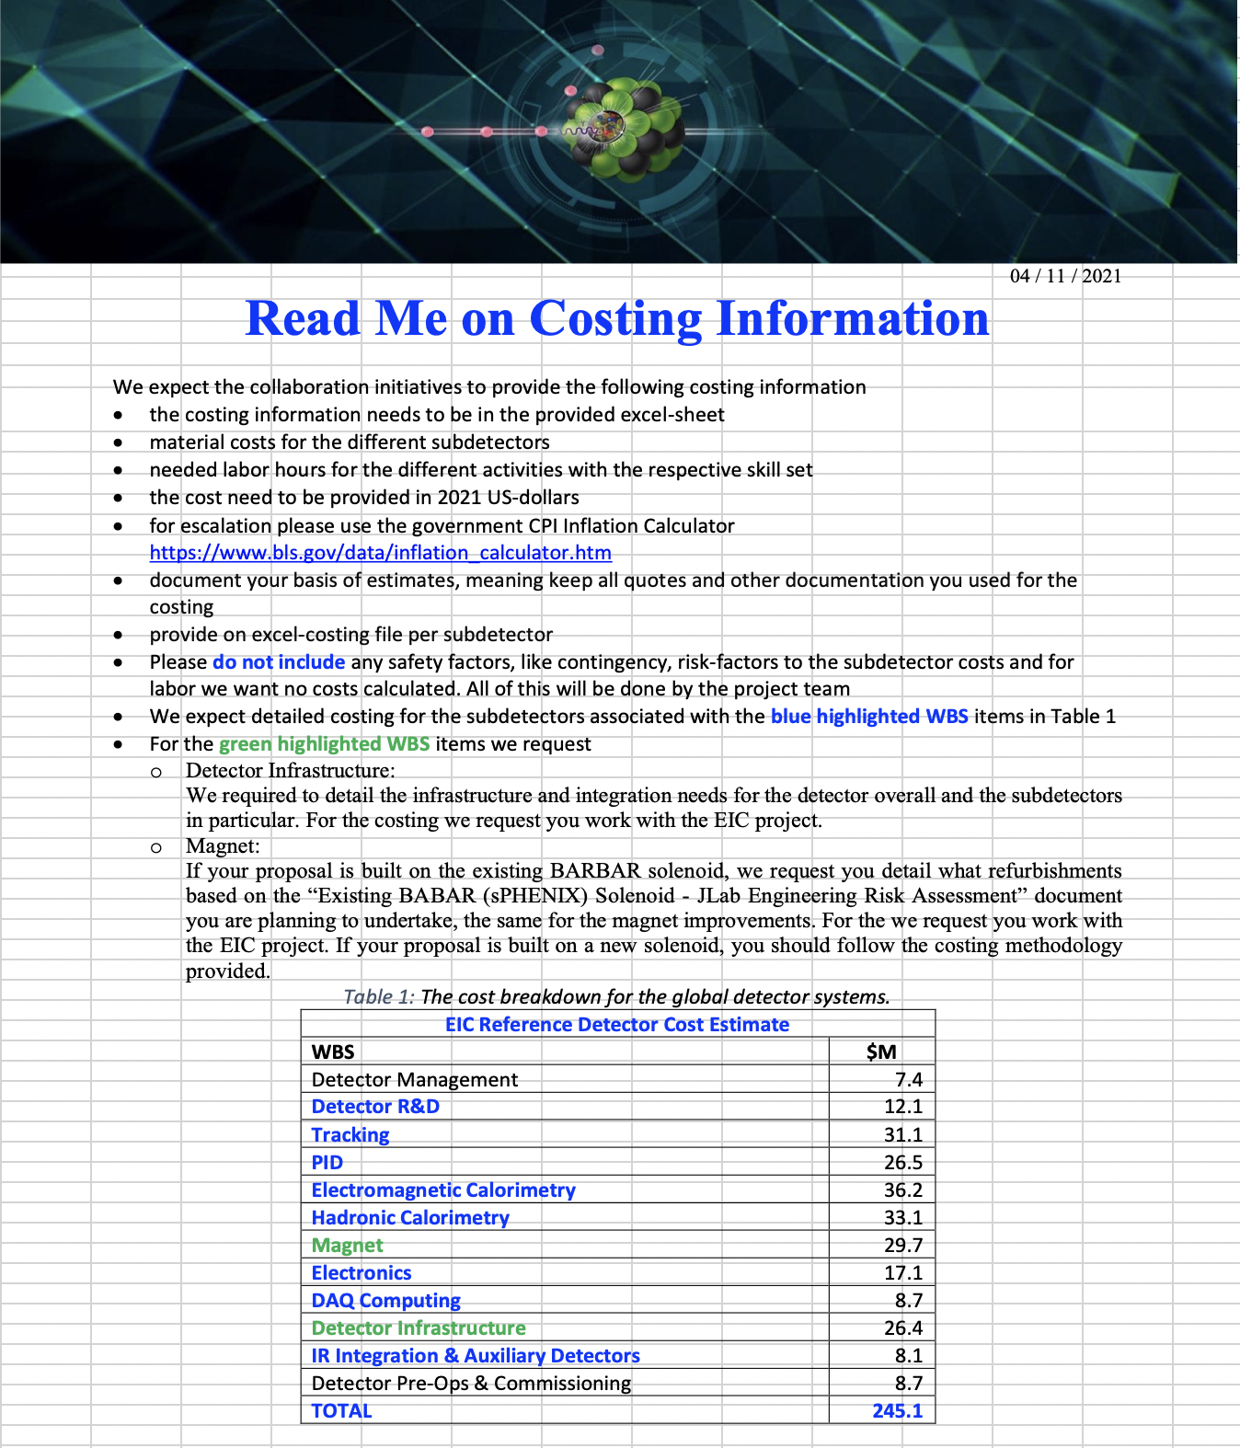
Costing.forCollaborations.xlsx
USER PROCEDURE
Column | Column Name | Action
A | WBS Id (Optional) | Optional: Select EIC WBS
B | WBS Name | Please fill in the detector you cost
C | Activity Description | Describe what you want to buy or do
D | Activity Type (Optional) | Optional: Select Type of Activity
E | Unit | Number of things of the same type
F | Unit Price | Price per part
G | Basis of estimate for Costing | give the info where the cost came from
H | Labor Hours | give the hours needed to do the activity
I | Resource Name | give the skill set needed to do the work
J | Funding Source | please provide the promary funding source
K | % of Funding source | give the procentage the funding source applies to the cost of the item
L | Total Material Cost | calculated from column E and F
M | Duration of activity in days | give the days needed for the activity
N | Projected Start Date of activity | give day activity starts
O,P,Q |  | get automatically calculated
R | Info | give any additional info you think can be useful
ss
←fixed
←fixed

Slide 4
Example Entries (1 Generic, 1 CORE)
WBS ID | WBS Name | Activity Description (Separate between conceptual design, preliminary design, final design, long lead procurements etc.) | Activity Type | Units | Unit Pricing | Basis of Estimate for costing (Pull Down) | Labor Hours | Resource Name (Pull Down) | Funding Source (Pull Down)
ECE06.10.03.03 | Hadron Endcap Tracking | GEM-TRD-OD Gem foils | Procurement of Material/ Vendor Fabrication/Leadtime | 72 | 3000 | Expert Opinion |  | Other | Project / In-kind
 |  |  | Procurement Support |  |  | Expert Opinion | 100 | Mechanical Engineer | Project
 |  |  | Final Design |  |  | Expert Opinion | 100 | Mecahnical Designer | In-kind
ECE06.10.07 | Magnets | Central Solenoid: 2.5 Tesla | Final Design | 1 |  |  |  | Mechanical Engineer | Project
 |  |  | Procurement of Material/ Vendor Fabrication/Leadtime | 1 | 5000000 | Expert Opinion |  | Other | In-kind
 |  |  | Procurement Support
 |  |  | In-House Testing
 |  |  | Installation
WBS ID | WBS Name | Units | Unit Pricing |  | Funding Source (Pull Down) | % of Funding source | Direct Materials $$ | Duration (Working Days) | Projected Start Date | Projected Start Date (Calculated) | Projected Finish Date (Calculated) | Cost Total (Calculated) | Notes
ECE06.10.03.03 | Hadron Endcap Tracking | 72 | 3000 |  | Project / In-kind | 60/40 | $216,000 | 120 | 4/20/23 | 4/20/23 | 10/11/23 | $0 | There are potential cost savings of about 30% with the use of microRWELL technology.
 |  |  |  |  | Project | 100 |  | 20 | 4/20/23 | 4/20/23 | 5/18/23 | $0
 |  |  |  |  | In-kind | 100 |  | 20 | 4/20/23 | 4/20/23 | 5/18/23 | $0
ECE06.10.07 | Magnets | 1 |  |  | Project | 100
 |  | 1 | 5000000 |  | In-kind | 100 | $5,000,000 | 500 | 4/20/23 | 4/20/23 | 4/21/25 | $0 | Reference detector is $30M

Slide 5
Costing Data: Costing.Info.xlsx
PBWO4

Slide 6
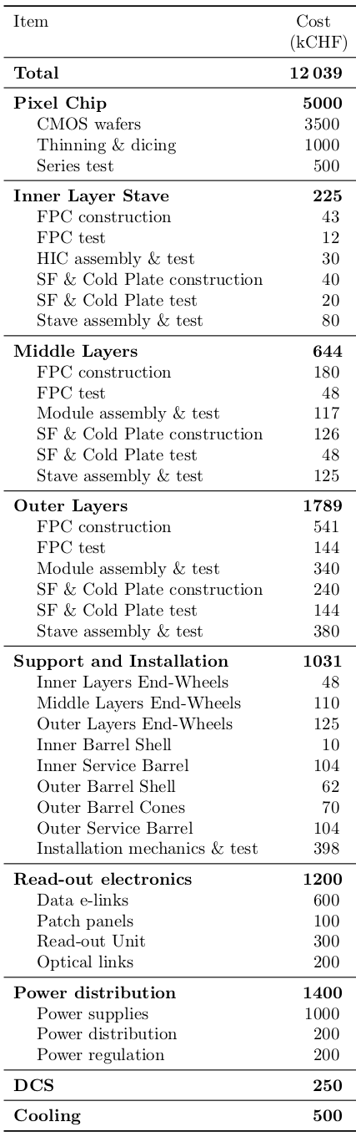
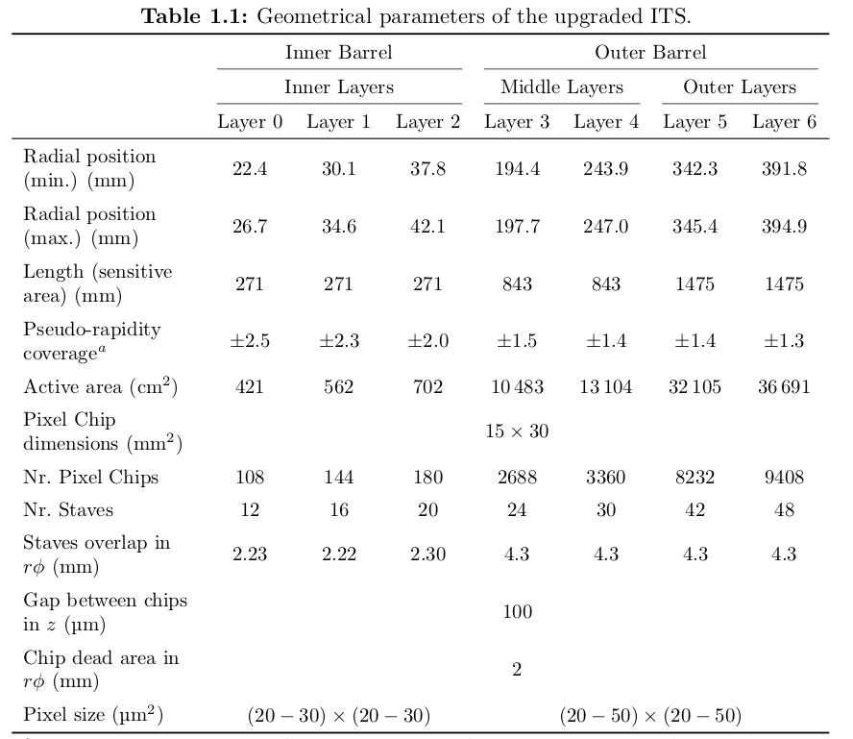
Costing Info: Si Tracker

Slide 7
Costing Summary
All Costing documentation Welcome, and to be shared
Please study the existing spreadsheets, Provide Comments and additional documents

Slide 8
PAUSE
Discussion

Slide 9
CORE Meeting with Project Engineering
14 May 2020
Rolf Ent (JLab), Elke Aschenauer (BNL), Walt Akers (JLab), Robert Wimmer (BNL)
Sketch-UP models of each proposed Detector
  https://physdiv.jlab.org/EIC/Menagerie/
  Sub-Detector modules are Generic
  CORE Geometry is not yet accurate in this database: Follow-up expected this week.
  Video posted to today’s indico page
Some preliminary Mechanical Engineering based on Sketch-up model

Slide 10
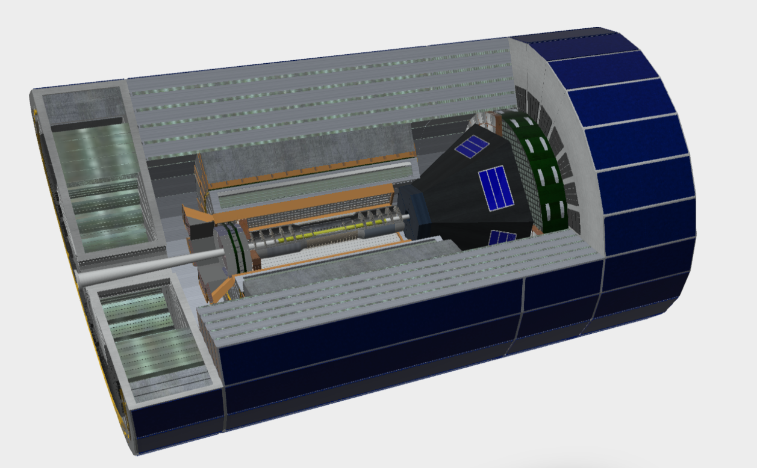
CORE in Sketch-Up
Core.skp in
Viewer.Autodesk.com
Many details are
inaccurate
Dual RICH is based on
update from INFN

