Slide 1
Hall B - Run Group K
Color Confinement and Strong QCD
Status Update
E12-16-010 A Search for Hybrid Baryons in Hall B with CLAS12
A. D’Angelo, V.D. Burkert, D.S. Carman, V. Mokeev, E. Golovach, R. Gothe
E12-16-010A Nucleon Resonance Structure Studies Via Exclusive KY Electroproduction at 6.6 GeV and 8.8 GeV
D.S. Carman, V. Mokeev, R. Gothe
E12-16-010B Deeply Virtual Compton Scattering with CLAS12 at 6.6 GeV and 8.8 GeV
L. Elouadrhiri, F.X. Girod
Approved:
50 PAC days at 8.8 GeV
50 PAC days at 6.6 GeV
Data Taken (Dec 2018):
6 PAC days at 7.5 GeV
6 PAC days at 6.5 GeV

Slide 2
Physics Program Highlights
The N* spectrum: what is the role of glue?
Search for new baryon states → hybrid states
E12-16-010
How does the role of the active degrees of freedom in the nucleon spectrum evolve with distance scale?
Probe underlying N* d.o.f. and their emergence from QCD from the Q² evolution of the resonance electrocouplings
E12-16-010A
How is color confinement realized in the force and pressure distributions resulting in stable nucleons?
Study GPDs and their moments from DVCS
E12-16-010B

Slide 3
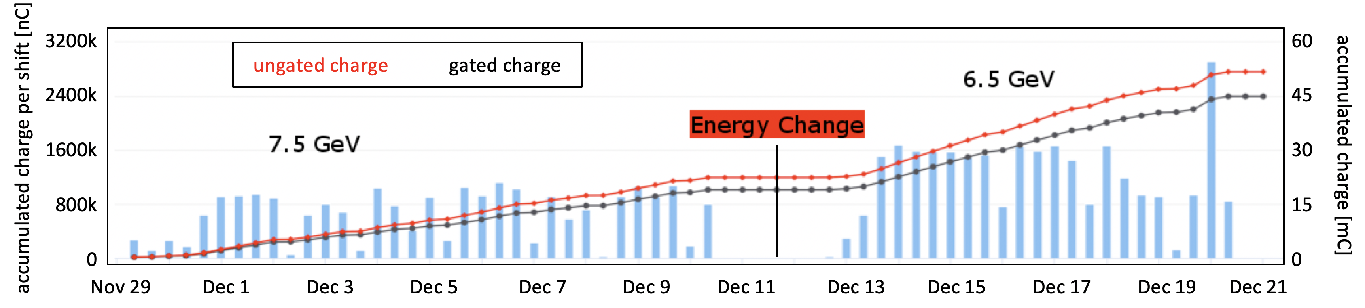
Run Group K Production
CHARGE
FT OFF
Q~45mC = 7% of
Expected 648mC
Opportunistic Run
RUN CONDITIONS – FALL 2018
Torus Current | 100% (3375 A) - negative outbending
Solenoid | -100 %
FT | ON @ 7.5 GeV -> OFF @ 6.5 GeV
Beam/Target | Polarized electrons, unpolarized LH₂ target
Luminosity | ~ 5 10 ³⁴ cm⁻²s⁻¹ @ 7.5 GeV 10 ³⁵ cm⁻²s⁻¹ @ 6.5 GeV FULL LUMINOSITY
12 PAC
days

Slide 4
Run Group K Production
CHARGE
FT OFF
Beam Energy | Beam Current | Target | Trigger | Collected Events
7.5 GeV | 35 nA | LH₂ | e in CLAS e in FT + 1 Fwd Hadron | 3.5 G
7.5 GeV | 45 nA | LH₂ | e in CLAS - prescaled e in FT + 1 Fwd Hadron | 4.3 G
6.5 GeV | 60 nA | LH₂ | e in CLAS | 7.8 G
Q~45mC = 7% of
Expected 648mC
EVENTS
15.6 G
All runs have been calibrated (Pass1) and cooked: 95% (7.5 GeV) /88% (6.5 GeV) golden files

Slide 5
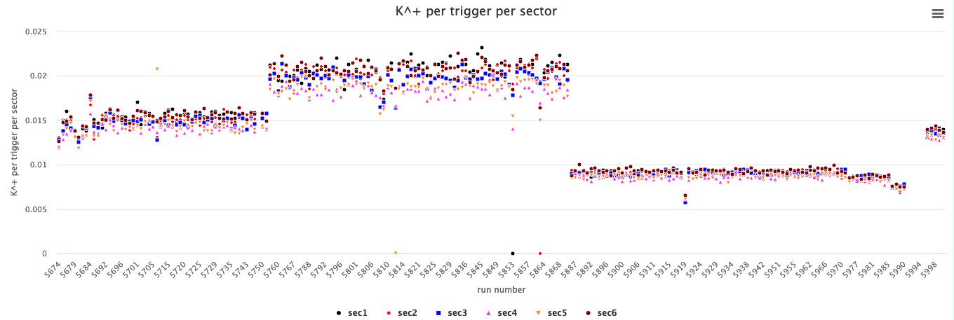
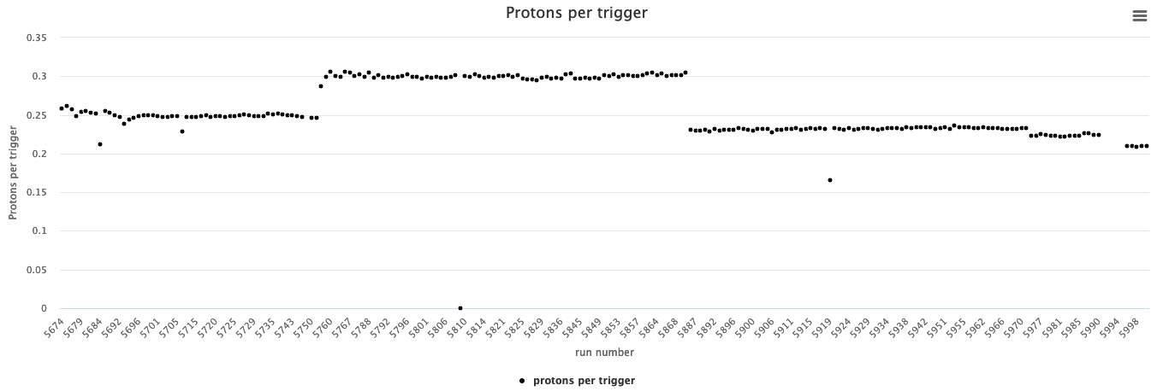
RGK data timelines
95% (7.5 GeV) / 88% (6.5 GeV) golden files
e- in FD + FT &1 H
Trigger
5809 Accelerator Vacuum Loss
k⁺ per trigger
(Forward)
set-up
e- in FD
Trigger
e- in FD (pre-scaled) + FT &1 H
Trigger
60nA
35nA
45nA
lumi
scan
runs 5694 - 5752
runs 5758 - 5780
runs 5875 - 5972
½ Torus
7.5 GeV
7.5 GeV
6.5 GeV
RG-k_v2
trigger
RG-k_v4 trigger
RG-k_v6 trigger
lumi
scan
35nA
protons per trigger
(Central)

Slide 6
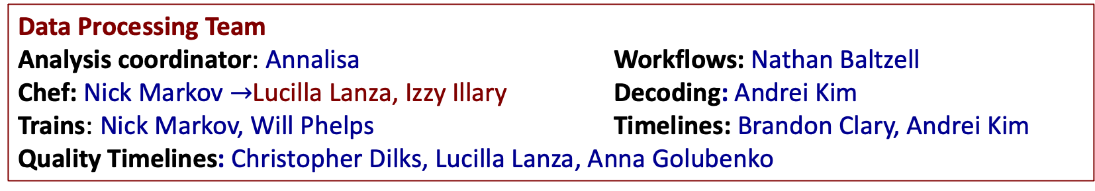
Manpower
Run group K experiments benefits of the collaboration with similar experiment of Run group A running at 10 GeV :
E12-06-108A Exclusive N* -> KY Studies with CLAS12 - D.S. Carman
E12-06-119 (a) Deeply Virtual Compton Scattering - F. Sabatie
The Run Group A Calibration Team has been available.
Leader: Dan Carman FTOF/CTOF: Dan Carman EC: Cole Smith HTCC: Nick Markov CND: Silvia, Pierre Chatagnon
DC: Mac Mestayer, Taya Chetry RICH: Marco Mirazita, Fatiha
FT/RF: Raffaella De Vita
Data Processing Team
Analysis coordinator: Annalisa Workflows: Nathan Baltzell
Chef: Nick Markov $→$Lucilla Lanza, Izzy Illary Decoding: Andrei Kim
Trains: Nick Markov, Will Phelps Timelines: Brandon Clary, Andrei Kim
Quality Timelines: Christopher Dilks, Lucilla Lanza, Anna Golubenko
Data Analysis Team Dedicated PhD students: Joshua Artam Tan, Izzy Illary,
Dedicated Post-doc: Lucilla Lanza Anna Frolova, Alexander Bulgacov
RGK Scientists: V. Burkert, D. Carman, A. D'Angelo, M. Defurne, L. Elouadrhiri, F.X. Girod,
E. Golovach, A. Golubenko, R. Gothe, K. Hicks, E. Isupov, N. Markov, V. Mokeev

Slide 7
RG-K trains
7.5 GeV - run 5700
6.5 GeV - run 5893
155 GB | 100% | DST |  | Custom
0.2 GB | 0.1 % | skim2 | ft | no
0.1 GB | 0.1 % | skim5 | FTTrigger | yes
3.0 GB | 2% | skim11 | ElecFTKaon | yes
0.2 GB | 0.1% | skim13 | MissingNeutron | yes
0.2 GB | 0.1% | skim16 | DVCS | yes
0.1 GB | 0.08% | skim17 | DVPi0P | yes
0.1 GB | 0.07% | skim18 | DVPipPimP | yes
0.1 GB | 0.06% | skim19 | DVPipPimPi0P | yes
0.06 GB | 0.04% | skim20 | DVKpKmP | yes
3.6 GB | 2.3% | skim21 | eK+ | yes
8 GB | 5% | Total
202 GB | 100% | DST |  | Custom
0.2 GB | 0.1% | skim13 | MissingNeutron | yes
0.2 GB | 0.1% | skim16 | DVCS | yes
0.2 GB | 0.1% | skim17 | DVPi0P | yes
0.1 GB | 0.05% | skim18 | DVPipPimP | yes
0.09 GB | 0.04% | skim19 | DVPipPimPi0P | yes
0.05 GB | 0.03% | skim20 | DVKpKmP | yes
13.4 GB | 6.1% | skim21 | eK+ | yes
14 GB | 6.5% | Total
Additional ep$γ skim has been approved and it is being implemented$

Slide 8
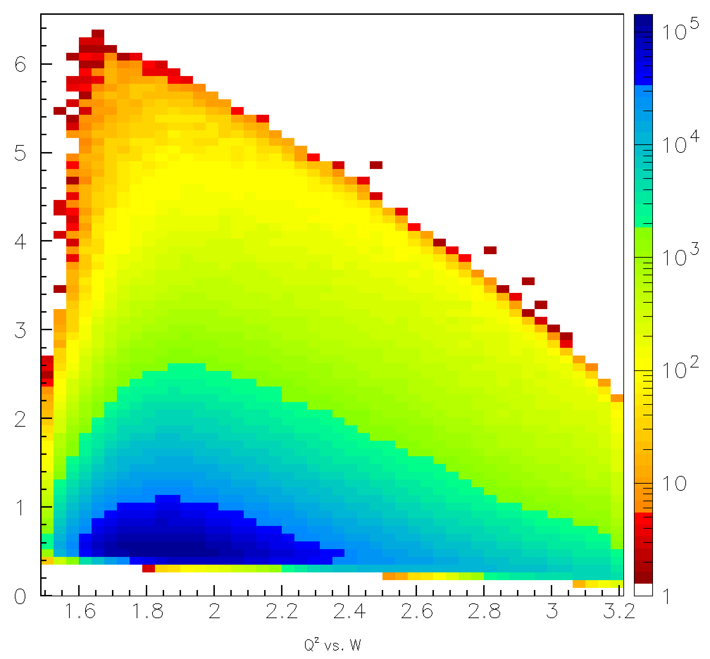
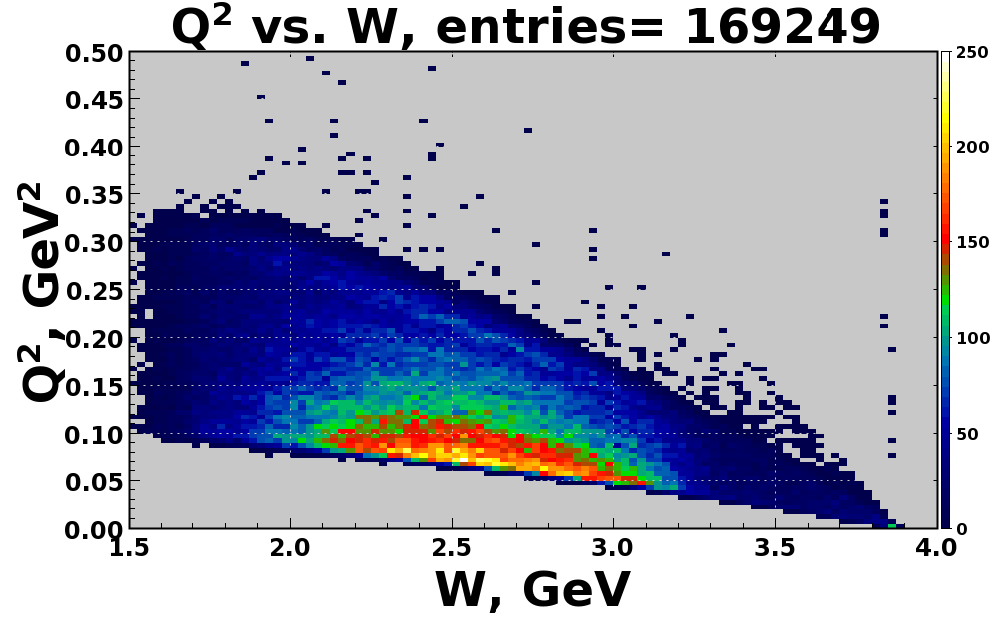
RG-K Kinematic Coverage
Q² vs. W
Q²>1 GeV²:
Evolution of active degrees of freedom in the N* structure
E_{e} =7.5 GeV
KY
Q² (GeV²)
e’ in the FD
Q²<1 GeV²:
search for:
hybrid baryon signature
meson-baryon contributions to the N* structure
0.4 GeV²≤Q² ≤ 5 GeV²
0.05 GeV²≤Q² ≤ 0.25 GeV²
e’ in the FT
Reactions of interest for the N*/hybrid program:
ep epπ⁺π⁻
ep eK⁺Y

Slide 9
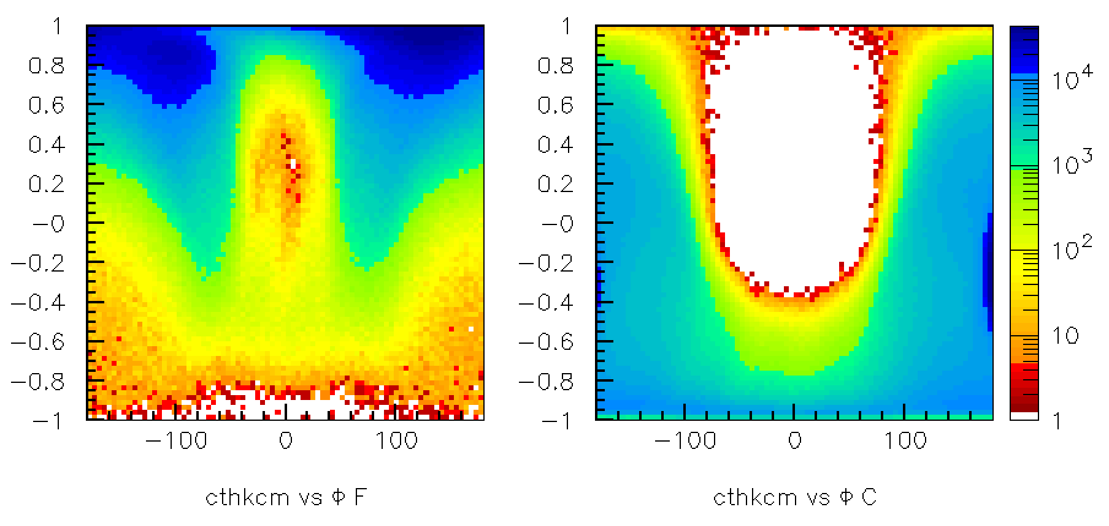
K⁺Y Analysis Status/Plans towards publication
K⁺ forward
K⁺ central
See Dan’s talk
cos θ_{K}^{cm}
Φ [deg]
Φ [deg]
Analysis objectives: (RG-K datasets at both 6.5 and 7.5 GeV)
  Extract the separated structure functions σ_{T} + εσ_{L}, σ_{TT}, σ_{LT}, σ_{LT’} in bins of Q², W, cos θ_{K}^{cm}, Φ
  Extract the recoil and beam-recoil hyperon polarization in bins of Q², W, cos θ_{K}^{cm}
To extract the resonance electrocouplings to access the N* structure information, development of a suitable KY reaction model is essential (work in progress by several phenomenology/theory groups)
Work is lead by D. Carman in coll. with L. Lanza (in conjunction with RG-A KY analysis)

Slide 10
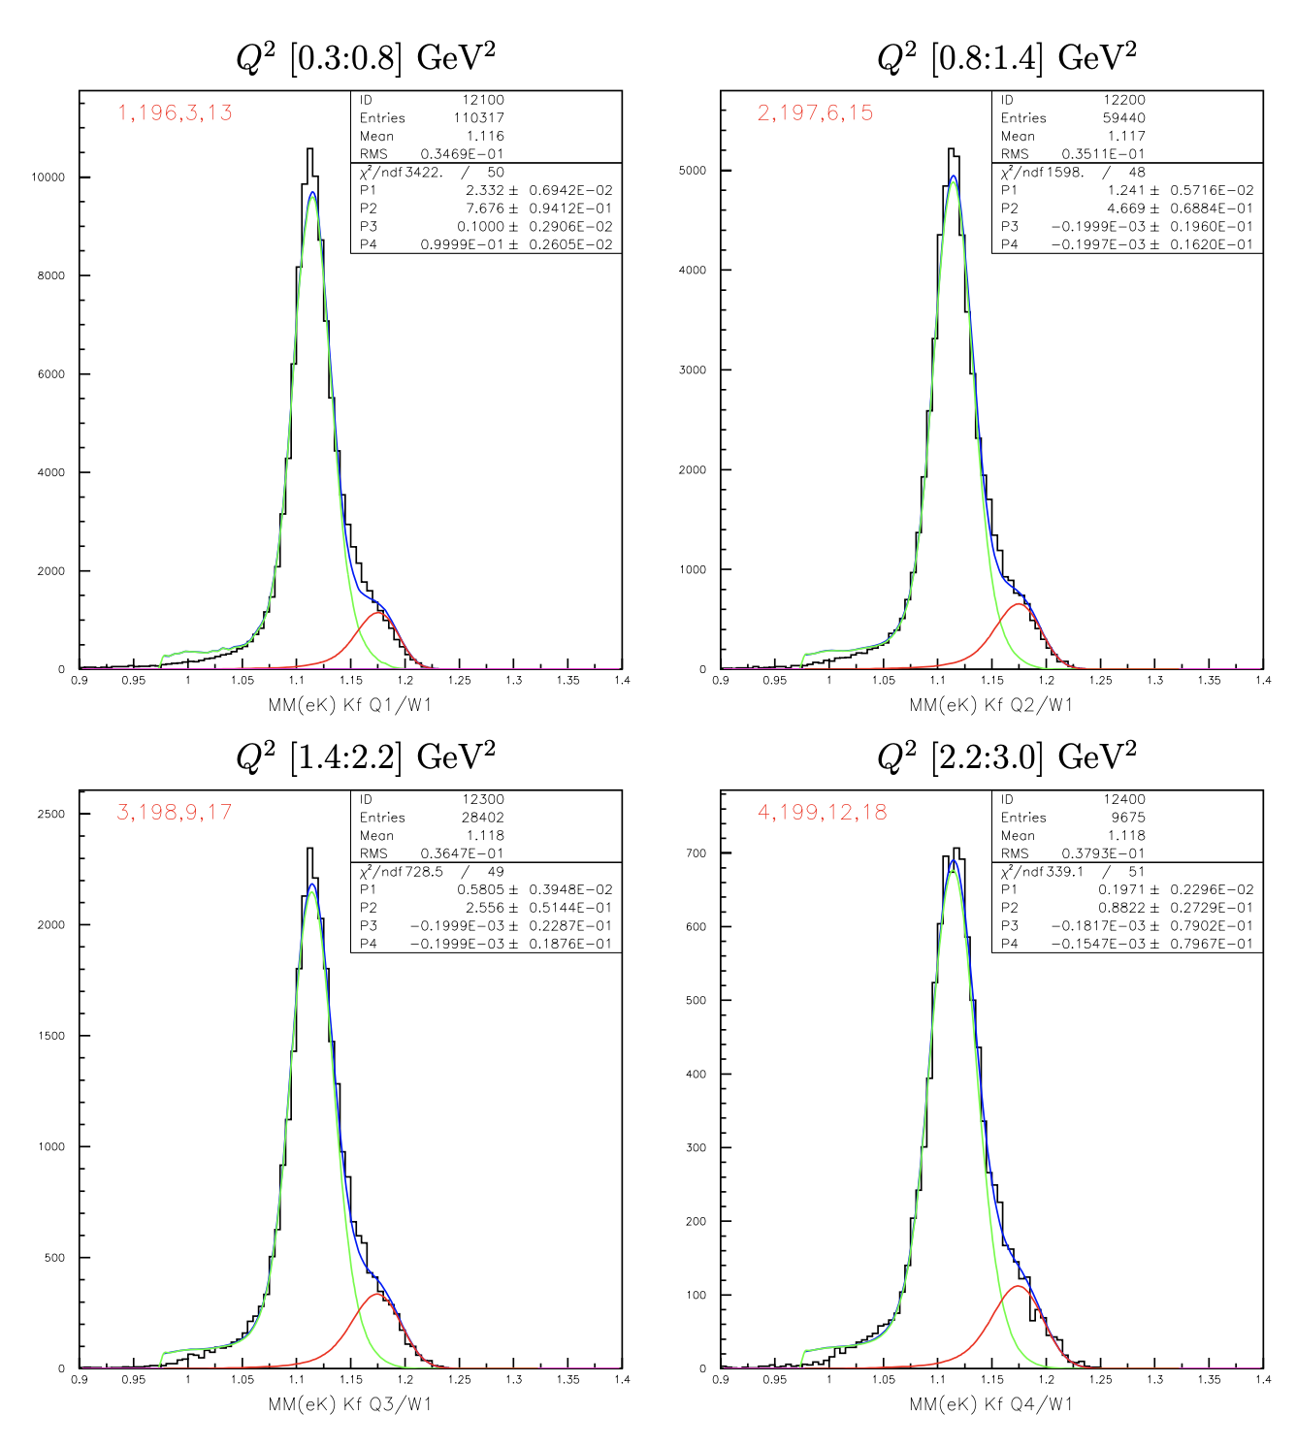
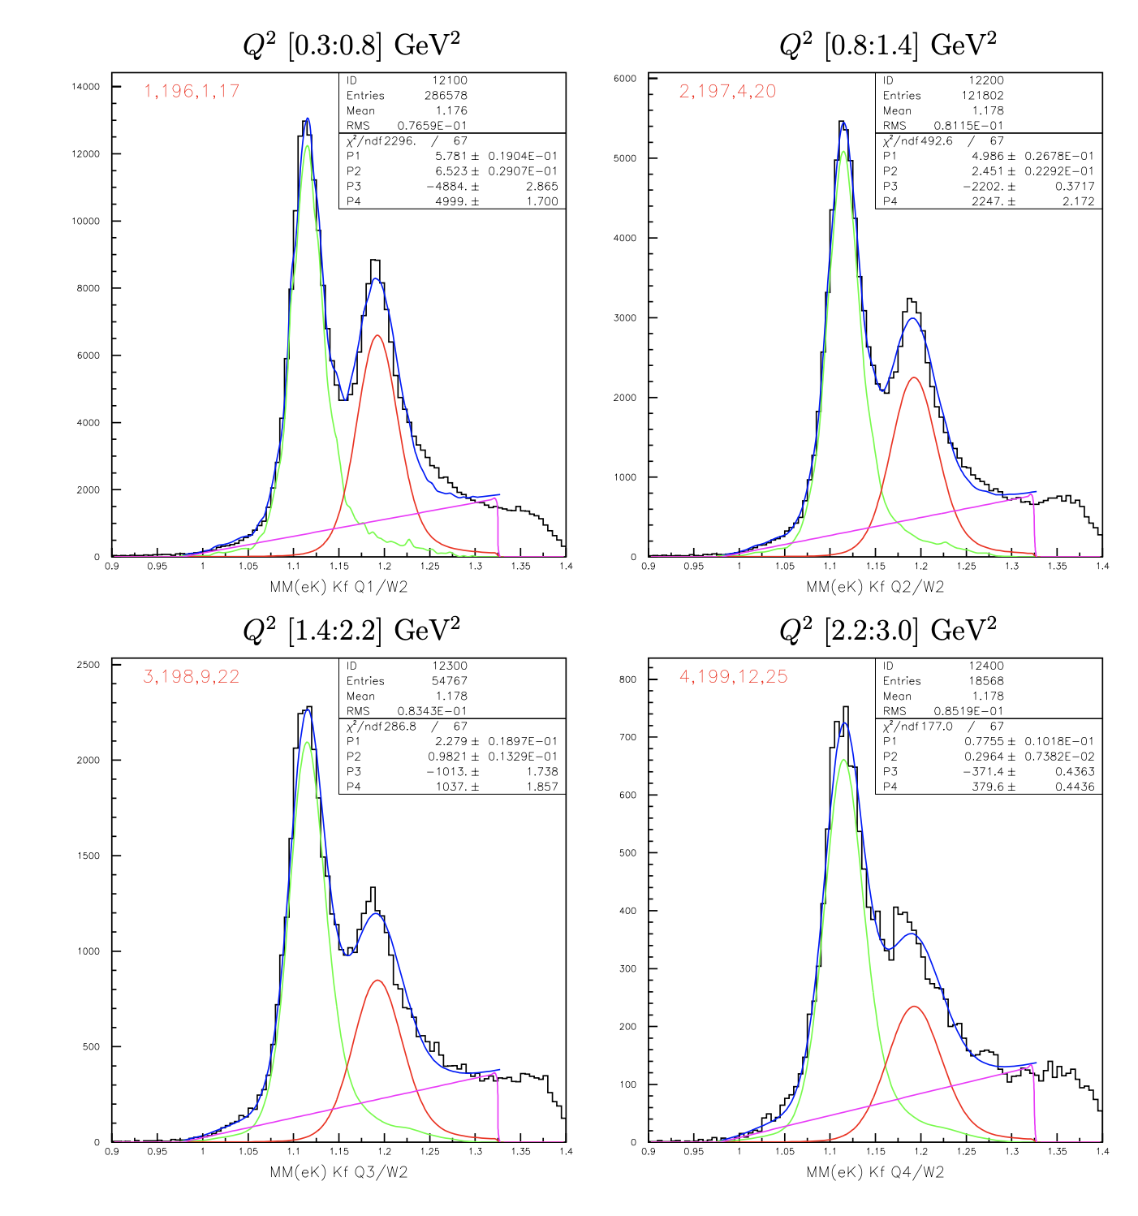
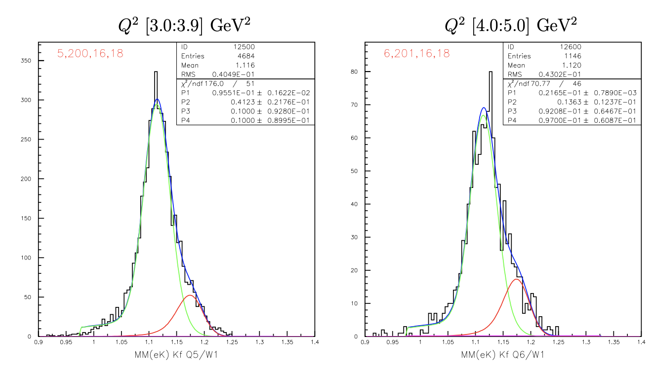
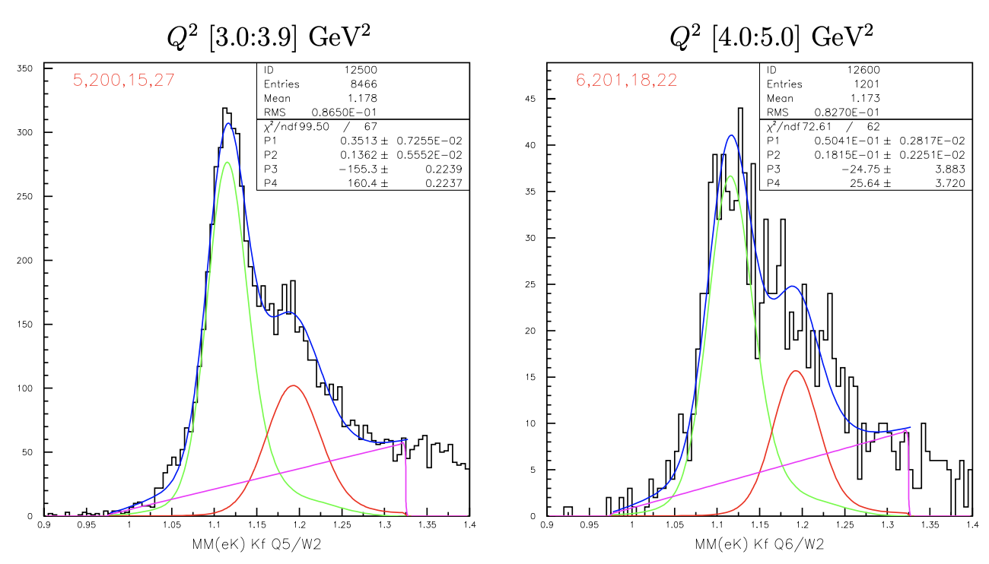
K⁺Y Yield Extraction Fits
W = 1.725 GeV
7.5 GeV
W = 1.925 GeV
MM(e’K⁺) [GeV]
by Dan Carman
MM(e’K⁺) [GeV]
Fit MM(e’K⁺) with MC K⁺Y templates convoluted with Gaussian + bck to minimize χ²

Slide 11
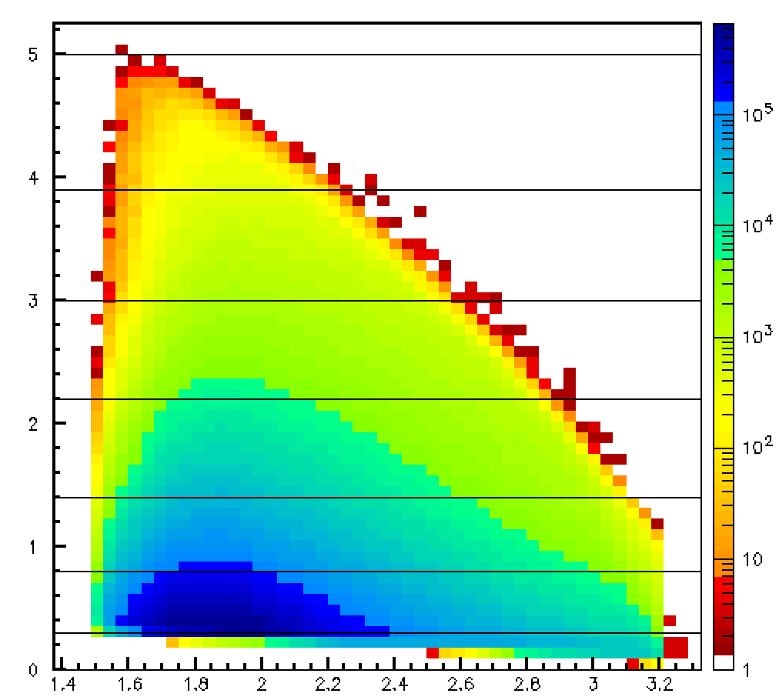
K⁺Y Yields
Estimate for full 6.5 RG-K dataset (analyzed stat. x10)
Kinematic phase space for RG-K @ 6.5 GeV
Q² GeV² | W GeV | RG-K K⁺Λ Yield | RG-K K⁺Σ⁰ Yield | CLAS e1f K⁺Λ Yield | CLAS e1f K⁺Σ⁰ Yield
0.3 – 0.8 | 1.7 - 1.75 | 967810 | 123250 | - | -
0.8 – 1.4 |  | 514170 | 74980 | - | -
1.4 - 2.2 |  | 240520 | 41050 | 10092 | 1032
2.2 – 3.0 |  | 81630 | 14170 | 7808 | 810
3.0 – 3.9 |  | 39550 | 6620 | 3925 | 450
4.0 – 5.0 |  | 8970 | 2190 | - | -
0.3 – 0.8 | 1.9 – 1.95 | 1241070 | 824020 | - | -
0.8 – 1.4 |  | 536520 | 309710 | - | -
1.4 - 2.2 |  | 245160 | 124080 | 11365 | 3843
2.2 – 3.0 |  | 83430 | 37440 | 7954 | 2537
3.0 – 3.9 |  | 37790 | 17190 | 3466 | 1122
4.0 – 5.0 |  | 5420 | 2290 | - | -
Q² [GeV²]
e’ in the FD
CLAS e1f data
by Dan Carman
W [GeV]
 | Total Yield
K⁺Λ | 35618500
K⁺Σ⁰ | 17702300
Full statistics for RG-K will allow for:
KY electroproduction measurements up to Q² = 3 GeV² with statistics comparable to photoproduction

Slide 12
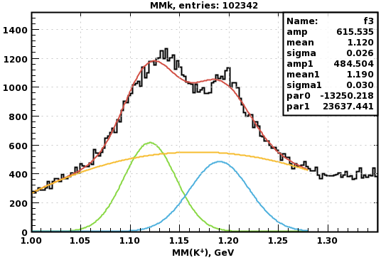
K⁺Y Yield at Low Q² - Electron Detected in FT
Estimate for full 7.5 RG-K dataset (analyzed stat. x10)
Q² GeV² | W GeV | RG-K K⁺Λ Yield | RG-K K⁺Σ⁰ Yield
0.05– 0.25 | 1.6 – 3 | 361250 | 196250
W (GeV) | RG-K K⁺Λ Yield | RG-K K⁺Σ⁰ Yield
thresh. – 2.0 | 75580 | 7830
2.0 – 2.5 | 198130 | 95410
2.5 – 3.2 | 101670 | 78360
Fully exclusive kinematics
CLAS12 momentum correction implementation will allow for analysis via e’K⁺ final state to maximize statistics
Full statistics for RG-K will allow for:
KY electroproduction measurements down to Q² = 0.05 GeV²
by Lucilla Lanza

Slide 13
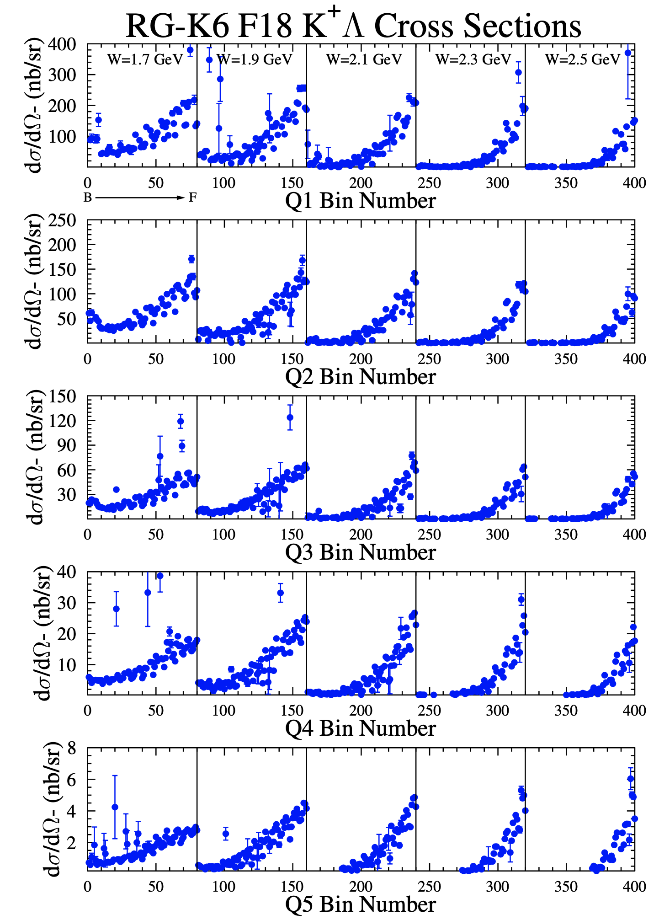
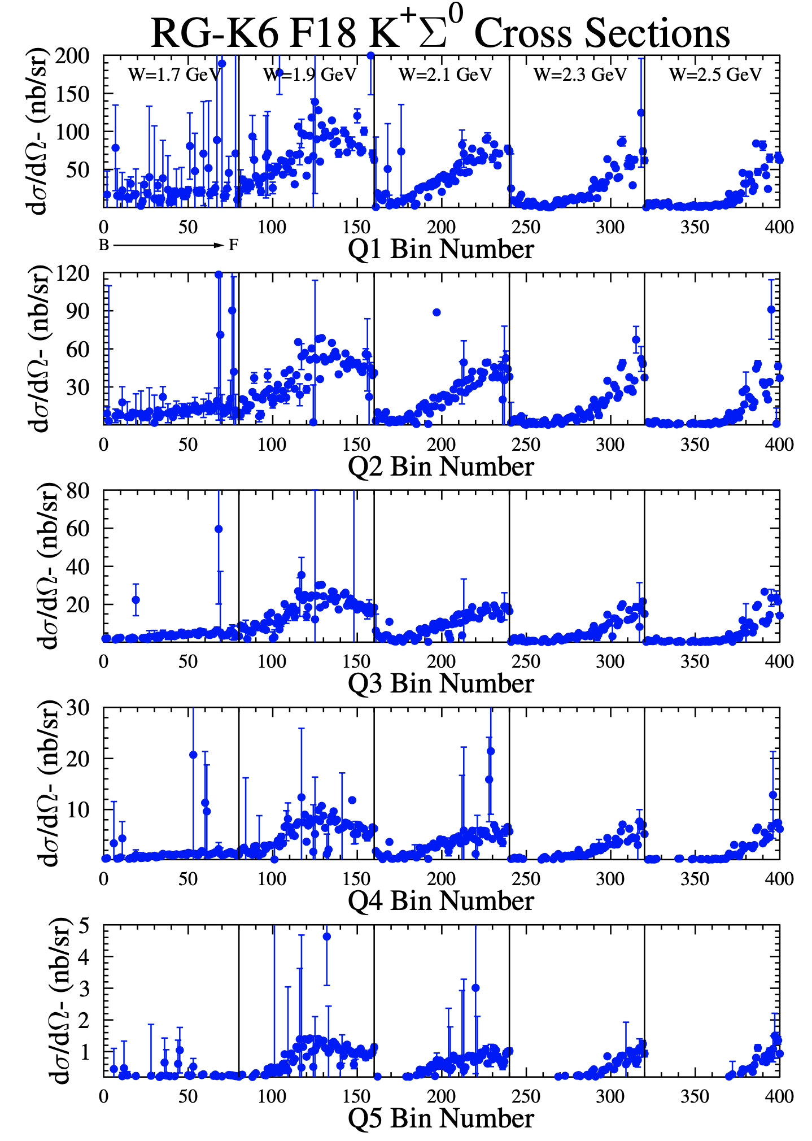
KY Differential Cross Sections
e’K⁺ topology
by Dan Carman
Q²
[GeV²]
0.3-0.4
0.4-0.6
PRELIMINARY
0.6-0.9
0.9-1.5
1.5-3.0

Slide 14
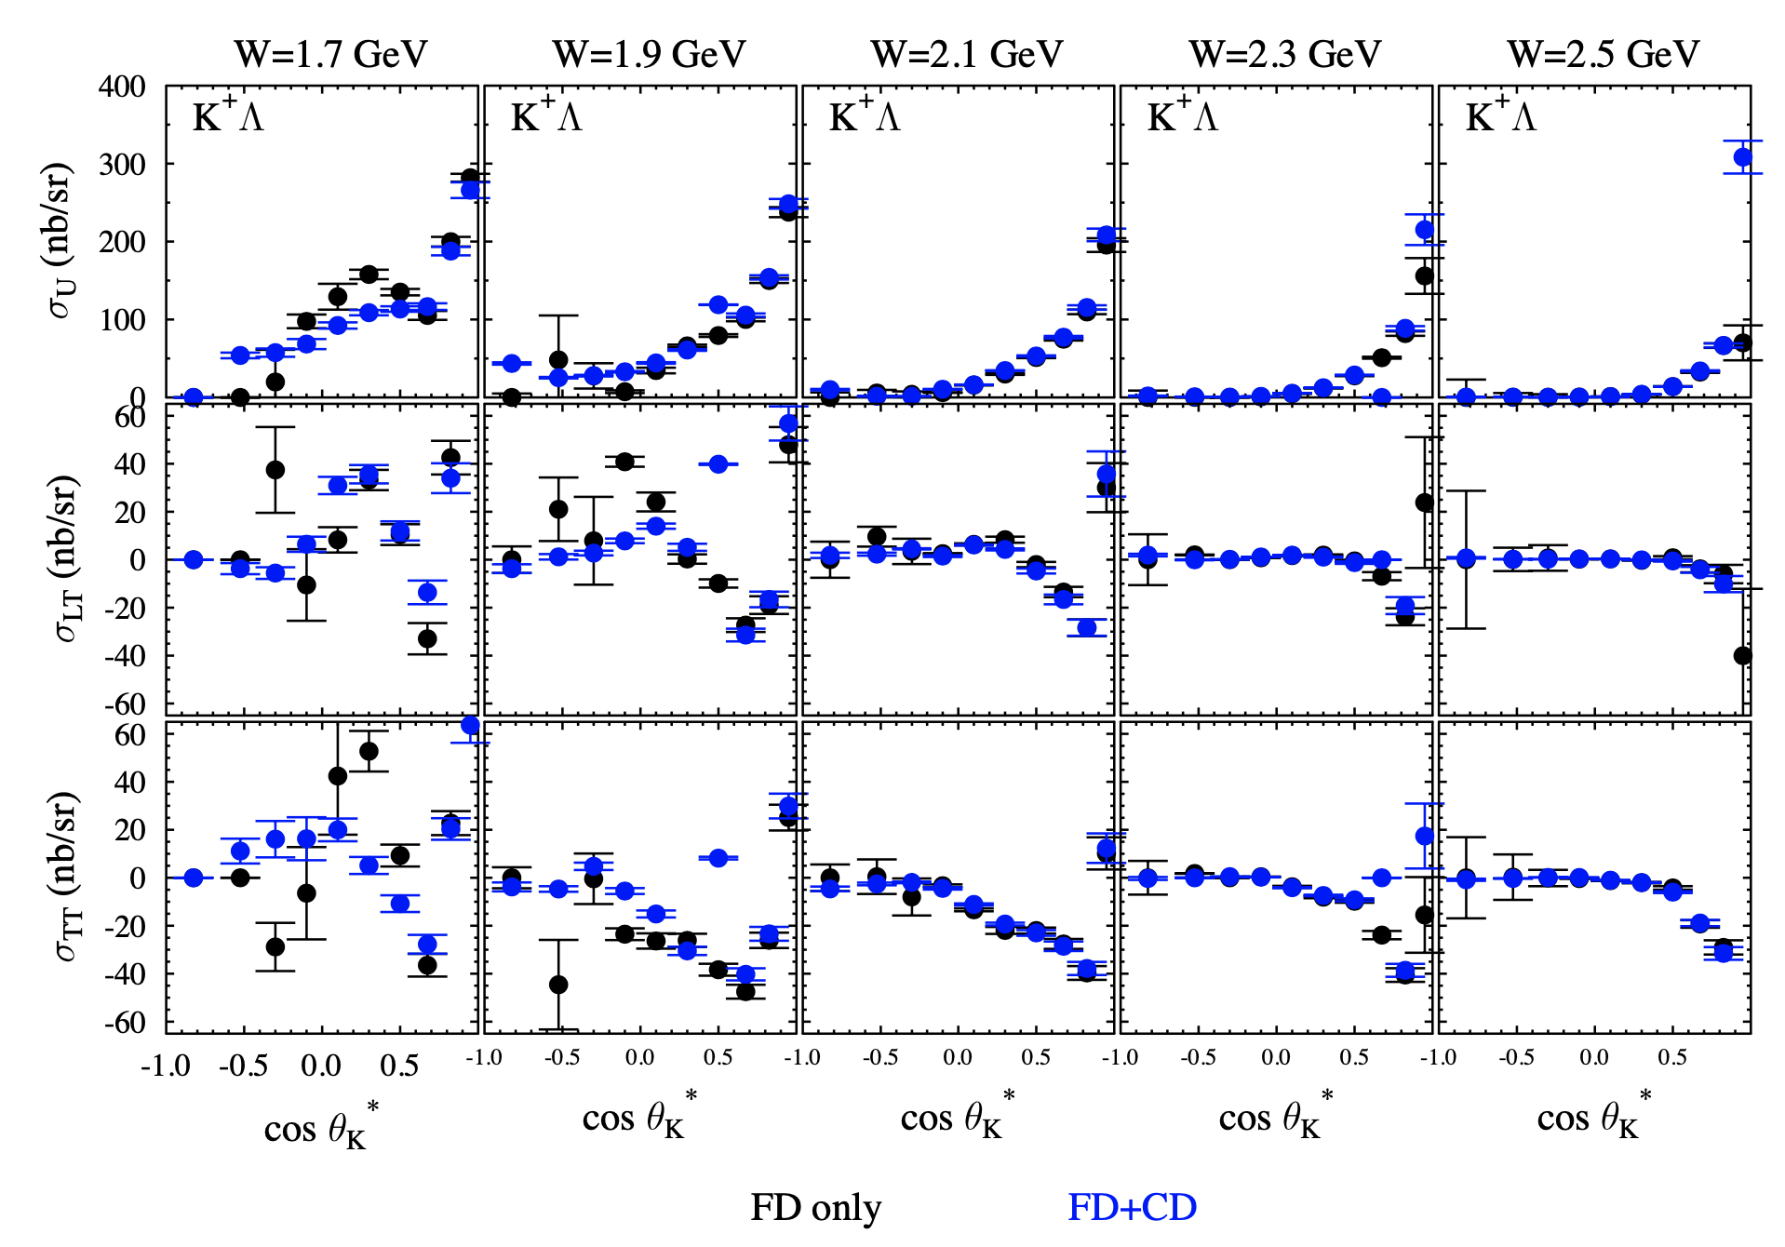
RG-K K⁺Λ Structure Functions
by Dan Carman
K⁺Λ, 6.5 GeV Q² [0.3:0.4] GeV²
e’K⁺ topology
PRELIMINARY

Slide 15
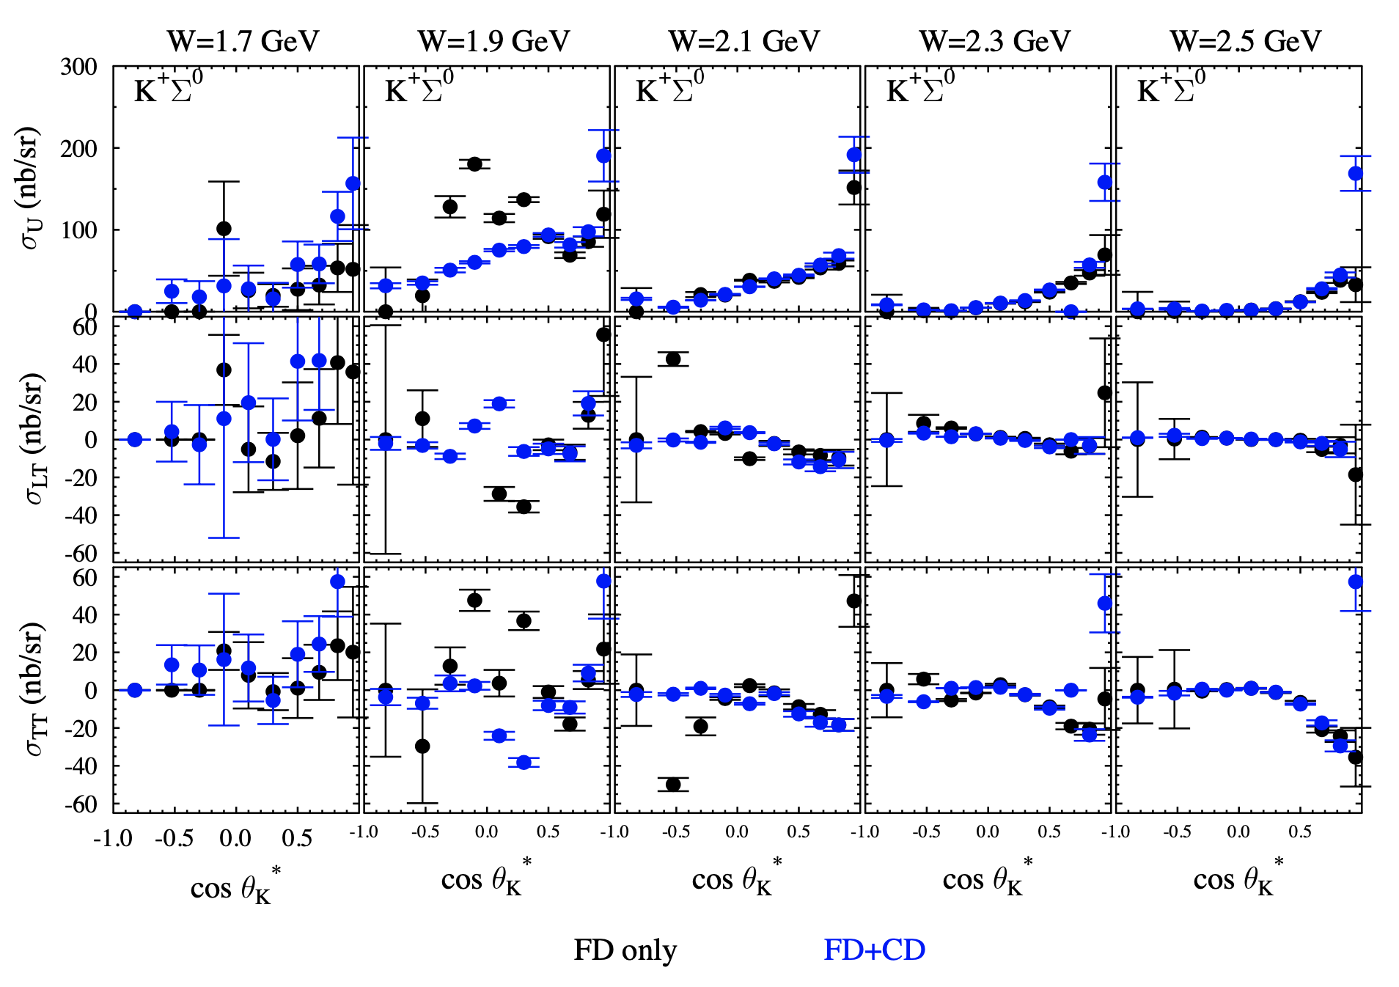
RG-K K⁺Σ⁰ Structure Functions
by Dan Carman
K⁺Σ⁰, 6.5 GeV Q² [0.3:0.4] GeV²
e’K⁺ topology
PRELIMINARY

Slide 16
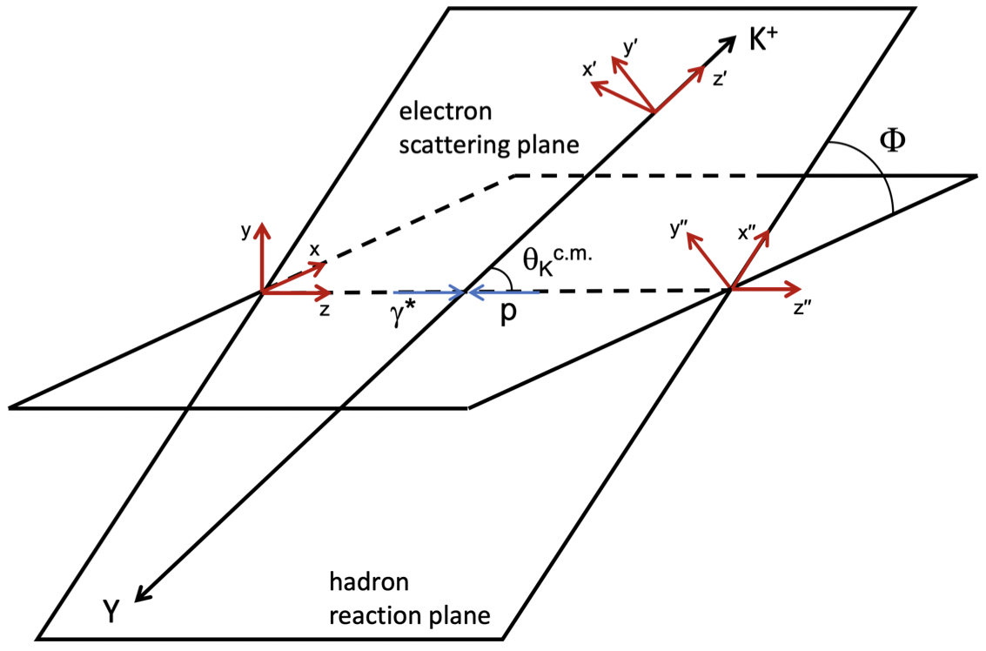
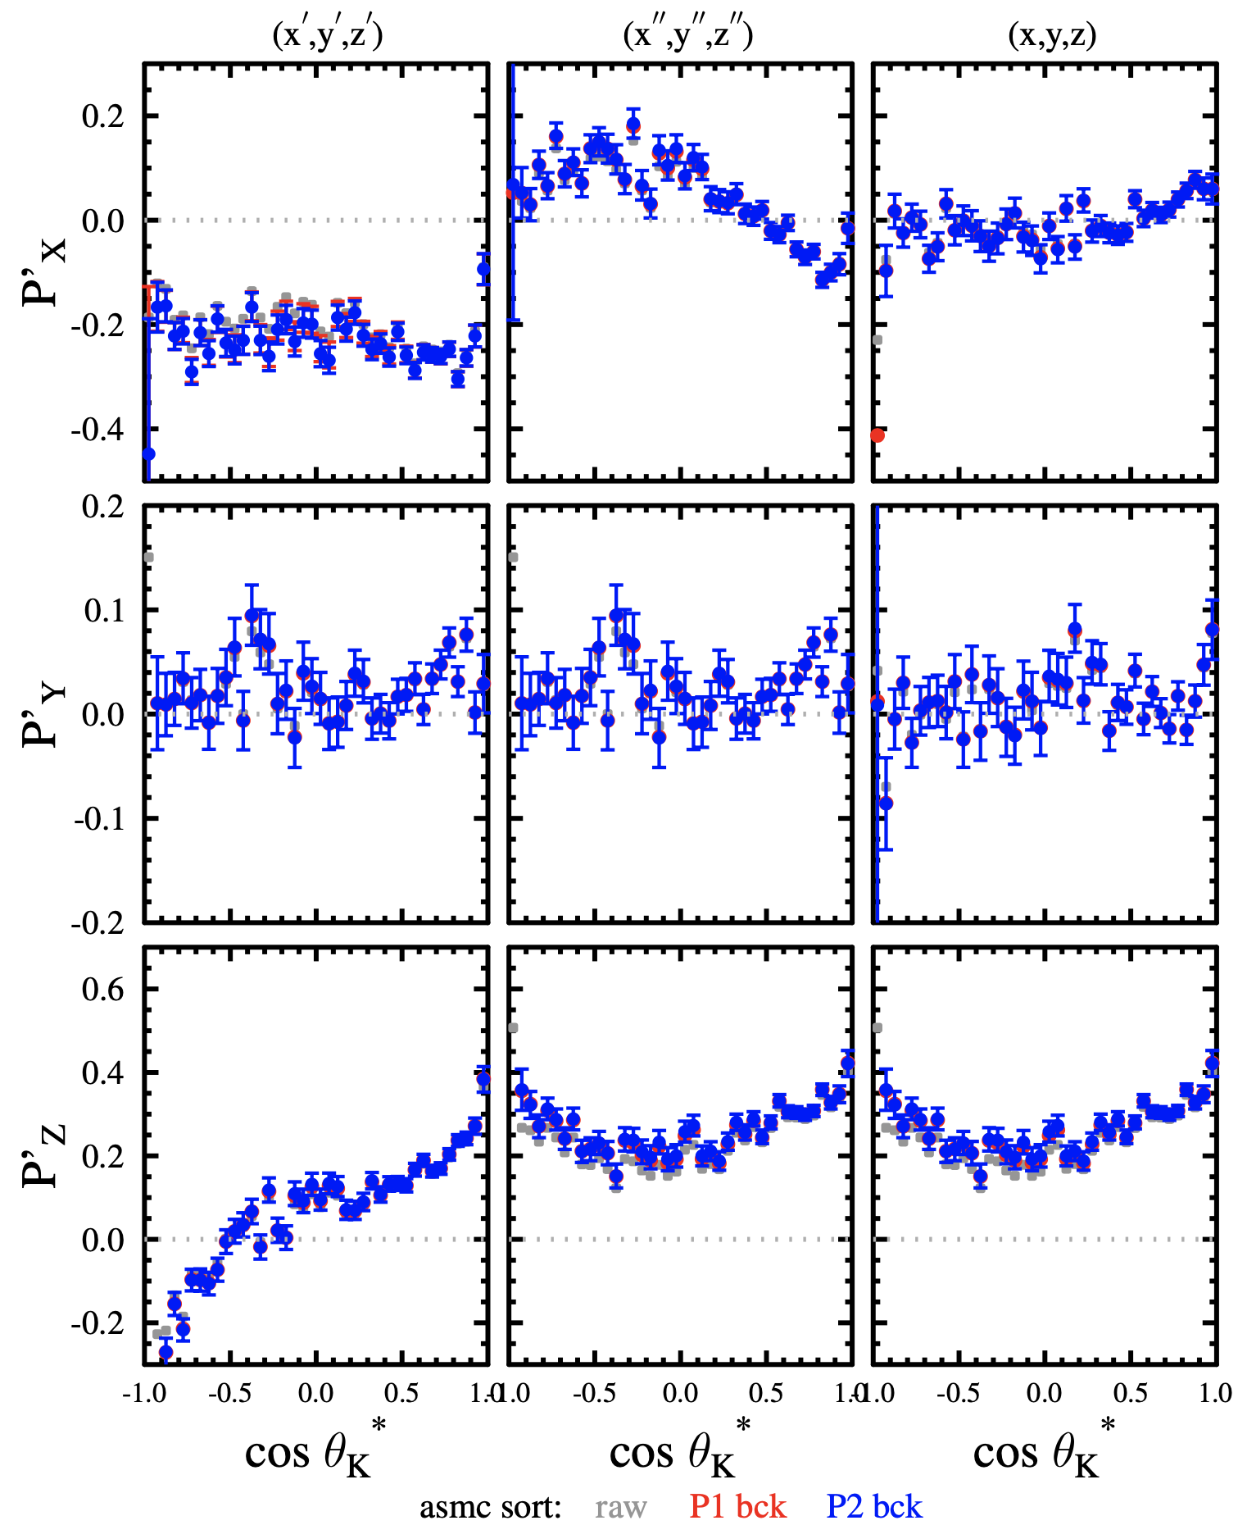
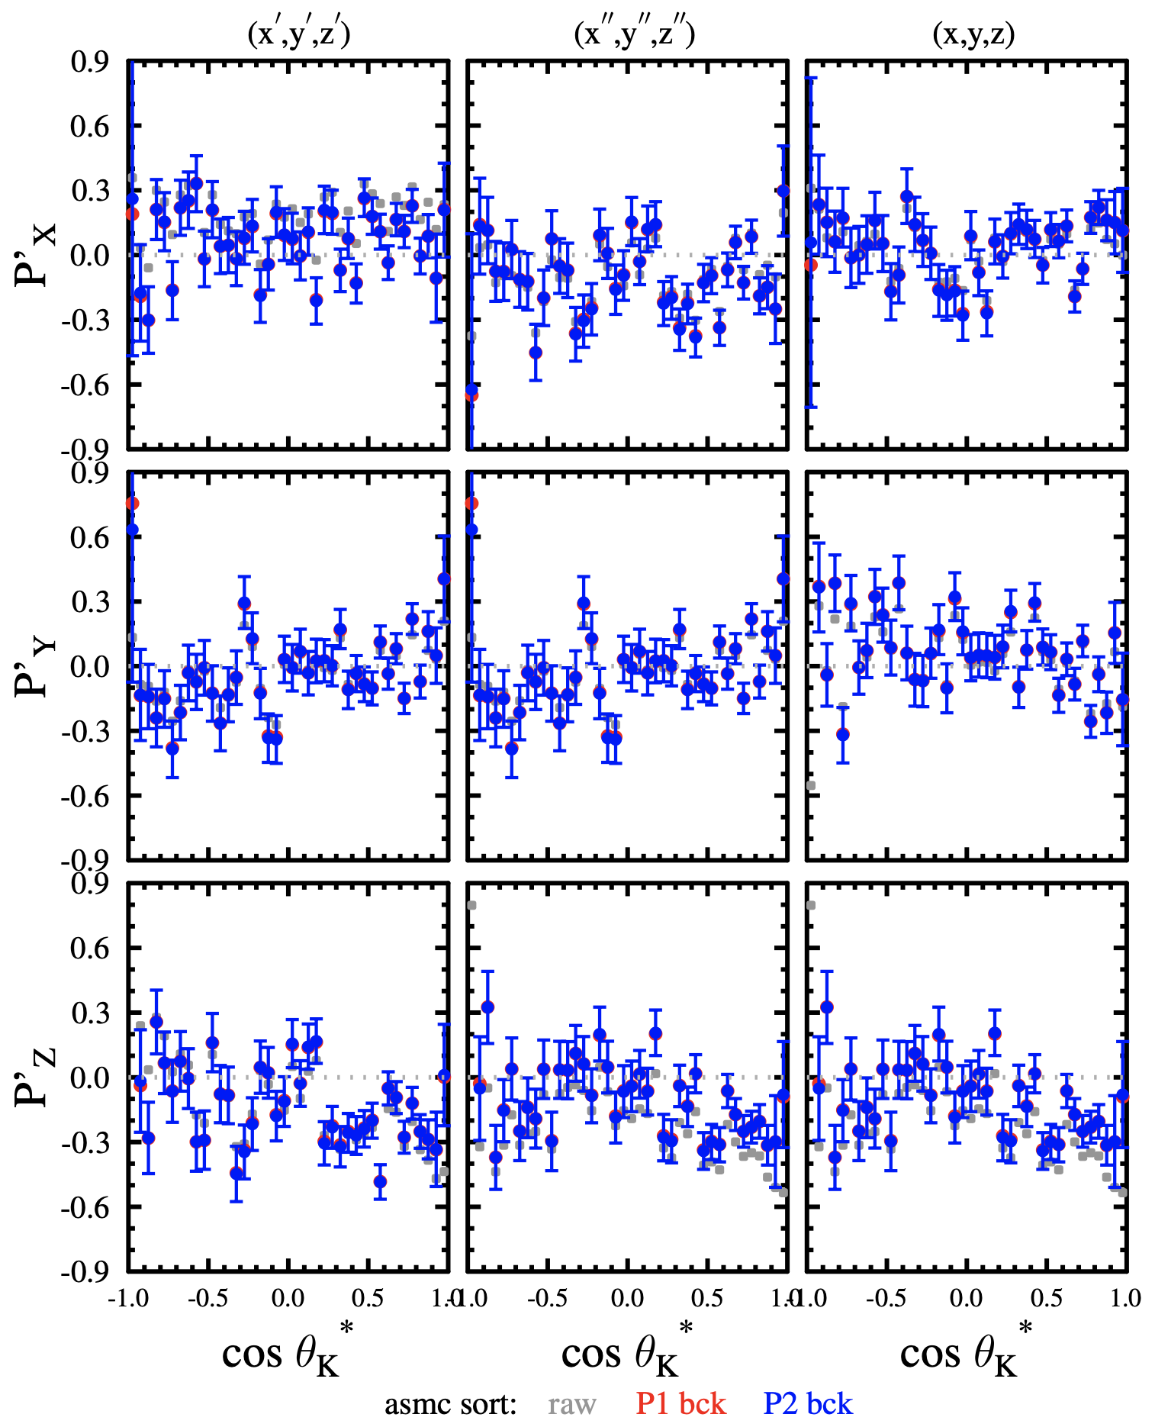
Beam-Recoil Transferred Polarization
Goal: Analysis of RG-K data to ready for review this year
Details presented at HSWG – D.S. Carman
by Dan Carman
K⁺Λ
K⁺Σ⁰
PRELIMINARY

Slide 17
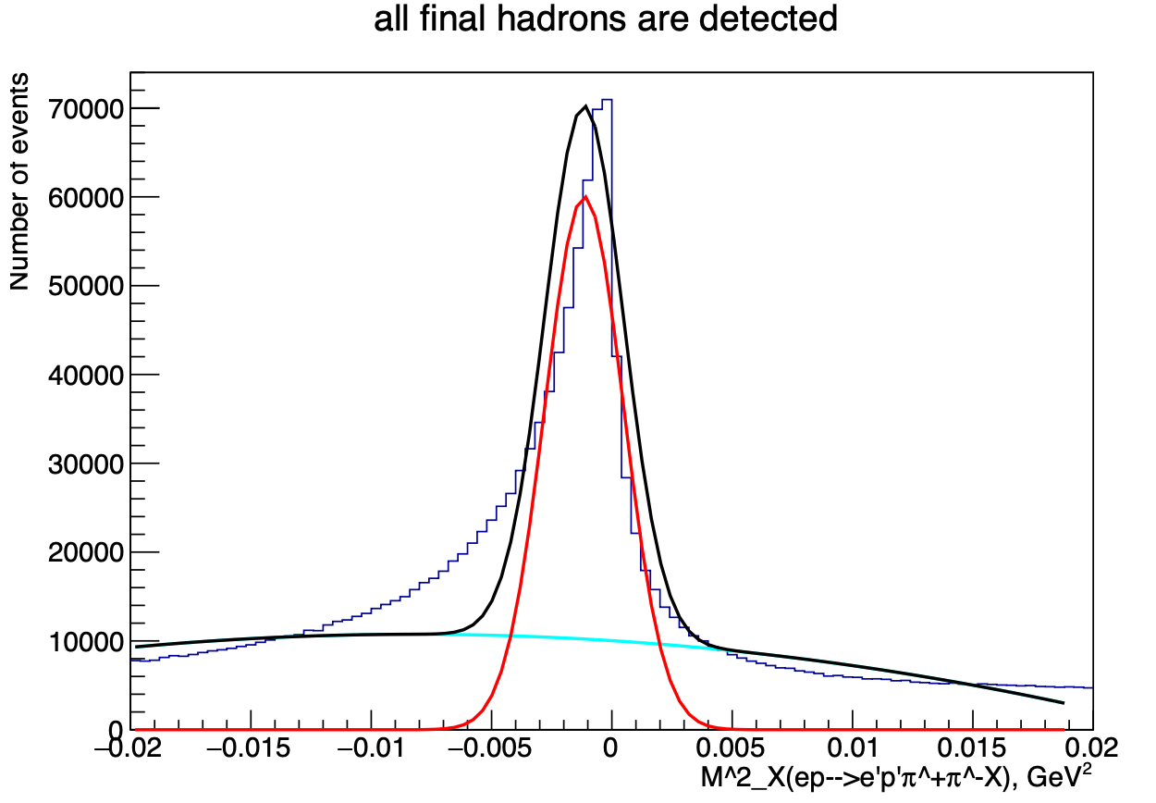
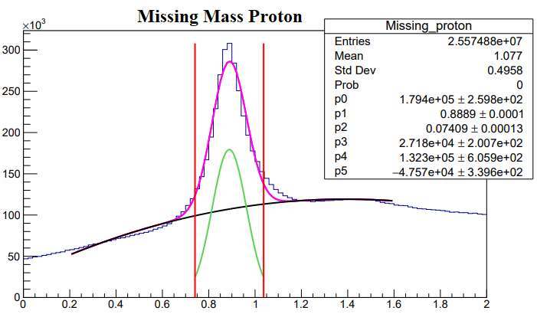
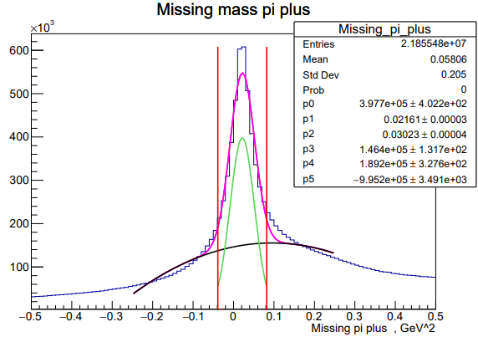
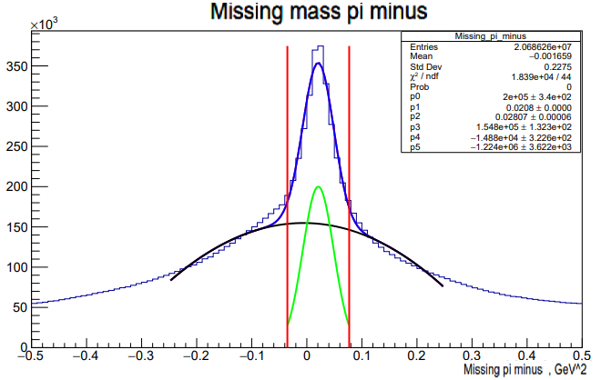


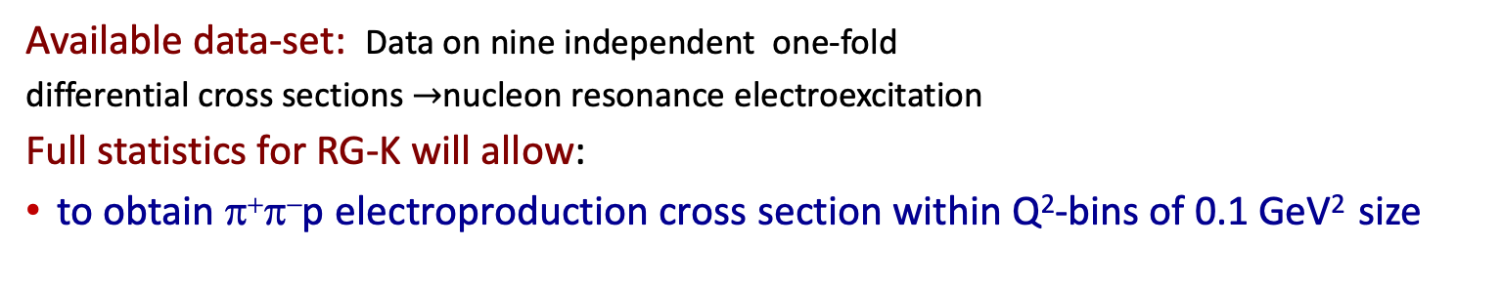

π⁺π⁻p Data analysis
RG-K @ 6.5 GeV
by Anna Frolova and Alexander Bulgakov
2.2<W<2.5 GeV
ep$→$eπ⁺π⁻X
Q² GeV² | e p π⁻ | e p π⁺
0.15-0.25 | 1080k | 800k
0.25-0.35 | 1550k | 940k
0.35-0.45 | 1100k | 660k
0.45-0.55 | 870k | 570k
0.55-0.65 | 660k | 480k
0.65-0.75 | 640k | 370k
0.75-0.85 | 450k | 270k
0.85-0.95 | 340k | 260k
0.95-1.05 | 360k | 210k
1.05-1.15 | 250k | 180k
1.15-1.25 | 250k | 170k
1.25-1.35 | 210k | 170k
1.35-1.45 | 150k | 100k
1.45-1.55 | 130k | 90k
Total | 7940k | 5270k
M²_{X ,} GeV²
M²_{X ,} GeV²
ep $→$e’p’π⁻X
ep $→$e’p’π⁻⁺X
M²_{X ,} GeV²
M²_{X ,} Gev²
Available data-set: Data on nine independent one-fold
differential cross sections $→$nucleon resonance electroexcitation
Full statistics for RG-K will allow:
to obtain π⁺π⁻p electroproduction cross section within Q²-bins of 0.1 GeV² size

Slide 18
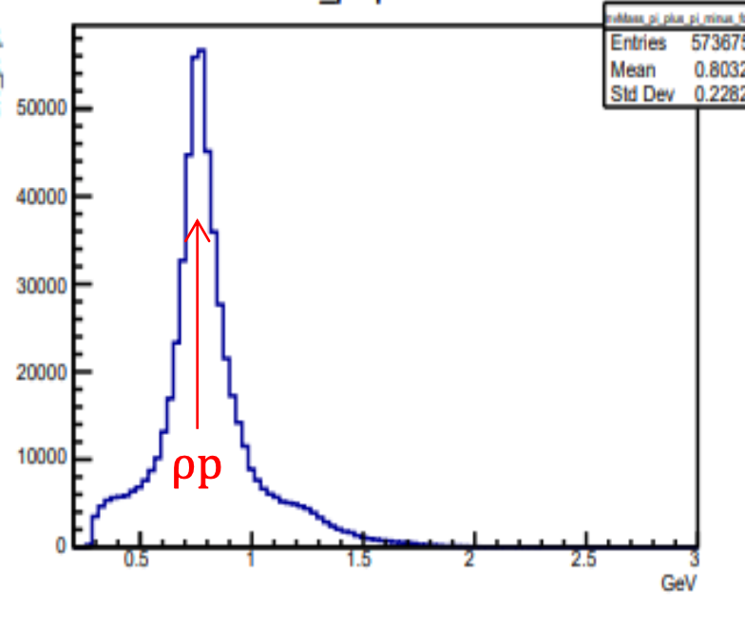
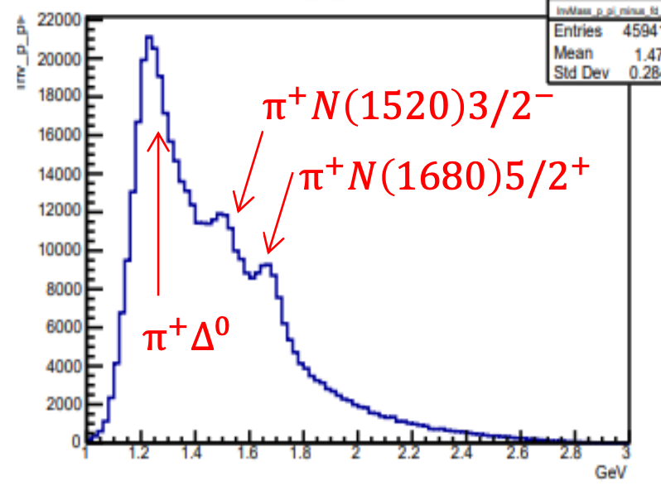
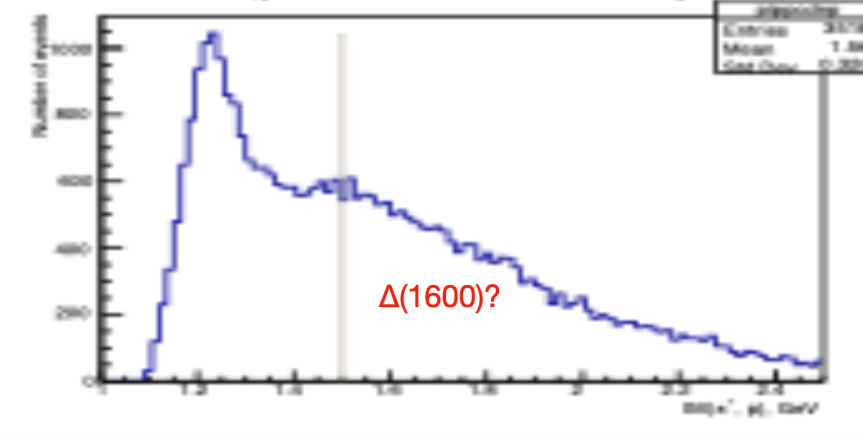
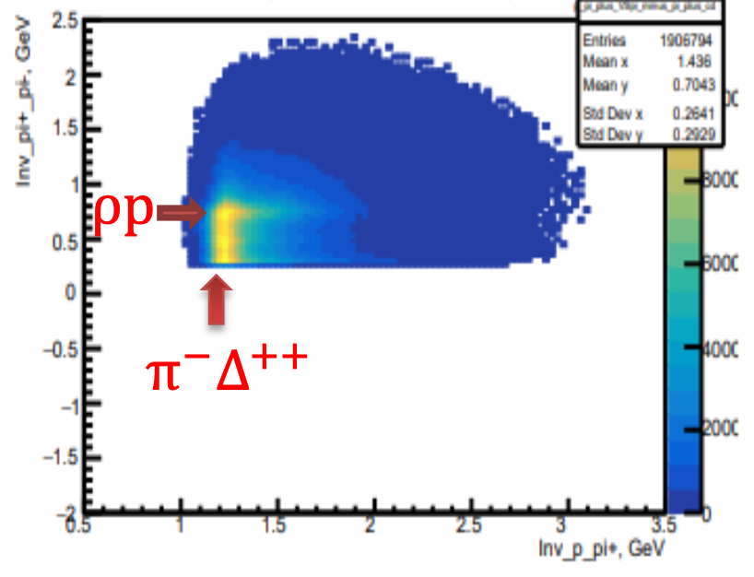
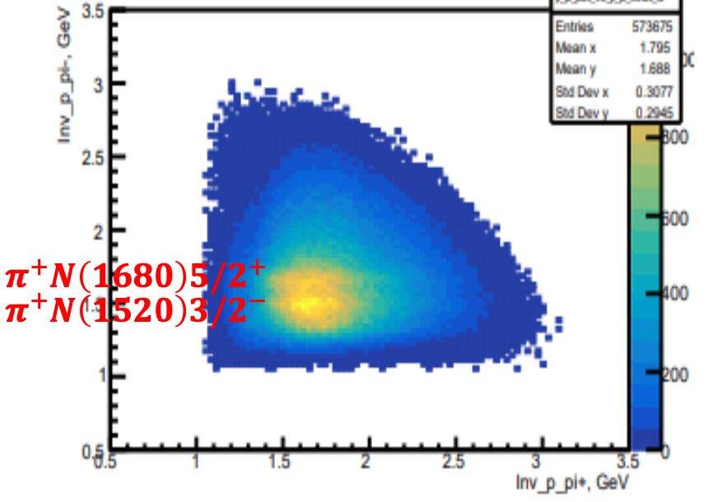
π⁺π⁻p Data analysis
by Anna Frolova and Alexander Bulgakov
f₂(1280)p
π⁻Δ⁺⁺(1232)
π⁻Δ⁺⁺(1600)
IM(π+π-) GeV
IM(π+p) GeV
IM(π−p) GeV
All meson-baryon channels established form the π⁺π⁻p CLAS data are present in RG-K data.
Hints for contributions from f₂(1280)p and π⁻Δ⁺⁺(1600)3/2⁺ channels have been observed
π⁺π⁻p is the ideal ground for resonance electrocoupling extraction as proved by the discovery of the N’(1720)3/2⁺ from the CLAS data analysis (V.I. Mokeev et al., Phys. Lett. B 805, 135457 (2020)).

Slide 19
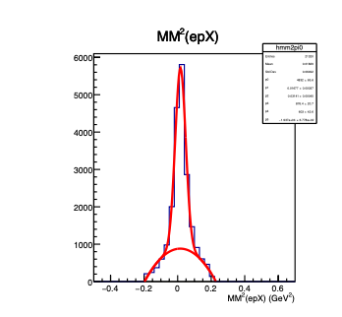
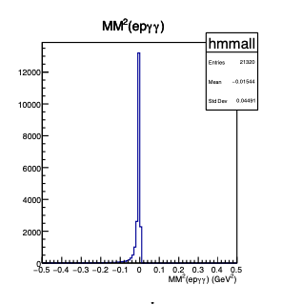
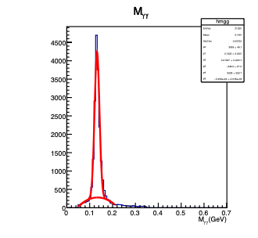
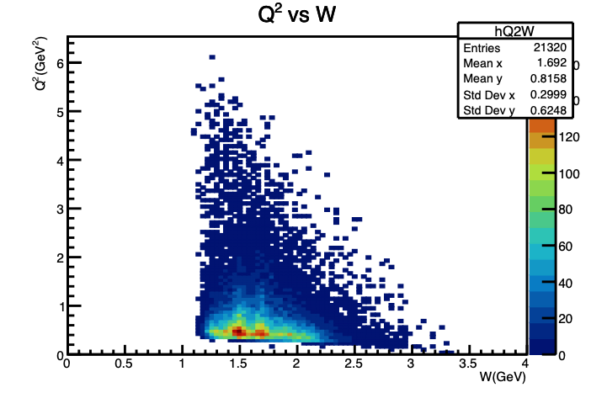
π⁰p Data analysis
Signal from e + p$→$e’+ π⁰ + p’$→$ e’ + γ + γ + p’ channel:
γγ invariant mass
by Anna Golubenko
Manifestation of the nucleon
resonances in the second and
the third resonance regions
2nd N*
region
3rd .N*
region
Goals:
Measurement of BSA and differential cross sections for π⁰p electroproduction off protons.

Slide 20
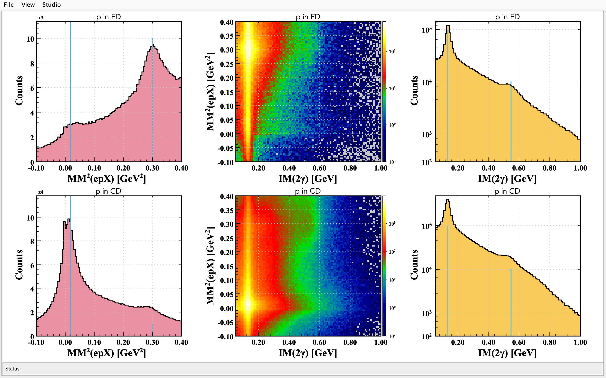
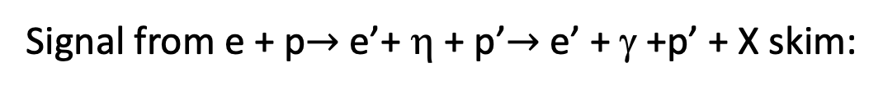
by Izzy Illary
ηp Data analysis
Signal from e + p$→$e’+ η + p’$→$ e’ + γ +p’ + X skim:
η detection is dominated by the π⁺π⁻π⁰ decay channel
Proton in FD
η
π⁰
Proton in FD
η
π⁰
Proton in CD
π⁰
Proton in CD
π⁰
η
η

Slide 21
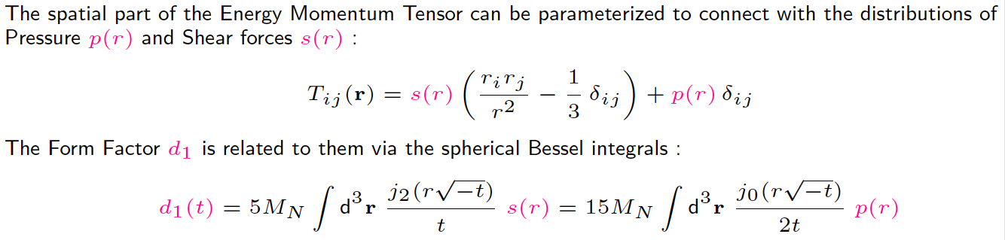
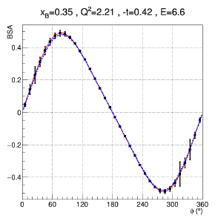

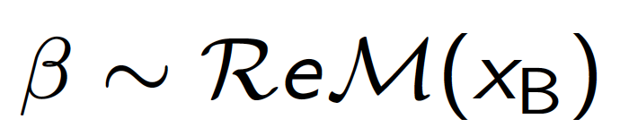
RG-K DVCS Physics
Dispersion relation relates
α and β to d₁(t)
α sin φ
1 + β cos φ

Slide 22
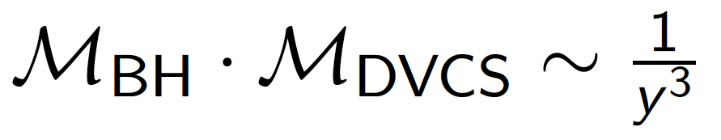
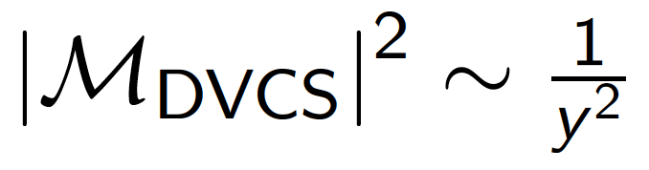
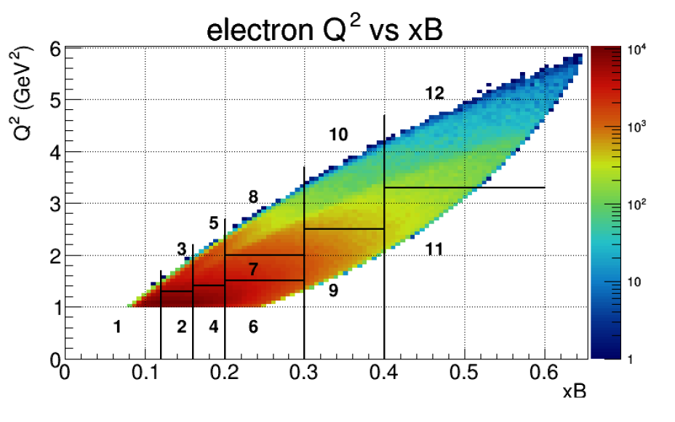
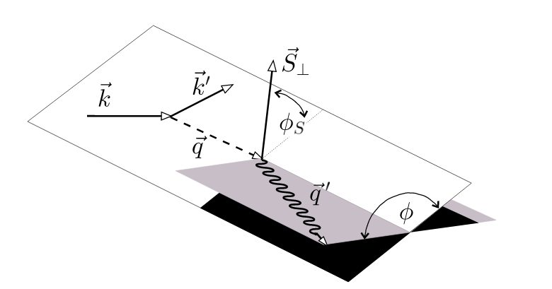
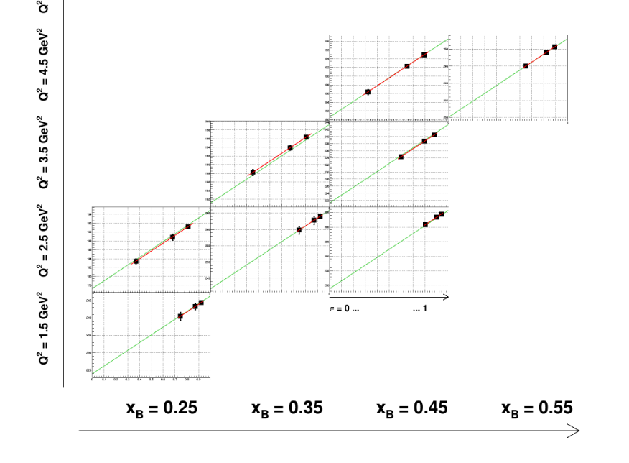

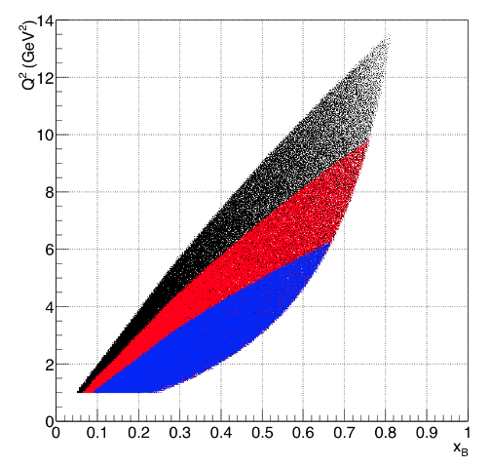
by FX Girod
RG-K DVCS Analysis Strategy
Need two beam energies, in addition to RGA 10.6 GeV
to separate the interference from
6.5&7.5
11 GeV
BSA(Q², x_{B,} t)
8.8 GeV
6.6 GeV
Different beam energies are needed for Rosenbluth separation

Slide 23
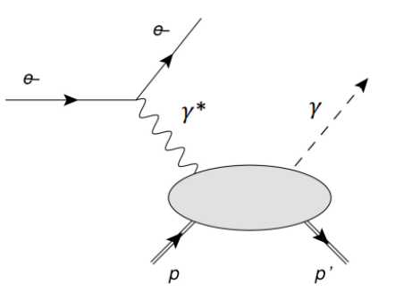
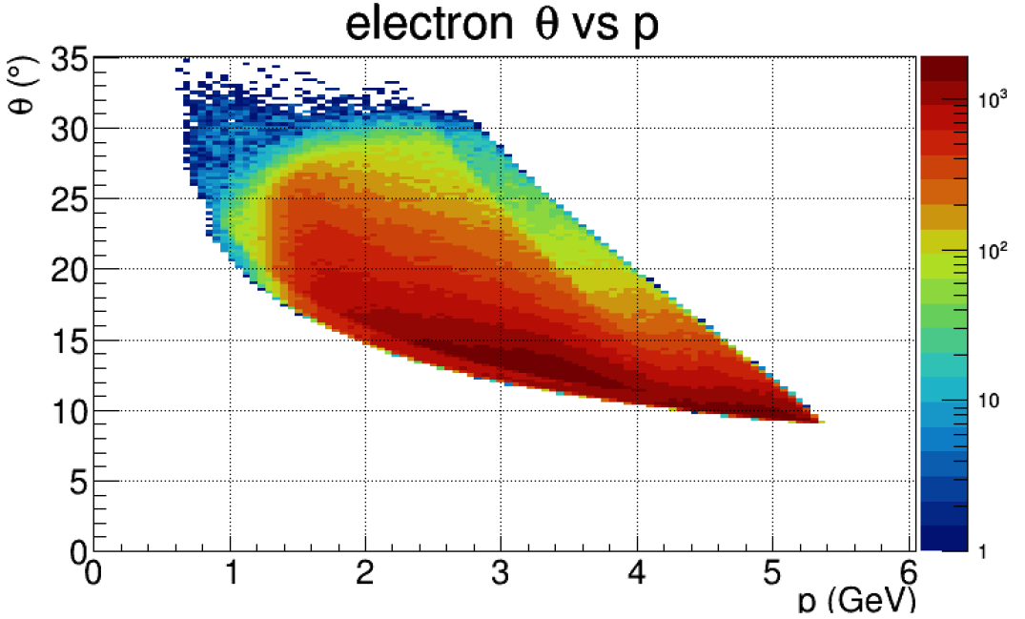
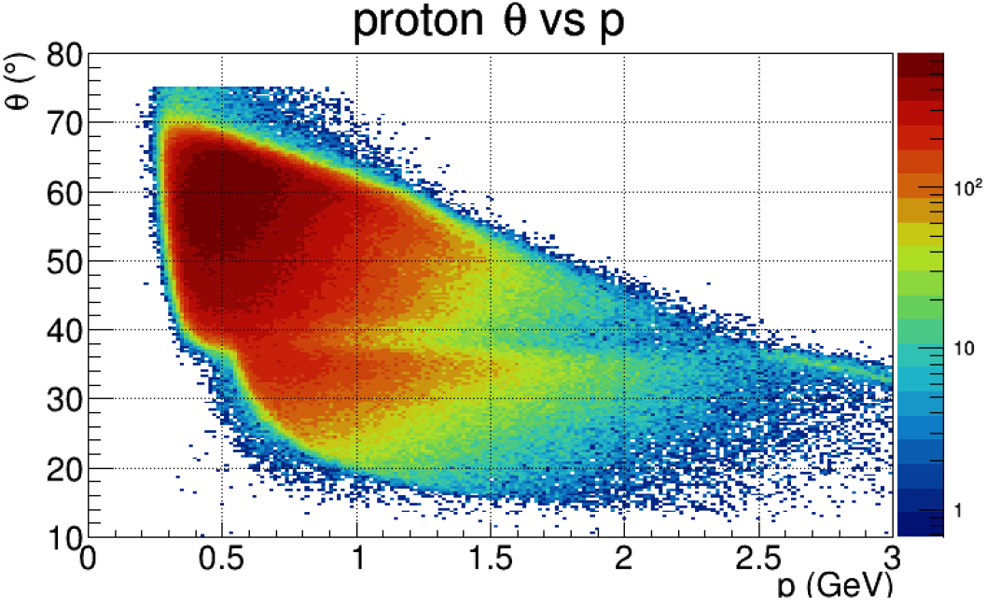
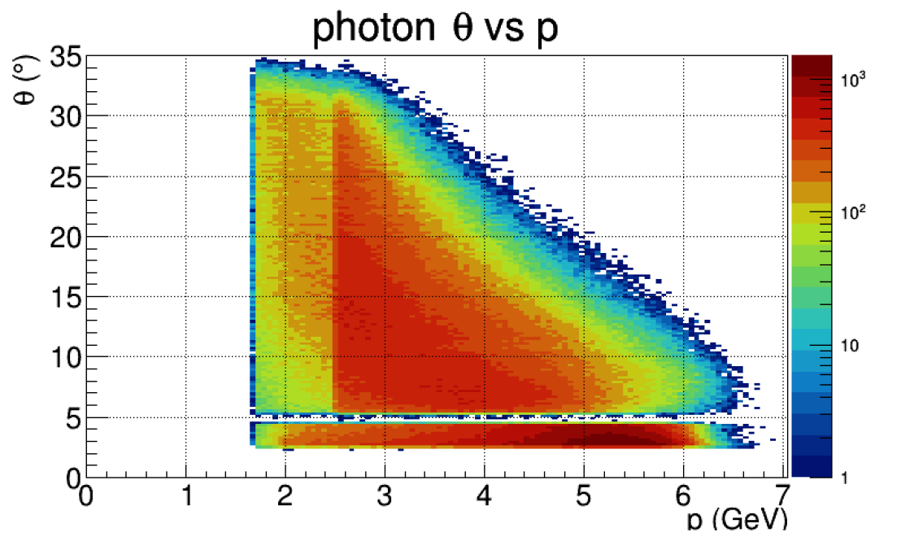
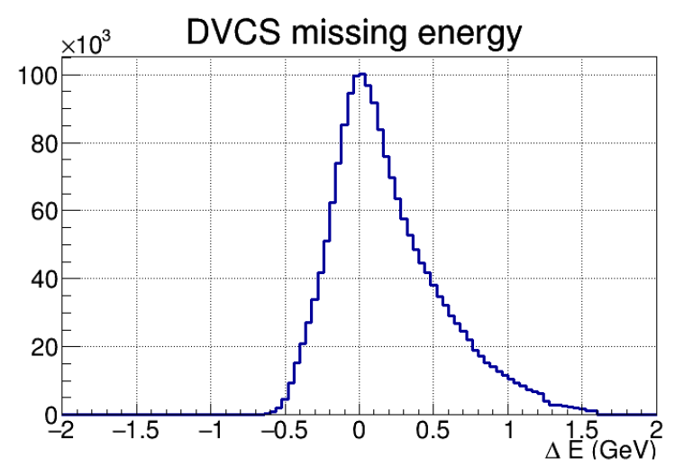

by FX Girod
RG-K DVCS Kinematics and Statistics
6.5 GeV and 7.5 GeV
Q² > 1 GeV² W > 2 GeV
e⁻ in the FD
p
CD
85%
FD
15%
p (GeV)
p (GeV)
All final particles are detected: e’ γ p
γ
FD
Ex
FT
Available statistics ~ 1.8 M events Full projected statistics ~ 20 M events

Slide 24



by FX Girod
RG-K DVCS BSA Preliminary Results
Proposed statistical accuracy
Appropriate matching with RGA statistics is essential
Large kinematical coverage is crucial to minimize systematic uncertainties
50 PAC days + 50 PAC days
6.6 GeV 8.8 GeV

Slide 25
Summary
Expected results from the RG-K data will address several fundamental open problems in hadron physics:
  - search for new states of baryon matter with glue as a structural component
  - insight into the emergence of the deconfined meson-baryon cloud from the confined core of three constituent quarks
  - shed light on the nature of the nucleon stability through the balance between the explosive/implosive parton pressure and shear forces
Available data-set correspond to 12% of expected statistics
On-going analysis on several exclusive channel is on-going:
  K⁺Y advanced analysis is expected to undergo Analysis Review by 2021
  π⁺π⁻p channel is expected to provide enough statistics for resonance electrocoupling extraction
  Analysis of π⁰p and ηp channels is underway
  data at different beam energies are of particular importance to isolate the interference term between the BH and DVCS amplitudes for gaining insight into energy-momentum tensor of QCD and the gravitation properties of the nucleon
The RG-K data is essential to clarify the active degrees of freedom of baryons and to get insight into the confinement mechanism of light quarks

Slide 26
Back-up Slides

Slide 27
Evidence for New N* in KY
State N(mass)J^{P} | PDG pre 2010 | PDG 2020 | KΛ | KΣ | Nγ | Nπ
N(1710)1/2⁺ | *** | **** | ** | * | **** | ****
N(1880)1/2⁺ |  | *** | ** | * | ** | *
N(2100)1/2⁺ | * | *** | * |  | ** | ***
N(1895)1/2⁻ |  | **** | ** | ** | **** | *
N(1900)3/2⁺ | ** | **** | ** | ** | **** | **
N(1875)3/2⁻ |  | *** | * | * | ** | **
N(2120)3/2⁻ |  | *** | ** | * | *** | **
N(2060)5/2⁻ |  | *** | * | * | *** | **
Δ(1600)3/2⁺ | *** | **** |  |  | **** | ***
Δ(1900)1/2⁻ | ** | *** |  | ** | *** | ***
Δ(2200)7/2⁻ | * | *** |  | ** | ** | ***
Study these states in electroproduction and extend to higher masses
Notes:
This slides shows a summary of the results in this analysis. The green column shows the rating by the PDG. The two columns show the importance of the strangeness channel in this results.

Slide 28


π⁺π⁻p CLAS data - Newly Discovered N’(1720)3/2⁺
π⁺π⁻p photoproduction
π⁺π⁻p electroproduction
V.I. Mokeev et al., Phys. Lett. B 805, 135457 (2020)
N(1720)3/2⁺
Resonant part
N’(1720)3/2⁺
N’(1720)3/2⁺
Resonant part w/o
N’(1720)3/2⁺,
& N(1720)3/2⁺
N(1720)3/2⁺
Evidence of a new N’(1720)3/2⁺ resonance from the combined analysis of CLAS photo- and electroproduction of the π⁺π⁻p channel
First result on Q² evolution of new resonance electrocoupling

Slide 29

Hybrid Baryons in LQCD
Hybrid hadrons with dominant gluonic contributions are predicted to exist by QCD
J.J. Dudek and R.G. Edwards, PRD85, 054016 (2012)
LQCD
regular states
clustered
in mass
hybrid states
1.3 GeV
The nucleon mass is shifted ~300 MeV to higher masses
N
Hybrid states have same J^{P} values as qqq baryons. How to identify them?
Overpopulation of N 1/2⁺ and N 3/2⁺ bands
A_{1/2} (A_{3/2}) and S_{1/2} show different Q² evolutions than for the regular baryons

Slide 30





Dissecting N* Structure & Hybrid Signatures
Precise CLAS results on electrocouplings clarified nature of the Roper
q³
q³
q³g
q³g
q³
q³G: Z. P. Li, V.D. Burkert, and Z.J. Li, Phys. Rev. D 46, 70 (1992)
A_{1/2} and S_{1/2} amplitudes at high Q² indicate 1st radial q³ excitation
Complex interplay between inner 3q core & external meson-baryon cloud
For hybrid “Roper”, A_{1/2}(Q²) drops off faster with Q² and S_{1/2}(Q²) ~ 0

Slide 31


Accessing Shear Forces & Parton Pressure
M.V. Polyakov and P. Schweitzer, Int. Mod. J. Phys. A 33, 26 1830025 (2018)
Nucleon matrix element of EMT contains:
M₂(t) : Mass distribution inside the nucleon
J (t) : Angular momentum distribution
d₁(t) : Pressure distribution
∫dx x [H(x,ξ,t) + E(x,ξ,t)] = 2 J(t)
Shear forces inside the nucleon
∫dx x H(x,ξ,t) = M₂(t) + 4/5 ξ² d₁(t)
Measuring these form factors, we learn about confinement forces
43 Web of Science citations
87 Inspire citations
Parton pressure inside the nucleon
V.D. Burkert, L. Elouadrhiri, & F.X. Girod, Nature, 557 396 (2018)
Notes:
The nucleon matrix element of the energy-momentum tensor is known to contain 3 form factors. They describe ….. and can only be measured directly in elastic graviton-nucleon scattering. However, these form factors appear as moments of the unpolarized GPDs as shown here. The quark angular momentum in the nucleon is given by the 2nd moment of the sum of GPD H and E. The mass and pressure distribution of the quarks are given by the 2nd moment of H where the pressure is probed by parameter xi.

Slide 32
RGK data timelines
e- in FD + FT &1 H
Trigger
5809 Accelerator Vacuum Loss
k⁺ per trigger
(Forward)
set-up
e- in FD
Trigger
e- in FD (pre-scaled) + FT &1 H
Trigger
60nA
35nA
45nA
lumi
scan
runs 5694 - 5752
runs 5758 - 5780
runs 5875 - 5972
½ Torus
7.5 GeV
7.5 GeV
6.5 GeV
RG-k_v2
trigger
RG-k_v4 trigger
RG-k_v6 trigger
lumi
scan
35nA
protons per trigger
(Central)

Slide 33

RG-K DVCS Preliminary Results
Flattening of the α(t) slope
evolution of transverse nucleon size with x

