Slide 1

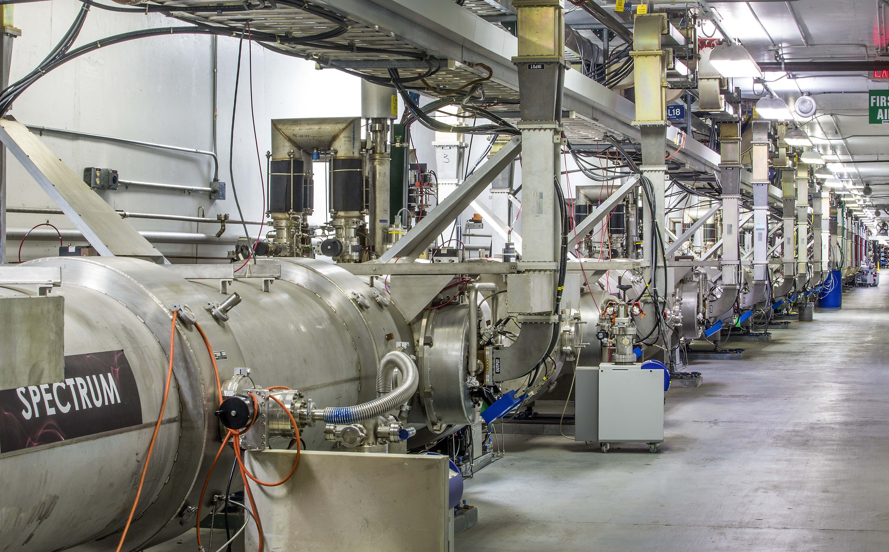
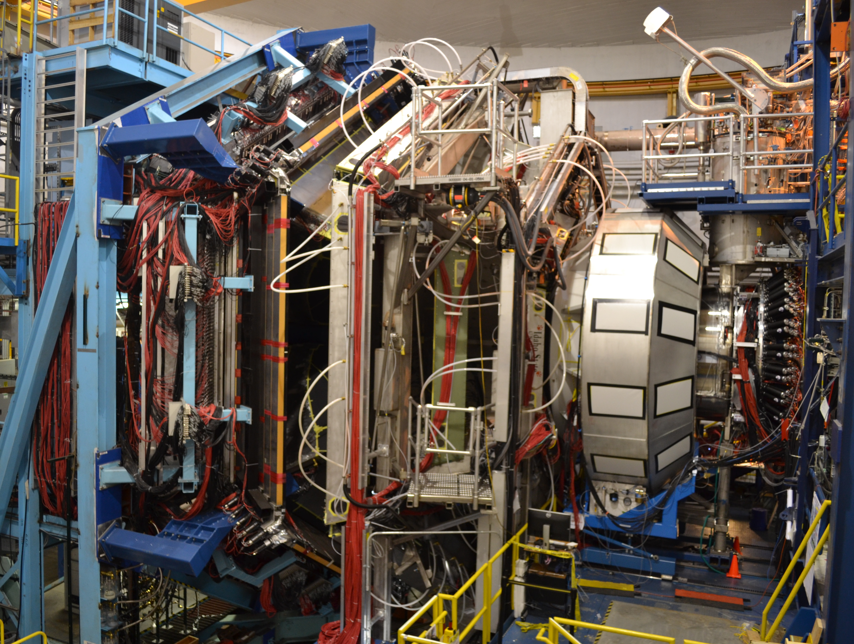

Hall B Run Group A (RG-A) (Pol. e on Unpol. H)
11 GeV Polarized Electrons on Unpolarized Liquid-Hydrogen Target to Study Proton Structure, 3D Imaging, and Gluonic Excitations with CLAS12
Latifa Elouadrhiri
For RG-A
CLAS Collaboration meeting
March 3, 2021

Slide 2
RG- A Science Program
The CLAS12 RG-A experiments were designed to perform complementary measurements to study proton structure for both the ground and excited states, 3D imaging, and gluonic excitations with the core mission to understand the manner in which the constituents of protons are held together by the strong force and the emergence of the dominant part of hadron mass.
RG-A is composed of 13 experiments driven by an international collaboration grouped in 5 categories:
  Deep Exclusive Processes (E12-06-119, E12-06-108 and E12-12-00): Study of Generalized Parton Distributions (GPDs), (2 +1)-D imaging of the proton and the study of its gravitational and mechanical structure
  Deep inclusive & SIDIS (E12-06-112, E12-06-112A and E12-06-112B): Study of the Transverse Momentum Distributions (TMDs) and the 3D structure in momentum space
  Nucleon structure (E12-09-003, E12-06-108A, E12-06-108B): Study of nucleon resonance structure at Q² from 2.0 to 12 GeV²
  Quasi photo-production (E12-12-001 and E12-12-001A): Study of J/ψ photoproduction, LHCb pentaquarks, and Time-like Compton Scattering
  MesonX program (E12-11-005 and E12-11-005A): Study of meson spectroscopy in search for hybrid mesons

Slide 3
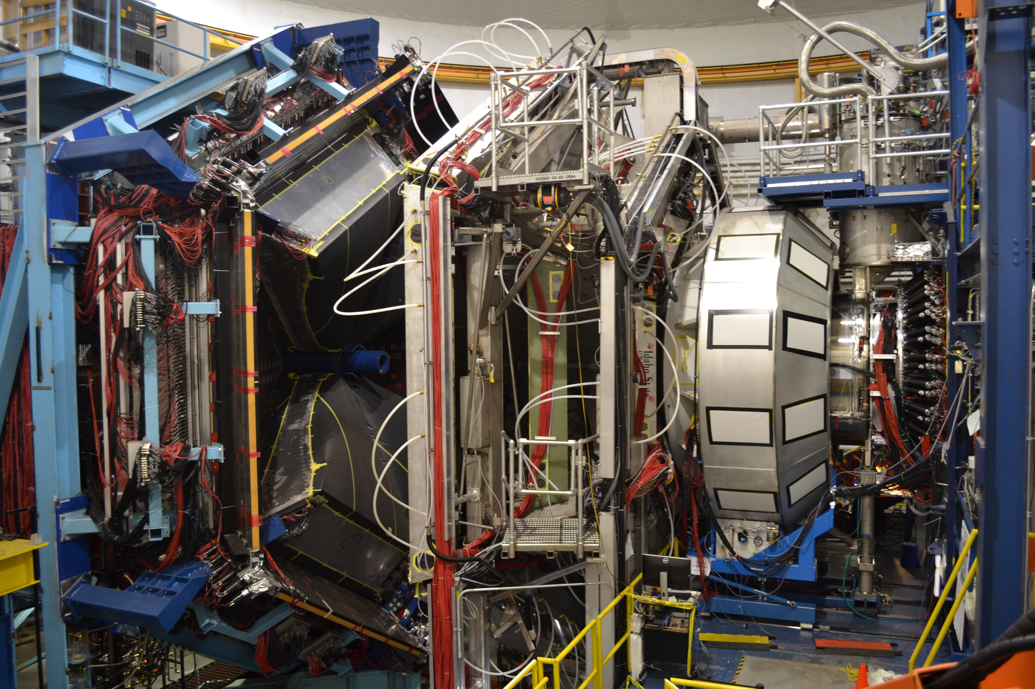
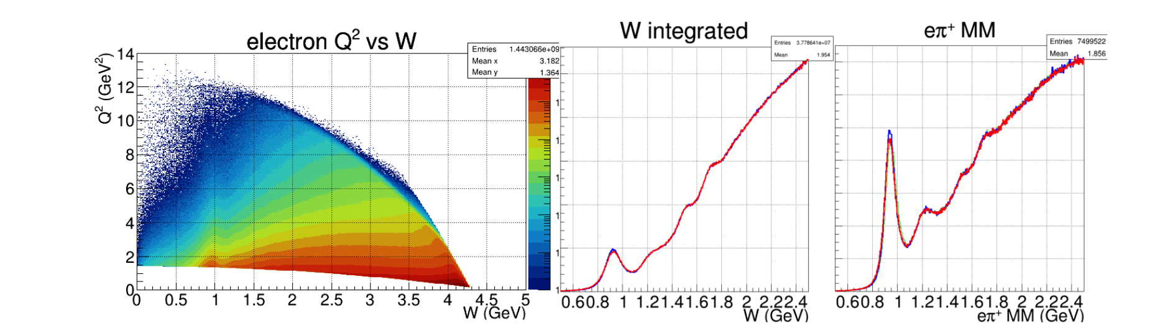
RG-A Experiment
CLAS12
RG-A has acquired data in three separate running periods, spring 2018 (126 mC), fall 2018 (99 mC), and spring 2019 (60 mC), with the collected charge amounting to roughly half of the full approved RG-A beam time. So far, the fall 2018 data set has been calibrated and processed for data analysis.
To fully realize the goals of the RG-A science program, the full statistics of the approved beam time is required.
Fall 2018: Data calibration and processing complete.
Spring 2019: Data calibration and processing complete.
Spring 2018: Data calibration in progress detailed day by day schedule being developed
Published in: Nucl. Instrum. Meth. A 959, 163419 (2020)

Slide 4
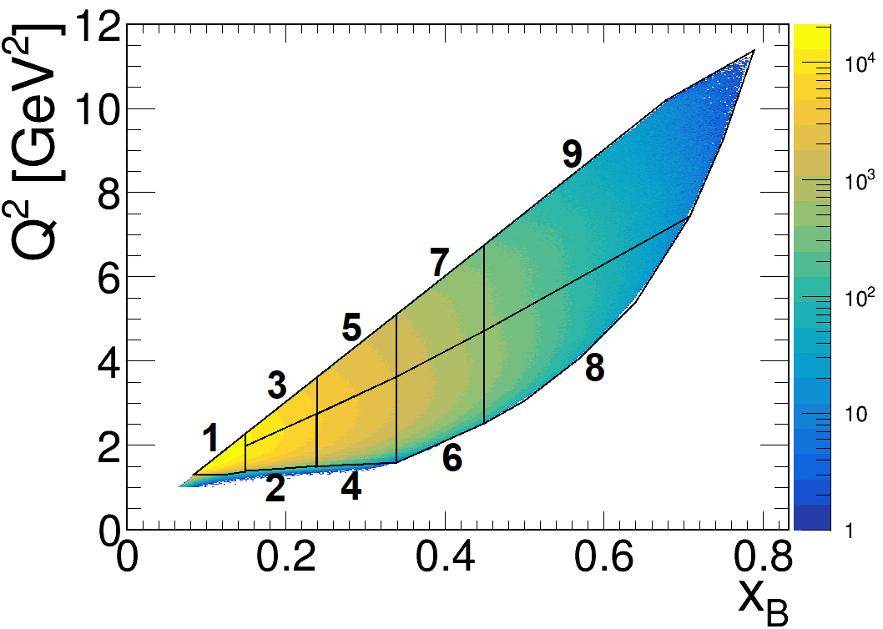
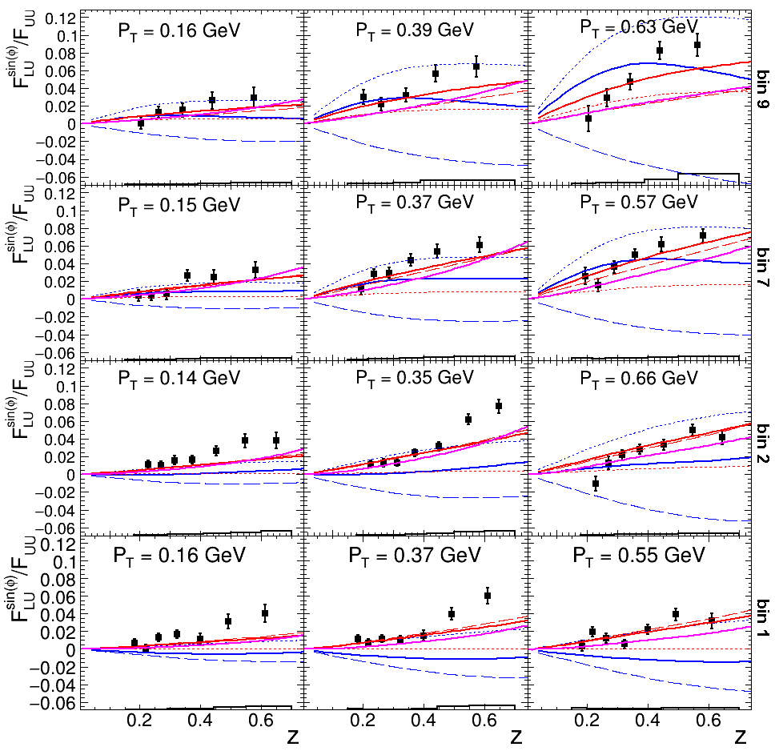
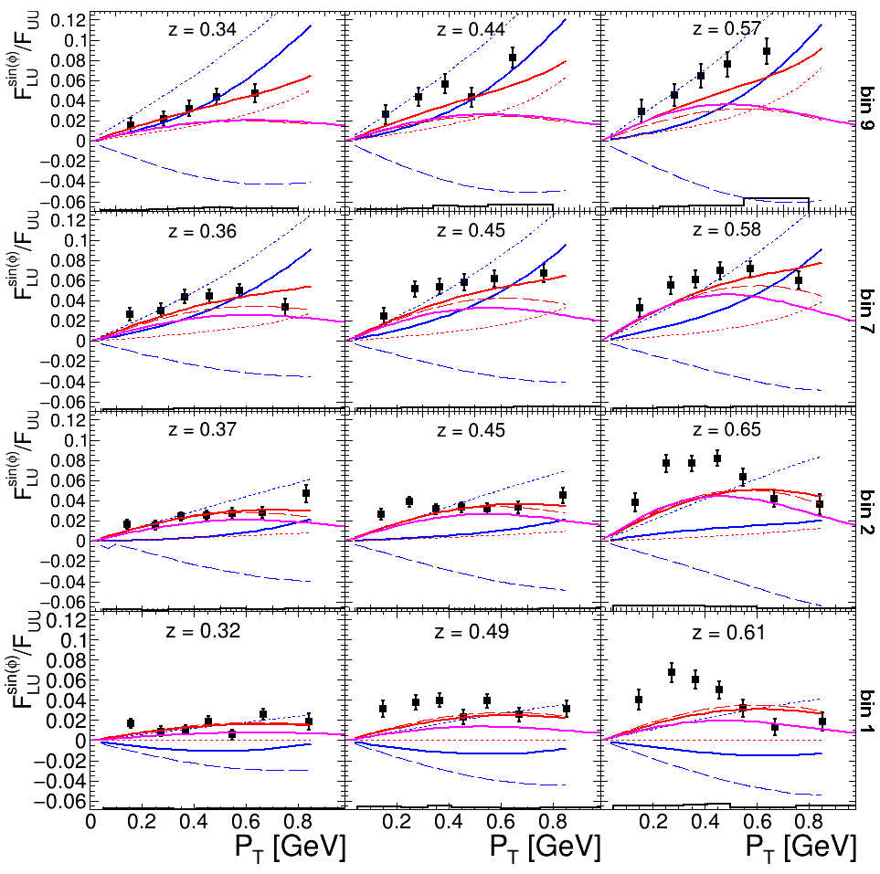
A first multidimensional, high precision study of SIDIS π⁺ beam single
spin asymmetry over a wide range of kinematics
SIDIS can probe the transverse momentum dependent parton structure
Previous experiments: Mostly only one dimensional studies
CLAS12: First fully differential study
High precision CLAS12 data can help to distinguish between
reaction models and to improve global fits of TMDs and FFs
Paper submitted to PRL

Slide 5
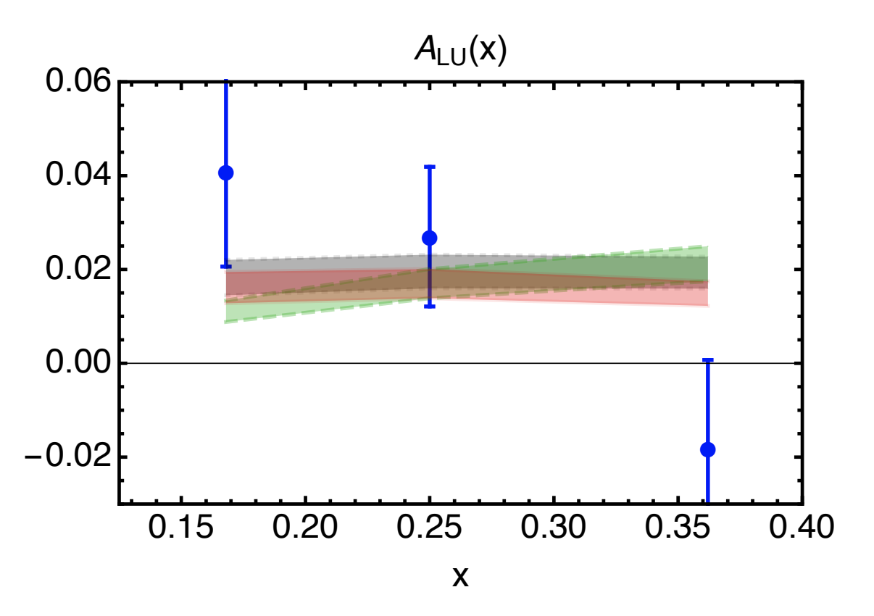
Measurements of Dihadron Beam-spin Asymmetries
Paper submitted to PRL
Physics quantities of interest:
  A_{LU} sin(ϕ_{R}) modulation: allowing the first significant access in a collinear framework to the twist-3 PDF e(x), which gives insight into largely unexplored quark-gluon correlations.
  A_{LU} sin(ϕ_{H}-ϕ_{R}) modulation: first measurement sensitive to the DiFF G₁⊥, which describes the helicity dependent fragmentation of a dihadron pair.
CLAS6 Preliminary
CLAS12
CLAS12
R. Jakob, P. J. Mulders and J. Rodrigues, Nucl. Phys. A 626 (1997)
R. L. Jaffe and X. D. Ji, Nucl. Phys. B 375 (1992)
B. Pasquini and S. Rodini, Phys. Lett. B 788 (2019)
Luo, Xuan and Sun, Hao and Xie, Yi-Ling, Phys. Rev. D 101 (2020)
(asymmetry for CLAS12 kinematics via personal correspondence)
The PDF e(x) can be extracted point by point from this asymmetry
A sign change is observed around the ρ mass

Slide 6
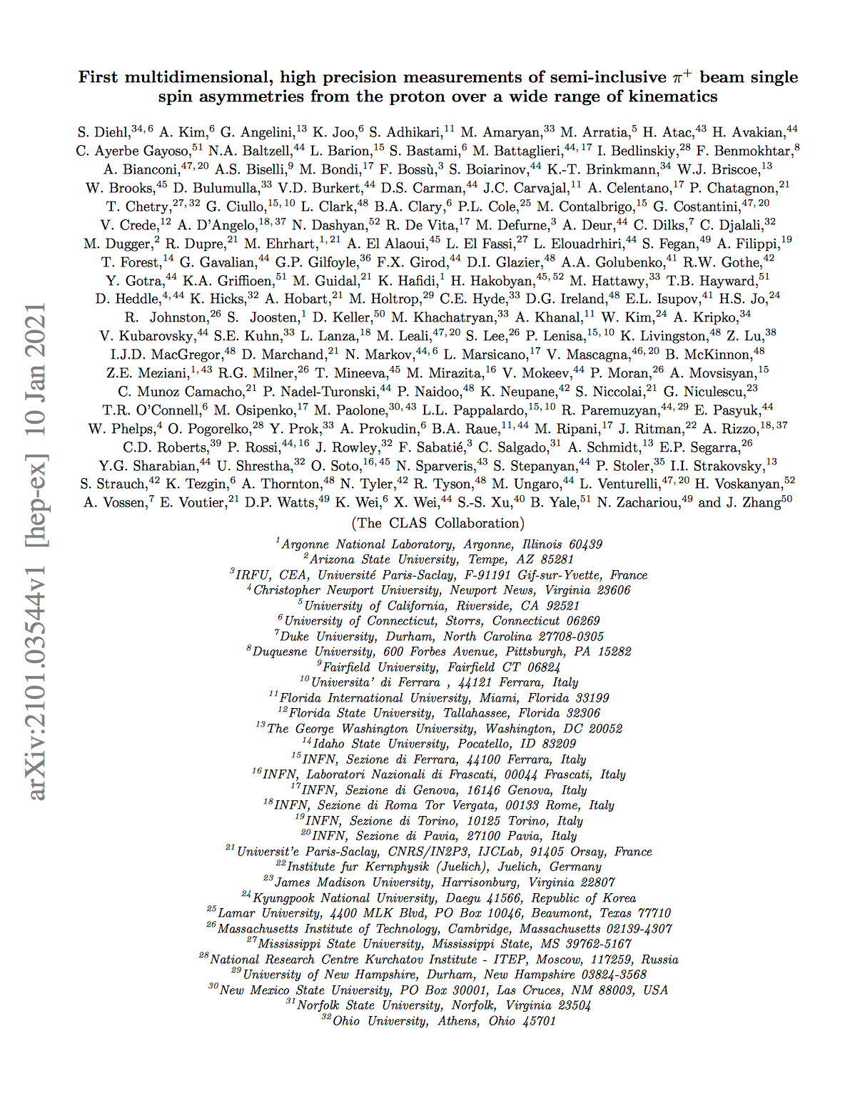
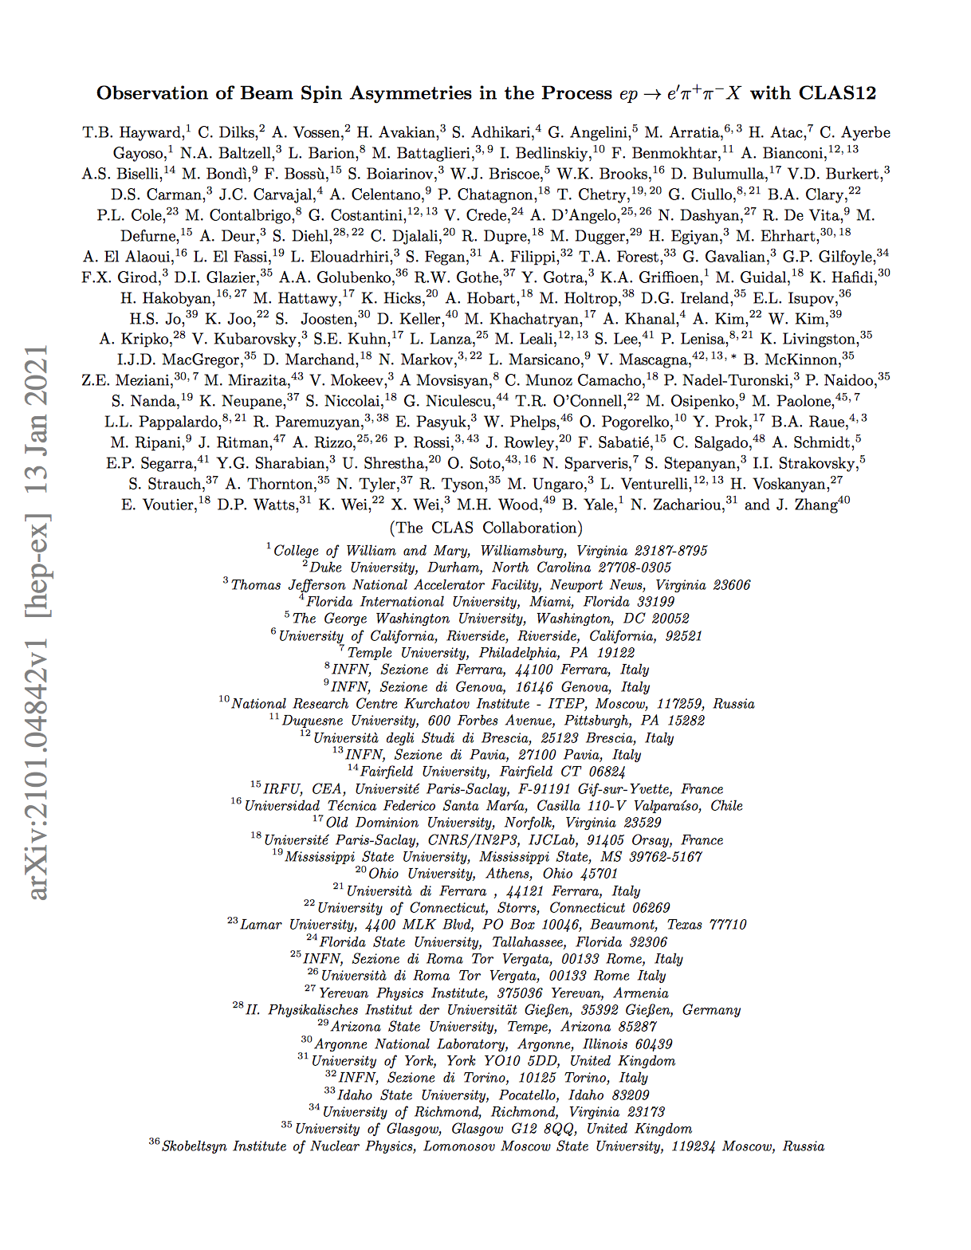
Status of the submitted papers
Paper submitted to PRL 01/10/21
Received referees’ reports 2/15/21: Lead authors addressing referees comments. Will schedule meeting to review the responses/paper before re-submission end of February
Paper submitted 1/12/21
Referee comments received 2/20/21
Response to the referee comments submitted 2/25/21

Slide 7
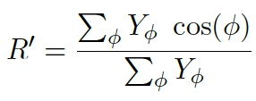
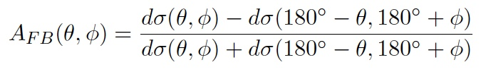
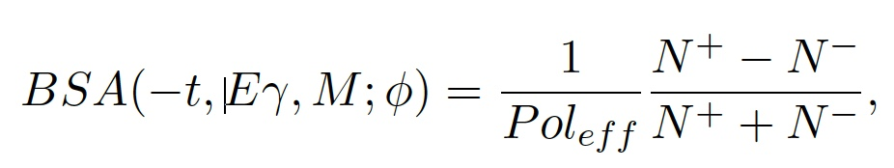
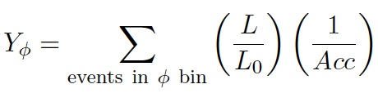
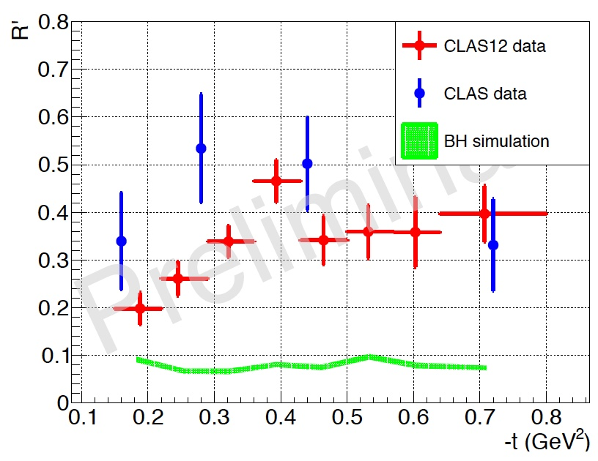
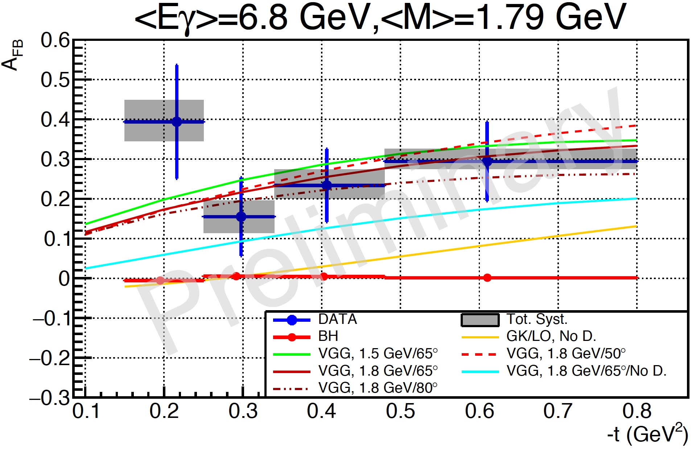
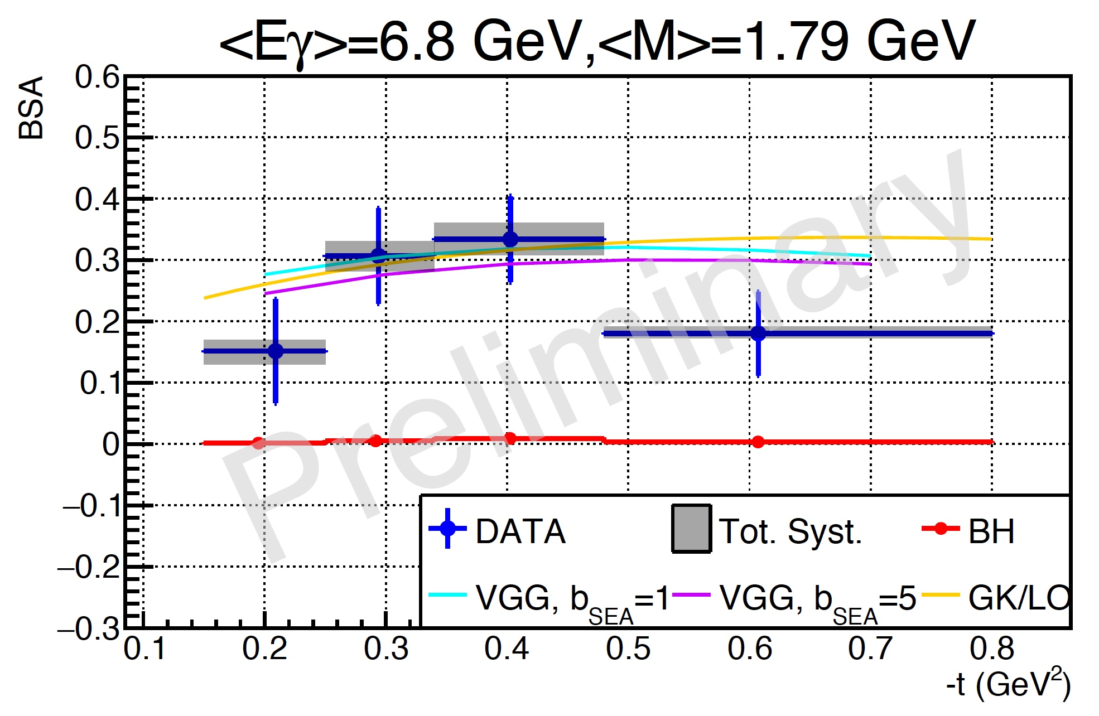
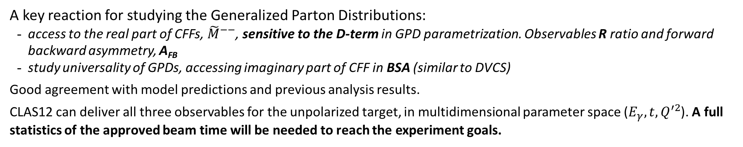
Time-like Compton Scattering
A key reaction for studying the Generalized Parton Distributions:
access to the real part of CFFs, ${\tilde{M}}^{−−}$, sensitive to the D-term in GPD parametrization. Observables R ratio and forward backward asymmetry, A_{FB}
study universality of GPDs, accessing imaginary part of CFF in BSA (similar to DVCS)
Good agreement with model predictions and previous analysis results.
CLAS12 can deliver all three observables for the unpolarized target, in multidimensional parameter space ($E_{γ}, t,Q^{′2}$). A full statistics of the approved beam time will be needed to reach the experiment goals.

Slide 8
TCS - analysis review - status
First round of comments received and Lead authors submitted responses
Drafting PRL
8

Slide 9
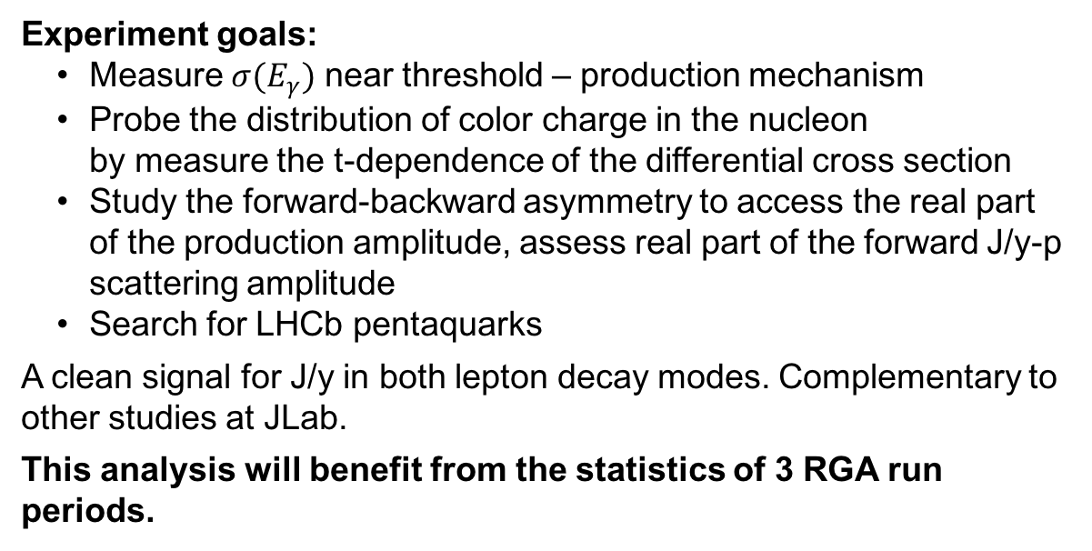
J/ψ Photoproduction
N(J/psi) = 200 +/- 21
Experiment goals:
Measure $σ(E_{γ})$ near threshold – production mechanism
Probe the distribution of color charge in the nucleon
by measure the t-dependence of the differential cross section
Study the forward-backward asymmetry to access the real part of the production amplitude, assess real part of the forward J/y-p scattering amplitude
Search for LHCb pentaquarks
A clean signal for J/y in both lepton decay modes. Complementary to other studies at JLab.
This analysis will benefit from the statistics of 3 RGA run periods.
N(J/psi) = 58 +/- 9

Slide 10
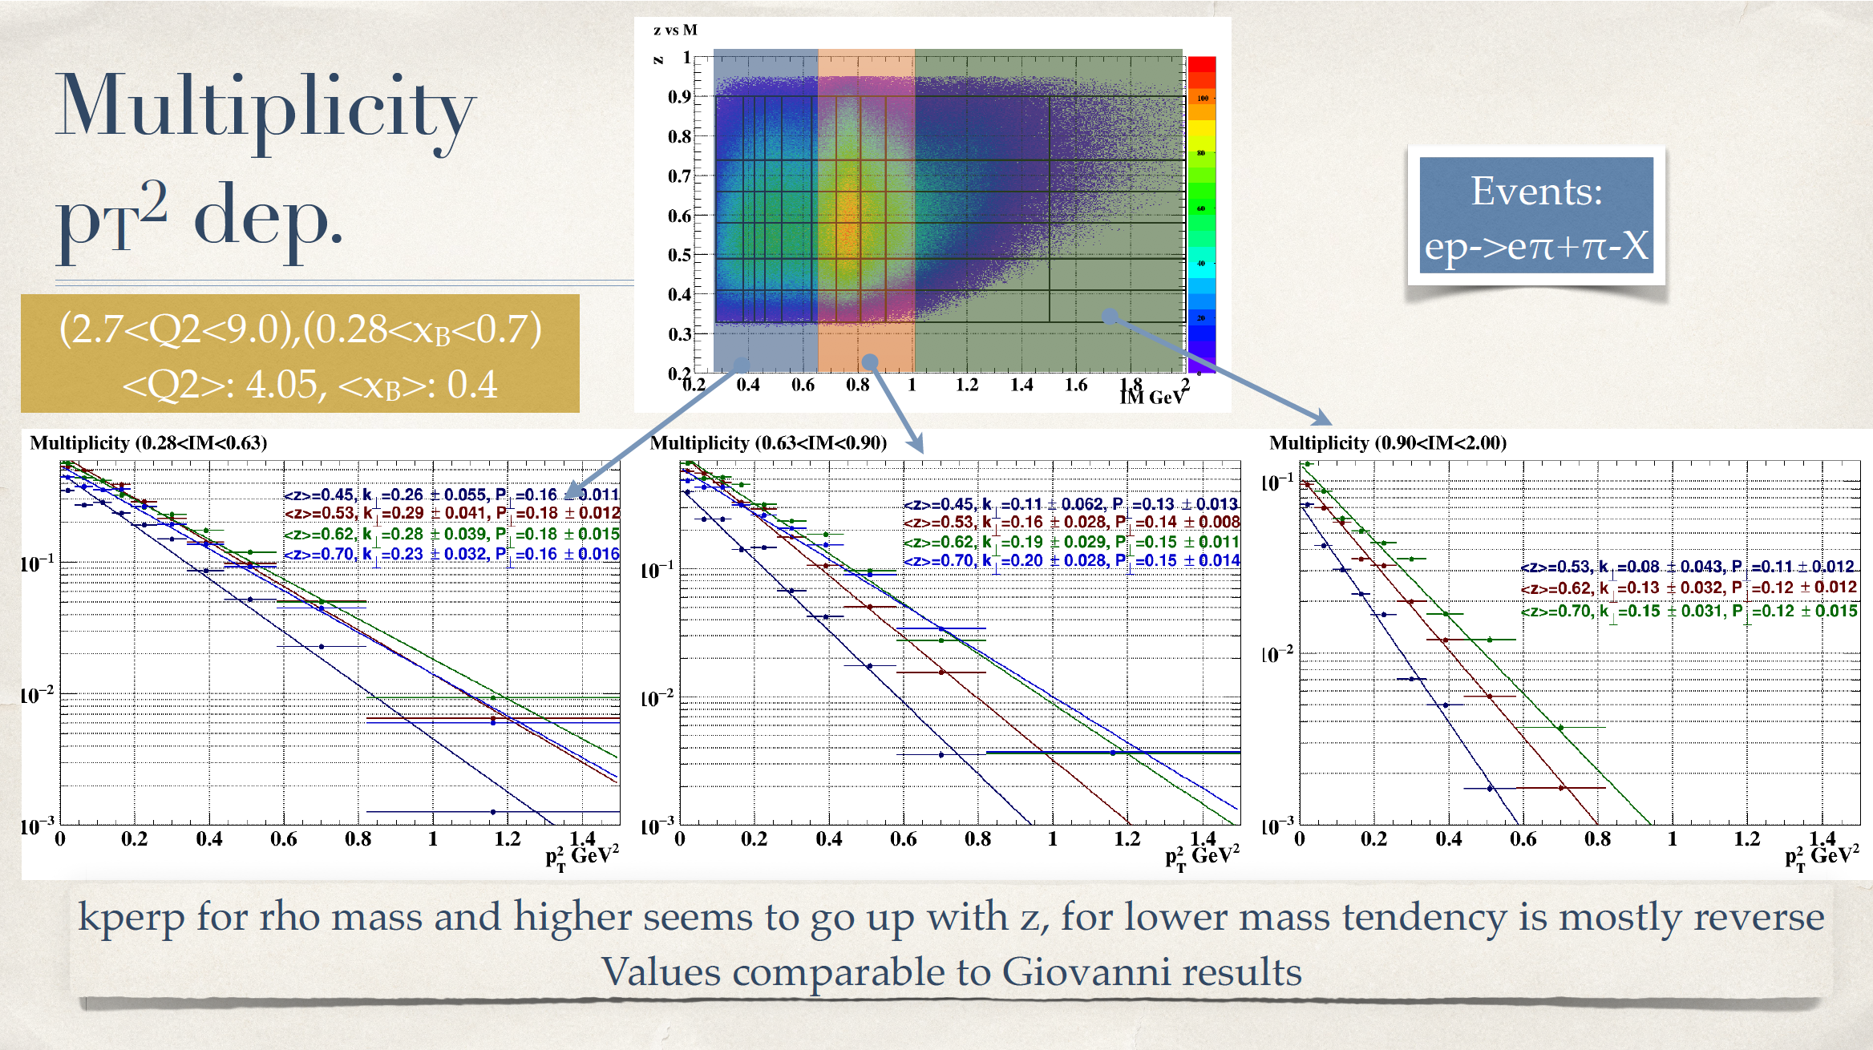

Slide 11
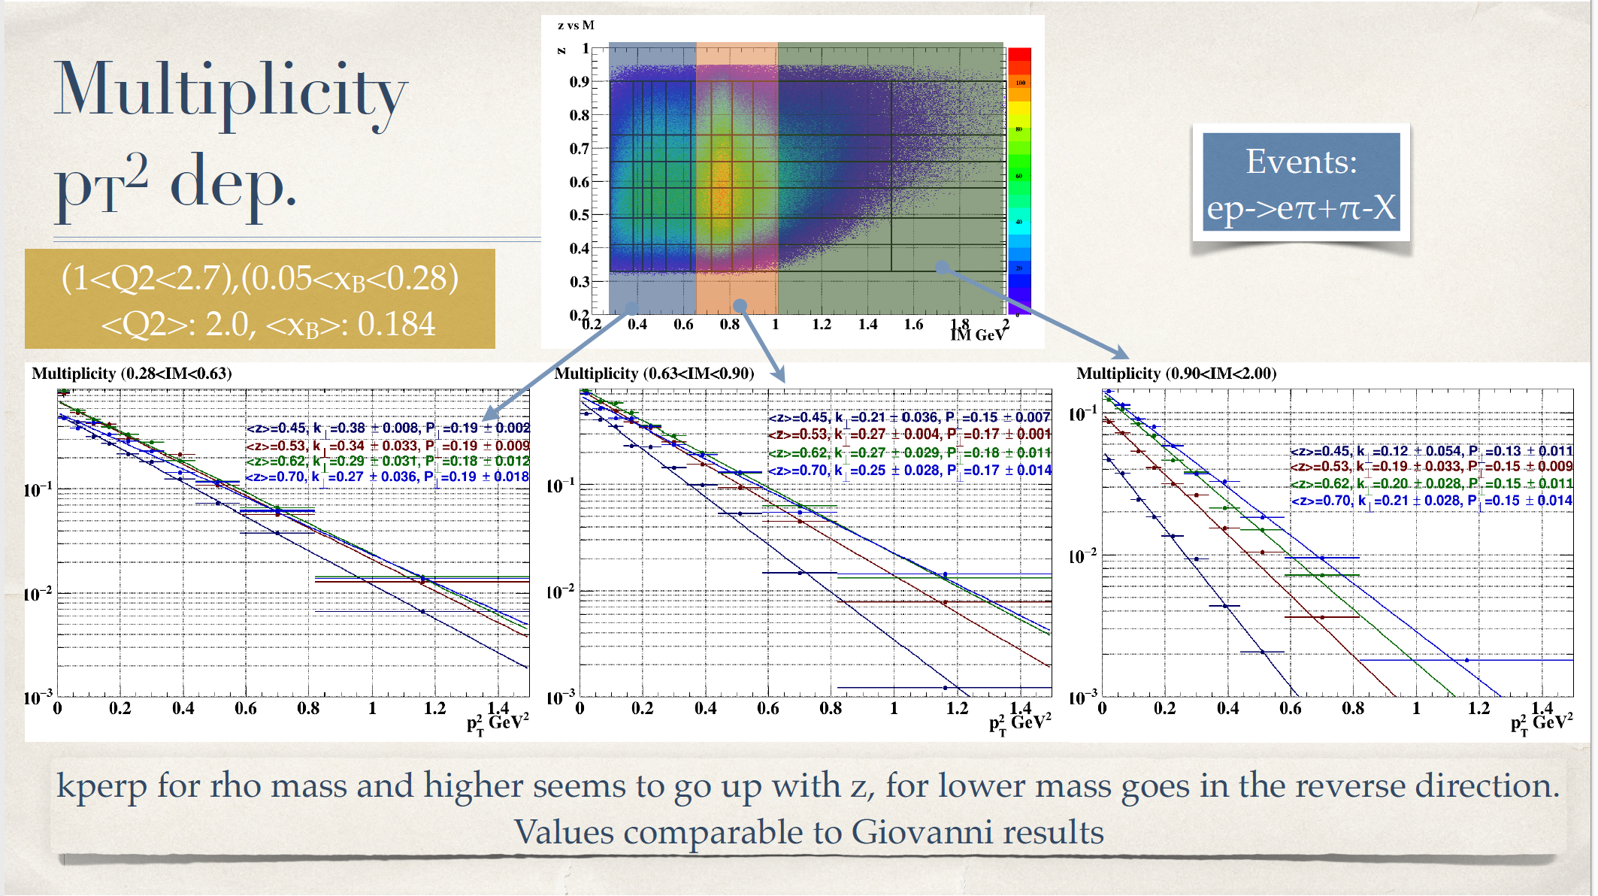

Slide 12
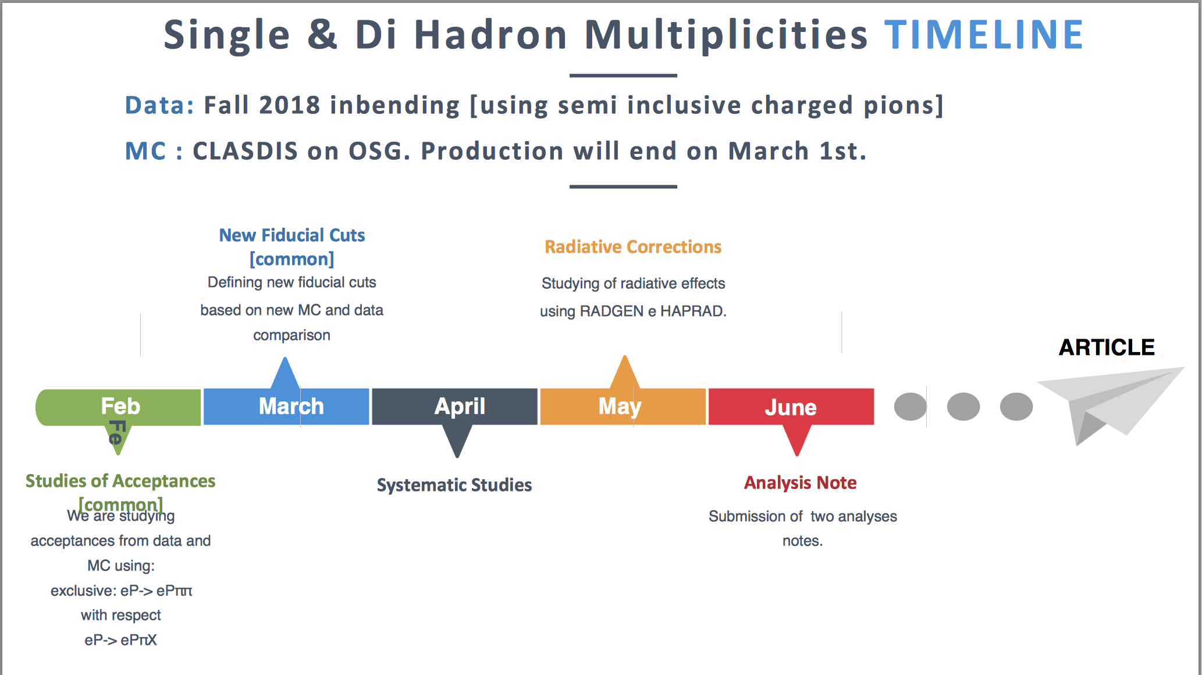

Slide 13
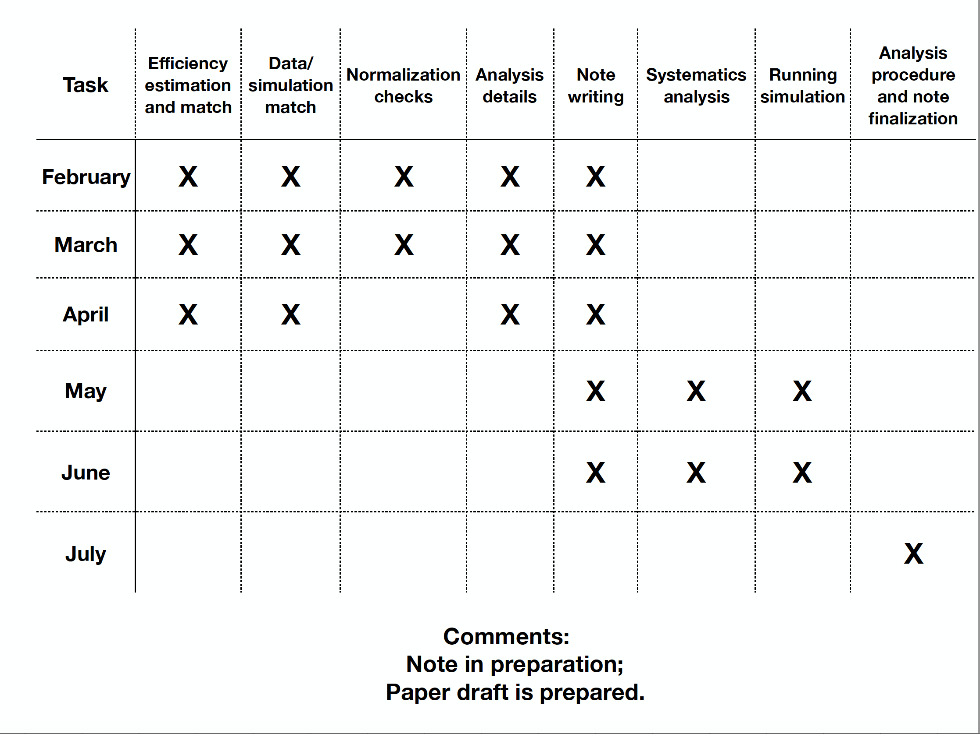
Inclusive Cross Section - RGA
Required absolute normalization:
  Acceptances
  Detector efficiencies
  Reconstruction efficiencies
  PID
  Radiative corrections
  others
Led by Hall-B TF (N. Markov)

Slide 14
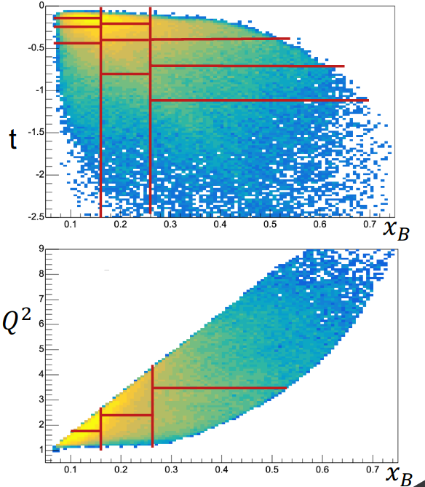
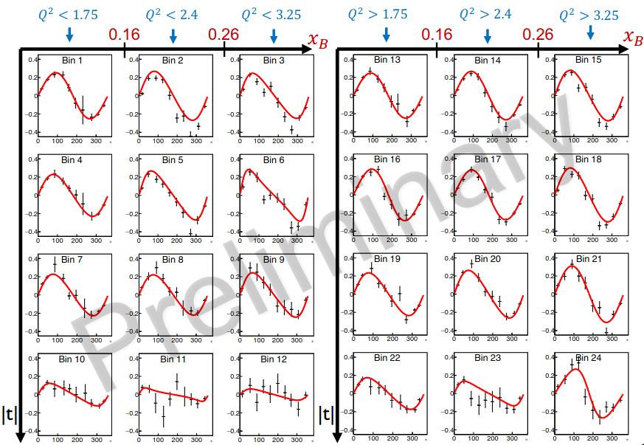
Ongoing DVCS analysis
All the programs have been written and validation almost finished.
(see G. Christiaens talk)
~66 % of the bins with limited contamination are quite well understood.
For the remaining 33 %, questions about :
- limitation of pi0 detection in PCAL/ECAL (see talk M. Defurne)
- question regarding delta-DVCS contamination due to CVT tracking.
Goal is to have an analysis note written for early june.

Slide 15
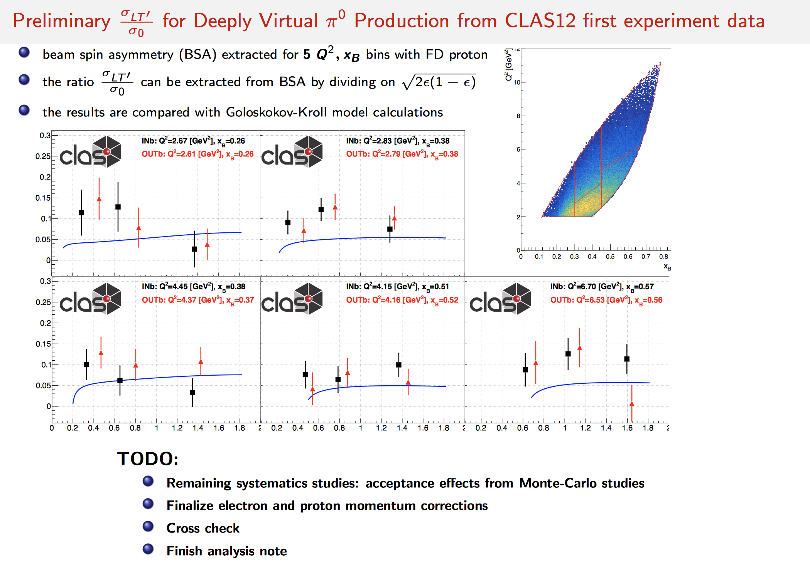
Exclusive pi0 analysis - RGA

Slide 16

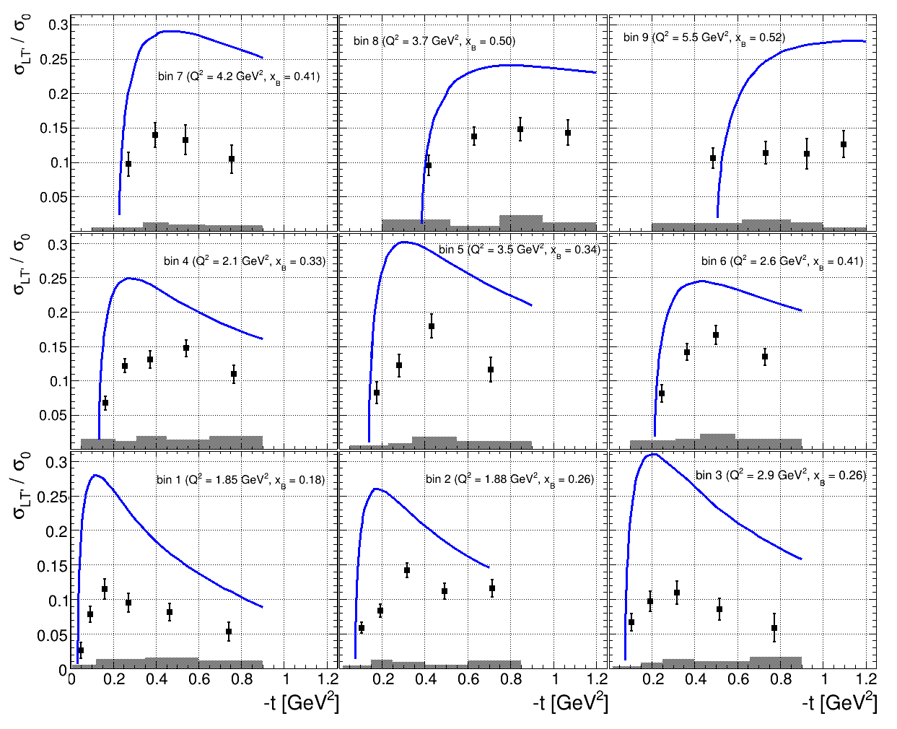


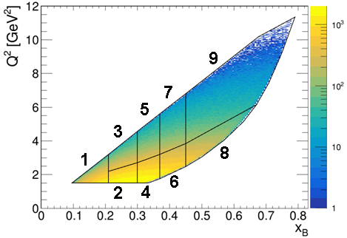
~
preliminary
GK model
Publication will show the first multidimensional study of hard exclusive π⁺
BSA in the GPD regime
Results will be compared to GK modell predictions
→ Data can be used to further cosntrain the GPD H_{T}
Analysis is currently in the finalisation stage
➔ Analysis note and paper are in preparation (review in 2 -3 month)

Slide 17
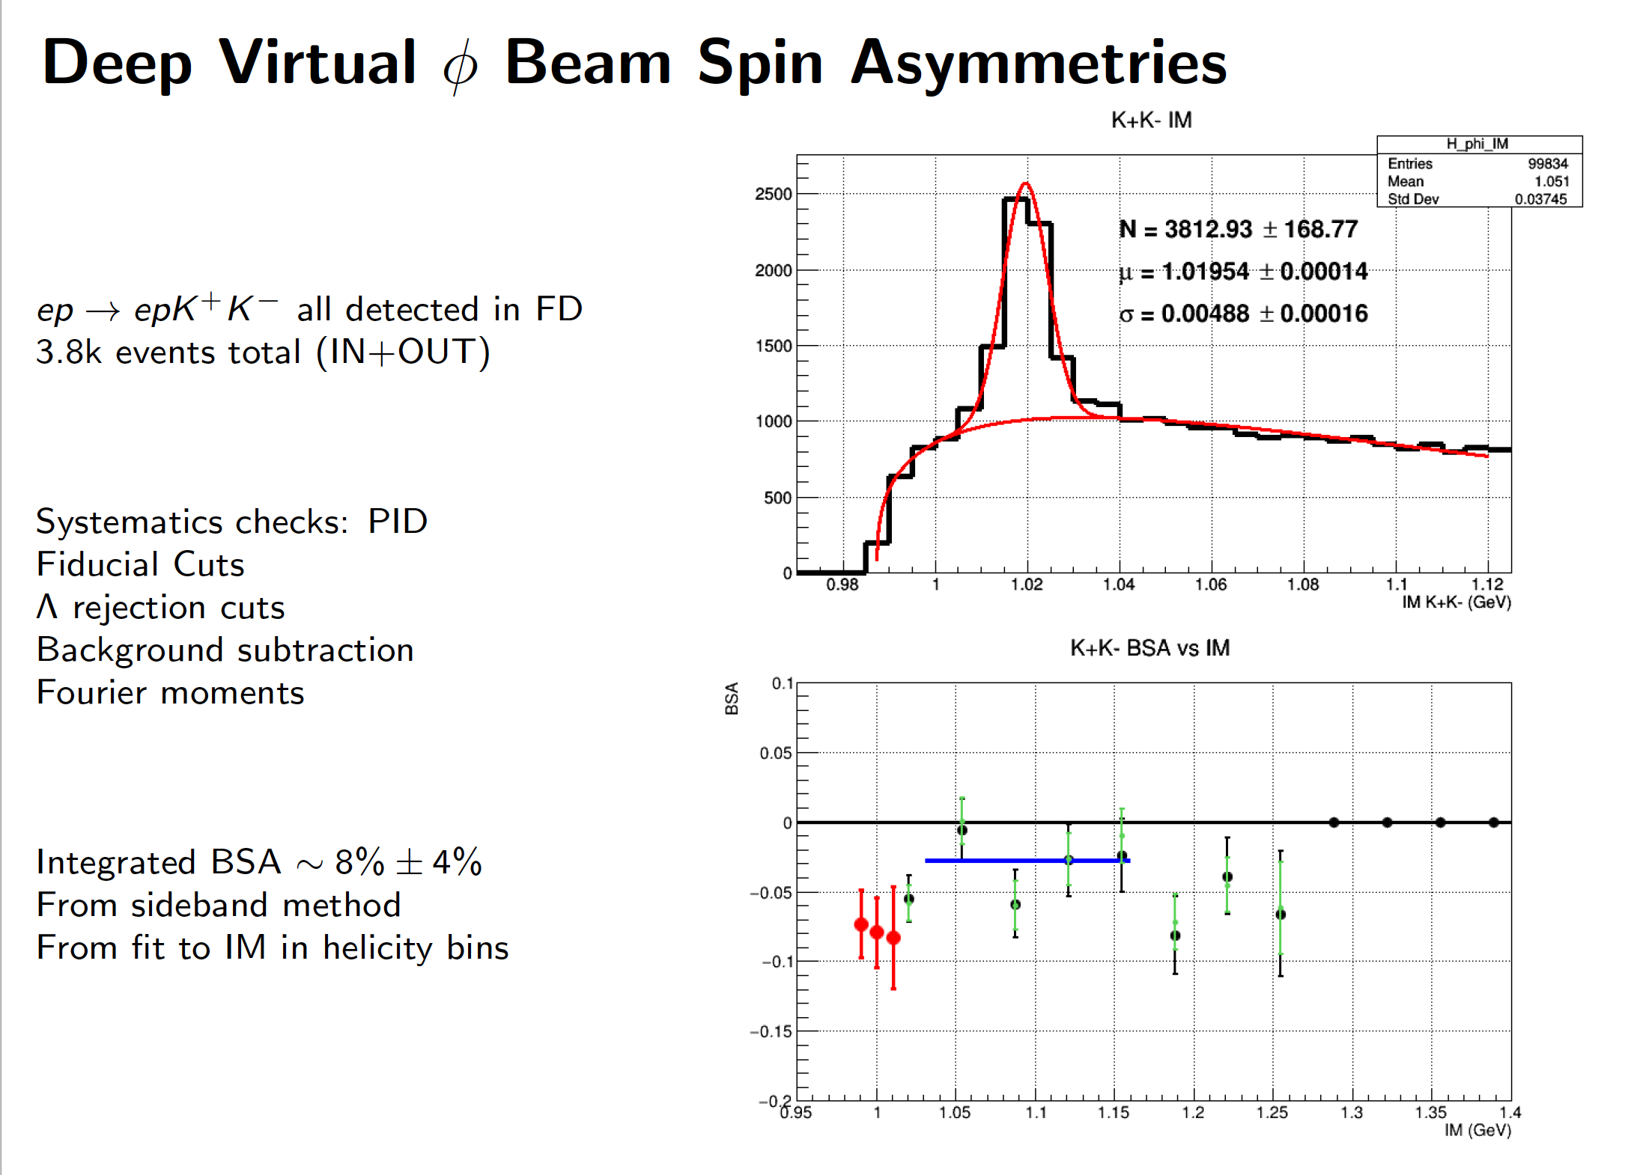
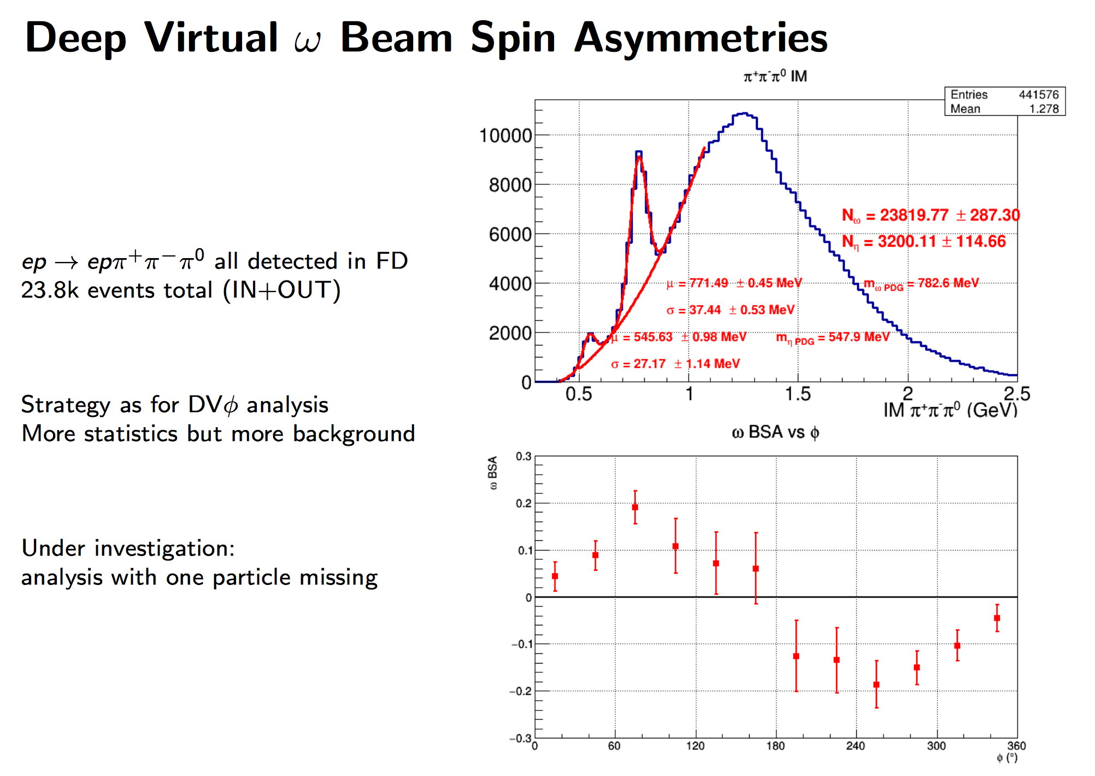
PHI and Omega – Beam Spin asymmetries

Slide 18
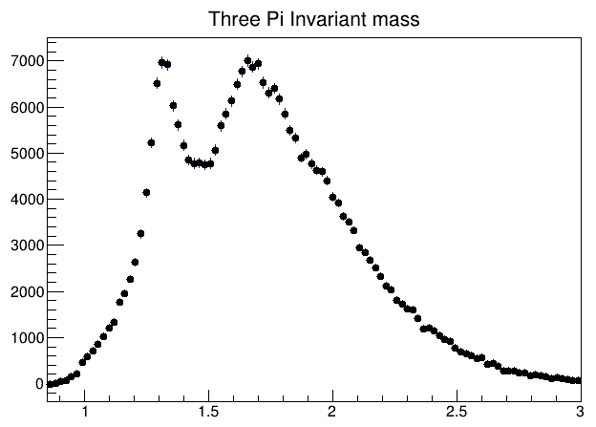
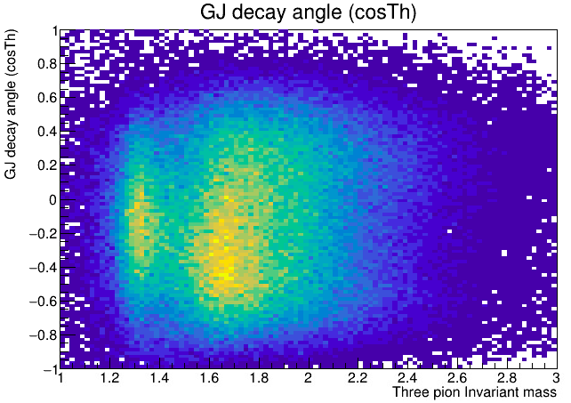
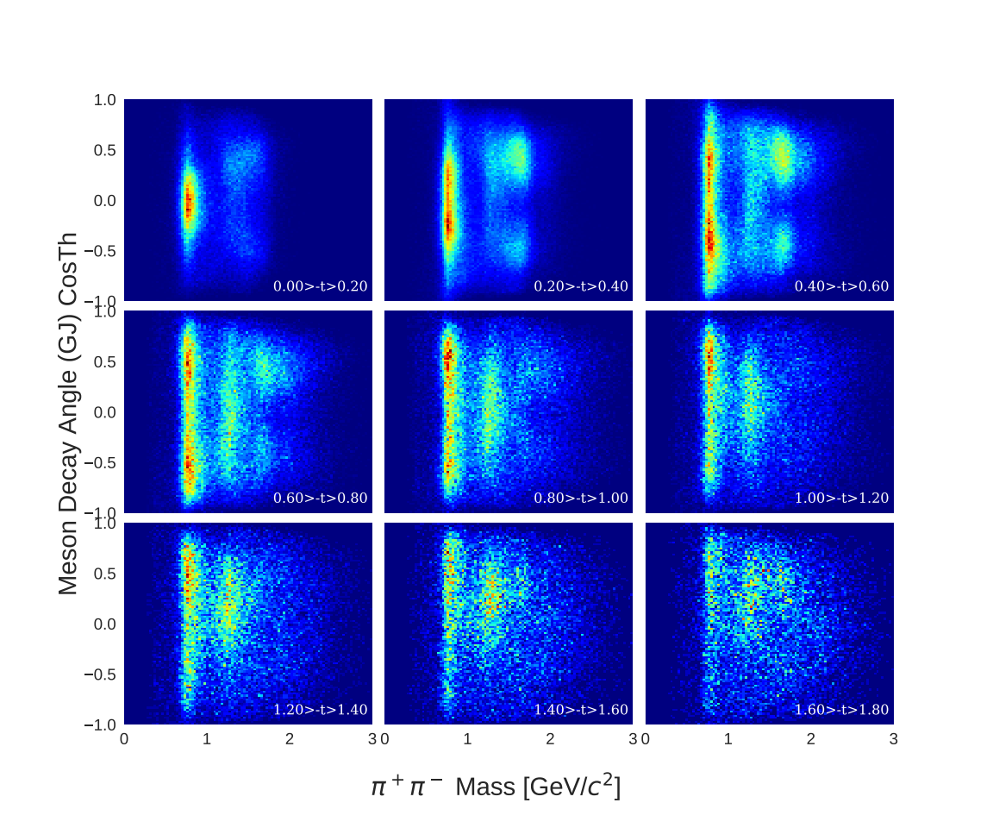
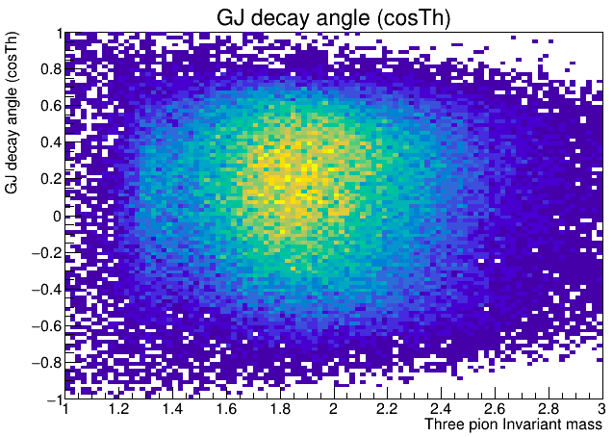
MesonEx Status
Currently focus on π⁰, 2π, 3π and 2K final states
Signal events isolated, preliminary fits underway
Trigger and FT e- efficiency to be studied
3π
2π
Dedicated software components
Event Generator : elSpectro
https://github.com/dglazier/elSpectro
CLAS12 analysis framework : chanser
https://github.com/dglazier/chanser
Maximum Likelihood event fitting : brufit
https://github.com/dglazier/brufit
Amplitude Analysis : pyPWA
https://github.com/JeffersonLab/PyPWA

Slide 19
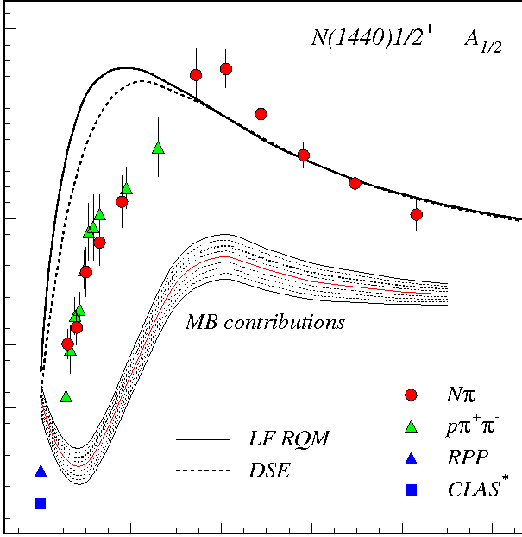
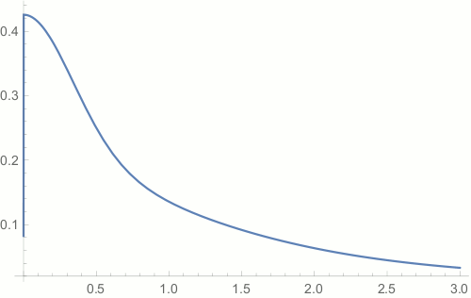
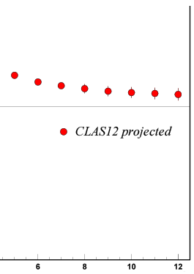
Hadron Structure Experiments (E12-09-003, E12-06-108A)
N* electroexcitation studies with CLAS12 will address the critical open questions:
How is >98% of hadron mass generated and how is it related to Dynamical Chiral Symmetry Breaking?
What is the behavior of QCD's running coupling at infrared momenta?
Mapping out the quark mass function from CLAS12 data on the γ_{v}pN* electrocouplings of spin-isospin flip, radial, and orbital excited nucleon resonances for Q²:[5:12] GeV² will allow us to explore how the dominant part of hadron mass is generated in the transition from the strong QCD to pQCD regimes
Chart the QCD running coupling from the results on the electrocouplings of orbital excited resonances
//
80
60
40
20
0
-20
-40
-60
-80
N(1440)1/2⁺
mass composition
<2% Higgs mechanism
>98% non-perturbative
strong interaction
CLAS12
range
A_{1/2} (GeV^{-1/2}) *1000
Dressed Quark Mass, GeV
confinement (approaching
constituent quark mass)
MB contributions
CLAS12 projected
approaching bare Higgs quark mass and pQCD regime
//
0 1 2 3 4 5 6 8 10 12
Quark Momentum, GeV
Q² (GeV²)
CLAS results vs. theory expectations with running quark mass
V.D. Burkert, C.D. Roberts, Rev. Mod. Phys. 91, 011003 (2019)
D.S. Carman, K. Joo, V.I. Mokeev, FBS 61, 29 (2020)

Slide 20
Summary
The RG-A science program is broad and rich and addresses several of the most fundamental questions in hadronic physics
Two papers SIDIS submitted to PRL for publications
TCS analysis under review and paper being written
RG-A Path to 2021 publications: Several publications planned for end of 2021
  Efficiency Task Force
  Kinematical corrections working group
  Master Schedule
  Common Technical Analysis Note
  Editorial board established:
  (H. Avakian, L. Elouadrhiri, F.X Girod, R. Gothe, R. Paremuzyan and N. Zachariou)
Potential for science discovery!
In Progress/preparation

