Slide 1
Presentation of the experiment
Experimental Readiness Review – Feb. 15th 2021
G. Ciovati

Slide 2
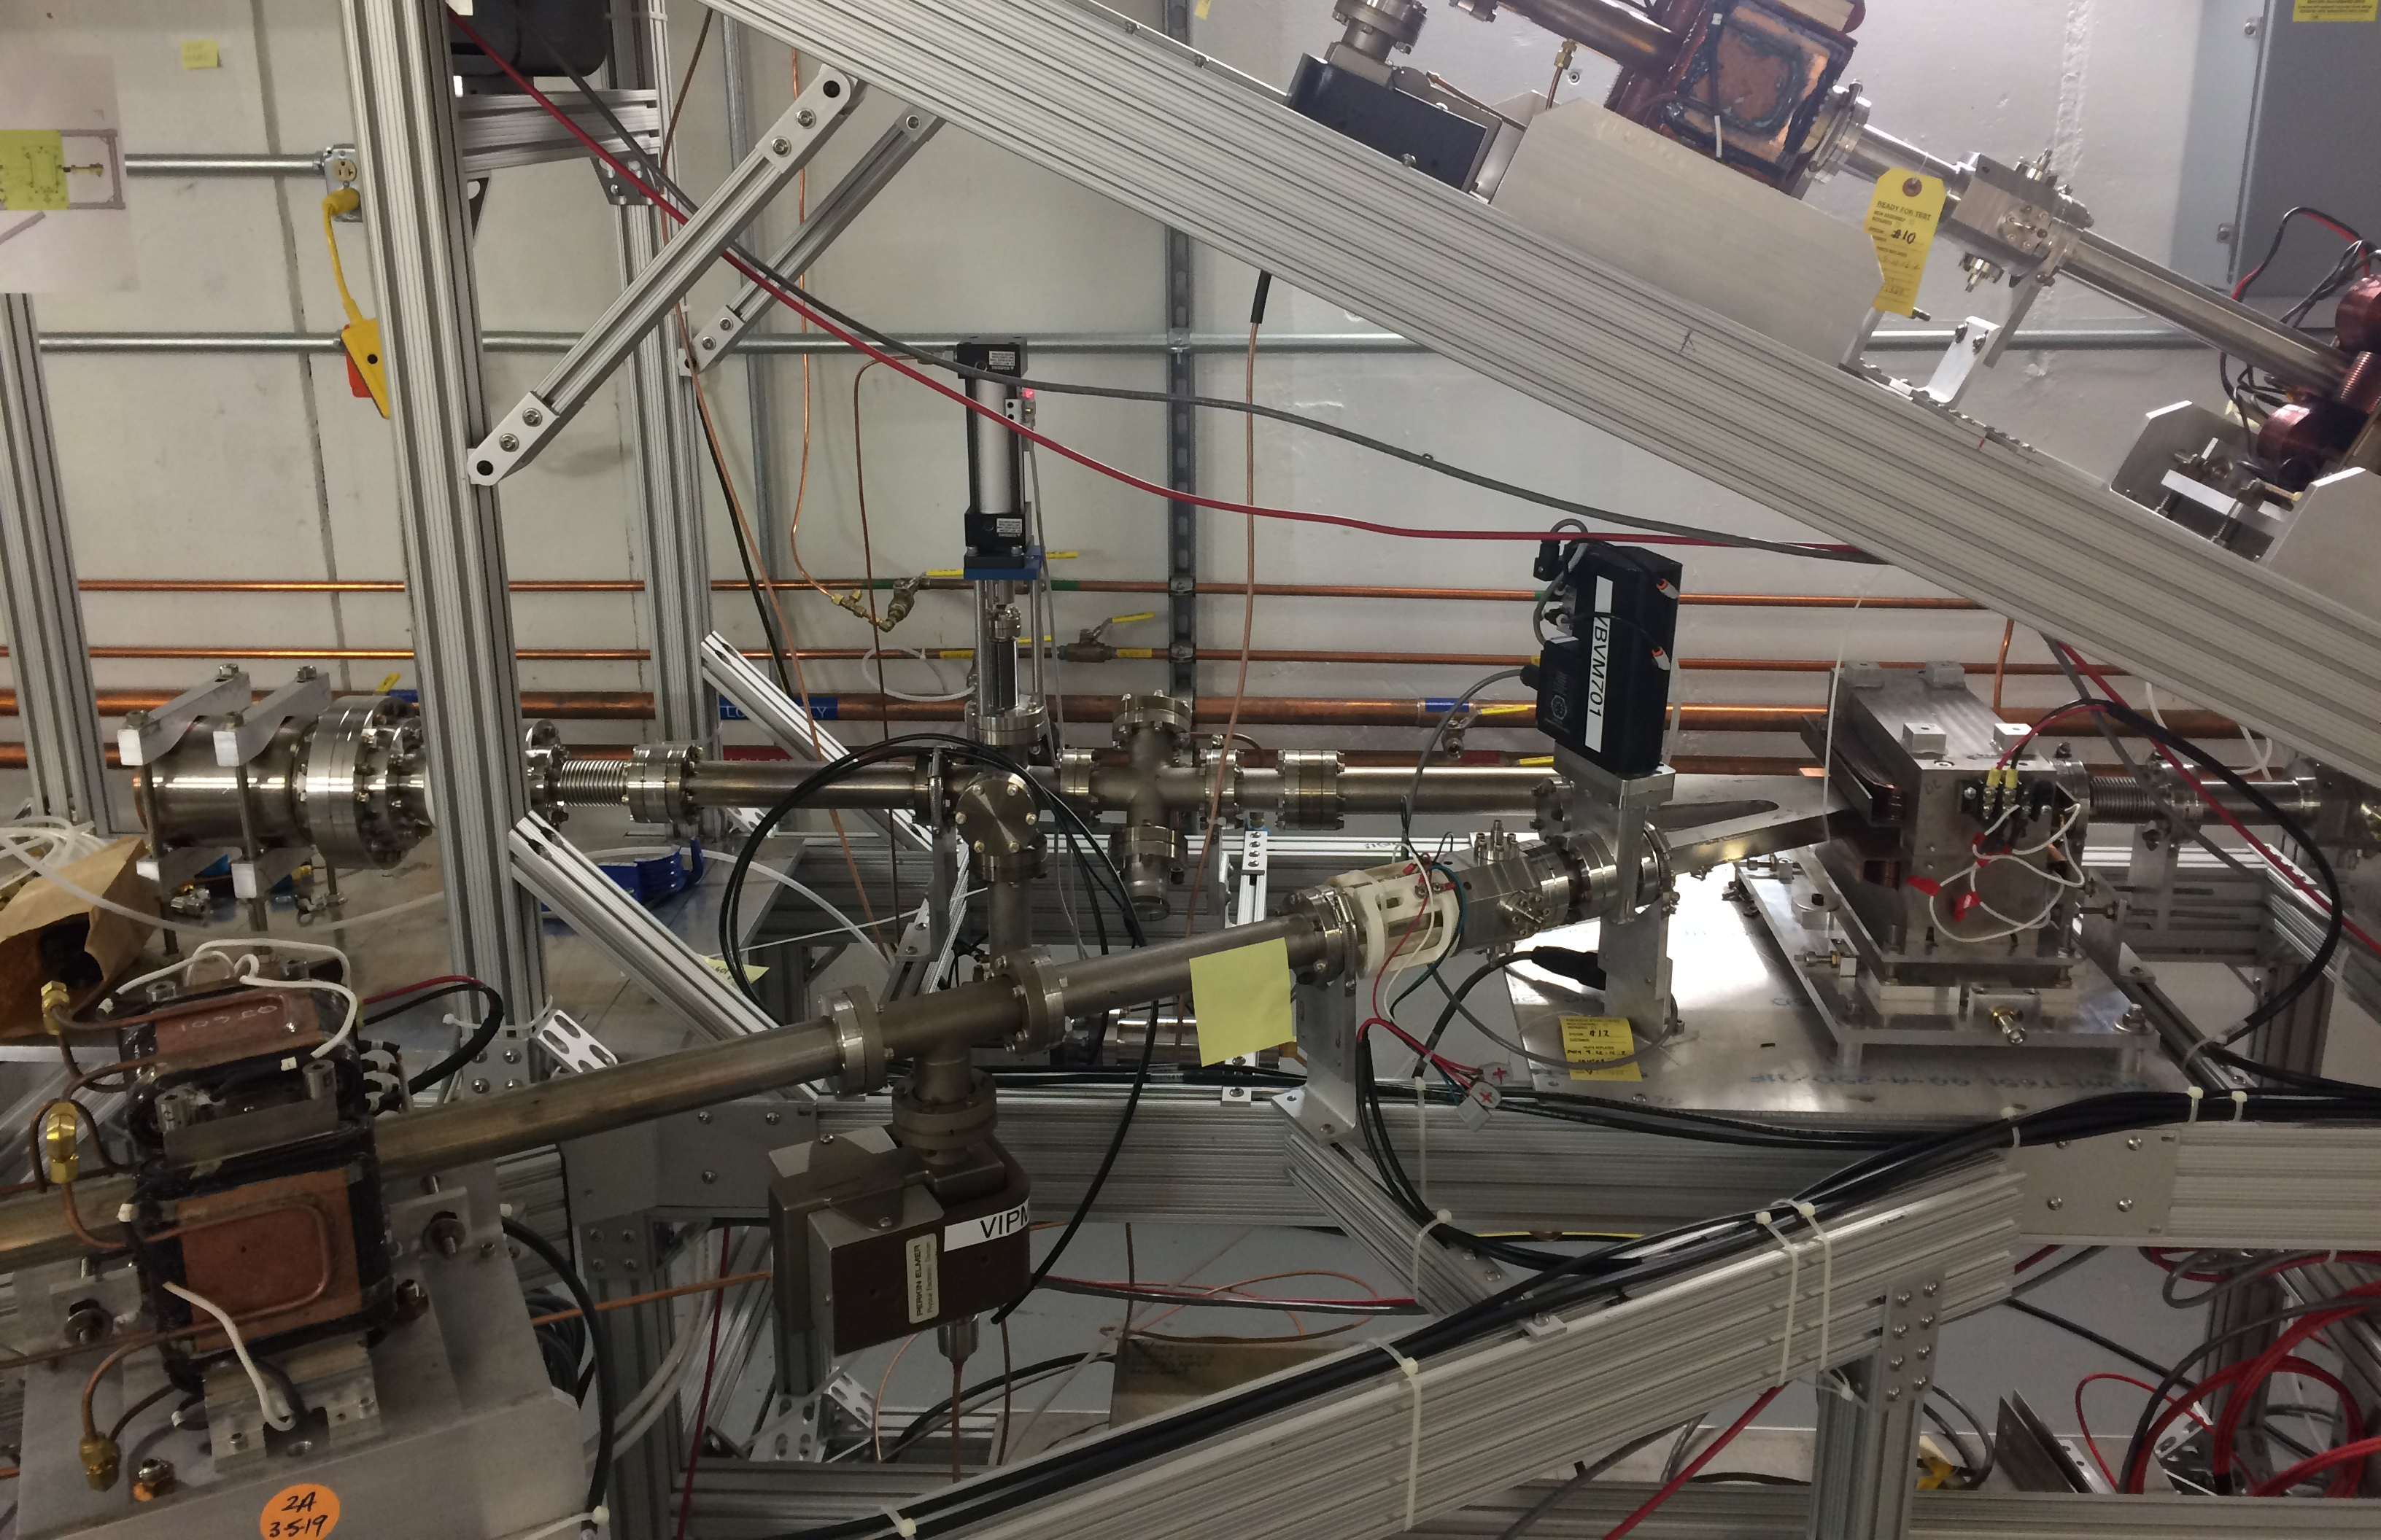
Objectives (1)
Experiment in its 2nd (final) year of funding by LDRD
The aim is at establishing a beamline in UITF that could be used for irradiation with an electron beam

Slide 3
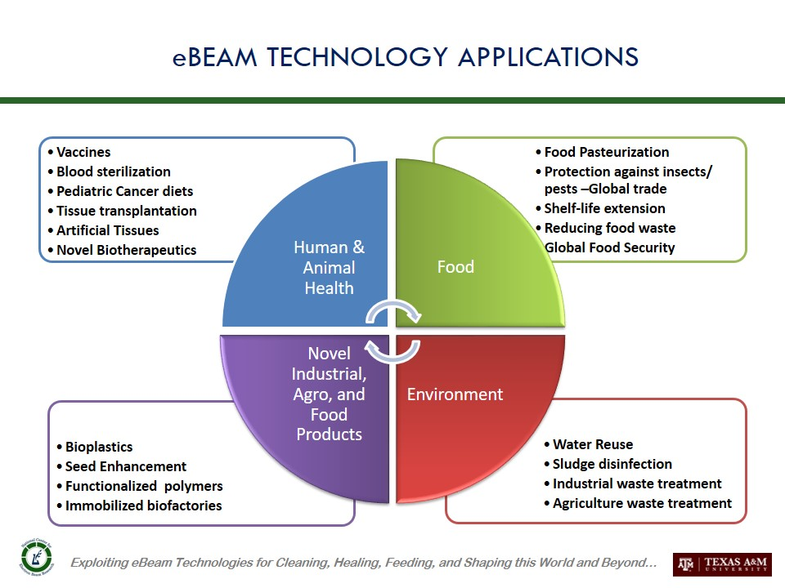
Motivation (1)
Establish an e-beam irradiation beamline that can be used by a variety of “customers”
https://ebeam-tamu.org/ebeam-technology

Slide 4
Motivation (2)
To my knowledge, there are only 3 other facilities in the US that could serve similar customers:
A2D2 at FNAL (9 MeV, 1.2 kW max power, pulsed NC linac, https://iarc.fnal.gov/capabilities-and-resources/accelerator-application-development-and-demonstration/ )
National Center for Electron Beam Research at TAMU (Two opposing 10 MeV, 18 kW max power, pulsed NC linacs, https://ebeam-tamu.org/ )
Notre Dame Radiation Laboratory at Univ. of Notre Dame (8 MeV, pulsed NC linac, https://rad.nd.edu/facilities/linear-accelerator/ )

Slide 5
Motivation (3)
HRSD is the first “customer” and will provide wastewater samples to be irradiated: investigate the removal of 1,4-dioxane as a function of dose
HRSD provides the water samples and their analysis
Operational beam parameters: 8 MeV, 100 nA (0.8 W beam power), ~50 mm beam diameter (3σ) at the exit window

Slide 6
Experiment details
JLab personnel will pick up 4 bottles, 0.5 L each, from HRSD facility:
1 bottle with low concentration (10 μg/L) 1,4-dioxane in UPW
1 bottle with high concentration (100 μg/L) 1,4-dioxane in UPW
1 bottle with low concentration (10 μg/L) 1,4-dioxane in secondary effluent wastewater
1 bottle with high concentration (100 μg/L) 1,4-dioxane in secondary effluent wastewater
Five sample holders, 75 mL each, will be filled with the content from one of the bottles
The water in each of the five sample holders will be irradiated with e-beam at different doses in the range 1-20 kGy. This will be done in a single “beam run”
The content of each sample holder will the transferred to 40 mL VOA vials provided by HRSD.
Steps 2-4 will be repeated for each bottle, resulting in 20 vials to be analyzed by HRSD.

Slide 7
Expected outcome
At least one peer-reviewed publication in Nucl. Instr. Meth. A is anticipated
At least one peer-reviewed publication in Chem. Eng. J. or similar is anticipated
Part of Ph. D. research of Xi Li (ODU, EE Dept.) and Mack Pearce (VATech, CEE Dept.)
Continued collaboration with HRSD and other partners, once the beamline will be fully commissioned

Slide 8
Project Milestones
Q1 (Jan. 5). Complete Experiment Readiness Review.
Q2 (Apr. 1). Complete installation of beamline components.
Q3 (Jul. 1). Complete programming of beamline controls in UITF EPICS control screen.
Q4 (Sep. 30). Complete commissioning with beam.
Complete irradiation of 20 samples from HRSD.

Slide 9
The Team…so far
G. Ciovati – management, analysis of beam exit window, procurements
Xi Li – ODU EE Grad. Student – beam transport and FLUKA simulations
F. Hannon – management, beam transport simulation, target design, procurements
S. Wang – beam transport simulation
M. Marchlik – target design
S. Gregory and C. Sutton – beamline design
M. Poelker – UITF Facility Manager (outgoing)
M. McCaughan - UITF Facility Manager (incoming)
H. Vennekate – UITF beam studies
Support from:
M. Beck – Solenoid testing
M. Stutzman – beamline vacuum
D. Meekins – beam exit window analysis
S. Windham, J. Kortze – controls
K. Cole – beam current monitor
K. Welch – radiation shielding
J. Williams – EH&S aspects
S. Phillips – solenoid power supply
P. Metcalf – MPS

