Slide 1
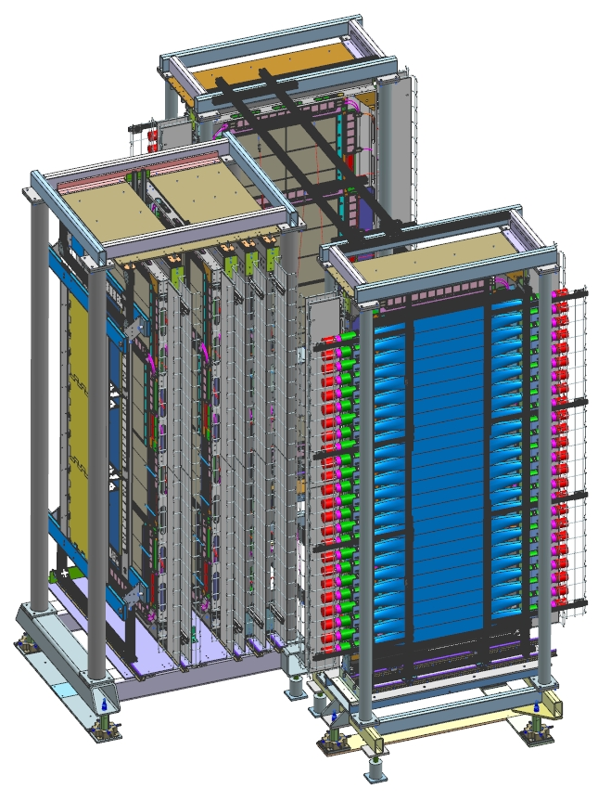
SBS GEMs for GEn-RP
Kondo Gnanvo
SBS Collaboration Meeting
02/17/2021

Slide 2
Outline
Status of GEM Layers for GEn-RP
  Purpose, Performances specifications
  Status of UVa GEM layers for GEn-RP
  Status of the U/V strip GEM productions
Detector equipment listing
  Table of readout electronics / DAQ and other hardware
Plan for installation of GEn-RP GEM layers in Hall A
  Timetable for installation of the layers in GEn-RP detector frames in ESB
  Timetable for installation in Hall A
Commissioning and Calibration plans with beam
  What software to be used for (who is in charge?)
  Online Monitoring and event display (who is in charge?)
  Timetable for completion
Accounting of manpower
  List of staff and users
  List of responsible personnel
Documentation status
  Operation manuals
  How-tos for shift worker

Slide 3
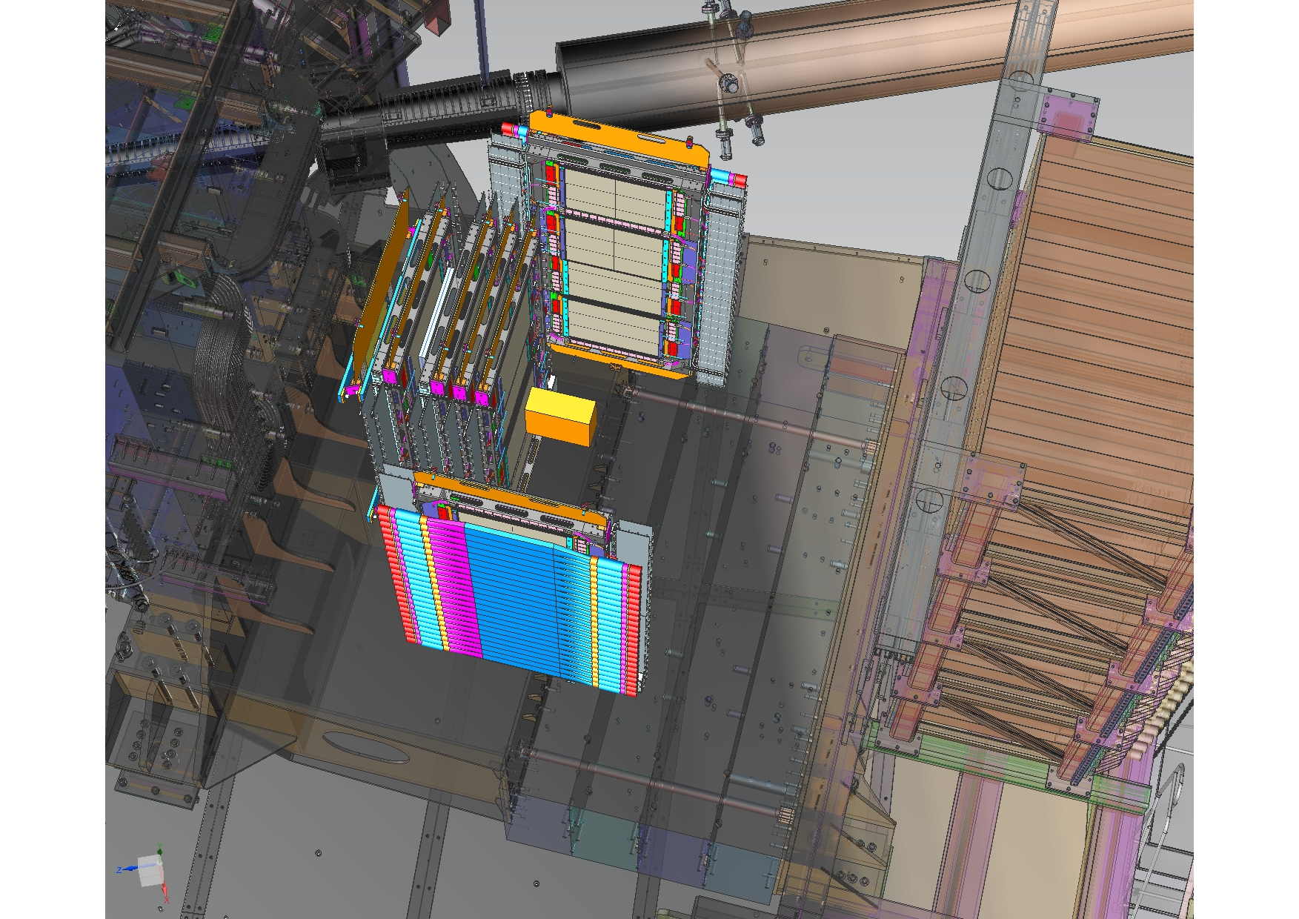
SBS GEM for GEn-RP: Purpose
Charge Exchange (CE) Polarimeter
High-momentum forward protons (towards HCAL) after CE np → p
2 INFN GEM planes
6 UVa GEM planes
1 Steel analyser
Proton Recoil (PR) Polarimeter
Low-momentum large-angle recoiling protons after np → np and also signal in HCAL (nn sct)
Active CH analyser
2 sections, one each side of CE Polarimeter
Each section has 2 UVa GEM planes and 1 plastic scintillator plane
GEMS
Plastic scintillatores
CH analyzer
Fe analyzer
Plastic scintillatores
Highlight of GEM technology:
High rate capability: 1 MHz / cm²
High spatial resolution: 100 µm
Large area capabilities: 150 cm x 55 cm
Low cost technology

Slide 4
Status of GEM Layers for GEn-RP

Slide 5
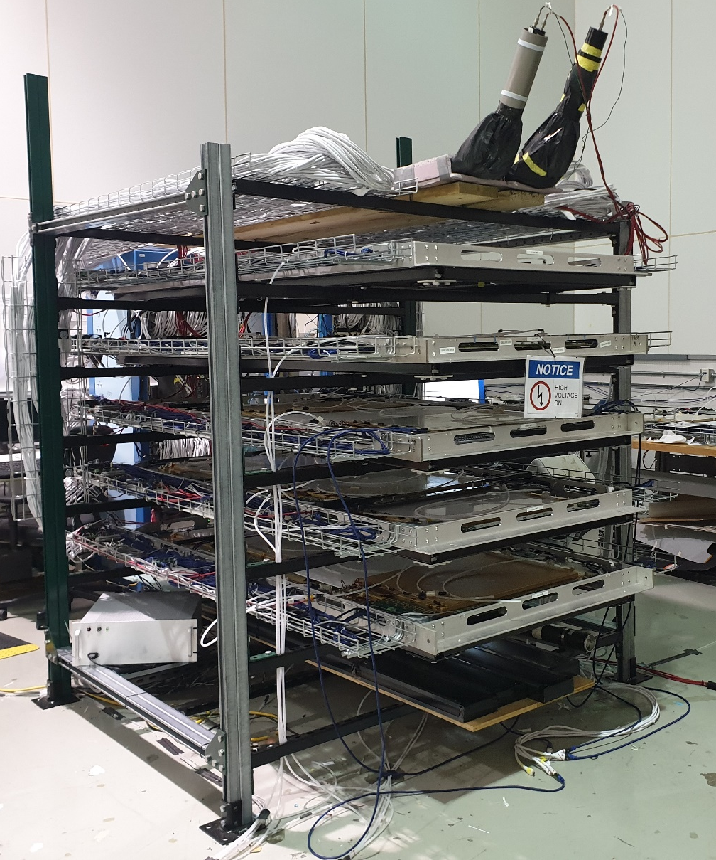
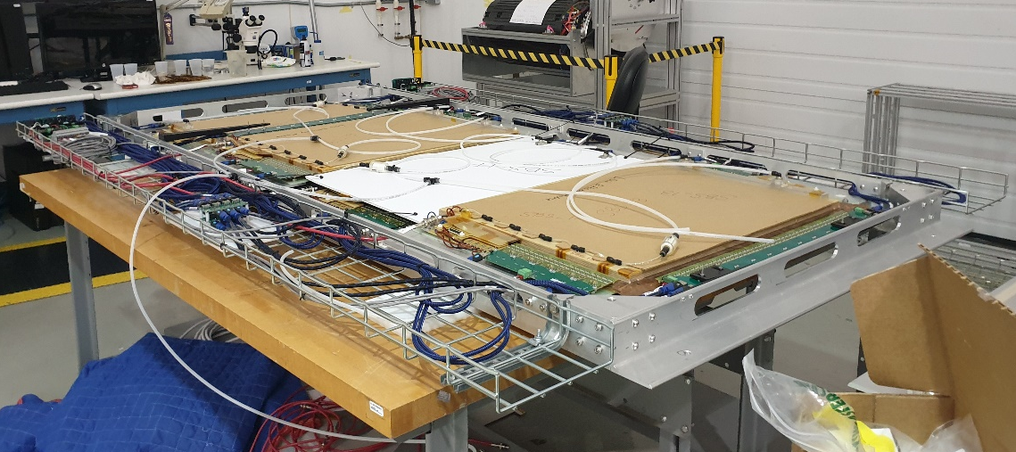
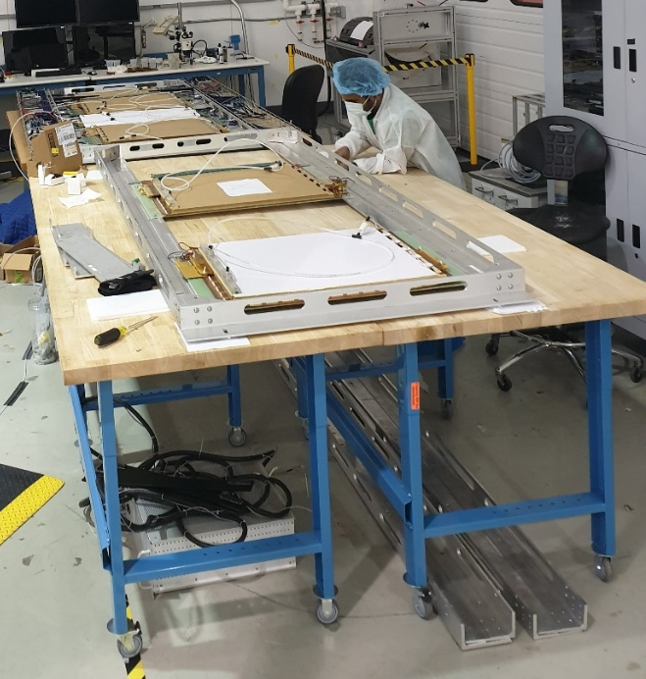
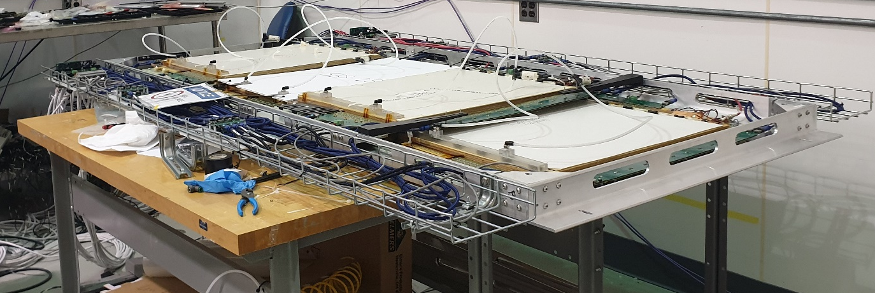
GEn-RP GEM layers: Assembly of UVa X/Y GEMs
Layer #1
Layer #5
Layer #4
Ready for installation in GEn-RP frames
Assembly completed, Need cosmic test validation
Layer #5: HV issue with 2 modules, still with old divider  will be fixed later
Ongoing layer assembly
Layer #8
Layer #7
Layer #6
Layer #9 under assembly
Layer #2
Layer #2

Slide 6
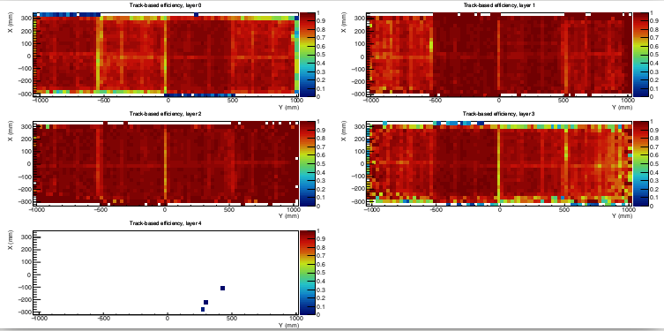
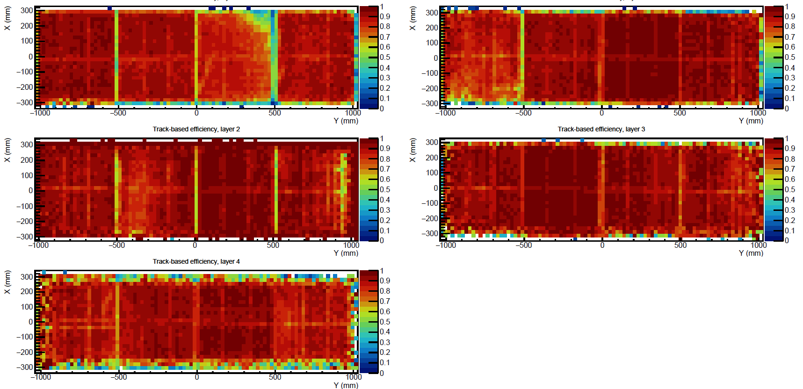
Performances of UVa X/Y GEMs: Efficiency Map
Tracking software for SBS GEMs by Andrew Puckett
Layer #8
Layer #7
Efficiency ~ 90% in all 32 modules of the 8 layers tested so far
HV scan to identify the optimal operating HV for each individual module
Layer #6
Layer #4
Feb. 8, 2021
HV issue with 2 modules under investigation
Layer #5
Layer #1
Layer #2
Layer #1 & #2: back on assembly tables
Layer #3: installed in BB frame in TEDF
Layer #5: HV issue with 2 modules, still with old divider  will be fixed later
All other layers other than #5 with new HV divider scheme
Layer #3
Layer #4
Nov. 3, 2020
Layer #5
Layer #2

Slide 7
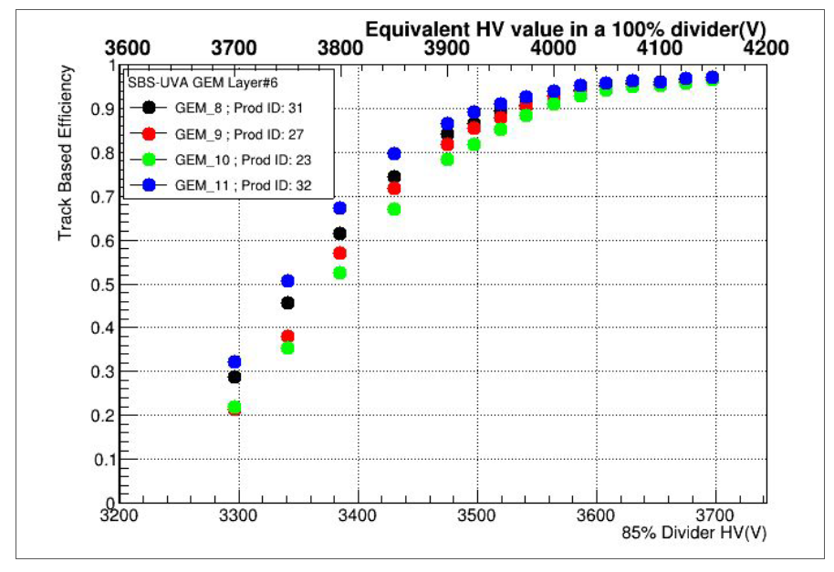
Performances of UVa X/Y GEMs: HV Scan of GEM modules
Tracking software for SBS GEMs by Andrew Puckett
HV scan performed for each individual GEM module to determine the optimum operating voltage
On the right plots, results is show for all 4 modules for layer #6
Efficiency plateau starts for all for @ around 3600 V (with new divider) or 4050 V equivalent with the old divider
This plots to be produced for the modules for all 10 layers and adequately documented for future reference
Layer #2

Slide 8
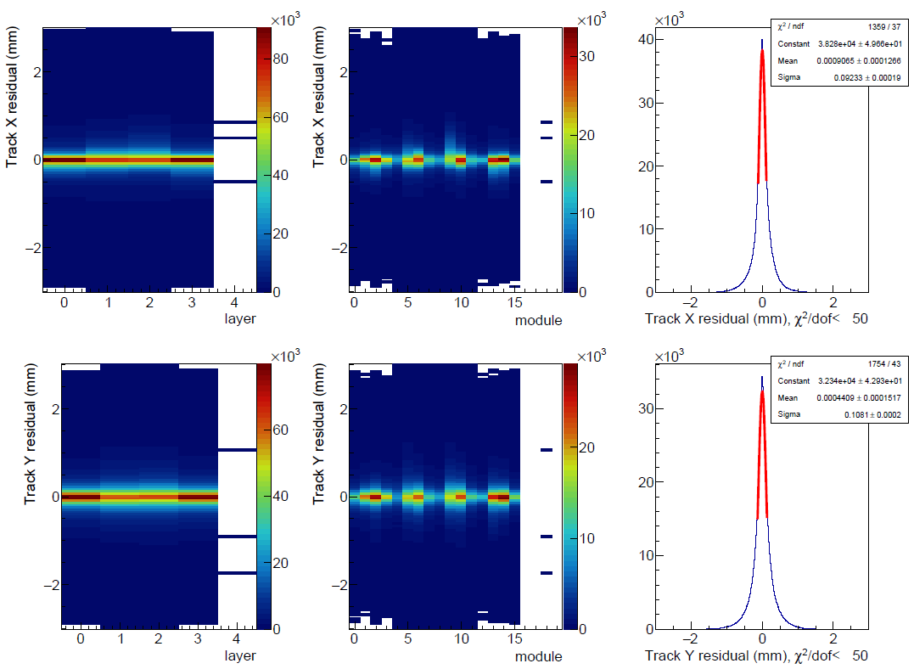
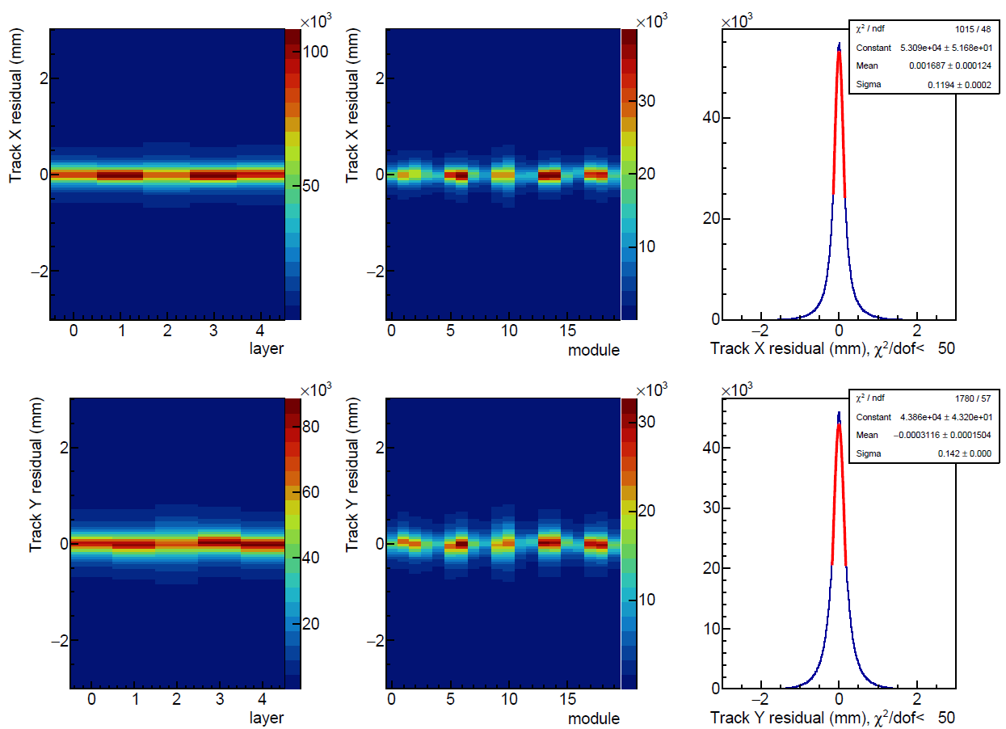
Performances of UVa X/Y GEMs: Spatial Resolution
Tracking software for SBS GEMs by Andrew Puckett
σ_{x}
=
92 µm
Better resolution performance for Feb. 8 2021 data probably because of better alignment
Resolution in x always better than in y because tracks in y has a larger angular distribution because of the size
Feb. 8, 2021
σ_{Y}
=
108 µm
σ_{x}
=
120 µm
Feb 08, 2021 data from layers #4, #6, #7 & #8:
new HV divider scheme
Nov. 3, 2020
Nov. 3, 2020 data from layers #1, #2, #3, #4 &#5:
old HV divider scheme
σ_{Y}
=
142 µm
Layer #2

Slide 9
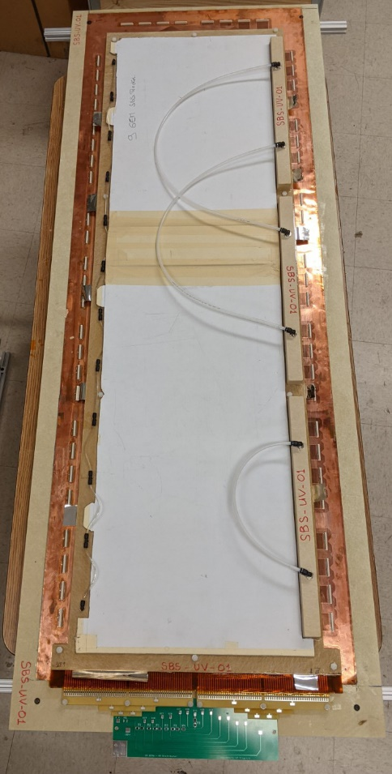
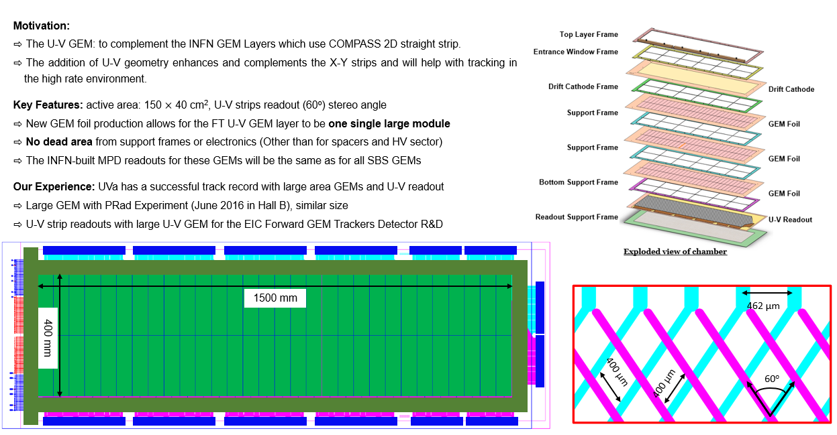
UVa U/V GEM layers: Status of assembly
SBS-UV-01
SBS-UV-01 & SBS-UV-02: Assembly completed
  Unexpected problem with gas flow for both chambers  Drift cathode foils received from CERN (which contribute to our gas flow system) did not satisfy the specifications  We believe we have a solution to modify the gas flow system but need to be tested
  Because of this issue, we will perform cosmic test with these 2 modules at UVa after the fix is applied
  if everything goes well, the two modules will be ready for installation in BB by end of March 2021
SBS-UV-03 & SBS-UV-04: Assembly of 2 remaining chambers to start in about two weeks from now (01 March 2021)
  Last batch of GEM foils shipment expected to be delivered next week
  CERN promise to ship two new cathodes foil with the correct specifications by end of Feb 2021
  The two chambers can be ready (assembled and tested in cosmic @ UVa) by the end of May 2021
  will be selected for installation in BB frame before May 15 if the gas distribution fix of SBS-UV-01 & SBS-UV-02 does not work as expected
  If fix for SBS-UV-01 & SBS-UV-02 work as expected, SBS-UV-03 & SBS-UV-04 could be reserved for GEn-RP

Slide 10
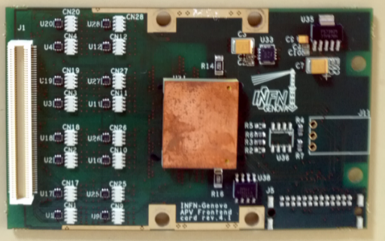
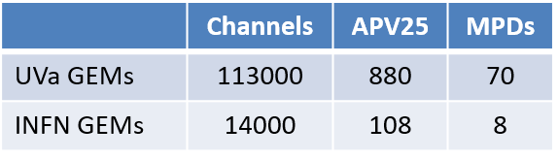
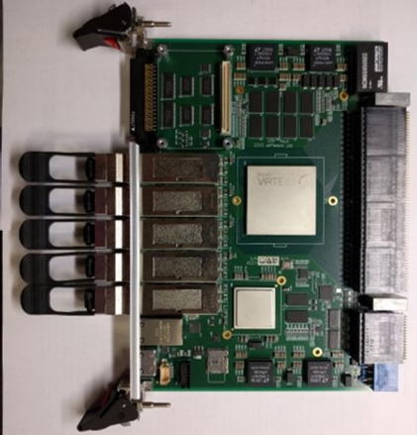
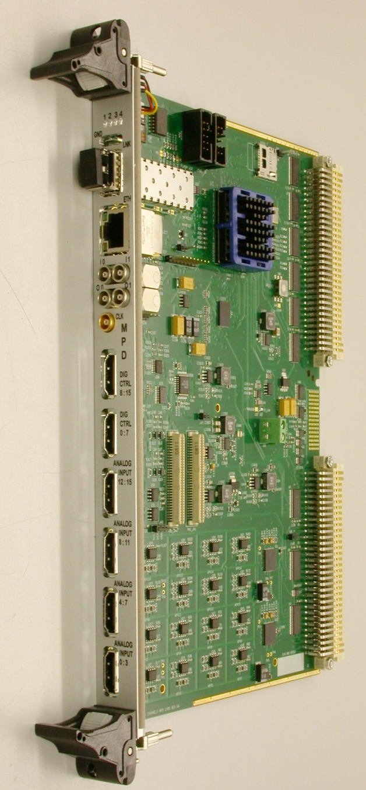
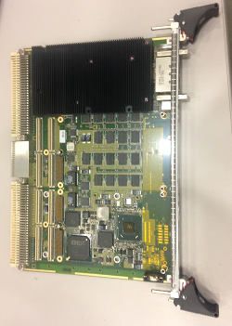
GEn-RP GEM Equipment: MPD Readout & DAQ
128 analog ch / APV25 ASIC
3.4 μs trigger latency (analog pipeline)
Capable of sampling signal at 40 MHz
Multiplexed analog output (100 kHz readout rate)
VTP
MPD Main Block
Arriga GX FPGA
128 MB DDR2-RAM
Firmware V4.0 (74% resources):
# FIR Filter (16 param)
# Zero Suppression
# Common mode and pedestal subtraction
# Remote config,
# ≈2 ns trigger time resolution
Aurora Protocol
MPD-VME Interface
VTP-Protocol
VME-Protocols
2eSST
2eVME
VME32 …
MPD-VTP Interface
VXS
Optical
Fiber
MPD
(INFN)
VME (64x)
VME Master
(Intel SBC)
  More detailed talks on:
  high rate MPD readout by B. Raydo (5:50 pm today)
  DAQ talk by A. Camsonne (4:50pm today)
Layer #2

Slide 11
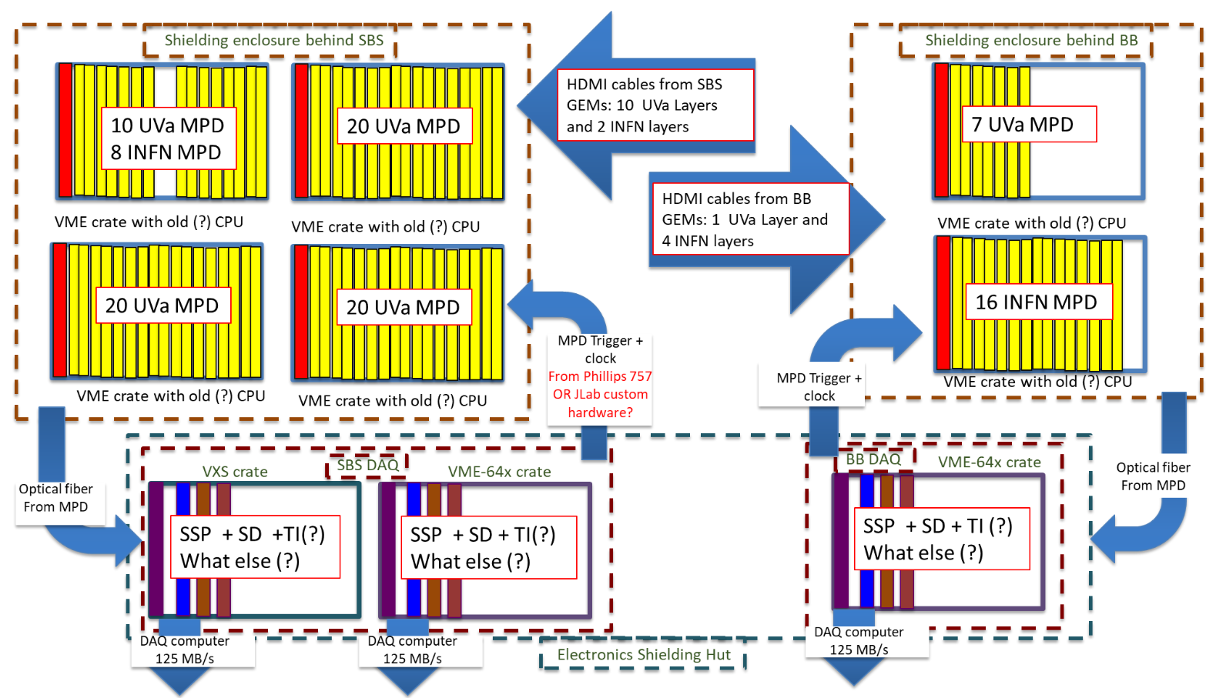
GEn-RP GEM Equipment: GEM readout layout
SBS GEMs Electronic Hut
VTP + SD +TI
VTP + SD +TI
VTP + SD +TI
10 gigE =1.25 GB/s
10 gigE =1.25 GB/s
10 gigE =1.25 GB/s
  More detailed talks on:
  high rate MPD readout by B. Raydo (5:50 pm today)
  DAQ talk by A. Camsonne (4:50pm today)
Layer #2

Slide 12
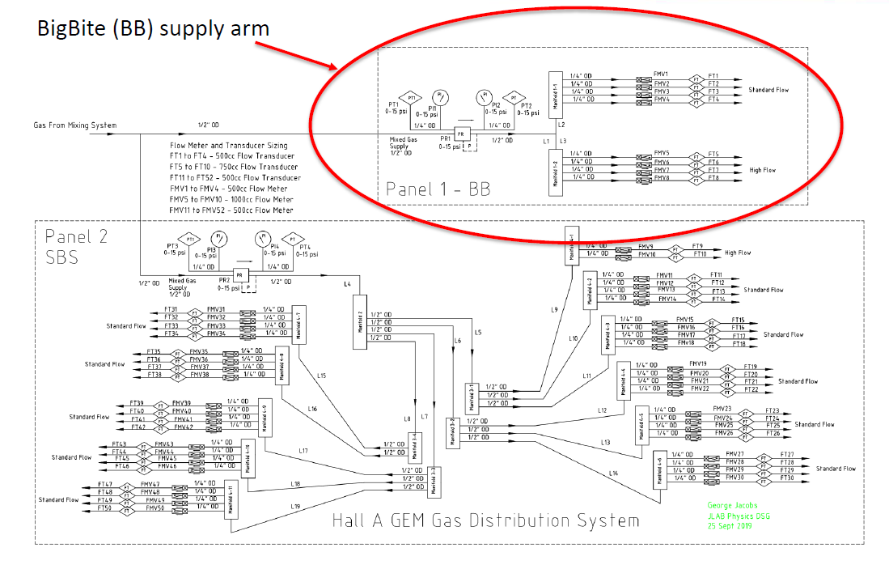
GEn-RP GEM: SBS GEM Gas System in Hall A
by DSG group at Jlab
Marc McMullen
Layout of the gas distribution In Hall A for Bigbite and SBS GEM layers
Layer #2

Slide 13
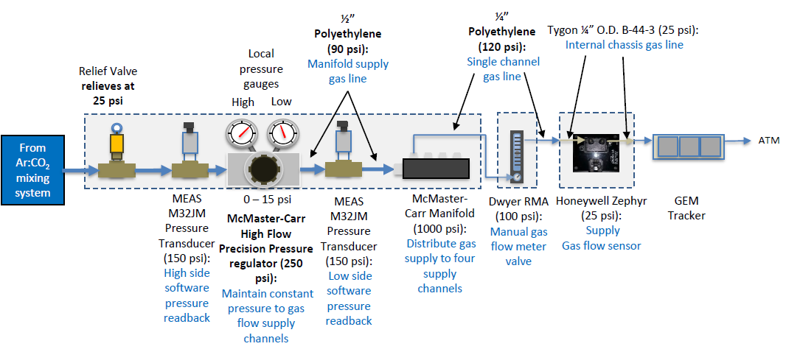
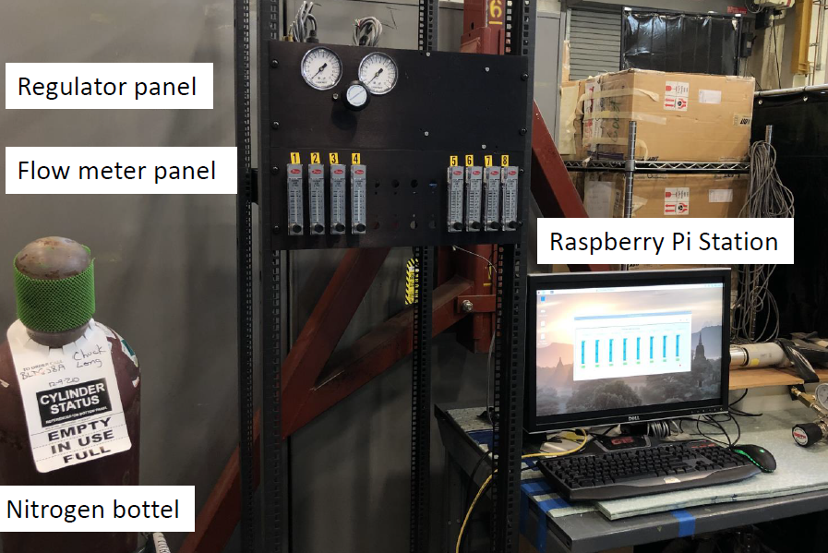
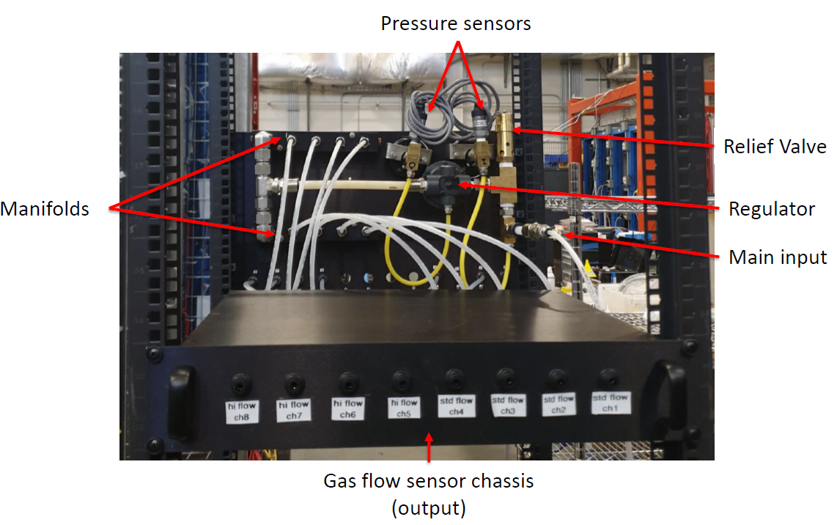
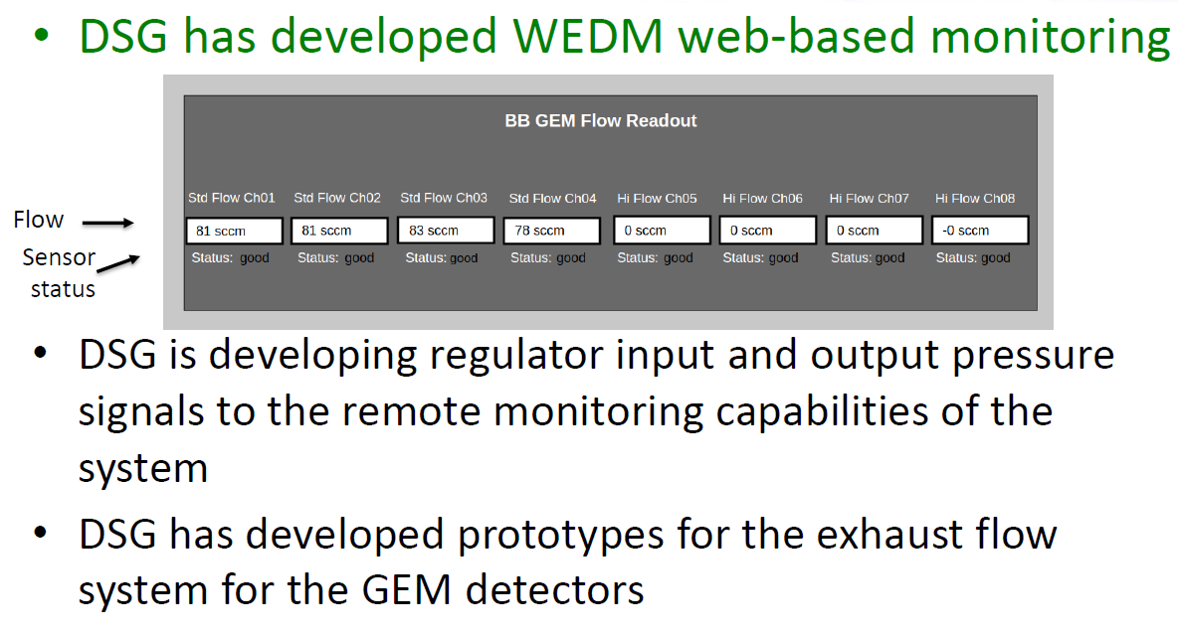
GEn-RP GEM: SBS GEM Gas System in Hall A
by DSG group at Jlab
Marc McMullen
Prototype under test with UVa GEM layer in Bigbite frame in TEDF
Layer #2

Slide 14
Equipment listing

Slide 15
GEn-RP GEMs: Tentative timeline for installation
Layer | Assembled | HV tested | Cosmic tested | Ready for installation as of 02/17/2021 | Comments
UVa #1 | Yes | Yes | Yes and No | No | Was re-assembled layer  require another round of cosmic test
UVa #2 | Yes | Yes | Yes and No | No | Was re-assembled layer  require another round of cosmic test
UVa #4 | Yes | Yes | Yes | Yes
UVa #5 | Yes | Yes? | Yes? | No | HV stability issues with 2 modules: need to replace divider
UVa #6 | Yes | Yes | Yes | Yes
UVa #7 | Yes | Yes | Yes | Yes
UVa #8 | Yes | Yes | Yes | Yes
UVa #9 | Ongoing | No | No | No
UVa #10 | March 2021 | No | No | No
UVa #11 | March 2021 | No | No | No
INFN - J1 | Yes | Yes | Yes | No | require another round of cosmic test after J0 and J2 are installed in BB
INFN - J3 | Yes | Yes | Ongoing | No | Some issue with data (readout electronics) but should not be a concern for the layer
Layer #2

Slide 16
GEn-RP GEMs: Equipment listing
Items | Need | In hand | Order in pipeline? | Other sources / comments
MPDs (UVa GEMs) | 70 | 65 (incl. order from Glasgow & JLab) | 3 (UVa) ? | Look like we are still missing 5 units
APV25 FE Cards (UVa GEMs) | 880 | 831 | Yes as more cards also needed for U/V GEMs | M. Kohl to provide about 100 additional cards if needed
12-slots backplane (UVa GEMs) | 44 | 47
5-slots backplane (UVa GEMs) | 88 | 92 (incl. recently purchased by JLab)
MPD (INFN GEMs) BB & SBS | 24 | 24 (+ spares…?)
APV25 FE Cards (INFN GEMs) BB & SBS | 324 | all in hand
Backplanes (INFN GEMs) BB & SBS |  | all in hand
4-slots backplanes (U/V GEMs) BB & SBS | 48 | 52 (recently purchased by JLab)
3-slots backplanes (U/V GEMs) BB & SBS | 16 | 18 (recently purchased by JLab)
HDMI (1m, 2m, 3m & 10m) |  | All in hands (look like we are missing a few 1m-cables) |  | Cheap and easily available on amazon. Not an issue
Low voltage regulators |  | All in hand (incl. recently purchased by JLab)
Low voltage PS |  | All in hand |  | JLab Electronics group (C. Cuevas)
Layer #2

Slide 17
GEn-RP GEMs: Equipment listing
Item | In Hand | Status
3 VTP modules (together with BB GEM readout) | To be ordered | ( can use 2 HCAL ones at worse and 1 SoLID )
3 TI – Trigger supervisor | 3 TI and 1 TS On hand
3 SD cards | 1 | 2 ordered by INFN
Master VME (for SSP and TI) | 3
Trigger / clock fan-out (78 channels) | 2 | 4
3 VXS crate (for SSP, TI …) (together with BB GEM readout) | 3
4 VME crate (no master) for MPDs | 3 ? | Need more ? ( could use VME64X crate )
50 Optical fiber MPD – SSP connection | 30 on hand need 20
78 (+ 1) NIM cables trigger distribution |  | To be identified / procured (1 from SBS GEM hut to electronic hut)
78 NIM cables (10 cm) for clock distribution |  | To be identified
46 x HV cables | Yes
6 x LV cables pairs (15 m?) | Yes | To be identified / procured
HV power supplies for 46 channels (40 UVa GEMs + 6 INFN GEMs) | 1 Wiener crate & 6 HV modules (8 ch. each) => 42 channels | UVa has 1 spare crate + at least one more HV module
LV power supplies (2xTTI-Eth., UVa system) | Yes: by JLab Electronic group (C. Cuevas) | Currently used in cosmic (+spare)
SBS GEMs Electronic Hut |  | JLab Engineering - (Jack Segal, Chandan Gosh)
Layer #2

Slide 18
Installation Plans

Slide 19
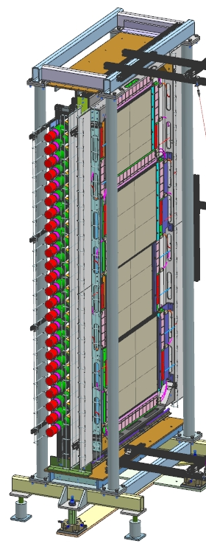
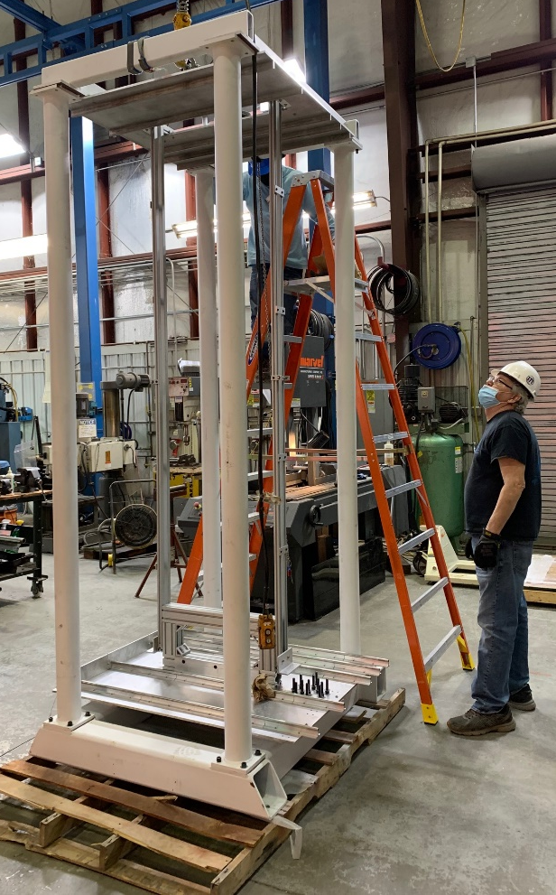
GEn-RP GEMs: Detector frames
Proton Recoil (PR) Polarimeter GEM frames
Charge Exchange (CE)
Polarimeter GEM frame
CE polarimeter frame to be assembled and moved to EEL124
UVa GEMs mounted in the frames in EEL
INFN GEMs will be added later
The frames will move to Hall A
PR polarimeter frame to be assembled in (ESB or EEL124)
2×2 UVa GEMs mounted
The frames will move to Hall A
Layer #2

Slide 20
GEn-RP GEMs: Tentative timeline for installation
Installation of 6 UVa GEM layers in Charge Exchange (CE) Polarimeter frame
  End Feb 2021*: Frame will be assembled near EEL124 then move to EEL 124 for mounting of UVa GEM layers
  March 2021**: 6 UVa GEM layers will be mounted  use EEL124 crane for the installation
    4 layers ready for installation & 2 other ready to be tested on the cosmic stand before installation in the frame
Installation of 2 × 2 UVa GEM layers in Proton Recoil (PR) Polarimeter frame
  Feb to March 2021*: 2 frames will be assembled in ESB and hodoscope will be mounted
  End April 2021**: Complete the assembly and cosmic test of the first three UVa U/V GEM layers
  End May 2021**: Complete the assembly and cosmic test of the forth UVa U/V GEM layer
No need to repeat cosmic test for layers on GEn-RP frames  Just HV test to check stability on N2 gas
Installation of 2 Front tracker GEM layers (INFN J1 & J3) in Charge Exchange (CE) Polarimeter frame
  May 2021***: INFN GEMs will be ready to be installed in EEL 124 after the step above
  May 08, 2021: The best UVa U/V GEM layers will be installed in BB frame and the remaining 2 will be reserved for GEn-RP
    U/V GEMs for GEn-RP will also depend on availability of APV25 with Panasonic connectors
All 3 frames will be moved to the Hall A after May 15 2021
  Final cabling (HDMI cables, gas, HV and LV) …
  HV test and the checking the readout electronics / DAQ with pedestal
* Schedule defined by crew helping at JLab  (Kondo & Brad)
** Schedule define by flow of activities in EEL124 as well as JLab technical support availability (Kondo & Brad)
*** Schedule for the U/V GEMs defined by how things are going at UVa (Nilanga) and with cosmic tests for INFN GEMs (Evaristo)
Layer #2

Slide 21
GEn-RP GEM layers: Project progress / status
A: Amount of work needed for completion of GEn-RP GEM layers before May 15
  Assembly of the last 3 UVa X/Y GEM layers (layers #9, #10 and #11)
  HV test and performance evaluation on cosmic stand of layers #1, #2, #9, #10, #11
  Fix HV test issues of layer #5  we believe it is just a matter of implementing the new divider 85%]
  Continue the evaluation of other minor issues such as dividers, the data and associated r/o and DAQ performance
  Installation of layers into the 3 GEn-RP detector frames
    By end March – early April 2021: Installation of 6 UVa X/Y GEM layers in inline CE detector frame in EEL124
    By end April – early May 2021: Installation of 4 UVa X/Y GEM layers in the 2 side PR detector frames in EEL124 (or maybe ESB)
    By mid May 2021: Installation of 2 INFN layers and / or UVa U/V GEM layers in the inline CE detector frame in EEL124
    HV test of all layers in all 3 frames and look at the pedestal data to ensure the R/O connection is ok
  Complete the assembly and cosmic test of all 4 UVa U/V GEM layers  May 2021
    By May 08, 2021: The best two layers would have been installed in BB frame and the remaining 2 will be reserved for GEn-RP
B: Amount of work accomplished over last 1.5 month (start from January 2021)
  Assembly of two layers (layers #1 and #2) and start assembly of layer #9
  HV test and performance evaluation on cosmic stand of 3 new layers #6, #7 and #8, together with layer #4 and #5
  A lot of troubleshooting of HV instabilities with a few modules  fortunately seems like divider problem and not from modules
  Complete the installation and beginning cosmic data commissioning of UVa X/Y layer #3 in BB detector frame
    Implement the gas system develop by DSG as prototype test for layer #3
    Complete the r/o connection and preliminary test of the R/O and DAQ for this layer in BB
Let assign some A/B ratio:
  Assembly and HV test and performance evaluation on cosmic stand of UVa X/Y layers: A = 3, B = 2  ratio A / B = 1.5
  Assembly and HV test and performance evaluation on cosmic stand of UVa U/V layers: A = 4, B = 2  ratio A / B = 2
  Installation of GEM layers in the 3 GEn-RP frames: A = 5 (for 10 layers), B = 1 (based on layer #3 in BB)  ratio A / B = 5 (does not mean that the task require 5 × more time rather that it is ~5 × more complicated / more demanding of manpower time)
Layer #2

Slide 22
GEn-RP GEMs: Commissioning and Calibration in Hall A
Target date to start moving the detectors in Hall A will be May 15
Commissioning with cosmic before the beam on
  Setup trigger scintillators for cosmic test of all GEn-RP GEM detectors when beam is off
  We might want to keep the external scintillator setup in place for systematic cosmic data for any extended period of beam down
Calibration runs with beam on
  Low luminosity runs with magnet off (straight tracks, low rate)
  Low luminosity runs with magnet on (nominal tracks, low rate)
Layer #2

Slide 23
Manpower & Documentation list

Slide 24
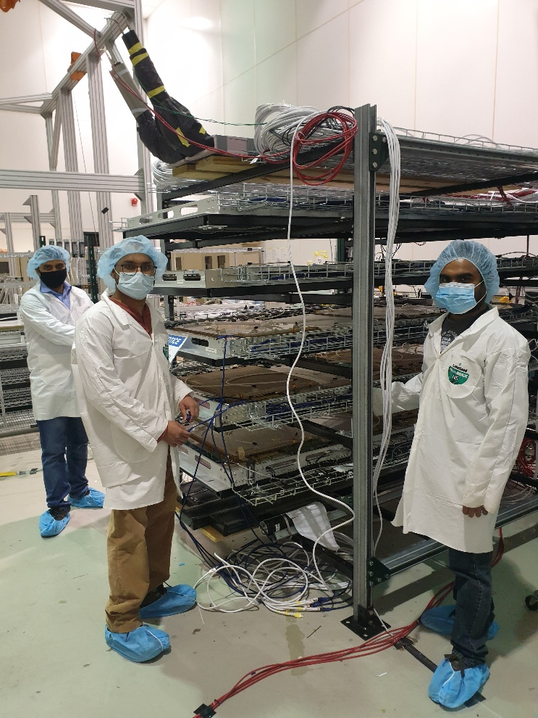
GEn-RP GEMs: Manpower
UVa GEMs
UVa GEMs: | FTE | Current roles
Kondo (UVa) |  | Leading
Nilanga (UVa) |  | Supporting
Huong Nguyen |  | Leading All GEM production and testing at UVa
Michael Kohl (HU) |  | Supporting
Thir Gautham (HU) (*) | Postdoc (0.5) | DAQ, monitoring, analysis, commissioning
Xinzhan Bai (UVa) | Postdoc (0.5) | DAQ, monitoring, analysis, commissioning
Salina Ali (UVa) | Postdoc (0.5) | U/V layer production, testing, and commissioning
John Boyd (UVa) | Student (0.5) | U/V layer production, testing, and commissioning
Sean Jeffas (UVa) | Student (0.5) | U/V layer production, DAQ, monitoring, analysis, commissioning
Anuruddha Rathnayake (UVa) | Student (0.5) | DAQ, monitoring, analysis, commissioning
Malinga Rathnayake (HU) (*) | Student (0.5) | DAQ, monitoring, analysis, commissioning
Manjukrishna Suresh (HU) (*) | Student (0.5) | DAQ, monitoring, analysis, commissioning
Vimukthi Gamage (UVa) | Student (0.5) | Start in June 2021
Bhashitha Dharmasena (UVa) | Student (0.5) | Start in June 2021
Thir
Malinga
Anu
(*) available until October, could be extended further
(*) will graduate this summer or maybe in the fall
(*) PhD research on GEnRP, and it would make every sense to get him trained and involved as soon as possible.
Layer #2

Slide 25
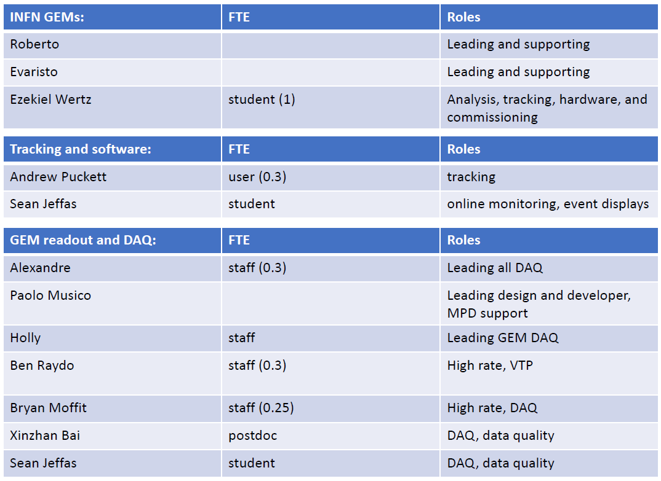
GEn-RP GEMs: Manpower
Stolen from Holly slides
INFN GEMs, Tracking Software, GEM readout ad DAQ
Zeke
Sean
Layer #2

Slide 26
GEn-RP GEMs: Documentation Status
GEM operation manuals:
  INFN GEMs: https://pandora.infn.it/public/3b9827
  UVa GEMs (in progress): https://www.overleaf.com/project/60280700719b746c97e92524
  GEn-RP GEMs ERR wiki: https://hallaweb.jlab.org/wiki/index.php/E12-17-004-ERR-29May2019#Responses_to_the_Committee_Recommendations
THA and OSP for GEMs (submitted):
  https://misportal.jlab.org/mis/apps/mis_forms/operational_safety_procedure_form.cfm?entry_id=113037
Still under development:
  Established benchmarks for beam commissioning
  How-to for shift workers
Stolen from Holly slides

Slide 27
Summary
Assembly of UVa X/Y layers on good tracks
  8 / 11 layers assembled and tested, 3 remaining could be completed in on month
  Troubleshooting issues with DAQ and GEM divider boards
Production of the 4 UVa U/V GEMs ongoing
  2 of these layers could be made available for GEn-RP by end May 2021
GEM MPD readout and DAQ status in good shape
SBS GEM gas system developed by the DSG
  Prototype of the system is under test with UVa layer in BB
Installation of all 10 UVa + 2 INFN layers in GEn-RP detector frames by early May 2021
GEn-RP GEMs move into the Hall mid May
  Commissioning with cosmic will be set up in the hall before beam run

Slide 28
Backup

Slide 29
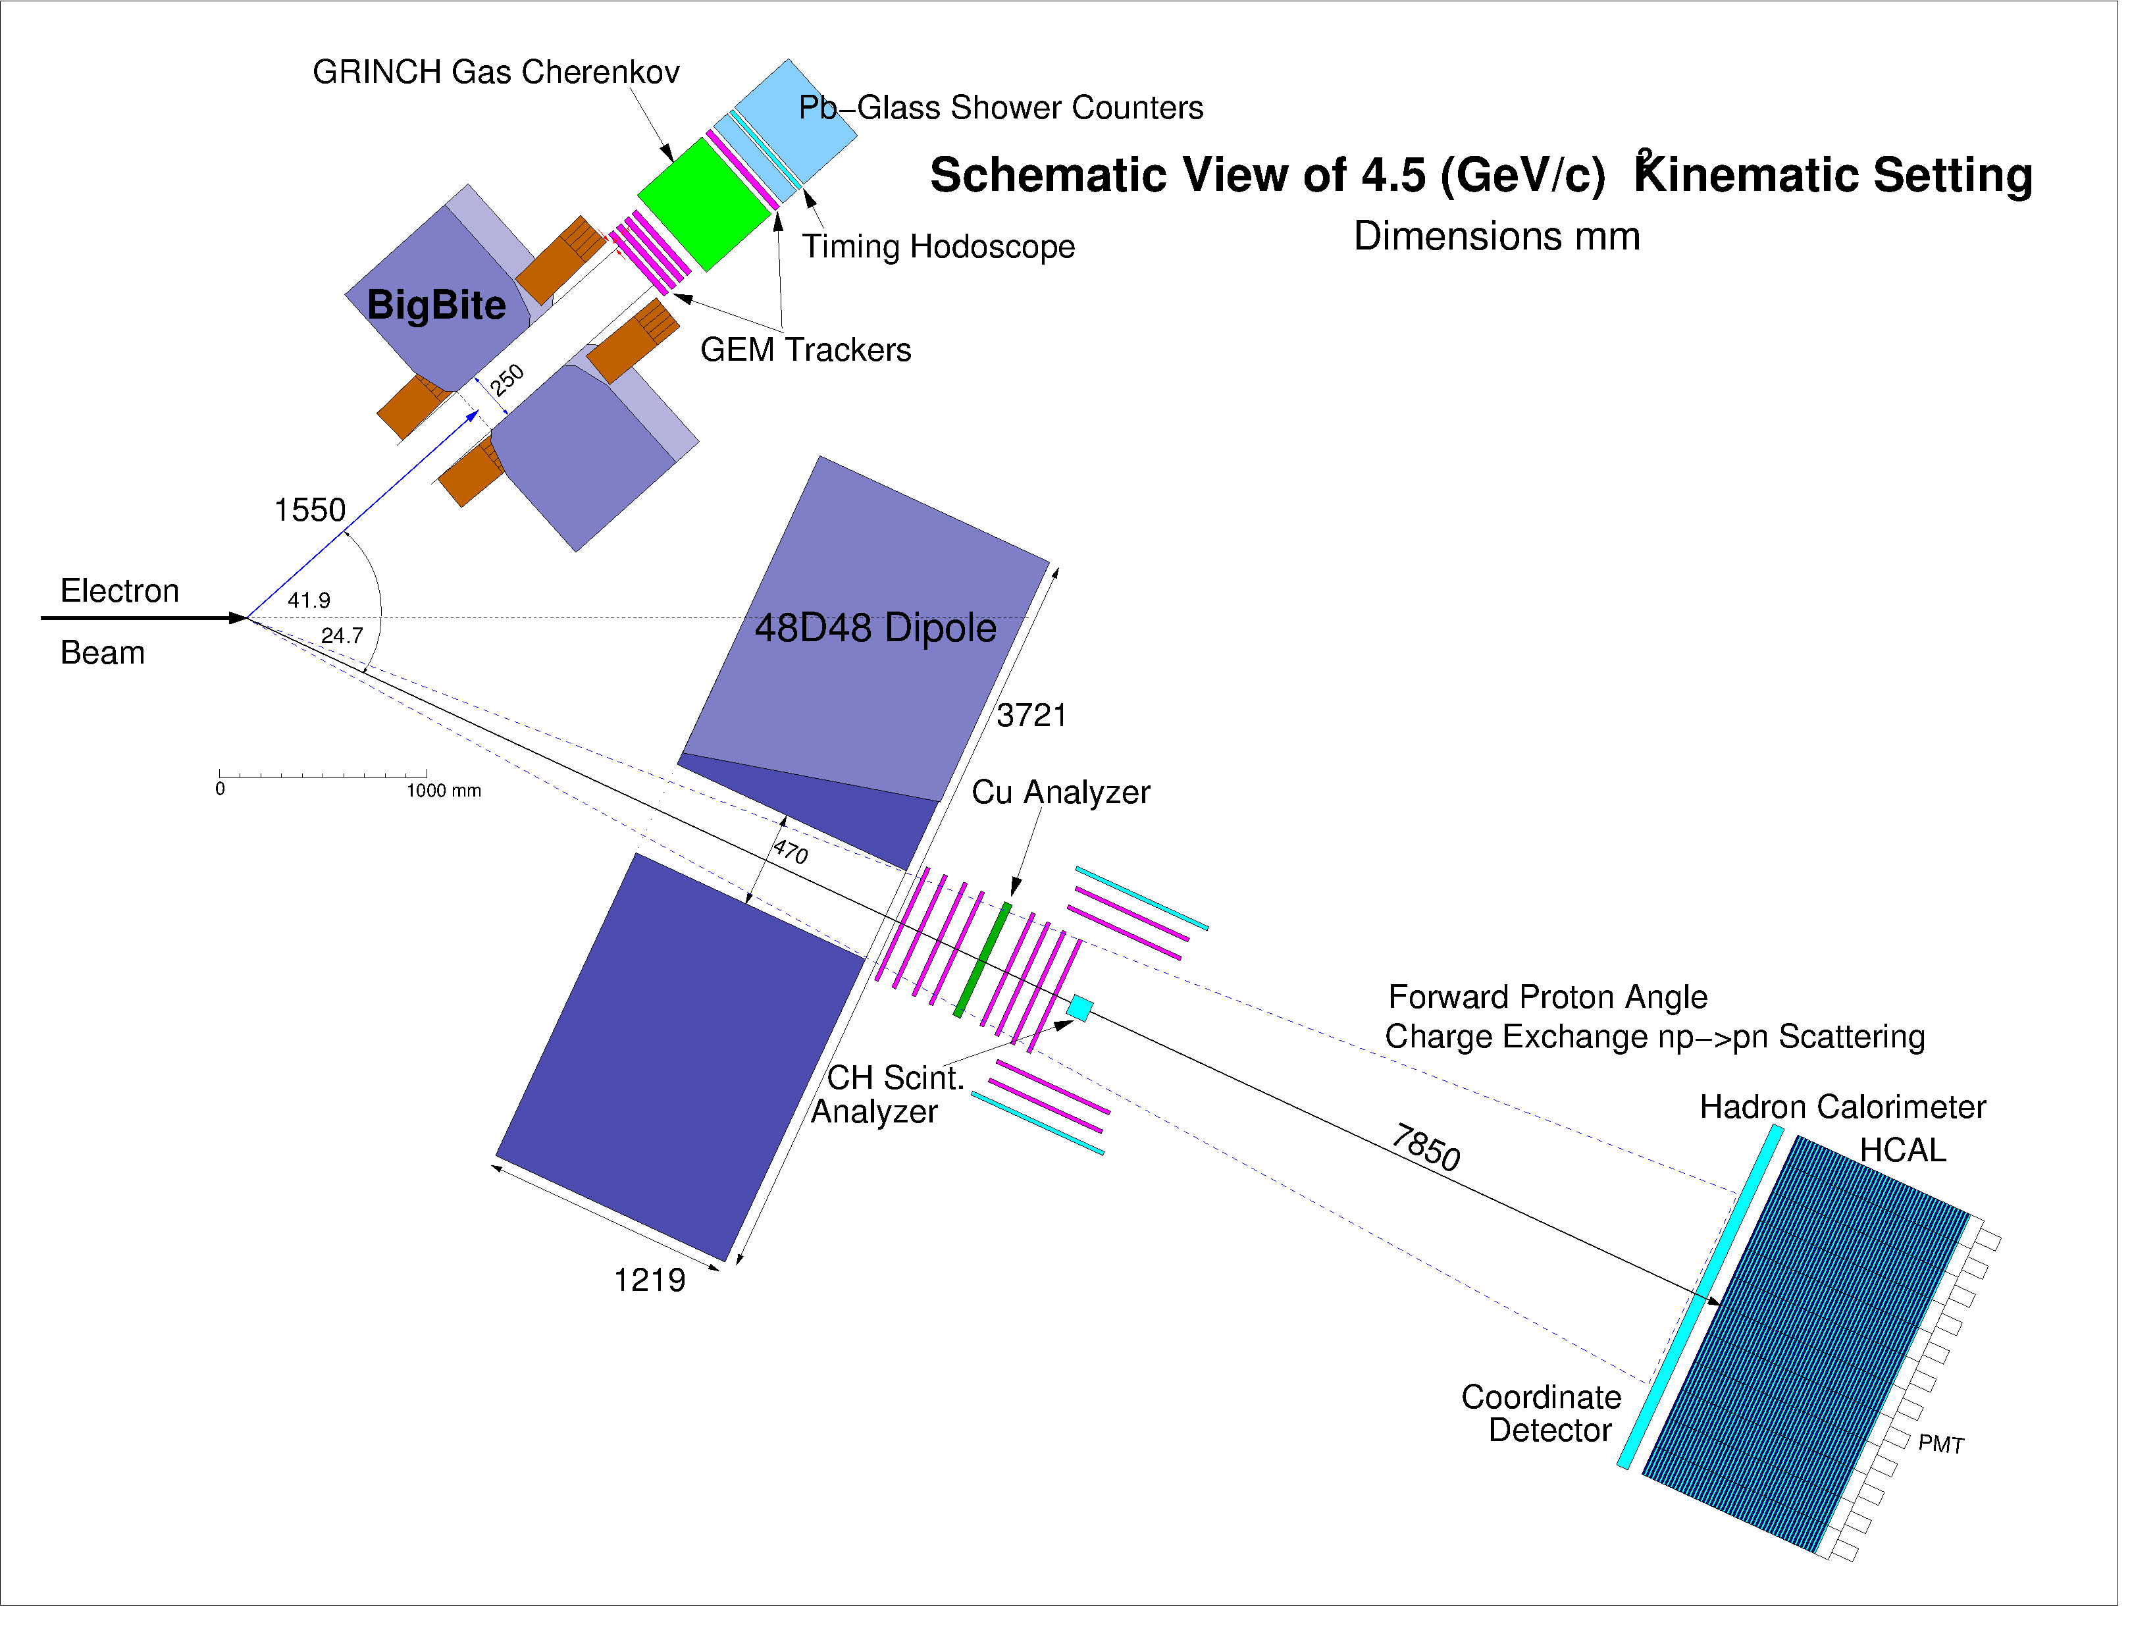
SBS GEM: Purpose
SBS is a 2.5 T*m dipole magnet with vertical bend, and a flexible configuration detectors
A large solid angle, high luminosity (up to 10³⁹ cm⁻² s⁻¹) with large momentum bite
Schematic view of 4.5 (GeV/c)² kinematic setting
Experiments being prepared with SBS:
→ Proton FFs: E12-07-109 (G^{p}_{E} up to Q² =12 GeV²)
→ Neutron FFs: E12-09-016 (G^{n}_{E} up to Q² = 13.5 GeV²)
E12-09-019 (G^{n}_{M} up to Q² = 13.5 GeV²)
→ Measurement of TPE to e-n elastic scatt. at Q² = 4.5 GeV²
→ G^{n}_{E}- RP: E12-17-004 at Q² = 4.5 GeV²
will utilize recoil neutron polarimetry at high momentum
²
Fe Analyzer
Analyzers, GEM trackers and
scintillator planes for G_{En}/G_{Mn}
Reference to the proposal E12-17-004: J.R.M. Annand et al.

Slide 30
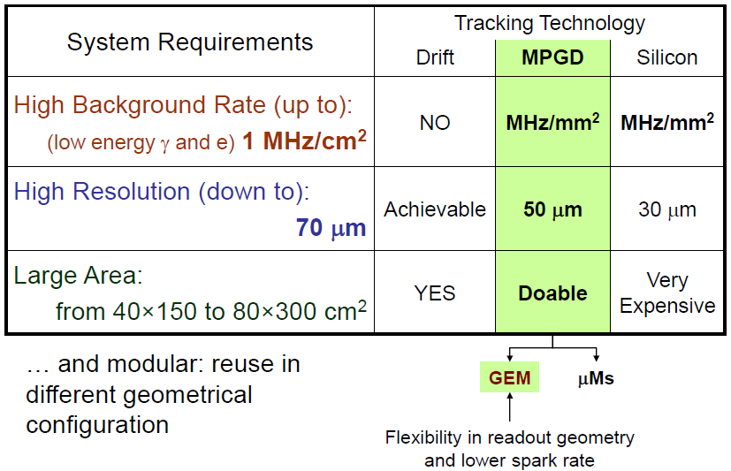
SBS GEM for GEn-RP: Requirements

Slide 31
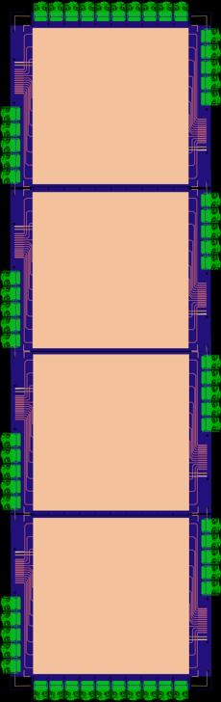
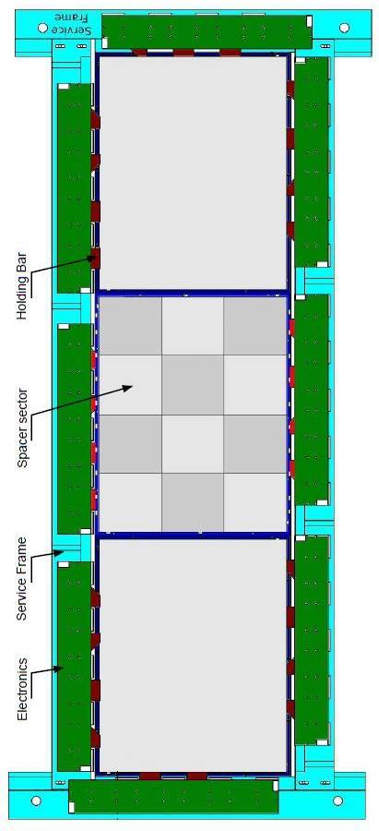

GEn-RP GEM Trackers
The Charge-Exchange (CE) Polarimeter:
  2 INFN + 2 UVa layers, in front of Cu analyzer.
  4 UVa layers behind the Cu analyzer.
The Proton-Recoil (PR) Polarimeter:
  2 Identical arms, 2 UVa GEM layers in each arm
10 UVa GEM layers
2 INFN GEM layers
60 cm
60 cm
GEMs
Plastic Scintillators
150 cm
200 cm
Stack of 3 GEM modules (40 × 50 cm²)
Stack of 4 GEM modules (60 × 50 cm²)
Cu Analyzer
CH Analyzer
Plastic Scintillators

Slide 32
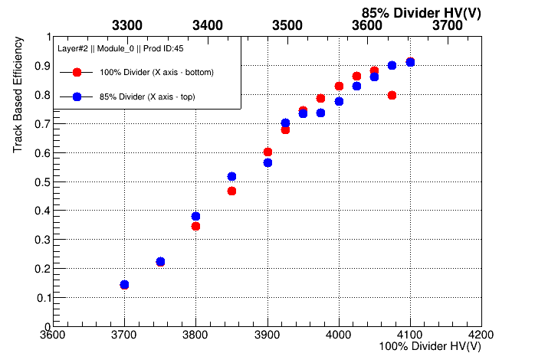
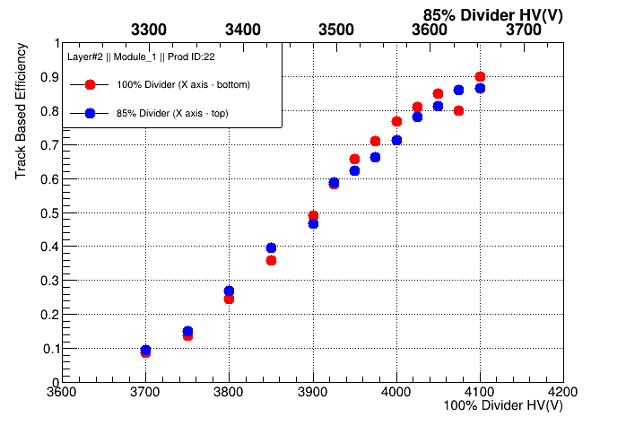
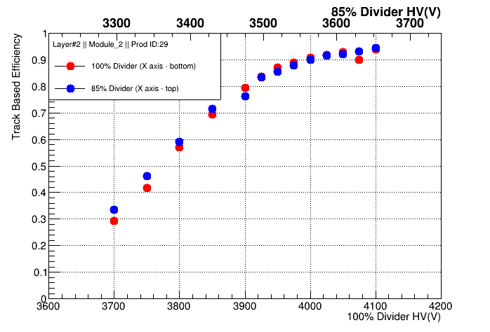
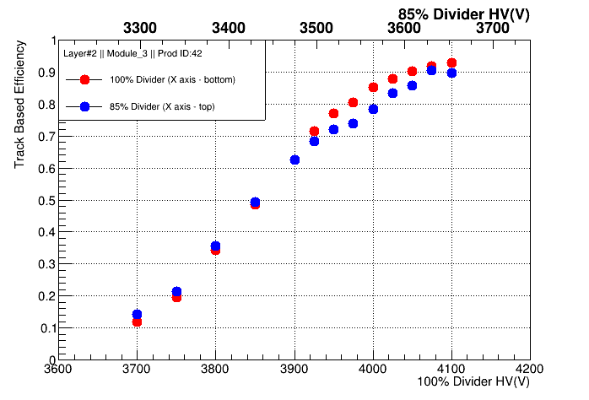
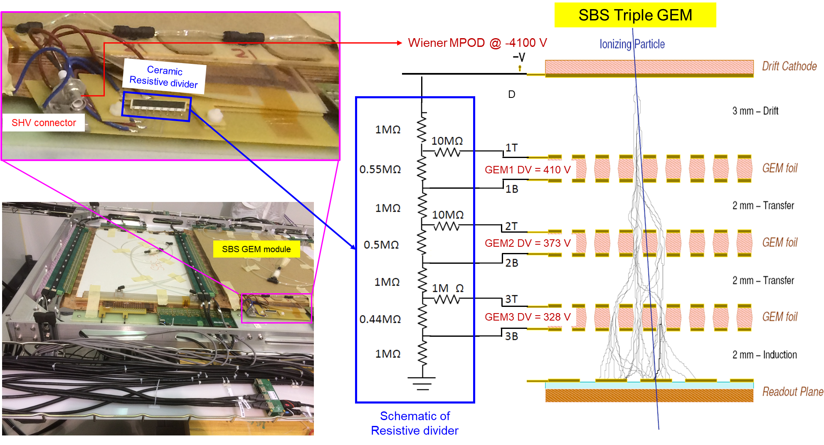
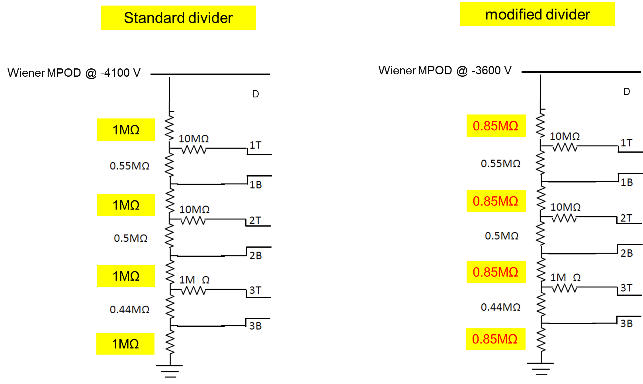
Performances of UVa GEMs: Divider Modification
Few modules show some stabilities issues with the HV, that we think are linked some vibrations between GEM foils cause the chamber to discharge
The problem disappear at lower voltage and / or if we reduce the gas flow rate from 5 Vol changes / hour to ~ 4 Vol changes / hour
Mitigate the problem by reducing the E-field between GEM foils while maintain the GEM amplification  Similar GEM gain = same performance
Modification was implemented on the 4 modules of layer #3 for first test
  Red dots: old divider 100% & Blue dots: modified divider 85%
Modification is now implemented in all assembled layers except #5
  Layer #5 on top of cosmic stand not accessible for the modification
HV scan: 4 modules of Layer#3
modification
Layer #2

Slide 33
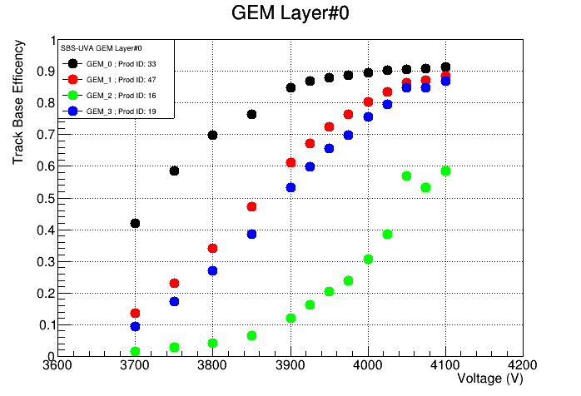
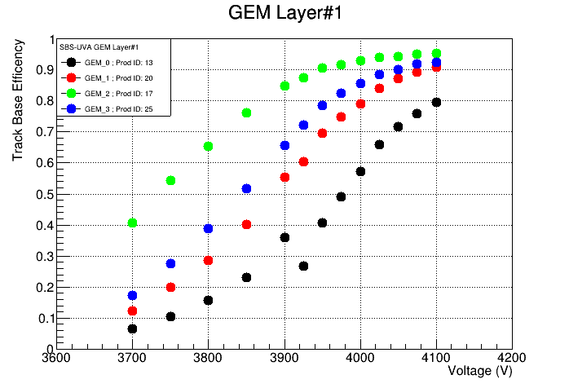
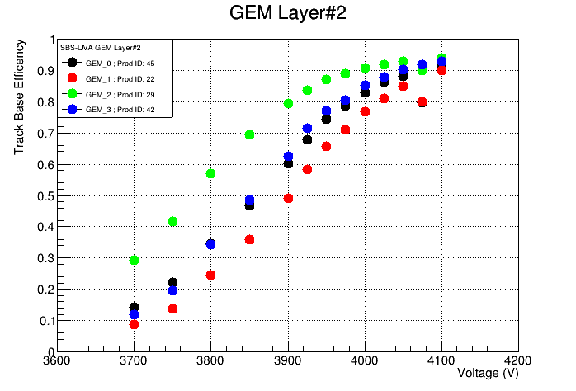
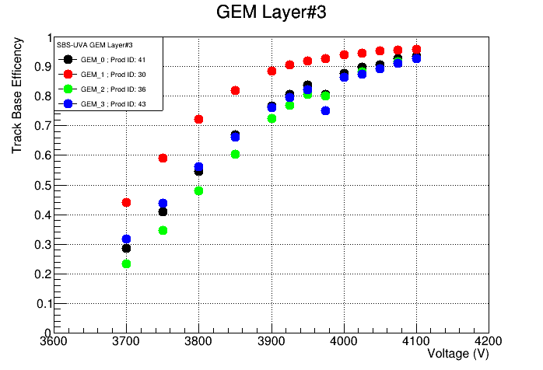
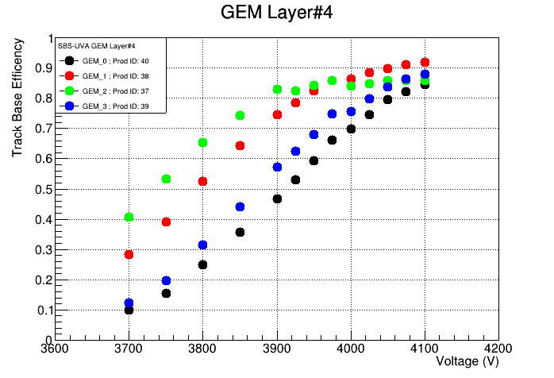
Performances of UVa GEMs: HV scan
Layer #1 & #2: back on assembly tables
Layer #3: now in BB frame in TEDF
Layer #5: HV issue with 2 modules, still with old divider  will be fixed later
Layer #6, #7 & #8 with new HV divider scheme
GEM Layer #4
GEM Layer #4
GEM Layer #5
Layer #2

Slide 34
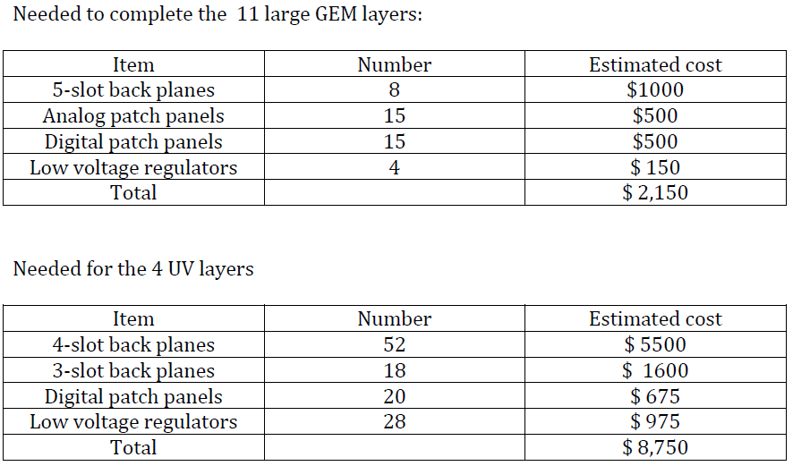
GEn-RP GEM Equipment List
Procurement by JLab (Bogdan …)
Status of the procurement
Patch panels:
PCBs (analog and digital) delivered (done)
Next: HDMI connectors assembly (couple of weeks)
Voltage regulators:
PCBs delivered (done)
voltage regulators chips delivered (done)
Next: Mounting of the voltage regulators
Back planes:
Order was issued to EES (Italy) on Feb. 2  Expected delivery Feb. 26
Layer #2

