Slide 1
BigBite Calorimeter status
Arun Tadepalli – Jefferson Lab

Slide 2
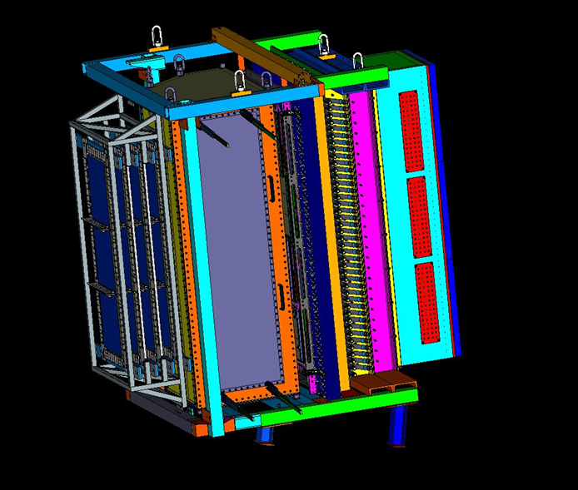
Contents
General introduction to the detector
Current status of shower and preshower
Before moving to the hall…
After the move and before day 1
Summary

Slide 3
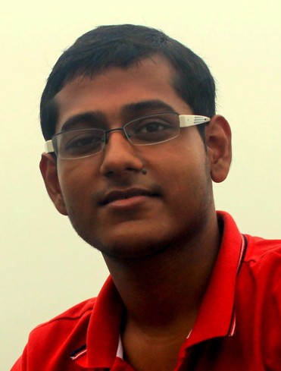
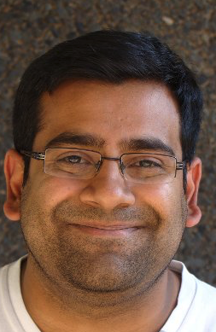
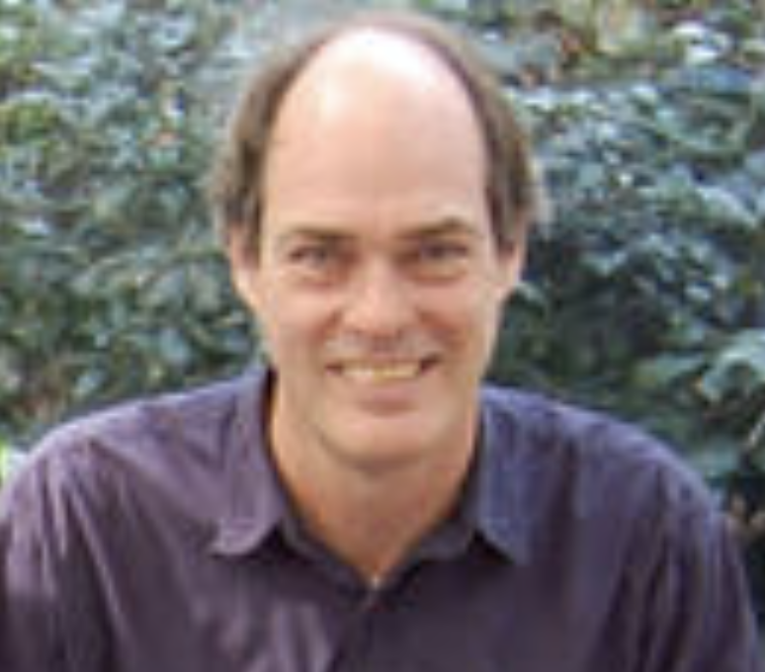
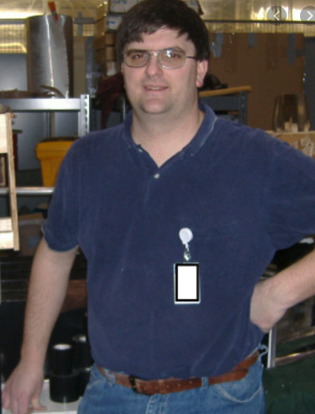
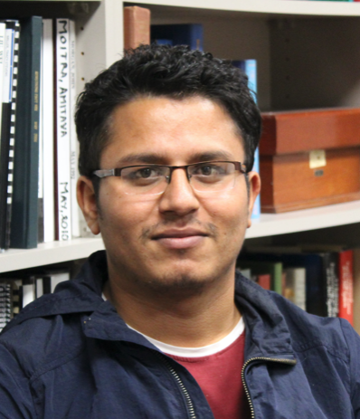
BigBite Workforce
Name | Location | Position | Role | FTE | Comments
Arun Tadepalli | JLab | Postdoc | Contact | >75% | onsite
Bogdan Wojtsekhowski | JLab | Staff | Detector |  | onsite
Mark Jones | JLab | Staff | DAQ, trigger | 20% | onsite
Eric Fuchey | UConn | Postdoc | Software/as needed | 15% | remote
Provakar Datta | UConn | Grad Student | WAPP trigger | More? | onsite
Bhesha Devkota | Miss. State. Univ | Grad student | Installation & Misc | 40% | onsite
Will Tireman | Northern. Mich. Univ | Prof. | HV calibration using cosmics | < 5% | remote
Gary Penman | Univ of Glasgow | Grad student | Software | 40 – 50% | remote
COULD BE YOU! | Anywhere | Alert | Very important! |  | onsite/remote

Slide 4
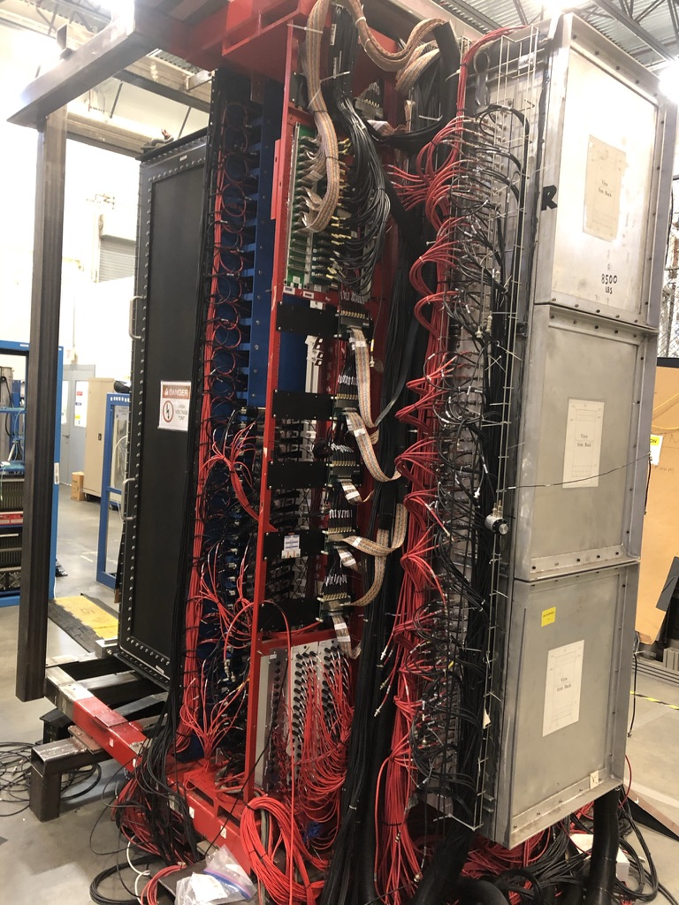
General detector capabilities
Purpose
Trigger (for all experiments other than GEp)
Determination of energy
PID
Starting point of track reconstruction and time determination
General principles
Collect Cherenkov light from relativistically charged particles including primaries and secondary e+/e- shower in electromagnetic cascades
Long axis of preshower perpendicular to e⁻ or pion
Long axis of shower parallel to e⁻ or pion
https://drive.google.com/drive/folders/1wp-CWXj9u6otH6OU8Wz1OW3F3scEEEc7?usp=sharing

Slide 5
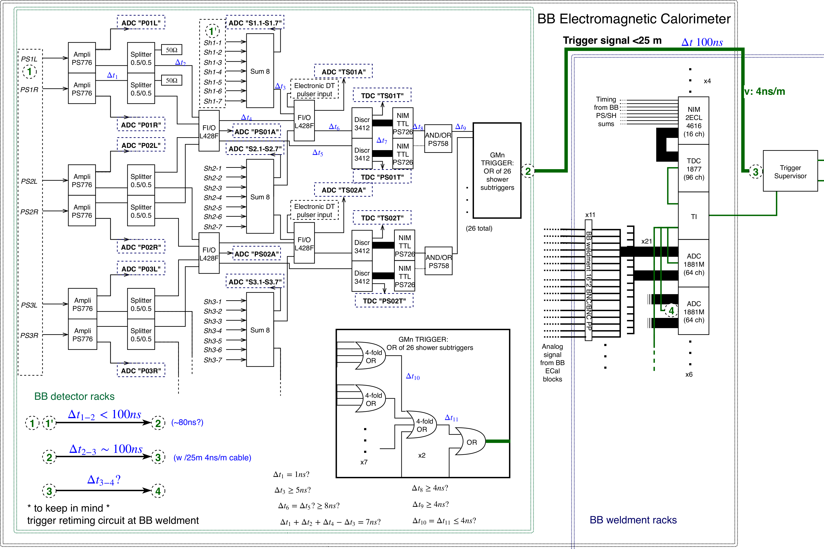
Trigger diagram
shower
preshower
Charged particle
26 row x 2 col blocks
9 x 9 x 30 cm rad hard lead glass blocks
Trigger concept:
PS + SH > Adjustable threshold
*will be updated after including WAPP trigger
27 row x 7 col
8.5 x 8.5 x 37 cm lead glass blocks
5

Slide 6
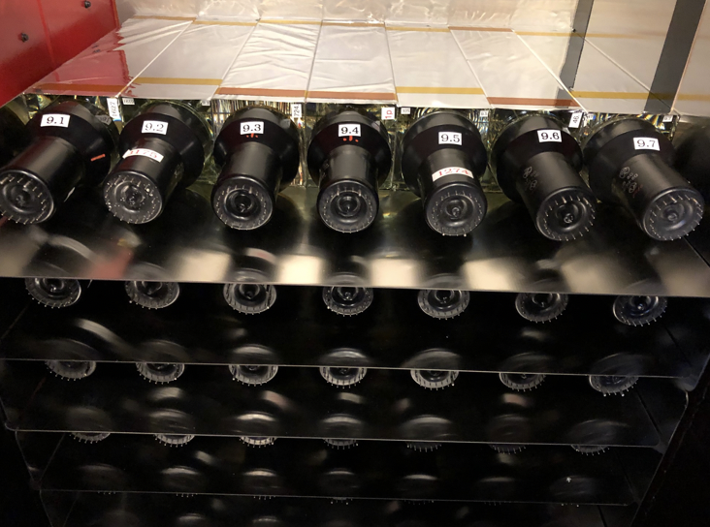
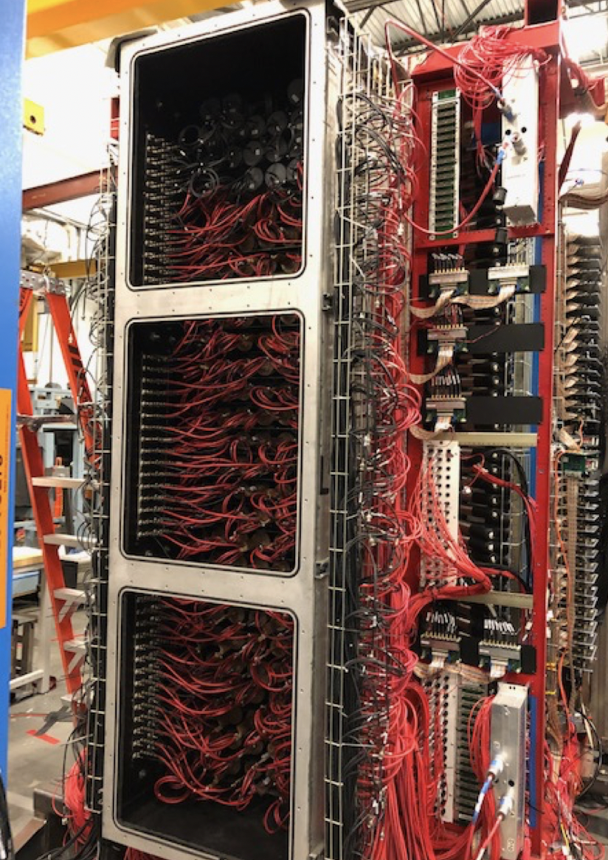
Inside the shower
Shower stacking with more efficient blocks and mu-metal plates
Replaced (previously adjusted) top layers of inefficient shower blocks with good preshower blocks
The HV bases for the shower have been installed

Slide 7
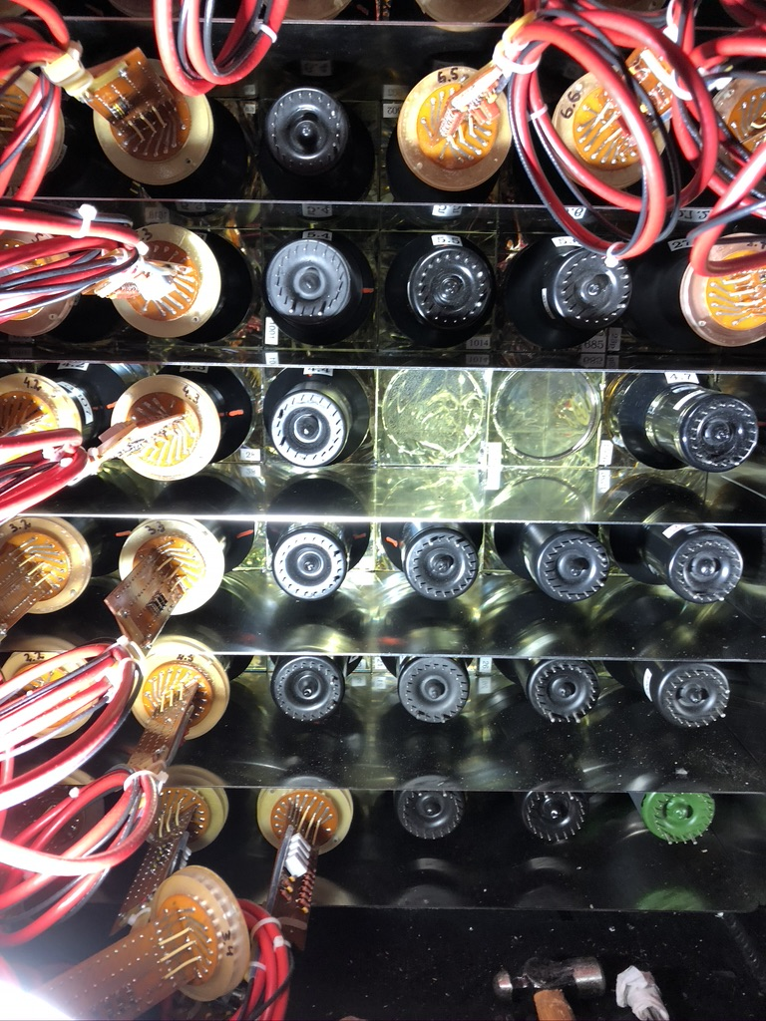
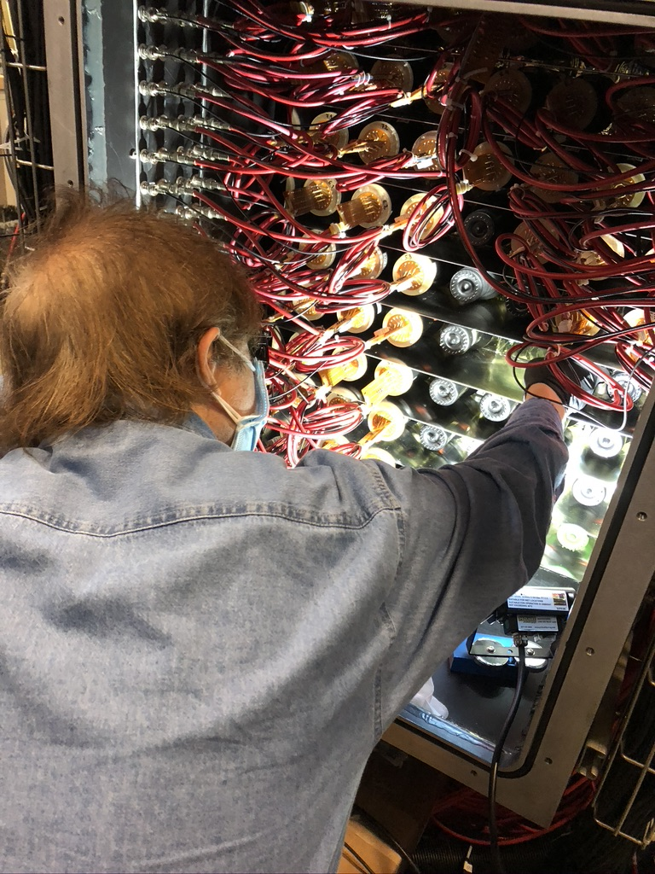
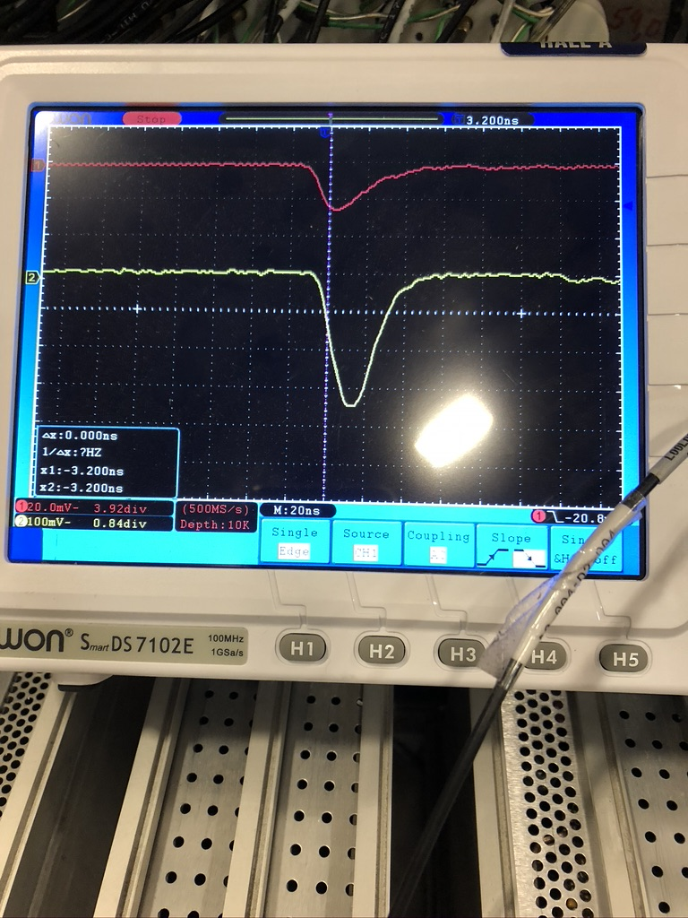
Red = signal from 5.6 top layer
Yellow = signal from 4.6 which is from the replaced PMT
It works!
Bogdan applying UV curing light to cure the epoxy
SBS docid#72

Slide 8
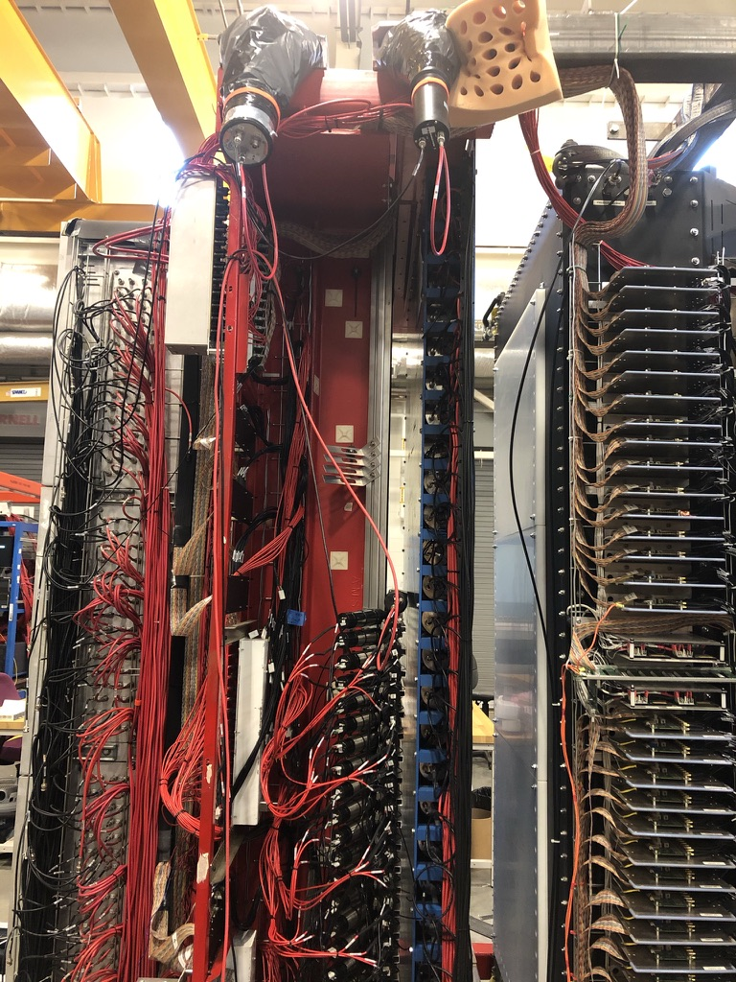
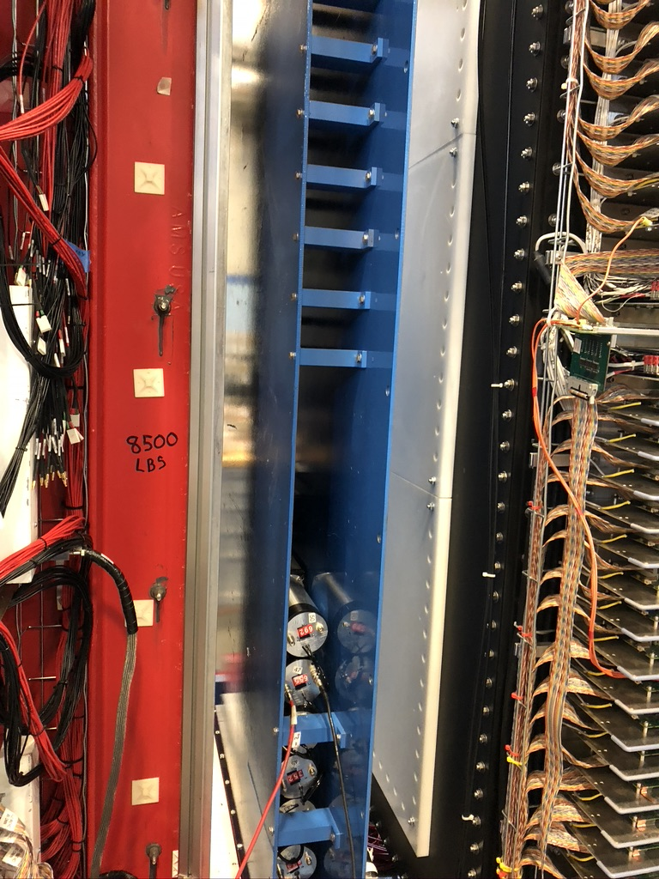
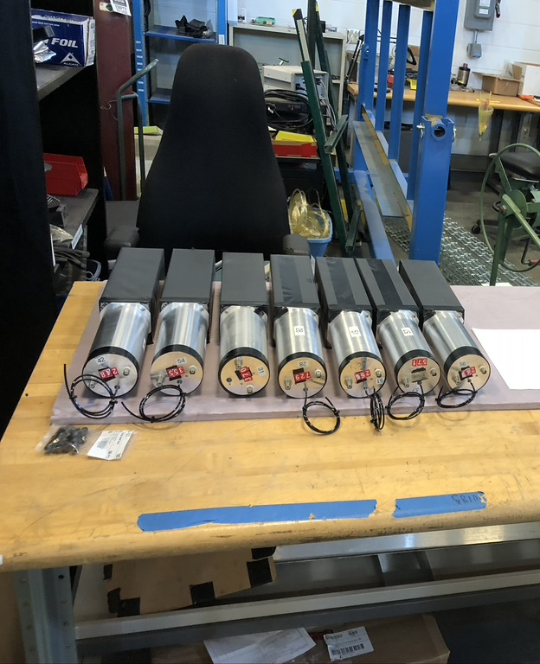
Preshower stacking completed

Slide 9
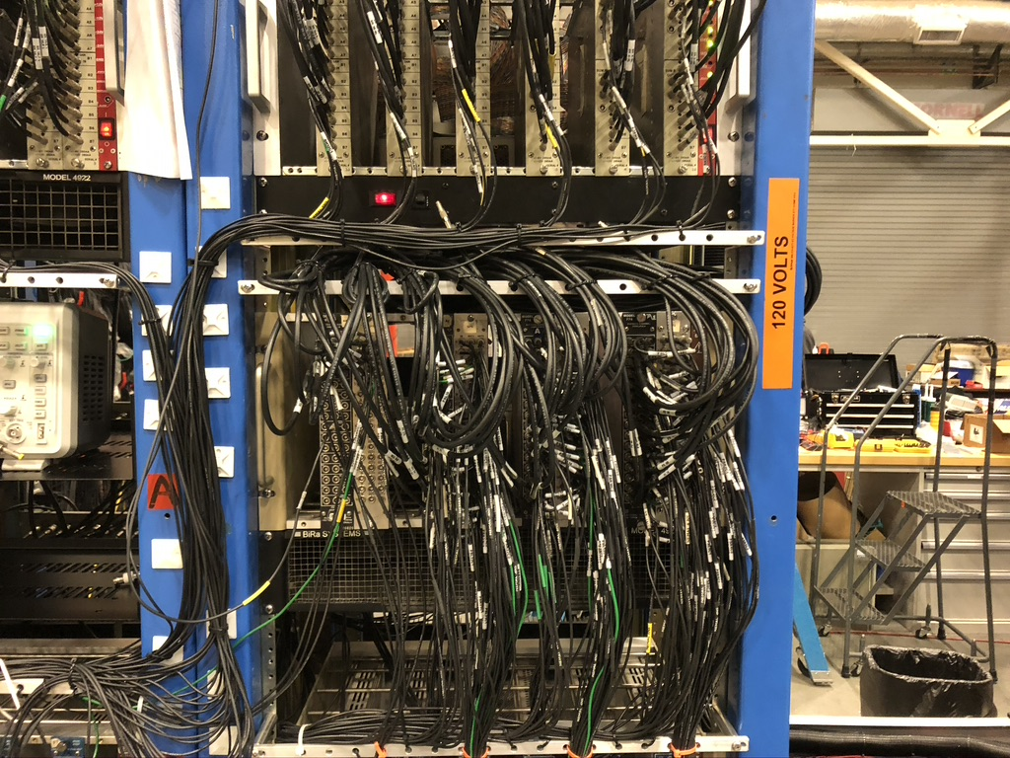
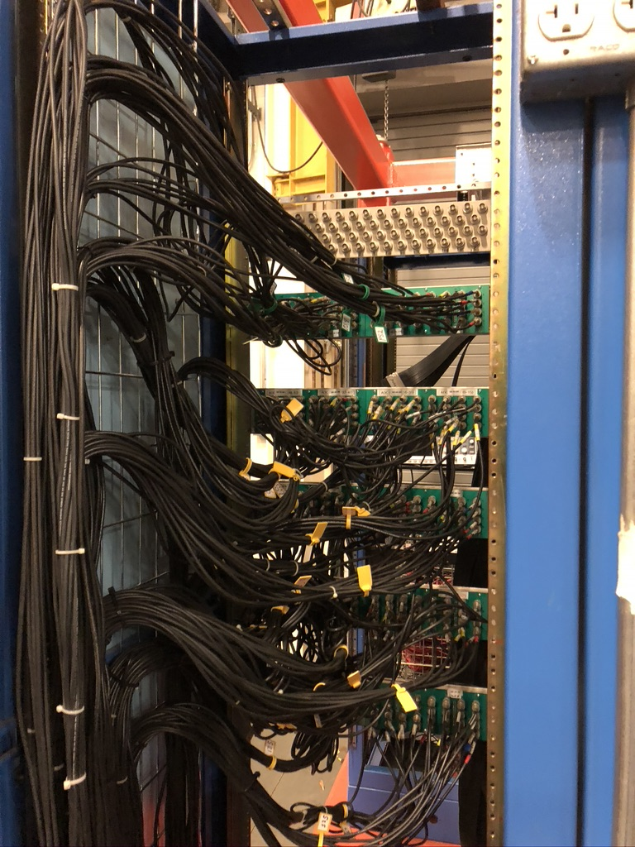
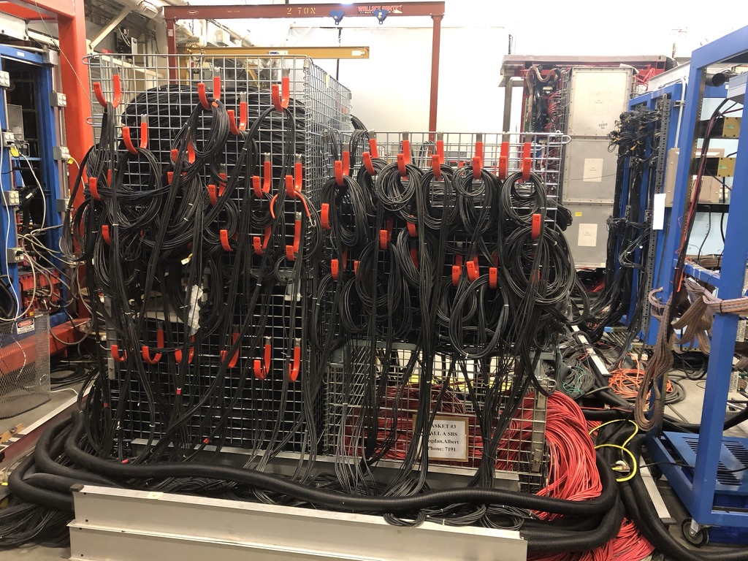
Cabling work completed

Slide 10
AT TEDF…
Cabling (signal and HV) - all cables and connectors intact – completed
Repaired broken modules in place – completed
Light leak checks (shining flash light and checking for current on pico-ammeter) - completed
Signals on individual channels - completed
Looking at pedestals with HV off - completed
Looking at the amplitude shape of the signals with HV on – completed (general noise issues pertains)
Attaching the cosmic counter and setting up the FastBus trigger – completed
Also set up the trigger using the sum of different layers in the shower and preshower – completed
Checking the shape of amplitude distribution – completed
Taking data using different HV settings for shower and preshower – completed
Alpha studies for shower and preshower completed – completed
Adjusting the gain and offset seen on amplifier summer modules – completed
Checking individual channels on the discriminator – completed
For more information see BigBite calorimeter status weekly meeting updates on Sep 14th 2020, Nov 9th 2020, Jan 11th 2021

Slide 11
At tedf…
Adding a copy of the trigger to get WAPP pion threshold (Provakar’s work) – in progress
Attaching new discriminators with tweakable discriminator thresholds – in progress
Remotely monitorable thresholds – need to think about this

Slide 12
From the DAQ side
FastBus connected and fully operational with cosmic trigger – completed
Upgrade to CODA3 – completed (thanks to Bryan Moffit, Alex Camsonne and Ben Raydo!)
Connecting preshower to FADC channels – completed
Raw data with 16 channels looks ok. Need to coordinate efforts with HCAL people on FADC software for BBCAL
Connecting shower to FADC channels – to do
LEMO to BNC FADC cable making in progress (120/272 finished by DSG).
There are plans (by Alex) to acquire the FADCs ahead of time and return after the shipment arrives in June – We strongly advocate for this!
No TDCs being used currently
Until more FADCs for the shower arrive, all calibrations will continue with the FastBus

Slide 13
From the software side
As mentioned before, software exists to looks at:
Raw hits
Pedestals
Analysis code to monitor ADC spectra
HV adjustment
Cosmic event display (to do)
Cosmic calibrations (Will Tireman’s talk)

Slide 14
Detector equipment
Detector stack
Shower and preshower
Cable system
52 signal cables for preshower and 189 signal cables with spares for shower
52 HV cables for preshower and 189 HV cables with spares for shower
Power supplies = 2
Adequate number of HV cards with 4 spares
Blue electronics racks = 1
Discriminator modules
Amplifier summer modules
Trigger (lower and upper threshold copies)
BigBite weldment
DAQ (FastBus or VME), cosmic trigger
4 FADC at hand (12 ordered for shower)
LEMO to BNC (64 ready for preshower, 120/252 being prepared by DSG, +16 spare)

Slide 15
Sequence of Moving equipment to the hall
Detector stack
After Shower & preshower fully uncabled
Signal cables from HCAL
HCAL will be moved first hence we have to give (up) the signal cables. HCAL TDC cables will have been freed for BigBite by then.
Front end blue rack + preshower & shower signal cables conduit
All cables are in conduit (easy to control and transport)
HV cables in a basket
Limitation is that they are underneath the signal cables which will be moved for HCAL folks so it should be ok
BigBite weldment that carries DAQ, patch panels, FADC cables and cosmic trigger

Slide 16
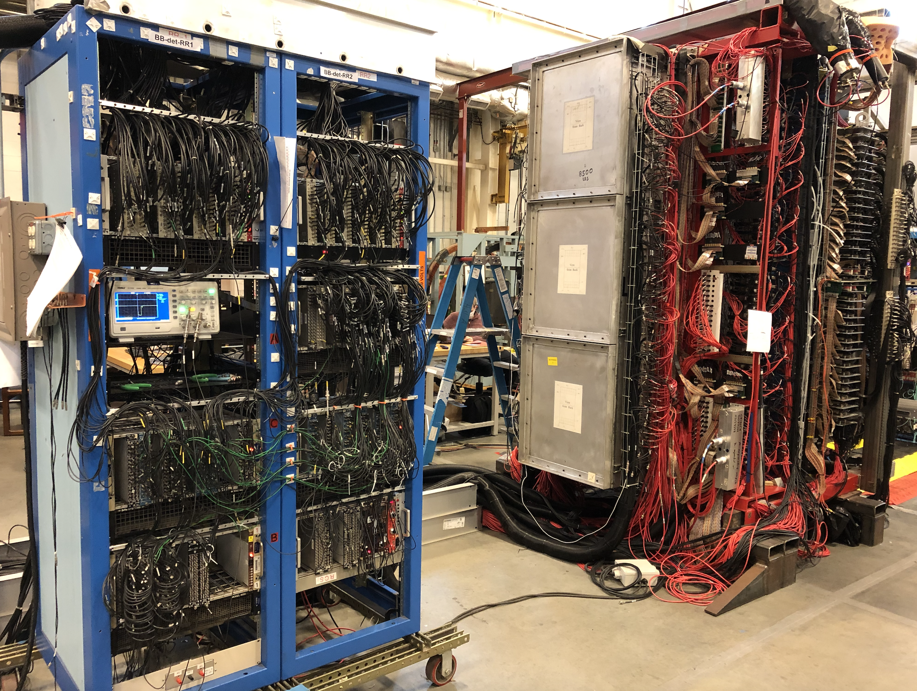
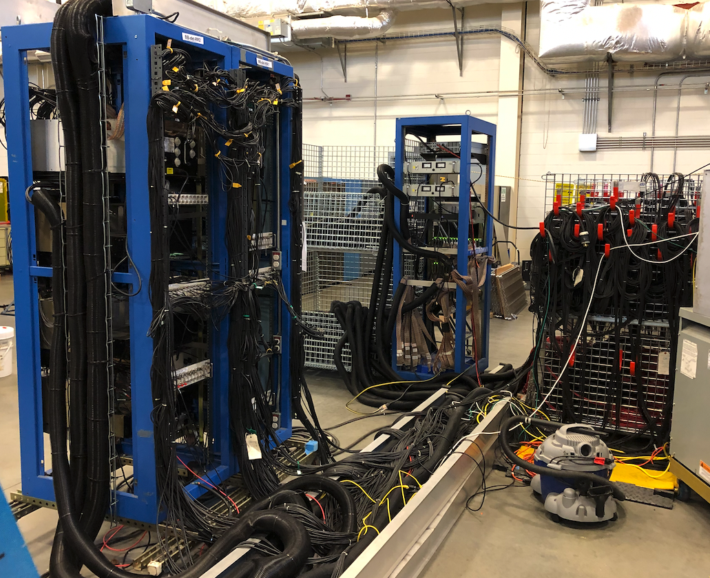
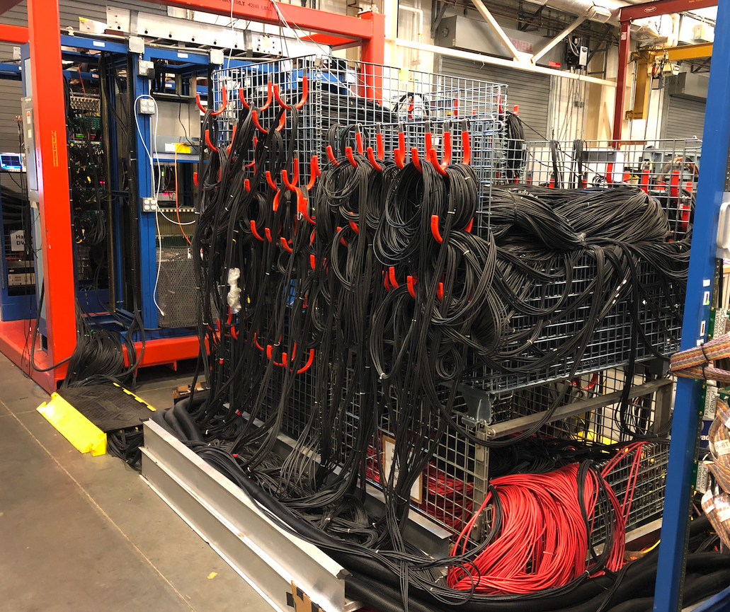
Moving cables to the hall…
Unplug shower and preshower cables and put in basket
Unplug HV cables and put in basket below
Preshower and shower front end signal cables can be taken with this rack

Slide 17
Floor plan in hall a
What we really need is someone to tell us, “Hey, this is where you can layout your cables”

Slide 18
Timeline of bigbite tasks (as per jessie’s gantt chart)
GMn run group
2 weeks
2 weeks
Jessie and co. tests in the pivot area to put bigbite at an angle
Decabling shower preshower
May 17th
Jun 1st
Jul 2nd
Aug 1st
Moving HCAL cables,
Moving BigBite weldment
Moving front end blue rack
HV cables to Hall A
Start attaching cables
Plan ahead due to COVID restrictions
Attach cosmic trigger
Check pedestals and ADC spectra with cosmics in the Hall
Moving BigBite to Hall A
EVERYTHING SHOULD BE READY!
Software for beam conditions (see next slide)

Slide 19
after move and before day 1…
Make sure that:
All connections are tested
Amplitude and time distributions are seen for all the channels on FADC or Fastbus
Online monitoring setup to see the counting rates, cosmic tracks and event display in individual blocks on a 27 x 7 and 26 x 2 grids
Trigger has been tested out and the thresholds are tweaked
HV display should be simple for shifters (green or red) and alert experts if needed
All observations are properly documented in the logbook!

Slide 20
Day 1
Will have to monitor all the quantities mentioned in the previous slides under beam conditions
Plan for calibrations under beam conditions
For E02-013 (GEn), calibrations were done using elastics on H2 data for electrons and pions (Seamus Riordan’s thesis).
Should we do this again? Need to discuss with BigBite group
Andrew pointed us to Freddy Obrecht’s thesis where the procedure is outlined in detail

Slide 21
Documentation/safety
Documentation
BigBite how to – Eric Fuchey (needs to be updated)
Making a cosmic trigger using FastBus (https://sbs.jlab.org/cgi-bin/DocDB/private/ShowDocument?docid=74)
THA (Task Hazard analysis) – to do
Safety
Ladder safety (to do)
COVID restrictions (to do)
Procedure to replace a PMT (https://sbs.jlab.org/cgi-bin/DocDB/private/ShowDocument?docid=72)
How-to for shift workers
Instructions on DAQ operation, monitoring ADC spectra etc will have to be written. The person who will do these tasks will write the documentation for shifters. Will have to be written for shifters but not worried at this point

Slide 22
summary
Current status of the shower and preshower from detector, software, and DAQ viewpoint
New people have joined and are enthusiastic about hardware experience and interested in contributing to analysis tasks.
Some preliminary thoughts on what to anticipate while moving detectors, cables, weldments, front end racks and calibrations were presented to invoke discussions
Need to communicate and coordinate effectively while following safety and COVID protocols
Exciting times ahead!!

Slide 23
SPECIAL Thanks TO
Many people who helped cable up the detector
Ashley Yoon, Abby Hellman, Maria Satnik
Eric Fuchey
Doug Higinbotham
Chuck Long for all continued help
DAQ debugging – Alex Camsonne, Bryan Moffit & Ben Raydo
DSG – Mindy Leffel and Marc McMullan for help with cables
Calibration software support – Will Tireman
Hall A staff and engineers

