Slide 1
JLab 24 GeV Beam Perspectives
Central Question: What is the feasibility of an FFA racetrack in the existing CEBAF tunnel to reach the top energy of 20-24 GeV?
CBETA Test Accelerator – Modern FFA technology
  CBETA-like FFA arc with TOF chicane switchyard
Synchrotron radiation effects mitigation - Beam quality
Magnet requirements
Summary
Alex Bogacz
*FFA (Fixed Field Alternating-Gradient)

Slide 2
CEBAF FFA Upgrade
  Start with 12 GeV CEBAF as a baseline
  NO new SRF (1090 MeV per linac)
  Remove the highest pass recirculation arcs (Arc 9 and Arc A) and replace them with a pair of FFA arcs
Arc 9
  Recirculate as many times as feasible to get to 20-24 GeV:
    4.5 passes with the current CEBAF (Arcs 1-8)
    At least 6+ passes through FFA arcs
Arc A

Slide 3

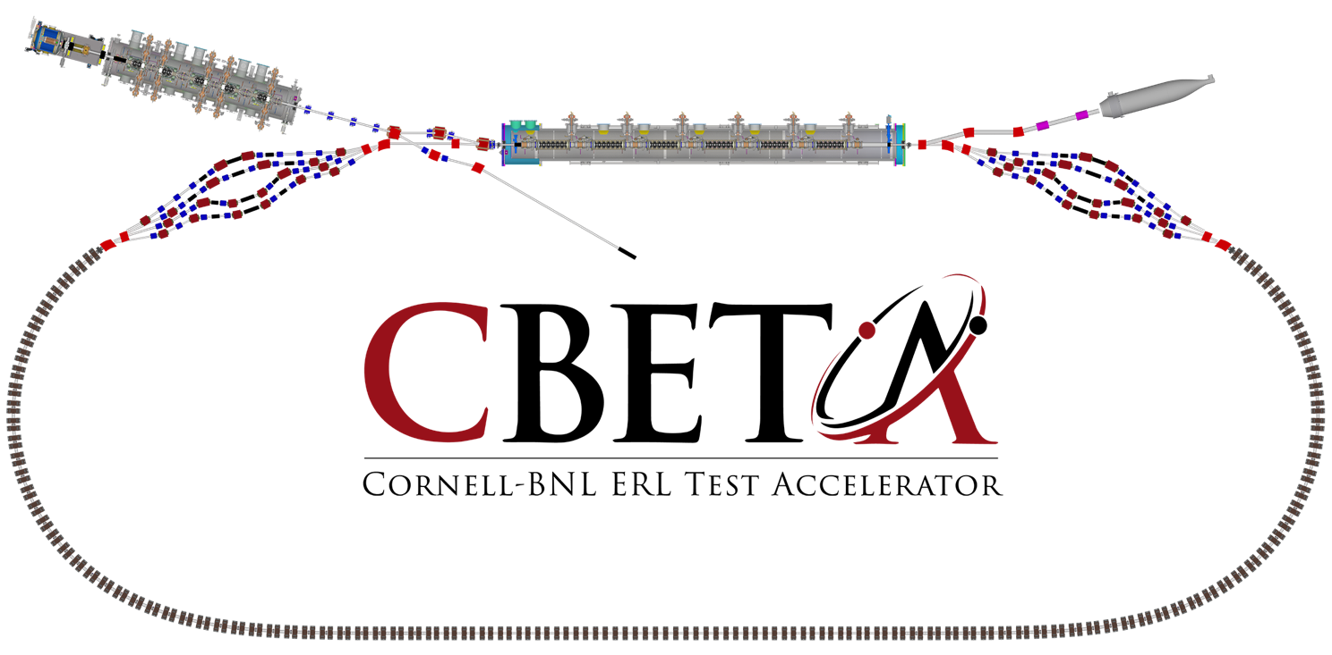
Test Accelerator
Non-scaling FFA, permanent magnet technology
Cornell DC gun
100 mA, 6 MeV SRF injector
600 kW beam dump
100 mA, 6-cavity SRF CW Linac
Georg Hoffstaetter
Cornell University
6 MeV
6 MeV
TOF Compensation Switchyard
TOF Compensation Switchyard
+/- 36 MeV
Electron Current up to 320 mA in the linac
Bunch charge Q of up to 2 nC
Bunch repetition rate 1.3 GHz/N
Beams of 100 mA for 1 turn and 40 mA for 4 turns
42, 78, 114, 150 MeV

Slide 4
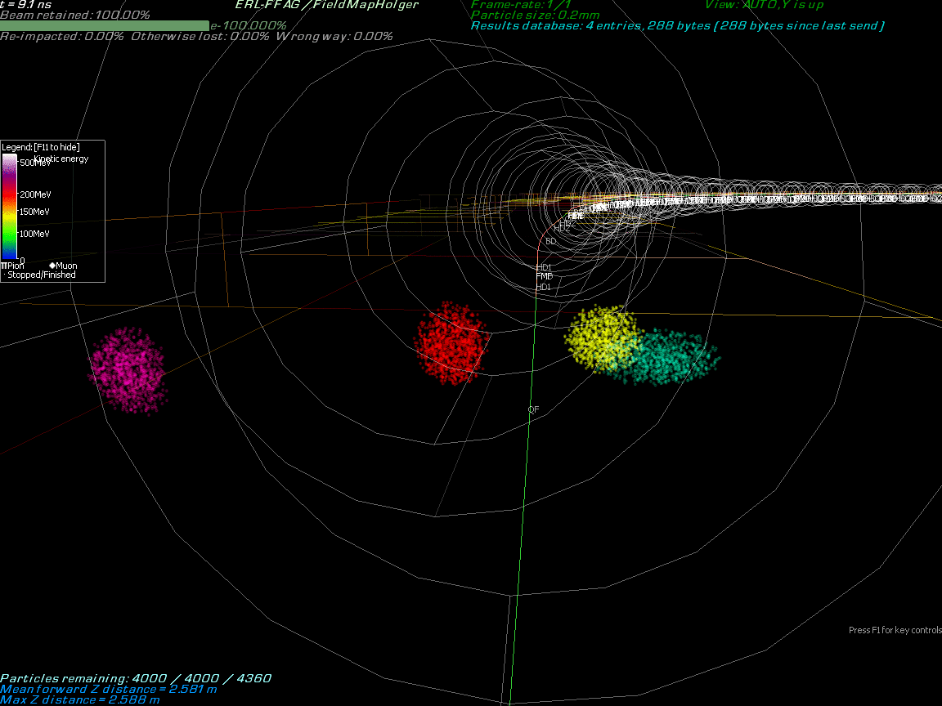
Multi-Bunch Dynamics in FFA Arc
Stephen Brooks
BNL

Slide 5
-like FFA Arc

Slide 6
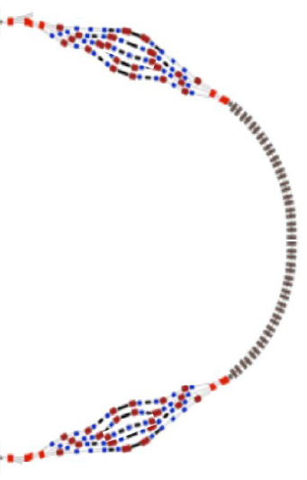
4.5-pass CEBAF + FFA Arcs ( -like)

Slide 7
4.5-pass CEBAF + FFA Arcs ( -like)

Slide 8
Synchrotron Radiation Effects on Beam Dynamics
Synchrotron radiated energy:
Natural energy spread due to quantum excitations:
Emittance dilution due to quantum excitations:
2

Slide 9
Energy Loss, Emittance Dilution (4-pass CEBAF)
arc 1 | 1.2 | 0.063 | 5.1 | 0 | 1.8E-01 | 2.8E-09 | 2.8E-09 | 2.6E-06 | 2.6E-06
arc 2 | 2.3 | 0.127 | 10.2 | 0 | 1.8E-01 | 3.3E-08 | 3.6E-08 | 6.4E-06 | 8.9E-06
arc 3 | 3.4 | 0.126 | 10.2 | 1 | 1.8E-01 | 3.4E-07 | 3.7E-07 | 1.7E-05 | 2.6E-05
arc 4 | 4.5 | 0.253 | 20.4 | 1 | 1.8E-01 | 4.5E-07 | 8.2E-07 | 1.7E-05 | 4.3E-05
arc 5 | 5.6 | 0.253 | 20.4 | 2 | 1.8E-01 | 8.2E-07 | 1.6E-06 | 2.9E-05 | 7.1E-05
arc 6 | 6.7 | 0.253 | 20.4 | 4 | 9.0E-02 | 2.4E-06 | 4.0E-06 | 4.5E-05 | 1.2E-04
arc 7 | 7.7 | 0.379 | 30.6 | 5 | 9.0E-02 | 2.6E-06 | 6.7E-06 | 4.4E-05 | 1.6E-04
arc 8 | 8.8 | 0.379 | 30.6 | 9 | 9.0E-02 | 5.8E-06 | 1.2E-05 | 6.1E-05 | 2.2E-04

Slide 10
-like FFA Racetrack
6 passes

Slide 11
Energy loss, Emittance Dilution

Slide 12
Average Bend Fields
7.2 ± 2.5 kGauss

Slide 13
Energy loss, Emittance Dilution (7-pass FFA)

Slide 14

Summary
  Recirculate 4.5 passes with the current CEBAF and additional 6/7 passes through a pair of FFA arcs to get 22.3/24 GeV (1.09 GeV per linac)
  Requirements on the FFA bending field, especially the peak field needed and the gradient across the orbits:
    0.8 Tesla ± 0.3 Tesla
    Quadrupole Gradient: 10 Tesla/m for ±2.5 cm orbit separation
  Order of magnitude estimate of the beam quality parameters (6/7 passes):
    Net transverse emittance dilution (normalized): 47/76 mm mrad
    Net natural energy spread: 1.7/2.3×10⁻³
    Net synchrotron radiated energy: 634/976 MeV

Slide 15
Thanks for your attention!

Slide 16
4.5-pass CEBAF + FFA Arcs ( -like)

