Slide 1



Double Deeply Virtual Compton
Scattering
Alexandre Camsonne
Jefferson Laboratory Hall A
CNF Mini workshop: Experiment and Theory Intersections: Future Planning
March 3rd 2021

Slide 2
Outline
Introduction DDVCS
DDVCS crosssection
DDVCS kinematic and observable
Kinematical coverage
CLAS12 setup
SoLID J/psi and dedicated setup
Hall C setup
CNF Questions
Conclusions

Slide 3
DVCS / Double DVCS
γ∗ + p
γ‘(∗) + p’
l⁺ + l⁻
Guidal and Vanderhaegen : Double deeply virtual Compton scattering off the nucleon (arXiv:hep-ph/0208275v1 30 Aug 2002)
Belitsky Radyushkin : Unraveling hadron structure with generalized parton distributions (arXiv:hep-ph/0504030v3 27 Jun 2005)

Slide 4
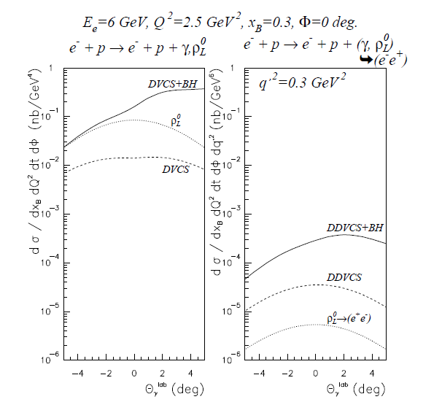
DDVCS cross section
VGG model
Order of
~0.1 pb = 10⁻³⁶cm²
About 100 to 1000 smaller than DVCS
Virtual Beth and Heitler
Interference term enhanced by BH
Contributions from mesons small when far from meson mass

Slide 5
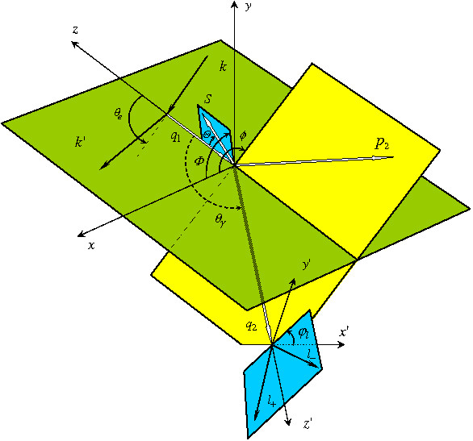
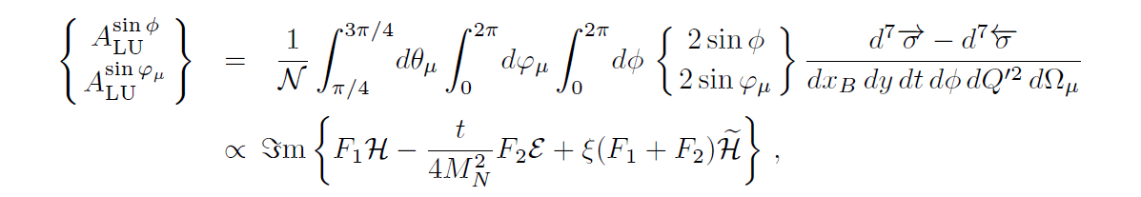
Double Deeply Virtual Compton Scattering
p = p1+p2
q = ½ (q1+q2)
Δ = p1-p2 = q2-q1
Q²= − q²
ξ =
Q²
η =
Δ.q
2p.q
p.q
scattered proton
scattered electron
Q²= -(k-k’)²
x_{bj}=
Q²
2p₁q₁
outgoing virtual photon
Belitsky Radyushkin : Unraveling hadron structure with generalized parton distributions (arXiv:hep-ph/0504030v3 27 Jun 2005)
lepton pair from virtual photon

Slide 6


Kinematical coverage
JLab 11 GeV
25 GeV
40 GeV
DVCS
η = ξ
2
H^{u}(η , ξ)
2
$$Q^{2}<M_{l^{+}l^{−}}^{}$$
$$Q^{2}>M_{l^{+}l^{−}}^{}$$
DVCS only probes η = ξ
line
Example with model of GPD H for up quark
Jlab : Q²>0
Kinematical range increases with beam energy ( larger dilepton mass )
η
ξ

Slide 7
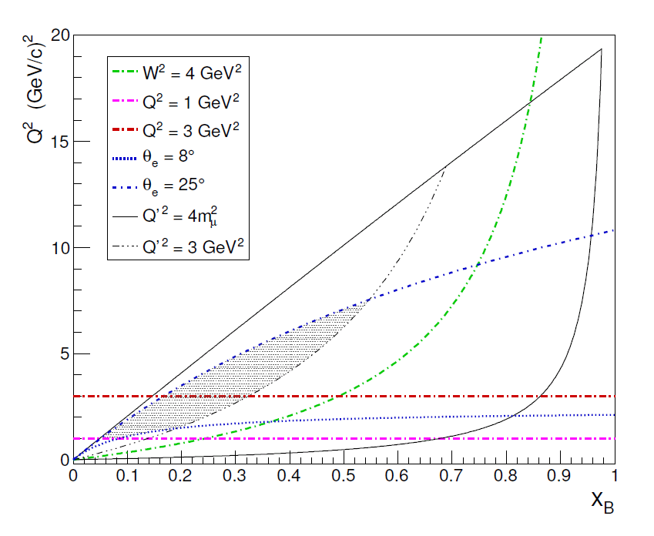
Kinematic coverage

Slide 8
Possible measurements
PAC 43 : Measurement of Double Deeply Virtual Compton Scattering (DDVCS) in the di-muon channel with the SoLID spectrometer
(Boer,Camsonne,Gnanvo,Sparveri,Voutier,Zhao)
PAC 44 : Electroproduction of muon pairs with CLAS12: Double DVCS and J/ψ electroproduction
(Boer,Guidal,Stepanyan,Guidal,Paremuzyan)
Possible Hall C new detector

Slide 9
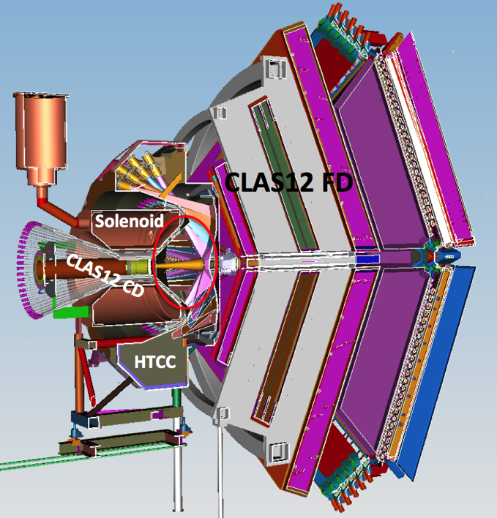
CLAS12 modifications for
Remove HTCC and install in the region of active volume of HTCC
  a new Moller cone that extends up to 7º
  a new PbWO₄ calorimeter that covers 7º to 30º polar angular range with 2π azimuthal coverage.
Behind the calorimeter, a 30 cm thick tungsten shield covers the whole acceptance of the CLAS12 FD
GEM tracker in front of the calorimeter for vertexing
30
30º
Location of HTCC mirrors
30º
7º
60
S
7º
5º
17 (24)
40
13 (20)
20
GEMs
PbWO₄
60
W shield
PbWO₄ modules with APD readout - ~ 1200 modules

Slide 10
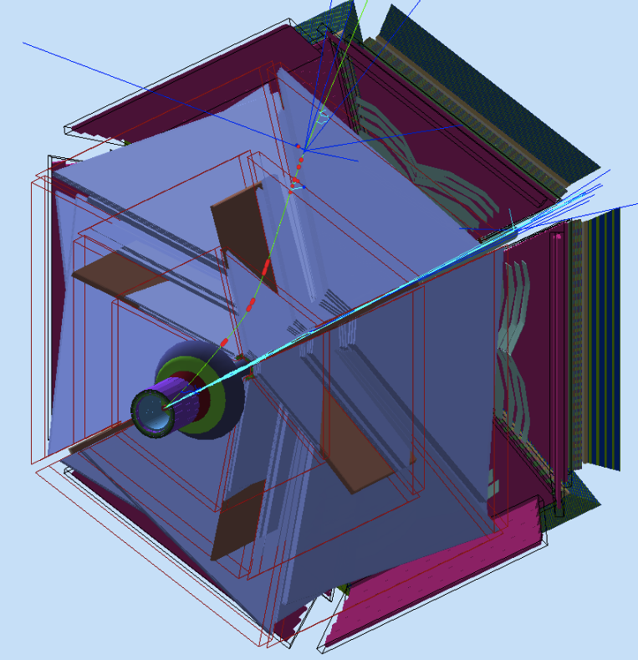
CLAS12 FD new configuration
In this configuration the forward drift chambers are fully protected from electromagnetic and hadronic background
Calorimeter/shield configuration will play a role of the absorber for the muon detector, i.e. the CLAS12 FD
The scattered electrons will be detected in the calorimeter
GEM based tracking detectors will aid reconstruction of vertex parameters (angles and positions) of charged particles.

Slide 11
DDVCS beam spin asymmetry
Sign change with change of kinematics – from Space-like to Time-like dominance region
The VGG code was used for DDVCS BSA
GRAPE-dilepton event generator was used to estimate rates

Slide 12
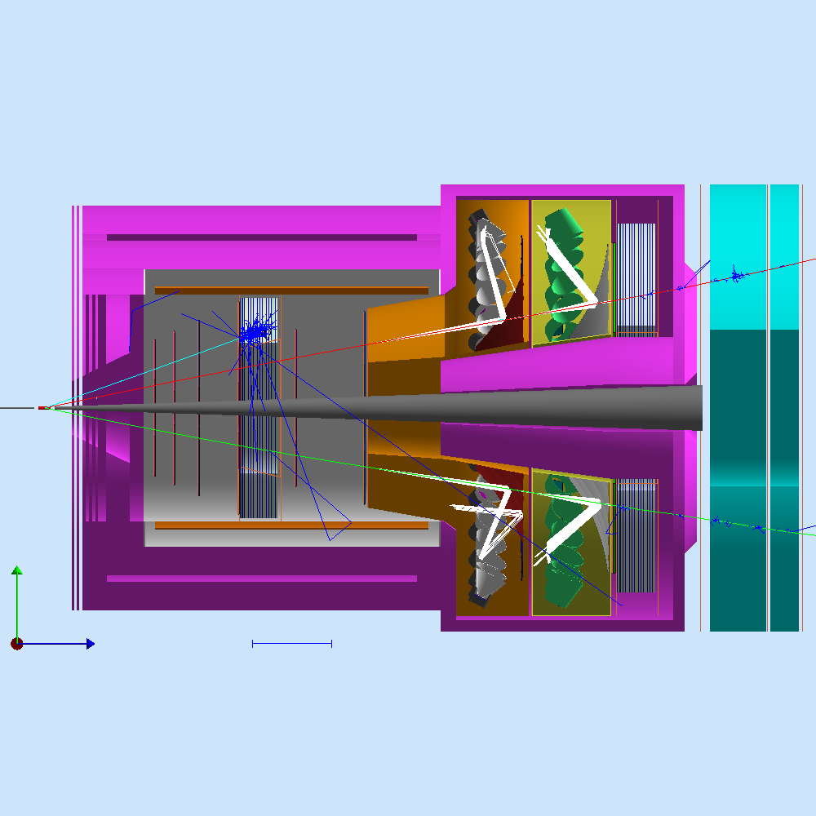
SoLID JPsi Setup
Muon chambers
Cernkov detectors
Large Angle Calorimeter
Iron plate
Iron plate
Forward Calorimeter
GEM trackers

Slide 13
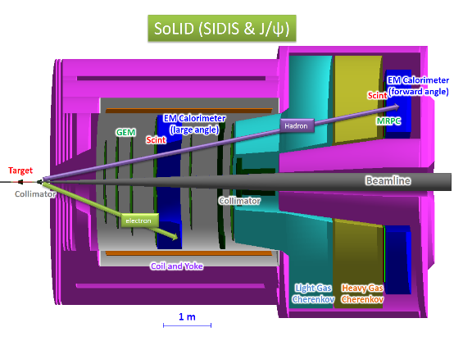
mini-drift μ-RWELL detector
Muons hitting the chambers at vary large incident angle
Using μ-RWELL in mini drift mode ⇨ Excellent tracking capability with one detector layer at very low overall cost
Large drift gap
CLEO magnet
Slide from Kondo Gnanvo
Curved mini drift μ-RWELL

Slide 14
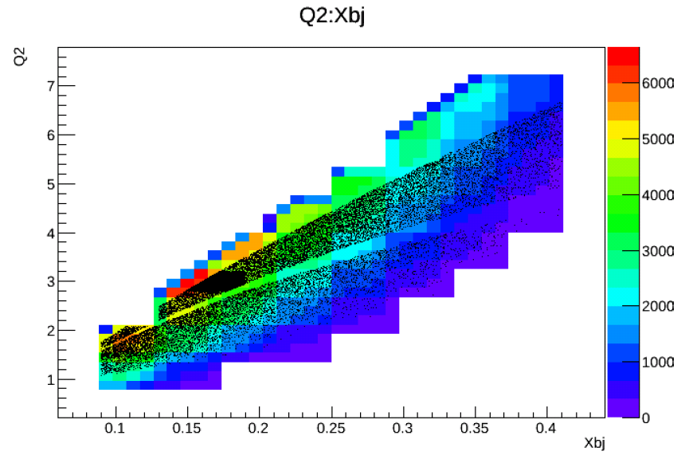
Counts J/psi setup 60 days at 10^37 cm⁻²s⁻¹

Slide 15
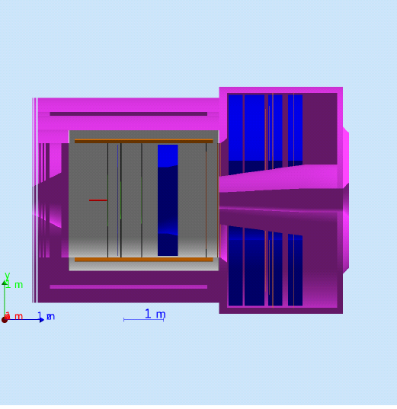
Dedicated setup for muon detection only
Iron plates
In addition to muon detector
Target moved 2m from Jpsi position inside and switch to 45 cm target
Iron plate from 3rd layer yoke in front and behind calorimeter ( low resolution e for trigger )
Remove / Upgrade Gas Cerenkov
Try to reach 10³⁸ cm⁻²s⁻¹
10 uA on 45 cm target

Slide 16
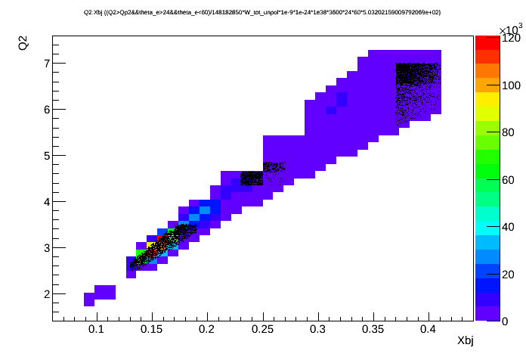
Expected accuracy dedicated setup
90 days at 10³⁸ cm⁻²s⁻¹

Slide 17
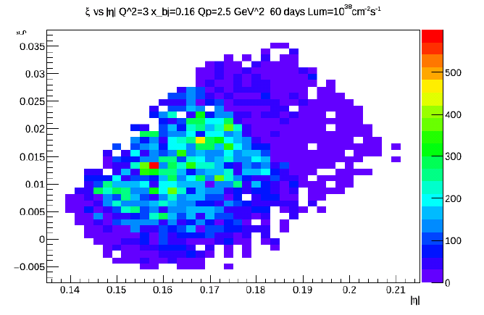
Eta and xi coverage

Slide 18
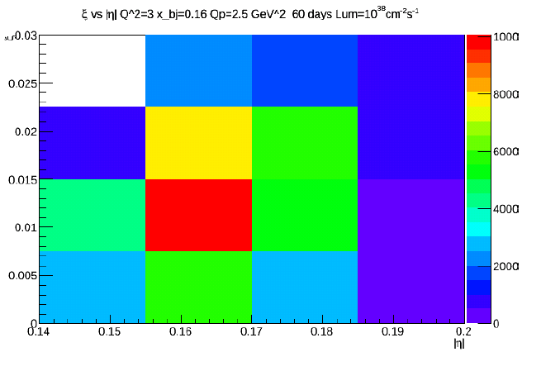
Eta Xi coverage large bin

Slide 19
Hall C proposal

Slide 20
Higher luminosity ?
Current could go up to 80 uA on 40 cm target ~ 7.10^38 to cm⁻²s⁻¹
Muon detector using GEM or uRWell should be ok since after material
Tracker occupancy and photon background
  Reduce amount of Copper in GEM
  2D MGPD readout
  Micromegas option
  Pixellized MAPS
  Superconducting tracker option
Calorimetry
  Study liquid scintillator and cryogenics calorimeter option
  Faster PMT or LAPPD/MCP PMT ( 1 ns width pulse to increase rate capability )
Cerenkov
  Faster PMT or LAPPD/MCP PMT ( 1 ns width pulse to increase rate capability )
  HBD type Cerenkov for Large Angle calorimeter
Technically doable mostly matter of cost

Slide 21
CNF Question sheet
what can be extracted from data, is it cross sections, asymmetries, both, CFFs?
  Asymmetries : 5 %
  Crossections : 10 % need to be studied
what has been done to get to the CFFs?
Looking into the future, what information is used to get: AM and similar mechanical properties, and the spatial structure?
  Azimuthal asymmetry
How can theory help, what and where is it needed, what tools?
  Impact on CFF and GPD fits
  What accuracy is required for
  Scheme for inclusion of data
In particular, how are data going to be shared by the community, can we plan on designing a public website?
Are pseudo data going to be available?
  VGG model
What level of model-independence can we reach in the extraction of Compton form factors?
  Not model dependent
Skewdness dependence gives access to D-term

Slide 22
Conclusion
Jlab 12 GeV beam along with high power target offers a unique opportunity to study DDVCS
Higher energy would give higher kinematical reach
Muon detection is interesting to distinguish from incoming electron and to increase luminosity
Hall B DDVCS and SoLID Parasitic measurement on J/Psi could give a first measurements of DDVCS
Hall C high luminosity detector proposal
Dedicated setup could increase luminosity by a factor of 10 up to 10³⁸ cm⁻².s⁻¹ for improved statistical accuracy
High statistics would allow binning in different variables to look a binning in Q’² to probe xi eta surface with xi different of eta of GPDs
Need develop physics case for proposals and funding requests

Slide 23
Backup

Slide 24
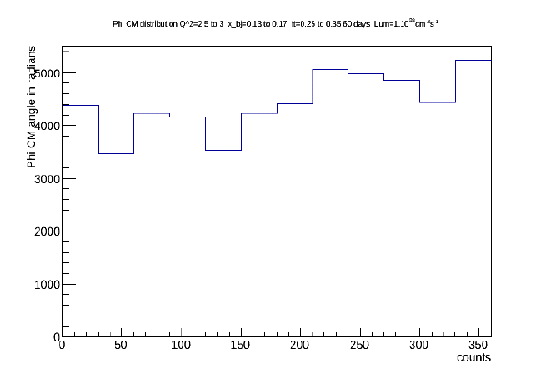
Counts SoLID dedicated setup 10^38 cm⁻²s⁻¹
~2 % statistical error

