Slide 1
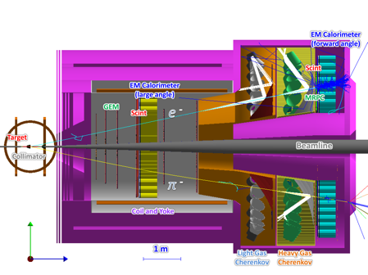
Study Generalized Parton Distributions using SoLID
Zhihong Ye
Tsinghua University, Beijing, China
On behalf of the SoLID Collaboration, Hall A, Jefferson Lab
CNF GPD Mini Workshop, 2020/12/09

Slide 2


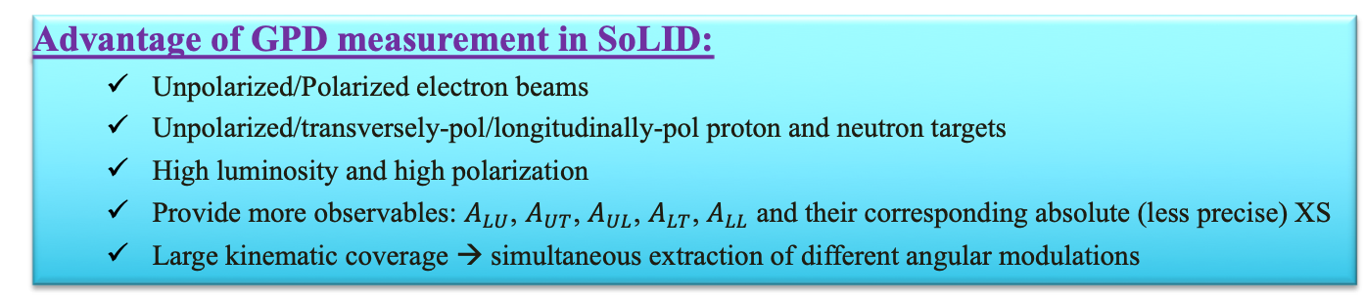
SoLID GPD Measurements
Original approved SoLID Programs:
  SIDIS with Transversely and Longitudinally Polarized He3 (“neutron”) and Proton Targets at E_{e}= 8.8/11 GeV
    Proton: Polarization ~ 70% in beam, Luminosity 10³⁵~ 10³⁶ cm⁻² s⁻¹
    Neutron: Polarization ~ 60% in beam, Luminosity 10³⁶ ~ 10³⁷ cm⁻² s⁻¹
  Near Threshold Electroproduction of J/ψ with Hydrogen Target at E_{e}=11GeV (Luminosity ~ 10³⁷ cm⁻² s⁻¹ )
  PVDIS with Hydrogen Target at E_{e} = 11 GeV (Luminosity ~ 10³⁹ cm⁻² s⁻¹ )
SoLID Status: DOE Science Review in early 2021 (expecting CD0 afterward)
  GPD Measurements using SoLID-SIDIS Configuration:
${\vec{e}}_{U,∥}+{\vec{N}}_{U,∥,⊥}→e^{′}+N+γ$
Deeply Virtual Compton Scattering with Polarized Nucleons:
${\vec{e}}_{U,∥}+{\vec{N}}_{U,∥,⊥}→e^{′}+N′+π^{ }/K^{ }$/ $ρ/ω$…
Deeply Virtual Meson Production with Polarized Nucleons:
Time-like Compton Scattering with Nucleons:
Doubly Deep Virtual Compton Scattering with Nucleons:
Advantage of GPD measurement in SoLID:
  Unpolarized/Polarized electron beams
  Unpolarized/transversely-pol/longitudinally-pol proton and neutron targets
  High luminosity and high polarization
  Provide more observables: $A_{LU}$, $A_{UT}$, $A_{UL}$, $A_{LT}$, $A_{LL}$ and their corresponding absolute (less precise) XS
  Large kinematic coverage → simultaneous extraction of different angular modulations

Slide 3
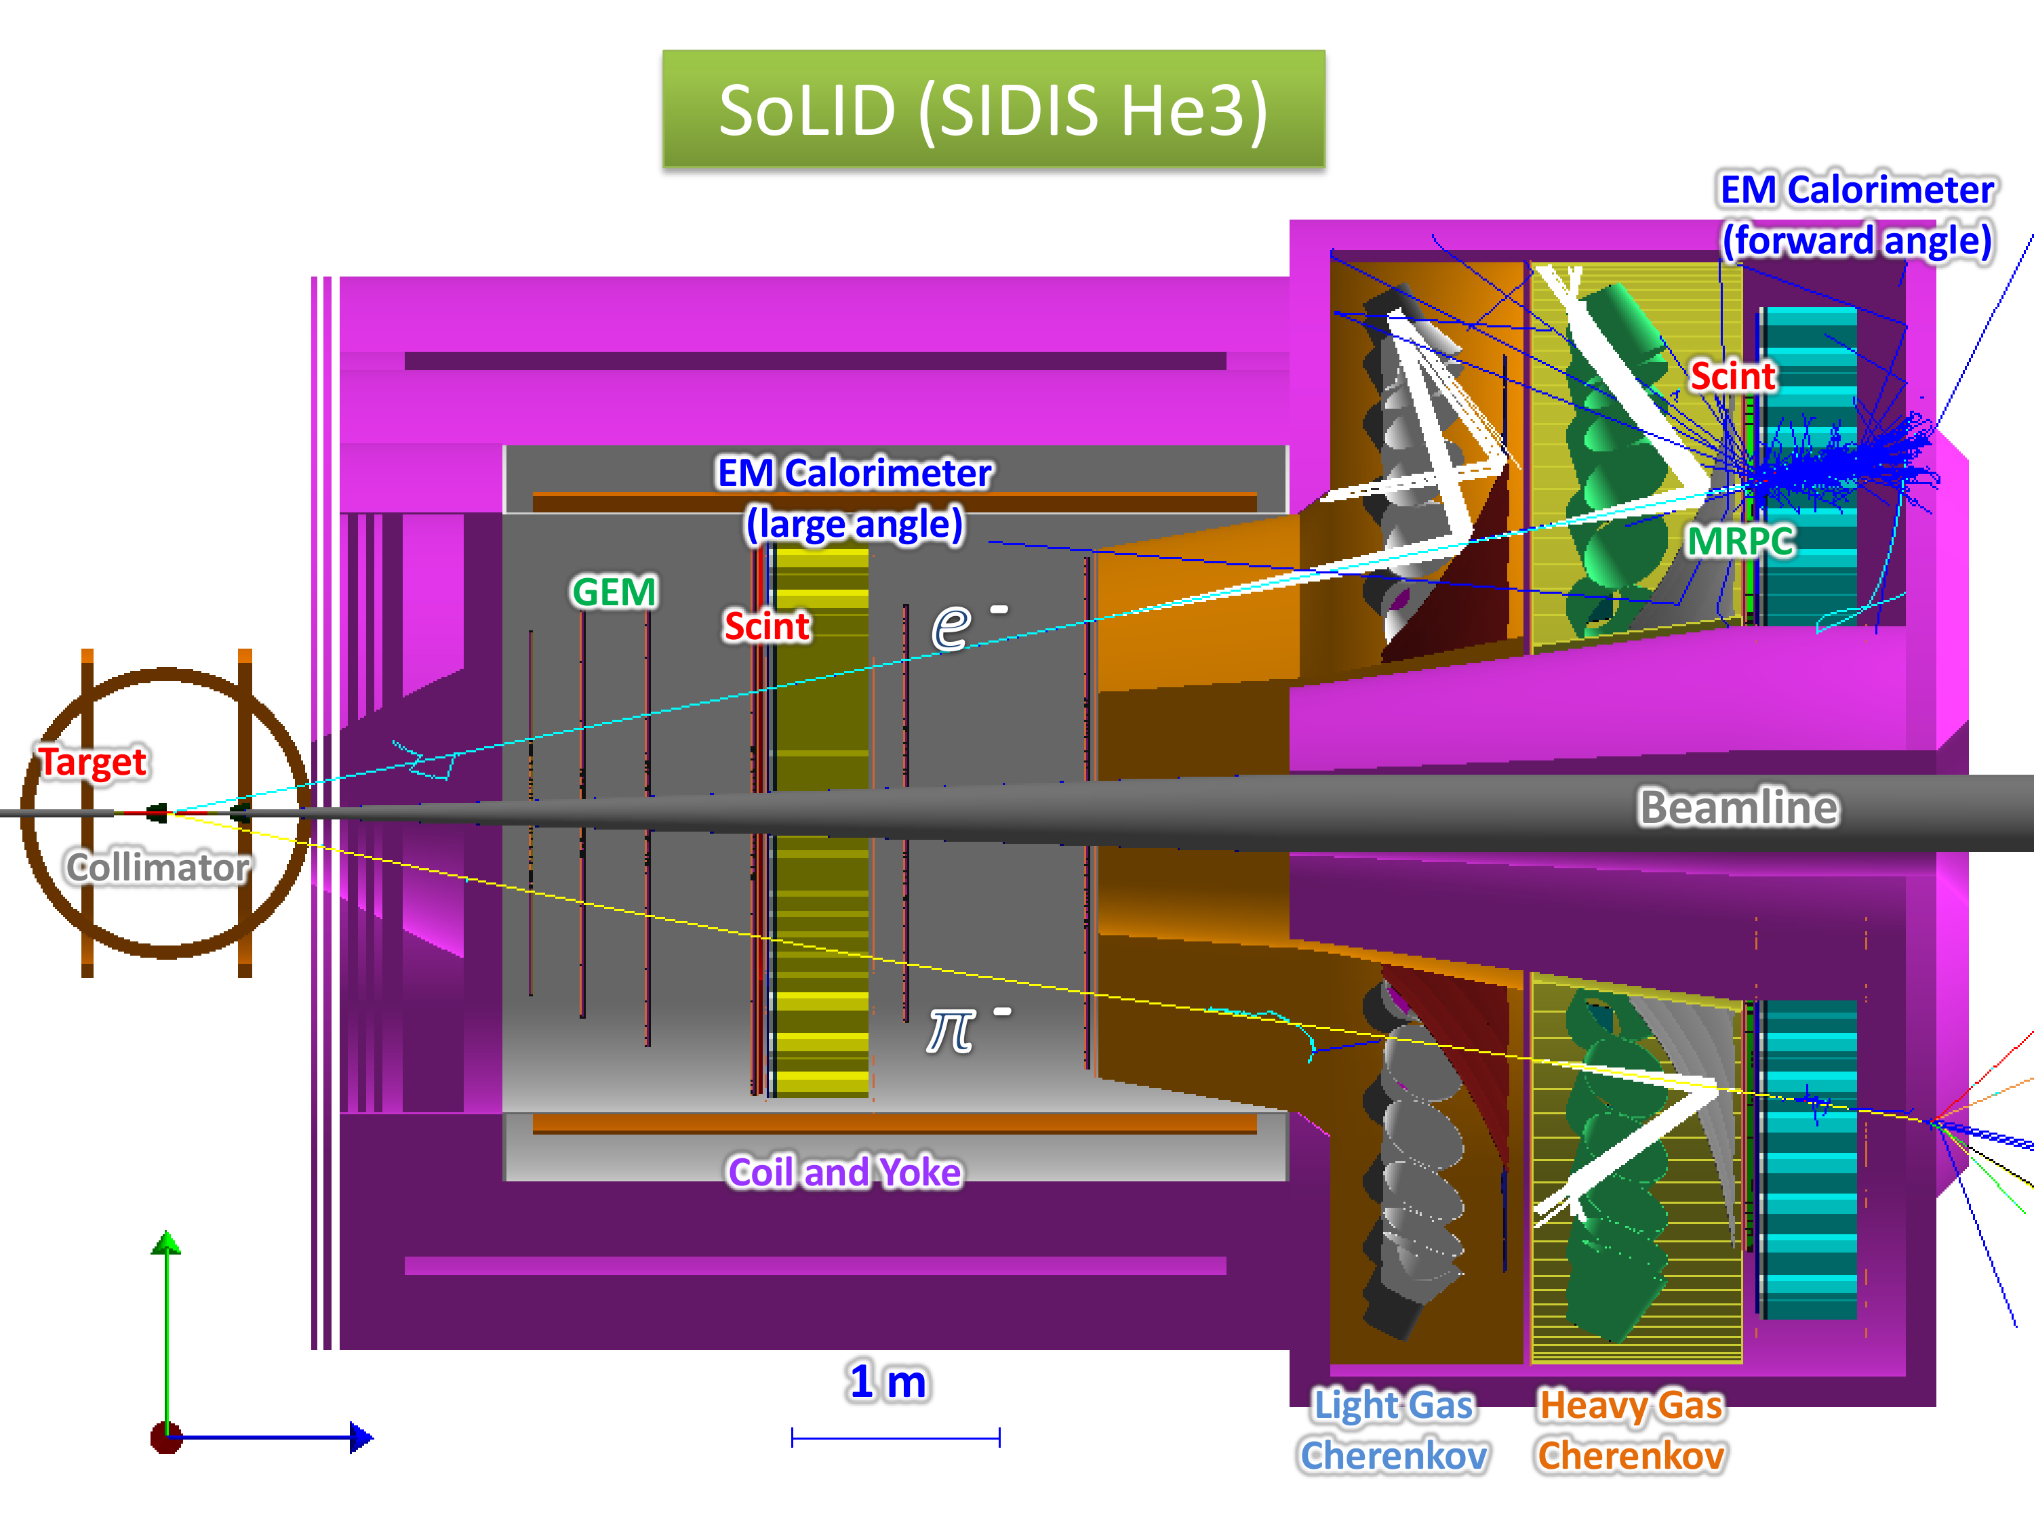
Experimental Setup:
SoLID SIDIS Configuration
Large-Angle :
Detect electrons, photons and protons
Forward-Angle :
Detect electrons, pions, kaons, photons and protons
GPD Mearsurement based on SIDIS Setup:
No additional beam time; No new configuration; Share the same trigger events with SIDIS
During offline analysis, identify more knocked-out particles, such as protons via TOF
Reconstructed Missing mass and Missing Momenta to ensure the exclusivity and further suppress background.

Slide 4
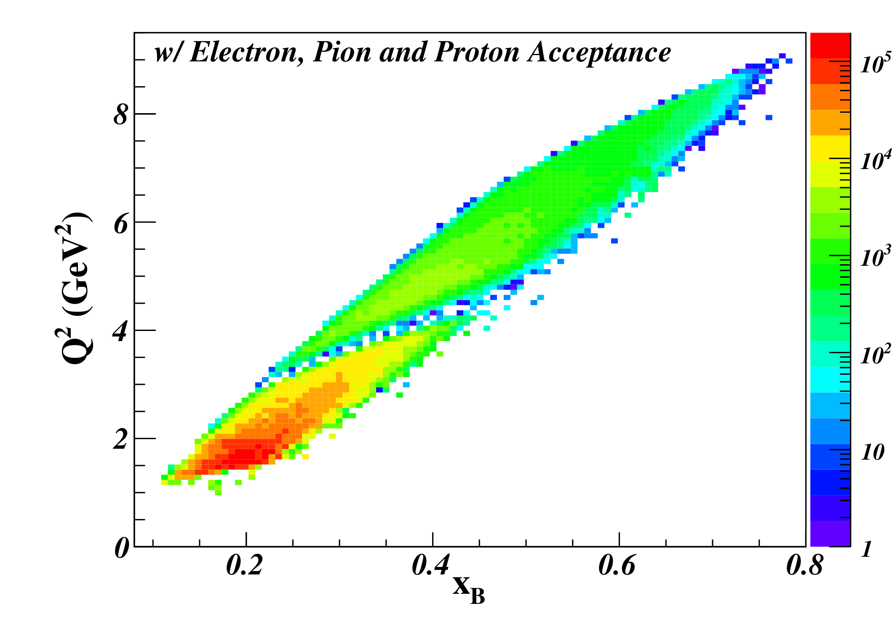
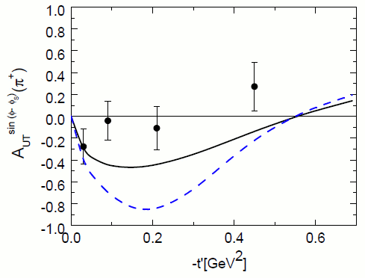
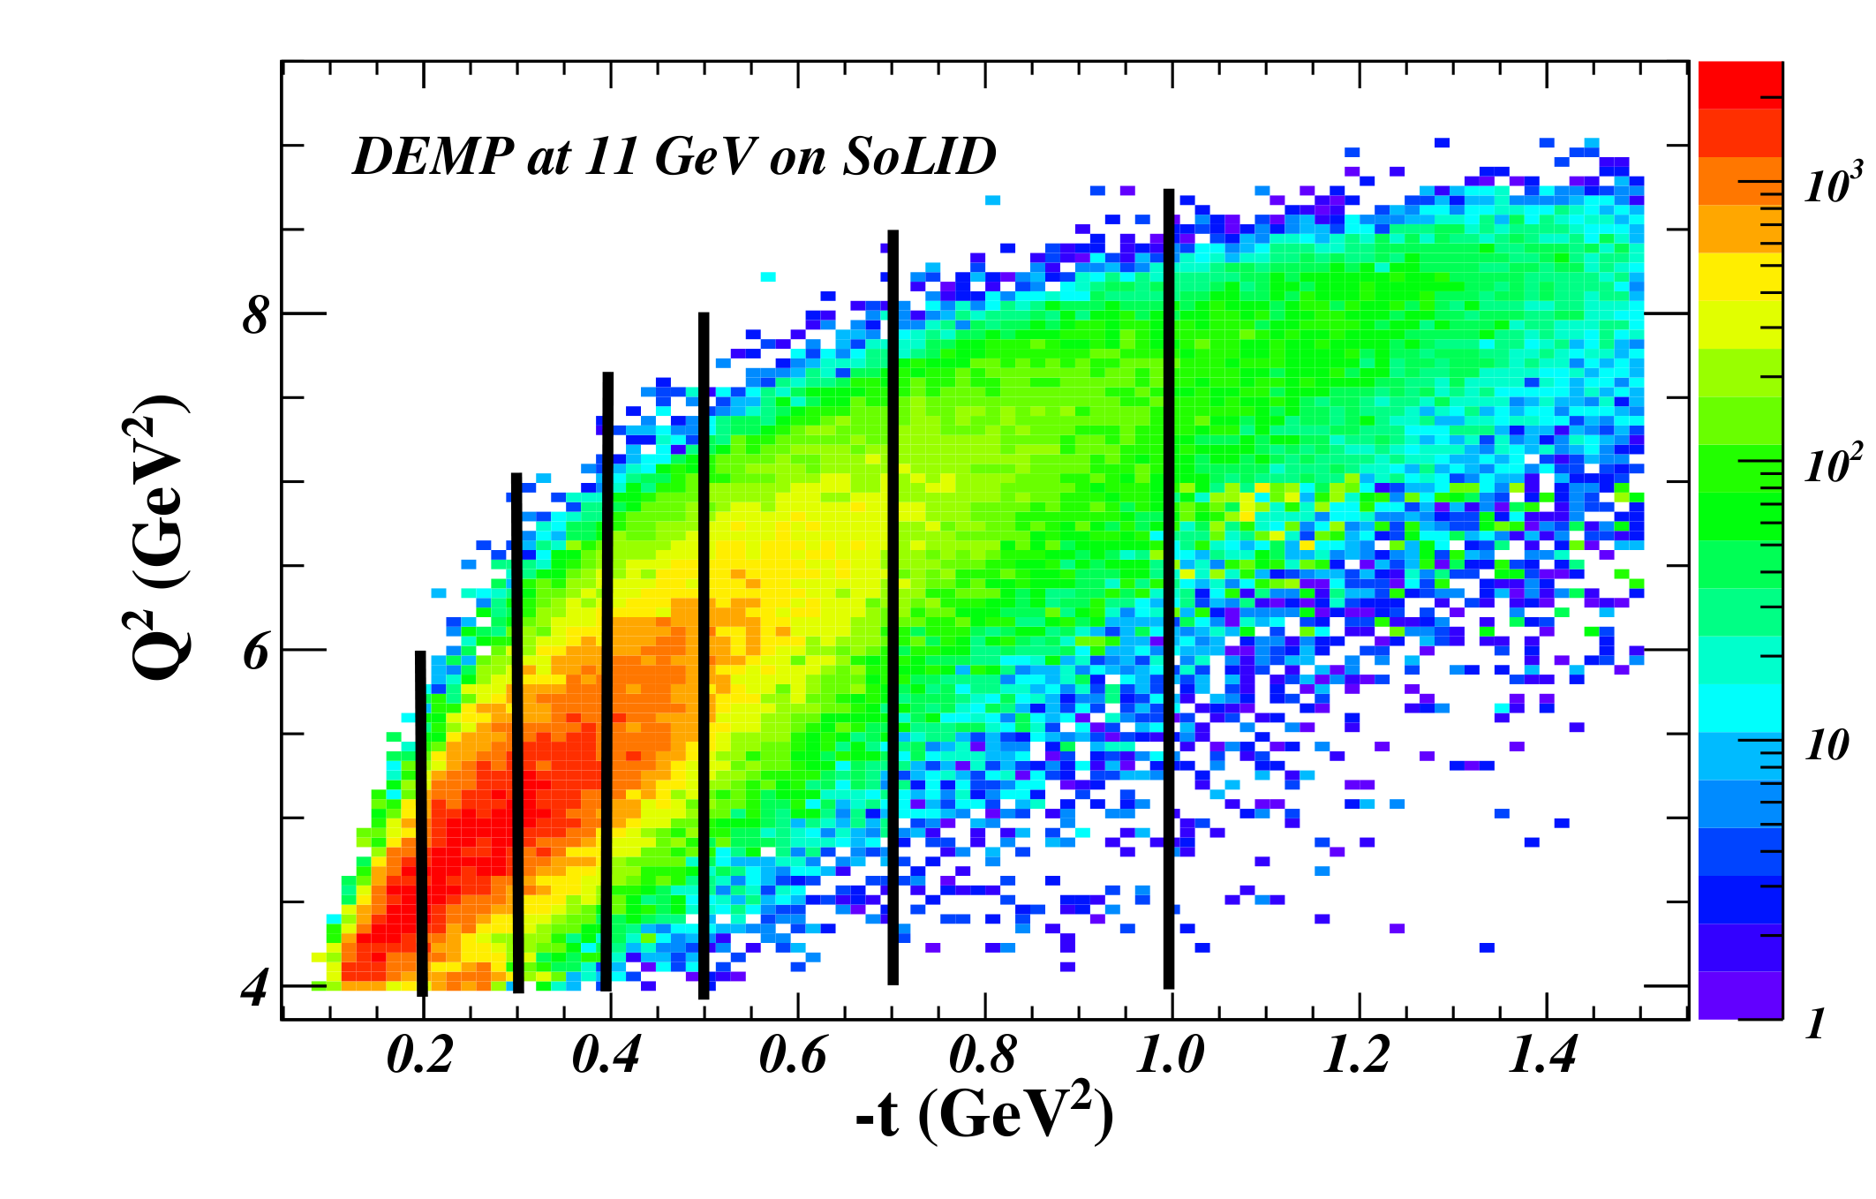
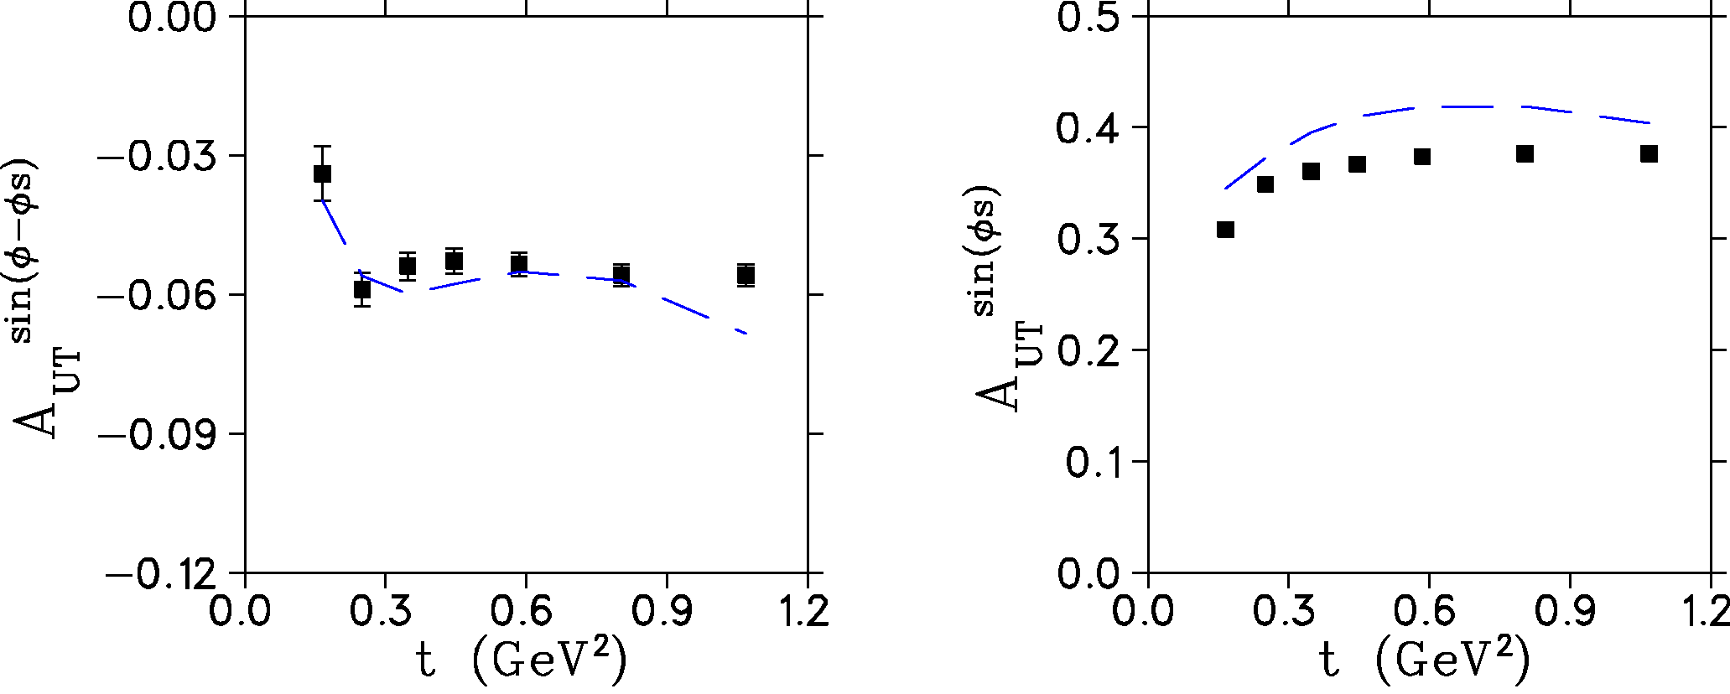
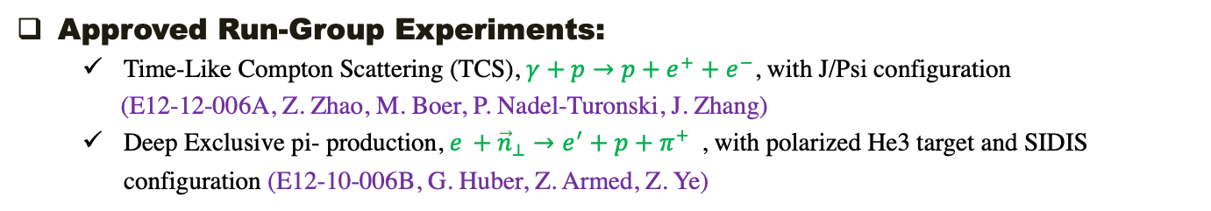
SoLID GPD Measurements
  Approved Run-Group Experiments:
    Time-Like Compton Scattering (TCS), $γ+p→p+e^{+}+e^{−}$, with J/Psi configuration
    (E12-12-006A, Z. Zhao, M. Boer, P. Nadel-Turonski, J. Zhang)
    Deep Exclusive pi- production, $e_{ }+{\vec{n}}_{⊥}→e^{′}+p+{π^{+}}^{ }$, with polarized He3 target and SIDIS configuration (E12-10-006B, G. Huber, Z. Armed, Z. Ye)
S. Goloskokov et. al. [PLB 682(2010)345]
HERMES Data (p)
‹Q²›=2.45 GeV², W=3.99 GeV
SoLID-nDVMP Projection
(model from P. Kroll)

Slide 5
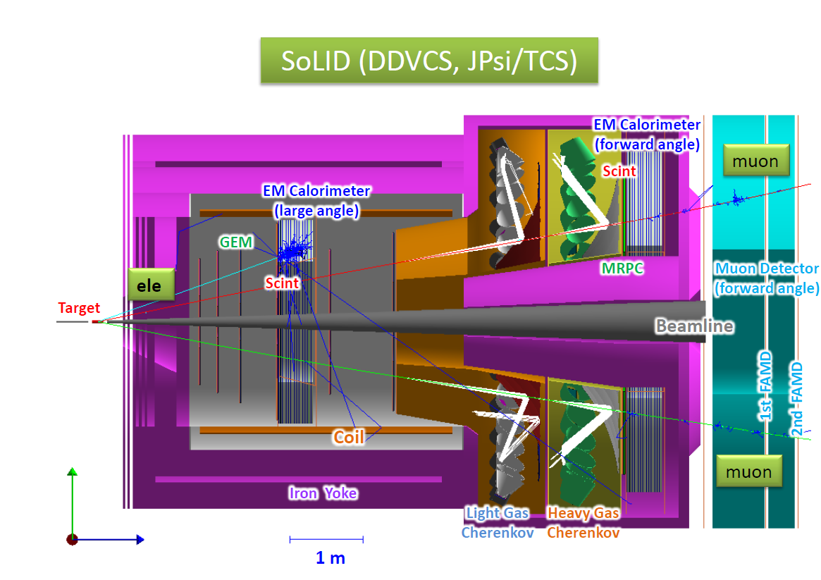
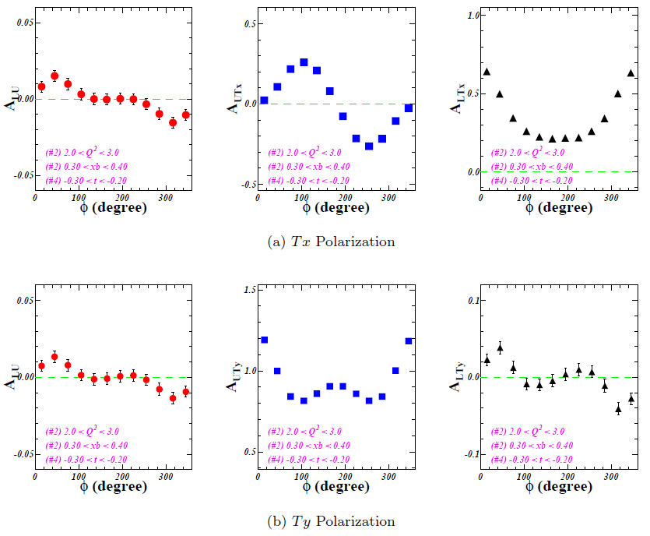
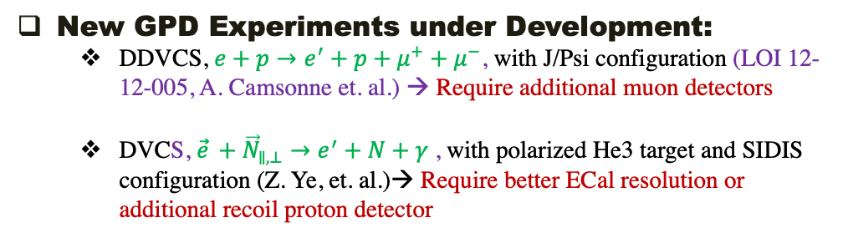
SoLID GPD Measurements
  New GPD Experiments under Development:
    DDVCS, $e+p→e^{′}+p+μ^{+}+μ^{−}$, with J/Psi configuration (LOI 12-12-005, A. Camsonne et. al.) → Require additional muon detectors
    DVCS, ${\vec{e}}_{ }+{\vec{N}}_{∥,⊥}→e^{′}+N+γ^{ }$, with polarized He3 target and SIDIS configuration (Z. Ye, et. al.)→ Require better ECal resolution or additional recoil proton detector
SoLID is optimized for charged particle detection → Need major upgrade to unlock its full power of GPD measurement
Dedicated SoLID-GPD Configuration
Recoil
Detector
SoLID DVCS with Polarized He3 Projection:
one (Q2, x, t) bin out of 1000+ bins
Muon Detector
High Resolution ECal
  More Future GPD Experiments:
    DVMP using both unpolarized/polarized proton and neutron, and with more pseudo-scaler and vector mesons
    DVCS with both unpolarized/polarized proton and neutron

Slide 6
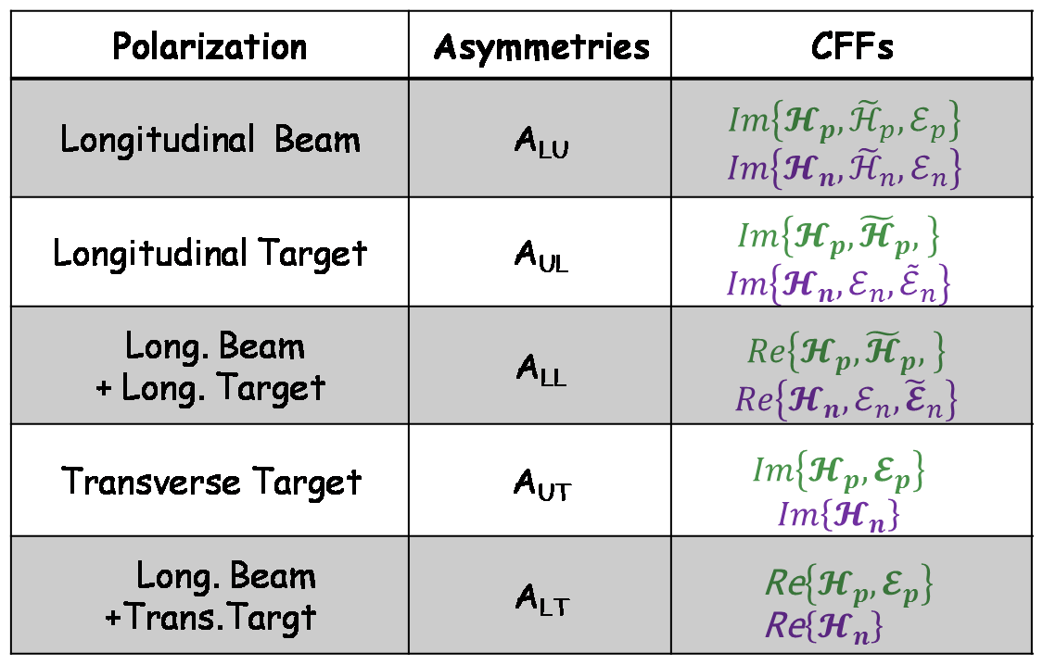
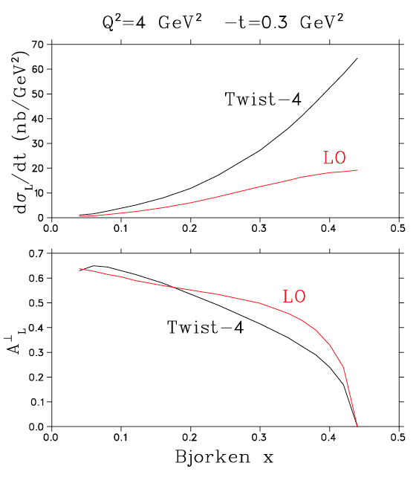
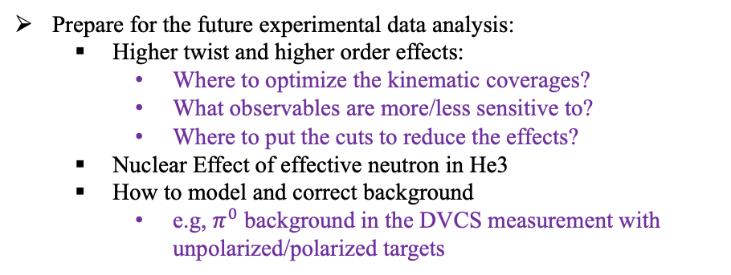
SoLID GPD Measurements
Helps needed from theorists
DVCS
Not just for SoLID, but all JLab 12GeV GPD programs
The impact study of DVCS, TCS, DVMP observables to the global analysis of GPD, e.g.
The sensitivity of different observables to different GPDs
Flavor separation
Theoretical models to develop more GPD measurements, e.g.
  DVMP models for different target polarization and mesons in final states
Prepare for the future experimental data analysis:
  Higher twist and higher order effects:
    Where to optimize the kinematic coverages?
    What observables are more/less sensitive to?
    Where to put the cuts to reduce the effects?
  Nuclear Effect of effective neutron in He3
  How to model and correct background
    e.g, $π^{0}$ background in the DVCS measurement with unpolarized/polarized targets
DVMP
And, you tell us what to do:
  SoLID has high luminosity, large acceptance, both polarized proton/neutron
  Existing SIDIS Setup provide high precision measurement of charged particles and certain precision of photons
  Future upgrade will have full potential of many GPD measurements
  A pre-EIC playground

Slide 7
Backup

Slide 8
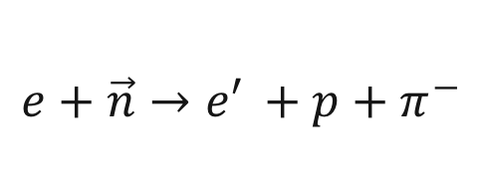
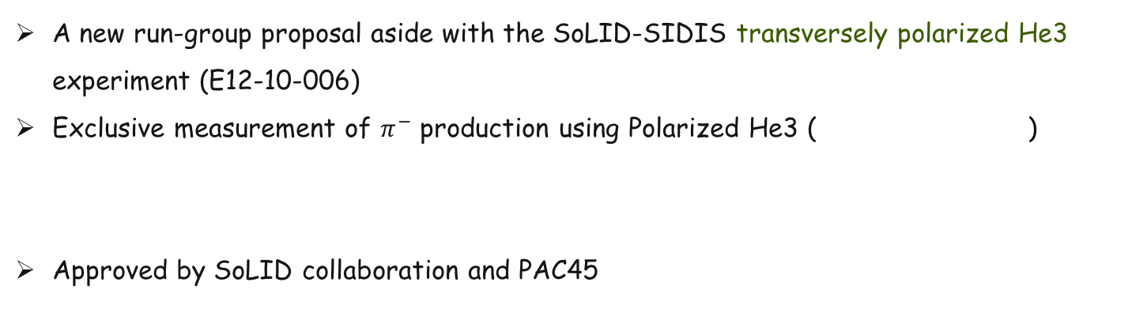
E12-10-006B
A new run-group proposal aside with the SoLID-SIDIS transversely polarized He3 experiment (E12-10-006)
Exclusive measurement of $π^{−}$ production using Polarized He3 ( )
Approved by SoLID collaboration and PAC45
$$e+\vec{n}→{e′}^{ }+p+π^{−}$$

Slide 9
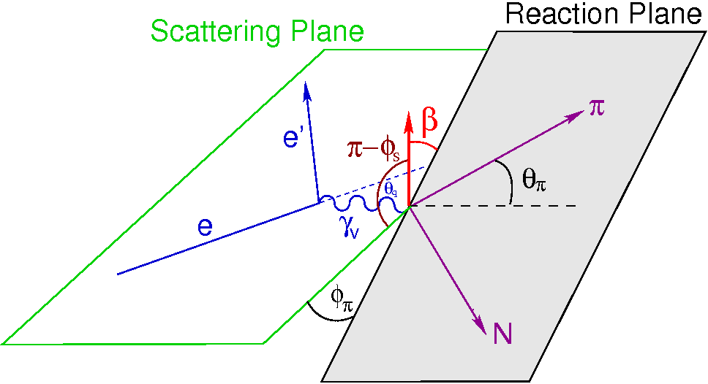
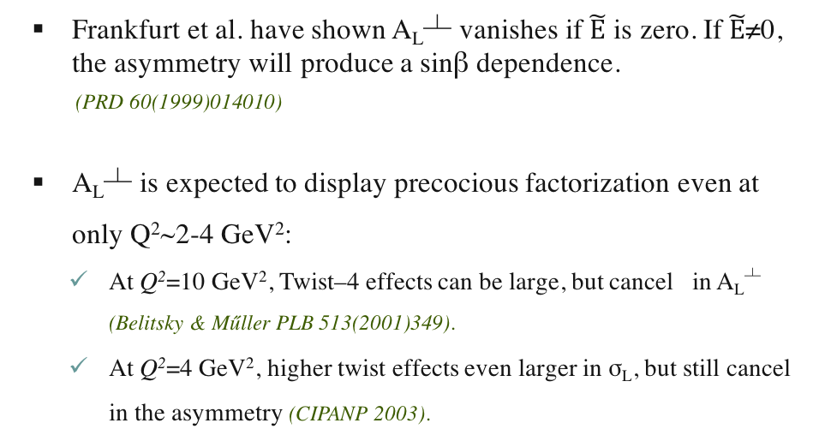
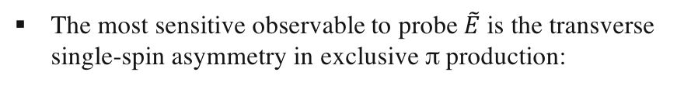

E12-10-006B
How to Probe $\tilde{E}$ with DEMP:
The most sensitive observable to probe $\tilde{E}$ is the transverse single-spin asymmetry in exclusive π production:
β=(φ-φ_{S})
where, dσ_{π}^{L} = exclusive π cross section for longitudinal γ*
Frankfurt et al. have shown A_{L}┴ vanishes if $\tilde{E}$ is zero. If $\tilde{E}$≠0, the asymmetry will produce a sinβ dependence.
(PRD 60(1999)014010)
A_{L}┴ is expected to display precocious factorization even at only Q²~2-4 GeV²:
  At Q²=10 GeV², Twist–4 effects can be large, but cancel in A_{L}┴ (Belitsky & Műller PLB 513(2001)349).
  At Q²=4 GeV², higher twist effects even larger in σ_{L}, but still cancel in the asymmetry (CIPANP 2003).
Because of requiring the virtual photon to be longitudinally polarized, it has not yet been possible to perform an experiment to directly measure A_{L}┴

Slide 10
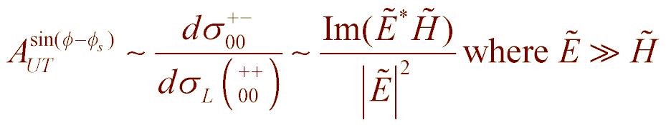
E12-10-006B
Experimental Observables w/o LT Separation
M. Diehl, S. Sapeta, Eur.Phys.J. C41(2005)515.
Unpolarized cross section:
Transversely polarized cross section has additional components
Gives rise to Asymmetry Moments
sin(φ_{s}) Asymmetry Moment
Unseparated sinβ=sin(φ-φ_{s}) Asymmetry Moment
helicities: [pion, neutron, photon, proton]

Slide 11
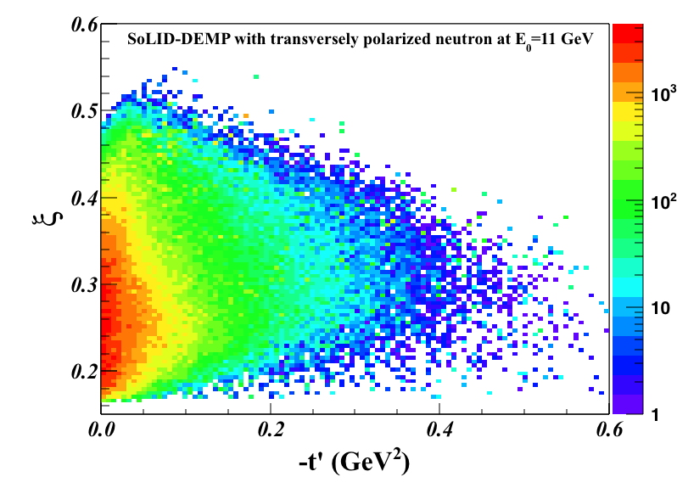
Kinematic Coverage and Binning
E12-10-006B
For this proposal, we only binned the data in 7 t-bins.
In actual data analysis, we will consider alternate binning.
All JLab data cover a range of Q², x_{Bj} values.
  x_{Bj} fixes the skewness (ξ).
  Q² and x_{Bj} are correlated. In fact, we have an almost linear dependence of Q² on x_{Bj}.
HERMES and COMPASS experiments are restricted kinematically to very small skewness (ξ<0.1).
We can measure the skewness dependence of the relevant GPDs over a fairly large range of ξ.

Slide 12
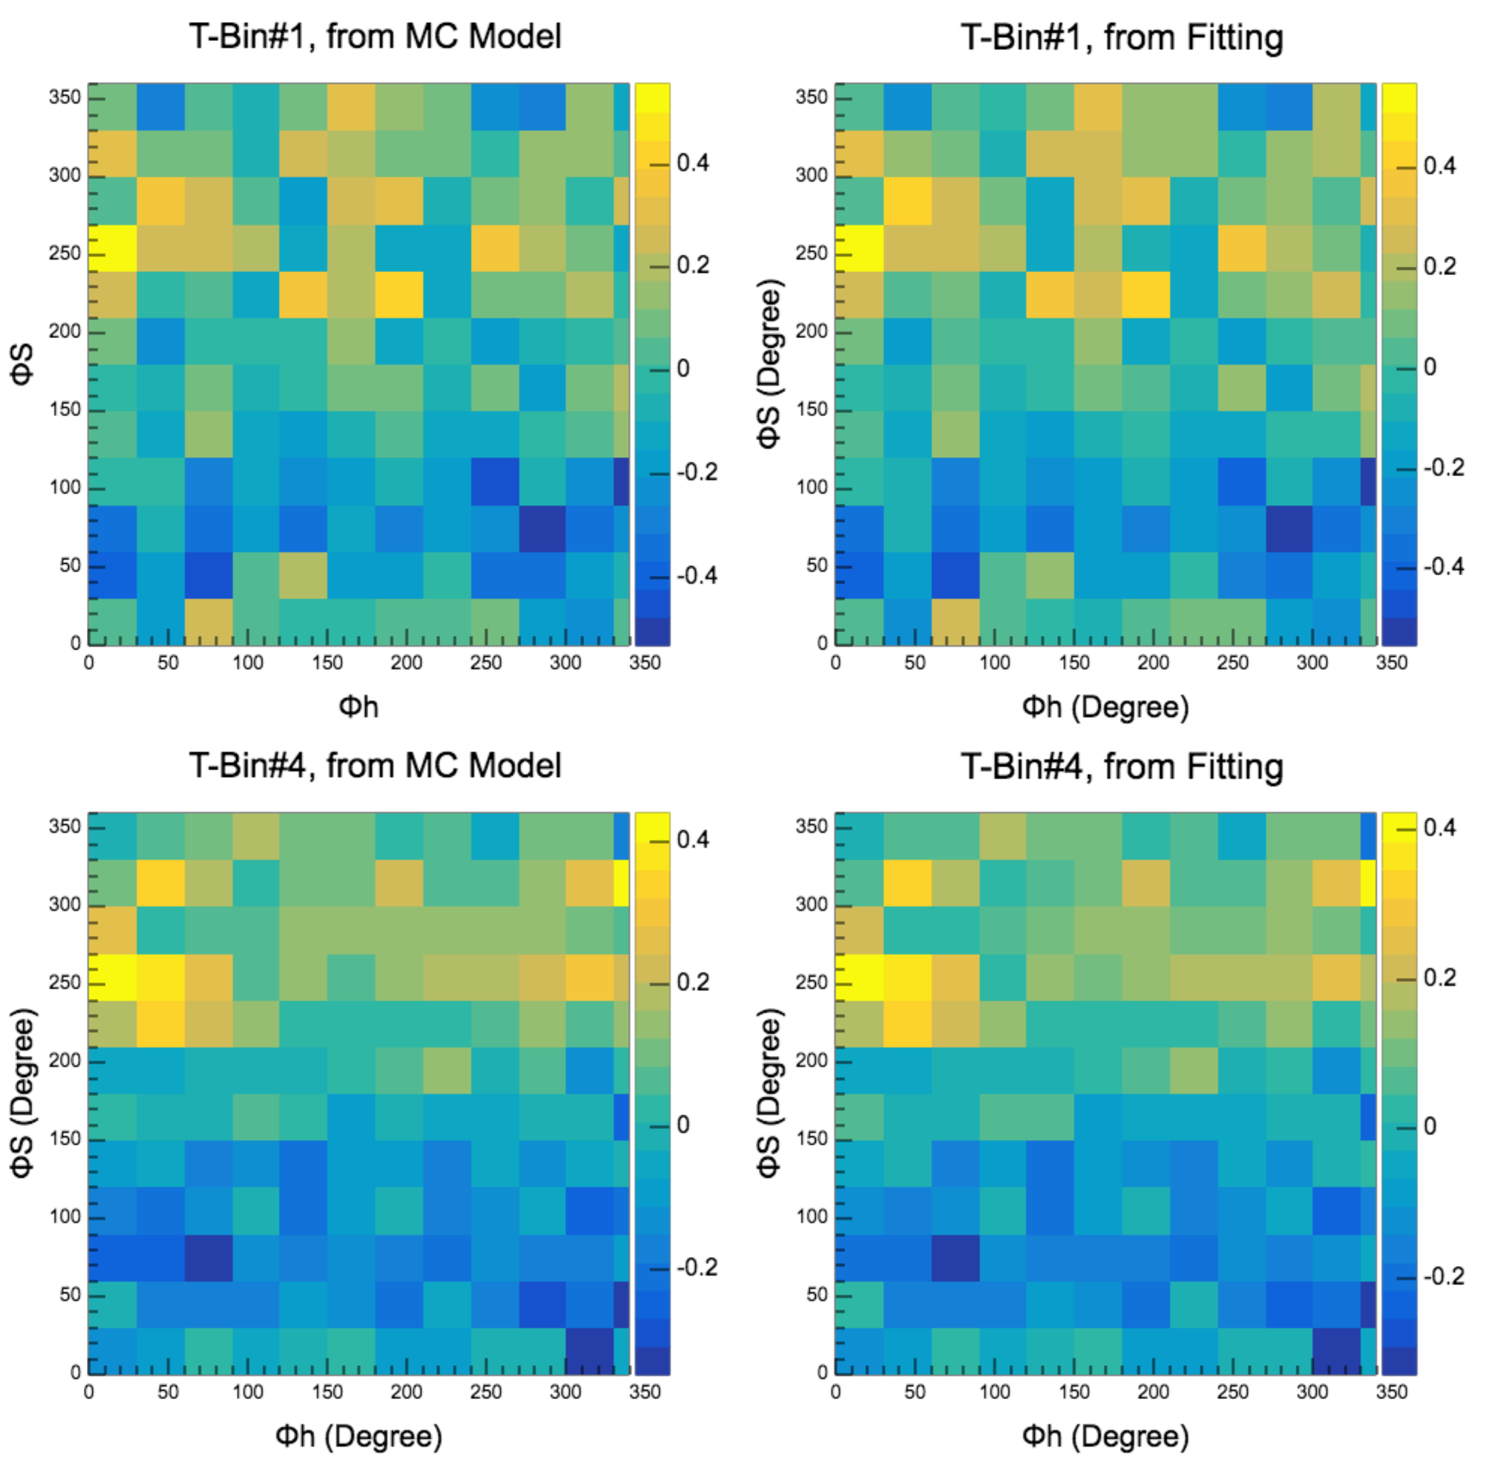
Unbinned Maximum Likelihood (UML) Method
E12-10-006B
Instead of dividing the data into (φ,φ_{s}) bins to extract the asymmetry moments, UML takes advantage of full statistics of the data, obtains much better results when statistics are limited.
  Construct probability density function
where A_{k} are the asymmetries that can minimize the
likelihood function.
2) Minimize negative log-likelihood function:
where w_{l}, w_{m} are MC event weights based on cross section
& acceptance.
3) As an illustration, reconstruct azimuthal modulations
& compare:
Same method used by HERMES in their DEMP analysis [PLB 682(2010)345].

Slide 13
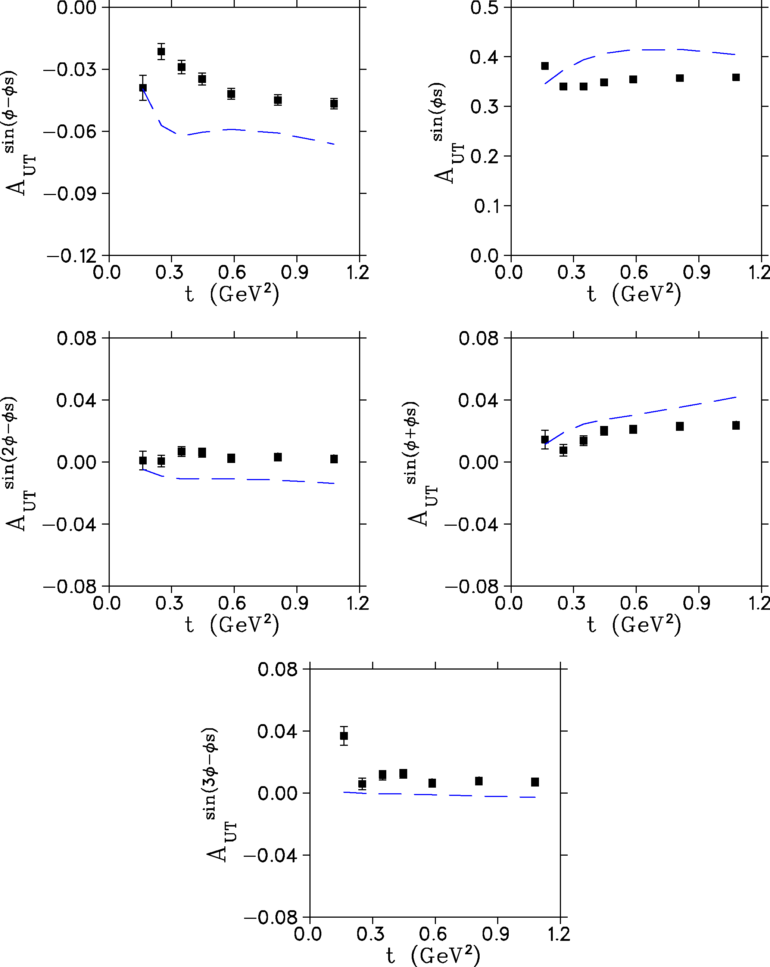
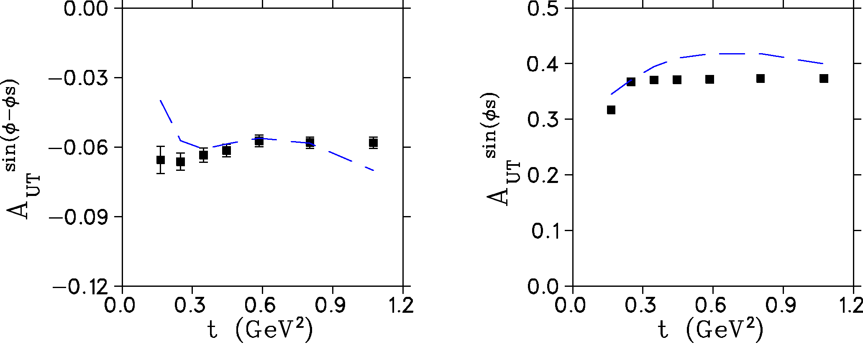
Projected Uncertainties
E12-10-006B
All effects on.
Includes all scattering, energy loss, resolution and Fermi momentum effects
Only Fermi momentum off.
Includes all scattering, energy loss, resolution effects. Similar to where proton resolution is good enough to correct for Fermi momentum effects.
All effects off.
Agreement between input and output fit values is very good. Validates the UML procedure.
Average input asymmetry per bin.

Slide 14
Summary
E12-10-006B
A_{UT}^{sin(φ-φs)} transverse single-spin asymmetry in exclusive π production is particularly sensitive to the spin-flip GPD.
A_{UT}^{sin(φs)} asymmetry can also be extracted, providing powerful additional GPD-model constraints and insight into the role of transverse photon contributions at small –t, and over wide range of ξ.
High luminosity and good acceptance capabilities of SoLID make it well-suited for this measurement. It is the only feasible manner to access the wide –t range needed to fully understand the asymmetries.
E12-10-006B shares the same SoLID-SIDIS experimental setup and will look for e-π⁻-p triple coincidence events.
We used a sophisticated UML analysis to extract the asymmetries from simulated data in a realistic manner, just as was used in the pioneering HERMES data. The projected data are expected to be a considerable advance over HERMES in kinematic coverage and statistical precision.
SoLID-DEMP measurement is also important preparatory work for future EIC.
The SoLID review committee identifies the SoLID-DEMP as the forth flagship experiment, in addition to the baseline programs (SIDIS, PVDIS, J/psi)

Slide 15
SoLID-DVCS Programs with polarized He3

Slide 16
SoLID-DVCS with Polarized He3
DVCS with polarized electron beam and targets:
Approved 12GeV DVCS experiments:
E12-06-114 (Hall-A)
unpol. proton, absolute XS & BSA, limited coverage
E12-13-010 (Hall-C)
unpol. proton, absolute XS &π⁰, limited coverage.
E12-06-119 (Hall-B)
longi. pol proton (DNP), BSA, TSA, wide coverage
C12-12-010 (Hall-B) conditional approved
trans. pol. proton (HDice), TSA,BSA, wide coverage
E-12-11-003 (Hall-B)
unpol. neutron, BSA
PR12-15-004 (Hall-B): c2 from PAC43
long. pol. Deuteron (“neutron”), TSA, BSA
No polarized neutron-DVCS experiment has been done or fully approved at Jlab!
GPDs study needs neutron data, e.g. flavor decomposition!
SoLID can bring:
Transversely polarized neutron-DVCS (He3, with E12-10-006 SIDIS setup)
Longitudinally polarized neutron-DVCS (He3, with E12-11-007 SIDIS setup)
Transversely polarized proton-DVCS (DNP, with E1211-108 SIDIS setup)
Longitudinally polarized proton-DVCS (DNP)

Slide 17
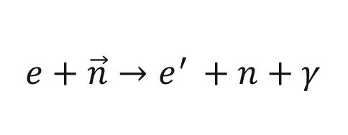
SoLID-DVCS with Polarized He3
This program was initialized in 2015 and a LOI was only submitted to SoLID collaboration.
Projected results look very promising, but need further study on the background issues.
$$e+\vec{n}→e^{′ }+n+γ$$
Large-Angle :
Detect electrons & photons
Forward-Angle :
Detect electrons & photons

Slide 18
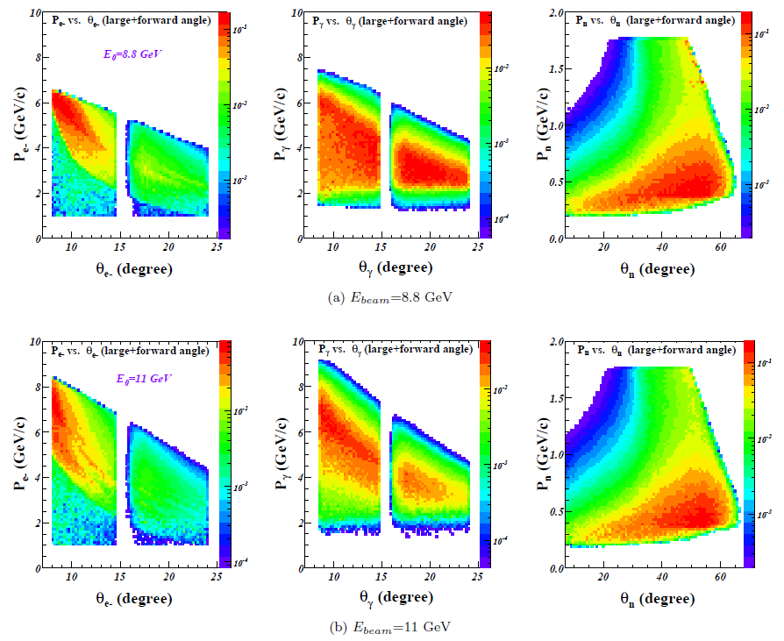
SoLID-DVCS with Polarized He3
Acceptance
Recoil neutrons:
(1) at large angles
(2) P~0.4GeV/c
It will be
difficult to
detect neutrons

Slide 19
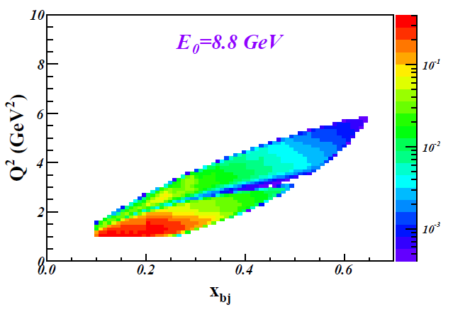
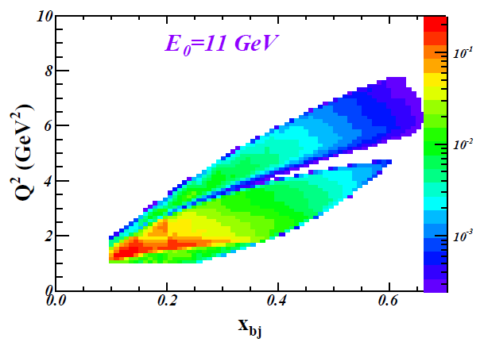
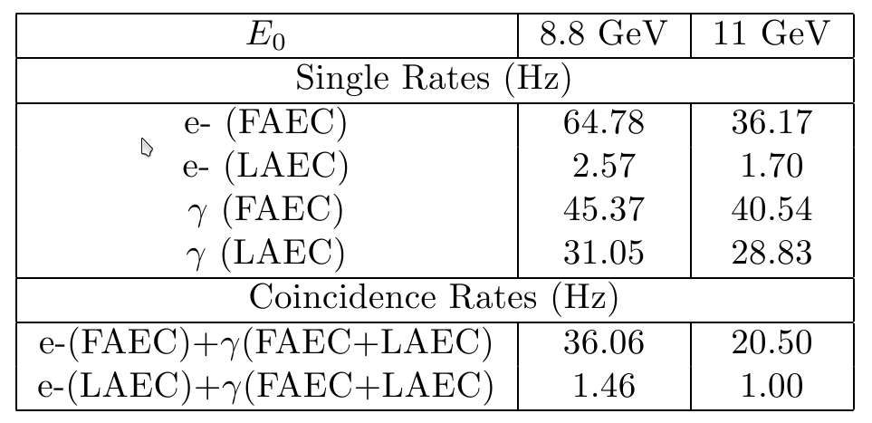
SoLID-DVCS with Polarized He3
Kinematic Coverage
Integrated Rate:
Single γ-rate from Background ~ 120KHz
The (e+γ) accidental coincidence rate reduced to ~100Hz
Based on VGG Model

Slide 20
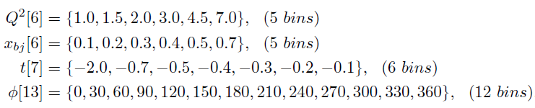

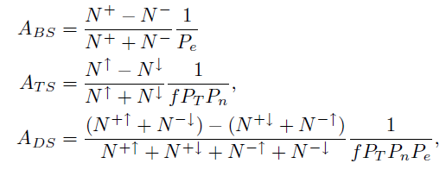
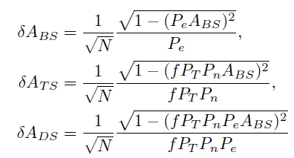
SoLID-DVCS with Polarized He3
Asymmetry Binning and Projection
21 days on E0=8.8GeV, 48 days on E0=11GeV
4D Binning:
Asymmetries:

Slide 21
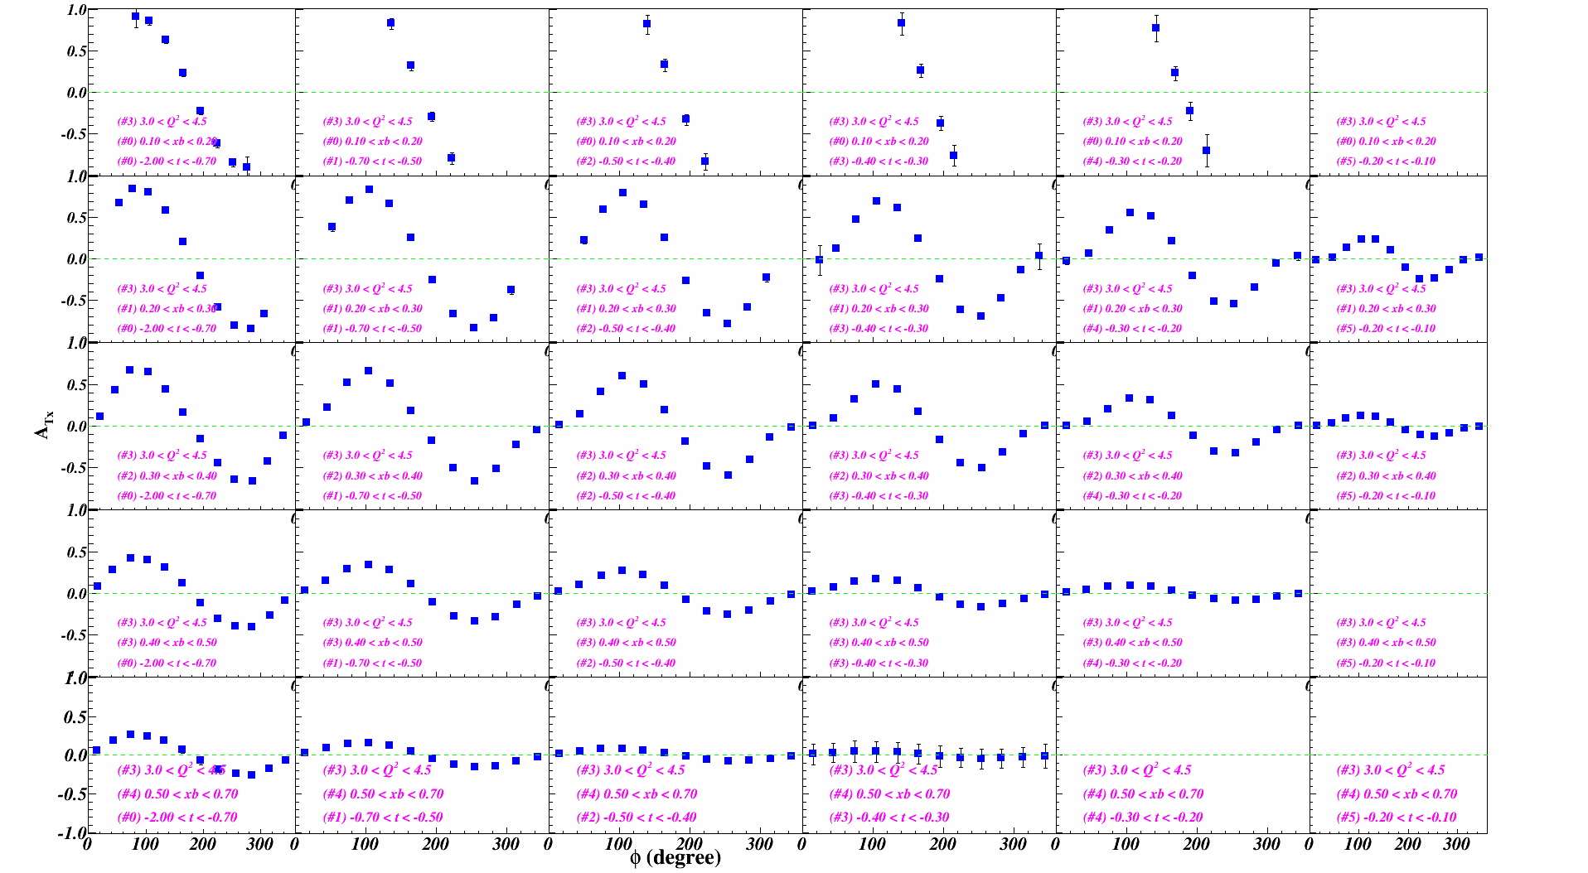
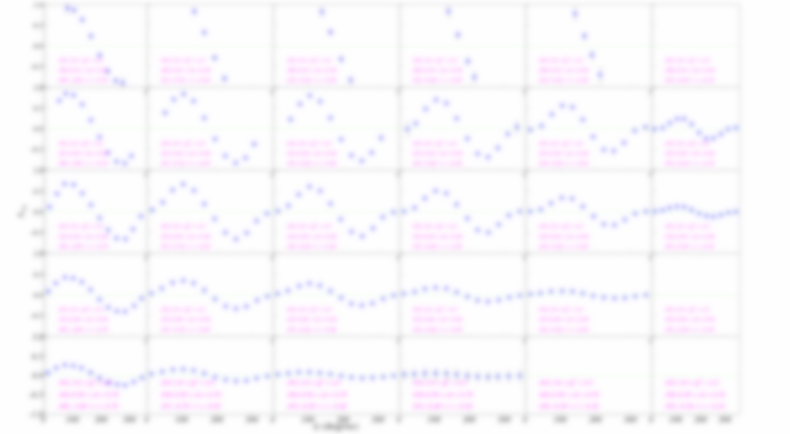
SoLID-DVCS with Polarized He3
Asymmetry Projection:
21 days on E0=8.8GeV, 48 days on E0=11GeV (approved for SIDIS); Bins match CLAS12’s projections

Slide 22
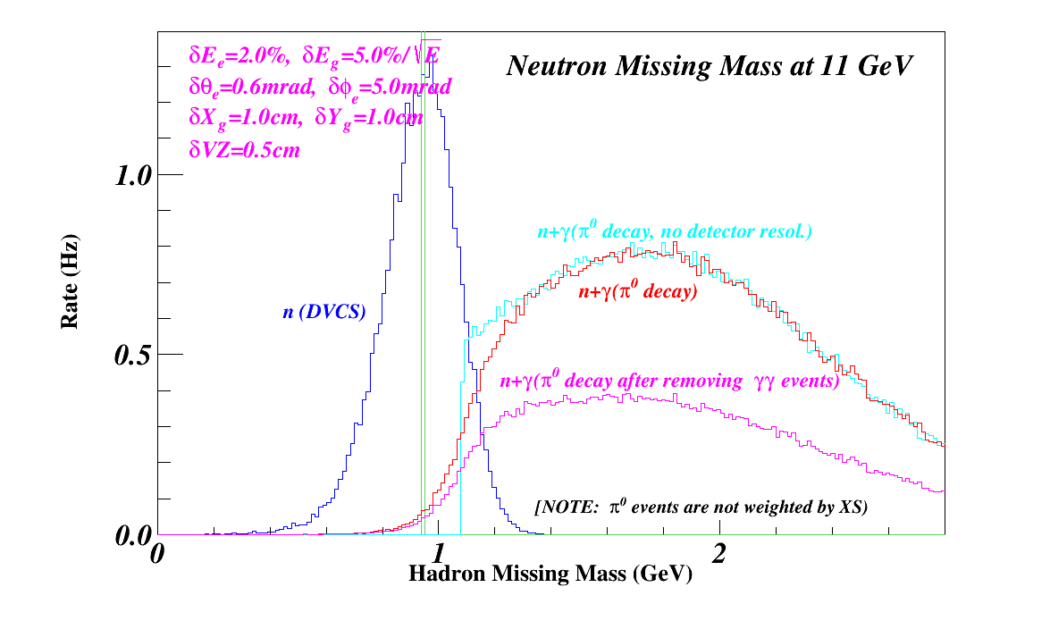
SoLID-DVCS with Polarized He3
Background Study with Missing Mass Reconstruction:
Main background if not detecting recoil neutrons: (n+γ) from π⁰ decay
Missing Mass Reconstruction: detect electron and photons (angles, momentum/energy)
The spectrum resolution is limited by the Electromagnetic Calorimeters’ (ECs) resolution (~5%)
Background Subtraction: ECs can detect partial π⁰ decay events
→Total real pi0 events (detected by SoLID)
→Total MC pi0 events (within SoLID acceptance)
(Same method applied in CLAS12’s DVCS proposals)
Pi0 background was generated uniformly
Need to find a neutron-pi0 model
Also learn from the recent Hall-A DVCS results and the new 12GeV DVCS data).
And other background and nuclear effect studies like what we did in the DEMP proposal

Slide 23
SoLID-DDVCS Programs with unpolarized targets
For Time-like Compton Scattering, see Zhiwen’s talk on week#3

Slide 24
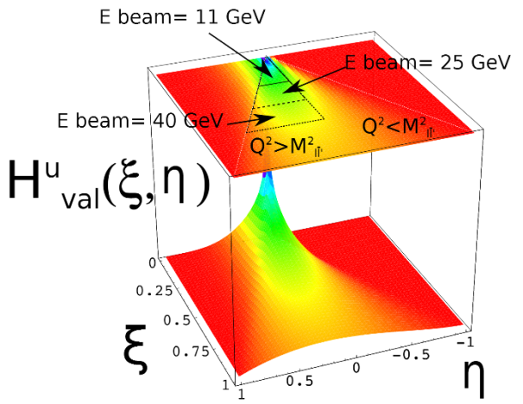
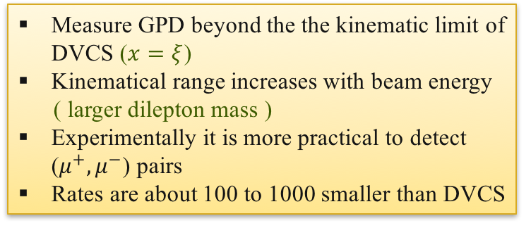

SoLID-DDVCS Programs (LOI)
Double-DVCS: (see Zhiwen’s talk on week#3)
Guidal& Vanderhaegen:arXiv:hep-ph/0208275v1 (2002)
Belitsky&Radyushkin: arXiv:hep-ph/0504030v3 (2005)
$$γ^{∗}+N→γ^{∗}+N→(l^{+}+l^{−})+N$$
Measure GPD beyond the the kinematic limit of DVCS ($x=ξ$)
Kinematical range increases with beam energy
( larger dilepton mass )
Experimentally it is more practical to detect ($μ^{+},μ^{−}$) pairs
Rates are about 100 to 1000 smaller than DVCS

Slide 25
SoLID-DDVCS Programs (LOI)
Double-DVCS: (see Zhiwen’s talk on week#3)
Guidal& Vanderhaegen:arXiv:hep-ph/0208275v1 (2002)
Belitsky&Radyushkin: arXiv:hep-ph/0504030v3 (2005)
$$γ^{∗}+N→γ^{∗}+N→(l^{+}+l^{−})+N$$
Measure GPD beyond the the kinematic limit of DVCS ($x=ξ$)
Kinematical range increases with beam energy
( larger dilepton mass )
Experimentally it is more practical to detect ($μ^{+},μ^{−}$) pairs
Rates are about 100 to 1000 smaller than DVCS
A parasitic run with the J/psi configuration was studied (a LOI was submitted to PAC43)
60 days with J/psi setup at 10³⁷ cm⁻²s⁻¹
Adding the ion chambers for muon detections.
A upgraded luminosity of 10³⁸ cm⁻²s⁻¹or higher is more feasible to have enough statistics for multiple-dimension binning study.
A similar effort to measure DDVCS with CLAS12 is also under developments with major upgrade to the Forward detectors (a LOI was submitted to PAC45)

