Slide 1
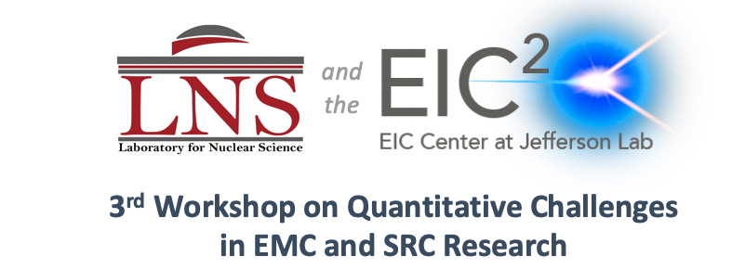

Isospin dependence of NN correlations,
quenching of spectroscopic factors,
and some speculations
Augusto O. Macchiavelli
Nuclear Science Division Lawrence Berkeley National Laboratory
March 22-26, 2021
Work supported under contract number DE-AC02-05CH11231.

Slide 2
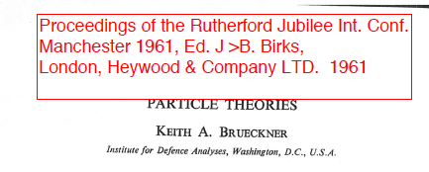
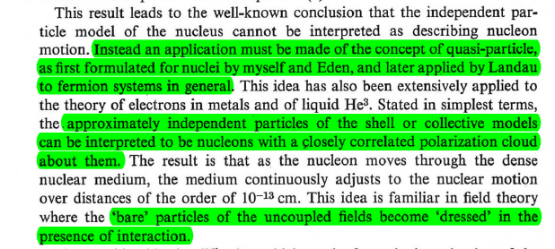

Slide 3
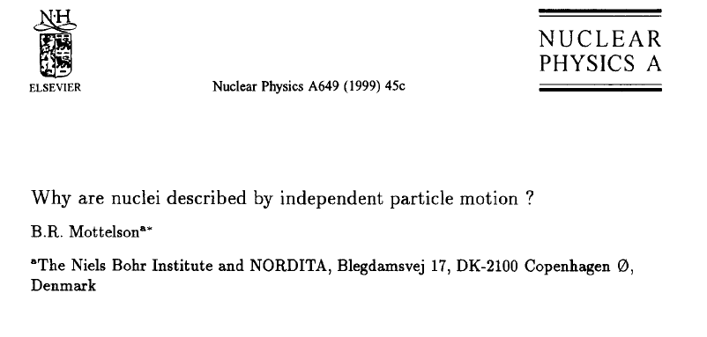

Slide 4
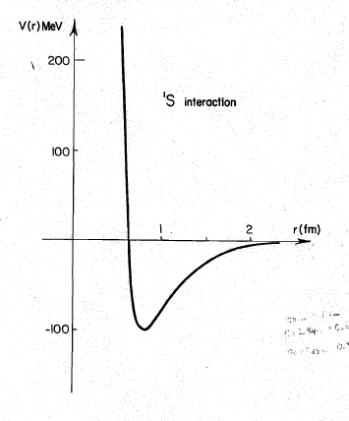
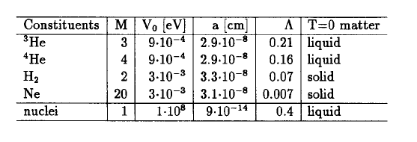
“Quantality Parameter”
Fermi Liquid → quasiparticles

Slide 5




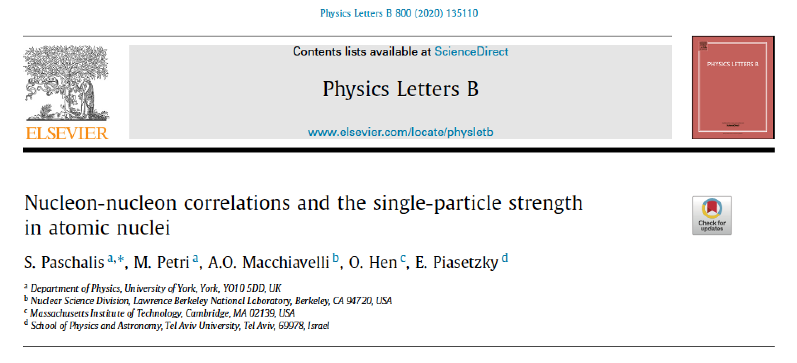


Slide 6
The questions we addressed:
Stefanos Paschalis - Monday
What are the individual contributions of LRC and SRC to the observed depletion (quenching of SF)?
What is the isospin dependence of these contributions, and how do they compete in very asymmetric nuclei?
Wim Dickhoff - Wednesday

Slide 7
The questions we addressed:
Stefanos Paschalis - Monday
What are the individual contributions of LRC and SRC to the observed depletion (quenching of SF)?
What is the isospin dependence of these contributions, and how do they compete in very asymmetric nuclei?
Wim Dickhoff - Wednesday
What did we do?
A phenomenological approach, in the spirit of Brueckner and Mottelson’s Fermi liquid

Slide 8


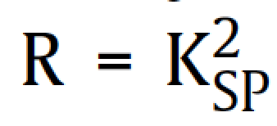
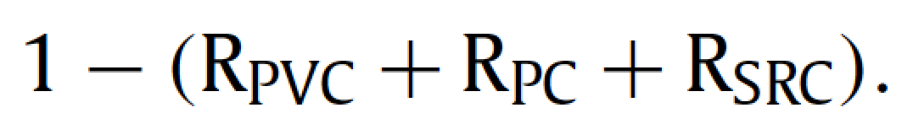
SURFACE
single-particle
configuration
Long-range
correlations
Short-range
correlations
Particle-vibration
coupling
Pairing
correlations
Missing strength
R = total single-particle Quenching Factor
represents the probability to find a nucleon in the pure single-particle configuration

Slide 9
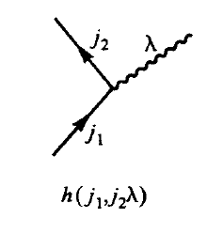
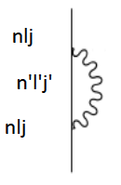
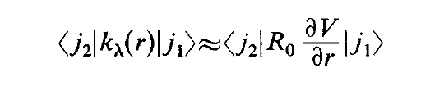


LRC Dressed nucleons
Particle Vibration Coupling
λ
Phonon
Radial coupling matrix element
~
|nlj > = A |nlj > + B |phonon> x |n’l’j’> + …

Slide 10

LRC Dressed nucleons
Pairing Vibrations
0p0h
Unperturbed gs
2p2h
4p4h
|gs > = A |0p0h> + B |2p2h> + … (small)
B ~ Matrix element / Energy
B ~ GΩ/ 2hbarW₀ = Δ/hbarW₀

Slide 11
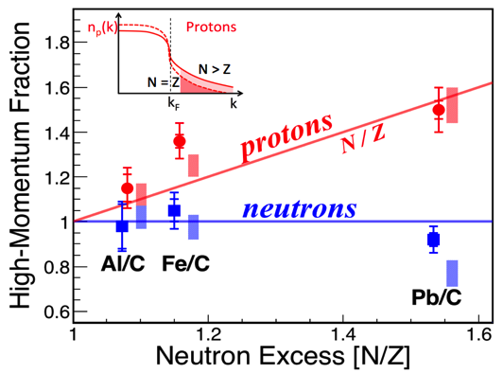
SRC: Quantitative information from JLAB
minority
M. Duer et al., Nature 560 (2018) 617
Jan Ryckebusch - Wednesday

Slide 12
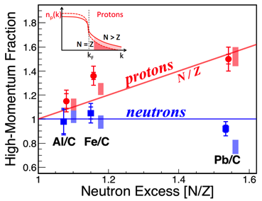
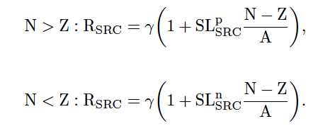
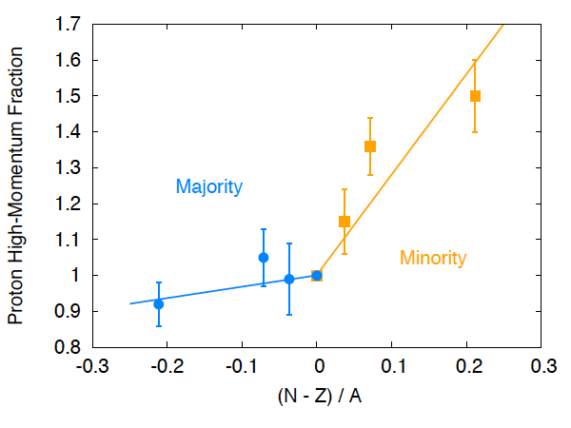


SRC

Slide 13
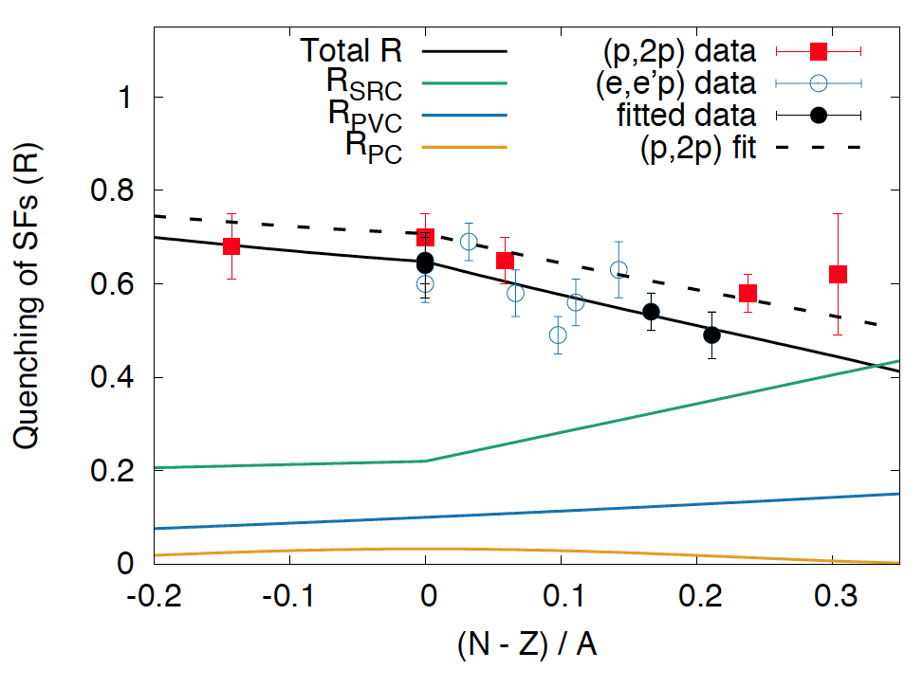
Our results
γ ≈22
α ≈10
β ≈3

Slide 14
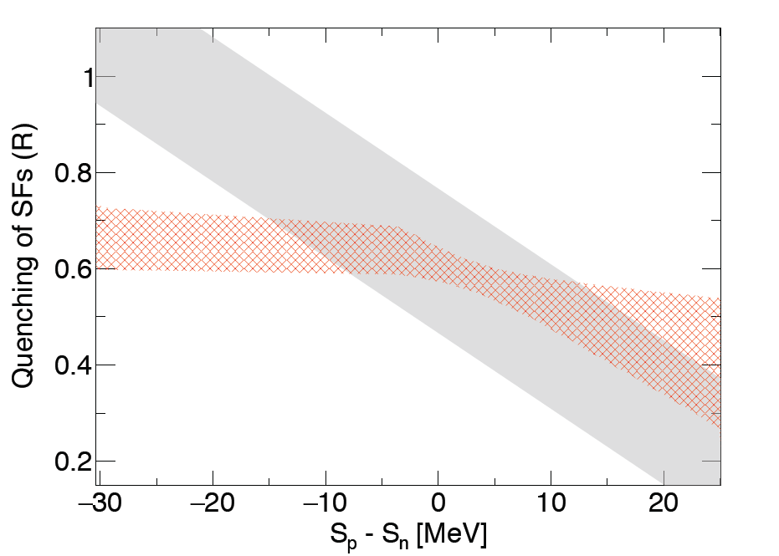
Our results in a Gade/Tostevin plot
(converting A,Z,N → S_{n} and S_{p})

Slide 15
Effects of weak binding ?
x (Vol_{p}/Vol_{n})
¹⁴O
¹⁶O
^{23,24}O
SRC Quenching Factor
RATIO
Oxygen Isotopes
Sp-Sn (MeV)

Slide 16
Other aspects

Slide 17
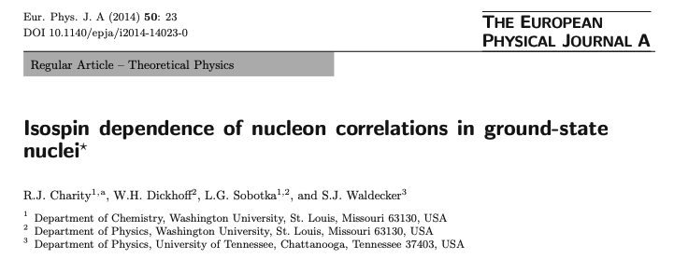
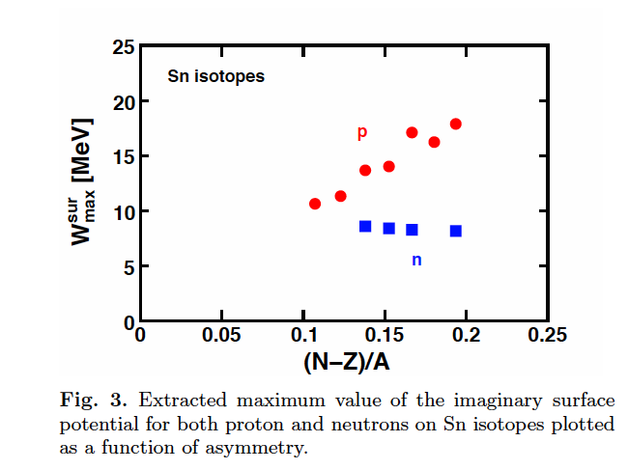
Wim Dickhoff - Wednesday

Slide 18
n
p
R/R(N=Z)
Our fit vs. DOM fit of W ^{surf} _{max}
W^{surf,max} /W ^{surf,max} (N=Z)
Wim Dickhoff - Wednesday

Slide 19
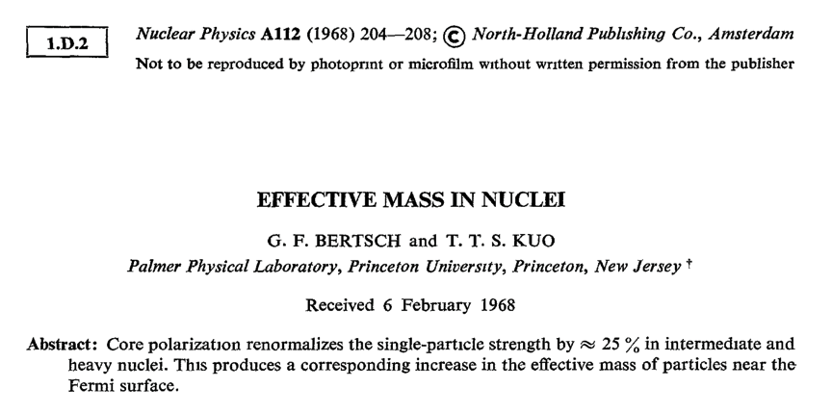
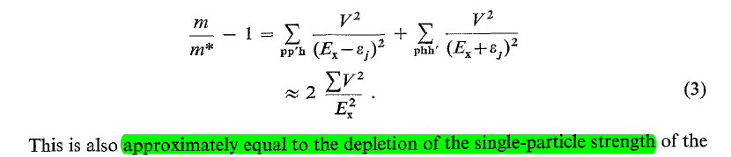
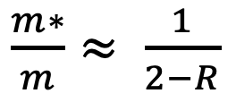
$\frac{m∗}{m}≈ \frac{1}{2−R}$

Slide 20
Effective Mass
Bao-An Li, Bao-Jun Cai, Lie-Wen Chen, and Jun Xu
Progress in Particle and Nuclear Physics 00 (2018) 1–109
Bao-An Li
n p
m*/m
(N-Z)/A
Bao-An Li - Tuesday

Slide 21
http://www.phy.anl.gov/theory/research/momenta/
Fit
Protons
ANL GFMC
Light nuclei
High Momentum Fraction
Neutrons
(N-Z)/A

Slide 22

http://www.phy.anl.gov/theory/research/momenta/
Fit
Protons
ANL GFMC
Light nuclei
High Momentum Fraction
Neutrons
(N-Z)/A

Slide 23
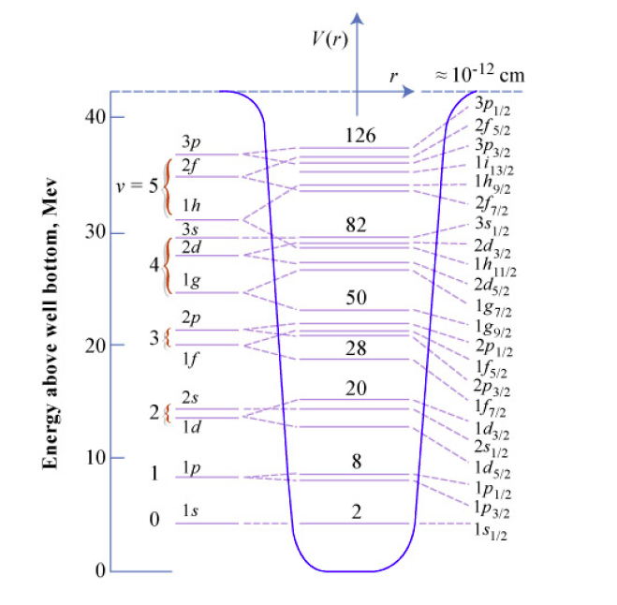
How do the IPM particles get dressed by the SRC?

Slide 24
How do the IPM particles get dressed by the SRC?
Quasi-deuteron
p
h
“d”
p
|qp > ~ 80% |p> + 20% |h > x |qd > ????

Slide 25
How do the IPM particles get dressed by the SRC?
Quasi-deuteron
Maria Patsyuk – Monday
BM@N
|qp > ~ 80% |p> + 20% |h > x |qd > ????

Slide 26
How do the IPM particles get dressed by the SRC?
Quasi-deuteron
Isao Tanihata - Monday
(p,pd) reaction studies
R3B @ GSI
M. Petri, S. Paschalis, AOM
|qp > ~ 80% |p> + 20% |h > x |qd > ????

Slide 27
Some speculations

Slide 28
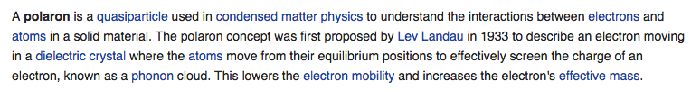
Arnau Rios - Wednesday

Slide 29

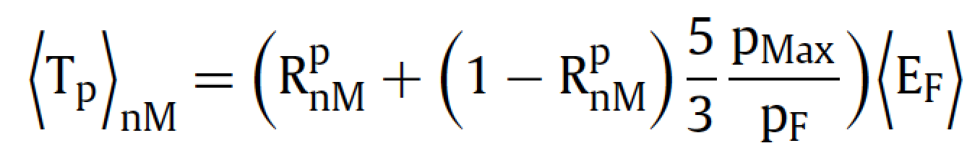
Interesting to consider the limit:
Quasi-proton (nuclear polaron) in neutron matter
LRC (Surface) → 0
~ 3 times that of a Fermi gas
M*/M ~ 0.54

Slide 30
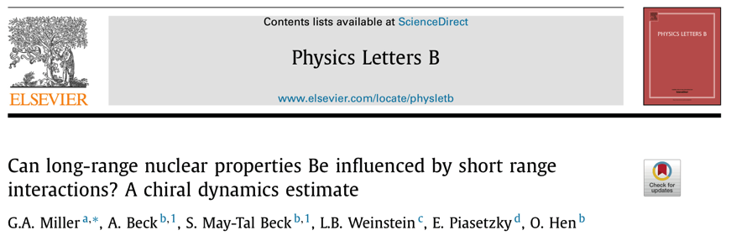
Gerry Miller - Tuesday
SRC in Electroweak Observables Saori Pastore - Tuesday

Slide 31
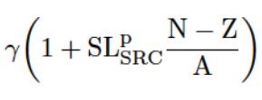
SRC and charge radius
Due to short range correlations single particle excitations of ΔE ~ 50 MeV will occur with the probability discussed above.
This corresponds to changes in the principal oscillator quantum number
And consequently, a change in the radius:

Slide 32
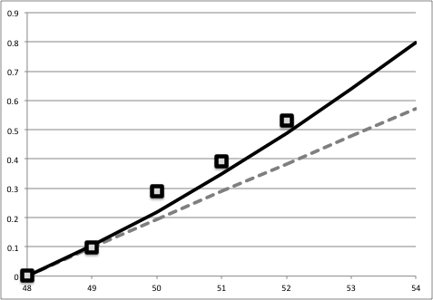

Calcium isotopes
SRC
R.F. Garcia Ruiz et al.,
Nature Physics 12, 594 (2016)
A^{2/3}
^{A}Ca

Slide 33
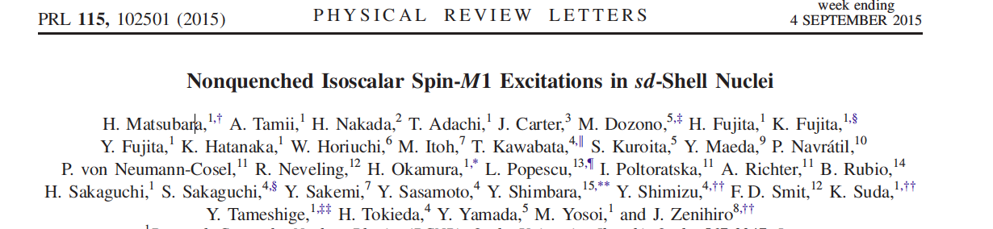
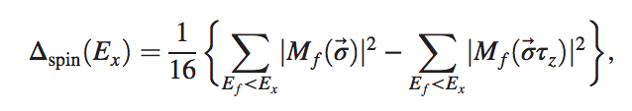

IS
IV
Measured by (p,p’) inelastic scattering near zero degree

Slide 35
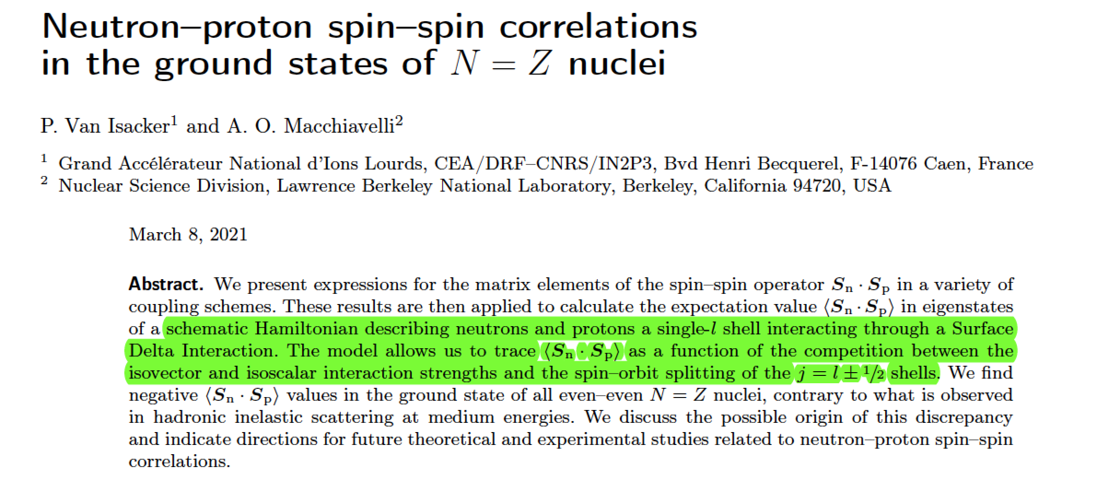
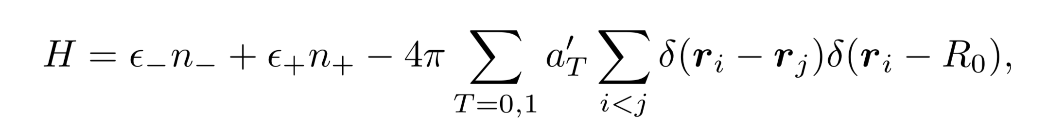


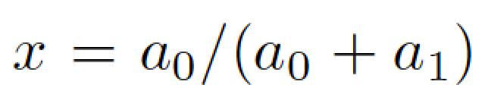
Submitted to EPJA
Competition between T=0 and T=1 channels
Competition between pairing and spin-orbit

Slide 36
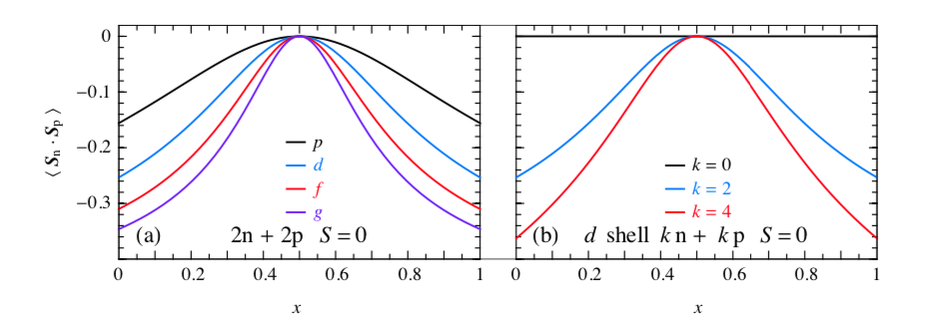
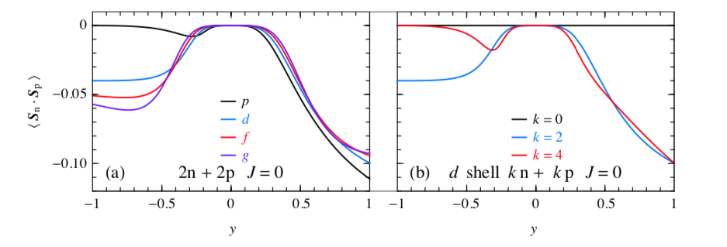
Even-even ground states

Slide 37
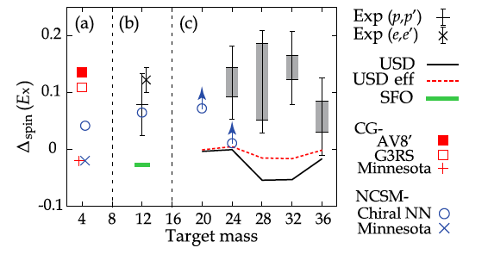

Slide 38
SRC ?

Slide 39
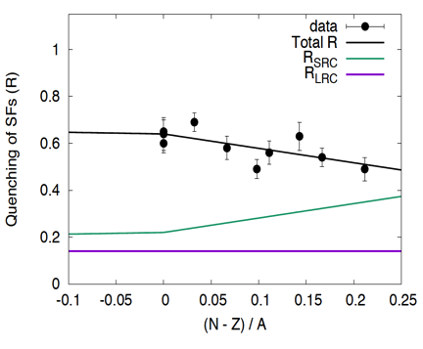
Two (somewhat related) questions:
One-nucleon direct reaction

Slide 40
Two (somewhat related) questions:
One-nucleon direct reaction
?????
Two-nucleon direct reaction

Slide 41
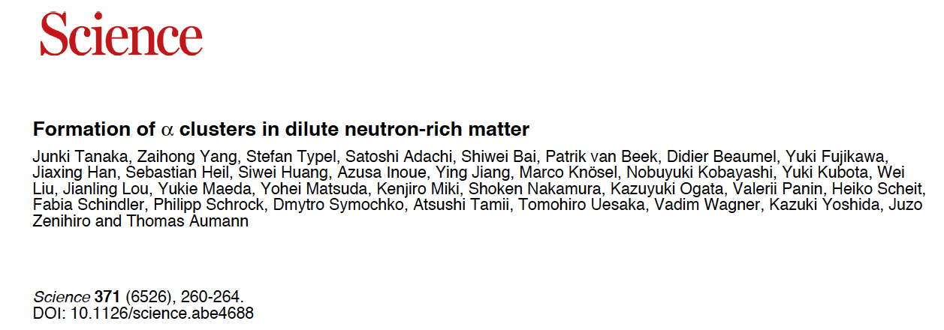
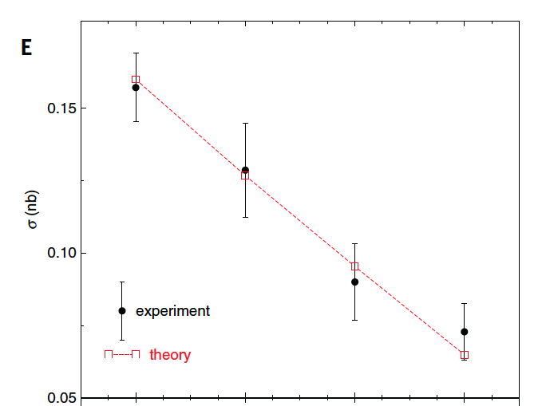

Two (somewhat related) questions:
Decrease in the number of alphas
Do SRC have anything to say?
Or Hen
Science 15 Jan 2021:
Vol. 371, Issue 6526, pp. 232

Slide 42
Conclusions
We derived simple phenomenological parametrizations for the combined effects of SRC, PVC, and PC that were used in an analysis of published data from electron scattering experiments
Our analysis consistently shows that ~ 20% of the missing strength observed in the region of N ≈ Z can be attributed to SRC, in agreement with reported expectations
We showed how the missing strength evolves with (N − Z)/A
Speculation on a quasi-proton (nuclear polaron) in the limit of neutron matter, A → ∞ and (N-Z)/A → 1, proton R ~ 0.2
Possible effects on the charge radius of neutron-rich Ca’s
and spin content of N=Z ground states.
How about effective charges?

Slide 43
Collaborators
Stefanos Paschalis and Marina Petri
Department of Physics, University of York, York, YO10 5DD, UK
Or Hen
Massachusetts Institute of Technology, Cambridge, MA 02139, USA
Eli Piasetzky
School of Physics and Astronomy, Tel Aviv University, Tel Aviv, 69978, Israel

Slide 44
Thank you !
Despite ZOOM hindering SRC, virtual LRC have been very effective in providing a stimulating Workshop environment …

