Slide 1
Study of High-Momentum Correlated Nucleon Pairs by (p,pd) reaction at RCNP
Isao Tanihata, RCNP Osaka University
Talk based on Terashima et al., PRL 121 (2018) 242501

Slide 2
Our aim
To observe strong tensor correlations in high-momentum nucleon pair and study the momentum dependence of tensor correlations in nuclei.
To identify the effects of the correlated pairs to the structure of nuclei near ground states.
The high-momentum correlated pairs not only reduce the spectroscopic amplitudes in Shell models but also change the configuration of structures. =“single particle orbitals” and “magic numbers”.=
IT, J. of Conference Series, 1643 (2020) 012109, Proceedings of INPC2019

Slide 3
Why (p, pd) at pickup kinematics?
Momentum matching is perfect for picking up a high- momentum neutron.
Tensor correlation and short-range central-force correlation can be separated.
(T=0, S=1) pair and (T=1, S=0) pair can be separated by the final state of recoil nucleus.

Slide 4
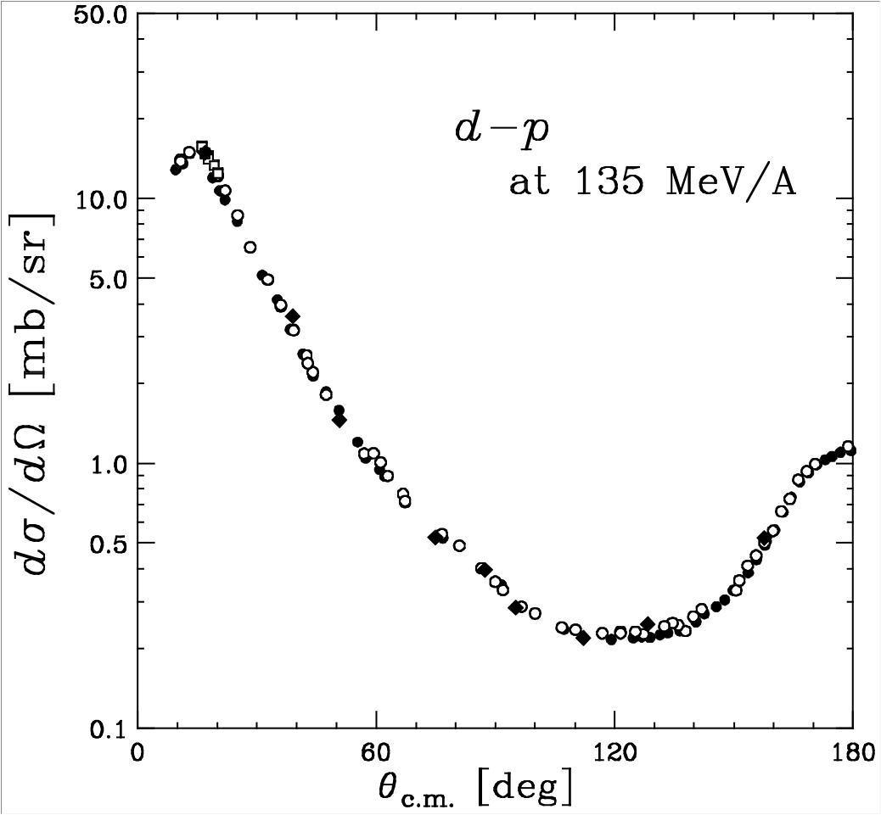
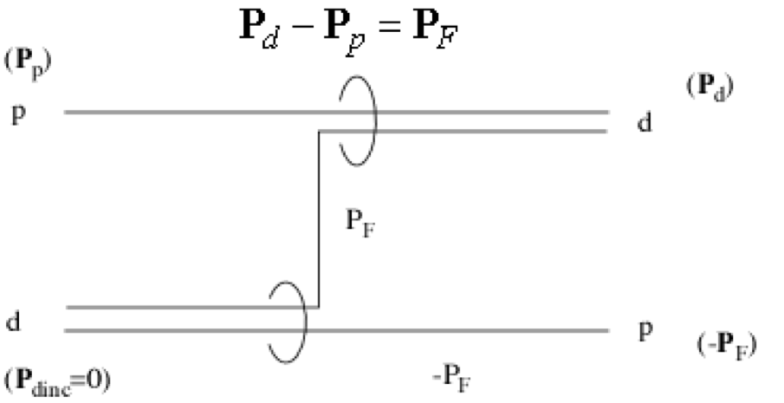
(p,d) scattering
= suitable to pick up high momentum neutron =
d in forward
Reaction at backward occurs by the high-momentum component.
K. Sekiguchi et al.,
PRL 95 (2004) 162301

Slide 5
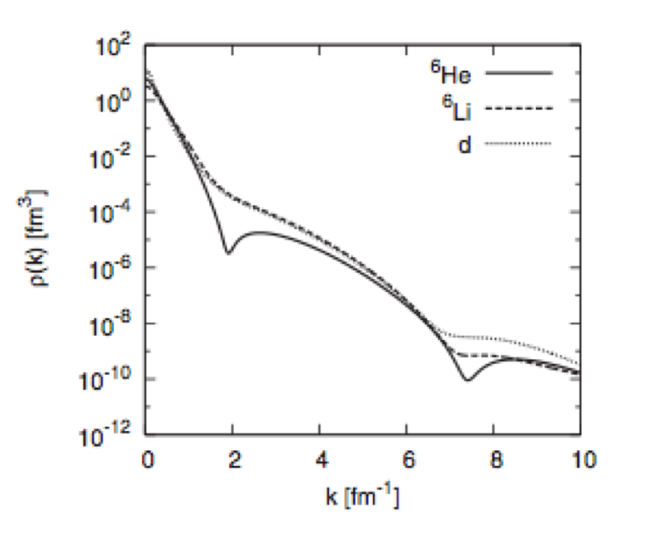
Why (p,d) not (p,2p),(e,e’p)
Momentum distribution of ejected p
0
-1
-2
-3
-4

Slide 6
Why (p, pd) at pickup kinematics?
Momentum matching is perfect for picking up a high- momentum neutron.
Short-range correlation by Tensor forces and Central-forces can be separated.
(S=1, T=0) pair and (S=0, T=1) pair can be separated by the final state of the recoil nucleus. Tensor interaction works only on (S=1, T=0) pair.
Also (p, nd) provide similar information.

Slide 7
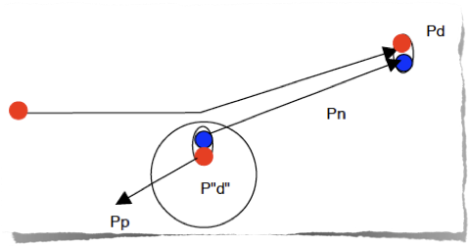
¹⁶O(p,pd)¹⁴N
3.95
(1,0)
2.31
(0,1)
How do we distinguish T=0 and T=1 pair.
0
0
¹⁴N
(J=1,T=0)
A measurement of correlated pn pairs in nuclei with large relative momenta.
High energy
proton
High energy
proton
P”pn”
Nuclei with T=0
p
Nuclei with T=1
T of residual nuclei = T of “d”
T of residual nuclei = T of “NN”

Slide 8
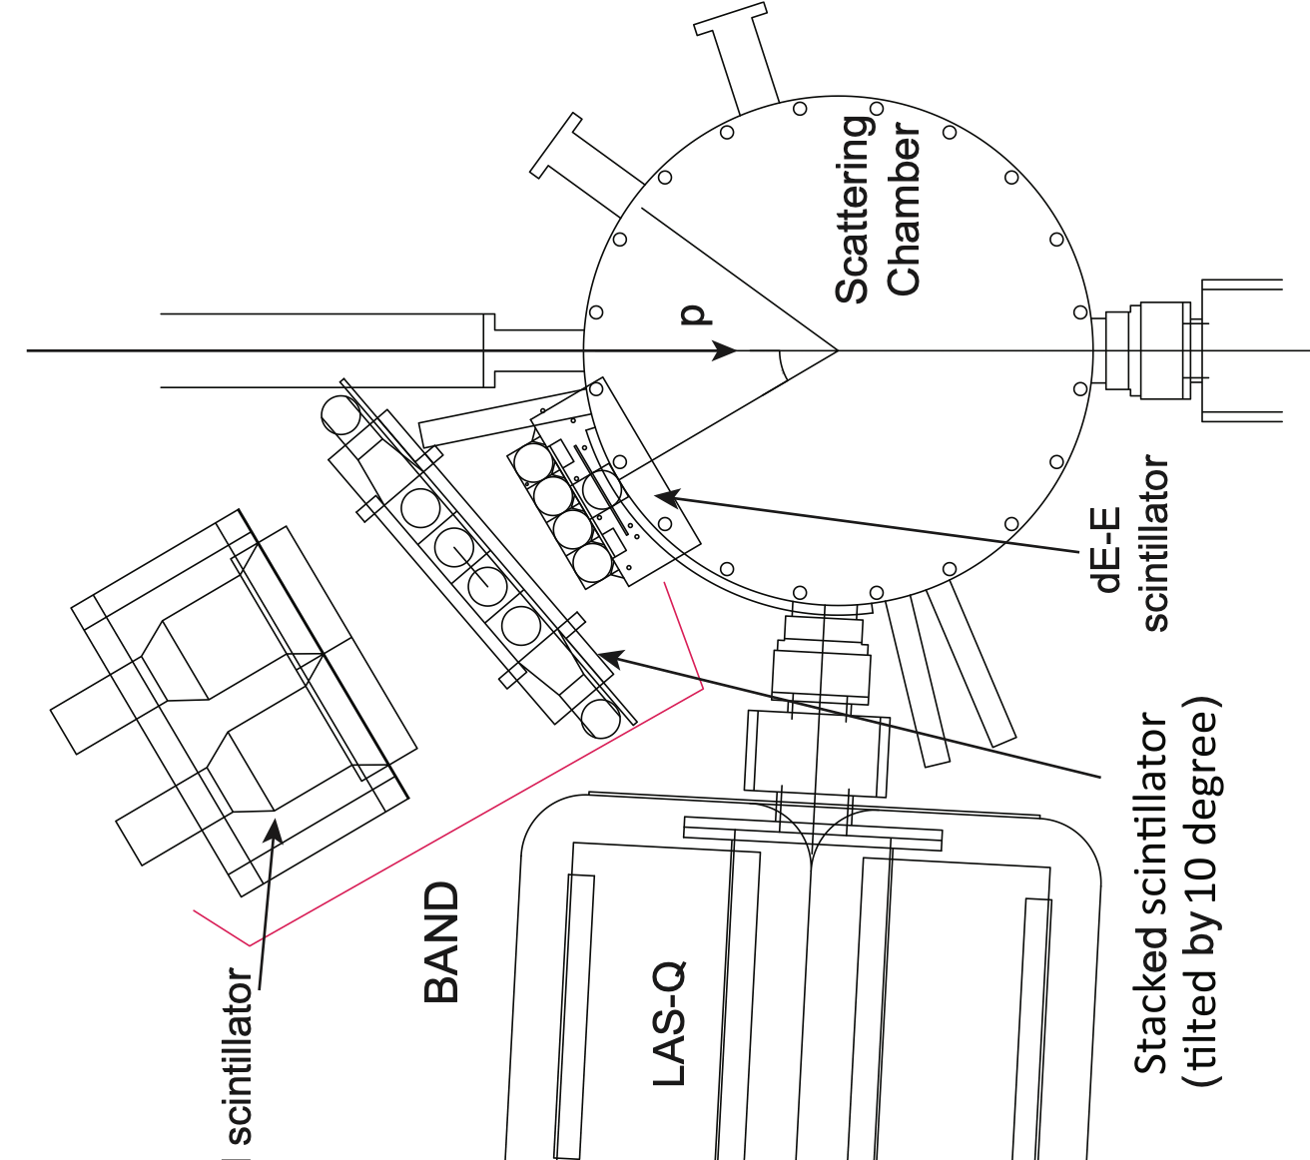
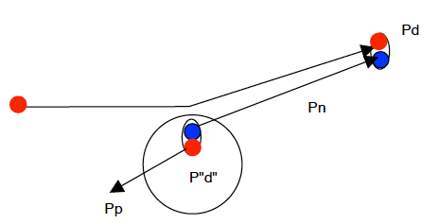
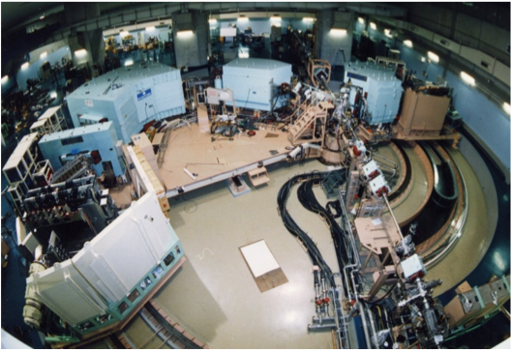
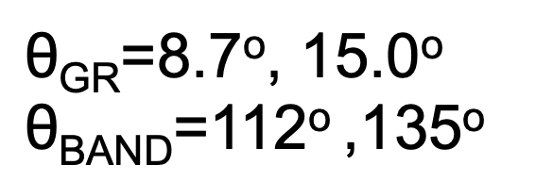
^{[RCNP-E443]} (p,dp), (p,dn) measurements
Proton beam:
400 MeV; 20 nA
d
p
p(n)
dE-E
scintillators
BOS⁴ (stacked
scintillators)
for protons and neutrons
Liquid
scintillators)

Slide 9
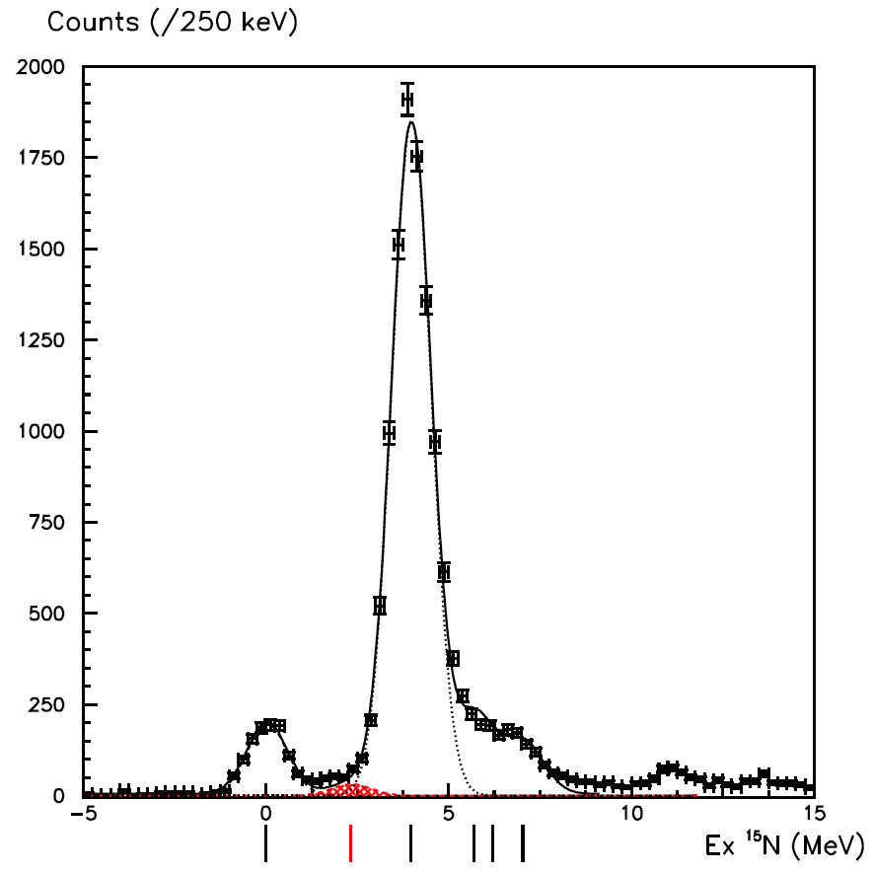
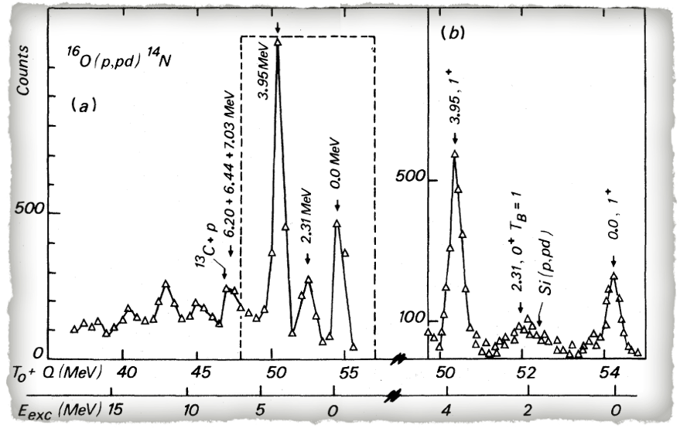
¹⁶O(p,pd)¹⁴N
Excitation energy spectrum
3.95
(1⁺, 0)
L=0
at ~400 MeV
(Ι^{π}, Τ)
2.31
(0⁺, 1)
L=0
at ~70 MeV
1⁺,0
2.31 MeV state is very weakly excited.
0⁺,1
1⁺,0
gs
(1⁺, 0)
L=2
J. Y. Grossiord et al., Phys. Rev. C 15 (1977) 843.

Slide 10
DWIA calculations
notation
(Ι^{π}, Τ)
where
Sd: “d” ’s spectroscopic factor
Fk: kinematic factor
Ti: overlap integral of initial and final state wave function including distortion.
where S
for “d”:(1⁺, 0) use p-d elastic scattering data.
for “d”:(0⁺, 1) use d(p, pn)p reaction at corresponding kinematic region.

Slide 11
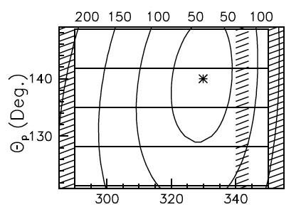
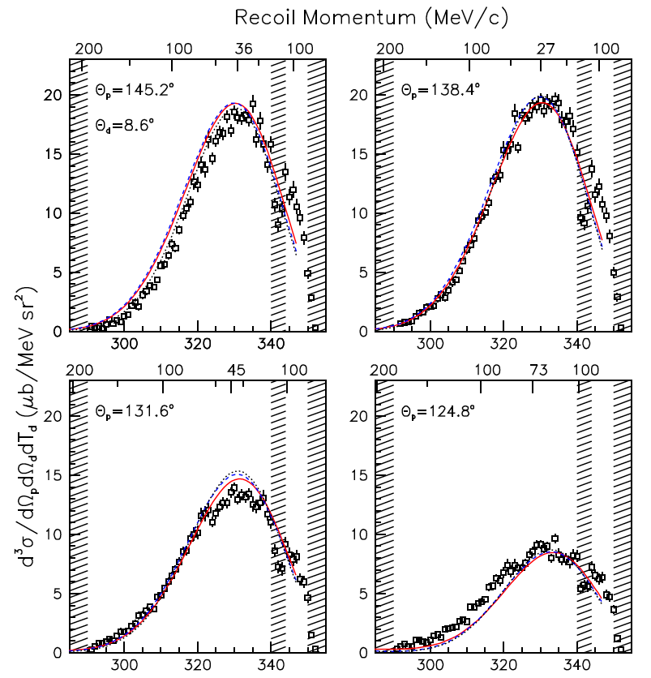
DWIA results
Td [MeV]
Cross sections are well reproduce by L=0 wave function
Td [MeV]

Slide 12
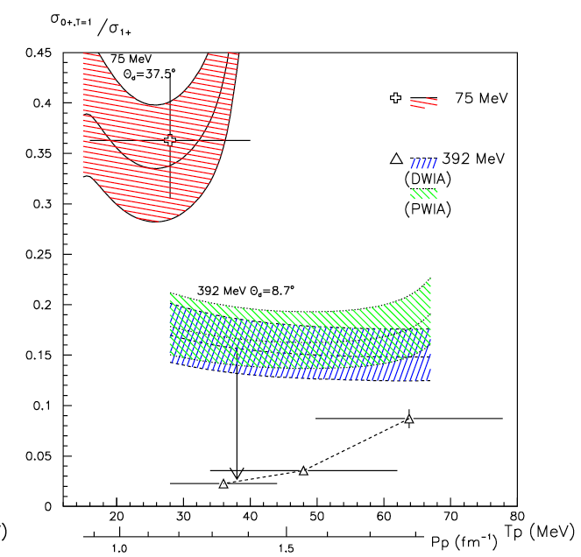
Comparison to the low energy data
We compare the ratio of cross sections σ(0+,1)/σ(1+,0) to compensate many delicate factors.
Spectroscopic factors are fixed by the low energy data.
DWIA and PWIA give the same change of ratio.
Tensor interactions bring the ratio down for high-energy data and is consistent with the data.
However the data shows stronger change of the ratio.
Difference of tensor interactions in deuteron and ¹⁶O?

Slide 13
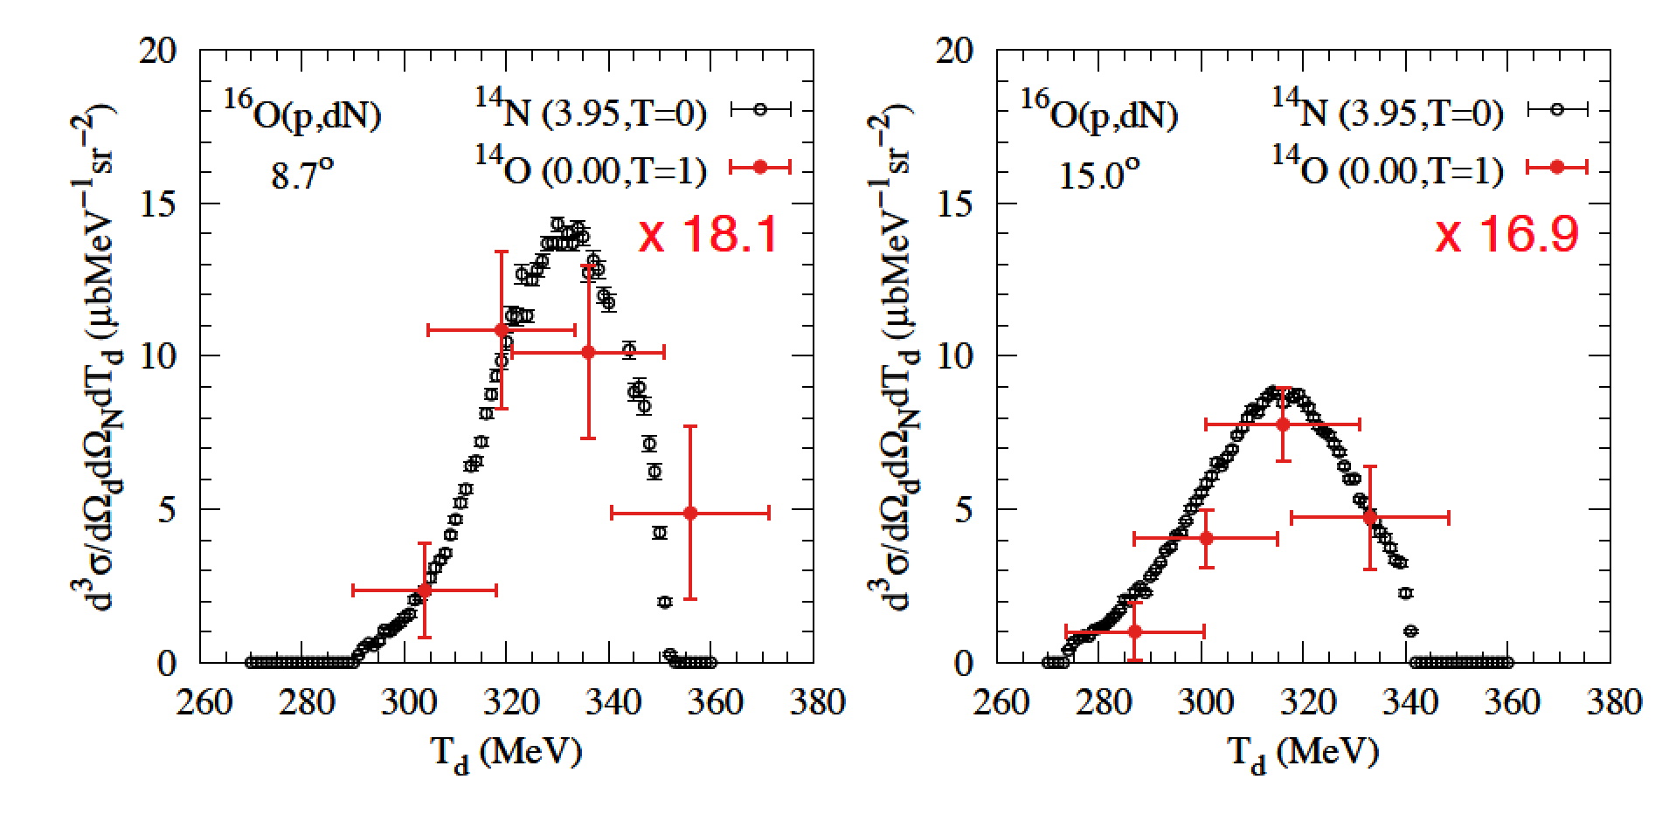
(p, nd) data

Slide 14
Comparison to the low energy data
We compare the ratio of cross sections σ(0+,1)/σ(1+,0) to compensate many delicate factors.
Spectroscopic factors are fixed by the low energy data.
DWIA and PWIA give the same change of ratio.
Tensor interactions bring the ratio down for high-energy data and is consistent with the data.
However the data shows stronger change of the ratio.
Difference of tensor interactions in deuteron and ¹⁶O?
(p,nd) data
Tn [MeV]

Slide 15
Summary (p, pd) reaction
Ratio of high-momentum nucleon in (S=1, T=0) and (S=0,T=1) nucleon pairs has been observed at around Pn = 1.5 ~ 2 fm⁻¹.
A strong relative increase of (S=1, T=0) pairs is observed, the expected effect by the tensor interactions.
The amount of increase, however, is much large than the one expected by the wave function of deuteron including tensor interactions.
Is the tensor interaction effect on momentum distribution different in ¹⁶O?

Slide 16
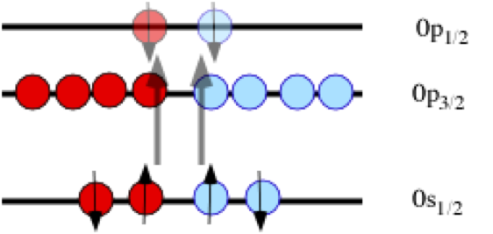
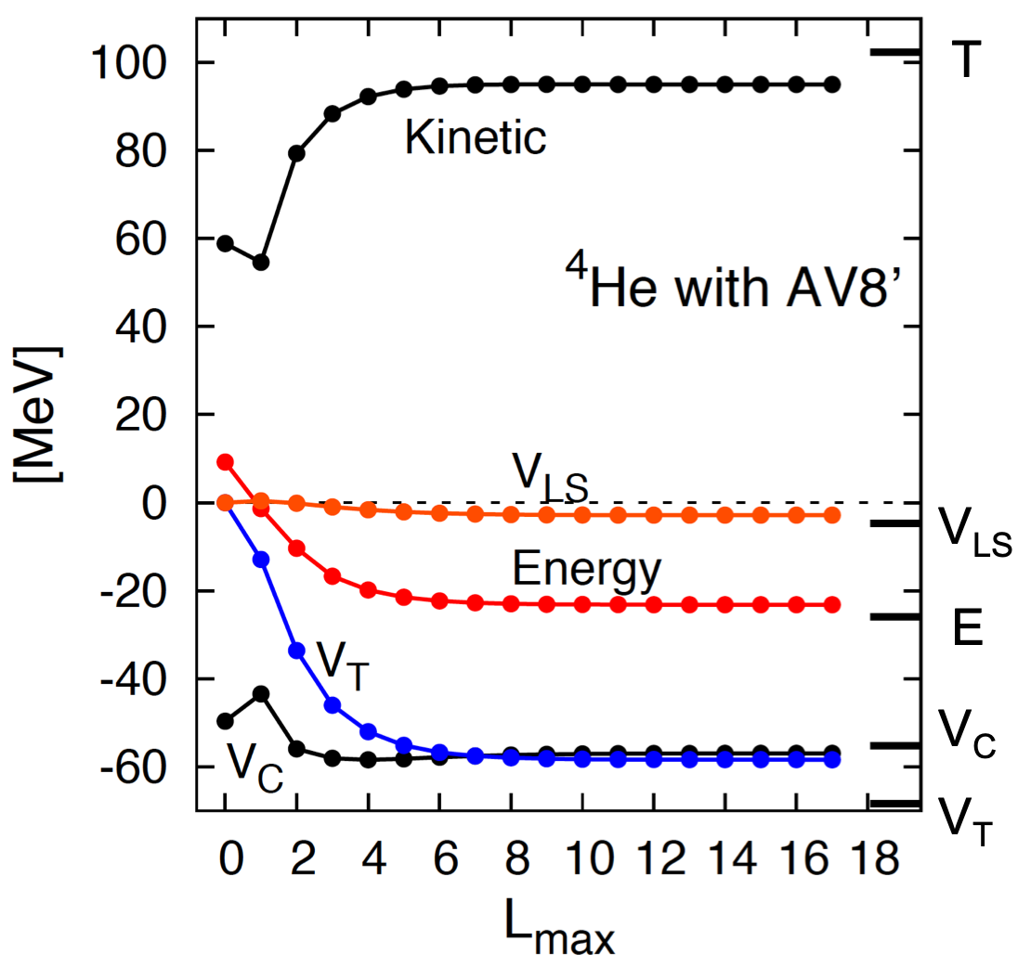
Why should high-momentum tensor correlated nucleons affect the low energy structure of nuclei?
Tensor interaction makes 2-particle 2-hole excitation with S=1,T=0 pair.
Selection rule of this transition is ΔS=2, ΔL=2
⁴He calculations
ΔL=2, ΔS=2
p-n pair: yes
n-n, p-p pair: no
13MeV gain already in Δl=1

Slide 17
Nuclear Saturation by Tensor Blocking
For Asymmetric Nuclei Blocking Changes
Blocking and Opening occurs simultaneously and keep the binding per nucleon to be almost constant.
Filling of only neutrons to the upper orbitals block the energy gain though tensor interactions!
2p1/2
2p1/2
2p1/2
1f5/2
1f5/2
1f5/2
2p3/2
2p3/2
2p3/2
1f7/2
1f7/2
1f7/2
1d3/2
1d3/2
1d3/2
2s1/2
2s1/2
2s1/2
1d5/2
1d5/2
1d5/2
1p1/2
1p1/2
1p1/2
1p3/2
1p3/2
1p3/2
1s1/2
p
n
1s1/2
1s1/2
p
n
p
n
¹²C
¹⁶O
⁴⁰Ca
¹⁶O suffer blocking from 1s1/2 to 1p1/2.
But open new excitation from 1p1/2 to 2s1/2.
¹²C do not suffer blocking of tensor!

Slide 18
Thank you for your attention.

Slide 19
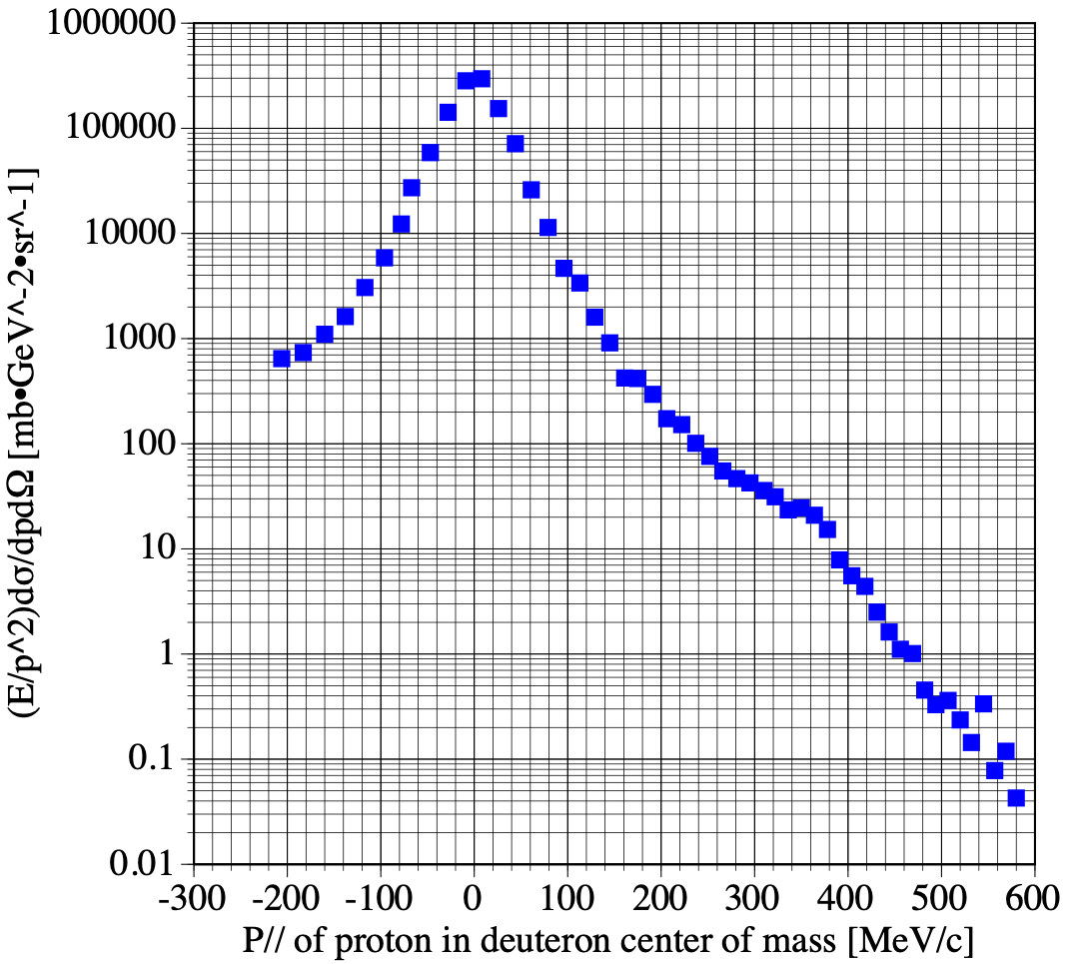
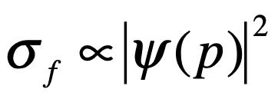
Projectile fragmentation
d+C -> p at 0 degrees, Ed=7.2 GeV
V. G. Ableev et al., Nucl. Phys. A 393 (1983) 491.

Slide 20
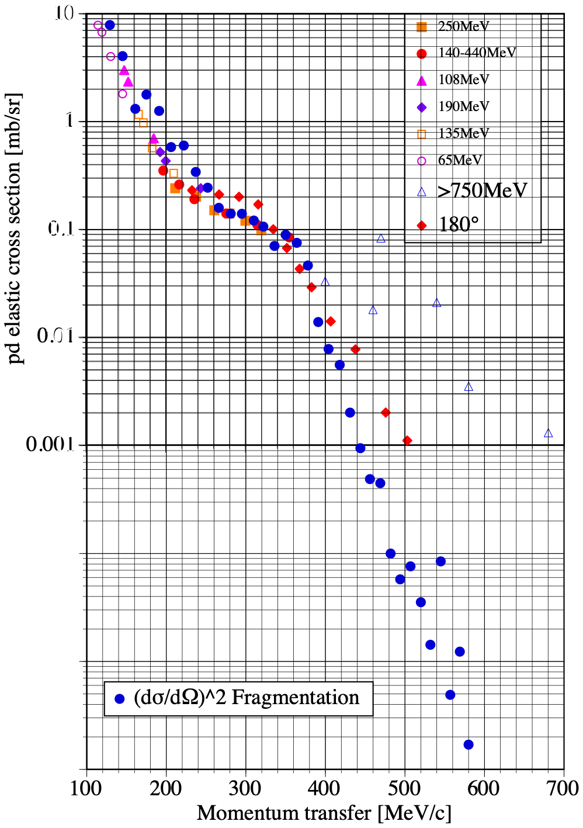
Overlay of pd elastic and d fragmentation
σel and (σf)² are overlaid together.
Their shapes are almost identical,
and thus, experimentally, indicate that the distributions are reflecting the momentum distribution of nucleons in deuteron.
But if we overlay the theoretical momentum distribution—-
Why? We need to have a mechanism to change the structure of deuteron.

