Slide 1
Building a Data Infrastructure on top of S3
Alastair Dewhurst
Notes:
The abstract pattern can be removed or repositioned if required. Be careful to ‘Send to Back’ so that it does not obscure any important information.

Slide 2
About RAL
European Space Agency
Scientific Computing Department
Diamond Light Source
Particle Physics Department
Rosalind Franklin Institute
ISIS Neutron and Muon source
Central Laser Facility
Harwell Science and Innovation Campus is 270 Hectares in size, located 30km south of Oxford.

Slide 3
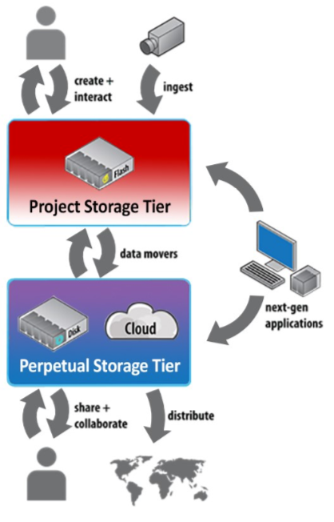
Strategy
STFC supports High Energy Physics, Nuclear and Space Science.
Close relationship with other research councils.
Scientific Computing Department (SCD) aims to provide computing resources for everyone.
Bespoke solutions (e.g. JASMIN)
General purpose OpenStack instance.
50k CPU Cores, 300+ GPUs
S3 storage (Echo)
~80PB raw capacity
Castor (soon to be CTA) Tape Archive
~200PB data stored
See recent HEPiX talk for more information.

Slide 4
IRIS (UK)
IRIS (not to be confused with the US IRIS-HEP) is an STFC project to fund shared computing for the non-LHC community.
We have observed modest growth in non-LHC grid usage.
Dune for data, LSST with their data challenges.
Massive growth in demand for Cloud resources (CPUs / GPUs)
Strong demand for S3 storage.
Plot show CPU resource usage by non-LHC experiments. Blue is Grid, Red is Cloud

Slide 5
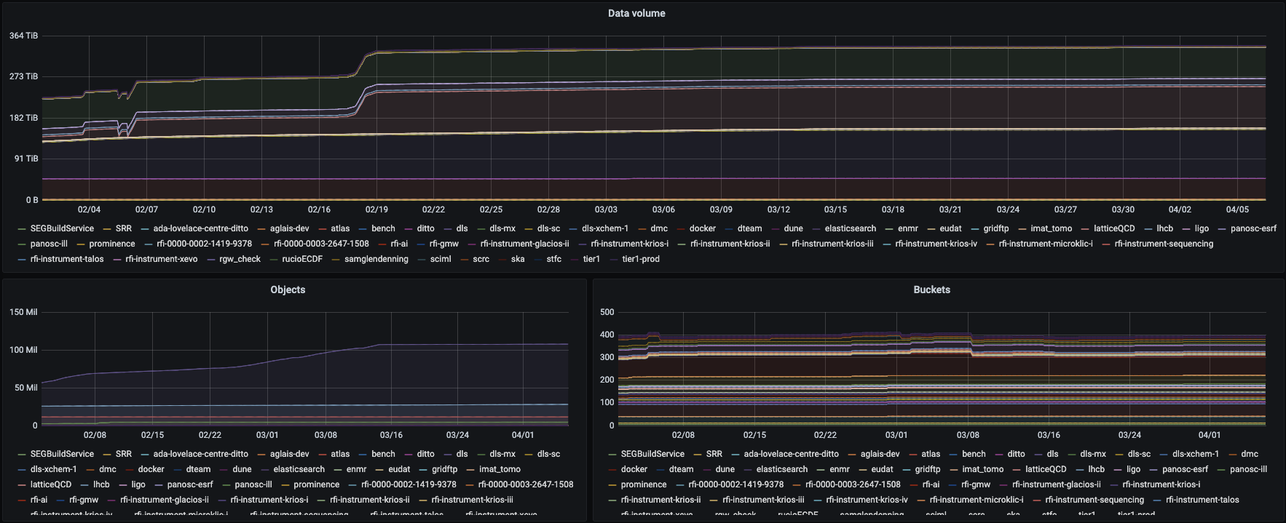
S3 Usage
New monitoring since start of February

Slide 6
Storage Architecture
HSM
Object Store
File System
Gateway / Door
Client
Meta Data Server
Storage Server
Storage Server
Storage Server
Tape System

Slide 7
Object Stores
Object stores offer advantages/disadvantages for both Storage Administrators and Users.
You can put an S3 API in front of non-object storage, you miss out on some of the benefits that administrators get.
Administrator
Larger choice of solutions.
More scalable / Easier to maintain
Better suited to certain features e.g. Erasure Coding.
User
More software supports it.
Better documentation.
Fewer features.
More responsible for their security.

Slide 8
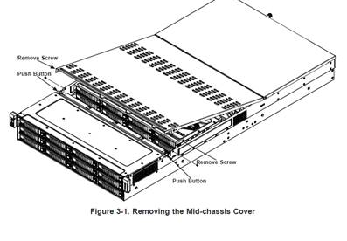
Hardware Installation
RAL has been able to rapidly expand Echo when required.
Leaf Switch
2 x Ceph management nodes
16 x Ceph Storage nodes with 24 disks in two layers
1152 x 16TB drives
= 18.4 PB raw storage

Slide 9
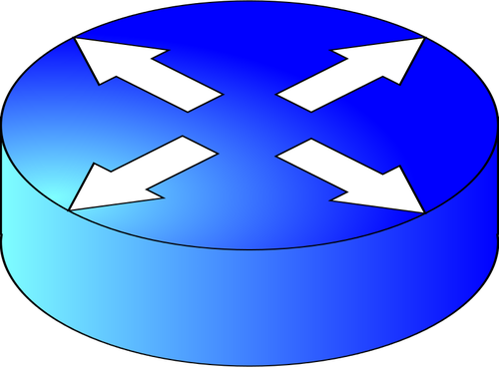
SCD Core network infrastructure
Super Spine
CTA
800Gb/s
Legacy
Tier-1
1600Gb/s
Cloud
400Gb/s
JASMIN
400Gb/s to Site Core
Tier-1 Spine 400Gb/s
400Gb/s
100Gb/s to CERN
200Gb/s to JANET
~80PB storage
50k CPU cores

Slide 10
Pre-signed URLs
Pre-Signed URLs are the main selling point of Coud APIs (S3).
If you have the secret + access key you can generate a URL to access the storage.
S3 is excellent for developers!
1. Credential + request
Job / user with credential
Experiment Service
2. Pre-signed URL
3. Data
S3

Slide 11
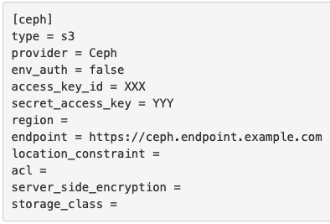
RClone
RClone has been chosen by several experiments to transfer their data in and out of Echo.
Access/private keys are in config, which is restricted to a handful of hosts.
Users regularly report they are able to saturate their bandwidth.
ILL Data Transfer Node

Slide 12
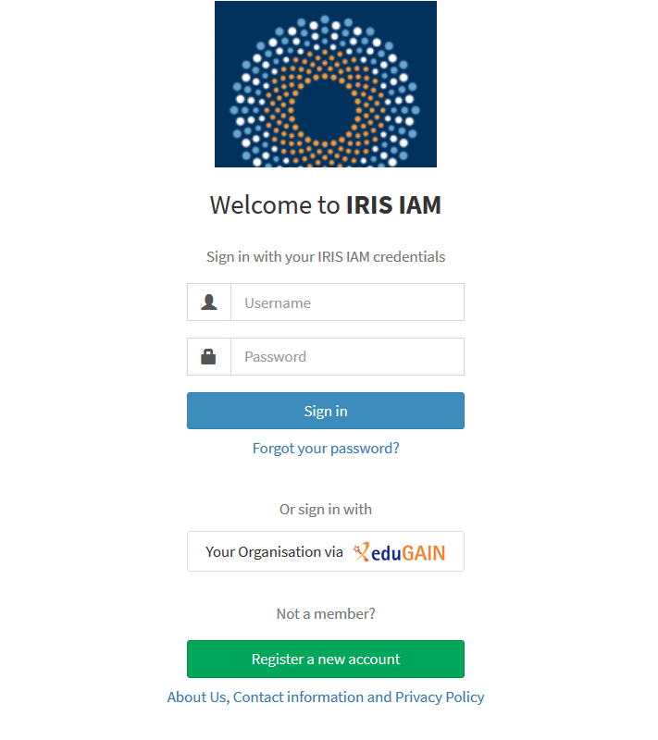
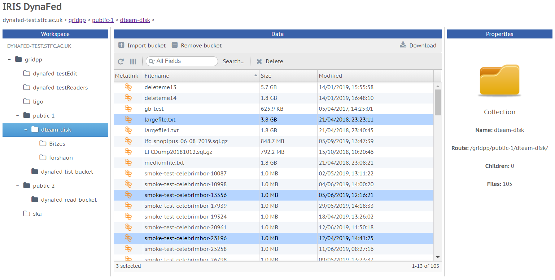
DynaFed
IAM
Authenticates with IAM
User wishes to browse
their projects data in Echo
User to project
mapping
DynaFed

Slide 13
Keystone
The RGW keystone integration is primarily to allow a Ceph cluster to provide Swift object storage for an Openstack deployment
Can do S3 too
The Openstack keystone service provides an authentication service
The Ceph RGWs (S3 gateways) can use these to authenticate and authorize requests for users that don’t exist on the RGW service.

Slide 14
Third Party Copies
FTS
DynaFed
ssh
GridFTP, XRootD,
S3
Site A Storage
Echo S3
Gateway
S3
Ceph backend
One solution to TPC was to use DynaFed via “4th party copies”
Works in principle, not done at scale.
FTS can also do this, but we want to avoid proxy transfers through it.
With DOMA-TPC work, problem is solving itself.

Slide 15
Bucket syncing
It is possible to sync S3 buckets.
Simple config change.
Not tried this yet but would like to try this with data export from SKA from South Africa.
They also use Ceph for S3.
Could potentially feed into a data lake model?!

Slide 16
Notes:
The abstract pattern can be removed or repositioned if required. Be careful to ‘Send to Back’ so that it does not obscure any important information.

