Slide 1
ERSAP
In Nutshell
By Vardan Gyurjyan

Slide 2
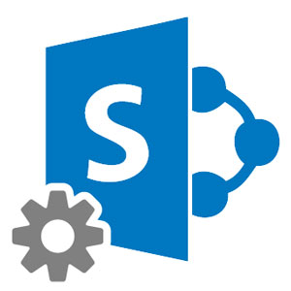
In a few words
Reactive event driven actors (micro-service), communicating data through data-stream pipes, controlled by the application orchestrator.
Stream of data quanta, flowing through directed graph of actors.
Application is a network of independent actors.
Data moves across actors not instructions
Actors communicate with each other by exchanging the data quanta across predefined connections by message passing, where connections are specified externally to actors.
User provided data processing single-threaded algorithms (engines) are presented as fully scalable actors in the framework.
Actor = Service engine + Data processing station
S4
Data processing station
S5
S8
S9
S1
Service engine
S2
S10
Data–stream pipe
S3
S6
S7
Orchestrator

Slide 3
Actor = User engine + Data processing station (DPS)
DPS provides
Runtime Environment
Multi-threading
Engine follows data-in/data-out interface.
Engine gets JSON object for run-time configuration.
DPS
Communication
Configuration
User provided code
Engine
Data Processing Station
Data Processing Actor
(micro-services)

Slide 4
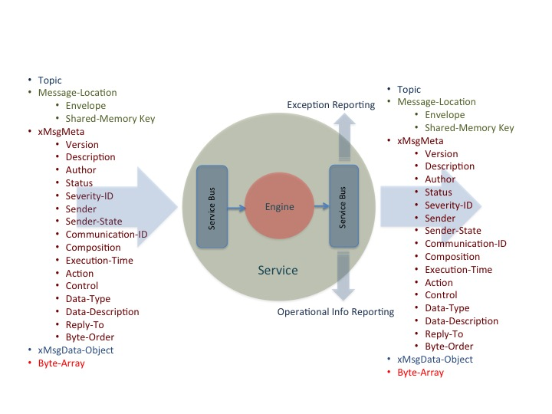
Data Stream Pipe
Publish/Subscribe
P2P
Communication
Transient Data
Meta-description
Serialization
0MQ/POSIX_SHM/Data-Grid
Data-Stream Pipe

Slide 5
Application Orchestrator
Application Monitoring,
Real-time Benchmarking
Command-Line Interface
Hardware Optimizations
Application Deployment
and Execution
Service Registration/Discovery
Orchestrator
Exception Logging and Reporting
Data-Set Handling
and Distribution
Farm (batch or cloud) Interface

Slide 6
Advantages of the actor model
Artifacts are small, simple and independent
Easier to understand and develop
Reduced develop-deploy-debug cycle
Easy to migrate to data
Scales independently
Independent optimizations
Improves fault isolation
Easy to embrace hardware heterogeneity
Eliminates long term commitment to a single technology stack.

Slide 7
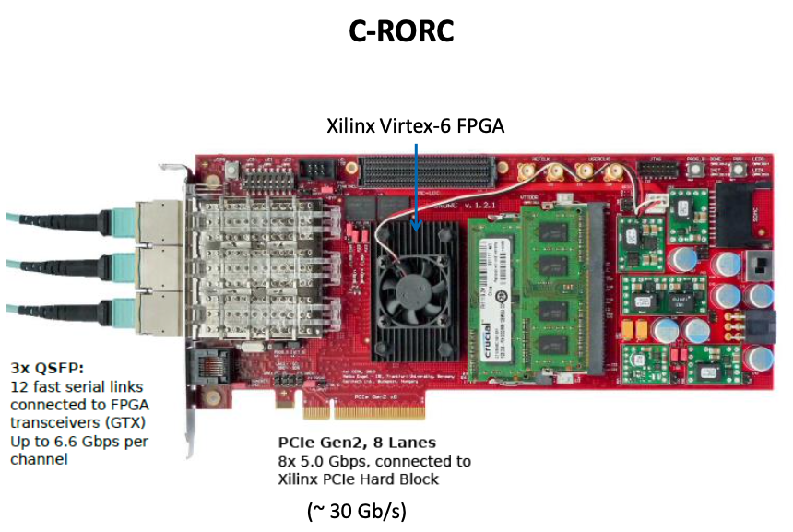
INDRA-ASTRA data pipeline ERSAP prototype
alkaid.jlab.org
ERSAP
Aggregator
service
Decoder
service
JANA-Processor
service
Persistency
service
ALICE code is modified to stream data

