Slide 1

INDRA-ASTRA: Evaluation & Development of Algorithms & Techniques for Streaming Detector Readout
Hindu mythology
INDRA Deity of lightning, thunder, rains and river flows
INDRA-ASTRA Indra’s weapon
Jefferson Lab
INDRA Facility for Innovations in Nuclear Data Readout and Analysis
INDRA-ASTRA LDRD on streaming readout
J. Bernauer (SBU), D. Blyth*(ANL), C. Cuevas*, M. Diefenthaler, A. Farhat**(ODU), W. Gu*, G. Heyes*, E. Pooser (JLAB → GTRI), B. Raydo*, Dmitry Romanov**
* Only FY19, ** Only FY20

Slide 2
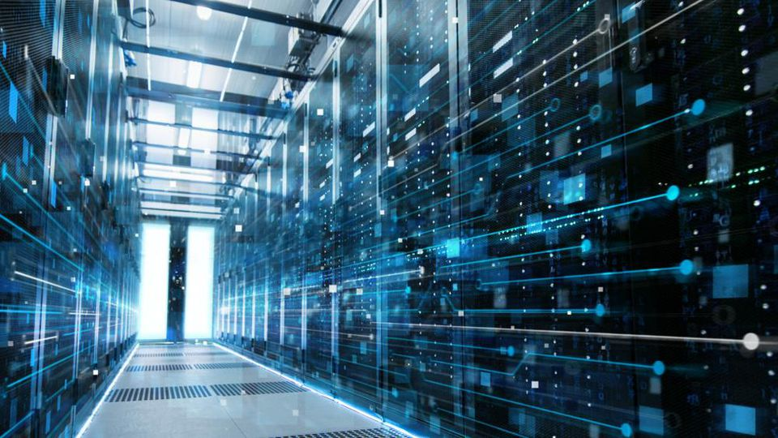
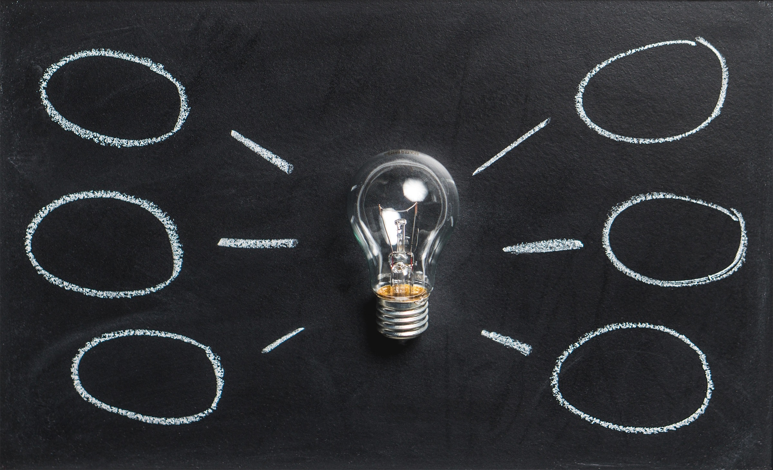
Towards the next-generation research model in Nuclear Physics
Science & Industry remarkable advances in electronics, computing, and software over last decade
Evolve & develop Nuclear Physics research model based on these advances
Role of computing Data processing from DAQ to analysis largely shaped by kinds of computing that has been available
Example Trigger-based readout systems
Advances in electronics, computing, and software Unique opportunity to think about new possibilities and paradigms
Example Streaming readout systems

Slide 3
History Enabling the Next Generation Research Model for Nuclear Physics (Chris Cuevas, Graham Heyes, Markus Diefenthaler, Rik Yoshida)
Why think about this?
  Nuclear Femtography is a new science requiring an understanding of multi-dimensional correlations. The current NP research model is arguably not-adequate.
  NP research model has not changed for over 30 years. There have been remarkable advances in computing, analytics and microelectronics capabilities. We want to see if these advances can fundamentally improve the research model.
How to think about this.
  Rethink the way experiment is compared to theory. Do computing advances enable a different way to do this? (Event Level Analysis, ELA)
  Rethink the way experimental data is handled. Are there ways to speed up the analysis, in the context of ELA, of the data given modern compute and data handling capabilities. (Additive Event Model, AEM)
  Rethink the way we read out the data from the Front-End and how they are assembled into events, in view of ELA and AEM. (Streaming Readout)
Each item ELA, AEM, and Streaming Readout has its own merits and implementing them on their own has immediate advantage.
However, most efficient ELA implies AEM, and ultimate efficiency of the Research Cycle can be achieved when Streaming Readout feeds AEM → ELA.
ELA + AEM + Streaming Readout (EASR?) could be a model for accelerating discovery in NP.

Slide 4
Streaming readout and its opportunities
Definition of streaming readout
data is read out in continuous parallel streams that are encoded with information about when and where the data was taken.
Advantages of streaming readout
opportunity to streamline workflows
take advantage of other emerging technologies, e.g. AI / ML
Integration of DAQ, analysis and theory to optimize physics reach
seamless data processing from DAQ to analysis using streaming readout
opportunity for near real-time analysis using AI / ML (alignment, calibration, reconstruction)
opportunity to accelerate science (significantly faster access to physics results)
Front End data
Data Processor
Theory
Front-End
Front End data
Analysis data
Front-End
Front End data
Front-End

Slide 5
Seamless integration of DAQ and analysis using AI/ML
  LDRD
  goal
prototype components of streaming readout at NP experiments
→ integrated start to end system from detector read out through analysis
→ comprehensive view: no problems pushed into the interfaces
prototype near real-time analysis of NP data
→ inform design of new NP experiments
Front End data
Near real-time processor of streamed data in JANA2
Near real-time, interactive analysis in JupyterLab
fADCs
Front End data
Analysis data
GEM detector
Front End data
Custom MC Simulated ADC and TDC output
ZeroMQ messages via ethernet

Slide 6
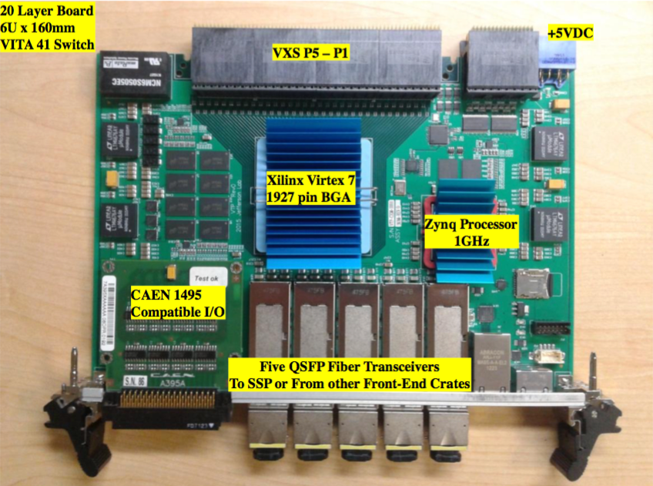
Streaming readout tests
Front End data
Near real-time processor of streamed data in JANA2
Near real-time, interactive analysis in JupyterLab
fADCs
Front End data
Analysis data
GEM detector
Front End data
Custom MC Simulated ADC and TDC output
Developed streaming readout simulations
Demonstrated how to integrate any MCEG into streaming readout
Streaming readout of fADC250
TDIS Streaming Readout Prototype

Slide 7
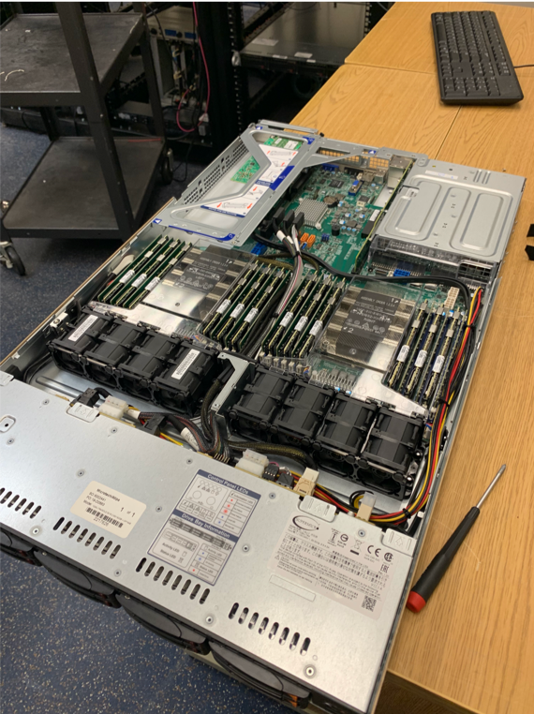
Streaming readout software
Front End data
Near real-time processor of streamed data in JANA2
Near real-time, interactive analysis in JupyterLab
fADCs
Front End data
Analysis data
GEM detector
Front End data
Custom MC Simulated ADC and TDC output
ZeroMQ messages via ethernet
Developed messaging library
receiving data from streaming data source
sending it efficiently over the network (TCP)
re-broadcasting the data using the ZeroMQ messaging protocol
subscribing to a stream of data
tested at rates up to ~50 Gbit/s
JANA2 for parallel processing of streamed data (with LD2014)
INDRA-ASTRA file server
1.5 TB of memory (Intel® Optane™)
1.0 TB of solid state storage

Slide 8
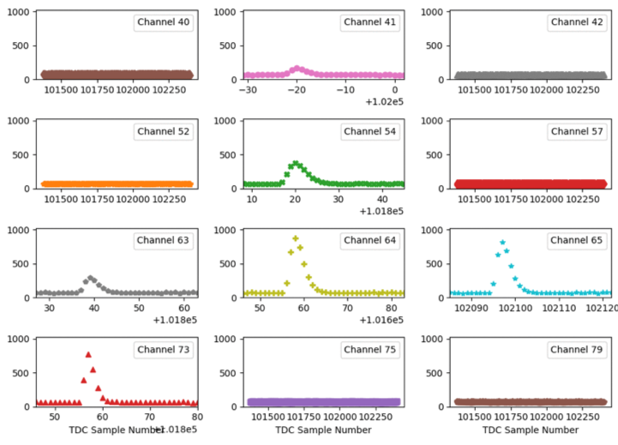
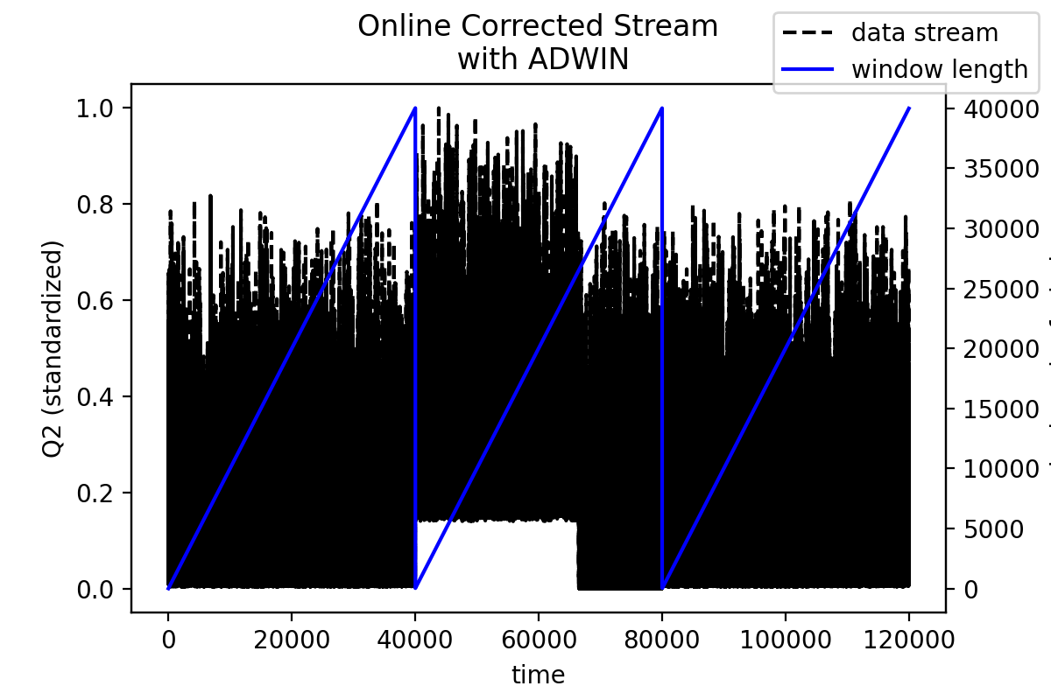
Streaming readout analysis
Front End data
Near real-time processor of streamed data in JANA2
Near real-time, interactive analysis in JupyterLab
fADCs
Front End data
Analysis data
GEM detector
Front End data
Custom MC Simulated ADC and TDC output
ZeroMQ messages via ethernet
Streaming plugins (data, MC)
decoding of streamed data
visualization of streamed data
automated data-quality monitoring
online calibrations
fully extensible in JupyterLab

Slide 9
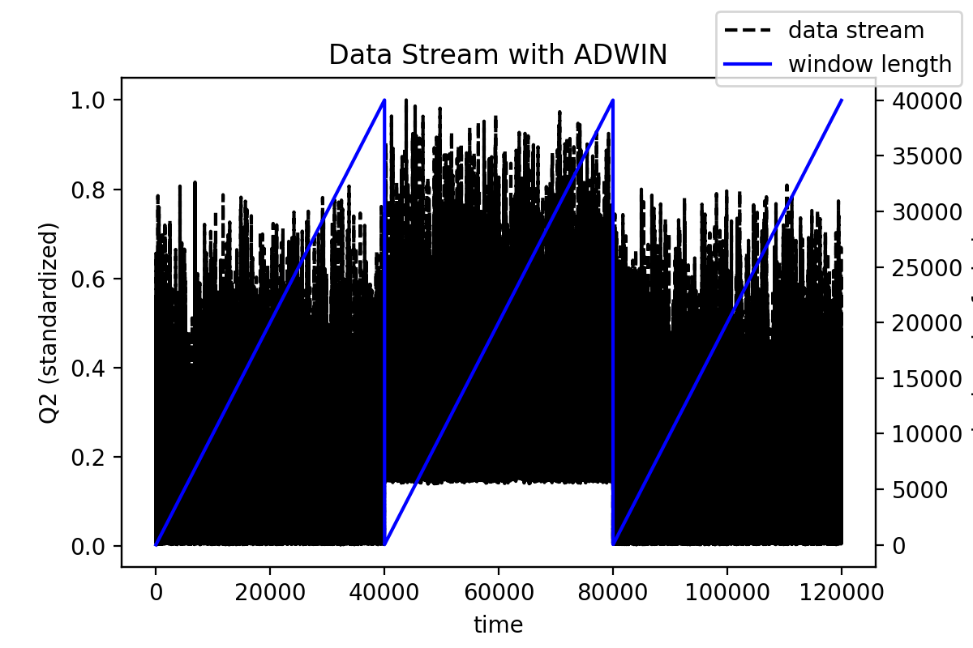
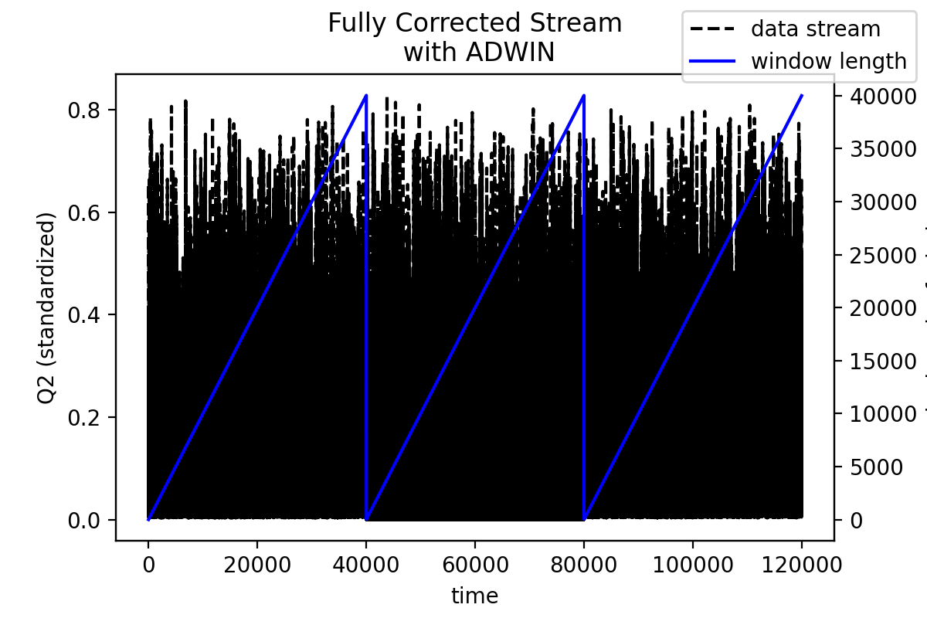
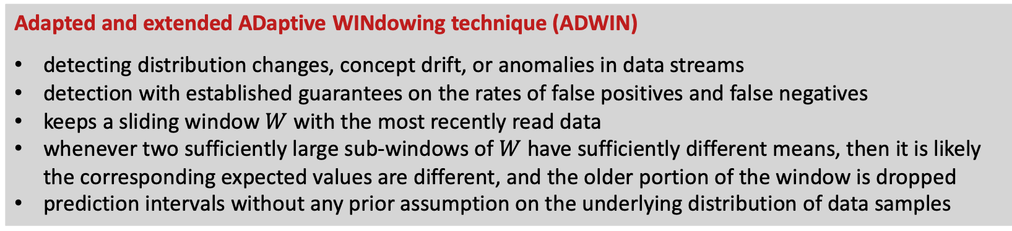
Automated data-quality monitoring and calibrations
Automatically identify changes in the underlying probability distribution
Re-calibrate in case of changes
Full re-calibration
Adapted and extended ADaptive WINdowing technique (ADWIN)
detecting distribution changes, concept drift, or anomalies in data streams
detection with established guarantees on the rates of false positives and false negatives
keeps a sliding window $W$with the most recently read data
whenever two sufficiently large sub-windows of $W$ have sufficiently different means, then it is likely the corresponding expected values are different, and the older portion of the window is dropped
prediction intervals without any prior assumption on the underlying distribution of data samples

Slide 10
Address Challenges of Autonomous Control and Experimentation
  Follow-up Project
Develop a prototype for a fully automated, responsive detector system as a first step towards a fully automated, self-conscious experiment
R&D fully integrated with:
streaming readout efforts at Jefferson Lab
AI/ML initiatives at Jefferson Lab and affiliated universities
  Team
Jefferson Lab
ENP M. Diefenthaler, E. Jastrzembski, H. Szumila-Vance, and CLAS12 involvement
CST D. Lawrence, V. Gyurjyan, and we for sure will work with N. Brei
Catholic University of America
Physics T. Horn (interested)
Old Dominion University
Applied Numerical Mathematics R. Fang, A. Farhat, Y. Xu

Slide 11
Work plan
Detector Readout | ML | Integration
Setup ERSAP prototype | Compare ADWIN2 and MULTISCALE algorithms in their capability for identifying gradual and sudden changes in streaming data and for distinguishing these changes from noise for online capability | Develop a service in ERSAP to report changes and noise levels to the streaming readout system
GEM detector Monitor pedestals in real time |  | GEM detector Automatically correct for pedestals in real time
GEM detector Study cosmics and establish baseline efficiency and tracking using current, non-ML approaches | GEM detector identify cosmic over background learn what is a good efficiency for detector plane | GEM detector Monitor efficiency in real time (e.g., some region not seeing hits) and automatically report on changes
Calorimeter pending on CLAS12 | Calorimeter pending on CLAS12 | Calorimeter pending on CLAS12
 |  | Identify limitations of automated system, e.g. by rapid changes of threshold or additional noise sources
Prepare tests in Halls A/C and B |  | Test integrated system in parasitic beam test

Slide 12
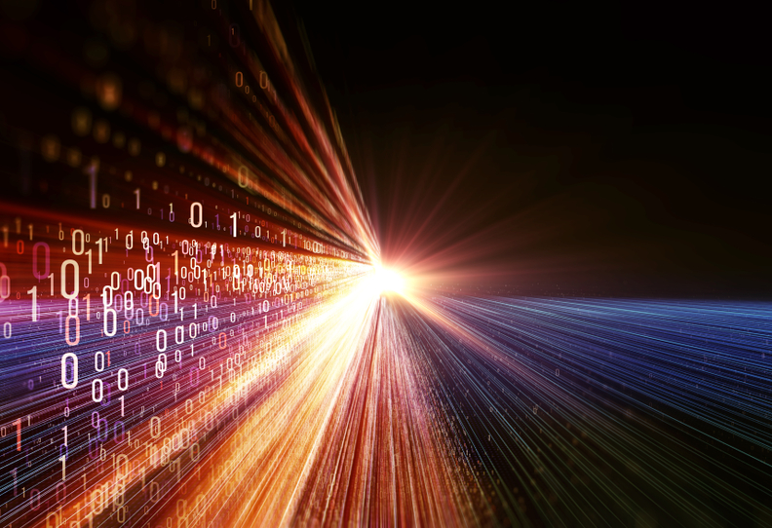
INDRA-ASTRA: Evaluation & Development of Algorithms & Techniques for Streaming Detector Readout
Markus Diefenthaler
mdiefent@jlab.org
New possibilities and paradigms for JLab 12 GeV and EIC
seamless data processing from DAQ to analysis using streaming readout
opportunity for near real-time analysis (auto-alignment, auto-calibration, near real-time reconstruction)
opportunity to accelerate science
LDRD project: INDRA-ASTRA
prototyped components of streaming readout
prototyped near real-time analysis
Collaboration with Experimental Physics Software and Computing Infrastructure (EPSCI)
  INDRA-ASTRA fulfills need for rapid prototyping tools for DAQ and detector R&D for Nuclear Physics and beyond
  develop INDRA-ASTRA into plugin for near real-time monitoring and auto calibrations at JLab 12 GeV and EIC
“The purpose of computing is insight, not numbers.”
(Richard Hamming)

