Slide 1
9th Workshop of the APS Topical Group on Hadronic Physics April 13 -16 , 2021
Julia Velkovska
Thank You for 4 exciting days of hadronic physics !

Slide 2
286 participants: thanks for the insightful discussions and collegiality
~160 speakers: thanks for sharing your research with the community
~30 session chairs and co-hosts: for running the meeting smoothly
The organizing committee: for many months of putting it together
Fatma Aslan (Jefferson Lab)
Astrid Hiller Blin (Jefferson Lab)
Vincent Cheung (UC Davis)
Ian Cloët (Argonne National Laboratory) (co-chair)
Lamiaa El Fassi (Mississippi State University)
Oleg Eyser (Brookhaven National Laboratory)
Susan Gardner (University of Kentucky)
Dave Gaskell (Jefferson Lab) (co-chair)
Tim Hobbs (Southern Methodist University)
Garth Huber (University of Regina)
Sookhyun Lee (University of Michigan)
Amy Nicholson (The University of North Carolina)
Dennis Perepelitsa (University of Colorado-Boulder)
Alexei Prokudin (Penn State Berks)
David Richards (Jefferson Lab)
Susan Schadmand (IKP Juelich)
Bjoern Schenke (Brookhaven National Laboratory)
Ralf Seidl (RIKEN)
Phiala Shanahan (MIT)
Matthew Sievert (New Mexico State University)
Michael Strickland (Kent State University)
Richard Trotta (The Catholic University of America)
Julia Velkovska (Vanderbilt University)
Ramona Vogt (LLNL & UC Davis)

Slide 3
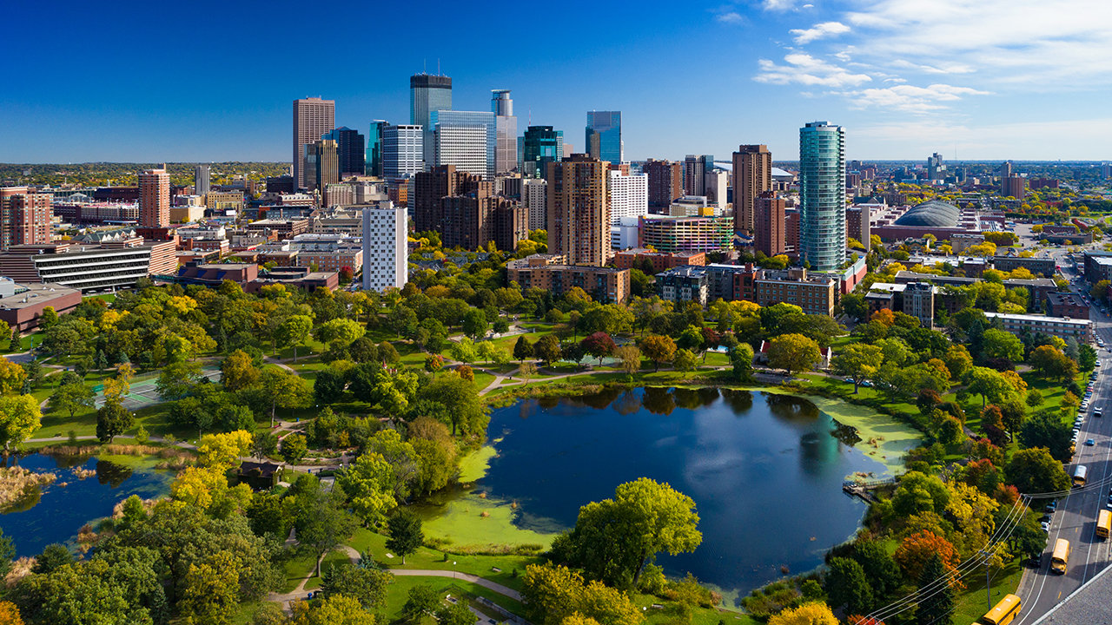
10th Workshop of the APS Topical Group on Hadronic Physics April 12-14, 2023 Minneapolis

Slide 4
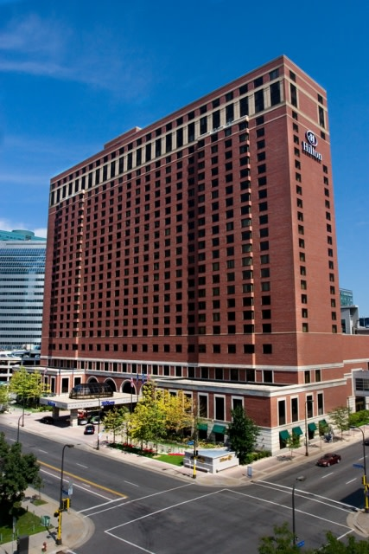
10th Workshop of the APS Topical Group on Hadronic Physics April 12-14, 2023 Hilton Hotel, Minneapolis
Save the date
Join GHP (or continue your membership)
Volunteer to help organize it
I, along with the vice chair elected this year, will chair the meeting. Contact me julia.velkovska@vanderbilt.edu
We are looking forward to welcoming you in person !

