Slide 1
Perspectives from DOE Nuclear Physics
Business Meeting of the 9th Workshop of the APS Topical Group on Hadronic Physics (GHP)
April 15, 2021

Slide 2
Budget Matters

Slide 3
Summary of 2021 Enacted Relative to FY 2020
Total, NP | 651,500 | 635,000 | -16,500
Total, NP Appropriation | 713,000 | 713,000 | -
FY 2020 Enacted | FY 2021 Enacted
Core Research reduced 5.5% from FY19 Enacted (including COL, this is a 7.4% cut from constant effort in FY19). New ECA awards were made. | Core research reduced 3.75% from FY20 Enacted. This reduction also includes a reduced number of new ECA awards in FY21.
LHC M&O commitments were met. | LHC M&O commitments met but subject to the research cut.
FRIB Research was supported as planned. | FRIB Research is reduced by 3.75% from FY20; planned ramp-up is not supported.
nEDM supported modestly below planned profile. | nEDM supported below planned profile, possibly impacting schedule.
SciDAC maintained relative to FY 2019 | SciDAC supported but subject to the research cut.
Nuclear Data held flat with FY19 Enacted | Nuclear Data research funds subject to the research cut. Experimental commitments met, but limited funding is available for new awards.
NP QIS at $6.8M (NP QIS flat with FY2019) | NP QIS at $9.5M, an increase of $2.7M from FY2020
Accelerator R&D was increased | Accelerator R&D is reduced by $1M beyond 3.75% cut.
Machine Learning/Artificial Intelligence awards were initiated through the SC ML/AI FOA. | The new ML/AI Initiative is supported with $4M of dedicated funds.

Slide 4
Summary of 2021 Enacted Relative to FY 2020
FY 2020 Enacted | FY 2021 Enacted
Facility operations at constant effort RHIC operates 28 weeks (100 % optimal) CEBAF operates 22.5 weeks (100 % maximum) ATLAS operates 41 weeks (90 % optimal) | Facilities operations funding is reduced by 3.75%. Estimated run times are: RHIC operates 24 weeks (100 % maximum) CEBAF operates 7 weeks (41 % maximum) ATLAS operates 39 weeks (92.6 % optimal)
FRIB operations supported at planned level $28.5M | FRIB ops supported slightly below planned levels ($50M vs $59.8M)
FRIB construction at baselined $40M | FRIB construction at baselined $5.3M
EIC construction at TEC of $1M and OPC of $10M | EIC construction at TEC of $5M and OPC of $24.65M
Ongoing Major Item of Equipment: GRETA reduced below planned levels ($6.6M) sPHENIX at planned baseline level ($9.52M) - SIPF at planned baseline level ($1.5M) | Ongoing Major Item of Equipment: GRETA flat with FY2020, below baselined level ($6.6M) sPHENIX at baseline level ($5.53M)
New Major Items of Equipment initiated - MOLLER at $2M TEC TSNLDBD at $1M TEC HRS at $1M TEC | Major Items of Equipment initiated in FY 2020 - MOLLER increased to $5M, but below planned level TSNLDBD at $1.4M TEC HRS at $3M TEC
Isotope Program at $60.5M | Isotope Program at $78M

Slide 5


The 2015 Long Range Plan for Nuclear Science
Recommendations:
Capitalize on investments made to maintain U.S. leadership in nuclear science.
Develop and deploy a U.S.-led ton-scale neutrino-less double beta decay experiment.
Construct a high-energy high-luminosity polarized electron-ion collider (EIC) as the highest priority for new construction following the completion of FRIB.
Increase investment in small-scale and mid-scale projects and initiatives that enable forefront research at universities and laboratories.
NP continues to execute on the 2015 LRP Vision

Slide 6
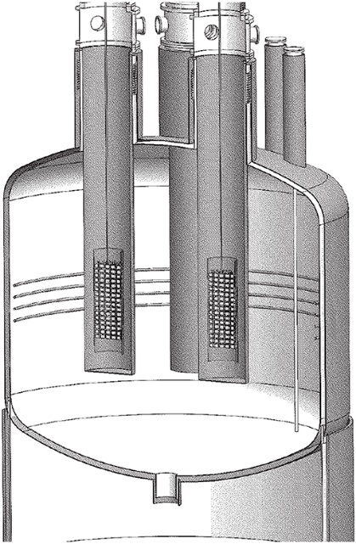
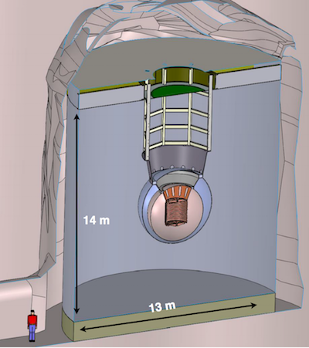
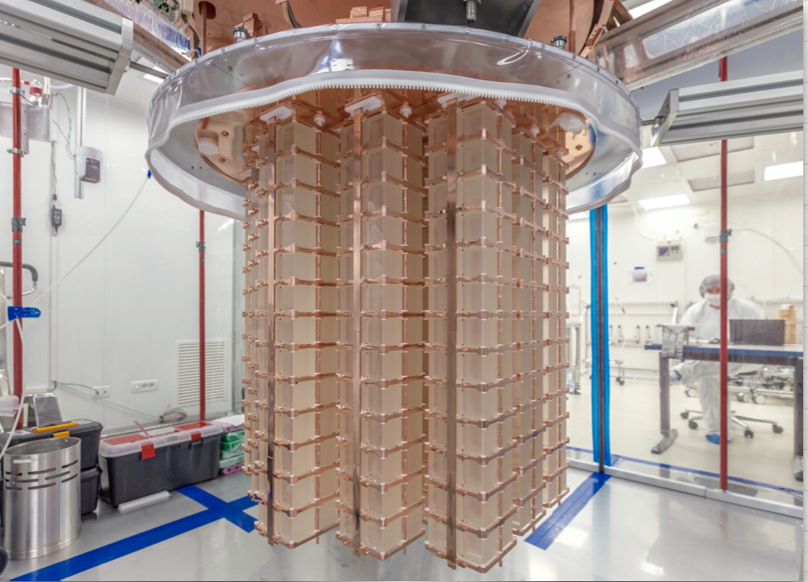
Upcoming Decisions on Neutrino-less Double Beta Decay
Three Front-Runner Technologies
Scintillating bolometry (CUPID, ¹⁰⁰ Mo enriched Li₂Mo₄ crystals)
Enriched ⁷⁶Ge crystals (LEGEND-1000, drifted charge, point contact detectors )
Liquid Xenon TPC (nEXO, light via APD, drifted ionization)
Background constraints are exceptionally challenging < 1 count/ton of material/year
Also, must choose between possible sites
SURF (SD)
SnoLab (Canada)
Gran Sasso (Italy)
CUPID
nEXO
LEGEND

Slide 7
0νββ Progression
Monthly Technical Updates with LEGEND-100, nEXO, and CUPID
Ongoing interactions with potential international collaborators to introduce U.S. perspectives, hear European perspectives, and suggest a global approach to investment in DBD science
DBD Portfolio Review will be held July 13-16, 2021 to inform U.S. investment strategy. Instructions published by April 15, 2021.
North American – European Summit will be held September 27-29, 2021 to see if common ground exists for an international approach to DBD investment
Funding for ton-scale 0νββ is going to be challenging

Slide 8
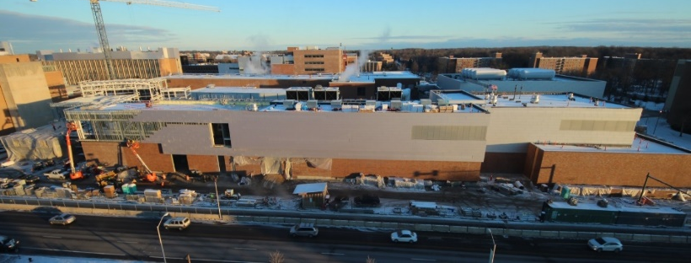
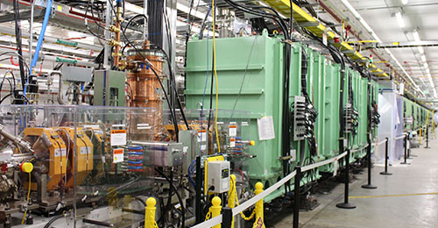
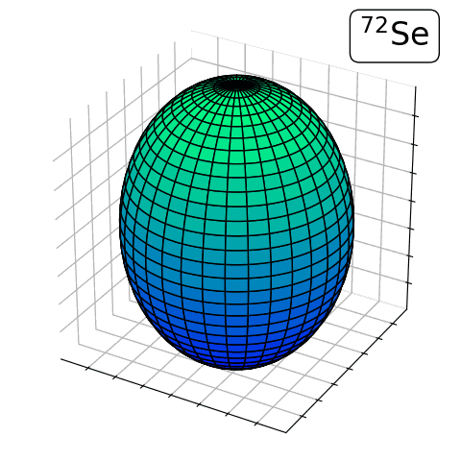
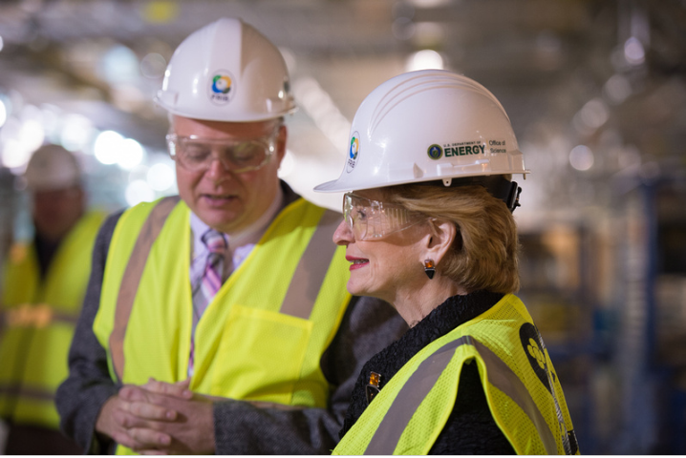
The Next Super High Current, Low Energy Microscope:
The Facility for Rare Isotope Beams (>96% Complete)
FRIB will increase the number of known isotopes from ~2,000 to ~5,000 and will enable world-leading research on:
Nuclear Structure
  The limits of existence for nuclei
  Nuclei that have neutron skins
  Synthesis of super heavy elements
Nuclear Astrophysics
  The origin of the heavy elements and explosive nucleo-synthesis
  Composition of neutron star crusts
Fundamental Symmetries
  Tests of fundamental symmetries,
  Atomic EDMs, Weak Charge
 | PYs | FY 2017 | FY 2018 | FY 2019 | FY 2020 | FY 2021 | DOE Total | MSU | TOTAL
FUNDING PROFILE | 318,000 | 100,000 | 97,200 | 75,000 | 40,000 | 5,300 | 635,500 | 94,500 | 730,000

Slide 9
FRIB Status
FRIB is approximately 96% complete and continues on cost and schedule, with a target early completion of December 2021.
FRIB will receive its final construction funding of $5.3M in FY 2021
The Gamma Ray Energy Tracking Array (GRETA) Major Item of Equipment (MIE) and the High Rigidity Spectrometer (HRS), both are included in the FY 2021 appropriation
The FY2021 appropriation includes $50M for FRIB operations.
In preparation for early science, the FRIB Directorate recently issued a call for proposals to its 1500 member user group.
In response to the call, 82 proposals from 130 institutions in 30 countries were received requesting 9,784 hours of beam time
A first FRIB Program Advisory Committee Meeting to advise on proposal selection will be held in May 2021.

Slide 10
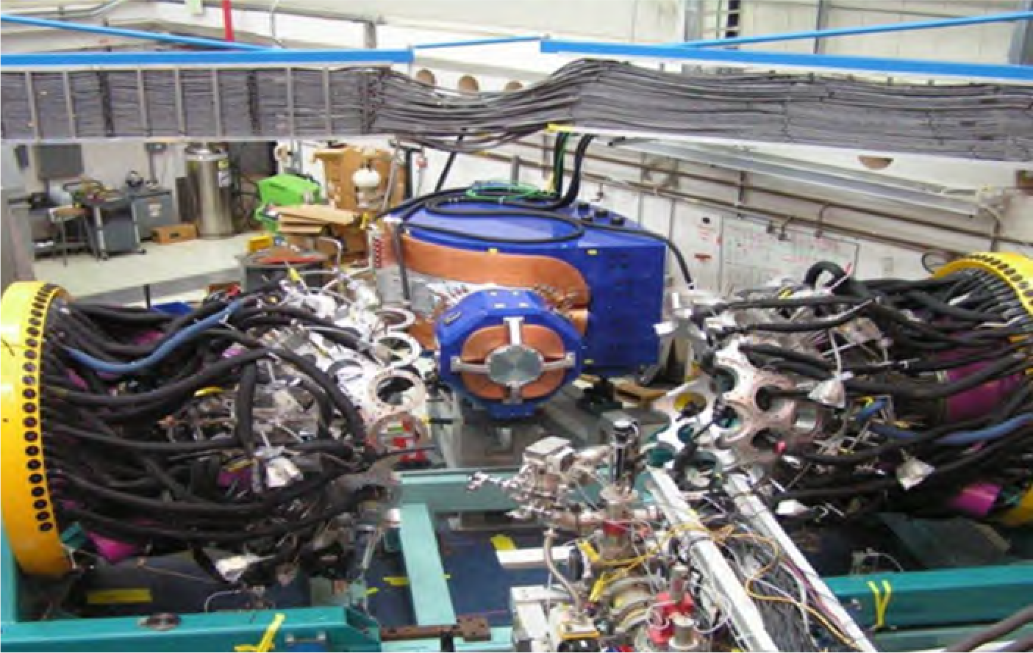
ATLAS Continues as a Premier Stable Beam Facility

Slide 11


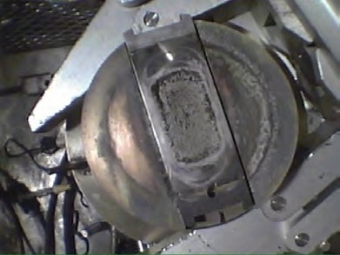
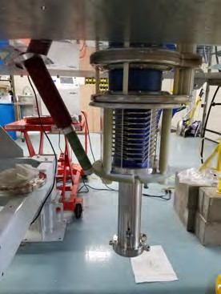
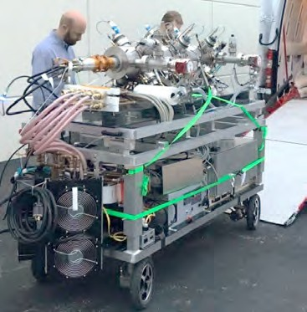


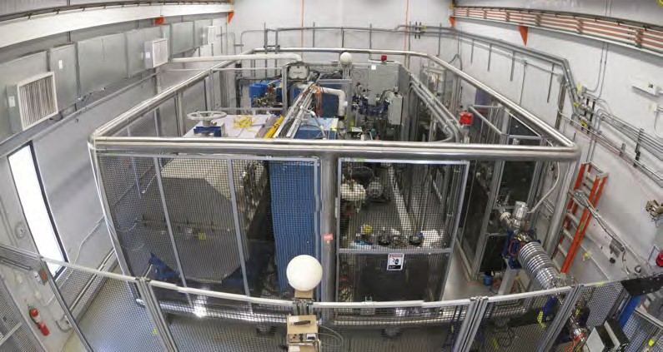
NEUTRON GENERATOR UPGRADE
Replace ²⁵²Cf source by neutron-induced fission on actinide foils
  More reliable source of fission products
  Operationally easier to maintain and operate
  Higher fission yield feeding in the ¹³²Sn region
OR
25

Slide 12


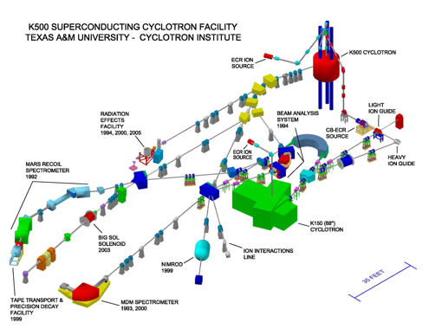
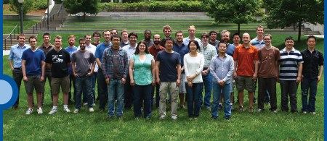

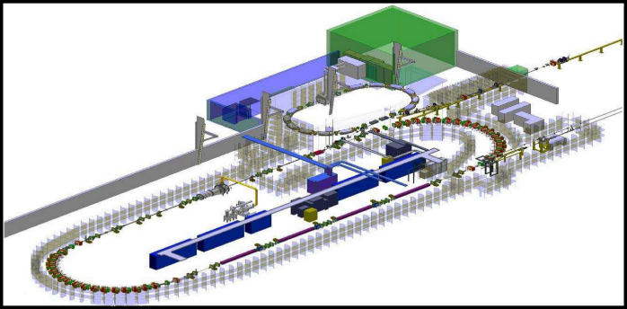
Two NP Centers of Excellence at TUNL and Texas A&M
The Triangle Universities Nuclear Laboratory (TUNL) is Center of Excellence that focuses on low-energy nuclear physics research. TUNL is a consortium Duke University, North Carolina State University, and the University of North Carolina at Chapel Hill comprising about 30 faculty members, 20 postdocs and research scientists, and 50 graduate students.
The Texas A&M University Cyclotron Institute jointly supported by DOE and the State of Texas focuses on conducting basic research, educating students in accelerator-based science and technology, and providing technical capabilities for a wide variety of applications in space science, materials science, analytical procedures and nuclear medicine.
The 88 inch cyclotron also plays a crucial role in space radiation effects chip testing for the Air Force

Slide 13


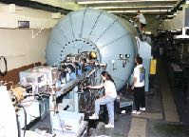
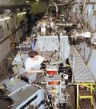
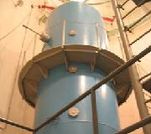
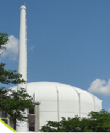
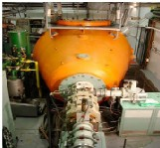
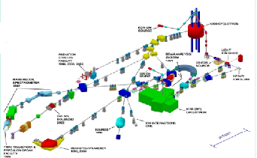
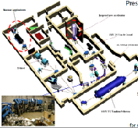
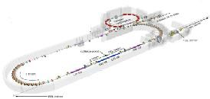

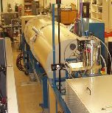
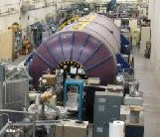
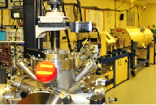

http://aruna.physics.fsu.edu
ARUNA-
10 members
~200 users
Association for Research at
University Nuclear Accelerators
FSU
John D. Fox Laboratory
U.Kentucky Accelerator
Ohio U Edwards Lab
U Mass Rad Lab
Texas A&M U. Cyclotron Lab.
Notre Dame Univ. ISNAP facilities
TUNL
HIGS
TUNL
Hope College
LENA
U of Washington CENPA
Ion Beam La
TUNL
Union College Ion Beam Lab
Tandem Lab

Slide 14
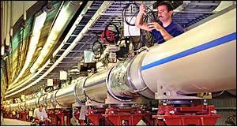
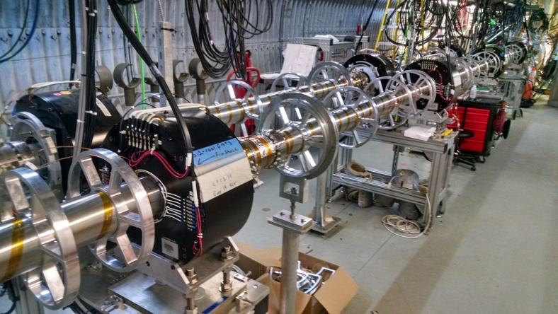
RHIC Machine Performance Continues to Set New Records
The continued focus at RHIC: search for a critical point between the phases of nuclear matter
LEReC
Cooling of low energy, bunched heavy ion beams (3.85–5.75 GeV/n) to increase luminosity
Project on track for use in low-energy RHIC runs
Consistently high facility availability (~85%)
No other facility worldwide, existing or planned, rivals RHIC in science reach and versatility as a heavy ion collider. It is the only polarized proton collider in the world.

Slide 15
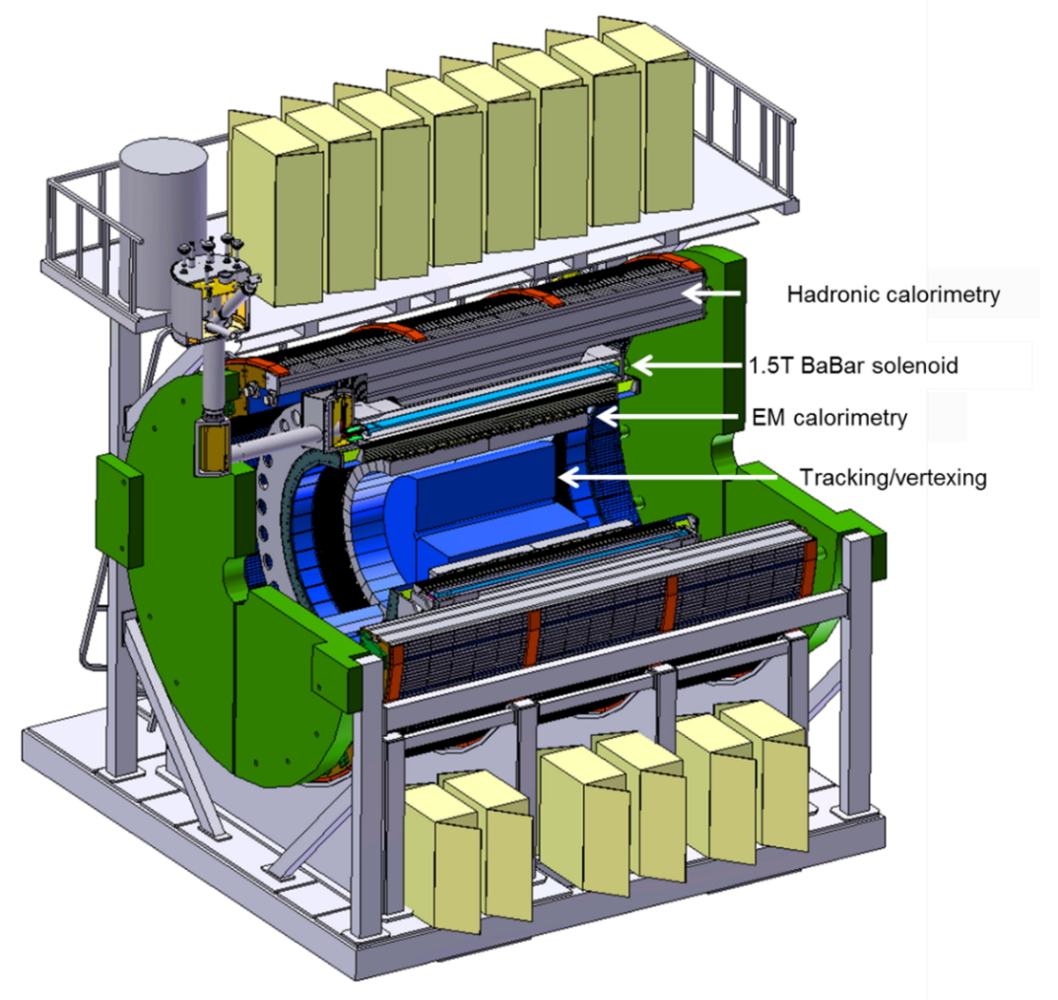
The sPHENIX Upgrade is Nears Completion
mapping the character of the hadronic matter under extreme conditions by varying the temperature of the medium, the virtuality of the probe, and the length scale within the medium.
understanding the parton–medium interactions by studying heavy-flavor jets.
probing the effect of the quark–gluon plasma on the Upsilon states by comparing the p-p (proton-proton), p-A (proton-nucleus), and A-A (nucleus-nucleus) collisions.
implemented from within RHIC base by limiting operations to one detector and periodically not operating facility.

Slide 16
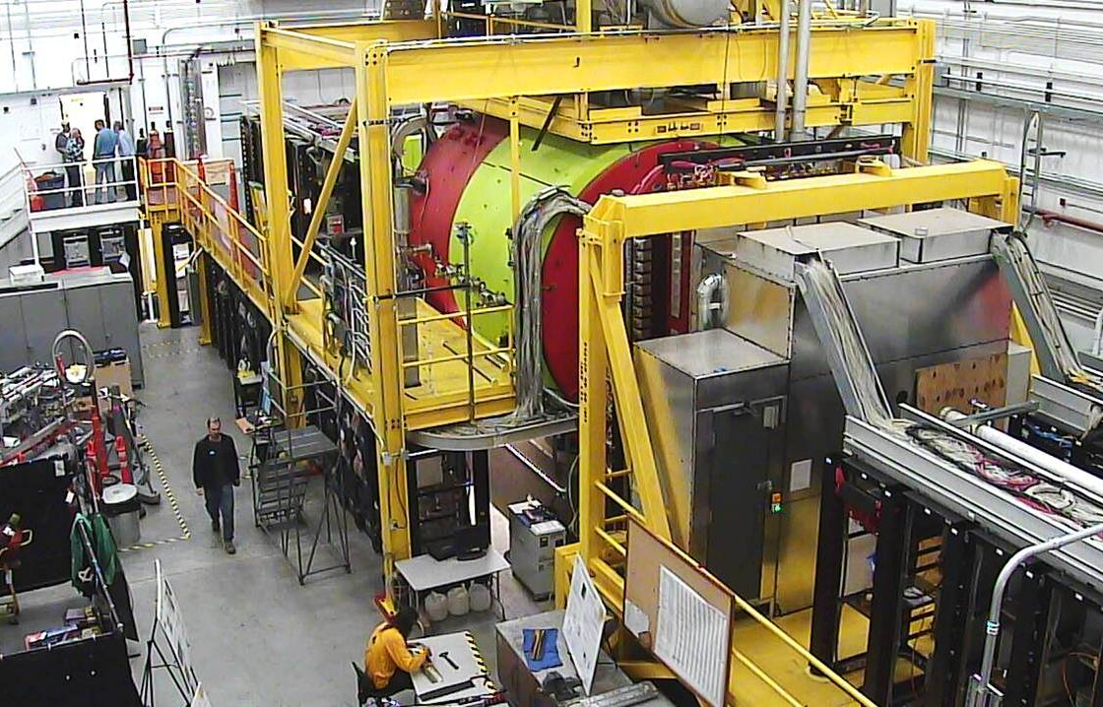
12 GeV CEBAF Science Program Continues
CEBAF Weeks Capped by CHL Install in FY21
New results from GlueX illuminate the mechanism of threshold J/Psi production and the upper limit on the pentaquark. The latter provides constraints on the structure of the LHCb pentaquark, favoring a molecular description.
Phys. Rev. Lett. 123, 072001(2019)
(Based on ~25% of collected data.)

Slide 17
New P-REX Results Unblinded !
The weak radius can be combined with the well-known charge density to obtain the baryon density of 208Pb
This is the first clean determination of the central baryon density of a heavy nucleus and is accurate to 2%
Provides an important benchmark to chiral EFT calculations that is closely related to nuclear saturation density
Result has direct relevance for bounding the radius of neutron stars in concert with neutron star merger data from LIGO
Rn-Rp[fm]

Slide 18
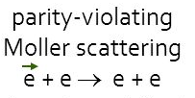
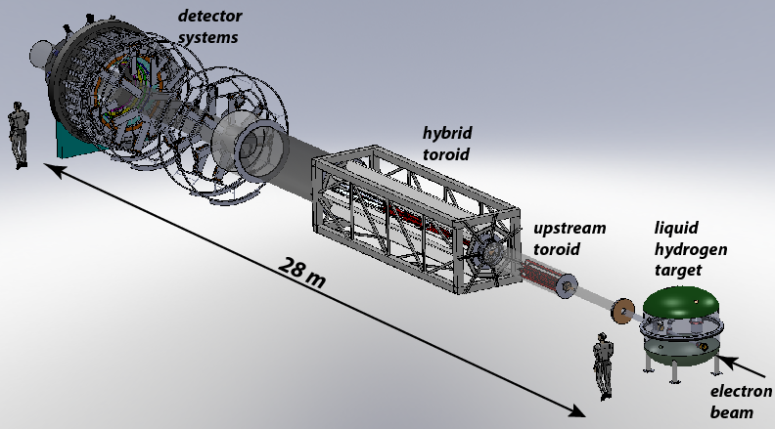
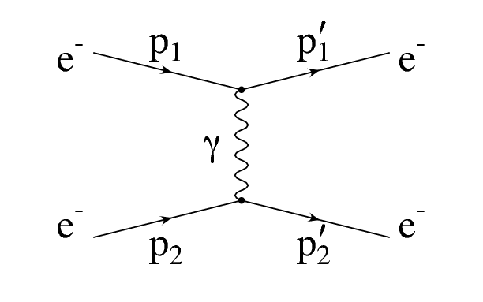
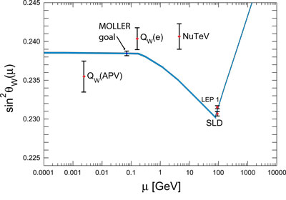
MOLLER: a “Must Do” Experiment To Point the Way to New Science
The scientific world rather desperately needs additional markers due to the consistency thus far of LHC data with Standard Model Predictions. Due to the technical challenge of constructing a next generation accelerator with very high accelerating gradients, those markers will have to come from “indirect” discovery experiments like MOLLER.
Z
In MOLLER, polarized electrons are scattered of unpolarized electrons. The amount of parity violation due to interference of the two possible exchange mechanisms (γ or Z) is precisely predictable in QED. (No messy quarks or color charge, or QCD to worry about, only quantum electrodynamics). The theory is so “clean” that like the g-2 approach, If the level of parity violation is greater than expected, a new particle must be the source of the discrepancy.
Projected sensitivity to Standard Model prediction
Project at CD-1, FY 2021 Enacted: $5M
SoLID Science Review is Underway

Slide 19
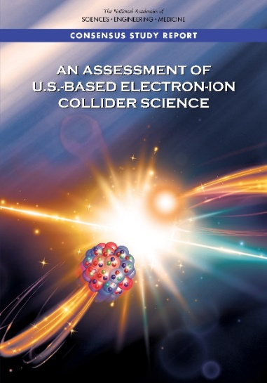
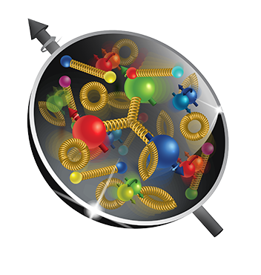
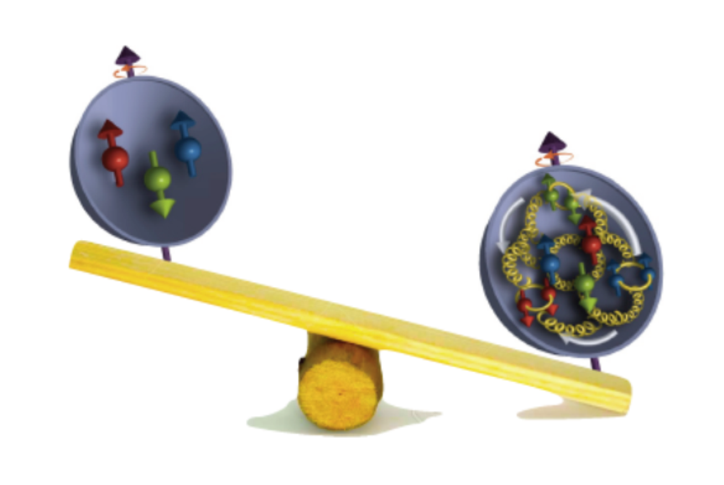
The Next Super High Power, High Energy Microscope:
The Electron-Ion Collider
National Academy of Science Report: AN ASSESSMENT OF U.S.-BASED ELECTRON-ION COLLIDER SCIENCE
“An EIC can uniquely address three profound questions
About nucleons—neutrons and protons—and how they
are assembled to form the nuclei of atoms:
• How does the mass of the nucleon arise?
• How does the spin of the nucleon arise?
• What are the emergent properties of dense systems of gluons?”
The EIC would be a unique facility & maintain leadership in nuclear science
The EIC would maintain leadership in the accelerator science and technology of colliders

Slide 20

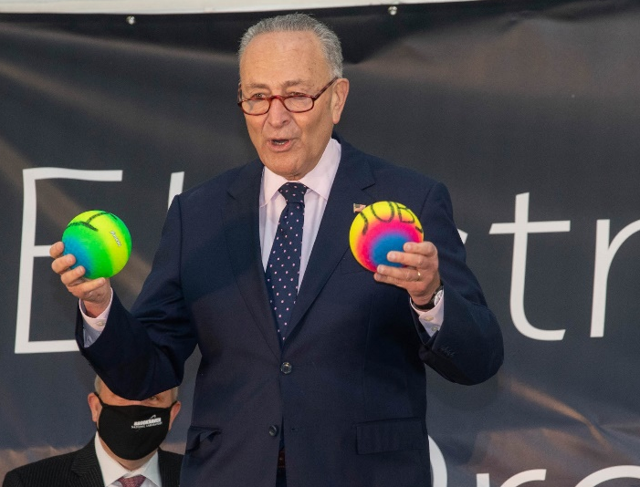
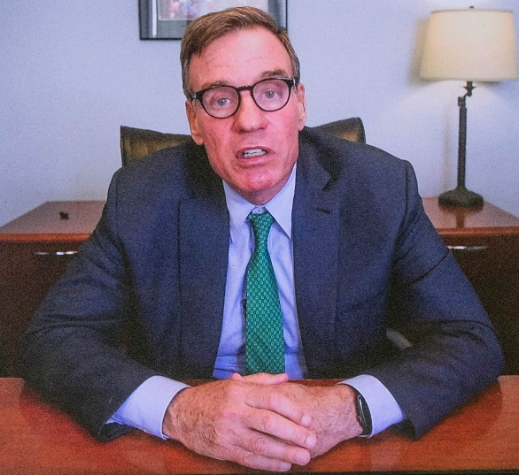
EIC CD-0, Site Selection, Project Start & Dedication in FY20
The EIC will be located at BNL and with TJNAF as a major partner. The realization of the EIC will be accomplished over the next decade at an estimated cost between $1.7 and $2.8 billion.
Utilize existing operational hadron collider; add electron storage ring, cooling in existing RHIC tunnel and electron injector.
EIC scope includes the machine upgrade to RHIC asset and two interactions regions with one of the interaction regions outfitted with a major detector. Working towards CD-1 in Q3 FY 2021
EIC Dedication September 18, 2020
The EIC will be a game-changing resource for the international nuclear physics community. DOE looks forward to engaging with the international community and the international funding agencies about potential collaborations and contributions to the EIC effort, in nuclear, accelerator and computer science.

Slide 21
The convergence of the Electron Ion Collider “Microscope” and the prospect of error corrected Quantum Computing is exceptionally exciting.
NP is contributing to the development of both

Slide 22
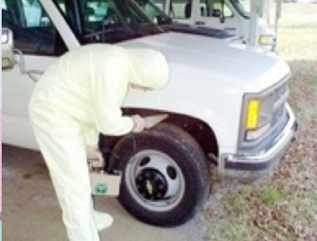
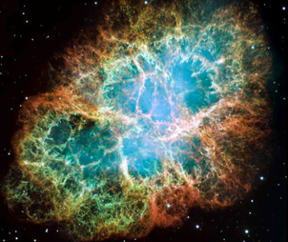
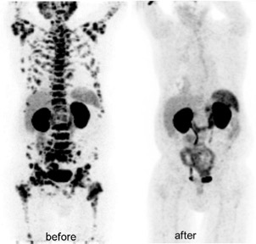
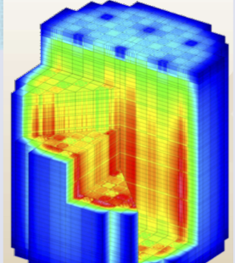
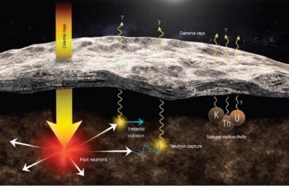
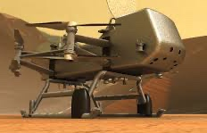
Many types of nuclear data are “crosscutting” to numerous applications
New & Traditional Frontiers Requiring Accurate Nuclear Data
Nonproliferation
Astrophysics
Materials Damage
Nuclear Data
Medicine
Energy
Elemental ID in Space Exploration
Gamma-rays
Cosmic rays
Fast neutrons
Natural
Radioactivity
NP Leads a Nuclear Data Interagency Working Group (NDIAWG) that has published 4 FOAs
Notes:
Replace figures as appropriate

Slide 23

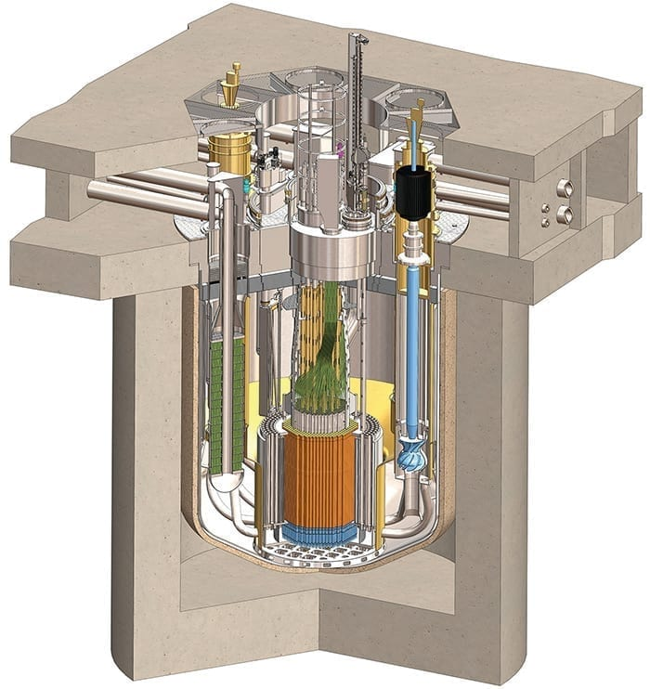
Next generation reactors use faster neutrons, different fuels, and coolants to achieve greater safety and modularity
In Support of Clean Energy Goals
$$neutron$$
$$multiplication$$
$$factor$$
Terrapower
$$Thermal$$
$$fision$$
$$factor$$
$$Thermal$$
$$Non−leakage$$
$$factor$$
$$Fast$$
$$Non−leakage$$
$$factor$$
$$Thermal$$
$$utilization$$
$$factor$$
$$Resonance$$
$$escape$$
$$factor$$
$$Fast$$
$$fission$$
$$factor$$
Kairos FHR
Non-existent or uncertain Nuclear Data needs to be redressed for new materials and fuels in order to correctly understand/model the neutronics in new designs at a high level of confidence
MCFR (Cl)
TRISO Pebble Fuel (U,C,Si)
Molten Salt Coolant
(Flibe)
https://nucleardata.berkeley.edu
SMR (Na)

Slide 24
Nuclear Data & Space Nuclear Propulsion
Presented to: Workshop on Applied Nuclear Data Activities (WANDA) 2021
Space Technology Mission Directorate
Technology Demonstration Mission Program
Space Nuclear Propulsion Project
Kelsa Palomares, AMA Inc. | January 25, 2020

Slide 25
Progress is Ongoing in Quantum Information Science

Slide 26
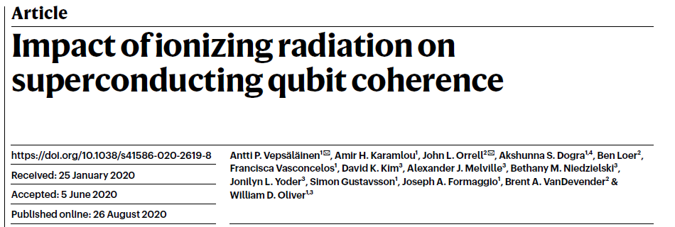
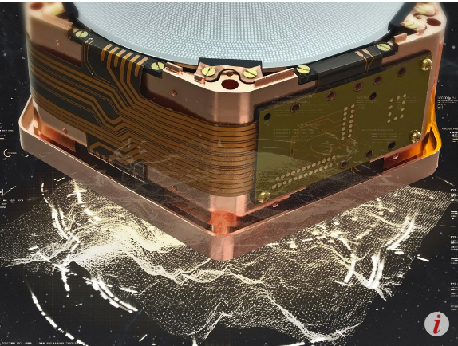
A Landmark Study Published in Journal Nature
Naturally occurring radiation produced by environmental radioactive materials and cosmic rays is enough to limit the useful lifetime of superconducting qubit state to just a few milliseconds… Identifying ionizing radiation as a dominant source of excess quasiparticles… is a first step towards developing to mitigate its impact on superconducting circuits, including those used for quantum computation and quantum sensing.
Popular press coverage: PNNL “Natural Radiation Can Interfere with Quantum Computers “and MIT Technology Review “Cosmic rays could pose a problem for future quantum computers “ https://www.pnnl.gov/news-media/natural-radiation-can-interfere-quantum-computers
https://www.technologyreview.com/2020/08/26/1007688/cosmic-rays-could-pose-a-problem-for-future-quantum-computers/
Independent, Future of Quantum Computing Could Be Disrupted by Space
https://www.independent.co.uk/life-style/gadgets-and-tech/news/quantum-computer-cosmic-rays-radiation-space-a9689946.html
The Vice, Particles From Space Are Messing With Our Quantum Computers, Scientists Discover
https://www.vice.com/en_us/article/wxqy5x/particles-from-space-are-messing-with-our-quantum-computers-scientists-discover
New Scientist, Quantum computers may be destroyed by high-energy particles from space
https://www.newscientist.com/article/2252933-quantum-computers-may-be-destroyed-by-high-energy-particles-from-space/
“Natural Radiation Can Interfere with Quantum Computers”

Slide 27
Research Traineeships to Broaden and Diversify the NP Workforce
NP Pilot: Research Traineeships to Broaden and Diversify the NP Workforce
In 2019, 88 NP-supported students received their Ph.D.’s. Only 5% were Black or Hispanic, nearly a factor of 7 below representation in the US population. The goal of the pilot is to increase minority community’s access to existing research infrastructure and expertise and thereby increase participation.
Research groups from National Labs and Universities, leveraging existing infrastructure, will work with MSIs to provide training and mentorship for undergraduates.
Extended duration traineeships will provide financial and mentoring support during the summer and academic year and may extend after graduation for up to one “gap” year.
Designed to remove barriers to graduate school and to fulfill several key recommendations of the recent AIP TEAM-UP Report:
Increasing a sense of belonging
Facilitating the development of a physics identity, and
Providing support to help students advance academically while earning money

Slide 28
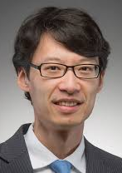

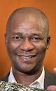













NP Pilot FOA on Diversity: Varied Expertise and Backgrounds
Mentoring, Diversity & Inclusion, MSI/HBCU, Undergrad Research, Nuclear Physics
Tan Ahn (Notre Dame, Nuclear Experiment, Experienced Undergrad Mentor)
Stephon Alexander (Brown, Cosmology Theory, Author, National Society of Black Physicists)
Ketevi Assamagan (BNL ATLAS Experiment, NSBP, Outstanding Mentor Award, co-founder of African School of Physics)
Brian Beckford (DOE, HEP Intensity Frontier Program Manager, AIP Team-up Task Force)
Tommy Boykin II (UMD, Condensed Matter Exp., APS Bridge Program Grad, Inclusive Grad. Ed. Network Advisory Board)
Jason Detwiler (UW Nuclear Experiment, Early Career Award, Physics Dept. Mentoring Award, Breakthrough Prize)
Paul DeYoung (Hope College, APS Outstanding Research and Mentoring at an Undergrad Inst.)
Evangeline Downie (GWU, Nuclear Experiment, Muse, Committee on the Status of Women in Physics)
Renee Fatemi (UK, Nuclear Experiment, STAR, g-2, Excellent Undergraduate Research Mentor Award)
Roy Lacey (Stony Brook, Chemistry Dept., Nuclear Experiment, STAR, AAPT, NSTA)
Dina Myers-Stroud (Executive Director Fisk-Vanderbilt Bridge Program)
Jesus Pando (DePaul U, Nuclear Experiment, National Society of Hispanic Physicists, SACNAS)
Diana Parno (Carnegie Mellon, Nuclear Experiment, Organizer LGBT+ Physicists advocacy group, Best Practices Guide)
Carol Scarlett (Florida A&M, Nuclear Theory, Axion Tech LLC.)
Yolanda Small (York College/CUNY, Theoretical Chemist, Chair Undergraduate Research Symposium)
Daniel Tapia Takaki (Kansas, Nuclear Experiment, ALICE and CMS Collaborations)
36 proposals to create collaborations with ~40 MSIs and HBCU’s submitted

Slide 29
Additional NP DOE FOAs
FOA/Lab Call | Nuclear Data Interagency Working Group Research Program
FOA/Lab Call | Quantum Horizons: QIS Research and Innovation for Nuclear Science
FOA/Lab Call | Pilot Program for Traineeships to Broaden and Diversify the NP Workforce
FOA/Lab Call | Data Analytic for Autonomous Optimization and Control of Accelerators and Detectors

Slide 30
Other News Items
New Staff in DOE NP
  Xiaofeng Guo Nuclear Physics Computing
  Ivan Graff Nuclear Physics Major Initiatives
  Kenneth Hicks (IPA) Heavy Ion
  Paul Mantica (IPA) Technical Advisory/Facilities & Project Management Division
  Melissa Emerson (CONTR) Administrative Specialist
  Saryna Cameron (CONTR) Program Support Specialist
George Fai has retired
Richard Witt has returned to USNA (Hicks HI, Farkhondeh ECA)
New FOAs contemplated in QIS, Nuclear Data, Accelerator R&D, Traineeships to Broaden and Diversify

Slide 31
Office of Nuclear Physics
Associate Director’s Office Staff
Brian Knesel, Financial Management Specialist
VACANT, Financial Management Analyst
Linnette Quick, Program Assistant (CONTR)
Brenda May, Program Analyst
VACANT, International Cooperation and Outreach
Timothy J. Hallman, Associate Director
Melissa Emerson, Administrative Specialist (CONTR)
Physics Research Division
VACANT, Director
Christine Izzo, Program Support Specialist
Facilities & Project Management Division
Jehanne Gillo, Director
Saryna Cameron, Program Support Specialist (CONTR)
Paul Mantica (IPA), Technical Advisor
Latifa Elouadrhiri (Detailee)
Medium Energy & Quantum Information Science
Gulshan Rai, Technical Advisor
Heavy Ion Nuclear Physics
VACANT
Kenneth Hicks (IPA)
Advanced Technology R&D
Manouchehr Farkhondeh, Deputy
Nuclear Structure and Astrophysics
Sharon Stephenson
Nuclear Physics Facilities
James Sowinski
Nuclear Theory
VACANT
Nuclear Physics Major Initiatives
Ivan Graff
Nuclear Data
Keith Jankowski
Nuclear Physics Instrumentation
Elizabeth Bartosz
Fundamental Symmetries
Paul Sorensen
Industrial Concepts
Michelle Shinn
(IPA) – Intergovernmental Personnel Act
Nuclear Physics Computing
Xiaofeng Guo

Slide 32






Overall, Progress in Implementing the LRP Has Been Good
RHIC
JLAB
Hall B
The vision to maintain U.S. leadership continues to be implemented: EIC construction; FRIB construction
ATLAS
At ANL
FRIB
World leading research supported at state-of-the-art NP National User Facilities
Pioneering experiments and research tools (MIEs) are created
Groundbreaking contributions to national cross-cutting priorities continue
FRIB
Underground Double Beta Decay Research

Slide 33
General Outlook
The experience with FY18 and FY19 budgets maybe similar in the next budget cycle.
We need to stay focused and continue to deliver important outcomes for the nation.
Delivering exciting discoveries, important scientific knowledge, technological advances, and workforce training is what we do.
We need to keep up the good work!

Slide 34

A Long Tradition of Partnership and Stewardship
There has been a long tradition in Nuclear Science of effective partnership between the community and the agencies in charting compelling scientific visions for the future of nuclear science.
Key factors:
Informed scientific knowledge as the basis for recommendations and next steps
Mutual respect among scientific sub-disciplines
Commitment to the greater good of nuclear science as a discipline
Meticulously level playing field leading to respect for process and outcomes
Deep appreciation for the wisdom of Ben Franklin
Staying united we can accomplish great things together
Division will setback the entire field and is the last thing needed right now

Slide 35
Additional Information

Slide 36



Science-Driven Project Requirements
Project Design Goals
High Luminosity: L= 10³³ – 10³⁴cm⁻²sec⁻¹, 10 – 100 fb⁻¹/year
Highly Polarized Beams: 70%
Large Center of Mass Energy Range: E_{cm} = 20 – 140 GeV
Large Ion Species Range: protons – Uranium
Large Detector Acceptance and
Good Background Conditions
Accommodate a Second Interaction Region (IR)
Conceptual design scope and expected performance meets or exceed NSAC Long Range Plan (2015) and the EIC White Paper requirements endorsed by NAS (2018)
These challenging performance goals require a machine that is state-of-the-art

Slide 37
Mo-99 Charge Letter

Slide 38
Mo-99 Charge Letter

Slide 39
Mo-99 Charge Letter

Slide 40


CUORE: Towards Ton-scale NLDBD Search
Phys.Rev.Lett. 124, 122501 (2020)
Collected TeO2 exposure: 1110 kg*year
Analyzable exposure: 1031 kg*year (*as of Oct 26, 2020)
>1 ton*year analyzable exposure
Largest dataset ever collected by a solid-state double-beta decay experiment
Continuous operations at 11mK since March 2019
Demonstrates readiness for a ton-scale bolometric double-beta decay experiment
CUPID proceeding to technical design

Slide 41



LEGEND-1000
The concept for LEGEND-1000 showing a number of the deployments Ge detectors. This cut-away view shows three of five 200-kg groupings of Ge.
Majorana Demonstrator
+
GERDA

Slide 42

nEXO Concept
Artist rendering of the nEXO TPC (left) and its installation at the SNOLAB cryopit (left).
The cryostat is submerged in a water tank which acts as active shielding. SiPMs will be mounted between field shaping rings and detector wall.
EXO 200

Slide 43



1,500 Users Engaged and Ready for Science fribusers.org
Users organized as part of independent FRIB Users Organization (FRIBUO)
  Chartered organization with an elected executive committee
  1,500 members (121 U.S. colleges and universities, 13 national laboratories, 53 countries) as of 31 August 2020
  19 working groups on instruments
On track for first experiments
  May 2020: FRIB First Experiments - Proposal Preparation workshop (1)
  Nov 2020: FRIB First Experiments - Proposal Preparation workshop (2)
  Dec 2020: Call for Proposals
  May 2021: FRIB Program Advisory Committee (PAC 1)
  Early 2022: first user experiments
User needs and high user satisfaction are important to FRIB
  ISO 9001 quality systems to assess user satisfaction
Annual meetings
  User meeting (three days with 200-300 participants)
» Most recent meeting August 2020 (online)
First Physics Spring of 2022

Slide 44




























Office of Science User Facilities
Number of User Facilities
28
ALCF
OLCF
ESnet
EMSL
ARM
JGI
NERSC
SSRL
ALS
LCLS
NSLS-II
TMF
APS
FACET II
CFN
CINT
CNM
CNMS
SNS
HFIR
DIII-D
NSTX-U
Fermilab AC
RHIC
ATLAS
CEBAF
ATF
FRIB

Slide 45


EIC User Community
EIC Users Group Formed in 2016
EICUG.ORG
Status February 2021:
Collaborators 1259
Institutions 252
Countries 34
Annual EICUG meeting
2016 UC Berkeley, CA
2016 Argonne, IL
2017 Trieste, Italy
2018 Washington, DC
2019 Paris, France
2020 Miami, FL
2021 Warsaw, Poland

