Slide 1
Error Mitigation in Quantum Computers Through Classical Bit-Flip Correction
Lena Funcke
GHP2021, Quantum Information Science and Hadron Physics

Slide 2
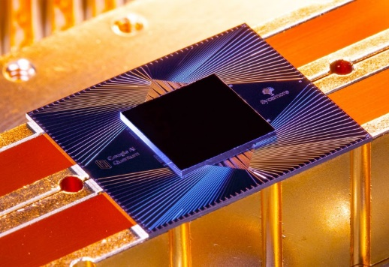
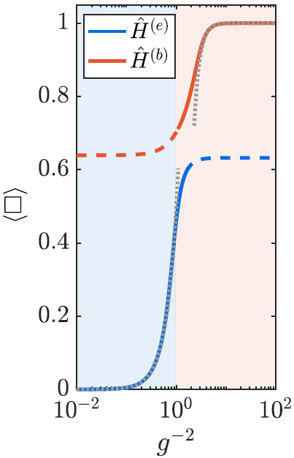
State of the art: quantum computing
NISQ devices: outperformed classical devices
platforms: superconducting qubits, trapped ions, …
Hardware
collider physics: jet clustering, particle tracking, …
nuclear and particle physics: lattice QFT, …
(Arute et al., 2019)
Applications
noise: large measurement and gate errors
mitigation: exponentially costly for measurement errors
Problems
(Paulson, …, Jansen, Zoller, Muschik, 2020)

Slide 3
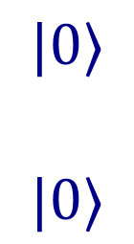
Measurement error mitigation
mitigate bit-flip errors during readout: $0\underset{→}{{ p}_{0 }}1$ or $1\underset{→}{{ p}_{1 }}0$
replace operators by noisy operators incorporating bit-flip noise: $\left\langle \tilde{ψ}\left|O\right|\tilde{ψ}\right\rangle →\left\langle ψ\left|\tilde{O}\right|ψ\right\rangle$
Goal
$$|ψ⟩$$
$$|\tilde{ψ}⟩$$
Example
Ff
ff
Ff
ff
errors:
$$0.1\%−0.3\%$$
$$0.3\%−5\%$$
$$1\%−30\%$$
Ff
ff

Slide 4
Measurement error mitigation
mitigate bit-flip errors during readout: $0\underset{→}{{ p}_{0 }}1$ or $1\underset{→}{{ p}_{1 }}0$
Z̃ $=\left(1−p_{0}\right)\left(1−p_{1}\right)Z+p_{0}p_{1}\left(−Z\right)+p_{0}(1−p_{1})\left(−𝕀\right)+\left(1−p_{0}\right)p_{1}𝕀$
mitigate bit-flip errors during readout: $0\underset{→}{{ p}_{0 }}1$ or $1\underset{→}{{ p}_{1 }}0$
replace operators by noisy operators incorporating bit-flip noise: $\left\langle \tilde{ψ}\left|O\right|\tilde{ψ}\right\rangle →\left\langle ψ\left|\tilde{O}\right|ψ\right\rangle$
Goal
$→Z_{mit.}=\frac{1}{1−p_{0}−p_{1}}$ Z̃ $− \frac{p_{1}−p_{0}}{1−p_{0}−p_{1}}𝕀$
Readout | Bit Flips | Probability | Noisy Operator
correct | $0→0$, $1→1$ | $$(1−p_{0})(1−p_{1})$$ | Z̃ $=Z=\left(\begin{matrix}1 & 0 \\ 0 & −1\end{matrix}\right)$
incorrect … for both outcomes | $0→1$, $1→0$ | $$p_{0}p_{1}$$ | $\text{Z}\text{̃ }\text{=}−$Z $=\left(\begin{matrix}−1 & 0 \\ 0 & 1\end{matrix}\right)$
… for outcome $0$ | $0→1,$ $1→1$ | $$p_{0}(1−p_{1})$$ | $$\text{Z}\text{̃ }\text{=}−𝕀=\left(\begin{matrix}−1 & 0 \\ 0 & −1\end{matrix}\right)$$
… for outcome $1$ | $0→0,$ $1→0$ | $$\left(1−p_{0}\right)p_{1}$$ | $$\text{Z}\text{̃ }\text{=} 𝕀=\left(\begin{matrix}1 & 0 \\ 0 & 1\end{matrix}\right)$$
Example
Ff
ff
Ff
ff
Ff
ff

Slide 5
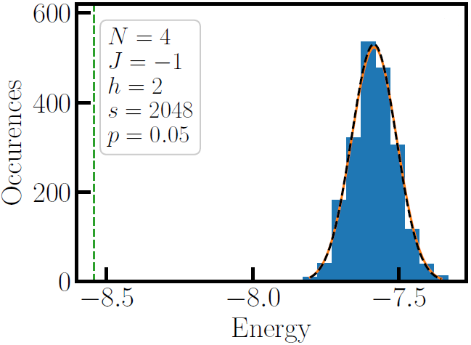
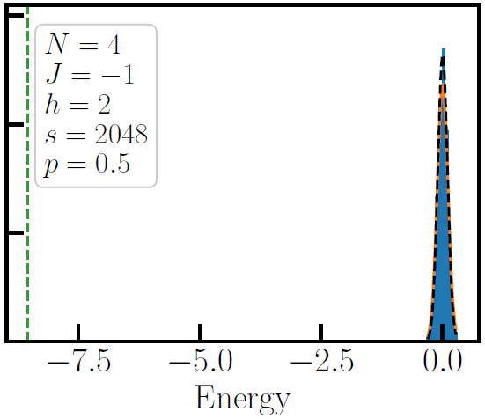
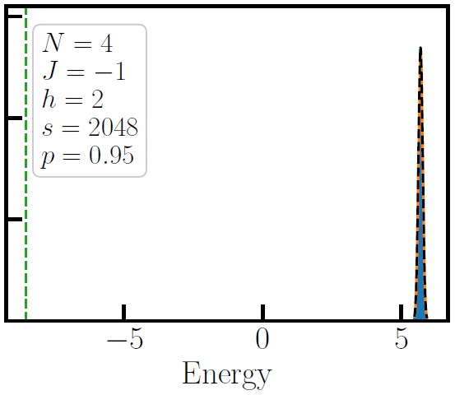

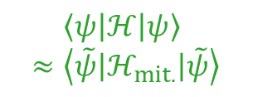

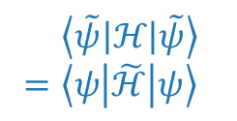
Measurement error mitigation
mitigate bit-flip errors during readout: $0\underset{→}{{ p}_{0 }}1$ or $1\underset{→}{{ p}_{1 }}0$
Z̃ $=\left(1−p_{0}\right)\left(1−p_{1}\right)Z+p_{0}p_{1}\left(−Z\right)+p_{0}(1−p_{1})\left(−𝕀\right)+\left(1−p_{0}\right)p_{1}𝕀$
Goal
$→Z_{mit.}=\frac{1}{1−p_{0}−p_{1}}$ Z̃ $− \frac{p_{1}−p_{0}}{1−p_{0}−p_{1}}𝕀$
benchmark with Ising model: $ℋ=J\sum_{i=1}^{N}{Z_{i}Z_{i+1}}+h\sum_{i=1}^{N}{X_{i}}$
$\left\langle \tilde{ψ}\left|ℋ\right|\tilde{ψ}\right\rangle$ $=\left\langle ψ\left|\tilde{ℋ}\right|ψ\right\rangle$
$p_{0,1}=$ 5%
$N=4$, $J=−1$, $h=2$
$p_{0,1}=$ 50%
$N=$ 4, $J=−1$, $h=2$
$p_{0,1}=$ 95%
$N=$ 4, $J=−1$, $h=2$
true energy
noisy data
best fit
prediction
Example
$$→$$
$$\left\langle ψ\left|ℋ\right|ψ\right\rangle$$
$$≈\left\langle \tilde{ψ}\left|ℋ_{mit.}\right|\tilde{ψ}\right\rangle$$

Slide 6
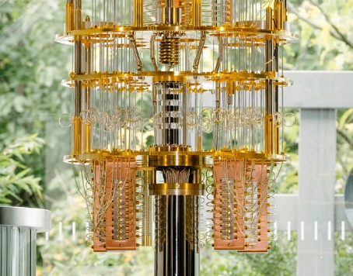
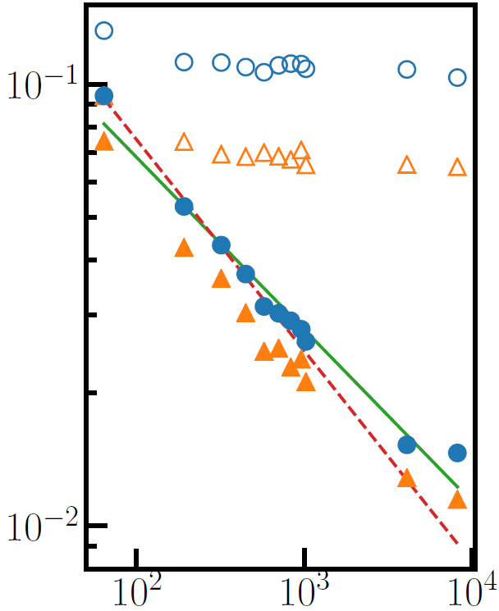

Measurement error mitigation
calibrate bit-flip probabilities $p_{q,0/1}$
measure $\left\langle ψ\left|\tilde{O}\right|ψ\right\rangle$ with $\tilde{O}∈{\left\{𝕀,\tilde{Z}\right\}}^{⊗N}$
IBM-Q quantum hardware data
Method
unmitigated
reconstruct ${\left(\left\langle ψ\left|O\right|ψ\right\rangle \right)}_{true}=\sum_{ij}{Ω_{ij}^{−1}(p_{q,0/1})}{\left(\left\langle ψ\left|\tilde{O}\right|ψ\right\rangle \right)}_{noisy}$
generic $ℋ=\sum_{k}{h_{k}U_{k}^{∗}O_{k}U_{k}}$ with $U_{k}^{∗}O_{k}U_{k}∈{\left\{𝕀,X,Y,Z\right\}}^{⊗N}$
(Image credit: IBM)
$$∝m^{−0.48}$$
$∝m^{−0.39}$
Mitigation
mitigated
benchmark: $Z$ and $Z_{1}Z_{2}$ operators on IBM-Q hardware
result: reduced measurement error by factor 10
(LF, Hartung, Jansen, Kühn, Stornati, Wang, arXiv:2007.03663)
mean error
standard deviation
Experiments
number of measurements m

Slide 7
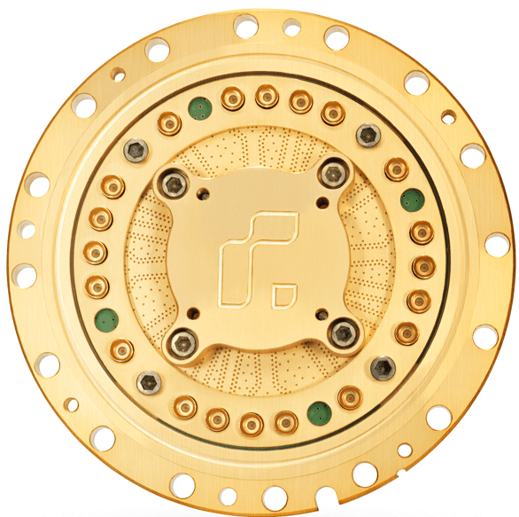
Discussion and outlook
overhead costs: polynomial for n-local Hamiltonians
implementation: deterministic or probabilistic
Advantages
multi-qubit correlations: calibration of multi-qubit bit-flips
relaxation errors: $Z=\frac{1}{p(t)}\tilde{Z}−\frac{1−p(t)}{p(t)}𝕀$ with $p\left(t\right)=\exp\left(−\frac{t}{T_{1}}\right)$
(Image credit: Rigetti Computing)
(Image credit: IKEA)
Extensions
Thanks for listening!
pre-processing: use bit-flip corrected operators for VQE
NP-hard optimization: track reconstruction at LHC
(LF, et al., work in progress)
Applications
Do you have any questions?

