Slide 1

Topological origin of
Mass and Spin
APS 21’

Slide 2
Outline
Vacuum
Mass
Spin
Summary

Slide 3
Vacuum

Slide 4
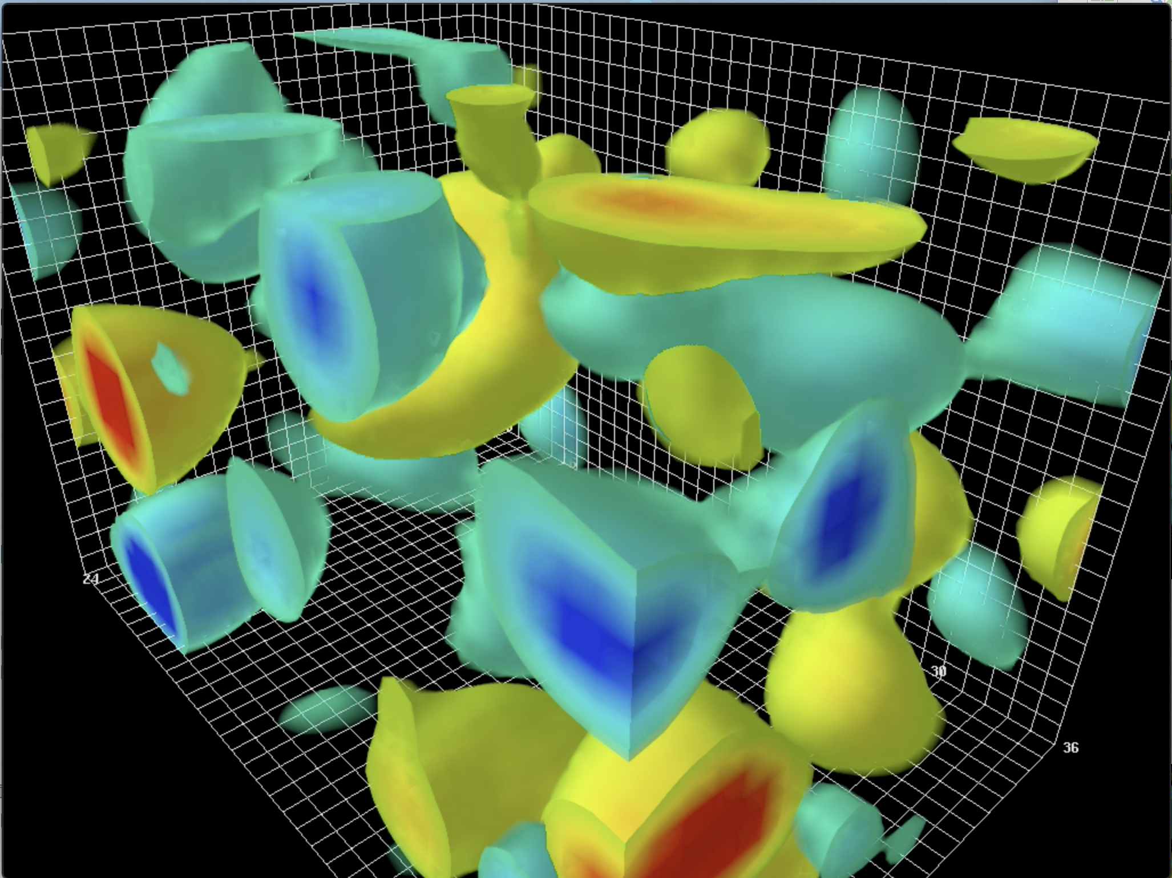
YM vacuum topologically active:
primordial glue!

Slide 5
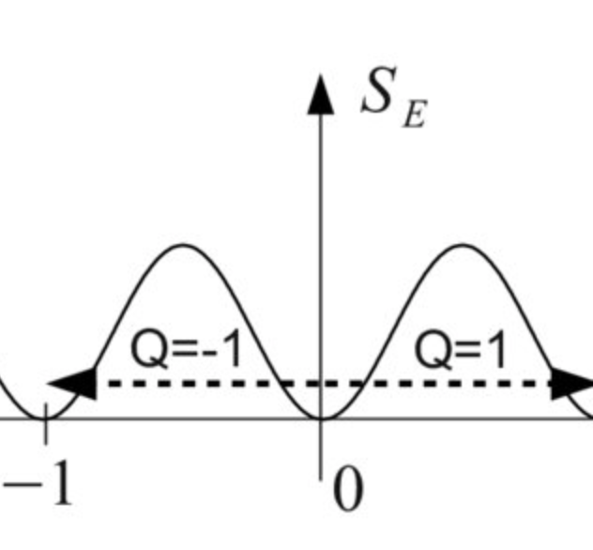
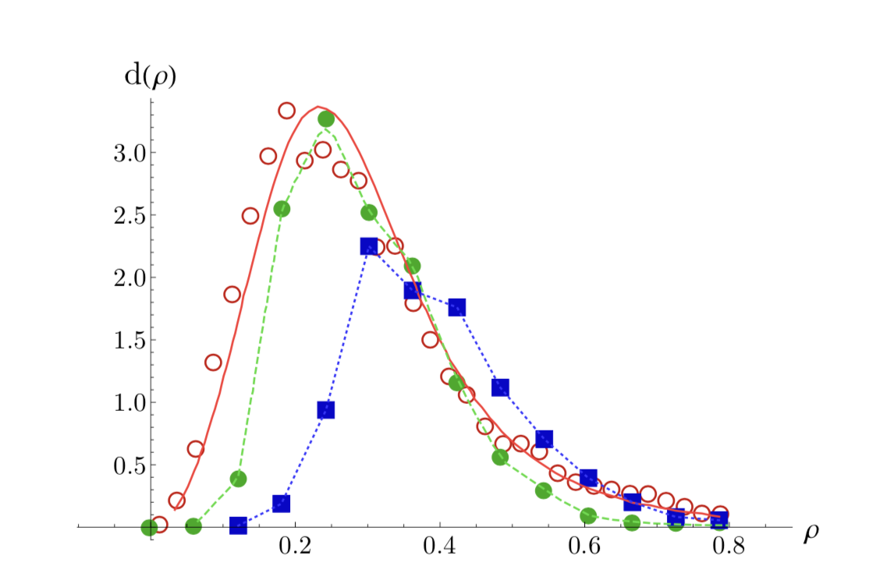
QCD Instantons : few facts

Slide 6
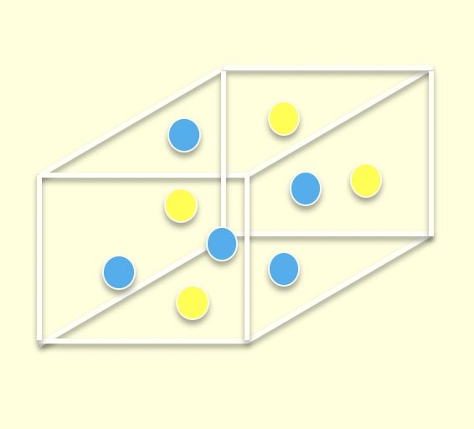
Instanton Vacuum: epoxy and fluctuations

Slide 7
Topological origin of mass: LR mixing and zero modes

Slide 8
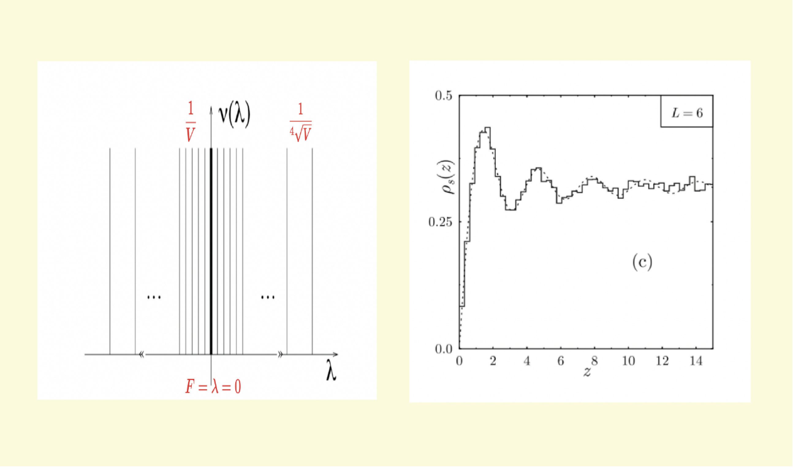
Lattice evidence for this mechanism

Slide 9
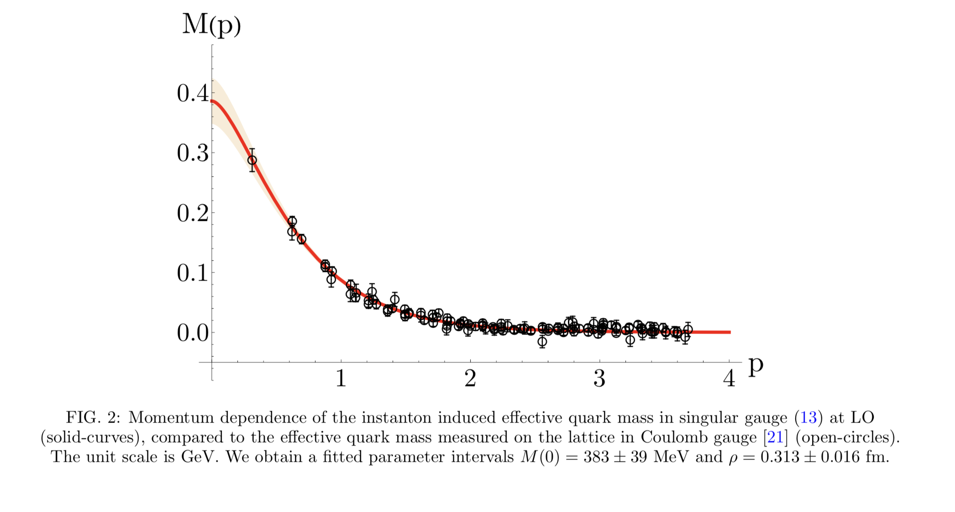
Running mass versus lattice

Slide 10
Mass

Slide 11
Ji Mass

Slide 12
Epoxy or in Nucleon

Slide 13
Ji Mass Sum Rule

Slide 14
Spin

Slide 15
Ji Spin

Slide 16
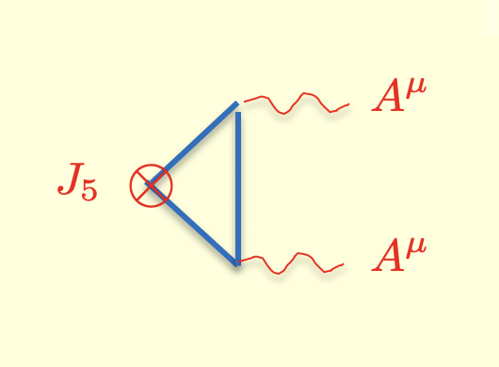
Intrinsic spin and U(1) axial anomaly

Slide 17
in Nucleon

Slide 18
Nucleon intrinsic quark spin

Slide 19
Ji Spin sum rule

Slide 20
Summary
Vacuum : topologically active
Mass : topo-compressibility
Spin : topo-susceptibility

