Slide 1
The EIC Project and its
Experimental Equipment
Elke-Caroline Aschenauer (BNL)

Slide 2
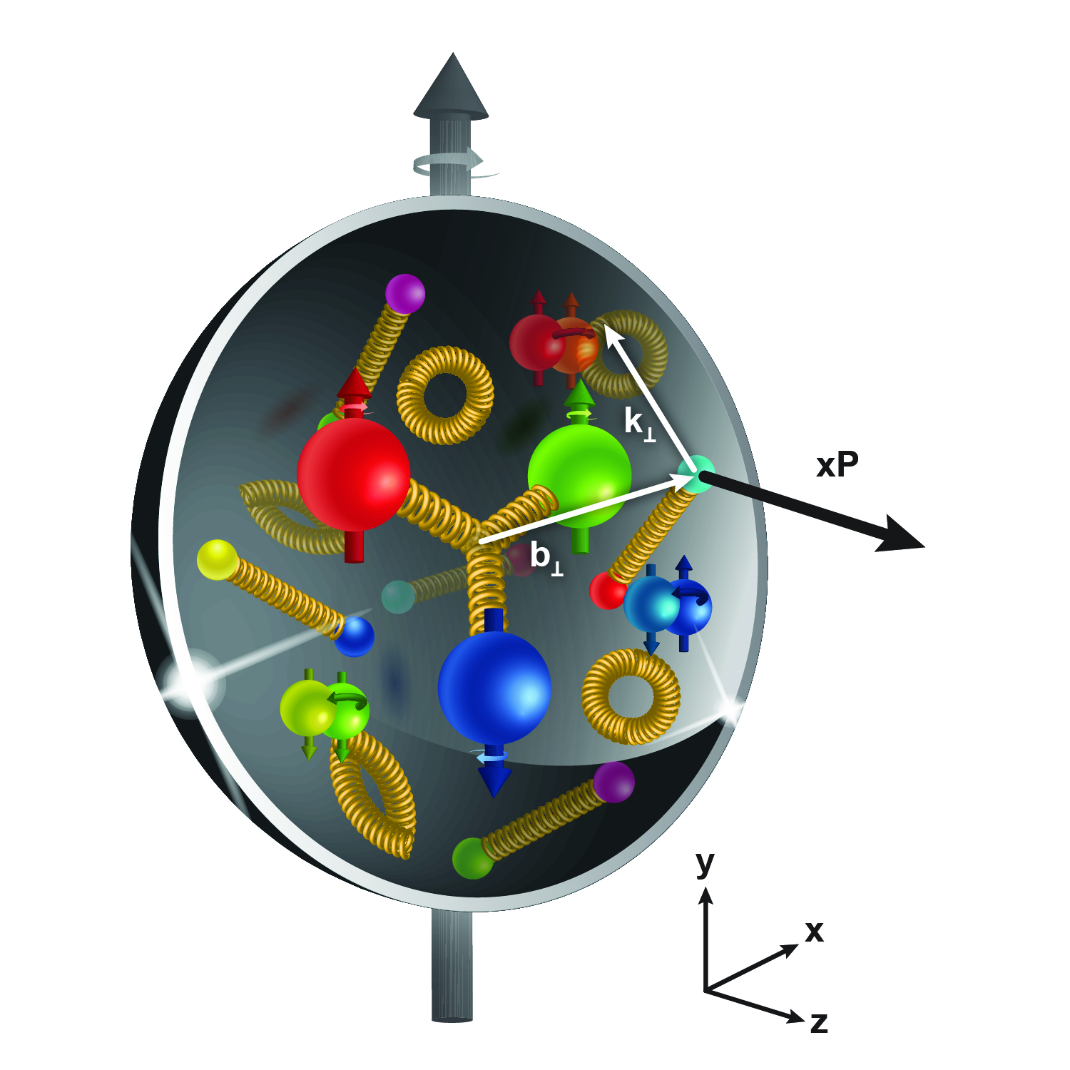
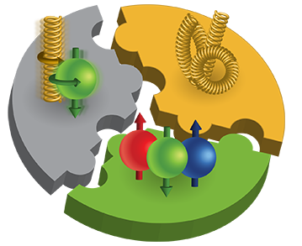
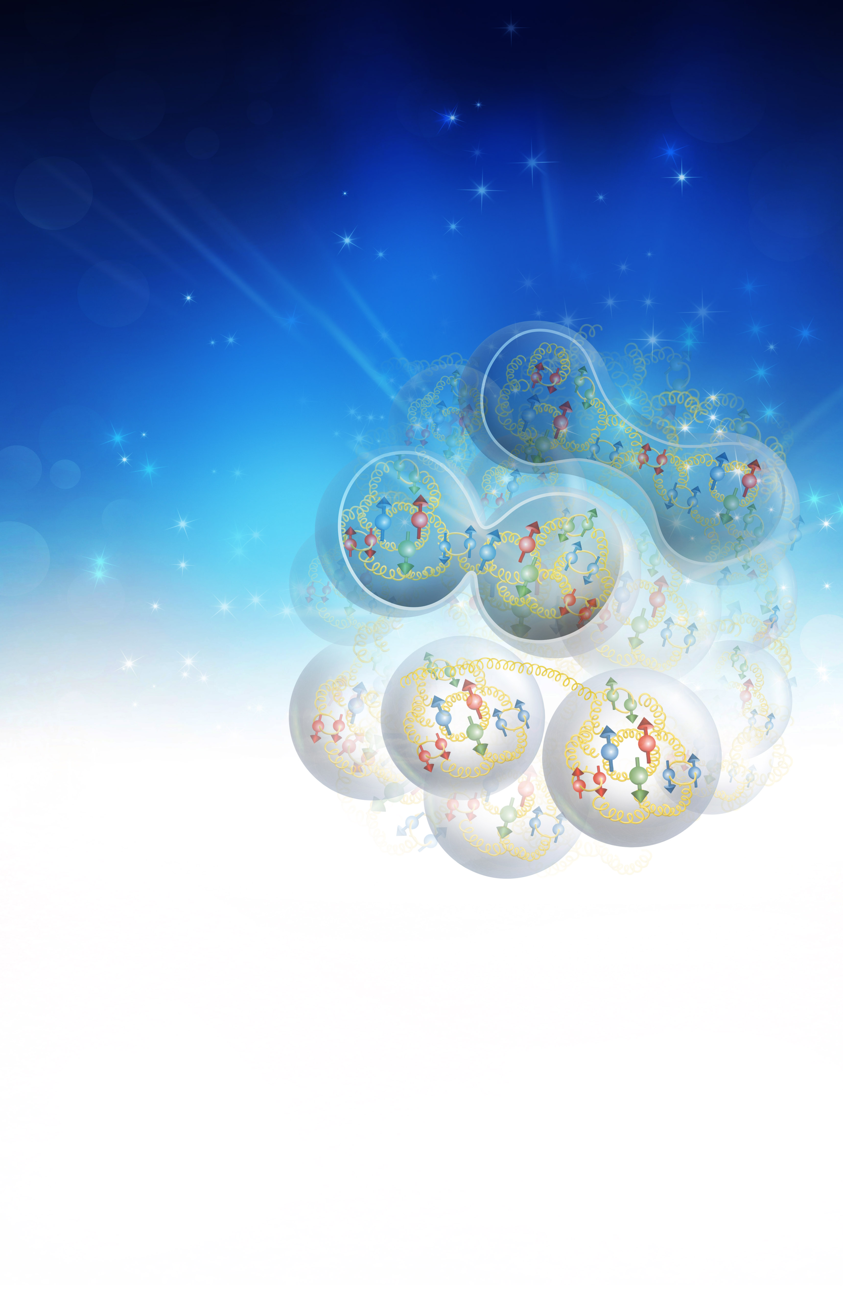
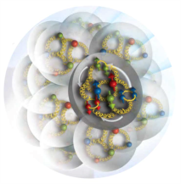
The EIC Physics
How are the sea quarks and gluons, and their spins, distributed in space and momentum inside the nucleon?
How do the nucleon properties emerge from them and
their interactions?
How do color-charged quarks and gluons, and colorless jets, interact with a nuclear medium?
How do the confined hadronic states emerge from these quarks and gluons?
How do the quark-gluon interactions create nuclear binding?
How does a dense nuclear environment affect the quarks and gluons, their correlations, and their interactions?
What happens to the gluon density in nuclei? Does it saturate at high energy, giving rise to a gluonic matter with universal properties in all nuclei, even the proton?
gluon
emission
gluon recombination
?
=

Slide 3
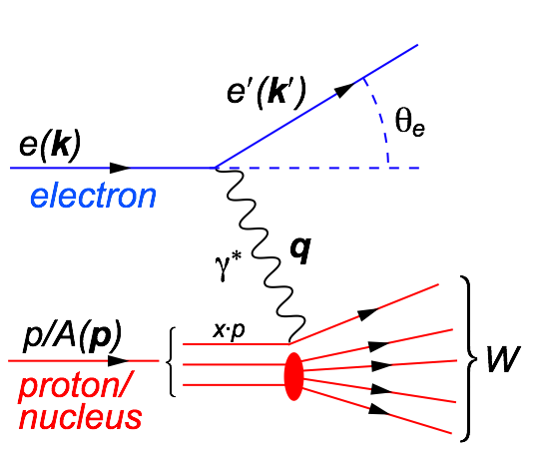
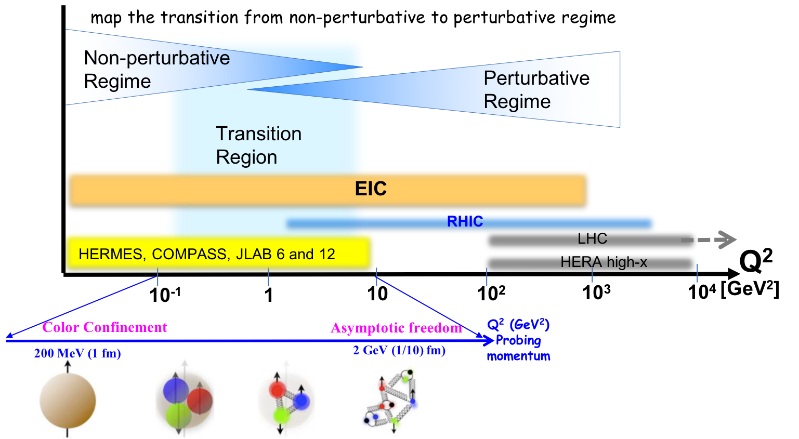
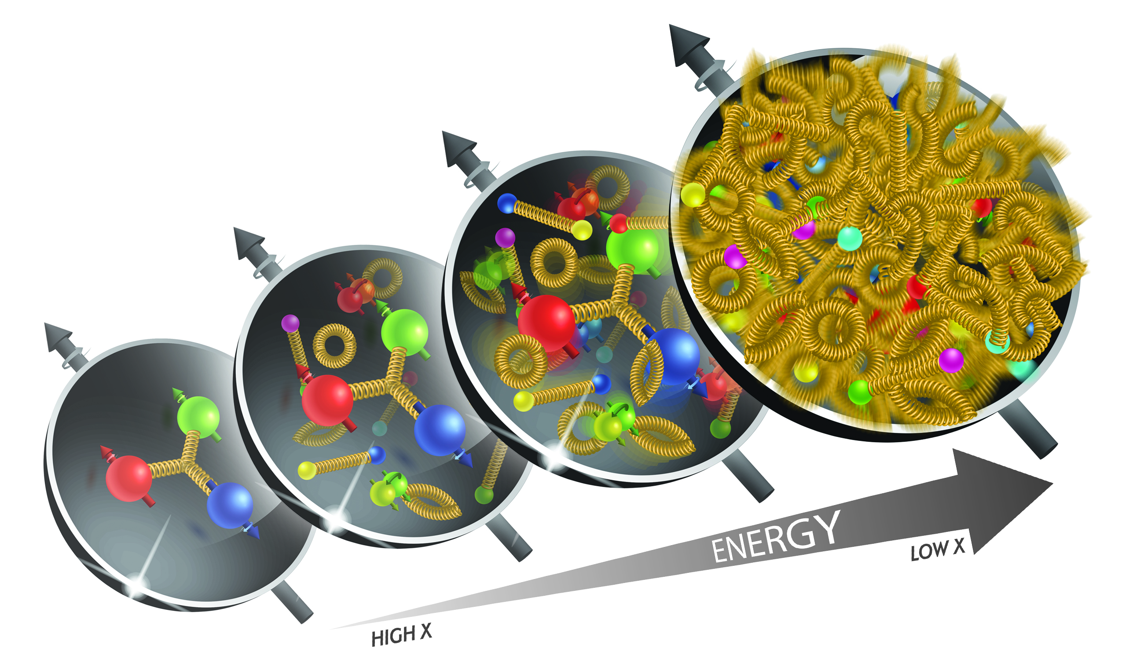
Deep Inelastic Scattering
Deep Inelastic Scattering (DIS):
As a probe, electron beams
provide unmatched precision of
the electromagnetic interaction
Direct, model independent
determination of parton
kinematics of physics
processes
s: center-of-mass energy squared
Q²: resolution power
x: the fraction of the nucleon’s
momentum carried by the
struck quark (0<x<1)
y: inelasticity
large kinematic coverage:
center-of-mass energy √s: 28 – 140 GeV
access to x and Q² over a wide range

Slide 4

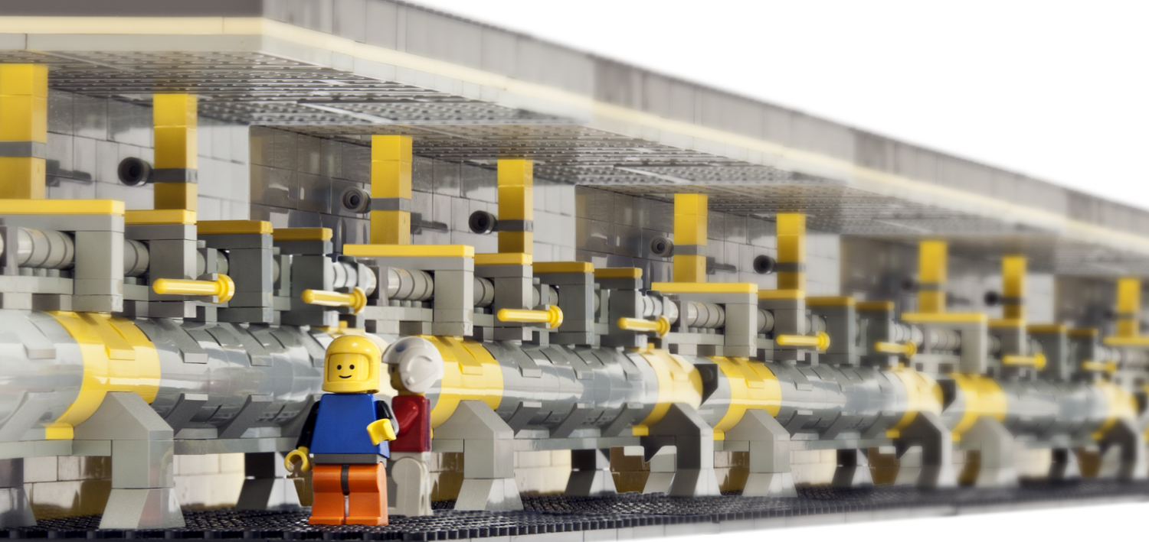
What is needed to make this happen

Slide 5
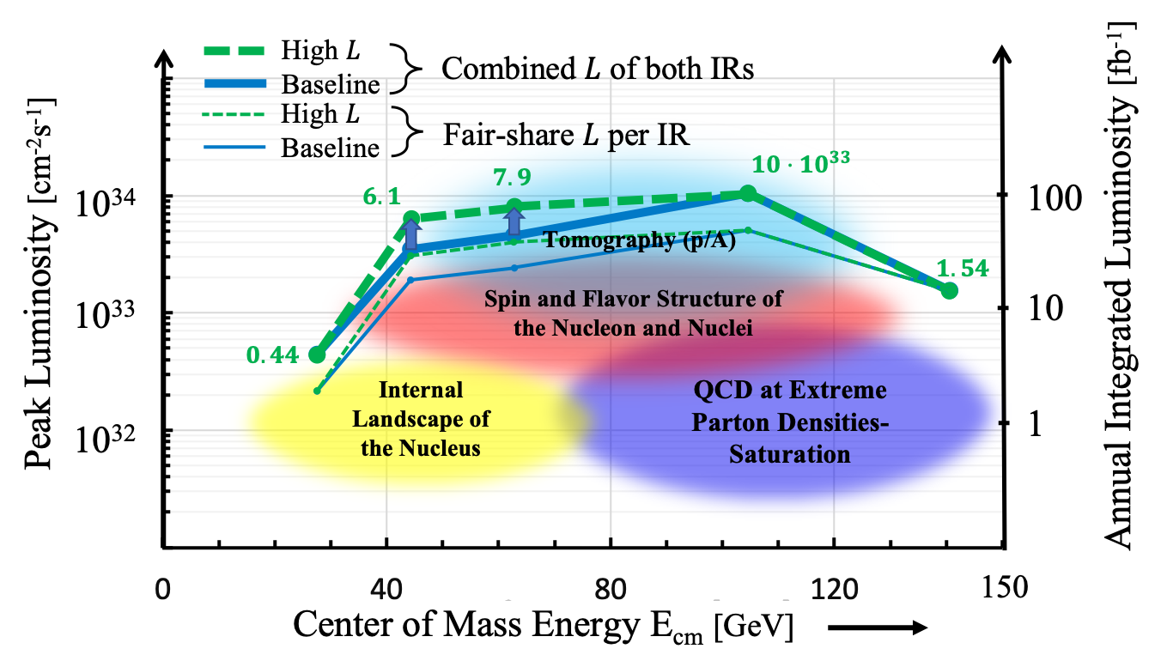

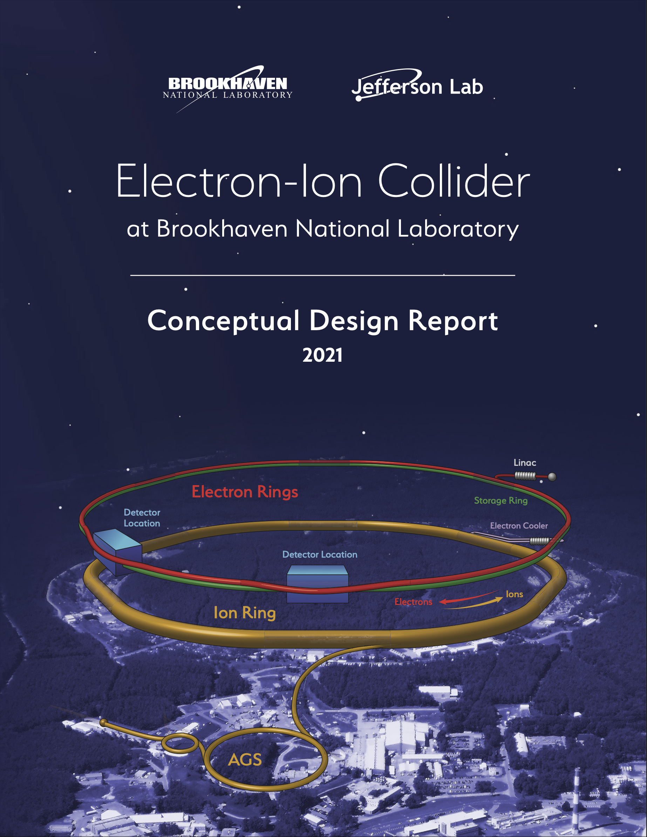
EIC Machine Parameters
CDR: https://www.bnl.gov/ec/files/EIC_CDR_Final.pdf
Double Ring Design Based on Existing RHIC Facilities
Hadron Storage Ring: 40 - 275 GeV |  | Electron Storage Ring: 2.5 - 18 GeV
RHIC Yellow Ring and Injector Complex |  | Many Bunches, Large Beam Current - 2.5 A
Many Bunches, 1160 @ 1A Beam Current 9 ns bunch spacing |  | 9 MW Synchrotron Radiation
Bright Beam Emittance e_{xp}= 9 nm |  | Superconducting RF Cavities , 10MW Power
Flat Beam, Requires Strong Cooling
High Luminosity Interaction Region(s) |  | Electron Rapid Cycling Synchrotron
25 mrad Crossing Angle with Crab Cavities |  | Spin Transparent Due to High Periodicity

Slide 6
The EIC: A Unique Collider
EIC
LHC /RHIC
collide different beam species: ep & eA
consequences for beam backgrounds
  hadron beam backgrounds,
  i.e. beam gas events
  → synchrotron radiation
asymmetric beam energies
boosted kinematics
  high activity at high |η|
Small bunch spacing: >= 9ns
crossing angle: 25mrad
wide range in center of mass energies
factor 6
both beams are polarized
→ stat uncertainty: ~ 1/(P₁P₂ (∫L dt )^{1/2})
collide the same beam species: pp, pA, AA
→ beam backgrounds
  hadron beam backgrounds,
  i.e. beam gas events, high pile up
symmetric beam energies
kinematics is not boosted
  most activity at midrapidity
moderate bunch spacing: 25 ns
no crossing angle yet
LHC limited range in center of mass energies
factor 2
RHIC wide range in center of mass energies :
→ factor 26 in AA and 8 in pp
no beam polarization
→ stat uncertainty: ~1/(∫L dt )^{1/2}
Differences impact detector acceptance and possible detector technologies

Slide 7

General Purpose Detector in EIC-CDR
The EIC facility is capable supporting a science program that includes two detectors and two interaction regions
The DOE-NP supported EIC Project includes one detector and one Interaction Region
Two possible locations – IP6 and IP8 – for detectors and Interaction Regions.
IP6 is the planned detector location for the project detector
Backward
Hadron Storage Ring
Electron Storage Ring
Electron Injector Synchrotron
Possible on-energy Hadron
injector ring
Hadron injector complex
p/A beam
electron beam
Forward
7

Slide 8
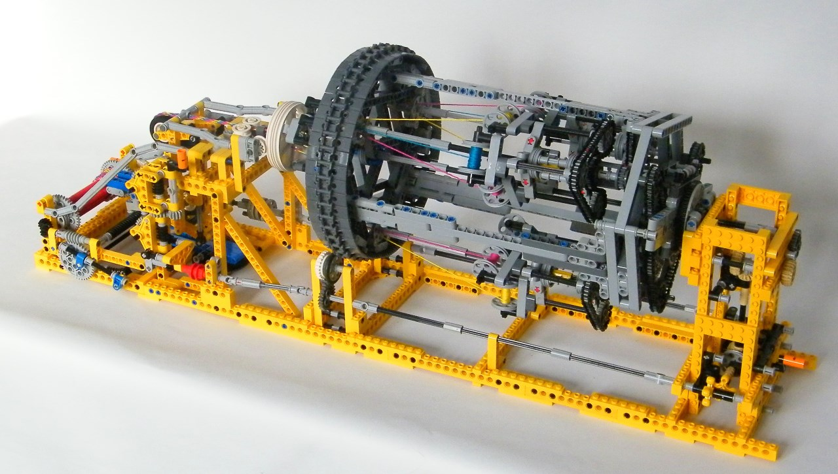
EIC Detector Concept

Slide 9


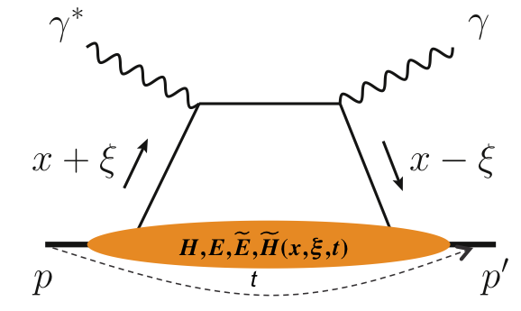
What is needed experimentally?
experimental measurements categories to address EIC physics:
Parton Distributions in nucleons and nuclei
QCD at Extreme Parton Densities - Saturation
Spin and
Flavor structure of nucleons and nuclei
Tomography Transverse Momentum Dist.
QCD at Extreme Parton Densities - Saturation
Tomography
Spatial Imaging
inclusive DIS
semi-inclusive DIS
exclusive processes
measure scattered lepton
multi-dimensional binning: x, Q²
reach to lowest x, Q² impacts
Interaction Region design
measure scattered lepton
and hadrons in coincidence
multi-dimensional binning:
x, Q², z, p_{T}, Θ
particle identification over entire region is critical
measure all particles in event
multi-dimensional binning:
x, Q², t, Θ
proton p_{t}: 0.2 - 1.3 GeV
  cannot be detected in main detector
  strong impact on Interaction Region design
∫Ldt:
1 fb⁻¹
10 fb⁻¹
10 - 100 fb⁻¹
machine & detector requirements

Slide 10
EICUG: Yellow Report (YR) Initiative
The EIC Users Group: EICUG.ORG
Report: https://arxiv.org/abs/2103.05419
Detector requirements and design driven by EIC Physics program and defined by EIC Community
Physics Topics ➝ Processes ➝ Detector Requirements
Physics Working Group:
  Inclusive Reactions
  Semi-Inclusive Reactions
  Jets, Heavy Quarks
  Exclusive Reactions
  Diffractive Reactions & Tagging
Detector Working Group:
  Tracking + Vertexing
  Particle ID
  Calorimetry
  DAQ/Electronics
  Polarimetry/Ancillary Detectors
  Central Detector: Integration & Magnet
  Far- Forward Detector & IR Integration
  Provides critical input for detector proposals – handoff between Physics & Detector Working Groups in “interactive detector matrix”: Collects physics requirements “real time”, lists all technologies for a given region, and links to studies that established the numbers

Slide 11
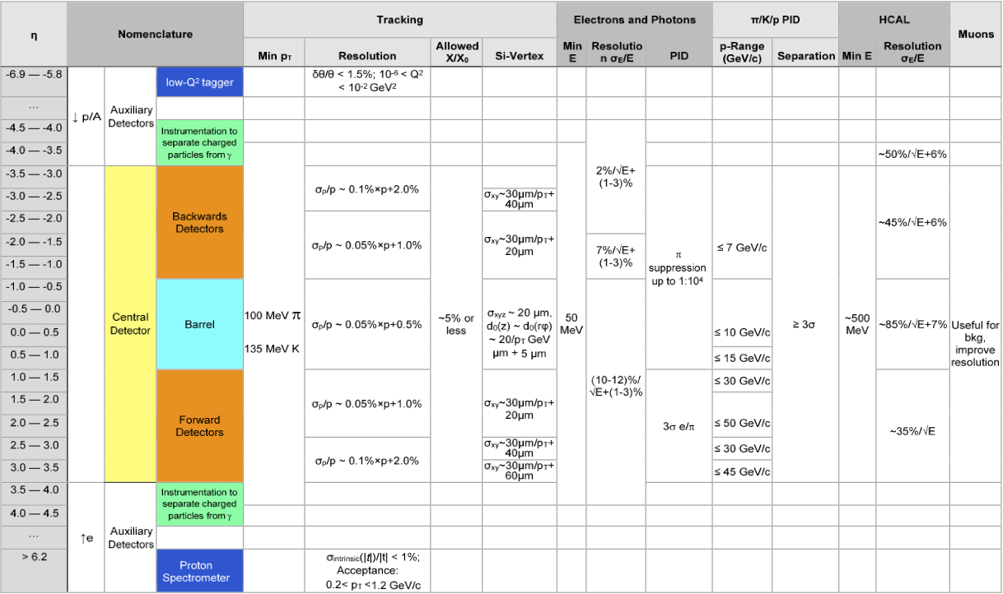
YR: Detector Requirements

Slide 12
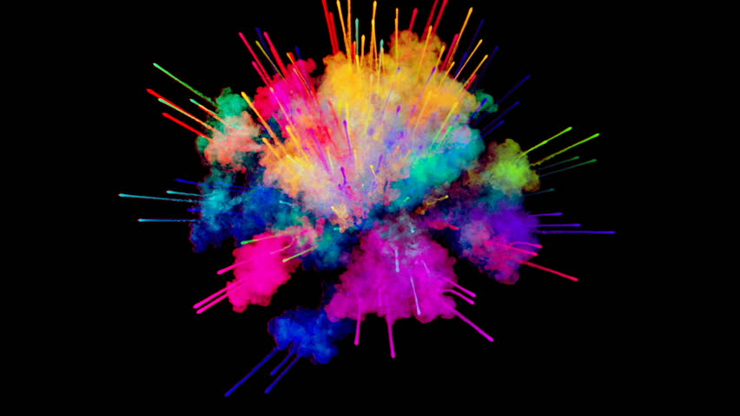
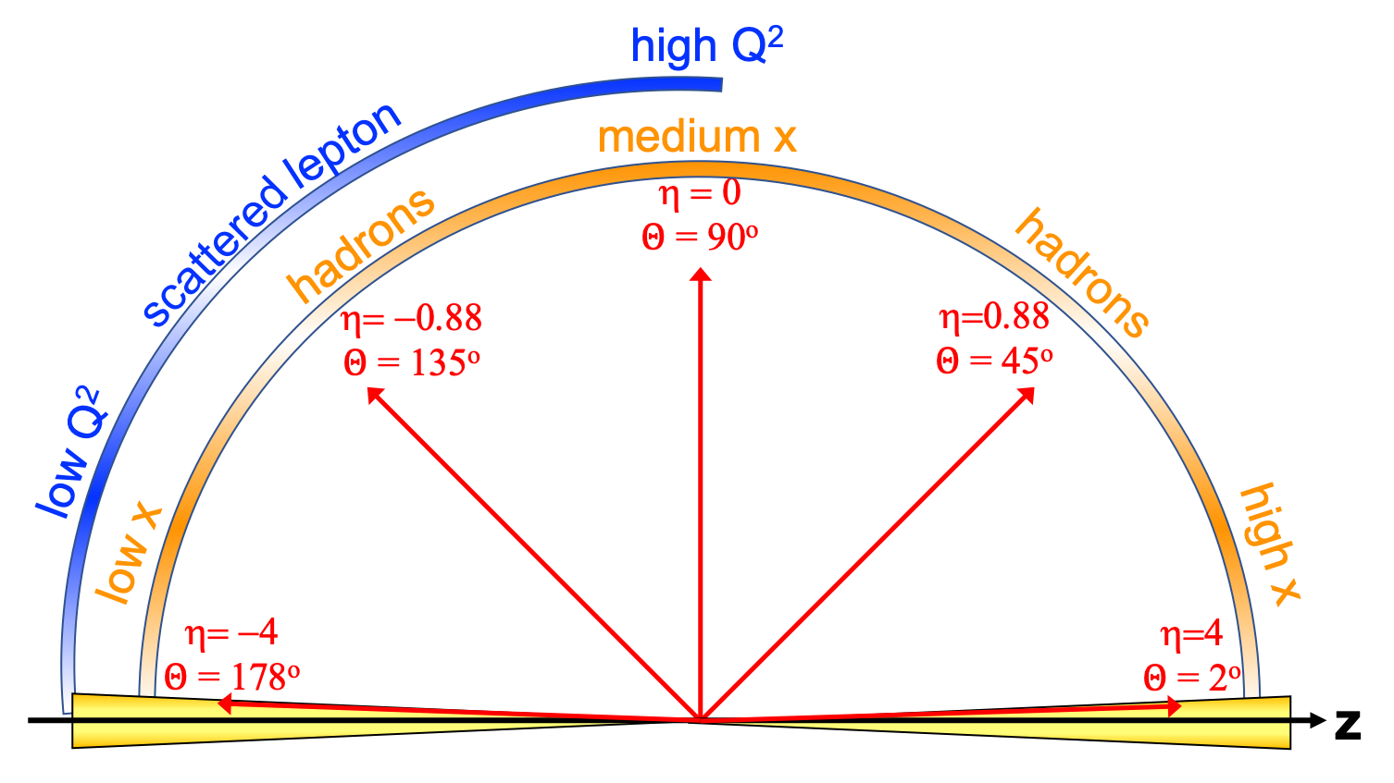
EIC General Purpose Detector: Concept
p/A beam
electron beam
inclusive DIS:
semi-inclusive DIS
Backward-η
Forward-η
Central
Detector
HCAL
Lepton
Endcap
Magnet
Hadron
Endcap
HCAL
ECAL
HCAL
ECAL
ECAL
Tracking
PID
PID
PID
Tracking
very low Q²
scattered lepton
Bethe-Heitler photons
for luminosity
Tracking
particles from nuclear
breakup and
from diffractive reactions
exclusive DIS
ZDC
Luminosity Detector
Forward Tracking
Low Q²-Tagger

Slide 13
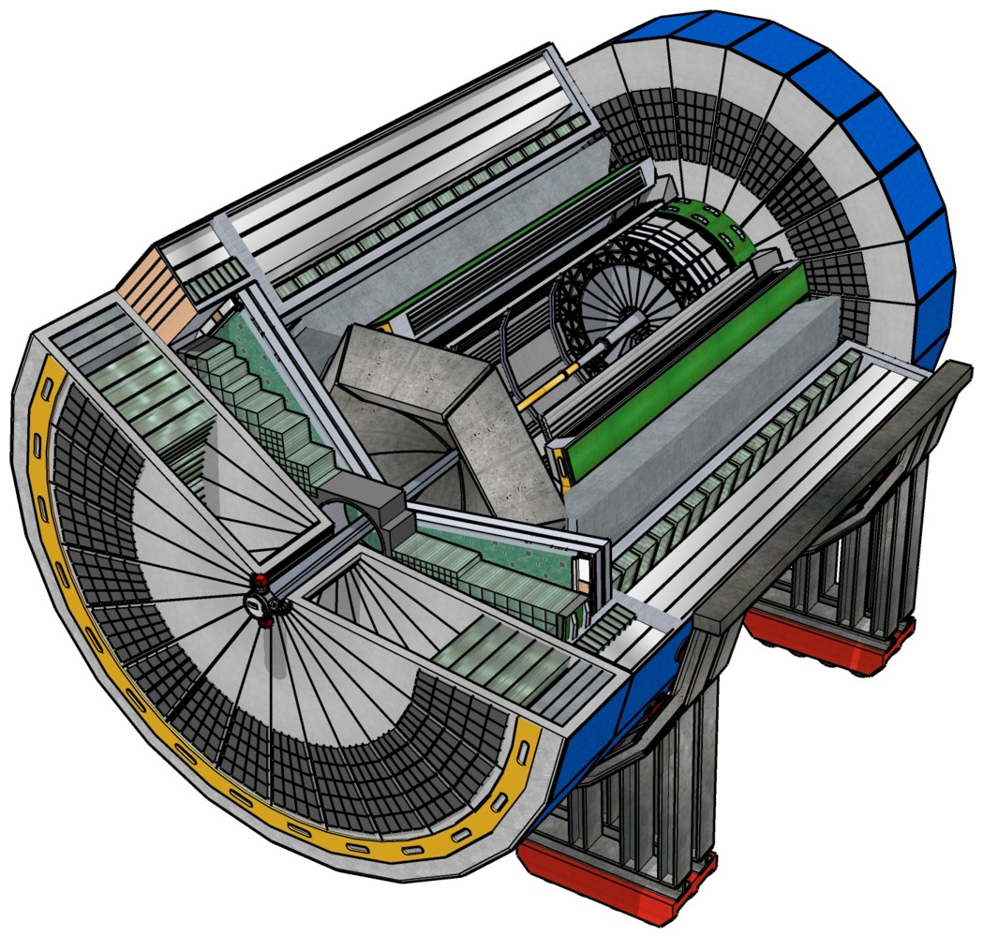
EIC Experimental Equipment
Any general purpose EIC Detector is complex
Overall detector requirements:
Large rapidity (-4 < η < 4) coverage; and far beyond in especially far-forward detector regions
High precision low mass tracking
  small (m-vertex) and large radius (gaseous-based) tracking
Electromagnetic and Hadronic Calorimetry
  equal coverage of tracking and EM-calorimetry
High performance PID to separate π, K, p on
track level
  also need good e/h separation for scattered electron
Large acceptance for diffraction, tagging, neutrons from nuclear breakup: critical for physics program
  Many ancillary detector integrated in the beam line: low-Q² tagger, Roman Pots, Zero-Degree Calorimeter, ….
High control of systematics
  luminosity monitor, electron & hadron Polarimetry
Integration into the Interaction Region is critical

Slide 14
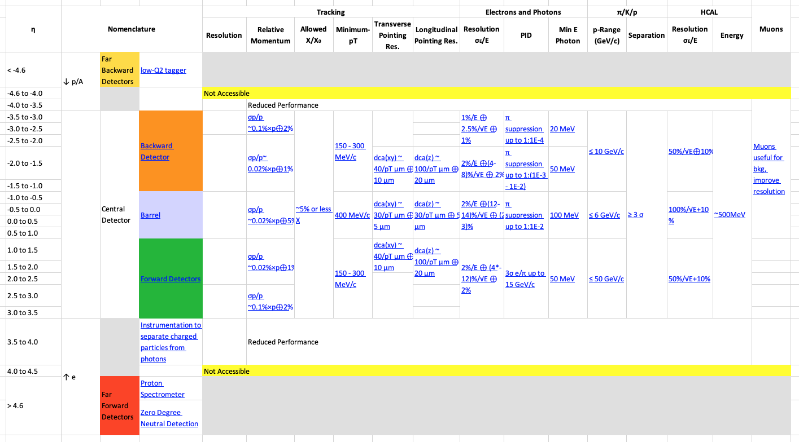
Requirements
EIC-UG Yellow Report results:
Detailed subdetector simulations and technology performance evaluations tabulated
  Interactive version: https://physdiv.jlab.org/DetectorMatrix
performance difference for different magnetic fields (1.4 T vs. 3 T) were evaluated
B = 3 T
Example of physics and detector technology requirement for IR/Roman Pots in backup

Slide 15
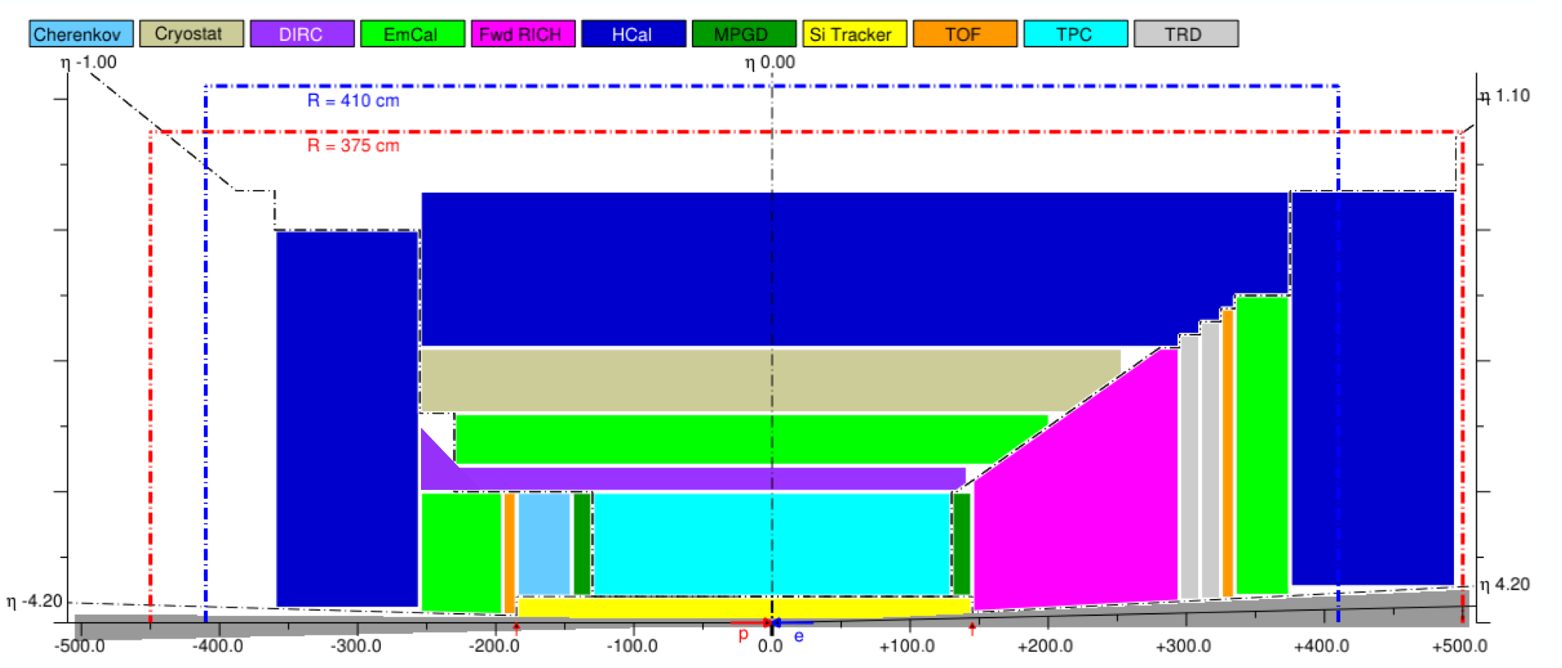
EIC General Purpose Detector
EIC general purpose Detector around a new 3T Solenoid with hermetic coverage
p/A
electron
Important to note:
low multiplicity per event: < 10 tracks
η > 2: avg. hadron track momenta @ 141 GeV: ~20 GeV
No pileup from collisions 500 kHz @10³⁴ cm⁻²s⁻¹ → coll. every 200 bunches
radiation environment much less harsh than LHC

Slide 16
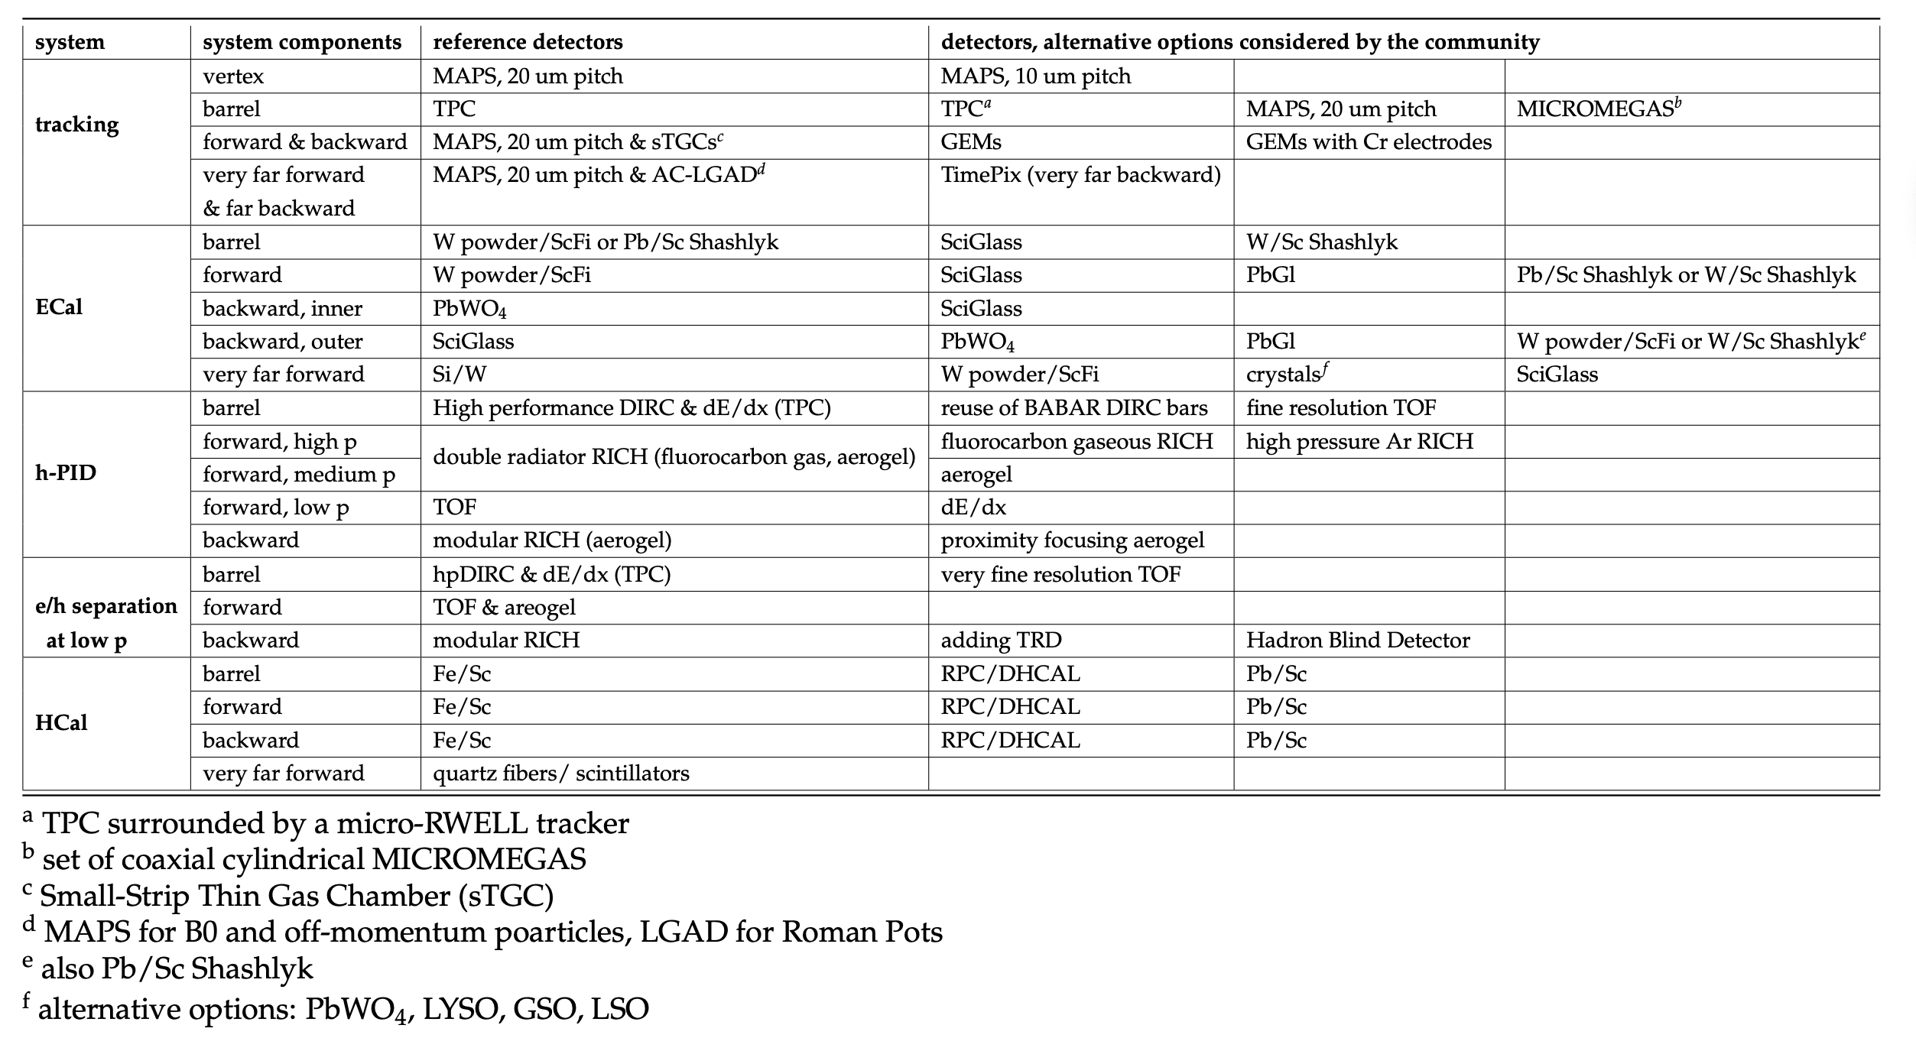
Subdetector Technology Choices
Alternatives to primary technologies for the different subdetectors
fulfilling the requirements
→ risk reduction and critical for complementarity

Slide 17
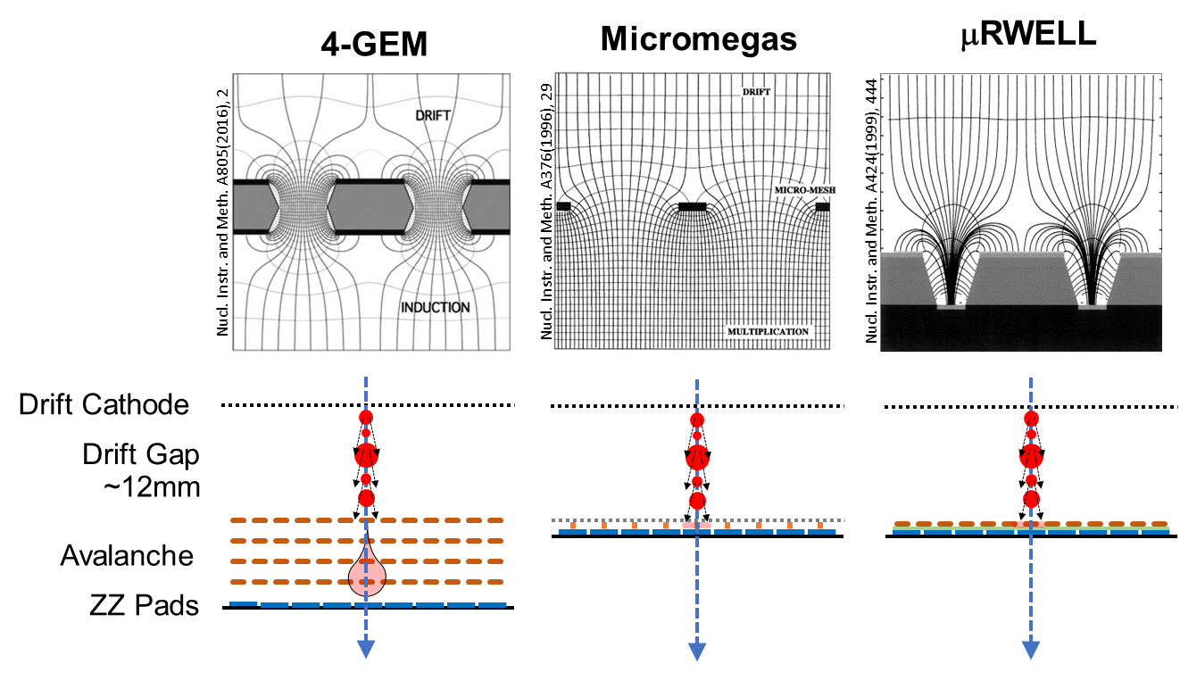
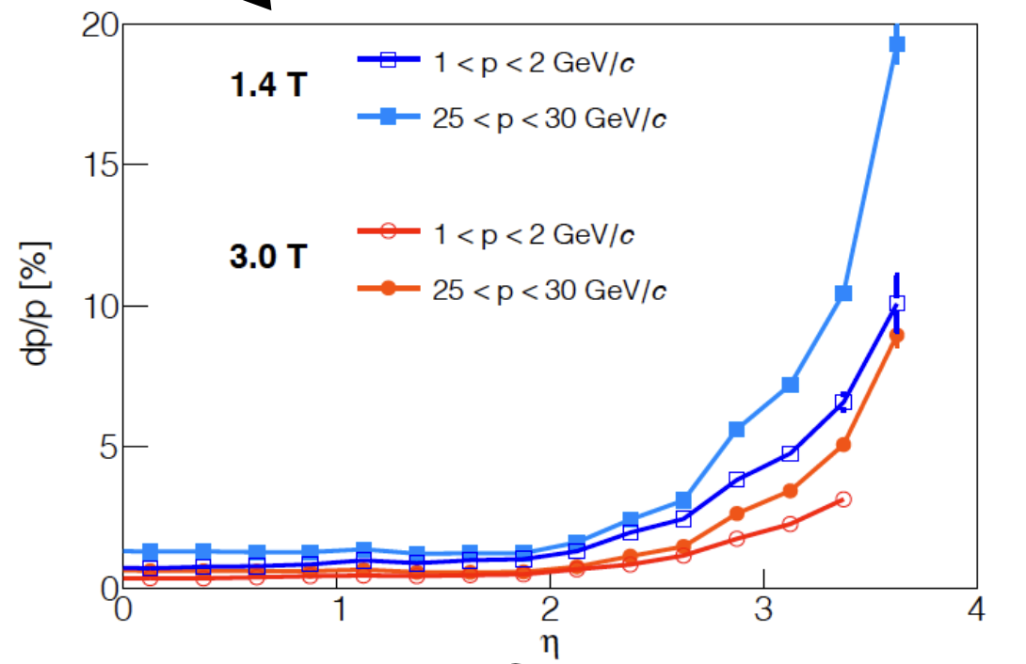
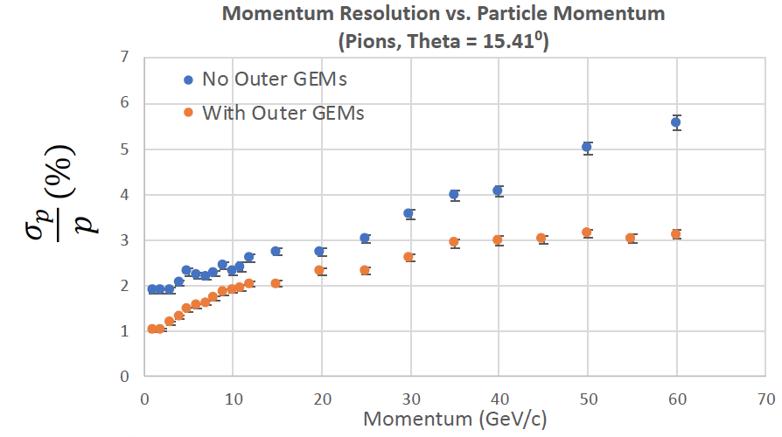
Barrel and EndcapTracking
μ-Vertex:
For primary and secondary vertex reconstruction
Low material budget: 0.05% X/X₀ per layer
High spatial resolution: 10 μm pitch MAPS
→ ref. Alice ITS3
Compromise:
  20 mm pixels and ~0.3% X/X₀ per layer
Barrel+ Disks for endcaps
Micro-Pattern Gas Detectors
To improve momentum resolution at large rapidities.
Spatial resolution well below 100 μm
Large-area detectors possible
Cost efficient compared to silicon

Slide 18
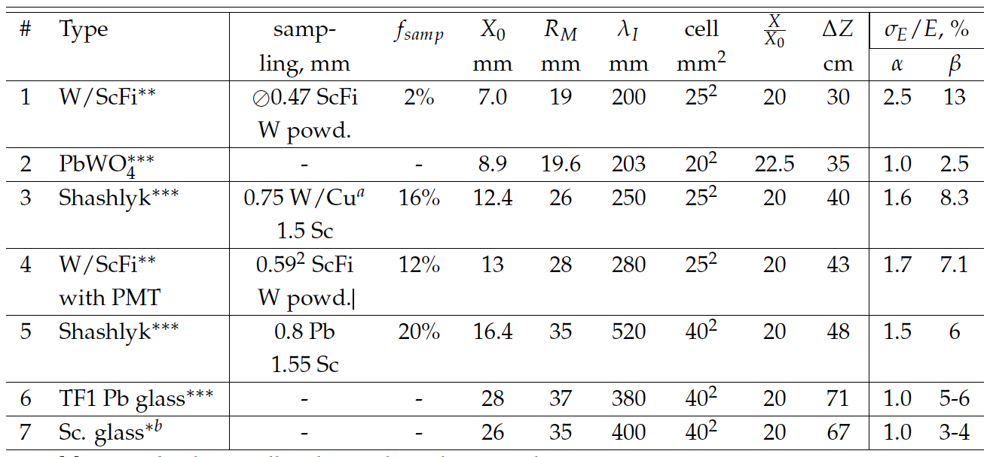
Electro-Magnetic Calorimeter
Applications
  Scattered electron kinematics measurement at large |h| in the e-endcap
  Photon detection and energy measurement
  e/h separation (via E/p & cluster topology)
  π⁰/γ separation → may also consider a highly segmented preshower combined with ToF and tracking → three in one
Anticipated stochastic term in energy resolution & available space
Other considerations
  Fast timing
  Compactness (small X₀ and R_{M})
  Tower granularity
  Readout immune to the magnetic field
η | [-4 .. -2] | [-2 .. -1] | [-1 .. 1] | [1 .. 4]
σ_{E}/E | ~2%/√E | ~7%/√E | ~10-12%/√E | ~10-12%/√E
space | ~50 cm | ~50 cm | ~30 cm | ~40 cm
EIC Yellow Report

Slide 19
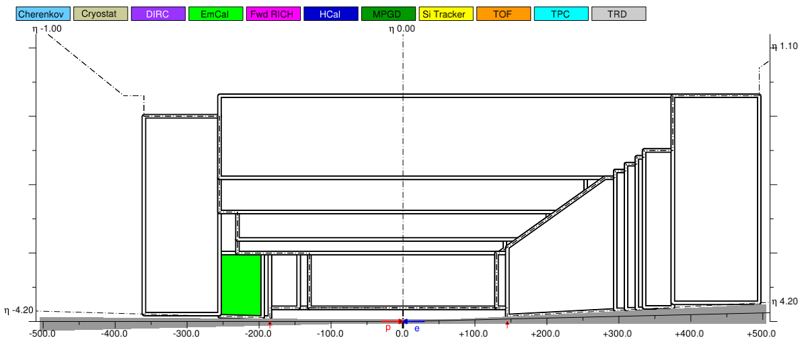
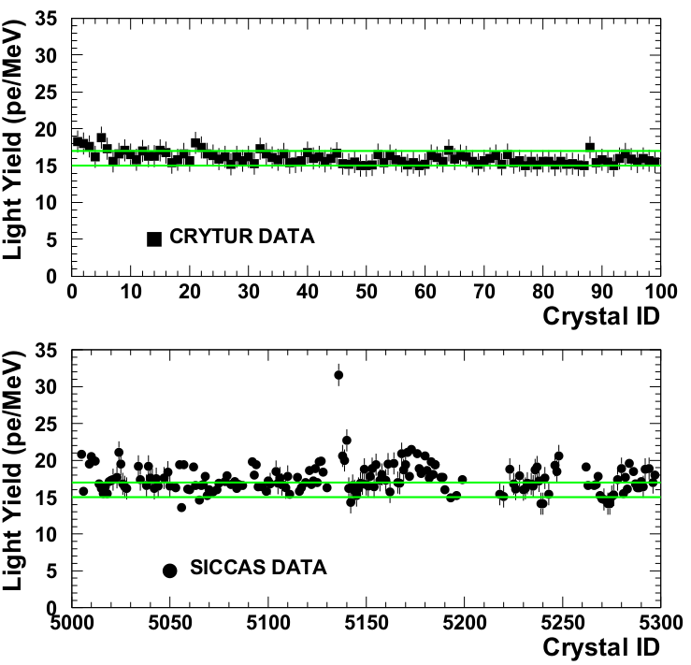
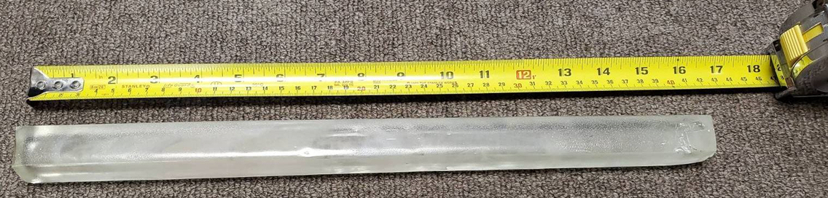
Crystals
High resolution EmCal in the electron-endcap for the scattering electron measurements
PWO where space is tight, and the highest possible energy resolution is required
Scintillating glass (EIC R&D) otherwise
  More cost efficient, easier manufacturing
  Potentially better optical properties
Example: SC1 glass
PWO: vendor characterization
2018: 1cm x 1cm x 1cm
2019: 2cm x 2cm x 4cm
CRYTUR
Feb 2020: 2cm x 2cm x 20cm (7 X0)
Dec 2020: 2cm x 2cm x 40cm ( 10-20 X0)
SICCAS

Slide 20

EIC PID
needs
are more demanding
then your
normal
collider detector
EIC
needs absolute
particle numbers at
high purity and low
contamination
E

Slide 21
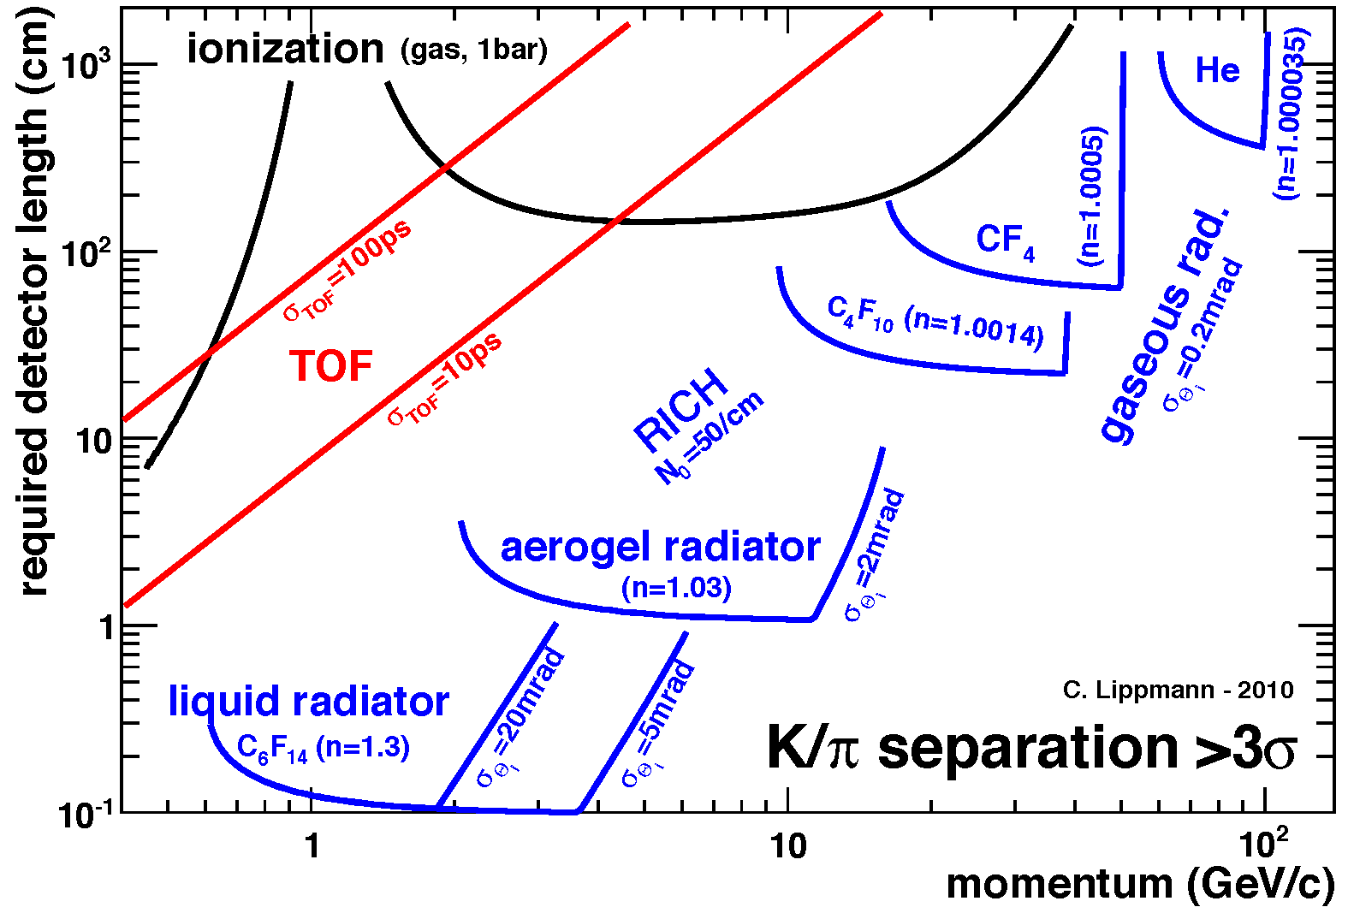
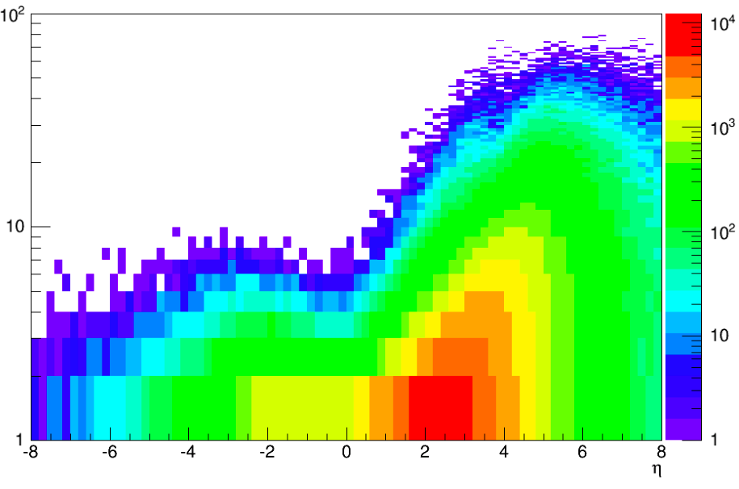


Particle ID
In general, need to separate:
Electrons from photons → 4p coverage in tracking
Electrons from charged hadrons → mostly provided by calorimetry
Charged pions, kaons and protons from each other → Cherenkov detectors
  Cherenkov detectors, complemented by other technologies at lower momenta
Illustration of PID detectors achievements:
Pythia MC
P [GeV]
$$π/K±$$
$$η$$
Physics requirements:
Need more than one technology to cover the entire momentum ranges at different rapidities
Rapidity | π/K/p and π0/γ | e/h | Min pT (E)
-3.5 − -1.0 | 7 GeV/c | 18 GeV/c | 100 MeV/c
-1.0 − 1.0 | 8-10 GeV/c | 8 GeV/c | 100 MeV/c
1.0 − 3.5 | 50 GeV/c | 20 GeV/c | 100 MeV/c

Slide 22
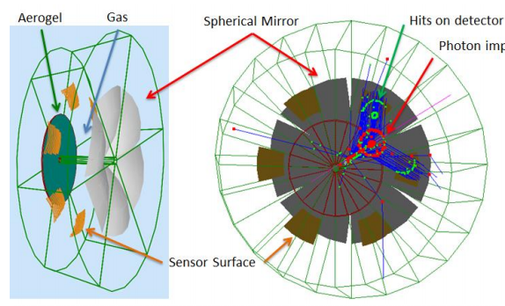
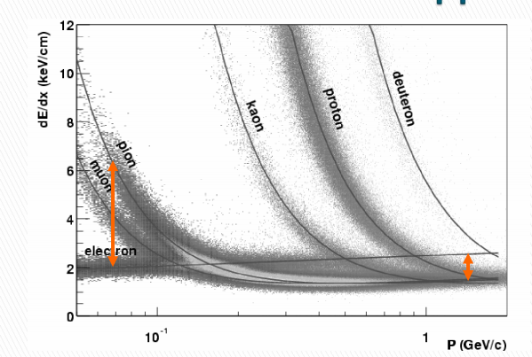
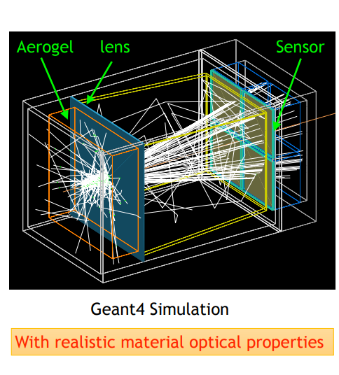
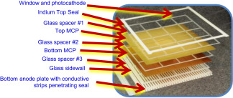
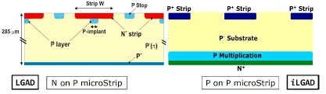

Hadron PID
Barrel
REFERENCE
hpDIRC (High Performance DIRC)
Quartz bar radiator, light detection with MCP-PMTs
Fully focused
p/K 3s sep. at 6 GeV/c
Reuse of BABAR DIRC as alternative
Integration into a 4$π$ detector can be challenging
Forward arm
REFERENCE
dRICH (dual RICH)
Aerogel and C-F gas radiators
Full momentum range
Sensor: Si PMs(TBC)
p/K 3σ sep. at 50 GeV/c
dE/dx from gaseous tracker, i.e. TPC
complementary
TOF on ~ 1m lever arm
LGAD (Low Gain Avalanche Detector)
STAR: ~ similar
resolution expected
windowless RICH
Gaseous sensors (MPGDs)
CF₄ as radiator and sensor gas
Low p complements required:
TOF ~ 2.5m lever arm / Aerogel (mRICH)
Backward arm
HP-RICH (high pressure RICH)
Eco-friendly alternative for dRICH/windowless RICH
Ar @ 3. 5 bar ↔ C₄ F₁₀ @ 1 bar
Ar @ 2 bar ↔ C F₄ @ 1 bar
REFERENCE
mRICH (Modular RICH)
Aerogel Cherenkov Det.
Focused by Fresnel lens
e, pi, K, p
Sensor: SiPMs/ LAPPDs
Adaptable to includeTOF
π/K 3σ sep. at 10 GeV/c
TOF on ~ 2m lever arm, 2 options
LAPPD (Large Area psec Photon Detector)
MCP, Cherenkov in window
5-10 psec
LGAD (Low Gain Avalanche Detector)
Silicon Avalanche
20-35 psec
Accurate space point for tracking
Relevant also to central barrel

Slide 23
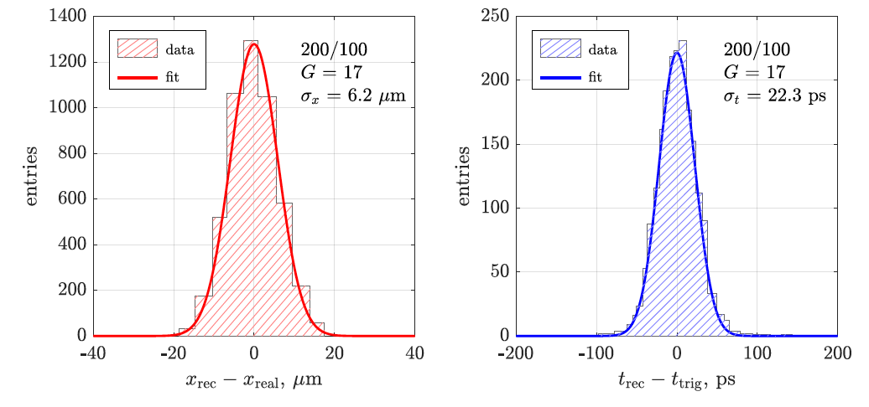
High resolution timing technologies
UV-enhanced version
UV
MCP-PMT / LAPPD
(AC)-LGAD
  QE routinely >20%
  >90% gain uniformity
  Single photon TTS <50 ps
  Performance in high B field
  is still of a concern
Argonne 10 μm
pore prototype
  Detectors can provide <20ps / layer
  AC-coupled variety gives 100% fill factor and potentially a high spatial resolution (dozens of microns) with >1mm large pixels
UV-enhanced version -> TOF!
Expecting affordable detectors with <10ps
timing on the EIC CD-2 time scale

Slide 24
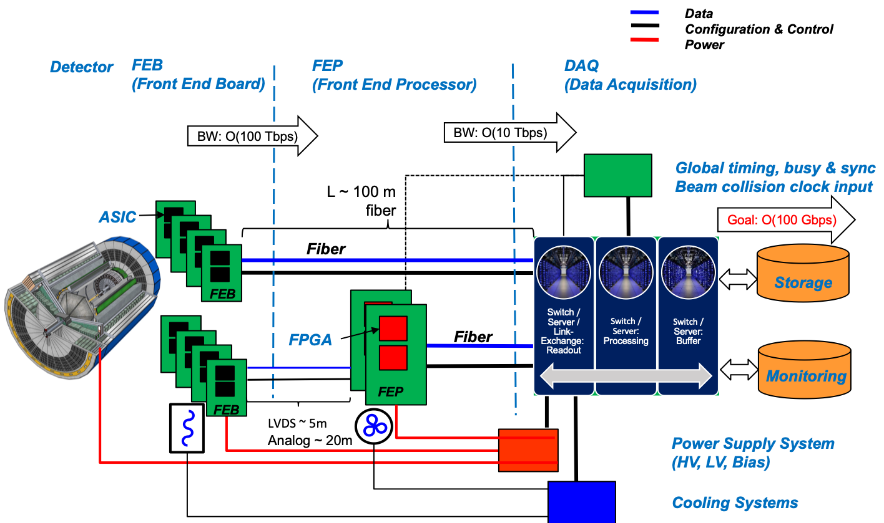
Streaming Readout Architecture
Possible at EIC as data rates manageable
(500 kHz, O(100) Gbps)
30 July 2020
EIC Yellow Report – Readout and DAQ FJ Barbosa, K Chen, J Huang

Slide 25
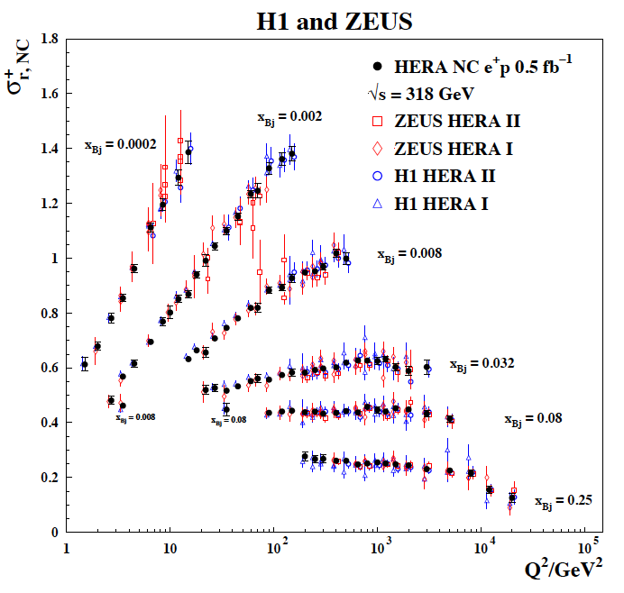
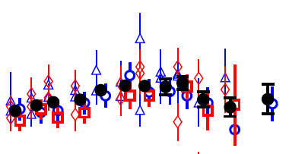
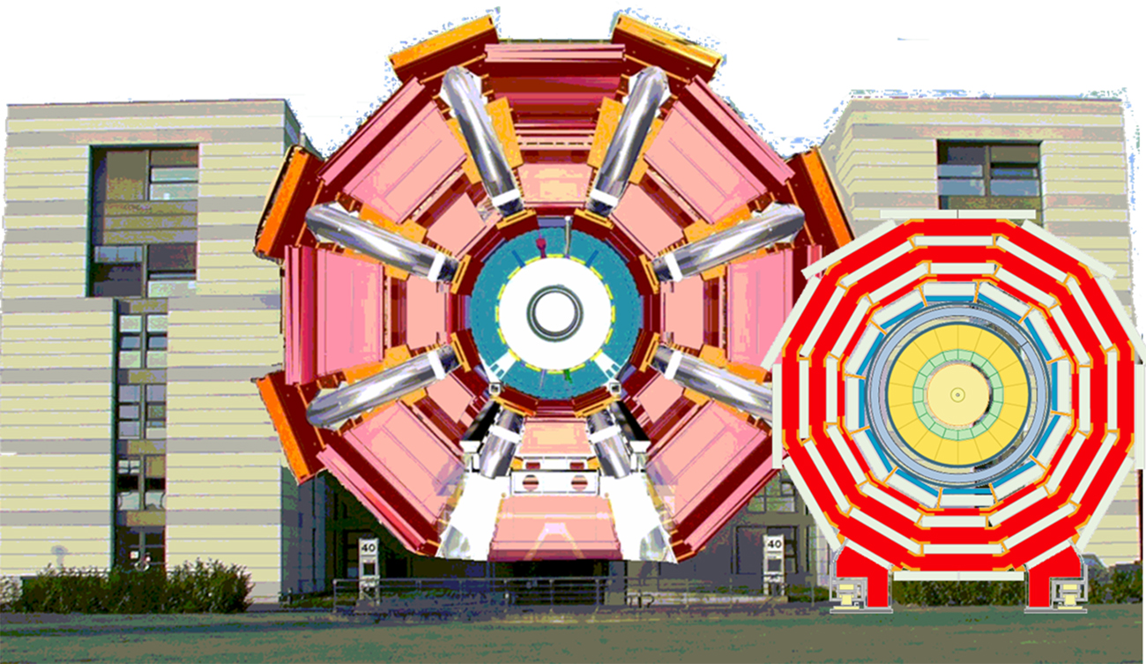
2nd Complementary Detector
What do we want from “Complementary”
Cross-checking important results (obvious!)
  Many examples of wrong turns in history of nuclear and particle physics.
  Independent cross checks (detector, community, analysis tools) are essential for timely verifications and corrections
Cross Calibration
  Combining data gave well beyond the √2 statistical
  improvement …
  Different dominating H1, ZEUS systematics…
  Effectively use H1 electrons with ZEUS hadrons
  … not all optimal solutions have to be in one detector…
Technology Redundancy
... by applying different detector technologies and philosophies
to similar physics aims
  mitigates technology risk vs. unforeseen backgrounds
  differently optimises precision and systematics
Different primary physics focuses
... EIC has unusually broad physics program
(from exclusive single particle production to high multiplicity
eA or gA with complex nuclear fragmentation)
→ Impossible to optimize for the full program in a single detector.
ATLAS
CMS

Slide 26
Complementarity for 1st-IR & 2nd-IR
Since CD-1 we made significant progress in the preliminary design for the 2nd IR with a focus on complementarity
1st IR (IP-6)
2nd IR (IP-8)
Geometry:
ring inside to outside
ring outside to inside
tunnel and assembly hall
are larger
Tunnel: ⦰ 7m +/- 140m
tunnel and assembly hall are smaller
Tunnel: ⦰ 6.3m to 60m then 5.3m
Crossing Angle:
25 mrad
35 mrad
secondary focus
different blind spots
different forward detectors and acceptances
different acceptance of central detector
Luminosity:
more luminosity at lower E_{CM}
optimize Doublet focusing FDD vs. FDF
→ impact of far forward p_{T} acceptance
Experiment:
1.5 Tesla or 3 Tesla
different subdetector technologies

Slide 27


EIC Project Status
The EIC received in the 2015 Long Range Planning of the NSAC the following recommendation
“We recommend a high-energy high-luminosity polarized EIC as the highest priority for new facility construction following the completion of FRIB”
“… In summary, the committee finds a compelling scientific case for such a facility (the EIC). The science questions that an EIC will answer are central to completing an understanding of atoms as well as being integral to the agenda of nuclear physics today. In addition, the development of an EIC would advance accelerator science and technology in nuclear science; it would as well benefit other fields of accelerator-based science and society, from medicine through materials science to elementary particle physics.”
Released July 24, 2018
January 2020: CD-0 & site selection → BNL
January 2021: DOE CD-1 Review → Move forward to CD-1
Accelerator Technical Reviews | Spring -- Autumn 2021
Start Preliminary Design | April 2021
Detector Proposals Submitted | December 2021
Selection of Project Detector | March 2022
Start Earned Value Tracking | Summer 2022
Clarify In-kind Deliverables - Agreements | Summer/Fall 2022
Goal for CD-2 Approval | January 2023
Goal for CD-3 Approval Goal for CD-4 Early Project Completion | March 2024 July 2031

Slide 28
Experimental Program Preparation
Yellow Report and EIC Conceptual Design Report are both available and include the reference detector concept.
BNL and TJNAF Jointly Leading Process to Select Project Detector | BNL and TJNAF Jointly Leading Process to Select Project Detector
2020 | Call for Expressions of Interest (EOI) https://www.bnl.gov/eic/EOI.php | May 2020
 | EOI Responses Submitted | November 2020
 | Assessment of EOI Responses | On-going
2021 | Call for Collaboration Proposals for Detectors https://www.bnl.gov/eic/CFC.php | March 2021
 | BNL/TJNAF Proposal Evaluation Committee | Spring 2021
 | Collaboration Proposals for Detectors Submitted | December 2021
✔️ | Decision on Project Detector | March 2022
  Critical to have excellent detector proposals with science and
  technology complementarity integrated

Slide 29
EICUG Activities towards Collaboration Formation
The EIC user community efforts on detector collaboration formation have started.
The ECCE consortium is looking at a detector proposal based on an existing 1.5 T magnet (and most likely IP8): https://www.ecce-eic.org
An inaugural organizational meeting March 12th-13th for a detector collaboration based on a 3 T magnet and IP6 (the Yellow Report/Project Reference Detector)
EIC@IP6: https://sites.temple.edu/eicatip6/
2nd IR for the EIC Workshop March 17th-19th had a session on detector proposals (https://indico.bnl.gov/event/10677/timetable/) focus on complementarity
CORE "Kick-Off" Workshop for an open collaboration for a EIC Detector proposal, 29-30 March 2021 https://indico.bnl.gov/event/11053/

Slide 30

Take Away Message
Why EIC now?
“all stars align”:
theory developments will allow to obtain the answers to the big questions discussed
detector technologies allow for a collider detector with high resolution, wide acceptance and particle identification
BUT MOST IMPORTANTLY
accelerator technologies allow to built a collider with
  high luminosity
  highly polarized electron and light hadron beams
  a wide range in center of mass energies
  hadron beams with highest A
  demanding acceptance requirements can be realized in IR design
Current
knowledge about
nucleon structure
and the glue
EIC science program will profoundly impact
our understanding of the inner structure
of the world around us
uniquely tied to a future high energy, high luminosity,
polarized ep / eA collider
never been measured before & will never without
with EIC

Slide 31


Slide 32
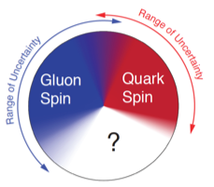
What is needed to address the EIC Physics
large kinematic coverage:
bridge between measurements in different regimes (s, x, Q²)
access to x and Q² over a wide range
→ center-of-mass energy √s: 20 – 140 GeV
polarized electron and hadron (p, He-3) beams:
access to spin structure of nucleons and nuclei
Spin vehicle to access the spatial and momentum structure of the nucleon in 3d
Full specification of initial and final states to probe q-g structure of NN and NNN interaction in light nuclei
unpolarized nuclear beams: d to Pb
accessing the highest gluon densities → saturation
quark and gluon interact with a nuclear medium
high luminosity 10³³-10³⁴ cm⁻²s⁻¹ :
mapping the spatial and momentum structure of nucleons and nuclei in 3d
access to rare probes, i.e. Ws

Slide 33
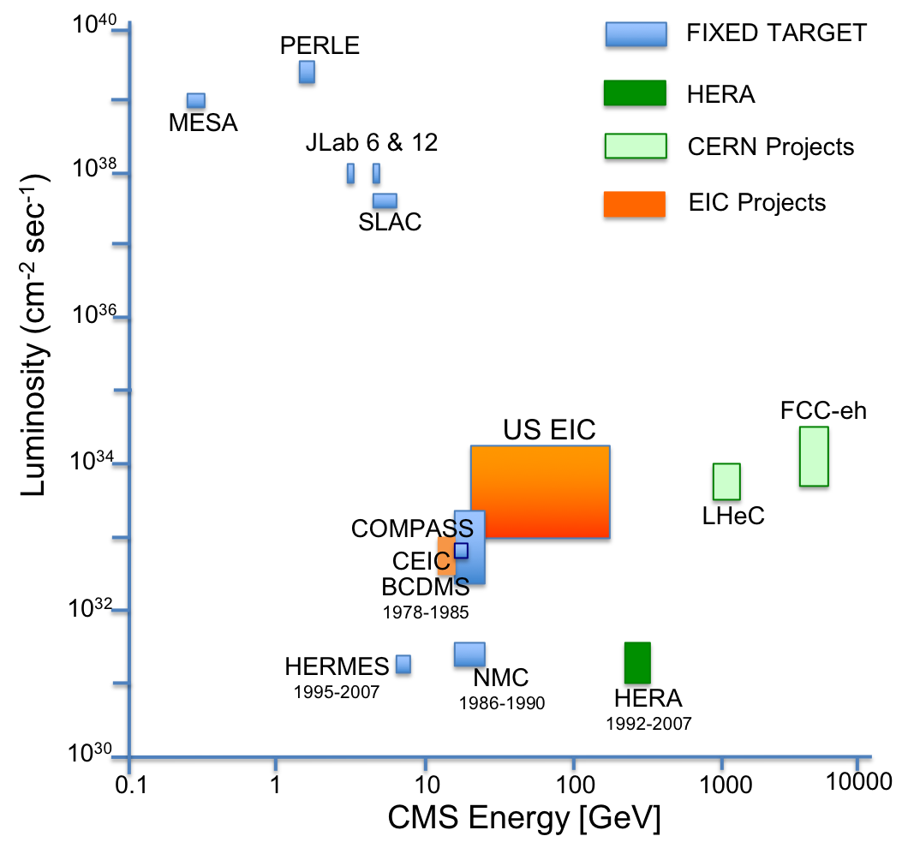
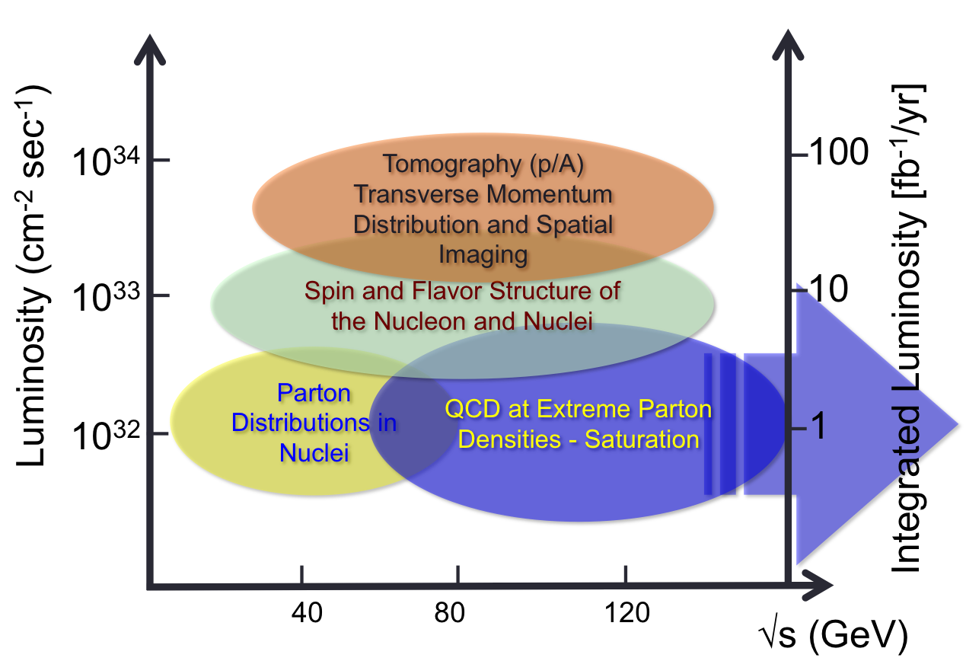
What is needed experimentally?
Luminosity - √s Energy and EIC Physics:
US-EIC:
polarization, ion species together with
its luminosity and √s coverage makes
it a completely unique machine world-wide.

Slide 34
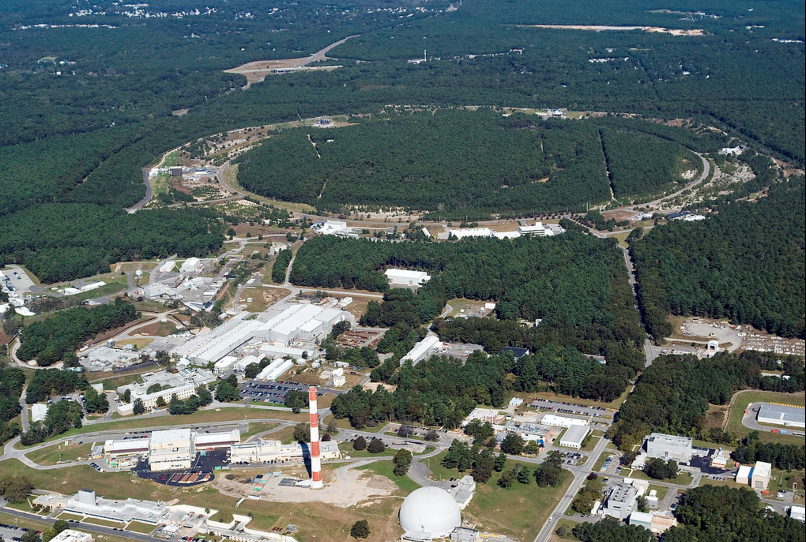
EIC Collider Concept
Design based on existing RHIC,
RHIC is well maintained, operating at its peak
Hadron storage ring 40-275 GeV (existing)
  RHIC Yellow Ring
  many bunches, 1160 @ 1A beam current
  bright beam emittance ε_{xp}= 9 nm, flat beam
  need strong cooling
Electron storage ring (2.5–18 GeV, new)
  many bunches,
  large beam current (2.5 A) ➔10 MW S.R. power
  s.c. RF cavities
  Energy independent radiation damping
Electron rapid cycling synchrotron (new)
  1-2 Hz
  Spin transparent due to high periodicity
High luminosity interaction region(s) (new)
  L = 10³⁴cm⁻²s⁻¹
  Superconducting magnets
  25 mrad Crossing angle with crab cavities
  Spin Rotators (longitudinal spin)
  Forward hadron instrumentation
EIC@BNL

Slide 35
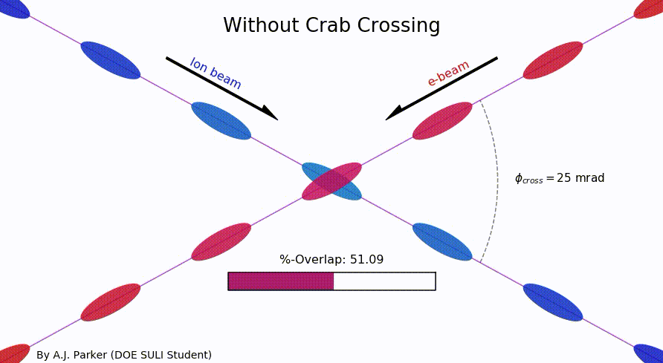
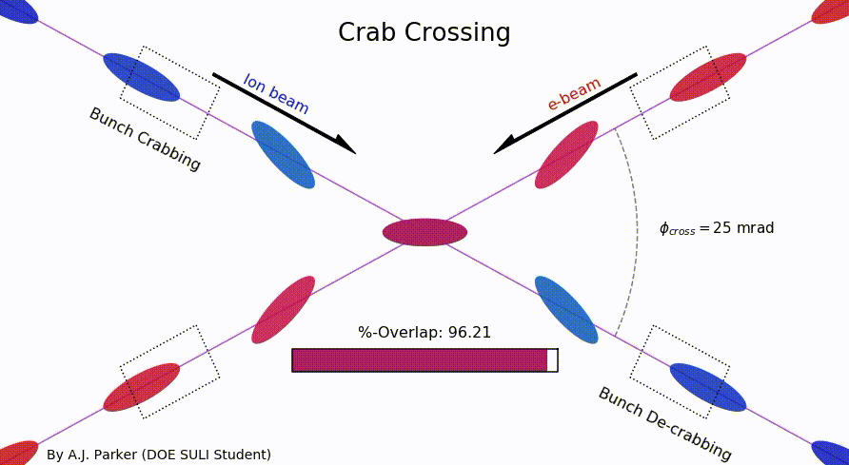
Why a Crossing Angle
Brings focusing magnets close to IP
→ high luminosity
Beam separation without separation dipoles
→ reduced synchrotron radiation
But significant loss of luminosity
Solution: Crab crossing
Head-on collision geometry is restored by rotating the bunches before colliding (“crab crossing”)
Bunch rotation (“crabbing”) is accomplished by transversely deflecting RF resonators (“crab cavities”)
Actual collision point moves laterally during bunch interaction
Challenges
    Bunch rotation (crabbing) is not linear due to finite
    wavelength of RF resonators (crab cavities)
    Severe beam dynamics effects
    Physical size of crab cavities
Significant impact on main and
forward detector acceptance

Slide 36
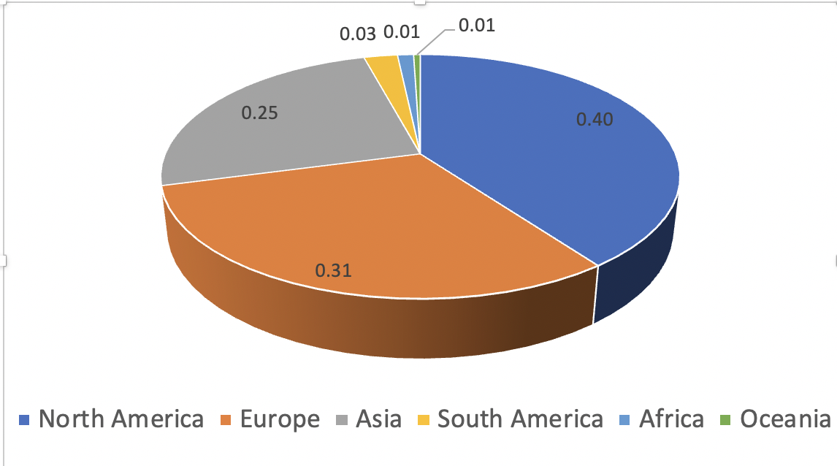
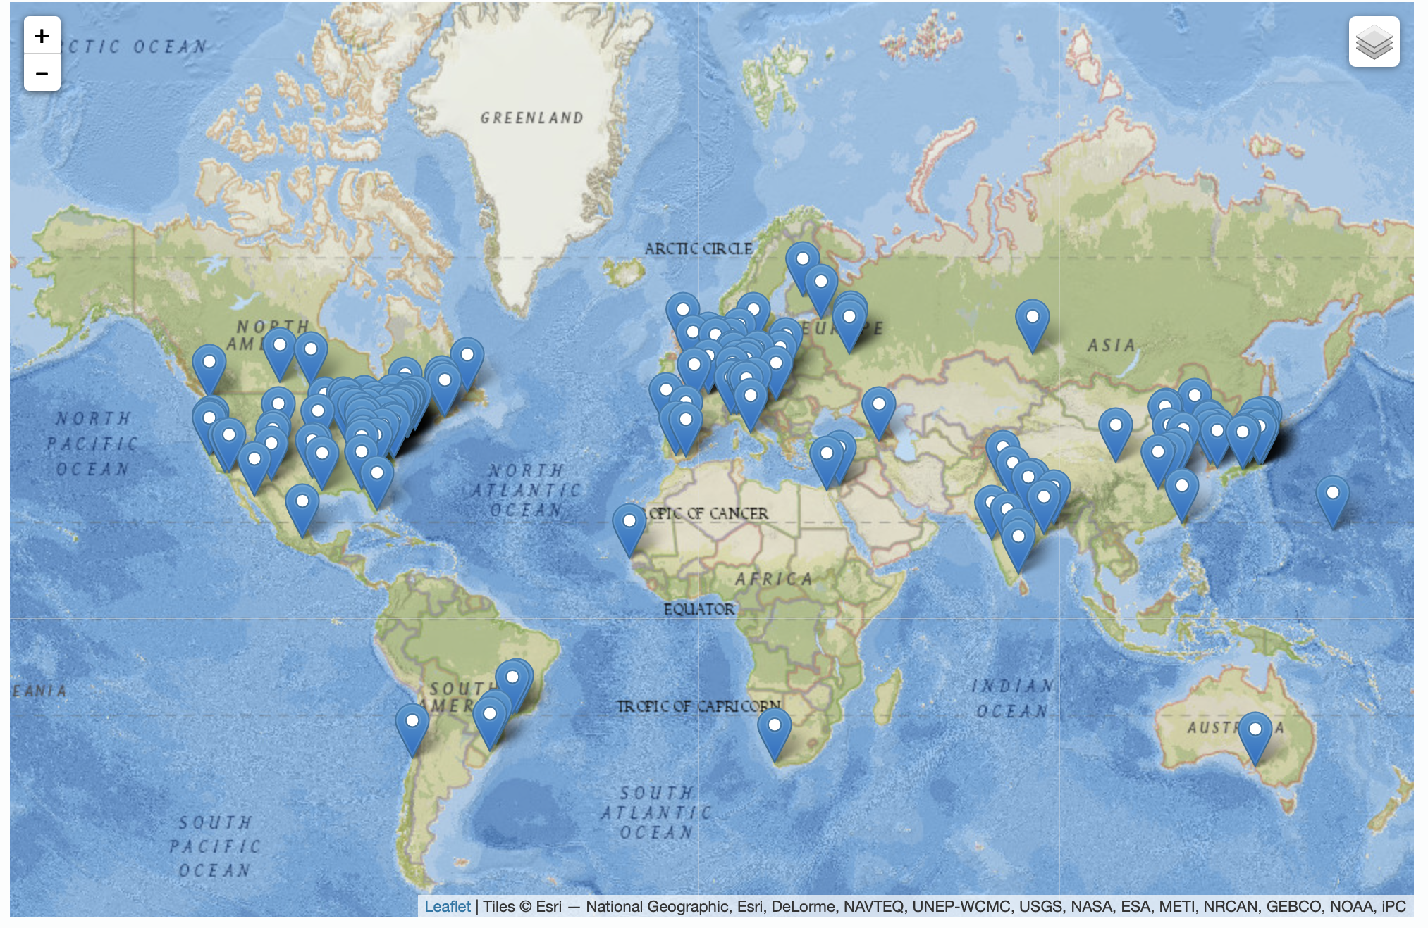
Worldwide Interest in EIC Physics
The EIC Users Group: EICUG.ORG
Formed 2016
February 2021: 1253 collaborators, 33 countries, 251 institutions
Map of institution’s locations
Size of EICUG has continuously grown since its formation, in particular after the award of CD0 / site-selection.
Expect growth to continue through the phases of EIC project.
Strong international representation

Slide 37
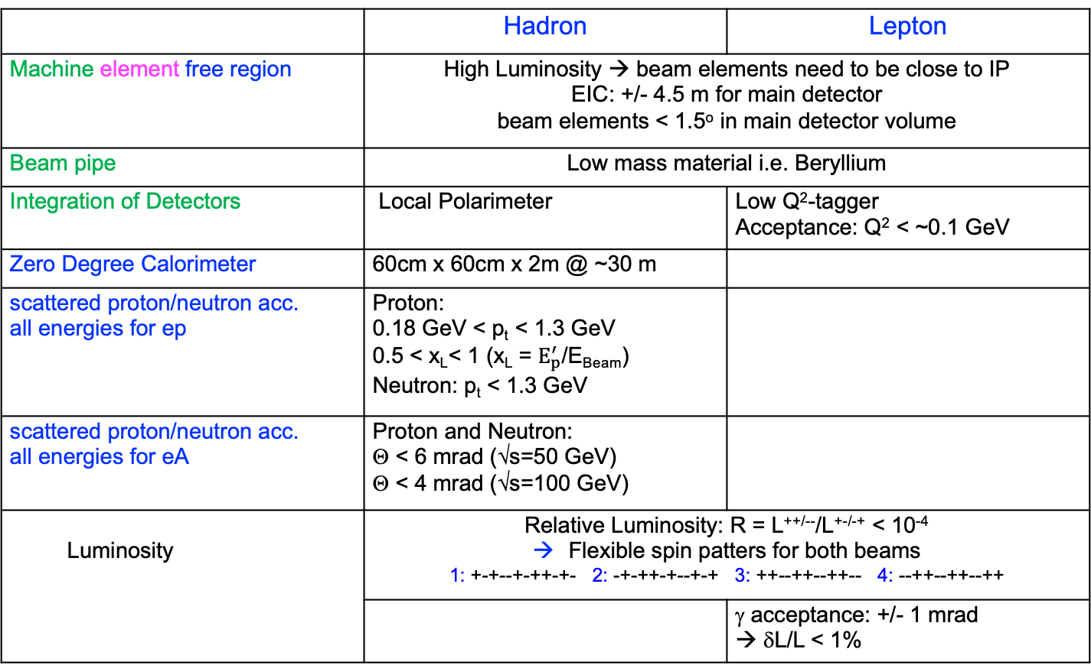
IR Requirements from Physics
 | Hadron | Lepton
Machine element free region | High Luminosity → beam elements need to be close to IP EIC: +/- 4.5 m for main detector beam elements < 1.5º in main detector volume
Beam pipe | Low mass material i.e. Beryllium
Integration of Detectors | Local Polarimeter | Low Q²-tagger Acceptance: Q² < ~0.1 GeV
Zero Degree Calorimeter | 60cm x 60cm x 2m @ ~30 m
scattered proton/neutron acc. all energies for ep | Proton: 0.18 GeV < p_{t} < 1.3 GeV 0.5 < x_{L}< 1 (x_{L} = $E_{p}^{′}$/E_{Beam}) Neutron: p_{t} < 1.3 GeV
scattered proton/neutron acc. all energies for eA | Proton and Neutron: Θ < 6 mrad (√s=50 GeV) Θ < 4 mrad (√s=100 GeV)
Luminosity | Relative Luminosity: R = L^{++/--}/L^{+-/-+} < 10⁻⁴ Flexible spin patters for both beams 1: +-+--+-++-+- 2: -+-++-+--+-+ 3: ++--++--++-- 4: --++--++--++
 |  | γ acceptance: +/- 1 mrad → δL/L < 1%
most demanding

Slide 38
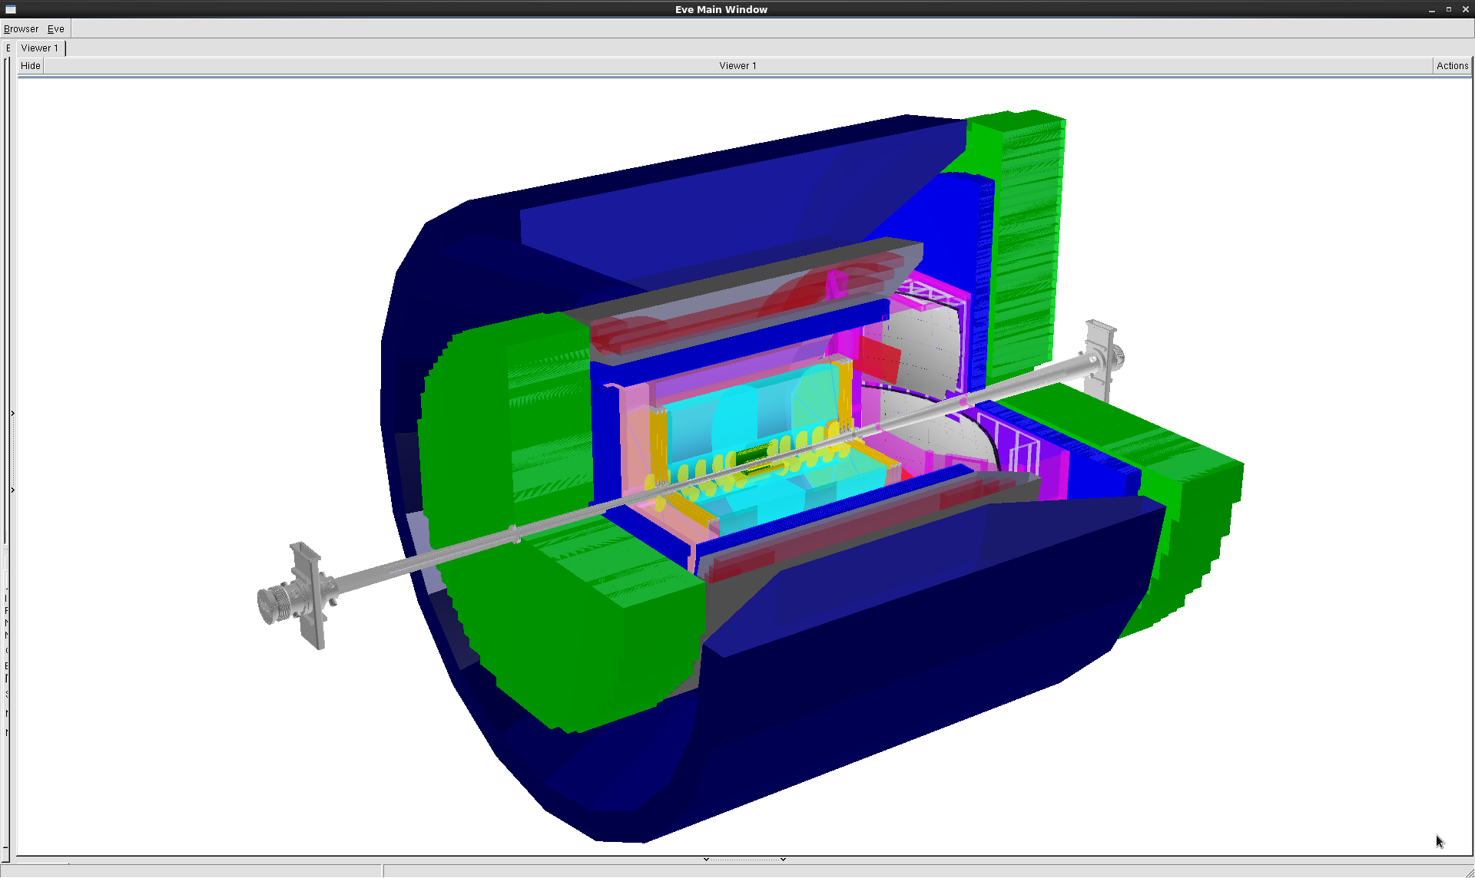
EIC General Purpose Detector
hadronic calorimeters
e/m calorimeters
PID/ RICH detectors
silicon trackers
TPC
GEM trackers
solenoid coils
EIC general purpose Detector around
a new 3T Solenoid
Hermetic coverage
→ as close as possible to 4π
Coverage: 2º < Θ < 178º (-4<η<4 ) with 2π in Φ
9.0m
Barrel Hadronic calorimeter not shown
Flow down of Physics Requirements
to detector design has been determined in 2020 EIC-UG
Yellow Report Initiative
http://www.eicug.org/web/content/yellow-report-initiative
electrons
hadrons
Technologies based on Generic EIC Detector R&D developed by EIC-UG members
https://wiki.bnl.gov/conferences/index.php/EIC_R%25D

Slide 39
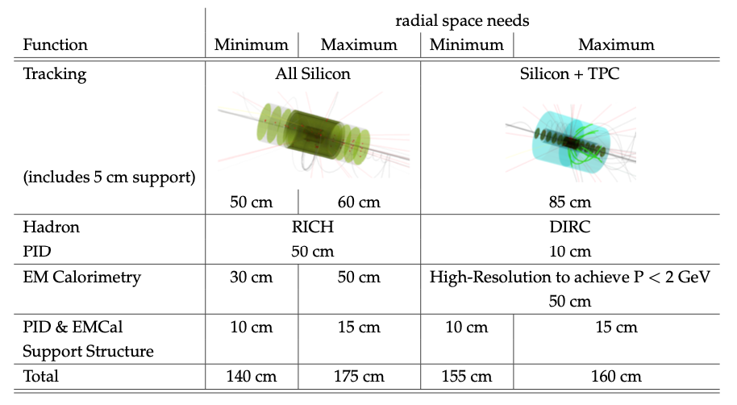

Detector integrated in EIC Project
Space considerations versus Magnet size:
Conclusion:
to fit all detectors in the existing magnet with bore 2.8 meter will be challenging and it is possible some functionality has to give. For a new magnet, a bore of 3.2 meter is a safer option. Only in one of these four cases, we needed 5 cm more.

Slide 40



Tracking/Material Budget
Vertex + central + forward / backward tracker layout ( moderate momentum resolution, vertex resolution ~20 μm)
At most 3T central solenoid field (maximize B*dl integral at high |η|)
Low material budget
  Minimize bremsstrahlung and conversions for primary particles
  Improve tracking performance at large |η| by minimizing multiple Coulomb scattering
  Minimize the dead material in front of the high resolution e/m calorimeters
Central area of beampipe (around IP):
  ~1.5m of beryllium to minimize multiple scattering for low Pt particles
Low-mass exit window for far-forward particles
Few % radiation length material thickness for the required angular range (low angle)

Slide 41




Endcaps: MPGDs
To improve momentum resolution at large rapidities.
Spatial resolution well below 100 μm
Large-area detectors possible
Cost efficient compared to silicon
~900mm
EIC R&D: large 2D GEM module

Slide 42



Central tracker
For momentum reconstruction
TPC: low material budget tracker
(similar to STAR, sPHENIX, ALICE... )
Sufficient spatial resolution
dE/dx for low-momentum PID
-1 < η < 1
Possible endcap upgrade for EIC

Slide 43






Sampling EmCal
Well established technology
  HERA-B, ALICE, PHENIX, PANDA, …
Medium energy resolution ~7..13%/√E
Compact (X₀ ~7mm or less), cost efficient
Pb/Sc shashlyk
W/SciFi spacal
Scintillating Fibers embedded in a W/epoxy mix
Light collection uniformity can yet be improved
~13.3%/√E + 3.5%

Slide 44
Hadronic Calorimeter
Main purpose: jet energy measurement
  Particle Flow Algorithm usage anticipated (where HCal role is identification and energy measurements of the neutral hadrons, namely neutrons and K_{L})
In general the “conventional” hadronic calorimetry is considered per default
Anticipated stochastic term in energy resolution & depth
Other considerations
  Space!
  Interplay with EmCal in a “binary” EmCal+HCal configuration
  Tower granularity (~10 x 10 cm² suffices)
  Readout immune to the magnetic field
η | [-4 .. -1] | [-1 .. 1] | [1 .. 4]
σ_{E}/E | ~50%/√E + 10% | ~100%/√E + 10% | ~50%/√E + 10%
depth | ~5 λ_{I} | ~5 λ_{I} | ~6-7 λ_{I}

Slide 45


Fe/Sc sandwich
HCAL in endcap
Compact LEGO-style design
  Can be used with a mixed Fe/Pb absorber
~60%/√E expected
EIC 2014 Pb/Sc prototype
~890mm
STAR 2019 Fe/Sc design

Slide 46



Fe/Sc ( barrel)
Similar as used in sPHENIX
  Solid 32-sector steel frame, but only ~3.5 λ_{Ι}
  Moderate energy resolution
~6 m
Scintillator plate with embedded WLS fiber
2017 test beam data

Slide 47




DIRC
Particle
Track
Focusing
Optics
Solid
Radiator
Detector
Surface
Mirror
Cherenkov
Photon Trajectories
Radially compact ( ~ 5cm)
high-performance DIRC with better optics and <100 ps timing ($π$/K up to ~6 GeV/c)
Re-use BaBar quartz bars ?
Integration into a 4$π$ detector can be challenging
hpDIRC

Slide 48


Dual radiator RICH
Hadron PID in the forward/hadron end-cap
Use a combination of aerogel and C_{m}F_{n} with indices of refraction matching EIC momentum range in the forward endcap
Similar to LHC-b, HERMES, JLAB/Hall-B, …
  Continuous >3σ π/K separation up to 60 GeV/c and K/p separation to higher momenta
  >3σ e/π separation up to ~15 GeV/c
e/π
π/K
K/p

Slide 49


Modular-RICH (mRICH)
For hadron PID in the electron end-cap
Compact version of a conventional aerogel-based proximity focusing RICH
~20 cm
3σ
Expect π/K 3σ separation up to 8-10 GeV/c
  Was also tested with SiPM readout
  LAPPD readout – spring 2021

Slide 50





Additional e⁻ ID
To improve e-identification for leptonic/semi-leptonic decays.
In addition to Calorimeters and Cherenkov detectors in the hadron-endcap considering TRD.
GEM -TRD/Tracker :
  e/π rejection factor ~10 for momenta between 2-100 GeV/c from a single ~15cm thick module.
Thickness [cm]
  Very precise Tracking segment behind dRICH:

Slide 51




Far forward (hadron going) region
$$x_{L}=\frac{p_{z, nucleon}}{p_{z, beam}}$$
Detector | Angular accept. [mrad] | Pt coverage
ZDC @ ~30m | $θ$<5.5 ( $η>6)$ | pT<1.3 GeV
Roman Pots | 0*<$θ$<5.0 ( $η>6)$ | *Low pT(t) cutoff (beam optics)
Off-Momentum Detectors | 0.0< $θ$ < 5.0 ( $η>6)$ | Low-rigidity particles from nuclear breakups
B0 forward spectrometer | $$5.5<θ<20.0$$ (4.6< $η<5.9)$ | High pT(t)
p/A
IP

Slide 52




Far-forward detectors
Roman-Pots and Off-momentum detectors
B0-spectrometer
(5.5 < 𝜽 < 20.0 mrad)
0.0* (10σ 𝑐𝑢𝑡) < 𝜽 < 5.0 mrad
Warm space for detector package insert located inside a vacuum vessel to isolate from insulating vacuum.
Higher granularity detectors needed in this area ( MAPS) with layers of fast-timing detectors (LGADs)
Shape and coverage of B0 tracker needs to be further evaluated
Low Pt particles Pt < 1.3 GeV
RPs: movable, integrated into the vacuum system
Fast Timing and moderate granularity
(500x500$μm2)$
AC-LGADs
Space for detectors
$$\boxed{σ(z)=\sqrt{ε∙β(z))}}$$

Slide 53
EIC Experimental Equipment Planning
The DOE-NP supported EIC Project includes
one detector and one Interaction Region
  The total detector cost: $250M Dir+Bur+Esc excluding contingency
  The DOE part: $152M (Dir+Bur+Esc excluding contingency ) the rest is assumed in-kind
  Costs for one Interaction Region included in accelerator scope: ~$183M (Dir+Bur+Esc excluding contingency )
The EIC facility is capable supporting a science program that includes two detectors and two interaction regions.
  2nd IR & Detector
  All stakeholders agree that a second IR and detector within the same timeline is
  desirable and will enhance the science output of the facility
  Costs depend on the complexity, assuming IP2 similar to IP-1 → $400 M
  Routes to make this possible are being explored.

Slide 54
Call for Detector Proposals Issued
Call for proposals for
  Detector 1 is within the scope of the EIC project and should be based on the “reference” detector and must address the EIC White Paper and NAS Report science case.
  Detector 2 should address major parts of the science described in the EIC White Paper and possibly science beyond that and enable some complementarity to Detector 1.
Evaluation Criteria:
  science capabilities
  risk, cost, and schedule of the proposed experiment, specifically for detector technology, design choices
  strength of the collaboration
Who Evaluates:
  scientific-technical committee of renowned and independent subject matter experts
  Members of the Detector Advisory Committee
Call Details: https://www.bnl.gov/eic/CFC.php
Deadline: 1st of December
Selection of Detectors by Early 2022

