Slide 1


First Analysis of World Polarized DIS Data in the Small-x Dipole Formalism
arXiv: 2102.06159
Matthew D. Sievert
Coauthors:
D. Adamiak, Y. Kovchegov, W. Melnitchouk, D. Pitonyak, N. Sato
9th Workshop of the APS Topical Group on Hadron Physics
April 16, 2021
M. Sievert
Small-x Global Analysis of Polarized DIS
1 / 12

Slide 2
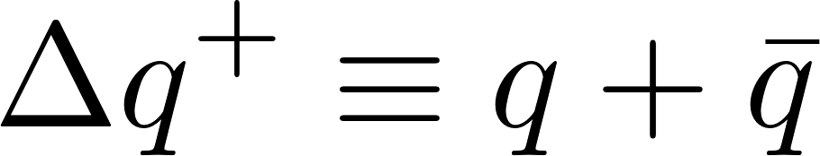
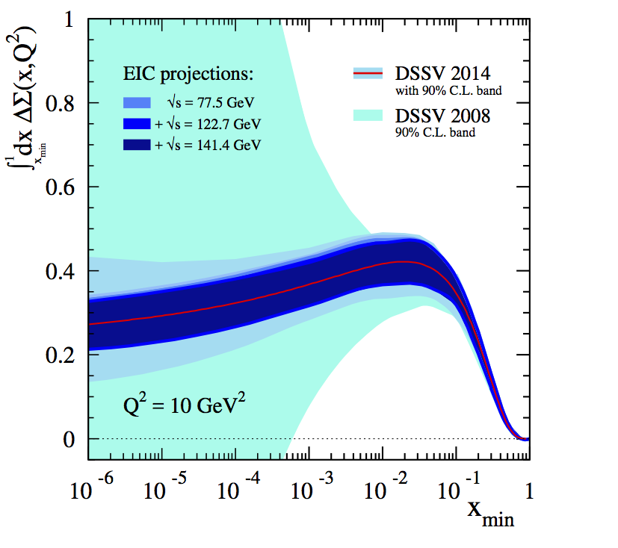
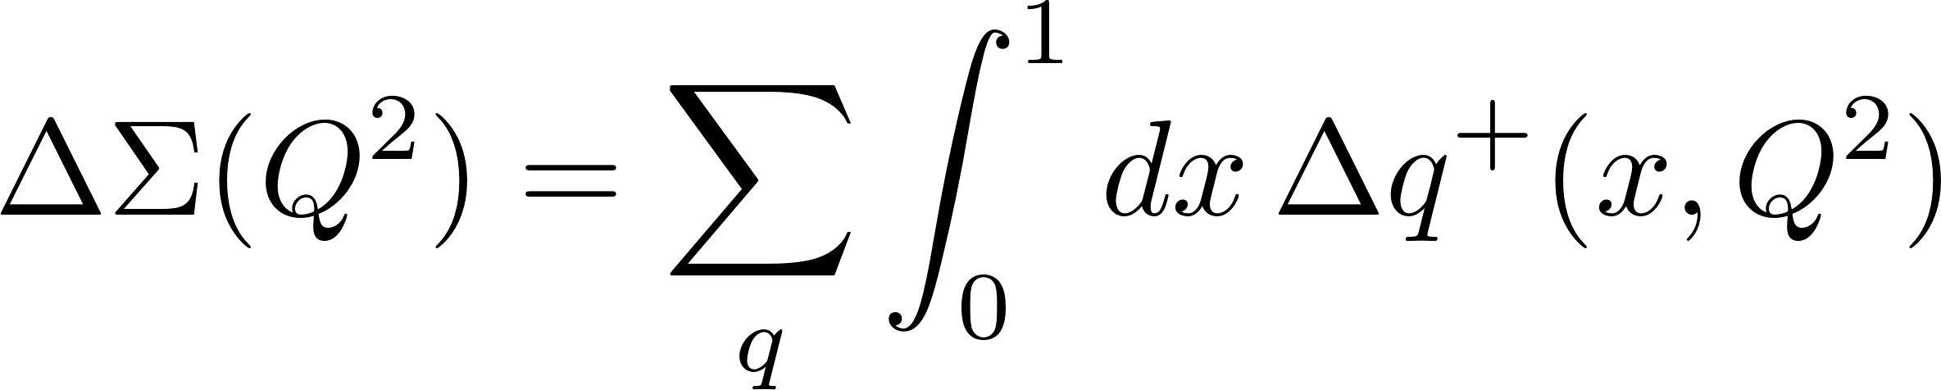
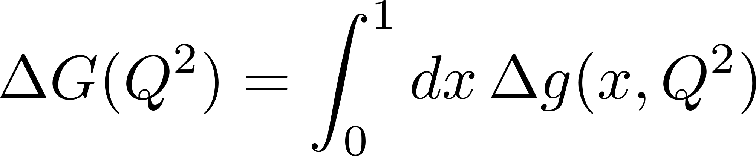
Motivation: Origin of the Proton Spin
Aschenauer et al., Phys. Rev. D92 (2015) no. 9 094030
Determination of the partonic origin of proton spin requires extrapolation to x=0
Extractions based on DGLAP are not predictive of the x dependence
  Inevitable that the uncertainty blows up once data constraints run out
  Controlled extrapolation to x=0 requires a theory which predicts spin at small x
M. Sievert
Small-x Global Analysis of Polarized DIS
2 / 12

Slide 3
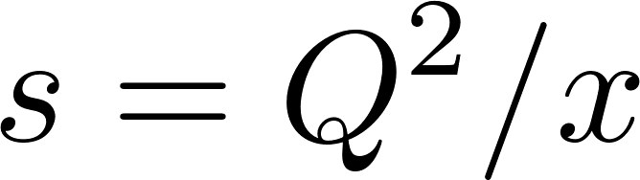
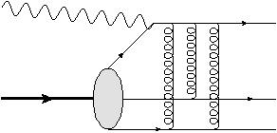
Spin at Small x: Beyond the Eikonal Framework
Small x: “Dipole” DIS
At large x, DIS is dominated by a “Knockout” process
  At small x, the leading channel is a “dipole” process
c.f) Large x: “Knockout” DIS
Leading-power dipole scattering is spin-independent
  Pure eikonal Wilson lines (gluons)
Spin at small x selects on different, sub-eikonal dynamics
  Spin observables are sensitive to novel small-x physics
M. Sievert
Small-x Global Analysis of Polarized DIS
3 / 12

Slide 4
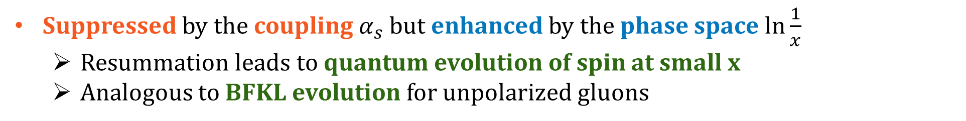
Helicity Evolution at Small x
…
Spin-dependent branching
Kovchegov, Pitonyak, M.D.S.,
JHEP 1601 (2016), Phys. Rev. D95 (2017)
Spin information from the valence sector (large x) is transmitted to small x by spin-dependent branching
See also Bartels, Ermolaev, Ryskin, Z. Phys. C70 (1996)
Suppressed by the coupling $α_{s}$ but enhanced by the phase space $\ln{\frac{1}{x}}$
  Resummation leads to quantum evolution of spin at small x
  Analogous to BFKL evolution for unpolarized gluons
M. Sievert
Small-x Global Analysis of Polarized DIS
4 / 12

Slide 5
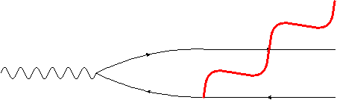
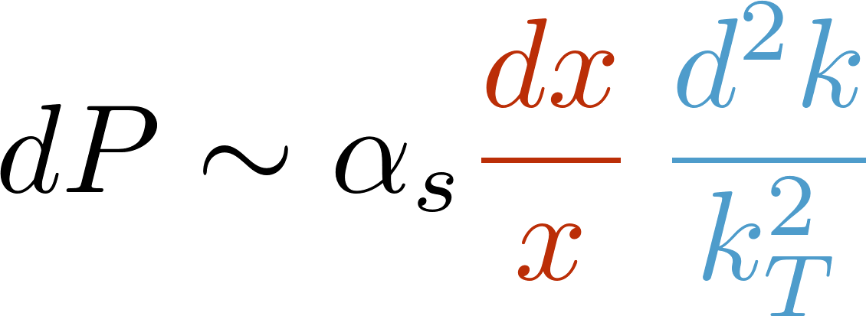

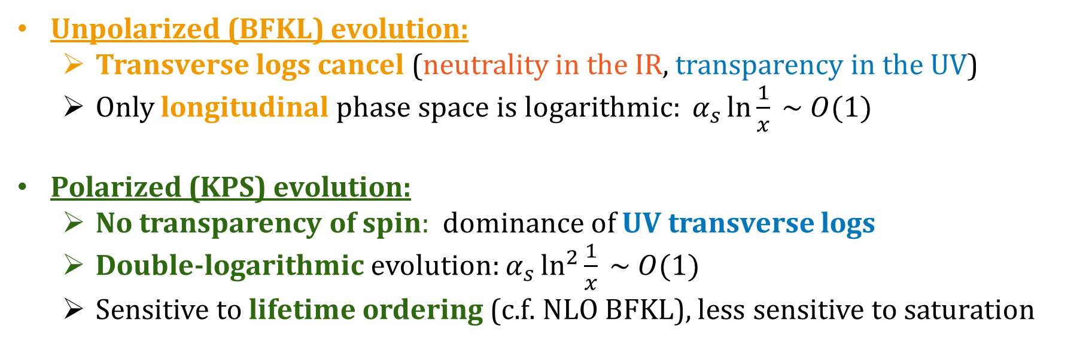
Polarized vs. Unpolarized Small-x Evolution
Longitudinal + transverse logarithmic phase space
Long wavelength/IR
Short wavelength/UV
Unpolarized (BFKL) evolution:
  Transverse logs cancel (neutrality in the IR, transparency in the UV)
  Only longitudinal phase space is logarithmic: $α_{s}\ln{\frac{1}{x}} \sim O(1)$
Polarized (KPS) evolution:
  No transparency of spin: dominance of UV transverse logs
  Double-logarithmic evolution: $α_{s}\ln^{2}{\frac{1}{x}} \sim O(1)$
  Sensitive to lifetime ordering (c.f. NLO BFKL), less sensitive to saturation
M. Sievert
Small-x Global Analysis of Polarized DIS
5 / 12

Slide 6
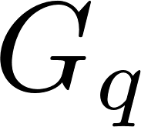
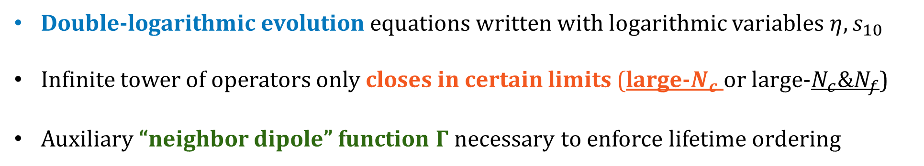
The KPS Evolution Equations
…
Double-logarithmic evolution equations written with logarithmic variables $η, s_{10}$
Infinite tower of operators only closes in certain limits (large-$N_{c}$ or large-$N_{c}\&N_{f}$)
Auxiliary “neighbor dipole” function $Γ$ necessary to enforce lifetime ordering
M. Sievert
Small-x Global Analysis of Polarized DIS
6 / 12

Slide 7
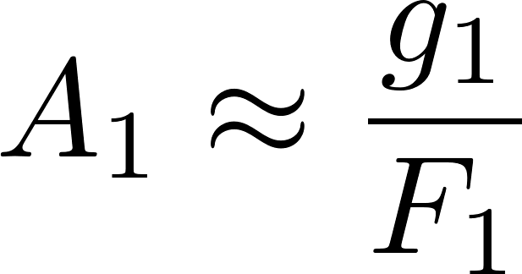
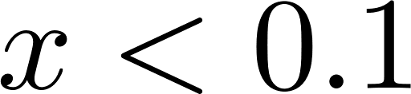
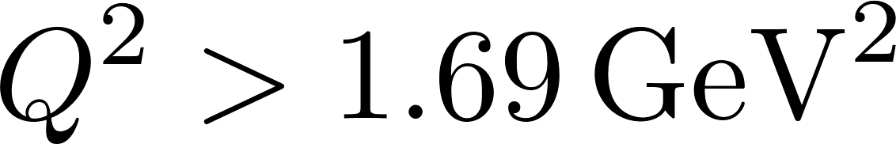
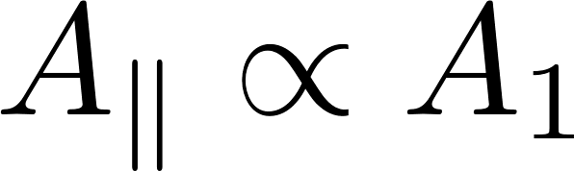
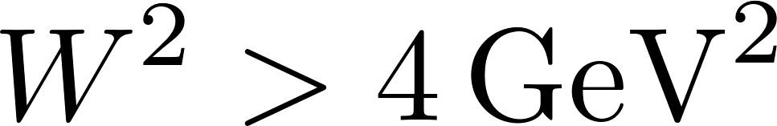
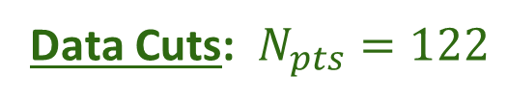
The Ambition: Bayesian Global Analysis of Polarized DIS
Previous estimates:
  Potentially substantial contribution to the proton spin from small-x quarks
  Exploratory methods: instantaneous transition from large-x fit (DSSV) to power-law asymptotics of KPS evolution
This work:
  JAM Bayesian analysis code
  Global analysis of world polarized DIS data (SLAC, EMC, SMC, COMPASS, HERMES)
  Proton, “neutron” (d, ³He) targets
  Inclusive DIS only
    Avoid complication of fragmentation
Kovchegov, Pitonyak, M.D.S., Phys. Rev. Lett. 118 (2017)
N. Sato et al., Phys. Rev. D93 (2016)
Data Cuts: $N_{pts}=122$
M. Sievert
Small-x Global Analysis of Polarized DIS
7 / 12

Slide 8
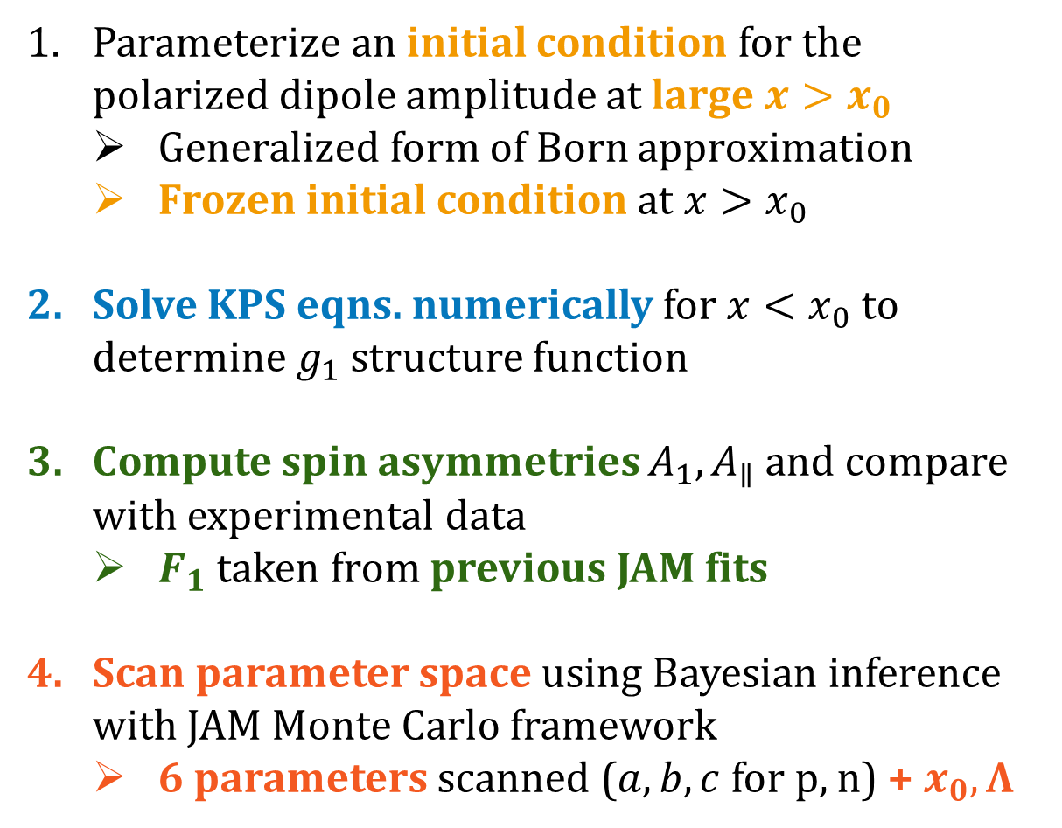
The Approach
Parameterize an initial condition for the
polarized dipole amplitude at large $x>x_{0}$
  Generalized form of Born approximation
  Frozen initial condition at $x>x_{0}$
Solve KPS eqns. numerically for $x<x_{0}$ to determine $g_{1}$ structure function
Compute spin asymmetries $A_{1}, A_{∥}$ and compare with experimental data
  $F_{1}$ taken from previous JAM fits
Scan parameter space using Bayesian inference with JAM Monte Carlo framework
  6 parameters scanned ($a,b,c$ for p, n) + $x_{0}, Λ$
M. Sievert
Small-x Global Analysis of Polarized DIS
8 / 12

Slide 9
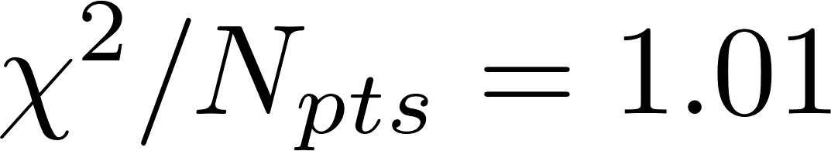
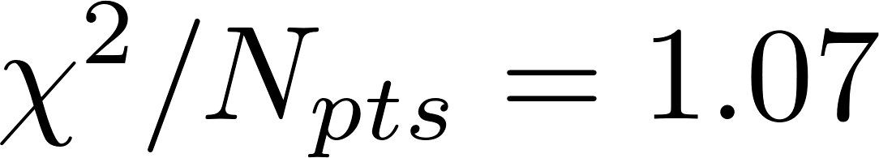
The KPS Formalism is Able to Describe World Data
Nontrivial test: purely small-x theory is able to describe the world DIS data
  Most constraining: a few data points below x = 0.01
JAMsmallx:
c.f. JAM16:
M. Sievert
Small-x Global Analysis of Polarized DIS
9 / 12

Slide 10
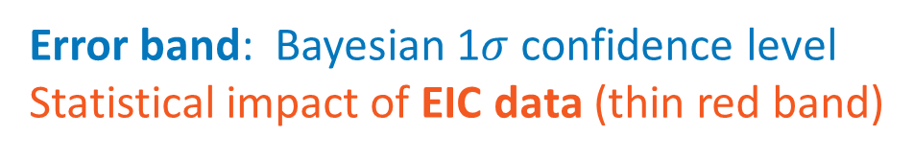
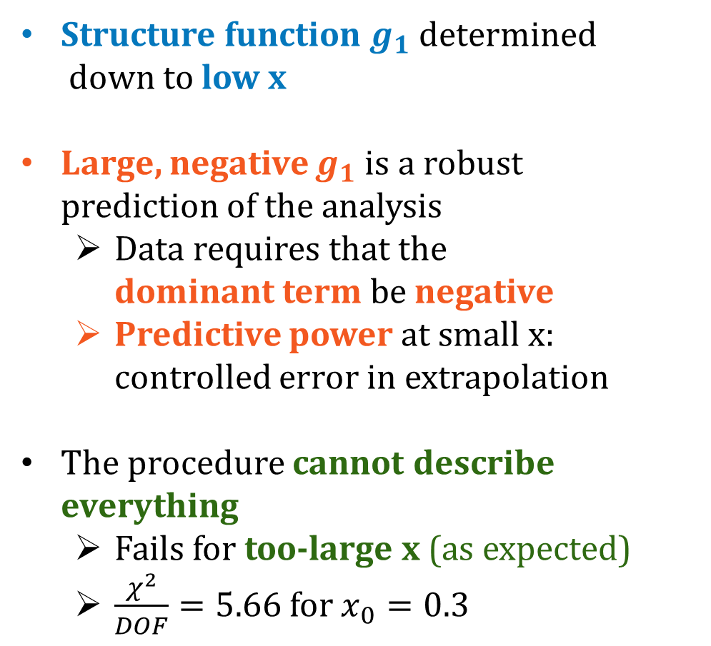
Results: Prediction of Stronger Negative g1
Structure function $g_{1}$ determined
down to low x
Large, negative $g_{1}$ is a robust
prediction of the analysis
  Data requires that the
  dominant term be negative
  Predictive power at small x: controlled error in extrapolation
The procedure cannot describe everything
  Fails for too-large x (as expected)
  $\frac{χ^{2}}{DOF}=5.66$ for $x_{0}=0.3$
Error band: Bayesian 1$σ$ confidence level
Statistical impact of EIC data (thin red band)
DSSV: de Florian et al., Phys. Rev. Lett. 113 (2014), Phys. Rev. D100 (2019)
M. Sievert
Small-x Global Analysis of Polarized DIS
10 / 12

Slide 11
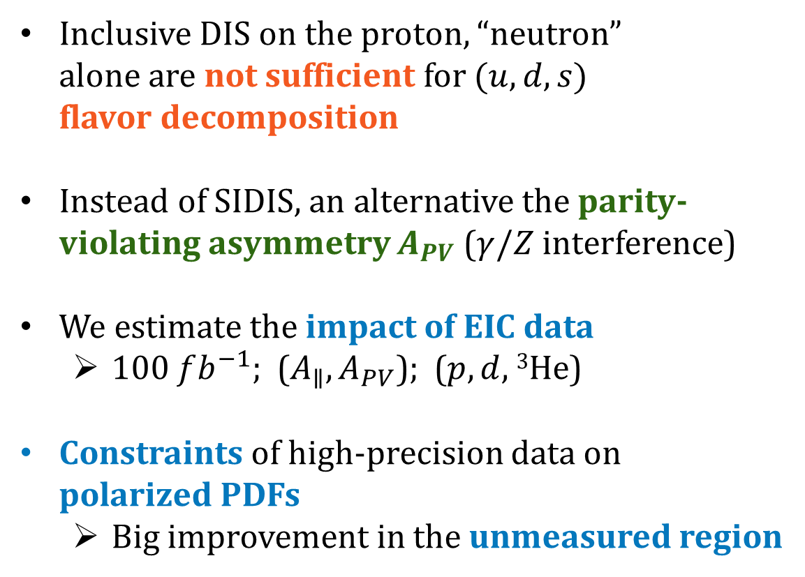
EIC Projections and Flavor Separation from $A_{PV}$
Inclusive DIS on the proton, “neutron”
alone are not sufficient for $(u,d,s)$
flavor decomposition
Instead of SIDIS, an alternative the parity-violating asymmetry $A_{PV}$ ($γ/Z$ interference)
We estimate the impact of EIC data
  100 $fb^{−1};$ ($A_{∥},A_{PV}$); ($p,d,$ ³He)
Constraints of high-precision data on
polarized PDFs
  Big improvement in the unmeasured region
M. Sievert
Small-x Global Analysis of Polarized DIS
11 / 12

Slide 12
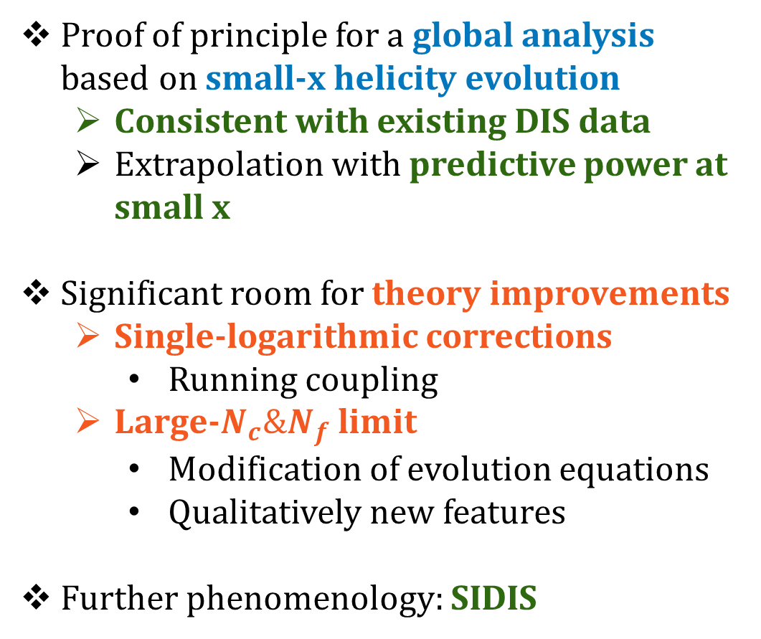
Future Outlook
Proof of principle for a global analysis based on small-x helicity evolution
  Consistent with existing DIS data
  Extrapolation with predictive power at small x
Significant room for theory improvements
  Single-logarithmic corrections
    Running coupling
  Large-$N_{c}\&N_{f}$ limit
    Modification of evolution equations
    Qualitatively new features
Further phenomenology: SIDIS
Y. Kovchegov, Y. Tawabutr, JHEP 08 (2020)
M. Sievert
Small-x Global Analysis of Polarized DIS
12 / 12

