Slide 1
Lensing Mechanism Meets Small-x: Transverse Single Spin Asymmetries in $p^{↑}+p$ and $p^{↑}+A$ Collisions
M. Gabriel Santiago
With Yuri Kovchegov
Phys.Rev.D 102 (2020) 1, 014022 arxiv: 2003.12650 [hep-ph]
work supported by the U.S. Department of Energy, Office of Science, Office of Nuclear Physics under Award Number DE-SC0004286

Slide 2
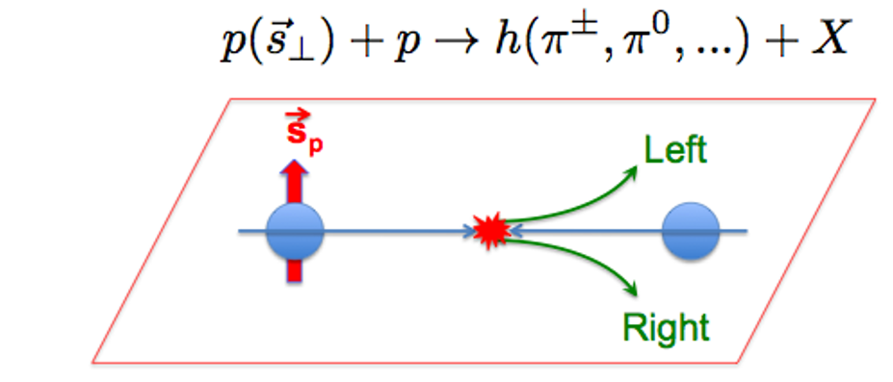
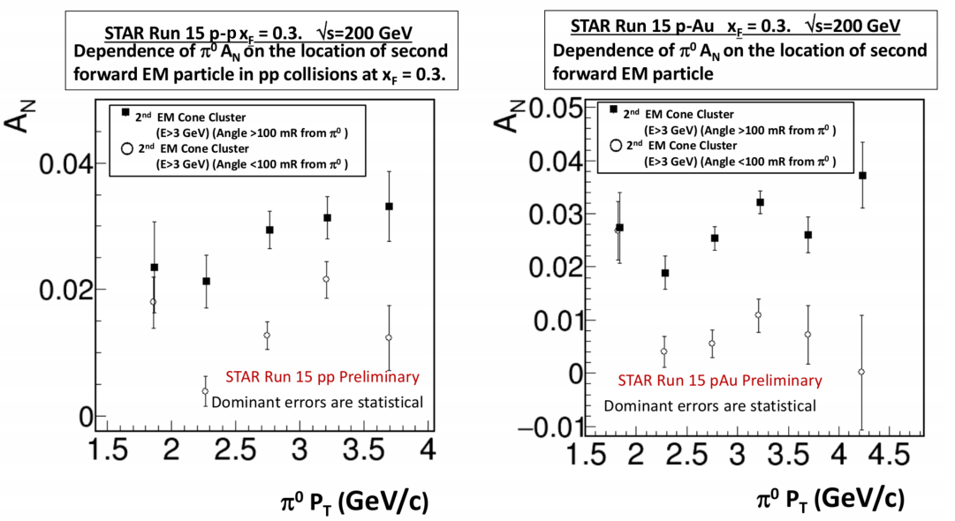
$A_{N}$ Experimental Puzzles
Traditional wisdom says that spin dependent effects fall off rapidly at large momentum, but $A_{N}$ does not have monotonic dependence on $k_{T,h}$
The asymmetry is larger for elastic processes than for inelastic processes
STAR, 2016
(preliminary)

Slide 3
Experimental Puzzles
The asymmetry has been observed to have different dependence on the target’s atomic number $A$ in different ranges of $x_{F}$
STAR, 2016
(preliminary)
PHENIX, 2019
STAR has observed an asymmetry which is roughly independent of $A$
PHENIX has observed an asymmetry which is suppressed by increasing $A$

Slide 4
Small-x Lensing Mechanism
Lensing mechanism: include a final state interaction among the projectile partons à la Brodsky et al (2002)
We work in the small-x saturation framework, which suppresses nonperturbative effects (cf. Kovchegov, Sievert 2012)
The saturation scale brings in factors of the target atomic number $A$
Use sum of quark and gluon unpolarized cross sections for denominator

Slide 5
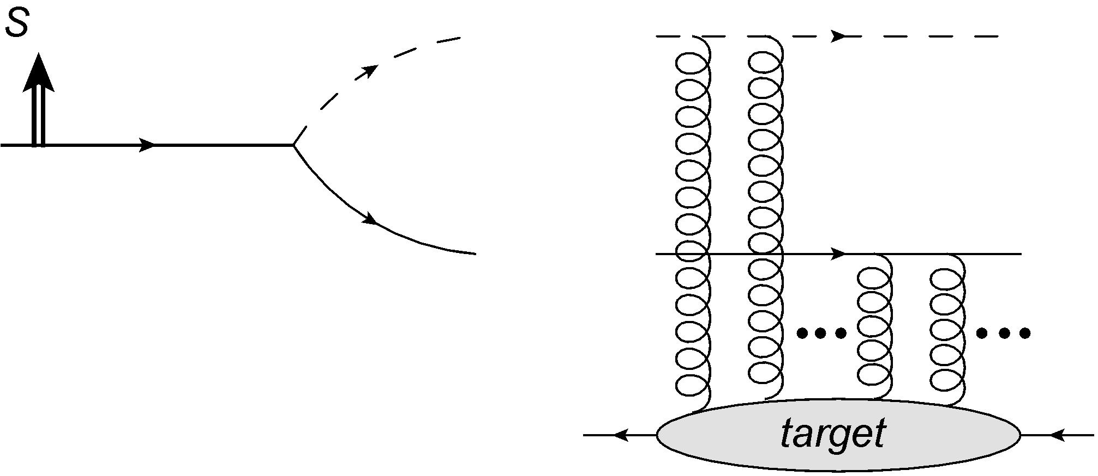
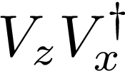
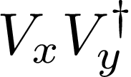
Small-x Lensing Mechanism
Working in the diquark model for the proton, we can build the cross sections out of the splitting wave function for the proton and the Wilson lines for the interactions of the quark and diquark with the target
scalar diquark
$$x_{⊥}$$
proton
conjugate terms
$$z_{⊥}$$
$$\vec{P}$$
quark

Slide 6
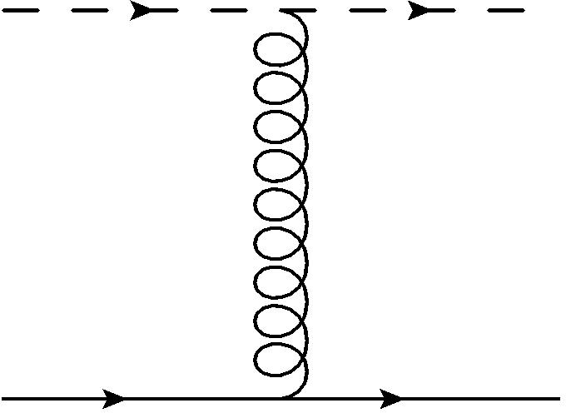
Small-x Lensing Mechanism
Working in the diquark model for the proton, we can build the cross sections out of the splitting wave function for the proton and the Wilson lines for the interactions of the quark and diquark with the target
scalar diquark
$$x_{⊥}$$
conjugate terms
without
proton
$$z_{⊥}$$
$$M_{FSI}$$
$$\vec{P}$$
quark
$$M_{FSI}$$
Final state lensing
interaction!
$$M_{FSI}$$

Slide 7
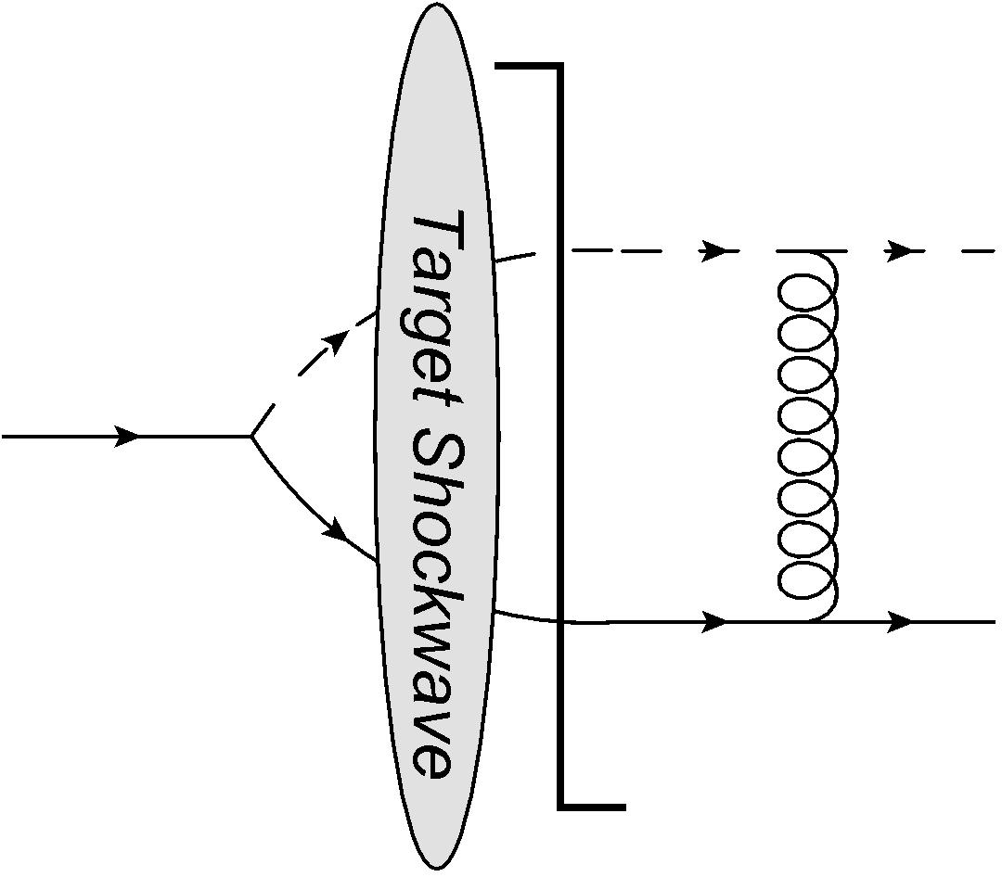
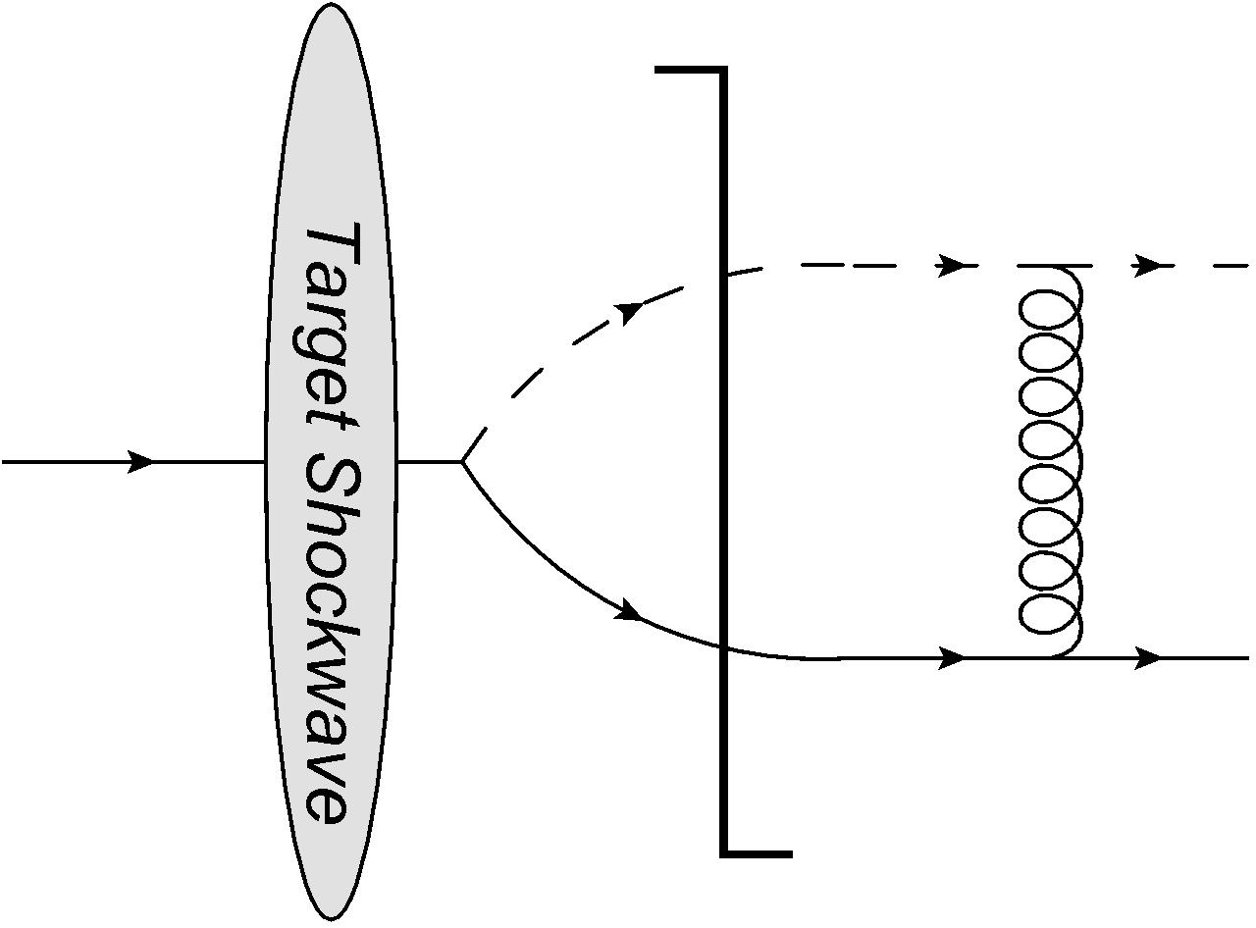
Phase From Final State Interaction Lensing
We can add an order $α_{s}$ final state interaction to generate the asymmetry instead of using odderon exchange
In the diquark model, this is just a single gluon exchange between the quark and diquark after scattering off the target
$$+$$
conjugate terms without
$$M_{FSI}$$
$$M_{FSI}$$
$$M_{FSI}$$

Slide 8
Polarized Cross Section
Neglecting the quark mass in all terms and the diquark mass in the final state interaction term, the polarized cross section in the limit $k_{T},Q_{s}≫M_{P}$ is

Slide 9
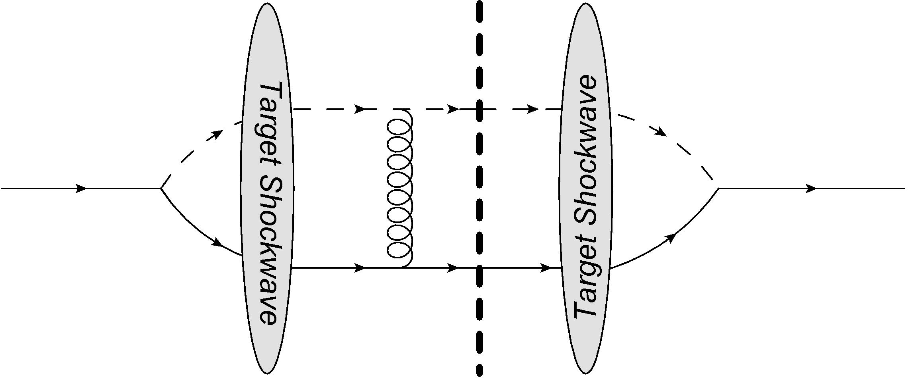
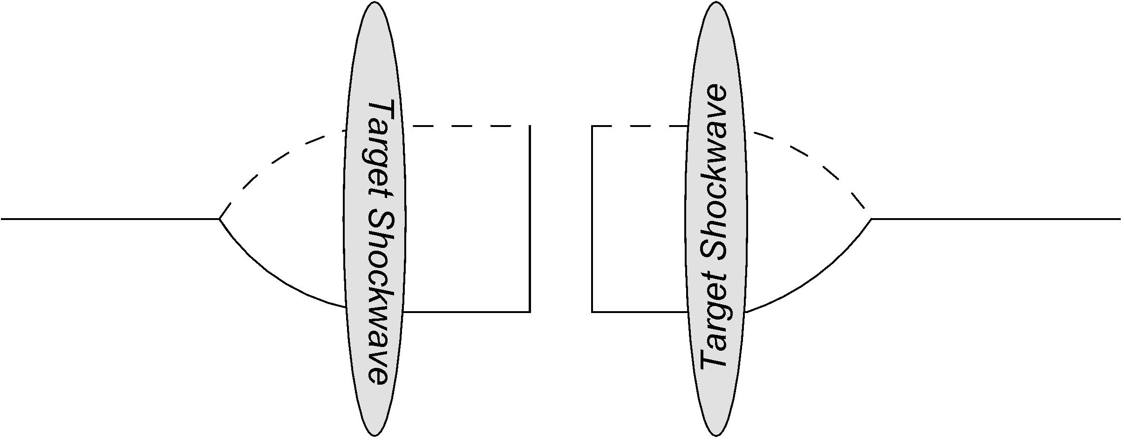
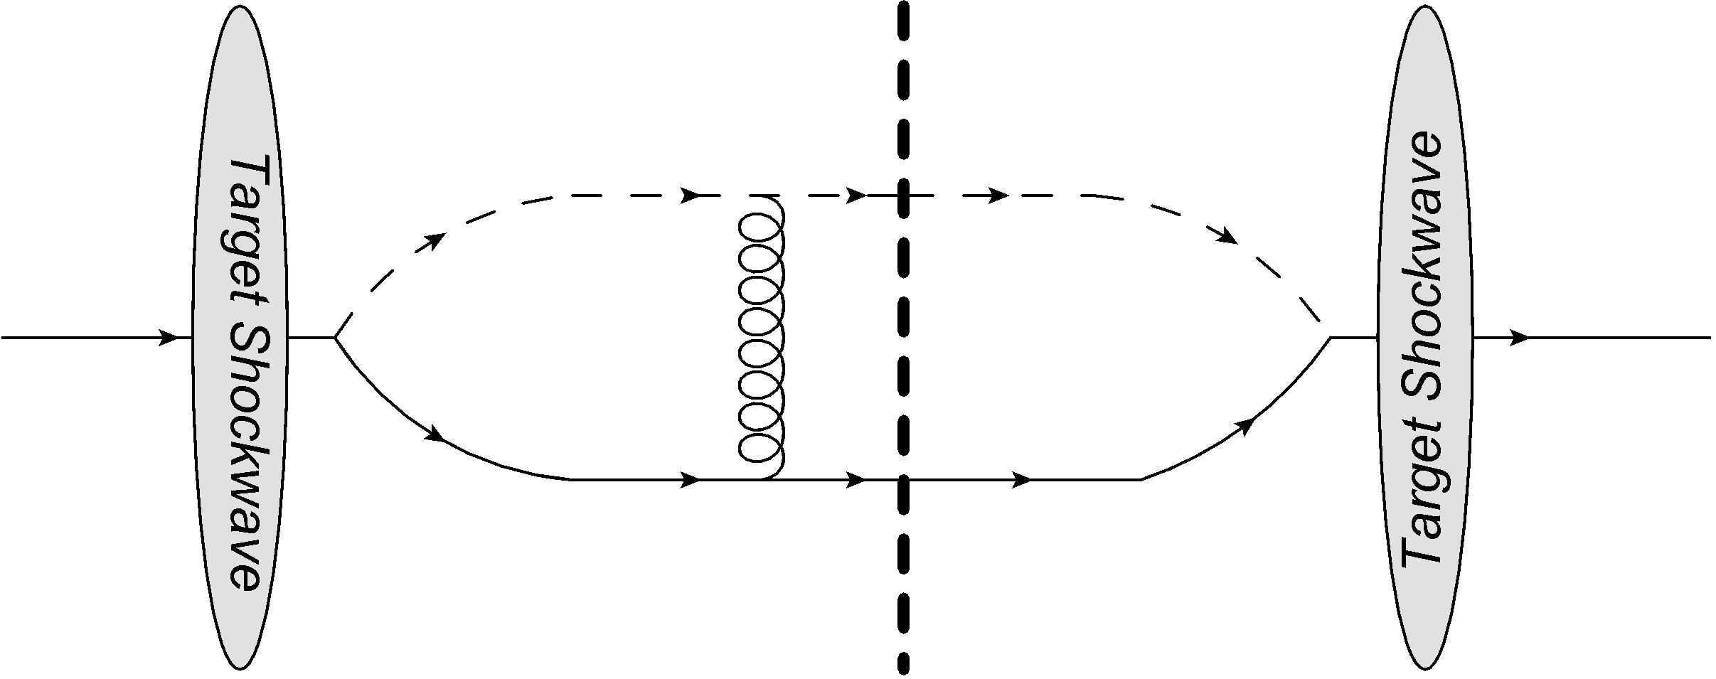
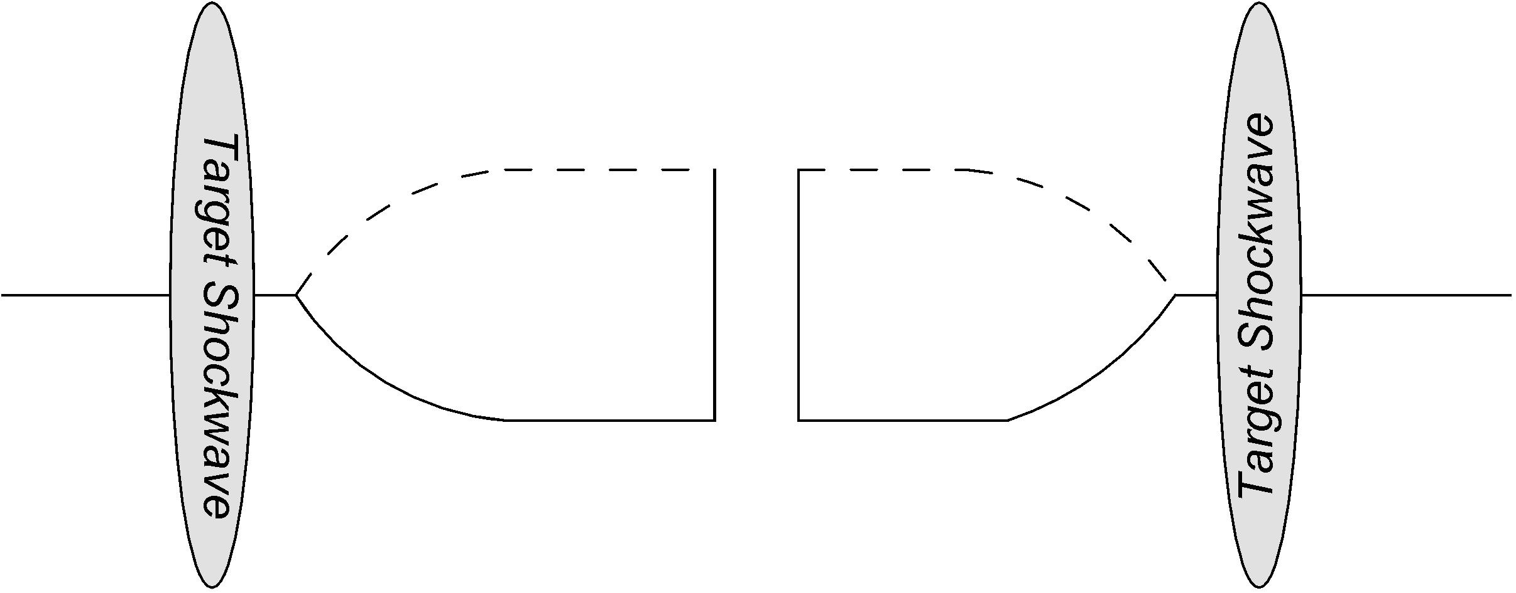
Large-$N_{C}$ Limit $→$ Elastic Dominance
At large-$N_{C}$ the gluon line becomes a double quark line
$$→$$
Product of elastic scattering processes!
$$→$$

Slide 10
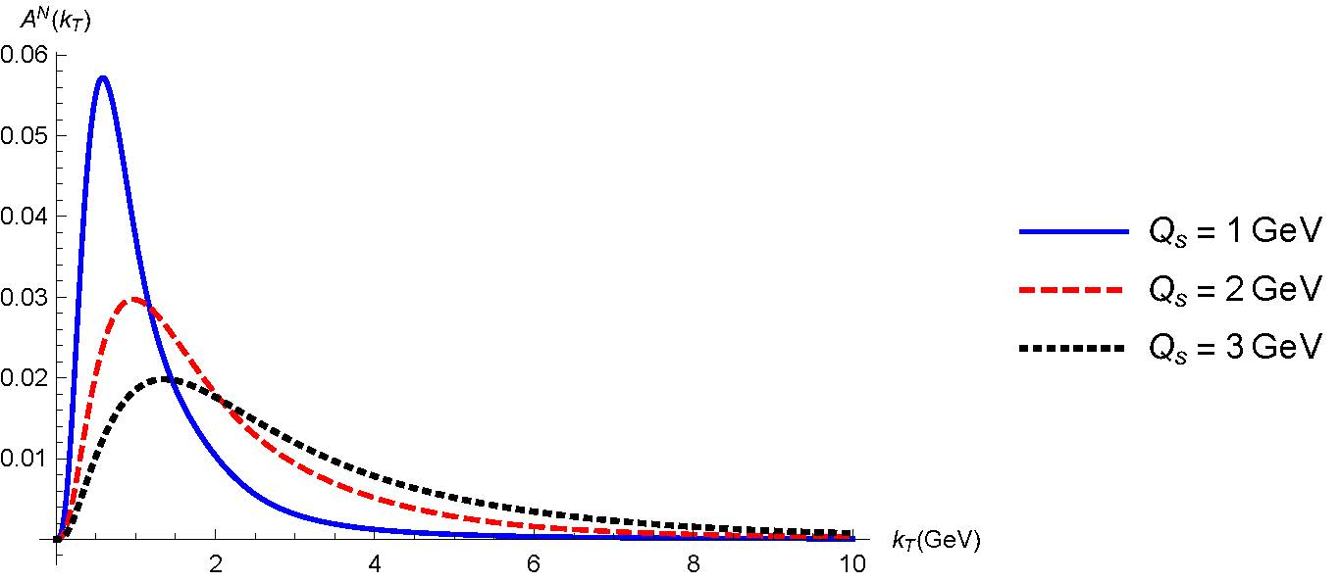
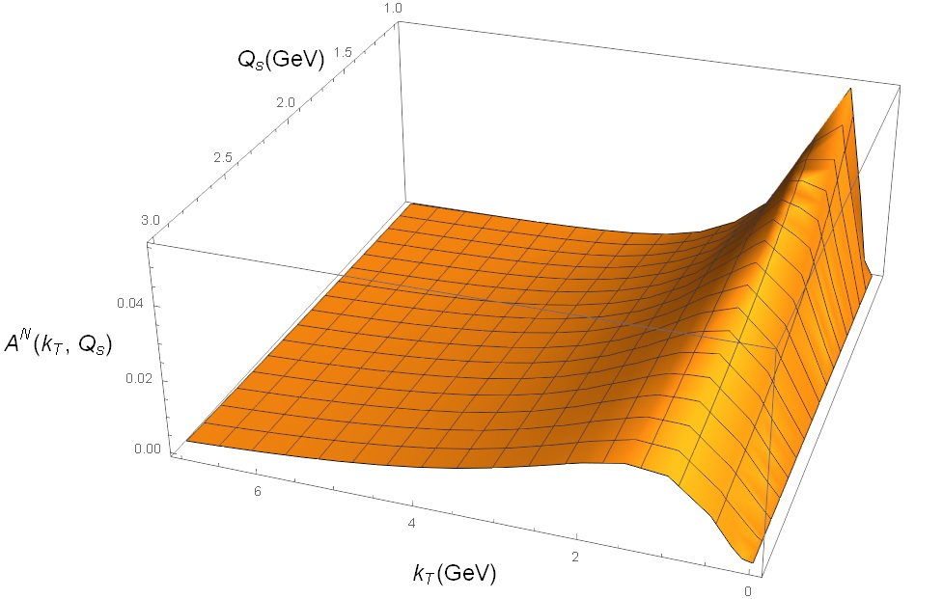
Quasi-Classical Large-$N_{C}$ Approximation
The dipole amplitudes can be evaluated in the MV model
We plot $A_{N}$ for strong coupling $α_{s}=0.3$
$A$ dependence from

Slide 11
Sub-leading $N_{C}$ Contribution
At $k_{T}≫Q_{s}$ the leading $N_{C}$ term falls off rapidly, so the sub-leading terms become dominant
Using the MV model we can approximate the color-quadrupole like terms and find
The falloff is much slower and the effect is independent of the target size $A$!

Slide 12
Outlook
The small-x lensing mechanism yields the slow falloff with $k_{T}$
The color structure gives dominance of elastic scattering in $A_{N}$
At low $k_{T}$ relative to $Q_{s}$ we see suppression with increasing $A$, similar to PHENIX
At large $k_{T}$ relative to $Q_{s}$ we get $A_{N}$ independent of $A$ as seen by STAR (cf. Benić, Hatta, 2018)
Phenomenology needs a more complete treatment involving fragmentation functions
Effects from small-x evolution?
Could clarify different $A$ dependence
TMD small-x evolution? Sivers function evolution coming soon

Slide 13
References
C. Dilks (STAR), Proceedings, 24th International Workshop on Deep-Inelastic Scattering and Related Subjects (DIS 2016): Hamburg, Germany, April 11-15, 2016, PoS DIS2016, 212 (2016), arXiv:1805.08875 [hep-ex].
C. Aidala et al. (PHENIX), Phys. Rev. Lett. 123, 122001 (2019), arXiv:1903.07422 [hep-ex].
Y. V. Kovchegov and M. D. Sievert, Phys.Rev. D86, 034028 (2012), arXiv:1201.5890 [hep-ph].
S. Beni´c and Y. Hatta, Phys. Rev. D99, 094012 (2019), arXiv:1811.10589 [hep-ph].
S. J. Brodsky, D. S. Hwang, and I. Schmidt, Phys.Lett. B530, 99 (2002), arXiv:hep-ph/0201296 [hep-ph]

Slide 14
Thank You

Slide 15
Outline
Strange behavior of $A_{N}$
Theoretical approaches: factorization, lensing
Small-x lensing
Cross section calculation
Large-$N_{C}$ and quasi-classical approximations
Sub-leading $N_{C}$ contribution

Slide 16
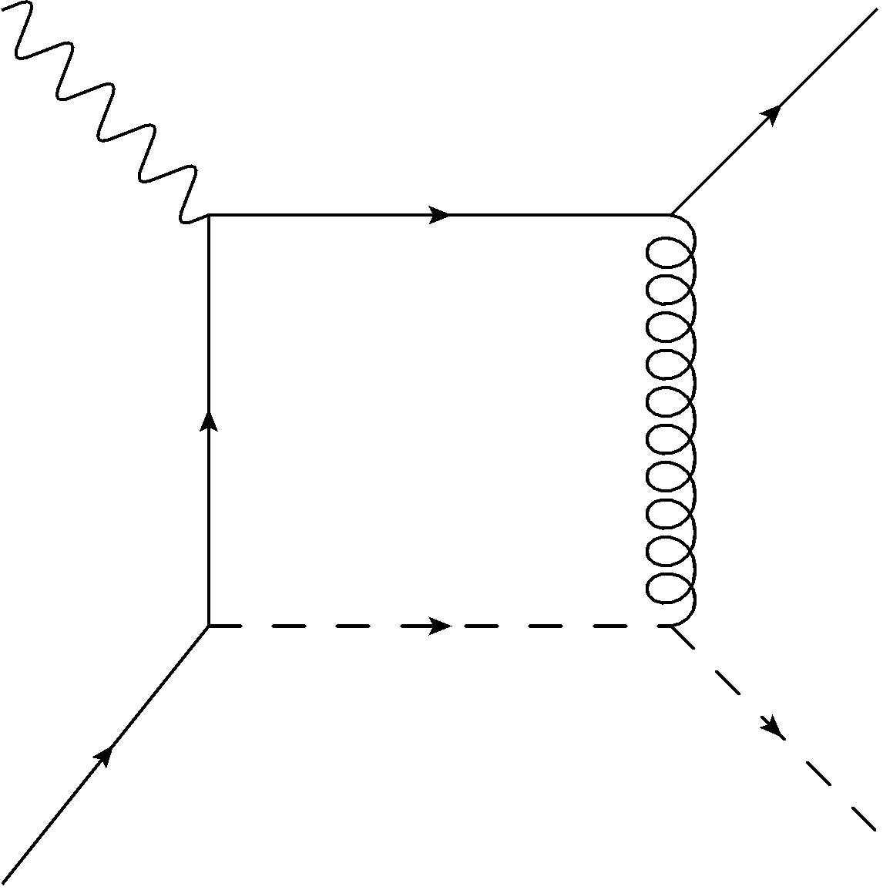
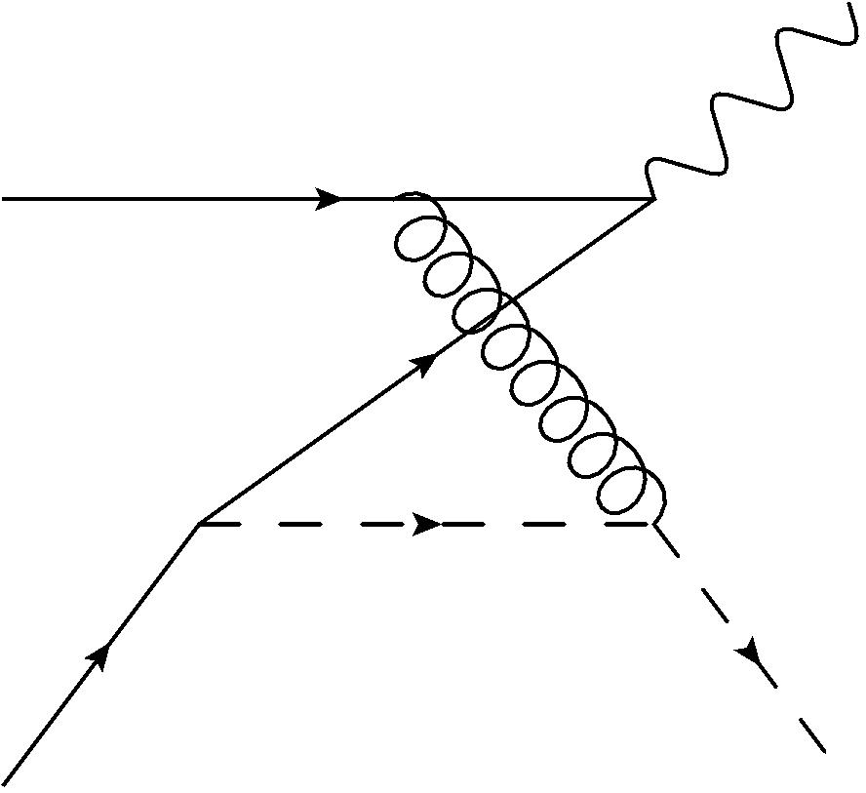
Lensing Mechanism for STSA
Brodsky et al demonstrated perturbative generation of asymmetry
Final state interactions distort parton distributions in SIDIS, initial state interactions in Drell-Yann
Phase comes from interference terms in the perturbative expansion
SIDIS
Drell-Yann
C
D
Proton splits into color singlet
→ attractive potential
Interacting color octets
→ repulsive potential
C
C
-C
-C
C

Slide 17
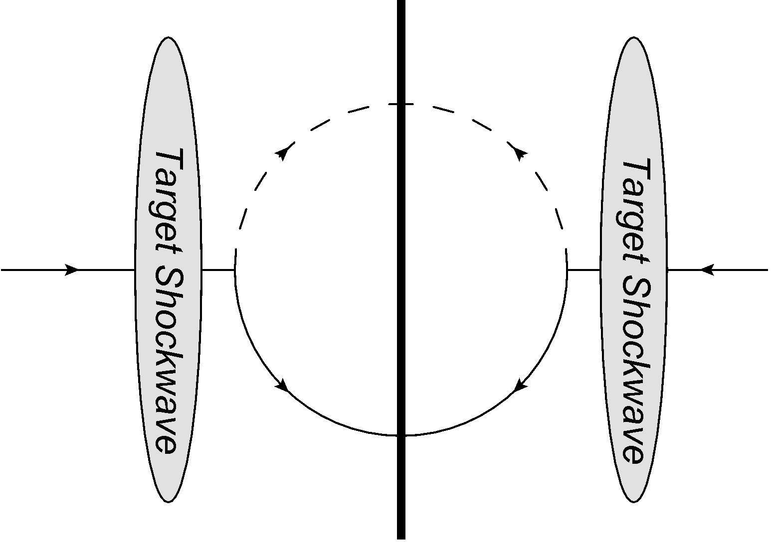
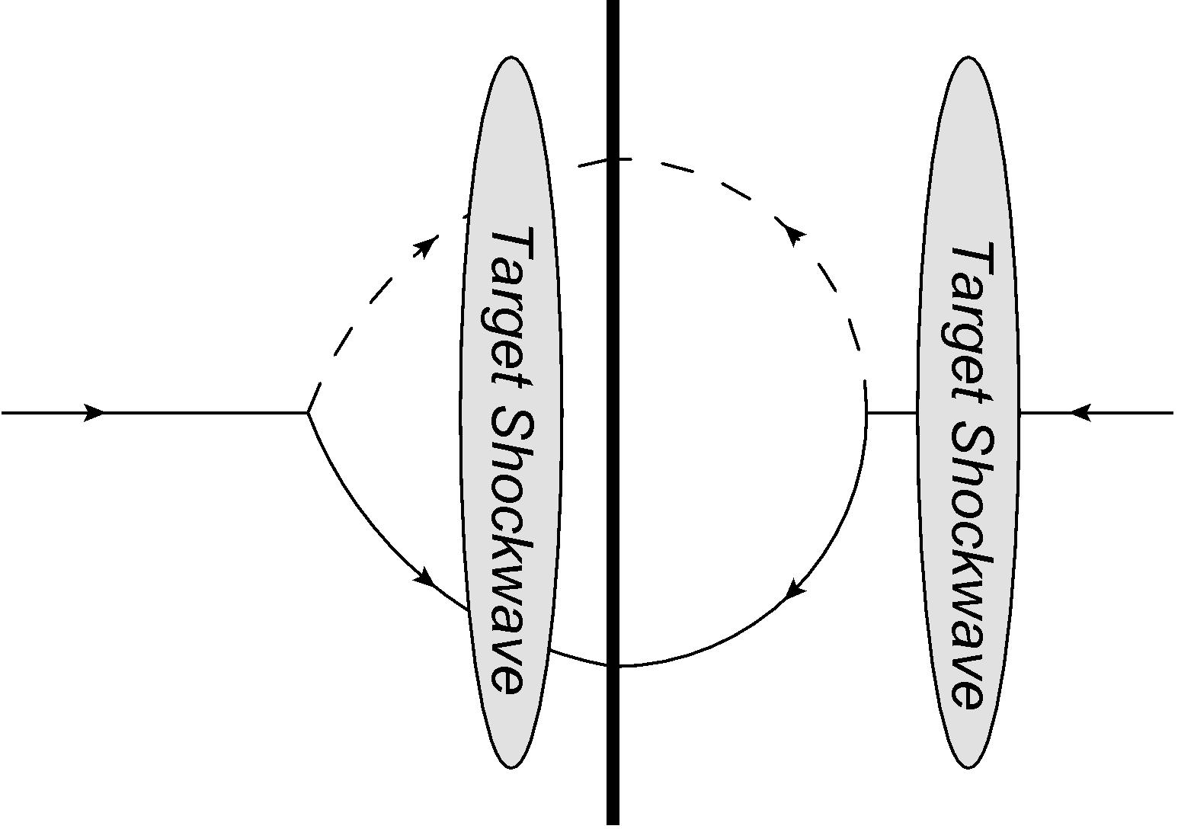
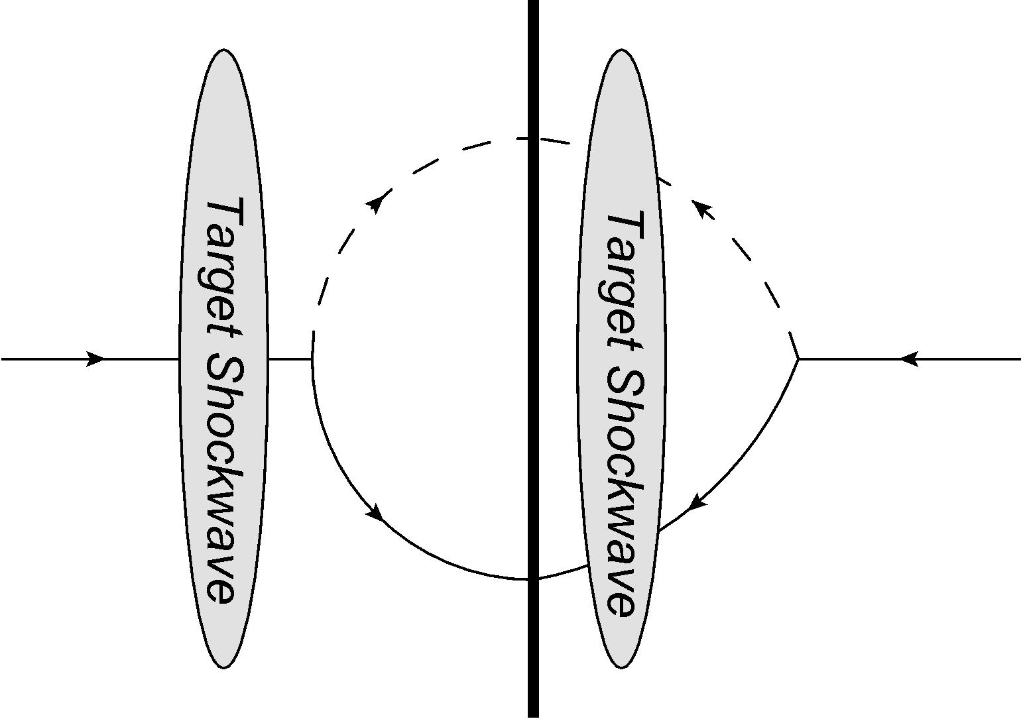
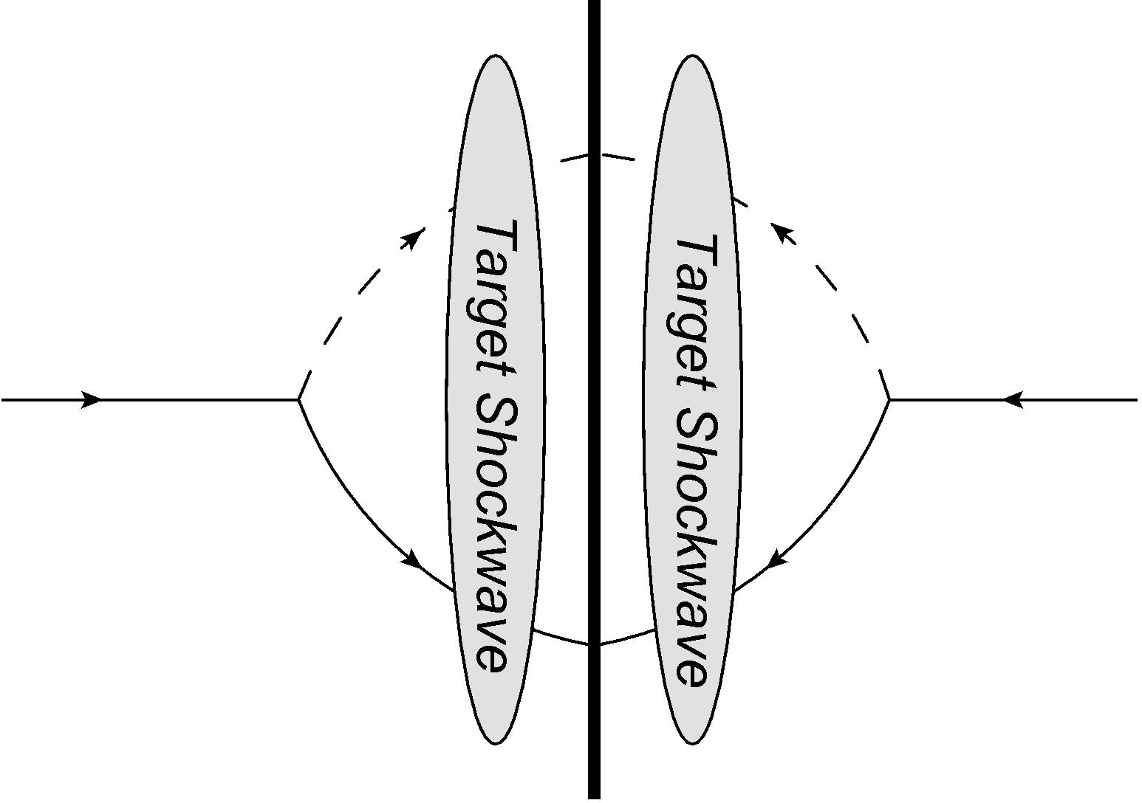
Generating The Phase
The numerator of the asymmetry comes from the imaginary part of the cross section
Since the squared wave function must give a real contribution, the imaginary term can only come from the color factor in the Wilson lines
In Kovchegov, Sievert 2012 this contribution was found coming from odderon exchange, but the resulting asymmetry fell off rapidly at higher momentum as $k_{T}^{−9}$

Slide 18
Large-$N_{C}$ Limit $→$ Elastic Dominance
One can rewrite the color factor in terms of color dipole and color quadrupole scattering amplitudes
In the large-$N_{C}$ limit the averaged products of dipole amplitudes factorize into products of averaged dipole amplitudes, and we get the leading term to be purely a product of dipole scattering terms
Elastic process!

