Slide 1
HPS EC Report
EXPERIMENT AT JLAB
S. Stepanyan (JLAB)
HPS Collaboration meeting
JLAB, November 18-19, 2020

Slide 2
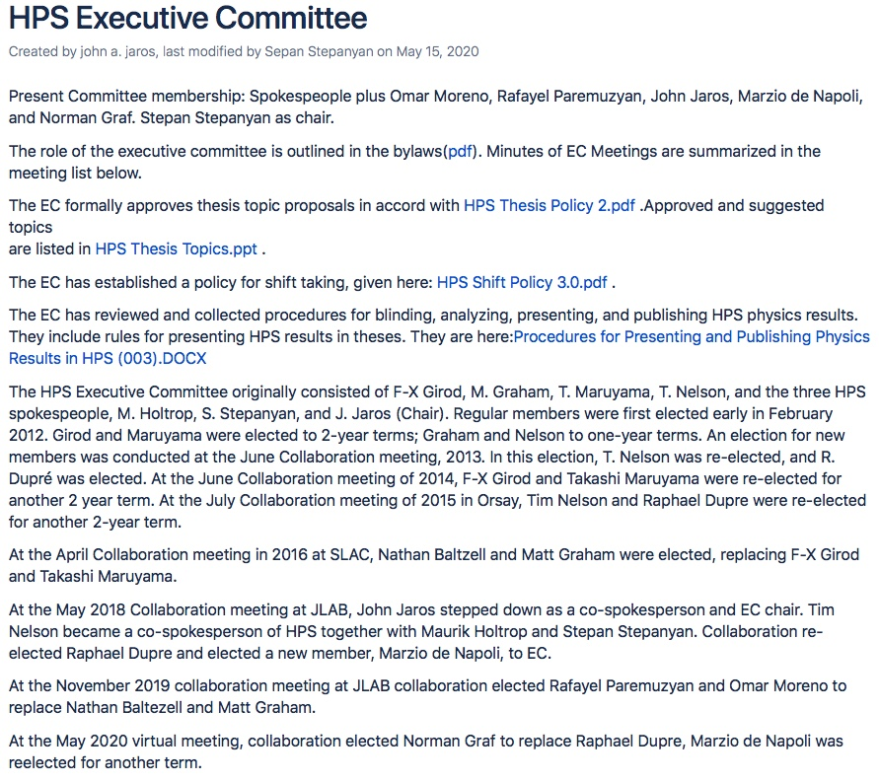
HPS Executive Committee
Members: Tim Nelson, Maurik Holtrop, John Jaros, Stepan Stepanyan, Marzio de Napoli, Omar Moreno, Norman Graf, Rafo Paremuzyan
Website on confluence with Meeting Summaries https://confluence.slac.stanford.edu/display/hpsg/HPS+Executive+Committee

Slide 3
EC activities
Since the last collaboration meeting, we had 15 meetings focused on items (goals) set at the last collaboration meeting,
The goals for this period were:
2016 data analysis, the release of results (before PAC-48) and publication – significant advancement in the analysis and understanding of data, robust results. But no publication yet. Preliminary results have been shown at PAC meeting;
advancing in the calibration and processing of 2019 – good progress on SVT alignment, ECal and hodoscope calibrations. Still aiming to start data processing in spring 2021;
preparations for PAC-48, writing the update, preparing presentation (Tim) – complete success! The PAC endorsed the HPS run plan and recommended maintaining the remaining time allocation (135 days) as well as the experiment grade A.

Slide 4
Other things discussed
Preparations to the 2021 run
Organization of elections, new collaboration member and two members of PPC (results will be announced at the end of this talk)
release of the preliminary results for presentation (Matt S. at the JLAB users meeting and Tim’s PAC jeopardy presentation)
Updated reach for 2019 and beyond, preliminary run plan for the remaining beam time (as presented by Cameron)
Restructuring the working groups (presented by Tim in his talk)
Snowmass LOI (submitted)
Organization of the collaboration meeting (this one)

Slide 5
HPS working groups, coordinators and EC oversight
Why organizational changes, a lot has to be done next 12 months:
about 6 months before our deadline to present the first preliminary results from 2019 data
less than 12 month to be ready for 2021 run
Proposed working groups and coordinators
Preparing for 2021 run:
DAQ, Sergey and Ryan
Trigger, Valery
Slow controls, Nathan and Omar
Monitoring, Matt G.
SVT, Tim
ECal/hodoscope, Rafo
Beamline, Stepan
2019 analysis:
Analysis, Matt G. and Cameron
Calibration and recon., Norman and PF
MC, Tongtong
Software, Norman
EC oversight
slow controls, Rafo
ECal/hodo, beamline, DAQ/trigger, Marzio
MC and Software, Maurik
analysis, Tim
monitoring, Norman
calibration/recon, Omar
SVT, Stepan

Slide 6
Responsibilities
Working group coordinators:
organize the work of the group, hold regular meetings
have a task list with timeline and milestones
update collaboration on the progress at HPS meetings
coordinate resource requests with EC oversight person
EC oversight person:
work closely with the run group coordinator
report progress to EC
request resources when needed

Slide 7
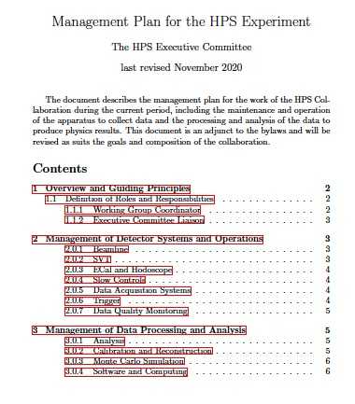
Will be presented as an addendum to our bylaws
Tim Nelson

Slide 8
Goals for the next six months
Prioritized:
Preparations to the 2021 run
Publication of 2016 results, both resonance search and displaced vertex search
Complete calibration and start processing of 2019 data

Slide 9
Elections – new collaboration member
Prof. Lauren Tompkins -
Congratulations and welcome to the collaboration!

Slide 10
PPC election
Nominees for two new members:
Matt Graham
Tongtong Cao
Alessandra Filippi
Pierfrancesco Butti
Keith Griffioen
Thanks to everyone for voting!
and the new members of PPC are:
Alessandra
Matt

Slide 11
Next Collaboration meeting
May/June 2021, remote, organized by SLAC
Must be before the run (June 21, 2021)

