Slide 1

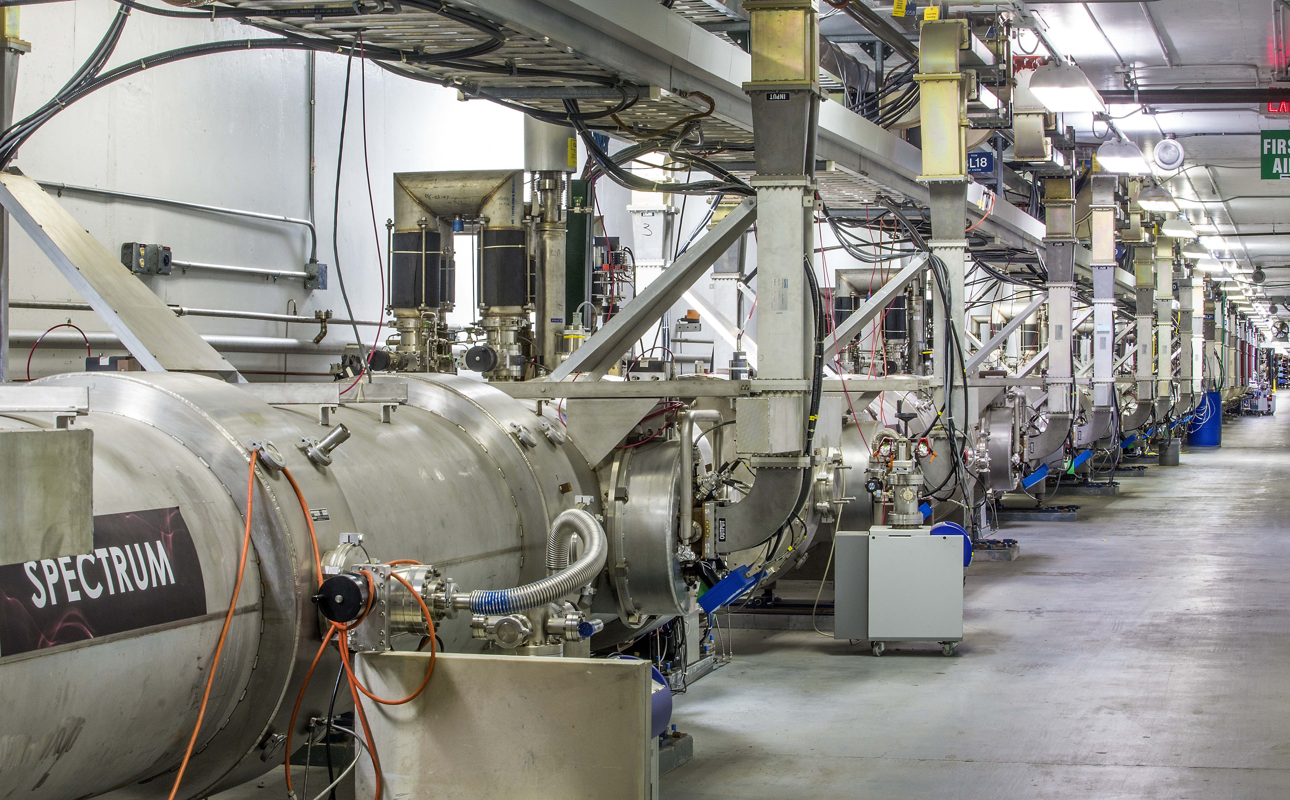
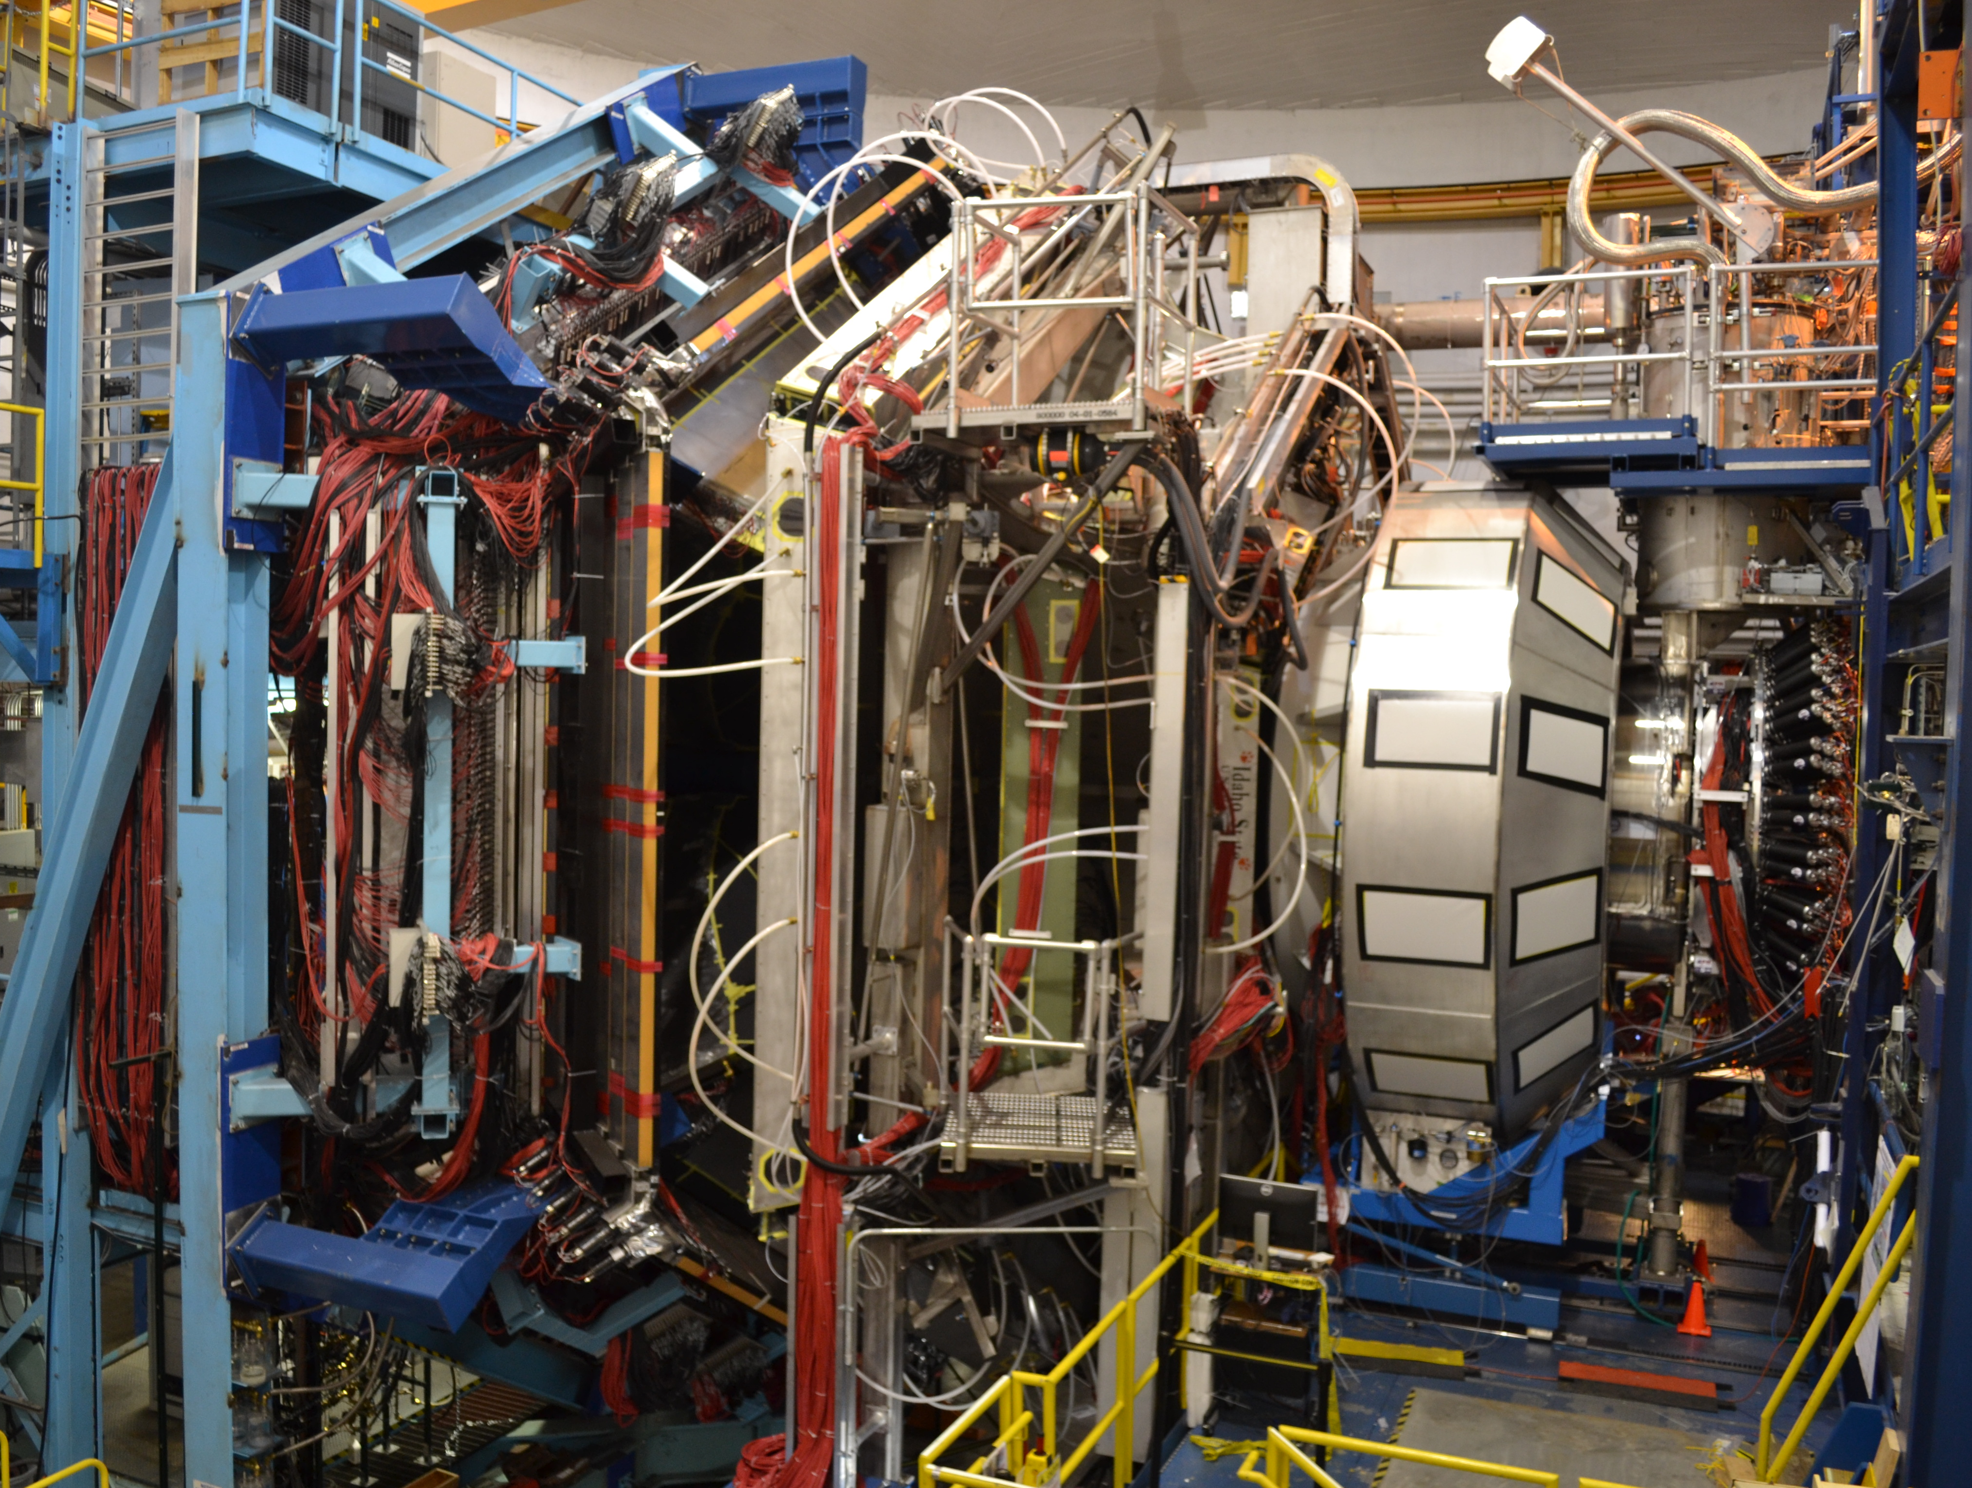
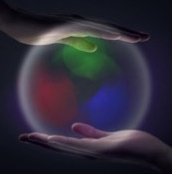
Hall B Run Group A (RG-A) (Pol. e on Unpol. H)
11 GeV Polarized Electrons on Unpolarized Liquid-Hydrogen Target to Study Proton Structure, 3D Imaging, and Gluonic Excitations with CLAS12
Path to Publications
Latifa Elouadrhiri
Jefferson Lab
CLAS Collaboration Meeting
November 11, 2020

Slide 2
RG- A Science Program
The CLAS12 RG-A experiments were designed to perform complementary measurements to study proton structure for both the ground and excited states, 3D imaging, and gluonic excitations with the core mission to understand the manner in which the constituents of protons are held together by the strong force and the emergence of the dominant part of hadron mass.
RG-A is composed of 13 experiments driven by an international collaboration grouped in 5 categories:
  Deep Exclusive Processes (E12-06-119, E12-06-108 and E12-12-00): Study of Generalized Parton Distributions (GPDs), (2 +1)-D imaging of the proton and the study of its gravitational and mechanical structure
  Deep inclusive & SIDIS (E12-06-112, E12-06-112A and E12-06-112B): Study of the Transverse Momentum Distributions (TMDs) and the 3D structure in momentum space
  Nucleon structure (E12-09-003, E12-06-108A, E12-06-108B): Study of nucleon resonance structure at Q² from 2.0 to 12 GeV²
  Quasi photo-production (E12-12-001 and E12-12-001A): Study of J/ψ photoproduction, LHCb pentaquarks, and Time-like Compton Scattering
  MesonX program (E12-11-005 and E12-11-005A): Study of meson spectroscopy in search for hybrid mesons

Slide 3
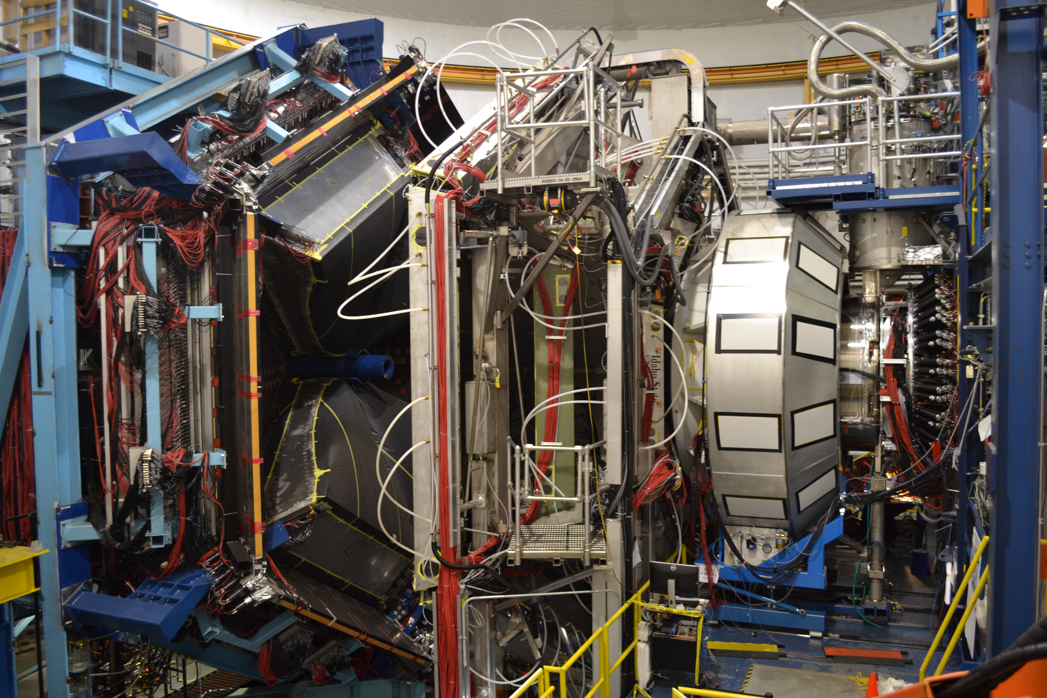
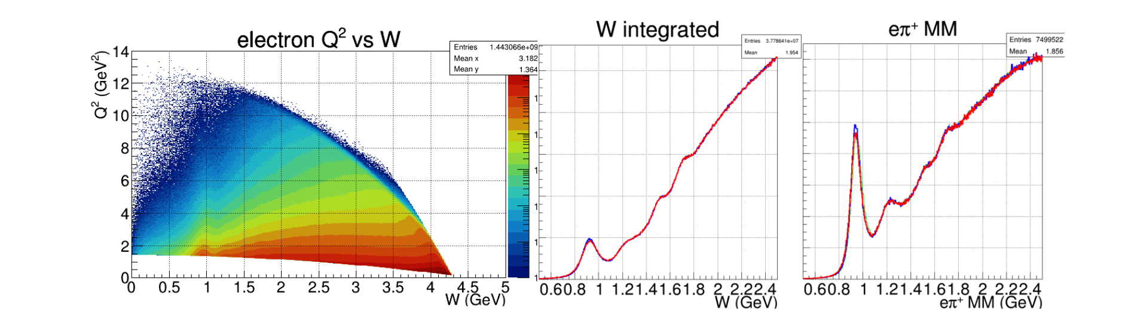
THE Experiment
CLAS12
RG-A has acquired data in three separate running periods, spring 2018 (126 mC), fall 2018 (99 mC), and spring 2019 (60 mC), with the collected charge amounting to roughly half of the full approved RG-A beam time.
To fully realize the goals of the RG-A science program, the full statistics of the approved beam time is required. PAC48 approved the remaining beam time for RG-A maintaining A rating for the Run Group!
Published in: Nucl. Instrum. Meth. A 959, 163419 (2020)

Slide 4
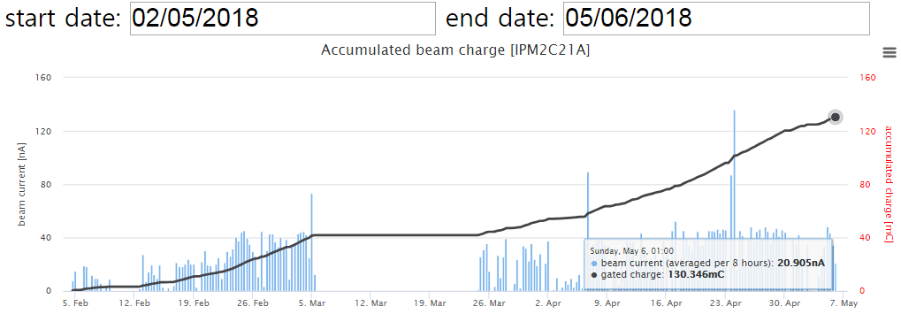
The Experiment
RG-A
Completed detector setting
Start 10.6 GeV RGA data taking
Spring 2018
~126mC
Machine
retuning
Machine Down
RGA – Fall 2018: Data processing completed
RGA – Spring2019: Data calibration completed, pass1 review scheduled for December 2, 2020
RGA – Spring 2018: Data calibration has started
RG-A
Fall 2018
E=10.6GeV
~99mC
RG-A
Spring 2019
E=10.2GeV
60mC
Sum: Q ~ 300mC
Expect total: 648mC
Q/Q_{tot}~ 46%

Slide 5
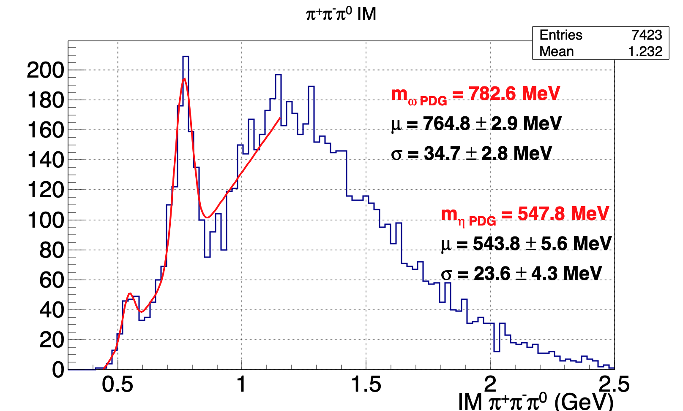
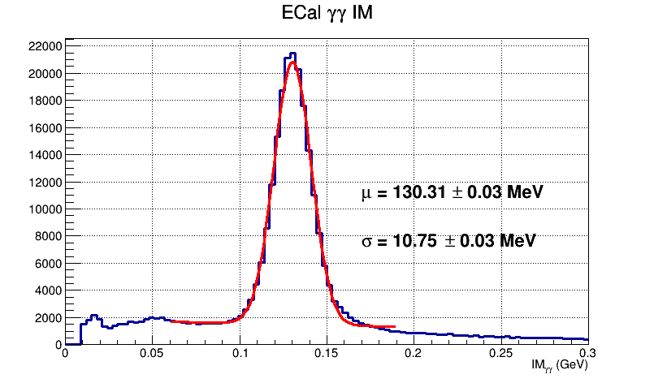
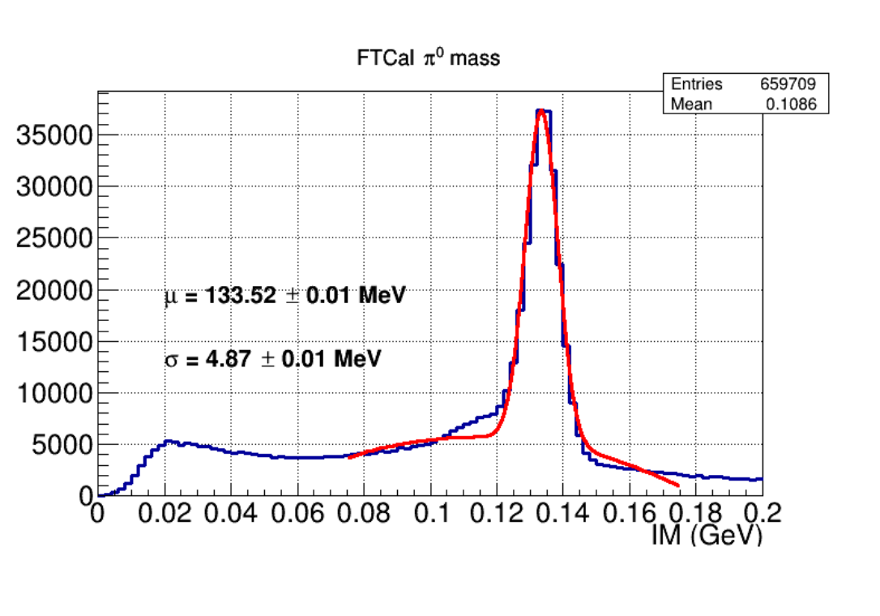
DATA quality - Examples
Spring 2019 DATA
Ready for Pass1 Review
All physics results in this presentation are based on Fall 2018 Data

Slide 6
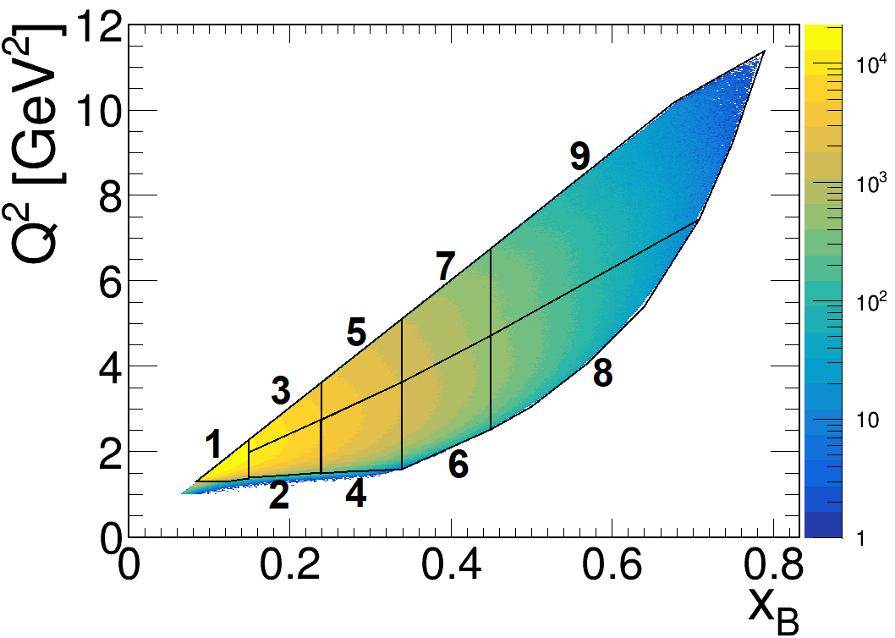
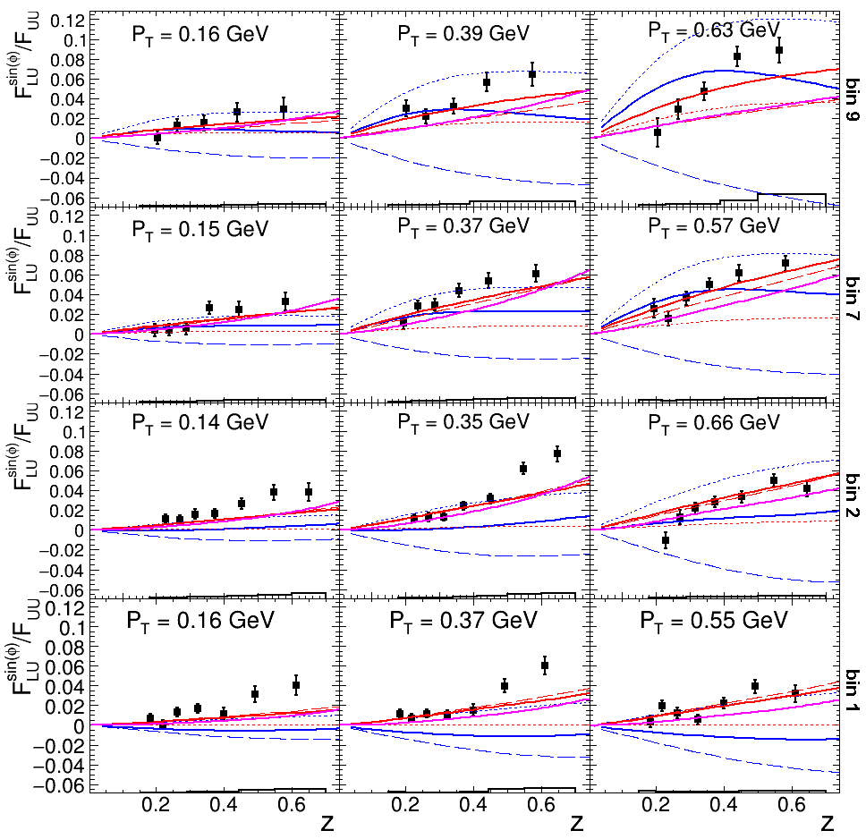
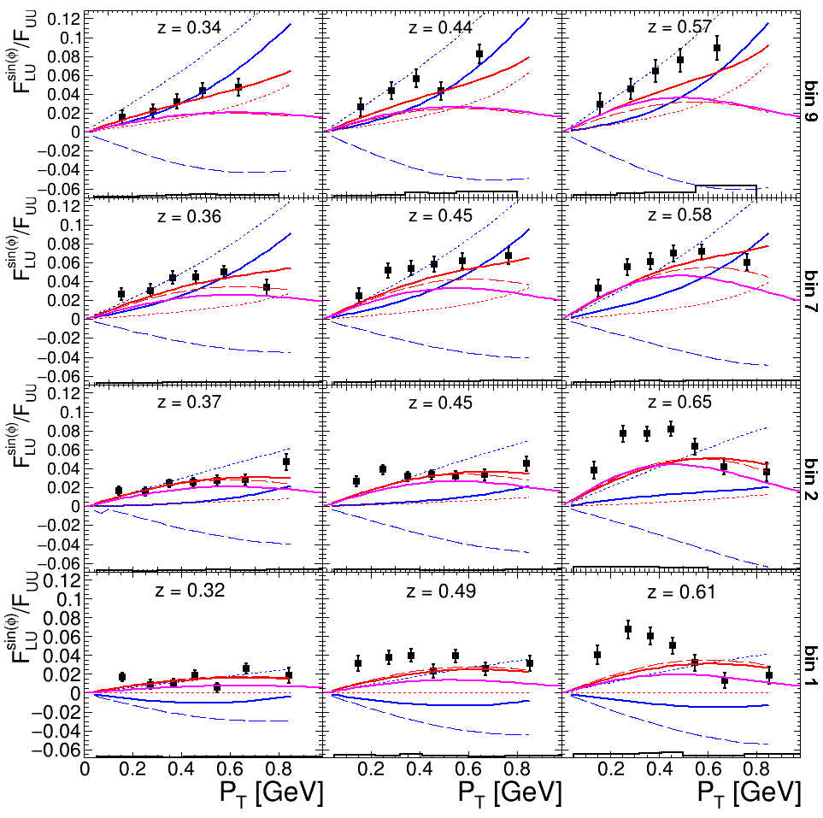
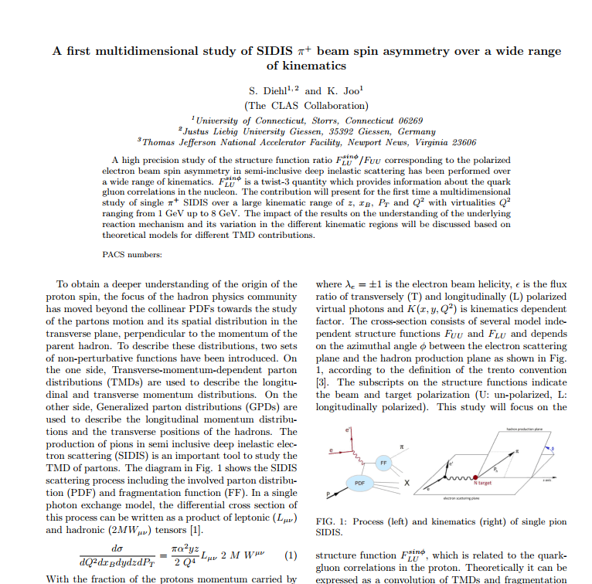
A first multidimensional, high precision study of SIDIS π⁺ beam single spin asymmetry over a wide range of kinematics
Previous experiments: Mostly only one dimensional studies
CLAS12: First fully differential study
High precision CLAS12 data can help to distinguish between
reaction models and to improve global fits of TMDs and FFs

Slide 7
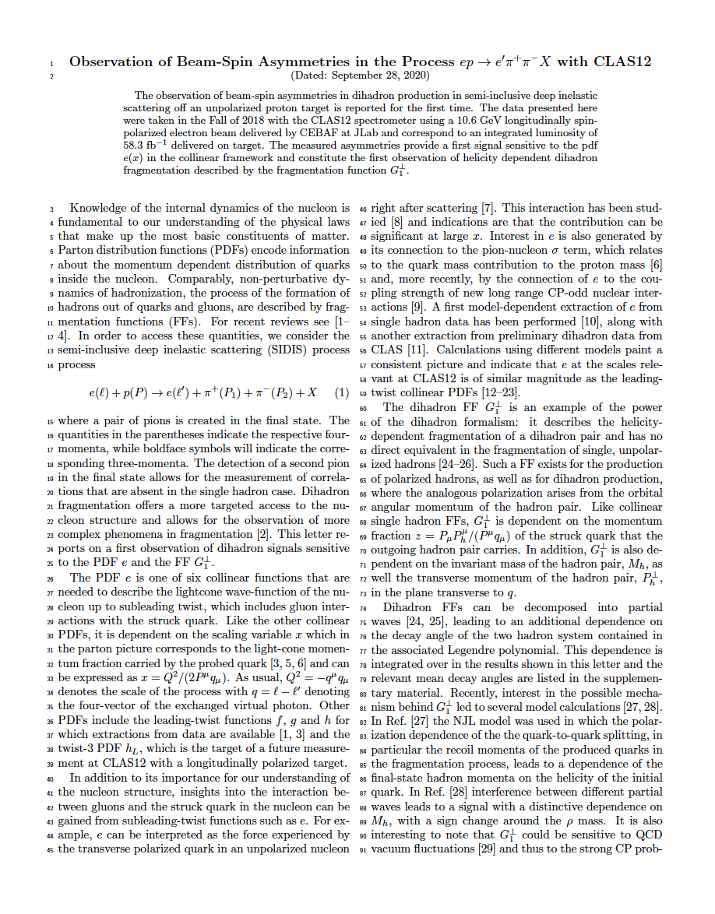
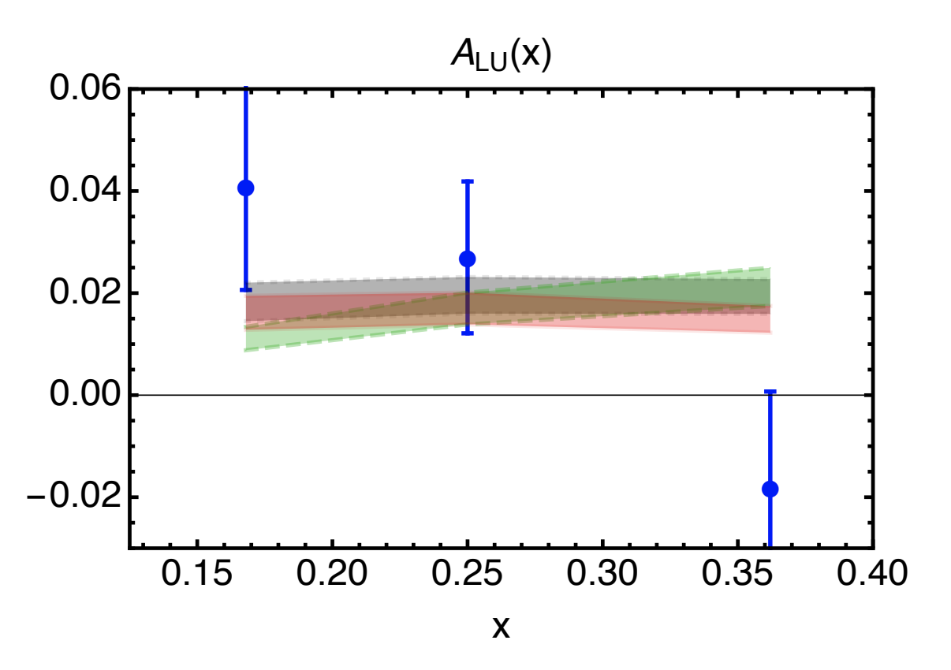
Measurements of Dihadron Beam-spin Asymmetries
Intent to publish a PRL paper with RGA dipion beam spin asymmetries.
Physics quantities of interest:
  A_{LU} sin(ϕ_{R}) modulation: allowing the first significant access in a collinear framework
  to the twist-3 PDF e(x), which gives insight into largely unexplored quark-gluon correlations.
  A_{LU} sin(ϕ_{H}-ϕ_{R}) modulation: first measurement sensitive to the DiFF G₁⊥,
  which describes the helicity dependent fragmentation of a dihadron pair.
CLAS6 Preliminary
CLAS12 Preliminary
CLAS12 Preliminary
R. Jakob, P. J. Mulders and J. Rodrigues, Nucl. Phys. A 626 (1997)
R. L. Jaffe and X. D. Ji, Nucl. Phys. B 375 (1992)
B. Pasquini and S. Rodini, Phys. Lett. B 788 (2019)
Luo, Xuan and Sun, Hao and Xie, Yi-Ling, Phys. Rev. D 101 (2020)
(asymmetry for CLAS12 kinematics via personal correspondence)
The PDF e(x) can be extracted point by point from this asymmetry
A sign change is observed around the ρ mass
7

Slide 8

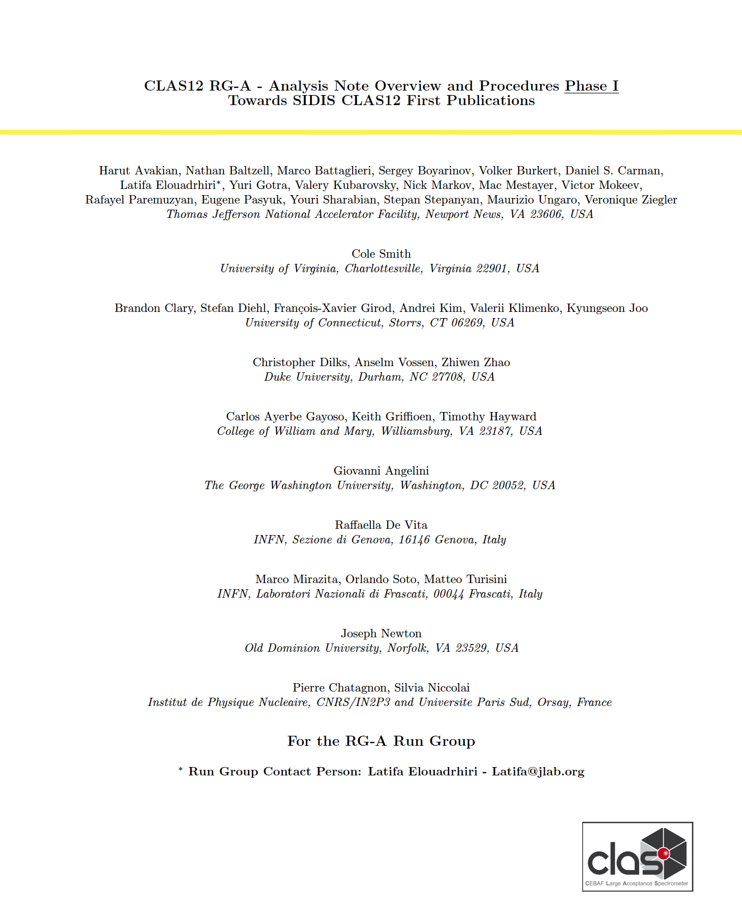
Path towards the first publications - Milestones
TODAY
A first multidimensional high precision study of SIDIS π⁺ beam single spin
asymmetry over a wide range of kinematics
Collaboration
Review
Observation of Beam Spin Asymmetries in the di-hadron process with CLAS12
02
Finalizing
the reviews
RGA- Common Analysis Note &Two Physics Analyses under Review
09/16
10/7
10/14
10/21
10/28
12/2
1
12/16
12/23
12/30
09/09
09/23
09/30
11/4
11/11
11/18
11/25
12/09
September 2020
October 2020
November 2020
December
01
03
Ad-hoc Review
Starts
Papers Submission

Slide 9
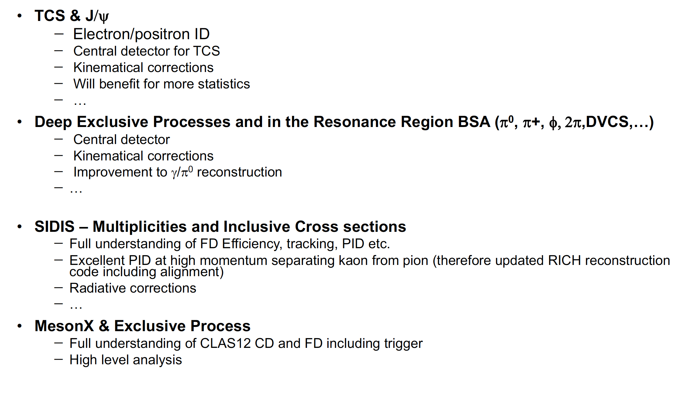
Phase II Publications Require

Slide 10
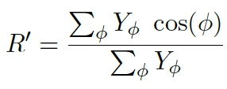
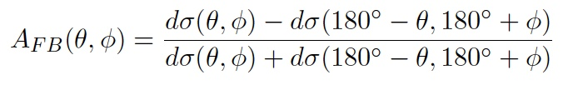
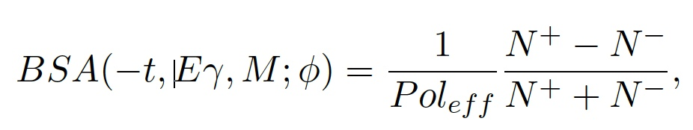
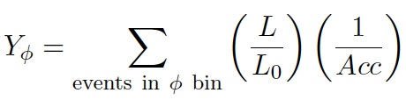
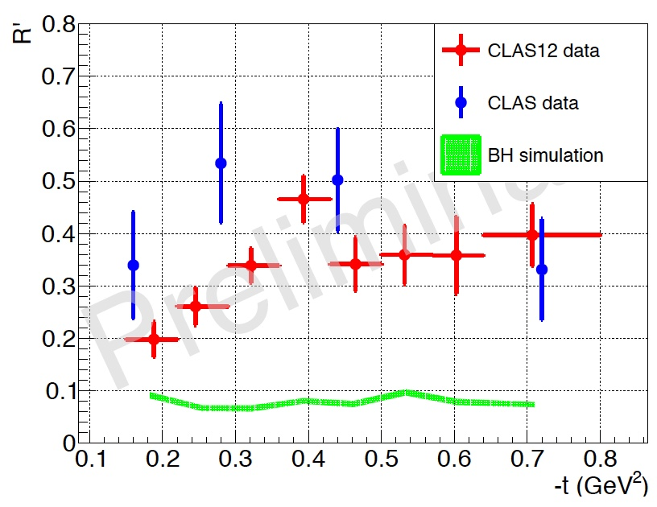
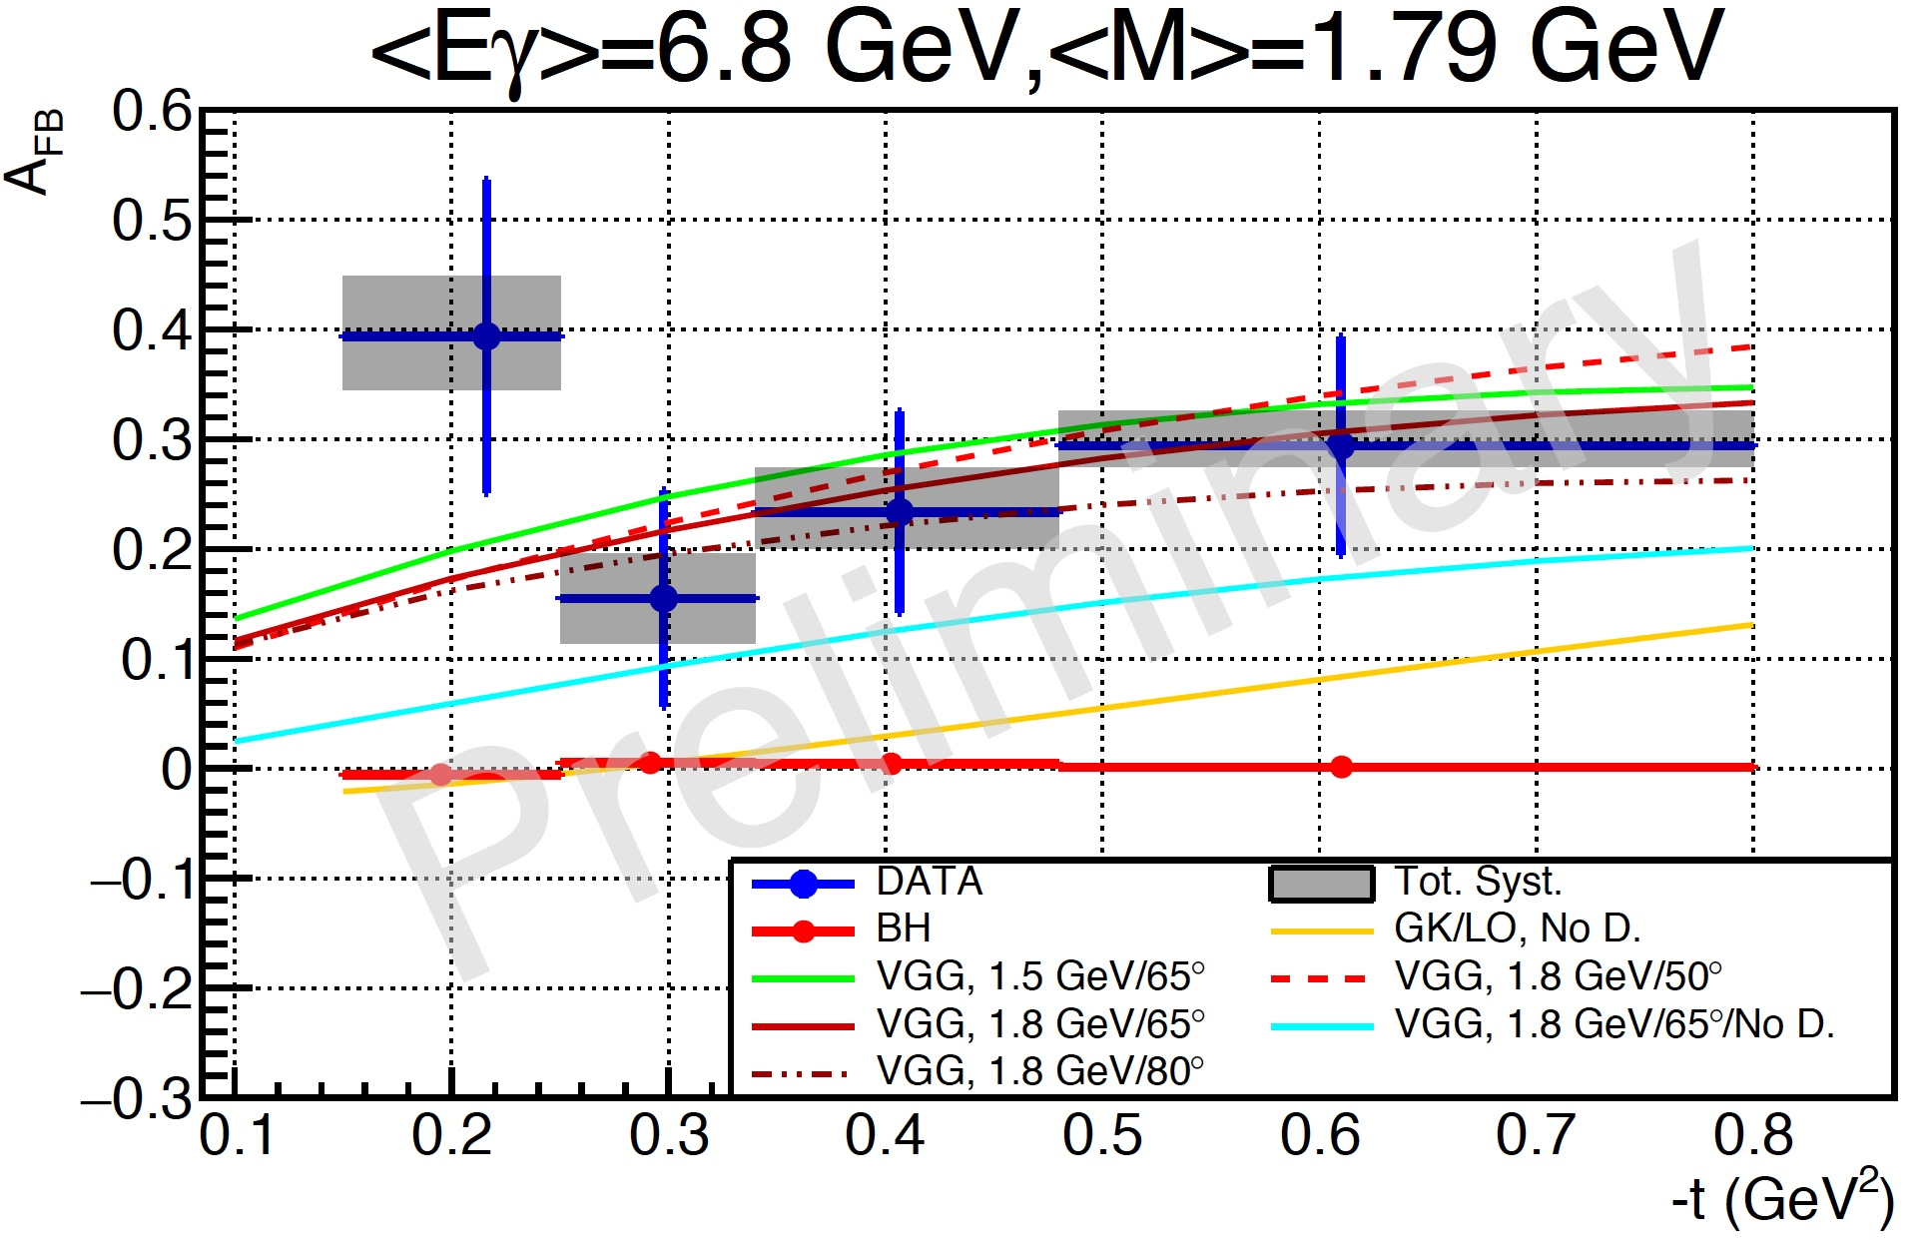
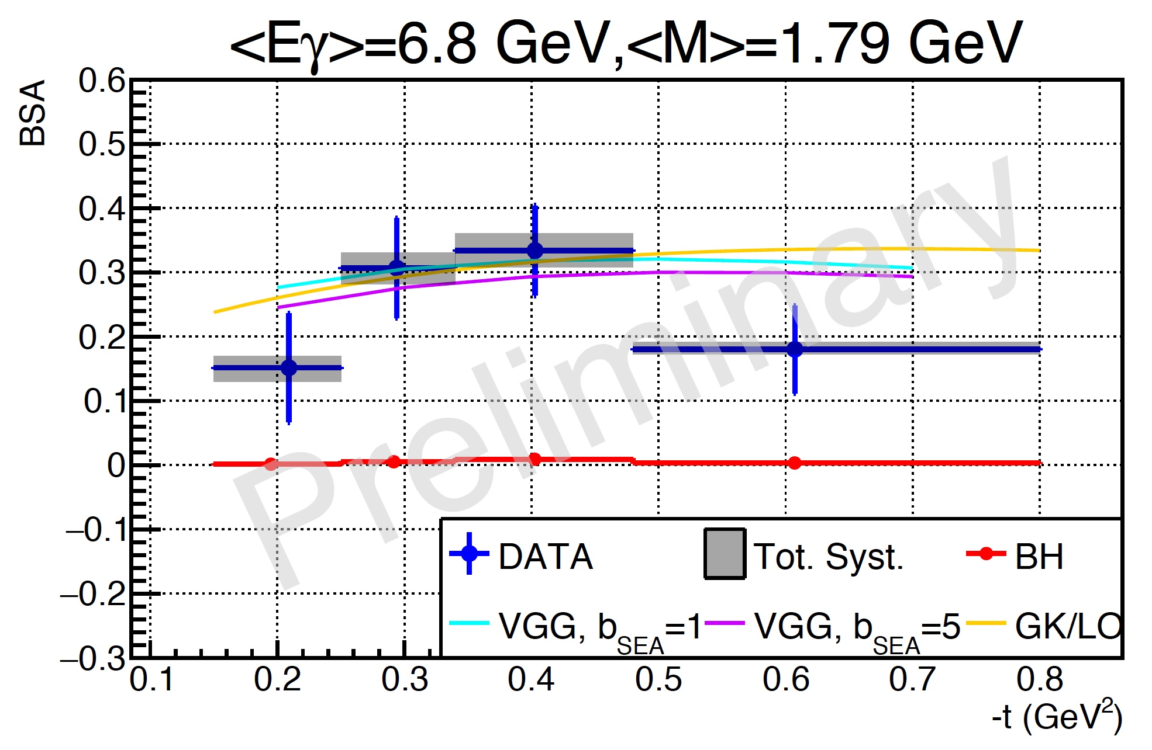
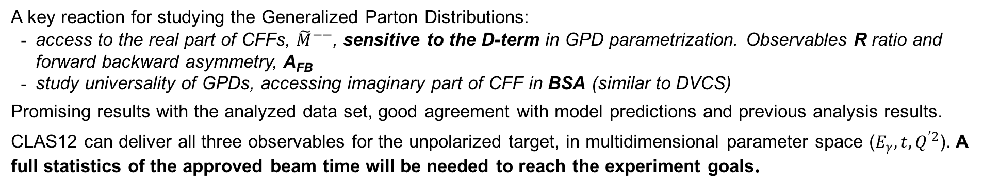
Time-like Compton Scattering
A key reaction for studying the Generalized Parton Distributions:
access to the real part of CFFs, ${\tilde{M}}^{−−}$, sensitive to the D-term in GPD parametrization. Observables R ratio and forward backward asymmetry, A_{FB}
study universality of GPDs, accessing imaginary part of CFF in BSA (similar to DVCS)
Promising results with the analyzed data set, good agreement with model predictions and previous analysis results.
CLAS12 can deliver all three observables for the unpolarized target, in multidimensional parameter space ($E_{γ}, t,Q^{′2}$). A full statistics of the approved beam time will be needed to reach the experiment goals.

Slide 11
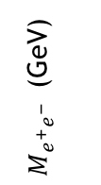
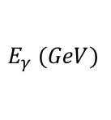
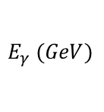
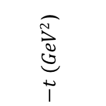
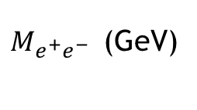
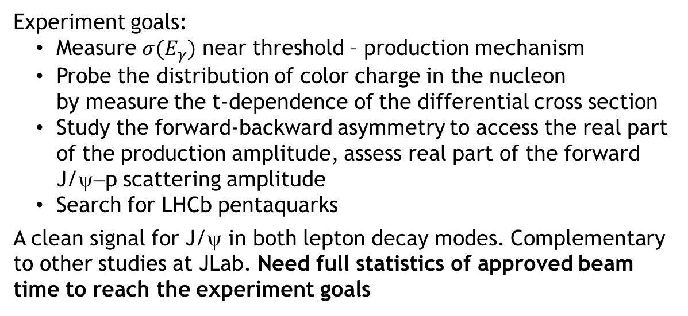
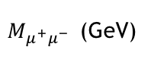

J/ψ Photoproduction
Experiment goals:
Measure $σ(E_{γ})$ near threshold – production mechanism
Probe the distribution of color charge in the nucleon
by measure the t-dependence of the differential cross section
Study the forward-backward asymmetry to access the real part of the production amplitude, assess real part of the forward J/ψ−p scattering amplitude
Search for LHCb pentaquarks
A clean signal for J/ψ in both lepton decay modes. Complementary to other studies at JLab. Need full statistics of approved beam time to reach the experiment goals
J/ψ yield = 218 +/- 21
Mass = 3.081 +/- 0.005 GeV
Sigma = 54 +/- 9 MeV
$M_{e^{+}e^{−} }$ (GeV)
$M_{e^{+}e^{−} }$ (GeV)
$${}_{}E$$
$−t (GeV2$)
$M_{μ^{+}μ^{−} }$ (GeV)
$$E_{γ} (GeV)$$
$$E_{γ} (GeV)$$

Slide 12

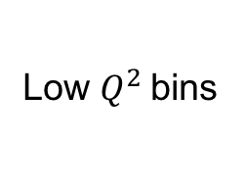
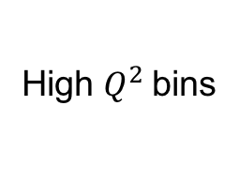


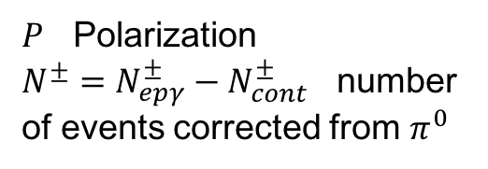

Proton DVCS Beam-spin asymmetry
$π^{0}$-corrected beam-spin asymmetry:
Low $Q^{2}$bins
$$x_{B}$$
High $Q^{2}$bins
$$x_{B}$$
$$A_{LU }= \frac{1}{P} \frac{N^{+}−N^{−}}{N^{+}+N^{−}}$$
$P$ Polarization
$N^{±}=N_{epγ}^{±}−N_{cont}^{±}$ number of events corrected from $π^{0}$
$$φ$$
$$φ$$
$$φ$$
$$φ$$
$$φ$$
$$φ$$
Preliminary
$$φ$$
$$φ$$
$$φ$$
$$φ$$
$$φ$$
$$φ$$
Statistical uncertainties only
RG-A inbending dataset
$$φ$$
$$φ$$
$$φ$$
$$φ$$
$$φ$$
$$φ$$
$$\frac{A\sin{φ}}{1+B\cos{φ}}$$
|t|
$$φ$$
$$φ$$
$$φ$$
|t|
$$φ$$
$$φ$$
$$φ$$
Fit function:

Slide 13
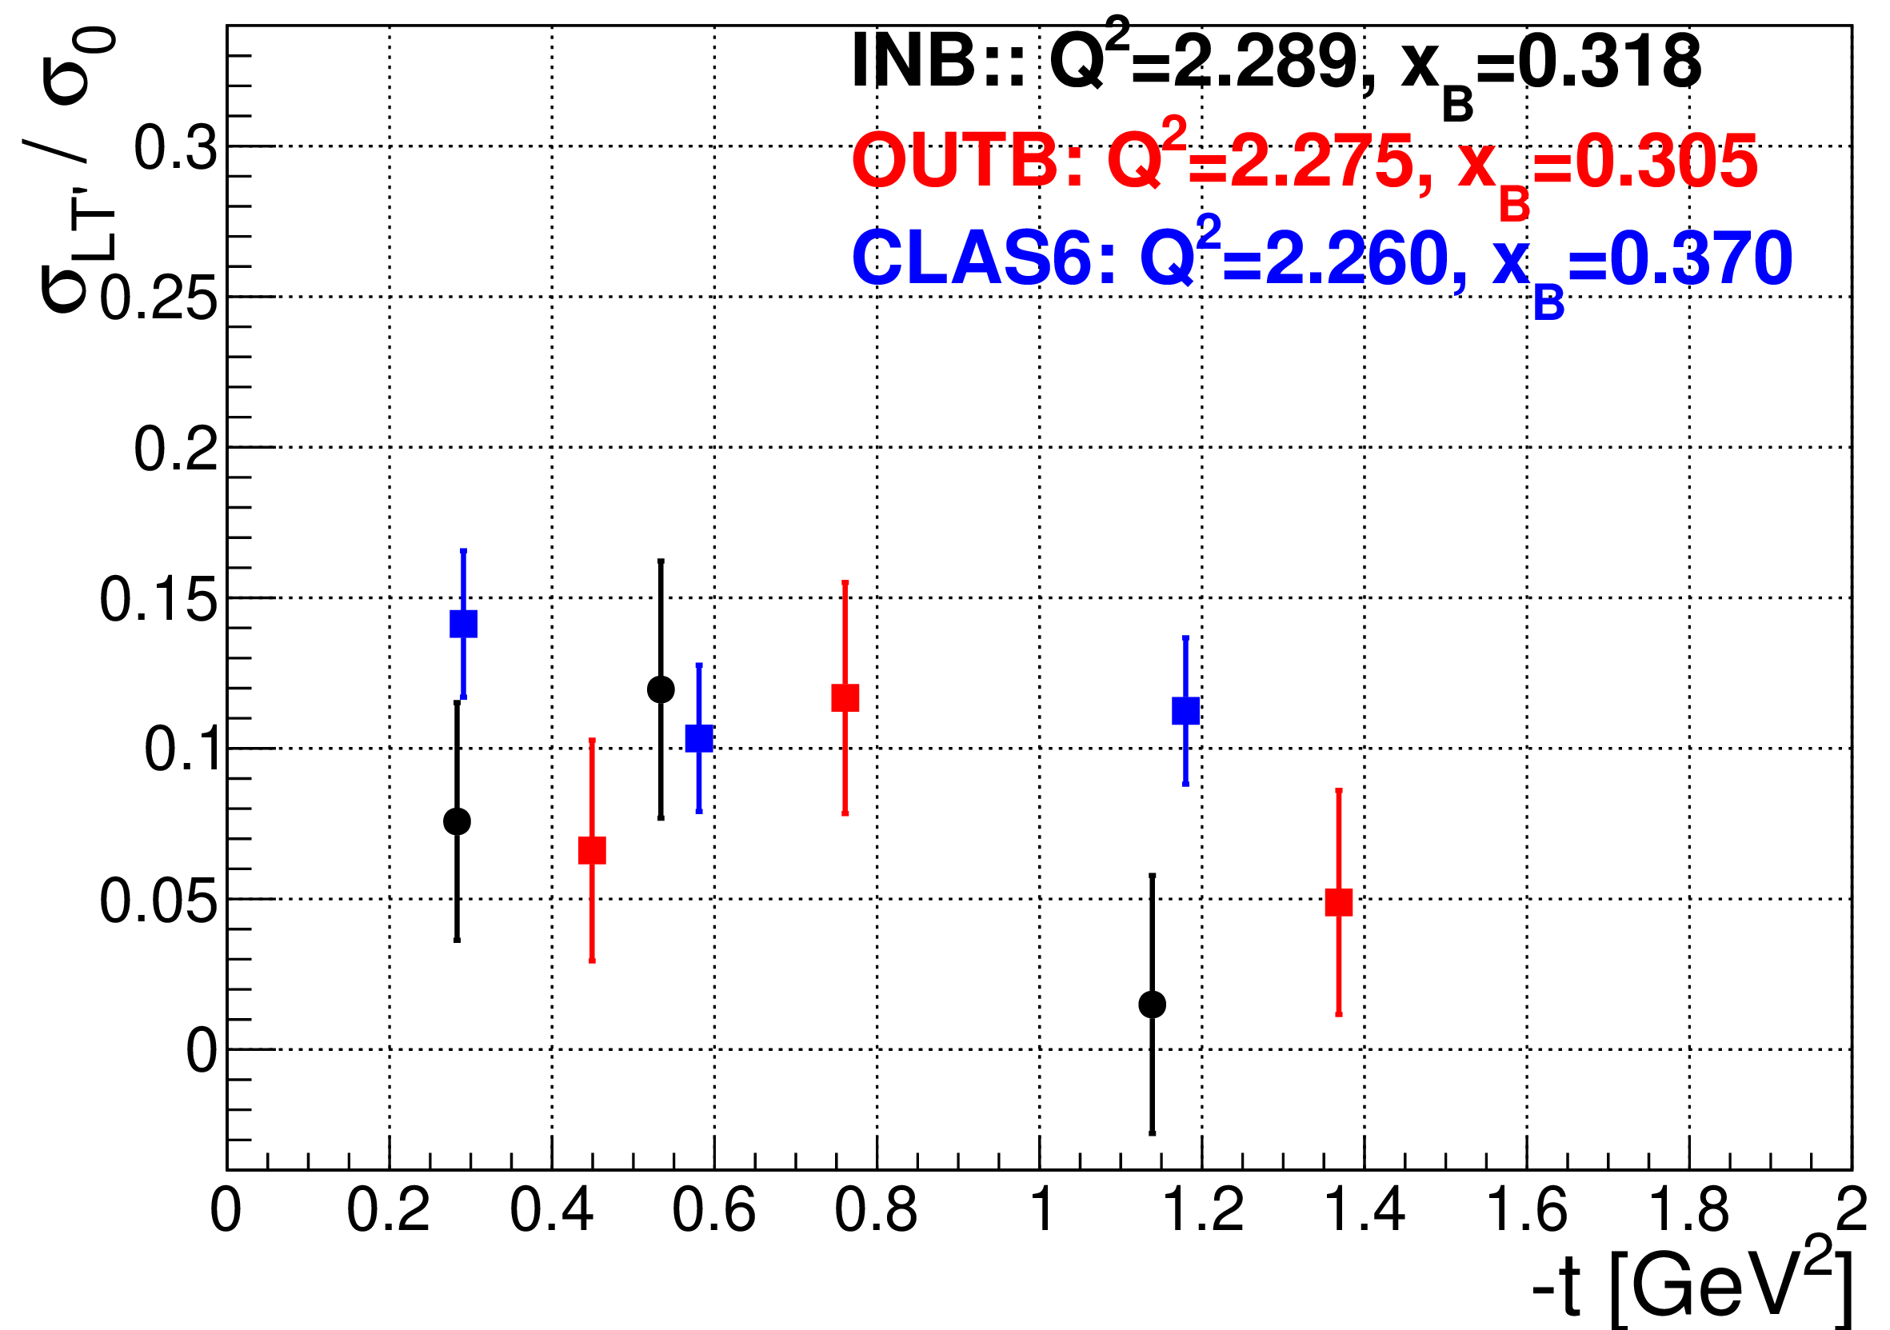
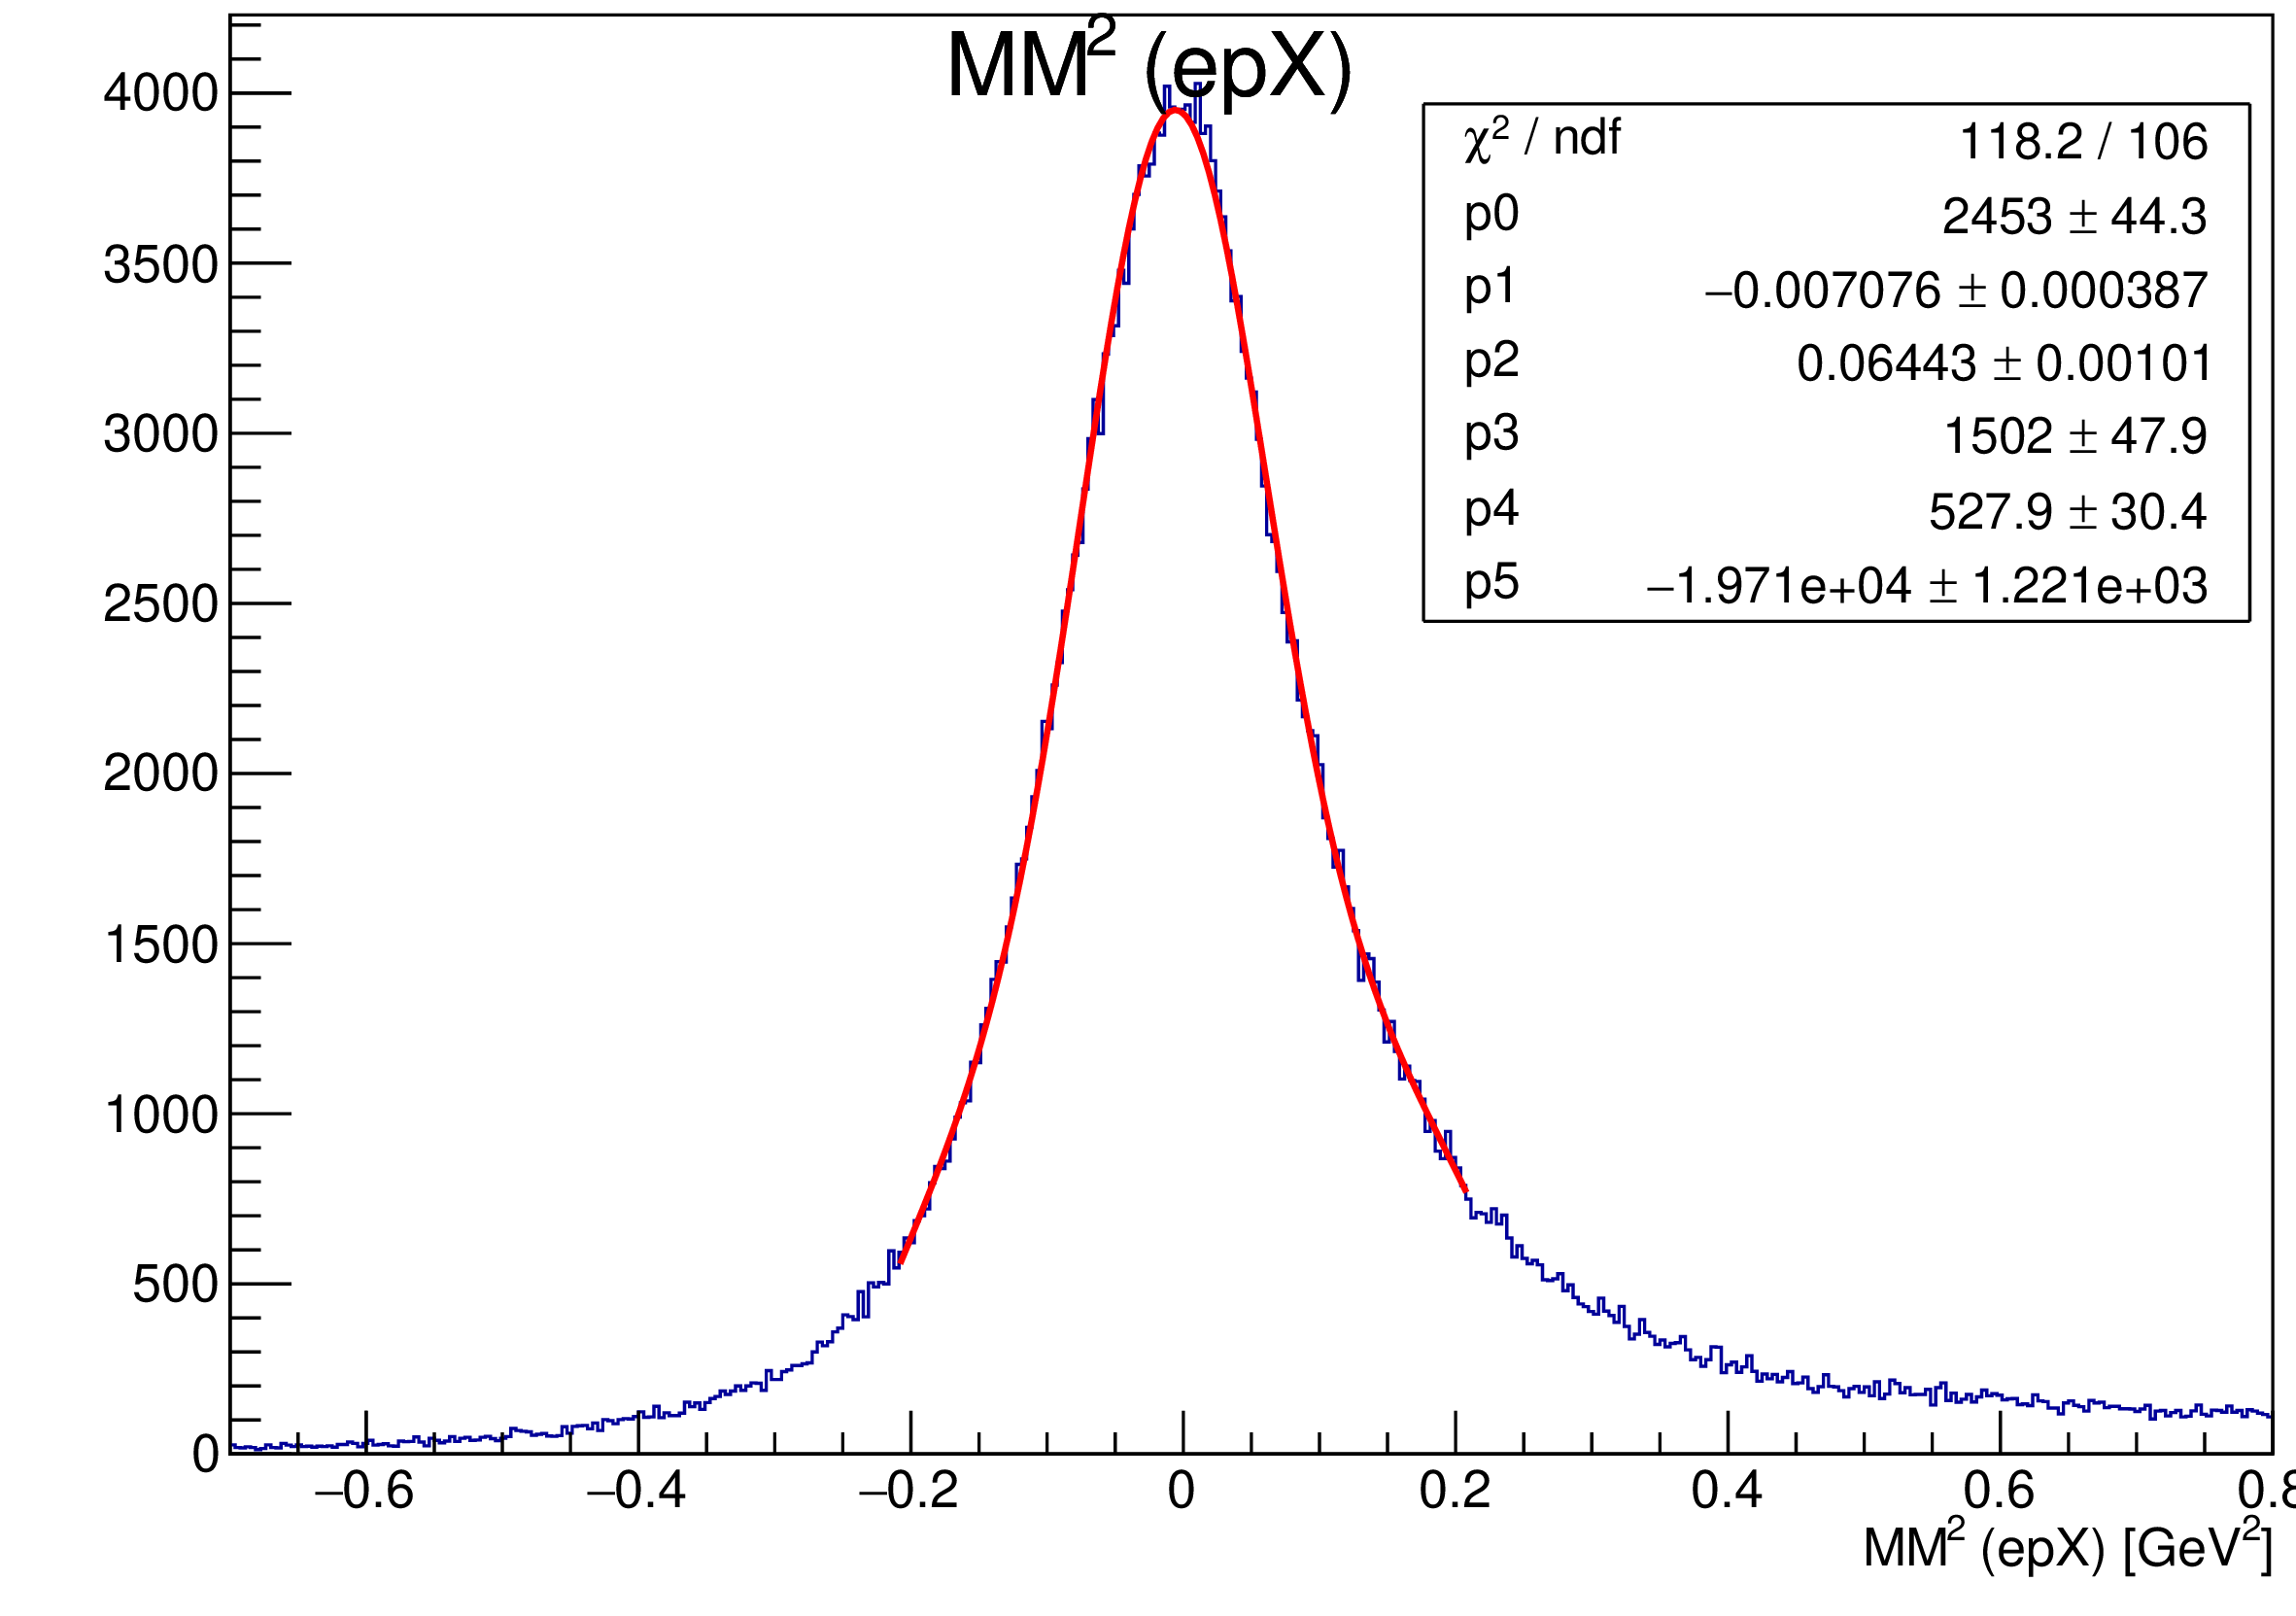
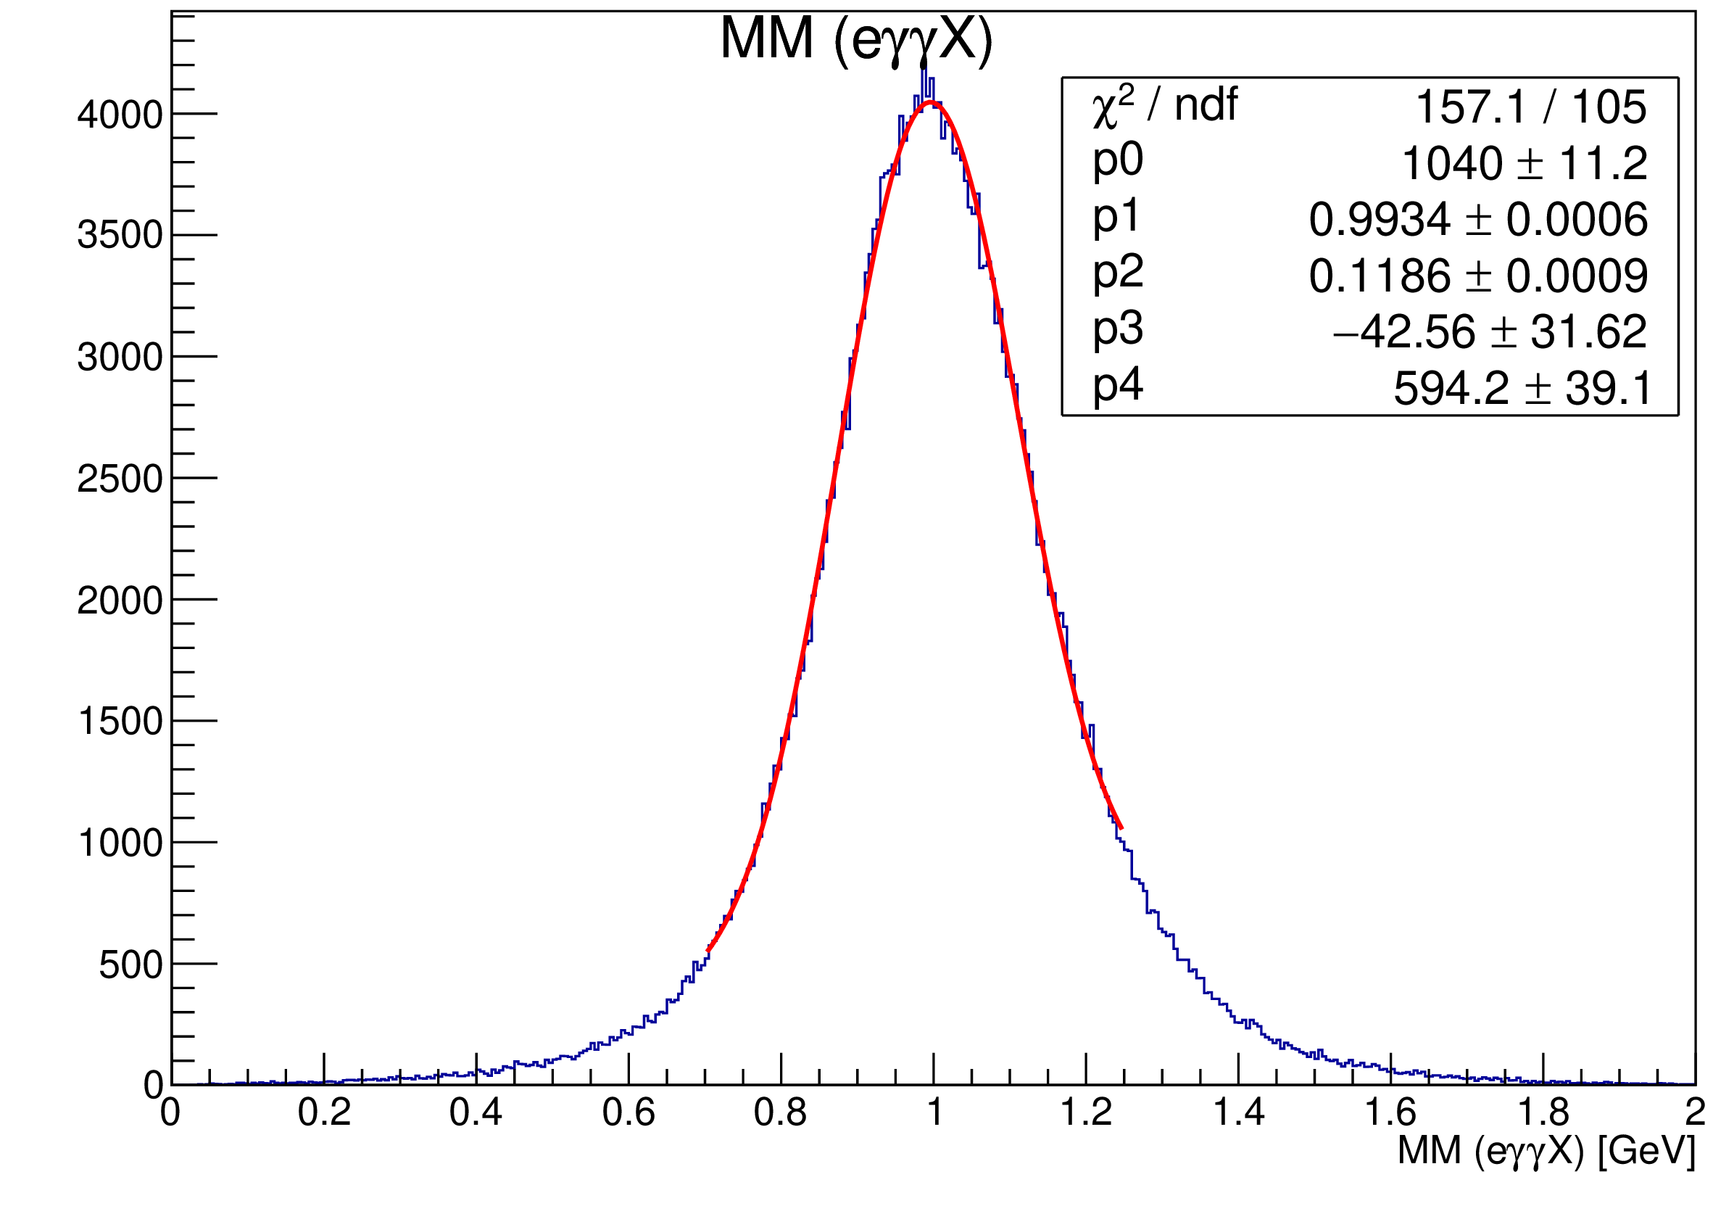
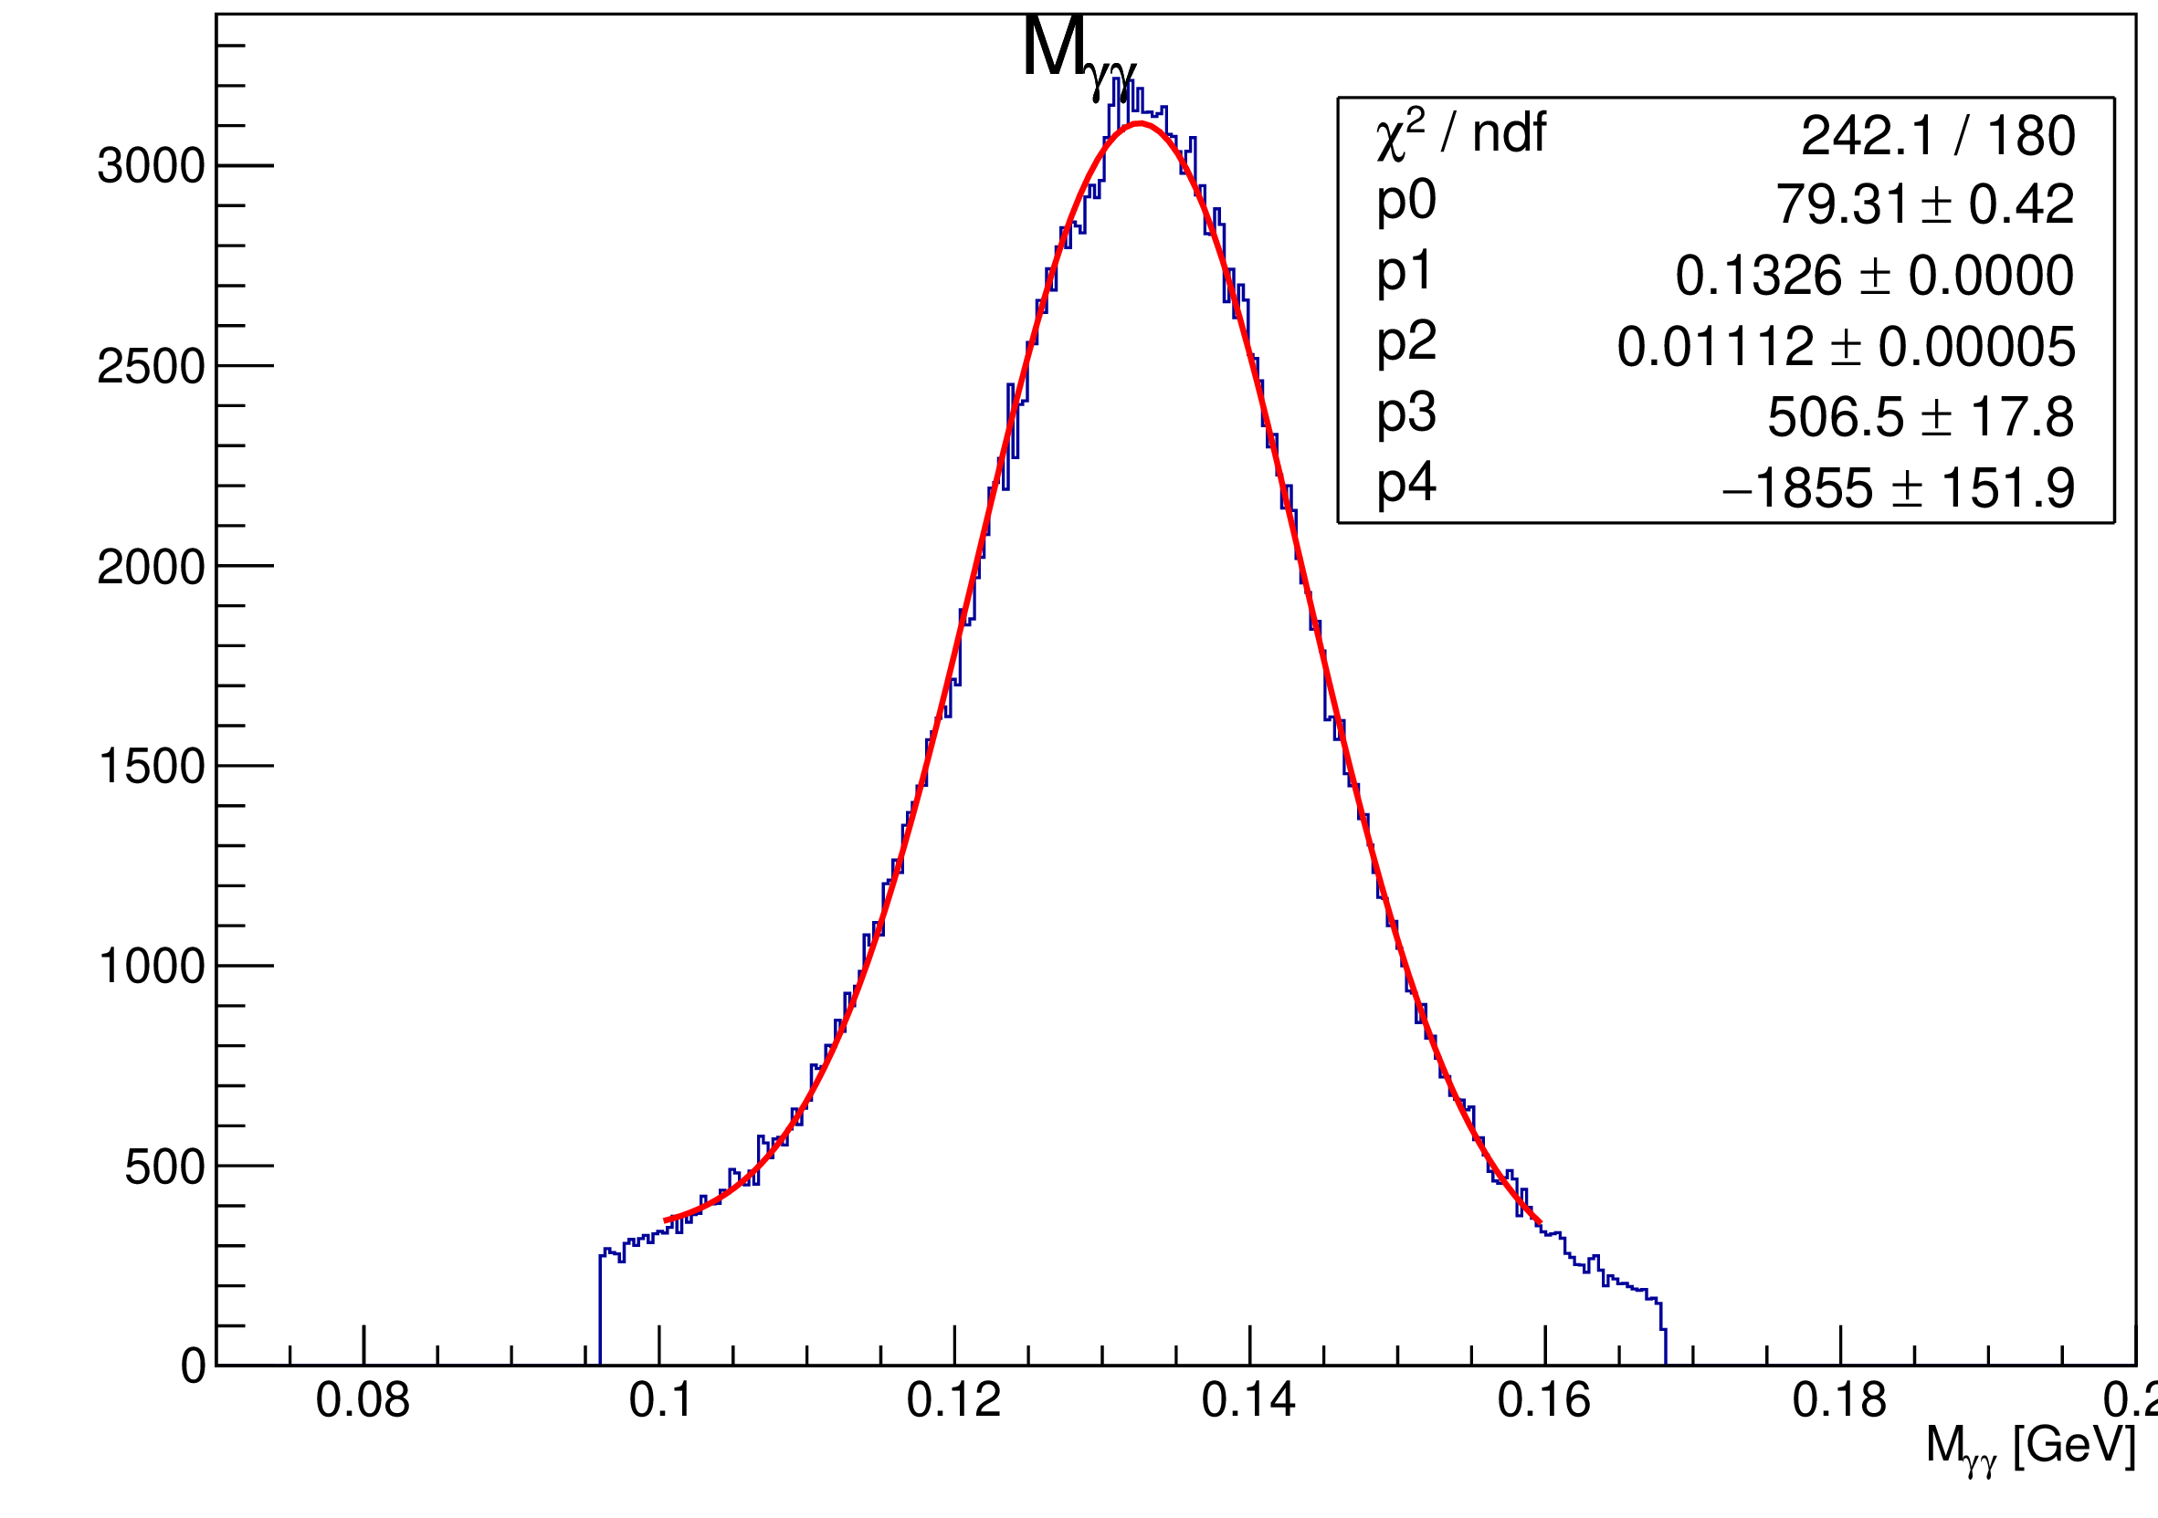
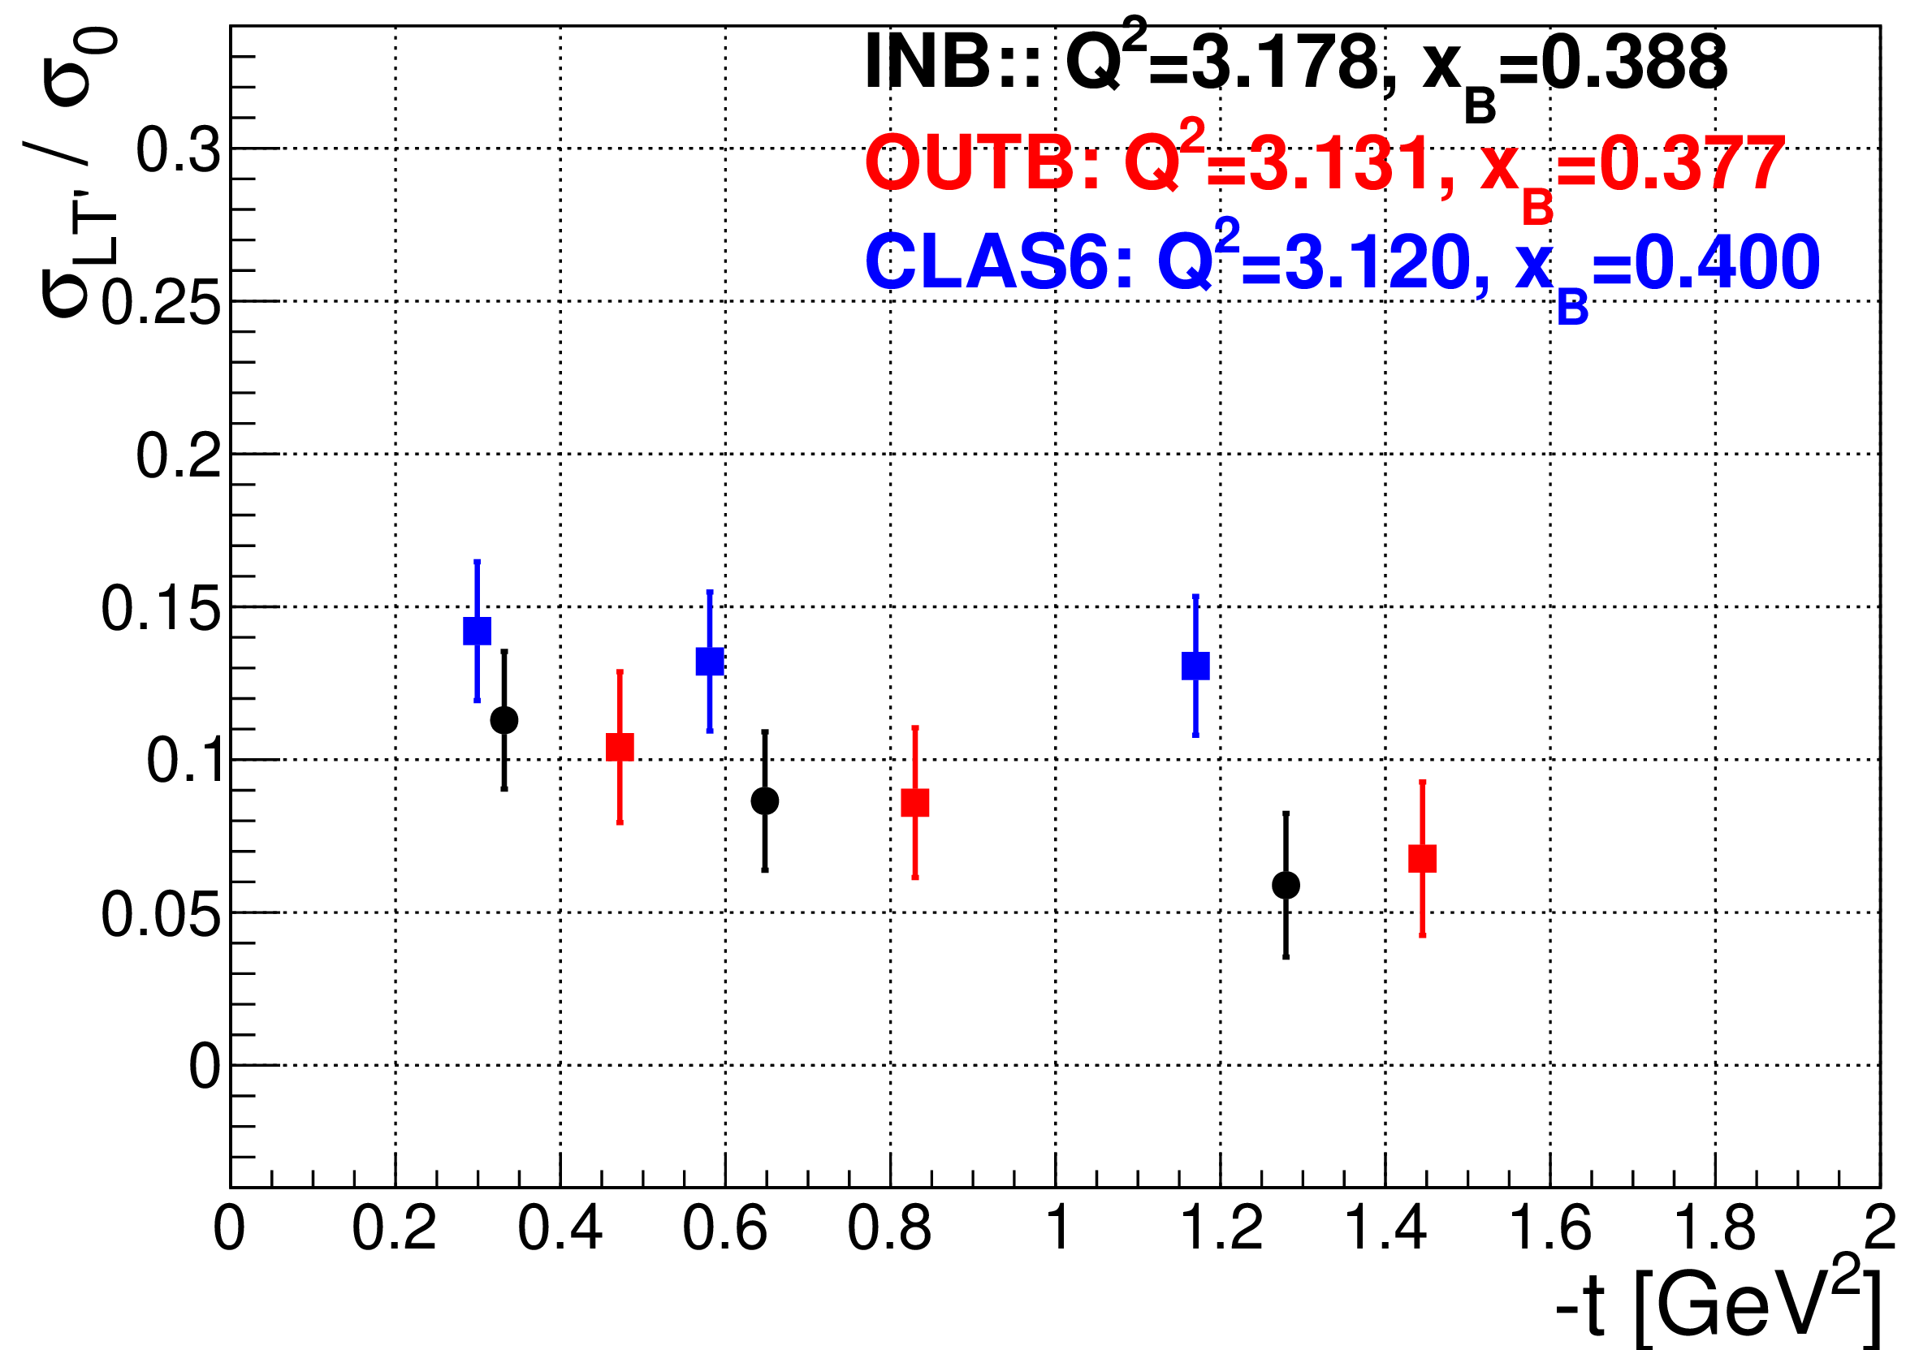
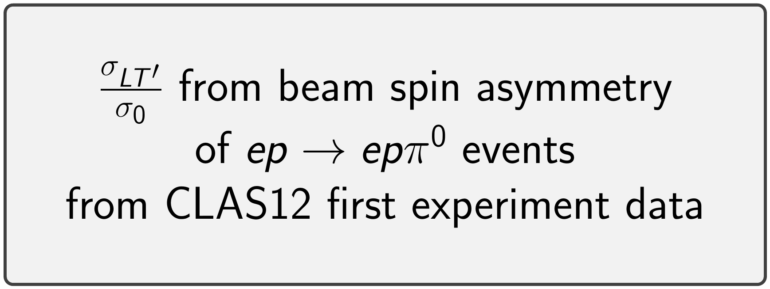
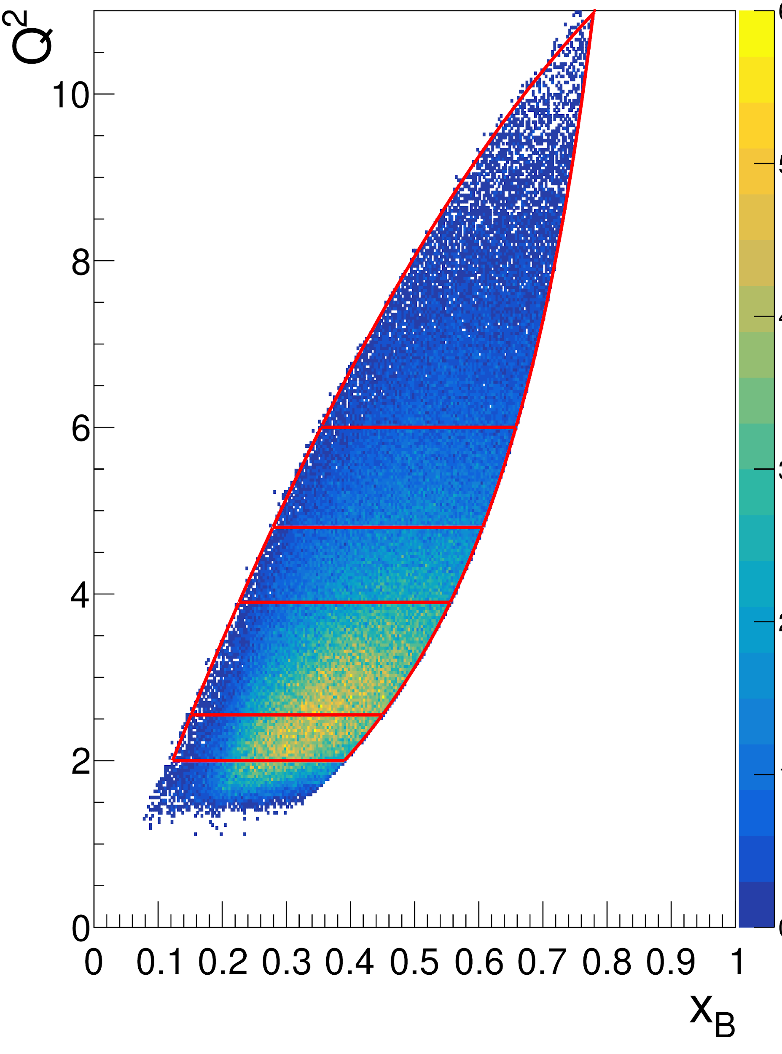
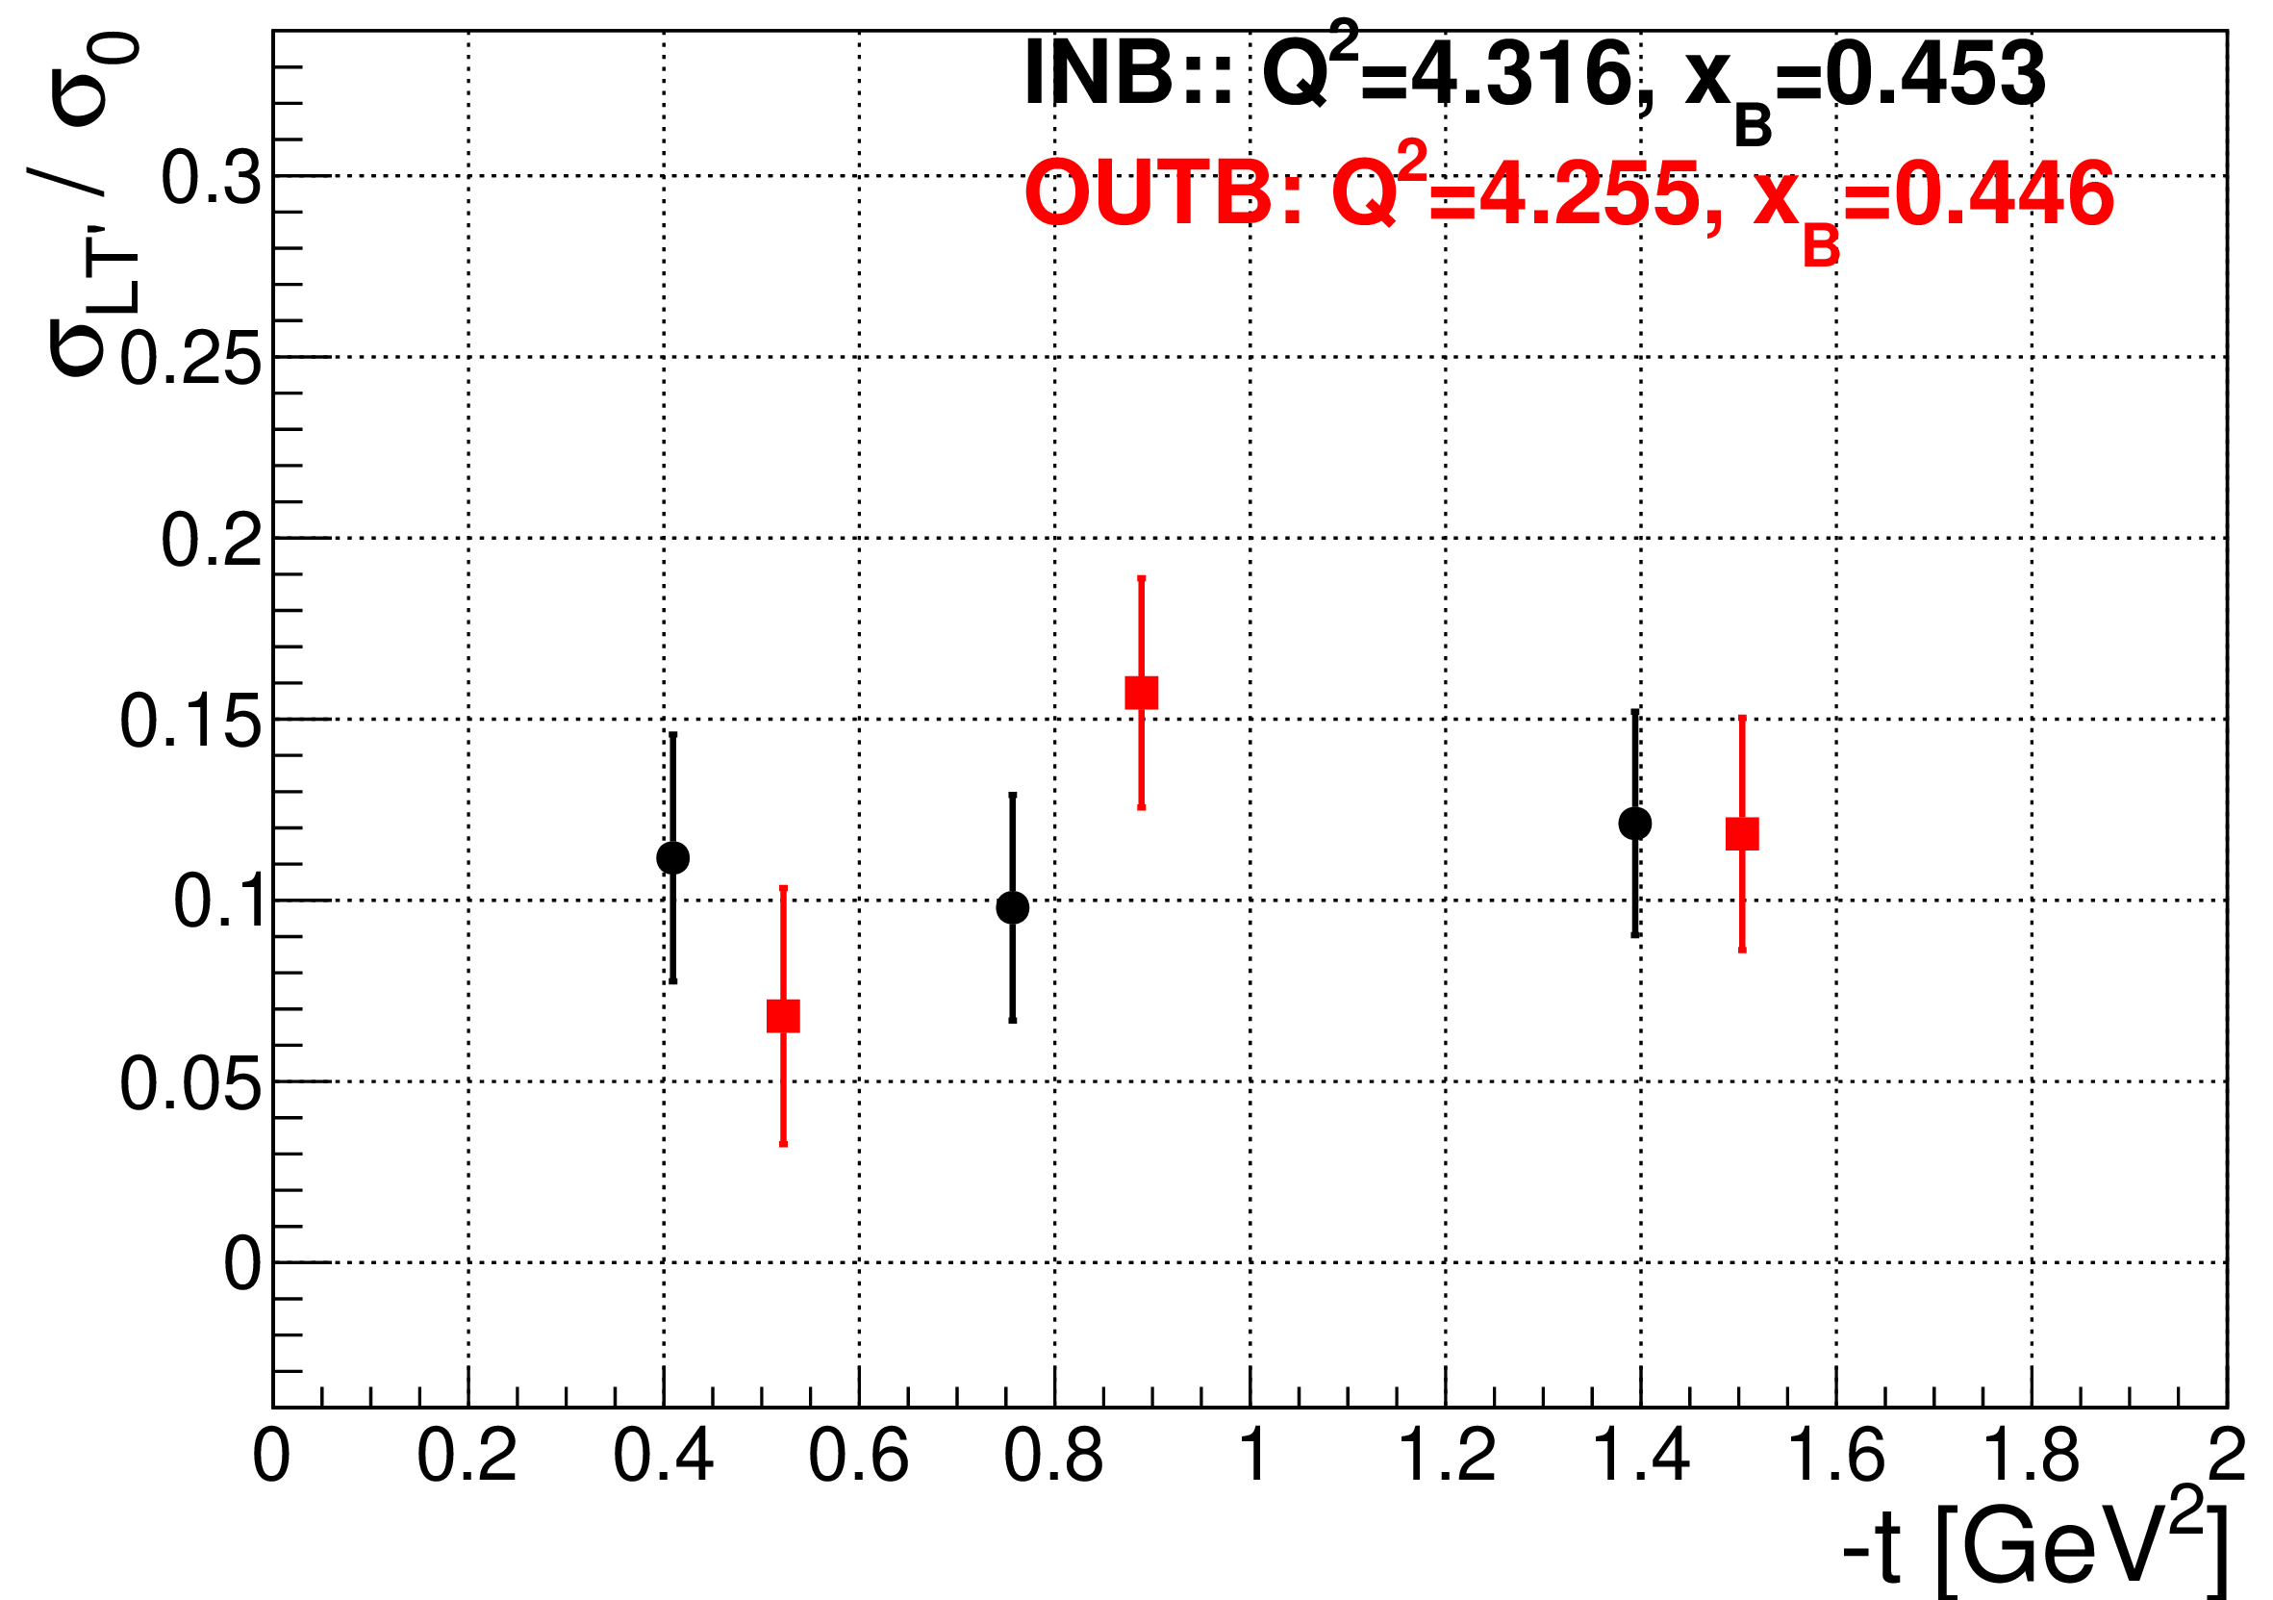
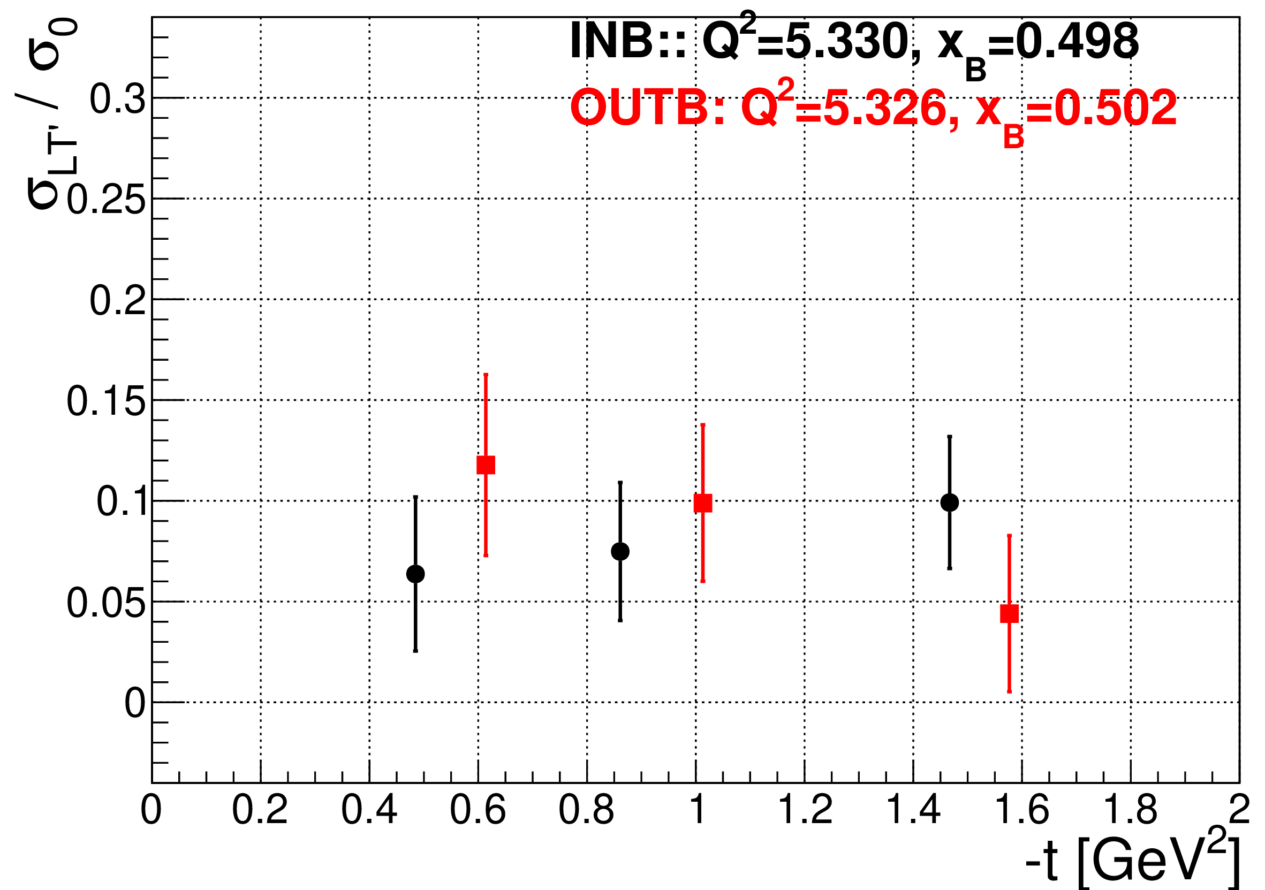
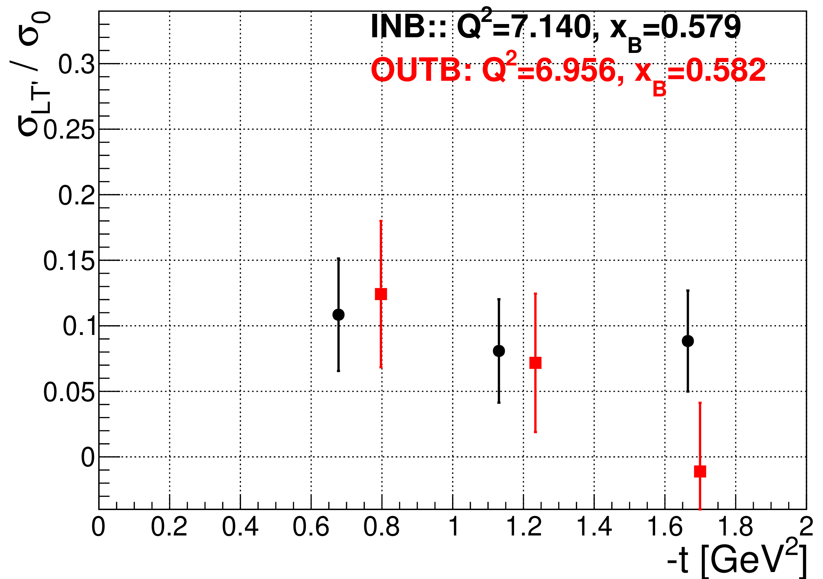
DVπ⁰P Beam Spin Asymmetry

Slide 14
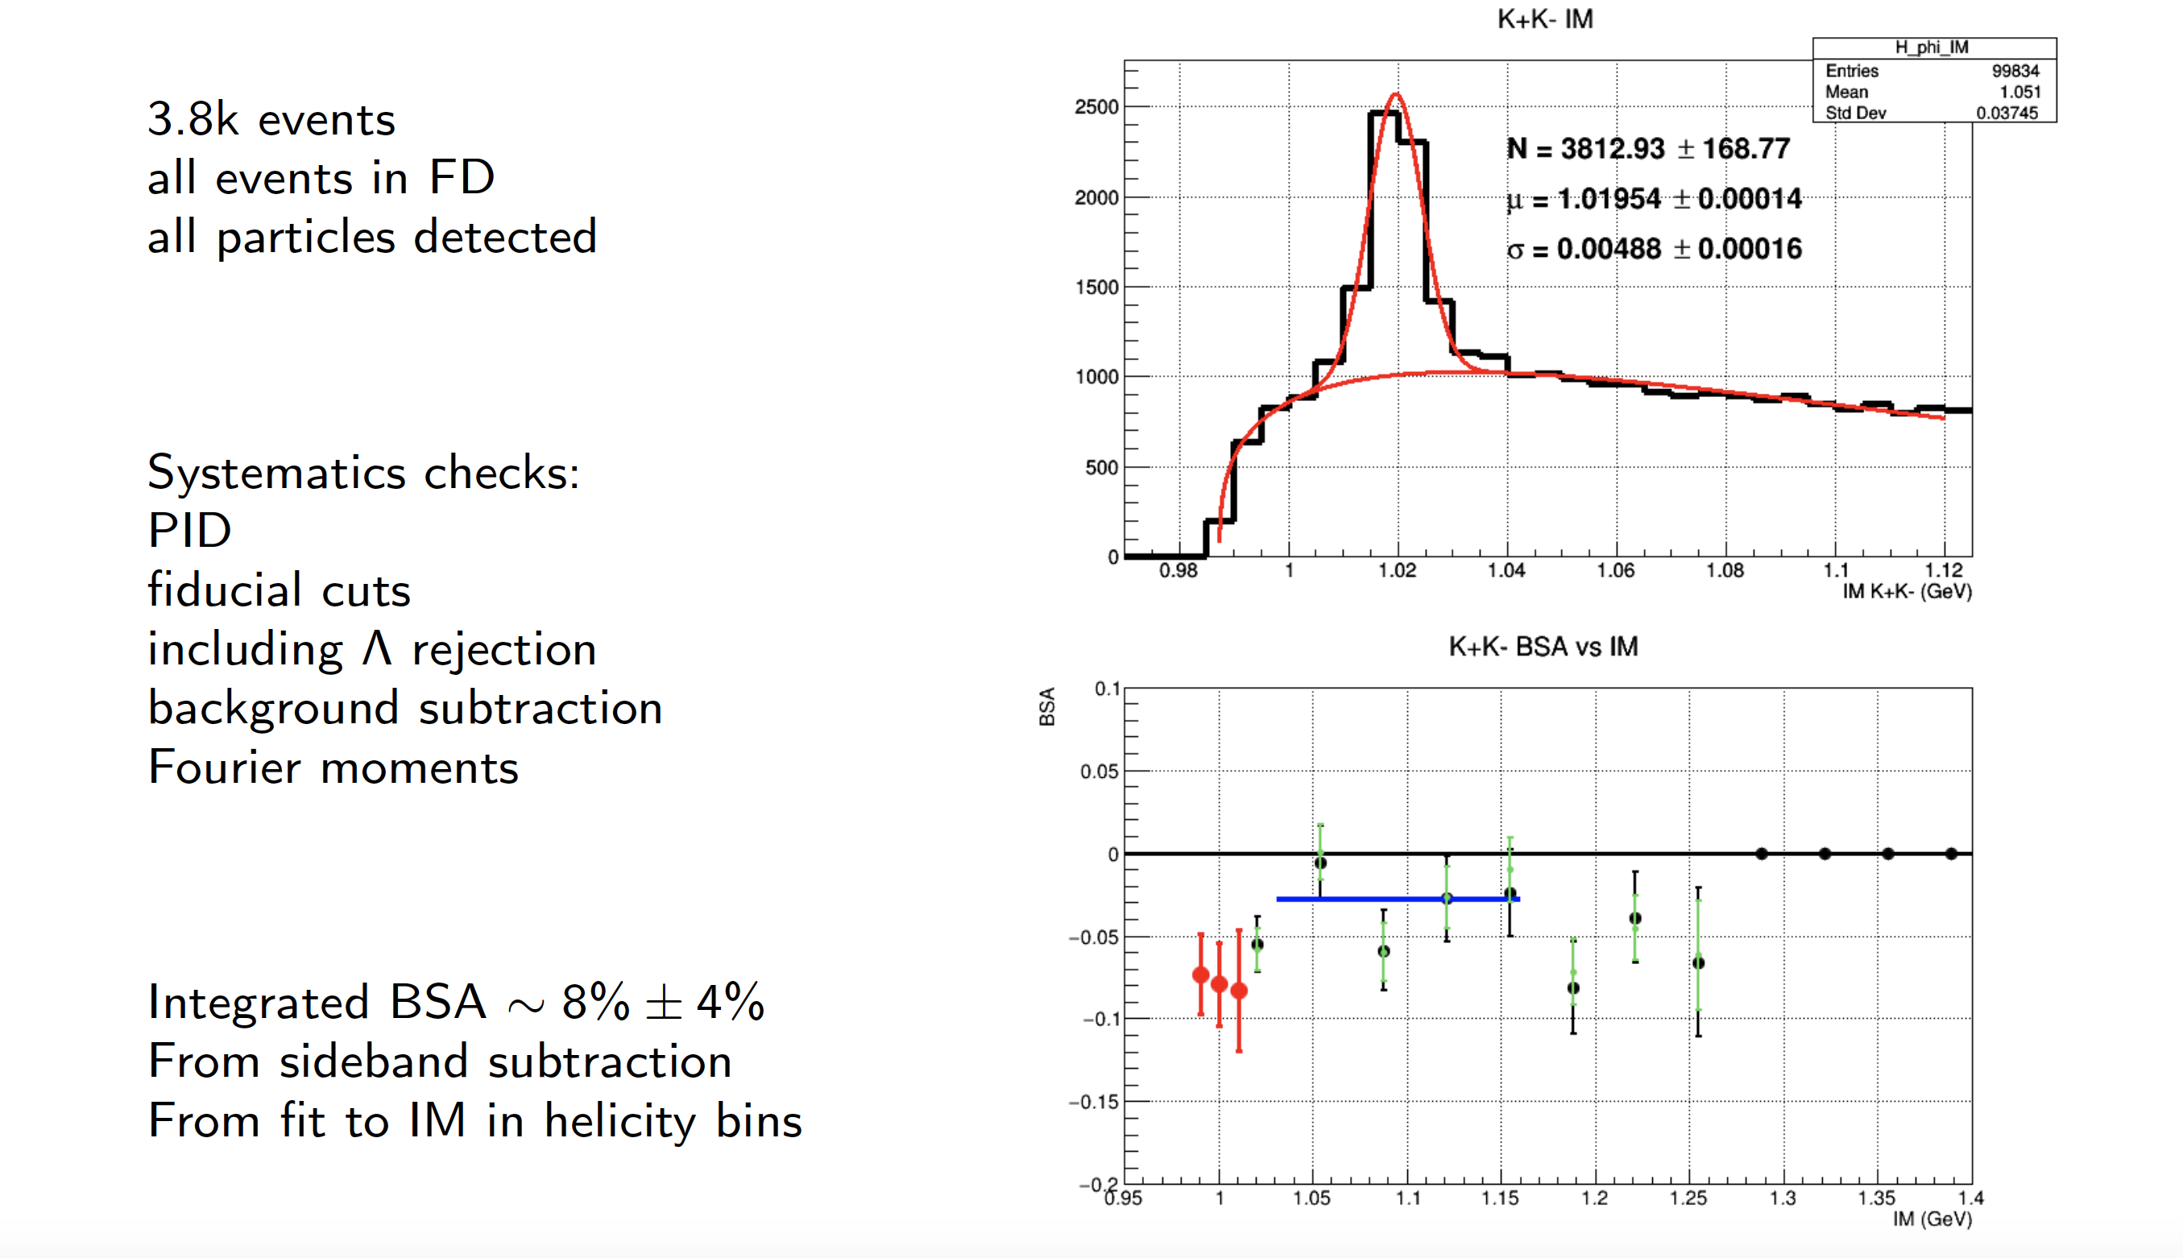
Phi - Beam Spin Asymmetry

Slide 15
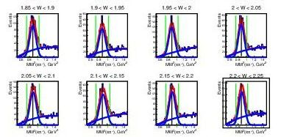
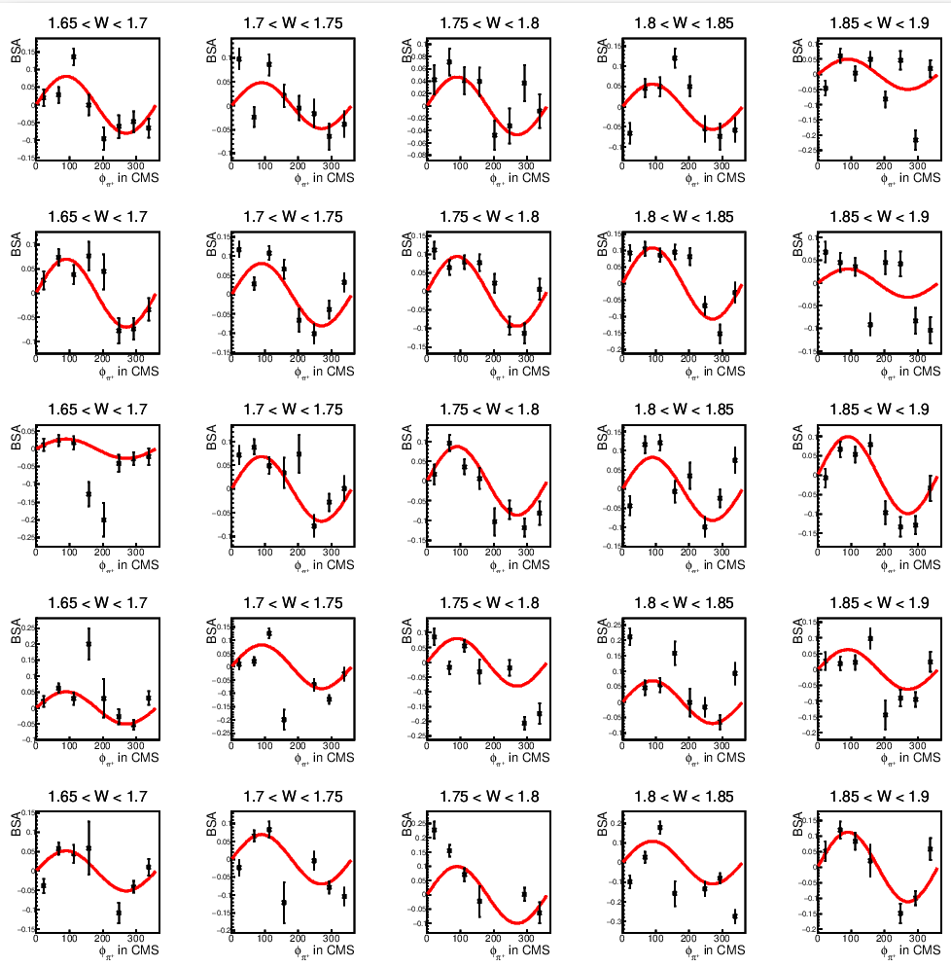
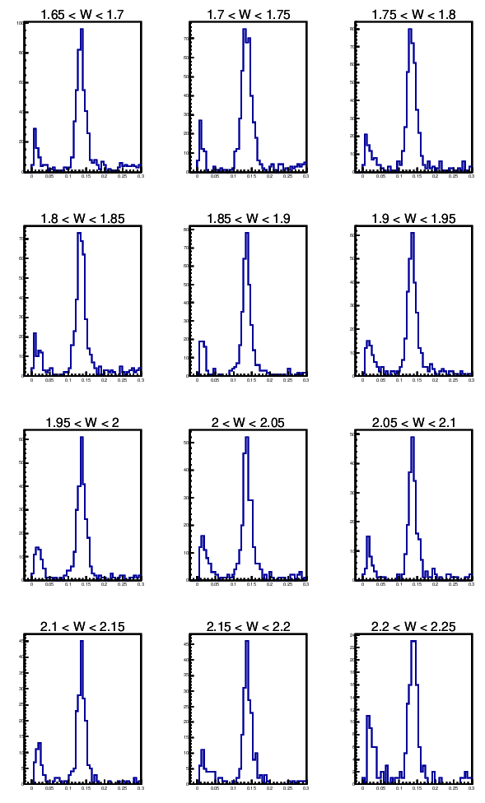
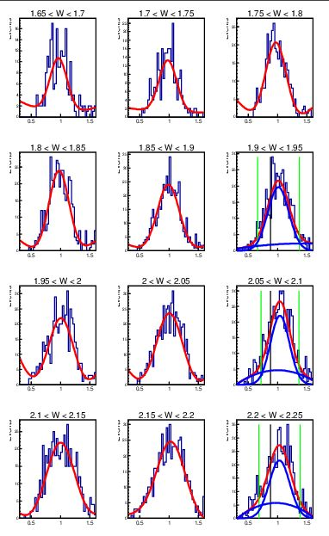
Beam spin asymmetry in the resonance region for ep->π⁺n and ep->π⁰p
Objective determine beam asymmetry in the resonance region in exclusive ep->π⁺n and ep->π⁰p electroproduction off photons.
PID is described in Analysis notes
MM(eπ⁺X)
2 gamma Invariant mass, 135<phi<180 channel: π⁰p
BSA for π⁺n:
MM(egg) for π⁰p
10 < theta < 20
20 < theta < 30
30 < theta < 40
40 < theta < 50
50 < theta < 60

Slide 16

SIDIS Multiplicity

Slide 17


Slide 18
Improvement to pass1 towards Phase II Publications
Momentum corrections (see next slide)
Improved neutral particle identification & efficiency (See Cole’s Talk)
RICH - Complete detector calibration post Processing (See Marco M.’s Talk)
Detector efficiency with first stage focusing on the FD (See Nick’s Talk)

Slide 19

Kinematical corrections

Slide 20
Phase 3 Publications
Require Pass2

Slide 21




N* Electroexcitation to high Q² with CLAS12
Expected outcome: The first results on the γ_{v}pN* electrocouplings of most N* states from data in the range W < 3.0 GeV and Q² > 5.0 GeV² for exclusive reaction channels: πN, ππN, KY, K*Y, KY*
kinematic coverage for RG-A data @ 10.6 GeV
π⁺n
K⁺Y
π⁺π⁻p
π⁺π⁻p
Q² (GeV²)
Q² (GeV²)
Q² (GeV²)
resonances?
3rd
resonance
regions
2nd
W (GeV)
W (GeV)
W (GeV)
W (GeV)
Expected events per Q²/W bin for full RG-A dataset
π⁺n |  |  | K⁺Λ & K⁺Σ⁰ |  |  |  |  | π⁺π⁻p
Q² [GeV²] | W [GeV] 1.5-1.55 | W [GeV] 1.7-1.75 | Q² [GeV²] | W_{Λ} [GeV] 1.7-1.75 | W_{Σ} [GeV] 1.7-1.75 | W_{Λ} [GeV] 1.9-1.95 | W_{Σ} [GeV] 1.9-1.95 | Q² [GeV²] | W [GeV] 1.7-1.75 | W [GeV] 1.9-1.95
 |  |  | 1.4-2.2 | 63417 | 6012 | 66564 | 33170
 |  |  | 2.2-3.0 | 72144 | 5364 | 77443 | 28720
5.2-5.8 | 15272 | 4175 | 3.0-4.0 | 52358 | 3945 | 51991 | 18936 | 5.2-5.8 | 2813 | 2808
5.8-6.5 | 10737 | 2637 | 4.0-5.0 | 24833 | 3103 | 26690 | 5925 | 5.8-6.5 | 1822 | 1969
6.5-7.2 | 7367 | 1684 | 5.0-6.0 | 11203 | 1598 | 11160 | 2642 | 6.5-7.2 | 1159 | 1294
7.2-8.1 | 4567 | 1290 | 6.0-7.0 | 5566 | 648 | 6300 | 943 | 7.2-8.1 | 661 | 924
8.1-9.1 | 2742 | 540 | 7.0-8.0 | 2606 | 338 | 3276 | 633 | 8.1-9.1 | 364 | 414
9.1-10.5 | 1453 | 194 | 8.0-9.0 | 1440 | 244 | 936 | 86 | 9.1-10.5 | 118 | 179
Collecting the remainder of the approved RG-A beam time will give a factor of two more statistics
This will extend the Q² range of the γ_{v}pN* electrocouplings to 8-10 GeV² for each of these channels – the data collected so far will limit us to 6-8 GeV²

Slide 22



MesonEx and Very Strange
Motivations
World-wide effort to understand the meson spectrum (COMPASS, LHCb, BES-III, BELLE, …)
Extensive scientific program at JLab to understand the role of gluonic excitations in the spectroscopy of light mesons
Hall-B is using of a combination of low-Q2 electron scattering (equivalent to an high intensity photon beam) and the CLAS12 detector (4π acceptance, excellent Pid, high resolution) to measure exclusive final states and perform a full Partial Wave Analysis on mesonic and baryonic systems
MesonEx (E-11-005): Study of meson spectrum in the 1-3 GeV mass range to identify gluons excitation of mesons (hybrids) and other quark configurations beyond the CQM
Very Strange (E-12-008): Serach for mission excited hyperon states
Unique opportunity to extend baryon photo production to the complementary electroproduction with the same data set
Assessment
I) MesonEx example: Search for exotic π₁ (1600) in e p → e’ n π+ π+ π-
M(3π)
M(3π)
Results for inbending fall 2018 e- data
CLAS12 acceptance low for 2π⁻
Extra data required for a₂(1230) region
M(π⁺₁π⁻)
M(π⁺₂π⁻)
Low cross sections in interesting mass region 1.5-2.5 GeV/c², containing several interesting resonances including π₁
Other final states with kaons have lower cross section but still accessible with CLAS12

Slide 23


MesonEx and Very Strange
Assessment
II) Very Strange example: Strange and very strange hyperons
MissingMass(e’ K⁺ X) [GeV]
MissingMass(e’ K⁺ K⁺) [GeV]
Results for inbending fall 2018 e- data
Clearly see hyperon resonances
Cascade electroproduction easily accessible and any results are new
Electroproduction (Q^2 dependence) provides with new and complementary information on these states
Σ⁰(1189)
Σ*
Λ*(1520)
Λ⁰(1110)
Ξ⁻(1320)
Future plans
Good performance of the CLAS12-FT to provide low Q2 electroproduction data
Clear benefit by collecting the remaining 50% of approved statistics
MesonEx: PWA requires high statistics to pin down the tiny signal (~1%) of exotic mesons
Very Strange: high statistics is needed to study excited cascades and Ω⁻ that require detection of final states with many particles(kaons)

Slide 24
Summary
The RG-A science program is broad and rich and addresses several of the most fundamental questions in hadronic physics.
We have also designed and optimized a smart trigger to run successfully all 13 experiments simultaneously!
PAC 48 Approved the remaining days to fully realize the goals of the RG-A science program
Excellent presentations at APS/DNP2020
First two physics publications in the final stages of the review
Preparation of the phase II publication underway with Focus on CD, Improvement to PID in the FD and understanding the CLAS12 detector efficiency

