Slide 1
First results of the RF performance of 1.3 GHz Nb coated cavities on high quality copper substrates 9th International Thin Films and New Ideas for Pushing the Limits of Superconductivity
Bianchi, L. Lain Amador, C. Pereira Carlos, G. Rosaz, L. Vega Cid, W. Venturini, P. Vidal Garcia
Special thanks to S. Atieh and K. Scibor for the preparation of the bulk machined substrate, and the colleagues from the cryolab and SRF section for their help and technical support for setting up the RF measurements.

Slide 2
Outline
Introduction
Nature of the Q slope
Research on thin films
Production of substrates
Results
Conclusions

Slide 3
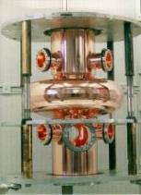
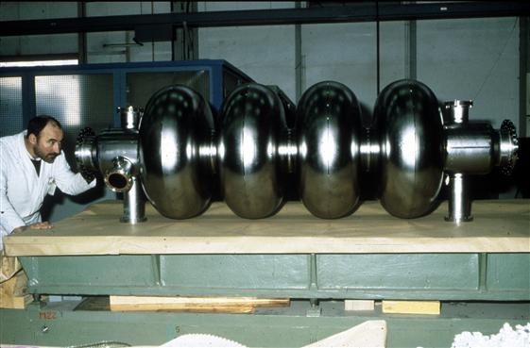
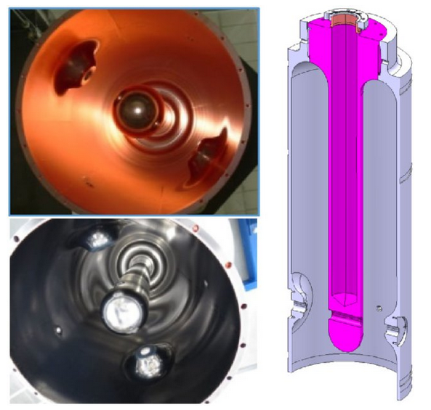
Introduction Nature of the Q slope Research on thin film Production of substrate Results Conclusions
Niobium on copper cavities at CERN
Operational considerations
LHC
LEP
HIE-ISOLDE

Slide 4
Introduction Nature of the Q slope Research on thin film Production of substrate Results Conclusions
Niobium on copper cavities at CERN
Operational considerations
Copper is cheaper than niobium
Better thermal properties which allow for operation in liquid helium bath at 4.2 K.
Sufficient thermal stability to avoid thermal quenches.
Lower sensitivity to trapped flux.
Strong increase of the surface resistance with increasing RF fields: Q slope
This limits the application of Nb/Cu technology when high accelerating gradients are needed.

Slide 5
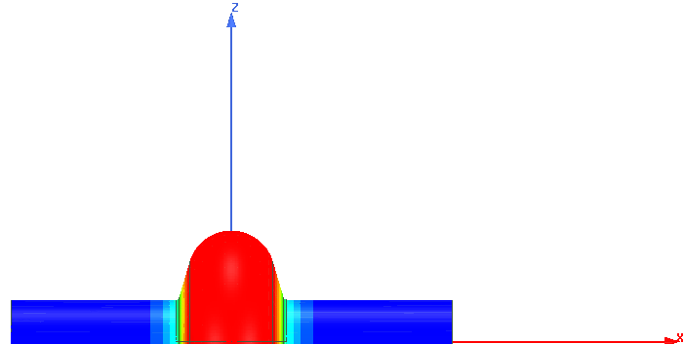
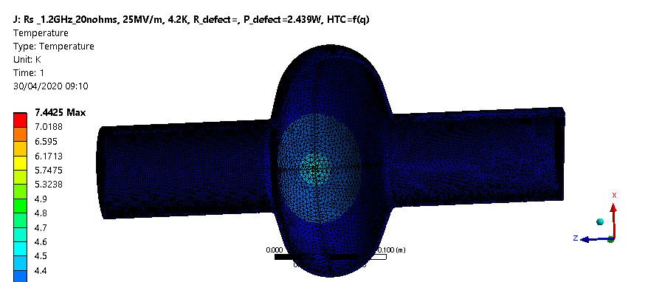
Introduction Nature of the Q slope Research on thin film Production of substrate Results Conclusions
Mechanism of Q drop in presence of defects
Mitigation of the phenomena
When RF field increases, power dissipates in defect
Local increase of temperature
Local increase of surface resistance
Q drop observed
$$Q=\frac{ωU}{\frac{1}{2μ}\int_{S}{R_{S}\left(B,T\right){\left\|B\right\|}^{2}dS}}=\frac{G}{R_{S}\left(B, T\right)}$$
Temperature increases around the defect
Defect: Area with higher resistance

Slide 6
Introduction Nature of the Q slope Research on thin film Production of substrate Results Conclusions
Mechanism of Q drop with increasing fields
Mitigation of the phenomena
Good bonding between them
Thin film of low Rs
High quality substrate

Slide 7
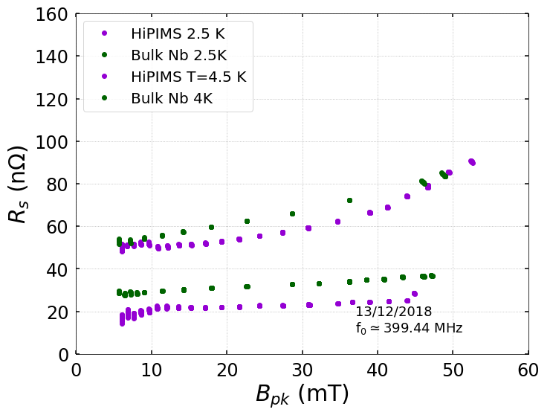
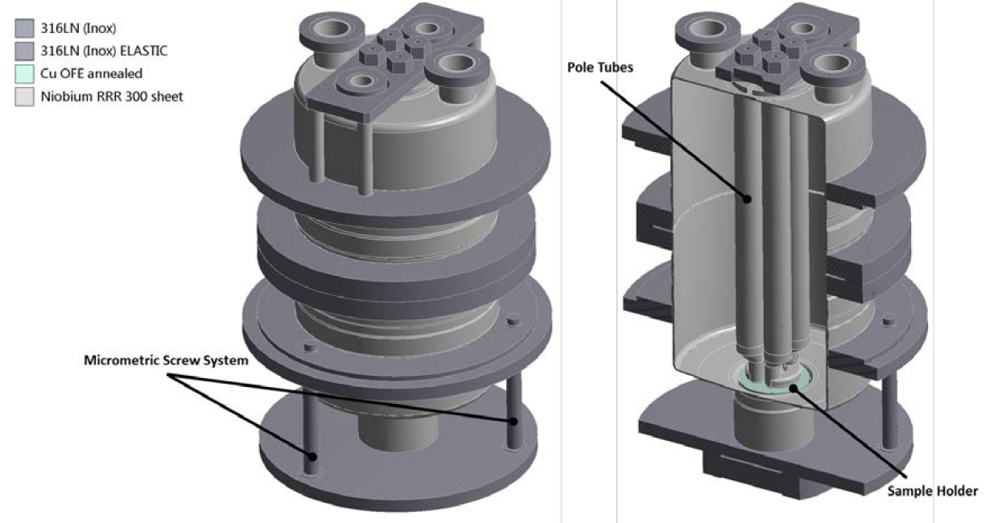
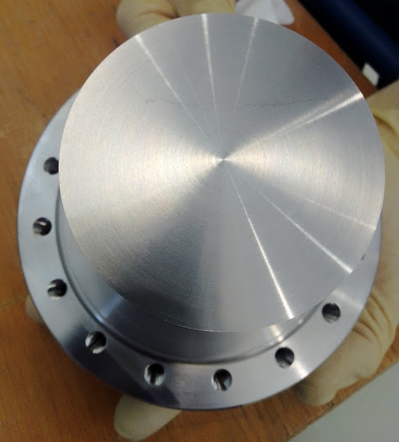
Introduction Nature of the Q slope Research on thin film Production of substrate Results Conclusions
Coating of QPR samples
Scale to 1.3 GHz cavities
Coating of 1.3 GHz cavities
Quadrupole Resonator (QPR)
Device conceived for applying RF fields on small flat superconducting samples for characterization.
HiPIMS technique: Results very promising, close to bulk Nb.
Copper substrate
Coating applied

Slide 8
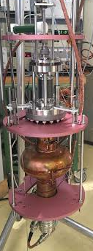
Introduction Nature of the Q slope Research on thin film Production of substrate Results Conclusions
Coating of QPR samples
Scale to 1.3 GHz cavities
Coating of 1.3 GHz cavities
QPR sample
1.3 GHz cavity
-Bias
-Temperature
-Pressure
-Pulse parameters
-Peak power
-Bias
-Temperature
-Pressure
-Pulse parameters
-Peak power
Measure RF performance

Slide 9
Introduction Nature of the Q slope Research on thin film Production of substrate Results Conclusions
Coating of QPR samples
Scale to 1.3 GHz cavities
Coating of 1.3 GHz cavities
HiPIMS technique allows to achieve denser layer in all the orientations, specific optimization for the cavity geometry.

Slide 10
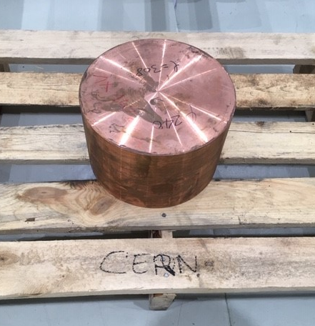
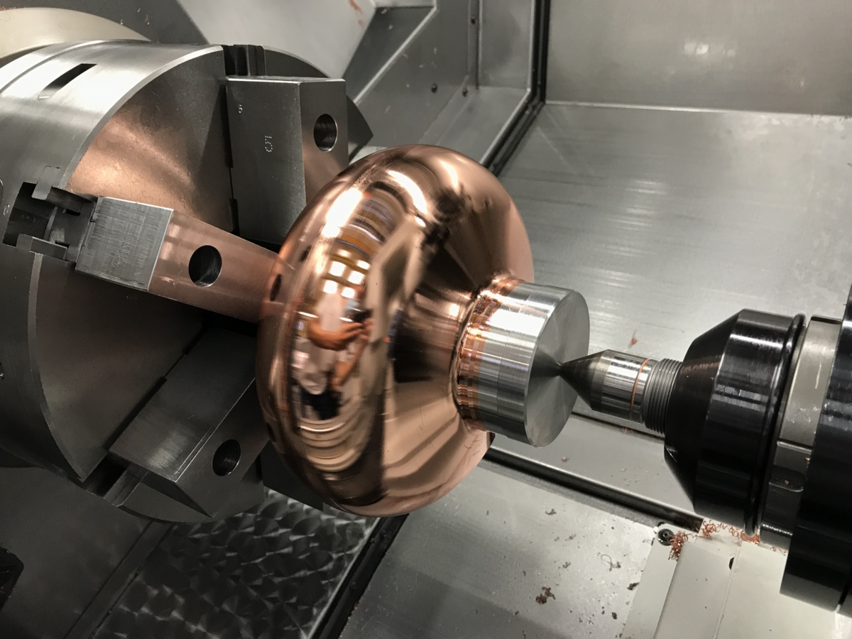
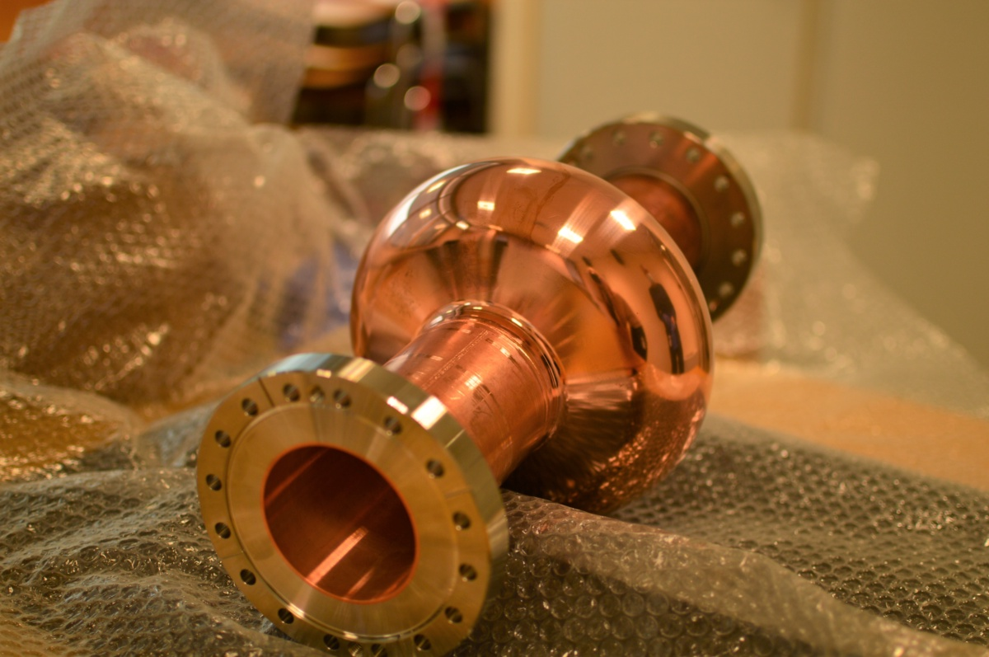
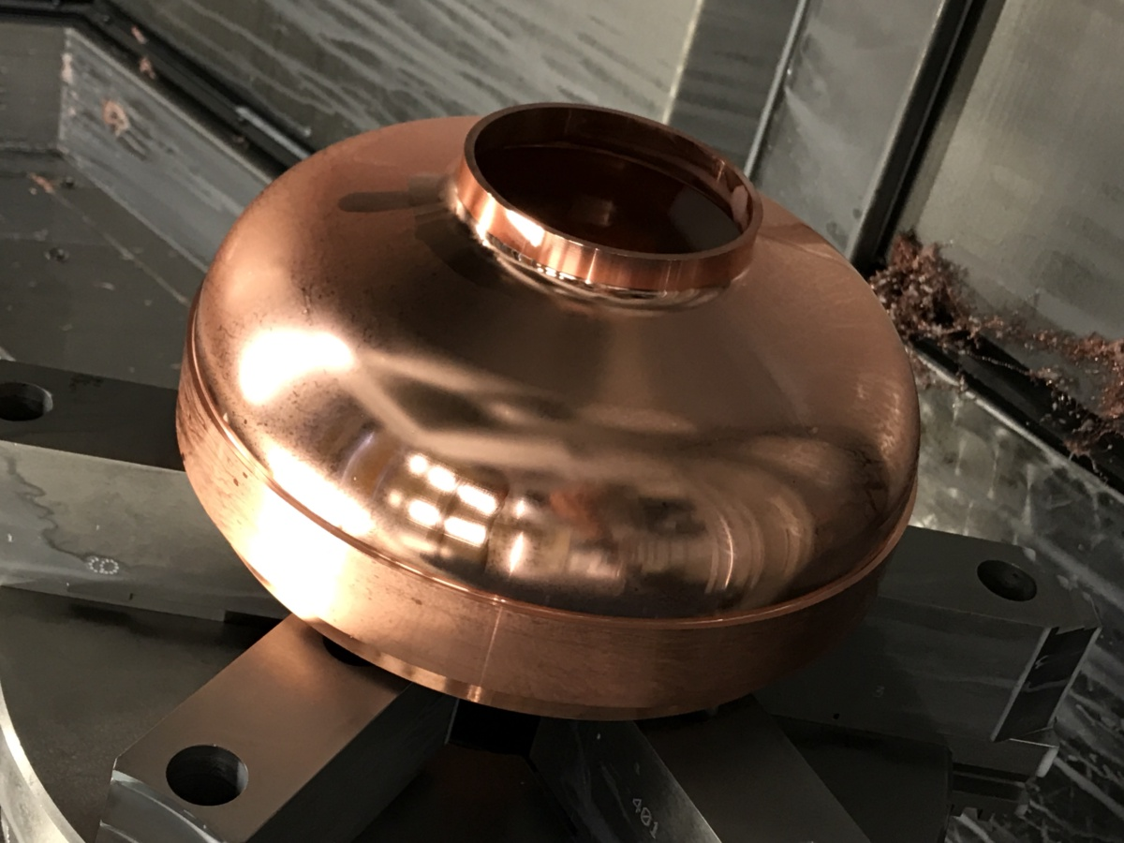
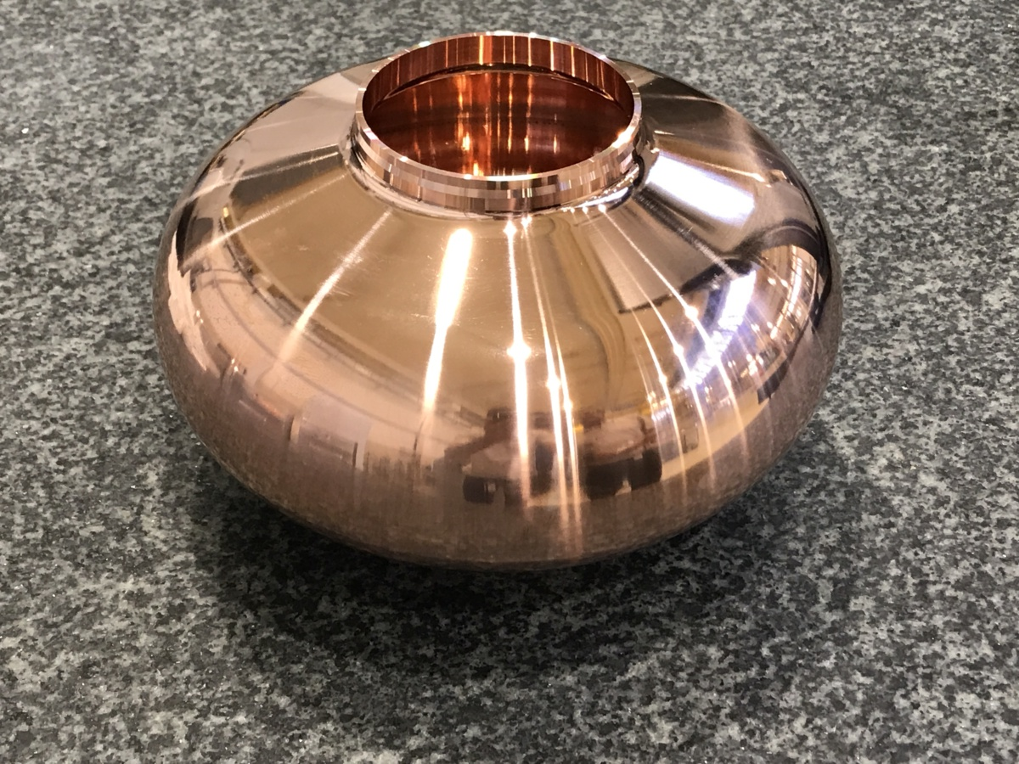
Introduction Nature of the Q slope Research on thin film Production of substrate Results Conclusions
Machined from a bulk billet
Electroformed
Bulk Cu billet
Machining of second half cell
E-beam welded to cut-offs
Machining of first half cell
Machined cell
Courtesy: K. Scibor
K. Scibor et al., “Machining of bulk 1.3 GHZ cavity”, euspen’s 20th International Conference & Exhibition, Geneva, CH, June 2020

Slide 11
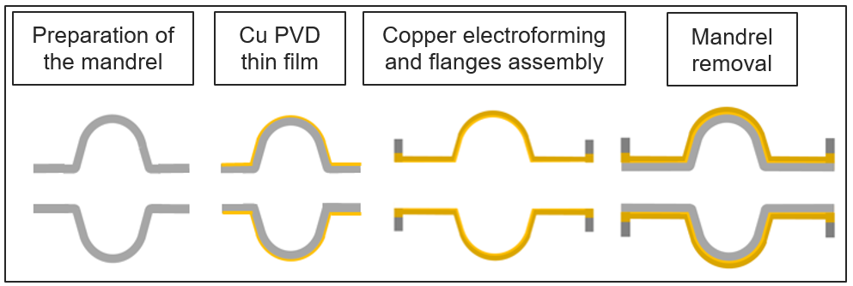
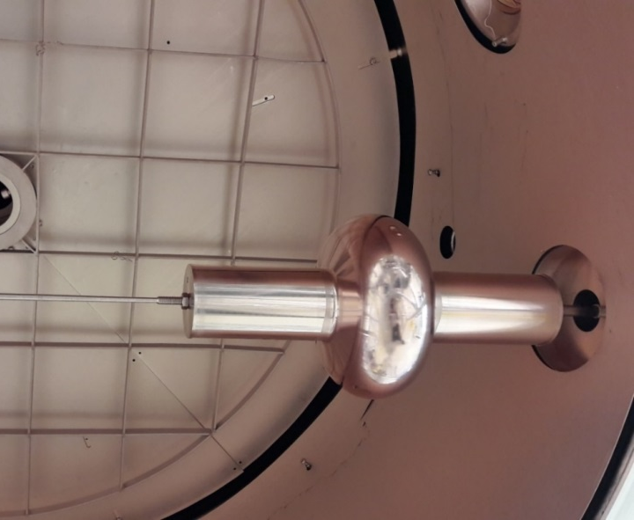
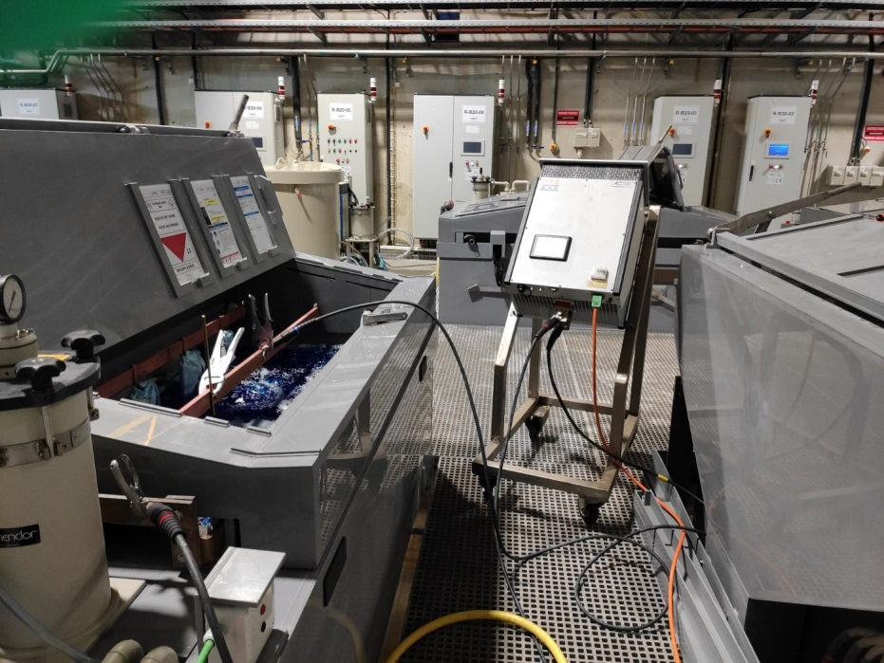
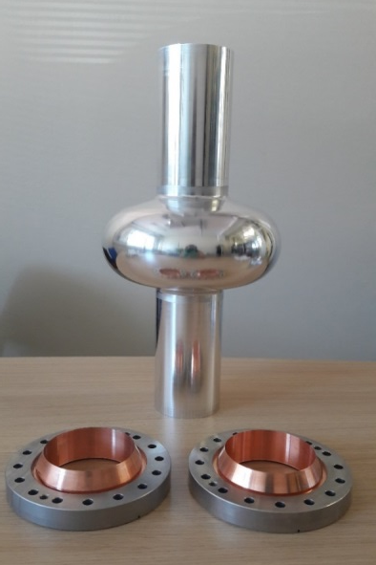
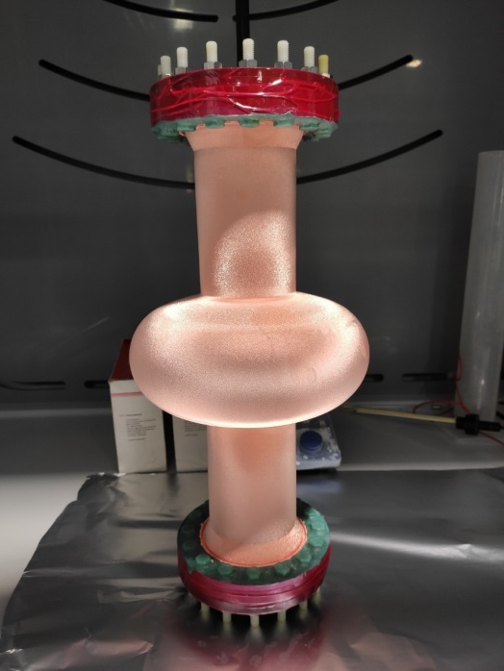
Introduction Nature of the Q slope Research on thin film Production of substrate Results Conclusions
Machined from a bulk billet
Electroformed
As you have seen in talk “Electrodeposition of copper applied to the manufacture of seamless SRF cavities”, L. Laín Amador.

Slide 12
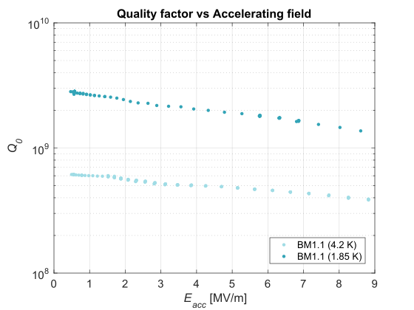
Introduction Nature of the Q slope Research on thin film Production of substrate Results Conclusions
Machined from bulk
Electroformed
Comparison
BM1.1
BM1.2
Degreased in detergent.
Sulfo-chromic acid rinsing.
HPWR at 100 bar
HiPIMS coating
HPWR at 50 bar
High Q at 4.2 K with mitigated slope.
Not very high Q reached at 1.85 K.
The diamond tooling caused a damage layer of 1-2 um.
No surface etching applied before coating to keep the surface as the as-machined state.

Slide 13
Introduction Nature of the Q slope Research on thin film Production of substrate Results Conclusions
Machined from bulk
Electroformed
Comparison
BM1.1
BM1.2
Degreased in detergent.
Sulfo-chromic acid rinsing.
HPWR at 100 bar
HiPIMS coating
HPWR at 50 bar
Stripping.
SUBU
HPWR at 100 bar
HiPIMS coating
HPWR at 50 bar
TO BE TESTED

Slide 14
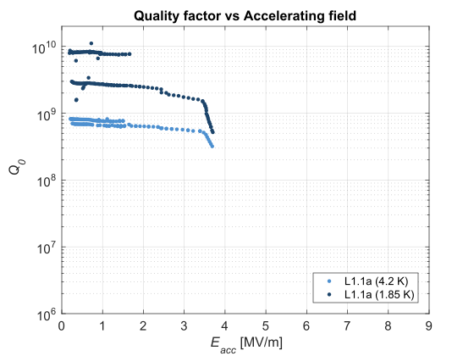
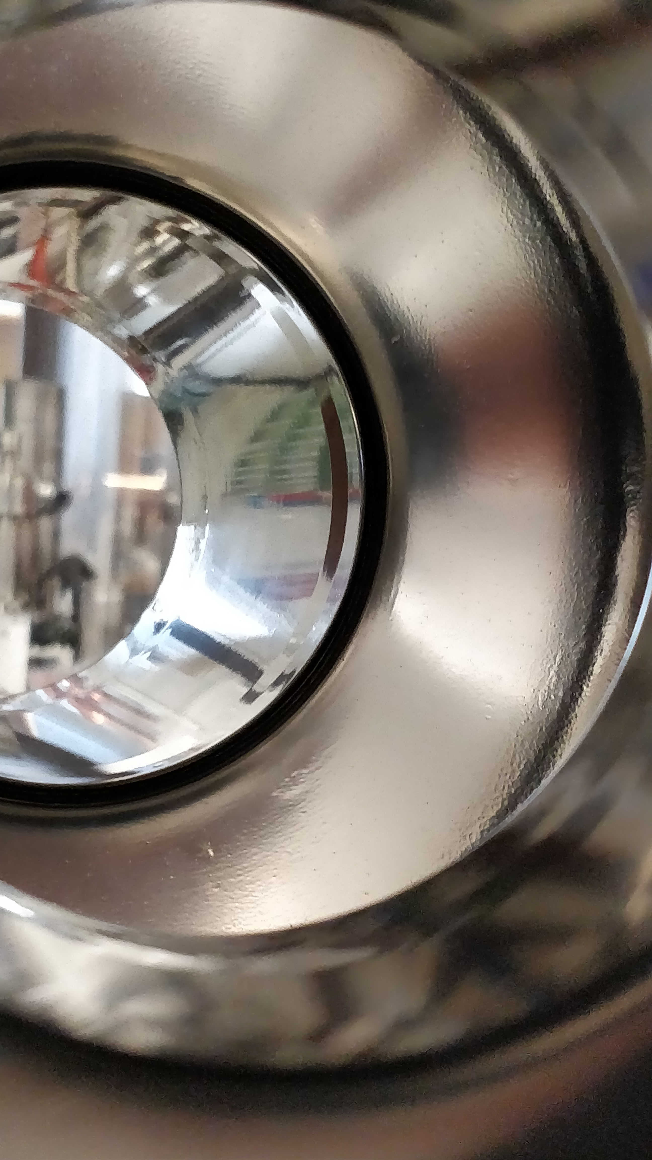
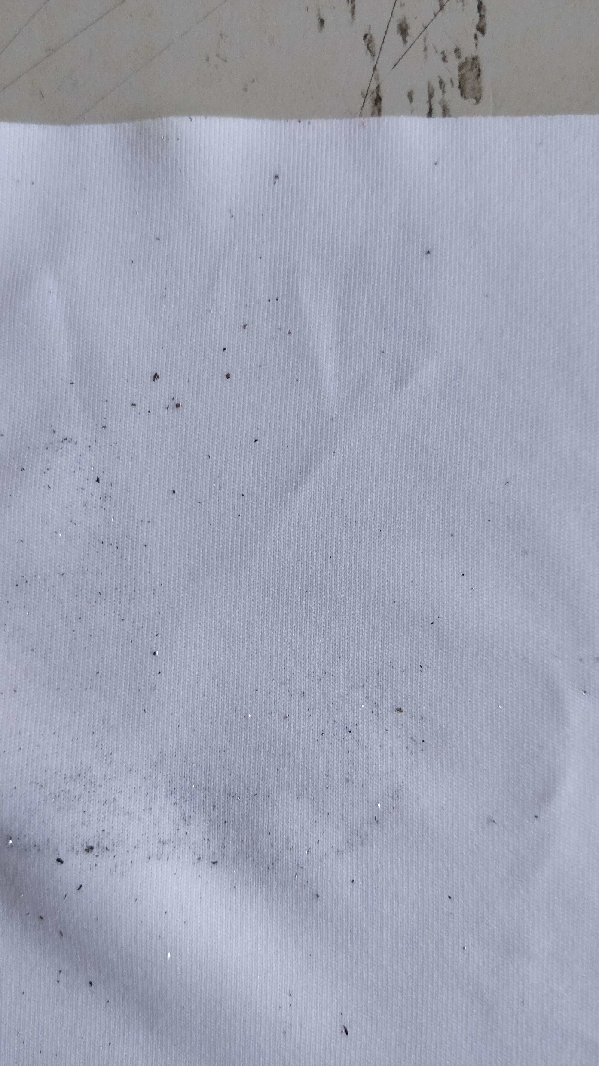
Introduction Nature of the Q slope Research on thin film Production of substrate Results Conclusions
Machined from a bulk fillet
Electroformed
Comparison
L1.1a
L1.1b
L1.1b
L1.2
L1.2
SUBU
HPWR at 100 bar
HiPIMS coating
HPWR at 50 bar
Field emission limiting at low fields.
No defects could be appreciated by optical inspection, but after the HPWR, some particulates observed.

Slide 15
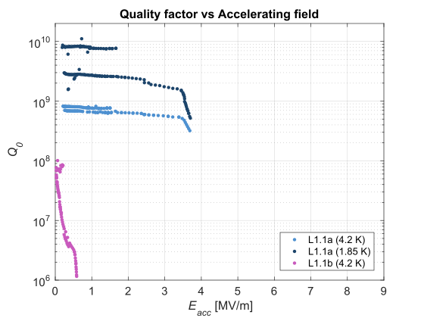
Introduction Nature of the Q slope Research on thin film Production of substrate Results Conclusions
Machined from a bulk fillet
Electroformed
Comparison
L1.1a
L1.1b
L1.2
L1.2
SUBU
HPWR at 100 bar
HiPIMS coating
HPWR at 50 bar
HPWR at 100 bar
Field emission limiting the RF testing at very low field at 4.2K. Not possible to measure at 1.85 K.
After HPWR at 100 bars, massive peel-offs at cut-off and cell were created.
Peel-off at cut-off
Peel-off at cell

Slide 16
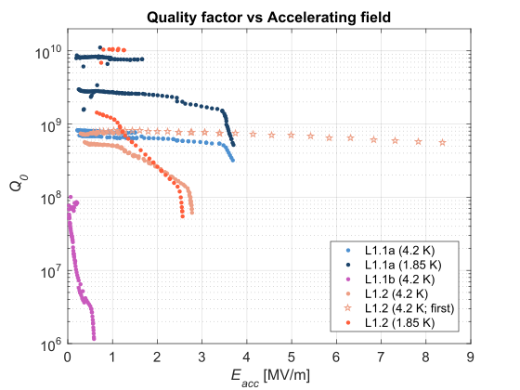
Introduction Nature of the Q slope Research on thin film Production of substrate Results Conclusions
Machined from a bulk fillet
Electroformed
Comparison
L1.1a
L1.1b
L1.2
SUBU
HPWR at 100 bar
HiPIMS coating
HPWR at 50 bar
HPWR at 100 bar
Stripping
Sulfo-chromic acid rinsing
HPWR at 100 bar
HiPIMS coating
HPWR at 50 bar
First Q scan at 4.2 K showed mitigated slope.
Afterwards, the Q dropped and it was not possible to reproduce this scan.
High Q reached at 1.85 K before Q switch.
A blister was observed in the coating.

Slide 17
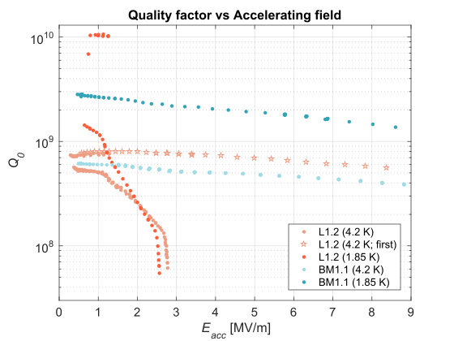
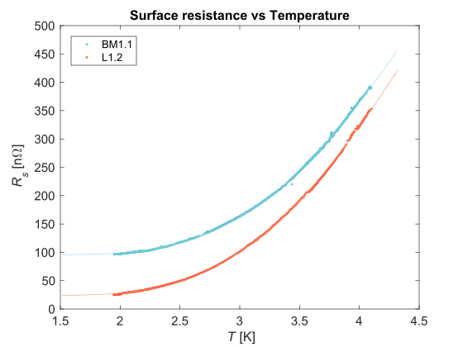
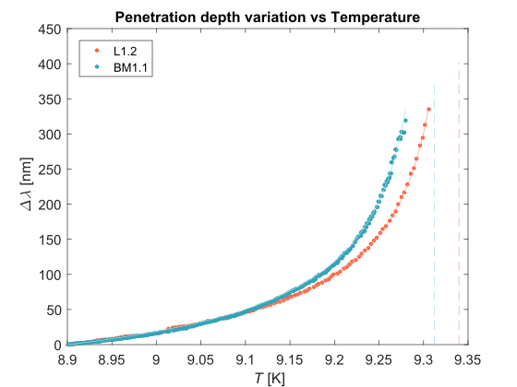
Introduction Nature of the Q slope Research on thin film Production of substrate Results Conclusions
Machined from bulk
Electroformed
Comparison
BM1.1
L1.2
 | R_{residual} [nΩ] | Δ₀/k_{B} [K] | A_{BCS} [nΩ K] | λ₀ [nm] | T_{c} [K]
BM1.1 | 95.6 | 20.2 | 1.68E5 | 53.96 | 9.31
L1.2 | 23.9 | 19.8 | 1.68E5 | 56.8 | 9.34

Slide 18
Introduction Nature of the Q slope Research on thin film Production of substrate Results Conclusions
Efforts have been done to avoid defects both at the thin film and the substrate.
Two high quality seamless substrates have been produced: One machined from bulk, used as benchmark, and one electroformed.
Presence of peel-offs or detachments in the coating have been observed in both cases: Currently investigating techniques to improve the adhesion of the Nb layer to the copper.
Promising results have been obtained:
High Q values with mitigated slope in both cases at 4.2K: Low R_{BCS}.
High Q values at 1.85 K with the electroformed substrate: Low R_{Residual}.
A thermal mapping system is going to be installed to increase our understanding on the thermodynamics of the defects and its impact upon the measured Q.

Slide 19
Thanks for your attention.

Slide 21
Introduction Nature of the Q slope Research on thin film Production of substrate Results Conclusions
Machined from bulk
Electroformed
Comparison
BM1.1
L1.2
 | R_{residual} [nΩ] | Δ₀/k_{B} [K] | A_{BCS} [nΩ K] | λ₀ [nm] | T_{c} [K]
BM1.1 | 95.6 | 20.2 | 1.68E5 | 53.96 | 9.31
L1.2 | 23.9 | 19.8 | 1.68E5 | 56.8 | 9.34
L1.1a | 33.92 | 19.84 | 1.42E5 | 51.54 | 9.36

Slide 22
Fitted parameters:
From the Rs(T) curve, the${ R}_{res} ,A_{BCS}$ and $∆/k_{B}$ are obtained as follows:
$$R_{s}\left(T\right)=R_{res}+R_{BCS}(T)$$
$$R_{BCS}\left(T, H=0\right)=\frac{A_{BCS}}{T}e^{−(∆/k_{B}T)}$$
The change in frequency measured with the VNA when increasing the temperature above the transition, $Δf$(T), can be correlated to the change in penetration depth (Gorter Casimir):
$$∆λ=−\frac{G}{πμ_{0}f_{0}^{2}}Δf$$
From the fitting $λ$ vs $T$: ${(λ}_{0}$, Tc, n) are obtained.
$$λ=−\frac{λ_{0}}{\sqrt{1−{\left(T/{T_{C}}\right)}^{4}}}+n$$

Slide 23
Results of previous tests
$$R_{s}\left(T\right)=R_{res}+R_{BCS}(T)$$
$$R_{BCS}\left(T, H=0\right)=\frac{A}{T}e^{−(∆/k_{B}T)}$$
 | A [10^-5 nΩ K] | Δ/k_{B} [K] | R_{Res} [nΩ]
N2 | 10.13 | 19.49 | 32.87
N3 | 13.48 | 19.22 | 86.25
QPR @1.2GHz | 9.77 | 20.2 | 100.8

